Slide 1
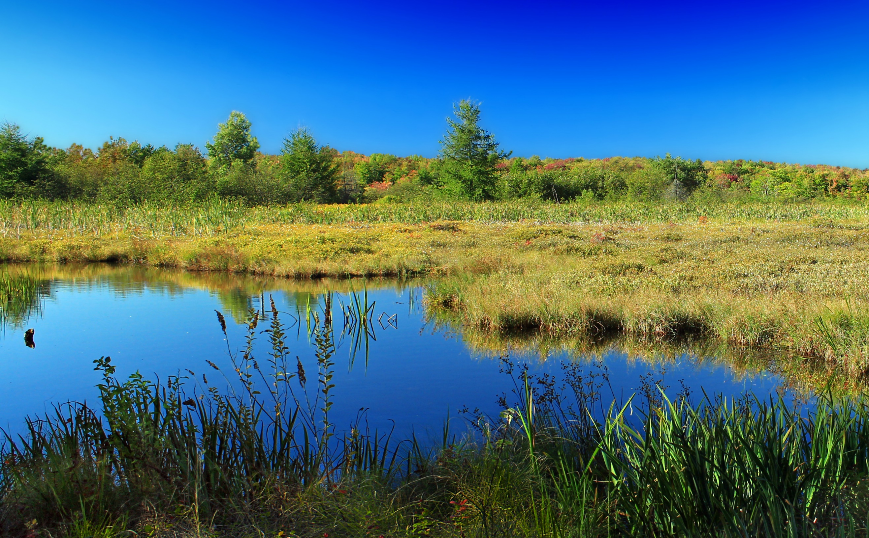
The Changing Futures
Cambridgeshire & Peterborough Ecosystem of Learning
CPPSB
Rain
The four pools
System Agents
Operational Partnerships
Co-production groups
Other sources
Information
Learning & change
Evaporation
Changing Futures team
Change Forums
Tactical Group
Strategic Board
The Sea =
The system
The four lakes
Notes:
Sue

