Slide 1
Mental Health Act Annual Report
11/01/2023
Giles Foster
Notes:
Standard title slide

Slide 2
Introduction
The Mental Health Act (1983) is the main piece of legislation that covers the assessment, treatment and rights of people with a mental health disorder. People detained under the Mental Health Act need urgent treatment for a mental health disorder and are at risk of harm to themselves or others.
Significantly revised in 2007 to update the rights, responsibilities and roles of patients and clinicians and to introduce Community Treatment Orders (CTOs).
Independent review and publication of a white paper in 2021.
Part II – Civil. Applies to people who are not subject to the Criminal Justice System
Part III – Criminal. Applies to sentenced prisoners and people subject to proceedings of the Criminal Justice System

Slide 3
Publication
Published MHA statistics in their current form since 2016/17 when MHSDS was introduced.
First publication in 16/17 was badged as experimental statistic.
Prior to 16/17 the source of data for MHA statistics was the KP90 aggregate return.
Includes data from MHSDS and the Acute sector (formerly HES A&E dataset, now ECDS).
Developments
Added new data on length of detention in 19/20 as a standalone report, now an integral part of the publication.
Addition of more detailed breakdowns of all detentions at STP level by various demographic breakdowns.
Updated the publication to an HTML publication from PDF / Powerpoint.
Currently exploring more granular STP level breakdowns looking at individual sections of the Act following a request from DHSC.

Slide 4
Findings 1: Detentions over time.
Drop in reported detentions following the change in data source to MHSDS in 16/17, but has increased year on year since then.
Data sources, submissions and data quality have increased over time.
This has affected the estimate of the true change in detentions over the years.
Changes in the number of detentions are likely to have been affected by the COVID pandemic and lockdown over the last 2 years.
+0.2%
-5.7%
Source: KP90
Source: MHSDS/Acute
Source: MHSDS/ECDS

Slide 5
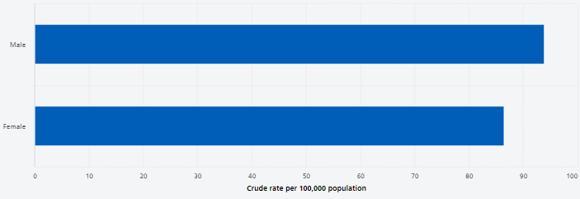
Findings 2: Detentions by age and gender.
Men (93.8) are more likely to be detained than women (86.4).
Rate of detentions peak between the ages of 18 – 34 then decrease.

Slide 6
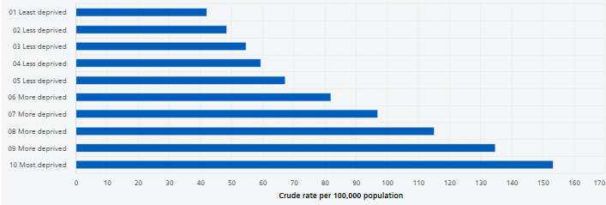
Findings 3: Detentions decile of deprivation.
National average is 90.1 / 100,000 population (where IMD is recorded).
Highest deprivation decile are over 3 times more likely to be detained that those in living in areas the lowest deprivation decile

Slide 7
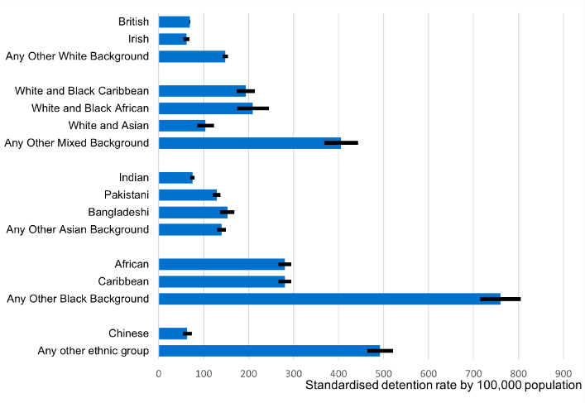
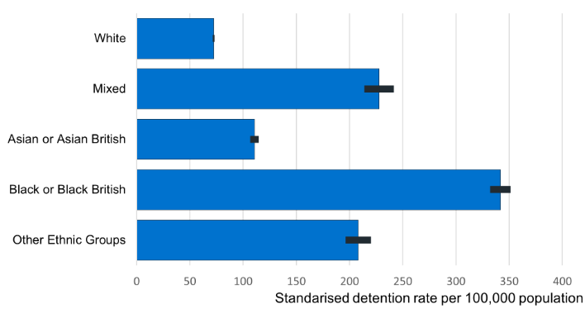
Findings 4: Detentions by ethnic category.
National rate = 87.4 / 100,000 population (where ethnicity is recorded).
Large differences in detention rates between upper ethnic groups and within lower ethnic groups.

Slide 8
Findings 5: Short Term Detention Orders (STDOs) and Community Treatment Orders (CTOs).
Section 136 orders are a type of Short Term Detention Order. They are used by the police to move a person to a ‘place of safety’. We report such uses where the place of safety is a hospital. The Home Office separately publish statistics on where the place of safety is a police station.
People can be treated in the community but subject to recall to hospital for assessment and/or treatment under a Community Treatment Order (CTO).
Differences in rates between demographic groups follow similar patterns to all detentions, but in some cases are more pronounced.
Those in the 18 to 34 age group are 2.5 times more likely to be subject to an STDO compared to ‘all ages’ (1.6 for all detentions).
Men are 70% more likely to be subject to a CTO compared to women. (9% for all detentions)
Those in the Black or Black British higher ethnic group are 11 times more likely to be subject to a CTO than the White group (around 4.5 times for all detentions).
Those in the Asian or Asian British are less likely to be subject to a STDO.

Slide 9
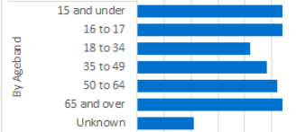
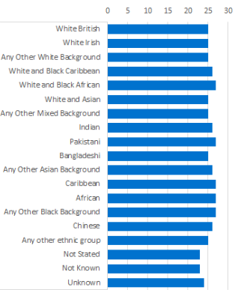
Findings 6: Length of detention.
Based on total length of continuous detention under a single or multiple sections.
Part II (civil). Median length of detention is 26 days (IQR 13 – 50 days).
Part III (criminal). Median length of detention is 78 days (IQR 20 – 52 days).
Men have slightly longer LODs than women (26 compared to 24 days)
Those aged between 18 – 35 have shorter LODs compared to other age groups (21 days compared to 25 for all ages).
People within the Pakistani, African, Caribbean and White and Black African ethnic groups were detained the longest (27 median days), although the difference is small.

Slide 10
Useful Links
Data and publications
Annual MHA publication https://digital.nhs.uk/data-and-information/publications/statistical/mental-health-act-statistics-annual-figures
Monthly dashboard https://app.powerbi.com/view?r=eyJrIjoiM2IxOTNlMTgtNWE4Mi00ZGRlLWI0ZTYtNTI2NmZmNmU0YTliIiwidCI6IjUwZjYwNzFmLWJiZmUtNDAxYS04ODAzLTY3Mzc0OGU2MjllMiIsImMiOjh9
MH Data Hub https://digital.nhs.uk/data-and-information/data-tools-and-services/data-services/mental-health-data-hub
External Links
https://www.legislation.gov.uk/ukpga/1983/20/contents
https://www.gov.uk/government/publications/code-of-practice-mental-health-act-1983
https://www.gov.uk/government/consultations/reforming-the-mental-health-act/reforming-the-mental-health-act-summary

Slide 11
Notes:
Connect with us

