Slide 1
Census 2021: Labour Market Topic Summary
Overview for Cambridgeshire and Peterborough
Research Team, Business Intelligence
9th December 2022
Research.group@cambridgeshire.gov.uk

Slide 2
Themes
A first overview of some of the local authority level Cambridgeshire and Peterborough data from the Labour Market topic summary published by the Office for National Statistics (ONS)
By local authority:
Hours Worked
Industry
Occupation
Socio-economic classification
Unemployment history
Economic activity status
Economic inactivity by reason

Slide 3
Definitions
Full-time: 31 or more hours worked per week
Part-time: 30 or less hours worked per week
Industry: Classifies people aged 16 years and over who were in employment between 15 March and 21 March 2021 by the Standard Industrial Classification (SIC) code that represents their current industry or business. The SIC code is assigned based on the information provided about a firm or organisation's main activity
Occupation: A person's occupation relates to their main job and is derived from either their job title or details of the activities involved in their job
NS-Sec: The National Statistics Socio-economic Classification (NS-SeC) provides an indication of socio-economic position based on occupation. It is an Office for National Statistics standard classification
Economically Active: Economically active is defined as those in employment plus those who are unemployed
Economically Inactive: People not in employment who have not been seeking work within the last 4 weeks and/or are unable to start work within the next 2 weeks

Slide 4
Census 2021 Headlines
72.7% of Cambridgeshire and Peterborough residents who are aged 16+ and in employment work full-time with 27.3% working part-time
The top three industries for employment are Wholesale and retail trade; repair of motor vehicles and motor cycles (14%), Human health and social work activities (13%) and Education (12%). These were also the top three industries in 2011
The largest proportion of employed Cambridgeshire and Peterborough residents (24.1%) work in Professional Occupations. Higher proportions of residents working in this occupation in Cambridge (42.4%) and South Cambridgeshire (31.6%)
The top three socio-economic classifications are Lower managerial, administrative and professional occupations (20.0%), Higher managerial, administrative and professional occupations (16.2%) and Routine occupations (12.5%)
The majority of residents who are unemployed in Cambridgeshire and Peterborough have not worked in the last year (62.4%) but have worked prior to this
The majority of residents in Cambridgeshire and Peterborough are economically active (62.8%) but this ranges from 58.2% in Fenland to 65.2% in South Cambridgeshire
All local authorities have seen increases in economic inactivity from 2011
Being retired is the reason given by the majority of economically inactive residents across Cambridgeshire and Peterborough (54.5%) with the exception of Cambridge where most economically inactive residents are students (50.8%)

Slide 5
Index
Cambridgeshire and Peterborough
Cambridge
East Cambridgeshire
Fenland
Huntingdonshire
South Cambridgeshire
Peterborough

Slide 6
Cambridgeshire and Peterborough

Slide 7
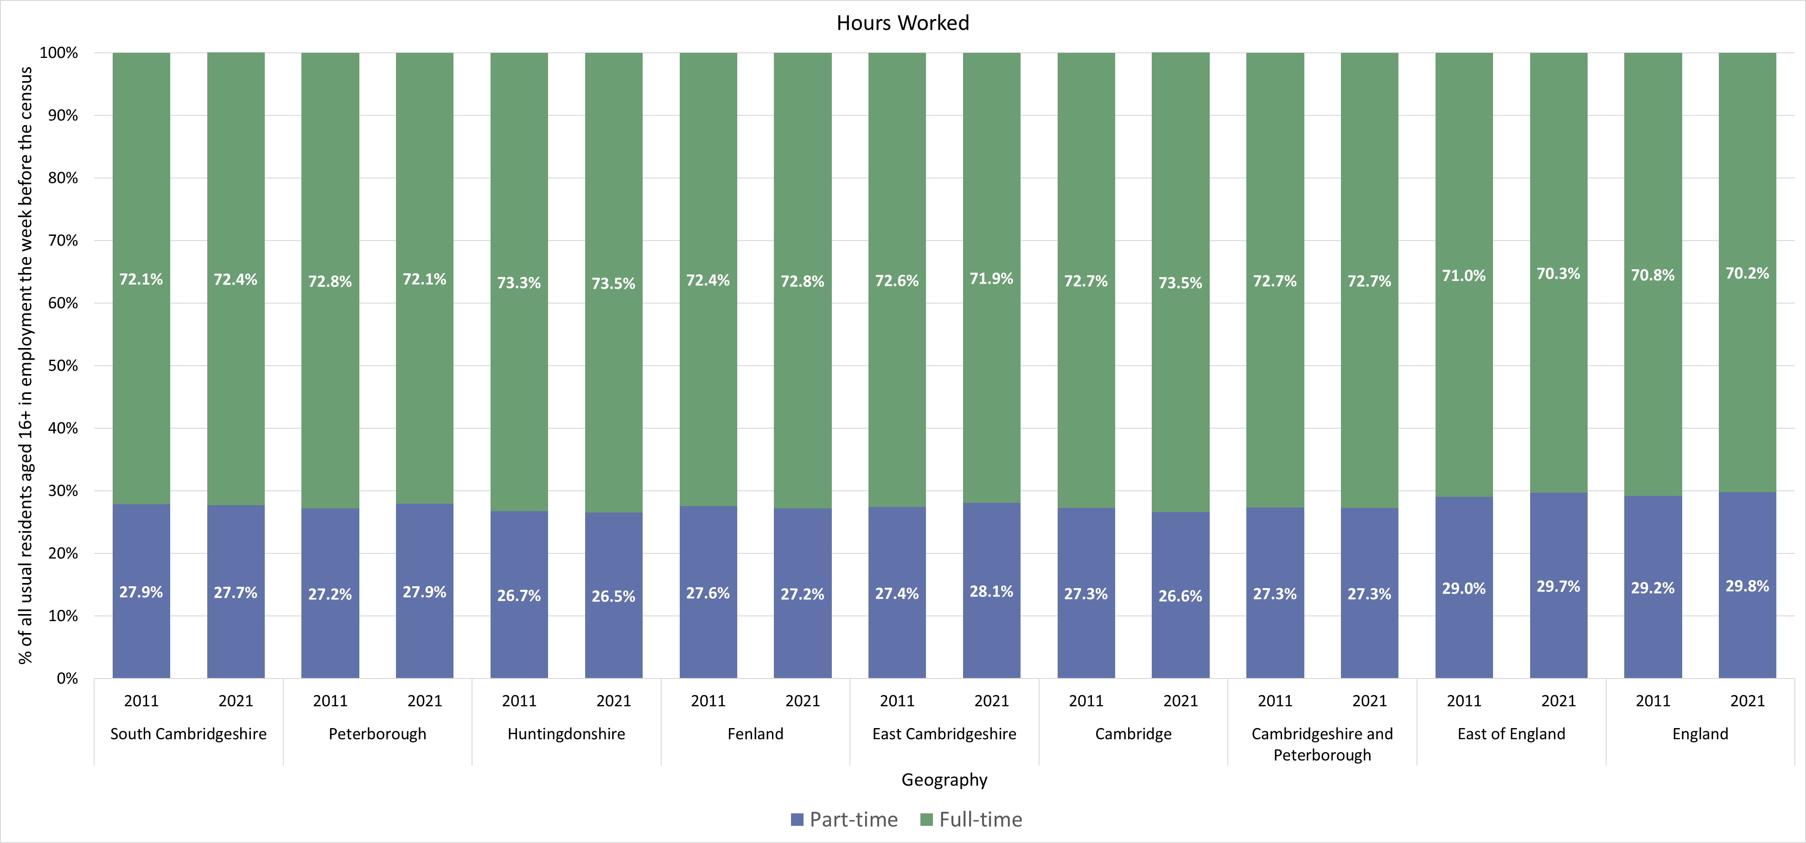
Hours Worked

Slide 8
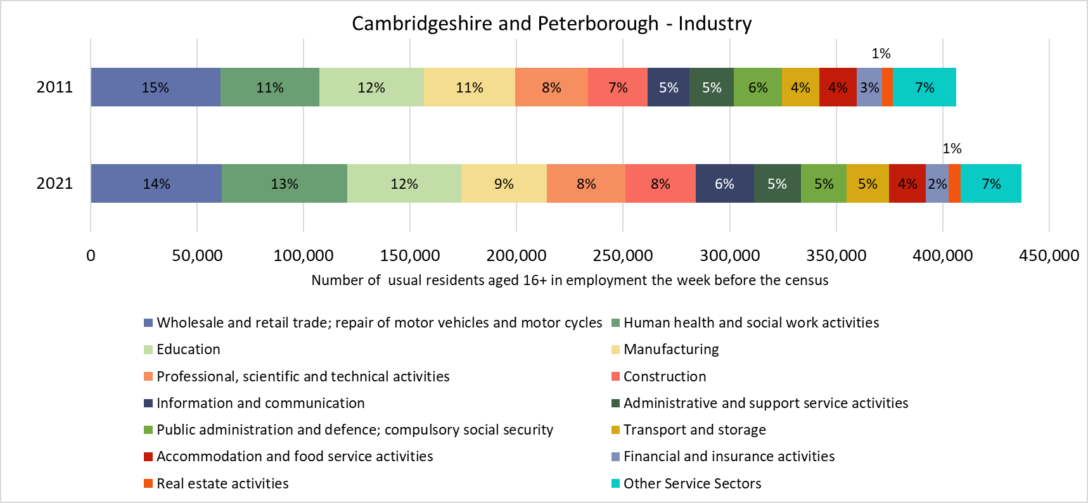
Industry

Slide 9
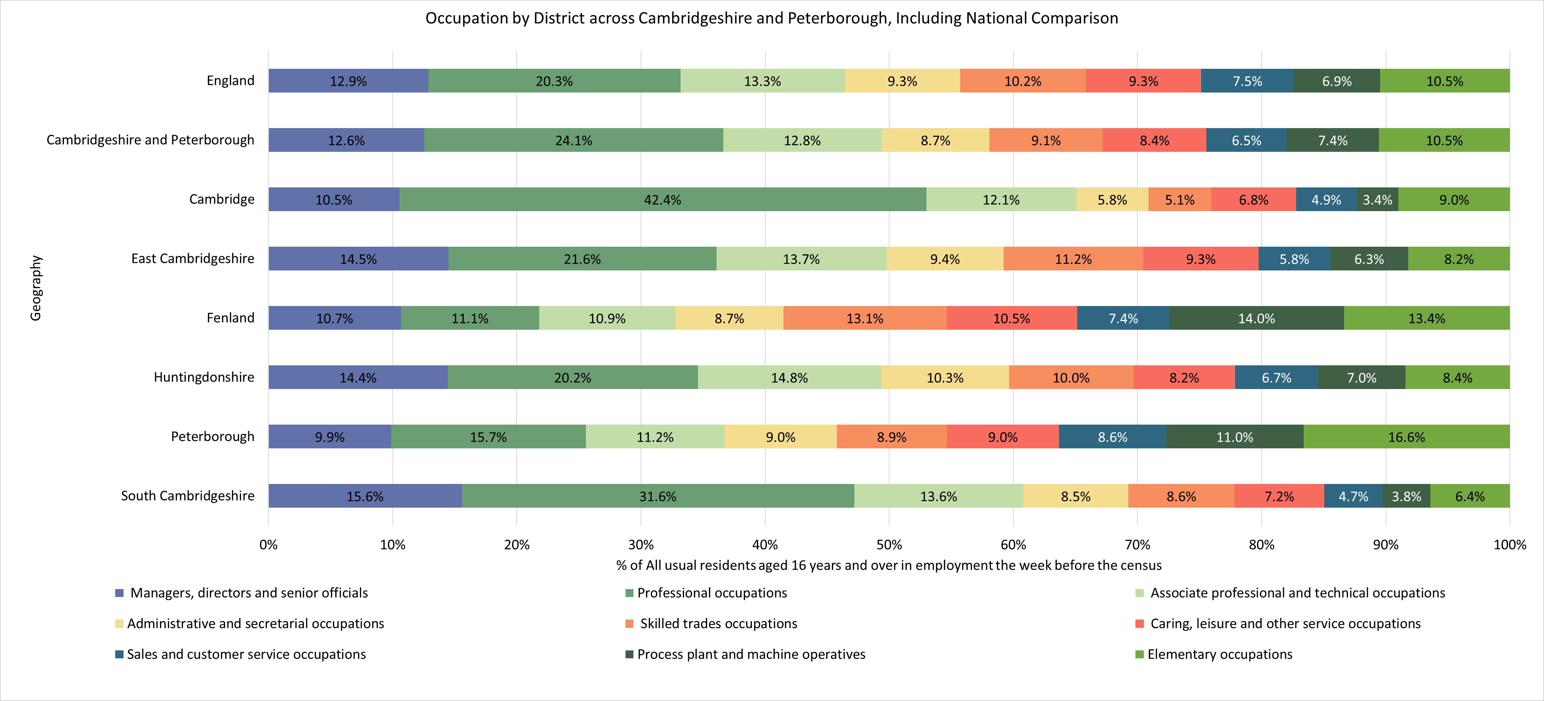
Occupation
*Not directly comparable to 2011. ONS changed the classification for Census 2021 and combined the categories previously available in the 2011 Census data.

Slide 10
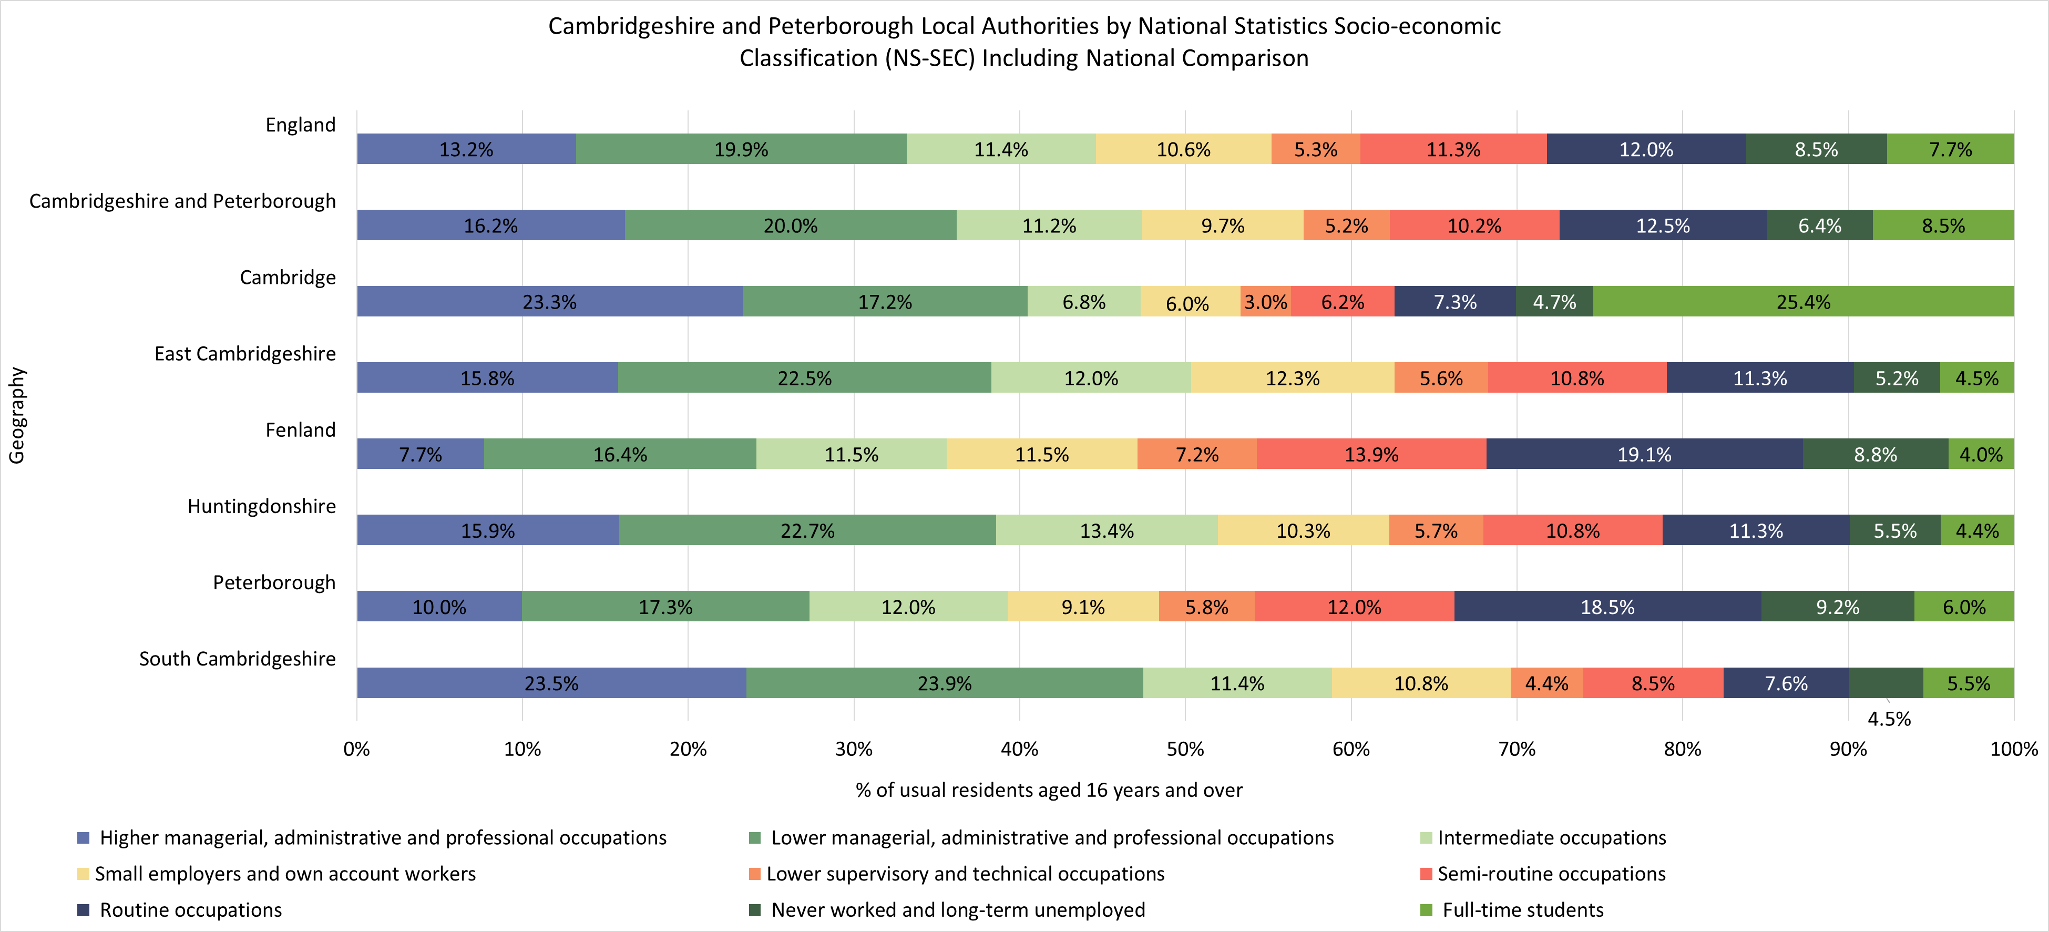
Socio-economic Classification

Slide 11
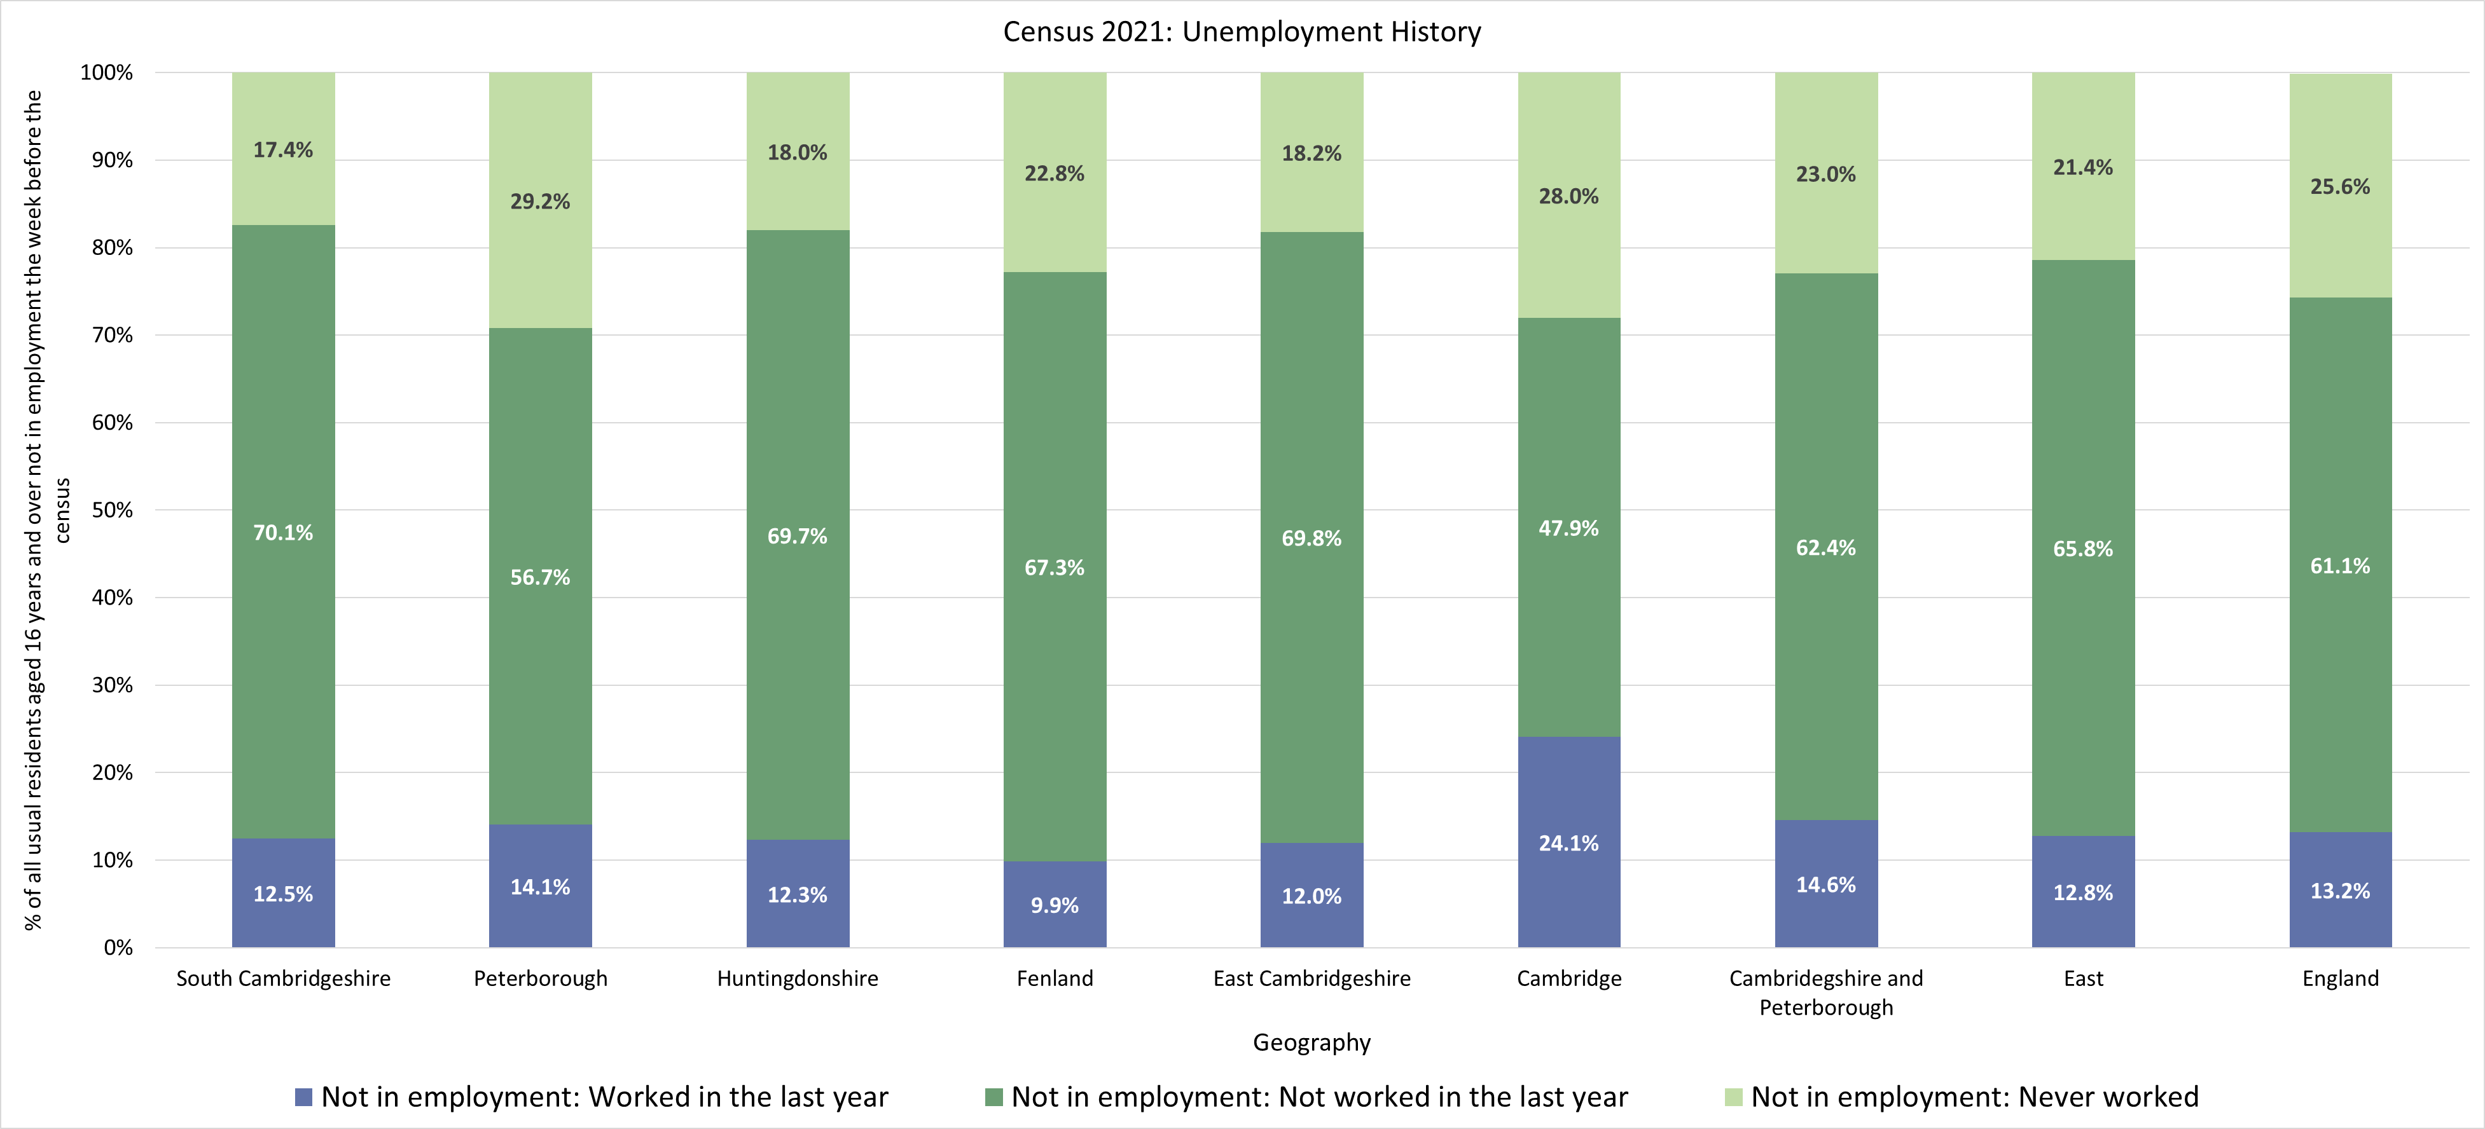
Unemployment history
*Not comparable to 2011. The question on employment history changed between the 2011 and 2021 census.

Slide 12
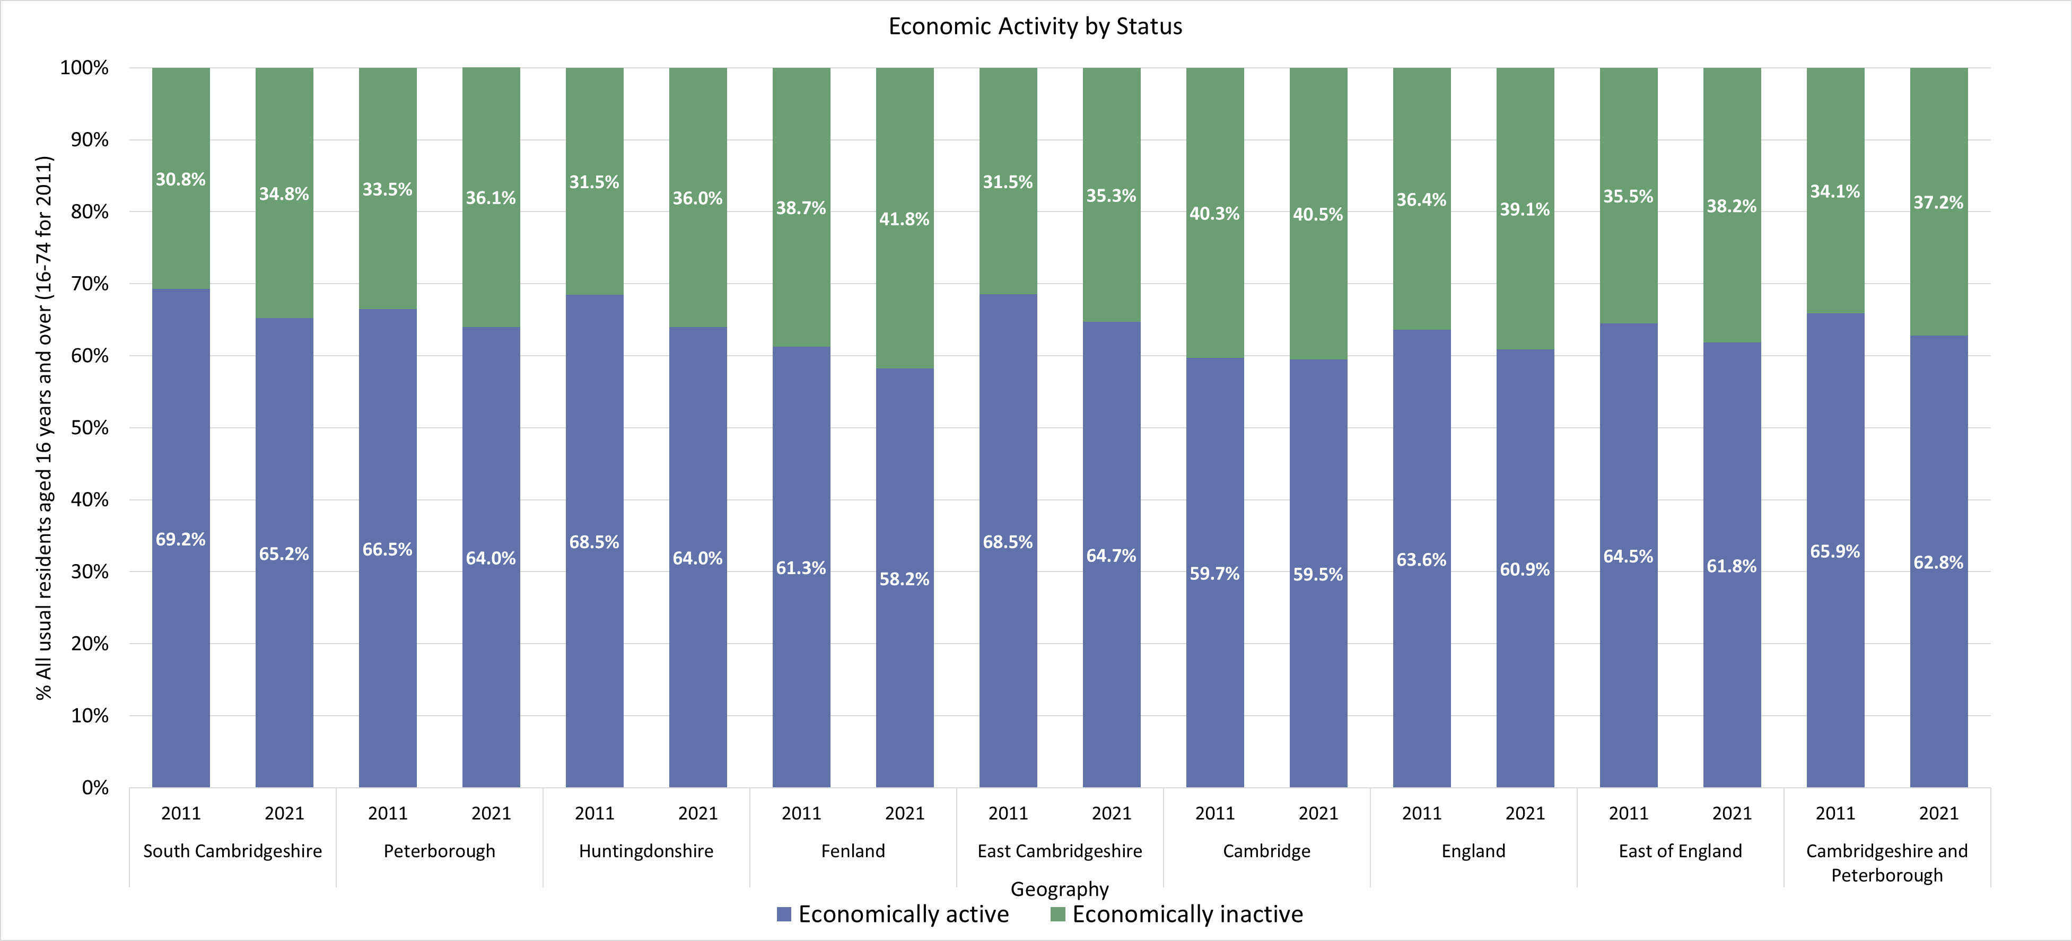
Economic activity status

Slide 13
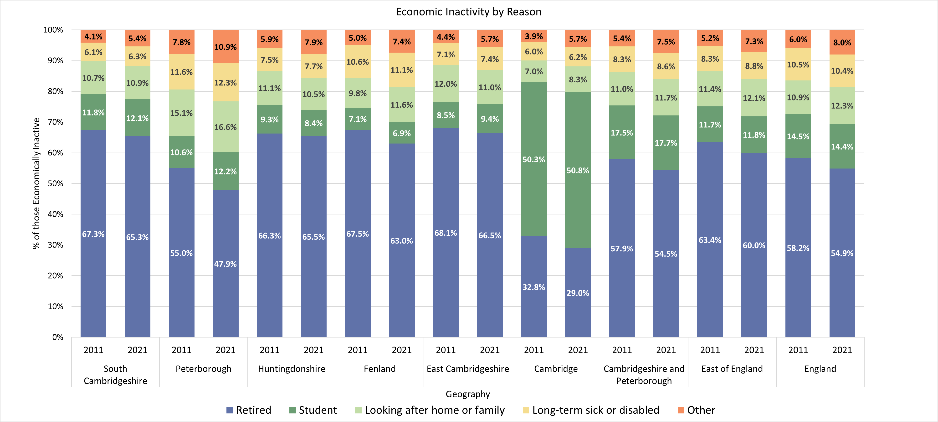
Economic Inactivity by Reason

Slide 14
Cambridge

Slide 15
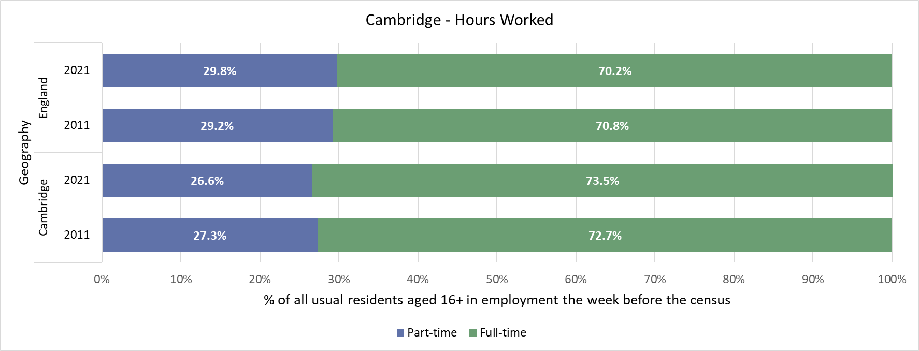
Cambridge -Hours Worked

Slide 16
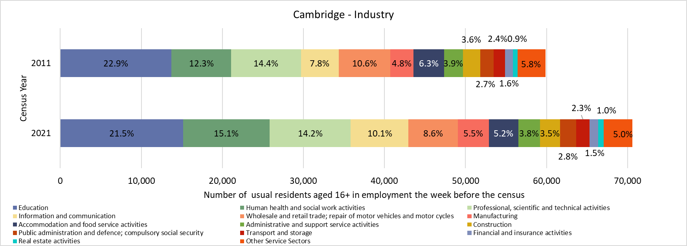
Cambridge - Industry

Slide 17
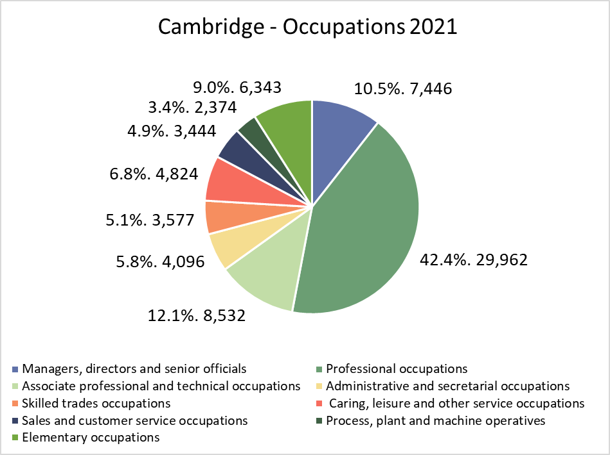
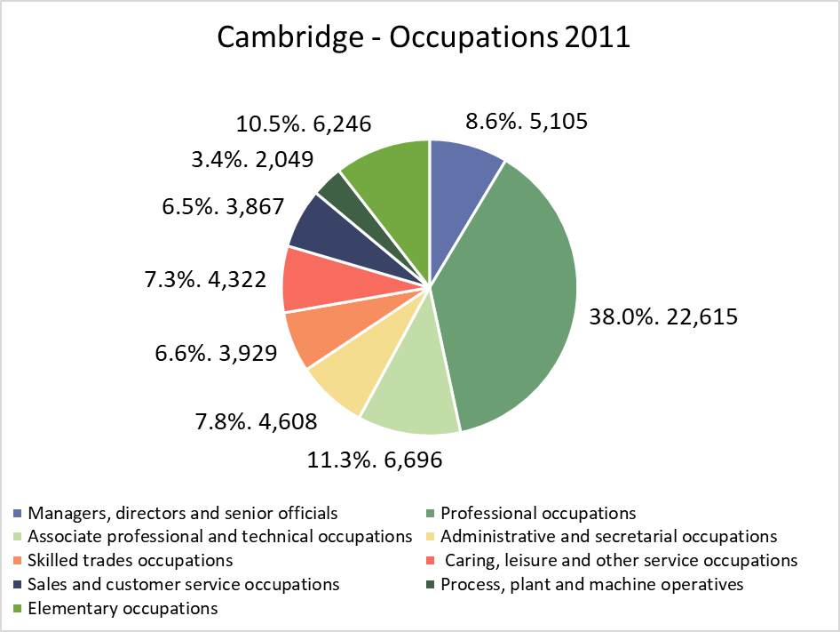
Cambridge - Occupation
*Not comparable to 2011. ONS changed the classification for Census 2021 and combined the categories previously available in the 2011 Census data. Therefore, comparisons are only indicative

Slide 18
Cambridge – Socio-economic Classification

Slide 19
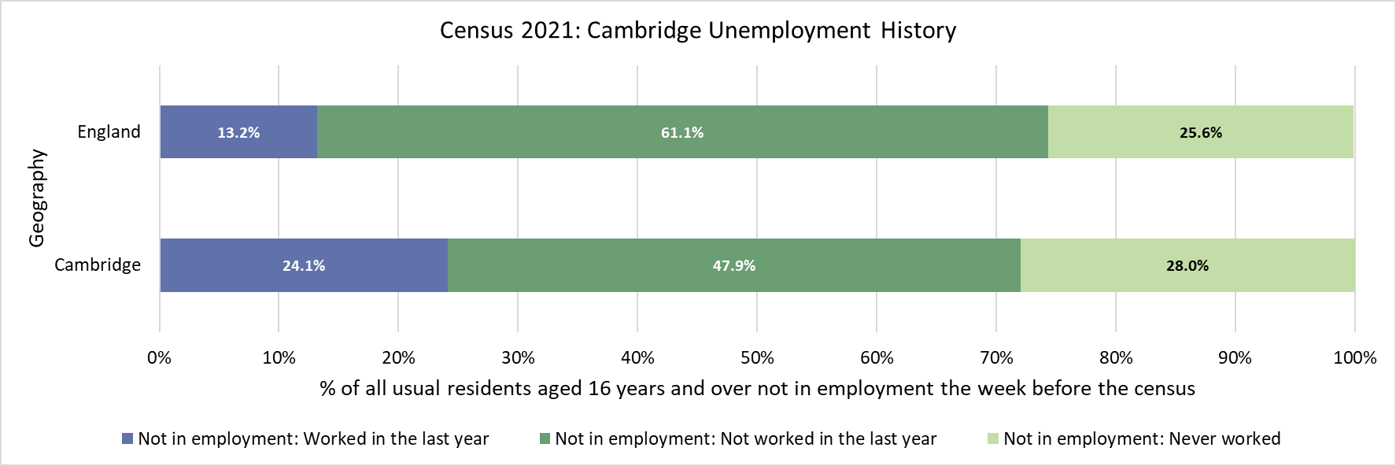
Cambridge - Unemployment history
*Not comparable to 2011. The question on employment history changed between the 2011 and 2021 census.

Slide 20
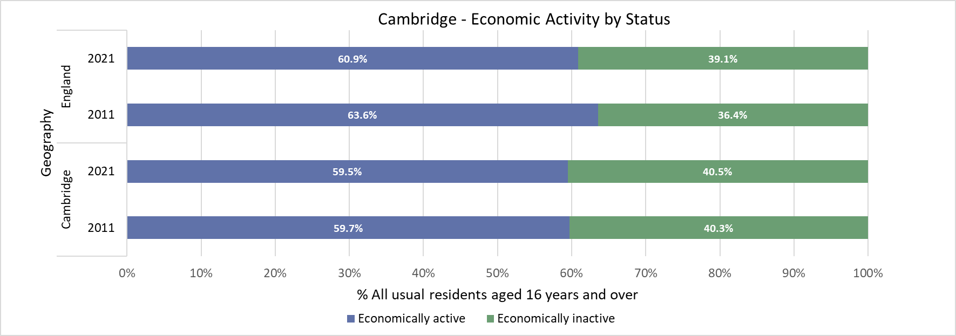
Cambridge – Economic activity status

Slide 21
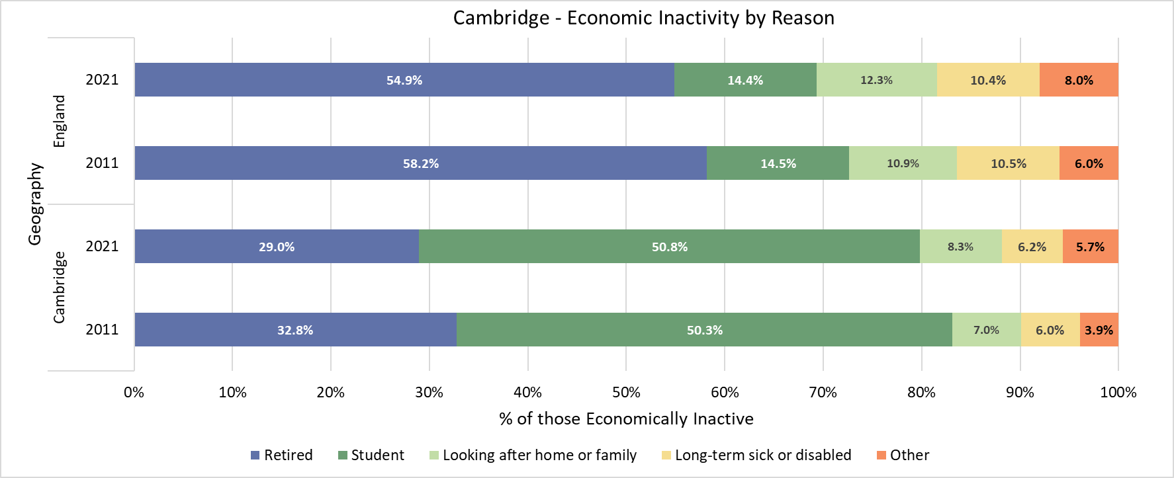
Cambridge – Economic inactivity by reason

Slide 22
East Cambridgeshire

Slide 23
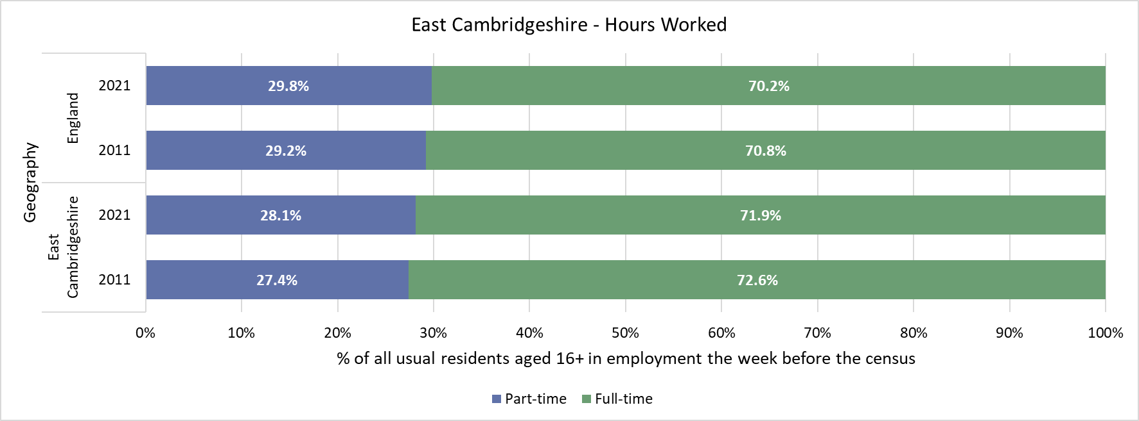
East Cambridgeshire -Hours Worked

Slide 24
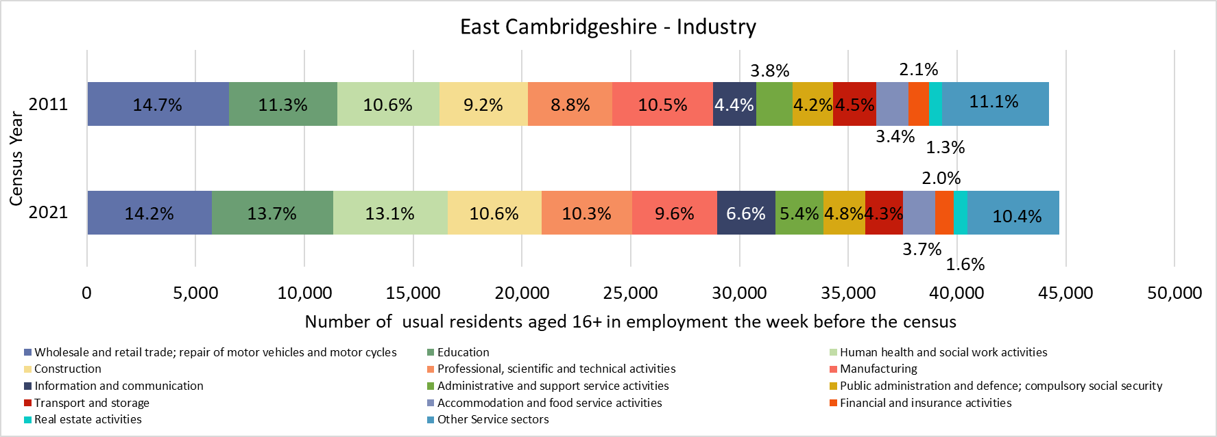
East Cambridgeshire -Industry

Slide 25
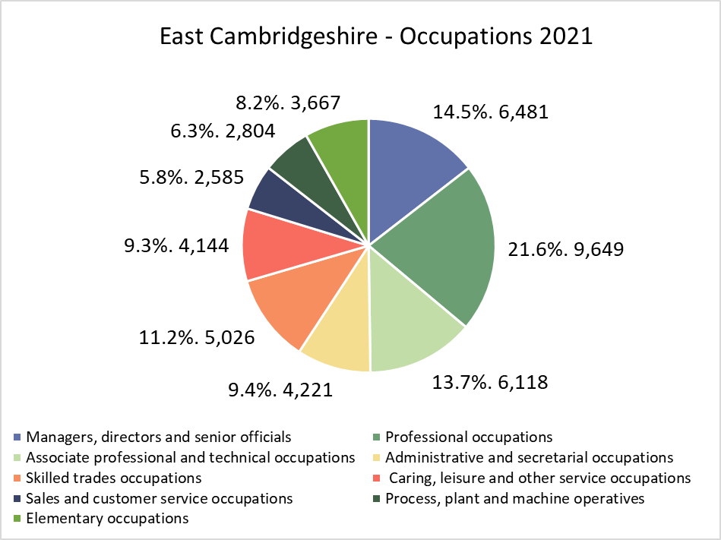
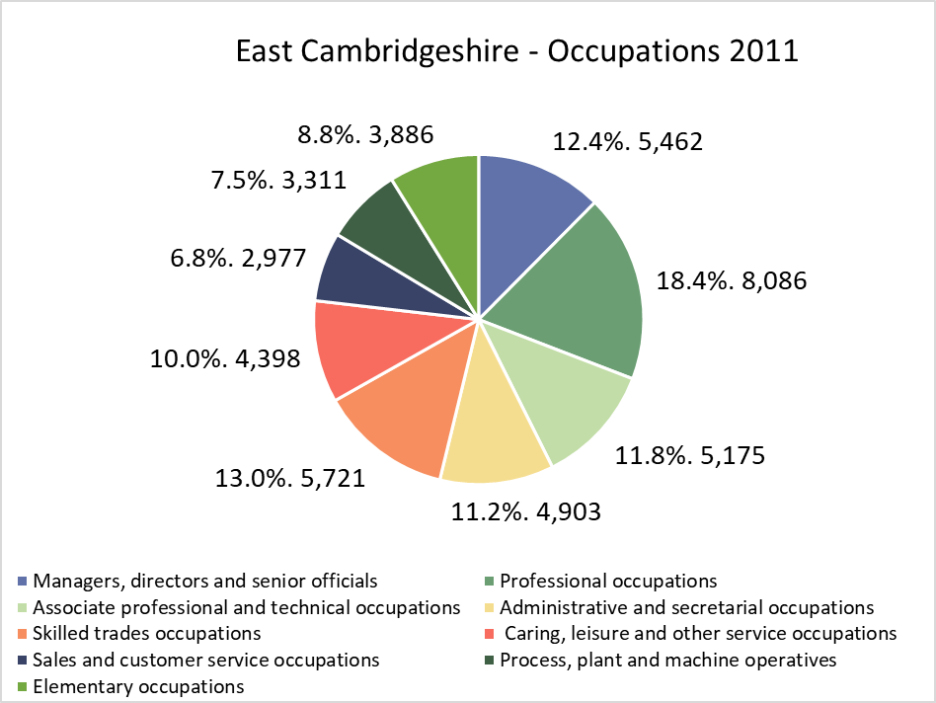
East Cambridgeshire-Occupation
*Not directly comparable to 2011. ONS changed the classification for Census 2021 and combined the categories previously available in the 2011 Census data. Therefore, comparisons are only indicative

Slide 26
East Cambridgeshire –Socio-economic Classification

Slide 27
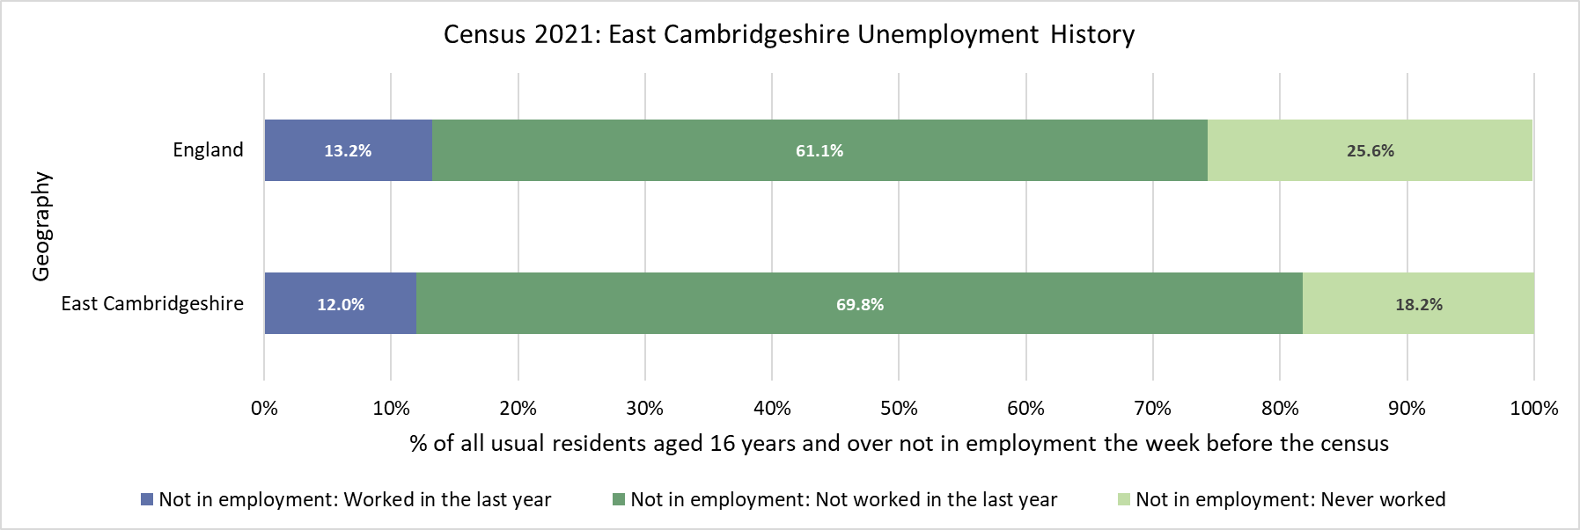
East Cambridgeshire -Unemployment history
*Not comparable to 2011. The question on employment history changed between the 2011 and 2021 census.

Slide 28
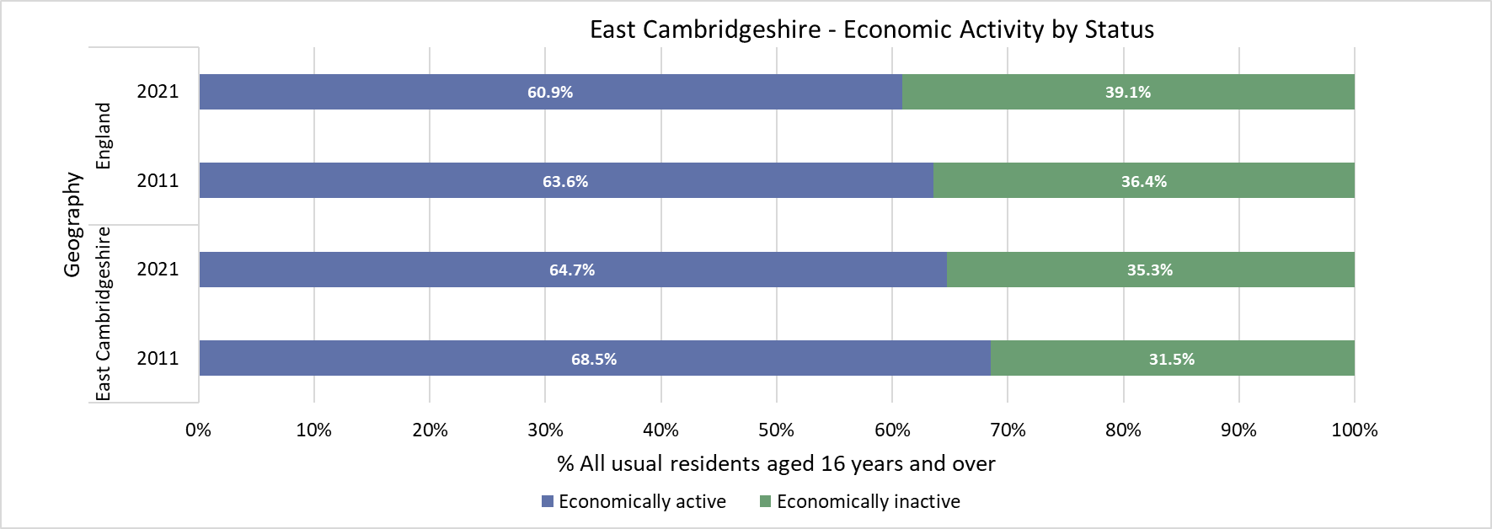
East Cambridgeshire -Economic activity status

Slide 29
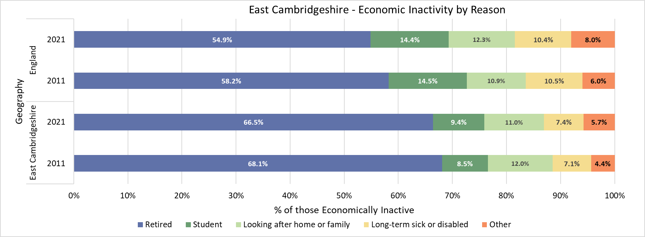
East Cambridgeshire – Economic inactivity by reason

Slide 30
Fenland

Slide 31
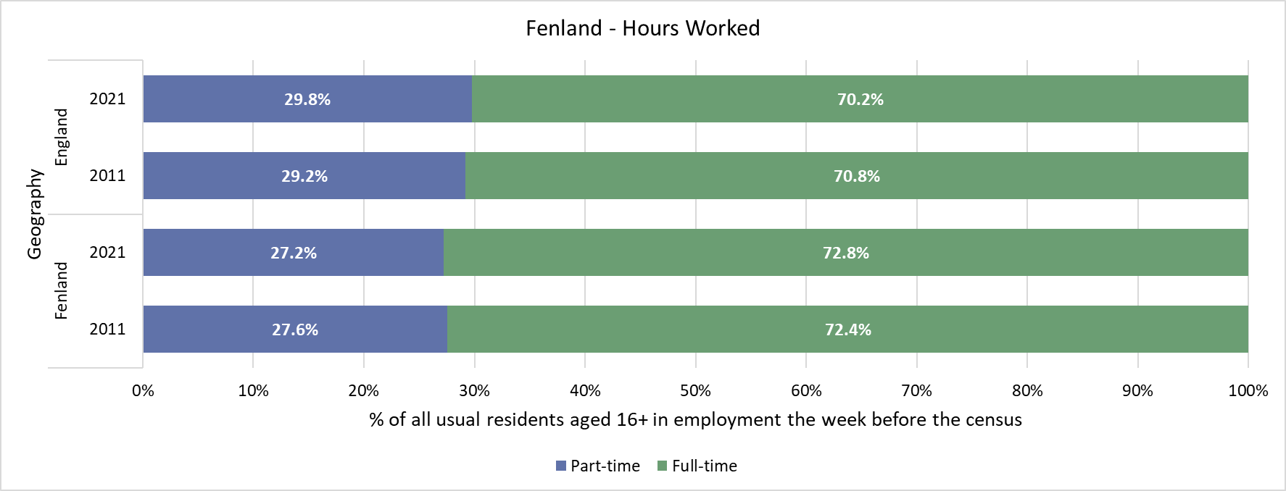
Fenland - Hours Worked

Slide 32
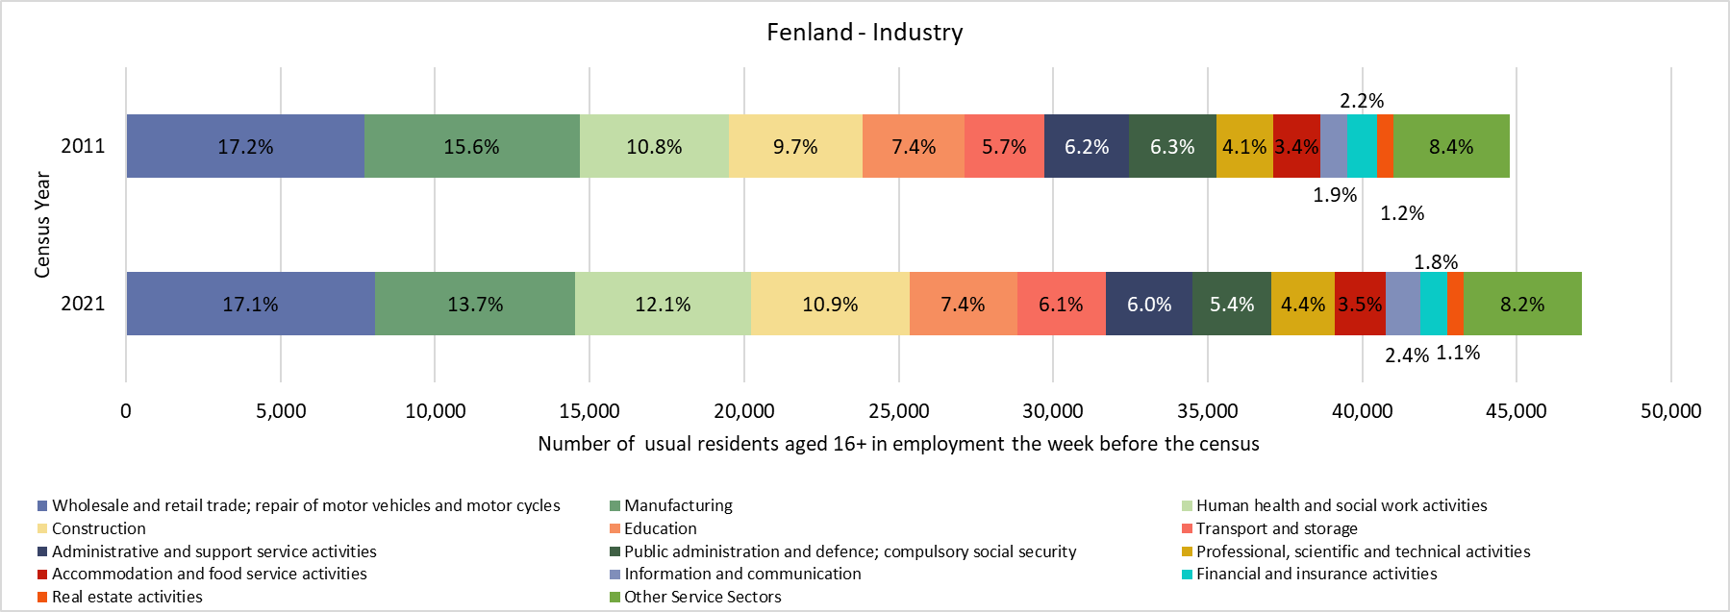
Fenland - Industry

Slide 33
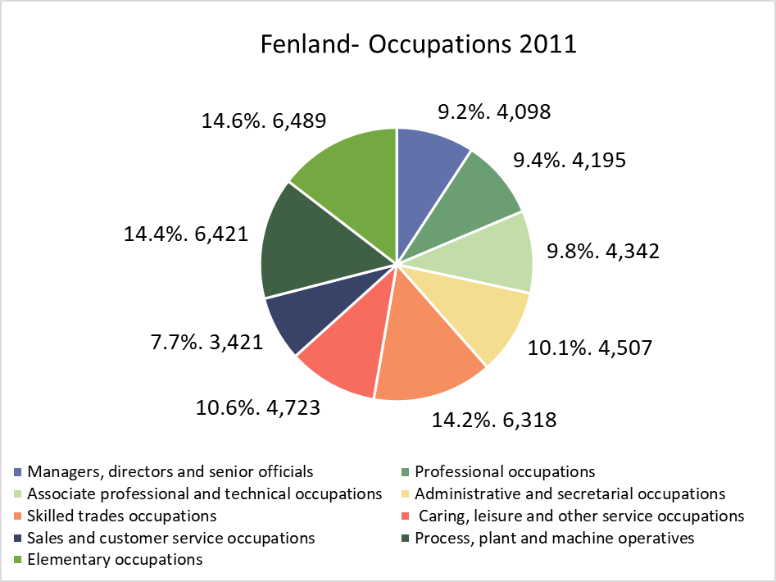
Fenland - Occupation
*Not directly comparable to 2011. ONS changed the classification for Census 2021 and combined the categories previously available in the 2011 Census data. Therefore, comparisons are only indicative

Slide 34
Fenland - Socio-economic Classification

Slide 35
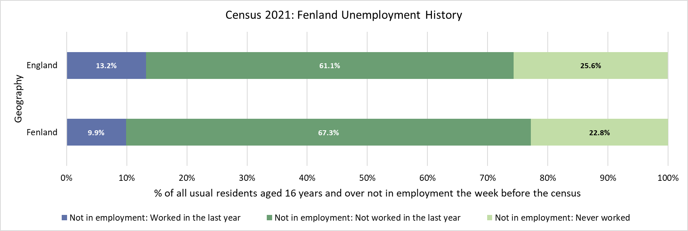
Fenland -Unemployment history
*Not comparable to 2011. The question on employment history changed between the 2011 and 2021 census.

Slide 36
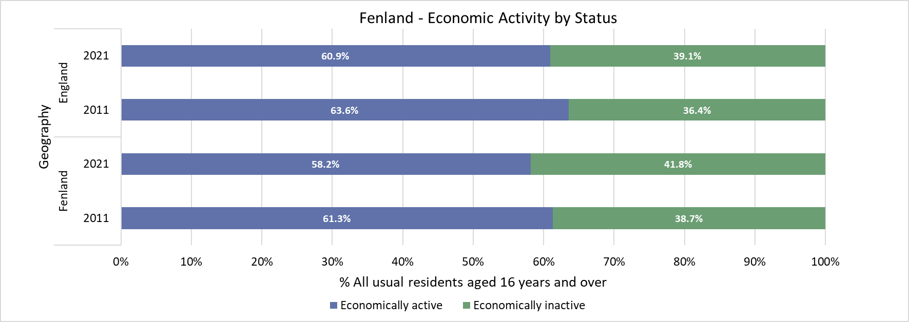
Fenland -Economic activity status

Slide 37
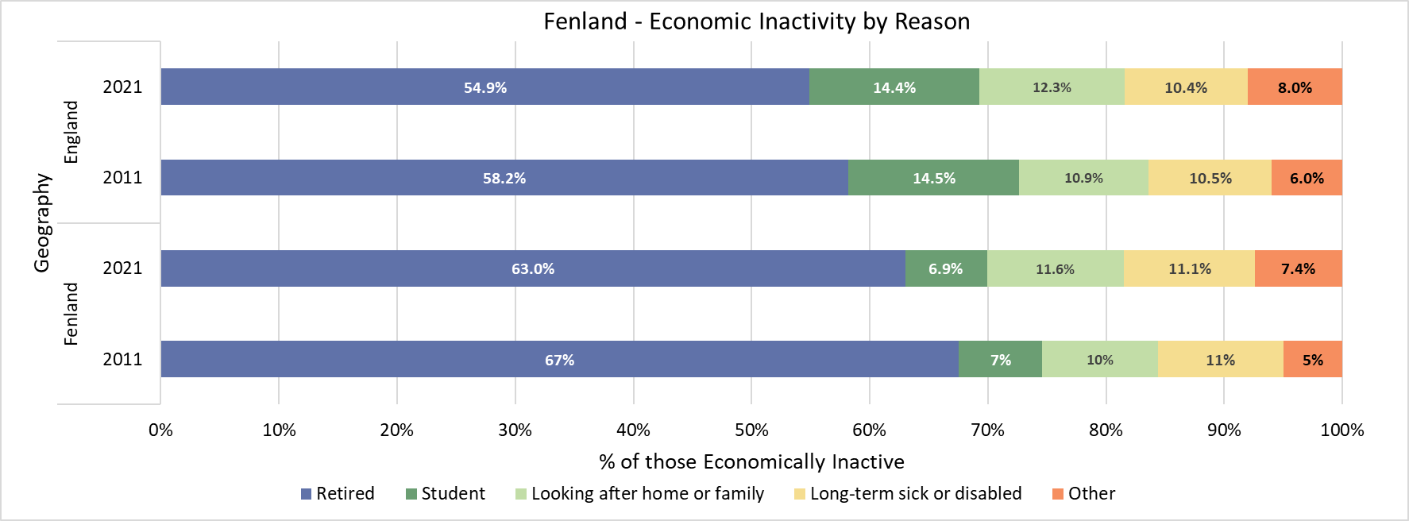
Fenland -Economic inactivity by reason

Slide 38
Huntingdonshire

Slide 39
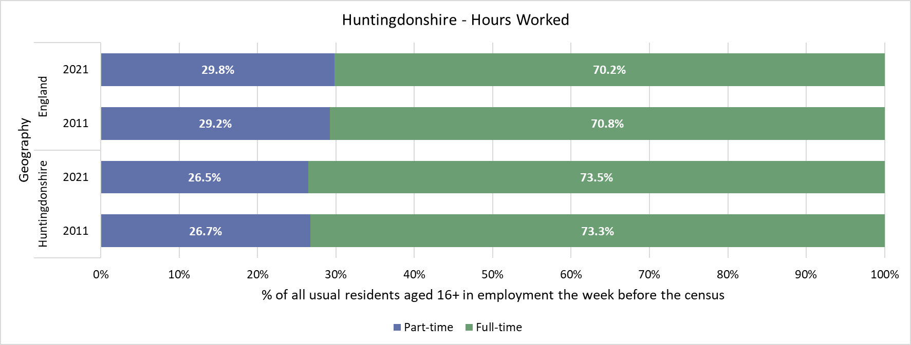
Huntingdonshire - Hours Worked

Slide 40
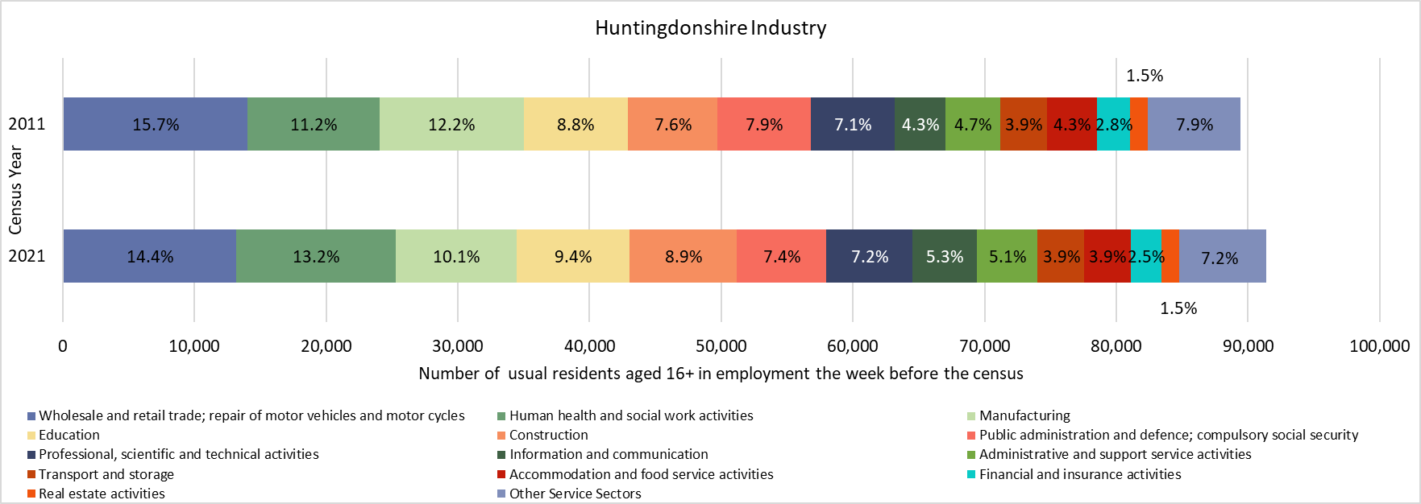
Huntingdonshire -Industry

Slide 41
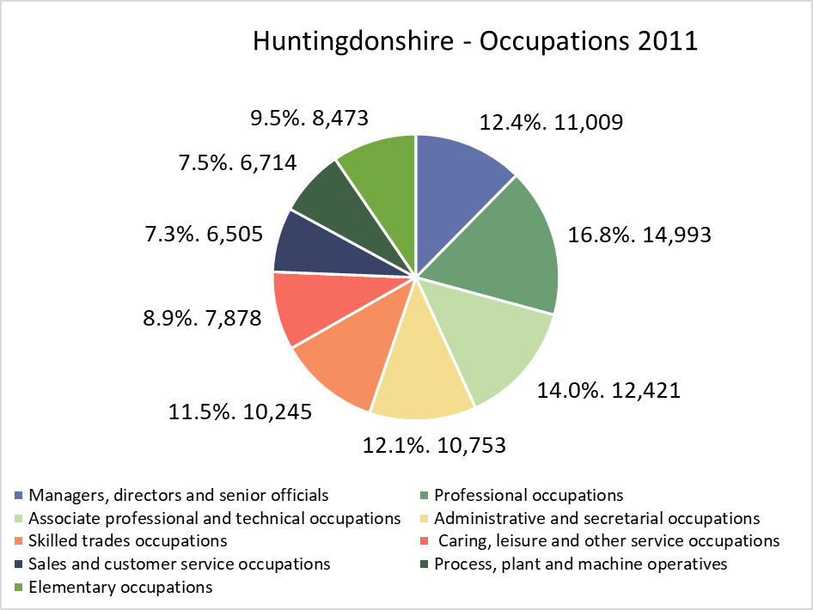
Huntingdonshire -Occupation
*Not directly comparable to 2011. ONS changed the classification for Census 2021 and combined the categories previously available in the 2011 Census data. Therefore, comparisons are only indicative

Slide 42
Huntingdonshire - Socio-economic Classification

Slide 43
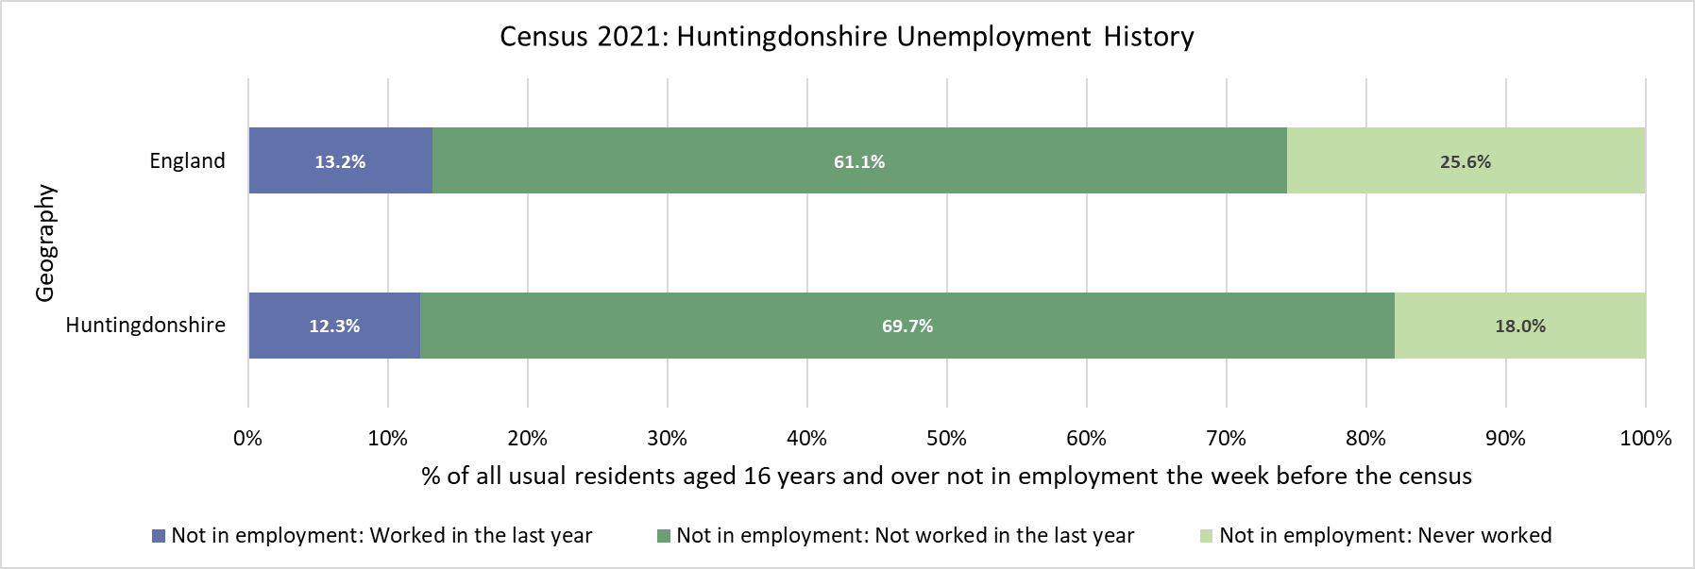
Huntingdonshire - Unemployment history
*Not comparable to 2011. The question on employment history changed between the 2011 and 2021 census.

Slide 44
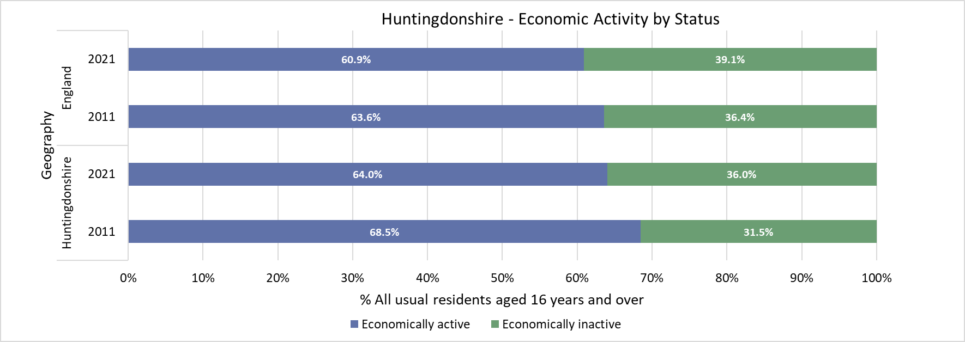
Huntingdonshire -Economic activity status

Slide 45
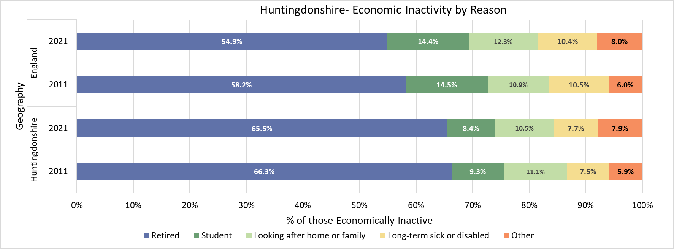
Huntingdonshire -Economic inactivity by reason

Slide 46
South Cambridgeshire

Slide 47
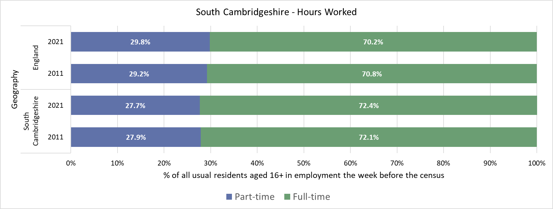
South Cambridgeshire -Hours Worked

Slide 48
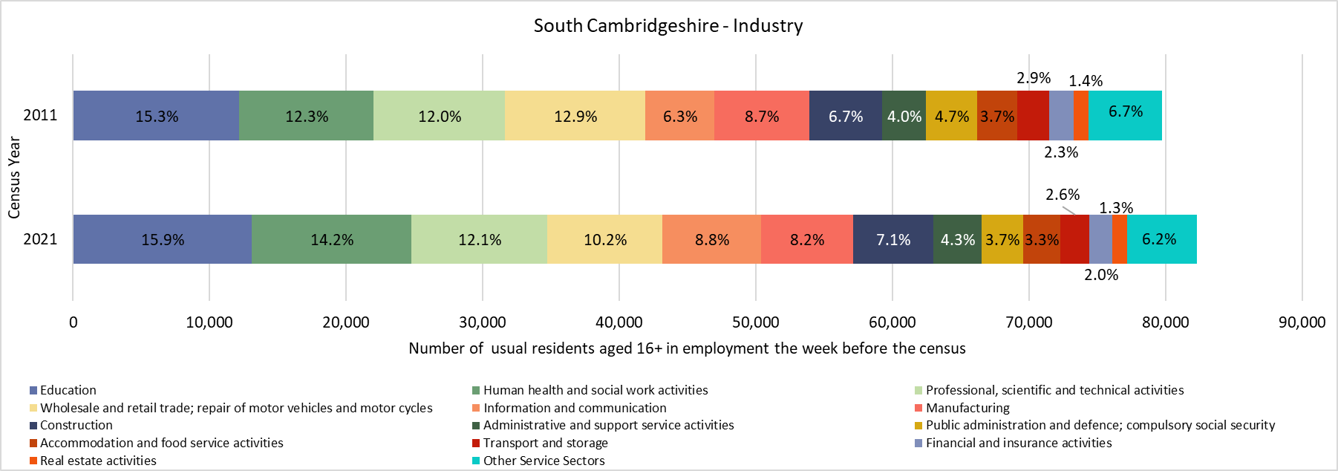
South Cambridgeshire - Industry

Slide 49
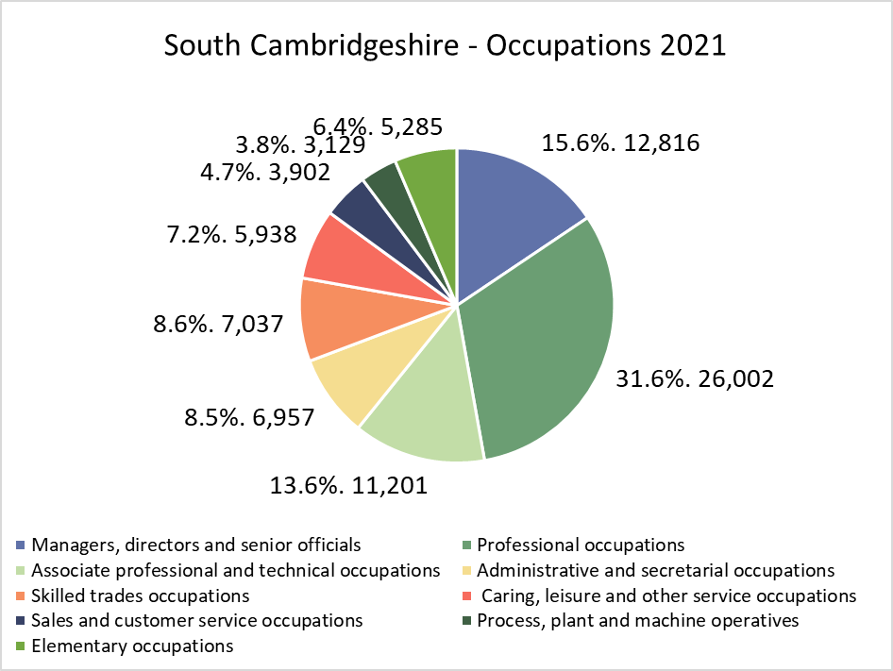
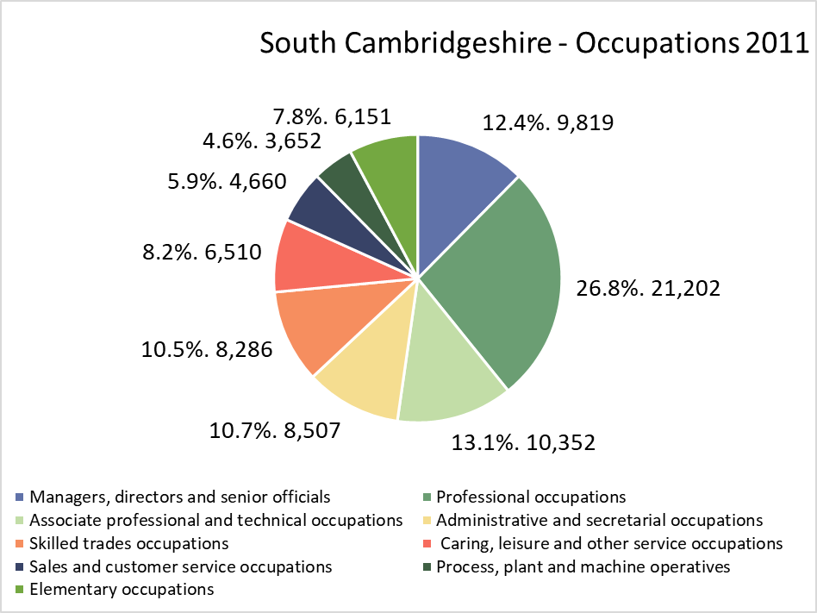
South Cambridgeshire -Occupation
*Not directly comparable to 2011. ONS changed the classification for Census 2021 and combined the categories previously available in the 2011 Census data. Therefore, comparisons are only indicative

Slide 50
South Cambridgeshire – Socio-economic Classification

Slide 51
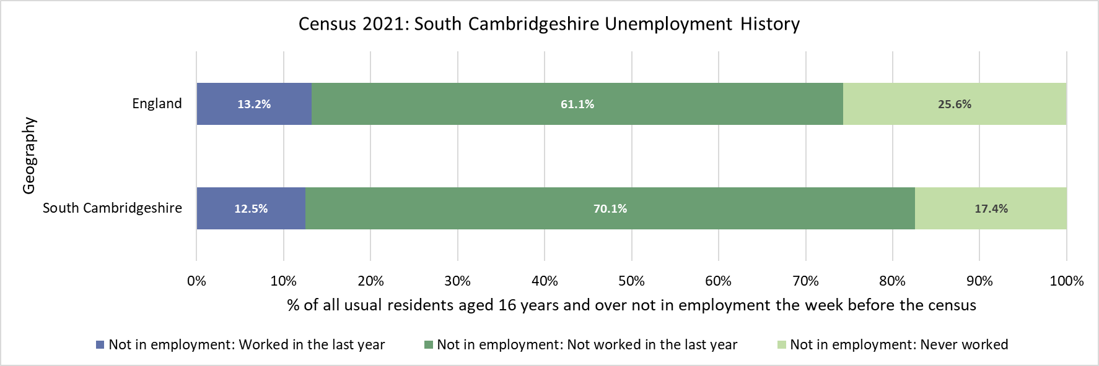
South Cambridgeshire -Unemployment history
*Not comparable to 2011. The question on employment history changed between the 2011 and 2021 census.

Slide 52
South Cambridgeshire -Economic activity status

Slide 53
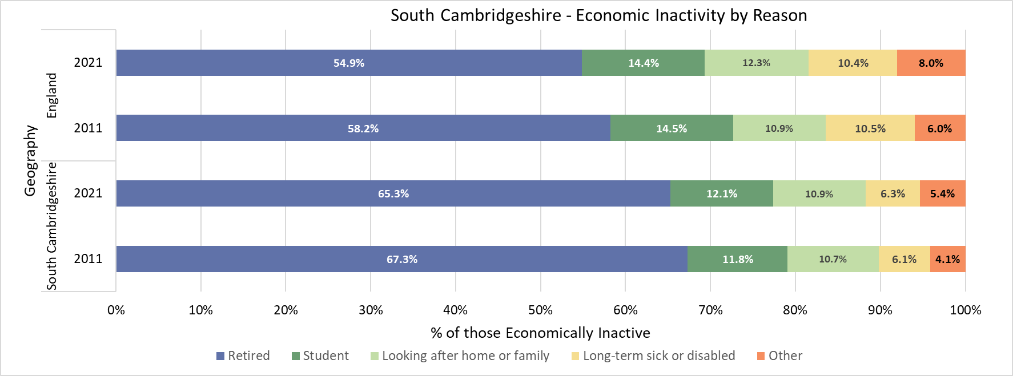
South Cambridgeshire -Economic inactivity by reason

Slide 54
Peterborough

Slide 55
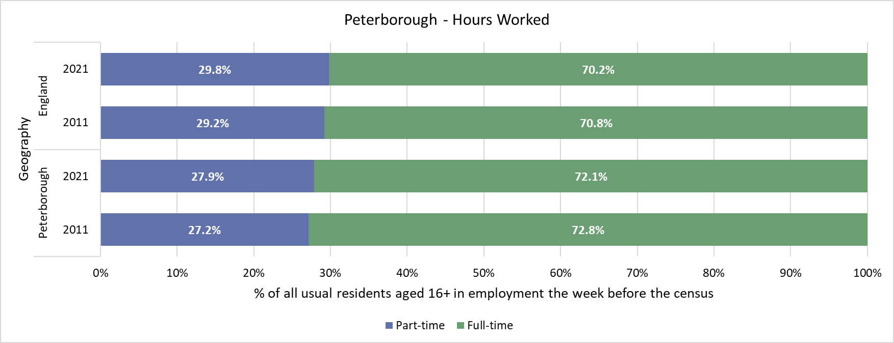
Peterborough – Hours Worked

Slide 56
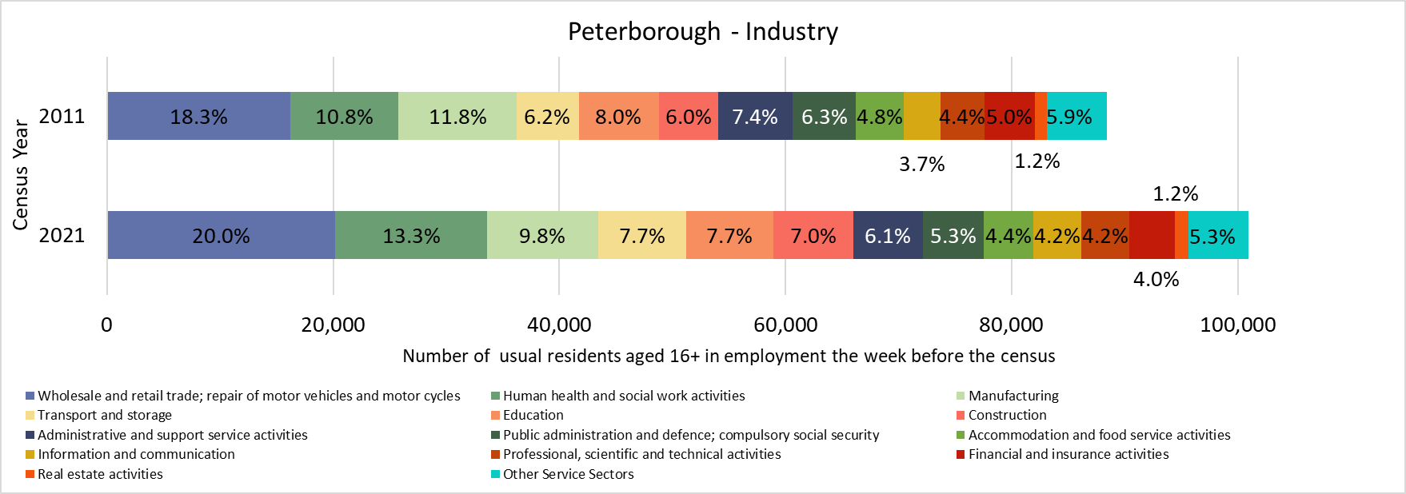
Peterborough – Industry

Slide 57
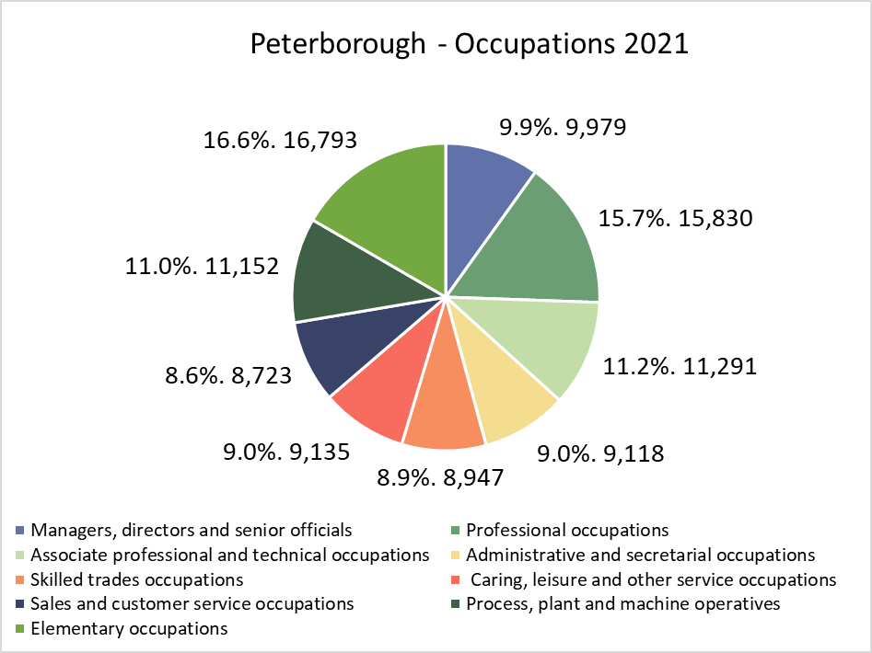
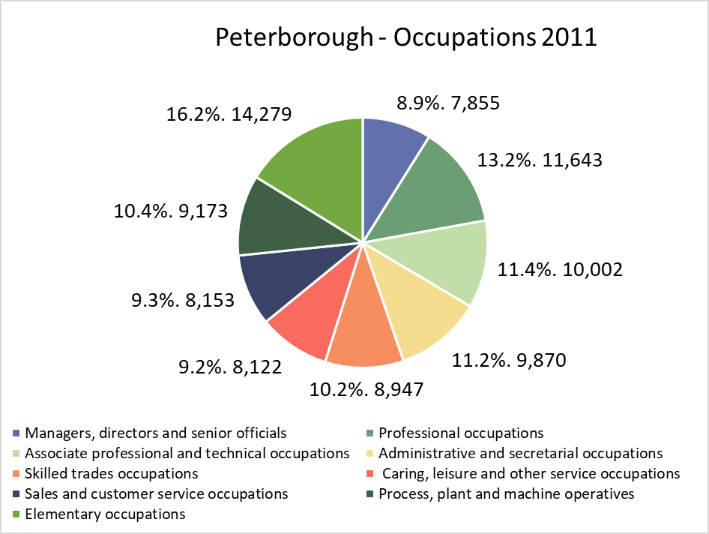
Peterborough -Occupation
*Not directly comparable to 2011. ONS changed the classification for Census 2021 and combined the categories previously available in the 2011 Census data. Therefore, comparisons are only indicative

Slide 58
Peterborough – Socio-economic Classification

Slide 59
Peterborough -Unemployment history
*Not comparable to 2011. The question on employment history changed between the 2011 and 2021 census.

Slide 60
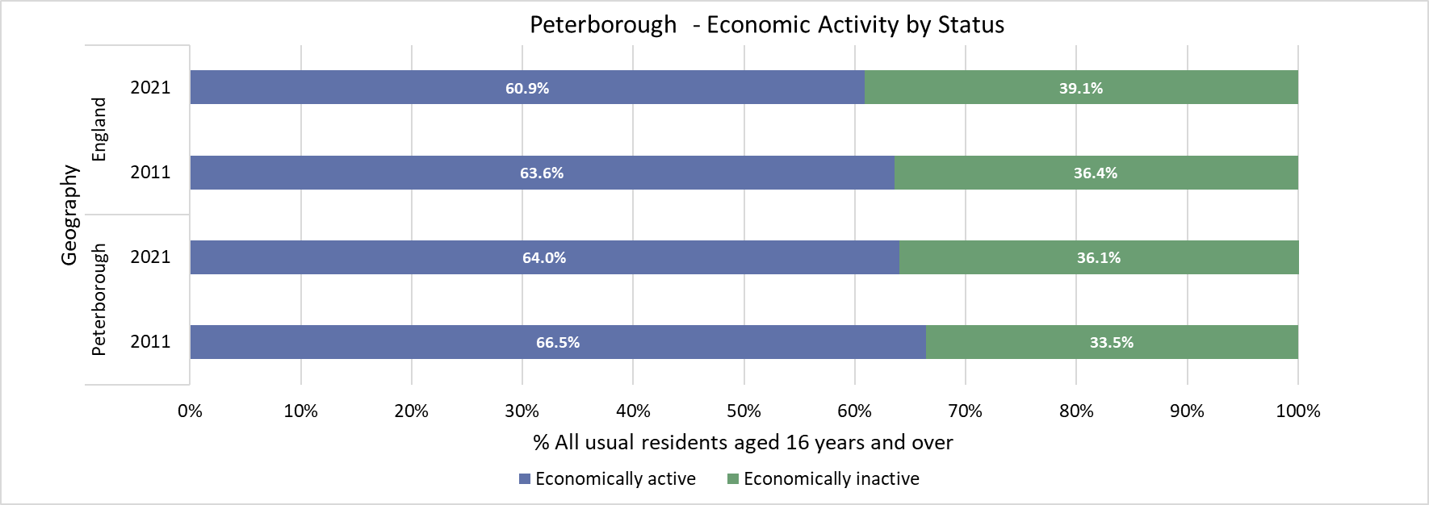
Peterborough – Economic activity status

Slide 61
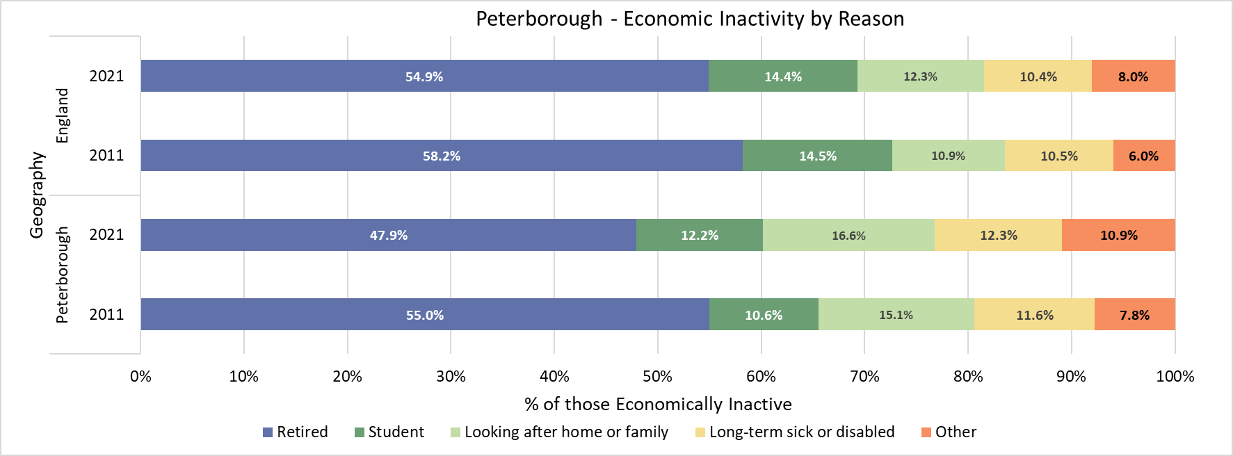
Peterborough – Economic inactivity by reason

Slide 62
When is the next release of data by the ONS?
8 topic summaries and area profiles, releasing between November 2022 and January 2023:
Demography and migration – 2nd November 2022 (published)
UK armed forces veterans – 10th November 2022 (published)
Ethnic group, national identity, language and religion – 29th November 2022 (published)
Labour market and travel to work – 8th December 2022 (published)
Housing – 5th January 2023 (provisional)
Sexual orientation and gender identity – 6th January 2023 (provisional)
Education – 10th January 2023 (provisional)
Health, disability, and unpaid care – 19th January 2023 (provisional)
Phase 2, early 2023 – multivariate data
Phase 3, Spring 2023 - data related to alternative population bases, small population data, origin destination data and micro-data

Slide 63
Useful links
Demography and Migration topic summary published by the Office for National Statistics (ONS) Demography and migration data, England and Wales - Office for National Statistics (ons.gov.uk)
ONS mapping tool ONS Census maps
Cambridgeshire Insight: Census 2021 updates and Cambridgeshire Insight Census 2021
Census 2021 data in the tools available on Cambridgeshire Insight, such as the Map Explorer and Interactive Reports
Further analysis and ward level estimates, where possible at this stage, are being progressed and will be published on Cambridgeshire Insight
Census data published by the ONS is also available on the Nomis website Dataset Selection - Query - Nomis - Official Census and Labour Market Statistics (nomisweb.co.uk)

