Slide 1

GCP Transport Working Group
COVID-19 transport impacts: data and monitoring report
July 2022
Research Team, Cambridgeshire County Council

Slide 2
Data and monitoring report aims
This report is intended to:
Summarise the on-going impacts of COVID-19 on transport and mobility.
Highlight changes in key indicators by comparing June 2022 data with the pre-pandemic baseline and to the same time last year (June 2021). Quarterly metrics are also provided.
Provide an updated picture up to 30th June 2022, where possible.
Provide a basis for discussion for the Greater Cambridge Partnership’s Transport Working Group to understand and identify existing challenges and future data needs.
Notes:
Comparison periods may vary across the different datasets based on the availability of historic data – comparison periods are clearly noted for each dataset.
In additional to monthly metrics, this report now also includes quarterly metrics. The quarters used in this report are defined as follows:
  Q1 = January – March
  Q2 = April – June
  Q3 = July – September
  Q4 = October - December

Slide 3






Changes in key indicators: June 2022
Significantly below pre-COVID (<80%)
Close to pre-COVID (>80%)
Above pre-COVID (>100%)
Many indicators are now returning to at or near pre-pandemic levels.
Maintained changes in habits post-pandemic, such as working from home and online shopping, are likely to be impacting all aspects of transport e.g. reduced car parking and bus passengers
The difference between weekend and weekday recovery seems to be less pronounced in recent months with weekdays starting to recover to a greater degree.
Motor vehicle volumes
Air pollution
Bus passengers
-3%*
Steady
-38%
Decreasing
-23%
Steady
June 2022
compared to pre-COVID
(June 2019)
Long-term trend between April 2022 and June 2022
June 2022
compared to pre-COVID
(All site average
2017-2019)
Long-term trend between April 2022 and June 2022
June 2022
compared to pre-COVID
(June 2019)
Long-term trend between April 2022 and June 2022
P
Car parking
Retail footfall
Walking and Cycling
-17%*
Steady
-1%*
Increasing
-30%
-12%
Steady
June 2022
compared to pre-COVID
(June 2019)
Long-term trend between April 2022 and June 2022
June 2022
compared to pre-COVID
(June 2019)
Long-term trend between April 2022 and June 2022
June 2022
compared to pre-COVID
(June 2019)
Long-term trend between April 2022 and June 2022
*Figures amended on January 18th, 2023.

Slide 4
Travel Demand

Slide 5
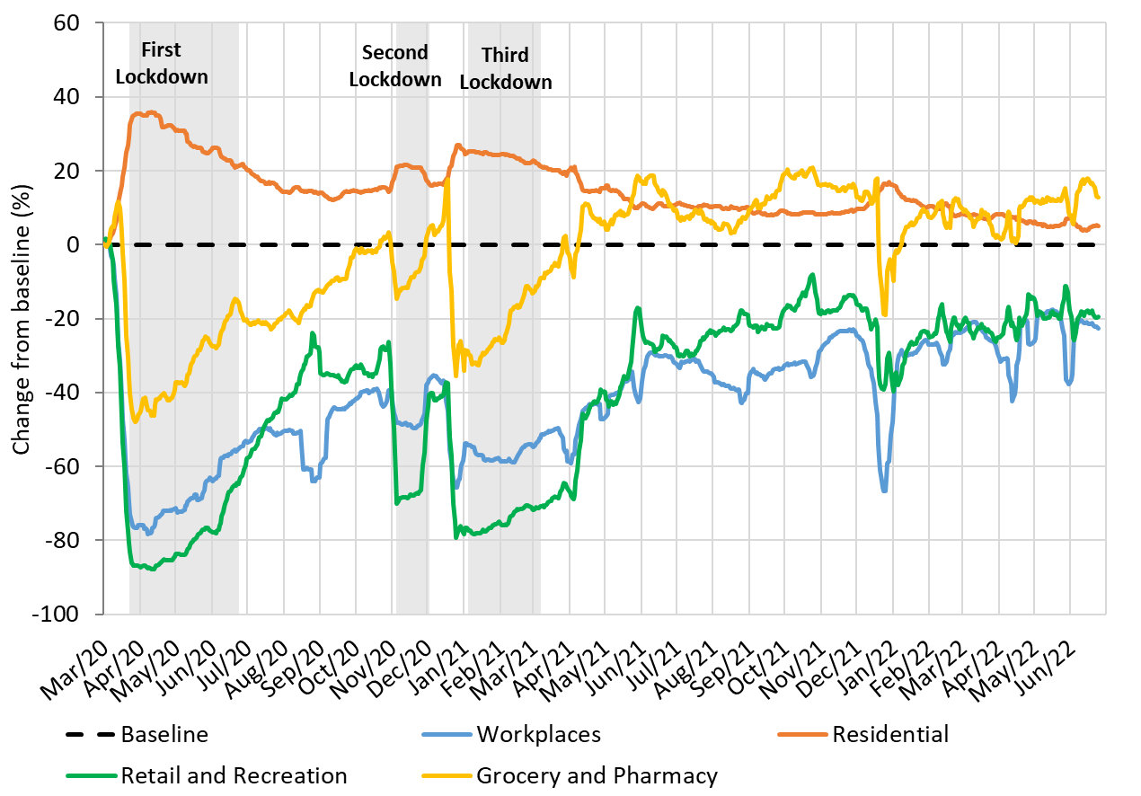
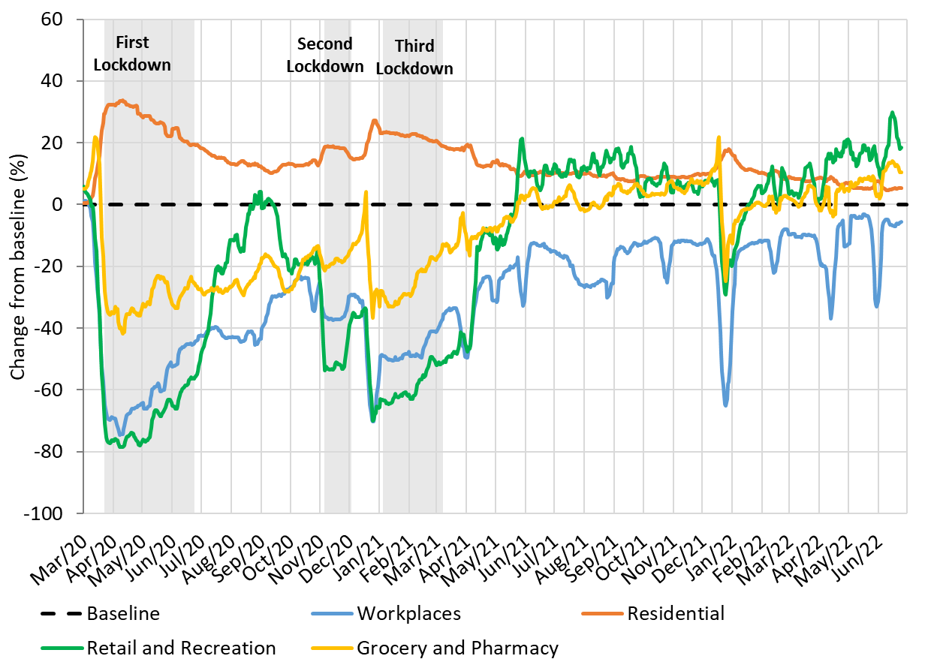
Travel Demand in Cambridge and South Cambridgeshire
Cambridge
South Cambridgeshire
Pre-Covid vs Now: | Workplaces | Residential | Retail and Recreation | Grocery and Pharmacy
Baseline to June 2022
Cambridge | -26 | +5 | -19 | +14
South Cambridgeshire | -12 | +6 | +19 | +10
Pre-Covid vs Now: | Workplaces | Residential | Retail and Recreation | Grocery and Pharmacy
Baseline to Q2 2022
Cambridge | -25 | +6 | -19 | +11
South Cambridgeshire | -12 | +6 | +16 | +6
Change against Google’s defined pre-COVID baseline: 3rd Jan – 6th Feb 2020
Notes:
Please note the graph shows a 7-day rolling average.
Commentary:
Cambridge: Cambridge grocery and pharmacy visits have recovered to above pre-pandemic levels but retail and recreation visits are at -19%, suggesting people have returned to their essential shopping habits but are perhaps not doing as much for leisure. The proportion of people making workplace visits is still distinctly below the baseline at -25%. Decreases in workplace visits on the right hand side of the graph are likely due to the Easter weekend/Easter holiday period. Residential visits remain higher than the baseline, in part likely due to the proportion of people still hybrid working.
South Cambridgeshire: Retail and recreation and grocery and pharmacy visits have both recovered to above pre-pandemic levels in South Cambridgeshire, suggesting that people’s shopping and leisure habits are returning to normal. Workplace visits are down on the baseline (-12%) but this is to be expected due to an increased move towards hybrid working for some businesses. This is also likely an influence on the higher rate of residential visits, as a greater proportion of people are probably home-working compared to pre-pandemic.
Source: Google LLC "Google COVID-19 Community Mobility Reports". https://www.google.com/covid19/mobility/
Data is gathered from Google account holders location history. This helps to demonstrate where people are spending their time.
The data is based on the most recent month (June 2022) compared to the median of the corresponding day in the baseline period (3rd Jan-6th Feb 2020) as calculated by Google. Tabulated percentages represent the change from the baseline (3rd Jan – 6th Feb) to the most recent month.
“Community Mobility Reports aim to provide insights into what has changed in response to policies aimed at combating COVID-19. The reports chart movement trends over time by geography, across different categories of places such as retail and recreation, groceries and pharmacies, parks, transit stations, workplaces, and residential.”

Slide 6
Strategic Road Network

Slide 7
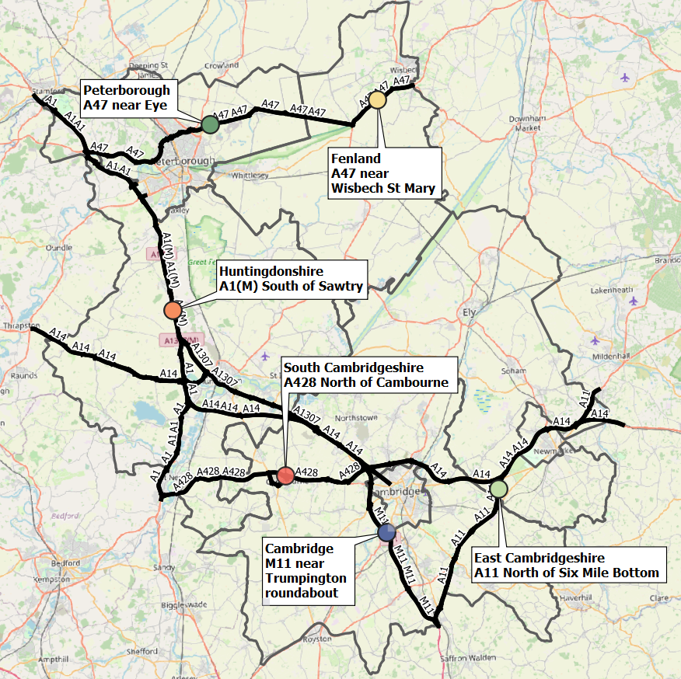
Strategic Road Network Site Locations
Traffic monitor locations in each district
 | District | Site location
 | Cambridge | M11 near Trumpington roundabout
 | Peterborough | A47 near Eye
 | East Cambridgeshire | A11 North of Six Mile Bottom
 | Fenland | A47 near Wisbech St Mary
 | Huntingdonshire | A1(M) South of Sawtry
 | South Cambridgeshire | A428 North of Cambourne
There are approximately 1,400 permanent traffic sensors on the strategic road network within Cambridgeshire and Peterborough.
The sensors vary in their ability to reliably provide data over time and periods of inactivity are common. It is therefore not appropriate to conduct a long-term analysis for all-sites.
For this reason, one sensor per district has been selected, which has a full dataset from 2019 onwards, so that a pre-/during-/post-COVID-19 comparison can be made.
As of April 2022, the A47 sensors in Fenland have stopped providing data so analysis for this district has not been possible.
Notes:
National Highways WebTRIS data
Site locations:
Cambridge
M11 near Trumpington roundabout
MIDAS site at M11/6820A
Peterborough
A47 near Eye
TMU Site 6351/1
East Cambridgeshire
A11 North of Six Mile Bottom
MIDAS site at A11/0883A
Fenland
A47 near Wisbech St Mary
TMU Site 6349/1
Huntingdonshire
A1(M) South of Sawtry
MIDAS site at A1M/2115B
South Cambridgeshire
A428 North of Cambourne
TMU Site 7124/2

Slide 8
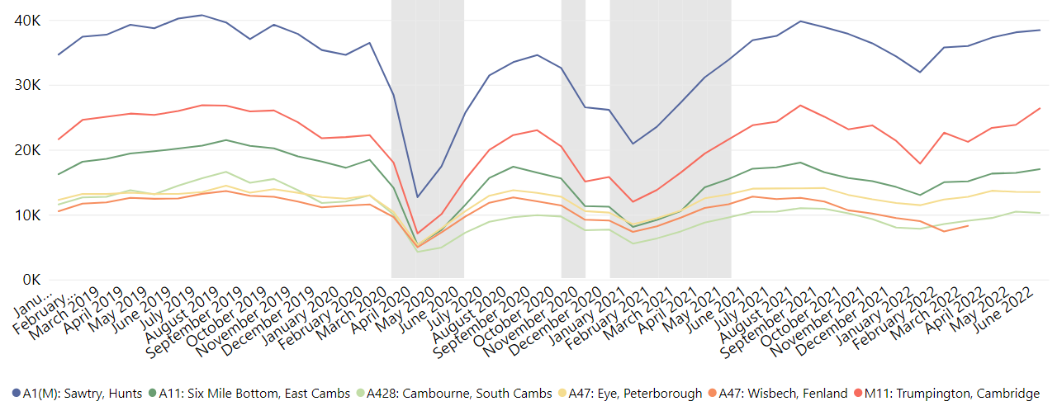
Strategic Road Network: Daily Flow by Month
Average Daily Flow in the Month (All Vehicles)
A47 (Fenland) sensors inactive since April 2022.
Site location | Pre-COVID vs Now: | Pre-COVID vs Now: | Mid-COVID vs Now: | Previous month vs Now:
 | June 2019 to June 2022 | June 2020 to June 2022 | June 2021 to June 2022 | May 2022 to June 2022
M11: Trumpington, Cambridge | +2% | +71% | +11% | +11%
A11: Six Mile Bottom, East Cambs | -16% | +48% | -0% | +3%
A47: Wisbech, Fenland | - | - | - | -
A1(M): Sawtry, Hunts | -4% | +49% | +4% | +1%
A428: Cambourne, South Cambs | -29% | +42% | -2% | -2%
A47: Eye, Peterborough | +2% | +28% | -4% | -0%
ALL | -7% | +50% | +3% | +3%
A428 overnight flows were high in 2019 due to the A14 overnight closures. A428 flows unlikely to reach this level again.
Notes:
Commentary:
All locations are close to or above June 2021 volumes and all sites are above 2020 volumes
Cambridge and Peterborough are now just above pre-pandemic 2019 volumes
Change from May 2022 is variable, but most sites show a stable or increasing trend
Source: National Highways WebTRIS data. Average Daily Flow in the month for 6 individual, main carriageway monitors , one in each district.

Slide 9
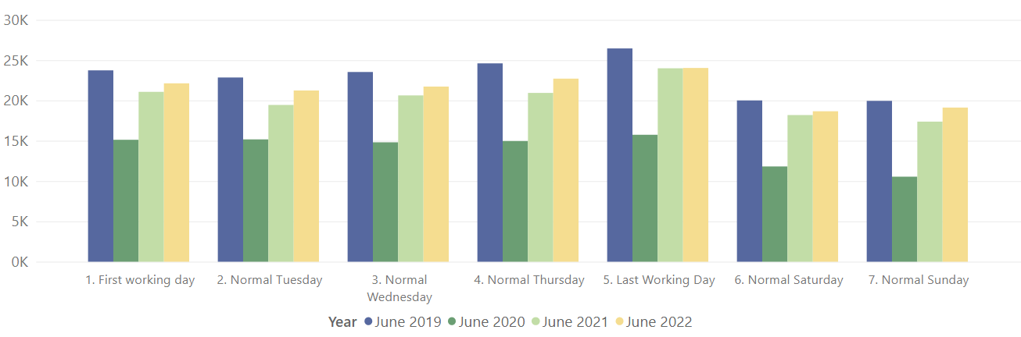
Strategic Road Network: Daily Flow by Day of Week
Average Daily Flow (All Vehicles)
% Difference | 1. First working day | 2. Normal Tuesday | 3. Normal Wednesday | 4. Normal Thursday | 5. Last Working Day | 6. Normal Saturday | 7. Normal Sunday
Pre-COVID vs Now: | -7% | -7% | -8% | -8% | -9% | -7% | -4%
June 2019 to June 2022
Pre-COVID vs Now: | +46% | +40% | +47% | +52% | +53% | +58% | +81%
June 2020 to June 2022
Mid-COVID vs Now: | +5% | +9% | +5% | +8% | 0% | +3% | +10%
June 2021 to June 2022
Previous month vs Now: | +1% | +3% | +2% | +2% | 0% | +9% | +13%
May 2022 to June 2022
Weekend / Weekday split | Pre-COVID Jun 2019 | Pre-COVID Jun 2020 | Mid-COVID Jun 2021 | Now Jun 2022
Weekday average | 24.2k | 15.2k | 21.2k | 22.4k
Weekend average | 20.0k | 11.2k | 17.8k | 18.9k
Weekend proportion of weekday | 0.83 | 0.74 | 0.84 | 0.84
Average Daily two-way flow, one site per district (monitors all active 2019 – 2022), excluding A47 in Fenland
Note: this data considers 'Normal' days which do not include days such as bank holidays, Christmas and school holidays.
Notes:
Note the use of ‘normal’ days which allow for a ‘like-for-like’ comparison between comparable days. For example, bank holidays and school holidays are excluded from average flow calculations for ‘normal’ days. As such, this dataset does not account for the Christmas period, bank holidays etc.
Commentary:
Flow rates still below June 2019 but are now above June 2020 on all days
Sundays closest to pre-pandemic 2019 volumes
All days except Friday see an increase from May 2022, this is particularly notable at the weekends which see a +9% and +13% increase from May 2022
Weekday/weekday flow ratios returned to close to pre-pandemic proportions suggesting similar proportions of travel on weekdays/weekends despite lower volumes remaining lower than 2019.
Source: National Highways WebTRIS data. Average Daily Flow in the week for 6 individual, main carriageway monitors , one in each district.

Slide 10
Cambridge: Modal split

Slide 11
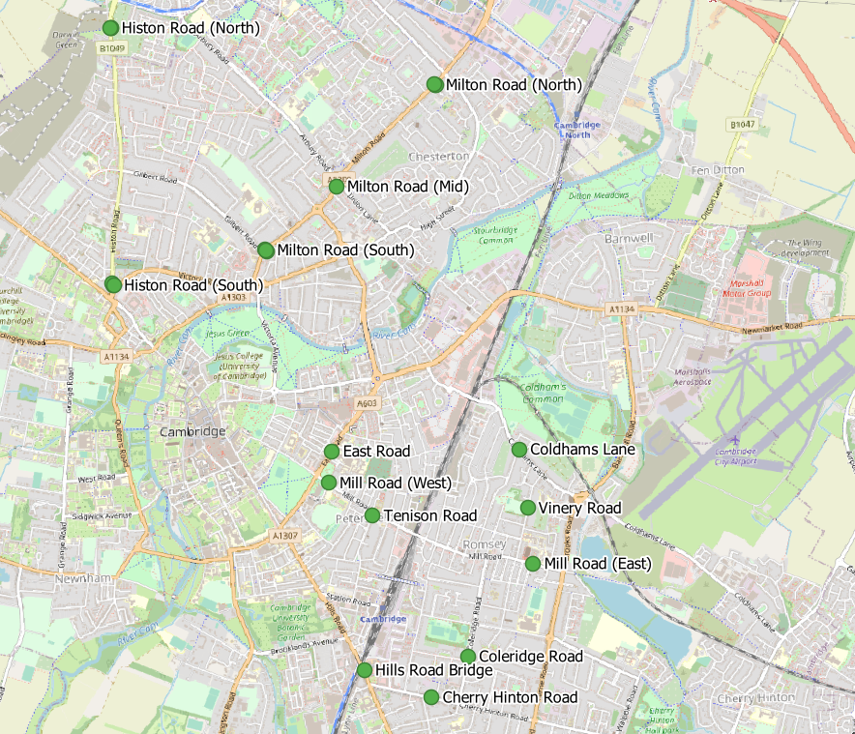
Cambridge Traffic Sensor Locations
Sensor Location​​ | Location description​​ | Installed​
Cherry Hinton Road ​​ | Near Rock Road​​ | May 2019​
Coldham’s Lane​​ | Near Coldham’s Common​​ | May 2019​
Coleridge Road ​​ | Near Coleridge recreation ground​​ | May 2019​
East Road​​ | Close to ARU site​​ | May 2019​
Hills Road Bridge​​ | Near Cherry Hinton Road​​ | May 2019​
Histon Road (North)​​ | Just south of A14​ | Sept 2019​
Histon Road (South) ​​ | Near Victoria Road​ | Sept 2019​
Mill Road (East)​​ | Close to Brookfield’s hospital​​ | May 2019​
Mill Road (West)​​ | Close to Parker’s Piece​​ | May 2019​
Milton Road (Mid)​​ | Near Union Lane​​ | May 2019​
Milton Road (North)​​ | Near King’s Hedges Road​ | Sept 2019​
Milton Road (South)​ | Near Gilbert Road​ | Sept 2019​
Tenison Road​​ | Near Mill Road​​ | May 2019​
Vinery Road ​​ | Near Romsey recreation ground​​ | May 2019​
Histon Road and Milton Road are excluded from the combined all-sites analysis as the sensors weren't installed until Sept-2019 so no pre-COVID 2019 Q2 data is available. These locations are included within the site-by-site analysis however so that the 2020-2022 volumes can be seen.
Cherry Hinton Road is also excluded due to tree growth affecting counts.
Please note that 2019 Q2 analysis does not include April since sensors were only installed in the May of that year.

Slide 12
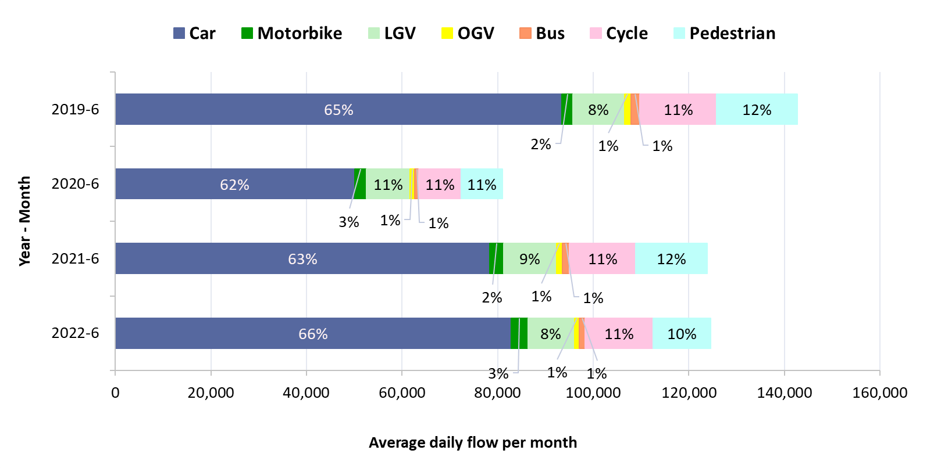
Traffic Sensor Modal Split: Cambridge – monthly analysis
Transport mode split – all sensors in Cambridge: June comparison
Year | Motor vehicle* % | Active travel* %
June 2019 | 77% | 23%
June 2020 | 78% | 22%
June 2021 | 77% | 23%
June 2022 | 79% | 21%
*Motor vehicles: Car, Motorbike, LGV, OGV, Bus. Active travel: Cyclist, Pedestrian
Notes:
Commentary
Motor vehicles dominate in all years. Active travel has decreased to 21% of total counts in June 2022.
Cars make up more than 60% of total traffic counts passing the Vivacity sensors in every year suggesting the car is the dominant form of transport on these roads.
Whilst transport volumes have decreased during the pandemic, the modal split of transport methods has remained similar throughout.
Source: Cambridge Vivacity sensors

Slide 13
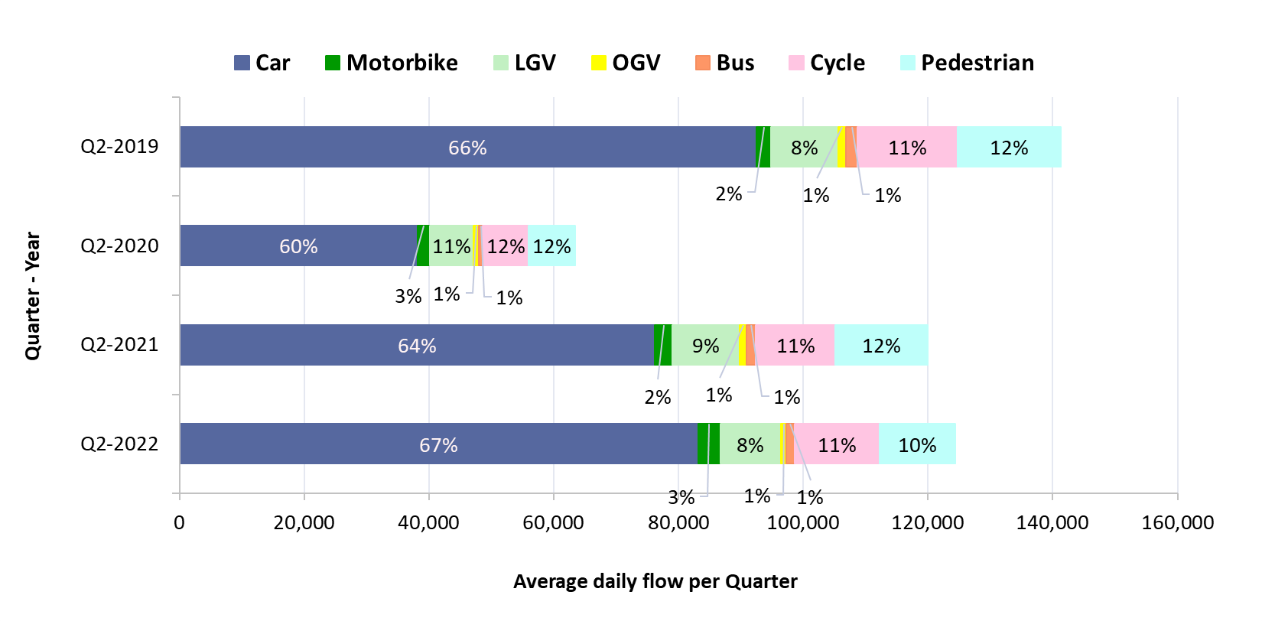
Traffic Sensor Modal Split: Cambridge – quarterly analysis
Transport mode split – all sensors in Cambridge: Q2 comparison
Year | Motor vehicle* % | Active travel* %
Q2 2019 | 77% | 23%
Q2 2020 | 77% | 23%
Q2 2021 | 77% | 23%
Q2 2022 | 79% | 21%
*Motor vehicles: Car, Motorbike, LGV, OGV, Bus. Active travel: Cyclist, Pedestrian
Notes:
Commentary
Motor vehicles dominate in all quarters. Active travel has decreased 2022 to 21% of total counts in Q2 2022.
Cars make up more than 60% of total traffic counts passing the Vivacity sensors in every year suggesting the car is the dominant form of transport on these roads.
Whilst transport volumes have decreased during the pandemic, the modal split of transport methods has remained similar throughout.
Source: Cambridge Vivacity sensors

Slide 14
Traffic Sensor Modal Split: Cambridge – June analysis
Average two-way daily flow during June for the last four years.
June 2022
Location​ | Motorised %​ | Active %​
Tenison Road | 58% | 42%
Mill Road (West) | 63% | 37%
Histon Road (South) | 70% | 30%
Milton Road (South) | 71% | 29%
Mill Road (East) | 72% | 28%
Vinery Road | 74% | 26%
Hills Road | 74% | 26%
Coleridge Road | 79% | 21%
Milton Road (North) | 86% | 14%
East Road | 86% | 14%
Histon Road (North) | 87% | 13%
Milton Road (Mid) | 89% | 11%
Coldham's Lane | 93% | 7%
ALL SITES | 79% | 21%
*Motor vehicles: Car, Motorbike, LGV, OGV, Bus
Active travel: Cyclist, Pedestrian
Notes:
Commentary
Cars are the largest category at all sites in all years.
Whilst absolute volumes decreased during the pandemic, the impact on modal split at sites has not been significant at most locations. Exceptions to this are: Mill Road (East and West), Histon Road (North) and Tenison Road which saw significant decreases in the proportion of cars travelling on the roads in comparison to other modes of transport.
8 of the 13 sites have active travel proportions of 20% or higher in June 2022. The proportion of motor vehicles to active travel has changed little since June 2019 at most sites.
*Note: the high proportion of pedestrians recorded at Histon Road (North) in March 2021 appears to be due to construction workers. The Histon Road scheme site compound was near to the sensor and any workers nearby may have been picked up repeatedly.
Source: Cambridge Vivacity sensors

Slide 15
Traffic Sensor Modal Split: Cambridge – quarterly analysis
Average two-way daily flow during quarter 2 (Apr-June) for the last four years.
Q2-2022
Location​ | Motorised %​ | Active %​
Tenison Road | 60% | 40%
Mill Road (West) | 63% | 37%
Milton Road (South) | 71% | 29%
Mill Road (East) | 73% | 27%
Hills Road | 74% | 26%
Histon Road (South) | 77% | 23%
Vinery Road | 78% | 22%
Coleridge Road | 80% | 20%
East Road | 86% | 14%
Milton Road (Mid) | 90% | 10%
Milton Road (North) | 90% | 10%
Histon Road (North) | 91% | 9%
Coldham's Lane | 92% | 8%
ALL SITES | 79% | 21%
*Motor vehicles: Car, Motorbike, LGV, OGV, Bus
Active travel: Cyclist, Pedestrian
Notes:
Commentary
Cars are the largest category at all sites in all years.
Whilst absolute volumes decreased during the pandemic, the impact on modal split at sites has not been significant at most locations. Exceptions to this are: Mill Road (East and West), Histon Road (North) and Tenison Road which saw significant decreases in the proportion of cars travelling on the roads in comparison to other modes of transport.
8 of the 13 sites have active travel proportions of 20% or higher in Q2 2022. The proportion of motor vehicles to active travel has changed little since Q2 2019 at most sites.
*Note: the high proportion of pedestrians recorded at Histon Road (North) in March 2021 appears to be due to construction workers. The Histon Road scheme site compound was near to the sensor and any workers nearby may have been picked up repeatedly.
Source: Cambridge Vivacity sensors

Slide 16







Traffic Sensor Change: Cambridge by Location and Mode – June analysis
All locations and the majority of modes still below pre-pandemic levels – potentially linked to continued working from home and/or long-term changes to habits such as increased online shopping?
% increase in traffic volume: June 2019 to June 2022
​ | Car​ | Motorbike​ | LGV​ | OGV​ | Bus​ | Cyclist​ | Pedestrian​ | All modes​ | Motorised Vehicles | Active Modes
Coldham's Lane | -6% | +71% | -11% | -7% | -31% | +21% | -31% | -5% | -5% | +1%
Coleridge Road | -18% | +57% | -13% | -24% | -36% | -15% | -48% | -18% | -16% | -26%
East Road | -8% | +29% | -4% | -35% | -65% | -32% | -53% | -16% | -8% | -46%
Hills Road | -12% | +35% | -9% | -29% | -29% | -16% | +16% | -10% | -11% | -7%
Mill Road (East) | -13% | +73% | -9% | -26% | -41% | -12% | -21% | -14% | -12% | -16%
Mill Road (West) | -24% | +108% | -29% | -54% | -31% | +31% | -34% | -19% | -21% | -13%
Milton Road (Mid) | -8% | +76% | -9% | -20% | -16% | -35% | -55% | -13% | -7% | -44%
Tenison Road | -16% | +54% | +21% | -15% | -65% | +8% | +14% | -3% | -12% | +12%
Vinery Road | -9% | +57% | -24% | +75% | -31% | -12% | -55% | -15% | -9% | -29%
ALL SITES | -11% | +55% | -10% | -29% | -34% | -11% | -29% | -13% | -10% | -20%
Car use in 2022 still lower than pre-pandemic levels in Cambridge
Motorbike volumes increased at most locations – possibly due to popularity of food delivery services.
Decrease in buses/coaches likely the result of reduced patronage/services since COVID-19
Walking and cycling both lower than pre-pandemic volumes in most locations
All sites:
June 2019 vs June 2022
All motor transport:
-10%
Since 2019
All active transport:
-20%
Since 2019
Car:
-11%
Since 2019
Motorbike:
+55%
Since 2019
LGV:
-10%
Since 2019
OGV:
-29%
Since 2019
Bus:
-34%
Since 2019
Cyclist:
-11%
Since 2019
Pedestrian:
-29%
Since 2019
Notes:
Commentary:
Most modes of transport are showing a decrease from June 2019 levels
Coldham’s Lane and Tenison Road have seen minor overall increases in actives modes of travel
OGVs, Buses and Pedestrians show the largest average decreases with % differences at some sites as low as -65% compared to June 2019.
Source: Cambridge Vivacity sensors

Slide 17
Traffic Sensor Change: Cambridge by Location and Mode – quarterly analysis
All locations and the majority of modes still below pre-pandemic levels – potentially linked to continued working from home and/or long-term changes to habits such as increased online shopping?
% increase in traffic volume: Q2 2019 to Q2 2022
​ | Car​ | Motorbike​ | LGV​ | OGV​ | Bus​ | Cyclist​ | Pedestrian​ | All modes​ | Motorised Vehicles | Active Modes
Coldham's Lane | -5% | +79% | -14% | -8% | -37% | +28% | -20% | -4% | -5% | +9%
Coleridge Road | -16% | +42% | -14% | -30% | -35% | -20% | -53% | -19% | -15% | -31%
East Road | -8% | +17% | -5% | -31% | -67% | -37% | -53% | -16% | -8% | -47%
Hills Road | -10% | +31% | -7% | -27% | -28% | -22% | +21% | -10% | -9% | -10%
Mill Road (East) | -13% | +74% | -8% | -20% | -39% | -18% | -21% | -14% | -11% | -20%
Mill Road (West) | -21% | +109% | -25% | -50% | -29% | +38% | -22% | -13% | -19% | -1%
Milton Road (Mid) | -7% | +69% | -7% | -22% | -17% | -37% | -56% | -12% | -6% | -46%
Tenison Road | -16% | +72% | +14% | -19% | -41% | -6% | +3% | -8% | -12% | -0%
Vinery Road | -4% | +44% | -17% | +57% | -23% | -21% | -66% | -15% | -4% | -39%
ALL SITES | -10% | +52% | -10% | -27% | -34% | -15% | -27% | -12% | -9% | -21%
Car use in 2022 still lower than pre-pandemic levels in Cambridge
Motorbike volumes increased at most locations – possibly due to popularity of food delivery services.
Decrease in buses/coaches likely the result of reduced patronage/services since COVID-19
Walking and cycling both significantly down compared to pre-pandemic volumes at most locations
All sites:
Q2 2019 vs Q2 2022
All motor transport:
-9%
Since Q2 2019
All active transport:
-21%
Since Q2 2019
Car:
-10%
Since Q2 2019
Motorbike:
+52%
Since Q2 2019
LGV:
-10%
Since Q2 2019
OGV:
-27%
Since Q2 2019
Bus:
-34%
Since Q2 2019
Cyclist:
-15%
Since Q2 2019
Pedestrian:
-27%
Since Q2 2019
Notes:
Commentary:
Most modes of transport are showing a decrease from Q2 2019 levels
Coldham’s Lane and Mill Road (West) have seen a significant increase of cyclists (~30% compared to 2019 levels)
OGVs, Buses and Pedestrians show the largest average decreases with % differences at some sites as low as -67% compared to Q2 2019.
Source: Cambridge Vivacity sensors

Slide 18
Cambridge: Motorised vehicles

Slide 19
Cambridge Traffic Sensor Locations
Sensor Location​​ | Location description​​ | Installed​
Cherry Hinton Road ​​ | Near Rock Road​​ | May 2019​
Coldham’s Lane​​ | Near Coldham’s Common​​ | May 2019​
Coleridge Road ​​ | Near Coleridge recreation ground​​ | May 2019​
East Road​​ | Close to ARU site​​ | May 2019​
Hills Road Bridge​​ | Near Cherry Hinton Road​​ | May 2019​
Histon Road (North)​​ | Just south of A14​ | Sept 2019​
Histon Road (South) ​​ | Near Victoria Road​ | Sept 2019​
Mill Road (East)​​ | Close to Brookfield’s hospital​​ | May 2019​
Mill Road (West)​​ | Close to Parker’s Piece​​ | May 2019​
Milton Road (Mid)​​ | Near Union Lane​​ | May 2019​
Milton Road (North)​​ | Near King’s Hedges Road​ | Sept 2019​
Milton Road (South)​ | Near Gilbert Road​ | Sept 2019​
Tenison Road​​ | Near Mill Road​​ | May 2019​
Vinery Road ​​ | Near Romsey recreation ground​​ | May 2019​
Histon Road and Milton Road are excluded from the combined all-sites analysis as the sensors weren't installed until Sept-2019 so no pre-COVID 2019 Q2 data is available. These locations are included within the site-by-site analysis however so that the 2020-2022 volumes can be seen.
Cherry Hinton Road is also excluded due to tree growth affecting counts.
Please note that 2019 Q2 analysis does not include April since sensors were only installed in the May of that year.

Slide 20
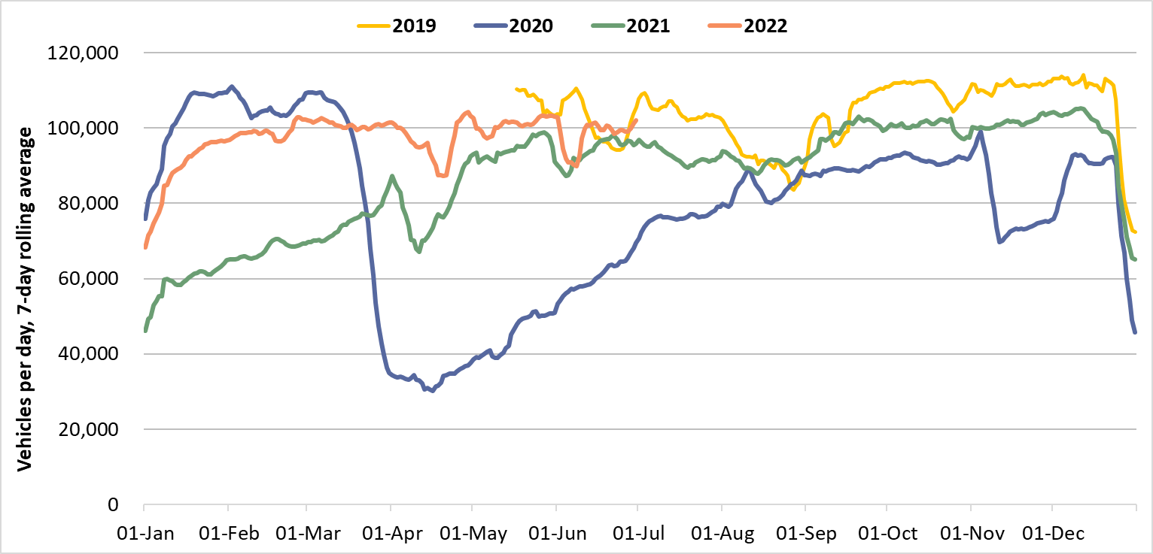
Motorised Vehicles: Cambridge Daily Flows – June analysis
Cambridge
2020
2019
2022
2021
 | Pre-COVID vs Now: June 2019 to June 2022 |  |  | Mid-COVID vs Now: June 2021 to June 2022 | Previous month vs Now: May 2022 to June 2022
 | Mon-Sun | Weekdays | Weekends | Mon-Sun | Mon-Sun | Weekdays | Weekends
Cambridge | -3% | -3% | -1% | 3% | -2% | -1% | -1%
Notes:
Commentary:
Very small decreases in motorised vehicles in Cambridge since May 2022 (-2% Mon-Sun).
Slight increases in motorised vehicles since June 2021
Cambridge flows still below June 2019 ‘pre-COVID’ levels, particularly at weekdays.
Source: Cambridge Vivacity sensors

Slide 21
Motorised Vehicles: Cambridge Daily Flows – quarterly analysis
Cambridge
2020
2019
2022
2021
 | Pre-COVID vs Now: Q2 2019 to Q2 2022 |  |  | Mid-COVID vs Now: Q2 2021 to Q2 2022 | Previous month vs Now: Q1 2022 to Q2 2022
 | Mon-Sun | Weekdays | Weekends | Mon-Sun | Mon-Sun | Weekdays | Weekends
Cambridge | -4% | -4% | -3% | 10% | 2% | 2% | 2%
Notes:
Commentary:
Very small increase in motorised vehicles in Cambridge since Q1 2022 (+2% Mon-Sun).
10% increase in motor vehicles from Q2 2021
Cambridge flows still slightly below Q2 2019 ‘pre-COVID’ levels
Source: Cambridge Vivacity sensors

Slide 22
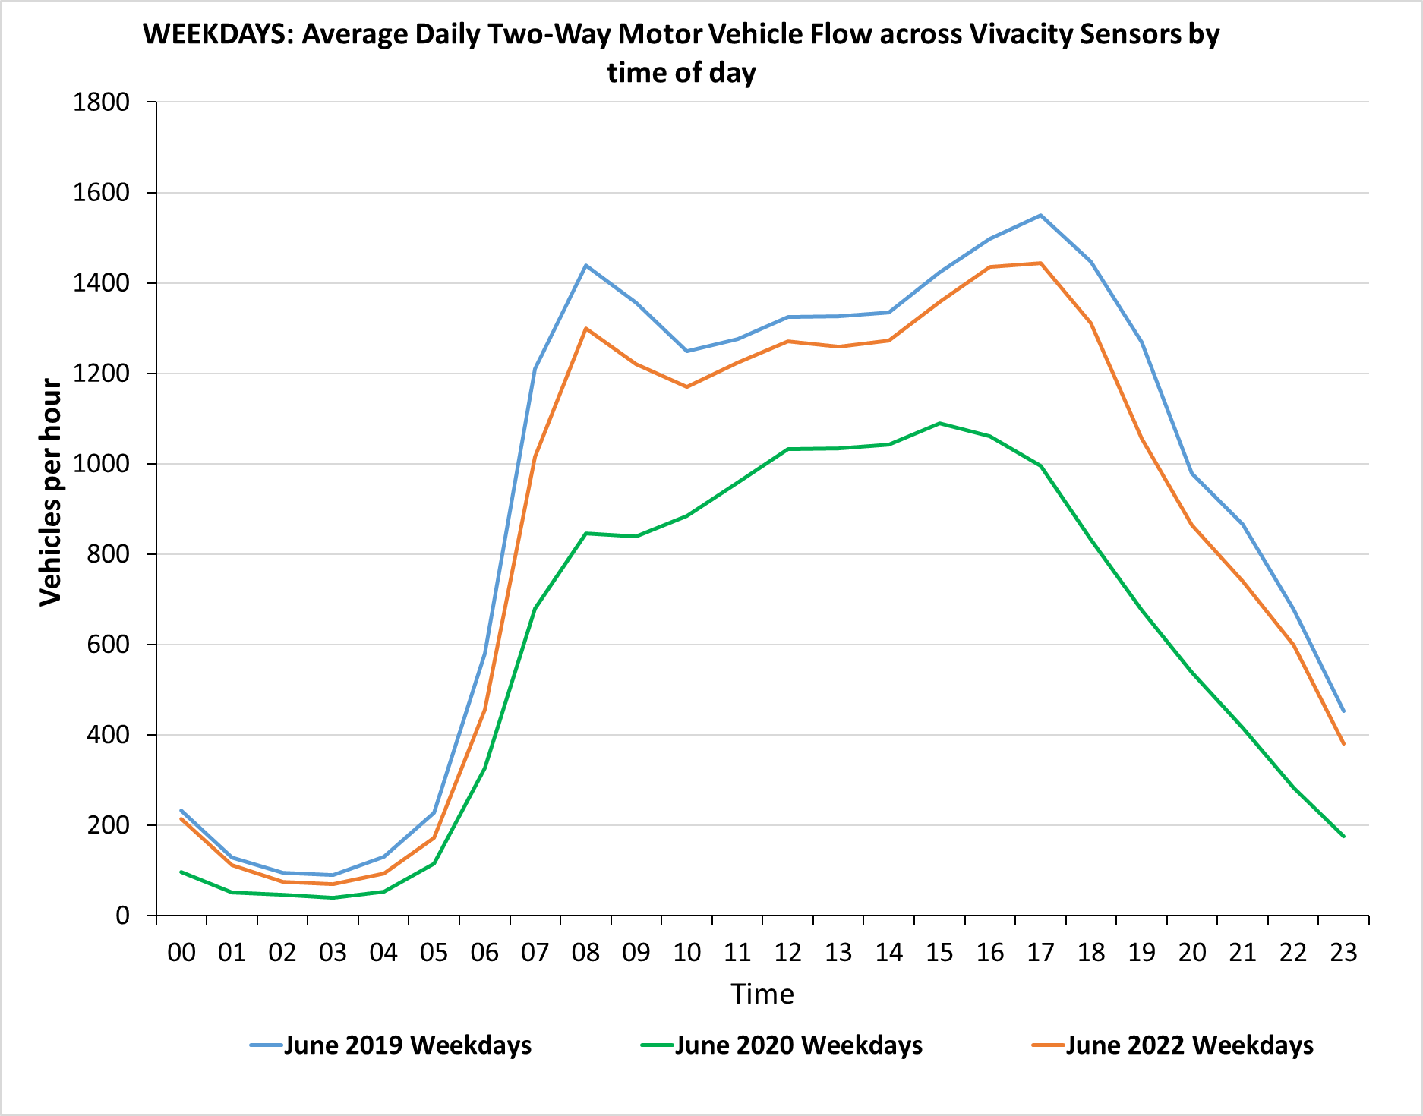
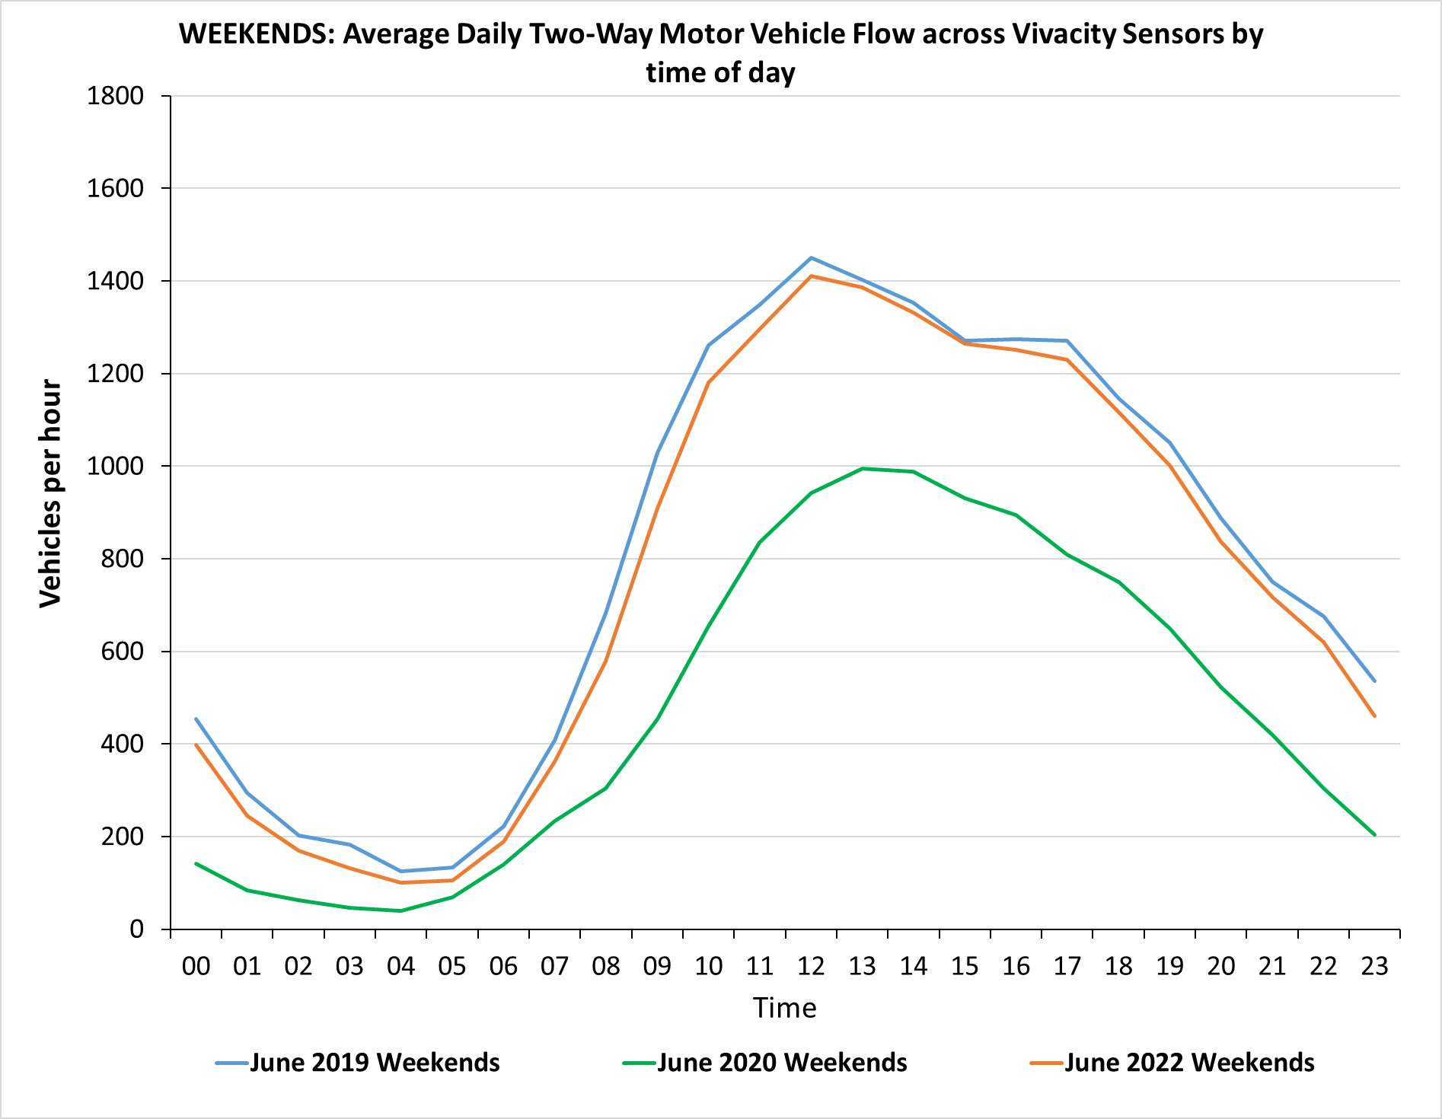
Motorised vehicles by hour: Cambridge – June analysis
Weekdays
Weekends
Pre-COVID
Pre-COVID
Now
Now
Mid-COVID
Mid-COVID
Weekdays
Weekday flows significantly exceeding mid-COVID levels
Slightly below pre-pandemic levels, especially at peak times
Weekends
Middle of the day continues to be the peak period
Weekend flows closer to Pre-COVID levels compared to weekday flows
Please note that the above chart (Cambridge Vivacity) only includes core sensors where data is available for all comparison periods to ensure consistency, therefore it is not comparable to the overall count charts on the slides prior.
Notes:
Commentary:
Weekdays in June 2022: current flows are nearing the levels seen pre-COVID
Weekends in June 2022: most hours have returned almost to pre-COVID levels
Source: Cambridge Vivacity sensors

Slide 23
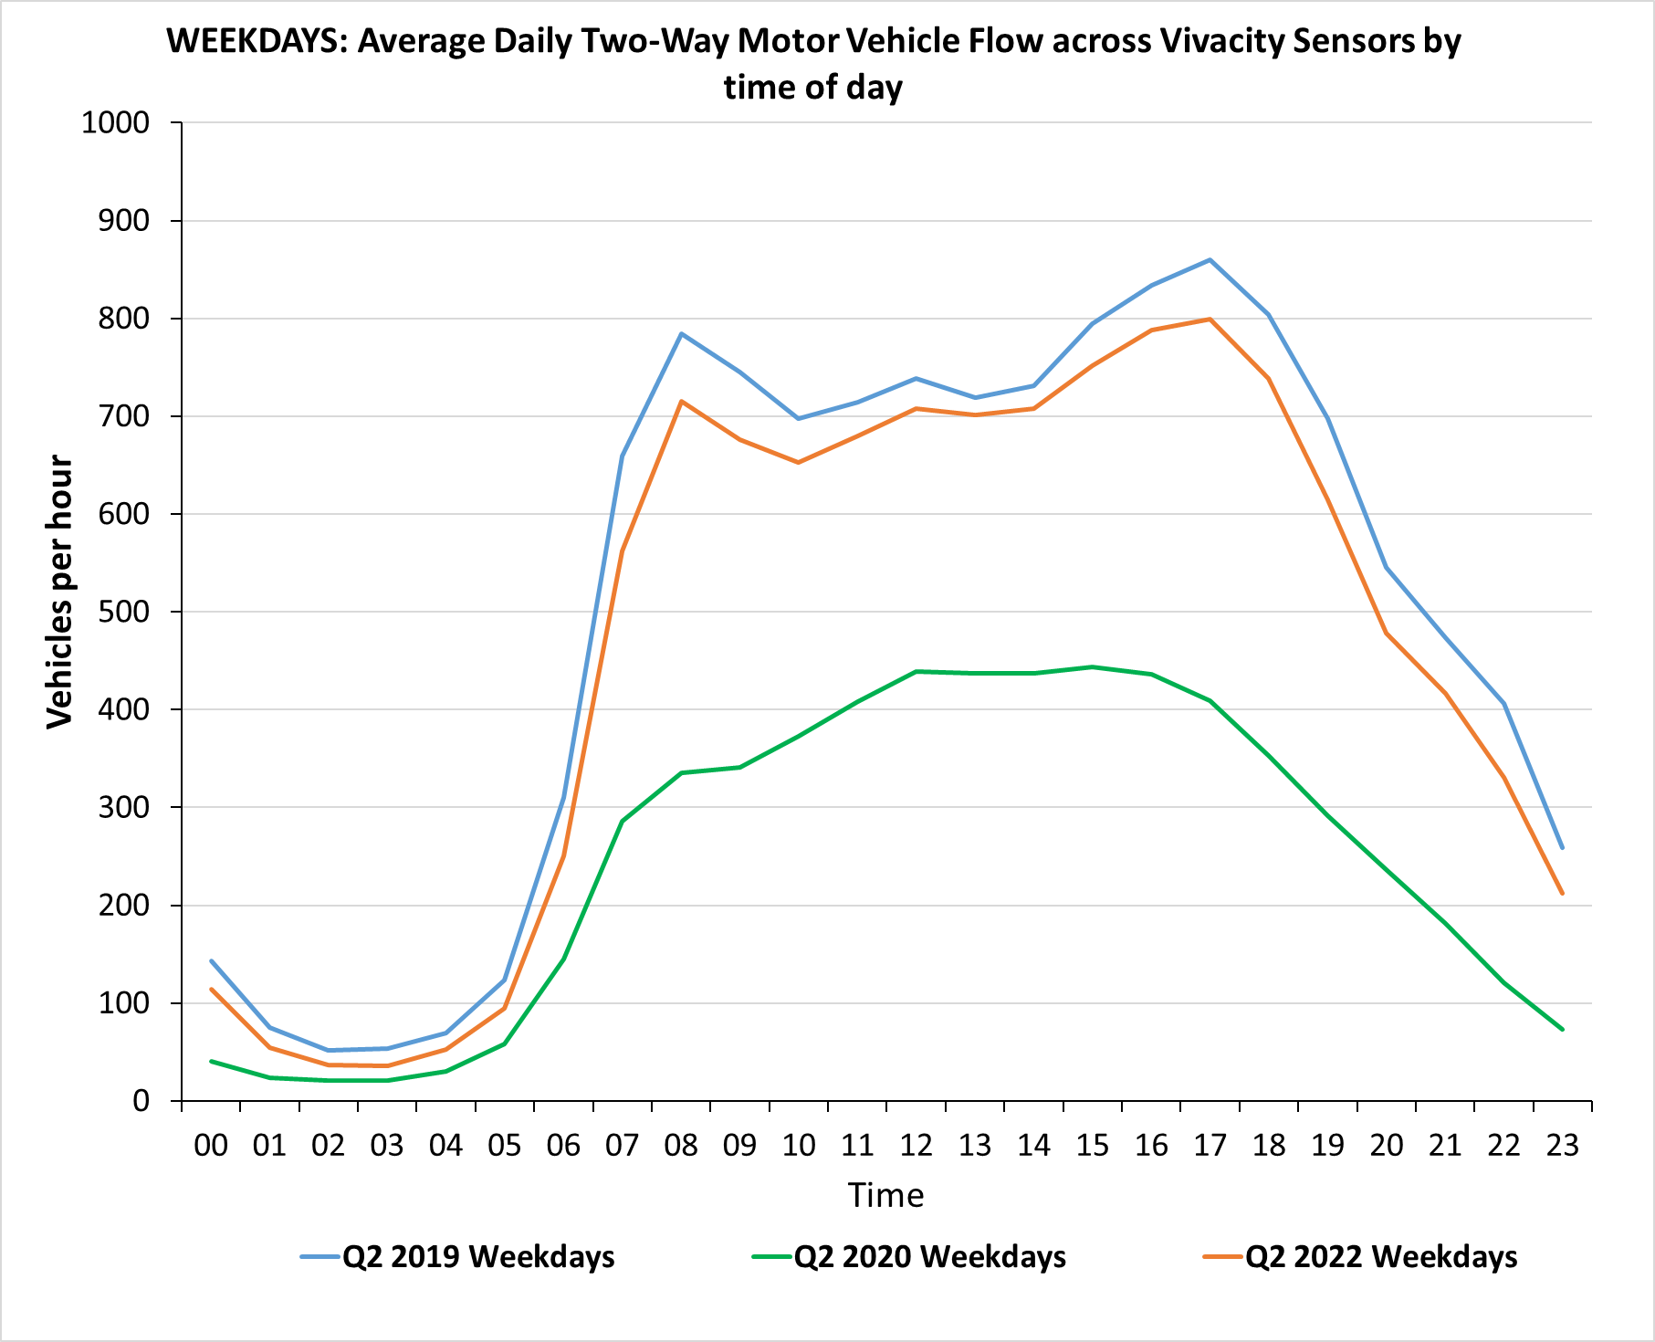
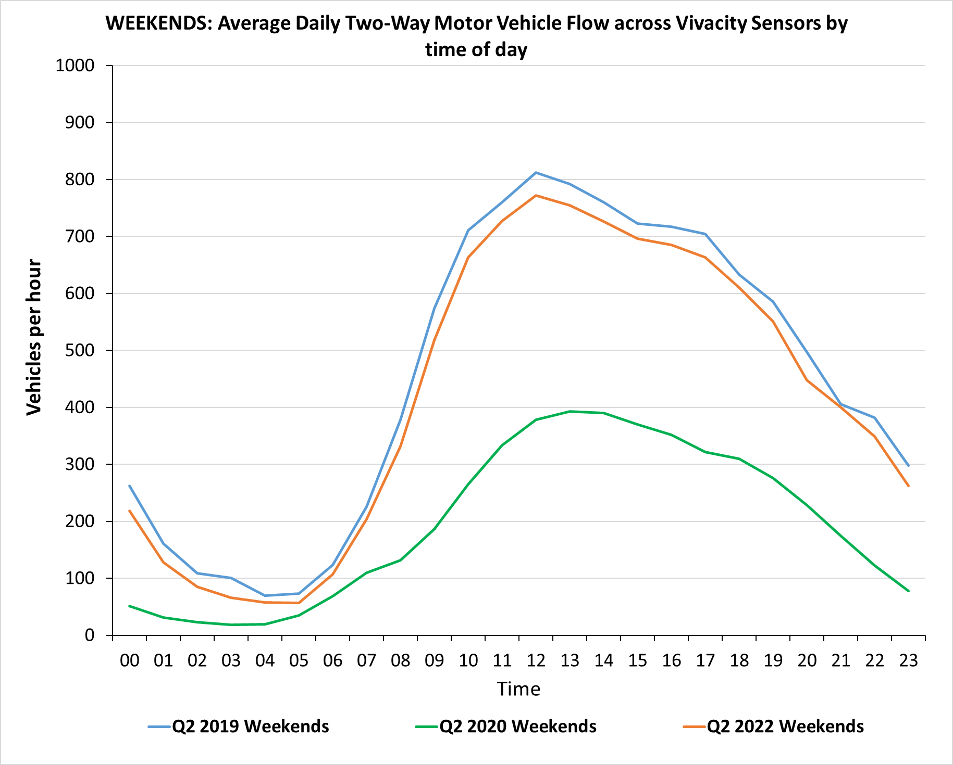
Motorised vehicles by hour: Cambridge – quarterly analysis
Weekdays
Weekends
Pre-COVID
Pre-COVID
Now
Now
Mid-COVID
Mid-COVID
Weekdays
Weekday flows significantly exceeding mid-COVID levels
Slightly below pre-pandemic levels, especially at peak times
Weekends
Middle of the day continues to be the peak period
Weekend flows closer to Pre-COVID levels compared to weekday flows
Please note that the above chart (Cambridge Vivacity) only includes core sensors where data is available for all comparison periods to ensure consistency, therefore it is not comparable to the overall count charts on the slides prior.
Notes:
Commentary:
Weekdays in Q2 2022: current flows are nearing the levels seen pre-COVID
Weekends in Q2 2022: many hours have returned to at/near pre-COVID level
Source: Cambridge Vivacity sensors

Slide 24
Cambridge: Active Travel

Slide 25
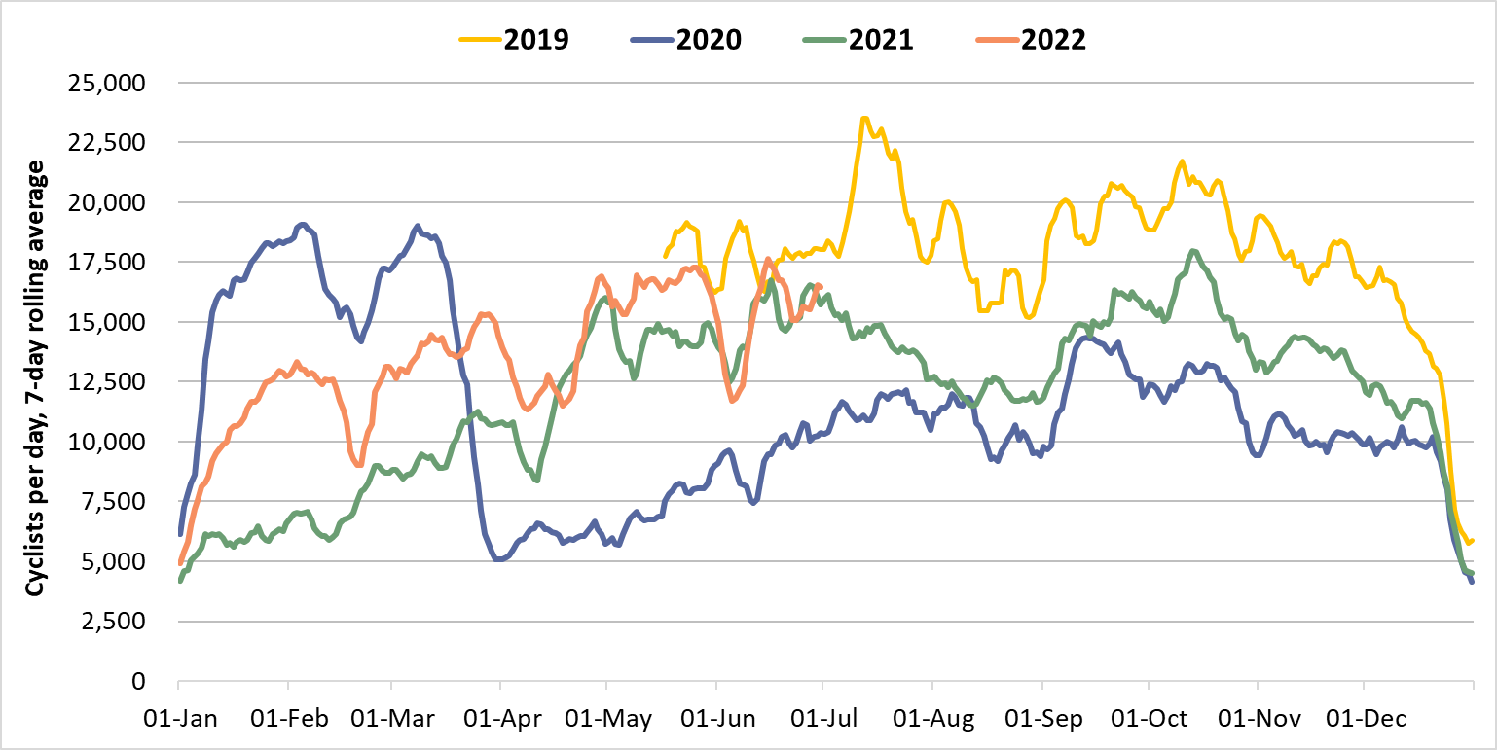
Cyclists: Cambridge Daily Flow
Cambridge
2020
2019
2022
2021
 | Pre-COVID vs Now: |  |  | Mid-COVID vs Now: | Previous month vs Now:
 | June 2019 to June 2022 |  |  | June 2020 to June 2022 | May 2022 to June 2022
 | Mon-Sun | Weekdays | Weekends | Mon-Sun | Mon-Sun | Weekdays | Weekends
Cambridge | -12% | -14% | No change | 62% | -5% | -2% | -9%
 | Pre-COVID vs Now: |  |  | Mid-COVID vs Now: | Previous quarter vs Now:
 | Q2 2019 to Q2 2022 |  |  | Q2 2020 to Q2 2022 | Q1 2022 to Q2 2022
 | Mon-Sun | Weekdays | Weekends | Mon-Sun | Mon-Sun | Weekdays | Weekends
Cambridge | -15% | -17% | -9% | 94% | 15% | 11% | 19%
Notes:
Commentary:
Long term trends: Expected seasonal variation can be seen in the data, with peaks during the summer months and decreases in the winter.
Cycling trends have picked up significantly since the start of 2022, though weekday trends still remain well below 2019 volumes, possibly the result of continued hybrid working for some.
Cycling trends show a significant increase from June 2020 and Q2 of 2022
Source: Cambridge Vivacity sensors

Slide 26
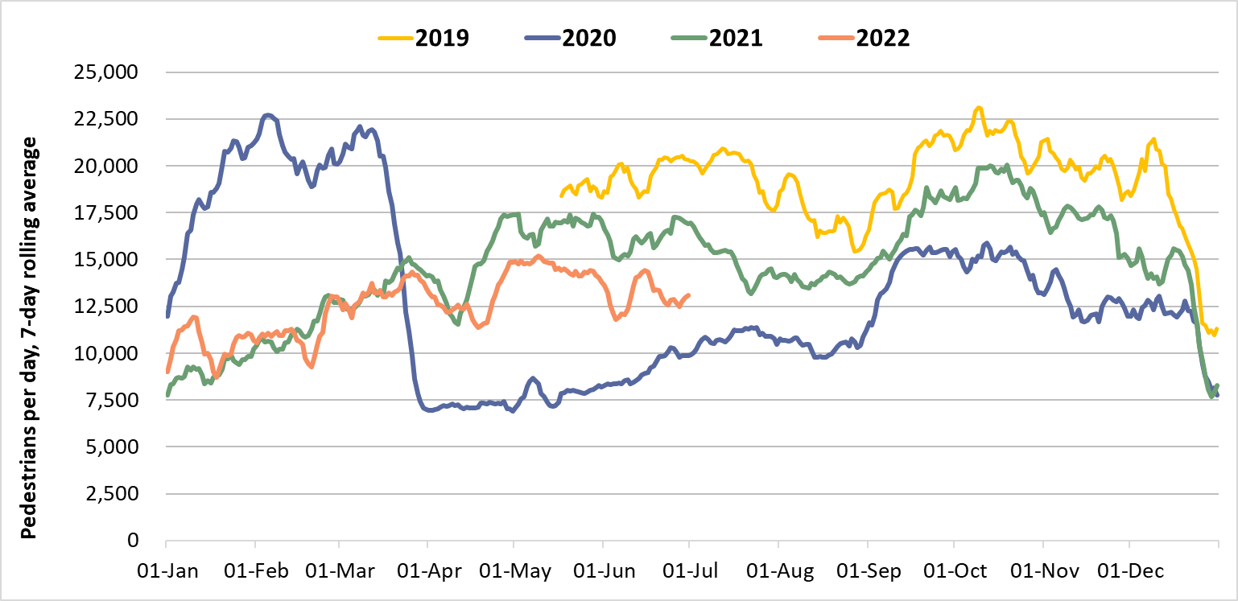
Pedestrians: Cambridge Daily Flow
Cambridge
2020
2019
2022
2021
 | Pre-COVID vs Now: |  |  | Mid-COVID vs Now: | Previous month vs Now:
 | June 2019 to June 2022 |  |  | June 2020 to June 2022 | May 2022 to June 2022
 | Mon-Sun | Weekdays | Weekends | Mon-Sun | Mon-Sun | Weekdays | Weekends
Cambridge | -30% | -30% | -28% | 45% | -5% | -3% | -6%
 | Pre-COVID vs Now: |  |  | Mid-COVID vs Now: | Previous quarter vs Now:
 | Q2 2019 to Q2 2022 |  |  | Q2 2020 to Q2 2022 | Q1 2022 to Q2 2022
 | Mon-Sun | Weekdays | Weekends | Mon-Sun | Mon-Sun | Weekdays | Weekends
Cambridge | -28% | -29% | -26% | 68% | 15% | 11% | 19%
Notes:
Commentary:
Pedestrian trends remain well below the 2019 pre-pandemic level, particularly on weekdays (-30%).
Significant increases in Q2 2022 compared to the previous quarter – likely attributable to more favourable weather conditions.
Source: Cambridge Vivacity sensors

Slide 27
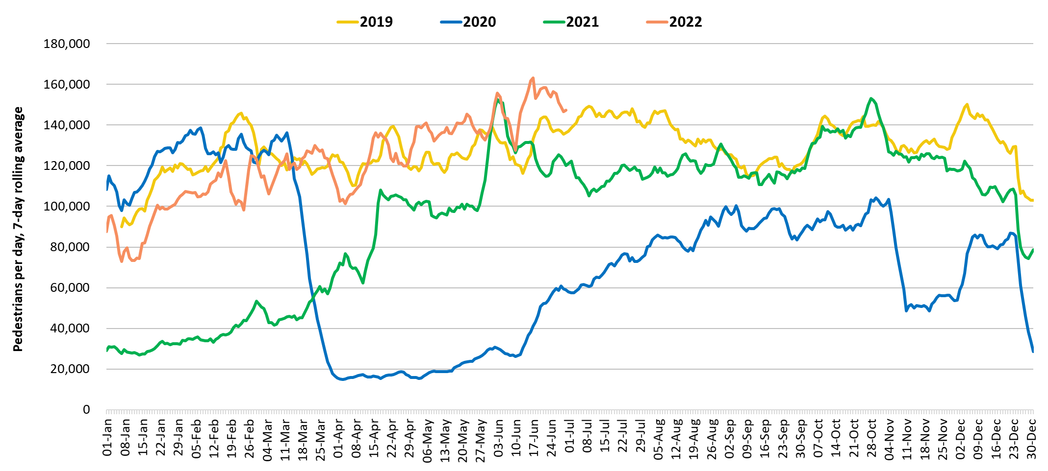
Retail footfall: Central Cambridge
2019
2022
2021
Third lockdown
2020
Second lockdown
First lockdown
 | Pre-COVID vs Now*: |  |  | Mid-COVID vs Now: | Previous month vs Now:
 | June 2019 to June 2022 |  |  | June 2020 to June 2022 | May 2022 to June 2022
 | Mon-Sun | Weekdays | Weekends | Mon-Sun | Mon-Sun | Weekdays | Weekends
Cambridge Retail | -1%​ | +2%​ | -2%​ | +228% | +9% | +15% | No Change
*Figures amended on January 18th, 2023.
 | Pre-COVID vs Now*: |  |  | Mid-COVID vs Now: | Previous quarter vs Now:
 | Q2 2019 to Q2 2022 |  |  | Q2 2020 to Q2 2022 | Q1 2022 to Q2 2022
 | Mon-Sun | Weekdays | Weekends | Mon-Sun | Mon-Sun | Weekdays | Weekends
Cambridge Retail | -3%​ | -5%​ | +1%​ | +384% | +29% | +31% | +22%
Notes:
Commentary:​
Central Cambridge footfall exceeding Q2 2019 and Q2 2020 volumes both at overall and across weekdays and weekends
Source: Cambridge BID footfall data​
*Q2 2019 and Q2 2020 data includes all locations except for King’s Parade. The King’s Parade sensor was recalibrated in 2021 and therefore counts are no longer comparable.​

Slide 28
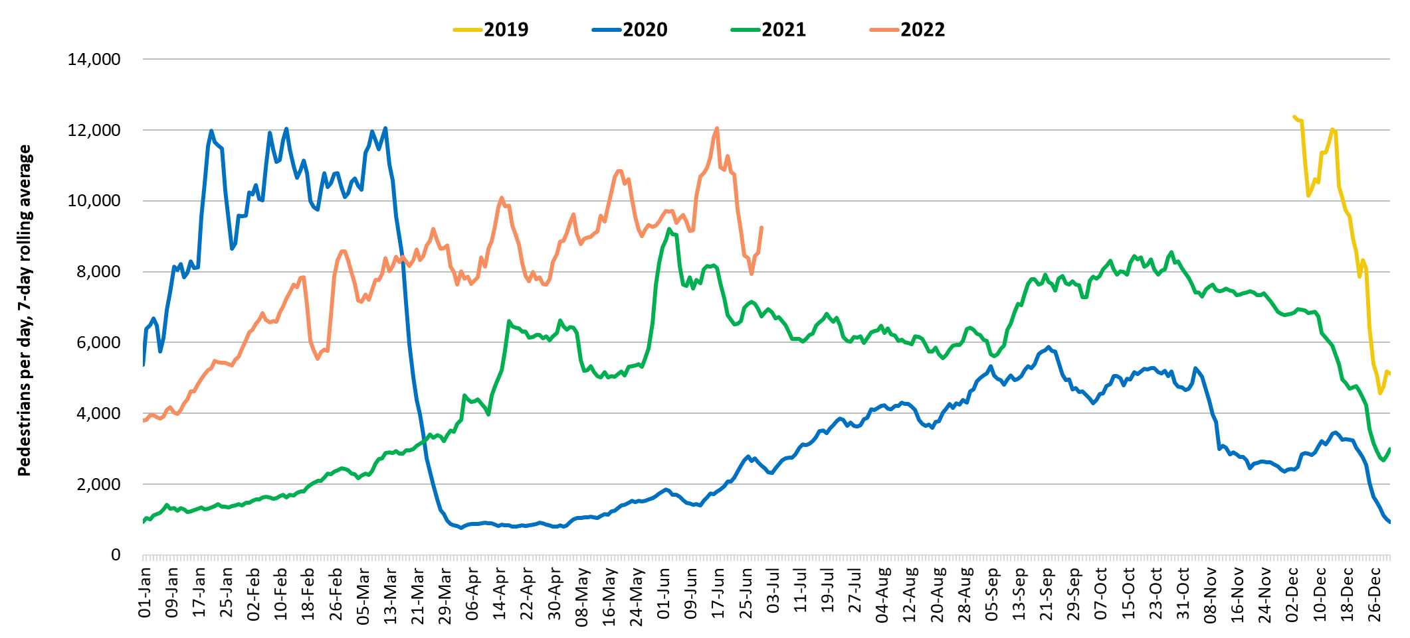
Footfall at One Station Square: Cambridge
*Data collection at One Station Square began in Dec 2019 so Q2 2019 data is not available to represent pre-COVID conditions. Q1 2020 (with the last two weeks of March 2020 excluded ) and Feb 2020 have therefore been used instead.
2019
2022
2021
Third lockdown
2020
First lockdown
Second lockdown
 | Pre-COVID vs Now: |  |  | Mid-COVID vs Now: | Previous month vs Now:
 | Feb 2020* to June 2022 |  |  | June 2020 to June 2022 | May 2022 to June 2022
 | Mon-Sun | Weekdays | Weekends | Mon-Sun | Mon-Sun | Weekdays | Weekends
One Station Square | -6% | -14% | +19% | +397% | +6% | +7% | +2%
 | Pre-COVID vs Now: |  |  | Mid-COVID vs Now: | Previous month vs Now:
 | Q1 2020* to Q2 2022 |  |  | Q2 2020 to Q2 2022 | Q1 2022 to Q2 2022
 | Mon-Sun | Weekdays | Weekends | Mon-Sun | Mon-Sun | Weekdays | Weekends
One Station Square | -7% | -13% | +12% | +568% | +39% | +36% | +42%
Notes:
Commentary: ​
Q1 2020 has been used as a Pre-Covid comparison as there is no data for Q2 2019 for One Station Square. The last weeks of March 2020 (14th -31st) have been excluded from Q1 2020 owing to the increasing impact of Covid-19
One Station square footfall exceeding Q2 2020 volumes but below Q1 2020 volumes apart from at the weekends
Source: Cambridge BID footfall data​
*The One Station Square sensor was fitted in December 2019​
*Data may be impacted by strike action
*Note that the substantial increase between 2020 and 2022 figures will be explained by lockdown restrictions in May 2020.

Slide 29
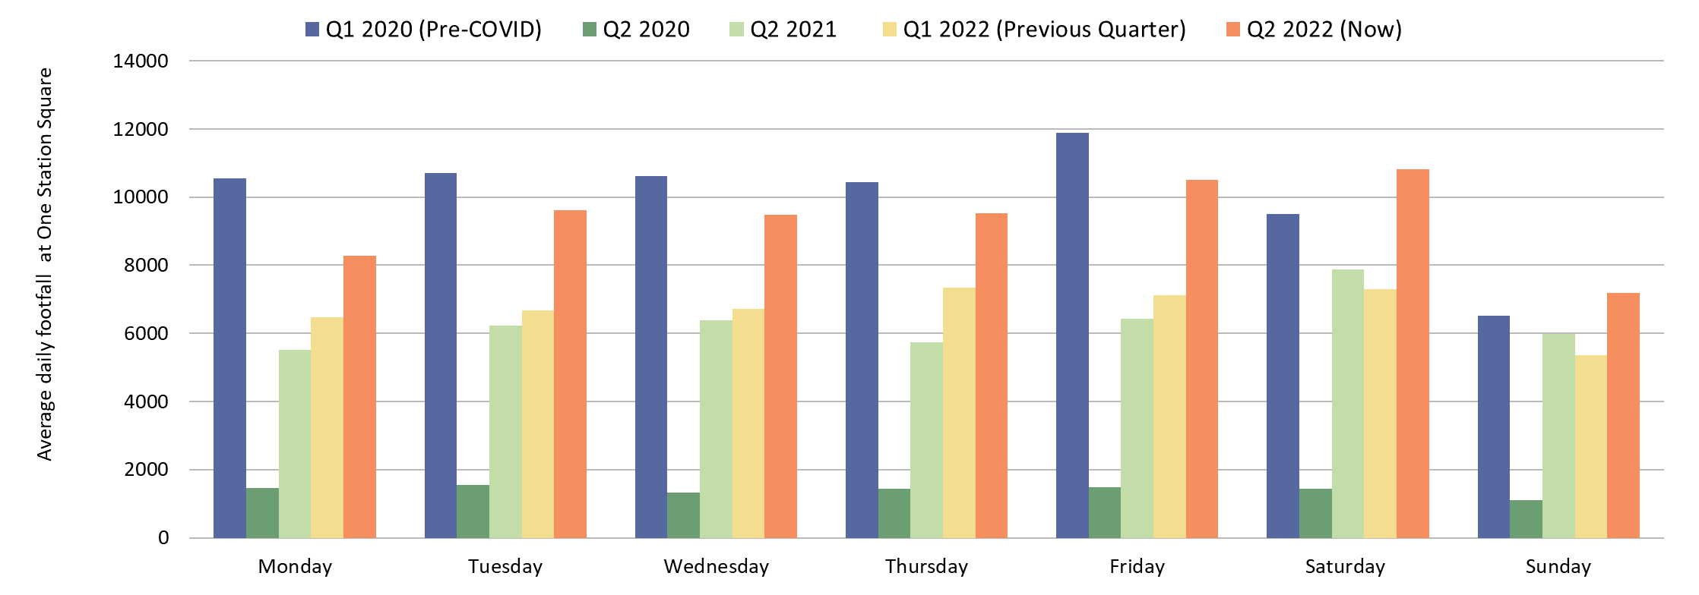
Footfall at One Station Square by day of week: Cambridge
Footfall at One Station Square
*
Weekdays remain below pre-COVID levels, particularly on Mondays (-22%). Thursdays are closest to pre-pandemic levels (-9%).
Saturdays are now +14% above Q1 2020
Sundays in Q2 2022 are +10% above
Q1 2020
*The Q1 2020 volumes exclude the last two weeks of March 2020 to avoid including mid-COVID data.
Notes:
Commentary:​
Q1 2020 has been used as a Pre-Covid comparison as there is no data for Q2 2019. The last weeks of March 2020 (14th -31st) have been excluded from Q1 2020 owing to the increasing impact of Covid-19.
Note that the substantial increase between 2020 and 2022 figures will be explained by lockdown restrictions in March – June 2020.
For weekdays, Thursdays in Q2 2022 are closest to pre-pandemic Q1 2020 levels (-9%).
Saturdays and Sundays in Q2 2022 exceed pre-pandemic Q1 2020 (+14% and +10% respectively).
Weekend increases on pre-COVID are likely in part driven by the fact that people are more likely be out and about more in the warmer Q2 months than they would in the colder Q1 months at the weekends due to better weather, Easter holidays etc.
Source: Cambridge BID footfall data​
*The One Station Square sensor was fitted in December 2019​
*Data may be impacted by strike action

Slide 30
Car Parking

Slide 31
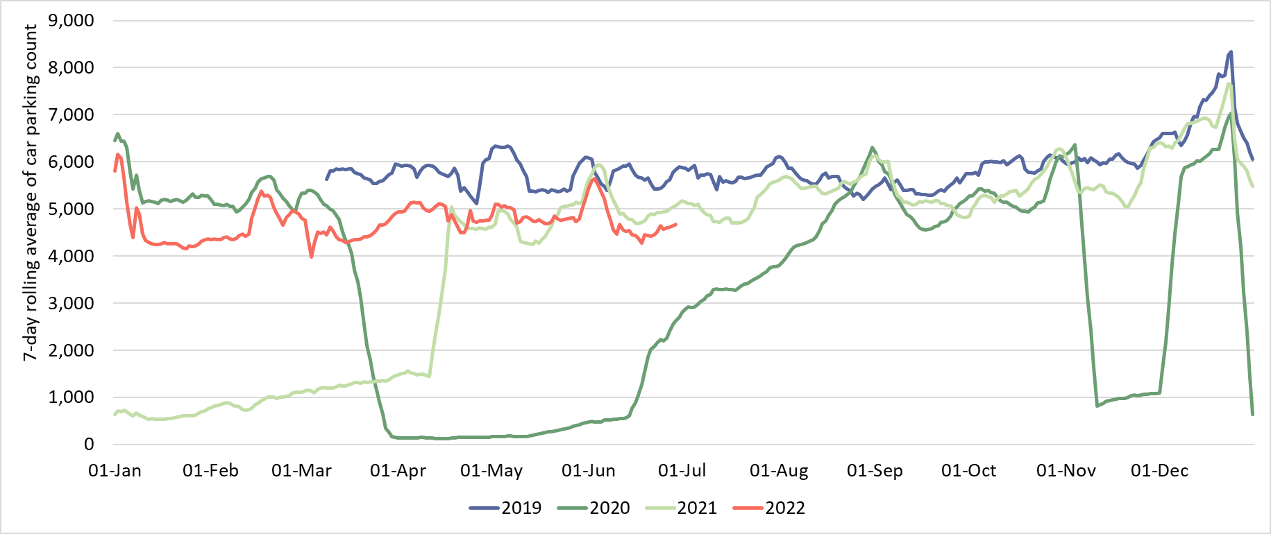
Car parking: Cambridge
7-day rolling average across Cambridge multi-storey car parks
Christmas/New Year
2019
2022
2020
Closure of Park Street car park
2021
Lockdown 3
Lockdown 1
Lockdown 2
**Figures amended on January 18th, 2023.
 | Pre-COVID vs Now**: |  |  | Previous year vs Now: |  |  | Previous month vs Now:
 | June 2019 to June 2022 |  |  | June 2021 to June 2022 |  |  | May 2022 to June 2022
 | Mon-Sun | Weekdays | Weekends | Mon-Sun | Weekdays | Weekends | Mon-Sun | Weekdays | Weekends
Cambridge | -17% | -15% | -16% | -8% | -7% | -10% | -5% | -2% | -10%
*Park Street car park closed for redevelopment on 4th January 2022. Usage figures for this car park are included in the data to establish whether the closure has affected overall numbers.
 | Pre-COVID vs Now: |  |  | Previous year vs Now: |  |  | Previous quarter vs Now:
 | Q2 2019 to Q2 2022 |  |  | Q2 2021 to Q2 2022 |  |  | Q1 2022 to Q2 2022
 | Mon-Sun | Weekdays | Weekends | Mon-Sun | Weekdays | Weekends | Mon-Sun | Weekdays | Weekends
Cambridge | -16% | -16% | -16% | +8% | +7% | +9% | +6% | +12% | -2%
Notes:
Commentary:
Q2 2022 parking is overall slightly above Q2 2021 (+8%) but still below pre-pandemic Q2 2019 (-16%)
June 2022 parking is slightly below June 2021 (-8%) and remains well below pre-pandemic (2019) level (-20%).
Source: Cambridge Car Parking data (Cambridge City Council)

Slide 32
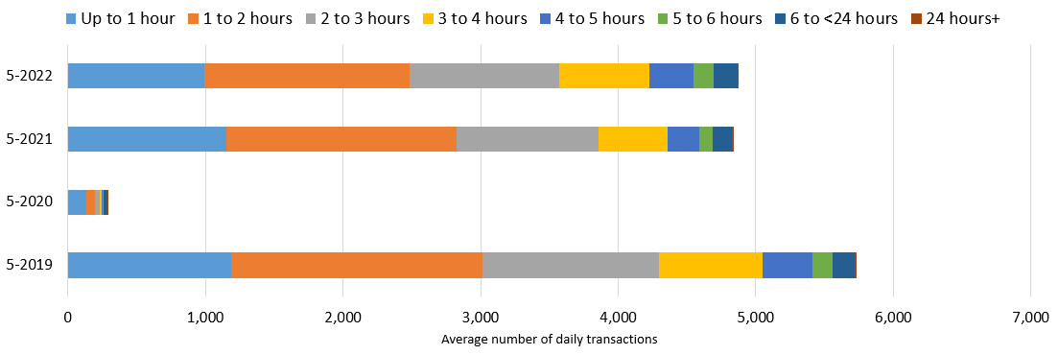
Car Parking: Cambridge by Length of Stay – monthly analysis
*Data only available
to May 2022
Car park usage by length of stay across Cambridge multi-storey car parks
-15% below 2019
-16% below 2019
-95% below 2019
 | Up to 1 hour | 1 to 2 hours | 2 to 3 hours | 3 to 4 hours | 4 to 5 hours | 5 to 6 hours | 6 to <24 hours | 24+ hours
05-2019 | 21% | 32% | 22% | 13% | 6% | 3% | 3% | 0%
05-2020 | 47% | 23% | 11% | 5% | 2% | 2% | 9% | 0%
05-2021 | 24% | 35% | 21% | 10% | 5% | 2% | 3% | 0%
05-2022 | 20% | 31% | 22% | 13% | 7% | 3% | 4% | 0%
* Park Street car park closed in Jan-22 and is therefore included in the May 2019, May 2020 and May 2021 stats but not within the May 22 stats so that the overall impact can be observed.
Notes:
Commentary:
Shorter stays of < 1 hour more prominent in May 2020 compared to May 2019 (pre-COVID)
May 2021 sees a return of longer car park stays
May 2022 length of stay profile now almost mirrors the pre-COVID profile. The majority of car park visits in the centre of Cambridge are less than 3 hours
Source: Cambridge Car Parking data (Cambridge City Council)

Slide 33
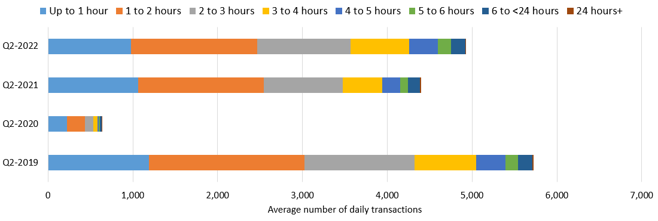
*Data only available
to May 2022
Car Parking: Cambridge by Length of Stay – quarterly analysis*
Car park usage by length of stay across Cambridge multi-storey car parks
-14% below 2019
-23% below 2019
-89% below 2019
 | Up to 1 hour | 1 to 2 hours | 2 to 3 hours | 3 to 4 hours | 4 to 5 hours | 5 to 6 hours | 6 to <24 hours | 24+ hours
Q2-2019 | 21% | 32% | 23% | 13% | 6% | 3% | 3% | 0%
Q2-2020 | 36% | 32% | 16% | 7% | 3% | 1% | 4% | 0%
Q2-2021 | 24% | 34% | 21% | 11% | 5% | 2% | 3% | 0%
Q2-2022 | 20% | 30% | 22% | 14% | 7% | 3% | 4% | 0%
* Q2 2022 analysis only includes April and May since data for June 2022 is not yet available.
**Park Street car park closed in Jan-22 and is therefore included in the Q2 2019, Q2 2020 and Q2 2021 stats but not within the Q2 2022 stats so that the overall impact can be observed.
Notes:
Commentary:
Shorter stays of < 1 hour more prominent in Q2 2020 compared to Q2 2019 (pre-COVID)
Q2 2021 sees a return of longer car park stays
Q2 2022 length of stay profile now almost mirrors the pre-COVID profile. The majority of car park visits in the centre of Cambridge are less than 3 hours
Source: Cambridge Car Parking data (Cambridge City Council)

Slide 34
Bus Passengers

Slide 35
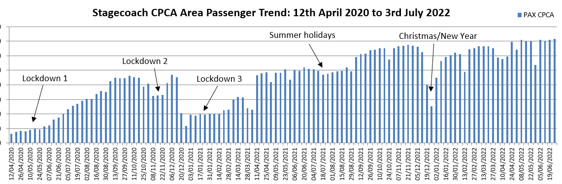
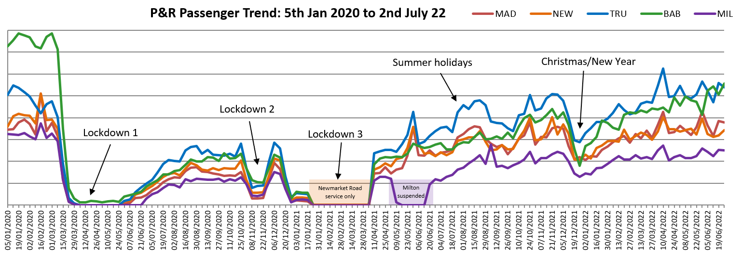
Bus Passengers: Cambridge Weekly Flows
Pre-COVID vs Now:
Cambridge bus passengers
June 2019 ->
June 2022
-23%
Previous month vs Now:
Cambridge bus passengers
May 2022 ->
June 2022
-1%
Previous month vs Now:
Cambridge P&R sites
May 2022 ->
June 2022
+1%
Due to the commercial sensitivity of this data, absolute counts of bus passengers have not been supplied.
Notes:
Commentary:
CPCA Area passengers
Passenger numbers have seen an increase from April 2022 onwards
Passenger numbers have increased a lot from Feb 2022 in both Cambridge (+22%) and Peterborough (+28%), though this will be in part affected by reductions in bus travel during February half term
Passengers numbers are still below pre-COVID levels in Cambridge (-23%)
P&R passengers
P&R passenger numbers have shown an overall increasing trend since the start of the year peaking during the school holidays (half terms and Easter holidays).
Milton and Babraham Road still remain distinctly below their pre-pandemic volumes, whilst the other sites have seen better recovery to at/near pre-pandemic volumes
Trumpington and Babraham Road have the highest volumes of passengers in June 2022
Source: Stagecoach data

Slide 36
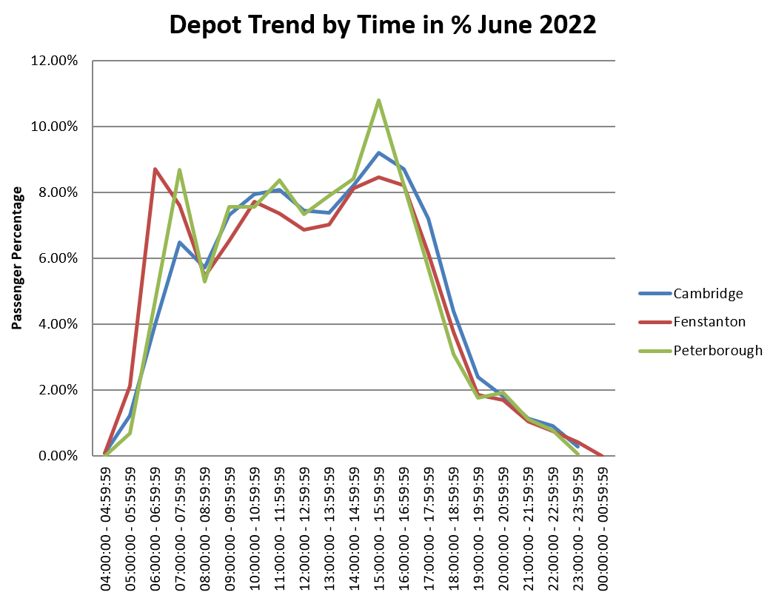
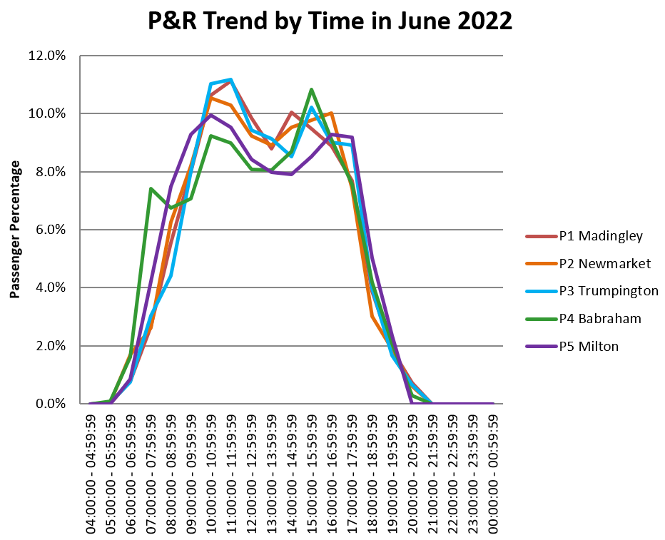
Bus Passengers: Cambridge by Time of Day
Bus Services
P&R Sites
Morning and afternoon peaks (6-8 am and 3-4pm) at all depots
Afternoon peak most prominent in Peterborough
Passenger numbers are more evenly spread across the day in Cambridge, increasing to a peak at 3-4pm.
Passenger numbers decline from 4pm in Cambridge and Peterborough and from 5pm in Fenstanton
Mid morning peak in passengers on all P&R services (10am – 12pm)
Babraham Road sees an early morning peak (7-8am)
Passenger numbers decline across all sites from 6pm onwards
Notes:
Source: Stagecoach data

Slide 37
e-Scooters

Slide 38
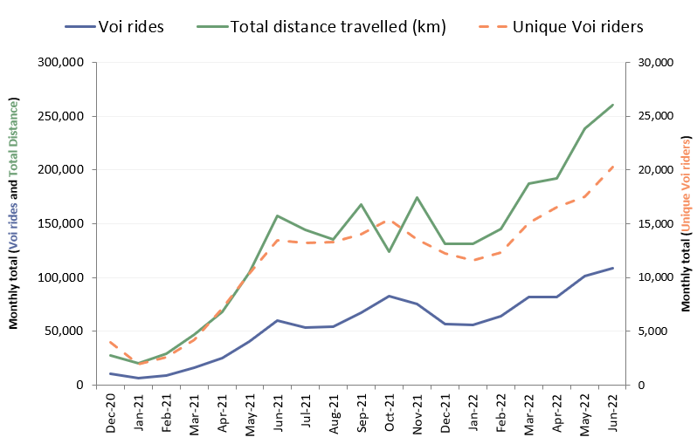






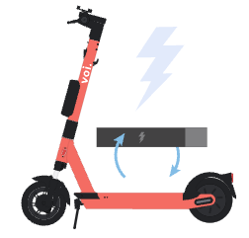
E-scooters: Cambridge Monthly Flows
E-scooter usage per month:
Popular scooter trip origins:
June 2022
Cambridge railway station
-> 6.9k rides
Cambridge bus station
-> 5.0k rides
Market Square
-> 3.7k rides
Average journey statistics:
June 2022
Average voi ride distance:
2.4 km
Average
no. rides
per month:
5.4 rides pp
+2% from May 2022
-7% from May 2022
 | Late-COVID vs Now: Jun 2021 to Jun 2022 | Previous month vs Now: May 2022 to Jun 2022 | Mid-COVID vs Now: Q2 2021 to Q2 2022
Number of voi rides | +81 | +7% | +131%
Number of unique voi riders | +51% | +16% | +76%
Total distance travelled (km) | +65 | +9% | +109%
Average voi ride duration:
11.2 mins
+1% from May 2022
Notes:
Commentary:
E-scooter usage has increased month on month in 2022 with the number of rides in Q2 of 2022 131% higher than in Q2 of 2021
The number of unique riders is increasing again since a plateau over the winter months
The most popular trip origins 1 and 2 remain unchanged from May 2022 but the 3rd most popular spot varies between Market Square and the Hills Road/Cherry Hinton Road junction – perhaps related to school terms and e-scooter use by young adults attending college on Cherry Hinton Road
The average journey statistics remain fairly stable each month – suggesting that e-scooters are most popular for short journeys of around 10 minutes
Source: Voi e-scooter dashboard

Slide 39
Air Quality

Slide 40
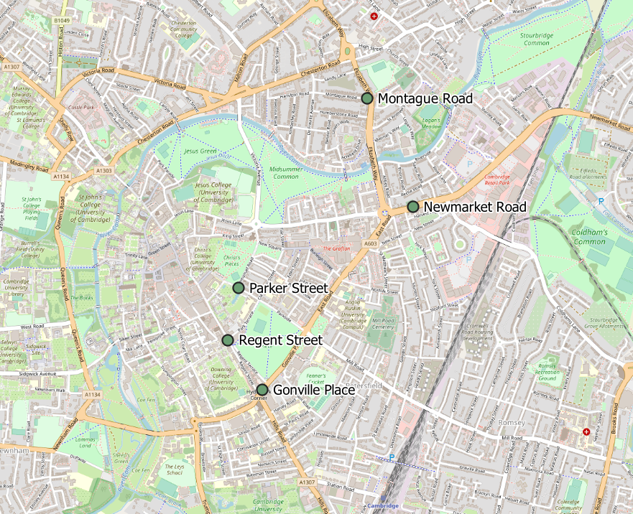
Air Quality: Cambridge Permanent Monitoring Sites
Location | Description
Montague Road | Close to the junction with Elizabeth Way
Newmarket Road | Close to Cambridge Retail park on Newmarket Road
Parker Street | Close to the bus station
Regent Street | To the West of Parker’s Piece
Gonville Place | Near Hill’s Road, South of Parker’s Piece (sensor moved, data for new site not yet available)
Notes:
Commentary:
This data in this pack is from the permanent air quality monitoring sites only. The permanent monitors measure Nitrogen Dioxide on primary routes into the city centre. There are also around 80 non-automatic Nitrogen Dioxide diffusion tubes around the city which provide a supplementary but not continual source of data.
Source: Cambridge City Council air quality team

Slide 41
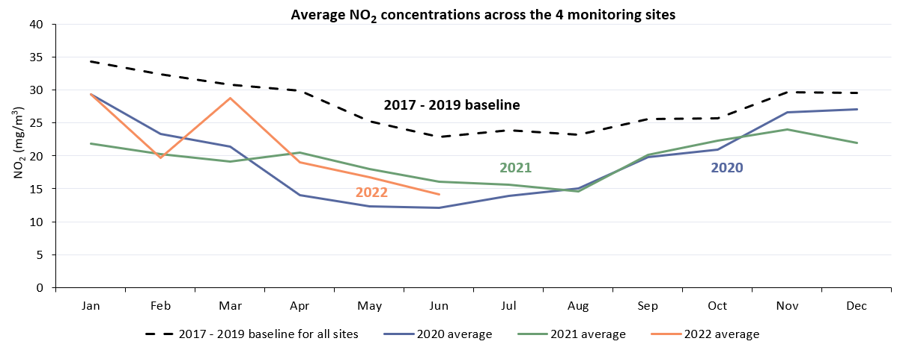
Air Quality: Cambridge Monthly Averages Across All Sites
 | Pre-COVID vs Now: June 2017-19 to June 2022 | Mid-COVID vs Now: June 2021 to June 2022
All sites average | -38% | -12%
 | Pre-COVID vs Now: Q2 2017-19 to Q2 2022 | Mid-COVID vs Now: Q2 2021 to Q2 2022
All sites average | -36% | -8%
Notes:
Commentary:
For all of 2022 so far, NO2 measurements remained below the 2017 – 2019 baseline.
After increases in January and March 2022, NO2 concentrations have again decreased.
NO2 monitoring is susceptible to seasonal changes and daily weather/general climate patterns. It is expected that NO2 levels are higher in the winter than in the summer.
The monthly averaged data from 2020 and 2021 will be affected by the COVID-19 lockdowns (e.g. April 2020 and Jan 2021) and the associated reductions in traffic on main routes into the city.
Source: Cambridge City Council air quality team

Slide 42
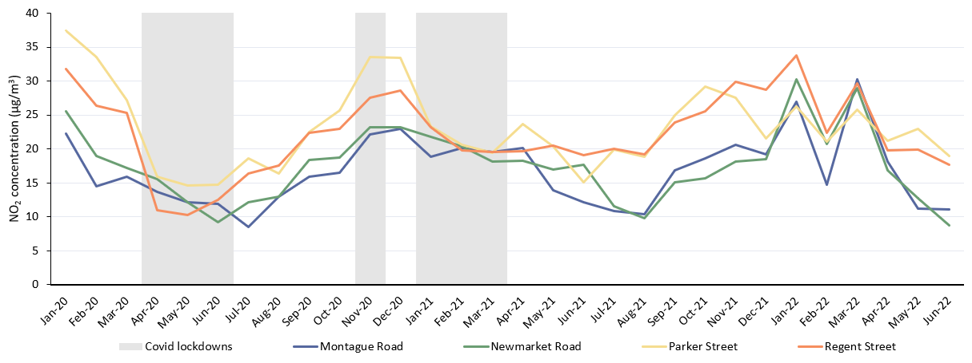
Air Quality: Cambridge Monthly Averages At Individual Sites
Monthly average NO2 concentration across each site
June analysis | Montague Road | Newmarket Road | Parker Street | Regent Street
Pre-COVID vs Early-COVID: June 2017-19 baseline to June 2020 | -40% | -49% | -50% | -48%
Pre-COVID vs Mid-COVID: June 2017-19 baseline to June 2021 | -38% | -1% | -49% | -20%
Pre-COVID vs Now: June 2017-19 baseline to June 2022 | -44% | -51% | -36% | -26%
Quarterly analysis | Montague Road | Newmarket Road | Parker Street | Regent Street
Pre-COVID vs Early-COVID: Q2 2017-19 baseline to Q2 2020 | -51% | -40% | -53% | -56%
Pre-COVID vs Mid-COVID: Q2 2017-19 baseline to Q2 2021 | -40% | -14% | -38% | -23%
Pre-COVID vs Now: Q2 2017-19 baseline to Q2 2022 | -47% | -38% | -34% | -26%
Notes:
Commentary:
The graph shows the absolute monthly average NO2 for each site for each month.
After an increase in NO2 in March 2022, NO2 concentrations have decreased.
All locations remain below the baseline in 2022.
NO2 monitoring is susceptible to seasonal changes and daily weather/general climate patterns and will have been affected by the national COVID-19 lockdowns.
Source: Cambridge City Council air quality team

Slide 43
Summary

Slide 44






Headlines: June 2022
Significantly below pre-COVID (<80%)
Close to pre-COVID (>80%)
Above pre-COVID (>100%)
Workplace attendance at 74%* of Jan 2020 levels in Cambridge and 88% in South Cambridgeshire in June 2022.
Walking within Cambridge is at 70% of pre-COVID levels.
Motor vehicle use is at 97%* of pre-COVID levels in Cambridge in June 2022.
Retail footfall in Cambridge is at 99%* of pre-COVID levels.
P
Car park use is at 83%* of May 2019 levels in Cambridge in May 2022
Footfall at One Station Square is at 94% of pre-COVID levels.
Bus use within Cambridge is at 77% of pre-COVID levels.
Cycling within Cambridge is at 88% of pre-COVID levels.
Active travel is at 80% of June 2019 and accounted for 21% of all counts in June 2022.
Air pollution is at 62% of the pre-COVID 2017-2019 baseline.
*Figures amended on January 18th, 2023.

