Slide 1
GCP Transport Working Group COVID-19 transport impacts: data and monitoring report
April 2022
Research Team, Cambridgeshire County Council

Slide 2
Data and monitoring report aims
This report is intended to:
Summarise the impacts of COVID-19 on transport and mobility.
Indicate changes in key indicators by comparing March 2022 data with the pre-pandemic baseline and to the same time last year (March 2021).
Continue to track weekly/monthly data to provide a more detailed understanding of recent trends.
To show the impact of previous restrictions up to the 31st March 2022.
Provide a basis for discussion for the Greater Cambridge Partnership’s Transport Working Group to understand and identify existing challenges and future data needs.
Data notes:
Comparison periods may vary across the different datasets based on the availability of historic data – comparison periods are clearly noted for each dataset.

Slide 3
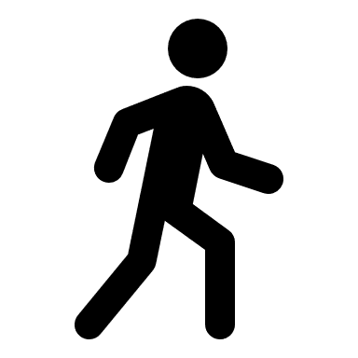
Changes in key indicators: March 2022
Significantly below pre-COVID (<80%)
Close to pre-COVID (>80%)
Above pre-COVID (>100%)
Transport trends show an increase from December 2021, with many indicators returning towards pre-pandemic levels.
The seasonal change from winter to spring has likely driven recent increases in active travel, along with increased working from the office.
Public transport remains below pre-pandemic levels and does not look to be increasing as the country adapts back to life without COVID-19 restrictions.
Motor vehicle volumes
Air pollution
Bus passengers
-9%
Increasing
-7%
Increasing
-35%
Steady
March 2022
compared to pre-COVID
(Feb 2020)
Long-term trend between Jan 2020 and March 2022
March 2022
compared to pre-COVID
(All site average
2017-2019)
Long-term trend between Jan 2022 and March 2022
March 2022
compared to pre-COVID
(March 2019)
Long-term trend between Jan 2022 and March 2022
P
Car parking
Retail footfall
Walking and Cycling
-24%*
Steady
-10%*
Increasing
-34%
-14%
Increasing
Mar 2022
compared to pre-COVID
(Mar 2019)
Long-term trend between June 2021 and Dec 2021
March 2022
compared to pre-COVID
(Feb 2020)
Long-term trend between Jan 2022 and March 2022
March 2020
compared to pre-COVID
(Feb 2020)
Long-term trend between Jan 2022 and March 2022
*Figures amended on January 18th, 2023.

Slide 4
Travel Demand

Slide 5
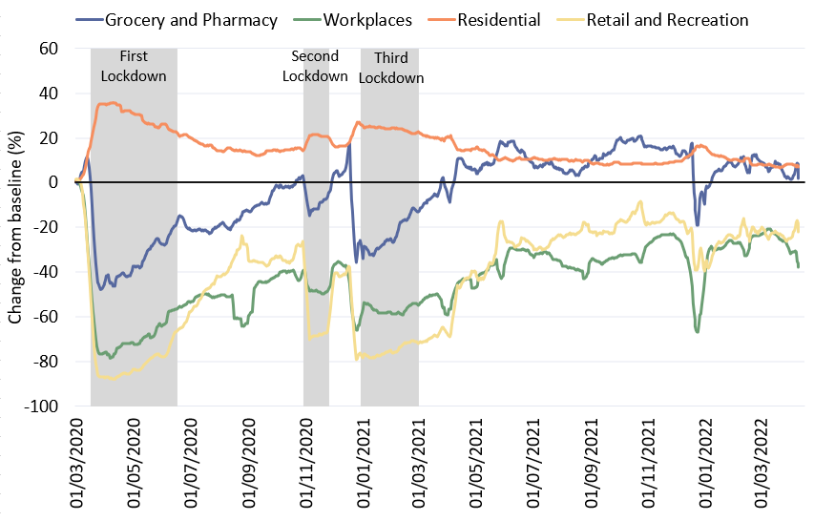
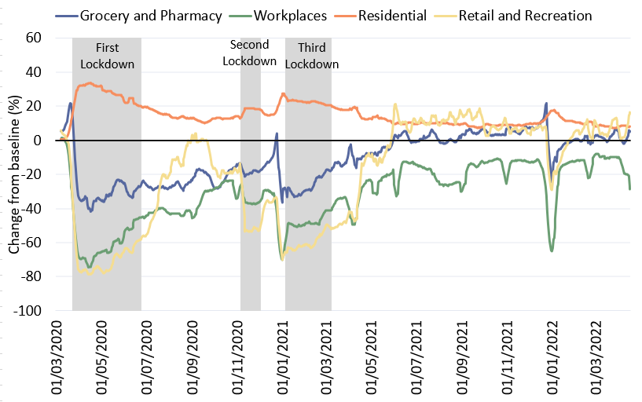
Travel Demand in Cambridge and South Cambridgeshire
Cambridge
South Cambridgeshire
Pre-COVID vs Now: Baseline to Mar 2022 | Workplaces | Residential | Retail and Recreation | Grocery and Pharmacy
Cambridge | -24% | +8% | -23% | +7%
South Cambridgeshire | -11% | +8% | +6% | +3%
Change against Google’s defined baseline: 3rd Jan – 6th Feb 2020
Notes:
Please note the graph shows a 7-day rolling average.
Commentary:
Cambridge: Cambridge grocery and pharmacy visits have recovered to above pre-pandemic levels but retail and recreation visits are at -23%, suggesting people have returned to their essential shopping habits but are perhaps not doing as much for leisure. The proportion of people making workplace visits is still distinctly below the baseline at -24%, though this is an increase on -37% in Dec 2021. Decreases in workplace visits on the right hand side of the graph are likely due to the Easter weekend/Easter holiday period. Residential visits remain higher than the baseline, in part likely due to the proportion of people still working from home/hybrid working.
South Cambridgeshire: Retail and recreation and grocery and pharmacy visits have all recovered to above pre-pandemic levels in South Cambridgeshire, suggesting that people’s shopping and leisure habits are returning to normal. Workplace visits are down on the baseline (-11%) but this is to be expected due to an increased move towards hybrid/flexi working for some businesses. This is also likely an influence on the higher rate of residential visits, as a greater proportion of people are probably home-working compared to pre-pandemic.
Source: Google LLC "Google COVID-19 Community Mobility Reports". https://www.google.com/covid19/mobility/ Accessed: 06/01/2022
Data is gathered from Google account holders location history. This helps to demonstrate where people are spending their time.
The data is based on the most recent month (March 2022) compared to the median of the corresponding day in the baseline period (3rd Jan-6th Feb 2020) as calculated by Google. Tabulated percentages represent the change from the baseline (3rd Jan – 6th Feb) to the most recent month.
“Community Mobility Reports aim to provide insights into what has changed in response to policies aimed at combating COVID-19. The reports chart movement trends over time by geography, across different categories of places such as retail and recreation, groceries and pharmacies, parks, transit stations, workplaces, and residential.”

Slide 6
Strategic Road Network

Slide 7
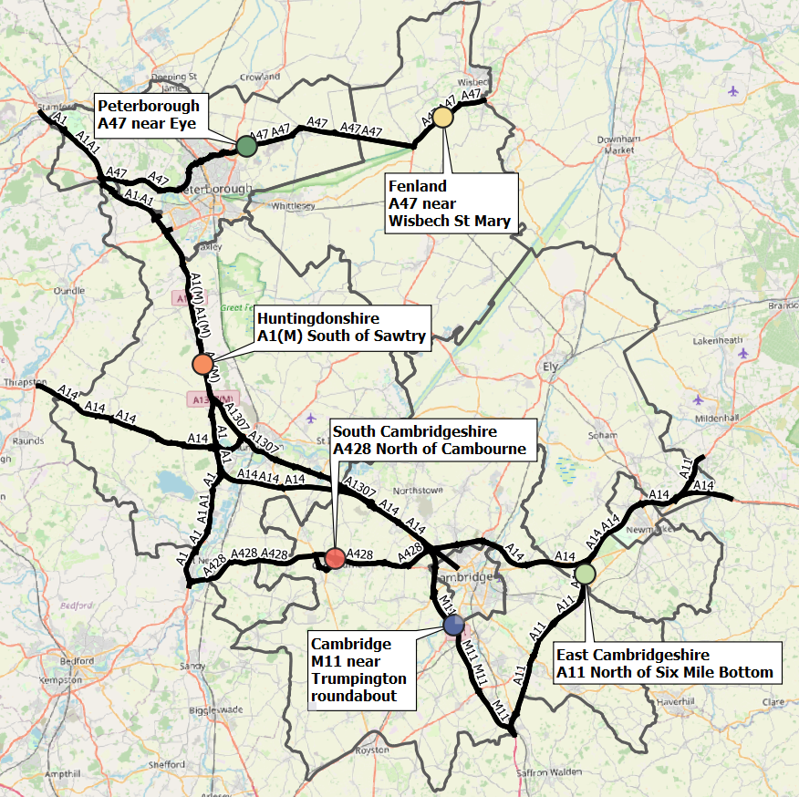
Strategic Road Network Site Locations
Traffic monitor locations in each district
 | District | Site location
 | Cambridge | M11 near Trumpington roundabout
 | Peterborough | A47 near Eye
 | East Cambridgeshire | A11 North of Six Mile Bottom
 | Fenland | A47 near Wisbech St Mary
 | Huntingdonshire | A1(M) South of Sawtry
 | South Cambridgeshire | A428 North of Cambourne
The number of Highways England traffic monitors increased significantly in 2020.
Their number, location and data collection reliability affects traffic counts over time, making long-term all-district series incomparable.
As such, one monitoring location per district which has a full dataset from 2019 onwards has been chosen so pre-/during-/post-COVID-19 comparisons can be fairly assessed
Notes:
National Highways data
Site locations:
Cambridge
M11 near Trumpington roundabout
MIDAS site at M11/6820A
Peterborough
A47 near Eye
TMU Site 6351/1
East Cambridgeshire
A11 North of Six Mile Bottom
MIDAS site at A11/0883A
Fenland
A47 near Wisbech St Mary
TMU Site 6349/1
Huntingdonshire
A1(M) South of Sawtry
MIDAS site at A1M/2115B
South Cambridgeshire
A428 North of Cambourne
TMU Site 7124/2

Slide 8
Strategic Road Network: Daily Flow by Month
A47 (Wisbech) flows low during March '22 due to roadworks at Guyhirn which are now complete.
Mon-Sun | Site location | Pre-COVID vs Now: Mar 2019 to Mar 2022 | Early-COVID vs Now: Mar 2020 to Mar 2022 | Mid-COVID vs Now: Mar 2021 to Mar 2022 | Previous month vs Now: Feb 2022 to Mar 2022
 | M11: Trumpington, Cambridge | -15% | 19% | 30% | -6%
 | A11: Six Mile Bottom, East Cambs | -20% | 5% | 41% | -1%
 | A47: Wisbech, Fenland | -30% | -14% | -13% | 12%
 | A1(M): Sawtry, Hunts | -6% | 24% | 30% | -1%
 | A428: Cambourne, South Cambs | -29% | -10% | 21% | 5%
 | A47: Eye, Peterborough | -4% | 22% | 20% | 3%
 | ALL | -15% | 12% | 24% | 0%
A428 flows were high in 2019 due to A14 overnight closures. A428 flows unlikely to reach this level again.
Notes:
Commentary:
All locations show increased volumes since the same time last year (during third COVID-19 lockdown), expect for on the A47 in Wisbech
All sites remain below 2019 volumes
Most sites are above 2020 volumes except the A47 near Wisbech and the A428 near Cambourne
Change from Feb 2022 is variable with some sites higher than Feb, some lower – overall this averages to a no-change (0%) situation
Source: National Highways WebTRIS data. Average Daily Flow in the month for 6 individual, main carriageway monitors , one in each district. Each monitor was active for the whole period January 2019 to March 2022.

Slide 9
Strategic Road Network: Daily Flow by Day of Week
% Difference | 1. First working day | 2. Normal Tuesday | 3. Normal Wednesday | 4. Normal Thursday | 5. Last Working Day | 6. Normal Saturday | 7. Normal Sunday
Pre-COVID vs Now: | -13% | -13% | -15% | -15% | -13% | -22% | -23%
Mar 2019 to Mar 2022
Early-COVID vs Now: | 13% | 15% | 7% | 8% | 15% | 10% | 8%
Mar 2020 to Mar 2022
Mid-COVID vs Now: | 22% | 19% | 17% | 21% | 27% | 35% | 54%
Mar 2021 to Mar 2022
Previous month vs Now: | 0% | -1% | -2% | -3% | 9% | -6% | 1%
Feb 2022 to Mar 2022
Weekend / Weekday split | Pre-COVID Mar 2019 | Pre-COVID Mar 2020 | Mid-COVID Mar 2021 | Now Mar 2022
Weekday average | 21.5k | 16.6 | 15.3k | 18.5k
Weekend average | 16.4k | 11.7 | 8.9k | 12.7k
Weekend proportion of weekday | 0.76 | 0.70 | 0.58 | 0.69
Average Daily Flow two-way flow, one site per district (monitors all active 2019 – 2022).
Note: this data considers 'Normal' days which do not include days such as bank holidays, Christmas and school holidays.
Notes:
Note the use of ‘normal’ days which allow for a ‘like-for-like’ comparison between comparable days. For example, bank holidays and school holidays are excluded from average flow calculations for ‘normal’ days. As such, this dataset does not account for the Christmas period, Christmas or New Year bank holidays etc.
Commentary:
Flow rates still below March 2019 (-16% average) but are now above March 2020 on all days (+11% average)
Weekdays closer to pre-pandemic volumes than weekends
Flow rates distinctly higher than March 2021 (during third COVID-19 lockdown) (+28% average)
Change from last month variable with some increases, some decreases and some no change – average across all days is 0% change from Feb 2022.
Weekday/weekday flow ratios returned to close to pre-pandemic proportions suggesting similar proportions of travel on weekdays/weekends despite lower volumes remaining lower than 2019.
Source: National Highways WebTRIS data. Average Daily Flow in the week for 6 individual, main carriageway monitors , one in each district. Each monitor was active during November 2019, 2020 and 2021.

Slide 10
Local Road Network Cambridge: Modal split

Slide 11
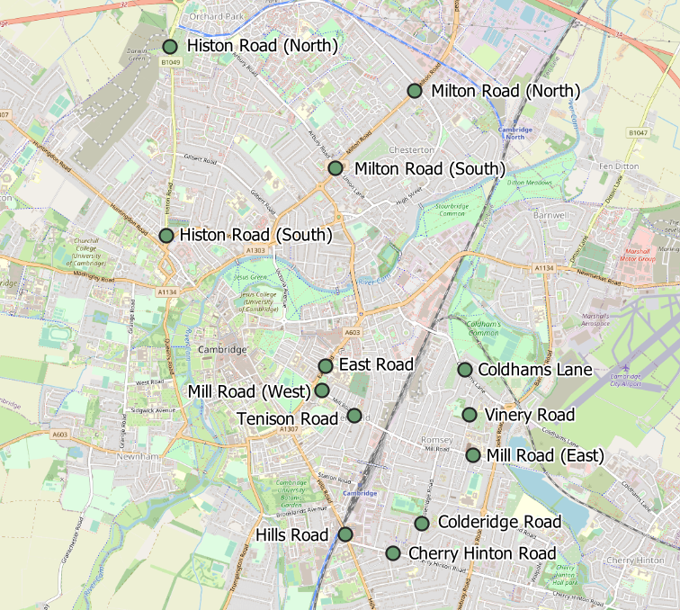
Traffic Sensor Locations
Sensor Location | Location description
Mill Road (East) | Close to Brookfield’s hospital
East Road | Close to ARU site
Milton Road (South) | Near to junction with Union Lane
Hills Road Bridge | Close to junction with Cherry Hinton Road
Milton Road (North) | Near King’s Hedges Road S18
Mill Road (West) | Close to Parker’s Piece
Histon Road (North) | Just South of A14 S20
Histon Road (South) | Towards Victoria Road junction S21
Coleridge Road | Close to Coleridge recreation ground
Vinery Road | By Romsey recreation ground
Cherry Hinton Road | Near junction with Rock Road
Tenison Road | Near Mill Road
Coldham’s Lane | Near Coldham’s Common
Notes:
Commentary
A sub-set of thirteen Vivacity sensors across Cambridge has been selected due to the ability of these sites having good long term data availability. Other sites were found to have gaps in data or had not been installed pre-COVID.
Source: Cambridge Vivacity sensors
These are the current locations of long-term Vivacity sensors across Cambridge. They do not cover all key roads in Cambridge but work is underway to expand this coverage.

Slide 12
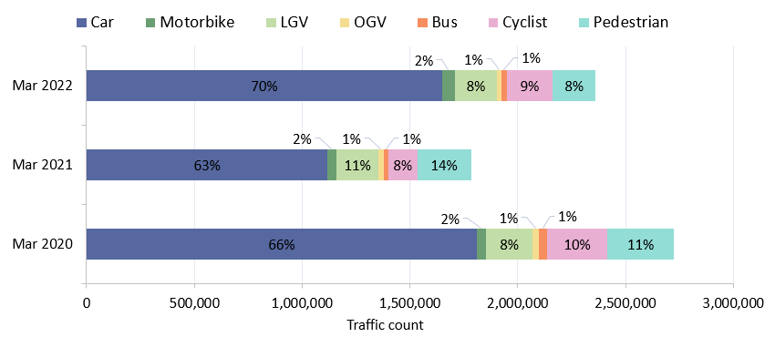
Traffic Sensor Modal Split: Cambridge
Transport mode split across traffic sensors in Cambridge: First 2 full weeks of March* 2020, 2021 and 2022
*As the end of March 2020 was affected by the first COVID-19 lockdown, this analysis uses the first 2 full weeks (Mon – Sun) of March for each year
During the third COVID-19 lockdown
Traffic count across the first two weeks of March
% change in transport volume by mode | Motorised vehicles |  |  |  |  | Active travel
 | Car | Motorbike | LGV | OGV | Bus | Cyclist | Pedestrian
Pre-COVID to now: Mar 2020 to Mar 2022 | -9% | +39% | -9% | -31% | -35% | -24% | -36%
Mid-COVID to now: Mar 2021 to Mar 2022 | +48% | +43% | +1% | -18% | +22% | +57% | -20%
Year | Motor vehicle* % | Active travel* %
March 2022 | 78% | 22%
March 2021 | 78% | 22%
March 2020 | 83% | 17%
*Motor vehicles: Car, Motorbike, LGV, OGV, Bus. Active travel: Cyclist, Pedestrian
Notes:
Commentary
Motor vehicles dominate in all years. Active travel has decreased significantly in 2022 to just 17% of total counts.
Cars make up more than 60% of total traffic counts passing the Vivacity sensors in every year suggesting the car is the dominant form of transport on these roads.
Whilst transport volumes have decreased during the pandemic, the modal split of transport methods has remained similar throughout.
Source: Cambridge Vivacity sensors

Slide 13
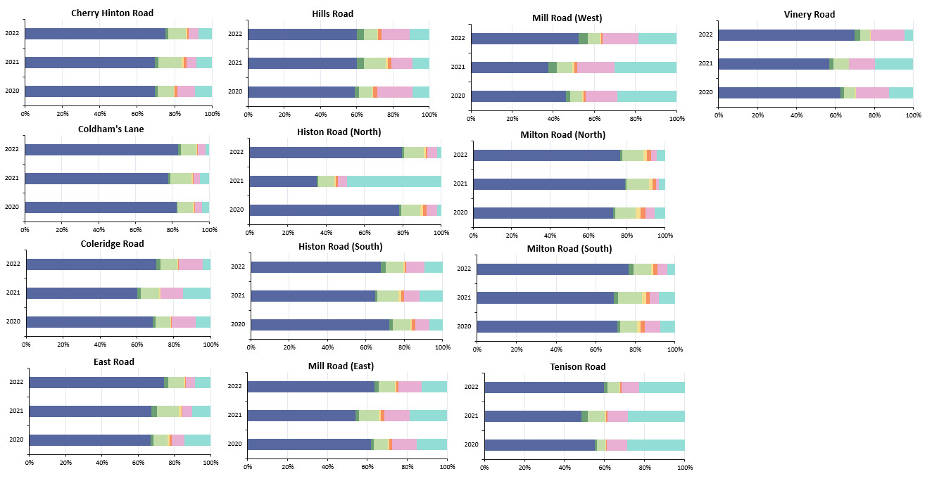
Traffic Sensor Modal Split: Cambridge – March
Transport mode split across traffic sensors in Cambridge: First 2 full weeks of March* 2020, 2021 and 2022
*As the end of March 2020 was affected by the first COVID-19 lockdown, this analysis uses the first 2 full weeks (Mon – Sun) of March for each year
*
First two weeks of March 2022
Location | Motorised % | Active %
Mill Road (West) | 64% | 36%
Tenison Road | 69% | 31%
Hills Road (Bridge) | 74% | 26%
Mill Road (East) | 76% | 24%
Vinery Road | 78% | 22%
Histon Road (South) | 81% | 19%
Coleridge Road | 83% | 17%
East Road | 86% | 14%
Cherry Hinton Road | 87% | 13%
Milton Road (South) | 91% | 9%
Milton Road (North) | 93% | 7%
Histon Road (North) | 93% | 7%
Coldham's Lane | 94% | 6%
*Motor vehicles: Car, Motorbike, LGV, OGV, Bus
Active travel: Cyclist, Pedestrian
Notes:
Commentary
Cars are the largest category at all sites in all years.
Whilst absolute volumes decreased during the pandemic, the impact on modal split at sites has not been significant at most locations. Exceptions to this are: Mill Road (East and West), Histon Road (North) and Tenison Road which saw significant decreases in the proportion of cars travelling on the roads in comparison to other modes of transport.
5 of the 13 sites have active travel proportions of 20% of higher in 2021: Mill Road (West), Tenison Road, Hills Road (Bridge), Mill Road (East) and Vinery Road. The proportion of motor vehicles to active travel has changed little since January 2022.
*Note: the high proportion of pedestrians recorded at Histon Road (North) in March 2021 appears to be due to construction workers. The Histon Road scheme site compound was near to the sensor and any workers nearby may have been picked up repeatedly.
Source: Cambridge Vivacity sensors

Slide 14
Local Road Network Cambridge: Motorised vehicles

Slide 15
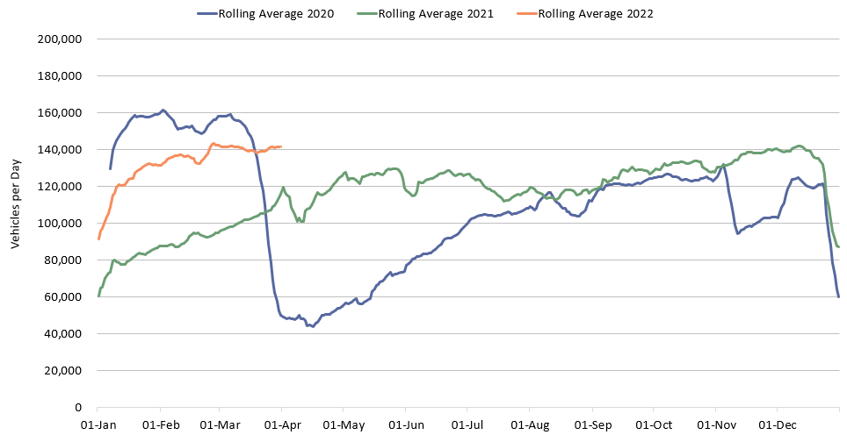
Motorised Vehicles: Cambridge Daily Flows
Cambridge
2020
2022
2021
 | Pre-COVID vs Now: Feb 2020 to March 2022 |  |  | Mid-COVID vs Now: March 2021 to March 2022 | Previous month vs Now: Feb 2022 to March 2022
 | Mon-Sun | Weekdays | Weekends | Mon-Sun | Mon-Sun | Weekdays | Weekends
Cambridge | -8% | -10% | -7% | +33% | +3% | +1% | +4%
Notes:
Commentary:
Small increases in motorised vehicles in Cambridge since Feb 2022, showing continued recovery in travel and transport.
Large increases in motorised vehicles since March 2021 due to the third COVID-19 lockdown at the beginning of 2021.
Cambridge flows now close to Feb 2020 ‘pre-COVID’ levels, particularly at weekends.
Source: Cambridge Vivacity sensors

Slide 16
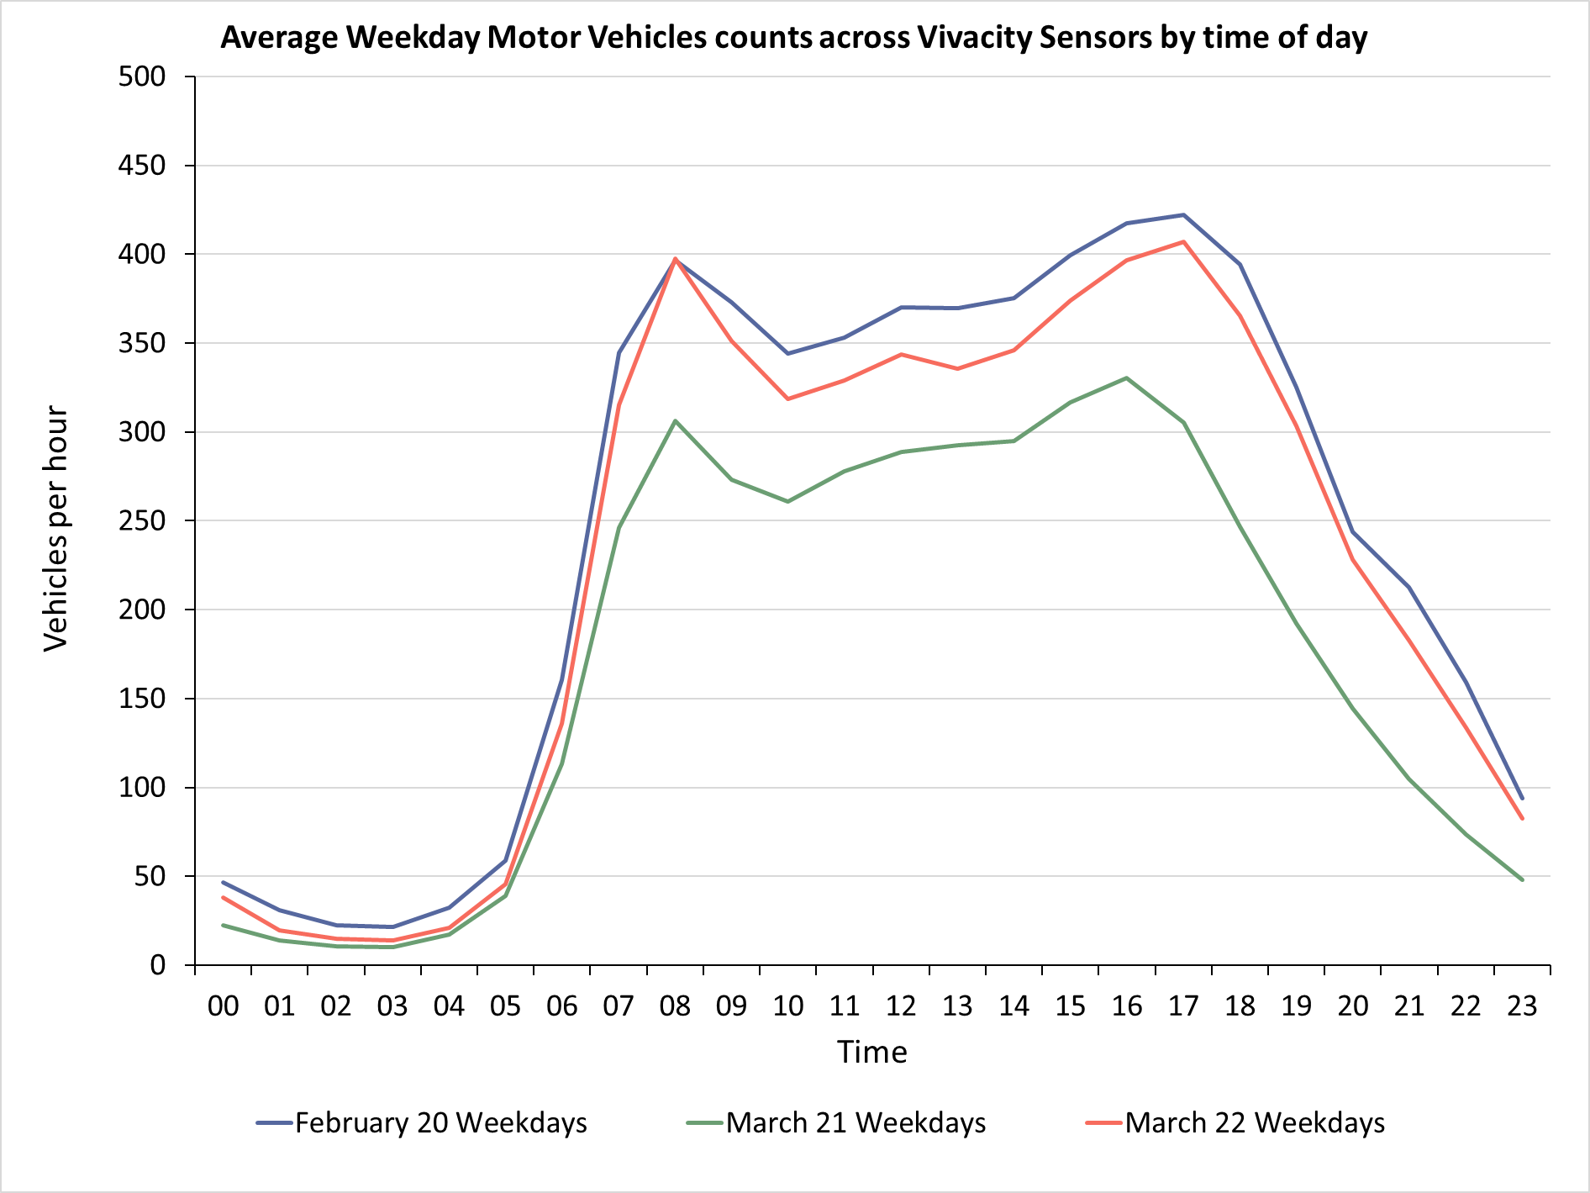
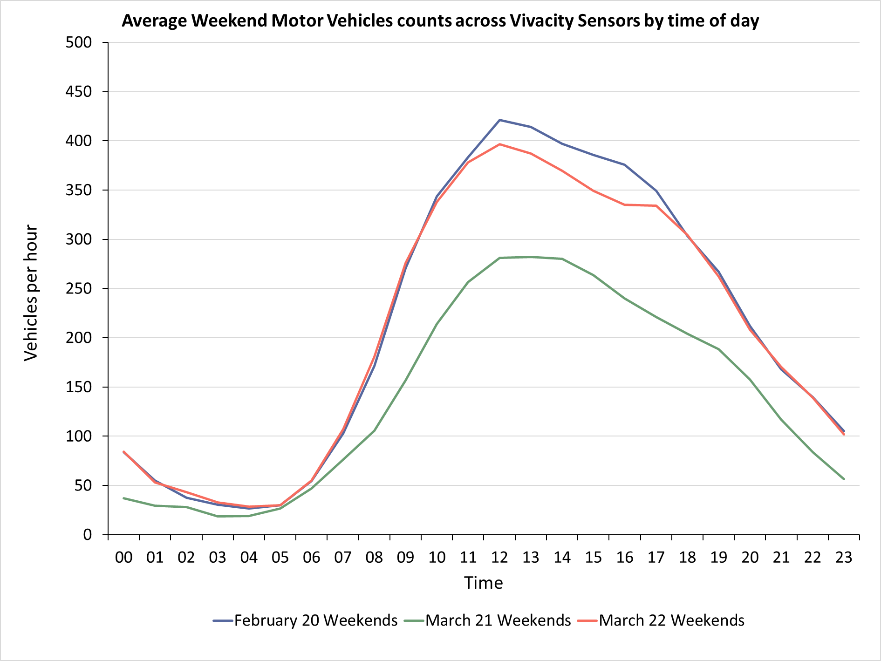
Motorised vehicles by hour: Cambridge
Weekdays
Weekends
Pre-COVID
Pre-COVID
Now
Now
Mid-COVID
Mid-COVID
Weekdays
Weekday flows exceeding mid-COVID levels
Close to pre-pandemic levels, especially morning peak
Weekends
Middle of the day continues to be the peak period
Weekend flows slightly below Pre-COVID levels from 10am – 6pm but at pre-pandemic levels during other times of day.
Please note that the above chart (Cambridge Vivacity) only includes core sensors where data is available for all comparison periods to ensure consistency, therefore it is not comparable to the overall count charts on the slides prior.
Notes:
Commentary:
Weekdays in March 2022: current flows are nearing the levels seen pre-COVID (approx. 5-10% below), particularly in the AM peak.
Weekends in March 2022: Many hours have returned to pre-COVID levels with the exception of 11am-5pm which are 10-20% lower.
Source: Cambridge Vivacity sensors

Slide 17
Local Road Network Cambridge: Active Travel

Slide 18
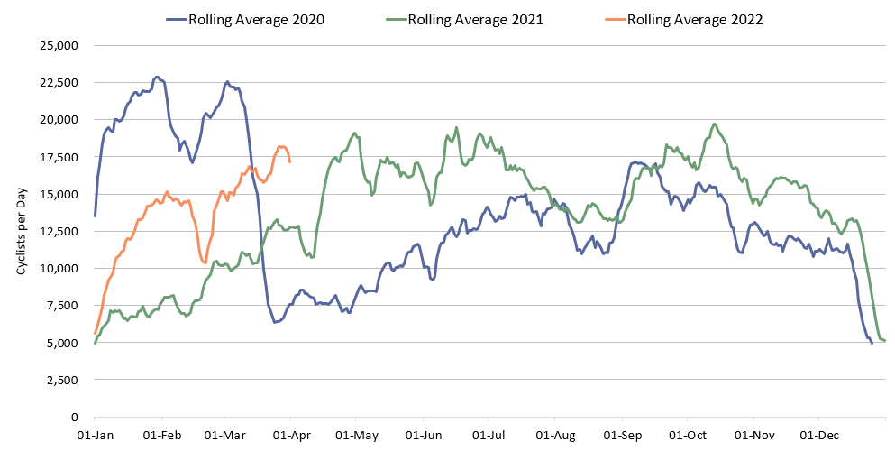
Cyclists: Cambridge Daily Flow
Cambridge
2020
2022
2021
 | Pre-COVID vs Now: |  |  | Mid-COVID vs Now: | Previous month vs Now:
 | Feb 2020 to March 2022 |  |  | March 2021 to March 2022 | Feb 2022 to March 2022
 | Mon-Sun | Weekdays | Weekends | Mon-Sun | Mon-Sun | Weekdays | Weekends
Cambridge | -14% | -20% | +3% | +43% | +23% | +18% | +25%
Notes:
Commentary:
Long term trends: Expected seasonal variation can be seen in the data, with peaks during the summer months and decreases in the winter.
Cycling trends have picked up significantly since the start of 2022, though weekday trends still remain below Feb 2020, possibly the result of continued hybrid working for some.
Cycling trends show an increase from both March 2021 (during Lockdown 3) and from Feb 2022.
Source: Cambridge Vivacity sensors
Accuracy is dependent on individual sensor location and calibration with some variation in accuracy.

Slide 19
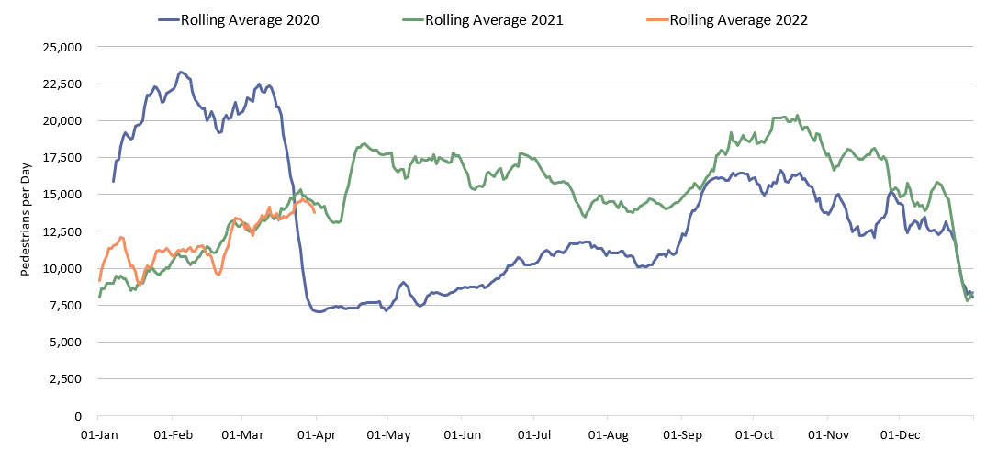
Pedestrians: Cambridge Daily Flow
Cambridge
2020
2022
2021
 | Pre-COVID vs Now: Feb 2020 to March 2022 |  |  | Mid-COVID vs Now: March 2021 to March 2022 | Previous month vs Now: Feb 2022 to March 2022
 | Mon-Sun | Weekdays | Weekends | Mon-Sun | Mon-Sun | Weekdays | Weekends
Cambridge | -34% | -37% | -30% | -2% | +19% | +15% | +25%
Notes:
Commentary:
Pedestrian trend remain well below the Feb 2020 pre-pandemic level, particularly on weekdays (-37%).
March 2022 actually shows a decrease on March 2021 pedestrian levels, despite the fact that March 2021 was during the third national COVID-19 lockdown.
March 2022 sees an increase on Feb 2022 pedestrian counts, likely attributable in part to improving weather.
Source: Cambridge Vivacity sensors
Accuracy is dependent on individual sensor location and calibration with some variation in accuracy.

Slide 20
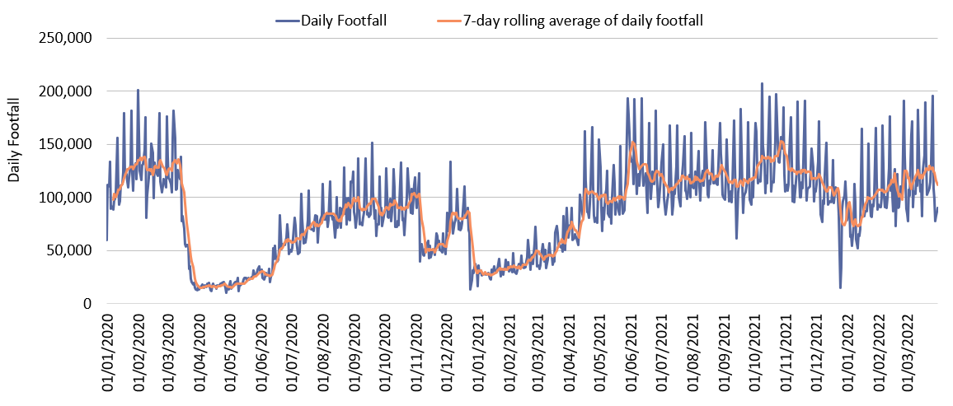
Retail footfall: Cambridge daily flow
 | Pre-COVID vs Now: |  |  | Mid-COVID vs Now: | Previous month vs Now:
 | Feb 2020 to March 2022 |  |  | March 2021 to March 2022 | Feb 2022 to March 2022
 | Mon-Sun | Weekdays | Weekends | Mon-Sun | Mon-Sun | Weekdays | Weekends
Cambridge Retail | -10% | -12% | +1% | +125% | +5% | No change | +15%
*Figures amended on January 18th, 2023.
Notes:
Commentary:​
Retail footfall in Cambridge has seen a strong recovery recently with weekend footfall exceeding Feb 2020 levels and continuing to increase post-Christmas. Weekday footfall continues to be below this level, likely due to the reduced amount of workplace use, particularly in Cambridge.
​
Source: Cambridge BID footfall data​
*March 2020 includes all locations except for King’s Parade. The King’s Parade sensor was recalibrated in 2021 and therefore counts are no longer comparable.​

Slide 21
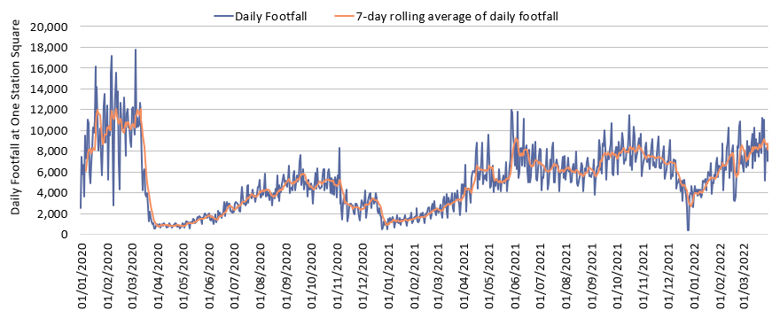
Footfall at One Station Square: Cambridge
 | Pre-COVID vs Now: |  |  | Mid-COVID vs Now: | Previous month vs Now:
 | Feb 2020 to March 2022 |  |  | March 2021 to March 2022 | Feb 2022 to March 2022
 | Mon-Sun | Weekdays | Weekends | Mon-Sun | Mon-Sun | Weekdays | Weekends
One Station Square | -24% | -30% | +6% | +171% | +15% | +14% | +20%
Notes:
Commentary: ​
One Station square footfall has reached Feb 2020 levels at the weekend but is still 30% below during weekdays. This is perhaps a reflection of office-based workers at CB1 now hybrid working and spending less time in offices during the week, whilst leisure trips at the weekend are continuing to grow in popularity.
Source: Cambridge BID footfall data​
*The One Station Square sensor was installed in December 2019​.

Slide 22
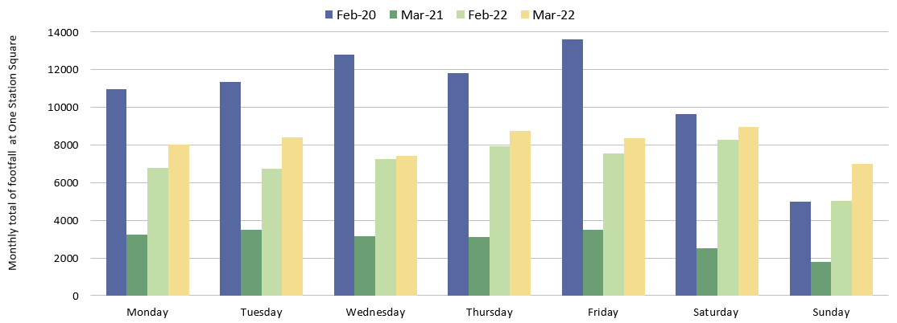
Footfall at One Station Square by day of week: Cambridge
Footfall at One Station Square
Saturdays are -7% below Feb 2020.
Sundays are +40% above
Feb 2020.
Weekdays remain significantly below pre-COVID levels, particularly on Wednesdays and Fridays. Tuesdays are closest to pre-pandemic levels (-26%).
Notes:
Commentary:​
Feb 2020 has been selected to represent ‘pre-COVID’ levels as March 2020 was affected by the first COVID-19 lockdown
Note that the substantial increase between 2021 and 2022 figures due to the strict lockdown restrictions in March 2021​
All days in March 2022 have seen increases from February 2022.
For weekdays, Tuesdays in March 2022 are closest to February 2020 levels.
Saturdays remain below pre-COVID (-7%) but Sundays in March 2022 exceed February 2020 (+40%).
Source: Cambridge BID footfall data​

Slide 23
Car Parking

Slide 24
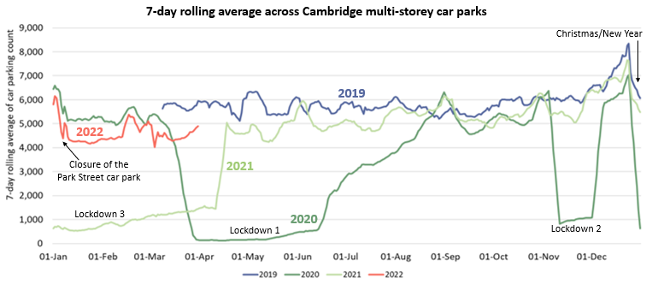
Car Parking: Cambridge by Daily Count
Pre-COVID vs Now**:
Mid-COVID vs Now:
Previous month vs Now:
Mar 2019 -> Mar 2022
-24%
Mar 2021 -> Mar 2022
+242%
Feb 2022 -> Mar 2022
-7%
*Park Street car park closed for redevelopment on 4th January 2022. Usage figures for this car park are included in the data to establish whether the closure has affected overall numbers.
**Figures amended on January 18th, 2023.
Notes:
Commentary:
After a peak at the beginning of January, there is a decline in parking early in the month before a plateau – this is likely in part due to the Park Street car park closure but also follows a similar pattern as 2020.
Parking is much higher than in January 2021 during the third COVID-19 lockdown but remains below pre-pandemic volumes.
Source: Cambridge Car Parking data (Cambridge City Council)

Slide 25
Car Parking: Cambridge by Length of Stay
Car park usage by length of stay across Cambridge multi-storey car parks
2020 -> 2022: -9% decrease in parking transactions
First 2 weeks of March only (i.e. pre-COVID)
2020 -> 2021 : -76% decrease in parking transactions
Length of stay proportions | Up to 1 hr | 1 to 2 hrs | 2 to 3 hrs | 3 to 4 hrs | 4 to 5 hrs | 5 to 6 hrs | 6 to 24 hrs | 24 hours +
Mar-20 | 27% | 32% | 20% | 11% | 5% | 2% | 3% | 0%
Mar-21 | 48% | 29% | 10% | 4% | 2% | 1% | 6% | 0%
Mar-22* | 22% | 31% | 21% | 13% | 6% | 3% | 3% | 0%
* Park Street car park closed in Jan-22 and is therefore included in the Mar-20 and Mar-21 stats but not within the Mar-22 stats so that the overall impact can be observed.
Notes:
Commentary:
Shorter stays of < 1 hour became dominant during the third lockdown (March 2021)
March 22 sees a return of longer car park stays meaning the length of stay profile now mirrors the pre-COVID profile. The majority of car park visits in the centre of Cambridge are less than 3 hours
Source: Cambridge Car Parking data (Cambridge City Council)

Slide 26
Bus Passengers

Slide 27
Bus Passengers: Cambridge Weekly Flows
Pre-COVID vs Now:
Cambridge bus passengers
Mar 2019 ->
Mar 2022
-27%
Previous month vs Now:
Cambridge bus passengers
Feb 2022 ->
Mar 2022
+22%
Previous month vs Now:
Cambridge P&R sites
Feb 2022 ->
Mar 2022
+18%
Due to the commercial sensitivity of this data, absolute counts of bus passengers have not been supplied.
Notes:
Commentary:
CPCA Area passengers
Passenger numbers are fairly stable during March 2022
Passenger numbers have increased a lot from Feb 2022 in both Cambridge (+22%) and Peterborough (+28%), though this will be in part affected by reductions in bus travel during February half term
Passengers numbers are still below pre-COVID levels in both Cambridge (-27%) and Peterborough (-38%)
P&R passengers
P&R passenger numbers have shown an overall increasing trend since the start of the year peaking in mid-Feb during half term week. Passenger numbers are back at pre-Christmas levels.
Trumpington and Babraham both show increases in March
Trumpington remains the route with the most passengers however increases of 26% from Feb to March 2022, Babraham could soon resume the top spot
Source: Stagecoach data

Slide 28
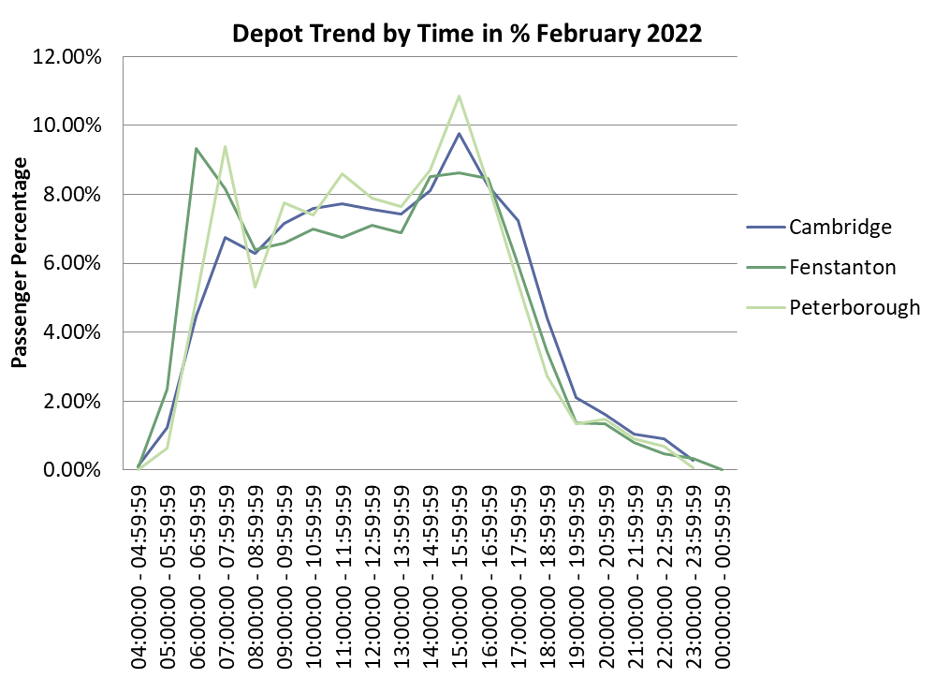
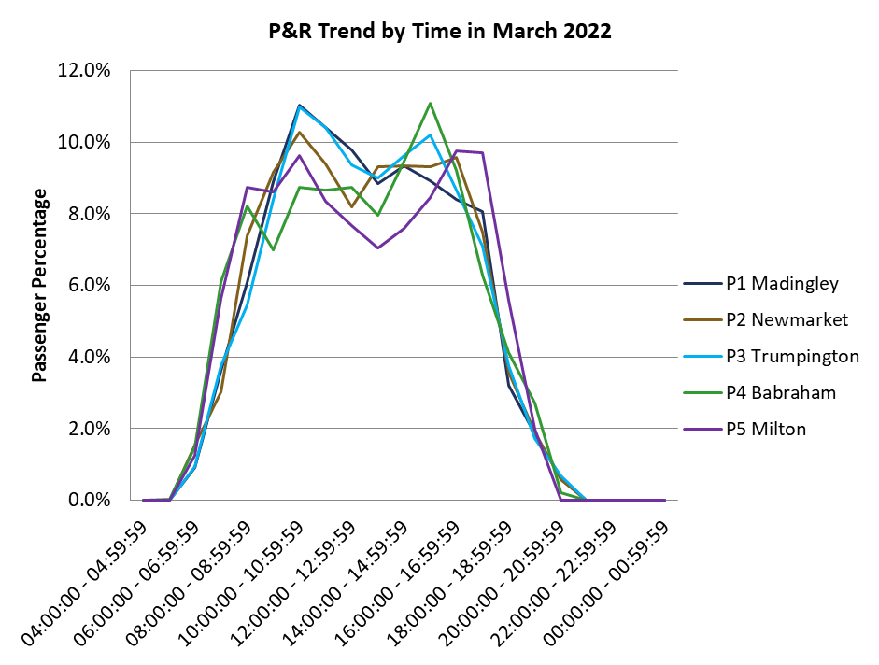
Bus Passengers: Cambridge by Time of Day
Bus Services
P&R Sites
Morning and afternoon peaks (6-8 am and 3-4pm) at all depots
Afternoon peak most prominent in Peterborough
Passenger numbers are more evenly spread across the day in Cambridge, increasing to a peak at 3-4pm.
Passenger numbers decline from 4pm onwards at all depots
Mid morning peak in passengers on all P&R services (10 – 11am)
Babraham Road and Madingley Road see an early morning peak (8-9am)
Fewer people boarding at the P&R sites from 5pm onwards except at Milton Road which sees a peak between 5pm and 6pm
Notes:
Commentary:
Bus Services Depot trends – Peaks seen in the am and pm – Peterborough pm peak particularly distinct – Cambridge sees more gradual increase in passenger numbers during the day
P&R trends – distinct mid-morning peak at all sites – Babraham Road and Milton Road see 2 morning peaks – decreases in P&R passengers from 5pm onwards except at Milton Road which sees a large peak 5-6pm in March – particularly distinct 10-11 am peak at Trumpington and Madingley P&R
Source: Stagecoach data

Slide 29
e-Scooters

Slide 30
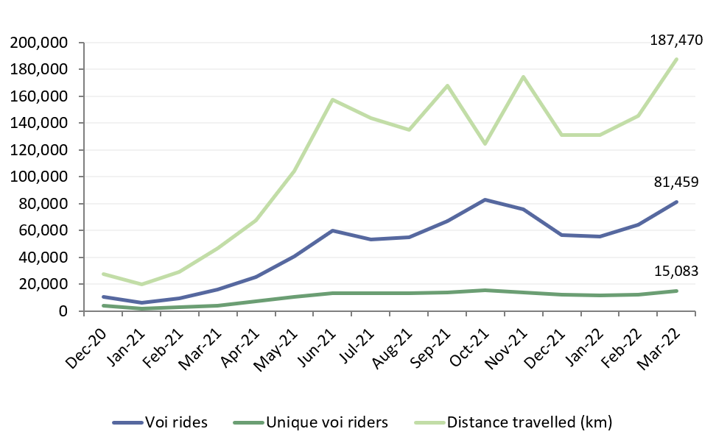
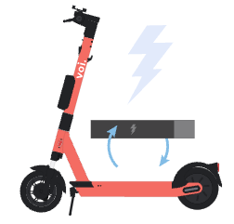
E-scooters: Cambridge Monthly Flows
E-scooter usage per month:
Popular scooter trip origins:
March 2022
Cambridge railway station
-> 5,533 rides
Cambridge bus station
-> 3,628 rides
Hills Road/Cherry Hinton Road
-> 2,476 rides
Monthly Total
Average journey statistics:
March 2022
Average voi ride distance:
2.3 km
Average
no. rides
per month:
5.4 rides pp
+2% from Feb 2022
+3% from Feb 2022
 | Mid-COVID vs Now: Mar 2021 to Mar 2022 | Previous month vs Now: Feb 2022 to Mar 2022
Number of voi rides | +411% | +27%
Number of unique voi riders | +261% | +23%
Total distance travelled (km) | +299% | +29%
Average voi ride duration:
10.8 mins
-1% from Feb 2022
Notes:
Commentary:
Escooter usage is up on January 2022 – this could be linked to better and warmer weather and the return of students to the city from mid-Jan onwards
The number of unique riders shows a plateauing long-term trend unlike distance and number of rides which are increasing again after a winter decrease
The most popular trip origins remain unchanged from previous months, though the number of trips from these origins has increased since Jan 2022
The average number of rides per person has increased 9% from 2022 – this could suggest the start of a ‘core’ group of scooter riders who use the e-scooters as a regular mode of transport
Source: Voi e-scooter dashboard

Slide 31
Summary

Slide 32
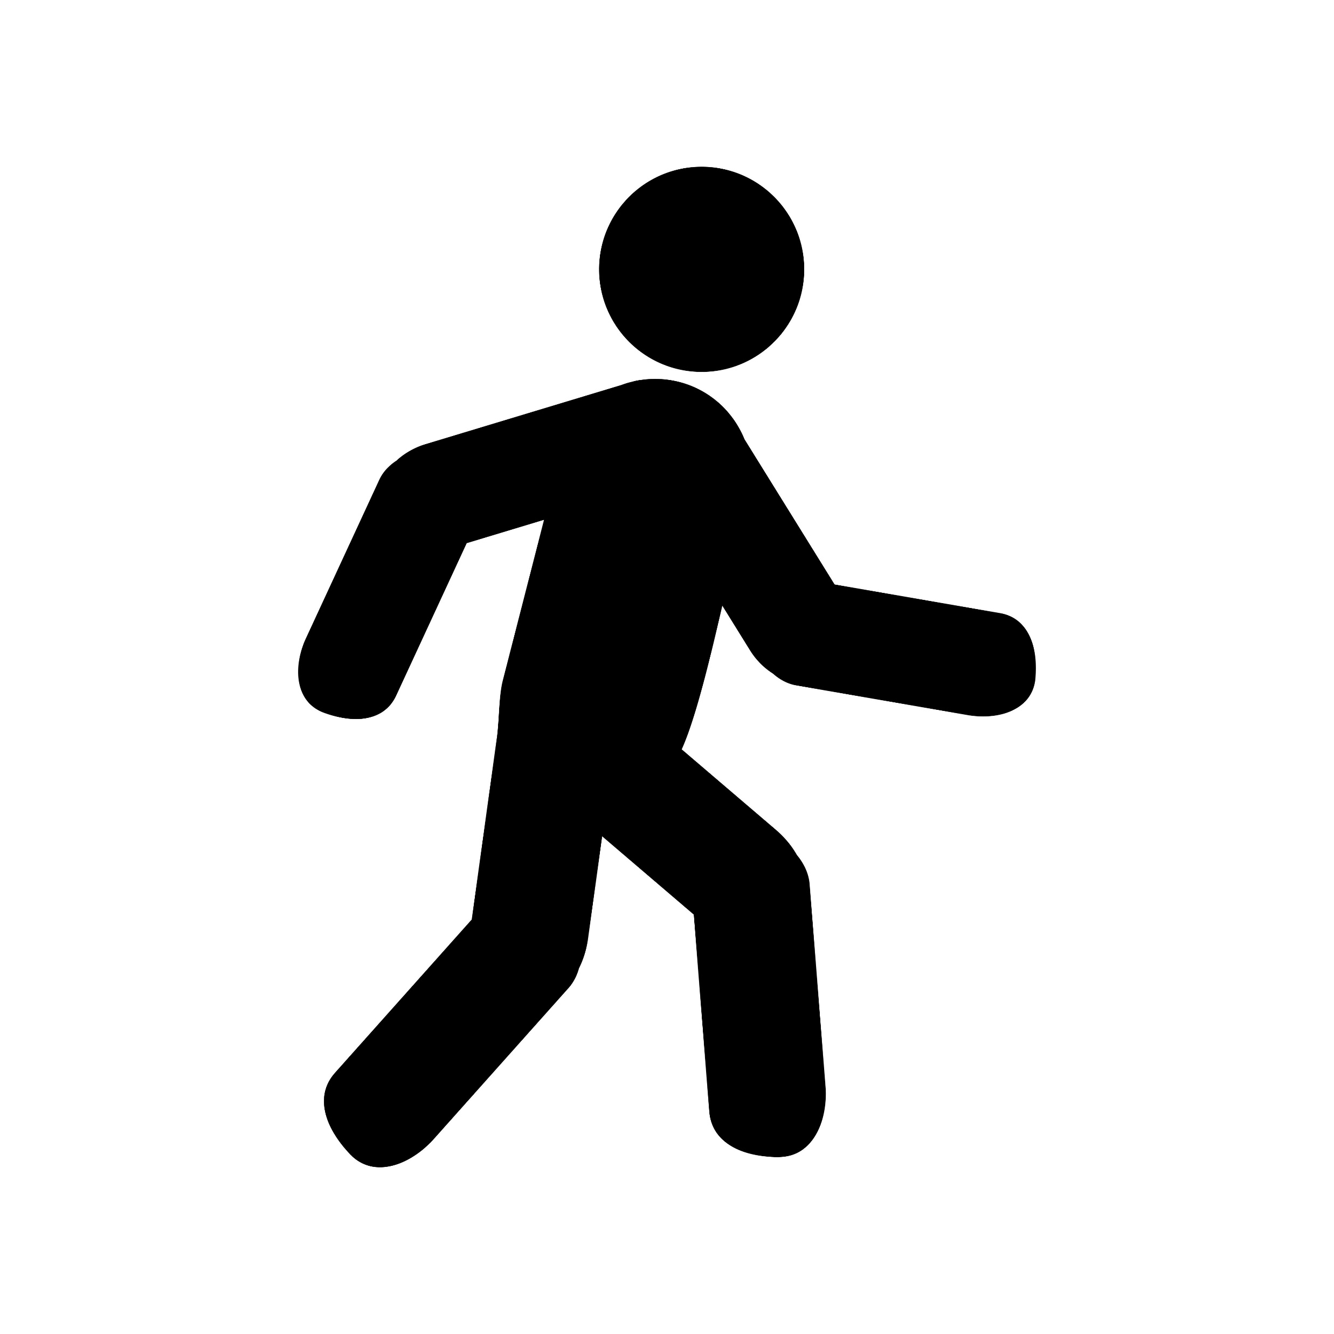
Headlines: March 2022
Significantly below pre-COVID (<80%)
Close to pre-COVID (>80%)
Above pre-COVID (>100%)
Workplace attendance at 76% of Jan 2020 levels in Cambridge and 89% in South Cambridgeshire.
Walking within Cambridge is at 66% of pre-COVID levels.
Motor vehicle use is at 92% pre-COVID levels in Cambridge.
Retail footfall in Cambridge is at 90%* of pre-COVID levels.
P
Car park use is at 76%* of pre-Covid levels in Cambridge
Footfall at One Station Square is at 76% of pre-COVID levels.
Bus use within Cambridge is at 73% of pre-COVID levels.
Cycling within Cambridge is at 86% of pre-COVID levels.
Active travel is at 70% of March 2020 and accounted for 17% of all counts in March 2022.
Air pollution is at 93% of the pre-COVID 2017-2019 baseline.
*Figures amended on January 18th, 2023.

