Slide 1
Cambridgeshire and Peterborough
All Age Mental Health and Learning Disabilities Needs Assessment
Chapter 1: Environmental factors
Data pack 2022

Slide 2
Table of contents
Introduction
Summary
Deprivation and inequality
Poverty and financial security
Housing and homelessness
Education and lifelong learning
Employment and working conditions
Crime, safety and violence
Community wellbeing and social capital

Slide 3
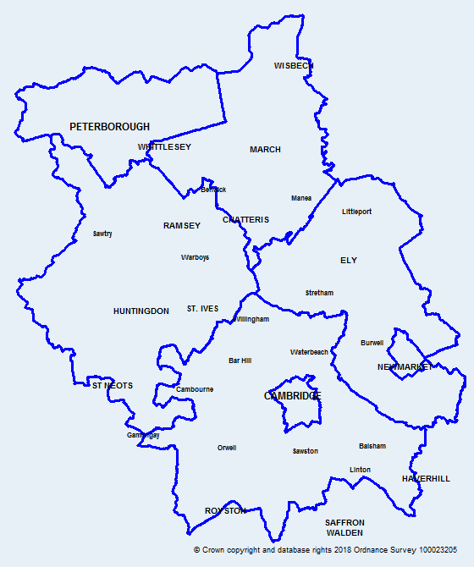
Introduction
Map of Cambridgeshire
and Peterborough
This data pack has been produced on wider determinants to support the Cambridgeshire and Peterborough all age mental health and learning disabilities needs assessment.
Colour coding and abbreviations used:
Key:
 | Statistically significantly worse than England
 | Statistically similar to England
 | Statistically significantly better than England
CCCRG | Cambridgeshire County Council Research Group
CPCA | Cambridgeshire and Peterborough Combined Authority
OHID | Office for Health Improvement and Disparities
ONS | Office for National Statistics
APS | Annual Population Survey
DfE | Department for Education
LSOA | Lower Super Output Area

Slide 4
All age mental health: Environmental factors | Summary
Risk factors Peterborough and Fenland have higher levels of deprivation when compared to England and Cambridgeshire averages. However, across the area there are smaller locations with higher levels of deprivation. The Income Deprivation Affecting Children Index (IDACI) score is higher in Peterborough and Fenland compared to the England score. The ratio of house price to annual earnings shows an increasing trend for all areas in Cambridgeshire and Peterborough, except for Cambridge, i.e., it’s becoming less affordable for a resident to purchase a house in recent years. The rate of households living in temporary accommodation is significantly lower than the national rate in all areas across Cambridgeshire and Peterborough. The proportion of 16-17 year olds who are not in education, employment or training or whose activity is unknown is significantly higher than the England average in Peterborough since 2017. Employment deprivation is high in urban areas and to the north of Fenland. The rates of Employment Support Allowance claimants for those with mental and behavioural conditions were significantly higher than the national average for Fenland and Peterborough in 2018. The rate of 10 to 17-year-olds receiving their first reprimand, warning, or conviction per 100,000 population is significantly higher than the national rate in Peterborough. However, an overall decline has been seen in Cambridgeshire and Peterborough since 2010. The proportion of re-offending levels is higher than the national average in Cambridge and Peterborough. The violent crime rate in Peterborough is significantly higher than the national rate and similar to that in Cambridge and Fenland. | Protective factors The proportion of adults who are receiving secondary mental health services recorded as living independently with or without support have been significantly higher than England between 2016/17 and 2019/20 for both Cambridgeshire and Peterborough. The average attainment 8 score of a pupil (15-16 years) in Fenland, Huntingdonshire, and Peterborough is significantly lower than the national average, while it is statistically similar to the national average in East Cambridgeshire. The proportion of children achieving a good level of development at the end of reception has been significantly lower than England for Peterborough and statistically similar to England in Cambridgeshire. The proportion of people aged 16–64 years in employment for the year 2020/21 has been statistically similar to England across all areas in Cambridgeshire and Peterborough except East Cambridgeshire (significantly better than England). The proportion of physically active adults in Peterborough and Fenland is significantly lower than the England average. Based on a self-reported wellbeing survey, the proportion of people who responded with low happiness and high anxiety in Cambridgeshire and Peterborough is statistically similar to the national value.

Slide 5
Deprivation and Inequality

Slide 6
Summary
Peterborough and Fenland have higher overall levels of deprivation when compared to England and Cambridgeshire averages. However, across the area there are smaller locations with higher levels of deprivation.
The Income Deprivation Affecting Children Index (IDACI) score is higher in Peterborough and Fenland compared to the England score.
In Peterborough, the average life expectancy at birth is significantly lower for both males and females than England’s averages.
The trend for the average healthy life expectancy at birth had a rapid decline for females in Peterborough since 2014-16 and remains significantly lower than England.
The infant mortality rate per 1,000 live births in Cambridgeshire and Peterborough is statistically similar to England for the period 2018–20.
The suicide rates in Cambridgeshire and Peterborough are statistically similar to the England rate for the period 2018–20.
Age-standardised mortality rates from causes considered preventable in people aged less than 75 years are consistently higher than English rates in Peterborough and Fenland.
Premature mortality rates in adults with severe mental illness are higher among men compared to women in Cambridgeshire, Peterborough, and England; rates in Peterborough are significantly higher than England for both men and women.

Slide 7
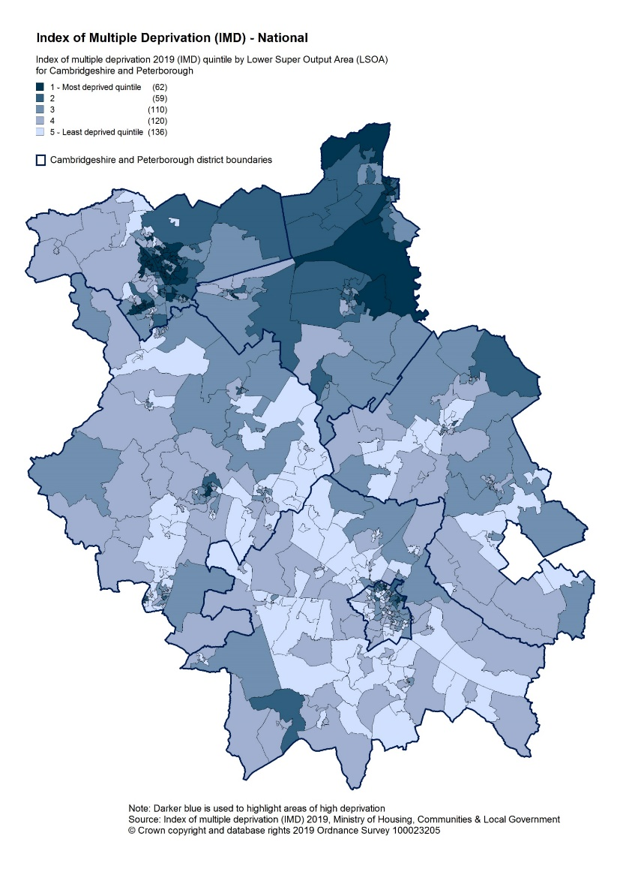
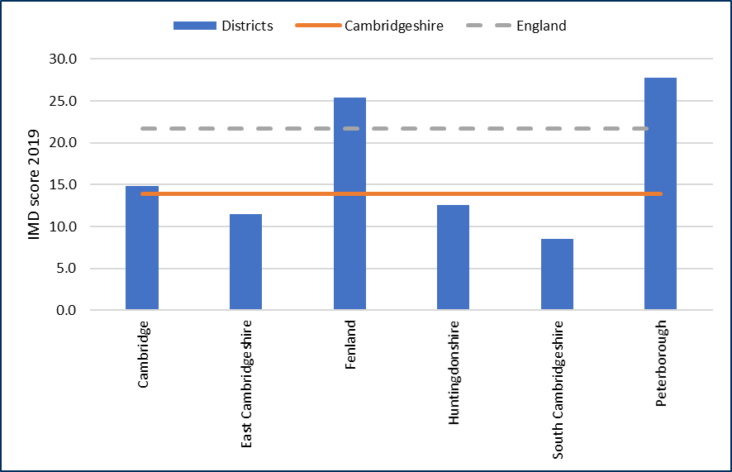
Deprivation and inequality
Index of Multiple Deprivation (IMD), 2019
Source: Indices of Deprivation 2019, Ministry of Housing, Communities and Local Government
Children’s and Older people’s indices and the percentage of LSOA in most deprived 20% of national LSOA’s
1 - Income Deprivation Affecting Children Index IDACI): Proportion of children aged 0–15 years living in income deprived households as a proportion of all children aged 0–15 years.
2 - Income Deprivation Affecting Older People Index (IDAOPI): Adults aged 60 or over living in income-deprived households as a percentage of all adults aged 60 or over.
3 - IMD 2019: % of LSOA in 20% most deprived areas in England.
Indices of deprivation, 2019 – overall IMD score
Overall IMD and IDACI scores in Peterborough and Fenland are higher than England scores.
112,000 people within Cambridgeshire and Peterborough live within the bottom IMD quintile. 95% reside within the North of the system – Peterborough, Huntingdonshire and Fenland, while 5% live in Cambridgeshire and Ely.
Note: Data is based on English Indices of Deprivation scores 2019, measured before the onset of pandemic and cost of living crisis.
Notes:
Deprivation score (IMD 2019) The Indices of Deprivation 2019 are relative measures of deprivation. This means it can tell you if one area is more deprived than another, but not by how much.
The Indices of Deprivation 2019 is not a measure of affluence; all of the indicators used in the index are designed to identify aspects of deprivation, not affluence. Therefore the area ranked as the least deprived is not necessarily the most affluent.
Link: https://www.gov.uk/government/statistics/english-indices-of-deprivation-2019

Slide 8
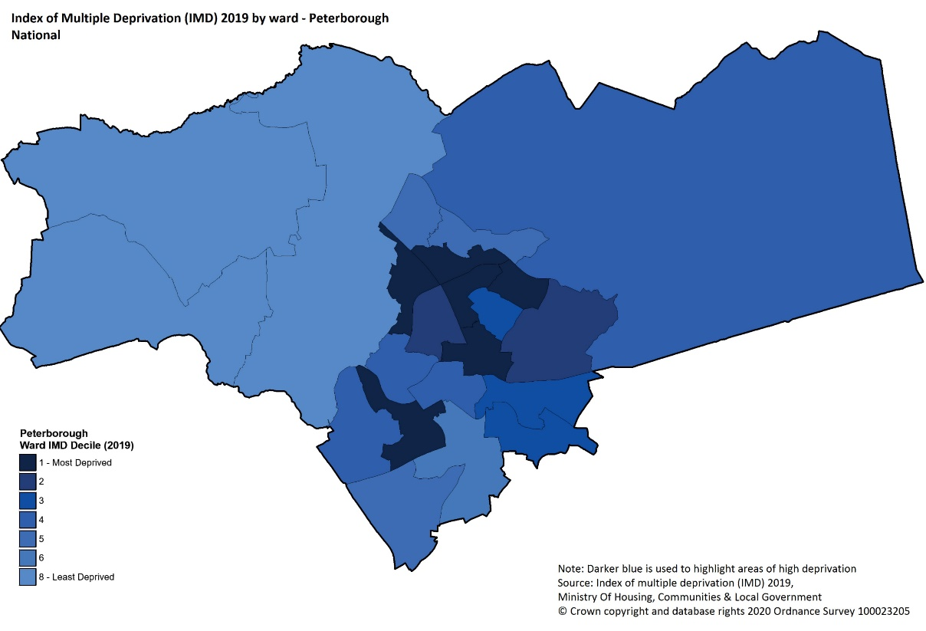
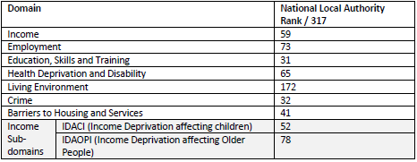
Deprivation in Peterborough
Source: Indices of Deprivation 2019, Ministry of Housing, Communities and Local Government
National IMD decile by ward in Peterborough, 2019
The deprivation domains for Peterborough by rank (out of 317 local authorities nationally) where the lower the rank the more deprived the domain (1 is the most deprived)
In Peterborough, Living Environment ranks significantly higher than the other domains, ranking over 100 more than the next domain (Employment), showing it is the least deprived domain by rank.
Education, training and Skills is the lowest ranking domain in Peterborough, very closely followed by Crime.
The average IMD deciles show that there is a large variation between wards, with the most deprived wards ranking in the 1st decile and the least deprived decile within the 8th decile.
Bretton, Central, Dogsthorpe, North, Orton Longueville, and Paston and Walton are the most deprived wards in the district.
Notes:
Note: LSOA and Wards are not coterminous, and therefore a best fit look up has been used. Ward boundaries are taken from the 2018 ward boundaries.
Domain rankings: the individual domain rankings present an absolute values for the lowest ranked and highest ranked domains in the district. The ranks are based on comparisons between all of the local authority nationally. There are 317 local authorities.
Link: https://cambridgeshireinsight.org.uk/deprivation/indices-of-multiple-deprivation/

Slide 9
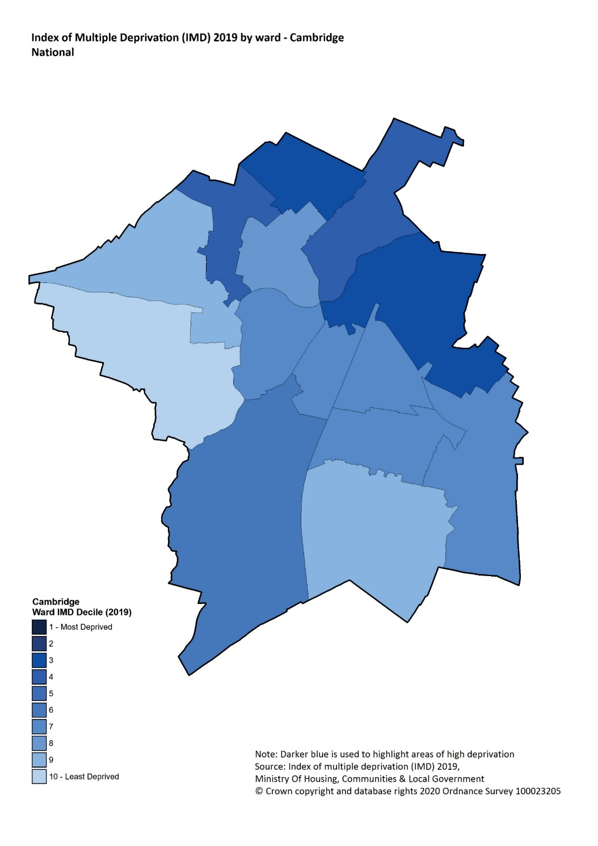
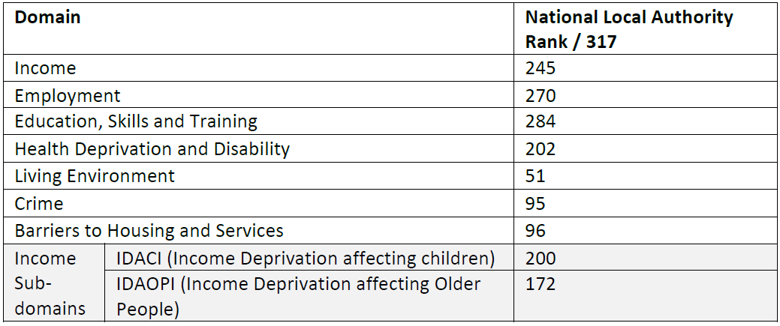
Deprivation in Cambridge City
Source: Indices of Deprivation 2019, Ministry of Housing, Communities and Local Government
National IMD decile by ward in Cambridge City, 2019
The deprivation domains for Cambridge City by rank (out of 317 local authorities nationally) where the lower the rank the more deprived the domain (1 is the most deprived)
In Cambridge City, Living Environment ranks significantly lower than other domains, showing it is the most deprived domain by rank.
Education, Skills and Training is the highest ranking domain in Cambridge City, closely followed by Employment and Income.
Abbey and King’s Hedges are the most deprived wards in the City, being in the 3rd decile nationally.
Average IMD deciles show that most wards are within the top half of the deciles (6-10).
Notes:
Note: LSOA and Wards are not coterminous, and therefore a best fit look up has been used. Ward boundaries are taken from the 2018 ward boundaries.
Domain rankings: the individual domain rankings present an absolute values for the lowest ranked and highest ranked domains in the district. The ranks are based on comparisons between all of the local authority nationally. There are 317 local authorities.
Link: https://cambridgeshireinsight.org.uk/deprivation/indices-of-multiple-deprivation/

Slide 10
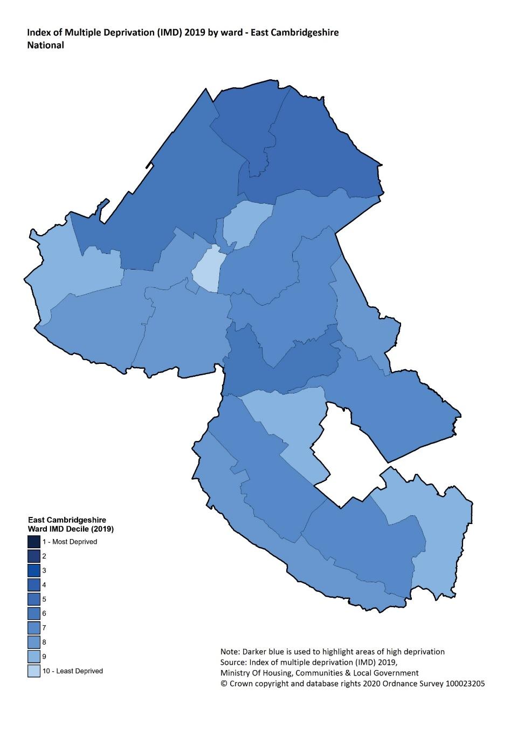
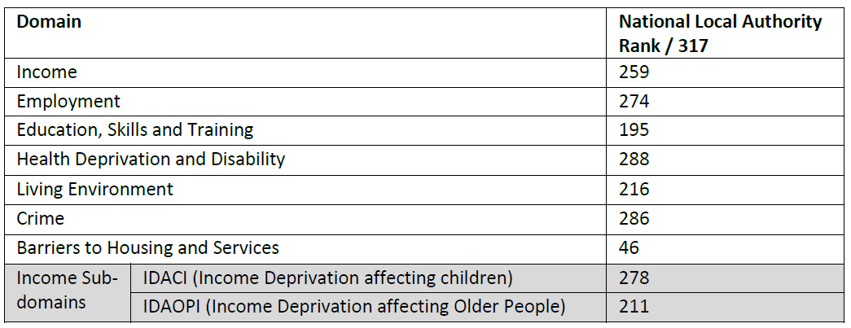
Deprivation in East Cambridgeshire
Source: Indices of Deprivation 2019, Ministry of Housing, Communities and Local Government
National IMD decile by ward in East Cambridgeshire, 2019
The deprivation domains for East Cambridgeshire by rank (out of 317 local authorities nationally) where the lower the rank the more deprived the domain (1 is the most deprived)
In East Cambridgeshire, Barrier to Housing and Services ranks significantly lower than the other domains, ranking over 100 less than the next domain (Education, Skills and Training), showing it is the most deprived domain by rank.
Health Deprivation and Disability is the highest ranking domain in East Cambridgeshire, closely followed by Crime domain.
In general, the wards in the north-east of the district are more deprived (Littleport East and West).
Average IMD deciles show that most wards are within the top half of the deciles, from 6-10.
Notes:
Note: LSOA and Wards are not coterminous, and therefore a best fit look up has been used. Ward boundaries are taken from the 2018 ward boundaries.
Domain rankings: the individual domain rankings present an absolute values for the lowest ranked and highest ranked domains in the district. The ranks are based on comparisons between all of the local authority nationally. There are 317 local authorities.
Link: https://cambridgeshireinsight.org.uk/deprivation/indices-of-multiple-deprivation/

Slide 11
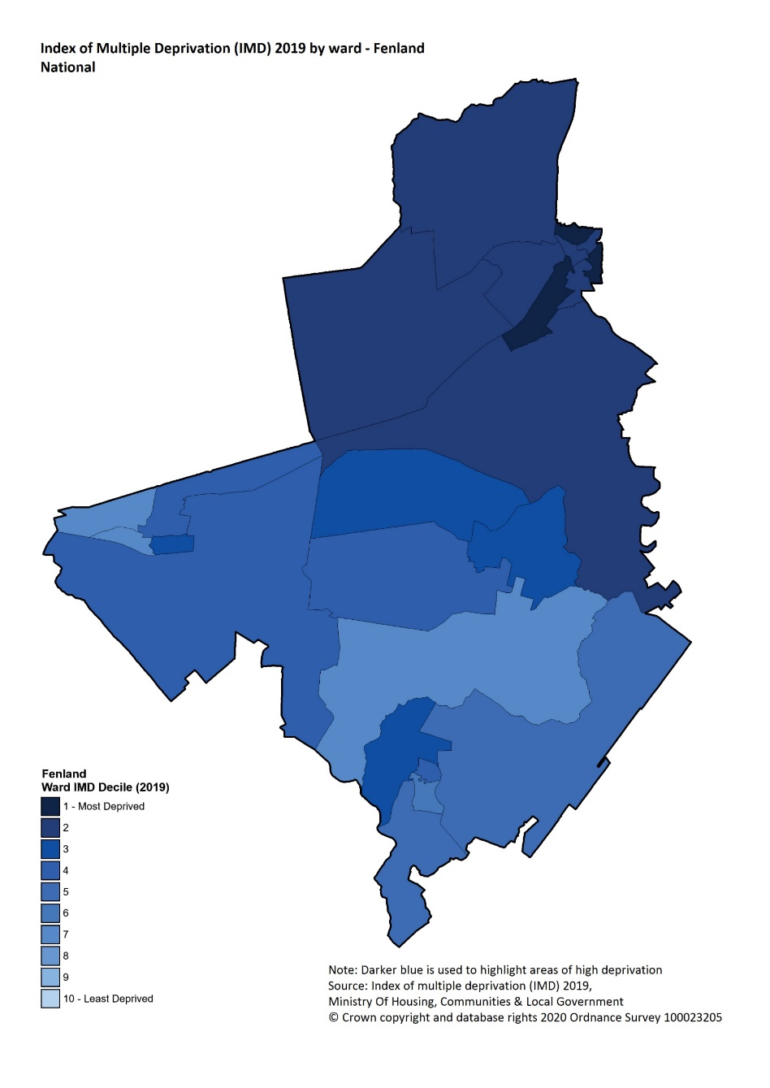
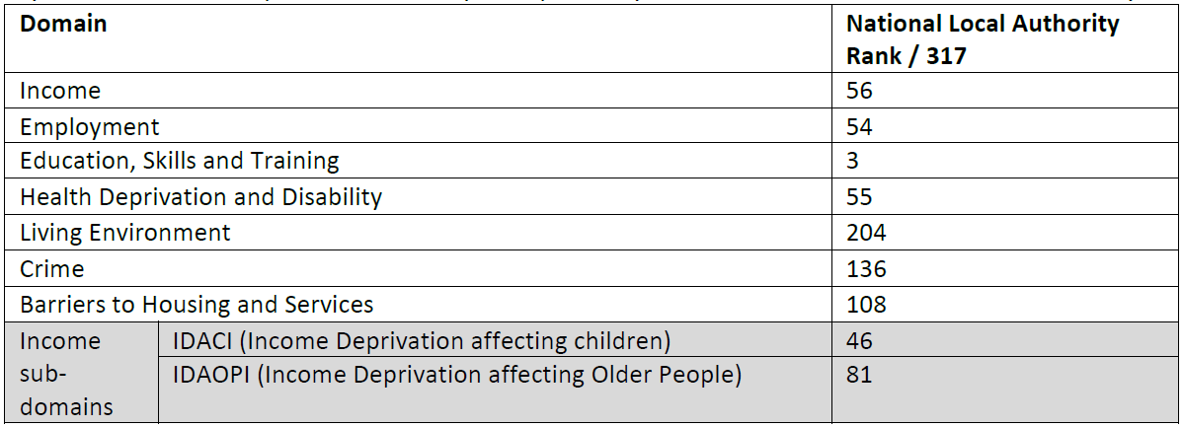
Deprivation in Fenland
Source: Indices of Deprivation 2019, Ministry of Housing, Communities and Local Government
National IMD decile by ward in Fenland, 2019
The deprivation domains for Fenland by rank (out of 317 local authorities nationally) where the lower the rank the more deprived the domain (1 is the most deprived)
In Fenland, Living Environment ranks significantly higher than the other domains.
Education, Skills and Training is the lowest ranking domain in Fenland, being substantially lower than the others.
Average IMD deciles show that most wards are within the bottom half of the deciles, from 1-5.
Medworth, Staithe and Waterlees Village are the most deprived wards in the district.
Notes:
Note: LSOA and Wards are not coterminous, and therefore a best fit look up has been used. Ward boundaries are taken from the 2018 ward boundaries.
Domain rankings: the individual domain rankings present an absolute values for the lowest ranked and highest ranked domains in the district. The ranks are based on comparisons between all of the local authority nationally. There are 317 local authorities.
Link: https://cambridgeshireinsight.org.uk/deprivation/indices-of-multiple-deprivation/

Slide 12
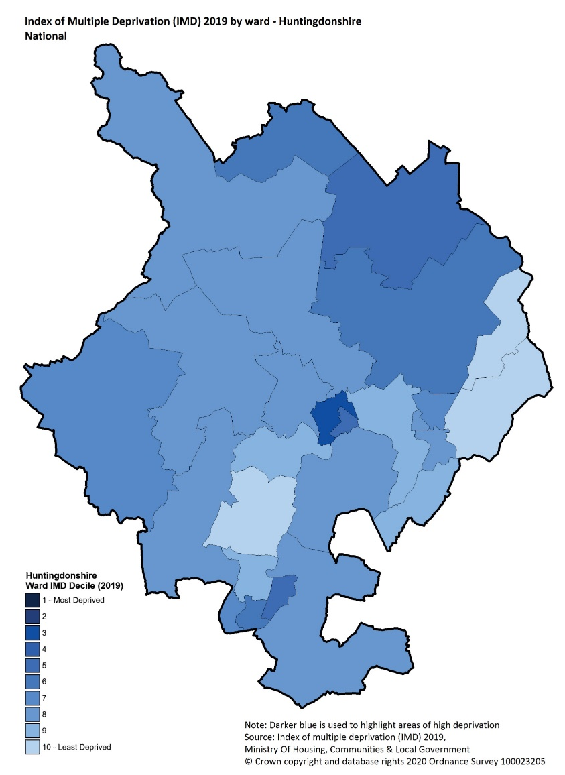
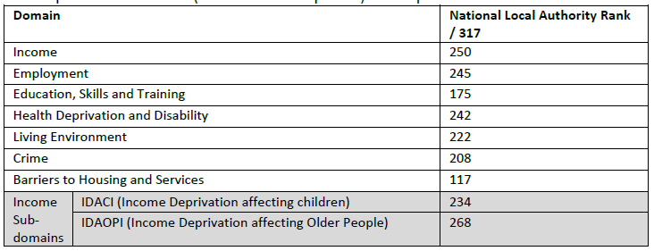
Deprivation in Huntingdonshire
Source: Indices of Deprivation 2019, Ministry of Housing, Communities and Local Government
National IMD by ward in Huntingdonshire, 2019
The deprivation domains for Huntingdonshire by rank (out of 317 local authorities nationally) where the lower the rank the more deprived the domain (1 is the most deprived)
In Huntingdonshire, barriers to Housing and Services is the lowest ranked domain (most deprived).
The highest ranked domain in Huntingdonshire is Income, closely followed by Employment and Health Deprivation and Disability.
Huntingdon North is the most deprived ward in Huntingdonshire, being in the 3rd decile nationally.
Average IMD deciles show that there is a large variation between wards, with the most deprived ward ranking in the 3rd decile and the least deprived wards within the 10th decile.
Notes:
Note: LSOA and Wards are not coterminous, and therefore a best fit look up has been used. Ward boundaries are taken from the 2018 ward boundaries.
Domain rankings: the individual domain rankings present an absolute values for the lowest ranked and highest ranked domains in the district. The ranks are based on comparisons between all of the local authority nationally. There are 317 local authorities.
Link: https://cambridgeshireinsight.org.uk/deprivation/indices-of-multiple-deprivation/

Slide 13
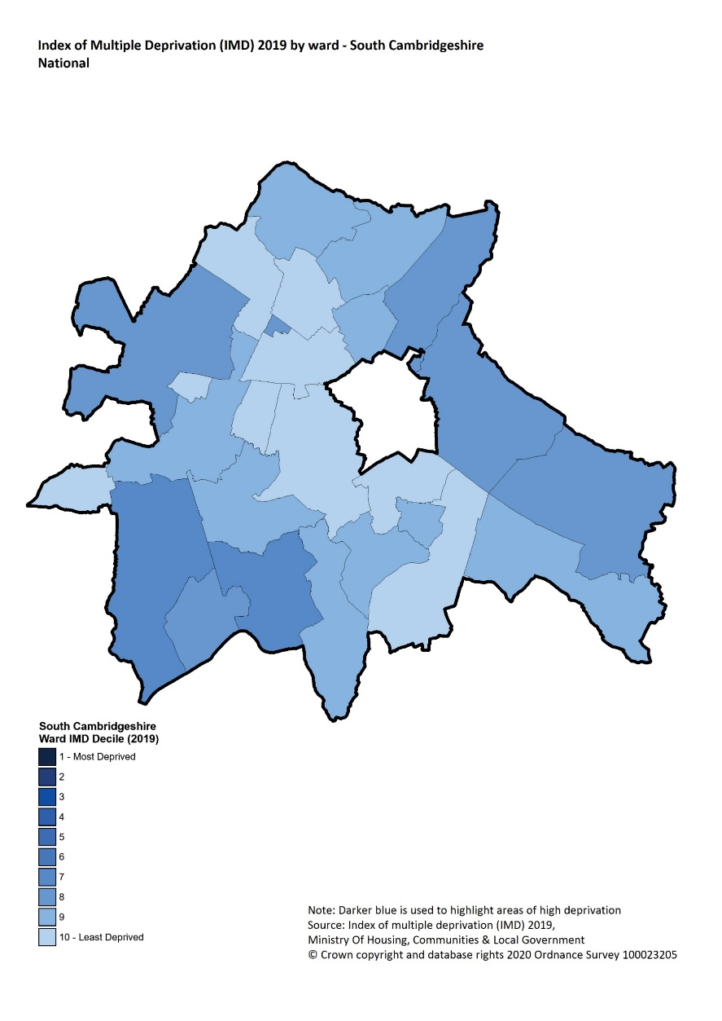
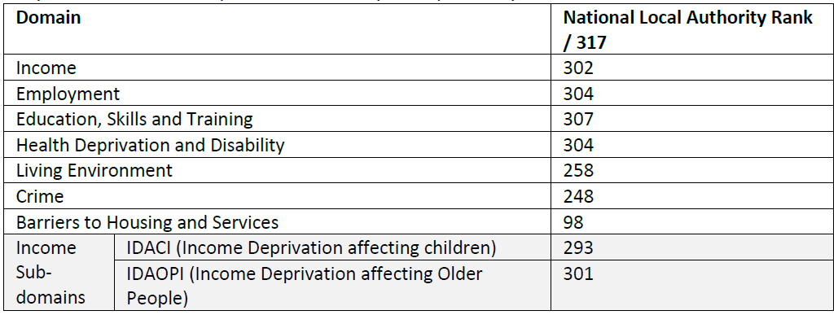
Deprivation in South Cambridgeshire
Source: Indices of Deprivation 2019, Ministry of Housing, Communities and Local Government
National IMD decile by ward in South Cambridgeshire, 2019
The deprivation domains for South Cambridgeshire by rank (out of 317 local authorities nationally) where the lower the rank the more deprived the domain (1 is the most deprived)
In South Cambridgeshire, Barriers to Housing and Services ranks significantly lower than the other domains, ranking over 150 less than the next domain (crime) showing it is the most deprived domain by rank.
Education, Skills and Training is the highest ranking domain in South Cambridgeshire.
Average IMD deciles show that all the wards in South Cambridgeshire are within the top half of the deciles (7 - 10) nationally.
Notes:
Note: LSOA and Wards are not coterminous, and therefore a best fit look up has been used. Ward boundaries are taken from the 2018 ward boundaries.
Domain rankings: the individual domain rankings present an absolute values for the lowest ranked and highest ranked domains in the district. The ranks are based on comparisons between all of the local authority nationally. There are 317 local authorities.
Link: https://cambridgeshireinsight.org.uk/deprivation/indices-of-multiple-deprivation/

Slide 14
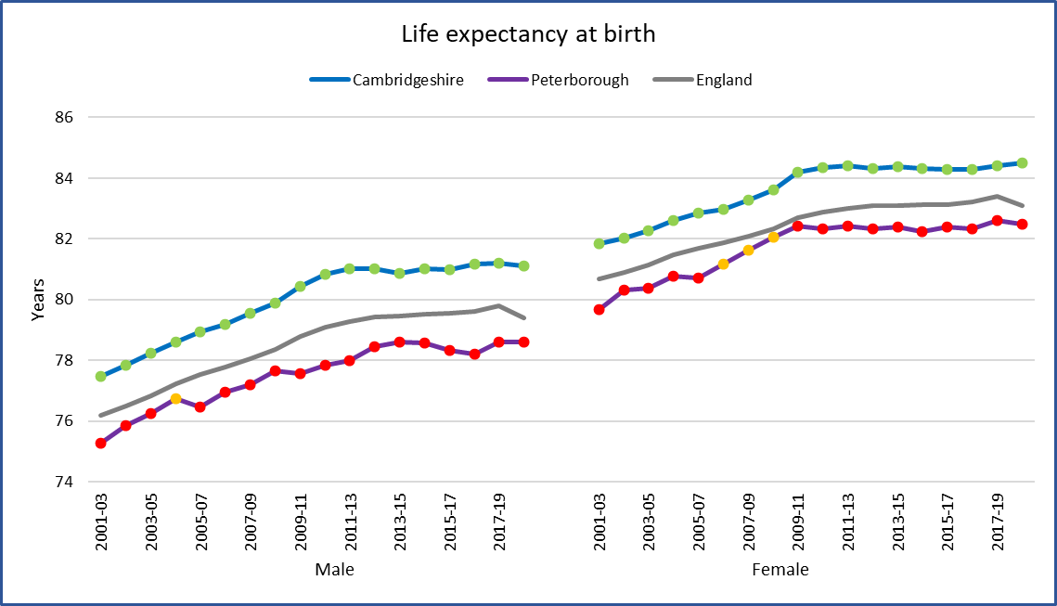
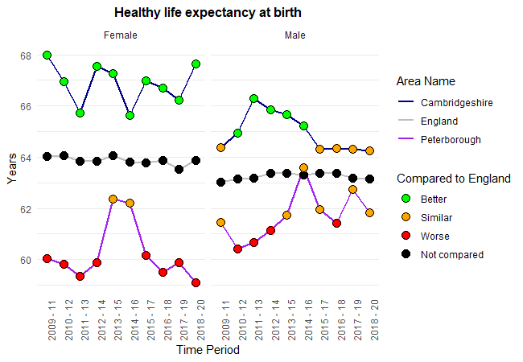
Inequality
Source: Public Health Outcomes Framework, Fingertips, OHID (downloaded – May 2022)
Change in Life expectancy at birth over time, 2001-03 to 2018-20
Healthy life expectancy at birth – trend over time
Note: Scale does not start at 0
Note: Scale does not start at 0
The trend for average number of years a person would expect to live in a good health show a rapid decline for females in Peterborough since 2014-16 and remain significantly lower than England in the recent time periods.
Healthy life expectancy among males in Peterborough was highest (63.6 years) during 2014-16 period and shows fluctuation since then.
Healthy life expectancy at birth for Cambridgeshire males show a relatively stable trend from 2015-17 and is statistically similar to the national average. However, the average years are substantially lower than the peak observed in 2011-13 period.
Life expectancy at birth is consistently higher in Cambridgeshire and lower in Peterborough compared to England average.
The life expectancy at birth for males and females in Peterborough showed an increase of 0.4 and 0.3 years respectively, in 2017–19 compared to 2016–18.
The trend for Cambridgeshire females show a slight increase in the last 2 time periods.
Notes:
Life expectancy at birth: The average number of years a person would expect to live based on contemporary mortality rates. For a particular area and time period, it is an estimate of the average number of years a newborn baby would survive if he or she experienced the age-specific mortality rates for that area and time period throughout his or her life.
Link: https://fingertips.phe.org.uk/profile/public-health-outcomes-framework/data#page/1
Healthy life expectancy at birth: A measure of the average number of years a person would expect to live in good health based on contemporary mortality rates and prevalence of self-reported good health.
Link: https://fingertips.phe.org.uk/profile/public-health-outcomes-framework/data#page/1

Slide 15
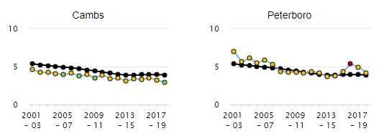
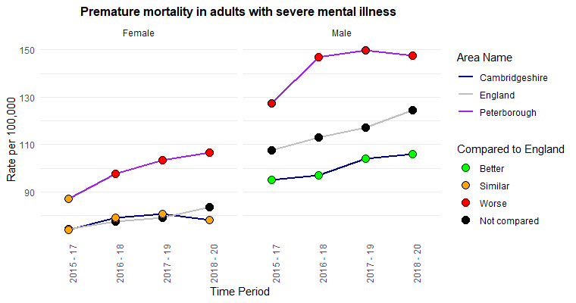
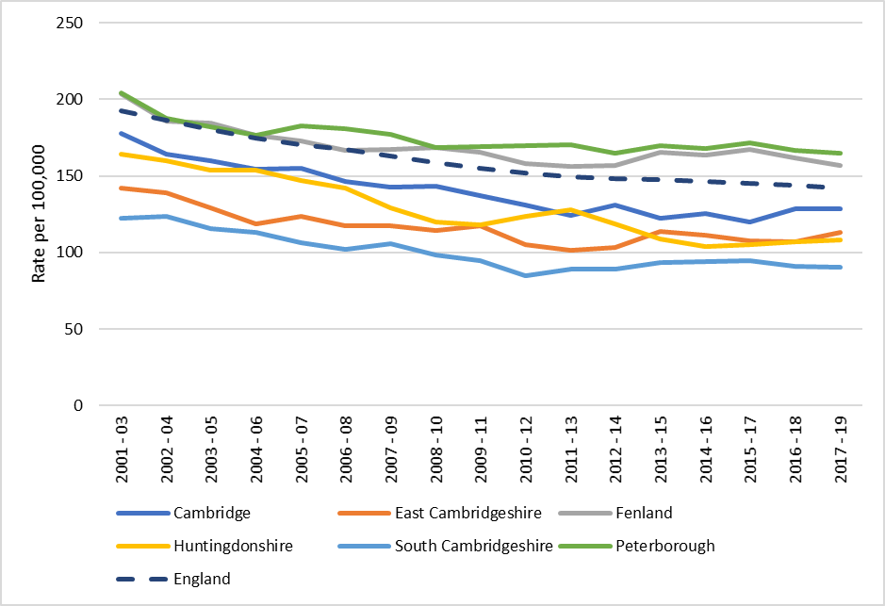
Inequality
Infant mortality rate, crude rate per 1,000 ¹
The rate of infant deaths under 1 year of age per 1,000 live births is statistically similar to England in Peterborough and significantly better than England in Cambridgeshire for the period 2018-20.
A declining trend in infant mortality rate is noted in the recent 3 time periods for both Cambridgeshire and Peterborough.
Premature mortality in adults with severe mental illness (SMI), trend over time ²
Under 75 mortality rate from causes considered preventable, trend over time ²
Note: Scale does not start at 0
Premature mortality rate in adults with severe mental illness is higher among men compared to women in Cambridgeshire, Peterborough and England.
Rates for both men and women in Peterborough are significantly higher than England rates.
An increasing trend is seen among Peterborough females and Cambridgeshire males since 2015-17.
The premature mortality rates are significantly lower for males in Cambridgeshire compared to Peterborough and the national average.
In Peterborough, under 75 mortality rates from causes that are considered preventable have been consistently higher than the national average since 2004-06.
Rates in Fenland are also higher than England rates since 2007-09.
Source: 1. Public health outcomes framework 2. Wider determinants of health, Fingertips, OHID (downloaded – June 2022)
Notes:
Infant mortality rate: Infant deaths under 1 year of age per 1000 live births
Link: https://fingertips.phe.org.uk/profile/public-health-outcomes-framework/data#page/1
Under 75 mortality rate from causes considered preventable (2019 definition): Age-standardised mortality rate from causes considered preventable in persons aged less than 75 years per 100,000 population.
The basic concept of preventable mortality is that deaths are considered preventable if, in the light of the understanding of the determinants of health at the time of death, all or most deaths from the underlying cause (subject to age limits if appropriate) could mainly be avoided through effective public health and primary prevention interventions.
Preventable mortality overlaps with, but is not the same as ‘treatable’ mortality, which includes causes of deaths which could potentially be avoided through effective healthcare interventions, including secondary prevention and treatment.
Preventable mortality and treatable mortality are the two components of ‘avoidable’ mortality.
Link: https://fingertips.phe.org.uk/profile/wider-determinants/data#page/1
Premature mortality in adults with severe mental illness (SMI): Directly age standardised rate of deaths of adults, aged 18 - 74, with SMI, per 100,000 population. SMI is defined as having a referral to mental health services in the five years preceding death.
Link: https://fingertips.phe.org.uk/profile/wider-determinants/data#page/1

Slide 16
Poverty and Financial Security

Slide 17
Summary
Several areas with a high rate of income deprivation are in Peterborough and Fenland. 15.6% of the population in Peterborough and 14% of the population in Fenland were income-deprived in 2019.
The proportion of children in relative low-income families has been significantly higher than the English average in Peterborough since 2014/15.
Average weekly earnings have been significantly lower than the national average for men in Peterborough for several years between 2011 and 2021.
In 2018, the estimated proportion of households that experienced fuel poverty in Cambridge (11.1%) and Fenland (10.8%) is higher than in England (10.3%).
The child Poverty rate in Peterborough (36%) and Fenland (31%) is higher than most areas in the East of England region.
Relative poverty is consistently higher for disabled people in the UK.
During Oct 2021 to April 2022, the proportion of households’ food insecurity levels has increased by 60% since the first six months of the pandemic in the UK.
Nationally, the number of people who contact the Citizens Advice Bureau for help with cost of living issues, including debt, housing, affordability of energy, benefits, and any crisis support, has rapidly increased in the last 2 years.

Slide 18
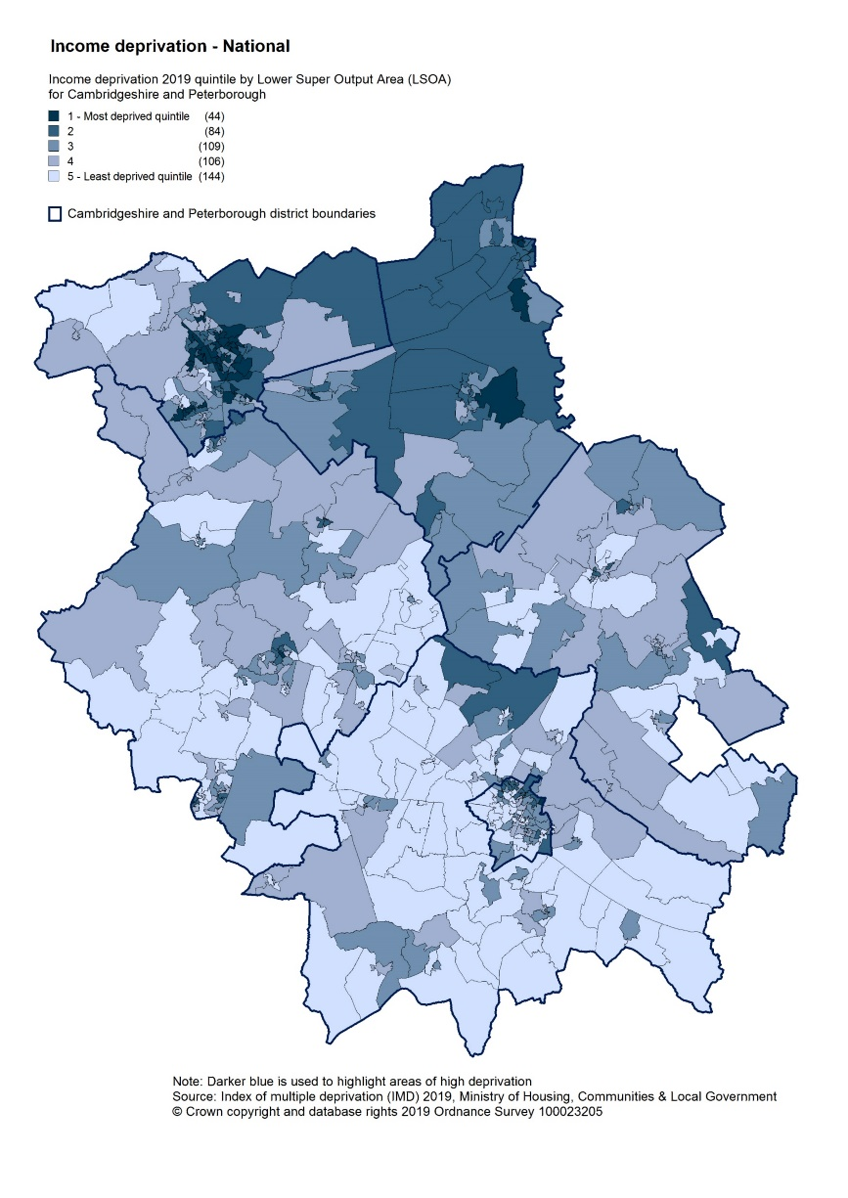
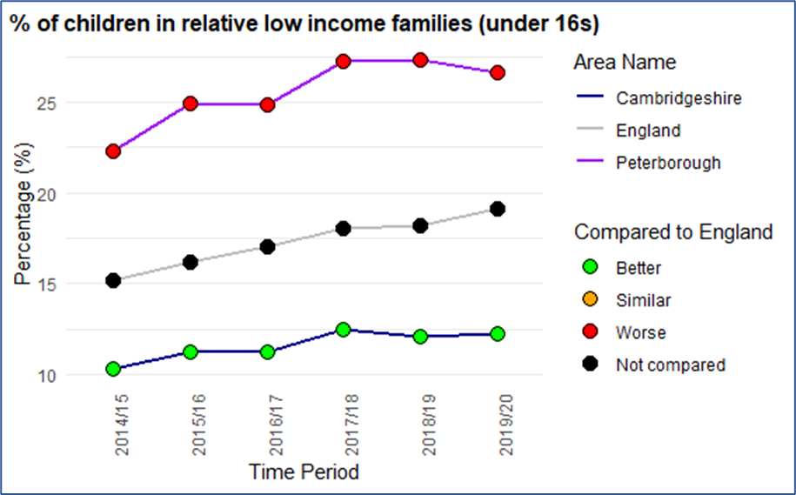
Poverty and financial security
Income deprivation, 2019 ¹
Source: 1. Indices of Deprivation 2019, Ministry of Housing, Communities and Local Government 2. Wider determinants of health, Fingertips, OHID (downloaded – May 2022)
Children in relative low income families (under 16s), 2019/20 ²
The proportion of under 16s in relative low income families is significantly higher than England for Fenland and Peterborough.
Change in % of children in relative low-income families (under 16s) over time ²
The proportion of children in relative low-income families in Peterborough has been significantly higher than the national average since 2014/15 whilst it remains significantly lower than the national average in Cambridgeshire.
The rate of Income deprivation is high in Peterborough and Fenland with fewer income deprived areas seen in other parts of Cambridgeshire.
Note: Scale does not start at 0
Notes:
Income deprivation: The Income Deprivation Domain measures the proportion of the population experiencing deprivation relating to low income. The definition of low income used includes both those people that are out-of-work, and those that are in work but who have low earnings.
Link: https://www.gov.uk/government/statistics/english-indices-of-deprivation-2019
Children in relative low income families: Percentage of children (<16) in a local area, living in relative low income families. A family is defined as a single adult; or a married or cohabitating couple; or a Civil Partnership; and any dependent children.
Relative low income is defined as a family in low income Before Housing Costs (BHC) in the reference year. A family must have claimed one or more of Universal Credit, Tax Credits or Housing Benefit at any point in the year to be classed as low income in these statistics.
Relative low income sets a threshold as 60% of the UK average (median) income and moves each year as average income changes. It is used to measure the number and proportion of individuals who have income below this threshold.
The percentage of individuals in relative low income will decrease if:
Average (median) income stays the same or rises, and individuals with lower incomes see their incomes rise more than the average; or
Average (median) incomes fall, and individuals with lower incomes see their incomes fall less than average incomes.
Link: https://fingertips.phe.org.uk/profile/wider-determinants/data#page/1

Slide 19
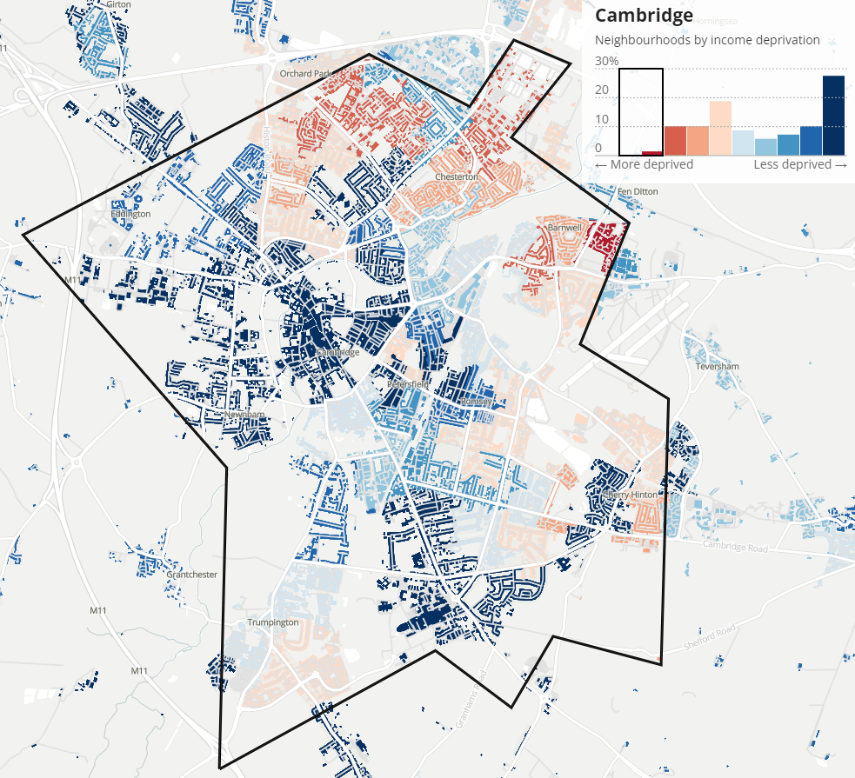
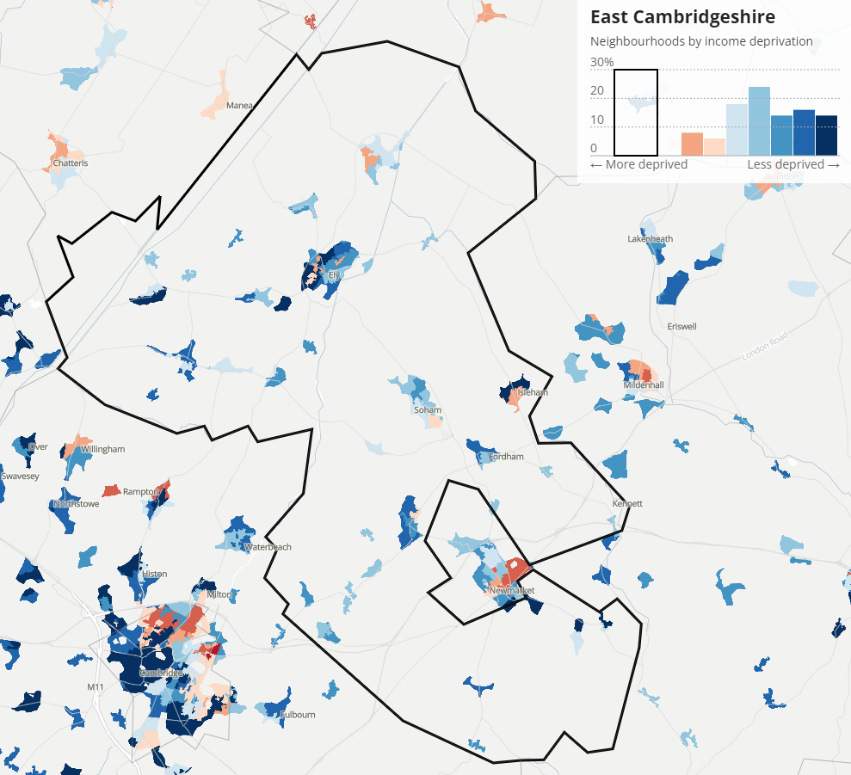
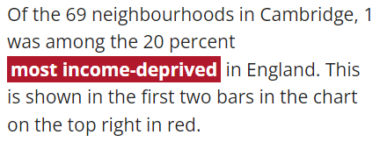
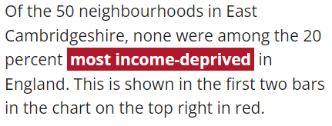
Local Authority Income Disparities
Source: IMD 2019, Income deprivation
Cambridge City
East Cambridgeshire
In Cambridge, 7.7% of the population was income-deprived in 2019.
In East Cambridgeshire, 7.0% of the population was income-deprived in 2019
Notes:
Exploring local income deprivation (ons.gov.uk)
Exploring local income deprivation
A detailed picture of disparities within English local authorities to a neighbourhood level

Slide 20
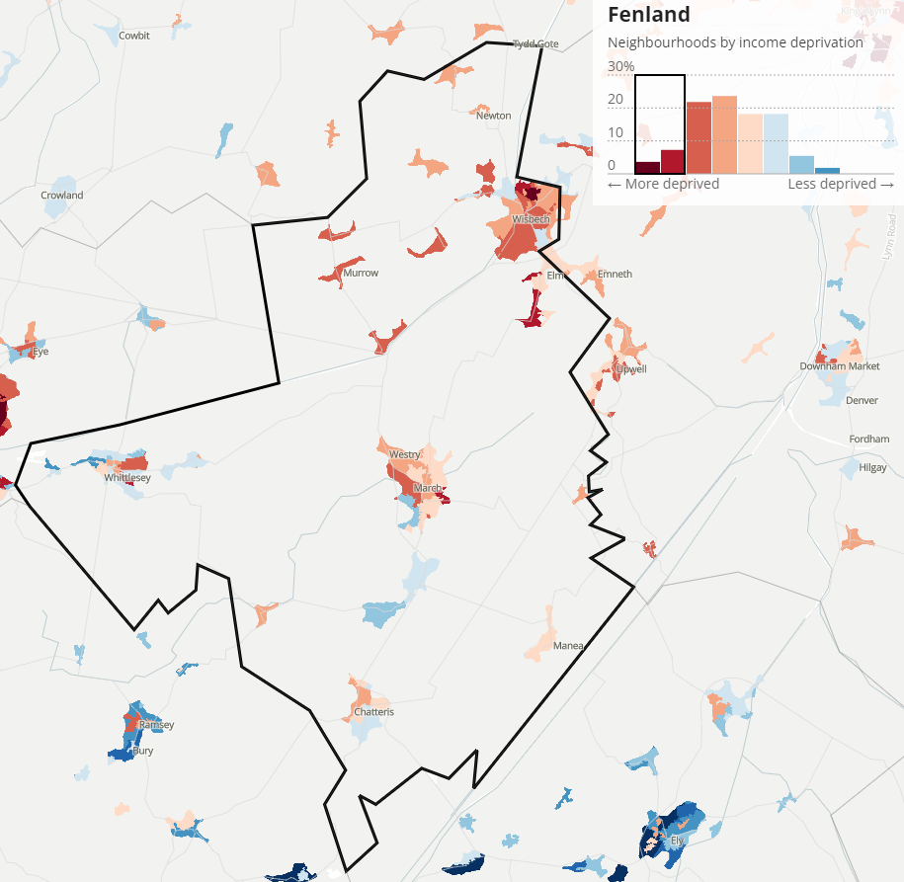
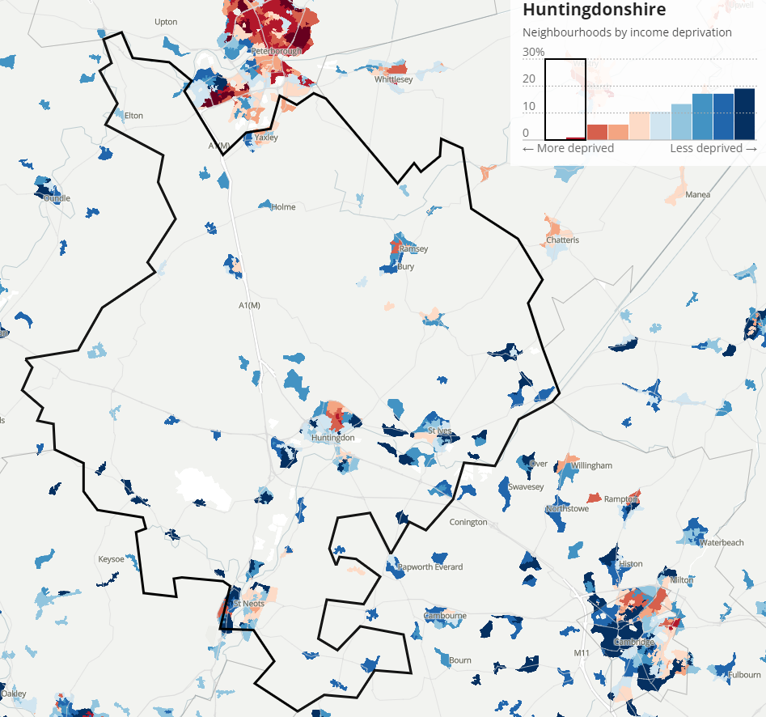
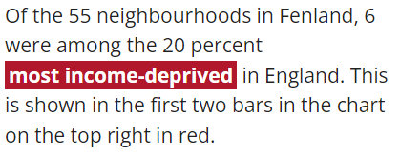
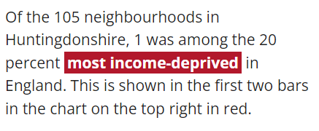
Local Authority Income Disparities
Source: IMD 2019, Income deprivation
Fenland
Huntingdonshire
In Fenland, 14.0% of the population was income-deprived in 2019.
In Huntingdonshire, 7.4% of the population was income-deprived in 2019.
Notes:
Exploring local income deprivation (ons.gov.uk)
Exploring local income deprivation
A detailed picture of disparities within English local authorities to a neighbourhood level

Slide 21
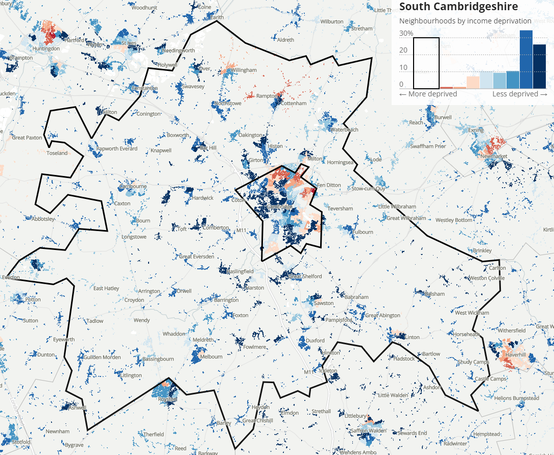
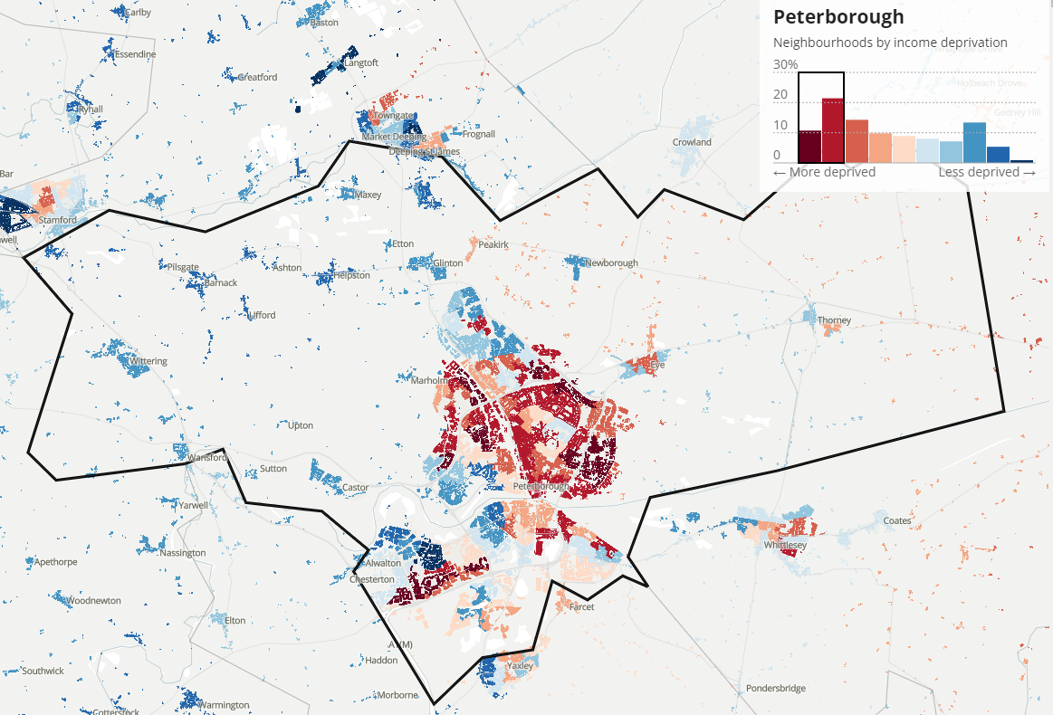
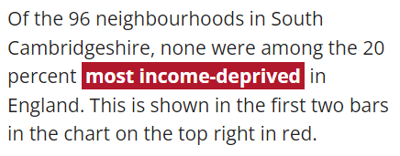
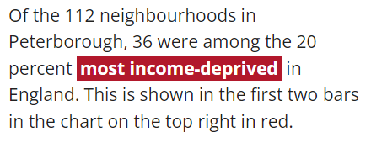
Local Authority Income Disparities
Source: IMD 2019, Income deprivation
South Cambridgeshire
Peterborough
In South Cambridgeshire, 5.6% of the population was income-deprived in 2019.
In Peterborough, 15.6% of the population was income-deprived in 2019.
Notes:
Exploring local income deprivation (ons.gov.uk)
Exploring local income deprivation
A detailed picture of disparities within English local authorities to a neighbourhood level

Slide 22
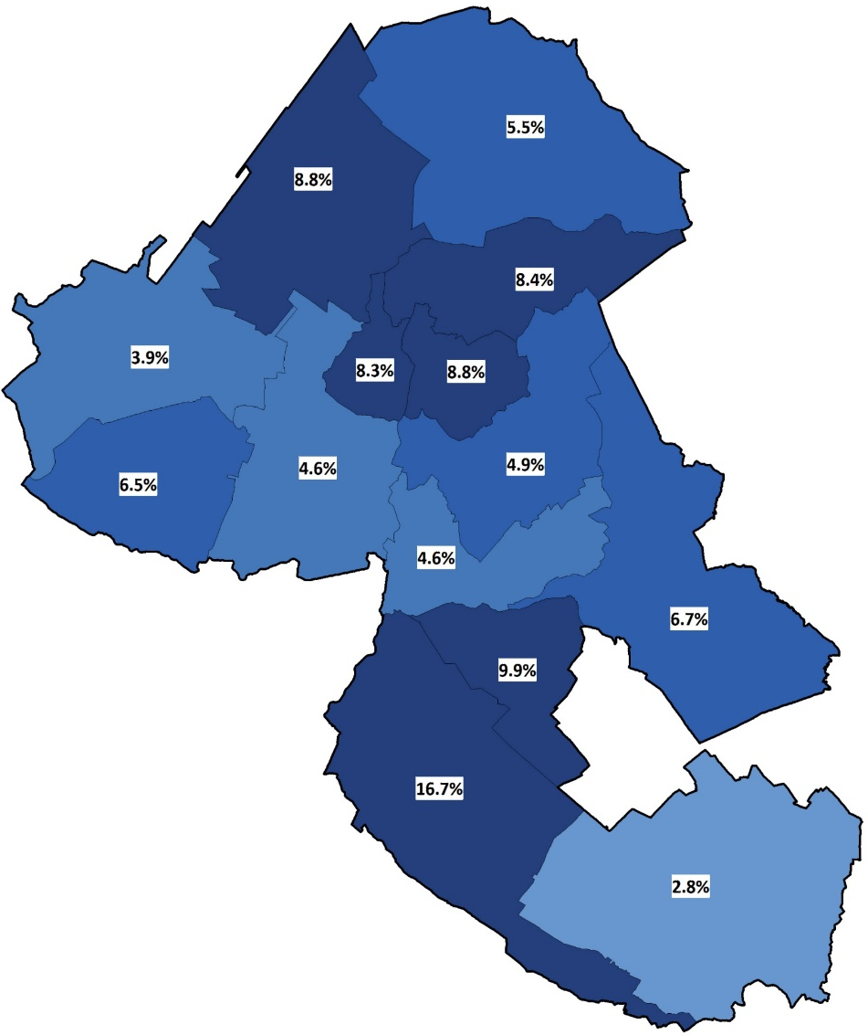
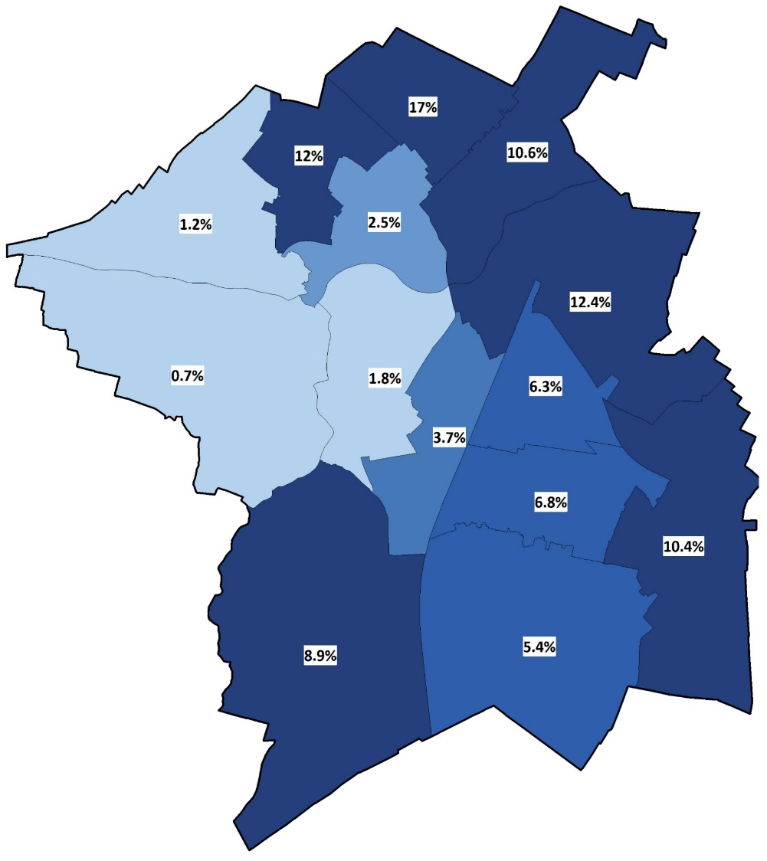
Children in relative low income families (LIF) (under 16s)
Source: https://fingertips.phe.org.uk/, OHID
Cambridge
East Cambridgeshire
Count and percentage of low income families by ward, 2020/21
Count and percentage of low income families by ward, 2020/21
2,418 families were identified as ‘low income’ within Cambridge for the year 2020/21. Accounting for 17% of LIF within Cambridgeshire.
1,737 families were identified as ‘low income’ within East Cambridgeshire for the year 2020/21. Accounting for 12% of LIF within Cambridgeshire.
Notes:
Data from https://fingertips.phe.org.uk/
Indicator: Children in relative low income families (under 16s)
Definition: Number of children aged under 16 living in families in receipt of Child Tax Credit whose reported income is less than 60 per cent of the median income or in receipt of Income Support or (Income-Based) Job Seeker's Allowance.
Source: The Office for Health Improvement and Disparities

Slide 23
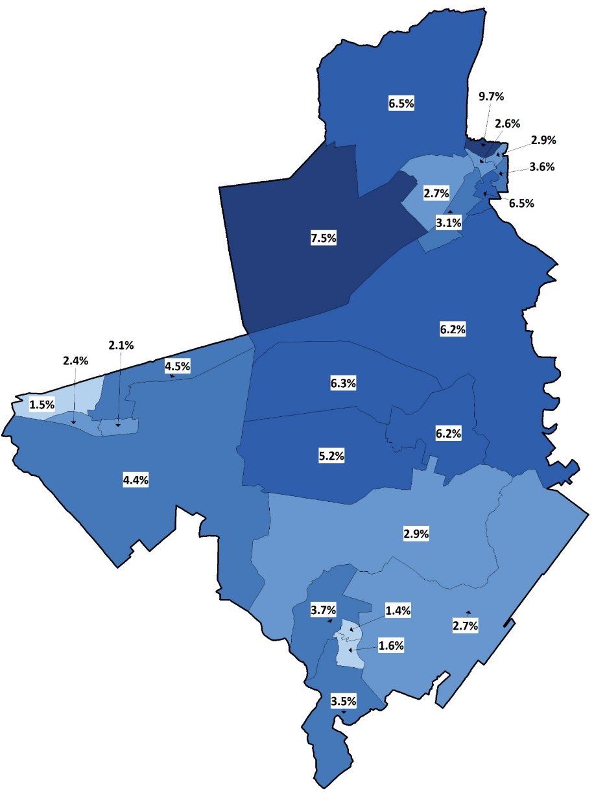
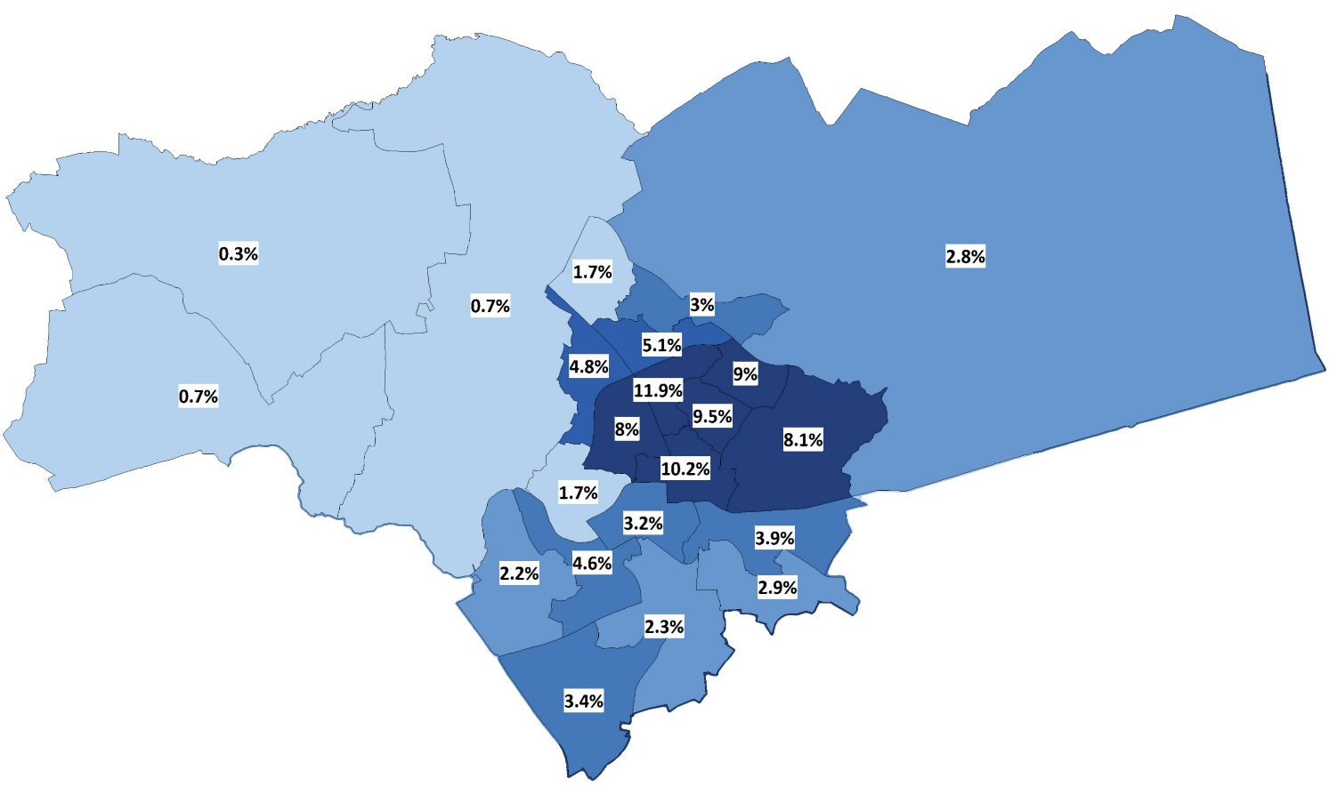
Children in relative low income families (LIF) (under 16s)
Source: https://fingertips.phe.org.uk/, OHID
Peterborough
Fenland
3,658 families were identified as ‘low income’ within Fenland for the year 2020/21. Accounting for 25% of LIF within Cambridgeshire.
Count and percentage of low income families by ward, 2020/21
Count and percentage of low income families by ward, 2020/21
12,196 families were identified as ‘low income’ within Peterborough for the year 2020/21. The top 10 wards shown here accounting for 75% of the total LIF’s with Peterborough.
The top 10 wards shown here accounting for 63% of the total LIF’s with Fenland.
Notes:
Data from https://fingertips.phe.org.uk/
Indicator: Children in relative low income families (under 16s)
Definition: Number of children aged under 16 living in families in receipt of Child Tax Credit whose reported income is less than 60 per cent of the median income or in receipt of Income Support or (Income-Based) Job Seeker's Allowance.
Source: The Office for Health Improvement and Disparities

Slide 24
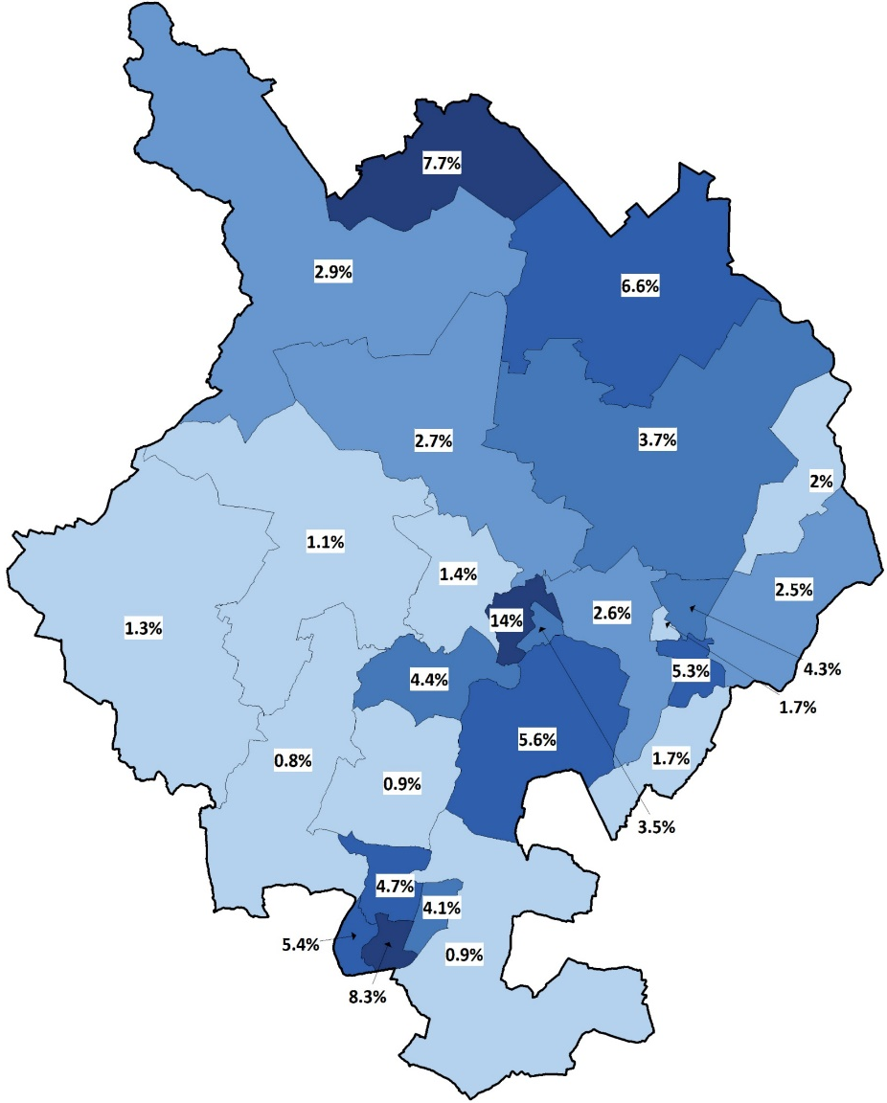
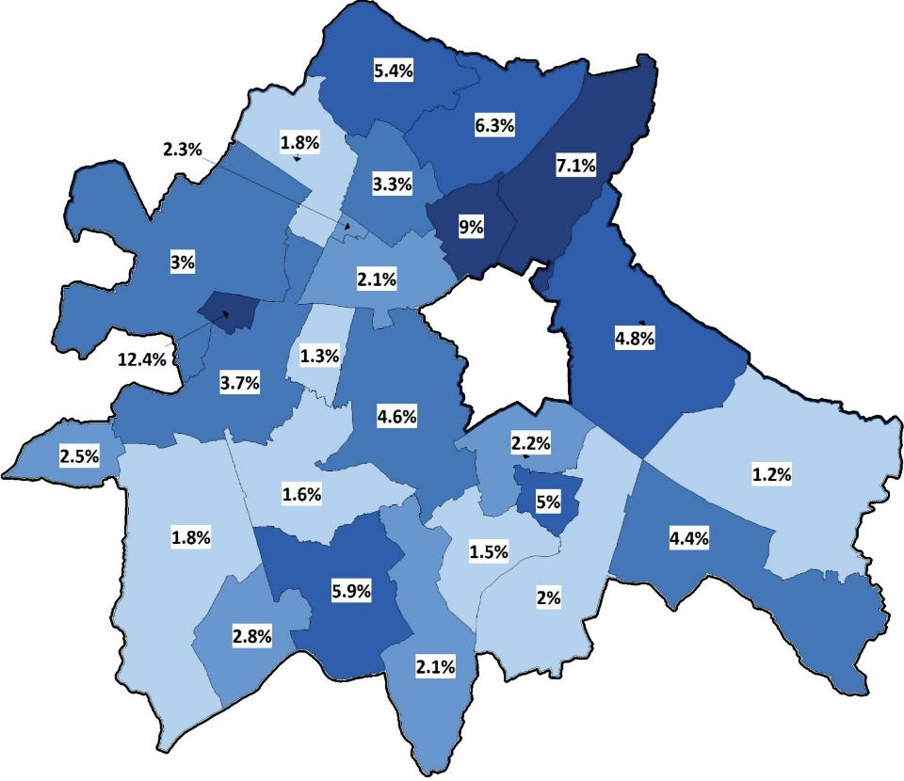
Children in relative low income families (LIF) (under 16s)
Source: https://fingertips.phe.org.uk/, OHID
Huntingdonshire
South Cambridgeshire
3,979 families were identified as ‘low income’ within Huntingdonshire for the year 2020/21.
2,680 families were identified as ‘low income’ within
South Cambridgeshire for the year 2020/21.
Count and percentage of low income families by ward, 2020/21
Count and percentage of low income families by ward, 2020/21
The top 10 wards shown here accounting for 65% of the total LIF’s with South Cambridgeshire and 19% of the total for Cambridgeshire.
The top 10 wards shown here accounting for 66% of the total LIF’s with Huntingdonshire and 27% of the total for Cambridgeshire.
Notes:
Data from https://fingertips.phe.org.uk/
Indicator: Children in relative low income families (under 16s)
Definition: Number of children aged under 16 living in families in receipt of Child Tax Credit whose reported income is less than 60 per cent of the median income or in receipt of Income Support or (Income-Based) Job Seeker's Allowance.
Source: The Office for Health Improvement and Disparities

Slide 25
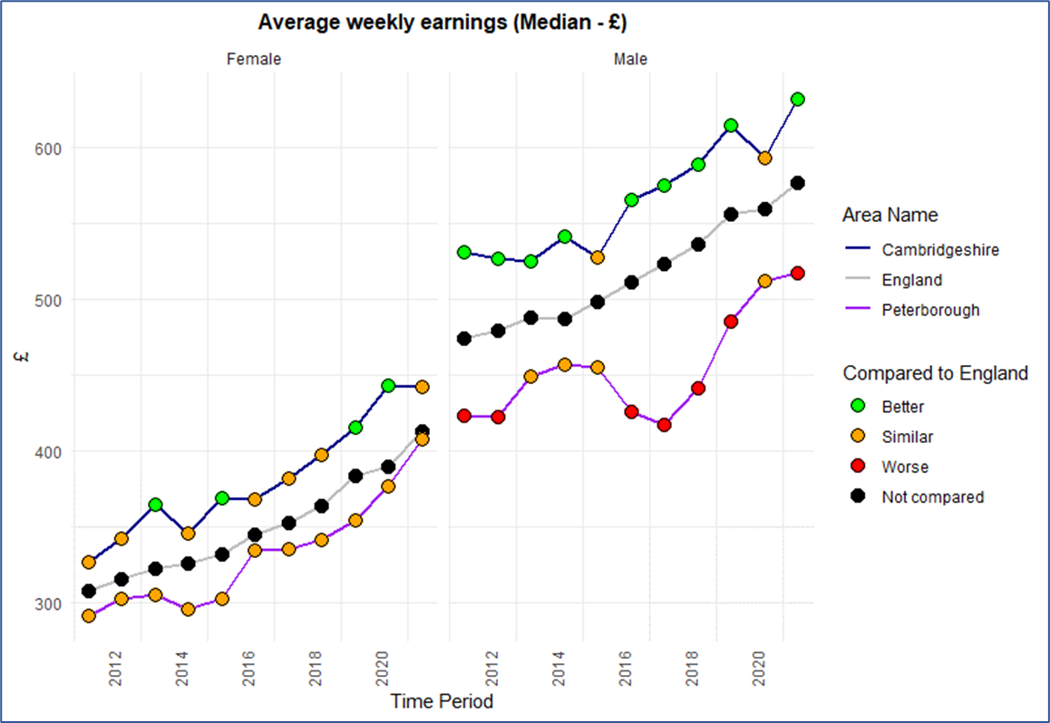
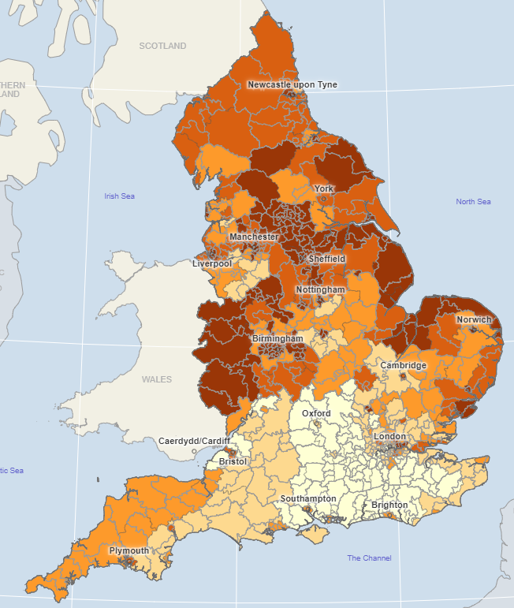
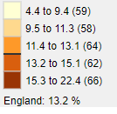
Poverty and financial security
Source: 1. Wider determinants of health, Fingertips, OHID (downloaded – May 2022) 2. Local Health, Department for Business, Energy and Industrial Strategy (downloaded June 2022)
Change in Average weekly earnings over time ¹
Modelled estimates of the proportion of households in fuel poverty, 2020 (%) ²
The estimated proportion of households that experienced fuel poverty in 2020 in Fenland (15.3%) falls within the highest range nationally.
Proportion in Peterborough (14.9%) and Cambridge (14.6%) is higher than England average and falls within the second highest range nationally.
East Cambridgeshire (12.7%) falls in the middle range for the proportion of households that experience fuel poverty.
Huntingdonshire (11.0%) and South Cambridgeshire (9.8%) falls within the second lowest range.
Note: Scale does not start at 0
The average weekly earnings in Cambridgeshire and Peterborough for both male and female show an overall increasing trend. This is also true for England.
The gap for average weekly earnings among men in Peterborough compared to England is narrowing since 2017.
Notes:
Average weekly earnings: Median gross (before tax, National Insurance and other deductions) weekly earnings in pounds (£) of full and part-time employees paid through the PAYE system, excluding over-time. Based upon employees resident location. Reference period is a point during April each year.
Link: https://fingertips.phe.org.uk/profile/wider-determinants/data#page/1
Estimated percentage of households that experience fuel poverty : The percentage of households in an area that experience fuel poverty based on the "low income, low energy efficiency (LILEE)" methodology.
A household is considered to be fuel poor if they are living in a property with a fuel poverty energy efficiency rating of band D or below and when they spend the required amount to heat their home, they are left with a residual income below the official poverty line.
Link: https://www.localhealth.org.uk/

Slide 26
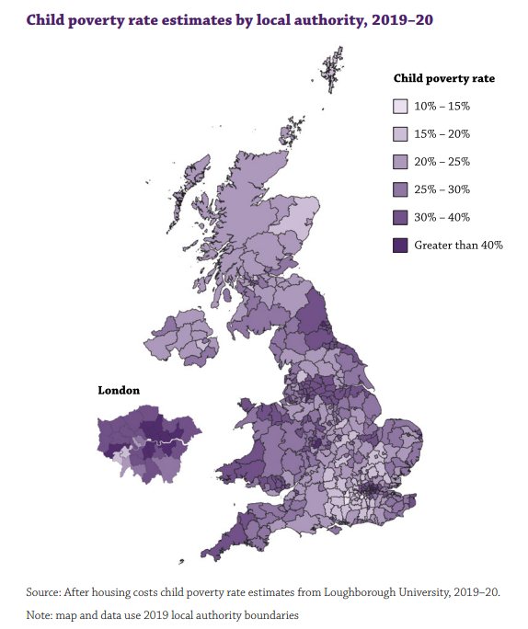
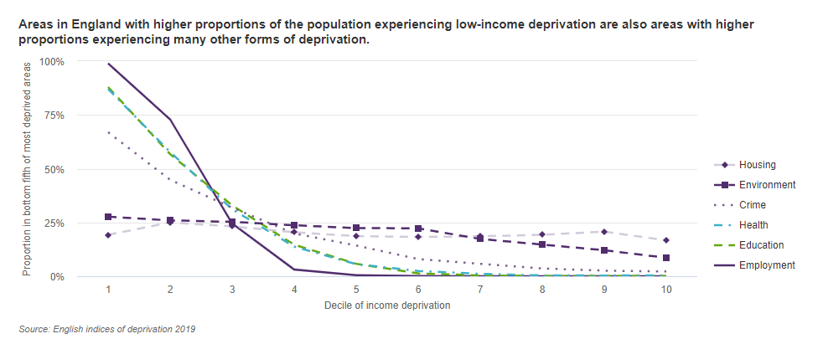
Child Poverty
Source: Joseph Rowntree Foundation – UK Poverty report 2022
The mapping of child poverty highlights the substantial variation within regions, with metropolitan, urban and suburban areas typically having higher rates of poverty than local authorities categorised as being rural or countryside.
Child Poverty rate in Peterborough (36%) and Fenland (31%) is higher than most areas in East of England region.
East Cambridgeshire (18%) and South Cambridgeshire (17%) are among the areas that have low level of child poverty rates in England.
Child poverty rate in Cambridge is 23% and 22% in Huntingdonshire.
Notes:
Poverty – relative poverty rate (after housing costs) is used to measure Poverty.
Child Poverty rate estimates by local authority: The overall poverty statistics cannot be broken down below the regional level, but research carried out by Loughborough University and published by EndChildPoverty.org provides further insight
into the geography of poverty by estimating the proportion of children who are in after housing costs poverty by local authority (End Child Poverty, 2020).
Link: https://www.jrf.org.uk/data

Slide 27
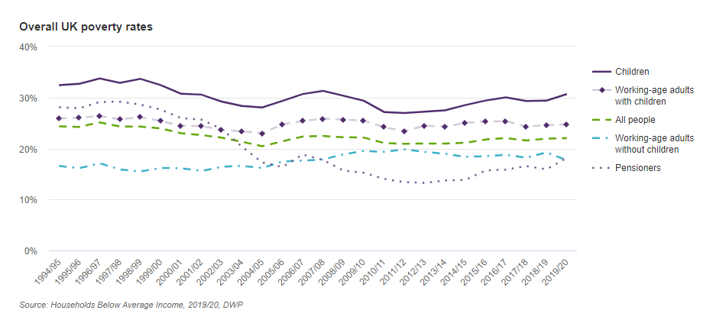
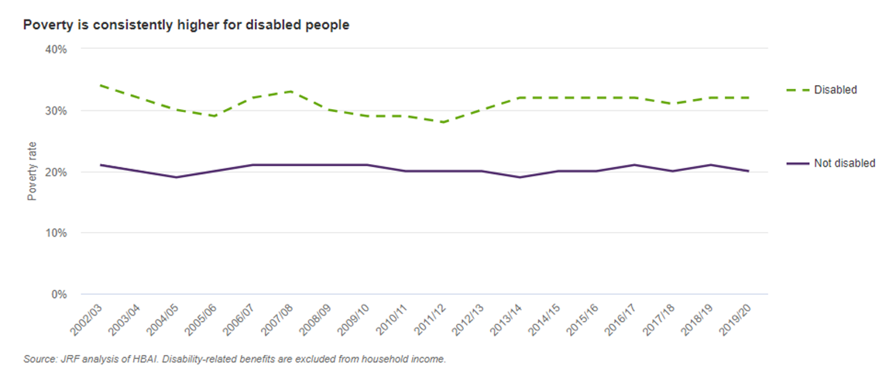
Poverty - UK
Source: Joseph Rowntree Foundation – UK Poverty report 2022
Child Poverty continues to rise in the UK. The latest data shows that one in three children in the UK living in Poverty (31%).
Children have had the highest poverty rates throughout the last 25 years.
The poverty rate for disabled people has remained stable since 2013/14.
Notes:
Relative poverty rate (after housing costs) is used to measure Poverty.
The term poverty rate in the graphs above refer to relative poverty rate.
Link: https://www.jrf.org.uk/data

Slide 28
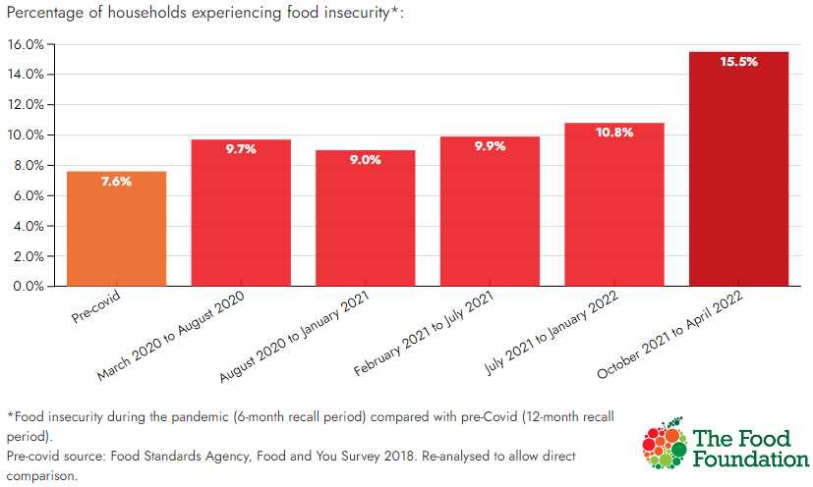
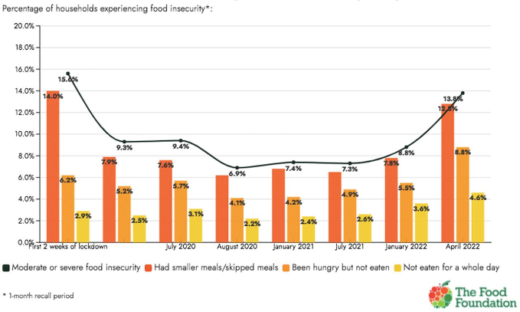
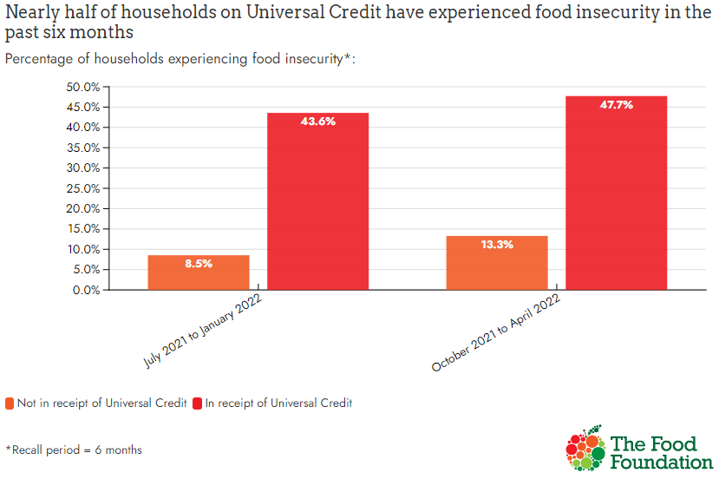
Food insecurity in the UK
Source: Food Insecurity Tracking, Food Foundation Survey, April 2022
The proportion of households’ food insecurity levels has increased by 60% since the first six months of the pandemic.
Nearly half of households on Universal Credits have experienced food insecurity in the past six months.
13.8% of households (7.3 million adults) have experienced food insecurity in the past month.
Notes:
The Food Foundation: conduct regular nationally representative surveys to asses UK food insecurity levels.
Survey data (YouGov)
Repeated at intervals since start of Covid pandemic – 10 in series to date
Nationally representative sample
Use 3 questions – based on US Household Food Security Survey Module
Did you/anyone else in your household:
1. have smaller meals than usual or skip meals because you couldn't afford or get access to food?
2. ever been hungry but not eaten because you couldn't afford or get access to food?
3. not eaten for a whole day because you couldn't afford or get access to food?
All figures are from YouGov Plc. Total sample size was 10,674 UK adults. Fieldwork was undertaken between 22nd – 29th April 2022. The survey was carried out online. The figures have been weighted and are representative of all UK adults 18+. The figures presented from the online survey have been analysed independently by The Food Foundation and the London School of Hygiene & Tropical Medicine. Missing answers were excluded from the analysis. Comparison to older figures is from a series of previous surveys conducted with YouGov commissioned by The Food Foundation. Population calculations made by the Food Foundation using 2020 mid-year population estimates.
Link : https://foodfoundation.org.uk/initiatives/food-insecurity-tracking

Slide 29



Food insecurity in the UK
Source: Food Insecurity Tracking, Food Foundation Survey, April 2022
Percentage of households experiencing food insecurity*, by ethnic groups
Non-white ethnic groups are at a higher risk of food insecurity than white ethnic groups.
People with disabilities are disproportionately affected by food insecurity compared to people who are not disabled.
A sharp increase in the proportion of households with children experiencing food insecurity in April (17.2%), up from 12.1% in January 2022.
Notes:
The Food Foundation: conduct regular nationally representative surveys to asses UK food insecurity levels.
Survey data (YouGov)
Repeated at intervals since start of Covid pandemic – 10 in series to date
Nationally representative sample
Use 3 questions – based on US Household Food Security Survey Module
Did you/anyone else in your household:
1. have smaller meals than usual or skip meals because you couldn't afford or get access to food?
2. ever been hungry but not eaten because you couldn't afford or get access to food?
3. not eaten for a whole day because you couldn't afford or get access to food?
All figures are from YouGov Plc. Total sample size was 10,674 UK adults. Fieldwork was undertaken between 22nd – 29th April 2022. The survey was carried out online. The figures have been weighted and are representative of all UK adults 18+. The figures presented from the online survey have been analysed independently by The Food Foundation and the London School of Hygiene & Tropical Medicine. Missing answers were excluded from the analysis. Comparison to older figures is from a series of previous surveys conducted with YouGov commissioned by The Food Foundation. Population calculations made by the Food Foundation using 2020 mid-year population estimates.
Link : https://foodfoundation.org.uk/initiatives/food-insecurity-tracking

Slide 30


Food insecurity in England: Citizens Advice Bureau (CAB) data
Source: Citizens Advice Bureau, cost of living data dashboard (updated November 2022)
Citizens’ Advice track the referrals that their advisors make to food banks; showing an increasing trend over the last few years.
The charts shown here are for all England. Increases in referrals have been seen across all ethnic groups, but it’s notable that mixed, Black, and ‘Other’ groups have a much higher rate of referral than Asian or White groups and that difference has been increasing.
Single adults, with or without children, are much more likely to be referred to food banks than couples.
Other data (not shown) emphasises that referral rates are also high among people with disabilities or long-term health conditions.
Key drivers of food bank use are:
Problems with the benefits system (delays, inadequacy and reductions)
Low or inconsistent income from paid work
Challenging life experiences or ill-health
Lack of informal or formal support
Notes:
Link: https://public.flourish.studio/story/1634399/ - dashboard updated every month

Slide 31


Cost of living issues: Citizens Advice Bureau (CAB) data
Source: Citizens Advice Bureau, cost of living data dashboard (updated November 2022)
National data from the Citizens Advice Bureau shows that in 2022, there has been a large increase in the number of people who are in crisis and need help with food bank referrals or another form of charitable support.
The data for 2022 shows that the cumulative number has already exceeded the levels for 2020 and 2019 as of June 2022 and has been increasing rapidly.
National data from CAB shows that in 2022 there has been a very large rise in the number of people unable to top up their energy prepayment meters.
People on prepayment meters are very likely to be on low incomes.
Notes:
Link: https://public.flourish.studio/story/1634399/ - dashboard updated every month

Slide 32


Cost of living issues: Citizens Advice Bureau (CAB) data
Source: Citizens Advice Bureau, cost of living data dashboard (updated November 2022)
The cost of living split for all people
The cost of living split for people with Disabilities/Long-term health conditions
Nationally, the number of people who contact the Citizens Advice Bureau for help with cost of living issues, including debt, housing, affordability of energy, benefits, and any crisis support, has rapidly increased in the last 2 years.
The gap between the number of people getting help for cost of living issues and other issues has narrowed.
Nationally, the number of people with disabilities or long-term health conditions contacting the Citizens Advice Bureau for cost of living issues is higher than the number of people contacting for all other issues.
Notes:
Link: https://public.flourish.studio/story/1634399/ - dashboard updated every month

Slide 33
Housing and Homelessness

Slide 34
Summary
341 households in Cambridgeshire and 269 households in Peterborough lived in temporary accommodations during 2020/21.
The rate per 1,000 households owed a duty under the Homeless Reduction Act (HRA) where the main applicant is 16–24 years old is significantly higher than the England rate in Cambridge and Peterborough, whilst the rate is significantly higher than England in Huntingdonshire, where the main applicant is over 55 years old.
In Cambridgeshire and Peterborough, "registered unemployed" or "not working due to long-term illness/disability" were the most common employment status for those owed a prevention or duty.
"Domestic abuse" was the most common reason for the loss of the last settled home for households owed a relief duty in Cambridgeshire and Peterborough.
Peterborough was ranked 6th nationally for local authorities with the highest number of people sleeping rough (36) on a single night in Autumn 2021, with an increase of 27 people from Autumn 2020 (9).

Slide 35

Housing and homelessness
Living Environment deprivation, 2019 ¹
Source: 1 Indices of Deprivation 2019, 2. Wider determinants of health, Fingertips, OHID (downloaded – May 2022)
Homelessness – Households in temporary accommodation, 2020/21 ²
The rate of households living in temporary accommodation is significantly lower than the national rate in all areas across Cambridgeshire and Peterborough.
*Aggregated from all known lower geography values
Homelessness – Households owed a duty under Homelessness Reduction Act (HRA), 2020/21 ²
*No data - value missing in source data
**Aggregated from all known lower geography values
Cambridge and Peterborough have significantly high rate of households owed a prevention or relief duty under the HRA during the financial year, where the main applicant is aged 16-24 years.
Huntingdonshire have significantly higher rates where the main applicant is aged 55+ years compared to England.
There are pockets of deprivation in indoor and outdoor living environment throughout Cambridgeshire and Peterborough and are most noticeable at the borders of the area.
Notes:
Living environment deprivation: The Living Environment Deprivation Domain measures the quality of the local environment. The indicators fall into two sub-domains. The 'indoors' living environment measures the quality of housing; while the 'outdoors' living environment contains measures of air quality and road traffic accidents.
Link: https://www.gov.uk/government/statistics/english-indices-of-deprivation-2019
Households in temporary accommodation - households living in temporary accommodation secured by a local housing authority under their statutory homelessness functions.
Link: https://fingertips.phe.org.uk/profile/wider-determinants/data#page/1

Slide 36

Housing and homelessness
Source: Wider determinants of health, Fingertips, OHID (downloaded – May 2022)
Homelessness – households with dependent children
Owed a duty under Homelessness Reduction Act (HRA), 2020/21
Adults in contact with secondary mental health services who live in stable and appropriate accommodation, 2020/21
%
The proportion of adults who are receiving secondary mental health services recorded as living independently with or without support have been significantly higher than England between 2016/17 and 2019/20 for both Cambridgeshire and Peterborough.
Note: the impact of Covid-19 must be considered for the year 2020/21, as this would have affected the data submissions and quality of the data submitted.
*No data - value missing in source data
Huntingdonshire has significantly high rate of households (278 households) including one or more dependent children owed a prevention or relief duty under the HRA than England.
Notes:
Homelessness - households with dependent children - Households including one or more dependent children owed a prevention or relief duty under the Homelessness Reduction Act, crude rate per 1,000 estimated households that include at least one dependent child. Children should count as dependent if they're under 18 and living at home. An 18 year old can also count as dependent if they're in full time education or can't support themselves for other reasons, and they live at home.
Link: https://fingertips.phe.org.uk/profile/wider-determinants/data#page/1
Adults in contact with secondary mental health services who live in stable and appropriate accommodation - adults who are receiving secondary mental health services on the Care Programme Approach recorded as living independently, with or without support, as a percentage of adults who are receiving secondary mental health services and who are on the Care Programme Approach (aged 18 to 69)
Link: https://fingertips.phe.org.uk/profile/wider-determinants/data#page/1

Slide 37


Housing and homelessness
Source: 1. Local Authority Housing Statistics (downloaded – June 2022) 2. Wider determinants of health, Fingertips, OHID (downloaded – July 2022)
Number of households on local authorities’ housing waiting lists – trend over time ¹
Affordability of home ownership, trend over time ²
Note: Scale does not start at 0
A notable increase is seen in number of households in local authorities’ waiting lists for Peterborough since 2018 whilst numbers in all Cambridgeshire districts show a decrease compared to 2018.
The ratio of house price to annual earning show an increasing trend for most areas in Cambridgeshire and Peterborough i.e. it’s becoming less affordable for a resident to purchase a house in the recent years.
However, the ratio of house price to annual earning show a steady decline in Cambridge since 2017.
Notes:
The number of households on the waiting list is not the same as the number of households waiting. Local authorities periodically review their lists to remove households who no longer require housing, so the total number of households on waiting lists may overstate the number of households who still require social housing at any one time. The frequency of reviews varies between local authorities. Waiting list size may also be affected by other factors for example, there is the potential for some households to be on the waiting list of more than one local authority.
The Localism Act 2011, which came into force in 2012, gave local authorities the power to set their own qualification criteria determining who may or may not go onto the housing waiting list. Previously, local authorities were only able to exclude from their waiting list people deemed guilty of serious unacceptable behaviour. The Localism Act changes have contributed to the decrease in the number of households on waiting lists since 2012.
Link: https://www.gov.uk/government/statistical-data-sets/live-tables-on-rents-lettings-and-tenancies
Affordability of home ownership: Ratio of median house price to median gross annual residence-based earnings (A higher ratio indicates that on average, it is less affordable for a resident to purchase a house in their local authority district)
Link: https://fingertips.phe.org.uk/profile/wider-determinants/data#page/1

Slide 38


Housing and homelessness
Source: Department for Levelling Up, Housing and Communities (downloaded – June 2022)
Age of main applicants owed a prevention or relief duty, Oct - Dec 2021
Higher proportion of main applicants owed a duty were among 25 – 34 year-olds in most areas across Cambridgeshire, Peterborough and England.
35 – 44 year-olds were among the highest number of main applicants in East and South Cambridgeshire.
Employment status of main applicants owed a prevention or relief duty, Oct - Dec 2021
‘Registered unemployed’ or ‘Not working due to long-term illness/disability’ were the most common employment status for those owed a prevention or duty in all areas.
Notable proportion of people who were working ‘Full-time’ also owed a prevention or relief duty in all Cambridgeshire districts, Peterborough and England.
Notes:
Prevention duties include any activities aimed at preventing a household threatened with homelessness within 56 days from becoming homeless.
Relief duties are owed to households that are already homeless and require help to secure settled accommodation.
Data only includes households assessed post the introduction of the Homelessness Reduction Act.
England and regional totals include estimates for authorities with partial returns.
Link: https://www.gov.uk/government/statistical-data-sets/live-tables-on-homelessness

Slide 39



Housing and homelessness
Source: Department for Levelling Up, Housing and Communities (downloaded – June 2022)
Reason for loss of last settled home for households owed a prevention duty, Oct - Dec 2021
Reason for loss of last settled home for households owed a relief duty, Oct - Dec 2021
For those owed a prevention duty, the most common reason for the threatened loss of last settled home was due to the ‘End of private rented tenancy – assured shorthold’ or ‘Family or friends no longer willing or able to accommodate ’ .
‘End of social rented tenancy’ also attributed as a common reason to a notable proportion of households in East Cambridgeshire and Huntingdonshire.
The most common reason for loss of settled home under relief was due to domestic abuse.
Notes:
Prevention duties include any activities aimed at preventing a household threatened with homelessness within 56 days from becoming homeless.
Relief duties are owed to households that are already homeless and require help to secure settled accommodation.
Data only includes households assessed post the introduction of the Homelessness Reduction Act.
England and regional totals include estimates for authorities with partial returns.
Link: https://www.gov.uk/government/statistical-data-sets/live-tables-on-homelessness

Slide 40


Household Tenure and impact of housing cost increases
Source: ONS
Estimates of households by tenure, 2012 to 2020
Households who own their home outright will be protected from the effects of interest rate rises on mortgages (between 29%-40% of residents). However, people who own their homes with a mortgage/loan (between 37% and 33% of residents outside Cambridge City) may be vulnerable to interest rate rises. Owning a home with a mortgage or loan is relatively rare in Cambridge City, at 23%.
Cambridge City and Peterborough have a higher proportion of people in social rented accommodation, who may be relatively protected from steep rent rises. However, Cambridge also has a high rate (over a quarter) of privately rented households which may be vulnerable to increased rents due to higher landlord mortgage costs.
Percentage of households who own their homes outright
Percentage of households who own their homes via mortgage or loan
Notes:
Source: ONS
https://www.gov.uk/government/statistical-data-sets/tenure-trends-and-cross-tenure-analysis
https://www.ons.gov.uk/peoplepopulationandcommunity/housing/datasets/subnationalestimatesofhouseholdsbytenureengland

Slide 41


Rough sleeping snapshot in England
Source: Department for Levelling Up, Housing & Communities, Rough sleeping snapshot in England: autumn 2021
Estimated number of people sleeping rough on a single night in autumn in England in since 2010
Estimated number of people sleeping rough on a single night in autumn by gender since 2017
The proportion of men sleeping rough on a single night in autumn is notably higher than that of women.
However, the estimated numbers have been declining since 2017 for both males and females.
The number of people sleeping rough on a single night in autumn in England has fallen for the fourth consecutive year.
Notes:
Rough sleeping snapshot England - provides information about the estimated number of people sleeping rough on a single night between 1 October and 30 November 2021. These statistics provide a way of estimating the number of people sleeping rough across England on a single night in autumn and to assess change over time.
In response to the pandemic, particularly in 2020, the government launched a range of extra support for people sleeping rough, in addition to the support already being provided as part of the Rough Sleeping Initiative (RSI).
As well as the pandemic, there are other factors that can affect the number of people who sleep rough on any given night. For example, the availability of night shelters, the weather, where people choose to sleep and the date and time chosen for the snapshot estimate. Whilst local authorities are asked to provide possible reasons for any significant changes in the numbers of people who sleep rough compared to previous years, the figures in this release are subject to some uncertainty and should be treated as estimates of the number of people sleeping rough on a single night in autumn.
Definitions
People sleeping rough are defined as follows: People sleeping, about to bed down (sitting on/in or standing next to their bedding) or bedded down in the open air (such as on the streets, in tents, doorways, parks, bus shelters or encampments). People in buildings or other places not designed for habitation (such as stairwells, barns, sheds, car parks, cars, derelict boats, stations, or ‘bashes’ which are makeshift shelters, often comprised of cardboard boxes). The definition does not include people in hostels or shelters, people in campsites or other sites used for recreational purposes or organised protest, squatters or travellers.
Bedded down is taken to mean either lying down or sleeping.
About to bed down includes those who are sitting in/on or near a sleeping bag or other bedding.
Link: https://www.gov.uk/government/statistics/rough-sleeping-snapshot-in-england-autumn-2021/rough-sleeping-snapshot-in-england-autumn-2021

Slide 42


Rough sleeping snapshot in England
Source: Department for Levelling Up, Housing & Communities, Rough sleeping snapshot in England: autumn 2021
Local authorities with the highest estimated number of people sleeping rough on a single night in autumn 2021
Local authorities with the largest increase in the estimated number of people sleeping rough on a single night in autumn 2021 compared to previous year.
Peterborough was in the top 10 local authorities (ranked 6th) with the highest number of people sleeping rough on a single night between 1st Oct and 30th Nov 2021.
Peterborough had the 2nd largest increase (+27) in the estimated number of people sleeping rough on a single night in autumn 2021 compared to previous year.
Estimated number of people sleeping rough on a single night in autumn 2021, by local authority
Peterborough (36) had the highest estimated number of people sleeping rough on a single night in autumn 2021, followed by Cambridge (14).
Notes:
Rough sleeping snapshot England - provides information about the estimated number of people sleeping rough on a single night between 1 October and 30 November 2021. These statistics provide a way of estimating the number of people sleeping rough across England on a single night in autumn and to assess change over time.
In response to the pandemic, particularly in 2020, the government launched a range of extra support for people sleeping rough, in addition to the support already being provided as part of the Rough Sleeping Initiative (RSI).
As well as the pandemic, there are other factors that can affect the number of people who sleep rough on any given night. For example, the availability of night shelters, the weather, where people choose to sleep and the date and time chosen for the snapshot estimate. Whilst local authorities are asked to provide possible reasons for any significant changes in the numbers of people who sleep rough compared to previous years, the figures in this release are subject to some uncertainty and should be treated as estimates of the number of people sleeping rough on a single night in autumn.
Definitions
People sleeping rough are defined as follows: People sleeping, about to bed down (sitting on/in or standing next to their bedding) or bedded down in the open air (such as on the streets, in tents, doorways, parks, bus shelters or encampments). People in buildings or other places not designed for habitation (such as stairwells, barns, sheds, car parks, cars, derelict boats, stations, or ‘bashes’ which are makeshift shelters, often comprised of cardboard boxes). The definition does not include people in hostels or shelters, people in campsites or other sites used for recreational purposes or organised protest, squatters or travellers.
Bedded down is taken to mean either lying down or sleeping.
About to bed down includes those who are sitting in/on or near a sleeping bag or other bedding.
Link: https://www.gov.uk/government/statistics/rough-sleeping-snapshot-in-england-autumn-2021/rough-sleeping-snapshot-in-england-autumn-2021

Slide 43
Education and life long learning

Slide 44
Summary
The deprivation of educational attainment and skills in the local population is high in Fenland and Peterborough, with pockets of deprivation seen across other Cambridgeshire districts also.
The average score of pupils' 8 attainment is significantly lower in Fenland, Huntingdonshire, and Peterborough than in England.
The average 8 attainment score of children in care is lower than in England for Cambridgeshire for the last 2 years.
The trend for the proportion of children achieving a good level of development at the end of reception in Cambridgeshire and Peterborough follows a similar pattern to England; however, it remains significantly lower in Peterborough than in England.
The proportion of pupil absence in Cambridgeshire and Peterborough is significantly lower or similar to England in the recent years.
The proportion of 16–17-year-olds whose activity is not known or not in education, employment, or training is significantly higher than the English average in Peterborough in the last 4 years to 2020.

Slide 45


Education and life long learning
Source: 1. Indices of Deprivation 2019, Ministry of Housing, Communities and Local Government 2. Wider determinants of health, Fingertips, OHID (downloaded – July 2022)
Education, skills & training deprivation, 2019¹
Average Attainment 8 score, 2020/21 ²
The average attainment 8 score of a pupil (15-16 years) in Fenland, Huntingdonshire, and Peterborough is significantly lower than the national average, while it is statistically similar to the national average in East Cambridgeshire.
Average Attainment 8 score of children in care ²
Mean - score
Mean - score
There are pockets of education, skills and training deprivation throughout Cambridgeshire and Peterborough, with high number of most deprived areas in Peterborough and Fenland.
Average 8 attainment score of children in care in Cambridgeshire is lower than England score whilst it has been higher than England for Peterborough for the last two years.
An increasing trend is noted in the recent year for both Cambridgeshire and Peterborough.
Notes:
Education, skills and training deprivation : The Education, Skills and Training Deprivation Domain measures the lack of attainment and skills in the local population. The indicators fall into two sub-domains: one relating to children and young people, and one relating to adult skills.
Link: https://www.gov.uk/government/statistics/english-indices-of-deprivation-2019
Average Attainment 8 score: Attainment 8 measures the achievement of a pupil (15-16 years) across 8 qualifications. These qualifications are:
1. A double weighted maths element that will contain the point score of the pupil’s English Baccalaureate (EBacc) maths qualification.
2. An English element based on the highest point score in a pupil’s EBacc English language or English literature qualification. This will be double weighted provided a pupil has taken both qualifications.
3. An element which can include the three highest point scores from any of the EBacc qualifications in science subjects, computer science, history, geography, and languages. For more information see the list of qualifications that count in the EBacc. The qualifications can count in any combination and there is no requirement to take qualifications in each of the ‘pillars’ of the EBacc.
4. The open element contains the three highest point scores in any three other subjects, including English language or literature (if not counted in the English slot), further GCSE qualifications (including EBacc subjects) or any other technical awards from the DfE approved list: http://www.gov.uk/government/collections/performance-tables-technical-and-vocational-qualifications).
Link: https://fingertips.phe.org.uk/profile/wider-determinants/data#page/1
Average Attainment 8 score of children in care:Key stage 4 average Attainment 8 score of children looked after continuously for at least twelve months at the end of March (excluding children in respite care). Only children who have been matched to key stage 4 data are included. This is the amended version of key stage 4 data. Includes entries and achievements for these pupils in previous academic years.
Link: https://fingertips.phe.org.uk/profile/wider-determinants/data#page/1

Slide 46



Education and life long learning
Source: 1. Wider determinants of health 2. Mental health and wellbeing JSNA, Fingertips, OHID (downloaded – July 2022)
School readiness: percentage of children achieving a good level of development at the end of Reception ¹
School readiness: percentage of children achieving the expected level in the phonics screening check in Year 1 ¹
%
%
The proportion of children achieving a good level of development at the end of reception has been significantly lower than England for Peterborough since 2013/14, but an increasing trend is noted.
The proportion in Cambridgeshire has been statistically similar to England since 2012/13.
The proportion of children scoring 32 or more out of a possible 40 in the phonic decoding test in year 1 is significantly lower than the England average for both Cambridgeshire and Peterborough. Although an increasing trend is noted for both areas since 2011/12.
Note: Due to the of Covid-19 pandemic, the data collection for the early years foundation stage (EYFS) profile and statistical released has been cancelled.
School pupils with social, emotional and mental health needs: % of school pupils with social, emotional and mental health needs ²
The proportion of school pupils with social, emotional and mental health needs for Peterborough has been significantly lower than the England average since 2016.
The proportion in Cambridgeshire has been significantly lower than England between 2017 and 2020, however with an increasing trend it is now statistically similar to England in 2021.
%
Notes:
Note: In 2020, as the demand increased for statistics and data to measure the impact of the COVID19 pandemic, the Department for Education has had to change its data gathering and release practices, focussing efforts on priority analysis and statistics. So the decision has been made to cancel the statistics release of Early years foundation stage profile (EYFSP) in 2020.
In 2021, the early years foundation stage (EYFS) profile was not mandatory. There was no requirement for schools to submit data to the local authority or to confirm completion to the Department for Education. The decision has, therefore, been made to cancel the data collection and it’s subsequent statistical release in 2021.
School readiness: percentage of children achieving a good level of development at the end of Reception: Children defined as having reached a good level of development at the end of the Early Years Foundation Stage (EYFS) as a percentage of all eligible children.
Children are defined as having reached a good level of development if they achieve at least the expected level in the early learning goals in the prime areas of learning (personal, social and emotional development; physical development; and communication and language) and the early learning goals in the specific areas of mathematics and literacy.
Link: https://fingertips.phe.org.uk/profile/wider-determinants/data#page/1
School readiness: percentage of children achieving the expected level in the phonics screening check in Year 1: Year 1 pupils achieving the expected level in the phonics screening check as a percentage of all eligible pupils. Pupils are deemed to have met the required standard of phonic decoding if they scored 32 or more out of a possible 40 in the test.
Link: https://fingertips.phe.org.uk/profile/wider-determinants/data#page/1
School pupils with social, emotional and mental health needs: % of school pupils with social, emotional and mental health needs: The number of school children with Special Education Needs (SEN) who are identified as having social, emotional and mental health as the primary type of need, expressed as a percentage of all school pupils.
Link: https://fingertips.phe.org.uk/profile-group/mental-health/profile/mh-jsna/data#page/1

Slide 47




Education and life long learning
Source: 1. Local Area Interactive Tool (LAIT), www.gov.uk 2. Wider determinants of health 3. Mental health and wellbeing JSNA, Fingertips, OHID (downloaded – July 2022)
Percentage of Children in Need with SEN support ¹
Percentage of Children in Need eligible for Free School Meals¹
Proportion of Children in Need who require SEN support is higher than national average in Peterborough in 2021 with an increasing trend seen since 2019.
Proportion of Children in Need who are eligible for free school meals show an increasing trend for Cambridgeshire, Peterborough and England in the recent years.
Pupil absence ²
16-17 year olds not in education, employment or training (NEET) or whose activity is not known ³
%
%
The proportion of 16-17 year olds who are not in education, employment or training or whose activity is unknown is significantly higher than the England average in Peterborough since 2017 with varying trend.
The trend is relatively stable in Cambridgeshire since 2016 and has been significantly lower than England.
The proportion of half days missed by pupils (5-15 years) due to overall absence is statistically similar to England in Peterborough and significantly lower than England in Cambridgeshire in the recent years.
Notes:
A child in need is one who has been assessed by children's social care to be in need of services. These services can include, for example, family support, leaving care support, adoption support, or disabled children's services.
Following SEND reforms, SEN pupils are categorised as ‘SEN with a statement of Education, health and care (EHC) plan’ and ‘SEN support’. SEN support replaces school action and action plus but some pupils remain with these provision types in first year of transition.
Link: https://www.gov.uk/government/publications/local-authority-interactive-tool-lait
Pupil absence: Percentage of half days missed by pupils due to overall absence (including authorised and unauthorised absence).
Link: https://fingertips.phe.org.uk/profile/wider-determinants/data#page/1
16-17 year olds not in education, employment or training (NEET) or whose activity is not known
Link: https://fingertips.phe.org.uk/profile-group/mental-health/profile/mh-jsna/data#page/1

Slide 48



Education and life long learning
Source: Widening participation in higher education statistics, Explore-education-statistics.service.gov.uk (downloaded – July 2022)
Progression to Higher Education by age 19 by Free School Meal (FSM) Status
England
Cambridgeshire
Peterborough
The proportion of state-funded and special school pupils who received Free School Meals (FSM) at age 15 entered Higher Education by age 19 show a steady increase from 2005/06 cohort in Cambridgeshire, Peterborough and England; The progression rates from 2005/06 to 2020/21 show an increase from 7.5% to 17.7% in Cambridgeshire, 12.9% to 22.6% in Peterborough and 14.2% to 28.1% in England.
The progression rate for pupils not receiving Free School Meals also shows long-term increases in Cambridgeshire and Peterborough since 2005/06.
The gap between Free School Meals and Non-Free School Meals progression rates show some fluctuation but have risen in Cambridgeshire and Peterborough compared to 2005/06. However, a relatively stable trend is seen for England.
Notes:
Link: https://www.gov.uk/government/collections/widening-participation-in-higher-education
Published : 28 July 2022
This statistics publication includes the latest information on measures of Widening Participation in Higher Education.
The publication focuses on progression rates to higher education by age 19 for state-funded pupils by personal characteristics at age 15 and for A level students at age 17.
Note the latest data covers A level students who sat their exams in 2018/19 and progressed to HE at age 18 in 2019/20 or age 19 in 2020/21.
These students would not have been affected by disruption to assessments caused by COVID-19. However , COVID-19 may have influenced the decision of 19 year olds to enter HE in 2020/21 and comparisons with earlier years should therefore be treated with caution.
The progression rate gap is the difference (in percentage points) between the HE progression rates of pupils who were eligible for Free School Meals and those who weren't eligible

Slide 49

Education and life long learning
Source: Further education and skills statistics, Explore-education-statistics.service.gov.uk (downloaded – July 2022)
Adult (19+) funded education and training learner participation demographic summary, England
Community learning participation and achievements by type, England
Adult (19+) participation in education and training remained unchanged at 751,960 in the latest figures, compared to the same period in 2020/21.
Most learners participated in Level 2 courses (361,560), followed by Basic skills (249,830).
Of the 751,960 learners participating in adult education and training:
Females account for 64.6% (485,960).
Learners aged 19-24, 25-49, and 50 and over accounted for 21.9% (164,510), 62.7% (471,780) and 15.4% (115,680) respectively.
Those declaring a learner learning difficulty and/or disability (LLDD) account for 20.8% (151,780).
Community learning participation increased by 25.4% to 247,600 so far in 2021/22, compared to the same period in 2020/21.
Personal and community development learning participation was 205,700.
Neighbourhood learning in deprived communities participation was 19,100.
Family English, maths and language participation was 8,800
Wider family learning participation was 19,100.
Notes:
Further education and skills statistics: updated 21 July 2022
This statistical release presents information on adult (19+) FE and skills participation in England, reported to date for the first three quarters of the 2021/22 academic year (covering August 2021 to April 2022).
The data includes Apprenticeships, Community Learning, and Education and Training provision taken at General Further Education Colleges (including Tertiary), Sixth Form Colleges, Special Colleges (Agricultural and Horticultural Colleges, and Art and Design Colleges), Specialist Colleges and External Institutions.
Also included data going back to 2018/19 which is the most recent period unaffected by covid.
Link: https://www.gov.uk/government/statistics/further-education-and-skills-july-2022

Slide 50


Education and life long learning : Covid impacts
Source: Covid Impacts and Needs Assessment Evidence Pack 2- https://cambridgeshireinsight.org.uk/coronavirus/impacts/
Learning loss during pandemic
Learning gap between disadvantaged pupils and their peers
Pupils' curriculum learning to normal expectations in July 2020
85% of teachers in a national survey reported that pupils were 2 or more months behind the normal expectations in curriculum learning.
It is worth noting that not all studies and surveys have drawn the same conclusions in terms of learning loss.
International studies of potential learning loss from other crises (e.g. Hurricane Katrina) reported that after initial increases in learning loss pupils' in fact achieved expected or in some cases better than expected results. Showing that with the right mitigation the impact can be reduced.
61% of teachers in a national survey reported that the learning gap between disadvantaged pupils and their peers has widened since the previous year, although there was a wide range of responses in relation to how wide the gap had become.
Only 7% of the teachers that responded felt that the gap had reduced between disadvantaged pupils and their peers.
Teachers in the most deprived schools are over three times more likely to report that their pupils are four months or more behind in their curriculum related learning in July 2020, compared to teachers in the least deprived schools (53 per cent compared to 15 per cent).
Existing inequalities are likely to be exacerbated by a variety of factors and it is worth noting that academic achievement as measured by GCSE scores is worse for all ethnic minorities compared to white students from high income families.
3% of primary and secondary schools in Cambridgeshire and 47% in Peterborough are located within the top 20% of disadvantaged areas (Lower Super Output Areas, or LSOAs) in the English Indices of Multiple Deprivation 2019
Notes:
Link: https://www.nfer.ac.uk/media/4119/schools_responses_to_covid_19_the_challenges_facing_schools_and_pupils_in_september_2020.pdf
See survey sample size detail within the report but the survey responses represented approximately 7% of primary schools and 20% of secondary schools
The Index of Multiple Deprivation (IMD) is the official measure of relative deprivation for small areas (lower super output areas) in England. IMD deciles range from the most deprived 10 per cent of small areas nationally (decile 1) to the least deprived 10 per cent of small areas nationally (decile 10). IMD 2019 has been used for 2019/20 and earlier years are based on IMD data that was available at the time. More information about IMD (Cambridgeshire Insight – Deprivation – Indices of Multiple Deprivation).
Contact:
Cambridgeshire Research Group: Business Intelligence, Cambridgeshire County Council (Research.Group@cambridgeshire.gov.uk)

Slide 51

Education and life long learning : Covid impacts
Source: Covid Impacts and Needs Assessment Evidence Pack 2- https://cambridgeshireinsight.org.uk/coronavirus/impacts/
Locally, young people’s interaction with education has been affected by the pandemic. Whilst some educational opportunities have seen increases, others have decreased
In 2020, young people (16-24 year olds) in full-time education increased by 11% in Cambridgeshire but decreased by 9% in Peterborough¹.
There was a 5% decrease in apprenticeship starts between Q3 of 2020/21 and 2019/20. However, uptake varies by age and apprenticeship type, with Intermediate Apprenticeships and Under 19s seeing the largest declines in starts².
Change in apprenticeship starts up to Q3 from 2019/20 to 2020/21 across Cambridgeshire and Peterborough²
Decreases in education during the pandemic is likely to have an impact on the future skills and employability of young people entering the workforce.
In the past 10 years, the proportions of 18-24 year olds in full time education in Cambridgeshire and Peterborough has generally been lower than the national average, usually fluctuating around 31 – 33%.¹
Notes:
Sources
1. Annual Population Survey, Economic Activity of those aged 18-24, ONS
2.Apprenticeships and Traineeships, Academic year 2020/21. Department for Education.
Contact:
Cambridgeshire Research Group: Business Intelligence, Cambridgeshire County Council (Research.Group@cambridgeshire.gov.uk)

Slide 52
Employment and working conditions

Slide 53
Summary
Deprivation in employment is high in urban areas across Cambridgeshire and Peterborough, and to the north of Fenland.
The proportion of people in employment has a declining trend for Cambridgeshire since 2018/19, whilst fluctuations are seen for Peterborough.
The rates of ESA claimants for those with mental and behavioural conditions were significantly higher than the national average for Fenland and Peterborough in 2018.
The percentage point gap between the employment rate for adults in contact with secondary mental health services and the employment rate of the population as a whole is statistically similar to England in Cambridgeshire and Peterborough.
Long-term unemployment rates are significantly lower than the national rate in all areas across Cambridgeshire and Peterborough.
In June 2022, East Cambridgeshire (+60%) and South Cambridgeshire (+59%) had the highest proportions of increase in claimant counts when compared to March 2020. Peterborough had the highest proportion (4.3%) of 16+ residents claiming benefits in June 2022.
The proportion of people aged 16–64 who are neither in employment nor unemployed is statistically similar to England in all areas except East Cambridgeshire (significantly lower than England).
16 – 24-year olds in Cambridgeshire and Peterborough faced decreased economic activity and increased benefits claims during the pandemic.
The proportion of 16 and 17-year olds who were not in education, employment or training (NEET) or whose activities were unknown increased from 3.0% to 3.2% in Cambridgeshire and from 6.4% to 7.0% in Peterborough from 2019/20 to 2020/21 (national average 2020/21: 5.5%).

Slide 54


Employment and working conditions
Source: 1. Indices of Deprivation 2019, Ministry of Housing, Communities and Local Government 2. Wider determinants of health, Fingertips, OHID (downloaded – May 2022)
Employment deprivation, 2019 ¹
People in employment (16-64 years), 2020/21 ²
The proportion of people aged 16–64 years in employment for the year 2020/21 has been statistically similar to England across all areas in Cambridgeshire and Peterborough except East Cambridgeshire (significantly better than England).
Percentage of people in employment - change over time ²
The proportion of people in employment shows a declining trend for Cambridgeshire since 2018/19, whilst fluctuations are seen in Peterborough.
Proportions are statistically similar to England in both areas in the last 2 years.
Employment deprivation is high in urban
areas and to the north of Fenland.
Notes:
Employment Deprivation: The Employment Deprivation Domain measures the proportion of the working-age population in an area involuntarily excluded from the labour market. This includes people who would like to work but are unable to do so due to unemployment, sickness or disability, or caring responsibilities.
Link: https://www.gov.uk/government/statistics/english-indices-of-deprivation-2019

Slide 55


Employment and working conditions
Source: 1. Wider determinants of health, Fingertips, OHID 2. NOMIS (downloaded – August 2022)
Long term claimants of Jobseeker’s allowance, 2021 ¹
Long term claimants of Jobseeker’s allowance – change over time ¹
The rate of long-term claimants of jobseekers' allowance is significantly lower than in England for all areas across Cambridgeshire and Peterborough.
Rates of Employment Support Allowance (ESA) claimants for those with mental health problems, 2018 ²
The rates of ESA claimants for those with mental and behavioural conditions were significantly higher than the national average for Fenland and Peterborough in 2018.
Notes:
Long term claimants of Jobseeker's Allowance: Count for jobseekers allowance claimants, 16-64 year olds claiming for more than 12 months, crude rate per 1,000 resident population, 16-64 year olds.
Link: https://fingertips.phe.org.uk/profile/wider-determinants/data#page/1
ESA claimants for mental and behavioural disorders: rate per 1,000 working age population: Number of claimants for Employment Support Allowance (ESA) for mental and behavioural conditions, expressed as a rate per 1,000 working age population
Link: https://www.nomisweb.co.uk/

Slide 56

Employment and working conditions
Source: Wider determinants of health, Fingertips, OHID (downloaded – July 2022)
Gap in employment rate between those with a long-term health condition and the overall employment rate, Gap - Percentage points
The percentage point gap between people aged 16–64 years with long-term health conditions and the overall employment rate is statistically similar to or lower than England for all Cambridgeshire districts and Peterborough. However, a varied trend is noted across the areas.
Notes:
Gap in the employment rate between those with a long-term health condition and the overall employment rate: The percentage point gap between the percentage of respondents in the Labour Force Survey who have a long-term condition who are classified as employed (aged 16-64) and the percentage of all respondents in the Labour Force Survey classed as employed (aged 16-64).
Link: https://fingertips.phe.org.uk/profile/wider-determinants/data#page/1

Slide 57

Employment and working conditions
Source: Wider determinants of health, Fingertips, OHID (downloaded – August 2022)
Gap in the employment rate for those in contact with secondary mental health services and the overall employment rate, Gap - Percentage points
Long-term unemployment – rate per 1,000 working age population, 2021/22
The percentage point gap between the employment rate for adults in contact with secondary mental health services and the employment rate of the population as a whole is statistically similar to England in Cambridgeshire and Peterborough.
* Value derived from monthly figures where counts <5 were suppressed, and all other counts rounded to the nearest 5
Economic inactivity rate, 2020/21
Long-term unemployment rates are significantly lower than the England rate in all areas across Cambridgeshire and Peterborough.
The proportion of people aged 16–64 who are neither in employment nor unemployed is statistically similar to England in all areas except East Cambridgeshire (significantly lower than England).
Notes:
Gap in the employment rate for those in contact with secondary mental health services and the overall employment rate: The percentage point gap between the percentage of working age adults who are receiving secondary mental health services and who are on the Care Programme Approach recorded as being employed (aged 18 to 69) and the percentage of all respondents in the Labour Force Survey classed as employed (aged 16 to 64)
Link: https://fingertips.phe.org.uk/profile/wider-determinants/data#page/1
Long-Term Unemployment- rate per 1,000 working age population: Average monthly claimants of Jobseeker's Allowance who have been claiming for more than 12 months, expressed as a rate per 1,000 of the working age population (16-64 years).
Link: https://fingertips.phe.org.uk/profile/wider-determinants/data#page/1
Economic inactivity rate: The percentage of the population aged 16-64 years who are economically inactive (i.e. neither in employment nor unemployed according to the ILO definition [not employed, available to start work within two weeks, and actively sought employment within past four weeks]).
Link: https://fingertips.phe.org.uk/profile/wider-determinants/data#page/1

Slide 58


Employment and working conditions
Source: Nomis (downloaded – June 2022)
Claimants count over time by age group, for Cambridgeshire and Peterborough
Claimants count over time by district
Claimant counts across all areas in Cambridgeshire and Peterborough show a significant increase in March/April 2020 .
Number of claimants among 25 – 49 year olds is substantially higher than other age groups, although a declining trend is noted since April 2021.
Number of claimants in 16-24 and 50+ age groups also show a decline compared to April 2021.
Claimant counts across all areas in Cambridgeshire and Peterborough show a sharp increase during the Covid-19 first lockdown.
Number of Claimants in Peterborough remained substantially higher than all Cambridgeshire districts.
Number of claimants in Peterborough and all Cambridgeshire districts show a decline since April 2021. However, it remains higher than the pre-pandemic levels.
Notes:
The Claimant Count measures the number of people claiming benefit principally for the reason of being unemployed: from April 2015, the Claimant Count includes all Universal Credit claimants who are required to seek work and be available for work, as well as all Job Seeker Allowance claimants
This data may be affected by a geographical definition issue. For further information see https://www.nomisweb.co.uk/articles/1199.aspx.
Under Universal Credit a broader span of claimants are required to look for work than under Jobseeker's Allowance. As Universal Credit Full Service is rolled out in particular areas, the number of people recorded as being on the Claimant Count is therefore likely to rise.
This dataset only includes claimant records with information to sufficiently classify them within the dataset. Totals from this dataset may not tally with the total number of claim records shown elsewhere as a small number of records do not have this information.
Link: https://www.nomisweb.co.uk/

Slide 59


Employment and working conditions
Source: CPCA Economic updates (July 2022)
Labour market – claimant count
In June 2022, East Cambridgeshire (+60%) and South Cambridgeshire (+59%) had the highest proportions of increase in claimant counts when compared to March 2020.
Peterborough had the highest proportion (4.3%) of 16+ residents claiming benefits in June 2022.
Several wards in Peterborough, Fenland and Cambridge had higher rates of claimants in June 2022.
Note: This figure includes all residents over the age of 16 (not just working age)
Notes:
Link: https://cambridgeshireinsight.org.uk/quartely-economic-updates/ – updated every quarter

Slide 60


Employment : Covid impacts
Source: Covid Impacts and Needs Assessment Evidence Pack 2- https://cambridgeshireinsight.org.uk/coronavirus/impacts/
16 – 24 year olds in Cambridgeshire and Peterborough faced decreased economic activity and increased benefits claims during the pandemic. Factors for this include students counted within the economically inactive group & impact of furlough.
Economic inactivity rates for Cambridgeshire (top) and Peterborough (bottom)³
In Cambridgeshire and Peterborough, about 91,600 people fall within the 16 – 24 working age bracket – known as ‘young people’¹. However, the total 16 – 24 population has been declining in recent years
Employment rates in Cambridgeshire decreased in 2020 by 11 percentage points to 45% but increased in Peterborough by 5 percentage points to 56%, the highest since 2008.²
Economic inactivity in young people increased during 2020 by 12 percentage points in Cambridgeshire and 3 percentage points in Peterborough. ³
Benefit claimant numbers in the 16 – 24 age bracket increased by 134% between March 2020 and June 2020 and counts remain high, with rates for September 2021 being 95% higher than in September 2019.⁴
The pandemic may have exacerbated existing inequalities within the region, with the highest proportions of claimant counts occurring in the north of the Cambridgeshire and Peterborough area.
Unemployment among those aged 16-24 has been notably higher compared to other age groups, with the pandemic having a greater effect and seeing unemployment levels increase at a faster rate.
Notes:
Sources:
1. ONS Mid-2020 population estimates.
2. Annual Population Survey, Employment Rate by age
3.Annual Population Survey, Economic inactivity rate by age
4.Claimant count by sex and age, Office for National Statistics.
Contact:
Cambridgeshire Research Group: Business Intelligence, Cambridgeshire County Council (Research.Group@cambridgeshire.gov.uk)

Slide 61

NEET : Covid impacts
Source: Covid Impacts and Needs Assessment Evidence Pack 2- https://cambridgeshireinsight.org.uk/coronavirus/impacts/
The proportion of 16 and 17 year olds that were either NEET or not known in Cambridgeshire remained relatively stable from 2018/19 to 2020/21. There was a slight reduction in Peterborough over the same period.
Cambridgeshire data remains below the national average, whilst Peterborough remains above.
The proportion of 16 and 17 year olds who were not in education, employment or training (NEET) or whose activities were unknown increased from 3.0% to 3.2% in Cambridgeshire and from 6.4% to 7.0% in Peterborough from 2019 to 2020 (national average 2020: 5.5%).
Caution should be taken as the full impact on educational attainment and retention into learning will not be clear for some time to come as pupils age through schools.
Proportion of 16- and 17-year old's known to be NEET and Not Known – February Average
Particularly vulnerable cohorts of young people that are overrepresented in the NEET are young offenders and children in care and care leavers.
Notes:
Source:
DfE Local Authority NEET comparison tables
Contact:
Cambridgeshire Research Group: Business Intelligence, Cambridgeshire County Council (Research.Group@cambridgeshire.gov.uk)

Slide 62
Crime, safety and violence

Slide 63
Summary
Several areas with high rates of crime deprivation (personal and material victimisation) are seen in Peterborough and Cambridge.
The violent crime rate in Peterborough is significantly higher than the national rate.
The hospital admission rates for violent crime have had a recent decline in Cambridgeshire and remain significantly lower than England. An overall declining trend has been seen in Peterborough since 2009/10–11/12, although the rates have been significantly worse than England.
Peterborough has the highest level of violent offences per 1,000 for the year 2020/21, followed by Cambridge and Fenland.
The sexual offence rate in Peterborough was higher than all Cambridgeshire districts and England in 2020/21.
The percentage of re-offending levels is higher than the national average in Cambridge and Peterborough in 2018/19.
The rates of violence and sexual offences in Cambridgeshire and Peterborough are higher than other types of crime, followed by anti-social behaviour.
The prison population in HMP Littlehey and Peterborough show an increase as at June 30, 2022, after a decline seen in the previous year.
IDVA (Independent Domestic Violence Advisor) referrals steadily increased throughout 2020-2021 and sharply peaked after the third national lockdown in Q1 2021-2022 with 270 referrals in Cambridgeshire and 161 referrals in Peterborough.

Slide 64


Crime, safety and violence
Source: 1. Indices of Deprivation 2019, Ministry of Housing, Communities and Local Government 2. Public Health Outcomes Framework, Fingertips, OHID (downloaded – June 2022)
Crime deprivation, 2019 ¹
Violent crime – hospital admissions for violence (including sexual violence), 2018/19 – 20/21 ²
The violent crime rate in Peterborough is significantly higher than the national rate and similar to that in Cambridge and Fenland.
Violent crime - change over time ²
The hospital admission rate for violent crime in Cambridgeshire has been significantly better than England and it follows the national trend.
The rates in Peterborough show a declining trend since 2009/10–11/12, although they have been significantly worse than the national rates since then. The gap between Peterborough and England’s rates has narrowed in the recent years.
High level of personal and material victimisation is seen in Peterborough and Cambridge.
Notes:
Crime Deprivation: The Index of Crime Deprivation measures the rate of recorded crime for four major crime types – violence, burglary, theft and criminal damage – representing the risk of personal and material victimisation.
Link: https://www.gov.uk/government/statistics/english-indices-of-deprivation-2019
Hospital admissions for violence (including sexual violence): The number of emergency hospital admissions for violence (external causes: ICD-10 codes X85 to Y09). Directly age standardised rate per 100,000 population.
Link: https://fingertips.phe.org.uk/profile/public-health-outcomes-framework/data#page/1

Slide 65

Crime, safety and violence
Source: 1 Wider determinants of health, Fingertips, OHID (downloaded – June 2022)
Violent crime - violence offences per 1,000 population, 2020/21
Violent crime – sexual offences per 1,000 population, 2020/21
* Aggregated from all known lower geography values
* Aggregated from all known lower geography values
Peterborough has the highest level of violent offences per 1,000 for the year 2020/21, followed by Cambridge and Fenland. Recent trend shows an increase in violence offence rate across all areas.
The sexual offence rate in Peterborough is higher than all Cambridgeshire districts and England. An increasing trend is seen in Peterborough and all Cambridgeshire districts except East and South Cambridgeshire.
Re-offending levels – percentage of offenders who re-offend, 2018/19
First time entrants to the youth justice system, rate per 100,000
The rate of 10 to 17-year-olds receiving their first reprimand, warning, or conviction per 100,000 population is significantly higher than the national rate in Peterborough. However, an overall decline has been seen in Cambridgeshire and Peterborough since 2010.
The proportion of re-offending levels is higher than the national average in Cambridge and Peterborough.
Notes:
Link: https://fingertips.phe.org.uk/profile/wider-determinants/data#page/1
Violence offences - Violence against the person offences, based on police recorded crime data, crude rate per 1,000 population.
Sexual offences - Rate of sexual offences based on police recorded crime data per 1,000 population
First time entrants to the youth justice system: Rate of 10 to 17 year olds receiving their first reprimand, warning or conviction per 100,000 population.

Slide 66


Crime, safety and violence
Source: data.police.Uk, CCCRG
Change in overall crime rate, May 21 – Apr 22
Cambridgeshire
The overall crime rate in Cambridgeshire has remained lower than the regional and national rates.
The Cambridgeshire crime rate trend follows a similar pattern to that of the East of England and England.
Peterborough
The overall crime rate in Peterborough has remained substantially higher than the regional and national rates.
The trend for the overall crime rate in Peterborough is increasing and the gap between Peterborough and England has widened in recent months.
Notes:
Single crime case data have been aggregated for Cambridgeshire and Peterborough and rates are calculated per 1,000 population. 12-month rolling figures use an average of the population monthly figures over the same period. Where the dates for the crime data exceed the latest available date for population estimates, the latest population figure was used for any crime rates after that date (no extrapolating).
Link: https://cambridgeshireinsight.org.uk/communitysafety/#/view-report/ccbc9a17fb634ec7a831edc16acf2f4f/___iaFirstFeature/G28

Slide 67


Crime, safety and violence
Source: data.police.Uk, CCCRG
Crime rate by type of crime, May 21 – Apr 22
Cambridgeshire
The rate of anti-social behaviour, and violence and sexual offences in Cambridgeshire is substantially lower than the national rate.
The bicycle theft rate in Cambridgeshire is higher than that of the regional and national averages.
Peterborough
The rate of violence and sexual offences in Peterborough is substantially higher than the regional and national rate.
The rate in Peterborough is higher than East of England and England for all types of crimes, except theft from a person.
Notes:
Single crime case data have been aggregated for Cambridgeshire and Peterborough and rates are calculated per 1,000 population. 12-month rolling figures use an average of the population monthly figures over the same period. Where the dates for the crime data exceed the latest available date for population estimates, the latest population figure was used for any crime rates after that date (no extrapolating).
Link: https://cambridgeshireinsight.org.uk/communitysafety/#/view-report/ccbc9a17fb634ec7a831edc16acf2f4f/___iaFirstFeature/G28

Slide 68

Local prison population
Source: Prison population statistics, gov.uk (downloaded – September 2022)
Total number of prisoners at a specific point in time each year, Cambridgeshire and Peterborough prisons
The total number of prisoners as at 30 June shows a stable trend from 2015 to 2019 in Littlehey prison, with a decline seen during the first 2 years of the pandemic (2020 and 21). However, an increase has been seen in the recent year.
The total number of prisoners as at 30 June shows a relatively stable trend in Whitemoor prison from 2004 to 2020. However, a decline is noted in the last 2 year’s snapshot.
The male prison population in Peterborough prison shows fluctuations in recent years.
The female prison population in HMP Peterborough has had a declining trend since 2017. However, a slight increase has been seen in the recent year.
Notes:
Prison population: Total number of prisoners at a specific point in time each year.
Link: https://www.gov.uk/government/collections/prison-population-statistics

Slide 69



Prison population: National statistics
Source: Prisons data, gov.uk (downloaded – September 2022)
National prison population – demographic profile (30 June 2022)
As at June 2022, there were 80,659 prisoners nationally. Of which, 77,406 (96%) were men and 4% (3,252) were women.
A high proportion of prisoners were aged 30–39 years (32.8%), followed by 40–49 year olds (19.2%) and 25–29 year olds (16.3%).
Stock and flow statistics relating to offenders who are in prison
As at June 30, 2022, there were 7,084 (8.8% of the total prison population) prisoners sentenced to life, 13,409 (16.6%) on remand and 1,492 (1.8%) prisoners who were in Imprisonment for Public Protection.
Violent and sexual offences account for half of the crimes for which prisoners are convicted in the June 2022 snapshot nationally.
Notes:
Link: https://www.gov.uk/government/collections/prison-population-statistics
Prison population: Total number of prisoners at a specific point in time each year.
Population –IPP (Imprisonment for Public Protection): The number of unreleased IPP prisoners at 30 Jun 2022
Population – life sentence: The number of unreleased life sentence prisoners
Population – remand : The number of remand prisoners
First receptions: A first reception is a measure which counts a prisoner's first movement into custody following a court hearing for a particular set of offences committed, and therefore gives the best indication of the number of new prisoners in the reporting period.
Releases: A release is defined as a release from prison where the prisoner has finished serving the custodial term of their sentence(s) and excludes:
civil non-criminal prisoners;
persons committed to custody for non-payment of a fine;
releases to hospital;
deported prisoners from HMPPS operated Immigration Removal Centres (IRCs); and
releases following recall after release on licence, except occasions:
where the offender has committed a new offence and is committed to custody for a new sentence and the subsequent release date falls after the sentence expiry date of the original sentence; or
where upon release the offender is subject to the licence condition of the new custodial sentence.

Slide 70




Substance misuse, 2019 – 20
Source: National Drug Treatment Monitoring System (NDTMS)
Proportions of all clients in treatment for substance misuse (18 – 99 years) in each of the family categories
Cambridgeshire had a total of 1,149 new presentations to treatment during this timeframe. Of those, 303 (26%) were parents or adults living with children, and 313 (27%) were parents not living with children. The proportion of parents or adults living with children in Cambridgeshire was higher than England (21%).
Peterborough had a total of 884 new presentations to treatment during this timeframe. Of those, 192 (22%) were parents or adults living with children, and 349 (39%) were parents not living with children. The proportion of parents not living with children was higher than England in Peterborough.
The proportion of people who were not parents was nearly half of the new presentations in Cambridgeshire and England.
Notes:
Source: Parents with problem alcohol and drug use: Data for England, Cambridgeshire and Peterborough, 2019 to 2020, NDTMS
Link: https://www.ndtms.net/ParentalSubstanceMisuse
This report focuses on new presentations to treatment in 2019 to 2020 (1 April 2019 to 31 March 2020) aged between 18 and 99.
To prevent potential patient identification, all local figures for Cambridgeshire and Peterborough in this report have been rounded to the nearest 5. Proportions have been calculated from the rounded figures. This is true of all local data except for the overall numbers in treatment.

Slide 71


Substance misuse, 2019 – 20
Source: National Drug Treatment Monitoring System (NDTMS)
Sources of referrals into treatment for new presentations to treatment
Prevalence of parental substance misuse, mental ill health and domestic abuse
Cambridgeshire
Peterborough
In Cambridgeshire, the rate of children in households where a parent has alcohol or drug problems was higher than the national rate.
The rate of children in households with all 3 issues (parental alcohol and drug problems, mental ill health and domestic abuse) was higher than the national rate in Cambridgeshire and Peterborough.
The prevalence of parental mental ill health was substantially higher than the prevalence of parental substance misuse and domestic abuse in Cambridgeshire, Peterborough and England in 2019–20.
In Cambridgeshire, the proportion of referrals for parents or adults living with children by children and family/social services was 2%, and 7% was referred by criminal justice. However, 14% of the parents not living with children were referred by criminal justice for treatment.
In Peterborough, the proportion of referrals by criminal justice for parents or adults living with children was 8%, for parents not living with children it was 30%, and 20% for people who are not parents.
Notes:
Source: Parents with problem alcohol and drug use: Data for England and Cambridgeshire, 2019 to 2020, NDTMS
Link: https://www.ndtms.net/ParentalSubstanceMisuse
Sources of referrals into treatment for new presentations to treatment:
This report focuses on new presentations to treatment in 2019 to 2020 (1 April 2019 to 31 March 2020) aged between 18 and 99.
To prevent potential patient identification, all local figures for Cambridgeshire and Peterborough in this report have been rounded to the nearest 5. Proportions have been calculated from the rounded figures. This is true of all local data except for the overall numbers in treatment.
Prevalence of parental alcohol and drug problems, mental ill health and domestic abuse:
The Childhood Local Data on Risks and Needs (CHLDRN) produced by the Children’s Commissioner for England provides data on the number of children at risk. This data, which is from 2019 to 2020, is used in the chart above.

Slide 72

Domestic abuse: Covid impacts
Source: Covid Impacts and Needs Assessment Evidence Pack 2- https://cambridgeshireinsight.org.uk/coronavirus/impacts/
The Independent Domestic Violence Advisor (IDVA) service supports medium-high risk victims of domestic abuse, a group of particular concern during the pandemic. Referrals to the Cambridgeshire & Peterborough IDVA service peaked in the first quarter of 2021/22: April – June 2021 above pre-pandemic levels. But have since reduced.
IDVAs work with adults, but often women experiencing domestic violence have children who are also at risk.
IDVA referrals increased from Q4 2019-2020 to Q1 2020-2021 across Cambridgeshire and Peterborough, but especially in Cambridgeshire.
IDVA referrals steadily increased throughout 2020-2021 and sharply peaked after the third national lockdown in Q1 2021-2022 with 270 referrals in Cambridgeshire and 161 referrals in Peterborough.
In the Q2 and Q3 of 2021-2022, referrals decreased and returned to a similar level as the Q3 in 2020-2021.
Quarterly IDVA Referrals Counts in Cambridgeshire and Peterborough
IDVA referrals have different risk levels. The data in this slide show all risk levels. Some IDVAS only work with victims at high risk, others work with victims at all risk levels. Risk level is assessed by the DASH (Domestic Abuse, Stalking and Honour Based Violence) risk assessment checklist.
Notes:
Explanation on DASH referrals and risk levels: Welcome to Cambridgeshire DASV Partnership (cambsdasv.org.uk)
Source:
Domestic Abuse Team - Quarterly DA Performance Report, Cambridgeshire and Peterborough (2019-2021)
Contact:
Cambridgeshire Research Group: Business Intelligence, Cambridgeshire County Council (Research.Group@cambridgeshire.gov.uk)

Slide 73
Community wellbeing and social capital

Slide 74
Summary
Peterborough and Fenland have a higher proportion of physically inactive adults than other Cambridgeshire districts and are significantly higher than the national average.
The proportion of looked after-children aged between 5 and 16 whose emotional wellbeing is a cause for concern is statistically similar to England in Cambridgeshire and Peterborough.
The proportion of respondents to the Adult Social Carers Survey (2021 – 22) who have as much social contact as they would like is similar to England (28%) in Cambridgeshire (27.6%); in Peterborough (21.3%), lower than England and several areas in the East of England.
In Cambridgeshire and Peterborough, parks and green spaces are distributed throughout the area and tend to cluster near the population/urban centres, particularly in Cambridge and Peterborough.
Majority of LSOAs in urban areas across Cambridgeshire and Peterborough have higher proportion of households with access to GPs within 15 minutes by public transport or walking. However, several areas in the rural villages have lower proportion of households with access to GPs within 15 minutes by public transport or walking.
Both males and females in the UK saw a reduction in well-being across all four indicators (life satisfaction, worthwhile, happiness, and anxiety) during the coronavirus (COVID-19) pandemic. During certain periods, females experienced lower levels of life satisfaction and happiness than males.

Slide 75


Community wellbeing
Source: Public Health Outcomes Framework, Fingertips, OHID (downloaded – June 2022)
Percentage of physically active adults, 2020/21
Percentage of physically inactive adults, 2020/21
Peterborough and Fenland have a higher proportion of physically inactive adults than other Cambridgeshire districts and are significantly higher than the national average.
The proportion of physically active adults in Peterborough and Fenland is significantly lower than the England average.
Percentage of physically active adults – change over time period
Percentage of physically inactive adults – change over time period
The proportion of physically active adults in Peterborough shows a substantial decrease over the pandemic. A decreasing trend is also seen in Cambridgeshire for the recent year.
The proportion of physically inactive adults shows a significant increase over the pandemic in Peterborough. An increasing trend has also been noted for England in the last 2 years.
Notes:
Source: Office for Health Improvement and Disparities (based on the Active Lives Adult Survey, Sport England)
Percentage of physically active adults: Weighted number of respondents aged 19 and over, with valid responses to questions on physical activity, doing at least 150 MIE minutes physical activity per week in bouts of 10 minutes or more in the previous 28 days.
Active Lives survey data is collected November-November.
Link: https://fingertips.phe.org.uk/profile/public-health-outcomes-framework/data#page/1

Slide 76


Community wellbeing
Source: Wider Determinants of Health, Fingertips, OHID (downloaded – June 2022)
Percentage of adults walking for travel at least three days per week, 2019/20
Percentage of adults cycling for travel at least three days per week, 2019/20
The proportion of adults walking or cycling for travel at least three days per week is significantly higher or similar to England across all areas in Cambridgeshire and Peterborough.
%
%
Based on a self-reported wellbeing survey, the proportion of people who responded with low happiness and high anxiety in Cambridgeshire and Peterborough is statistically similar to the national value.
Notes:
Self-reported wellbeing: The percentage of respondents who answered 0-4 to the question "Overall, how happy did you feel yesterday?"
ONS are currently measuring individual/subjective well-being based on four questions included on the Integrated Household Survey:
Overall, how satisfied are you with your life nowadays?
Overall, how happy did you feel yesterday?
Overall, how anxious did you feel yesterday?
Overall, to what extent do you feel the things you do in your life are worthwhile?
Responses are given on a scale of 0-10 (where 0 is “not at all satisfied/happy/anxious/worthwhile” and 10 is “completely satisfied/happy/anxious/worthwhile”)
In the ONS report, the percentage of people scoring 0-4, 5-6, 7-8 and 9-10 have been calculated for this indicator. The percentage of those scoring 0-4 (respondents in that area that scored themselves the lowest marks) in the question: 'Overall, how happy did you feel yesterday?' will be presented in this indicator.
Link: https://fingertips.phe.org.uk/profile/wider-determinants/data#page/1

Slide 77


Community wellbeing
Source: Wider Determinants of Health, Fingertips, OHID (downloaded – September 2022)
Percentage of looked after children whose emotional wellbeing is a cause for concern
Social Isolation: percentage of adult social care users who have as much social contact as they would like (18+ yrs)
%
%
The proportion of looked after children aged between 5 and 16 (inclusive) whose emotional wellbeing is a cause for concern is statistically similar to England in Cambridgeshire and Peterborough.
The proportion of respondents to the Personal Social Care Survey of service users who have as much social contact as they would like is statistically similar to England for Cambridgeshire and Peterborough.
Notes:
Percentage of looked after children whose emotional wellbeing is a cause for concern: Proportion of all looked after children aged between 5 and 16 (inclusive) at the date of their latest assessment, who have been in care for at least 12 months on 31 March whose SDQ (Strengths and Difficulties Questionnaire) score was 17 or over .
Data is collected by local authorities through a strengths and difficulties questionnaire (SDQ) and a single summary figure for each child (the total difficulties score), ranging from 0 to 40, is submitted to the Department for Education through the looked after children return (SSDA903). A higher score indicates greater difficulties (a score of under 14 is considered normal, 14-16 is borderline cause for concern and 17 or over is a cause for concern).
Link: https://fingertips.phe.org.uk/profile/wider-determinants/data#page/1
Social Isolation: percentage of adult social care users who have as much social contact as they would like (18+ yrs):
The percentage of respondents to the Adult Social Care Survey (service users) who responded to the question "Thinking about how much contact you've had with people you like, which of the following statements best describes your social situation?" with the answer "I have as much social contact as I want with people I like".
This measure applies to those people in receipt, at the point that data are extracted, of long-term support services funded or managed by social services following a full assessment of need.
Link: https://fingertips.phe.org.uk/profile/wider-determinants/data#page/1

Slide 78



Community wellbeing
Source: NHS Digital, Survey of Adult Carers in England (SACE)
Percentage of adult social carers who have had as much social contact as they would like (18+ years), 2021-22
Percentage of adult social carers who have a mental health problem or illness, 2021-22
The proportion of respondents to the Adult Social Carers Survey who said they have a mental health problem or illness in Cambridgeshire (17.9%) is substantially higher than the national rate (13.2%) and lower than England in Peterborough (9.2%).
The proportion of respondents to the Adult Social Carers Survey who have as much social contact as they would like is similar to England (28%) in Cambridgeshire (27.6%); in Peterborough (21.3%), lower than England and several areas in the East of England.
The proportion of respondents who said they have little social contact with people and feel socially isolated in Cambridgeshire (18.5%) is lower than England (20.9%); in Peterborough it is 25.6%, higher than England and most areas in the East of England.
Notes:
Link: https://app.powerbi.com/view?r=eyJrIjoiMGM5OGRlOTAtY2QxYy00YzAxLWEyZWEtNjI3ZWRmOTE2OWI4IiwidCI6IjUwZjYwNzFmLWJiZmUtNDAxYS04ODAzLTY3Mzc0OGU2MjllMiIsImMiOjh9
This national survey takes place every other year and is conducted by Councils with Adult Social Services Responsibilities (CASSRs). The survey seeks the opinions of carers aged 18 or over, caring for a person aged 18 or over, on a number of topics that are considered to be indicative of a balanced life alongside their unpaid caring role.
Carers are included regardless of whether they have received an assessment or review in the previous year.

Slide 79
Health-Related Behaviour Survey, Cambridgeshire
Source: Covid Impacts and Needs Assessment Evidence Pack 2- https://cambridgeshireinsight.org.uk/coronavirus/impacts/
Local data, collected in 2021 from Cambridgeshire schools only, indicates that there have been some considerable changes in several areas for secondary school pupils since 2018.
The ‘Health Related Behaviours Survey’ takes place regularly in a sample of Cambridgeshire schools only, including young people in years 8 and 10.
The most recent survey shows some significant differences compared with 2018, which may be attributable to the pandemic.
Students have lower resilience and poorer wellbeing on many measures, and life satisfaction has fallen.
Poverty is affecting more pupils.
However the picture on health behaviour is more mixed, and there is some positive news that fewer students reported alcohol, tobacco and drug use, and fewer risky sexual behaviours. However, sleep is poorer in 2021 and fewer pupils agree they are in charge of their own health.
Survey carried out in 2021 in a sample of Cambridgeshire schools. Peterborough did not partake in the 2021 survey
Notes:
TECHNICAL NOTES:
Sources:
Schools Health Education Unit (2021) The Cambridgeshire Children and Young People’s Health and Wellbeing Survey 2021
The Health-Related Behaviour Survey, developed by the Schools Health Education Unit, is designed for young people of primary and secondary school age. In 2021, in Cambridgeshire 8502 children took part from Years 8 and 10 of secondary school.
(Peterborough did not partake in the 2021 survey)
Contact: Cambridgeshire Research Group: Business Intelligence, Cambridgeshire County Council (Research.Group@cambridgeshire.gov.uk)

Slide 80


Access to GP practice
Source : SHAPE Place Atlas
Journey time to GP by public transport or walking: 15 minutes
The indicator compares percentage of households with access to GPs within 15mins by public transport or walking.
Majority of LSOAs in urban areas across Cambridgeshire and Peterborough have higher proportion of households with access to GPs within 15 minutes by public transport or walking.
However, several areas in the rural villages have lower proportion of households with access to GPs within 15 minutes by public transport or walking.
Notes:
The indicator compares percentage of households with access to GPs within 15mins by public transport or walking.
Cambridge, East Cambridgeshire, Huntingdonshire, Fenland, Peterborough, South Cambridgeshire's percentage of households with access to GPs within 15mins by public transport or walking is 56.64%.
The England-wide LSOA distribution is 0% to 100% with a mean value of 70.7%.

Slide 81

Parks and green spaces
Source : Cambridgeshire and Peterborough Future Parks Programme
Accessible greenspaces in Cambridgeshire and Peterborough
Cambridgeshire is a green county with nearly 2,900 publicly accessible greenspaces.
Parks and green spaces are distributed throughout the county and tend to cluster near population/urban centres, particularly in Peterborough and Cambridge.
The parks currently receive an estimated 15 million recreational visits per year and may receive 18 million visits per year by 2031, a 15-18% increase.

Slide 82

Road accidents
Source: Wider Determinants of Health, Fingertips, OHID (downloaded – September 2022)
Killed and seriously injured (KSI) casualties on England's roads, crude rate – per billion vehicle miles
The rate of killed and seriously injured casualties on the roads in Cambridgeshire has been significantly lower than in England since 2017.
Although, the rate in Peterborough shows an increase since 2018 and is statistically similar to the national rate.
Notes:
Killed and seriously injured (KSI) casualties on England's roads: Number of people reported killed or seriously injured (KSI) on the roads, all ages, per 1 billion vehicle miles travelled.
Link: https://fingertips.phe.org.uk/profile/wider-determinants/data#page/1

Slide 83


Support networks and diversity of friendship groups, England
Source : Community Life Survey, 2020/21
Percentage of respondents with support networks available by limiting long-term illness/disability (LLTI/Disability), 2020/21
Similarity of friends to respondent in terms of ethnic group, religion, education and age group, 2020/21
In 2020/21, the majority of respondents had diverse friendship groups in terms of ethnic group, religion, age and education, similar to in 2019/20.
Just over a third (39%) of respondents said that all of their friends are the same ethnic group as themselves, 28% said all were from the same religious group, 18% were all the same age group and 20% said all their friends had a similar level of education.
Those with a long term limiting illness reported lower levels of agreement across all statements than those without, suggesting possibly less access to support networks.
The largest difference in response was seen for the statement ‘I agree that if I wanted company or to socialise, there are people I can call on’, where 87% of those with a long term limiting illness or disability agreed, compared to 95% of those without.
Notes:
The Community Life Survey (CLS) is a household self-completion survey (online, with paper survey for adults not digitally engaged) of adults aged 16+ in England which ran from April 2020 to March 2021.
Link: https://www.gov.uk/government/collections/community-life-survey--2

Slide 84


Volunteering and charitable giving in England
Source : Community Life Survey, 2020/21
Participation in any formal or informal volunteering, 2013/14 – 2020/21
Reasons for taking part in formal volunteering, 2020/21,
In 2020/21, 41% of respondents (approximately 19 million people in England) had taken part in either formal or informal volunteering at least once a month. This was in line with rates in 2019/20.
In the same period, 62% (approximately 28 million people in England) had taken part in either formal or informal volunteering at least once in the last 12 months. This was in line with rates in 2019/20.
%
Most common reasons for formal volunteering were
‘I wanted to improve things/help people’ – 50%
‘The cause was really important to me’ – 33%
Notes:
The Community Life Survey is a household self-completion survey (online, with paper survey for adults not digitally engaged) of adults aged 16+ in England which ran from April 2020 to March 2021.
The Community Life Survey reports the incidence of volunteering among the sample. Respondents are not the same year to year in the Community Life Survey and so the survey only provides a representative snapshot of what proportion of people in the country are volunteering. This allows us year to year to compare the net change in volunteering.
Link: https://www.gov.uk/government/collections/community-life-survey--2

Slide 85


Neighbourhood and community cohesion in England
Source : Community Life Survey, 2020/21
Percentage of adults (16+) who chat to their neighbours at least once a month (more than just to say hello), and the percentage who agree they borrow things and exchange favours with their neighbours, 2013/14 - 2020/21
Percentage of adults (16+) who agree their neighbourhood is a place where people from different backgrounds get on well together, and the percentage who agree people in the neighbourhood pull together to improve the local area, 2013/14-2020/21
The percentage of respondents agreeing that their area is a place where people from different backgrounds get along well together has remained fairly consistent over the last seven years, with 83% agreeing in 2020/21.
In addition, in 2020/21, 65% agreed that people in their neighbourhood pull together to improve the neighbourhood. This is higher than in 2019/20 (59%) and the highest agreement recorded since the Community Life Survey began in 2013/14.
The proportion of respondents who either said they ‘definitely agree’ or ‘tend to agree’ that they borrow things and exchange favours with their neighbours in 2020/21 was similar to 2019/20, following a gradual decline since 2013/2014.
In 2020/21, 37% agreed compared with 42% in 2013/14
Notes:
The Community Life Survey is a household self-completion survey (online, with paper survey for adults not digitally engaged) of adults aged 16+ in England which ran from April 2020 to March 2021.
Link: https://www.gov.uk/government/collections/community-life-survey--2

Slide 86


Neighbourhood satisfaction in England
Source : Community Life Survey, 2020/21
Percentage satisfied with local area by IMD quintile, 2019/20-2020/21
Feeling of belonging to neighbourhood by IMD quintile, 2020/21
In 2019/20 and 2020/21, a higher proportion of those from the least deprived areas reported satisfaction with their local area than those from the most deprived areas.
People from the least deprived areas (72%) were more likely to agree that they felt strongly that they belonged to their neighbourhood than those from the most deprived areas (57%).
Notes:
The Community Life Survey is a household self-completion survey (online, with paper survey for adults not digitally engaged) of adults aged 16+ in England which ran from April 2020 to March 2021.
Link: https://www.gov.uk/government/collections/community-life-survey--2

Slide 87


Personal well-being
Source : https://www.ons.gov.uk/ (downloaded – September 2022)
Average (mean) ratings of personal well-being in the UK, April 2011 to September 2021
Average (mean) ratings of personal well-being in the UK by sex, January 2019 to September 2021
Both sexes saw a reduction in well-being across all four indicators during the coronavirus (COVID-19) pandemic. During certain periods, females experienced lower life satisfaction and happiness than males.
The declines in life satisfaction and happiness largely recovered by Quarter 2 2021 for both sexes.
In the latest period, well-being levelled off across all four indicators (life satisfaction, feeling things done in life are worthwhile, happiness, and anxiety), with no significant differences between Quarter 2 (Apr to June) 2021 and Quarter 3 (July to Sept) 2021.
Notes:
This bulletin reports personal well-being on a quarterly basis in the UK from April 2011 to September 2021. The accompanying datasets include unadjusted and seasonally adjusted data at the UK level. Unadjusted estimates are also provided for:
16 age groups (those aged 16 to 19 years through to those aged 90 years or over)
the four UK nations
regions of England
both sexes
This bulletin provides over a decade long time series of well-being estimates using the Annual Population Survey (APS).

Slide 88

Relationships
Source : ONS, Measures of National Well-being Dashboard: Quality of Life in the UK
The percentage of adults aged 16 and over assessing their relationships as fairly or extremely unhappy was 4.3% in United Kingdom in 2019 – 2020. This represents no short-term change (4.0% in 2017-2018).
In June to July 2022, 86.8% of adults aged 16 and over in Great Britain agreed that they can rely on people in their life if they have a serious problem and 66.1% of adults reported that in general they trust most people.
In England, 6.5% of people aged 16 and over reported feeling lonely often or always in 2020/21, this is relatively stable compared to 2019/20 (6.4%).
Notes:
The national well-being indicators come from several data sources with different geographical coverage and data collection periods. As such, caution should be exercised when making comparisons between indicators and over time. When interpreting the latest estimates and the presented assessments of change, the potential impact of the coronavirus (COVID-19) pandemic on data collection and the reported scores should be considered.
Historical trends in the data are charted for each indicator in the dashboard. Over-time changes are assessed using non-overlapping 95% confidence intervals (where available). Long-term change is assessed and reported by comparing the latest data to that from 5 years prior or, if not available, to the next previous figure. Short-term change over the previous year is also presented in the chart commentary.
Link: https://www.ons.gov.uk/peoplepopulationandcommunity/wellbeing/articles/measuresofnationalwellbeingdashboardqualityoflifeintheuk/2022-08-12

Slide 89


Participation in and satisfaction with leisure activities
Source : ONS, Measures of National Well-being Dashboard: Quality of Life in the UK
In the UK, 45% of adults aged 16 and over reported being mostly or completely satisfied with the amount of leisure time they have in 2019-2020. This represents no change compared to both short-term ( 43.7% in 2018-19) and long-term (43.7% in 2014-15).
Between Oct 2021 and Mar 2022, 86.8% of adults aged 16 and over in England reported that they engaged with the arts in person (attended an event or participated in an activity) in the last 12 months.
In 2020-21, 60.9% of adults aged 16 and over reported participation in sport or physical activity for an average of at least 150 minutes a week. This represents a short-term decline from 62.8% in 2019-20.
Notes:
The national well-being indicators come from several data sources with different geographical coverage and data collection periods. As such, caution should be exercised when making comparisons between indicators and over time. When interpreting the latest estimates and the presented assessments of change, the potential impact of the coronavirus (COVID-19) pandemic on data collection and the reported scores should be considered.
Historical trends in the data are charted for each indicator in the dashboard. Over-time changes are assessed using non-overlapping 95% confidence intervals (where available). Long-term change is assessed and reported by comparing the latest data to that from 5 years prior or, if not available, to the next previous figure. Short-term change over the previous year is also presented in the chart commentary.
Link: https://www.ons.gov.uk/peoplepopulationandcommunity/wellbeing/articles/measuresofnationalwellbeingdashboardqualityoflifeintheuk/2022-08-12

Slide 90

Governance
Source : ONS, Measures of National Well-being Dashboard: Quality of Life in the UK
At the 2019 UK general election, voter turnout was 67.3% This represents a short-term deterioration from 68.8% at the 2017 general election, but a long-term improvement compared to 2015 (66.2%).
In January – February 2022, 22% of adults aged 16 and over in the UK said that they tend to trust the national government. This represents deterioration over both short-term (48% in Feb – Marc 2021) and the long term (35% in Nov 2016).
In June – July 2022, 65.8% of adults aged 16 and over in Great Britain reported feeling that they don’t have any say in what the government does.
Notes:
The national well-being indicators come from several data sources with different geographical coverage and data collection periods. As such, caution should be exercised when making comparisons between indicators and over time. When interpreting the latest estimates and the presented assessments of change, the potential impact of the coronavirus (COVID-19) pandemic on data collection and the reported scores should be considered.
Historical trends in the data are charted for each indicator in the dashboard. Over-time changes are assessed using non-overlapping 95% confidence intervals (where available). Long-term change is assessed and reported by comparing the latest data to that from 5 years prior or, if not available, to the next previous figure. Short-term change over the previous year is also presented in the chart commentary.
Link: https://www.ons.gov.uk/peoplepopulationandcommunity/wellbeing/articles/measuresofnationalwellbeingdashboardqualityoflifeintheuk/2022-08-12

Slide 91

Environment
Source : ONS, Measures of National Well-being Dashboard: Quality of Life in the UK
In 2021, based on the provisional estimates, 424.5 million tonnes of CO2 equivalent (MtCO2e) greenhouse gas were emitted in the UK. Foe 2020, the final estimate of greenhouse gas emission was 405.5 MtCo23. Short-term change between 2021 and 2020 represent an increase in greenhouse gas emission, following a short-term decrease between 2020 and 2019 (447.9 MtCO2e). Both 2021 and 2020 estimates represent an decline over the long-term (483.1 MtCO2e in 2016 and 507.9 MtCO2e in 2015).
In March 2021, 40.6 million hectares of land and sea were designated as protected areas (same as in December 2020). This is an improvement over both the short term (28.6 million hectares in Dec 2019) and long term (21.3 million hectares in Dec 2015).
In 2020, 13.6% of all (capped gross) energy consumed in the UK came from renewable sources. This represents an increase over both the short-term (11.7% in 2019) and long-term (7.6% in 2015).
In 2020, 44.4% of household waste was recycled in the UK. This represents a short-term decline from 46.0% in 2019, but no long-term change since 2015 (44.5%)
Notes:
The national well-being indicators come from several data sources with different geographical coverage and data collection periods. As such, caution should be exercised when making comparisons between indicators and over time. When interpreting the latest estimates and the presented assessments of change, the potential impact of the coronavirus (COVID-19) pandemic on data collection and the reported scores should be considered.
Historical trends in the data are charted for each indicator in the dashboard. Over-time changes are assessed using non-overlapping 95% confidence intervals (where available). Long-term change is assessed and reported by comparing the latest data to that from 5 years prior or, if not available, to the next previous figure. Short-term change over the previous year is also presented in the chart commentary.
Link: https://www.ons.gov.uk/peoplepopulationandcommunity/wellbeing/articles/measuresofnationalwellbeingdashboardqualityoflifeintheuk/2022-08-12

