Slide 1
Census 2021: Health, Disability and Unpaid Care summary for Cambridgeshire and Peterborough
26/01/2023
Research Team, Business Intelligence
Research.Group@cambridgeshire.gov.uk

Slide 2
Themes
A first overview of some of the local authority level Cambridgeshire and Peterborough data from the Health, Disability and Unpaid Care topic summary published by the Office for National Statistics (ONS)
Health, disability, and unpaid care: Census 2021 in England and Wales - Office for National Statistics (ons.gov.uk)
By local authority:
General health
Disability
Unpaid care

Slide 3
Definitions
General health
A person's assessment of the general state of their health from very good to very bad (see categories below). This assessment is not based on a person's health over any specified period of time.
Very good health
Good health
Fair health
Bad health
Very bad health
Disability
People who assessed their day-to-day activities as limited by long-term physical or mental health conditions or illnesses are considered disabled (see categories below). This definition of a disabled person meets the harmonised standard for measuring disability and is in line with the Equality Act (2010).
Disabled under the Equality Act: Day-to-day activities limited a lot
Disabled under the Equality Act: Day-to-day activities limited a little
Not disabled under the Equality Act: Has long term physical or mental health condition but day-to-day activities are not limited
Not disabled under the Equality Act: No long term physical or mental health conditions

Slide 4
Definitions continued
Unpaid care
An unpaid carer may look after, give help or support to anyone who has long-term physical or mental ill-health conditions, illness or problems related to old age. This does not include any activities as part of paid employment. This help can be within or outside of the carer's household.
Provides no unpaid care
Provides 9 hours or less unpaid care a week
Provides 10 to 19 hours unpaid care a week
Provides 20 to 34 hours unpaid care a week
Provides 35 to 49 hours unpaid care a week
Provides 50 or more hours unpaid care a week

Slide 5
Definitions continued
Number of disabled people in household
The number of people in a household who assessed their day-to-day activities as limited by long-term physical or mental health conditions or illnesses and are considered disabled. This definition of a disabled person meets the harmonised standard for measuring disability and is in line with the Equality Act (2010).
No people disabled under the Equality Act in household.
1 person disabled under the Equality Act in household.
2 or more people disabled under the Equality Act in household.
Does not apply.
Age Standardising
Health, disability and unpaid care are all closely related to the age of a population. In a more elderly population, you would expect poorer health, more disability and more unpaid care.
For example, we know the number of elderly people in the England and Wales population has increased over this period, so a finding of poorer health in 2021 could be directly due to a decline in health, or just reflect that the population has aged.
Age-standardised proportions (ASPs) take into consideration both population size and age-structure, to compare like with like.
When using ASPs to compare between local authorities, we can say that the higher proportion of disabled people found in Fenland and South Cambridgeshire is due to a difference in prevalence, rather than a difference in the age or size of the population.

Slide 6
Comparability
Comparability between 2011 and 2021 censuses
It has not been possible to compare age standardised health between 2011 and 2021 because there are no local data for 2011 to compare with 2021 data.
Disability cannot accurately be compared between 2011 and 2021 because in 2011 the question focussed on long term disability – not disability as a whole therefore the decision was made locally not to compare between the two censuses on this question.

Slide 7
General Health Headlines (Non age standardised)
83.5% of Cambridgeshire and Peterborough residents reported being in good or very good health, above the national average (82.2%), with 4.4% reporting being in bad or very bad health, below the national average (5.2%). There was no notable change between 2011 and 2021.
In Cambridgeshire there was a 0.1% decrease from 2011, in Peterborough there was a 0.4% increase in self reported good or very good health.
The biggest change in good or very good health between 2011 and 2021 occurred in Huntingdonshire with a reduction of 0.9% from 84.4% to 83.6% (rounded) in good or very good health.
The biggest change in bad or very bad health between 2011 and 2021 occurred in Cambridge with a reduction of 0.4% from 3.6% to 3.2%.

Slide 8
General Health (non age standardised) comparison 2011-2021 comparison %
Health | Cambridgeshire and Peterborough 2011 | Cambridgeshire and Peterborough 2021 | Cambridgeshire 2011 | Cambridgeshire 2021 | Peterborough 2011 | Peterborough 2021 | England 2011 | England 2021 | East of England 2011 | East of England 2021
Very good health | 48.2% | 48.6% | 49.4% | 49.4% | 44.3% | 46.2% | 47.2% | 48.5% | 47.2% | 48.3%
 | 388,185 | 434,648 | 306,910 | 335,098 | 81,275 | 99,550 | 25,005,712 | 27,390,829 | 2,761,271 | 3,058,673
Good health | 35.3% | 34.9% | 34.7% | 34.6% | 37.3% | 35.9% | 34.2% | 33.7% | 35.2% | 34.6%
 | 284,239 | 312,492 | 215,746 | 235,114 | 68,493 | 77378 | 18,141,457 | 19,040,735 | 2,060,157 | 2,194,562
Fair health | 12.1% | 12.1% | 11.8% | 11.9% | 13.3% | 12.9% | 13.1% | 12.7% | 12.9% | 12.5%
 | 97,748 | 108,267 | 73,386 | 80,537 | 24,362 | 27,730 | 6,954,092 | 7,147,346 | 752,324 | 791,639
Bad health | 3.4% | 3.4% | 3.2% | 3.2% | 4.0% | 4.0% | 4.2% | 4.0% | 3.6% | 3.6%
 | 27,140 | 30,618 | 19,715 | 22,036 | 7,425 | 8,582 | 2,250,446 | 2,248,255 | 212,830 | 226,719
Very bad health | 0.9% | 0.9% | 0.9% | 0.9% | 1.1% | 1.1% | 1.2% | 1.2% | 1.0% | 1.0%
 | 7,529 | 8,497 | 5,453 | 6,064 | 2,076 | 2,433 | 660,749 | 662,881 | 60,383 | 63,479

Slide 9
General Health by district (Non age standardised) %
Health | Cambridge 2011 | Cambridge 2021 | East Cambridgeshire 2011 | East Cambridgeshire 2021 | Fenland 2011 | Fenland 2021 | Huntingdonshire 2011 | Huntingdonshire 2021 | Peterborough 2011 | Peterborough 2021 | South Cambridgeshire 2011 | South Cambridgeshire 2021
Very good health | 54.7% | 55.1% | 48.8% | 48.3% | 39.4% | 40.3% | 48.8% | 47.9% | 44.3% | 46.2% | 52.5% | 52.2%
Good health | 32.0% | 32.1% | 35.2% | 35.1% | 37.8% | 37.5% | 35.7% | 35.7% | 37.3% | 35.9% | 33.7% | 33.6%
Fair health | 9.7% | 9.6% | 12.1% | 12.4% | 16.5% | 15.9% | 11.6% | 12.2% | 13.3% | 12.9% | 10.6% | 10.7%
Bad health | 2.9% | 2.6% | 3.1% | 3.3% | 4.8% | 4.9% | 3.1% | 3.4% | 4.0% | 4.0% | 2.5% | 2.7%
Very bad health | 0.8% | 0.7% | 0.8% | 0.9% | 1.4% | 1.4% | 0.9% | 0.9% | 1.1% | 1.1% | 0.7% | 0.8%

Slide 10
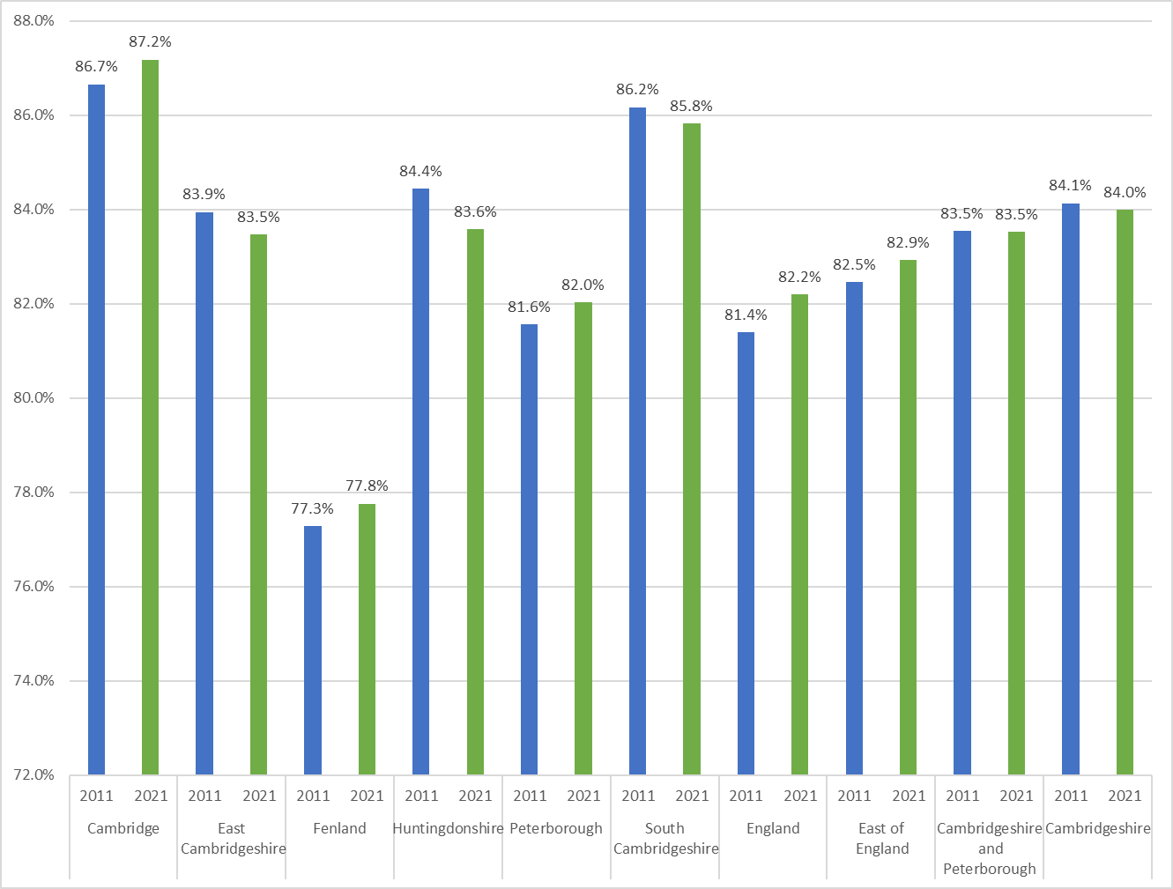
General Health (non age standardised): Good or Very Good 2011 – 2021, % of population
The lowest levels of good and very good health remain in Fenland despite a 0.5% increase from 2011 to 2021
Cambridge remains the area with the highest level of good or very good health and also saw a 0.5% increase.
Nowhere had a higher proportional increase than experienced in England.
Locally, Huntingdonshire saw the largest fall of 0.8% in good or very good health.

Slide 11
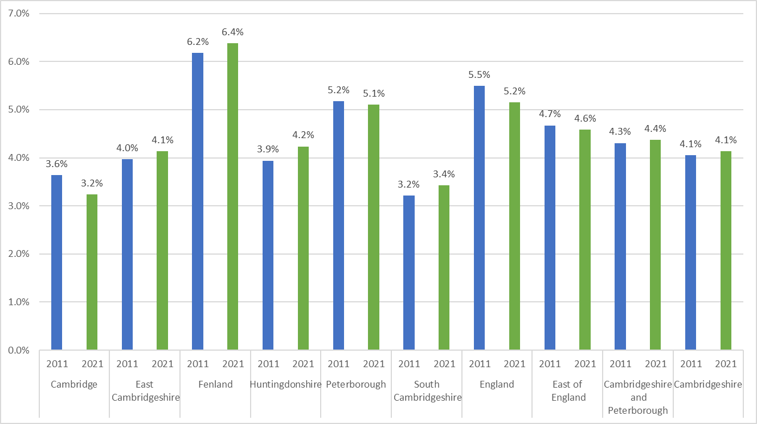
General Health (non age standardised): Bad or Very Bad 2011 – 2021, % of population
Fenland remained the area with the highest level of bad or very bad health reported rising from 6.2% to 6.4%.
Cambridge is now the area with the lowest proportion of reported bad or very bad health falling from 3.6% to 3.2%.
Peterborough was the only other area to see a small reduction in reported bad or very bad health from 5.2% to 5.1%.

Slide 12
General Health (Age Standardised) Headlines
‘Good or very good’ health is reported most highly in South Cambridgeshire (85.9%) and East Cambridgeshire (84%), this is higher than England (81.7%) and the East of England (82.9%).
The lowest level of ‘good or very good’ health is reported in Fenland (79%) and Peterborough (79.3%).
‘Bad or very bad’ health is highest at 6% in both Fenland and Peterborough. This is higher than England 5.3% and the East of England 4.6%.
‘Bad or very bad’ health is lowest in South Cambridgeshire (3.4%) and East Cambridgeshire (3.9%).

Slide 13
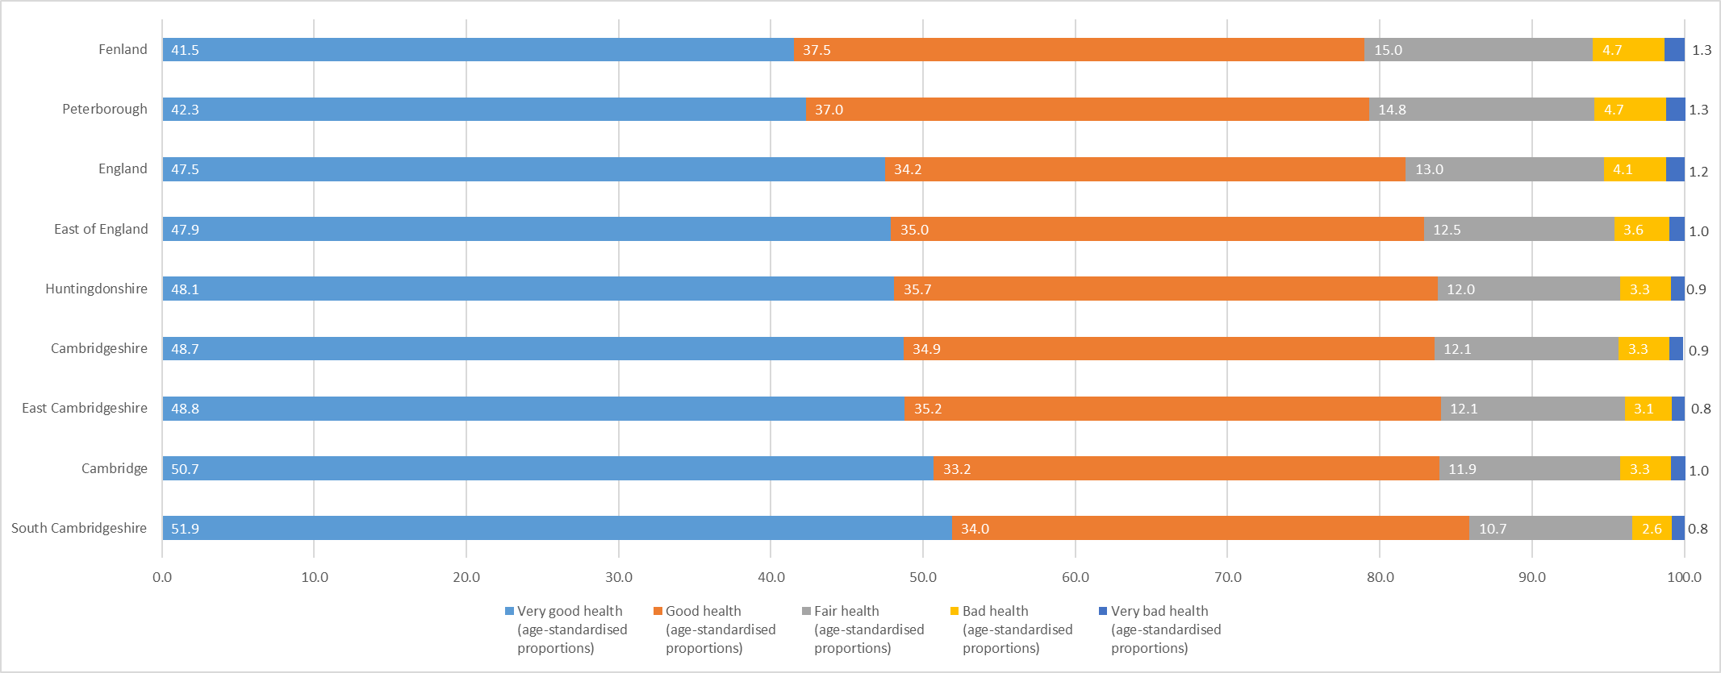
General Health – Age Standardised

Slide 14
Unpaid Care Headlines (Non age standardised)
Number and proportion of residents providing no unpaid care has risen from 2011 to 2021 across all areas of Cambridgeshire and Peterborough.
Breakdown of those providing unpaid care shows an unexpected increase in number of residents providing more hours of care in 2021 than in 2011.
These trends are seen in the East of England and nationally.
Unpaid Care | Cambridge 2011 | Cambridge 2021 | East Cambridgeshire 2011 | East Cambridgeshire 2021 | Fenland 2011 | Fenland 2021 | Huntingdonshire 2011 | Huntingdonshire 2021 | Peterborough 2011 | Peterborough 2021 | South Cambridgeshire 2011 | South Cambridgeshire 2021 | Cambridgeshire 2011 | Cambridgeshire 2021
Provides No unpaid care | 92.1% | 93.7% | 90.1% | 91.4% | 88.9% | 90.4% | 90.3% | 91.7% | 90.4% | 91.9% | 89.9% | 91.6% | 90.3% | 91.9%
Provides 1 to 19 hours unpaid care a week | 5.8% | 3.7% | 6.8% | 4.9% | 6.5% | 4.2% | 6.6% | 4.5% | 5.8% | 3.6% | 7.5% | 5.1% | 6.7% | 4.5%
Provides 20 to 49 hours unpaid care a week | 0.8% | 1.1% | 1.1% | 1.4% | 1.6% | 2.1% | 1.1% | 1.4% | 1.4% | 1.9% | 0.9% | 1.3% | 1.1% | 1.4%
Provides 50 or more hours unpaid care a week | 1.3% | 1.5% | 2.0% | 2.3% | 3.1% | 3.4% | 2.0% | 2.4% | 2.4% | 2.5% | 1.6% | 2.0% | 1.9% | 2.2%

Slide 15
Unpaid Care (Non age standardised) number of hours table
Unpaid Care | Cambridge 2011 | Cambridge 2021 | East Cambridgeshire 2011 | East Cambridgeshire 2021 | Fenland 2011 | Fenland 2021 | Huntingdonshire 2011 | Huntingdonshire 2021 | Peterborough 2011 | Peterborough 2021 | South Cambridgeshire 2011 | South Cambridgeshire 2021 | Cambridgeshire 2011 | Cambridgeshire 2021
Provides No Unpaid Care | 114090 | 130613 | 75529 | 76067 | 84668 | 87974 | 152983 | 157021 | 165941 | 185265 | 133764 | 140468 | 561034 | 592143
Provides 1 to 19 hours unpaid care a week | 7146 | 5151 | 5725 | 4079 | 6154 | 4046 | 11150 | 7645 | 10732 | 7313 | 11138 | 7869 | 41313 | 28790
Provides 20 to 49 hours unpaid care a week | 1042 | 1523 | 927 | 1185 | 1496 | 1998 | 1911 | 2466 | 2616 | 3853 | 1409 | 1998 | 6785 | 9170
Provides 50 or more hours unpaid care a week | 1589 | 2040 | 1637 | 1912 | 2944 | 3272 | 3464 | 4040 | 4342 | 5078 | 2444 | 3012 | 12078 | 14276

Slide 16
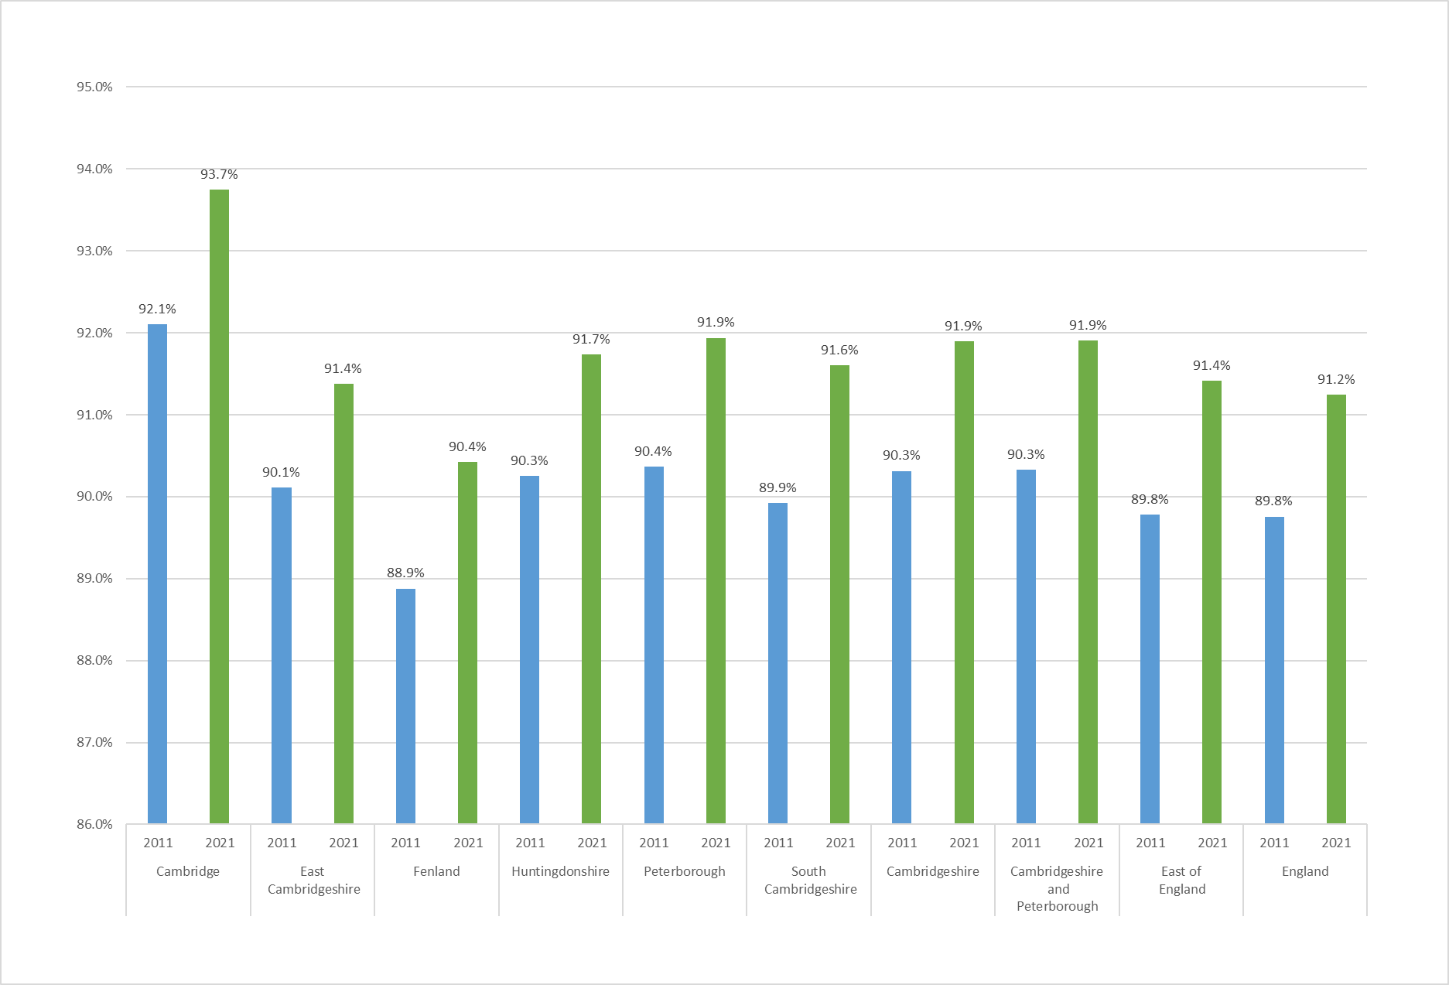
% of Residents that provide no Unpaid Care 2011-2021
All areas have a higher proportion of residents not providing any unpaid care.
Cambridgeshire and Peterborough (91.9%) are higher than the East of England (91.4%) and England (91.2%).
Cambridge (93.7%) has the highest level of residents providing no unpaid care, above the Cambridgeshire average of 91.9%. Fenland (90.4%) has the lowest.

Slide 17
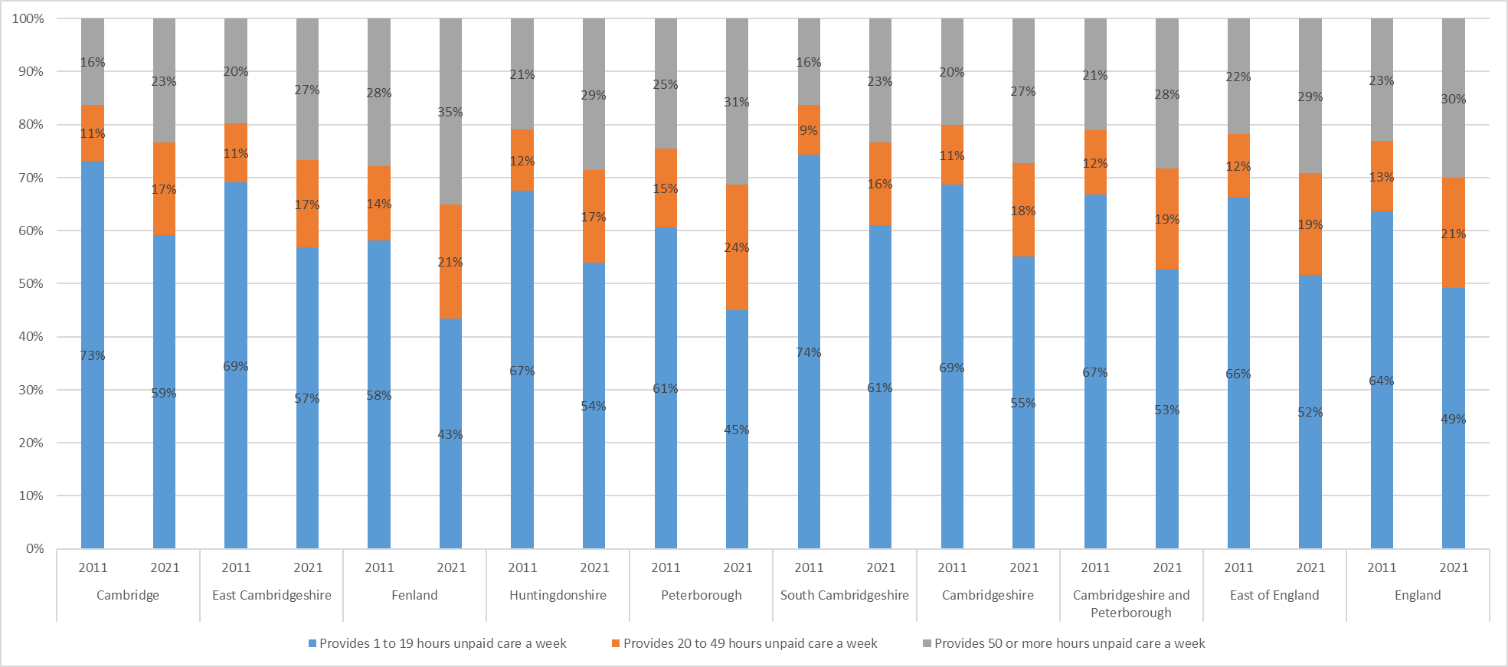
Of those that provide unpaid care:
All areas have seen the distribution of unpaid care skew toward a higher number of hours of unpaid care being provided from 2011 to 2021.
Peterborough (55%) and Fenland (56%) are the two areas with the highest proportions of residents providing more than 20 hours of unpaid care per week.

Slide 18
Unpaid Care: distribution skew
The previous slides showed that among residents that provide unpaid care, there has been an unexpected proportional distribution shift between 2011 and 2021 away from lower numbers of hours to higher numbers of hours being provided. The following points could explain why this has happened;
coronavirus guidance on reducing travel and limiting visits to people from other households
unpaid carers who previously shared caring responsibilities may have taken on all aspects of unpaid care because of rules on household mixing during the coronavirus pandemic
there were a higher number of deaths than expected in the older population at the beginning of 2021 due to coronavirus (COVID-19) and other causes; this could have led to a reduction in the need for unpaid care
changes in the question wording between 2011 and 2021 may have had an impact on the number of people who self-reported as unpaid carers
Unpaid care, England and Wales - Office for National Statistics (ons.gov.uk)

Slide 19
Unpaid care hours: question change between 2011 - 2021
Note: Census 2021 asked "Do you look after, or give any help or support to, anyone because they have long-term physical or mental health conditions or illnesses, or problems related to old age?". People were asked to exclude anything they did as part of their paid employment. The wording of the question differs from the 2011 Census question, which began "Do you look after, or give any help or support to family members, friends, neighbours or others".
Unpaid care, England and Wales - Office for National Statistics (ons.gov.uk)

Slide 20
Disability
Comparability:
To identify disability in England and Wales, the Census asked people "Do you have any physical or mental health conditions or illnesses lasting or expected to last 12 months or more?". If they answered yes, a further question "Do any of your conditions or illnesses reduce your ability to carry out day-to-day activities?" was presented. The identification of disability differs from the 2011 Census question used, which asked "Are your day-to-day activities limited because of a health problem or disability which has lasted, or expected to last, at least 12 months?”.
The question changed in order to collect data that more closely aligned with the definition of disability in the Equality Act (2010). The Equality Act defines an individual as disabled if they have a physical or mental impairment that has a substantial and long-term negative effect on their ability to carry out normal day-to-day activities. The way we identify disabled people has therefore changed between 2011 and 2021 and this may have had an impact on the number of people identified as disabled. See Section 8: Measuring the data for more information on the question change.”
For this reason, this local summary has not compared the 2021 results to the 2011 results.

Slide 21
National headline
In England, the proportion of disabled people (age standardised*) decreased between censuses (from 19.3% in 2011 to 17.7% in 2021). However, there was an increase in the number of disabled people (from 9.4 million in 2011 to 9.8 million in 2021).
Note: The ONS produced national age standardised findings for the 2011 and 2021 census but there are no local age standardised findings for 2011 so we are not able to compare age standardised disability between censuses from this initial data release. The following data is not age standardised unless marked.
*Disability and age are closely related, with older people being more likely to be disabled. Age-standardised proportions (ASPs) account for different age structures in populations and are more appropriate than crude percentages when drawing comparisons over time and across areas

Slide 22
Upper tier headlines
Cambridgeshire and Peterborough have lower percentages of residents reporting as Disabled under the Equality Act against the East of England and England.
Cambridgeshire has a higher proportion of residents reporting as not disabled but with a long term physical or mental health condition but day to day activities are not limited (8%) than Peterborough (5.8%), East of England (7.2%) and England (6.8%).
Disability | Cambridgeshire number | Cambridgeshire % | Peterborough number | Peterborough % | Cambridgeshire and Peterborough number | Cambridgeshire and Peterborough % | East % | England %
Total: All usual residents | 678,849 | 100.0 | 215,673 | 100.0 | 894,522 | 100 | 100.0 | 100.0
Disabled under the Equality Act | 109,908 | 16.2 | 35,180 | 16.3 | 145,088 | 16.2% | 16.6 | 17.3
Disabled under the Equality Act: Day-to-day activities limited a lot | 40,853 | 6.0 | 14,875 | 6.9 | 55,728 | 6.2% | 6.6 | 7.3
Disabled under the Equality Act: Day-to-day activities limited a little | 69,055 | 10.2 | 20,305 | 9.4 | 89,360 | 10.0% | 10.0 | 10.0
Not disabled under the Equality Act | 568,941 | 83.8 | 180,493 | 83.7 | 749,434 | 83.8% | 83.4 | 82.7
Not disabled under the Equality Act: Has long term physical or mental health condition but day-to-day activities are not limited | 54,457 | 8.0 | 12,609 | 5.8 | 67,066 | 7.5% | 7.2 | 6.8
Not disabled under the Equality Act: No long term physical or mental health conditions | 514,484 | 75.8 | 167,884 | 77.8 | 682,368 | 76.3% | 76.1 | 75.9

Slide 23
District breakdown
Fenland has the highest proportion with 20.3% of residents reporting as disabled under the Equality Act, and it is the only district which is higher than the East of England and England averages.Cambridge and South Cambridgeshire have the lowest proportion with 14.7%.
Peterborough has the highest number of residents reporting as disabled with 35,180. East Cambridgeshire has the lowest number of residents reporting as disabled with 14,166.
Disability | Cambridge number | Cambridge % | East Cambridgeshire number | East Cambridgeshire % | Fenland number | Fenland % | Huntingdonshire number | Huntingdonshire % | Peterborough number | Peterborough % | South Cambridgeshire number | South Cambridgeshire %
Total: All usual residents | 145,674 | 100.0 | 87,762 | 100.0 | 102,462 | 100.0 | 180,832 | 100.0 | 215,673 | 100.0 | 162,121 | 100.0
Disabled under the Equality Act | 21,433 | 14.7 | 14,166 | 16.1 | 20,836 | 20.3 | 29,577 | 16.4 | 35,180 | 16.3 | 23,898 | 14.7
Disabled under the Equality Act: Day-to-day activities limited a lot | 7,162 | 4.9 | 5,227 | 6.0 | 9,046 | 8.8 | 11,048 | 6.1 | 14,875 | 6.9 | 8,370 | 5.2
Disabled under the Equality Act: Day-to-day activities limited a little | 14,271 | 9.8 | 8,939 | 10.2 | 11,790 | 11.5 | 18,529 | 10.2 | 20,305 | 9.4 | 15,528 | 9.6
Not disabled under the Equality Act | 124,241 | 85.3 | 73,596 | 83.9 | 81,626 | 79.7 | 151,255 | 83.6 | 180,493 | 83.7 | 138,223 | 85.3
Not disabled under the Equality Act: Has long term physical or mental health condition but day-to-day activities are not limited | 11,269 | 7.7 | 7,375 | 8.4 | 7,186 | 7.0 | 14,805 | 8.2 | 12,609 | 5.8 | 13,822 | 8.5
Not disabled under the Equality Act: No long term physical or mental health conditions | 112,972 | 77.6 | 66,221 | 75.5 | 74,440 | 72.7 | 136,450 | 75.5 | 167,884 | 77.8 | 124,401 | 76.7

Slide 24
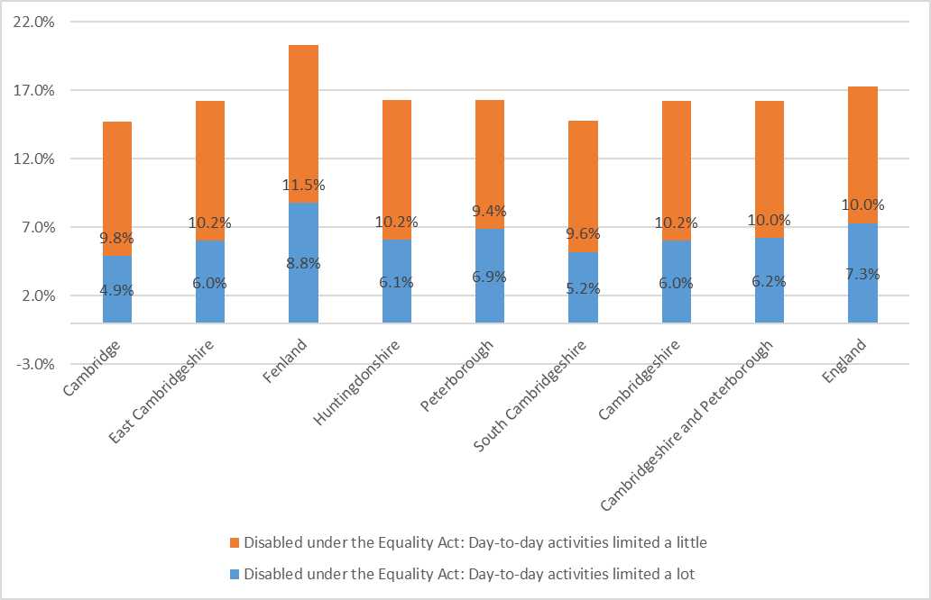
Disabled under the Equality Act: day to day activities limited a little / a lot %
Fenland has the highest proportion of residents reporting as being disabled. It also has the highest proportions in both ‘day to day activities limited a lot’ and ‘day to day activities limited a little’.

Slide 25
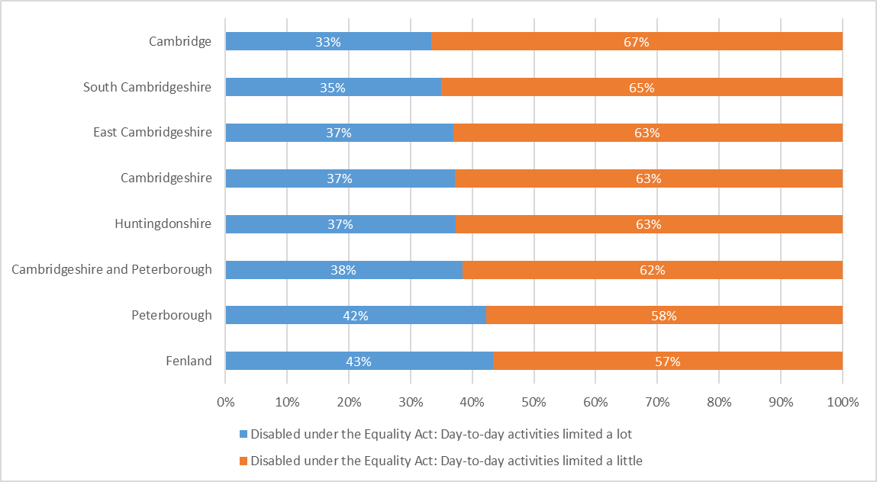
Of those with a disability
37% of disabled Cambridgeshire residents have their activities limited a lot.
Fenland has the largest proportion of its disabled population reporting that their activities are limited a lot.

Slide 26
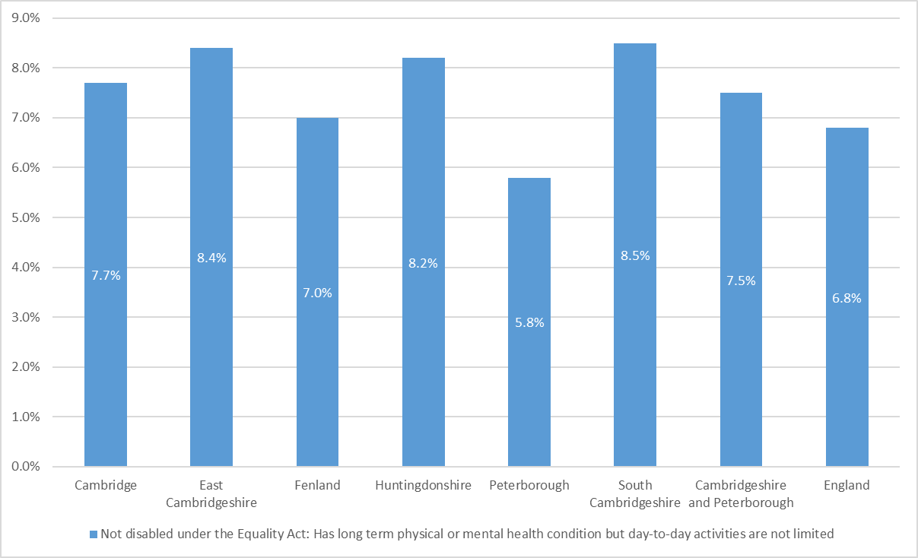
Not disabled under the Equality Act: Has long term physical or mental health condition but day-to-day activities are not limited %
There are those that are not disabled under the Equality Act definition but have long term physical or mental health conditions that do not affect their day to day activities.
South Cambridgeshire (8.5%) and East Cambridgeshire (8.4%) have the highest proportion of residents that are not disabled but have a long term physical or mental health condition.
Peterborough with 5.8% has the lowest.

Slide 27
Disability Headlines (Age Standardised)
In Cambridgeshire, 16.4% of residents report as being disabled, this is lower than East of England (16.6%) and England (17.7%).
South Cambridgeshire has the lowest proportion of residents reporting as disabled with 14.8%. East Cambridgeshire (15.9%) also has a lower proportion than the East of England and England.
Huntingdonshire (16.7%), Peterborough (18.3%) and Fenland (19.6%) have a higher proportion than the East of England and England.
Disability | Disabled under the Equality Act: Day-to-day activities limited a lot | Disabled under the Equality Act: Day-to-day activities limited a little | Not disabled under the Equality Act
Fenland | 8.4 | 11.2 | 80.5
Peterborough | 7.9 | 10.4 | 81.7
England | 7.5 | 10.2 | 82.3
Cambridge | 6.2 | 10.5 | 83.3
East of England | 6.6 | 10.0 | 83.4
Cambridgeshire | 6.1 | 10.3 | 83.6
Huntingdonshire | 6.1 | 10.2 | 83.7
East Cambridgeshire | 5.8 | 10.1 | 84.1
South Cambridgeshire | 5.1 | 9.7 | 85.2

Slide 28
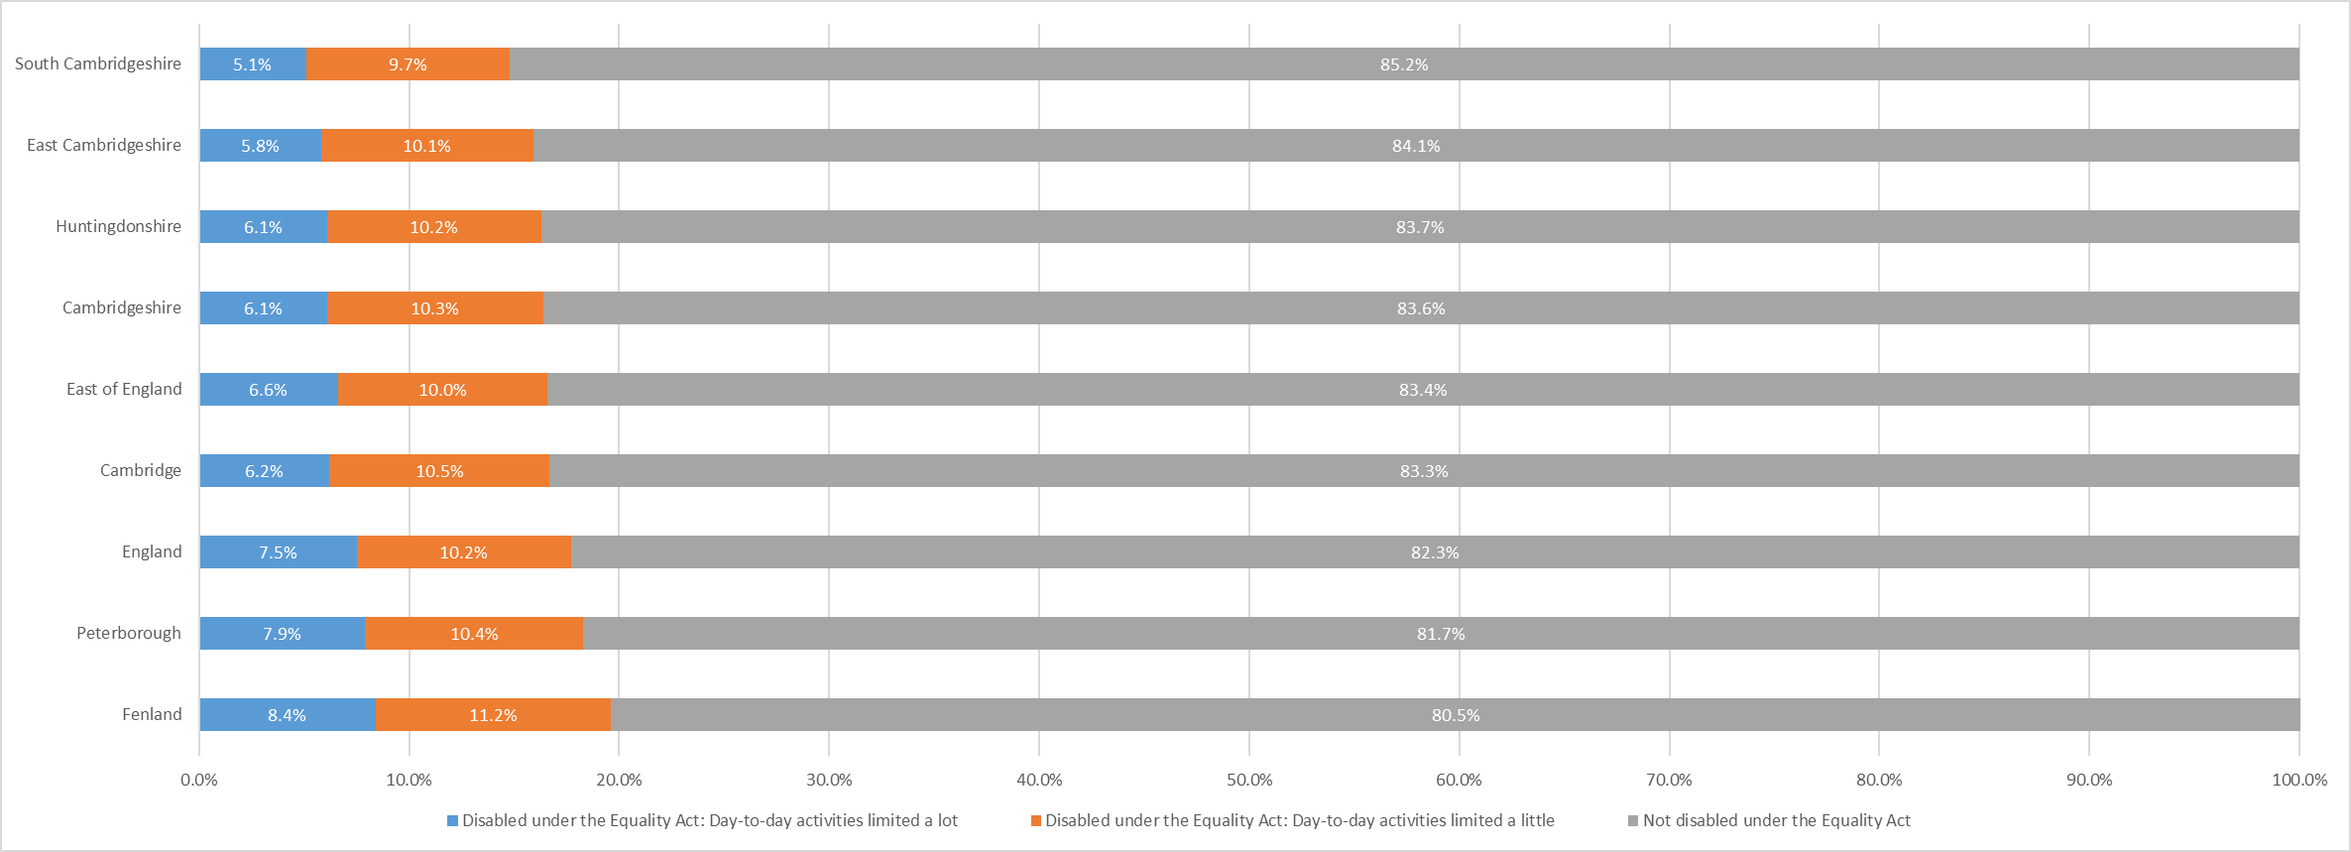
Disability (Age Standardised) %

Slide 29
Number of Disabled People in a Household
Disabled people in the household | Total: All households | Total: All households | No people disabled under the Equality Act in household | No people disabled under the Equality Act in household | 1 person disabled under the Equality Act in household | 1 person disabled under the Equality Act in household | 2 or more people disabled under the Equality Act in household | 2 or more people disabled under the Equality Act in household
Area | number | % | number | % | number | % | number | %
Fenland | 44,083 | 100.0 | 28,361 | 64.3 | 12,155 | 27.6 | 3,567 | 8.1
England | 23,436,085 | 100.0 | 15,928,198 | 68.0 | 5,950,081 | 25.4 | 1,557,806 | 6.6
Peterborough | 84,533 | 100.0 | 57,836 | 68.4 | 20,888 | 24.7 | 5,809 | 6.9
East | 2,628,782 | 100.0 | 1,816,840 | 69.1 | 644,288 | 24.5 | 167,654 | 6.4
Cambridgeshire and Peterborough | 26,064,867 | 100.0 | 17,745,038 | 69.6 | 6,594,369 | 24.1 | 1,725,460 | 6.3
Cambridgeshire | 277,634 | 100.0 | 194,134 | 69.9 | 66,561 | 24.0 | 16,939 | 6.1
East Cambridgeshire | 37,203 | 100.0 | 26,086 | 70.1 | 8,852 | 23.8 | 2,265 | 6.1
Huntingdonshire | 76,880 | 100.0 | 53,965 | 70.2 | 18,294 | 23.8 | 4,621 | 6.0
South Cambridgeshire | 66,996 | 100.0 | 48,056 | 71.7 | 15,367 | 22.9 | 3,573 | 5.3
Cambridge | 52,472 | 100.0 | 37,666 | 71.8 | 11,893 | 22.7 | 2,913 | 5.6
Cambridgeshire (30.1%) and Peterborough (31.6%) have a lower proportion of households with a disabled person resident than nationally (32%).
Fenland (35.7%) has the highest percentage of homes with at least one disabled person resident and is the only area higher than England.

Slide 30
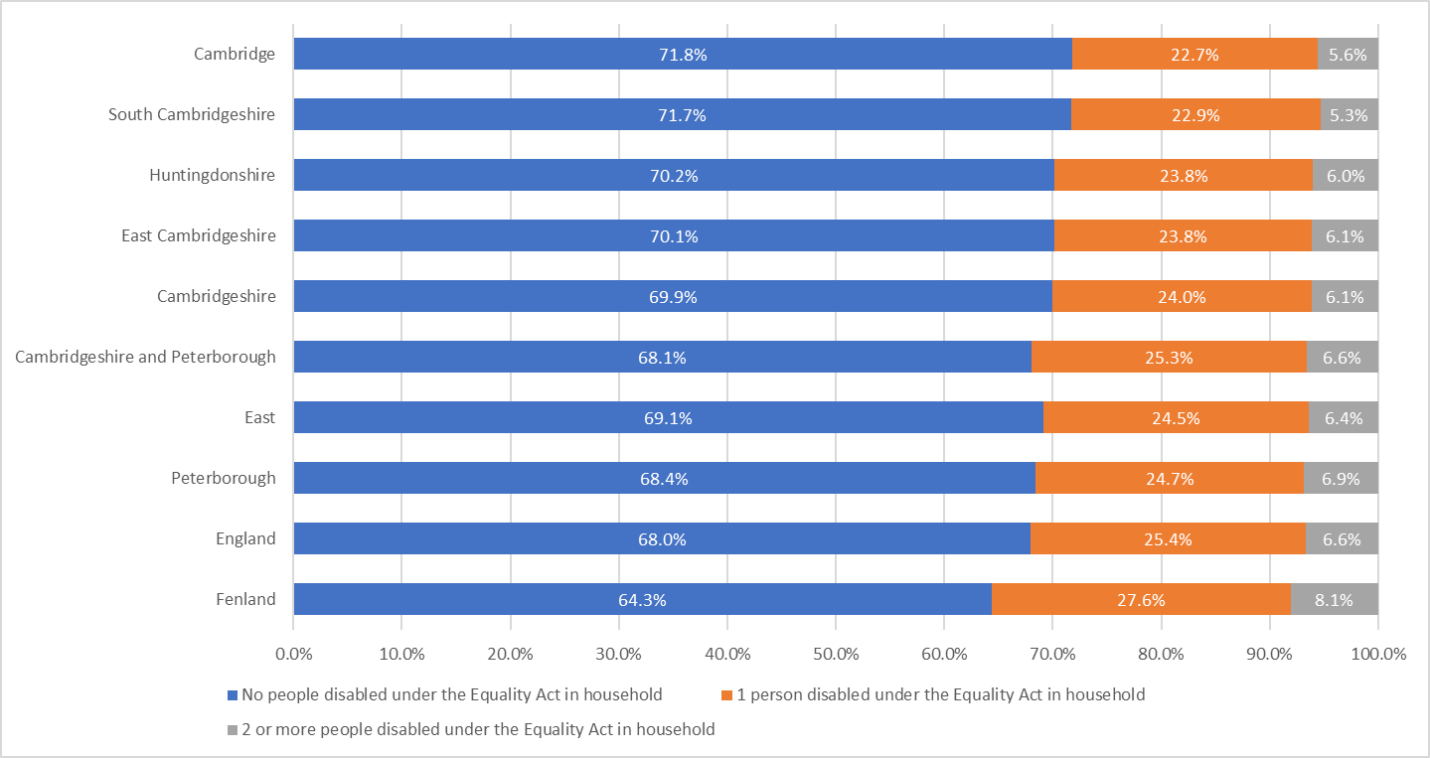
Number of disabled people in households
Fenland has the highest proportion of homes with at least 1 disabled person resident (35.7%).
Fenland is the only area with a higher proportion than England.

Slide 31
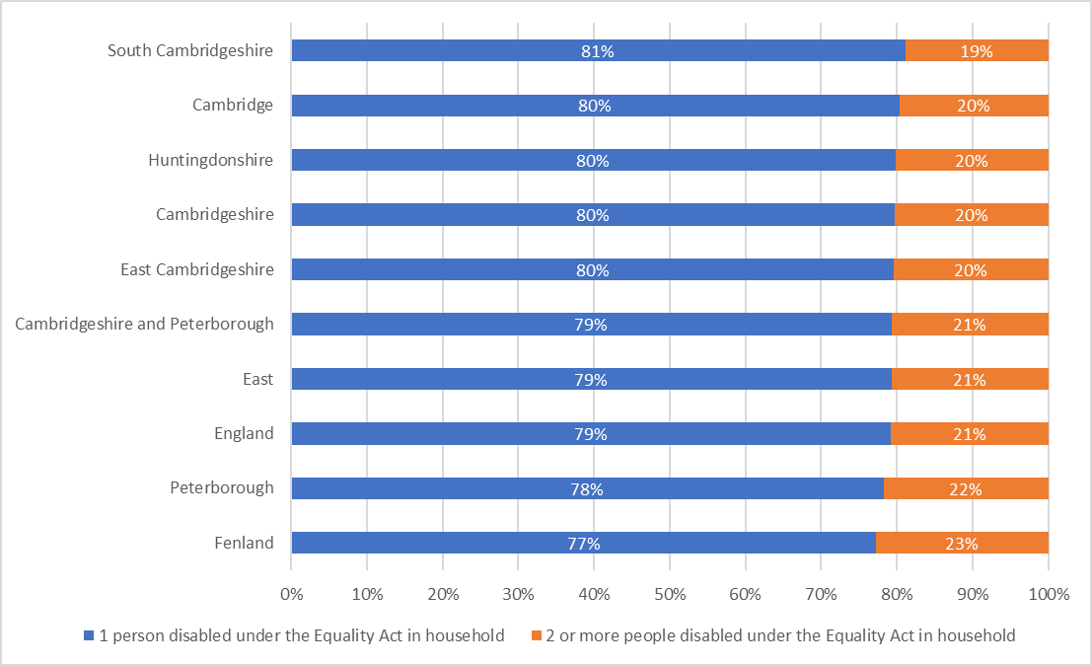
Households with a disabled person breakdown
Majority of disabled people live in households where they are the only disabled person under the equality act.
Fenland (23%) has the highest proportion of households with 2 or more disabled people.
South Cambridgeshire (19%) has the lowest proportion.

Slide 32
Census 2021: useful links
Census 2021 Cambridgeshire Insight – Population – Census 2021 webpages on Cambridgeshire Insight, including:
Census 2021 first results: published report, recorded presentation and dataset,
Census 2021 topic summaries: Cambridgeshire and Peterborough summaries and further resources available
Cambs Insight tools already have demography and migration datasets, and they will be updated with the release of each topic summary:
Map explorer
Data explorer
Census 2021 data published on the ONS website and on NOMIS
ONS tools:
Census maps
Area profiles – available on NOMIS at local authority level.
How your area has changed in 10 years: Census 2021

