Slide 1
Census 2021: Education Topic Summary
Overview for Cambridgeshire and Peterborough
Research Team, Business Intelligence
10th January 2023
Research.group@cambridgeshire.gov.uk

Slide 2
Themes
A first overview of some of the local authority level Cambridgeshire and Peterborough data from the Education topic summary published by the Office for National Statistics (ONS)
By local authority:
Highest level of qualification
Schoolchildren and full-time students

Slide 3
Definitions
The highest level of qualification is derived from the question asking people to indicate all qualifications held, or their nearest equivalent. This may include foreign qualifications where they were matched to the closest UK equivalent.
The types of qualification included in each level are:
Level 1 and entry level qualifications: 1 to 4 GCSEs grade A* to C , Any GCSEs at other grades, O levels or CSEs (any grades), 1 AS level, NVQ level 1, Foundation GNVQ, Basic or Essential Skills
Level 2 qualifications: 5 or more GCSEs (A* to C or 9 to 4), O levels (passes), CSEs (grade 1), School Certification, 1 A level, 2 to 3 AS levels, VCEs, Intermediate or Higher Diploma, Welsh Baccalaureate Intermediate Diploma, NVQ level 2, Intermediate GNVQ, City and Guilds Craft, BTEC First or General Diploma, RSA Diploma
Level 3 qualifications: 2 or more A levels or VCEs, 4 or more AS levels, Higher School Certificate, Progression or Advanced Diploma, Welsh Baccalaureate Advance Diploma, NVQ level 3; Advanced GNVQ, City and Guilds Advanced Craft, ONC, OND, BTEC National, RSA Advanced Diploma
Level 4 qualifications and above: degree (BA, BSc), higher degree (MA, PhD, PGCE), NVQ level 4 to 5, HNC, HND, RSA Higher Diploma, BTEC Higher level, professional qualifications (for example, teaching, nursing, accountancy)
Other qualifications: vocational or work-related qualifications, other qualifications achieved in England or Wales, qualifications achieved outside England or Wales (equivalent not stated or unknown)
Quality information: There are quality considerations about higher education qualifications, including those at Level 4+, responses from older people and international migrants, and comparability with 2011 Census data.
Comparability with 2011:
The structure and content of Census 2021 questions on qualifications largely differ from those in the 2011 Census. This means that differences in these estimates from the two censuses may partly represent real change and partly be because of the change in the way data was collected.
The new question structure and content for Census 2021 improved the estimated accuracy for highest level qualification however this may be because of online response. The structure and content of Census 2021 questions on qualifications largely differ from those in the 2011 Census. This means that differences in these estimates from the two censuses may partly represent real change and partly be because of the change in the way data was collected. Therefore, the highest qualification variable is not comparable with the 2011 census.
The number of residents recorded as having no qualifications is not affected by this comparability issue and therefore we have produced a chart comparing between the 2011 and 2021 Census for this category.

Slide 4
Definitions (Continued)
Usual resident population
Anyone in the UK and had stayed or intended to stay in the UK for a period of 12 months or more; or
Had a permanent UK address and was outside the UK and intended to be outside the UK for less than 12 months.
Schoolchild or full-time student
The usual resident population aged 5 years and over that were in full-time education on Census Day, 21 March 2021. This includes schoolchildren and adults in full-time education.
Schoolchildren and students in full-time education studying away from home are treated as usually resident at their term-time address.
Within this briefing for the Cambridgeshire and Peterborough region, we have avoided making comparisons to the equivalent Census 2011 dataset on schoolchildren and students (table KS101EW). This is because:
The Census 2011 dataset is based on the usual resident population aged 4 and above, while Census 2021 is based on the usual resident population aged 5 and above; and
The Census 2011 dataset counts schoolchildren and students at their non term-time address, while the Census 2021 dataset counts schoolchildren and students at their term-time address.

Slide 5
Highest Level of Qualification – Comparability with the 2011 Census
The structure and content of Census 2021 questions on qualifications largely differ from those in the 2011 Census. This means that differences in these estimates from the two censuses may partly represent real change and partly be because of the change in the way the data was collected.
For example, some people who hold an older or non-UK qualification when answering the question in Census 2021 may have chosen a higher qualification level than they did in the 2011 Census, although they hold the same qualifications.
The new question structure and content for Census 2021 improved the estimated accuracy for highest level qualification however this may be because of online response. The structure and content of Census 2021 questions on qualifications largely differ from those in the 2011 Census. This means that differences in these estimates from the two censuses may partly represent real change and partly be because of the change in the way we collected the data. Therefore, the highest qualification variable is not comparable with the 2011 census.
More information on the how the questions changed between the two census releases please read this article: Link
Within this briefing for the Cambridgeshire and Peterborough region we have avoided, in the most part, in making direct comparisons between the 2011 and 2021 census data. The only direct comparison we have made is in the proportion of the population reporting that they had no formal qualifications as the wording for selecting this option was the same between the two censuses.

Slide 6
Census 2021 headlines – Highest Level of Qualification
Level 4 and Above
In Cambridgeshire and Peterborough 37% (266,749) of normal residents aged 16 and over had Level 4 or above qualifications (for example, Higher National Certificate, Higher National Diploma, Bachelor's degree, and post-graduate qualifications). This was higher proportion than both the East of England (32%) and England (34%) as a whole.
Looking at individual local authorities these proportions were higher than England as a whole in Cambridge City where more than half of the 16+ population had a level 4 or above qualification (56%, 69,666), South Cambridgeshire (48%, 62,375) and East Cambridgeshire (35%, 25,007).
In all the other Cambridgeshire and Peterborough local authorities the proportions were lower than England as a whole. Fenland had the lowest proportion residents aged 16 and over who had a qualification level of 4 or above at 19% (16,152 residents).
No Qualifications
In Cambridgeshire and Peterborough 17% (121,744) of normal residents aged 16 and over had no formal qualifications. This was a lower proportion than both the East of England (18%) and England (18%) as a whole.
Looking at individual local authorities these proportions were higher than England in Fenland (26%, 21,889) and Peterborough (22%, 37,471).
In all other Cambridgeshire and Peterborough local authorities that proportions were lower than England as a whole and were lowest in Cambridge City (10%, 11,957) and South Cambridgeshire (12%, 15,409)
Compared to 2011, the proportion of 16+ residents who had no qualifications dropped by 3 percentage points from 20% to 17%, this is lower than both the East of England and England where it decreased by 5 percentage points (23% to 18% for both)
The proportion of residents aged 16+ with no qualifications decreased in each local authority, with the largest decrease being in Fenland from 31% to 26%, 5 percentage points.

Slide 7
Census 2021 headlines – schoolchildren and full-time students
In Cambridgeshire and Peterborough 21.3% (180,372) of usual residents aged 5 and above were schoolchildren or full-time students, higher than both the England (20.4%) and East of England (19.4%) averages.
At district level, Cambridge has both the highest number (46,205) and proportion (33.2%) of residents aged 5 and above that were schoolchildren or full-time students.
Peterborough was also above the England and East of England averages with 21.8% (43,896) residents aged 5 and above being schoolchildren or full-time students.
The remaining local authorities in Cambridgeshire had proportions below the England average (20.4%), while only South Cambridgeshire was above the East of England average (19.4%).

Slide 8
Index
Cambridgeshire and Peterborough
Highest Level of Qualification – District and Unitary Charts
Cambridge
East Cambridgeshire
Fenland
Huntingdonshire
South Cambridgeshire
Peterborough

Slide 9
Cambridgeshire and Peterborough

Slide 10
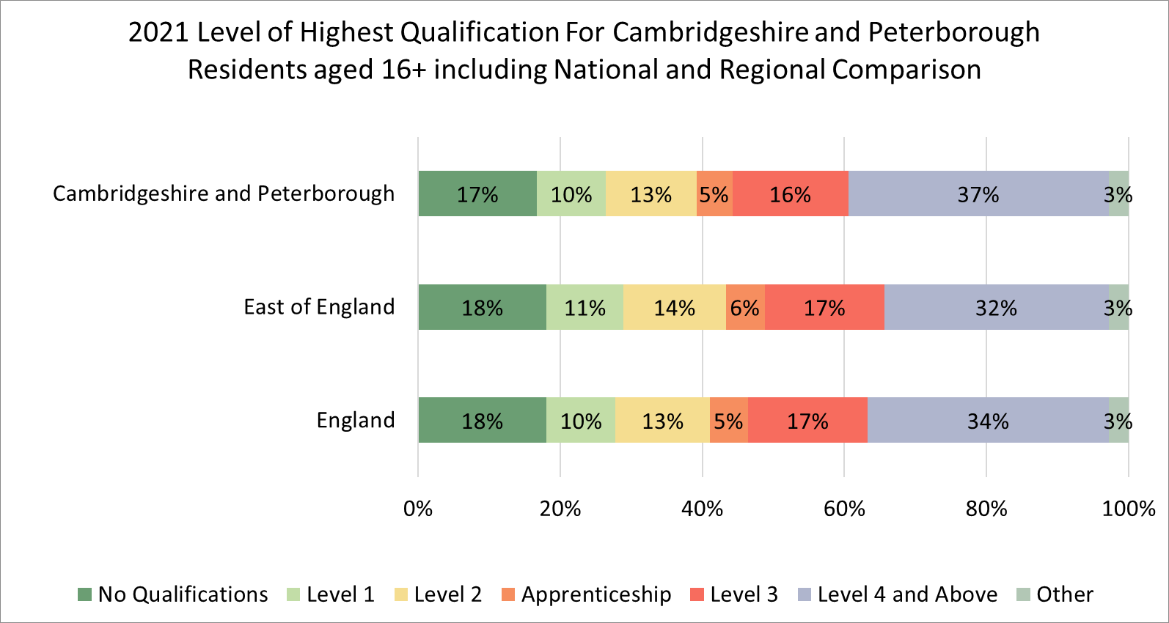
Highest level of qualification

Slide 11
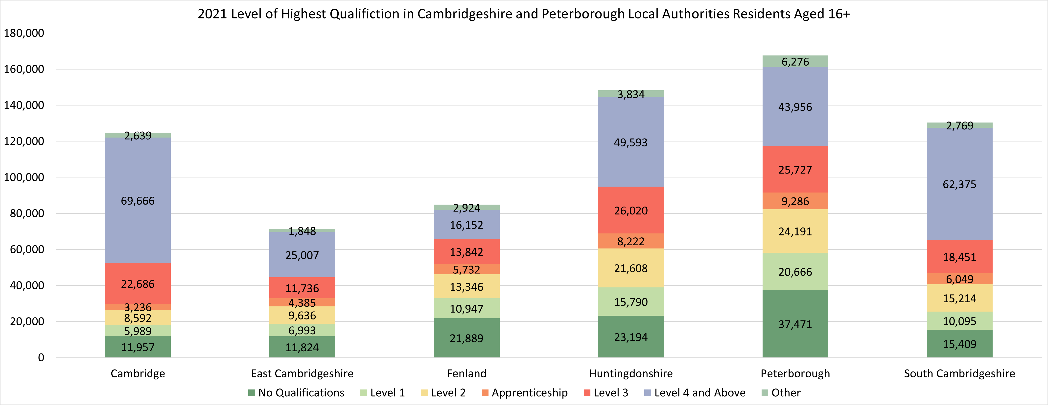
Highest level of qualification

Slide 12
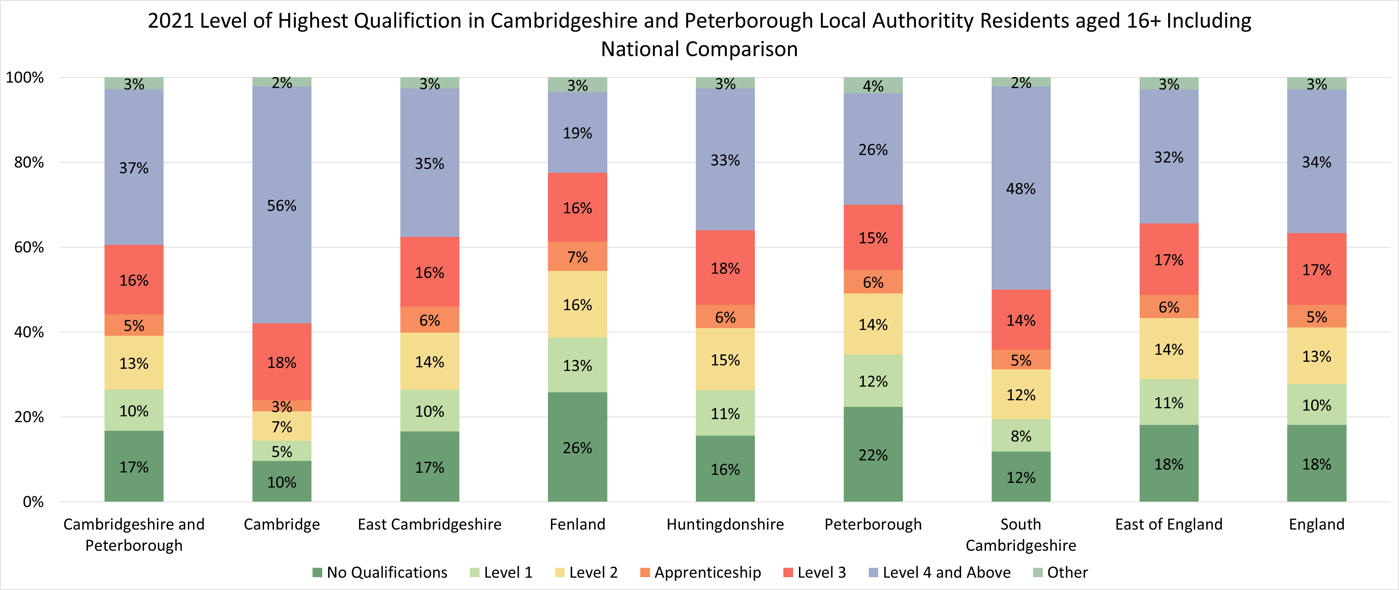
Highest level of qualification

Slide 13
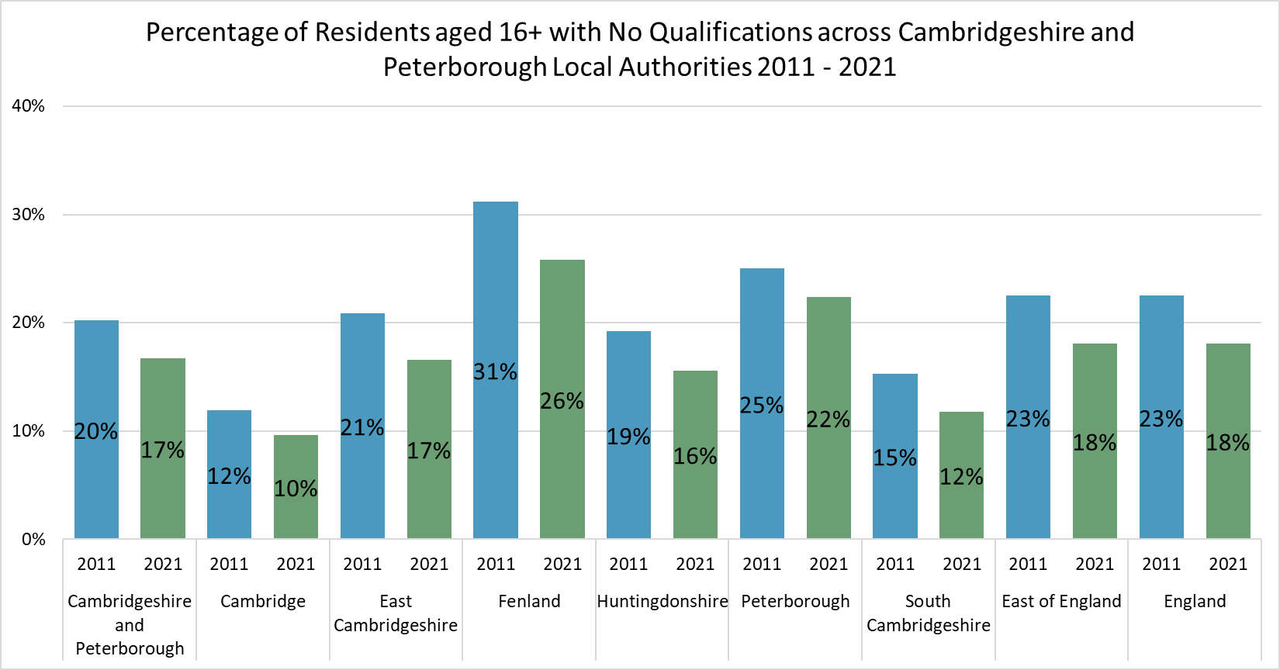
Highest level of qualification - No Qualifications 2011 to 2021 Comparison
Compared to 2011, the proportion of 16+ residents who had no qualifications dropped by 3 percentage points from 20% to 17%, this is lower than both the East of England and England where it decreased by 5 percentage points (23% to 18% for both)
The proportion of residents aged 16+ with no qualifications decreased in each district/unitary local authority, with the largest decrease being in Fenland from 31% to 26%, 5 percentage points.
Please note – This is the only comparison we have made between the 2011 and 2021 data as the wording for selecting this option was broadly the same between the two censuses. For more details on comparability please read the explanation on slide 5 - Link

Slide 14
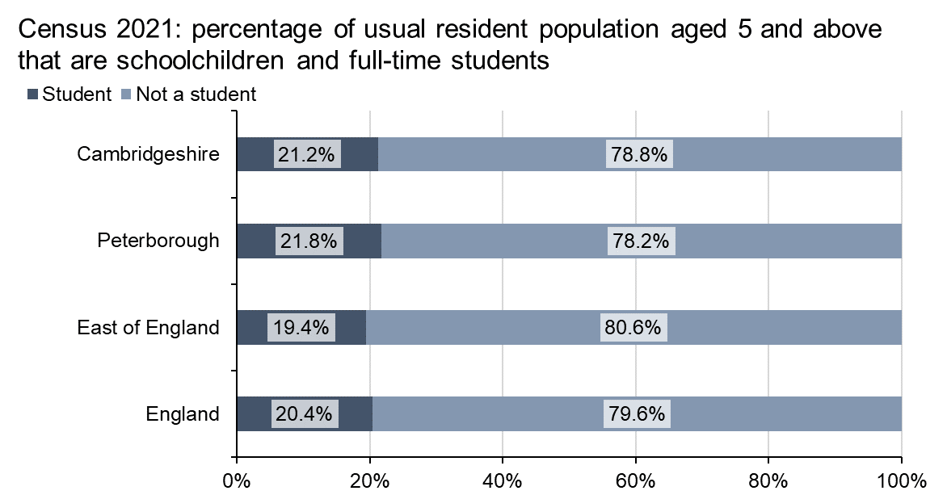
Cambridgeshire and Peterborough- schoolchildren and full-time students
In Cambridgeshire, there were 136,476 schoolchildren and full-time students, which is 21.2% of Cambridgeshire’s usual resident population aged 5 and above.
In Peterborough, there were 43,896 schoolchildren and full-time students, which is 21.8% of Peterborough’s usual resident population aged 5 and above.
Both Cambridgeshire and Peterborough have a higher proportion of their population that are schoolchildren and full-time students than England (20.4%) and the East of England (19.4%).

Slide 15
Cambridgeshire and Peterborough- schoolchildren and full-time students by district
At a district level, Cambridge has the highest number of schoolchildren and full-time students with 46,205, as well as the highest proportion of the total population aged 5 and over at 33.2%.
Peterborough is also above the East of England and England averages, with 21.8% the population aged 5 and above being schoolchildren or full-time students.
The proportions for the remaining districts ranges between 16.2% in Fenland to 19.6% in South Cambridgeshire, which are all below the England average. Only South Cambridgeshire is above the East of England average of 19.4%.
Local authority | Schoolchildren and full-time students (aged 5 and above) | Total population (aged 5 and above) | Percentage of total population
Cambridge | 46,205 | 139,327 | 33.2%
East Cambridgeshire | 14,966 | 83,243 | 18.0%
Fenland | 15,783 | 97,290 | 16.2%
Huntingdonshire | 29,428 | 171,172 | 17.2%
South Cambridgeshire | 30,094 | 153,347 | 19.6%
Peterborough | 43,896 | 201,510 | 21.8%
East of England | 1,159,811 | 5,985,931 | 19.4%
England | 10,920,505 | 53,413,097 | 20.4%

Slide 16
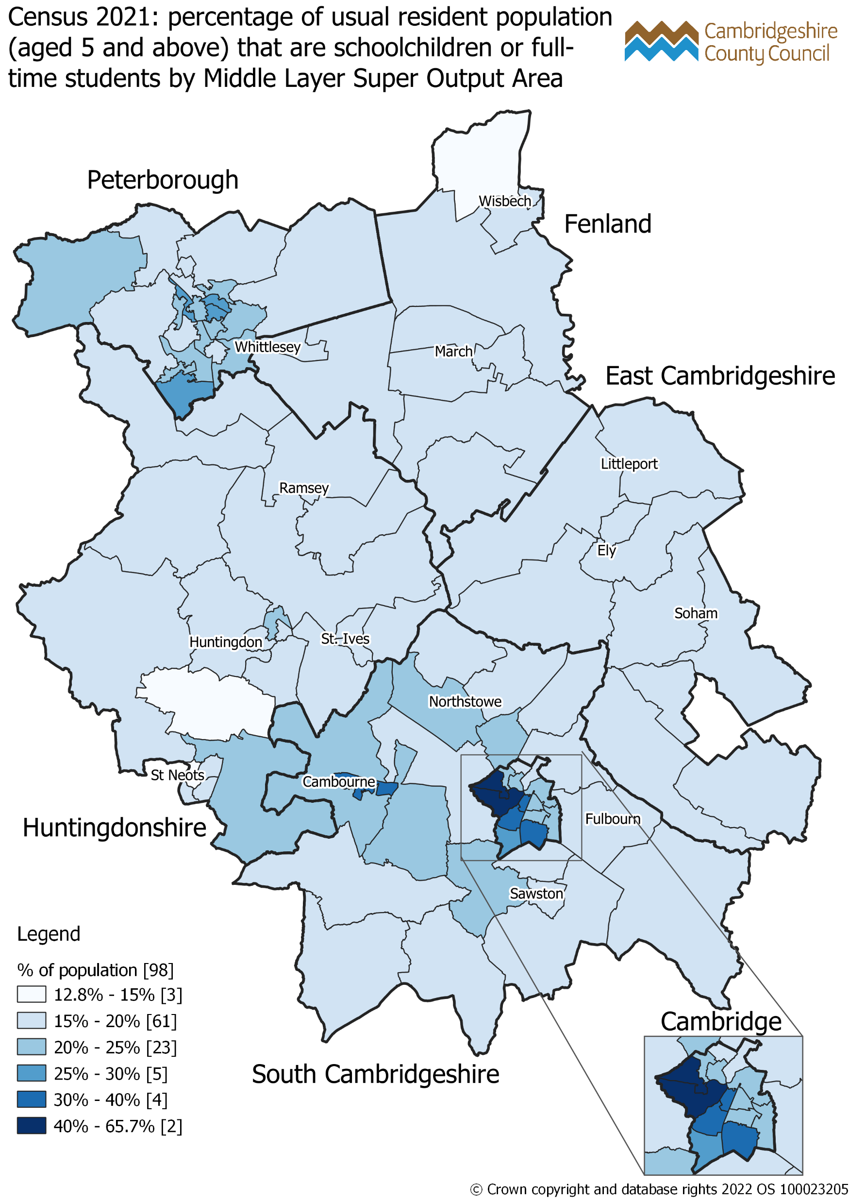
Census 2021: percentage of usual resident population (aged 5 and above) that are schoolchildren and full-time students by Middle Layer Super Output Area (MSOA)
The percentage of the population aged 5 and above that are schoolchildren and full-time students ranges between 12.8% to 25% for most MSOAs in Cambridgeshire and Peterborough.
MSOAs where a higher percentage of the population are schoolchildren or students are mostly concentrated in Cambridge, notably in Eddington & Castle MSOA and Central & West Cambridge MSOA where 60.9% and 65.7% of the population are schoolchildren and students respectively.

Slide 17
District and Unitary Local Authorities – Highest Level of Qualification

Slide 18
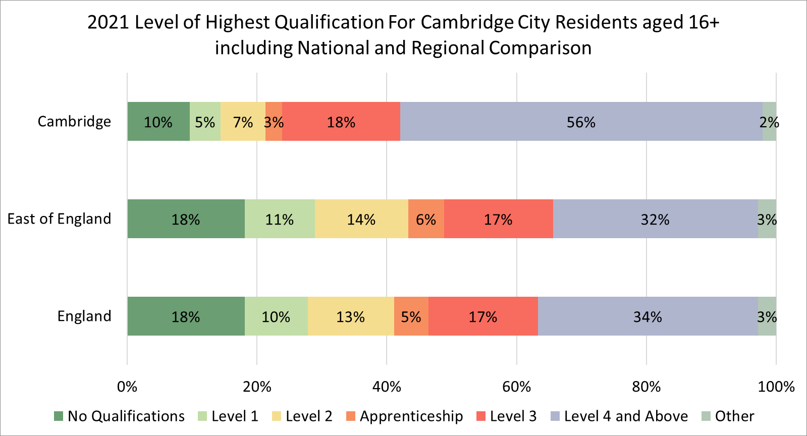
Cambridge - Highest level of qualification

Slide 19
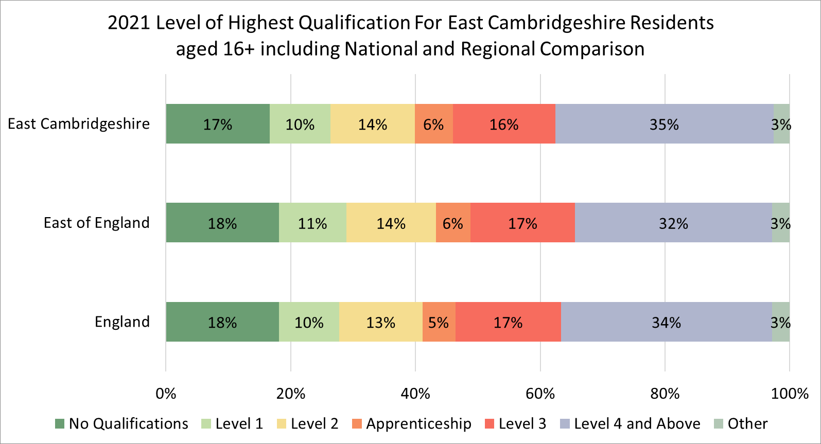
East Cambridgeshire - Highest level of qualification

Slide 20
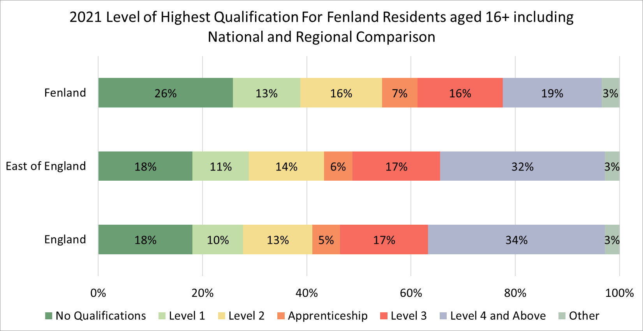
Fenland - Highest level of qualification

Slide 21
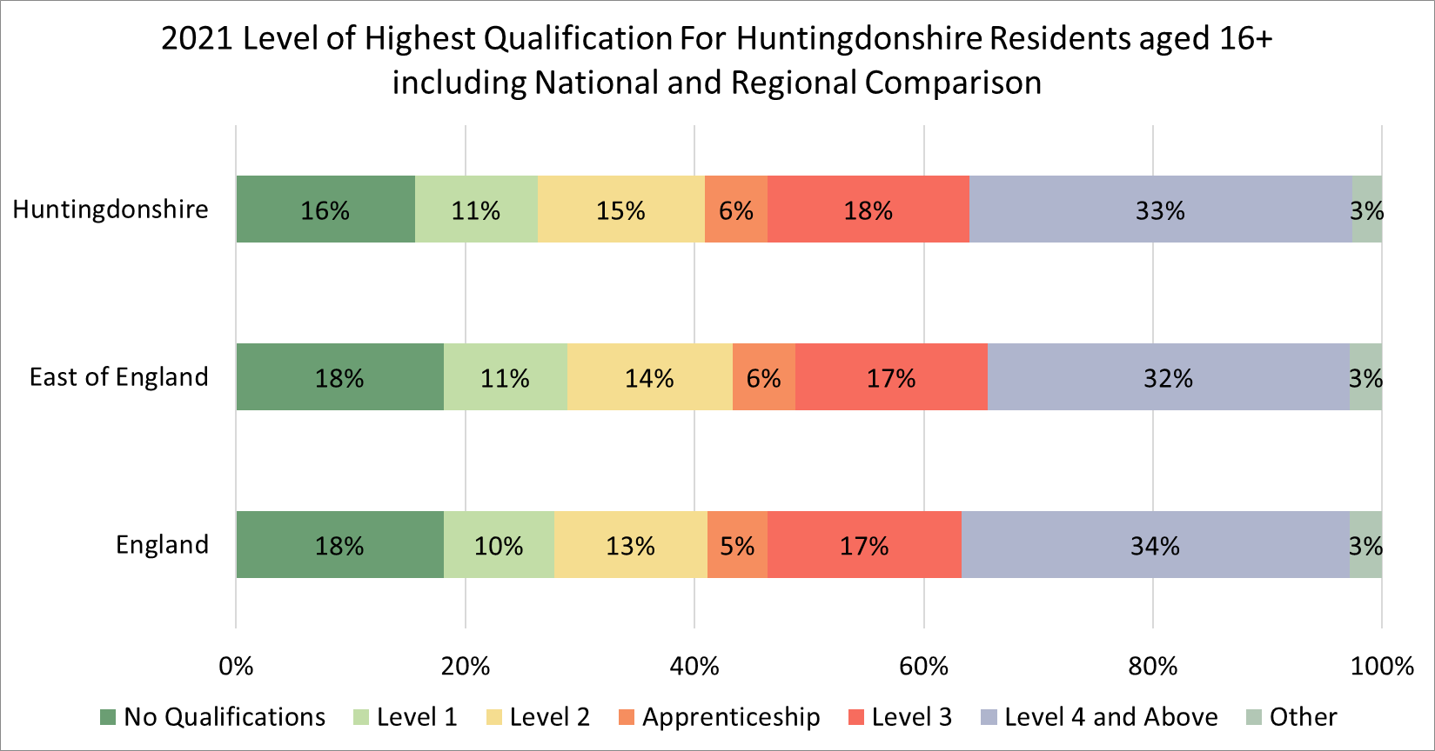
Huntingdonshire - Highest level of qualification

Slide 22
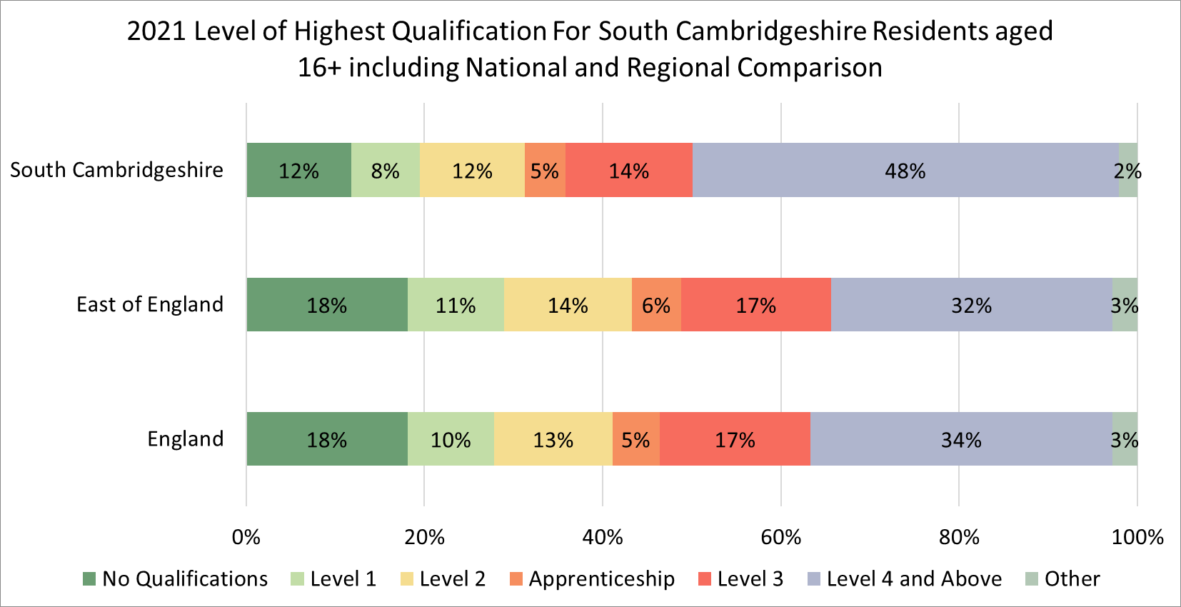
South Cambridgeshire - Highest level of qualification

Slide 23
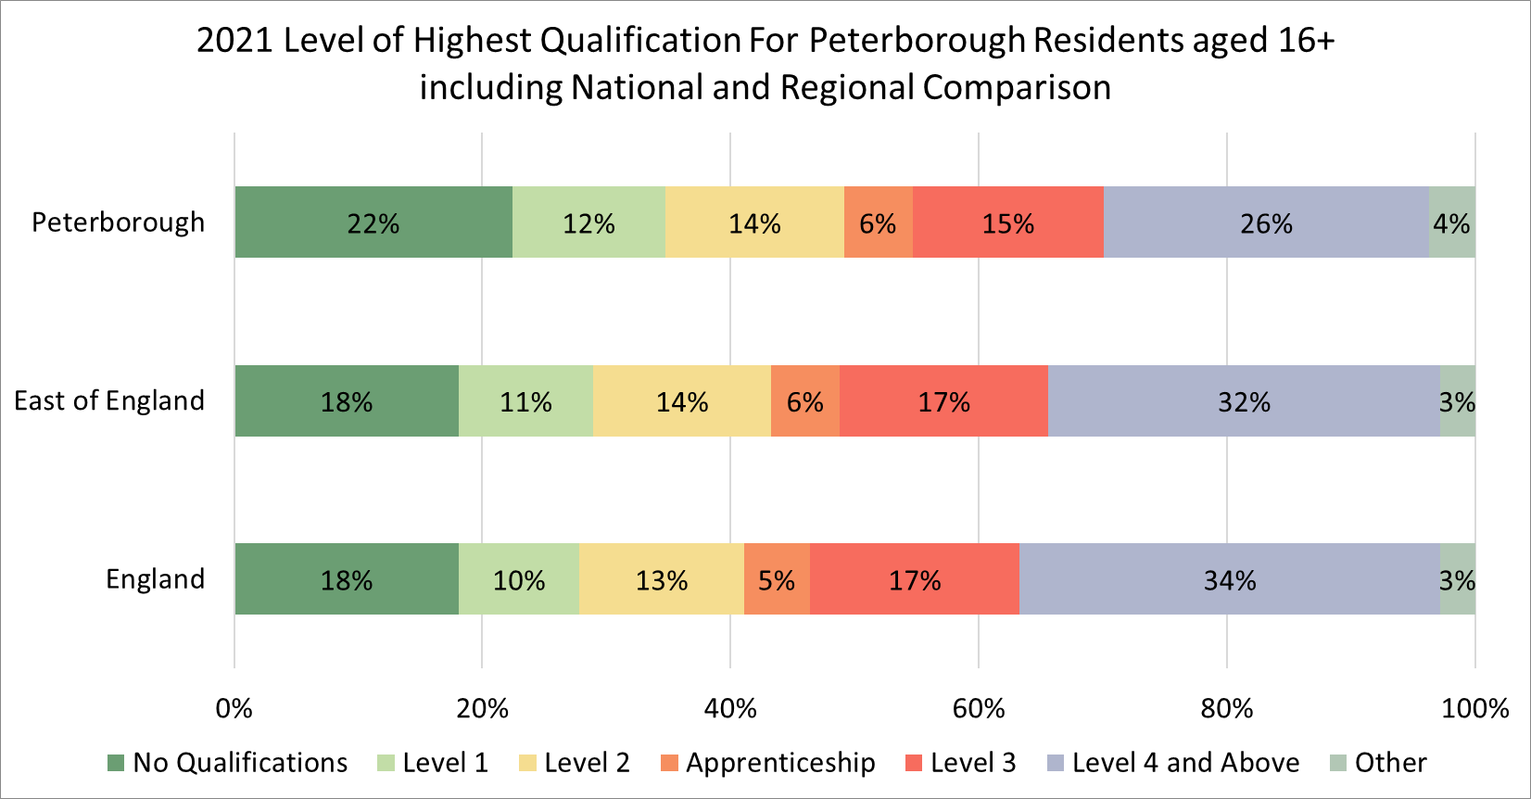
Peterborough - Highest level of qualification

Slide 24
When is the next release of data by the ONS?
8 topic summaries and area profiles, releasing between November 2022 and January 2023:
Demography and migration – 2nd November 2022 (published)
UK armed forces veterans – 10th November 2022 (published)
Ethnic group, national identity, language and religion – 29th November 2022 (published)
Labour market and travel to work – 8th December 2022 (published)
Housing – 5th January 2023 (published)
Sexual orientation and gender identity – 6th January 2023 (published)
Education – 10th January 2023 (published)
Health, disability, and unpaid care – 19th January 2023 (confirmed)
Phase 2, early 2023 – multivariate data Some multivariate data by age and sex is expected to be published across January 2023 this includes
Ethnic group by age and sex – 23rd January 2023 (confirmed)
Gender identity by age and sex – 25th January 2023 (confirmed)
Sexual orientation by age and sex – 25th January 2023 (confirmed)
Religion by age and sex – 30th January 2023 (confirmed)
Phase 3, Spring 2023 - data related to alternative population bases, small population data, origin destination data and micro-data

Slide 25
Useful links
Education topic summary published by the Office for National Statistics (ONS) Education: Census 2021 in England and Wales - Office for National Statistics
ONS mapping tool ONS Census maps
Cambridgeshire Insight: Census 2021 updates and Cambridgeshire Insight Census 2021
Census 2021 data in the tools available on Cambridgeshire Insight, such as the Map Explorer and Interactive Reports
Further analysis and ward level estimates, where possible at this stage, are being progressed and will be published on Cambridgeshire Insight
Census data published by the ONS is also available on the Nomis website Dataset Selection - Query - Nomis - Official Census and Labour Market Statistics (nomisweb.co.uk)

