Slide 1
Census 2021: Sexual Orientation and Gender Identity summary for Cambridgeshire and Peterborough
18/01/2023
Research Team, Business Intelligence
Research.Group@cambridgeshire.gov.uk

Slide 2
Themes covered
A first overview of some of the local authority and MSOA level Cambridgeshire and Peterborough data from the sexual orientation and gender identity topic summary published by the Office for National Statistics (ONS)
Sexual orientation and gender identity: Census 2021 in England and Wales - Office for National Statistics (ons.gov.uk)
By local authority and MSOA:
Usual resident population aged 16 years and over by sexual orientation
Usual resident population aged 16 years and over by gender identity

Slide 3
Data and definitions
This is the first census in which this data has been collected
The ONS states that the data will help to provide better quality information
for monitoring purposes,
to support anti-discrimination duties
to aid allocation for resources and policy development.
The questions on sexual orientation and gender identity were voluntary and only asked of people aged 16 years and over
Sexual orientation: is an umbrella term covering sexual identity, attraction, and behaviour. For an individual respondent, these may not be the same. For example, someone in an opposite-sex relationship may also experience same-sex attraction, and vice versa. This means the statistics should be interpreted purely as showing how people responded to the question, rather than being about whom they are attracted to or their actual relationships
Gender identity: refers to a person’s sense of their own gender, whether male, female or another category such as non-binary. This may or may not be the same as their sex registered at birth

Slide 4
Sexual orientation
In all districts the proportions of the population aged 16 years and over responding that they are asexual, bisexual, gay or lesbian, pansexual, queer, or other sexual orientation apart from straight or heterosexual, were generally very similar to national averages, apart from
in Cambridge a greater proportion of the population aged 16 years and over responded that they are bisexual, 3.8% compared to the England average of 1.3%, and gay or lesbian, 2.7% compared to the England average of 1.5%
in all other districts and in Peterborough 1.1% responded as gay or lesbian, apart from Huntingdonshire where the proportion was 1.3%
The proportion of the population aged 16 years and over responding that they are straight or heterosexual in Cambridgeshire, 88.3%, and Peterborough, 89.2%, was just slightly below the East of England, 90.2% and England, 89.4%, averages
In Cambridge the proportion was much lower at 80.6%
compared to a range of 90.0% (Fenland, South Cambridgeshire) to 91.1% (Huntingdonshire) in the other districts of Cambridgeshire

Slide 5
Sexual orientation: proportions choosing not to answer
Nationally, 7.5% of the population aged 16 years or over chose not to answer the sexual orientation question
the East of England average was slightly lower at 7.2%
slightly higher proportions of the population in both Cambridgeshire, 8.0% (44,828 residents), and Peterborough, 8.1% (13,565 residents), chose not to answer the question
in Cambridgeshire, Cambridge had the highest proportion, at 11.9% (14,860 residents), and Huntingdonshire the lowest proportion, at 6.2% (9,198 residents), of residents choosing not to answer the sexual orientation question

Slide 6
Sexual Orientation by percentage of population aged 16 years and over, Census 2021
Sexual Orientation | England | East of England | Cambridgeshire | Peterborough
Asexual | 0.1% | 0.1% | 0.1% | 0.1%
Bisexual | 1.3% | 1.1% | 1.8% | 1.2%
Gay or lesbian | 1.5% | 1.2% | 1.5% | 1.1%
Pansexual | 0.2% | 0.2% | 0.2% | 0.3%
Queer | <0.1% | <0.1% | 0.1% | <0.1%
Straight or heterosexual | 89.4% | 90.2% | 88.3% | 89.2%
All other sexual orientations | <0.1% | <0.1% | <0.1% | <0.1%
Not answered | 7.5% | 7.2% | 8.0% | 8.1%

Slide 7
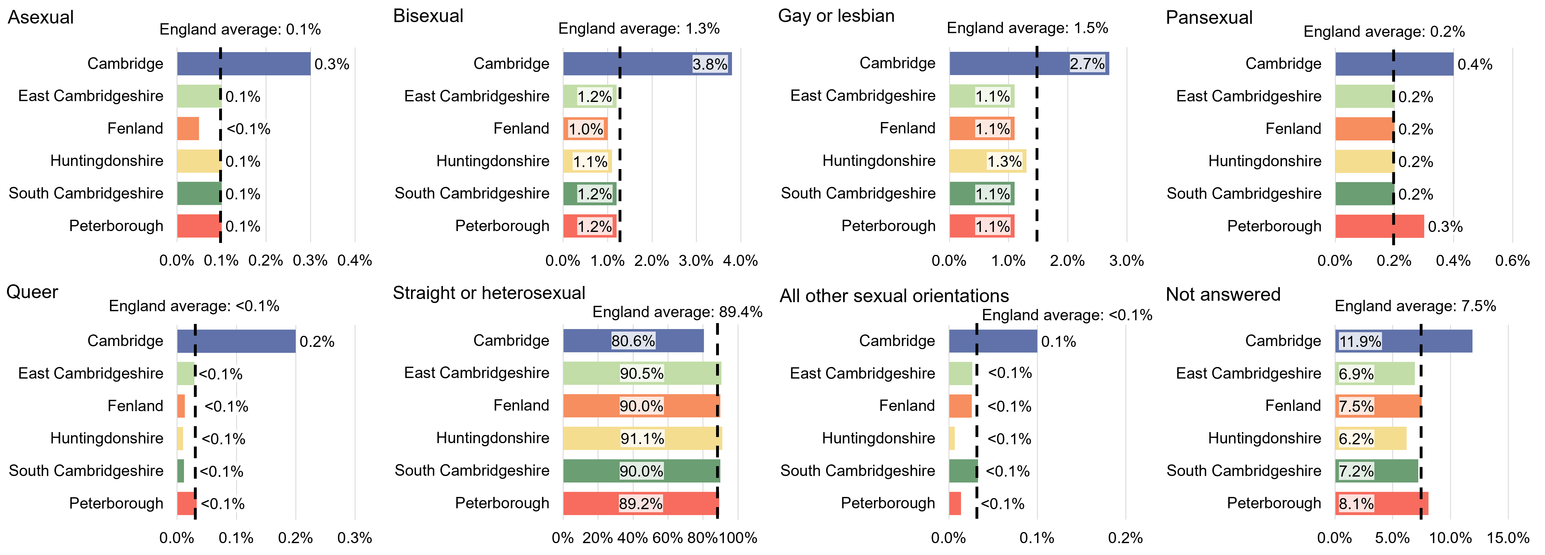
Cambridgeshire and Peterborough: per cent of population aged 16 years and over by sexual orientation, Census 2021

Slide 8
Gender identity
In Cambridgeshire the proportions of the population aged 16 years and over identifying with the different gender identity groups were very similar to the East of England and England averages
the greatest differences are in Cambridge, where 89.7% identified their gender as the same as their sex registered at birth compared to a range of 93.1%, Fenland, to 94.9%, Huntingdonshire, in the other districts of Cambridgeshire and compared to the East of England, 93.9%, and England, 93.5%, averages
in Fenland, 0.4% identified their gender as different to their sex registered at birth without giving their specific identity compared to the Cambridgeshire average, 0.1%, and the East of England and England averages of 0.2%
In Peterborough a slightly lower proportion, 92.0%, identified their gender as the same as their sex registered at birth, compared to the East of England, 93.9%, and England, 93.5%, averages
a slightly higher proportion, 0.6%, identified their gender as different from their sex registered at birth without giving their specific identity compared to the East of England and England averages of 0.2%

Slide 9
Gender identity: proportions choosing not to answer
Nationally 6.0% of the population aged 16 years and over chose not to answer the question on gender identity
the East of England average was slightly lower at 5.6%
In Cambridgeshire a slightly higher proportion of the population, 6.2% (34,488 residents), chose not to answer the question on gender identity
in Cambridge it was much higher at 9.3% (11,582 residents)
elsewhere in Cambridgeshire proportions ranged between 4.7% (6,989 residents) Huntingdonshire, and 6.3% (5,325 residents) Fenland
A higher proportion in Peterborough, 7.1% (11,896 residents), also chose not to answer the question

Slide 10
Gender Identity by percentage of population aged 16 years and over, Census 2021
Gender identity | England | East of England | Cambridgeshire | Peterborough
Gender identity different from sex registered at birth but no specific identity given | 0.2% | 0.2% | 0.2% | 0.6%
Gender identity the same as sex registered at birth | 93.5% | 93.9% | 93.3% | 92.0%
Non-binary | 0.1% | 0.1% | 0.1% | 0.0%
Trans man | 0.1% | 0.1% | 0.1% | 0.1%
Trans woman | 0.1% | 0.1% | 0.1% | 0.1%
All other gender identities | <0.1% | <0.1% | 0.1% | <0.1%
Not answered | 6.0% | 5.6% | 6.2% | 7.1%

Slide 11
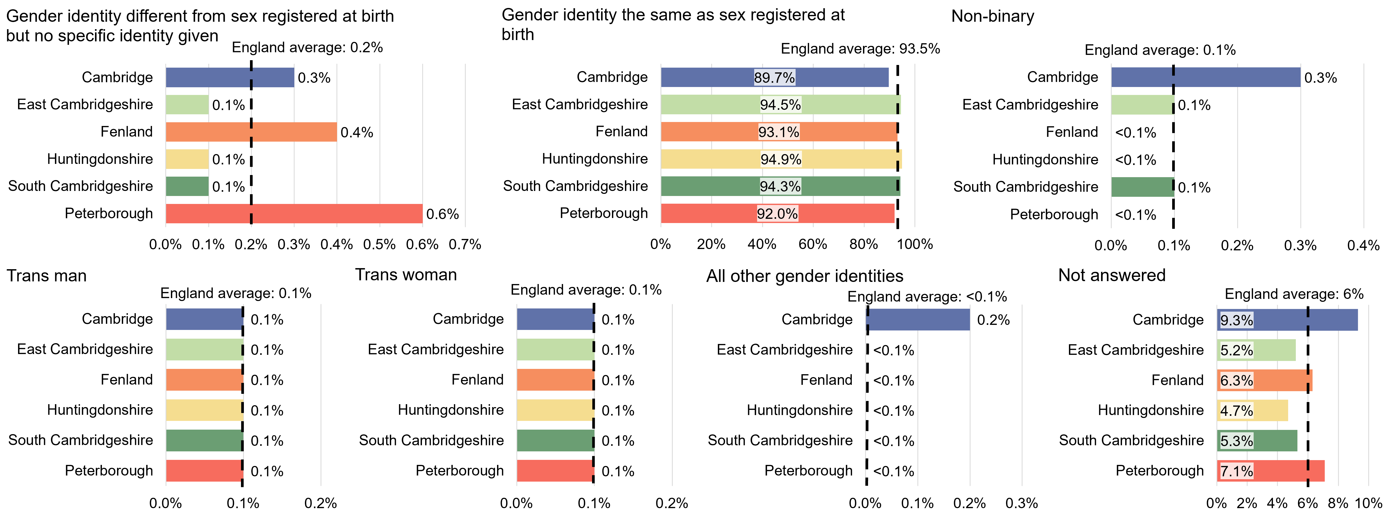
Cambridgeshire and Peterborough: per cent of population aged 16 years and over by gender identity, Census 2021

Slide 12
Cambridge

Slide 13
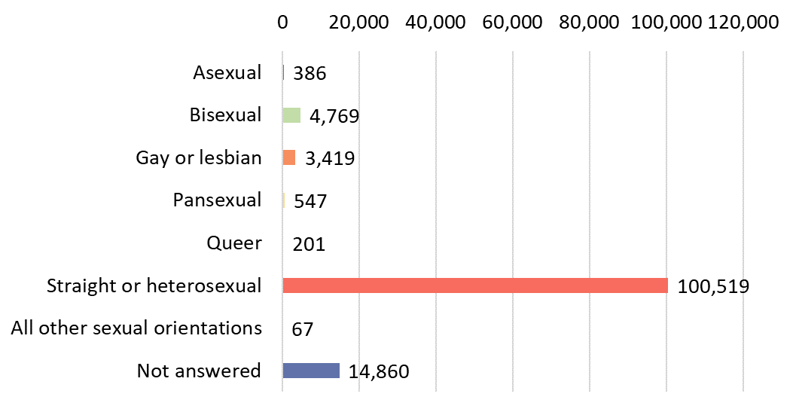
Cambridge: number of residents aged 16 years and over by sexual orientation Census 2021

Slide 14
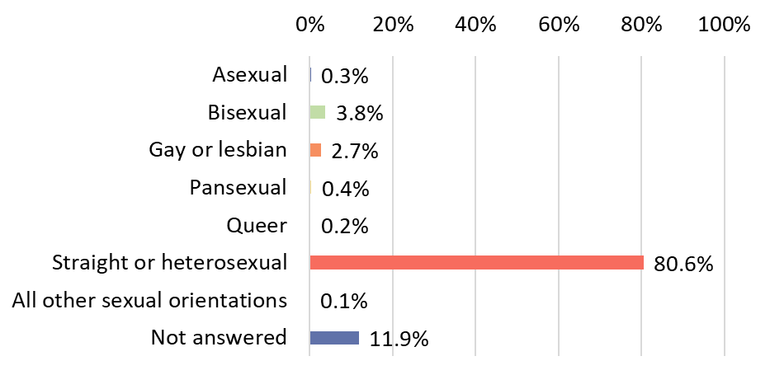
Cambridge: per cent of residents aged 16 years and over by sexual orientation Census 2021

Slide 15
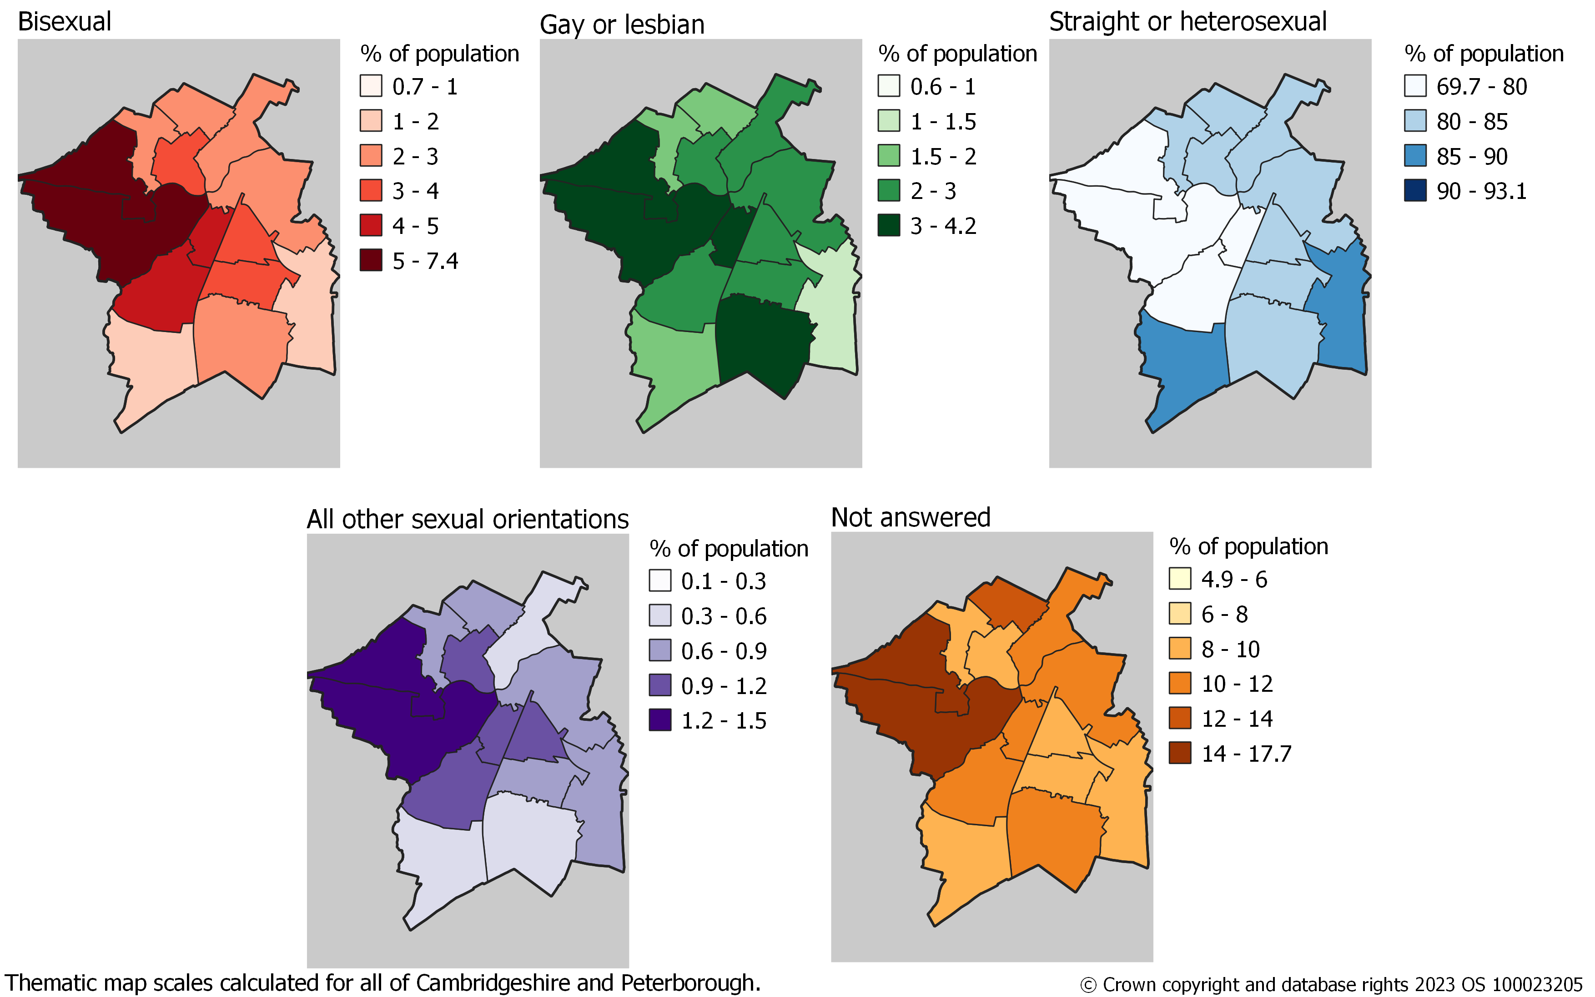
Cambridge: percentage of Middle Layer Super Output Area population aged 16 years and over by sexual orientation, Census 2021

Slide 16
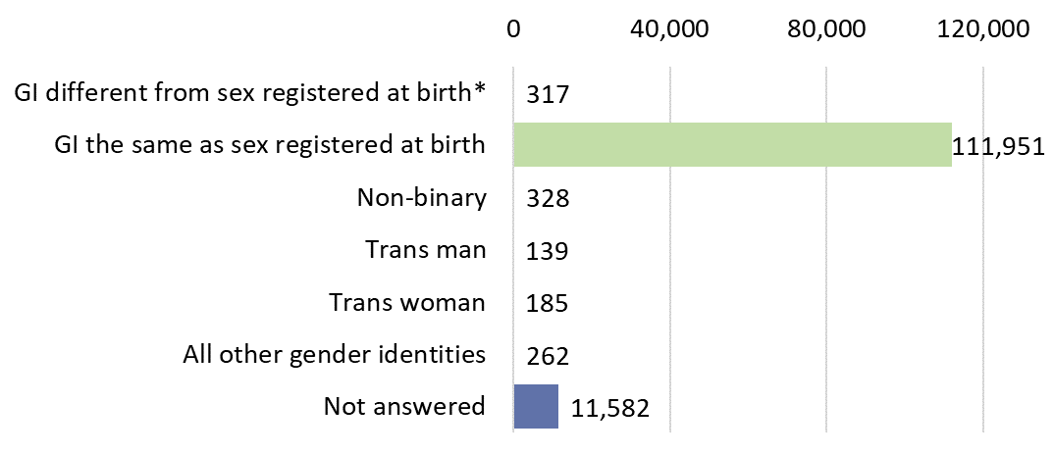
Cambridge: number of residents aged 16 years and over by gender identity Census 2021
GI different from sex registered at birth* is Gender identity different from sex registered at birth but
no specific identity given

Slide 17
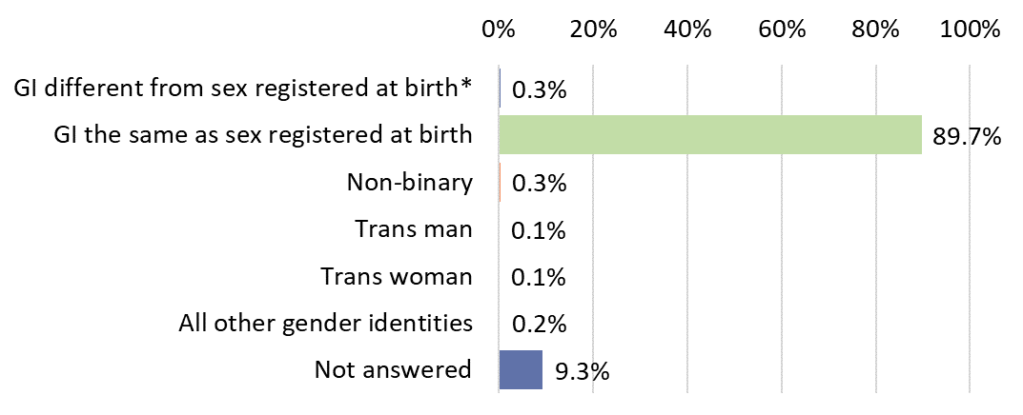
Cambridge: per cent of residents aged 16 years and over by gender identity Census 2021
GI different from sex registered at birth* is Gender identity different from sex registered at birth but
no specific identity given

Slide 18
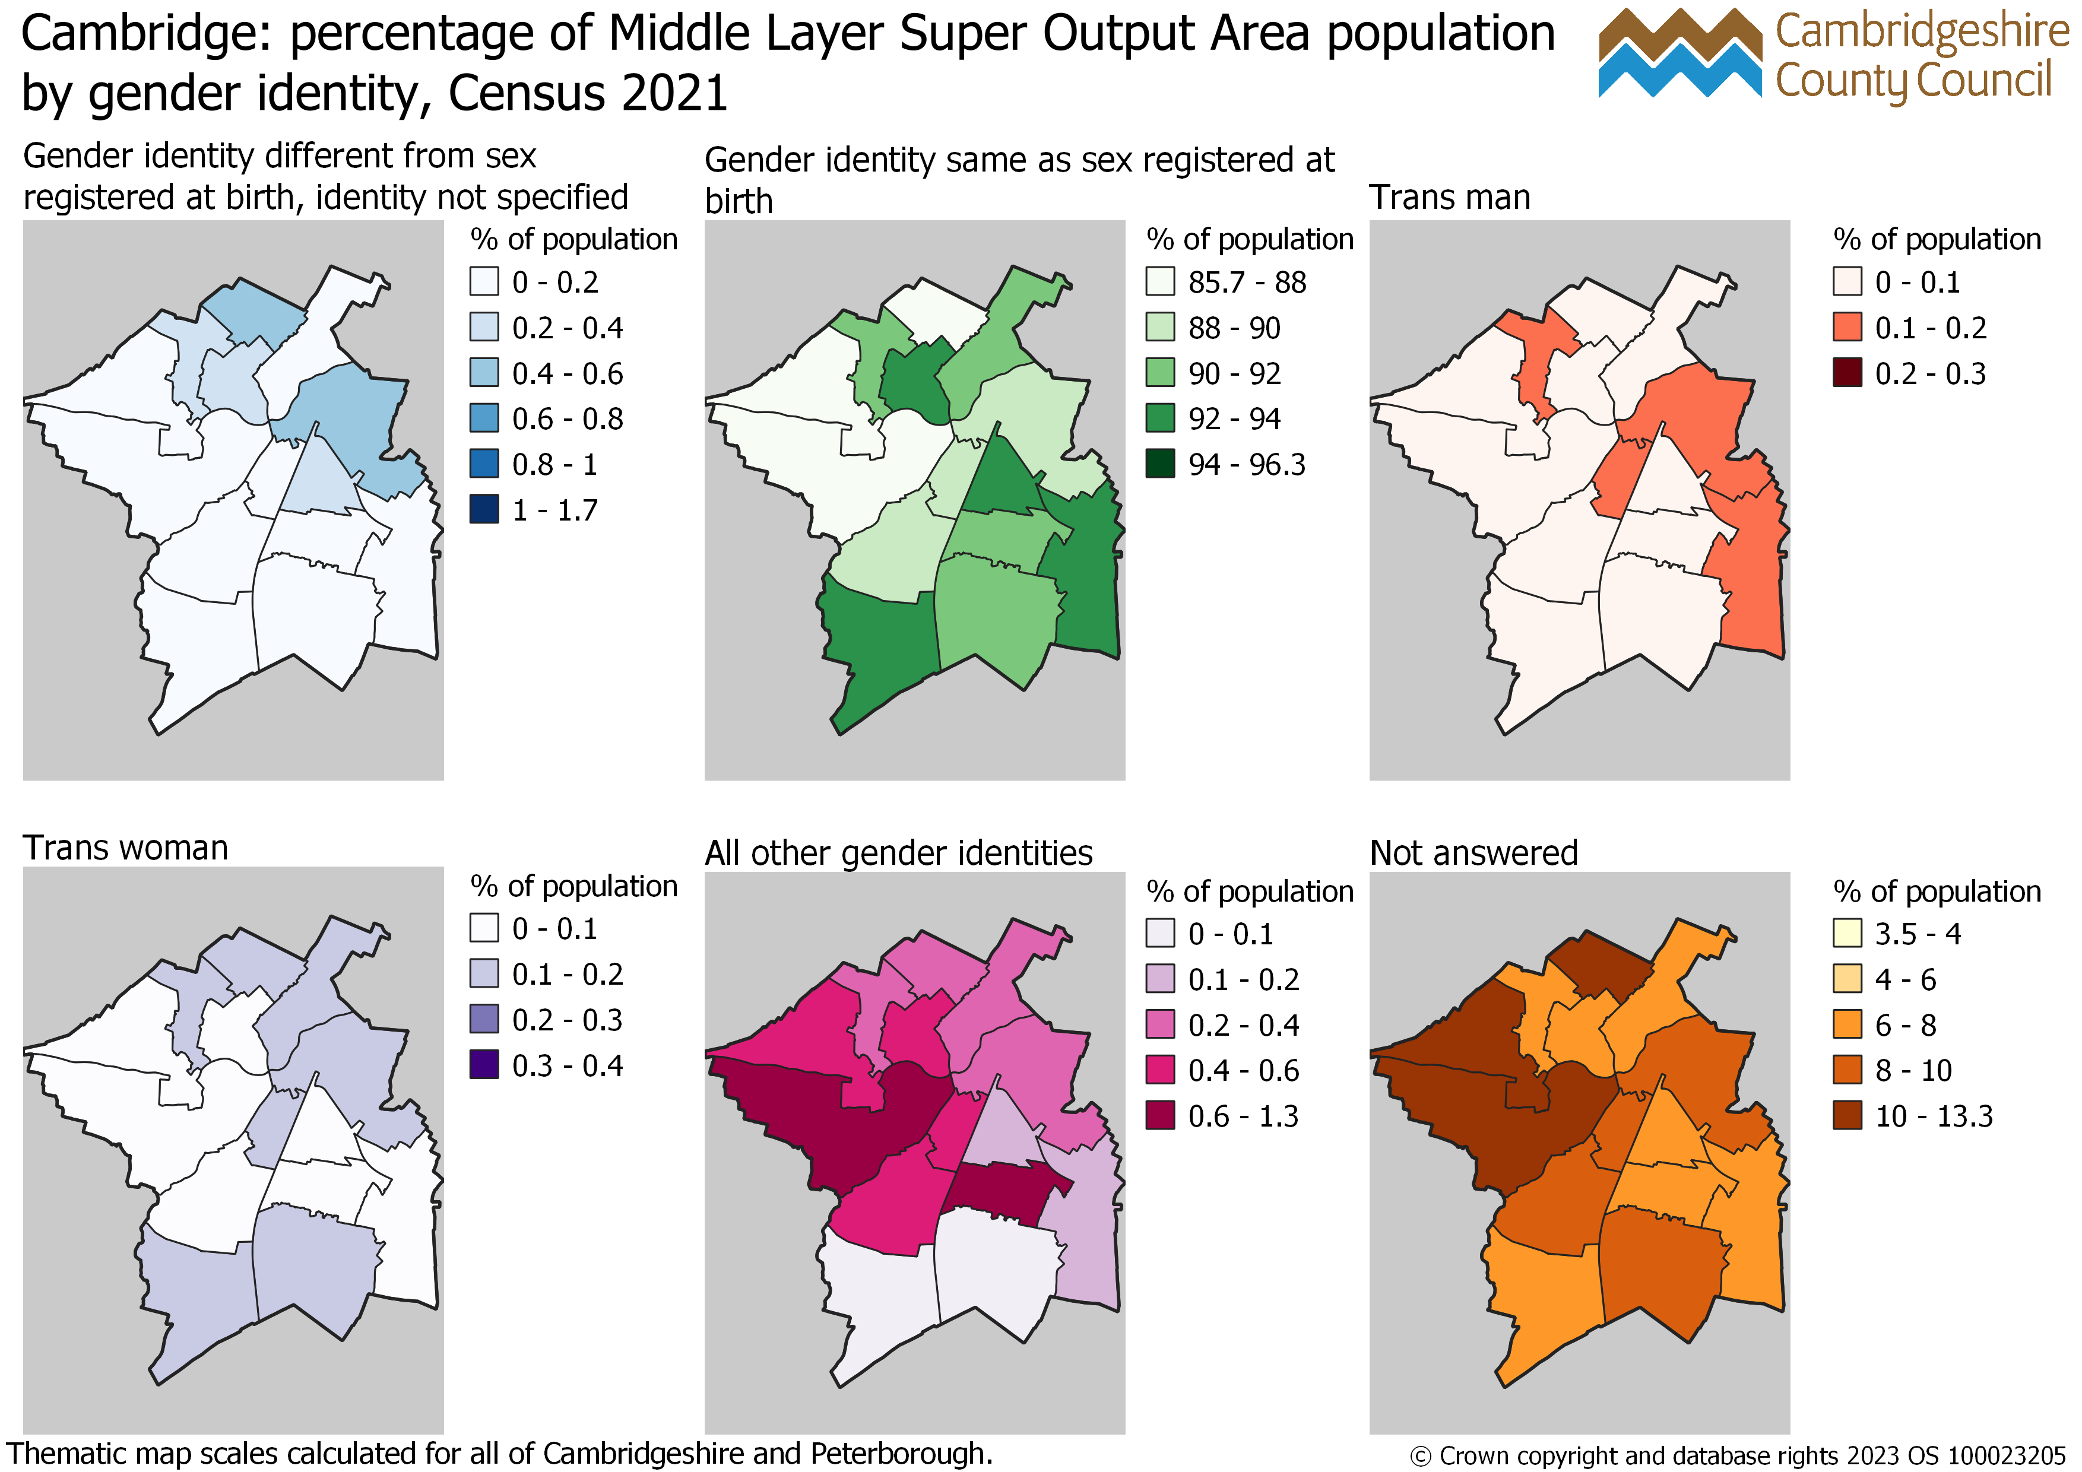
Cambridge: percentage of Middle Layer Super Output Area population aged 16 years and over by gender identity, Census 2021

Slide 19
East Cambridgeshire

Slide 20
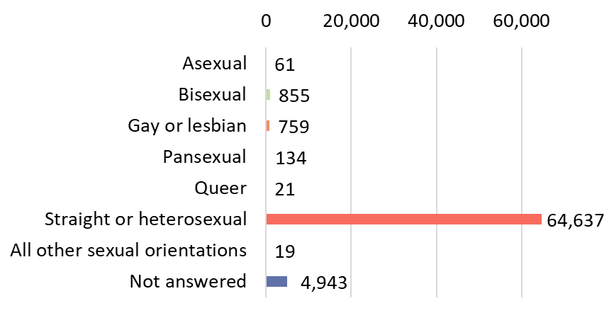
East Cambridgeshire: number of residents aged 16 years and over by sexual orientation Census 2021

Slide 21
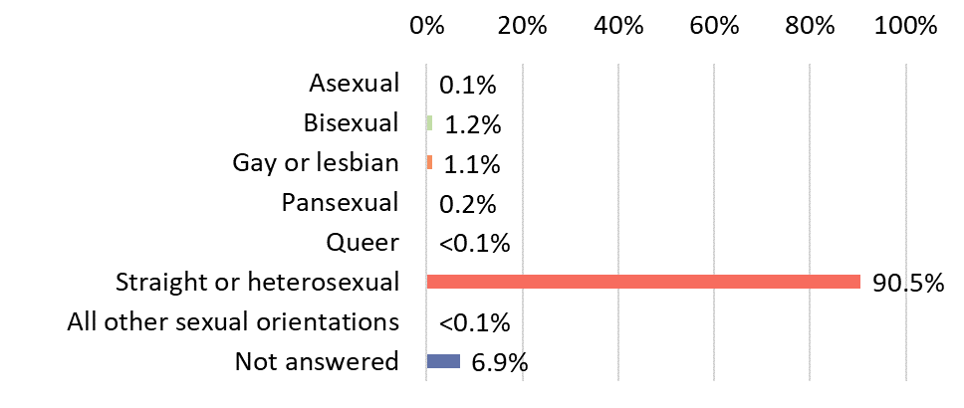
East Cambridgeshire: per cent of residents aged 16 years and over by sexual orientation Census 2021

Slide 22
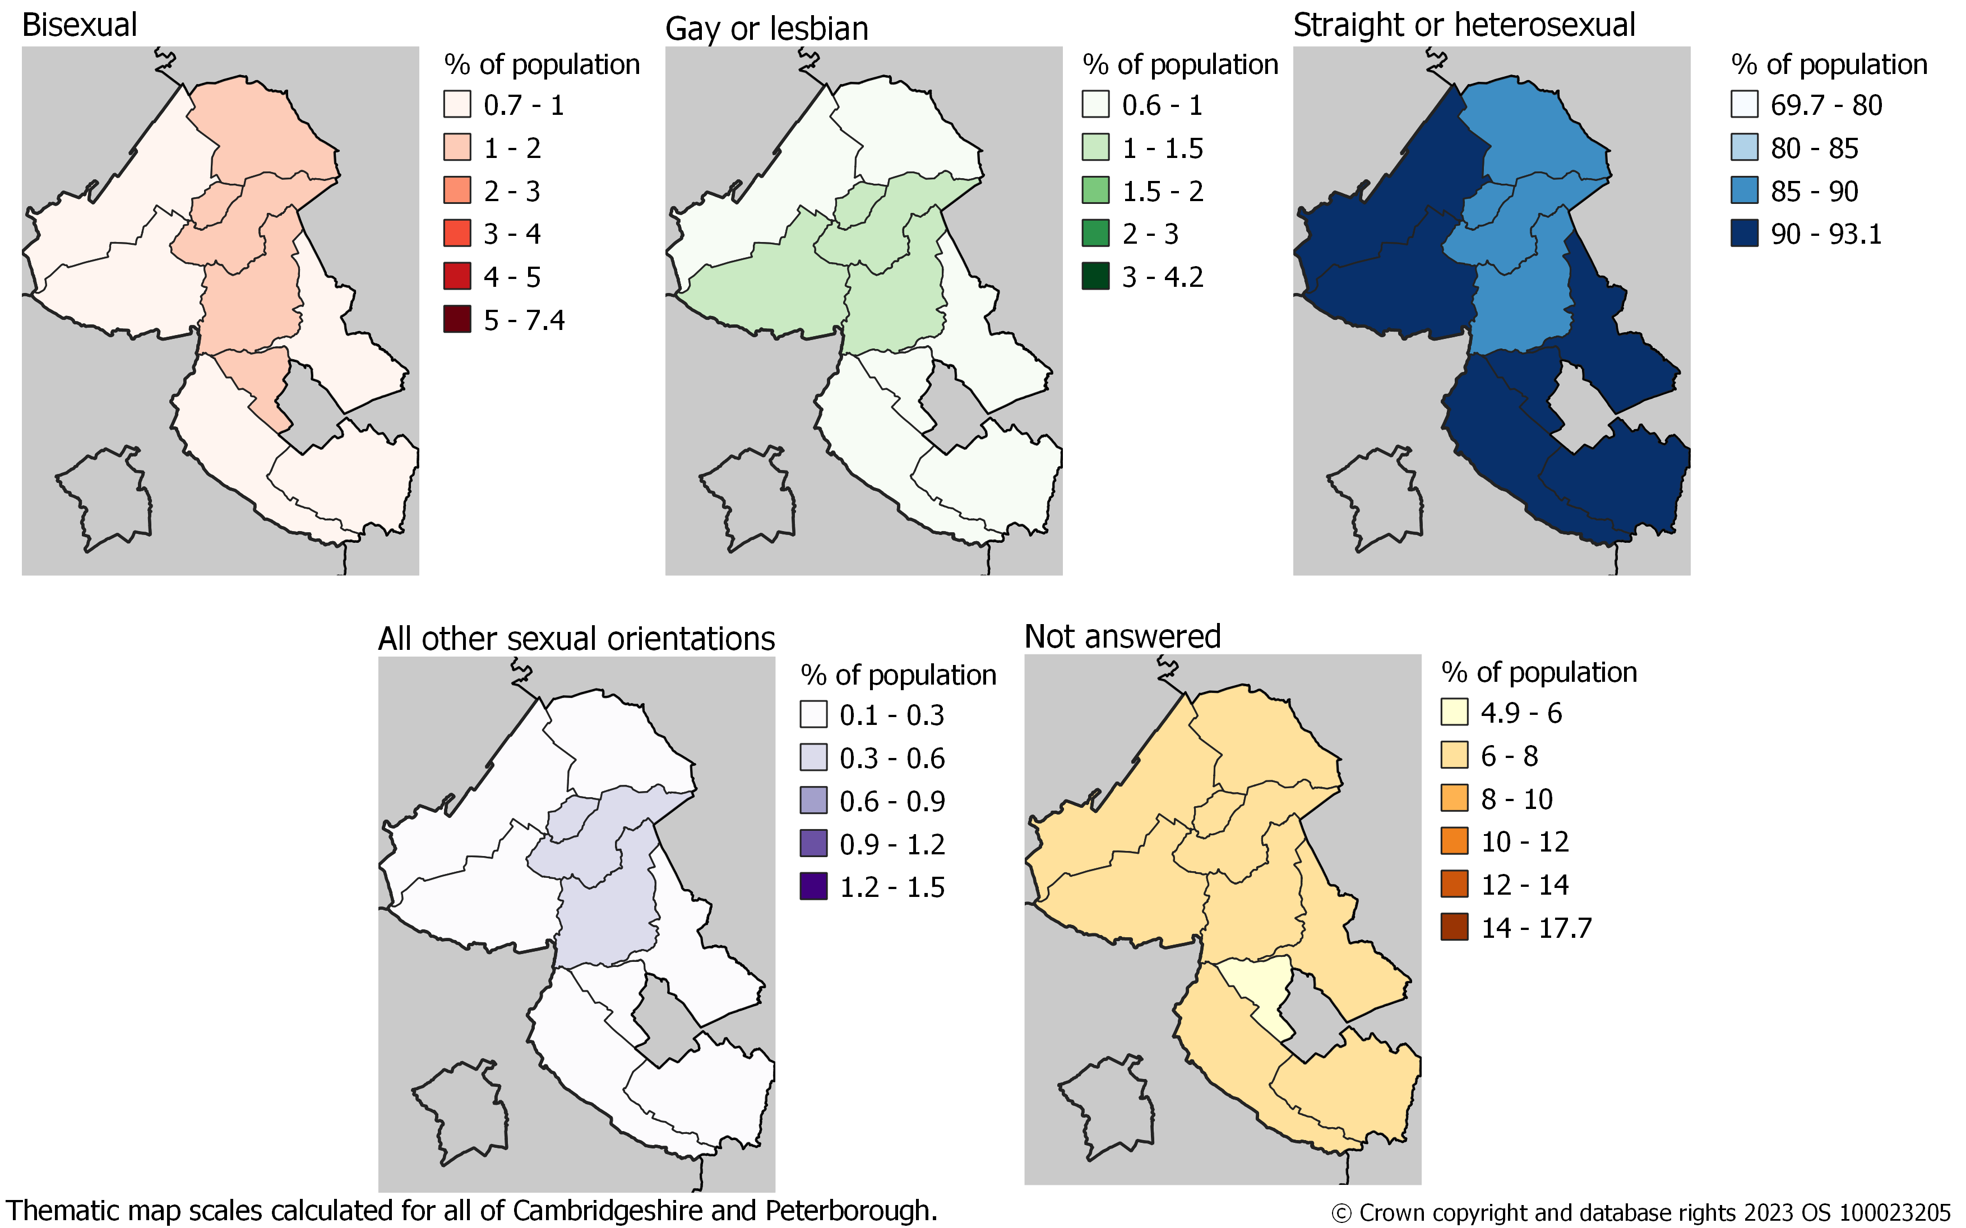
East Cambridgeshire: percentage of Middle Layer Super Output Area population aged 16 years and over by sexual orientation, Census 2021

Slide 23
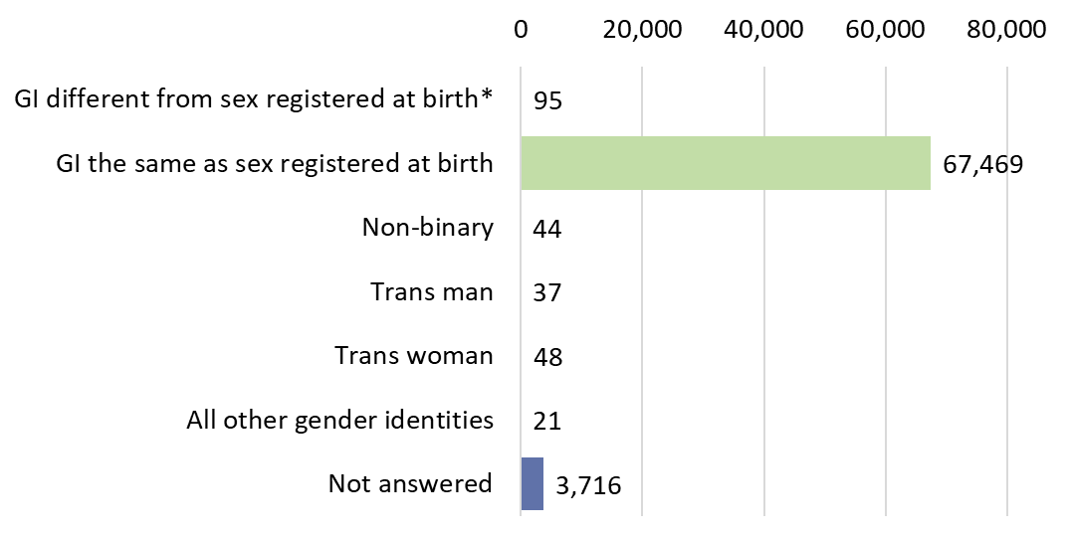
East Cambridgeshire: number of residents aged 16 years and over by gender identity Census 2021
GI different from sex registered at birth* is Gender identity different from sex registered at birth but
no specific identity given

Slide 24
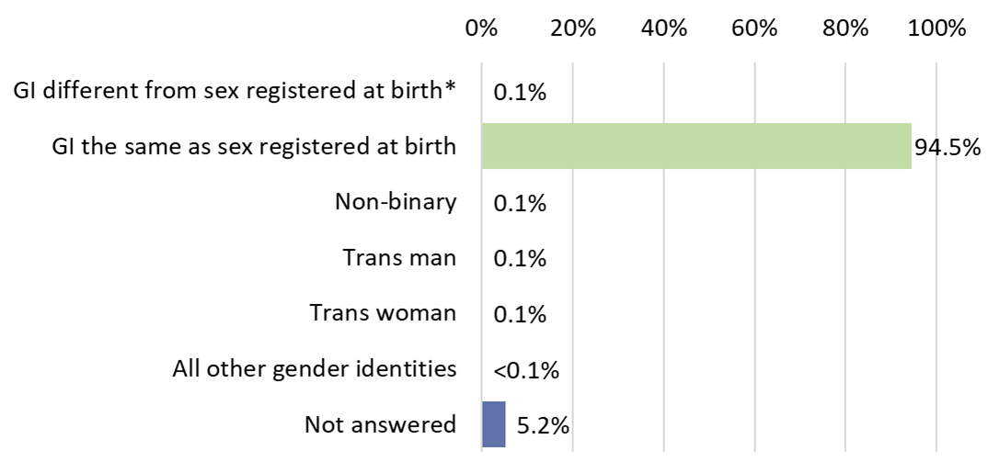
East Cambridgeshire: per cent of residents aged 16 years and over by gender identity Census 2021
GI different from sex registered at birth* is Gender identity different from sex registered at birth but
no specific identity given

Slide 25
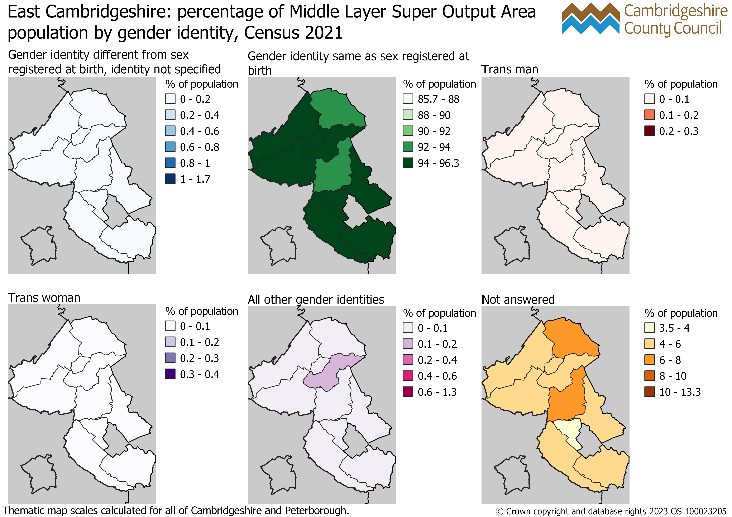
East Cambridgeshire: percentage of Middle Layer Super Output Area population aged 16 years and over by gender identity, Census 2021

Slide 26
Fenland

Slide 27
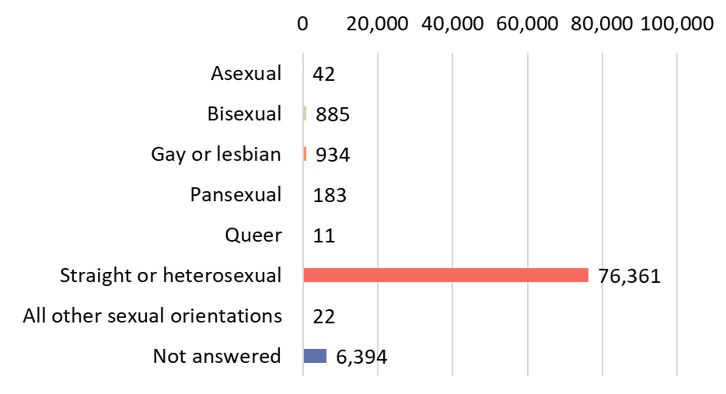
Fenland: number of residents aged 16 years and over by sexual orientation Census 2021

Slide 28
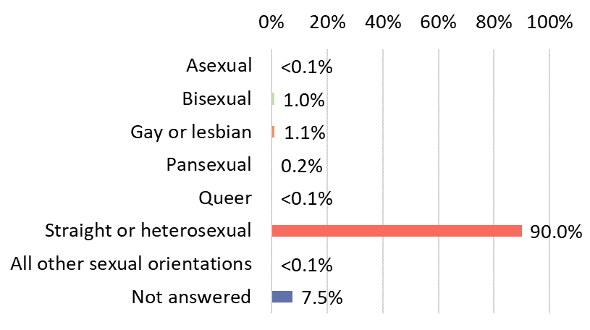
Fenland: per cent of residents aged 16 years and over by sexual orientation Census 2021

Slide 29
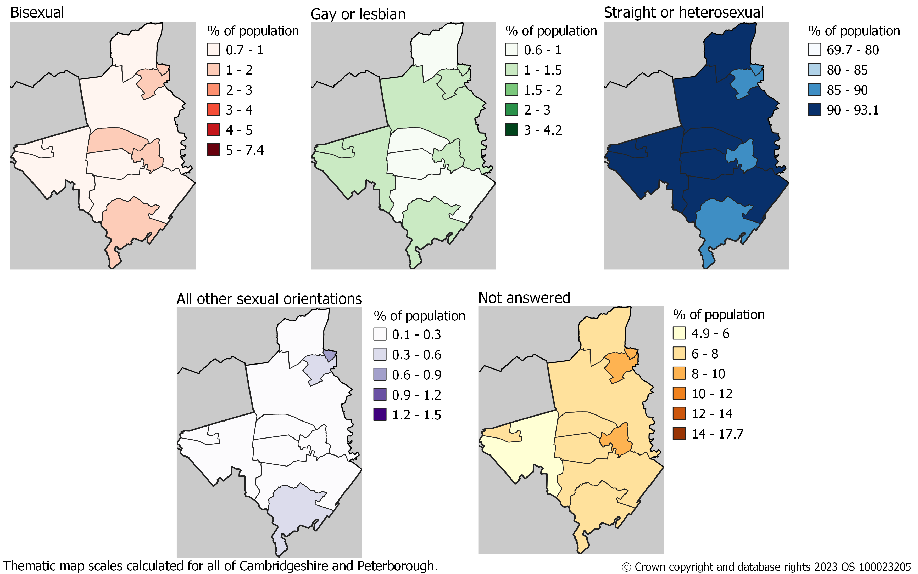
Fenland: percentage of Middle Layer Super Output Area population aged 16 years and over by sexual orientation, Census 2021

Slide 30
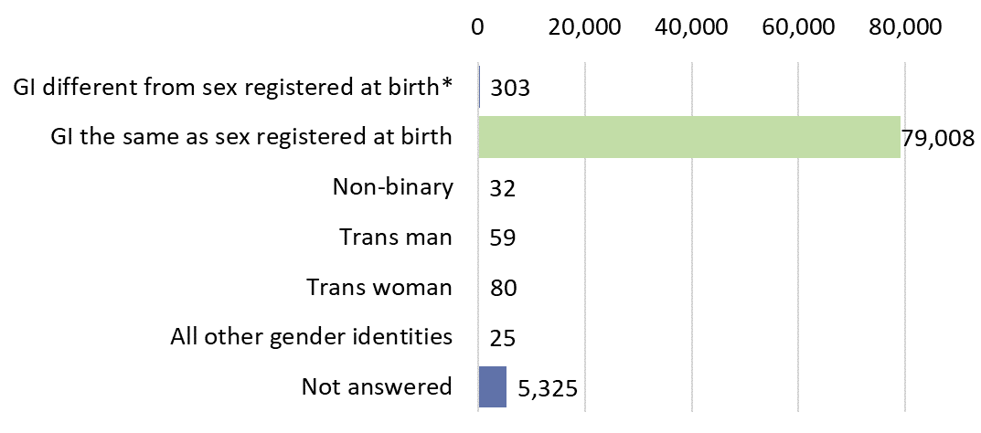
Fenland: number of residents aged 16 years and over by gender identity Census 2021
GI different from sex registered at birth* is Gender identity different from sex registered at birth but
no specific identity given

Slide 31
Fenland: per cent of residents aged 16 years and over by gender identity Census 2021
GI different from sex registered at birth* is Gender identity different from sex registered at birth but
no specific identity given

Slide 32
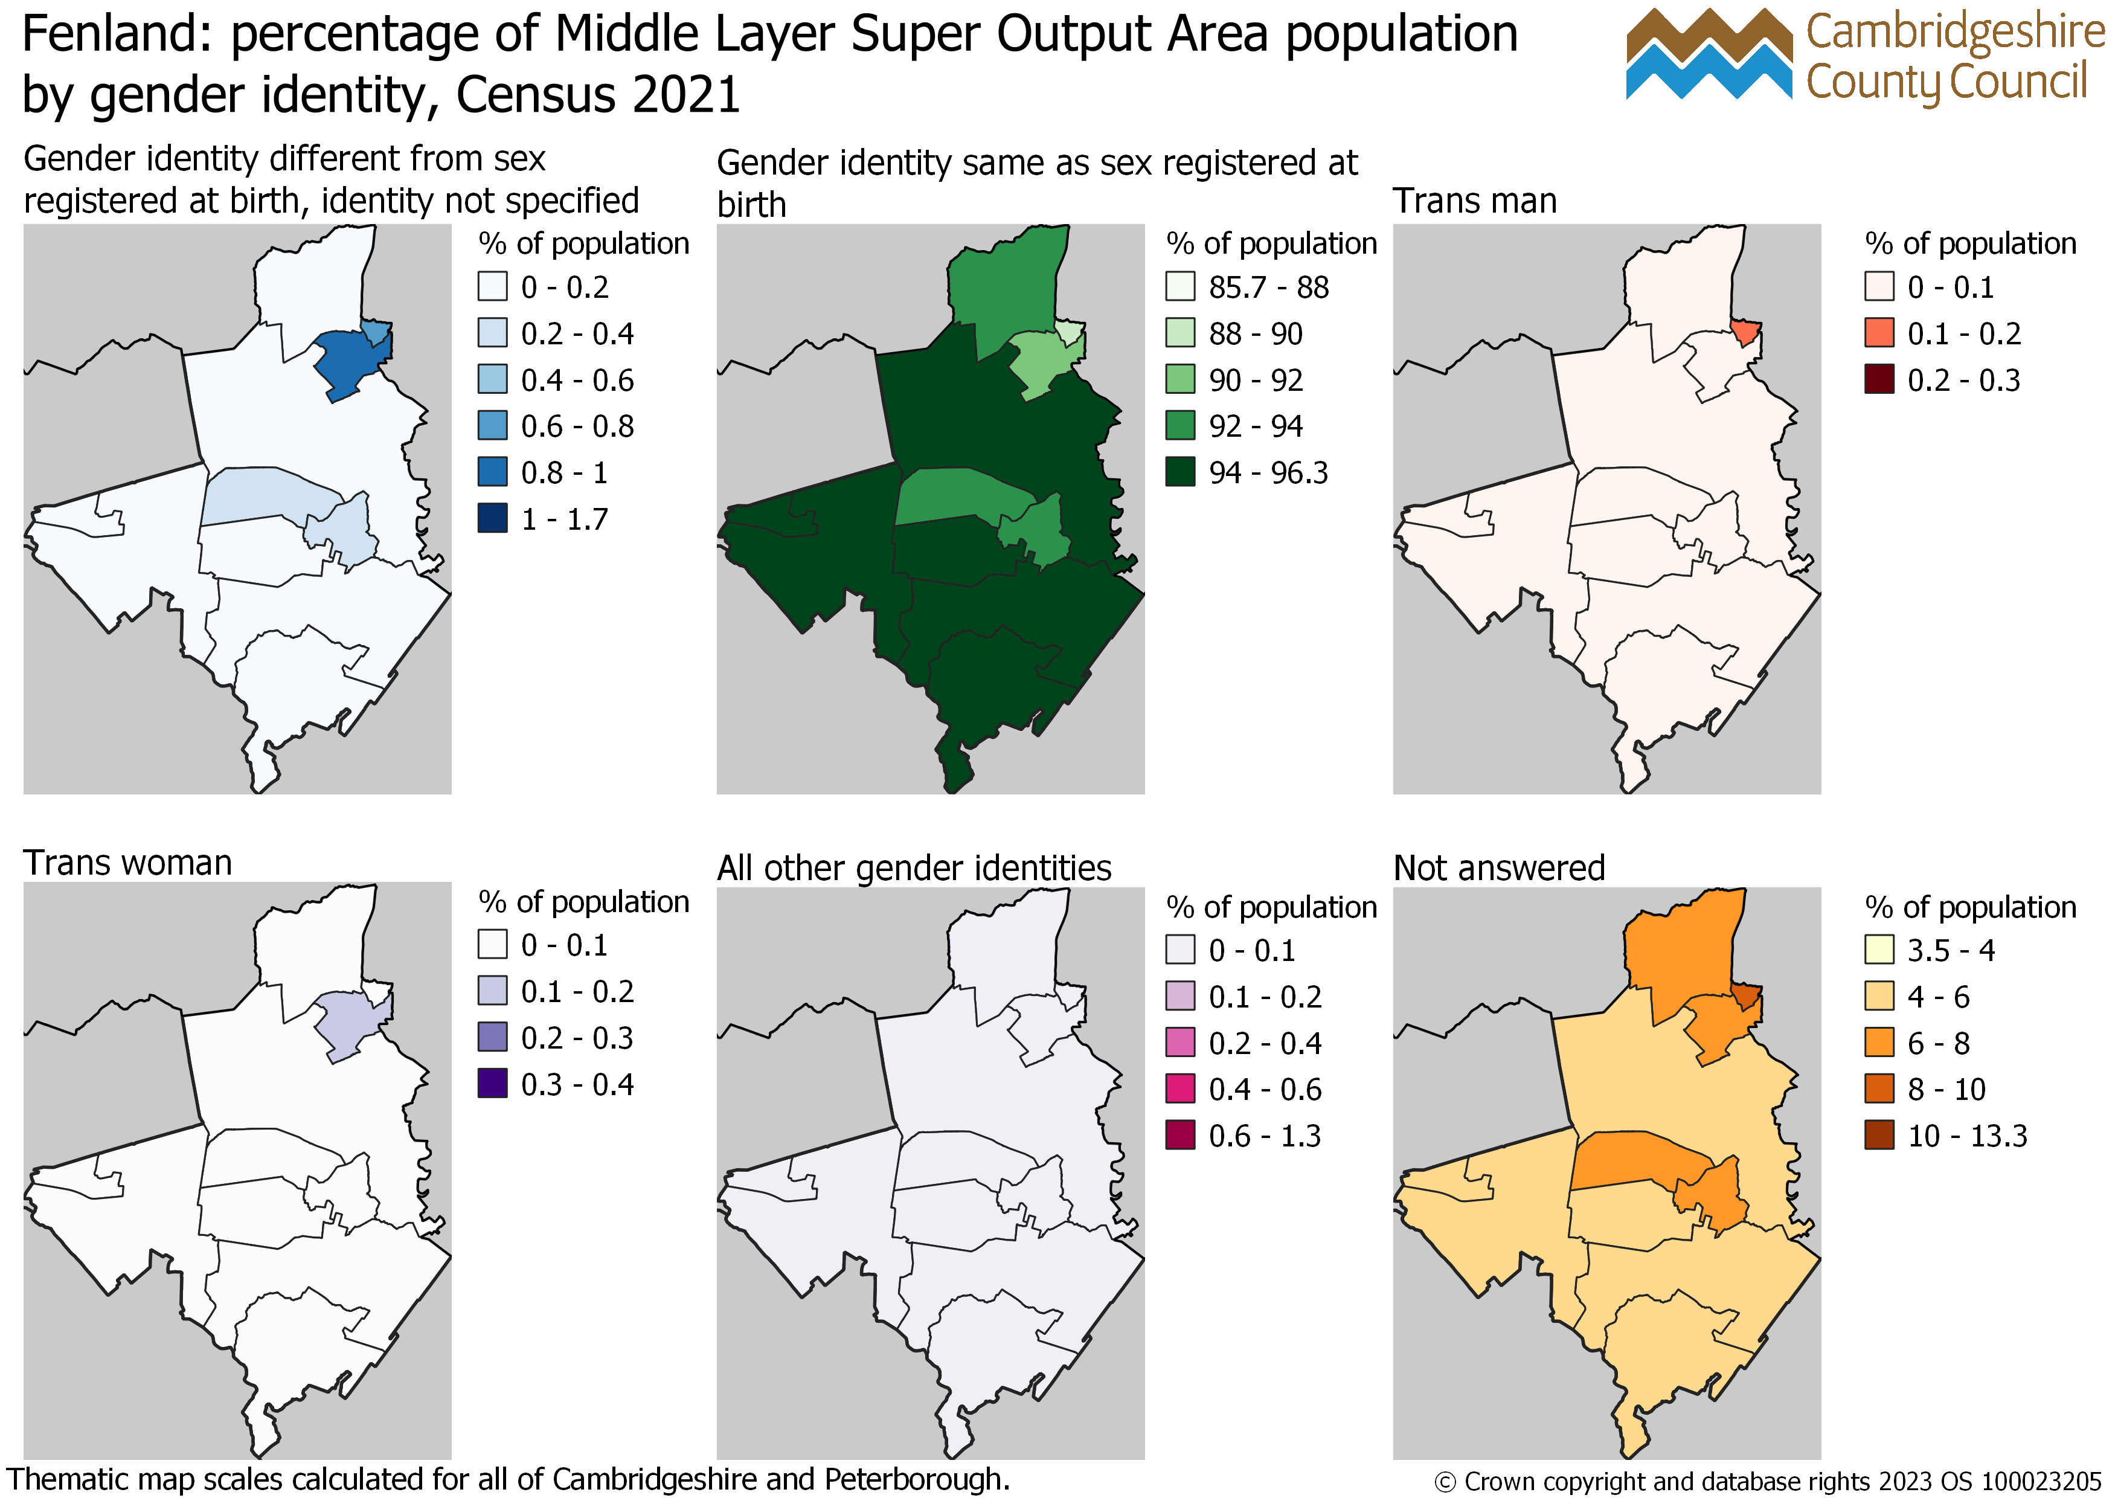
Fenland: percentage of Middle Layer Super Output Area population aged 16 years and over by gender identity, Census 2021

Slide 33
Huntingdonshire

Slide 34
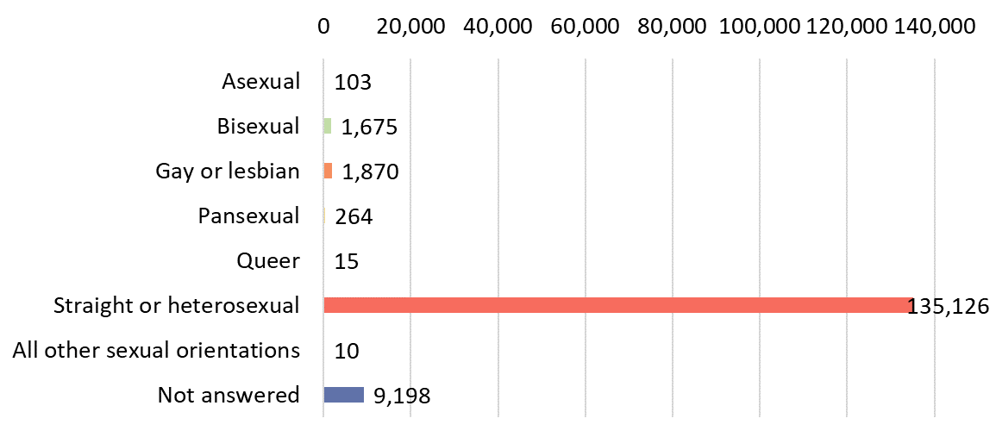
Huntingdonshire: number of residents aged 16 years and over by sexual orientation Census 2021

Slide 35
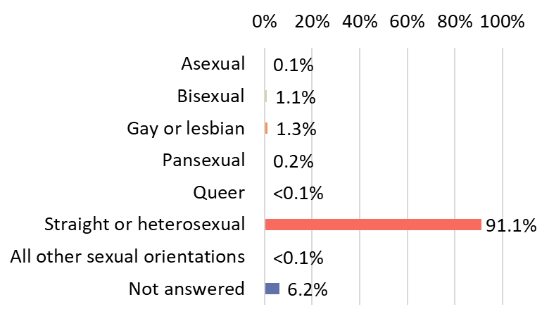
Huntingdonshire: per cent of residents aged 16 years and over by sexual orientation Census 2021

Slide 36
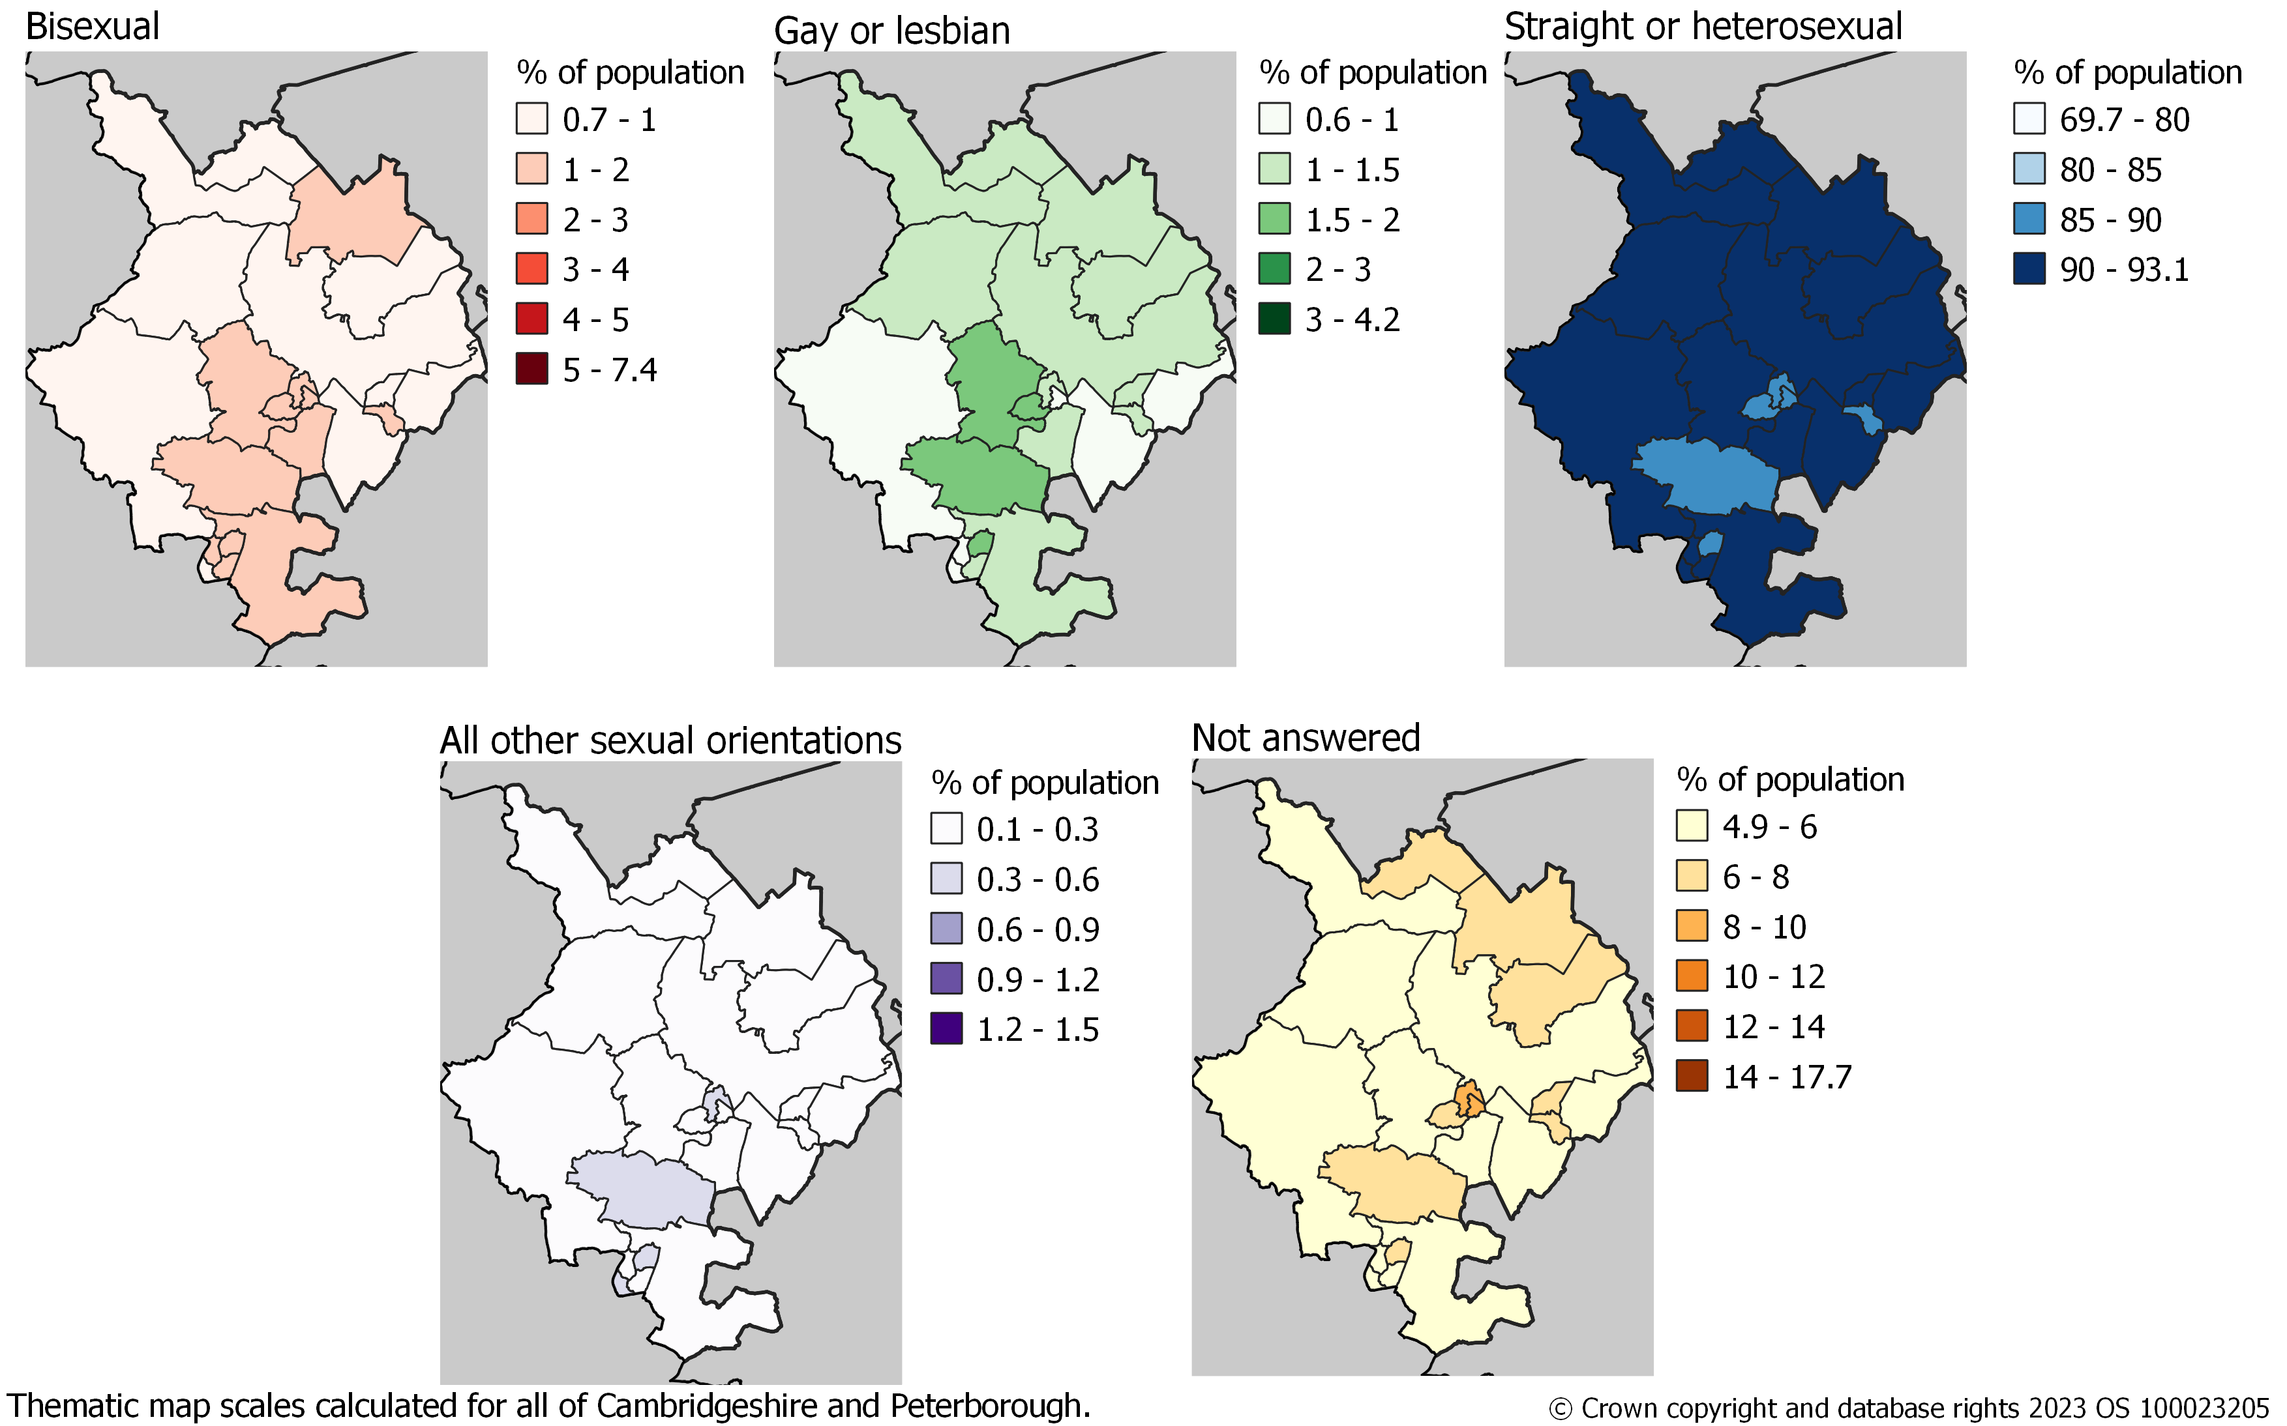
Huntingdonshire: percentage of Middle Layer Super Output Area population aged 16 years and over by sexual orientation, Census 2021

Slide 37
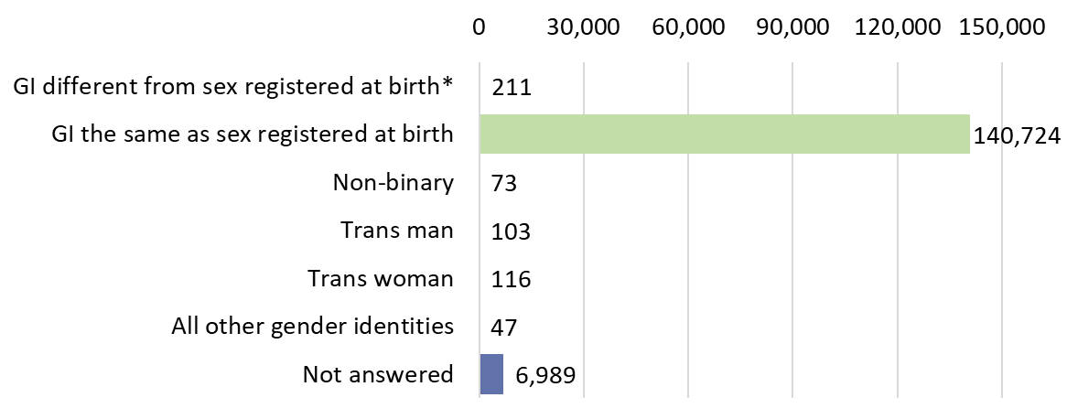
Huntingdonshire: number of residents aged 16 years and over by gender identity Census 2021
GI different from sex registered at birth* is Gender identity different from sex registered at birth but
no specific identity given

Slide 38
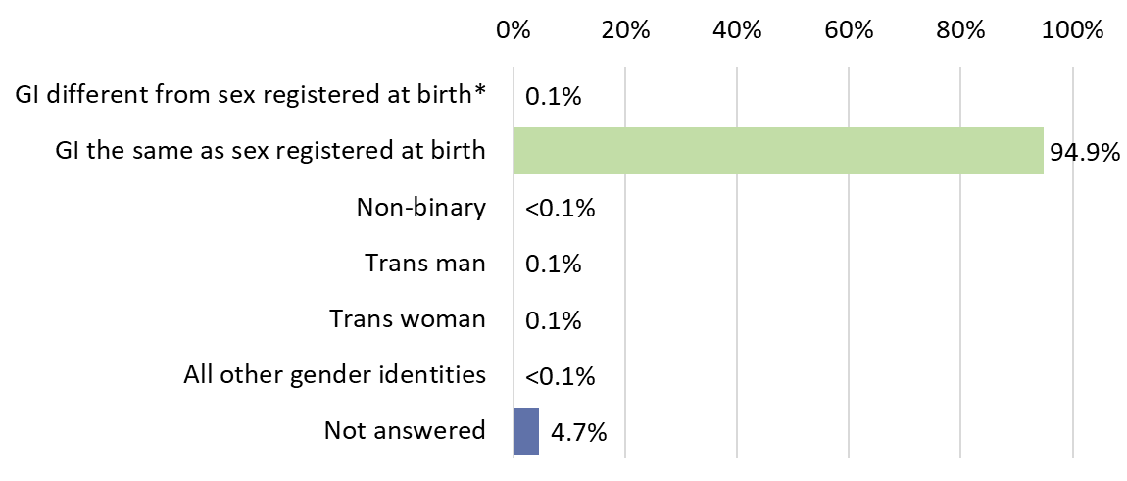
Huntingdonshire: per cent of residents aged 16 years and over by gender identity Census 2021
GI different from sex registered at birth* is Gender identity different from sex registered at birth but
no specific identity given

Slide 39
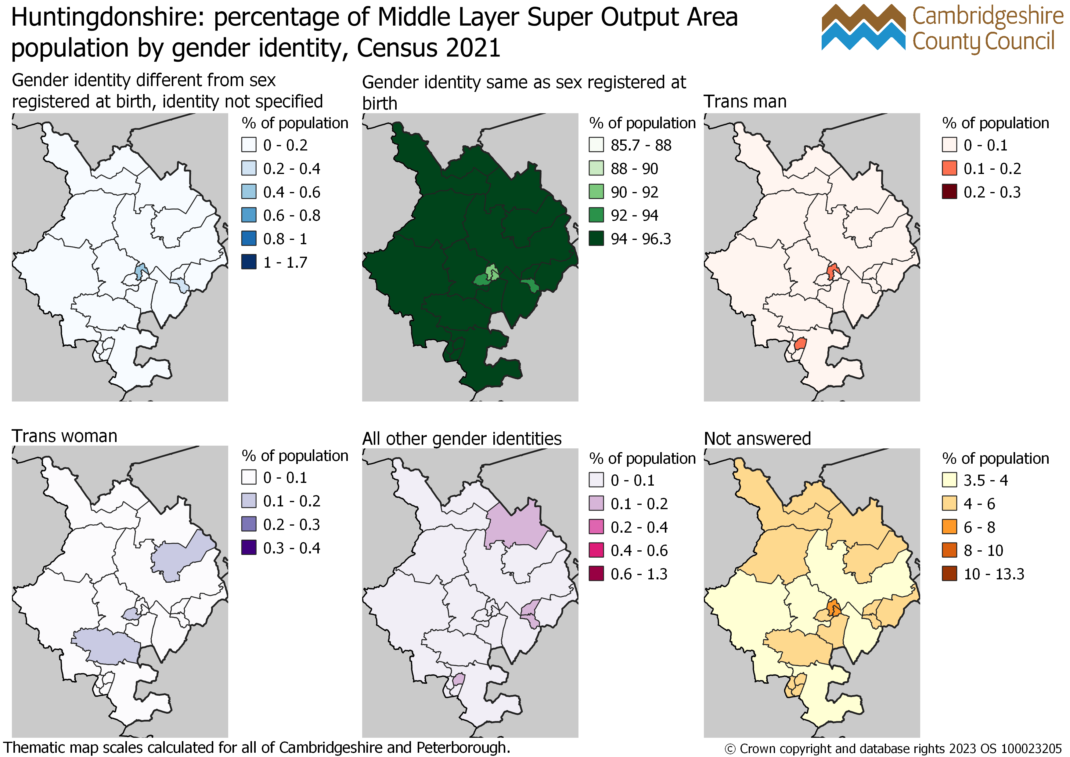
Huntingdonshire: percentage of Middle Layer Super Output Area population aged 16 years and over by gender identity, Census 2021

Slide 40
South Cambridgeshire

Slide 41
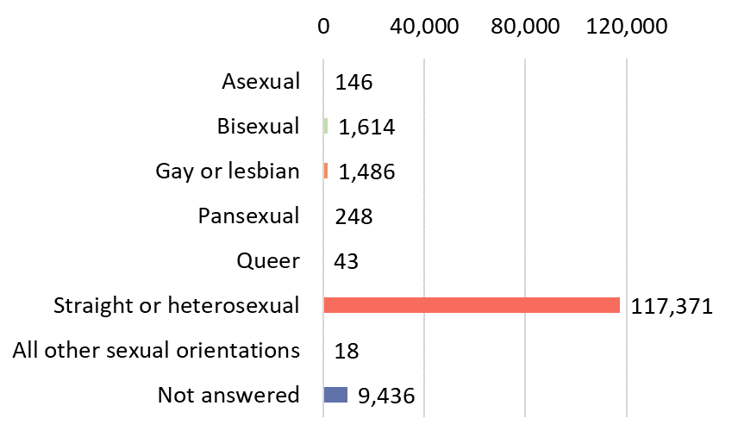
South Cambridgeshire: number of residents aged 16 years and over by sexual orientation Census 2021

Slide 42
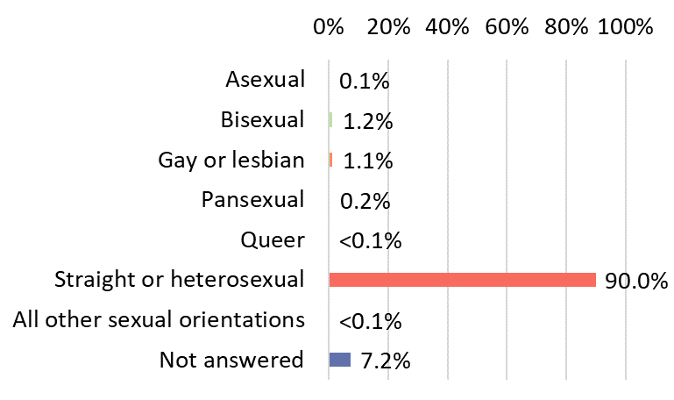
South Cambridgeshire: per cent of residents aged 16 years and over by sexual orientation Census 2021

Slide 43
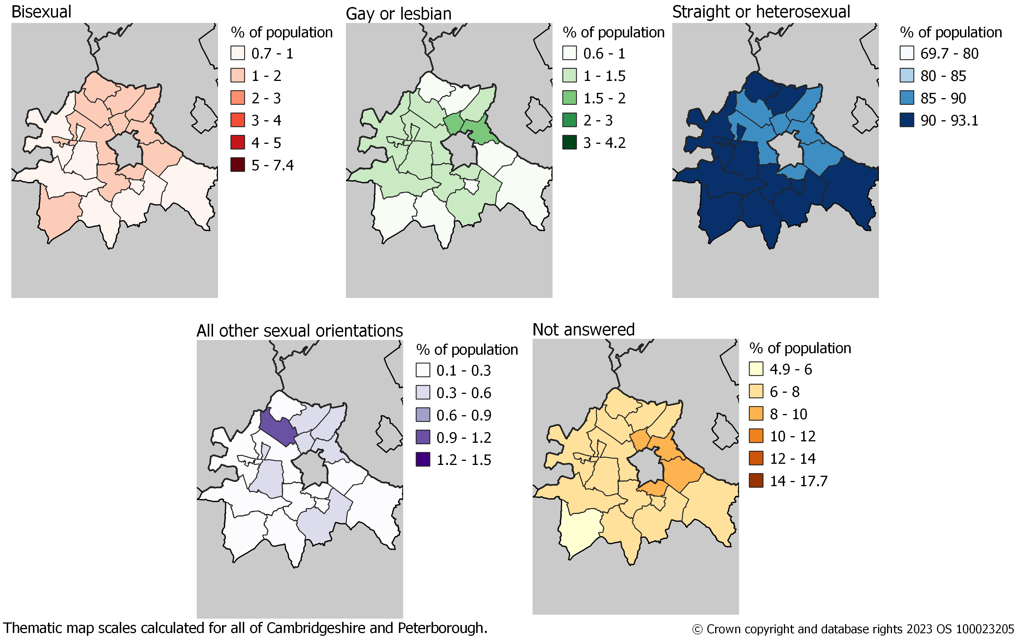
South Cambridgeshire: percentage of Middle Layer Super Output Area population aged 16 years and over by sexual orientation, Census 2021

Slide 44
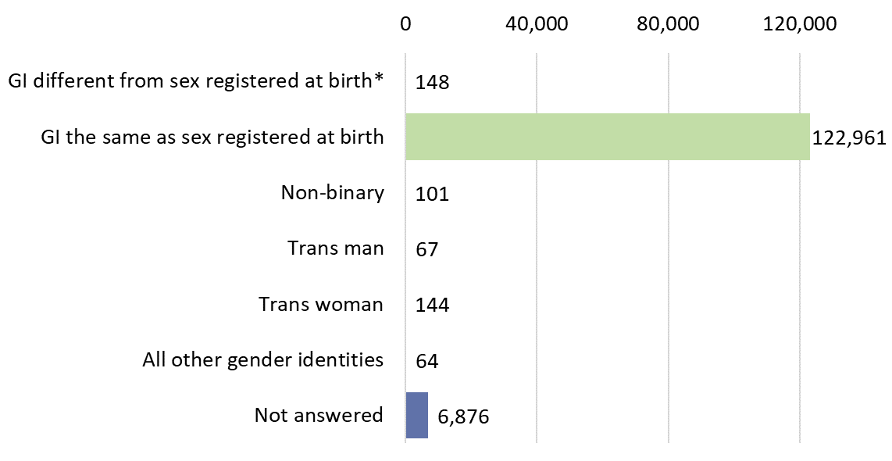
South Cambridgeshire: number of residents aged 16 years and over by gender identity Census 2021
GI different from sex registered at birth* is Gender identity different from sex registered at birth but
no specific identity given

Slide 45
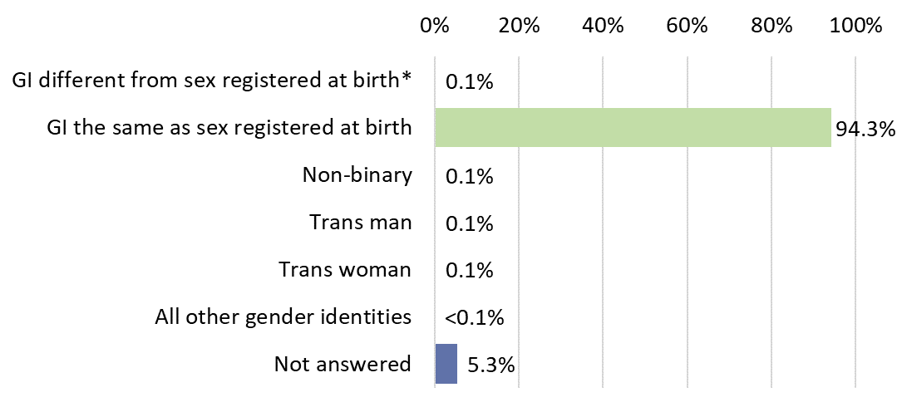
South Cambridgeshire: per cent of residents aged 16 years and over by gender identity Census 2021
GI different from sex registered at birth* is Gender identity different from sex registered at birth but
no specific identity given

Slide 46
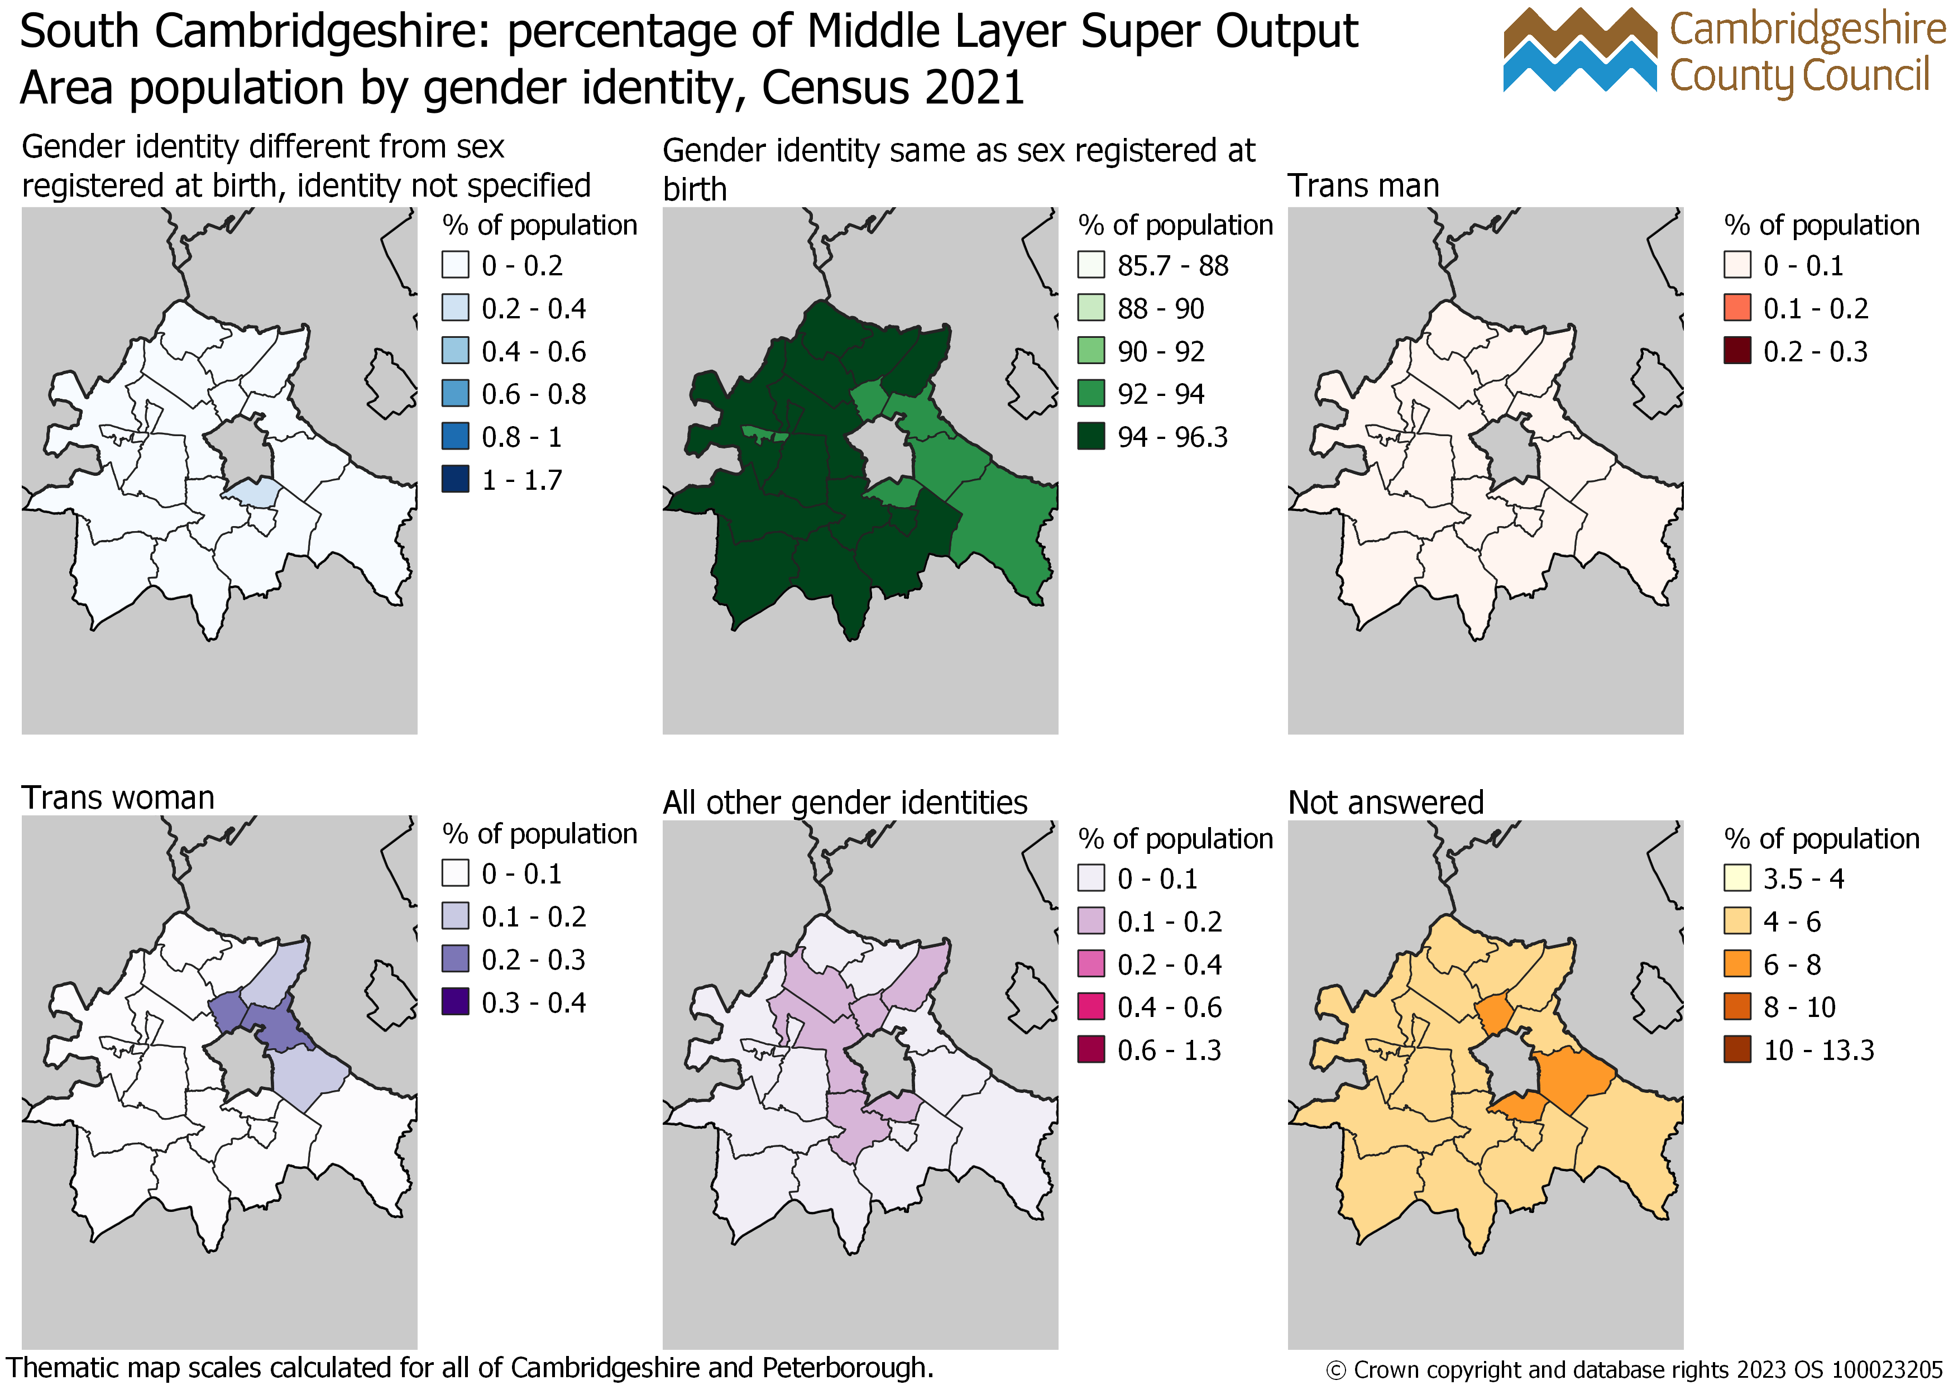
South Cambridgeshire: percentage of Middle Layer Super Output Area population aged 16 years and over by gender identity, Census 2021

Slide 47
Peterborough

Slide 48
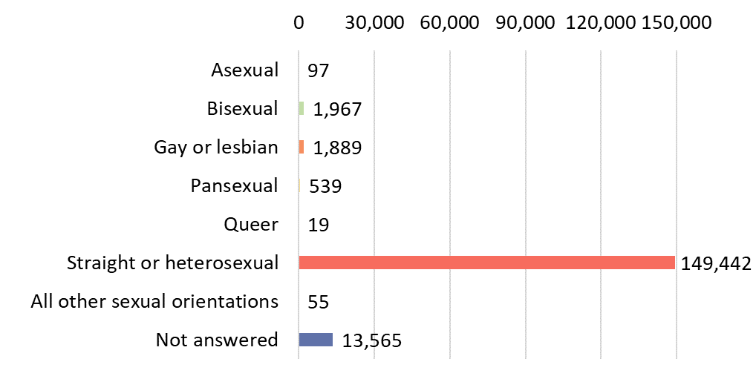
Peterborough: number of residents aged 16 years and over by sexual orientation Census 2021

Slide 49
Peterborough: per cent of residents aged 16 years and over by sexual orientation Census 2021

Slide 50
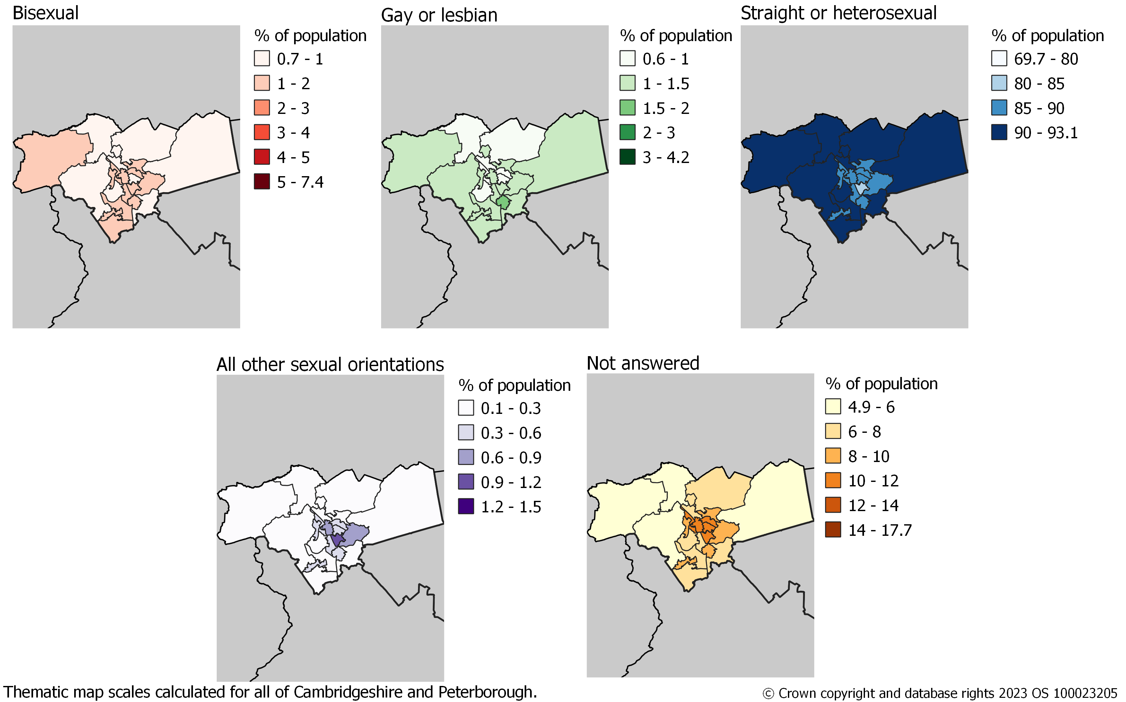
Peterborough: percentage of Middle Layer Super Output Area population aged 16 years and over by sexual orientation, Census 2021

Slide 51
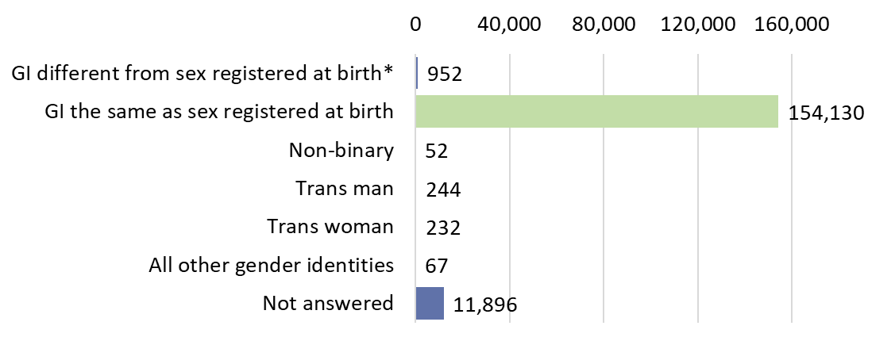
Peterborough: number of residents aged 16 years and over by gender identity Census 2021
GI different from sex registered at birth* is Gender identity different from sex registered at birth but
no specific identity given

Slide 52
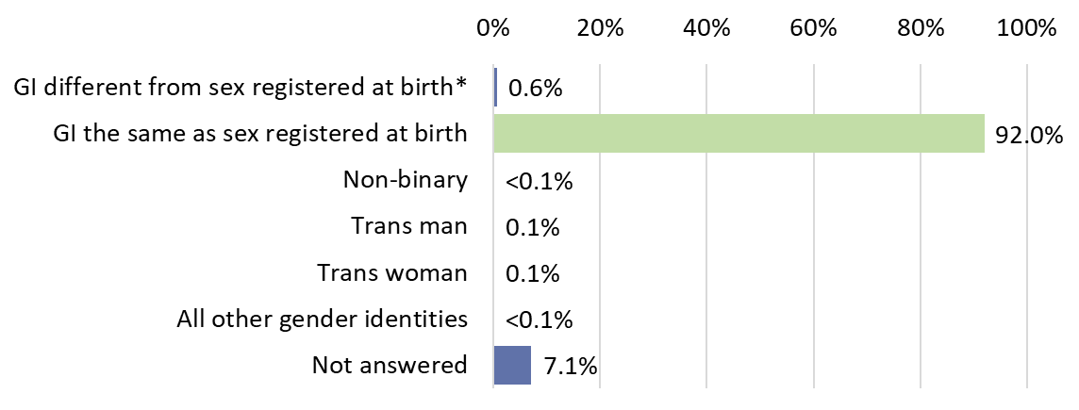
Peterborough: per cent of residents aged 16 years and over by gender identity Census 2021
GI different from sex registered at birth* is Gender identity different from sex registered at birth but
no specific identity given

Slide 53
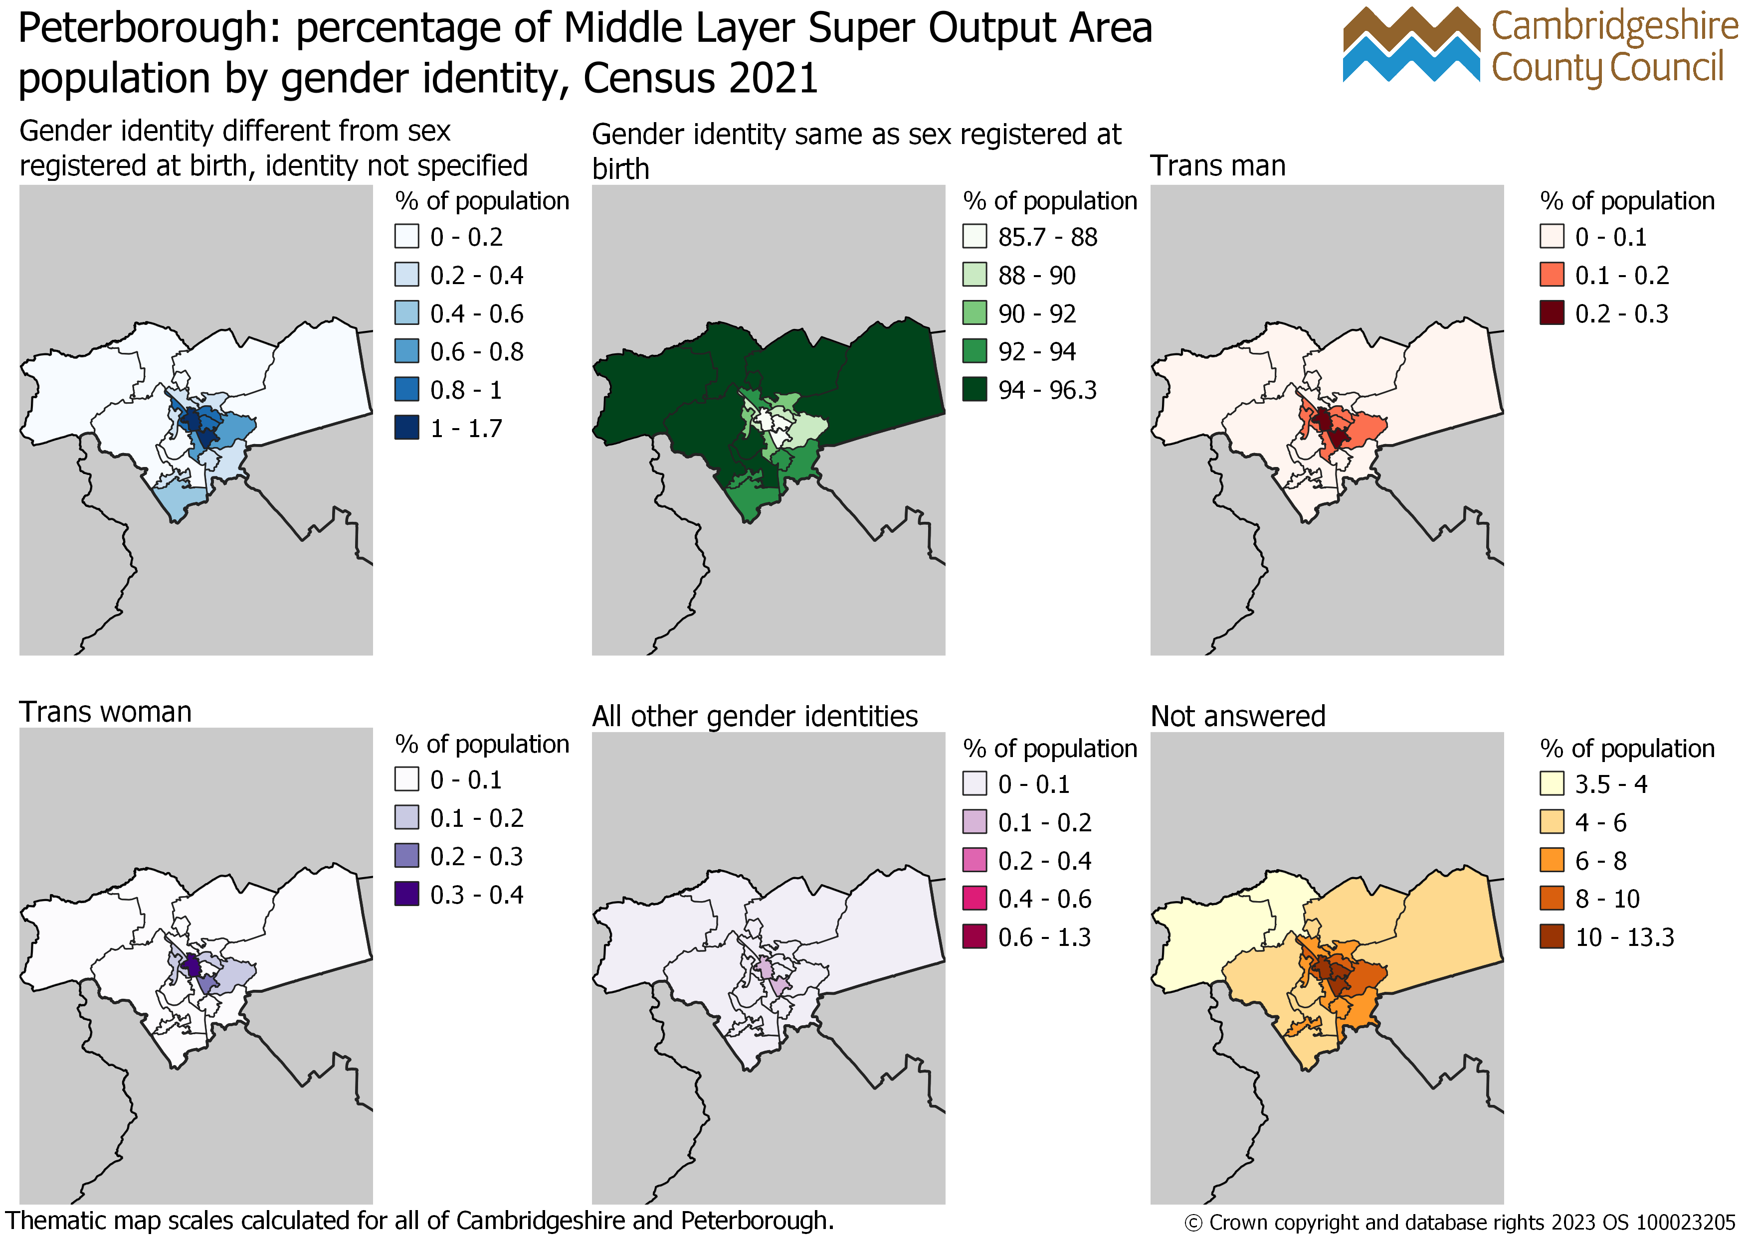
Peterborough: percentage of Middle Layer Super Output Area population aged 16 years and over by gender identity, Census 2021

Slide 54
Census 2021: useful links
Census 2021 Cambridgeshire Insight – Population – Census 2021 webpages on Cambridgeshire Insight, including:
Census 2021 first results: published report, recorded presentation and dataset,
Census 2021 topic summaries: Cambridgeshire and Peterborough summaries and further resources available
Cambs Insight tools already have demography and migration datasets, and they will be updated with the release of each topic summary:
Map explorer
Data explorer
Census 2021 data published on the ONS website and on NOMIS
ONS tools:
Census maps
Area profiles – available on NOMIS at local authority level.
How your area has changed in 10 years: Census 2021

