Slide 1
Census 2021: Housing summary for Cambridgeshire and Peterborough
16/01/2023
Research Team, Business Intelligence
Research.Group@cambridgeshire.gov.uk

Slide 2
Themes covered
A first overview of some of the local authority level Cambridgeshire and Peterborough data from the Housing, People with Second Addresses and Communal Establishment Residents topic summary published by the Office for National Statistics (ONS)
By local authority
Accommodation type
Car or van availability
Central heating
Communal establishment residents by age and sex
Number of bedrooms
Occupancy rating for bedrooms
Purpose of second address
Tenure

Slide 3
Contents
Overview
Cambridgeshire and Peterborough
Cambridge
East Cambridgeshire
Fenland
Huntingdonshire
South Cambridgeshire
Peterborough
Definitions and comparability to Census 2011

Slide 4
Overview: Change in occupied household numbers
Area | Number of occupied households Census 2011 | Number of occupied households Census 2021 | Change 2011-2021, %
Cambridge | 46,714 | 52,474 | 12.3
East Cambridgeshire | 34,614 | 37,202 | 7.5
Fenland | 40,620 | 44,083 | 8.5
Huntingdonshire | 69,333 | 76,880 | 10.9
South Cambridgeshire | 59,960 | 66,996 | 11.7
Cambridgeshire | 251,241 | 277,634 | 10.5
Peterborough | 74,023 | 84,533 | 14.2
Cambridgeshire and Peterborough | 325,264 | 362,167 | 11.3
East of England | 2,423,035 | 2,628,782 | 8.5
England | 22,063,368 | 23,436,085 | 6.2
Household growth exceeded the England average of 6.2% in all districts
In East Cambridgeshire household growth was lower than the East of England average of 8.5%
Growth in other districts ranged between 8.5% in Fenland to 14.2% in Peterborough.

Slide 5
Overview: a rise in rented households
Overall, the proportion of total households living in different accommodation types is relatively similar between Census 2011 and Census 2021, with the largest proportional increase being those who live in flats, maisonettes or apartments, or mobile/temporary accommodation:
rising from 13.2% of total households at Census 2011 to 14.8% at Census 2021 in Cambridgeshire, and from 16.1% to 17.5% in Peterborough
Similar to national trends, there has been an overall fall in the proportion of total households owning their homes and a rise in the proportion of households privately renting:
the proportion of privately rented households has increased from 16.0% of the total at Census 2011 to 19.3% at Census 2021 in Cambridgeshire, and from 19.1% to 24.4% in Peterborough
In terms of household size, the largest numeric increases between Census 2011 and Census 2021 have been in numbers of households with 4 or more bedrooms and this is across all districts
There has been a decrease in the proportion of overcrowded households in Cambridgeshire from Census 2011 to Census 2021 (from 3.0% to 2.4%), whereas in Peterborough there has been an increase (from 5.1% to 6.1%)

Slide 6
Overview: fewer households with no central heating
There has been a fall in the number of households with no central heating from Census 2011 to Census 2021 in both Cambridgeshire (from 1.9% of households to 1.1%) and Peterborough (from 1.6% to 1.2%)
Gas central heating (mains, tank or bottled) still accounts for the greatest proportion of households
but its proportion has decreased since Census 2011: from 72.5% of households to 70.2% in Cambridgeshire, and from 82.9% to 77.8% Peterborough
Census 2021 captured data on households using renewable energy:
2.0% of households in Cambridgeshire and 1.1% in Peterborough used some form of renewable energy for central heating (whether alone or in combination with another type)
The proportion of total households with no car or van available has decreased between Census 2011 and Census 2021, except in Cambridge
there has been an increase across all districts in the proportion of households that have 3 or more cars or vans available
Cambridgeshire (7.5%) is above the national average (5.4%) for usual residents reporting a second address at Census 2021 but this is due to Cambridge (19.6%), as all other districts in Cambridgeshire are below the national average
higher than average second addresses in Cambridgeshire are driven by the number of students, as 34.2% of those residents with a second address were for a student’s home address
Cambridge was the local authority with the second highest percentage of usual residents who used a second address nationally (19.6%, after Oxford with 20.5%)
Peterborough is below the national average with 3.6% reporting a second address

Slide 7
Cambridgeshire and Peterborough overview

Slide 8
Accommodation type
In Cambridgeshire in 2021 there were 99,628 households (35.9%) living in detached housing, 84,863 (30.6%) in semi-detached housing, 52,202 (18.8%) in terraced housing and 40,941 (14.8%) were living in flats, maisonettes or apartments, or mobile/temporary accommodation
In Peterborough in 2021 there were 23,554 households (27.9%) living in detached housing, 27,721 (32.8%) in semi-detached and 18,495 (21.9%) in terraced housing. 14,763 households (17.5%) were living in flats, maisonettes or apartments, or mobile/temporary accommodation
Across all districts, and nationally, the greatest percentage increases have been in households living in flats, maisonettes or apartments, or mobile/temporary accommodation
The proportion living in flats, maisonettes or apartments, or mobile/temporary accommodation has increased from 33,140 (13.2%) in 2011 to 40,941 (14.8%) in 2021 in Cambridgeshire, and this change has been largest in Cambridge (32.3% in 2011 to 35.2% in 2021)
In Peterborough, the proportion living in flats, maisonettes or apartments, or mobile/temporary accommodation has increased from 11,909 (16.1%) in 2011 to 14,763 (17.5%) in 2021

Slide 9
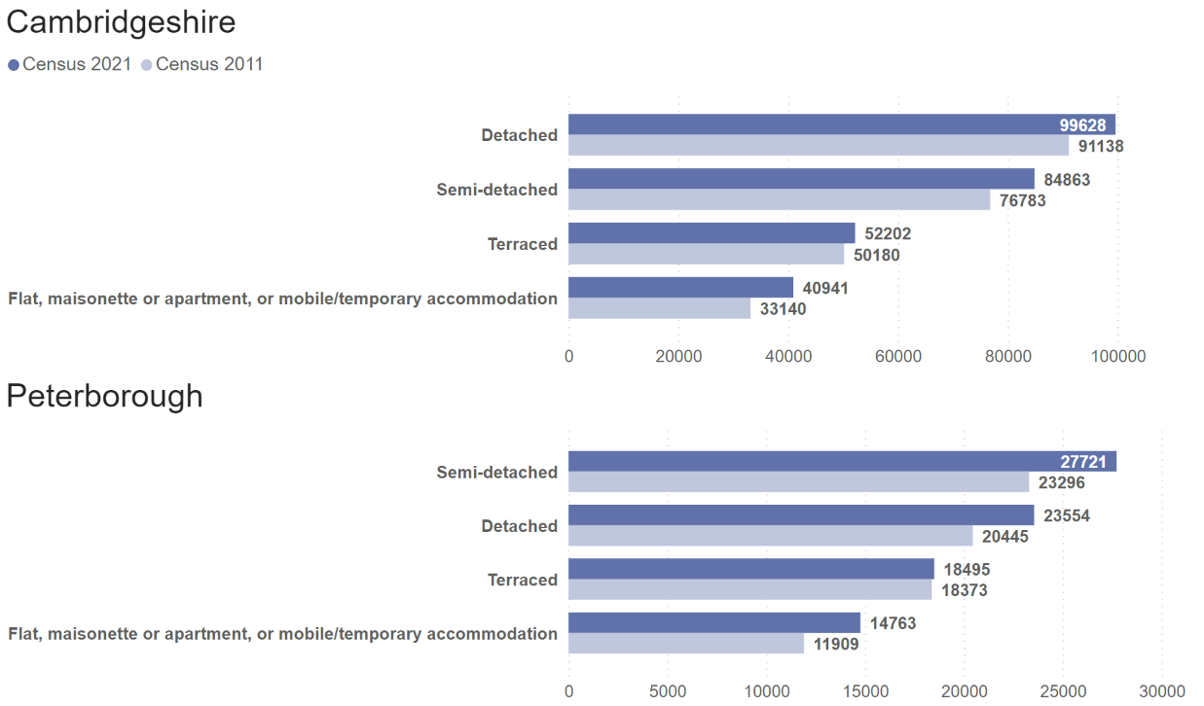
Number of occupied households by accommodation type, Census 2011 and Census 2021

Slide 10
Changes in tenure: Cambridgeshire
Similar to national trends, there has been an overall fall in the proportion of total households owning their homes and a rise in the proportion of households privately renting
63.8% (177,075 households) of total households are owned either outright or with a mortgage or loan compared to 66.0% at Census 2011
the proportion of households owning their home outright has increased from 31.9% in 2011 to 34.2% of total households, with increases in the numbers of these households seen across all districts,
but there has been a fall across all districts apart from South Cambridgeshire in numbers of households owning their home with a mortgage or loan, and they now account for 29.5% of total households compared to 34.1% at Census 2011
There have been rises of around one-third in the number of privately rented households across all districts:
at 53,690 they now account for 19.3% of total households compared
to 16.0% at Census 2011

Slide 11
Changes in tenure 2: Cambridgeshire
There has been a small rise of 0.4% in the proportion of total households which are shared ownership at Census 2021 compared to Census 2011:
ranging from no change in Fenland to a 0.6% increase in Huntingdonshire
the number of shared ownership households ranges from 236 in Fenland to 1,677 in South Cambridgeshire
Although there are 3,747 more social rented households (a rise of 9.7%) in Cambridgeshire, there has been little change in the proportion of the total that social rented households represent between Census 2011 (15.3%) and Census 2021 (15.2%):
increases in numbers of social rented households range from 5.2% (256 households) in East Cambridgeshire to 13.5% (1,150 households) in South Cambridgeshire

Slide 12
Cambridgeshire – number of households by tenure, Census 2011 and Census 2021
Tenure of Household | Number of households Census 2011 | Number of households Census 2021 | % of total households Census 2011 | % of total households Census 2021
Lives rent free | 3,760 | 215 | 1.5% | 0.1%
Owned: Owns outright | 80,204 | 95,061 | 31.9% | 34.2%
Owned: Owns with a mortgage or loan | 85,649 | 82,014 | 34.1% | 29.5%
Private rented: Other private rented | 4,154 | 6,892 | 1.7% | 2.5%
Private rented: Private landlord or letting agency | 35,965 | 46,798 | 14.3% | 16.9%
Shared ownership: Shared ownership | 3,003 | 4,401 | 1.2% | 1.6%
Social rented: Other social rented | 22,770 | 26,269 | 9.1% | 9.5%
Social rented: Rents from council or Local Authority | 15,736 | 15,984 | 6.3% | 5.8%
Grand Total | 251,241 | 277,634 | 100.0% | 100.0%
Social rented: as reported by respondents, but note there is evidence of people incorrectly identifying their
type of landlord as "Council or local authority" or "Housing association“ so the split between
Social rented: other and Social rented: rents from Council or Local Authority should be used with some caution

Slide 13
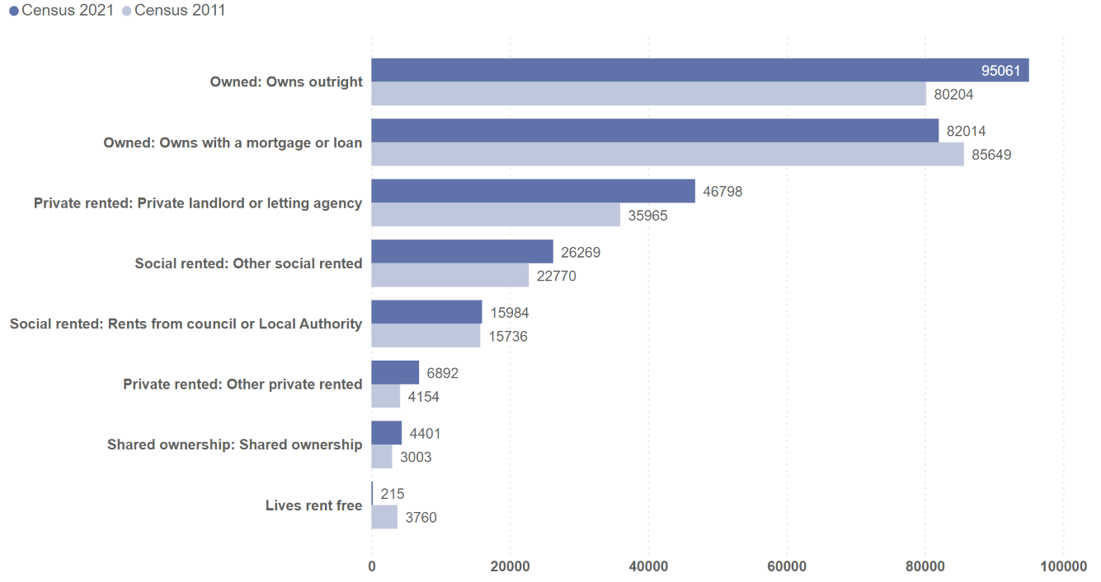
Cambridgeshire – number of households by tenure, Census 2011 and Census 2021

Slide 14
Changes in tenure: Peterborough
Similar to national trends and as seen in Cambridgeshire, there has been an overall fall in the proportion of total households owning their homes and a rise in the proportion of households privately renting
55.4% (46,892 households) of total households are owned either outright or with a mortgage or loan compared to 59.3% at Census 2011
the proportion of households owning their home outright has increased slightly from 25.8% in 2011 to 26.3% of total households,
but there has been a marginal fall in numbers of households owning their home with a mortgage or loan, and they now account for 29.1% of total households compared to 33.4% at Census 2011

Slide 15
Changes in tenure 2: Peterborough
There has been a rise of 45.5% in the number of privately rented households
at 20,612 they now account for almost one-quarter (24.4%) of total households compared to 19.1% at Census 2011
There has been an increase of 478 in the number of shared ownership households, they now account for 1.4% (1,167) of total households compared to 0.9% at Census 2011
There are 15,760 social rented households, an increase of 1,326, accounting for 18.6% of total households compared to 19.5% at Census 2011

Slide 16
Peterborough – number of households by tenure, Census 2011 and Census 2021
Tenure of Household | Number of households Census 2011 | Number of households Census 2021 | % of total households Census 2011 | % of total households Census 2021
Lives rent free | 855 | 102 | 1.2% | 0.1%
Owned: Owns outright | 19,134 | 22,268 | 25.8% | 26.3%
Owned: Owns with a mortgage or loan | 24,743 | 24,624 | 33.4% | 29.1%
Private rented: Other private rented | 1,313 | 1,937 | 1.8% | 2.3%
Private rented: Private landlord or letting agency | 12,855 | 18,675 | 17.4% | 22.1%
Shared ownership: Shared ownership | 689 | 1,167 | 0.9% | 1.4%
Social rented: Other social rented | 9,683 | 10,751 | 13.1% | 12.7%
Social rented: Rents from council or Local Authority | 4,751 | 5,009 | 6.4% | 5.9%
Grand Total | 74,023 | 84,533 | 100.0% | 100.0%
Social rented: as reported by respondents, but note there is evidence of people incorrectly identifying their
type of landlord as "Council or local authority" or "Housing association“ so the split between
Social rented: other and Social rented: rents from Council or Local Authority should be used with some caution

Slide 17
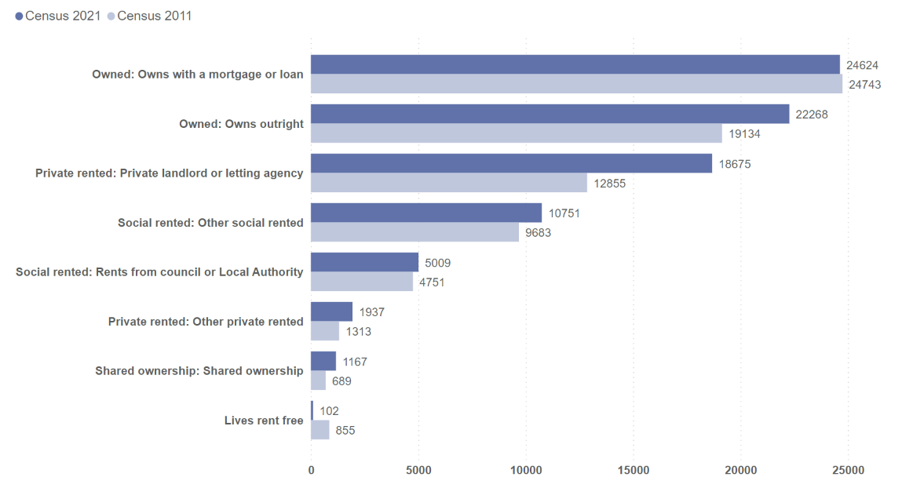
Peterborough – number of households by tenure, Census 2011 and Census 2021

Slide 18
Rise in overall proportion of households with 4 or more bedrooms
The number of households by number of bedrooms has increased across all sizes between Census 2011 and 2021
The largest numeric increases have been in numbers of households with 4 or more bedrooms and across all districts
The proportion of total households with four or more bedrooms has also increased across all districts:
from 26.2% of total households in 2011 to 28.2% in 2021 in Cambridgeshire,
households with 4 or more bedrooms now represent the largest sector in South Cambridgeshire (35.6% of total households)
from 20.1% in 2011 to 21.6% in 2021 in Peterborough

Slide 19
Fall in overall proportion of households with 3 bedrooms
The proportion of 1 and 2 bedroom households of total households in Cambridgeshire (34.6%) and Peterborough (36.4%) have remained similar between Census 2011 and 2021
Cambridge has a much higher proportion of 1 and 2 bedroom households (46.1%)
The proportion of total households accounted for by households with 3 bedrooms has fallen
from 39.1% of total in 2011 to 37.2% in 2021 in Cambridgeshire
from 43.8% in 2011 to 42.0% in 2021 in Peterborough

Slide 20
Households by number of bedrooms
Local authority | Number of bedrooms | Number of households Census 2011 | Number of households Census 2021 | % of total households Census 2011 | % of total households Census 2021
Cambridgeshire | 1 bedroom | 24,514 | 26,941 | 9.8% | 9.7%
Cambridgeshire | 2 bedrooms | 62,596 | 69,076 | 24.9% | 24.9%
Cambridgeshire | 3 bedrooms | 98,258 | 103,317 | 39.1% | 37.2%
Cambridgeshire | 4 or more bedrooms | 65,873 | 78,300 | 26.2% | 28.2%
Cambridgeshire | Grand Total | 251,241 | 277,634 | 100.0% | 100.0%
Peterborough | 1 bedroom | 8,722 | 9,608 | 11.8% | 11.4%
Peterborough | 2 bedrooms | 17,979 | 21,161 | 24.3% | 25.0%
Peterborough | 3 bedrooms | 32,433 | 35,502 | 43.8% | 42.0%
Peterborough | 4 or more bedrooms | 14,889 | 18,262 | 20.1% | 21.6%
Peterborough | Grand Total | 74,023 | 84,533 | 100.0% | 100.0%
In Census 2011, data was collected on number of households with 0 bedrooms, of which there were
500 in Cambridgeshire and 195 in Peterborough. In this table this data has been included within the
Census 2011 data for number of households with 1 bedroom

Slide 21
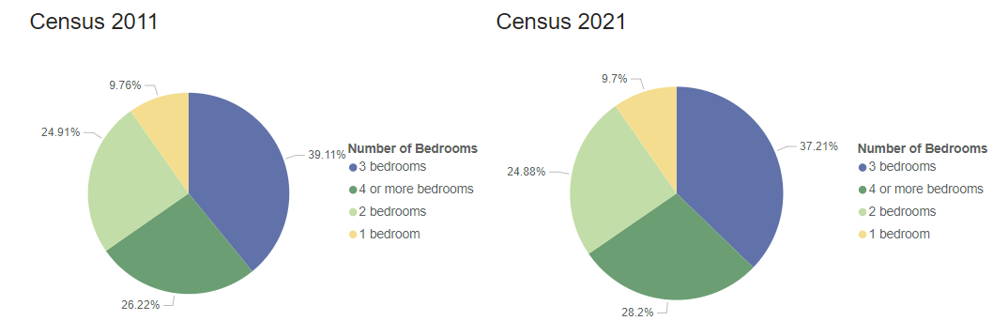
Cambridgeshire – proportion of households by number of bedrooms, Census 2011 and Census 2021
In Census 2011, data was collected on number of households with 0 bedrooms, of which there were
500 in Cambridgeshire. In this chart this data has been included within the Census 2011 data for
number of households with 1 bedroom

Slide 22
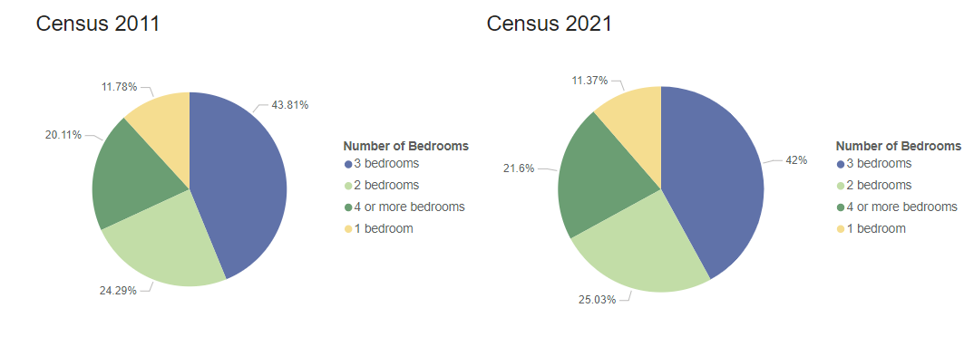
Peterborough – proportion of households by number of bedrooms, Census 2011 and Census 2021
In Census 2011, data was collected on number of households with 0 bedrooms, of which there were
195 in Peterborough. In this chart this data has been included within the Census 2011 data for
number of households with 1 bedroom

Slide 23
Overcrowding and under-occupancy (number of bedrooms)
The proportion of households classed as having the right number of bedrooms for its occupants is
22.8% of total households in Cambridgeshire, ranging from 18.4% in South Cambridgeshire to 35.3% in Cambridge, and being 28.6% in Peterborough, compared to the East of England average of 25.2% and national average of 26.8%
Overcrowding
In Cambridgeshire 6,714 households (2.4% of total) had fewer bedrooms than required and so are classed as overcrowded, compared to 7,531 households (3.0% of total) in 2011
this is lower than the national figure of 4.3%
Cambridge has the highest proportion of overcrowded households at 4.5%
In Peterborough 5,128 households (6.1%) had fewer bedrooms than required, compared to 3,807 (5.1%) in 2011
Under-occupation
The proportion of households with more bedrooms than required and so classed as under-occupied is little changed at Census 2021 compared to Census 2011
in Cambridgeshire 74.7% (207,493 households) are classed as under-occupied at 2021 compared to 74.9% (188,171) in 2011
ranging from 60.3% in Cambridge to 80.1% in South Cambridgeshire
national average is 68.8%
The proportion of households with more bedrooms than required in Peterborough was 65.3% (55,258), compared to 67.7% (50,145) in 2011

Slide 24
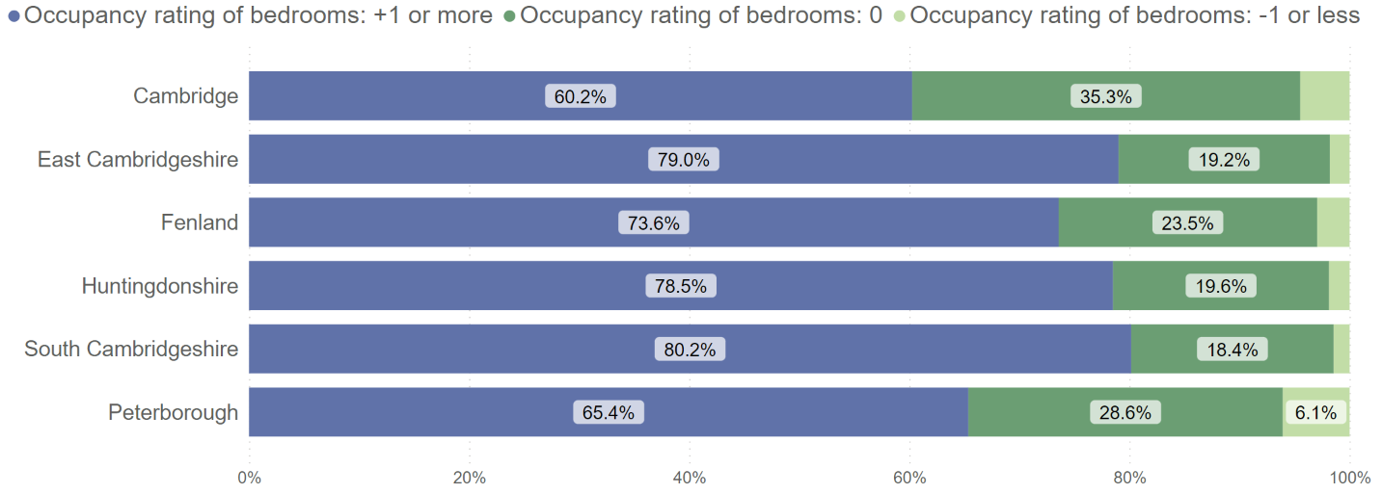
Cambridgeshire and Peterborough – proportion of households by occupancy rating for bedrooms, Census 2021
An occupancy rating of: -1 or less implies that a household's accommodation has fewer bedrooms than required (overcrowded), +1 or more implies that a household's accommodation has more bedrooms than required (under-occupied), and 0 suggests that a household's accommodation has an ideal number of bedrooms

Slide 25
Central heating
There has been a fall in the number of households with no central heating since Census 2011
2,964, 1.1% of, households in Cambridgeshire had no central heating in 2021, a decrease from 4,816 (1.9%) in 2011
1,024, 1.2% of, households in Peterborough had no central heating in 2021, this is a decrease from 1,145 (1.6%) in 2011
The most common type of central heating was mains gas or tank or bottled gas accounting for
194,961, 70.2% of, households in Cambridgeshire, this proportion has decreased from 2011 (72.5%)
65,779, 77.8% of households in Peterborough from 82.9% at Census 2011

Slide 26
Central heating: renewable energy
For the first time, Census 2021 recorded if a household used renewable energy sources
A total of 2,672 households (1.0%) in Cambridgeshire used renewable energy only and 2,807 (1.0%) used renewable energy alongside another source of energy
the proportion using renewable energy is highest in South Cambridgeshire (1.6% renewable energy only, 1.5% in combination with another source of energy)
A total of 216 households (0.3%) in Peterborough used renewable energy only and 669 (0.8%) used renewable energy alongside another source of energy

Slide 27
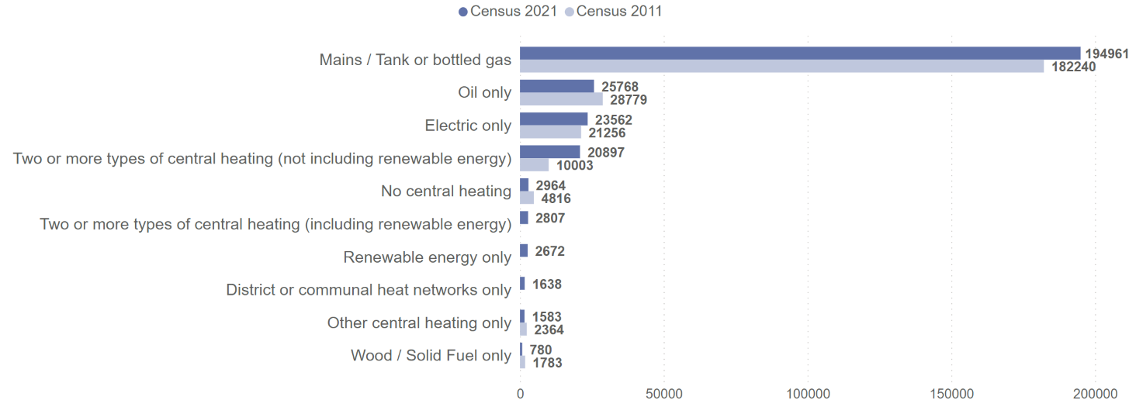
Cambridgeshire – number of households by central heating type, Census 2011 and Census 2021
In Census 2021, data on renewable energy and district or communal heat networks was collected for the first time, so comparable data from Census 2011 is not available

Slide 28
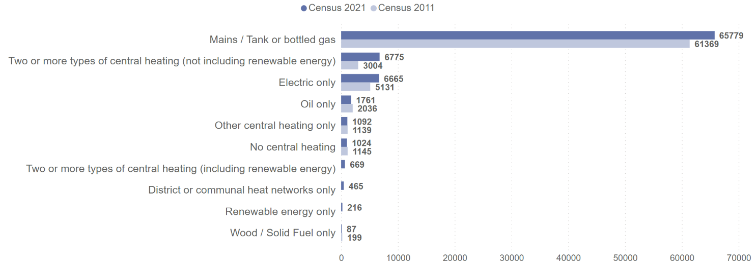
Peterborough – number of households by central heating type, Census 2011 and Census 2021
In Census 2021, data on renewable energy and district or communal heat networks was collected for the first time, so comparable data from Census 2011 is not available

Slide 29
Households with car or van availability
Although the number of households with no car or van available has generally increased(similar in East Cambridgeshire, decreased in Fenland) between Census 2011 and 2021, these households now generally represent a smaller proportion of total households (except in Cambridge)
In Cambridgeshire there are 46,904 of these households (16.9% of total) in 2021, (43,588 households, 17.3% of total at Census 2011)
the proportion of these households remains highest in Cambridge, 18,032 (34.4% of total) households at 2021, compared to 33.6% of total in 2011
in Fenland the number of households with no car or van available has fallen by 335, and now accounts for 15.9% of total households
in Peterborough 19,149 households (22.7% of total) had no car or van in the household at Census 2021, compared to 24.9% in 2011
There have been notable rises in numbers of households with 3 or more cars or vans available across all districts
in Cambridgeshire now accounting for 11.2% of households (9.7% Census 2011) and in Peterborough 7.7% of households (6.1% Census 2011)
in Cambridge the proportion is much lower at 4.0% of households, compared to 3.6% at Census 2011

Slide 30
Number of households by car or van availability
Local authority | Car or van availability | Number of households Census 2011 | Number of households Census 2021 | % of total households Census 2011 | % of total households Census 2021
Cambridgeshire | 1 car or van in household | 106,212 | 115,487 | 42.3% | 41.6%
Cambridgeshire | 2 cars or vans in household | 76,970 | 84,278 | 30.6% | 30.4%
Cambridgeshire | 3 or more cars or vans in household | 24,471 | 30,965 | 9.7% | 11.2%
Cambridgeshire | No cars or vans in household | 43,588 | 46,904 | 17.3% | 16.9%
Cambridgeshire | Grand Total | 251,241 | 277,634 | 100.0% | 100.0%
Peterborough | 1 car or van in household | 33,372 | 36,755 | 45.1% | 43.5%
Peterborough | 2 cars or vans in household | 17,712 | 22,088 | 23.9% | 26.1%
Peterborough | 3 or more cars or vans in household | 4,527 | 6,541 | 6.1% | 7.7%
Peterborough | No cars or vans in household | 18,412 | 19,149 | 24.9% | 22.7%
Peterborough | Grand Total | 74,023 | 84,533 | 100.0% | 100.0%

Slide 31
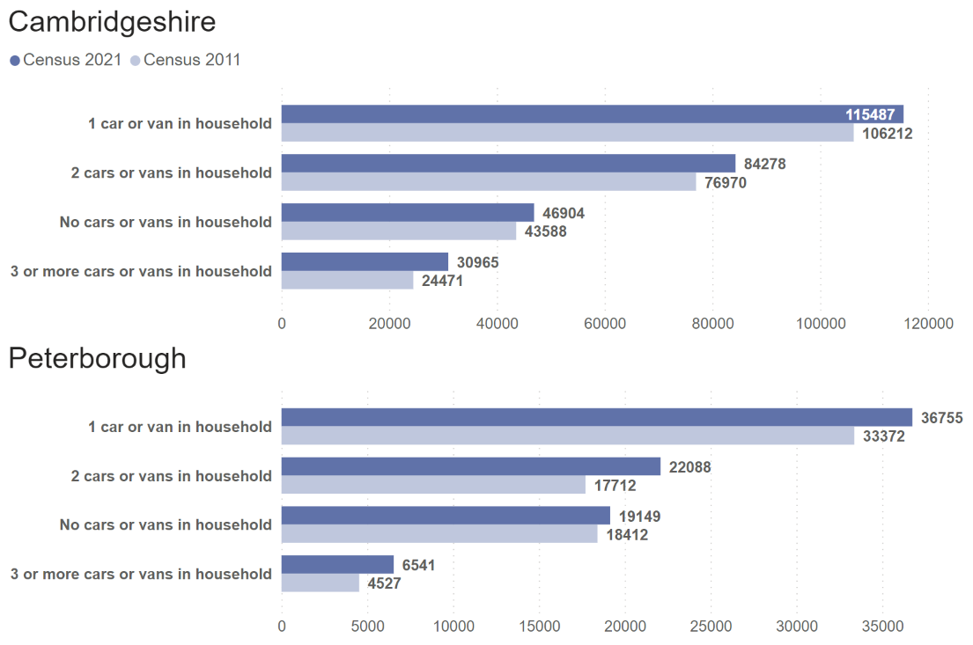
Number of households by car or van availability, Census 2011 and Census 2021

Slide 32
Usual residents with a second address
At Census 2021 50,997 (7.5%) usual residents in Cambridgeshire reported living at a second address for more than 30 days a year
an increase from 7.1% in 2011 and higher than the national average of 5.4%
16,999 (32.7%) of these were residents in Cambridge whose second address was for a student’s home address
Cambridge was the local authority with the second highest percentage of usual residents who used a second address nationally (19.6%, after Oxford with 20.5%)
the most common type of second address in the rest of Cambridgeshire was another parent or guardian’s address, ranging from 35.1% in South Cambridgeshire to 40.9% in East Cambridgeshire
of the usual residents who had a second address, 38,244 (75.0%) used an address in the UK and 12,752 (25.0%) an address outside the UK
In Peterborough, 7,701 (3.6%) usual residents reported living at a second address for more than 30 days a year, a decrease from 3.7% in 2011
the most common type of second address in Peterborough was another parent or guardian’s address (40.5%)
of the usual residents who used a second address, 5,719 (74.3%) used an address in the UK and 1,982 (25.7%) outside the UK

Slide 33
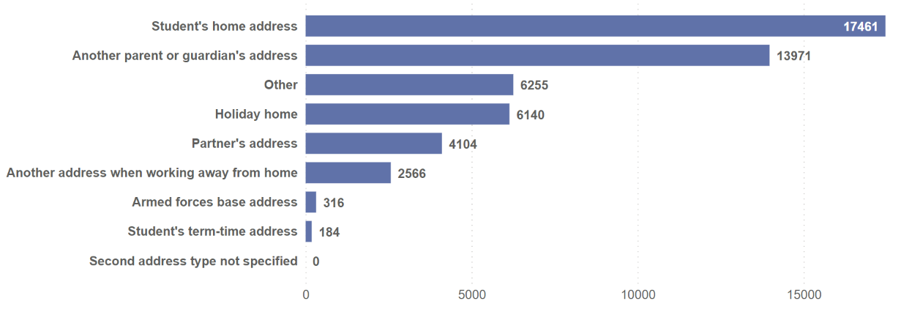
Cambridgeshire – number of usual residents with a second address by type, Census 2021

Slide 34
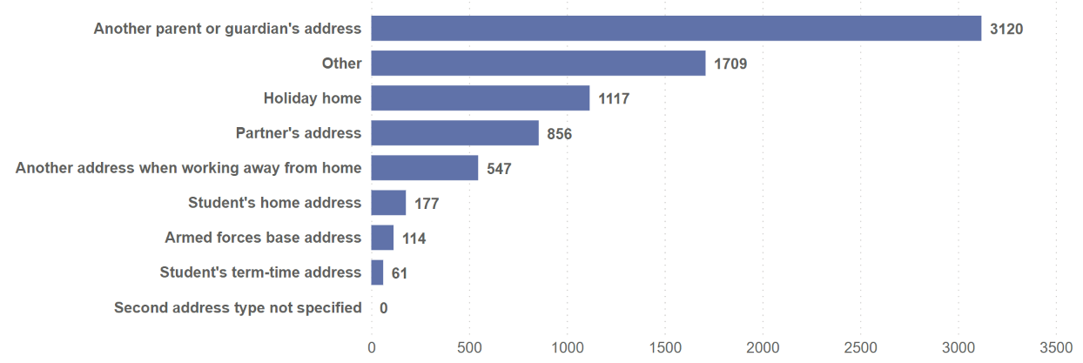
Peterborough – number of usual residents with a second address by type, Census 2021

Slide 35
Communal establishment residents, Cambridgeshire
In Census 2021, there were 25,241 usual residents in Cambridgeshire living in communal establishments (3.7% of all usual residents)
this is higher than 23,144 in 2011 (but a similar proportion to 3.7% of all usual residents in 2011)
At Census 2021, 47.4% of communal establishment residents in Cambridgeshire were female and 52.6% were male
64.1% of communal establishment residents in Cambridgeshire were aged 16-24 years, much higher than the national average of 46.3%
in Cambridge this rises to 79.6%, and it is likely that this group consists primarily of those in educational establishments such as university halls or boarding schools.
The percentage of communal establishment residents aged 75 years and older is higher for females than males
this may reflect the care home population and the difference in life expectancy between men and women

Slide 36
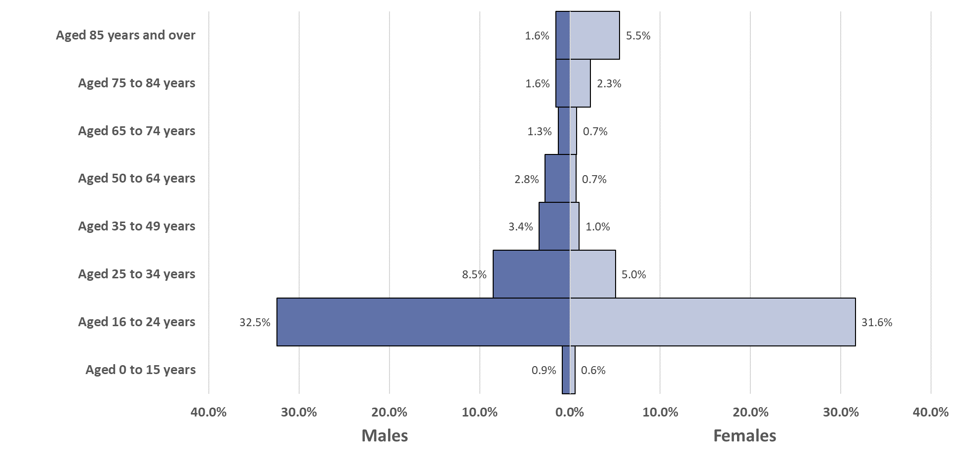
Cambridgeshire – population pyramid of communal establishment residents by their age group and sex, Census 2021 (% of total)

Slide 37
Communal establishment residents, Peterborough
In 2021, there were 2,207 people in Peterborough living in communal establishments (1.0% of all usual residents)
an increase from 1,804 in 2011 but a similar proportion (1.0%) of all usual residents
In 2021 42.1% of communal establishment residents in Peterborough were female and 57.9% were male
In contrast with Cambridgeshire, the age range of communal establishment residents in Peterborough is more evenly distributed
As with Cambridgeshire, the percentage of communal residents aged 75 years and older is much higher for females than males
this may reflect the care home population and the difference in life expectancy between men and women

Slide 38
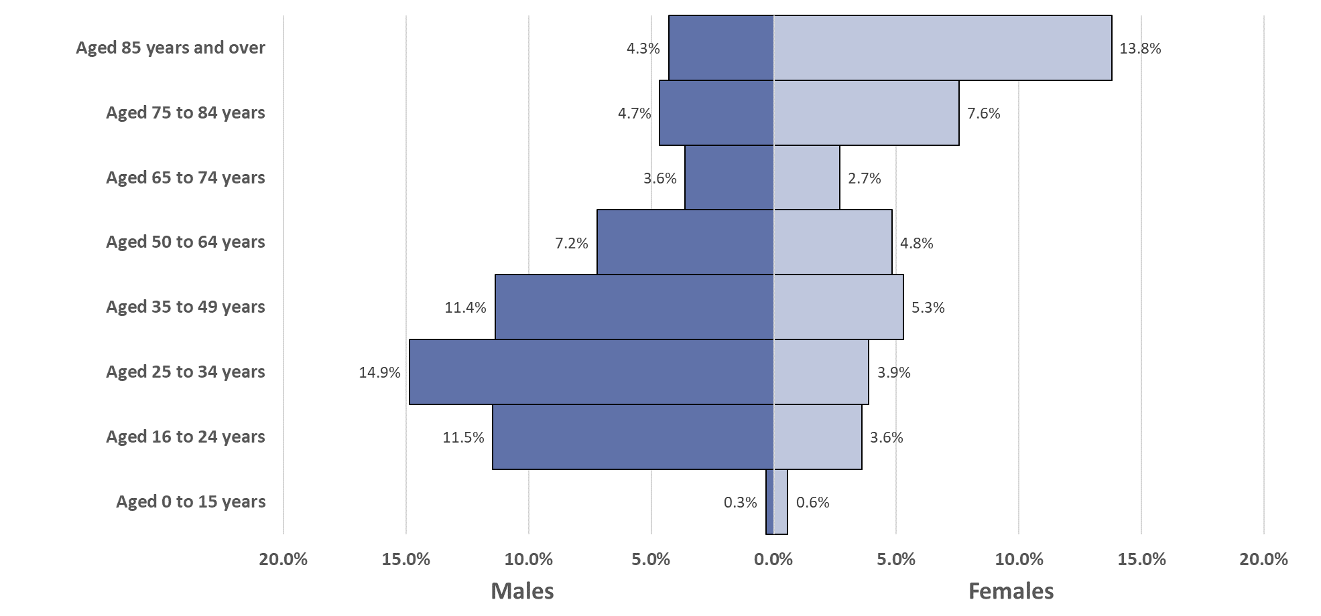
Peterborough – population pyramid of communal establishment residents by their age group and sex, Census 2021 (% of total)

Slide 39
Cambridge

Slide 40
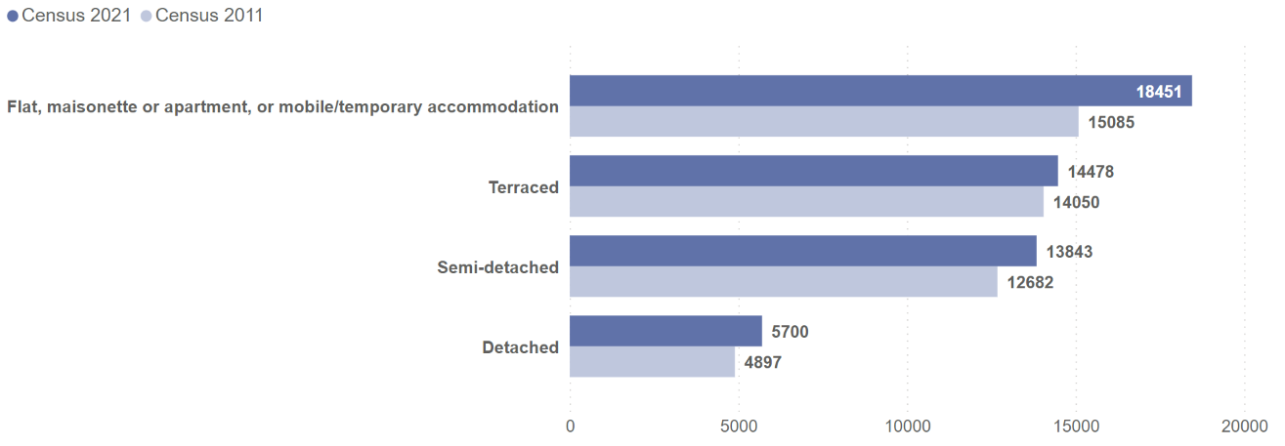
Cambridge – number of occupied households by accommodation type, Census 2011 and Census 2021

Slide 41
Cambridge – number of occupied households by accommodation type, Census 2021

Slide 42
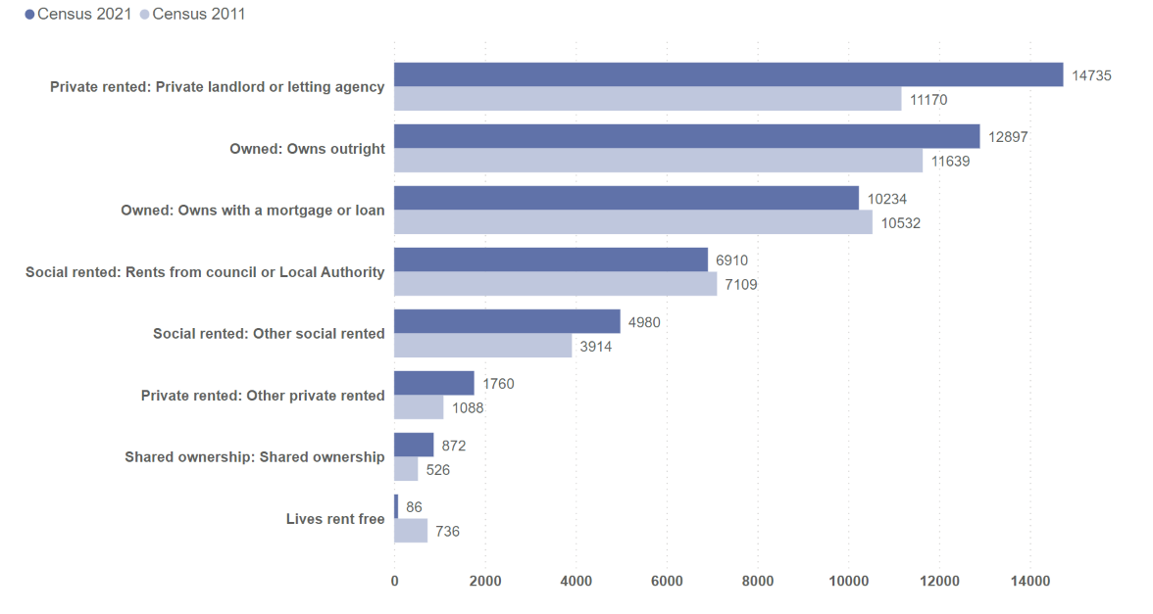
Cambridge – number of households by tenure, Census 2011 and Census 2021

Slide 43
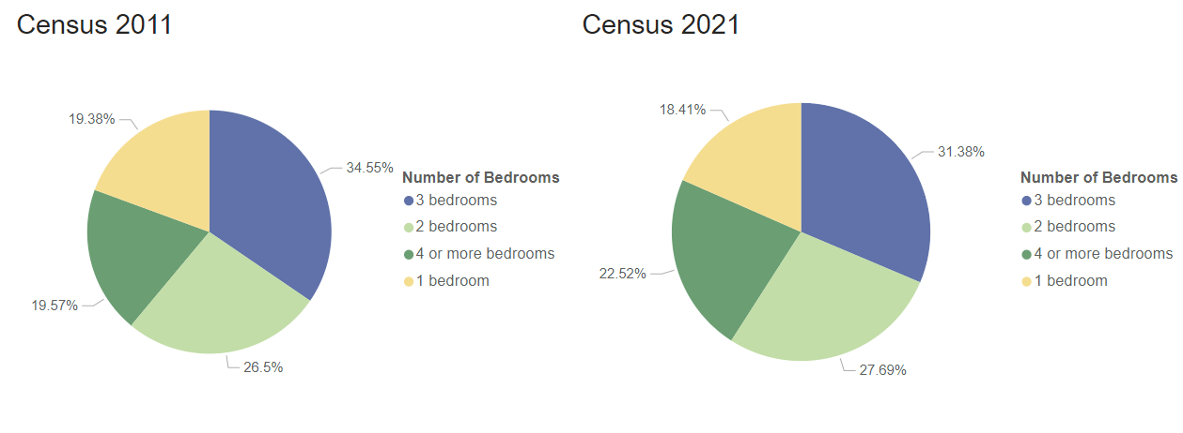
Cambridge – proportion of households by number of bedrooms, Census 2011 and Census 2021
In Census 2011, data was collected on number of households with 0 bedrooms, of which there were
164 in Cambridge. In this chart this data has been included within the Census 2011 data for
number of households with 1 bedroom.

Slide 44
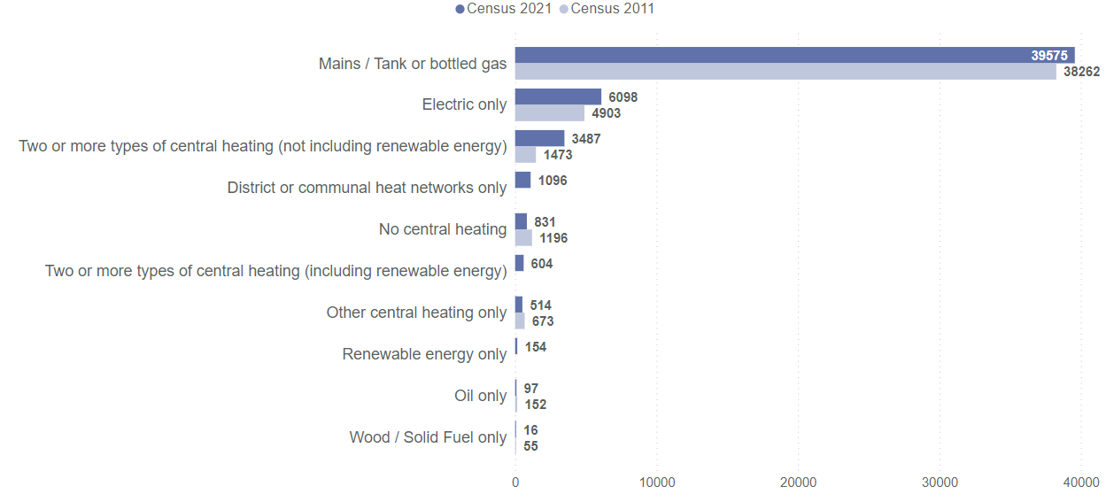
Cambridge – number of households by central heating type, Census 2011 and Census 2021
In Census 2021, data on renewable energy and district or communal heat networks was collected for the first time, so comparable data from Census 2011 is not available.

Slide 45
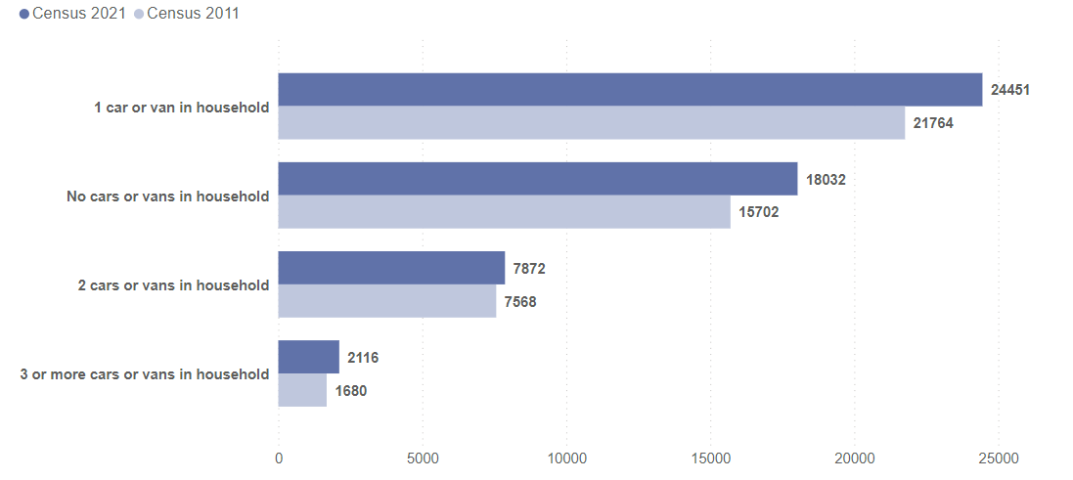
Cambridge – number of households by car or van availability, Census 2011 and Census 2021

Slide 46
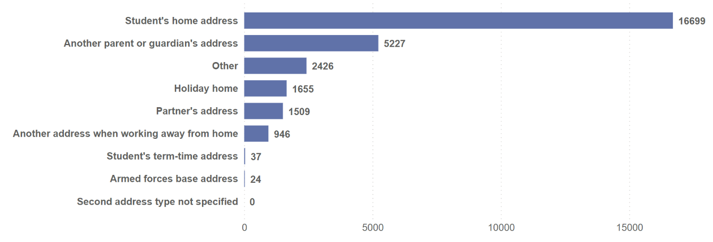
Cambridge – number of usual residents with a second address by type, Census 2021

Slide 47
East Cambridgeshire

Slide 48
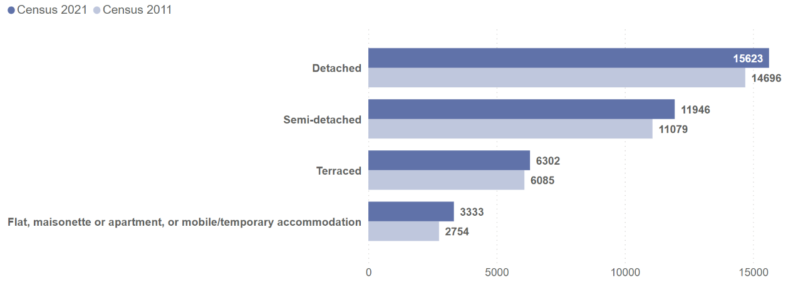
East Cambridgeshire – number of occupied households by accommodation type, Census 2011 and Census 2021

Slide 49
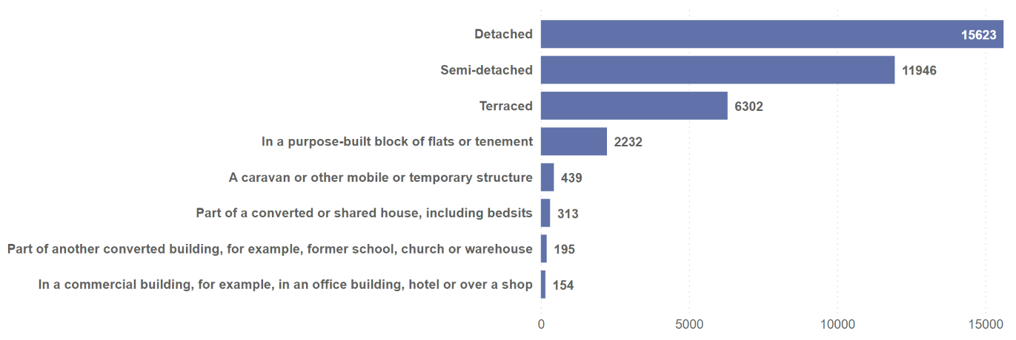
East Cambridgeshire – number of occupied households by accommodation type, Census 2021

Slide 50
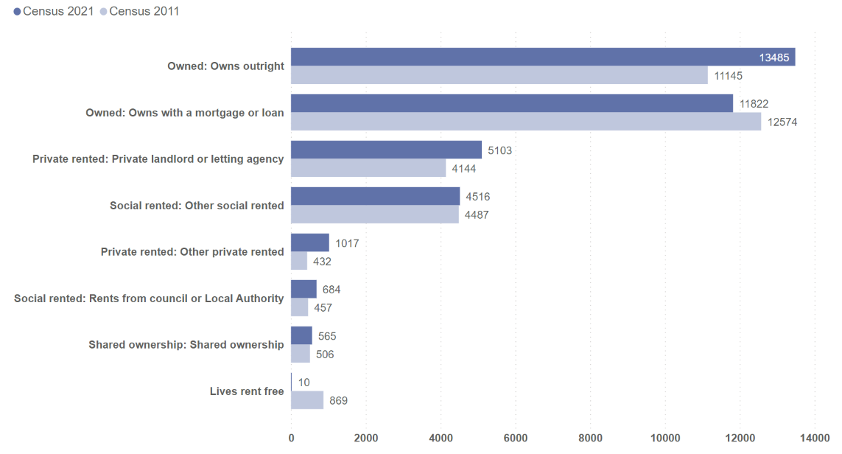
East Cambridgeshire – number of households by tenure, Census 2011 and Census 2021

Slide 51
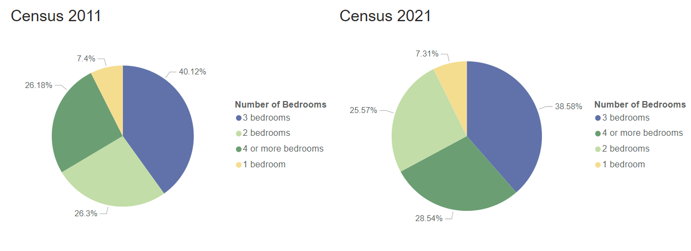
East Cambridgeshire – proportion of households by number of bedrooms, Census 2011 and Census 2021
In Census 2011, data was collected on number of households with 0 bedrooms, of which there were
48 in East Cambridgeshire. In this chart this data has been included within the Census 2011 data for
number of households with 1 bedroom.

Slide 52
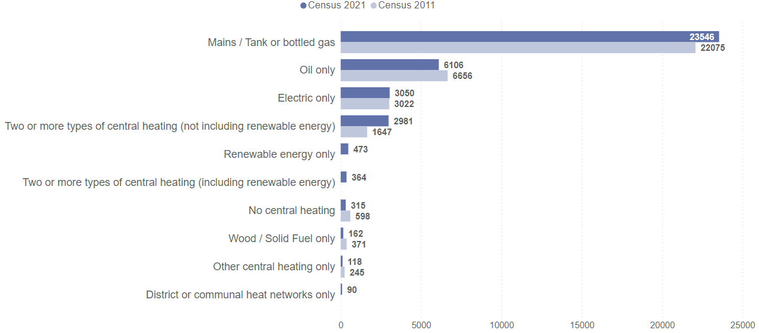
East Cambridgeshire – number of households by central heating type, Census 2011 and Census 2021
In Census 2021, data on renewable energy and district or communal heat networks was collected for the first time, so comparable data from Census 2011 is not available.

Slide 53
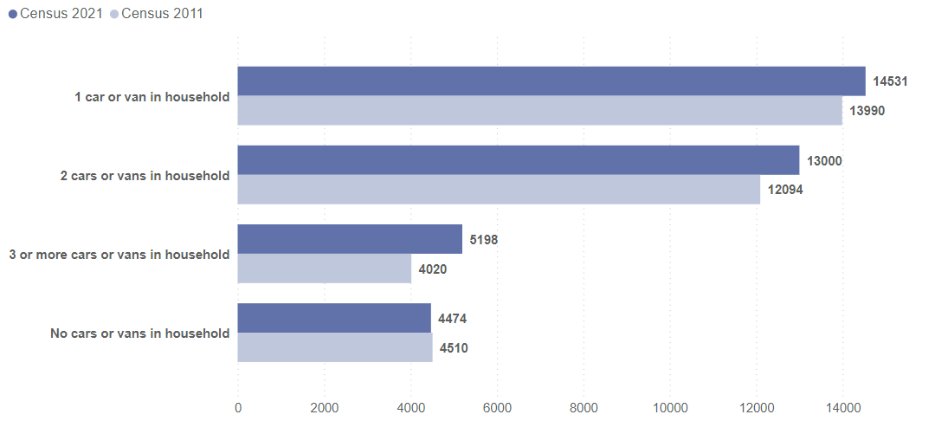
East Cambridgeshire – number of households by car or van availability, Census 2011 and Census 2021

Slide 54
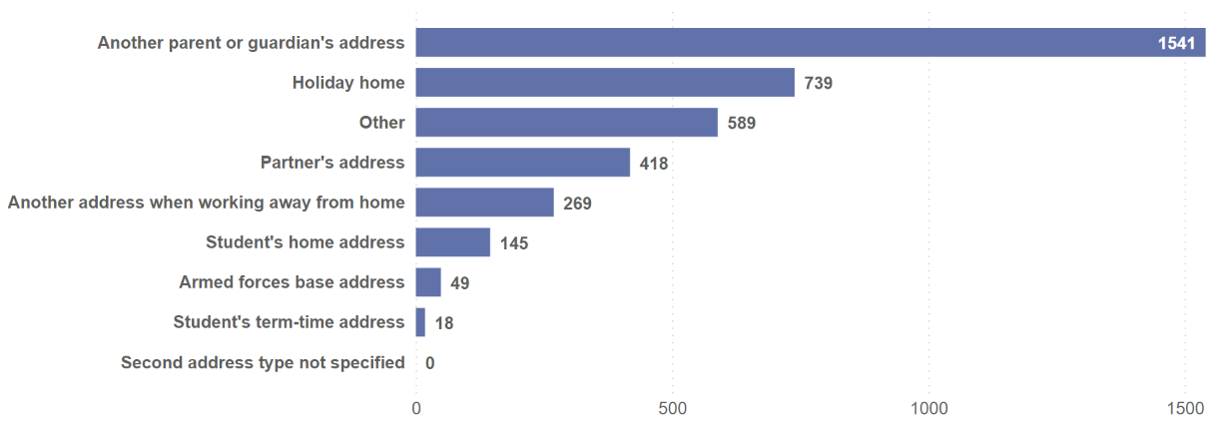
East Cambridgeshire – number of usual residents with a second address by type, Census 2021

Slide 55
Fenland

Slide 56
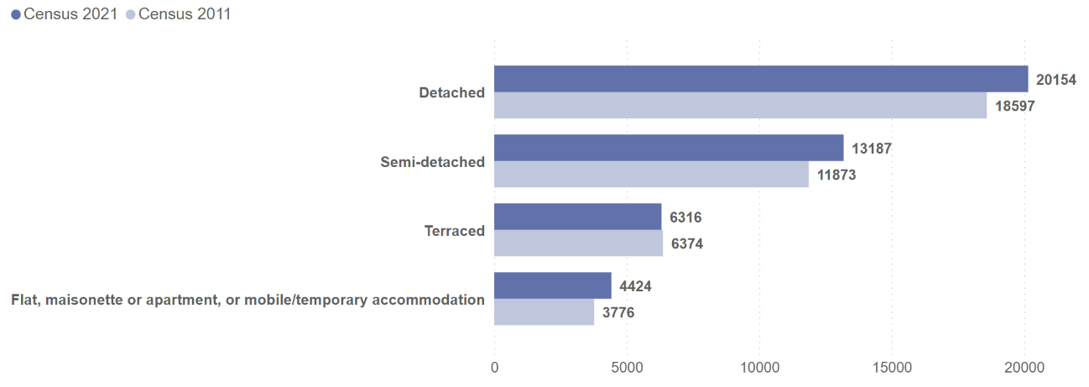
Fenland – number of occupied households by accommodation type, Census 2011 and Census 2021

Slide 57
Fenland – number of occupied households by accommodation type, Census 2021

Slide 58
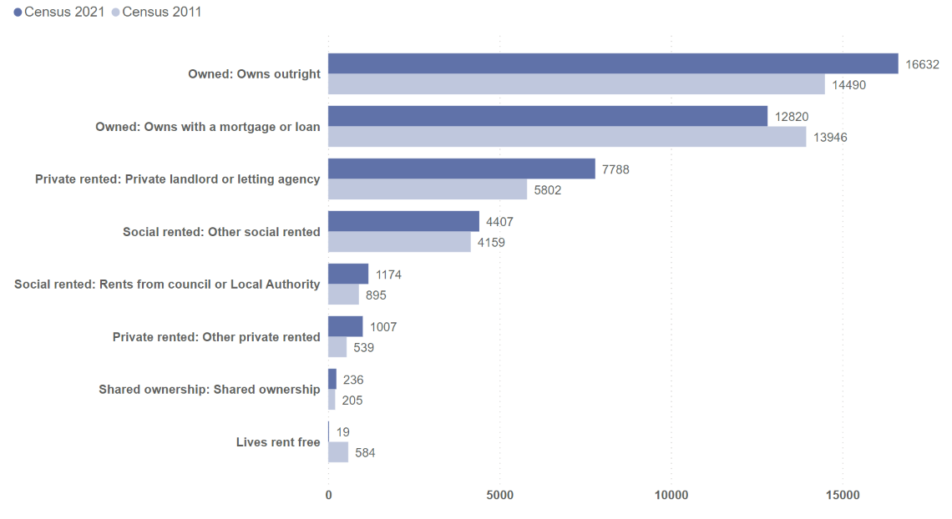
Fenland – number of households by tenure, Census 2011 and Census 2021

Slide 59
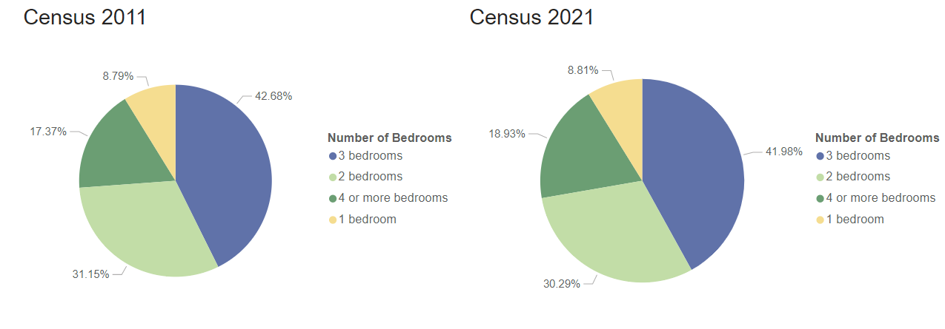
Fenland – proportion of households by number of bedrooms, Census 2011 and Census 2021
In Census 2011, data was collected on number of households with 0 bedrooms, of which there were
82 in Fenland. In this chart this data has been included within the Census 2011 data for
number of households with 1 bedroom.

Slide 60
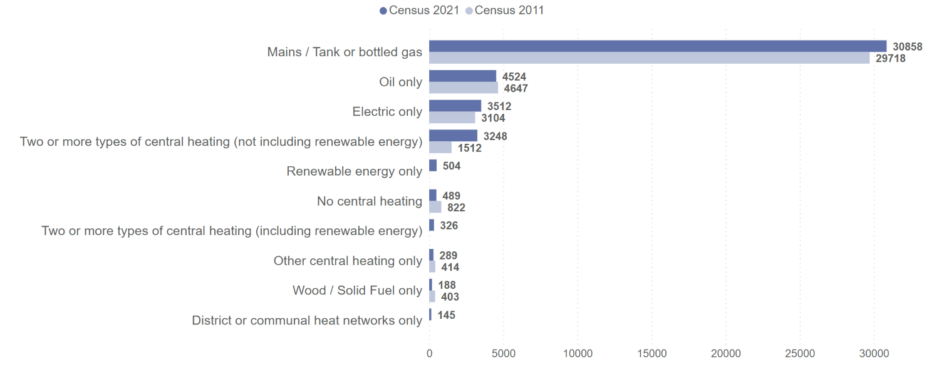
Fenland – number of households by central heating type, Census 2011 and Census 2021
In Census 2021, data on renewable energy and district or communal heat networks was collected for the first time, so comparable data from Census 2011 is not available.

Slide 61
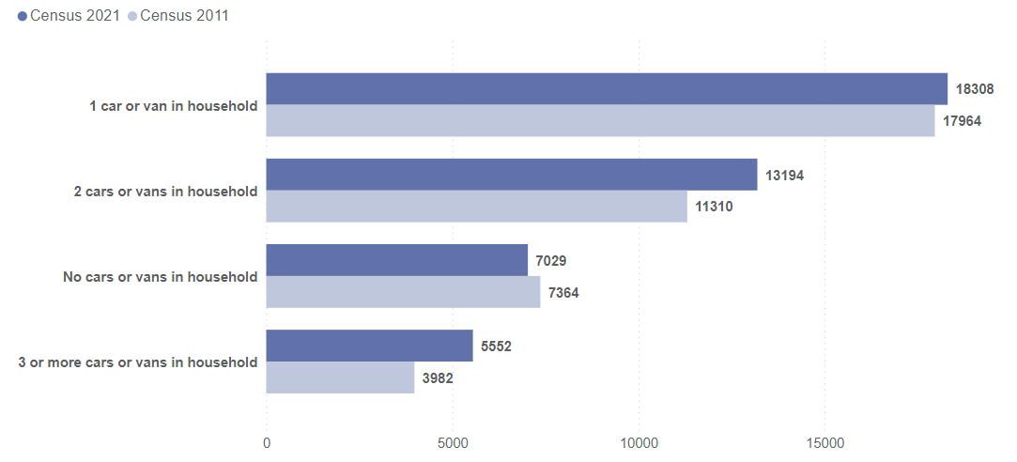
Fenland – number of households by car or van availability

Slide 62
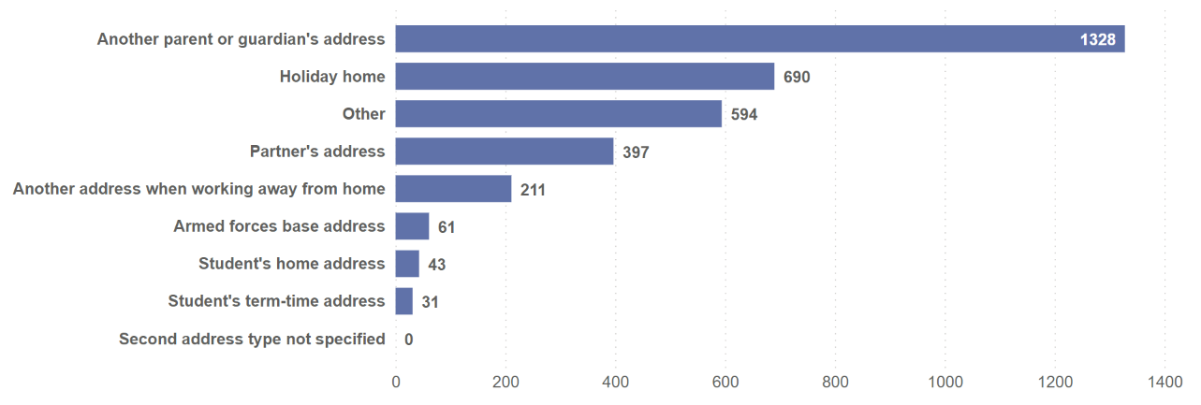
Fenland – number of usual residents with a second address by type, Census 2021

Slide 63
Huntingdonshire

Slide 64
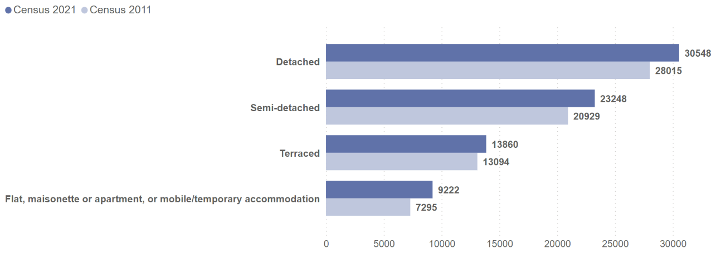
Huntingdonshire – number of occupied households by accommodation type, Census 2011 and Census 2021

Slide 65
Huntingdonshire – number of occupied households by accommodation type, Census 2021

Slide 66
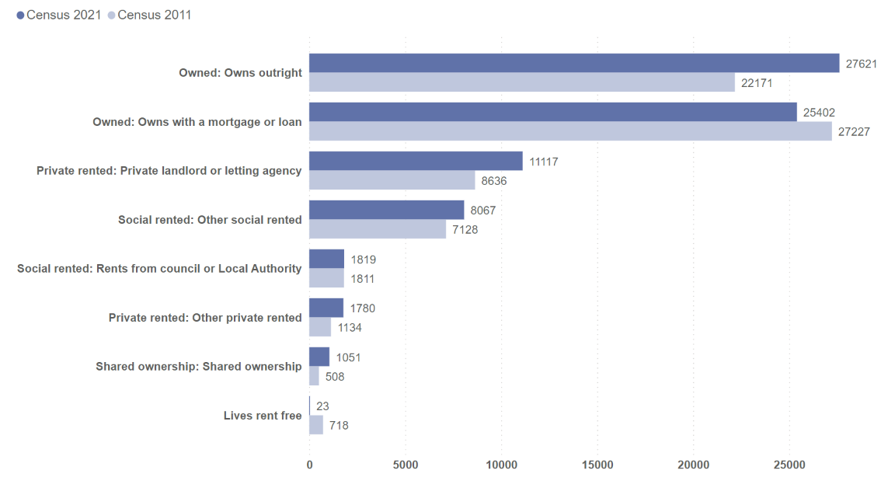
Huntingdonshire – number of households by tenure, Census 2011 and Census 2021

Slide 67
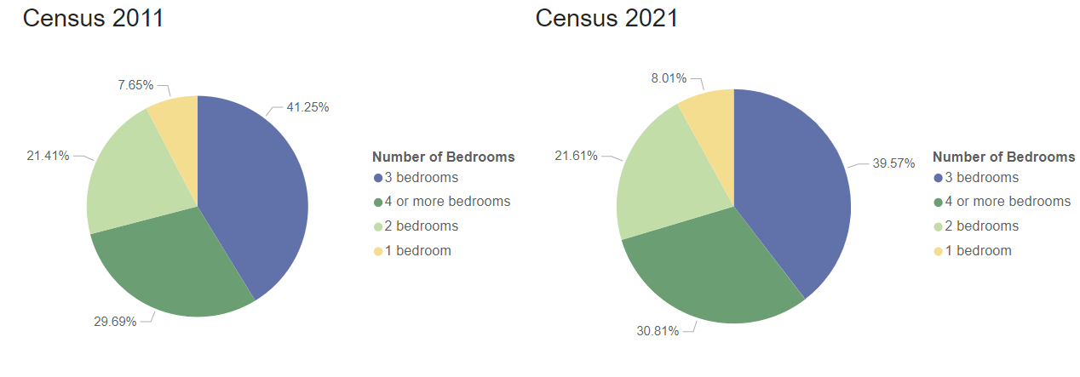
Huntingdonshire – proportion of households by number of bedrooms, Census 2011 and Census 2021
In Census 2011, data was collected on number of households with 0 bedrooms, of which there were
118 in Huntingdonshire. In this chart this data has been included within the Census 2011 data for
number of households with 1 bedroom.

Slide 68
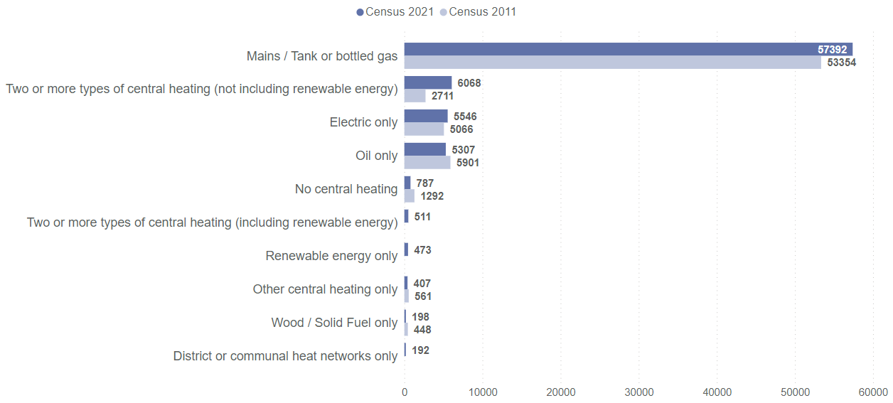
Huntingdonshire – number of households by central heating type, Census 2011 and Census 2021
In Census 2021, data on renewable energy and district or communal heat networks was collected for the first time, so comparable data from Census 2011 is not available.

Slide 69
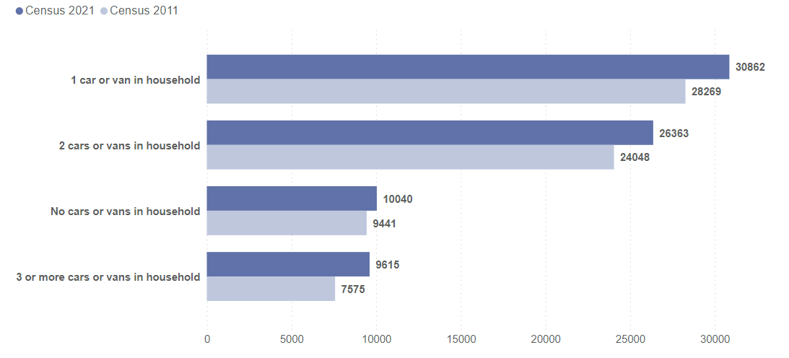
Huntingdonshire – number of households by car or van availability, Census 2011 and Census 2021

Slide 70
Huntingdonshire – number of usual residents with a second address by type, Census 2021

Slide 71
South Cambridgeshire

Slide 72
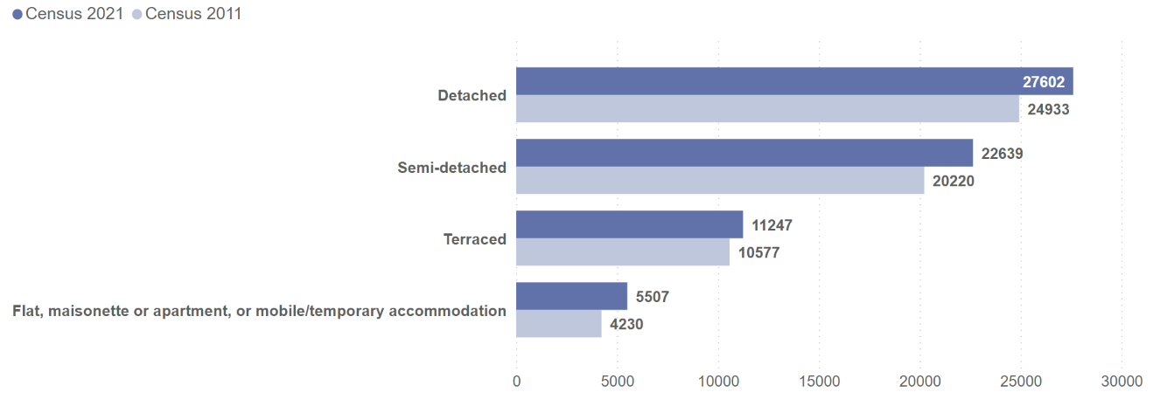
South Cambridgeshire – number of occupied households by accommodation type, Census 2011 and Census 2021

Slide 73
South Cambridgeshire – number of occupied households by accommodation type, Census 2021

Slide 74
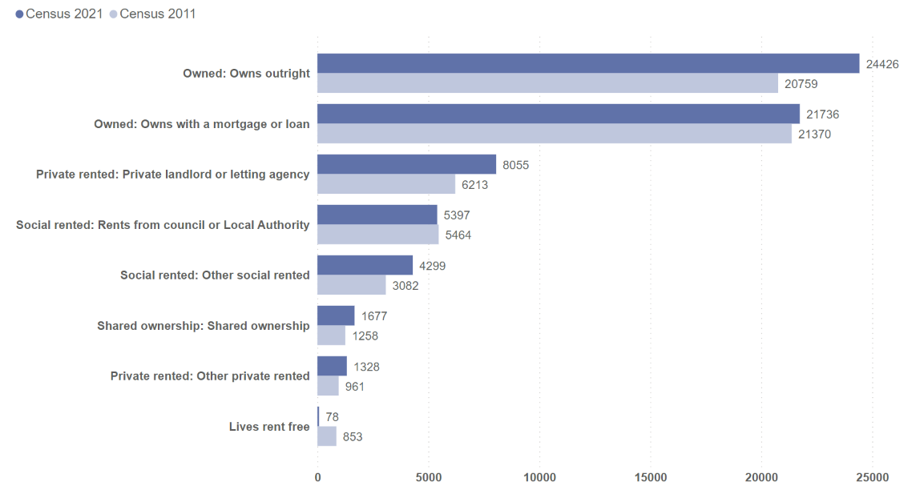
South Cambridgeshire – number of households by tenure, Census 2011 and Census 2021

Slide 75
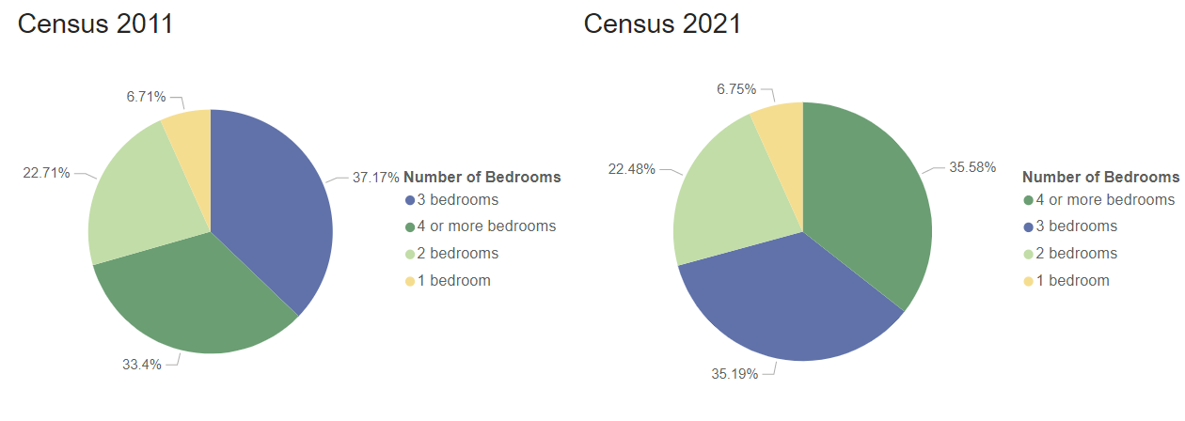
South Cambridgeshire – proportion of households by number of bedrooms, Census 2011 and Census 2021
In Census 2011, data was collected on number of households with 0 bedrooms, of which there were
88 in South Cambridgeshire. In this chart this data has been included within the Census 2011 data for
number of households with 1 bedroom.

Slide 76
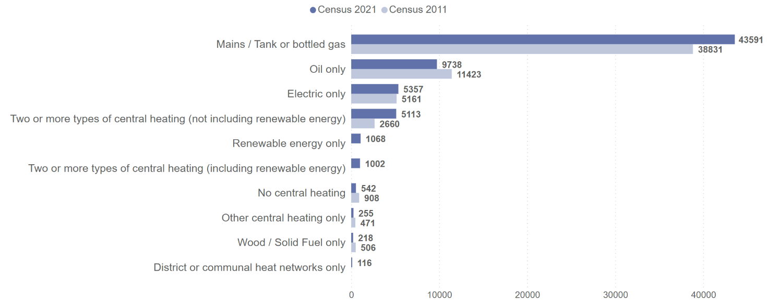
South Cambridgeshire – number of households by central heating type, Census 2011 and Census 2021
In Census 2021, data on renewable energy and district or communal heat networks was collected for the first time, so comparable data from Census 2011 is not available.

Slide 77
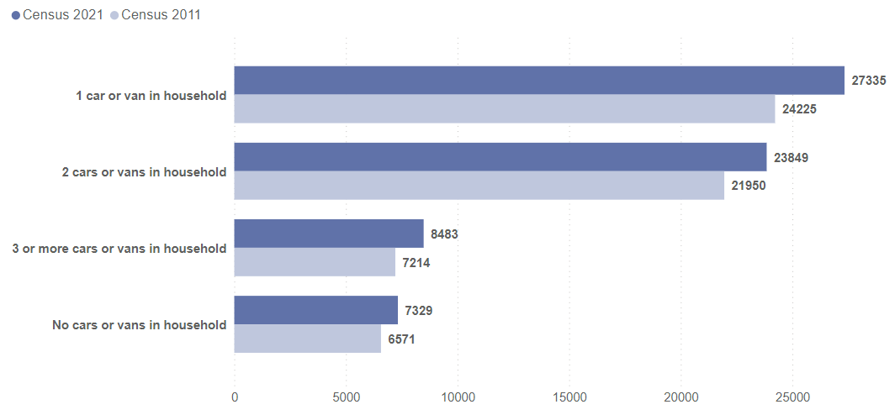
South Cambridgeshire – number of households by car or van availability, Census 2011 and Census 2021

Slide 78
South Cambridgeshire – number of usual residents with a second address by type, Census 2021

Slide 79
Peterborough

Slide 80
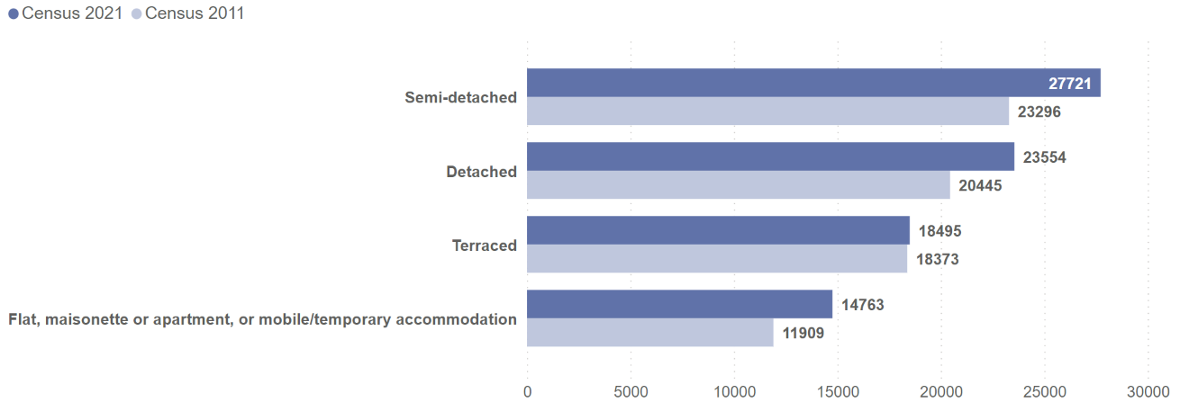
Peterborough – number of occupied households by accommodation type, Census 2011 and Census 2021

Slide 81
Peterborough – number of occupied households by accommodation type, Census 2021

Slide 82
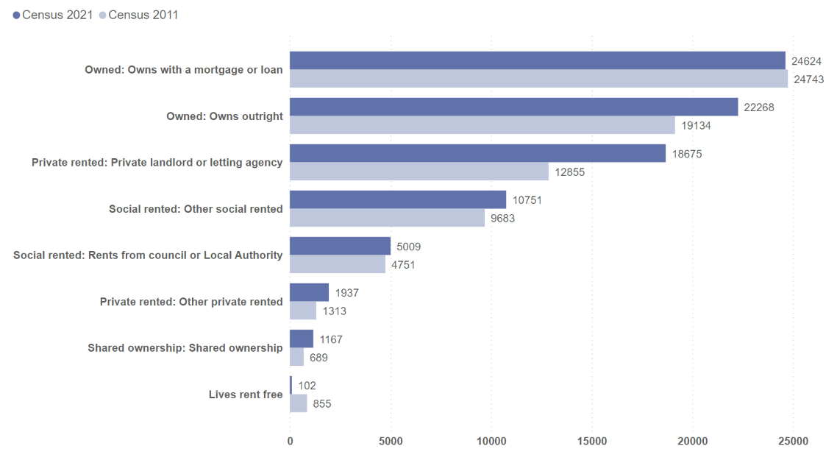
Peterborough – number of households by tenure, Census 2011 and Census 2021

Slide 83
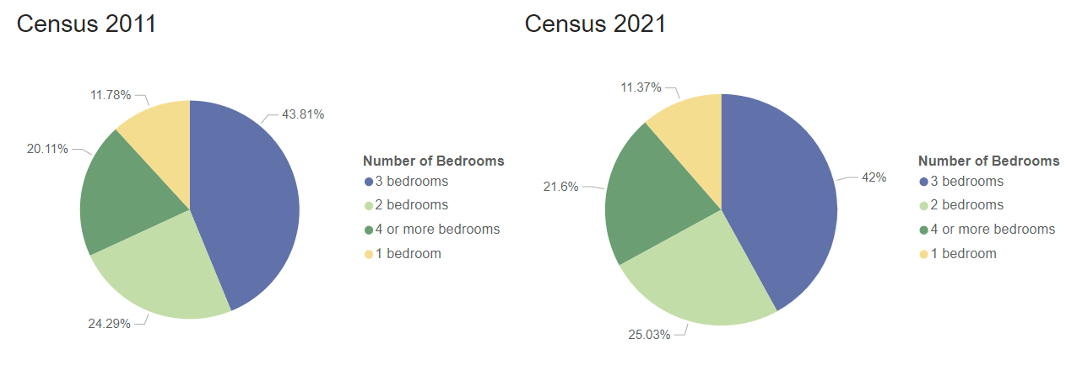
Peterborough – proportion of households by number of bedrooms, Census 2011 and Census 2021
In Census 2011, data was collected on number of households with 0 bedrooms, of which there were
195 in Peterborough. In this chart this data has been included within the Census 2011 data for
number of households with 1 bedroom.

Slide 84
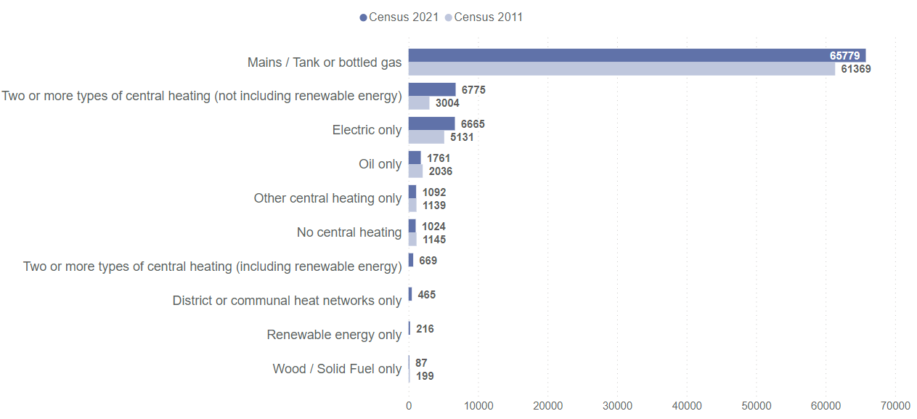
Peterborough – number of households by central heating type, Census 2011 and Census 2021
In Census 2021, data on renewable energy and district or communal heat networks was collected for the first time, so comparable data from Census 2011 is not available.

Slide 85
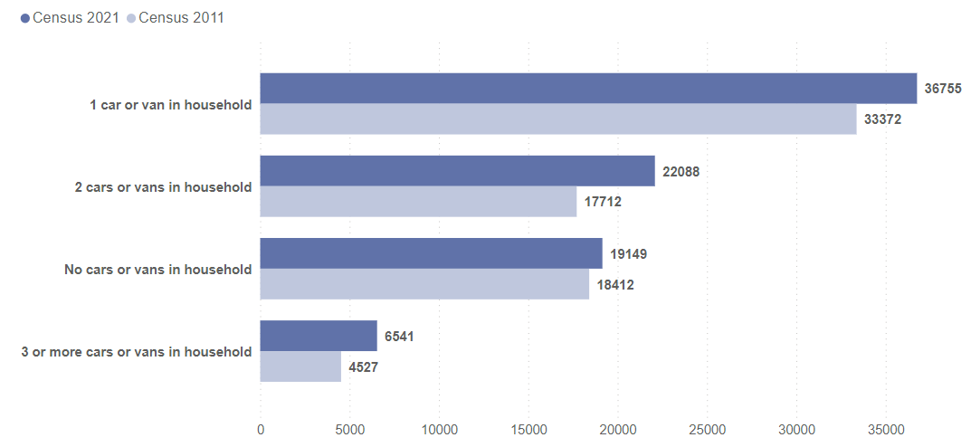
Peterborough – number of households by car or van availability, Census 2011 and Census 2021

Slide 86
Peterborough – number of usual residents with a second address by type, Census 2021

Slide 87
Census 2021: useful links
Census 2021 Cambridgeshire Insight – Population – Census 2021 webpages on Cambridgeshire Insight, including:
Census 2021 first results: published report, recorded presentation and dataset,
Census 2021 topic summaries: Cambridgeshire and Peterborough summaries and further resources available
Cambs Insight tools already have demography and migration datasets, and they will be updated with the release of each topic summary:
Map explorer
Data explorer
Census 2021 data published on the ONS website and on NOMIS
ONS tools:
Census maps
Area profiles – available on NOMIS at local authority level. Build your own area profiles has a release date of 17th January 2023
How your area has changed in 10 years: Census 2021

Slide 88
Definitions
Usual resident population
Anyone in the UK and had stayed or intended to stay in the UK for a period of 12 months or more; or
Had a permanent UK address and was outside the UK and intended to be outside the UK for less than 12 months
Households
One person living alone; or
A group of people (not necessarily related) living at the same address, who share cooking facilities and share a living room or sitting room or dining area
Must contain at least one usual resident
Accommodation type
The type of building or structure used by an individual or household. This could be: the whole house or bungalow, a flat, maisonette or apartment, or a temporary or mobile structure such as a caravan
Car or van availability
The number of cars or vans owned or available for use by household members
Cars or vans used by communal establishment residents are not included

Slide 89
Definitions (continued)
Central heating
Central heating is a heating system used to heat multiple rooms in a building by circulating air or heated water through pipes to radiators or vents. Single or multiple fuel sources can fuel these systems
Central heating systems that are unused or not working are still considered
Occupancy rating
Whether a household's accommodation is overcrowded, ideally occupied or under-occupied.
An occupancy rating of: -1 or less implies that a household's accommodation has fewer bedrooms than required (overcrowded), +1 or more implies that a household's accommodation has more bedrooms than required (under-occupied), and 0 suggests that a household's accommodation has an ideal number of bedrooms
Tenure
Whether a household rents or owns the accommodation that it occupies. Households that rent their accommodation were asked what type of landlord owns or manages it
Second address
Indicates whether a person has an alternative address (somewhere they stay for more than 30 days per year)

Slide 90
Comparability to Census 2011
Some datasets in this briefing may contain variables that are not directly comparable to Census 2011
Central heating: Census 2021 collected data on renewable energy and district or communal heating systems for the first time, so comparable data for Census 2011 is not available
Communal establishments: a change in the definition of some housing types means that some addresses defined as communal establishments in Census 2011 may now be defined as households in Census 2021
Number of bedrooms: Census 2021 removed the option for 0 bedrooms which was present in Census 2011. This briefing includes Census 2011 data for 0 bedrooms within the Census 2011 1 bedroom variable
Due to ONS statistical disclosure controls used for Census 2021, the totals between different datasets may not be identical, including where data is aggregated from district level to county level. This briefing uses Census 2021 data published at county level for county analysis and district level for district analysis

