Slide 1
Changing Futures Cambridgeshire & Peterborough Strategic Group

Slide 2
Welcome and Introductions
Robert Pollock
(Cambridge City Council)
Notes:
Use this design for sub-section titles within a presentation

Slide 3
Programme update
Tom Tallon
(Counting Every Adult)
Carl Brown
(Making Every Adult Matter)
Notes:
Use this design to present text, images or charts and graphs

Slide 4
Recent progress
Appointment of MEAM in October to help lay the foundations for the programme
Change Forums
Coproduction
Fenland / East Cambridgeshire Partnership
Changing Futures Cambridgeshire and Peterborough SharePoint Site
Cambridgeshire Insight – Changing Futures Cambridgeshire & Peterborough

Slide 5
Vision and Values
“To support people with multiple disadvantages to live better lives, as defined by them.”
Purpose (why)
Visions (what)
Principles (how)
Trusted Person
Trauma Informed
Shared Learning
Co-creation
- Recognising complexity
- Building trust
- Open (no wrong) door
- Meeting people where they are
- Embrace learning

Slide 6
Infrastructure and System Relationships
Supported Housing providers
Op’s case-load
Council
Adult social care
Tactical group
Strategic group
MEAM cohort
Coordinator
Service / Systems Issues
Embedded systems issues
Embedded systems issues
Systems Flex
Change forum
Systems Change
Systems Change
Police
Voluntary sector
Coproduction Hubs
Lived experience
Systems agents
Systems Agent Support Network
Service / Systems Issues
Systems Flex
Other parts of the system
Notes:
Name the bits that are happening
- This

Slide 7
Programme Team Development

Slide 8
The National Multiple Disadvantage Context
Oliver Hilbery (Making Every Adult Matter)
Notes:
Alternative design to present text, images or charts and graphs

Slide 9
History of multiple disadvantage work
Revolving Doors Link worker prog
Lankelly Chase - PCN and place-based approaches
Homeless Link MCN project
MEAM Approach model and network
RSU
ACE pilots
TNLCF Fulfilling Lives programme
RSI and HMI Initiative
Supporting People
Public Service Transformation Network
RSI
Social Exclusion Unit and SETF
Social Justice Strategy and SJCC
Changing Futures
1990 1995 2000 2005 2010 2015 2020 2025
RDA formed
Reaching Out – An Action Plan on Social Exclusion
MEAM formed
MA network launched
Fulfilling Lives launched
Hardest to Reach?
Changing Futures launched
Turning the Tide
Note: Dates are approximate and graphic is not comprehensive

Slide 10
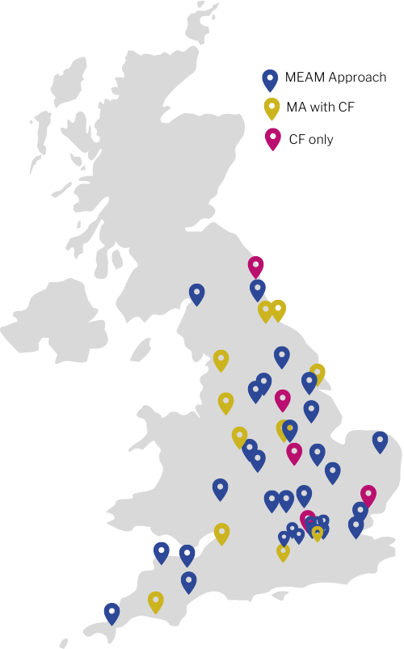
National networks
MEAM Approach network [2012 – to date]
(42 areas, including 11 with CF funding)
Fulfilling Lives programme [2014 – 2022]
(12 areas)
Changing Futures programme [2021 – to date] (15 areas - 11 were MA or FL areas)

Slide 11
Similarities and differences
 | MEAM Approach | Fulfilling Lives | Changing Futures | Cambs/P’borough
Funding | Locally pooled, often small scale | External - Lottery grant, large scale | External - Government grant, large scale | Locally pooled – significant investment
Leadership | Cross-sector p’ships, often statutory lead | VCS lead with wider partners | Statutory lead with wider partners | Cross-sector partnership, statutory lead
Scale of beneficiaries reached | Small to medium | Large | Large | Medium
Oversight from | MEAM and MA network peers | Lottery team | CF team in govt | Local accountability
External support | MEAM team, Cordis Bright eval | MEAM team, CFE team eval | Social Finance, CFE/CB eval | MEAM team (commissioned)
Systems change ambitions | Yes | Yes | Yes | Yes

Slide 12
The Changing Futures Learning Eco System
Sue Beecroft
(Cambridge City Council)

Slide 13
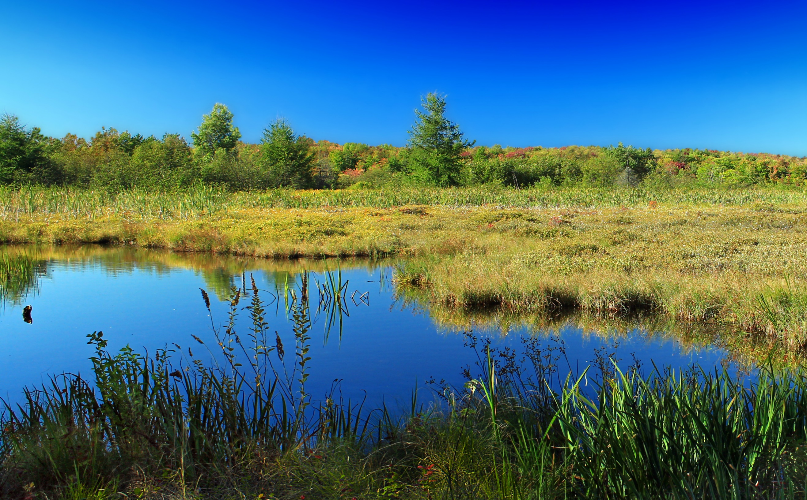
Changing Futures
“Ecosystem of Learning” diagram
CPPSB
Rain
The four pools
System Agents
Information
Co-production groups
Operational Partnerships
Learning &
change
Other sources
Evaporation
Changing Futures team
Change Forums
Tactical Group
Strategic Board
The Sea =
The system
The four lakes
Notes:
Sue

Slide 14
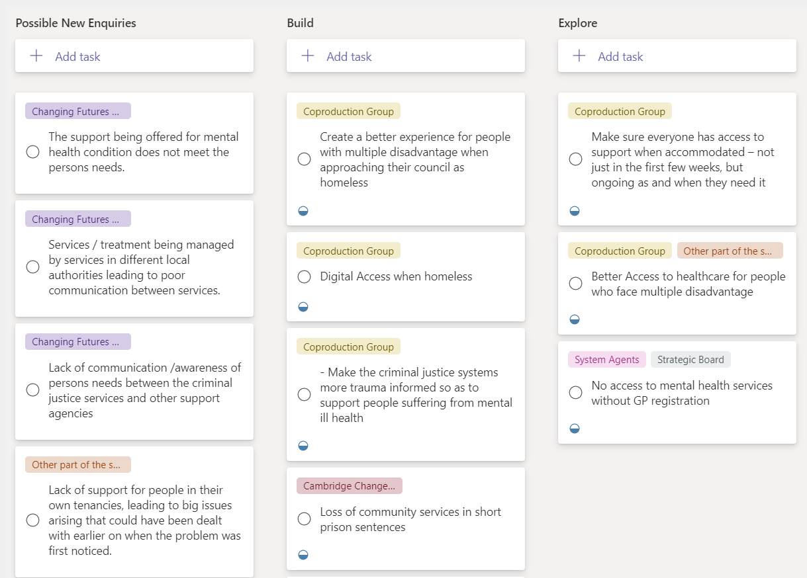

Slide 15
Workshop – What is the role of the strategic group within the learning infrastructure
Carl Brown, Oliver Hilbery, Gav Roberts
(Making Every Adult Matter)
Strategic Group TOR
The Changing Futures Cambridgeshire & Peterborough Strategic Board is a senior officer group, whose function is to:
Provide input to Changing Futures Cambridgeshire & Peterborough leadership from all the agencies involved
Ensure system-level interventions are considered, with lived experience input, and introduced effectively in each agency
Support and promote system-wide learning, both on successes and on barriers broken down
Support the principles of co-production and co-design at a strategic level

Slide 16
How are you feeling about the work to date?
3 words
Post in chat
Notes:
Sum up thoughts in 3 words

Slide 17
Activity: Fleshing out the role of the strategic group
Who are we as group?
Does the group have the right people?
Are there any gaps?
Is it consistent in turnout?
What are the key roles for us as a group?
What does the strategic group need to contribute into the programme?
Collective problem solving
Individual action in your own organisation/sector (how to act in your role?)
How are we going to be in this work?
How do we, practically, live the values in this forum?

Slide 18
Close

