Slide 1

GCP Transport Working Group
COVID-19 transport impacts: data and monitoring report
October 2022
Research Team, Cambridgeshire County Council

Slide 2
Data and monitoring report aims
This report is intended to:
Summarise the on-going impacts of COVID-19 on transport and mobility.
Highlight changes in key indicators by comparing September 2022 data with the pre-pandemic baseline and to the same time last year (September 2021). Quarterly metrics are also provided.
Provide an updated picture up to 30th September 2022, where possible.
Provide a basis for discussion for the Greater Cambridge Partnership’s Transport Working Group to understand and identify existing challenges and future data needs.
Notes:
Comparison periods may vary across the different datasets based on the availability of historic data – comparison periods are clearly noted for each dataset.
In additional to monthly metrics, this report also includes quarterly metrics. The quarters used in this report are defined as follows:
  Q1 = January – March
  Q2 = April – June
  Q3 = July – September
  Q4 = October - December

Slide 3






Changes in key indicators: September 2022
Significantly below pre-COVID (<80%)
Close to pre-COVID (>80%)
Above pre-COVID (>100%)
Many indicators are now returning to at or near pre-pandemic levels.
Maintained changes in habits post-pandemic, such as working from home and online shopping, continue to impact transport e.g. reduced car parking and bus passengers.
The difference between weekend and weekday recovery seems to be less pronounced in recent months with weekdays starting to recover to a greater degree.
Motor vehicle volumes
Air pollution
Bus passengers (excl. P&R)
-8%
Stable
-36%
Increasing*
-21%
Increasing
Sept 2022
compared to pre-COVID
(Sept 2019)
Long-term trend between June 2022 and September 2022
Sept 2022
compared to pre-COVID
(All site average
2017-2019)
Long-term trend between June 2022 and September 2022
Sept 2022
compared to pre-COVID
(Sept 2019)
Long-term trend between June 2022 and September 2022
*Seasonal increases expected
P
Car parking
Retail footfall
Walking and Cycling
-15%
Steady
-5%
Stable
-24%
-21%
Decreasing*
Sept 2022
compared to pre-COVID
(Sept 2019)
Long-term trend between June 2022 and September 2022
Sept 2022
compared to pre-COVID
(Sept 2019)
Long-term trend between June 2022 and September 2022
Sept 2022
compared to pre-COVID
(Sept 2019)
Long-term trend between June 2022 and September 2022
*Seasonal decrease expected

Slide 4
Travel Demand

Slide 5
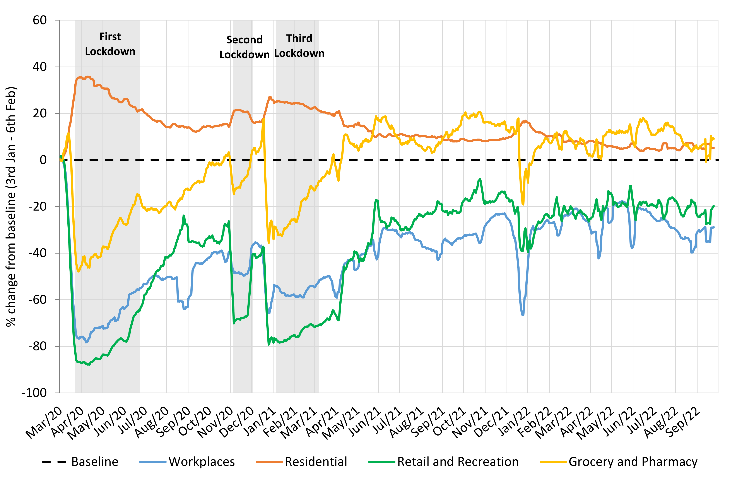
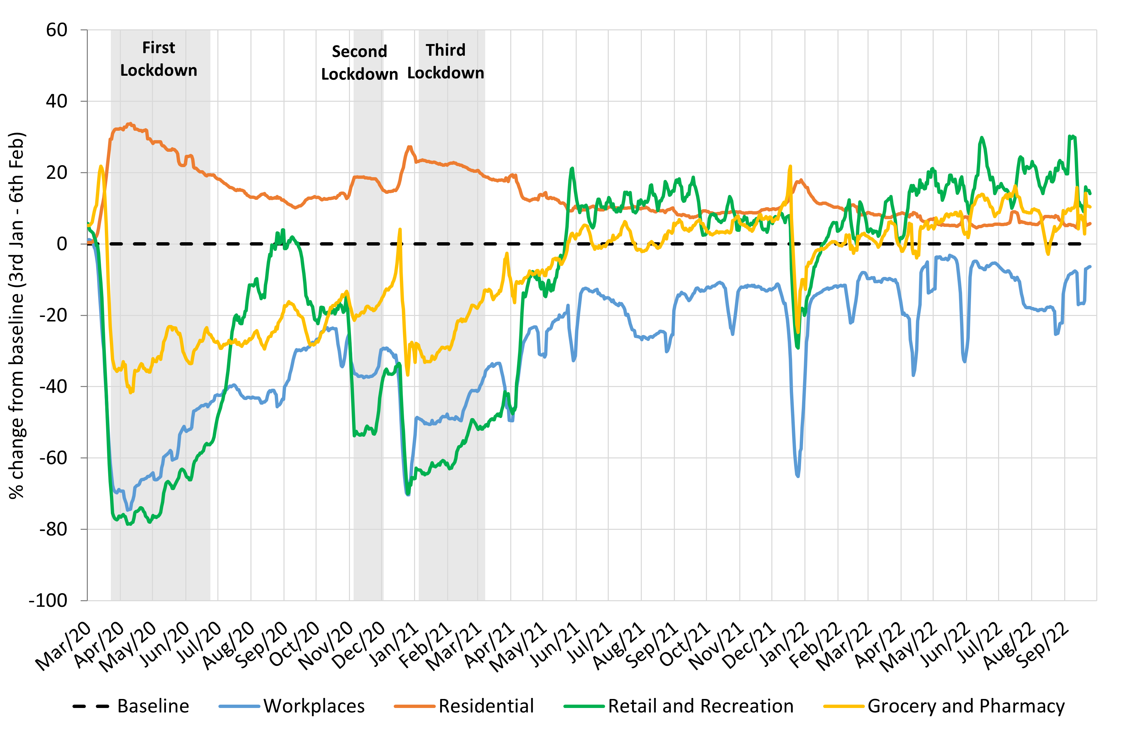
Travel Demand
Cambridge
South Cambridgeshire
Quarterly Stats
Latest Month Stats
Pre-Covid vs Now: | Workplaces | Residential | Retail and Recreation | Grocery and Pharmacy
Baseline to Q3 2022
Cambridge | -31 | +6 | -21 | +9
South Cambridgeshire | -14 | +6 | +18 | +9
Pre-Covid vs Now: | Workplaces | Residential | Retail and Recreation | Grocery and Pharmacy
Baseline to September 2022
Cambridge | -31 | +6 | -23 | +6
South Cambridgeshire | -11 | +6 | +19 | +9
Change against Google’s defined pre-COVID baseline: 3rd Jan – 6th Feb 2020
Notes:
Please note the charts show a 7-day rolling average.
Commentary:
Cambridge: Cambridge grocery and pharmacy visits continue to be above pre-pandemic levels and retail and recreation visits continue to be below pre-pandemic levels (-21% in Q3 2022), suggesting that people continue to undertake their essential shopping habits but are not doing as much discretionary travel for retail and leisure purposes. The proportion of people making workplace visits is still distinctly below the baseline at -31%. The reduction in workplace visits during the summer is most likely due to the summer holiday period and bank holidays. Residential visits remain higher than the baseline, in part likely due to the persistence of remote working.
South Cambridgeshire: Workplace visits continue to be lower than pre-pandemic (-14%) which is notably more recovered in South Cambs than it is in Cambridge. Retail and recreation and grocery and pharmacy visits have both remained above the pre-pandemic baseline in South Cambridgeshire for almost all of Q3 2022, suggesting that people’s shopping and leisure habits have now stabilised.
Source: Google LLC "Google COVID-19 Community Mobility Reports". https://www.google.com/covid19/mobility/
Data is gathered from Google account holders location history. This helps to demonstrate where people are spending their time.
The data is based on the most recent month (September 2022) compared to the median of the corresponding day in the baseline period (3rd Jan-6th Feb 2020) as calculated by Google. Tabulated percentages represent the change from the baseline (3rd Jan – 6th Feb) to the most recent month.
“Community Mobility Reports aim to provide insights into what has changed in response to policies aimed at combating COVID-19. The reports chart movement trends over time by geography, across different categories of places such as retail and recreation, groceries and pharmacies, parks, transit stations, workplaces, and residential.”

Slide 6
Strategic Road Network

Slide 7
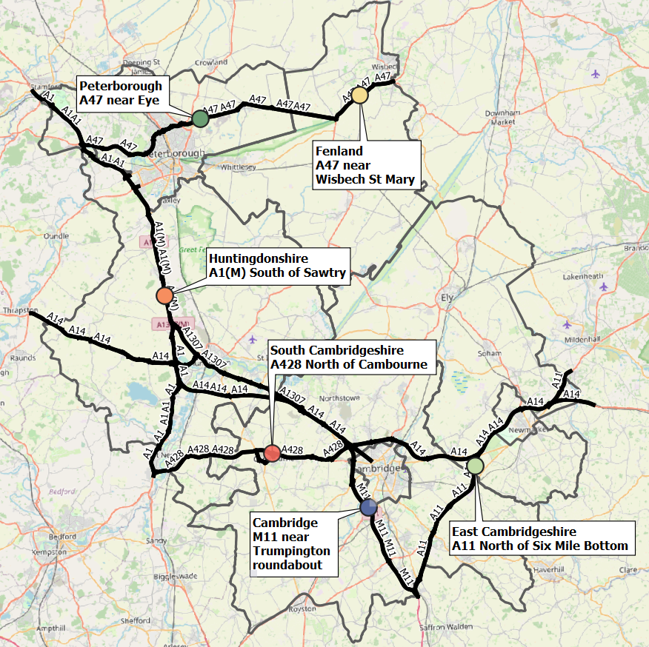
Strategic Road Network Site Locations
Traffic monitor locations in each district
 | District | Site location
 | Cambridge | M11 near Trumpington roundabout
 | Peterborough | A47 near Eye
 | East Cambridgeshire | A11 North of Six Mile Bottom
 | Fenland | A47 near Wisbech St Mary
 | Huntingdonshire | A1(M) South of Sawtry
 | South Cambridgeshire | A428 North of Cambourne
National Highways manage approximately 1,400 permanent traffic sensors on the Strategic Road Network within Cambridgeshire and Peterborough.
The sensors vary in their ability to reliably provide data over time and periods of inactivity are common. It is therefore not appropriate to conduct a long-term analysis for all-sites.
For this reason, one sensor per district has been selected, which has a full dataset from 2019 onwards, meaning a pre-/during-/post-COVID-19 comparison can be made.
As of April 2022, the A47 sensors in Fenland were not providing data so analysis for this district has not been possible.
Notes:
National Highways WebTRIS data
Site locations:
Cambridge
M11 near Trumpington roundabout
MIDAS site at M11/6820A
Peterborough
A47 near Eye
TMU Site 6351/1
East Cambridgeshire
A11 North of Six Mile Bottom
MIDAS site at A11/0883A
Fenland
A47 near Wisbech St Mary
TMU Site 6349/1
Huntingdonshire
A1(M) South of Sawtry
MIDAS site at A1M/2115B
South Cambridgeshire
A428 North of Cambourne
TMU Site 7124/2

Slide 8
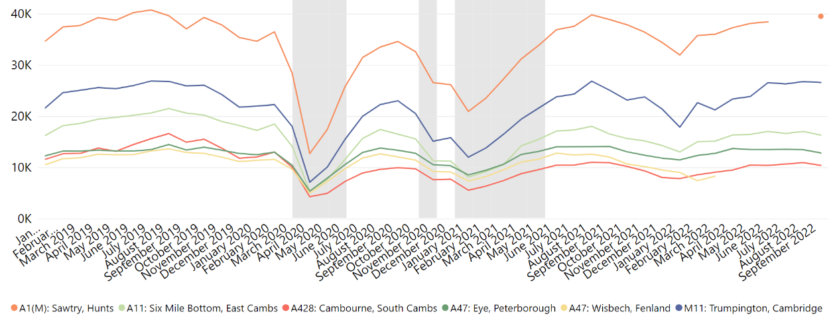
Strategic Road Network: Average Daily Flow by Month
Missing A1(M) Huntingdonshire data in July/August 2022
Average Daily Flow in the Month (All Vehicles)
On-going problem with Fenland sensors since April 2022
A428 overnight flows were high in 2019 due to the A14 overnight closures. A428 flows unlikely to reach this level again.
Site location | Pre-COVID vs Now: | Mid-COVID vs Now: | Mid-COVID vs Now: | Previous update vs Now:
 | Sept 2019 to Sept 2022 | Sept 2020 to Sept 2022 | Sept 2021 to Sept 2022 | June 2022 to Sept 2022
M11: Trumpington, Cambridge | +3% | +16% | +6% | No change
A11: Six Mile Bottom, East Cambs | -21% | -1% | -2% | -4%
A1(M): Sawtry, Hunts | +7% | +14% | +2% | +3%
A428: Cambourne, South Cambs | -30% | +5% | -5% | No change
A47: Eye, Peterborough | -4% | -4% | -9% | -5%
A47: Wisbech, Fenland | - | - | - | -
ALL | -6% | +8% | No change | No change
Notes:
Commentary:
The M11 and A1(M) have recovered to pre-pandemic volumes (+3% and +7% respectively in Sept 2022).
Change since June 2022 has been minimal with some slight increases/decreases (maximum +/- 5%) – this suggests some stability to volumes in mid-2022
Peterborough and East Cambridgeshire sites have fallen below mid-pandemic (Sept 2020) volumes in September 2022.
Source: National Highways WebTRIS data. Average Daily Flow in the month for 6 individual, main carriageway monitors , one in each district. Each monitor was active for most of: January 2019 to September 2022.

Slide 9
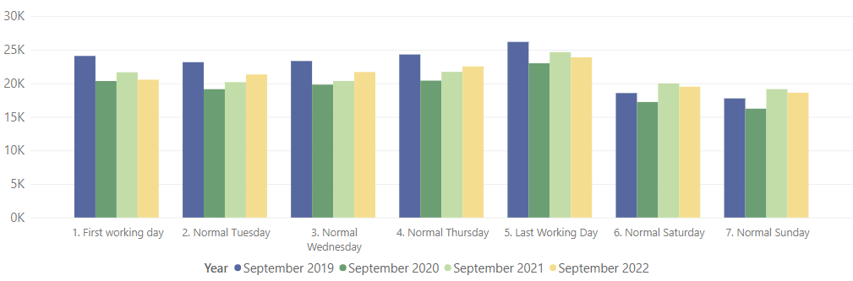
Strategic Road Network: Daily Flow by Day of Week
The ‘First Working Day’ metrics for September 2022 include the unplanned bank holiday on Monday 19th September 2022 which will be reducing the reported traffic volume.
Average Daily Flow (All Vehicles)
% Difference | 1. First working day | 2. Normal Tuesday | 3. Normal Wednesday | 4. Normal Thursday | 5. Last Working Day | 6. Normal Saturday | 7. Normal Sunday
Pre-COVID vs Now: | -15% | -8% | -7% | -7% | -9% | +5% | +5%
Sept 2019 to Sept 2022
Mid-COVID vs Now: | +1% | +11% | +9% | +10% | +4% | +13% | +15%
Sept 2020 to Sept 2022
Mid-COVID vs Now: | -5% | +6% | +7% | +4% | -3% | -2% | -3%
Sept 2021 to Sept 2022
Previous update vs Now: | -7% | No change | No change | -1% | -1% | +5% | -3%
June 2022 to Sept 2022
Weekend / Weekday split | Pre-COVID Sept 2019 | Mid-COVID Sept 2020 | Mid-COVID Sept 2021 | Now Sept 2022
Weekday average** | 24.2k | 20.6k | 21.7k | 22.4k
Weekend average | 18.2k | 16.7k | 19.6k | 19.1k
Weekend proportion of weekday | 75% | 85% | 90% | 85%
** Tues to Fri only to avoid including the unplanned bank holiday
Notes:
Average daily two-way flow, one site per district, excluding A47 in Fenland due to missing data.
Note the use of ‘normal’ days which allow for a ‘like-for-like’ comparison between comparable days. For example, bank holidays and school holidays are excluded from average flow calculations for ‘normal’ days. As such, this dataset does not account for the Christmas period, Christmas or New Year bank holidays, school summer holidays etc.
Commentary:
Flow rates still below Sept 2019 for weekdays (-9% average) but are now above Sept 2019 at weekends (+5% average)
All days are higher than mid-pandemic Sept 2020 (+9% average)
Mid-week days (Tues – Thurs) have increased in volume since 2021 but all other days see a small decrease in volumes from Sept 2021
Mondays have decreased in popularity since June 2022 (-7%) which may be in part attributed to the unexpected bank holiday on Sept 19th. Saturdays are a bit busier than June 2022 (+5%). Most other days remain similar to June 2022.
Source: National Highways WebTRIS data. Average Daily Flow in the week for 6 individual, main carriageway monitors , one in each district. Each monitor was active during November 2019, 2020 and 2021.

Slide 10
Cambridge: Modal split

Slide 11
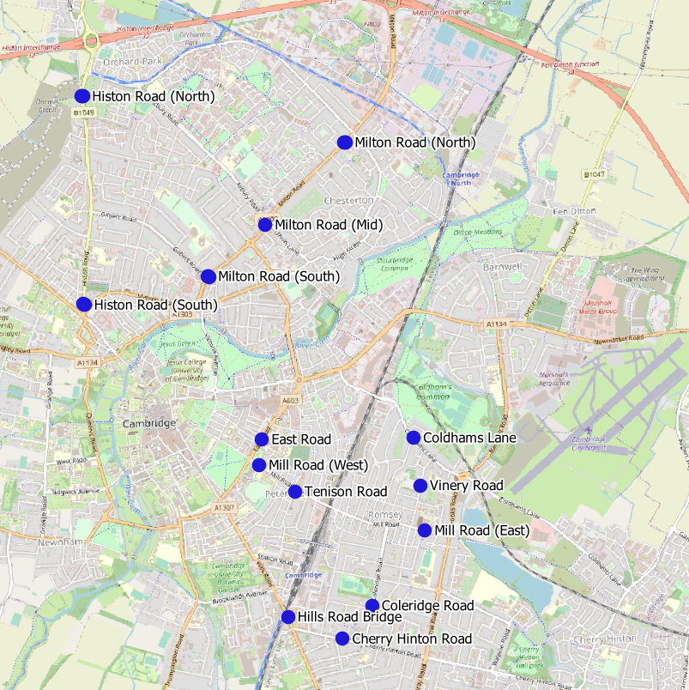
Vivacity Traffic Sensor Locations
Long Term Vivacity Monitoring Sites
Sensor Location​​ | Location description​​ | Installed​
Cherry Hinton Road ​​ | Near Rock Road​​ | May 2019​
Coldham’s Lane​​ | Near Coldham’s Common​​ | May 2019​
Coleridge Road ​​ | Near Coleridge recreation ground​​ | May 2019​
East Road​​ | Close to ARU site​​ | May 2019​
Hills Road Bridge​​ | Near Cherry Hinton Road​​ | May 2019​
Histon Road (North)​​ | Just south of A14​ | Sept 2019​
Histon Road (South) ​​ | Near Victoria Road​ | Sept 2019​
Mill Road (East)​​ | Close to Brookfield’s hospital​​ | May 2019​
Mill Road (West)​​ | Close to Parker’s Piece​​ | May 2019​
Milton Road (Mid)​​ | Near Union Lane​​ | May 2019​
Milton Road (North)​​ | Near King’s Hedges Road​ | Sept 2019​
Milton Road (South)​ | Near Gilbert Road​ | Sept 2019​
Tenison Road​​ | Near Mill Road​​ | May 2019​
Vinery Road ​​ | Near Romsey recreation ground​​ | May 2019​
Individual analysis for each of the 14 sites is presented on slide 12.
A comparison of pre-COVID and current volumes is presented on slide 13 for the 11 sensors with comparable data available for Sept 2019 and Sept 2022. *The Mill Road and East Road sensors were upgraded in Sept 2022 and are now detecting significantly more pedestrians and cyclists so have been excluded from this analysis.
A comparison of September volumes over the last four years is presented on slide 14 for the 7 sensors with comparable data available for Sept 2019, 2020, 2021 and 2022 (see map). The Mill Road and East Road sensors are excluded. The Cherry Hinton Road, Histon Road and Milton Road (South) sensors all have missing data and are also excluded.
© OpenStreetMap Contributors

Slide 12
Vivacity Traffic Sensor Volumes: By Site – September analysis
Average two-way weekday flow during September for the last four years.
*The Mill Road and East Road sensors were upgraded in Sept 2022 and are now detecting significantly more cycles and pedestrians as a result. The active travel flows at these locations are no longer comparable pre/post Sept 2022.
*
Missing data
September 2022
Location​ | Motorised %​ | Active %​
Mill Road (West) | 49% | 51%
Tenison Road | 55% | 45%
Mill Road (East) | 68% | 32%
Vinery Road | 70% | 30%
Milton Road (South) | 70% | 30%
East Road | 73% | 27%
Hills Road | 73% | 27%
Histon Road (South) | 74% | 26%
Coleridge Road | 78% | 22%
Cherry Hinton Road | 79% | 21%
Milton Road (North) | 83% | 17%
Histon Road (North) | 87% | 13%
Milton Road (Mid) | 91% | 9%
Coldham's Lane | 91% | 9%
ALL SITES | 80% | 20%
Roadworks
Roadworks
Roadworks
Roadworks
*
*
Roadworks
Motor vehicles: Car, Motorbike, LGV, HGV, Bus
Active travel: Cyclist, Pedestrian
Roadworks
Roadworks
Notes:
Commentary
Cars are the largest category at all sites in all years.
Whilst absolute volumes decreased during the pandemic, the impact on modal split at sites has not been significant at most locations. Exceptions to this are: Mill Road (East and West), Histon Road (North) and Tenison Road which saw significant decreases in the proportion of cars travelling on the roads in comparison to other modes of transport.
8 of the 13 sites have active travel proportions of 20% or higher in June 2022. The proportion of motor vehicles to active travel has changed little since June 2019 at most sites.
*Note: the high proportion of pedestrians recorded at Histon Road (North) in March 2021 appears to be due to construction workers. The Histon Road scheme site compound was near to the sensor and any workers nearby may have been picked up repeatedly.
Source: Cambridge Vivacity sensors

Slide 13









Vivacity Traffic Sensor Change: by Location and Mode
% change in weekday volumes: September 2019 vs September 2022
Only includes data from the 11 sensors with comparable data available for September 2019 and 2022.
​ | Car​ | Motorbike​ | LGV​ | OGV​ | Bus​ | Cyclist​ | Pedestrian​ | All modes​ | Motorised Vehicles | Active Modes
Cherry Hinton Road | -11% | +55% | -4% | -45% | -45% | +10% | -16% | -8% | -10% | -0%
Coldham's Lane | -1% | +122% | -8% | -8% | -64% | +11% | -47% | -2% | -1% | -12%
Coleridge Road | -14% | +53% | -10% | -20% | -38% | -11% | -48% | -14% | -12% | -22%
Hills Road | -7% | +49% | -14% | -33% | -23% | -20% | -26% | -12% | -7% | -22%
Histon Road (North) | -13% | -1% | -9% | -13% | -37% | +69% | +196% | -6% | -13% | +79%
Histon Road (South) | -21% | +25% | -19% | -21% | -27% | +32% | +19% | -11% | -19% | +26%
Milton Road (Mid) | -13% | +53% | -12% | -29% | -28% | -49% | -60% | -19% | -12% | -53%
Milton Road (North) | -19% | +3% | -15% | -17% | -4% | +30% | +139% | -10% | -18% | +60%
Milton Road (South) | -24% | +25% | -13% | -38% | +11% | +35% | +100% | -7% | -21% | +56%
Tenison Road | +1% | +77% | +20% | -14% | -71% | -6% | +43% | +13% | +3% | +27%
Vinery Road | -32% | +97% | -26% | +11% | +104% | -20% | -60% | -31% | -29% | -35%
ALL SITES | -12% | +42% | -11% | -25% | -23% | -1% | -2% | -10% | -12% | -2%
Car use in 2022 is still lower than pre-pandemic levels. Likely influenced by persistence in remote working.
Motorbike volumes continue to be increased at all locations – likely due to continued increase in online food/retail delivery services.
Decrease in buses/coaches likely the result of reduced patronage/services since COVID-19.
Significant active travel spikes in certain locations, but overall volumes are almost back at
pre-COVID levels.
All sites:
Sept 2019 vs Sept 2022
All motor transport:
-12%
Since 2019
All active transport:
-21%
Since 2019
Car:
-8%
Since 2019
Motorbike:
+62%
Since 2019
LGV:
-11%
Since 2019
OGV:
-26%
Since 2019
Bus:
-29%
Since 2019
Cyclist:
-21%
Since 2019
Pedestrian:
-22%
Since 2019
Notes:
Commentary:
Most modes of transport are showing a decrease from June 2019 levels
Coldham’s Lane and Tenison Road have seen minor overall increases in actives modes of travel
OGVs, Buses and Pedestrians show the largest average decreases with % differences at some sites as low as -65% compared to June 2019.
Source: Cambridge Vivacity sensors

Slide 14
Vivacity Traffic Sensor Volumes: by Mode
Transport mode split – sum of 7 sensors in Cambridge: September comparison
Year | Motor vehicle % | Active travel %
Sept 2019 | 79% | 21%
Sept 2020 | 83% | 17%
Sept 2021 | 83% | 17%
Sept 2022 | 81% | 19%
Motor vehicles: Car, Motorbike, LGV, HGV, Bus.
Active travel: Cyclist, Pedestrian
Only includes data from the 7 sensors with comparable data for September 2019, 2020, 2021 and 2022 - Coldham’s Lane, Coleridge Road, Hills Road, Milton Road x 2, Tenison Road and Vinery Road.
Notes:
Commentary
Motor vehicles dominate in all years. Active travel has decreased to 21% of total counts in June 2022.
Cars make up more than 60% of total traffic counts passing the Vivacity sensors in every year suggesting the car is the dominant form of transport on these roads.
Whilst transport volumes have decreased during the pandemic, the modal split of transport methods has remained similar throughout.
Source: Cambridge Vivacity sensors

Slide 15
Cambridge: Motorised vehicles

Slide 16
Vivacity Traffic Sensor Locations
Long Term Vivacity Monitoring Sites
Sensor Location​​ | Location description​​ | Installed​
Cherry Hinton Road ​​ | Near Rock Road​​ | May 2019​
Coldham’s Lane​​ | Near Coldham’s Common​​ | May 2019​
Coleridge Road ​​ | Near Coleridge recreation ground​​ | May 2019​
East Road​​ | Close to ARU site​​ | May 2019​
Hills Road Bridge​​ | Near Cherry Hinton Road​​ | May 2019​
Histon Road (North)​​ | Just south of A14​ | Sept 2019​
Histon Road (South) ​​ | Near Victoria Road​ | Sept 2019​
Mill Road (East)​​ | Close to Brookfield’s hospital​​ | May 2019​
Mill Road (West)​​ | Close to Parker’s Piece​​ | May 2019​
Milton Road (Mid)​​ | Near Union Lane​​ | May 2019​
Milton Road (North)​​ | Near King’s Hedges Road​ | Sept 2019​
Milton Road (South)​ | Near Gilbert Road​ | Sept 2019​
Tenison Road​​ | Near Mill Road​​ | May 2019​
Vinery Road ​​ | Near Romsey recreation ground​​ | May 2019​
A comparison of weekday volumes by month over the last four years is presented on slide 17 for the 6 sensors with comparable data available for 2019, 2020, 2021 and 2022 (see map).
*The Mill Road and East Road sensors were upgraded in Sept 2022 and are now detecting significantly more pedestrians and cyclists so have been excluded. The Cherry Hinton Road, Histon Road and Milton Road (North and South) sensors all have missing data and are also excluded.
© OpenStreetMap Contributors

Slide 17
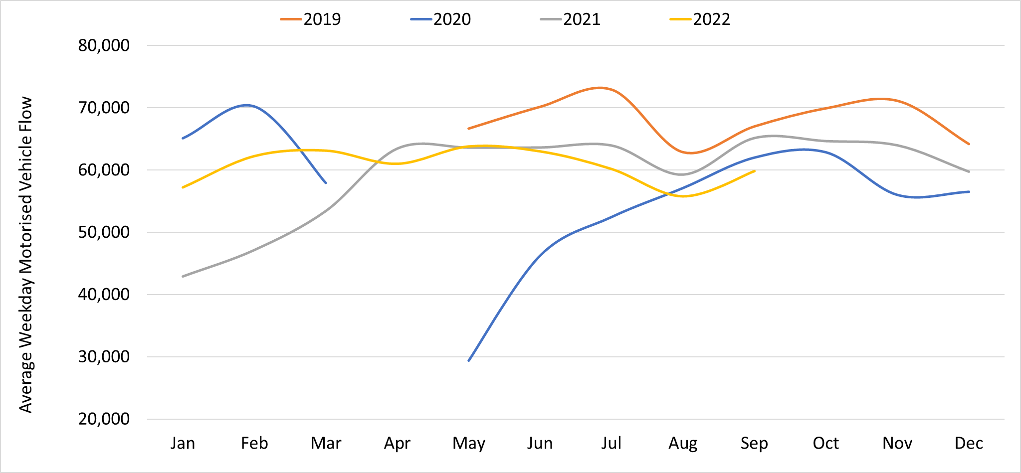
Motorised vehicles per day: Cambridge
Two-Way Motor Vehicle Weekday Flow by Month:
2019
2020
2022
2021
 | Pre-COVID vs Now: September 2019 to September 2022 |  |  | Mid-COVID vs Now: Sept 2020 to Sept 2022 | Previous update vs Now: June 2022 to September 2022
 | Mon-Sun | Weekdays | Weekends | Mon-Sun | Mon-Sun | Weekdays | Weekends
Cambridge | -8% | -11% | -5% | -2% | -3% | -5% | -2%
Only includes data from the 6 sensors with sufficient comparable data for 2019, 2020, 2021 and 2022 - Coldham’s Lane, Coleridge Road, Hills Road, Milton Road (Mid), Tenison Road and Vinery Road.
 | Pre-COVID vs Now: Q3 2019 to Q3 2022 |  |  | Mid-COVID vs Now: Q3 2020 to Q3 2022 | Previous quarter vs Now: Q2 2022 to Q3 2022
 | Mon-Sun | Weekdays | Weekends | Mon-Sun | Mon-Sun | Weekdays | Weekends
Cambridge | -12% | -14% | -10% | +3% | -6% | -7% | -6%
Notes:
Commentary:
Small decreases in motorised vehicles in Cambridge since Q2 2022 (-6% Mon-Sun).
Cambridge flows remain below Sept 2019 ‘pre-COVID’ levels, particularly during the week.
Motorised vehicle volumes particularly low during the summer 2022 period.
This chart shows the average volume of motor vehicles counted per weekday for each month/year at the six Vivacity sensors shown on Slide 16. Improved data cleaning processes are being developed to improve the omission of any poor quality / non-comparable data – gaps on the graph may be present for this reason. Care should be taken in interpreting these charts as they are solely based on the six locations – which dilutes the geographical coverage and may not provide a city-wide / holistic view.
Source: Cambridge Vivacity sensors

Slide 18
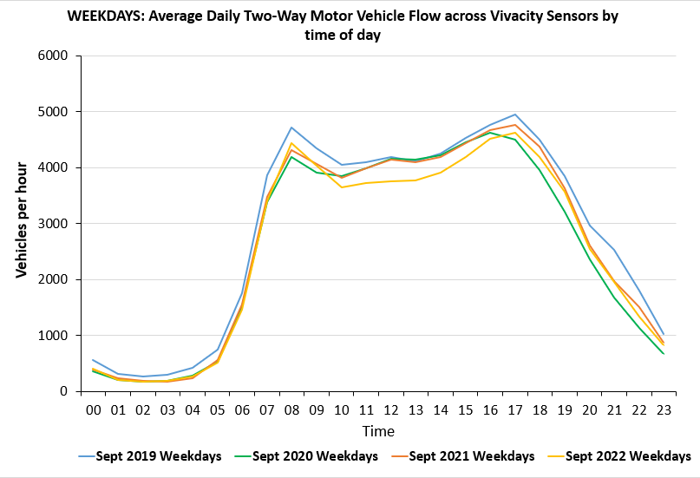
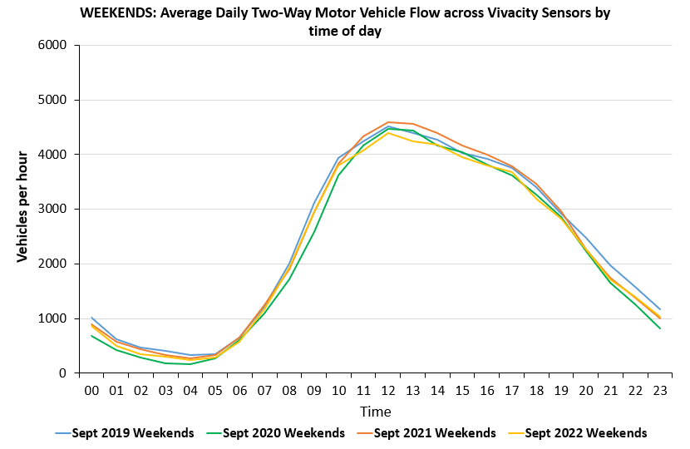
Motorised vehicles per hour: Cambridge
Weekdays
Weekends
Weekdays
Morning peak edging closer to pre-pandemic levels.
Lunchtime traffic noticeably lower than that seen in previous years.
Weekends
Slightly lower midday peak volumes in 2022 compared to previous years.
Weekend flow overall is closer to pre-pandemic levels than weekday flows.
Only includes data from the 6 sensors with sufficient comparable data for 2019, 2020, 2021 and 2022 - Coldham’s Lane, Coleridge Road, Hills Road, Milton Road (Mid), Tenison Road and Vinery Road.
Notes:
Commentary:
Weekdays in Q2 2022: current flows are nearing the levels seen pre-COVID
Weekends in Q2 2022: many hours have returned to pre-COVID levels – 3pm, 6pm, 8-9pm
Source: Cambridge Vivacity sensors

Slide 19
Cambridge: Active Travel

Slide 20
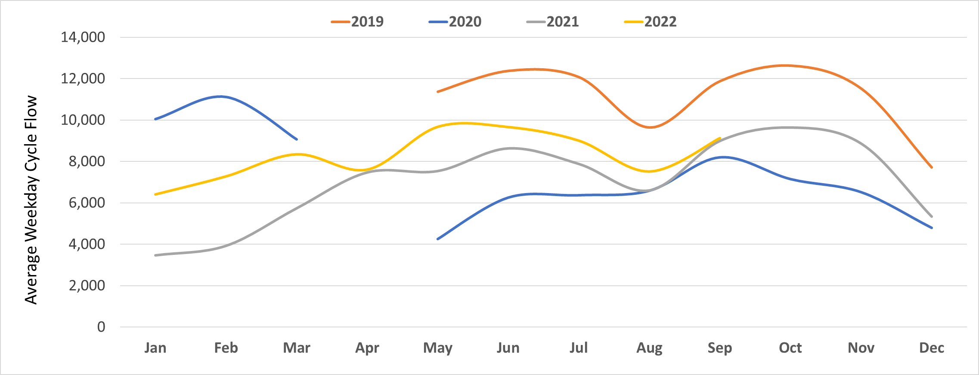
Cyclists: Cambridge Daily Flow
Two-Way Cyclist Weekday Flows by Month:
2019
2020
2022
2021
 | Pre-COVID vs Now: |  |  | Mid-COVID vs Now: | Previous update vs Now:
 | September 2019 to September 2022 |  |  | Sept 2020 to Sept 2022 | June 2022 to September 2022
 | Mon-Sun | Weekdays | Weekends | Mon-Sun | Mon-Sun | Weekdays | Weekends
Cambridge | -21% | -23% | -14% | +9% | -5% | -6% | -4%
Only includes data from the 6 sensors with sufficient comparable data for 2019, 2020, 2021 and 2022 - Coldham’s Lane, Coleridge Road, Hills Road, Milton Road (Mid), Tenison Road and Vinery Road.
 | Pre-COVID vs Now: |  |  | Mid-COVID vs Now: | Previous quarter vs Now:
 | Q3 2019 to Q3 2022 |  |  | Q3 2020 to Q3 2022 | Q2 2022 to Q3 2022
 | Mon-Sun | Weekdays | Weekends | Mon-Sun | Mon-Sun | Weekdays | Weekends
Cambridge | -22% | -24% | -13% | +15% | -5% | -6% | -2%
Notes:
Commentary:
Long term trends: Expected seasonal variation can be seen in the data, with peaks during the summer months and decreases in the winter.
Cycling trends have picked up significantly since the start of 2022, though weekday trends still remain well below 2019 volumes, possibly the result of continued hybrid working for some.
Cycling trends show a significant increase from both June 2020 and Q2 2020 overall (Mid-COVID).
Source: Cambridge Vivacity sensors

Slide 21
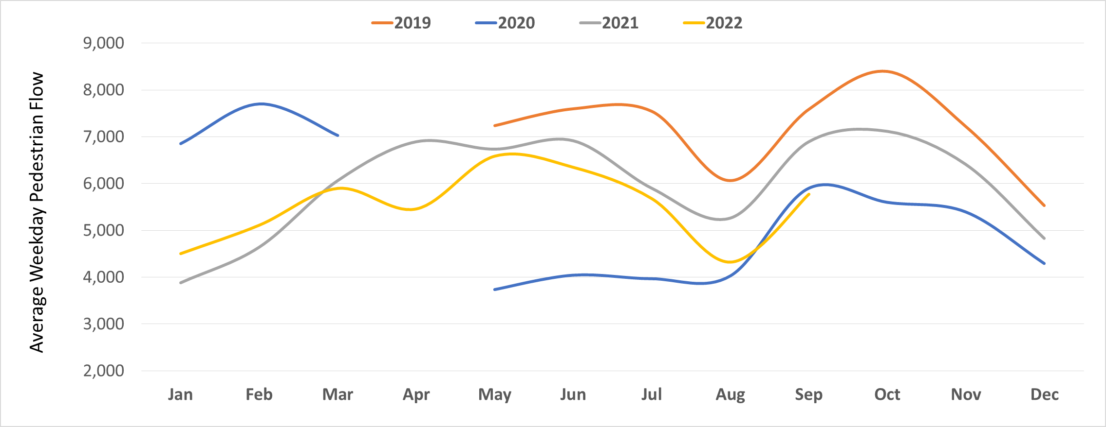
Pedestrians: Cambridge Daily Flow
Two-Way Pedestrian Weekday Flows by Month:
2020
2019
2022
2021
 | Pre-COVID vs Now: |  |  | Mid-COVID vs Now: | Previous update vs Now:
 | September 2019 to September 2022 |  |  | Sept 2020 to Sept 2022 | June 2022 to September 2022
 | Mon-Sun | Weekdays | Weekends | Mon-Sun | Mon-Sun | Weekdays | Weekends
Cambridge | -24% | -24% | -23% | -5% | -11% | -9% | -16%
Only includes data from the 6 sensors with sufficient comparable data for 2019, 2020, 2021 and 2022 - Coldham’s Lane, Coleridge Road, Hills Road, Milton Road (Mid), Tenison Road and Vinery Road.
 | Pre-COVID vs Now: |  |  | Mid-COVID vs Now: | Previous quarter vs Now:
 | Q3 2019 to Q3 2022 |  |  | Q3 2020 to Q3 2022 | Q2 2022 to Q3 2022
 | Mon-Sun | Weekdays | Weekends | Mon-Sun | Mon-Sun | Weekdays | Weekends
Cambridge | -25% | -26% | -23% | +8% | -15% | -15% | -14%
Notes:
Commentary:
Pedestrian trends remain well below the 2019 pre-pandemic level, particularly on weekdays (-30%).
Significant increases in Q2 2022 compared to the previous quarter – likely attributable to more favourable weather conditions.
Source: Cambridge Vivacity sensors

Slide 22
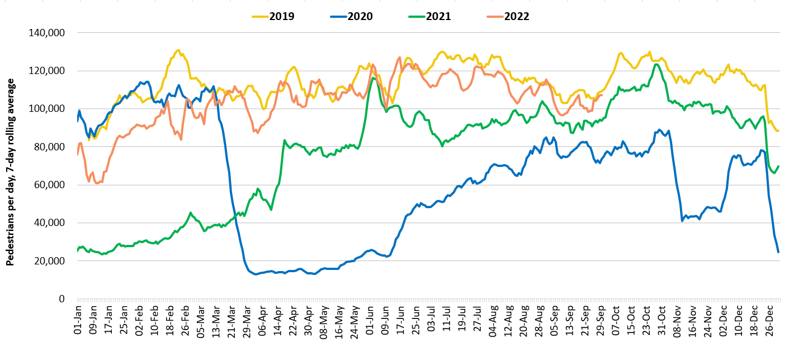
Retail footfall: Central Cambridge
2019
2022
2021
2020
Third lockdown
Second lockdown
First lockdown
 | Pre-COVID vs Now: |  |  | Mid-COVID vs Now: | Previous update vs Now:
 | Sept 2019 to Sept 2022 |  |  | Sept 2020 to Sept 2022 | June 2022 to September 2022
 | Mon-Sun | Weekdays | Weekends | Mon-Sun | Mon-Sun | Weekdays | Weekends
Cambridge Retail | -5% | -9% | +3% | +33% | -13% | -18% | -4%
Includes data from 6 locations in central Cambridge – Bridge Street, Fitzroy Street, Market Hill, Regent Street, Rose Crescent and Sidney Street.
 | Pre-COVID vs Now: |  |  | Mid-COVID vs Now: | Previous quarter vs Now:
 | Q3 2019 to Q3 2022 |  |  | Q3 2020 to Q3 2022 | Q2 2022 to Q3 2022
 | Mon-Sun | Weekdays | Weekends | Mon-Sun | Mon-Sun | Weekdays | Weekends
Cambridge Retail | -6% | -10% | -2% | +59% | No change | No change | No change
Notes:
Commentary:​
Central Cambridge footfall is below Q3 2019 footfall in Q3 2022, especially on weekdays (-10%)
Q3 2022 footfall is higher than Q3 2020 min-pandemic volumes (+59%)
There is little change between Q2 and Q3 2022 volumes, suggesting footfall in stable in Cambridge
Data from the following locations: Bridge Street, Fitzroy Street at Waitrose, Market Hill, Regent Street, Rose Crescent, Sidney Street. Excludes data for King’s Parade and One Station Square.
Source: Cambridge BID footfall data​

Slide 23
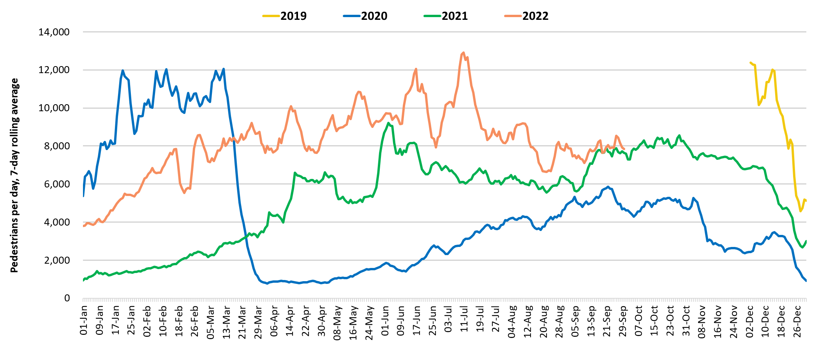
Footfall at One Station Square: Cambridge
2019
2022
2021
2020
Third lockdown
First lockdown
Second lockdown
 | Pre-COVID vs Now: |  |  | Mid-COVID vs Now: | Previous update vs Now:
 | Feb 2020* to September 2022 |  |  | September 2020 to September 2022 | June 2022 to September 2022
 | Mon-Sun | Weekdays | Weekends | Mon-Sun | Mon-Sun | Weekdays | Weekends
One Station Square | -27% | -32% | -8% | +52% | -22% | -20% | -23%
*Data collection at One Station Square began in Dec 2019 so Sept 2019 data is not available to represent pre-COVID conditions. Feb 2020 has therefore been used instead.
 | Pre-COVID vs Now: |  |  | Mid-COVID vs Now: | Previous quarter vs Now:
 | Q1 2020* to Q3 2022 |  |  | Q3 2020 to Q3 2022 | Q2 2022 to Q3 2022
 | Mon-Sun | Weekdays | Weekends | Mon-Sun | Mon-Sun | Weekdays | Weekends
One Station Square | -15% | -21% | +3% | +101% | -9% | -10% | -9%
Notes:
Commentary: ​
Data collection at One Station Square began in Dec 2019 so Q3 2019 data is not available to represent pre-COVID conditions. Q1 2020 has therefore been used instead with the last two weeks of March 2020 excluded.
One Station square footfall exceeding Q3 2020 (mid-pandemic) volumes but below Q1 2020 volumes apart from at the weekends (+3%)
There is a downwards trend in footfall around One Station Square over the summer, with a 22% decrease from June to September 2022.
Source: Cambridge BID footfall data​
*The One Station Square sensor was fitted in December 2019​
*Data may be impacted by strike action
*Note that the substantial increase between 2020 and 2022 figures will be explained by lockdown restrictions in May 2020.

Slide 24
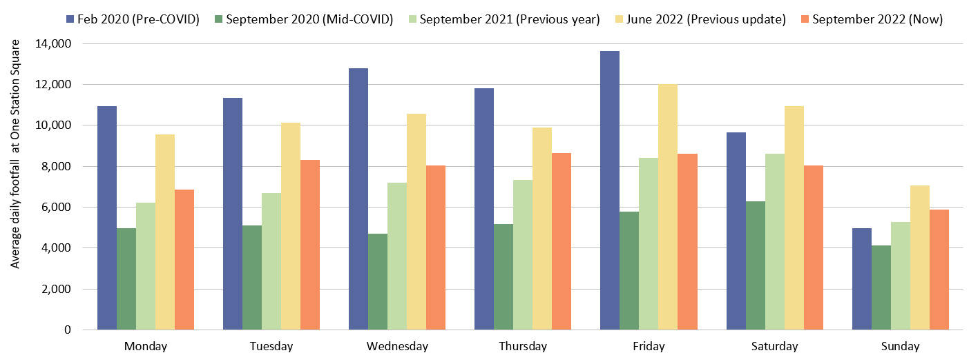
Footfall at One Station Square by day of week: Cambridge
Footfall at One Station Square
All weekdays remain below pre-COVID (Feb 2020) volumes. Mondays, Wednesdays and Fridays are least recovered (37% below pre-COVID levels) whilst Tuesdays and Thursdays are most recovered (27% below pre-COVID levels).
Saturdays in September are 17% below
pre-COVID
Sundays in September are 19% above
pre-COVID
*Data collection at One Station Square began in Dec 2019 so Sept 2019 data is not available to represent pre-COVID conditions. Feb 2020 has therefore been used instead.
Notes:
Commentary:​
Feb 2020 has been used as a Pre-Covid comparison as there is no data for 2019.
On weekdays, Thursdays in September 2022 are closest to pre-pandemic 2020 (-27%).
Saturdays in September 2022 are 17% below Feb 2020 whilst Sundays are 19% above Feb 2020.
Source: Cambridge BID footfall data​
*The One Station Square sensor was fitted in December 2019​
*Data may be impacted by strike action

Slide 25
Car Parking

Slide 26
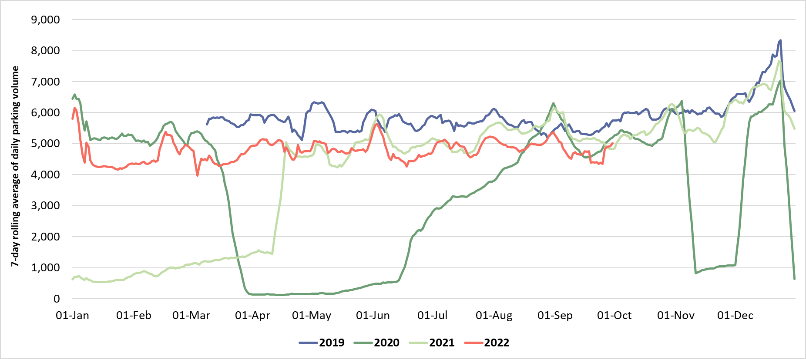
Car parking: Cambridge
Cambridge multi-storey car parks usage
Christmas/New Year
2019
2022
Closure of Park Street car park
2021
2020
Lockdown 3
Lockdown 1
Lockdown 2
 | Pre-COVID vs Now: |  |  | Previous year vs Now: |  |  | Previous update vs Now:
 | September 2019 to September 2022 |  |  | September 2021 to September 2022 |  |  | June 2022 to September 2022
 | Mon-Sun | Weekdays | Weekends | Mon-Sun | Weekdays | Weekends | Mon-Sun | Weekdays | Weekends
Cambridge | -15% | -17% | -8% | -9% | -11% | -4% | +1% | -4% | +11%
*Park Street car park closed for redevelopment on 4th January 2022. Usage figures for this car park are included in the data to establish whether the closure has affected overall parking volumes.
 | Pre-COVID vs Now: |  |  | Previous year vs Now: |  |  | Previous quarter vs Now:
 | Q3 2019 to Q3 2022 |  |  | Q3 2021 to Q3 2022 |  |  | Q2 2022 to Q3 2022
 | Mon-Sun | Weekdays | Weekends | Mon-Sun | Weekdays | Weekends | Mon-Sun | Weekdays | Weekends
Cambridge | -12% | -14% | -10% | -7% | -9% | -4% | +1% | +1% | +3%
Notes:
Commentary:
Q3 2022 parking is overall lower than at this point last year (-7%), and also sits well below pre-pandemic (Q3 2019) levels (-12%).
September 2022 parking is slightly below September 2021 (-9%) and remains well below pre-pandemic (2019) level (-15%).
The September volumes will have been influenced by the additional bank holiday in September 2022.
Source: Cambridge Car Parking data (Cambridge City Council)

Slide 27
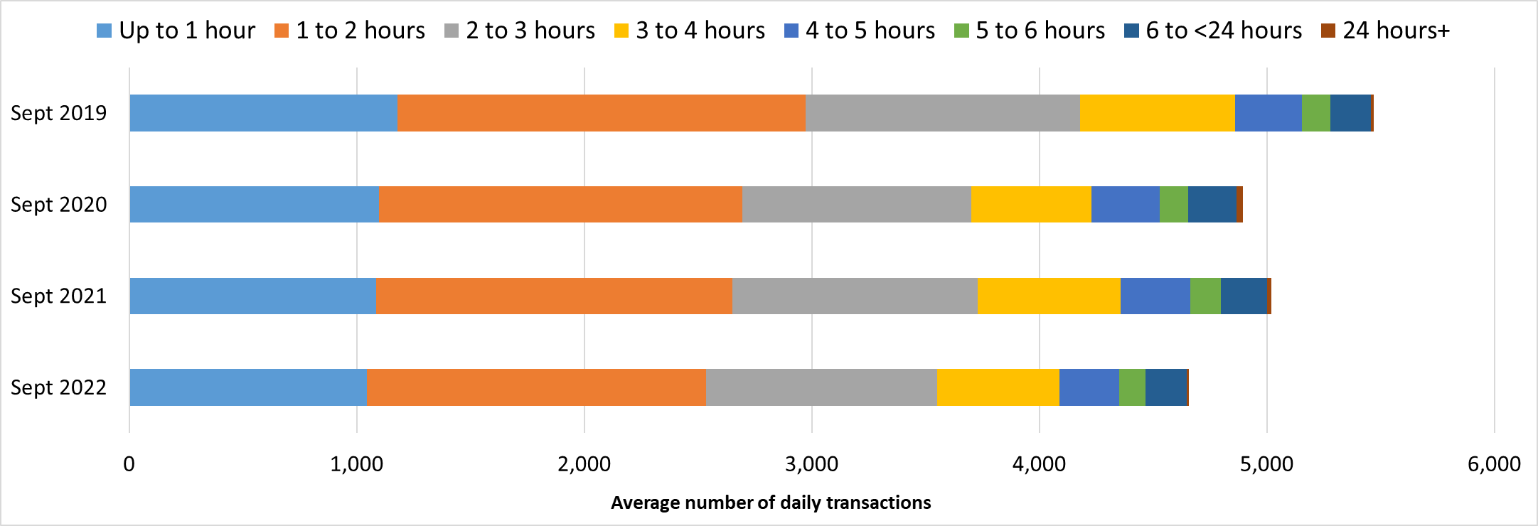
Car Parking: Cambridge by Length of Stay
Car park usage by length of stay across Cambridge multi-storey car parks*
11% below Sept 2019 volumes
8% below Sept 2019 volumes
15% below Sept 2019 volumes
Length of Stay | Up to 1 hour | 1 to 2 hours | 2 to 3 hours | 3 to 4 hours | 4 to 5 hours | 5 to 6 hours | 6 to <24 hours | 24+ hours
Sept 2019 | 22% | 33% | 22% | 12% | 5% | 2% | 3% | 0%
Sept 2020 | 22% | 33% | 21% | 11% | 6% | 3% | 4% | 1%
Sept 2021 | 22% | 31% | 22% | 12% | 6% | 3% | 4% | 0%
Sept 2022 | 22% | 32% | 22% | 12% | 6% | 2% | 4% | 0%
* Park Street car park closed in Jan 2022 and it is therefore included in Sept 2019, 2020 and 2021 but not within Sept 2022. This means the impact on overall parking volumes can be observed.
Notes:
Commentary:
Overall usage numbers in September 2022 are the lowest in this four-year period, with average daily transactions down 15% compared to 2019, and down 5% in comparison to 2020. This will have been partly influenced by the additional bank holiday in September. All individual car parks show markedly lower volumes on September 19th.
September 2022 length of stay profile closely mirrors previous years - including pre-Covid (2019) and mid-Covid (2020). The vast majority of car park visits in the centre of Cambridge are less than 3 hours, with over 50% less than 2 hours in September 2022.
Source: Cambridge Car Parking data (Cambridge City Council)

Slide 28
Bus Passengers

Slide 29
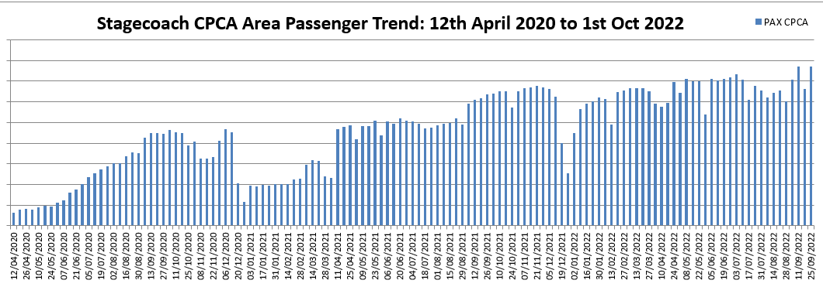
Bus Passengers: Cambridge
Christmas / New Year
Half
term
Summer holidays
Easter
Lockdown 2
Lockdown 1
Lockdown 3
Pre-COVID vs Now:
Previous update vs Now:
Sept 2019 ->
Sept 2022
-21%
June 2022 ->
Sept 2022
+2%
Due to the commercial sensitivity of this data, absolute counts of bus passengers have not been supplied on the y-axis of the graphs.
Notes:
Commentary:
CPCA Area passengers
Passenger numbers in September 2022 are the highest they have been since April 2020
Passenger numbers still remain below pre-COVID levels in Cambridge (-21%) and Peterborough (-33%)
Passenger numbers saw their usual decrease during the school holidays
P&R passengers
P&R passenger numbers have shown peaks in the school holidays after having plateaued from April onwards. This came after a gradual increase in numbers between January and April
Several of the P&Rs still remain distinctly below their pre-pandemic volumes (e.g. Babraham Road, though this continues to increase) whilst others are back to pre-pandemic volumes (e.g. Trumpington, exceeding Jan 2020 volumes).
Trumpington and Babraham Road consistently have the highest volumes of passengers in 2022.
Source: Stagecoach data

Slide 30
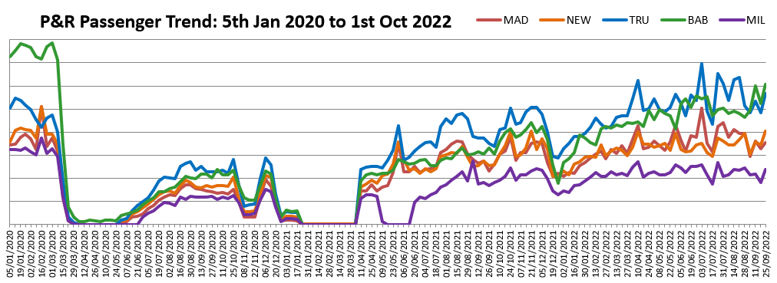
P&R Passengers: Cambridge
Summer holidays
Christmas/New Year
Lockdown 2
Lockdown 1
Lockdown 3
Milton Road service suspended
Pre-COVID vs Now:
Cambridge P&R sites
Previous update vs Now:
Cambridge P&R sites
*Q1 2020 used to represent “pre-COVID” as no 2019 data is available.
Pre-COVID* ->
Sept 2022
-16%
June 2022 ->
Sept 2022
-1%
Due to the commercial sensitivity of this data, absolute counts of bus passengers have not been supplied on the y-axis of the graphs.
Notes:
Commentary:
CPCA Area passengers
Passenger numbers in September 2022 are the highest they have been since April 2020
Passenger numbers still remain below pre-COVID levels in Cambridge (-21%) and Peterborough (-33%)
Passenger numbers saw their usual decrease during the school holidays
P&R passengers
P&R passenger numbers have shown peaks in the school holidays after having plateaued from April onwards. This came after a gradual increase in numbers between January and April
Several of the P&Rs still remain distinctly below their pre-pandemic volumes (e.g. Babraham Road, though this continues to increase) whilst others are back to pre-pandemic volumes (e.g. Trumpington, exceeding Jan 2020 volumes).
Trumpington and Babraham Road consistently have the highest volumes of passengers in 2022.
Source: Stagecoach data

Slide 31
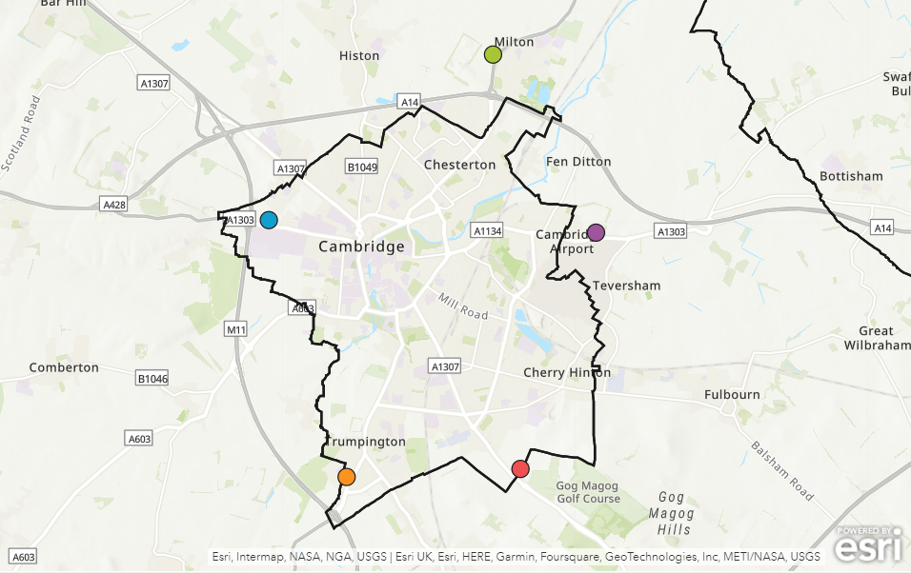
Park and Ride: Average Passenger Volumes by Site
All P&R Site Average
Milton P&R
Pre-COVID 2020* -> Sept 2022: -16%
Pre-COVID 2020* -> Sept 2022: -35%
Q2 2022 -> Q3 2022: +4%
Q2 2022 -> Q3 2022: -5%
Newmarket Road P&R
Madingley Road P&R
Pre-COVID 2020* -> Sept 2022: -13%
Pre-COVID 2020* -> Sept 2022: -11%
Q2 2022 -> Q3 2022: +2%
Q2 2022 -> Q3 2022: +5%
Trumpington Road P&R
Babraham Road P&R
Pre-COVID 2020* -> Sept 2022: +5%
Pre-COVID 2020* -> Sept 2022: -26%
Q2 2022 -> Q3 2022: +6%
Q2 2022 -> Q3 2022: +7%
*Pre-Covid: 05/01/2020 – 07/03/2020
Notes:
Pre-Covid: 05/01/2020 – 07/03/2020
Source: Stagecoach data

Slide 32
Bus Passengers: Cambridge by Time of Day – Sept 2022
Bus Services
P&R Services
Morning and afternoon peaks (6-8 am and 4pm) at all depots.
Morning peak much less pronounced in Cambridge.
Afternoon peak most prominent in Peterborough.
Passenger numbers are more evenly spread across the day in Cambridge, increasing to a peak at 4pm.
Passenger numbers decline from 4pm at all locations.
Mid-morning peak in passengers on all P&R services around 10am.
Babraham Road sees an early morning peak (7-8am).
Passenger numbers decline across all sites from 4pm onwards.
Notes:
Source: Stagecoach data

Slide 33
e-Scooters

Slide 34
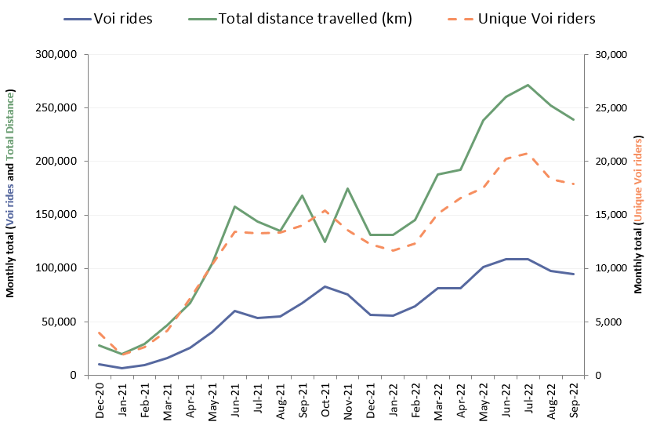






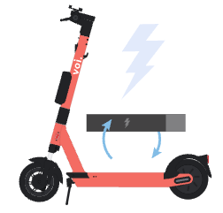
E-scooters: Cambridge
Voi E-scooter usage per month:
Popular scooter trip origins:
September 2022
Cambridge railway station
-> 6.1k rides
Cambridge bus station
-> 4.0k rides
Market Square
-> 2.6k rides
Average journey statistics:
September 2022
Average voi ride distance:
2.53 km
Average
no. rides
per month:
5.3 rides pp
+5% from June 2022
-1% from June 2022
 | Late-COVID vs Now: Sept 2021 to Sept 2022 | Previous update vs Now: June 2022 to Sept 2022 | Mid-COVID vs Now: Q3 2021 to Q3 2022
Number of voi rides | +41% | -13% | +72%
Number of unique voi riders | +28% | -12% | +40%
Total distance travelled (km) | +42% | -8% | +71%
Average voi ride duration:
11.7 mins
+4% from June 2022
Notes:
Commentary:
E-scooter usage has seen a decrease since July 2022, potentially linked to a reduction in students in the city over the summer months.
E-scooter usage is still higher than the same time last year, with the total number of rides 41% higher in Sept 2022 than in Sept 2021.
The most popular trip origins are extremely consistent, with these three locations almost always making up the top 3.
The average journey statistics remain fairly stable each month – suggesting that e-scooters are most popular for short journeys (~2.5 km, ~10 minutes)
Source: Voi e-scooter dashboard

Slide 35
Summary

Slide 36







Headlines: September 2022
Significantly below pre-COVID (<80%)
Close to pre-COVID (>80%)
Above pre-COVID (>100%)
Workplace attendance at 69% of Jan 2020 levels in Cambridge and 89% in South Cambridgeshire.
Walking around Cambridge is at 76% of pre-COVID levels.
Motor vehicle use is at 92% of pre-COVID levels in Cambridge.
Retail footfall in Cambridge is at 95% of pre-COVID levels.
P
Car park use is at 85% of pre-COVID levels in Cambridge.
Footfall at One Station Square is at 73% of pre-COVID levels.
Bus use within Cambridge is at 79% of pre-COVID levels.
Cycling within Cambridge is at 79% of pre-COVID levels.
P&R use within Cambridge is at 84% of pre-COVID levels.
Air pollution is at 64% of the pre-COVID 2017-2019 baseline.

