Slide 1
Census 2021: Ethnic Group, National Identity, Language and Religion summary for Cambridgeshire and Peterborough
01/12/2022
Research Team, Business Intelligence
Research.Group@cambridgeshire.gov.uk

Slide 2
Themes covered
A first overview of some of the local authority level Cambridgeshire and Peterborough data from the Ethnic Group, National Identity, Language and Religion topic summary published by the Office for National Statistics (ONS)
Ethnic group, national identity, language, and religion: Census 2021 in England and Wales - Office for National Statistics (ons.gov.uk)
By local authority:
Usual resident population by ethnic group
Usual resident population by main language and proficiency in English
Occupied households by main household language
Usual resident population by religion
By Middle Layer Super Output Area (MSOA):
Usual resident population by ethnic group

Slide 3
Definitions
Usual resident population
Anyone in the UK and had stayed or intended to stay in the UK for a period of 12 months or more; or
Had a permanent UK address and was outside the UK and intended to be outside the UK for less than 12 months.
Occupied households
One person living alone; or
A group of people (not necessarily related) living at the same address, who share cooking facilities and share a living room or sitting room or dining area
Must contain at least one usual resident
High level ethnic groups
This slide pack uses the Census 2021 definitions of the high level ethnic groups for which respondents are asked to identify with “Asian, Asian British, Asian Welsh”, “Black, Black British, Black Welsh, Caribbean or African”, “Mixed or Multiple”, “White”, “Other ethnic group”.
White UK - refers to those residents who identified themselves as in the “White: English, Welsh, Scottish, Northern Irish or British” ethnic group. All other White ethnic groups are grouped into “White: Other ethnic group”

Slide 4
Increasing diversity in ethnicity
Communities have become more diverse, especially in the “urban” areas:
In Cambridgeshire and Peterborough the proportions of the population in all high level ethnic groups apart from “White” have increased since 2011
In Cambridgeshire the proportions of the population who identify in ethnic groups other than “White” remain below the national and East of England averages
Apart from those who identify as in “Mixed or multiple ethnic groups” where it is very similar
But in Cambridge the proportions in the “Asian, Asian British or Asian Welsh”, “Mixed or Multiple ethnic groups”, “White: Other ethnic group”, and “Other ethnic groups” are all higher than the national and East of England averages
In Peterborough, the proportion of the population who identify as “Asian, Asian British or Asian Welsh” is notably higher than both the national and East of England averages,
For other ethnic groups apart from “White” Peterborough is similar to the national average

Slide 5
Increasing diversity in ethnicity part 2
Similar to national trends, the percentage of the population in the “White” category has fallen across Cambridgeshire and Peterborough compared to Census 2011
The falls have been most pronounced in Cambridge and Peterborough and the White UK populations there now account for 53.0% and 59.5% of total population compared to 66.0% and 70.9% at Census 2011, respectively
And in Cambridge (-5.6%), South Cambridgeshire (-0.6%) and Peterborough (-1.4%) the number of residents who identify as White UK has fallen compared to Census 2011
All districts have seen a notable increase in the White: Other ethnic groups since Census 2011

Slide 6
Ethnic Group % of total population, Census 2021
Ethnic Group | England | East of England | Cambridgeshire | Peterborough
Asian, Asian British or Asian Welsh | 9.6% | 6.4% | 5.8% | 14.3%
Black, Black British, Black Welsh, Caribbean or African | 4.2% | 2.9% | 1.4% | 4.1%
Mixed or Multiple ethnic groups | 3.0% | 2.8% | 2.9% | 3.5%
White | 81.0% | 86.5% | 88.6% | 75.4%
White of which White: UK | 73.5% | 78.5% | 77.2% | 59.5%
White of which White: Other ethnic group | 7.5% | 8.0% | 11.3% | 15.9%
Other ethnic group | 2.2% | 1.4% | 1.3% | 2.7%

Slide 7
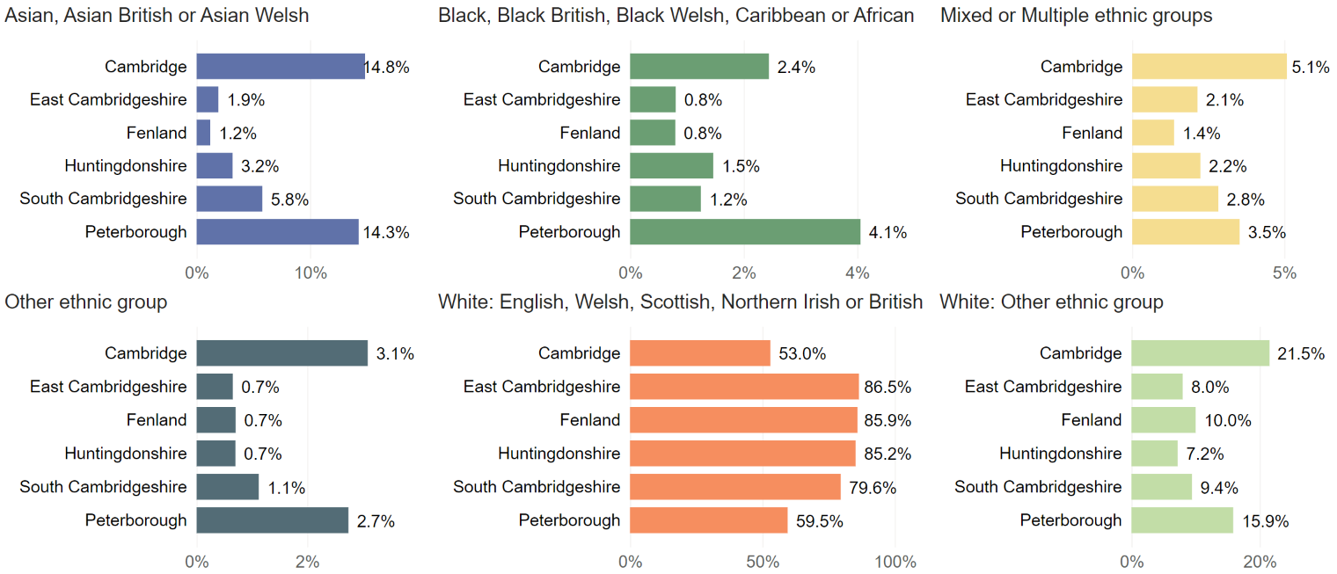
Cambridgeshire and Peterborough: per cent of population by ethnic group, Census 2021

Slide 8
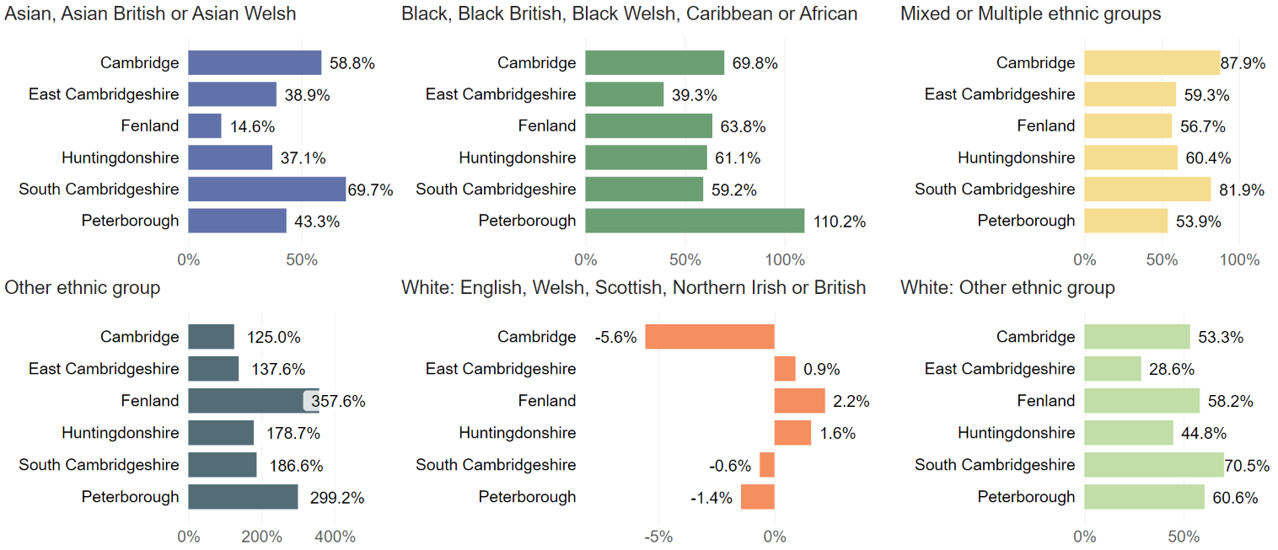
Cambridgeshire and Peterborough: per cent change in population by ethnic group, Census 2011 to Census 2021

Slide 9
And increasing diversity in main languages
There is increasing diversity in the range of main languages, with falls in the percentage of total residents having English as a main language in all districts
The proportion of residents (aged 3 years and over) whose main language is English varies widely across Cambridgeshire and Peterborough:
Averaging 90.7% for Cambridgeshire, and ranging from 80.0% in Cambridge to 95.1% in East Cambridgeshire, while in Peterborough it is also 80%
There have been increases in the proportions of residents who don’t have English as a main language who can speak English well or very well in all districts
And small rises in the proportions of residents (aged 3 years and over) who cannot speak English well or at all, with Peterborough seeing a decrease, compared to Census 2011
1.2% of residents cannot speak English well or at all in Cambridgeshire (amounting to 8,200 residents), ranging from 0.6% in South Cambridgeshire to 2.5% in Fenland, and being 4.5% in Peterborough (amounting to 9,400 residents)

Slide 10
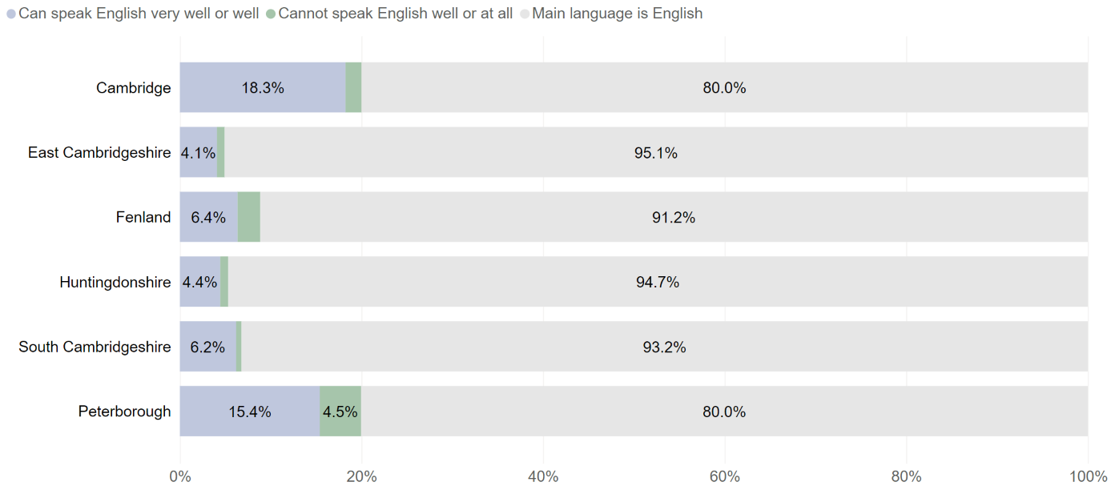
Cambridgeshire and Peterborough: per cent of population aged 3 years and above by proficiency in English, Census 2021

Slide 11
Percentage of households with English as main language has fallen
The proportion of households where all adults (16 years and over) have English as a main language has fallen across all districts compared to Census 2011
Ranging between falls of 1.0% (East Cambridgeshire) and 4.1% (Cambridge)
In Peterborough, in 77.4% of households all adults have English as the main language compared to 83.7% at Census 2011
There have generally been notable increases in the proportion of households where at least one adult or at least one person aged 3 to 15 has English as a main language
The proportion of these households ranges from 3.2% in East Cambridgeshire to 13.3% in Cambridge, and being 10.5% in Peterborough
There have been small increases of between 0.6% and 2% across all districts in the proportion of households where:
No people have English as a main language – the proportion of these households now ranges from 2.8% in East Cambridgeshire (770 households) to 11.9% in Cambridge (4,900 households), and being 12.1% in Peterborough (7,450 households)

Slide 12
Religion
There have been notable decreases in the proportion of residents stating that they are Christian across all districts:
The proportion of Christians in the population ranges from 35.2% in Cambridge to 52.1% in Fenland, and being 46.3% in Peterborough
Other religions have generally increased in numbers since Census 2011
There have been more notable increases in residents stating that they are Muslim in Cambridge (now accounting for 5.1% of the total population) and Peterborough (12.2%)
Other religions have generally grown but have seen relatively little change in terms of proportions of the total populations compared to Census 2011
The numbers of those with no religion has increased, in Cambridgeshire now accounting for between 39.9% (Fenland) and 44.7% (Cambridge) of the population, and 32.5% in Peterborough
A relatively high proportion of residents did not state their religion, ranging from 5.8% in Huntingdonshire and Peterborough to 9.8% in Cambridge

Slide 13
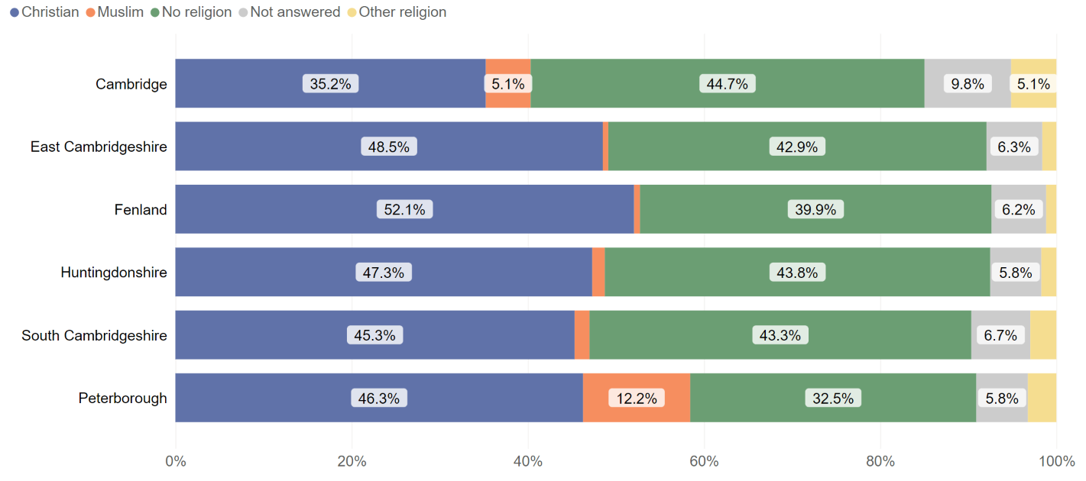
Cambridgeshire and Peterborough: per cent of population by religion, Census 2021

Slide 14
Cambridge

Slide 15
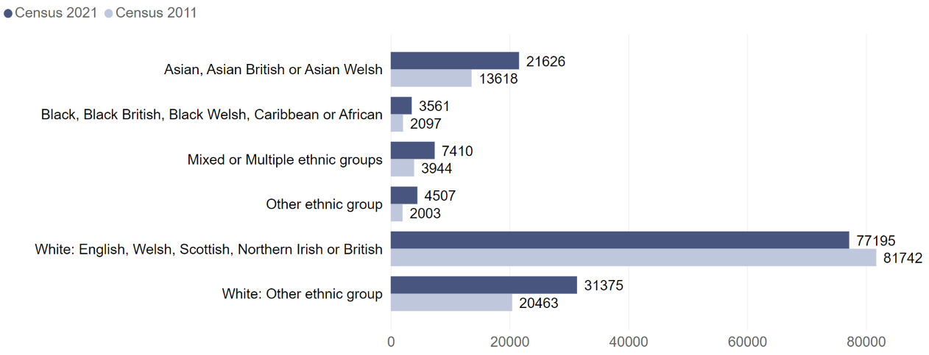
Cambridge: number of residents by ethnic group Census 2011 and Census 2021

Slide 16
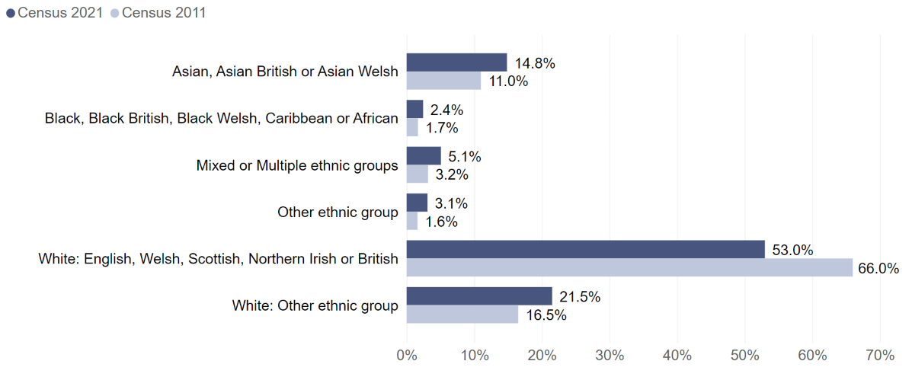
Cambridge: per cent of residents by ethnic group Census 2011 and Census 2021

Slide 17
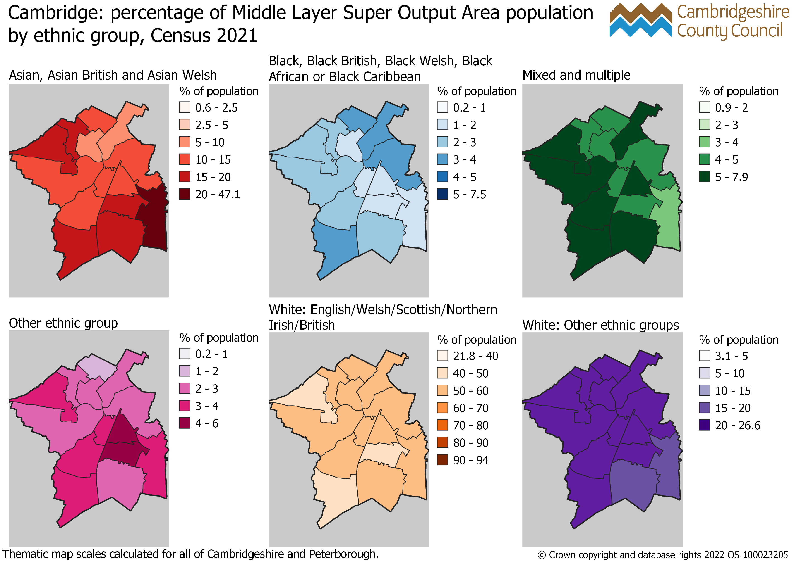
Cambridge: percentage of MSOA population by ethnic group, Census 2021

Slide 18
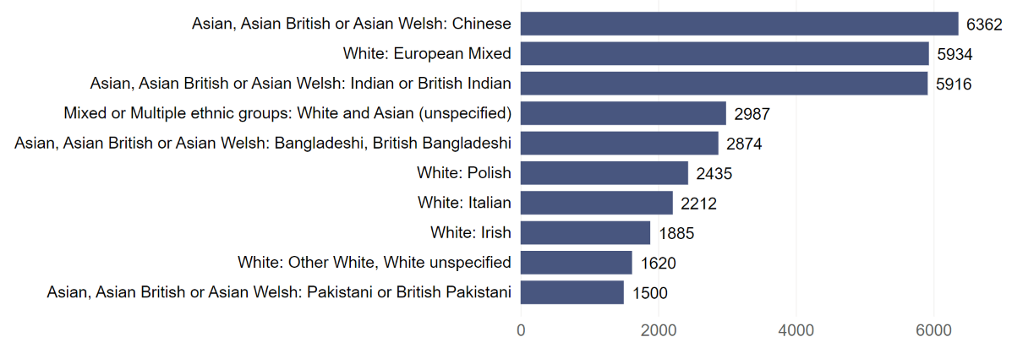
Cambridge: top 10 ethnic groups by population Census 2021
White: English, Welsh, Scottish, Northern Irish or British ethnic group excluded from the chart. There were 77,195 residents in Cambridge in this ethnic group at Census 2021.

Slide 19
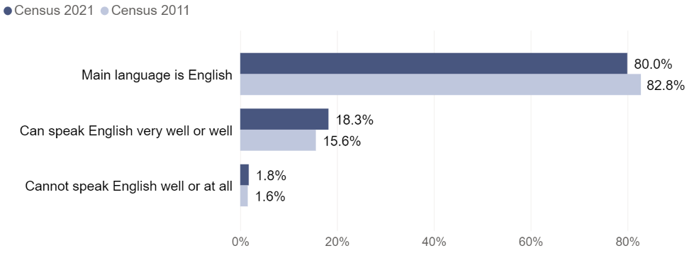
Cambridge: per cent of residents aged 3 years and over by proficiency in English, Census 2011 and Census 2021

Slide 20
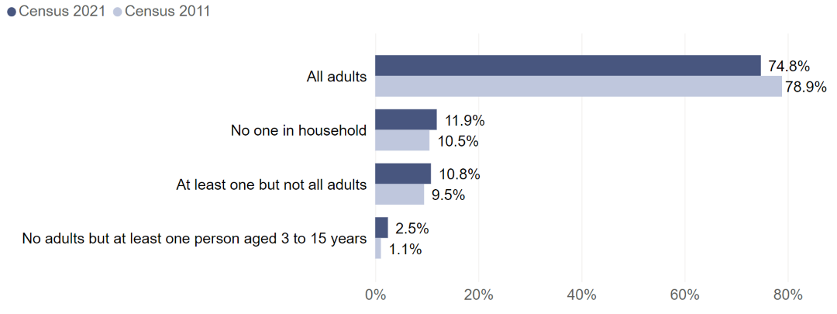
Cambridge: per cent of households by how many people in the household have English as a main language, Census 2011 and Census 2021

Slide 21
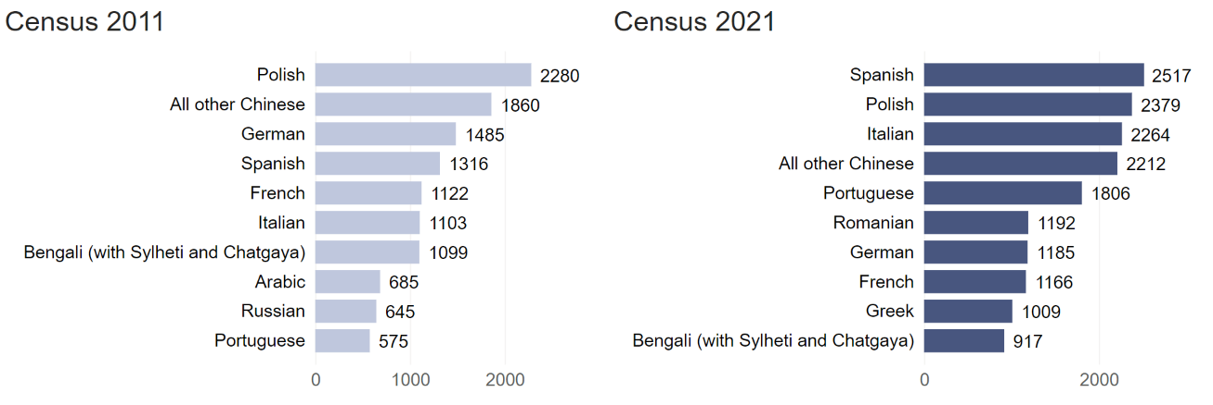
Cambridge: top 10 main languages by number of residents aged 3 years and over, Census 2011 and 2021
Residents with English as a main language are excluded from the chart. There were 113,476 residents aged 3 years and over in Cambridge who had English as a main language at Census 2021, compared to 99,062 at Census 2011.

Slide 22
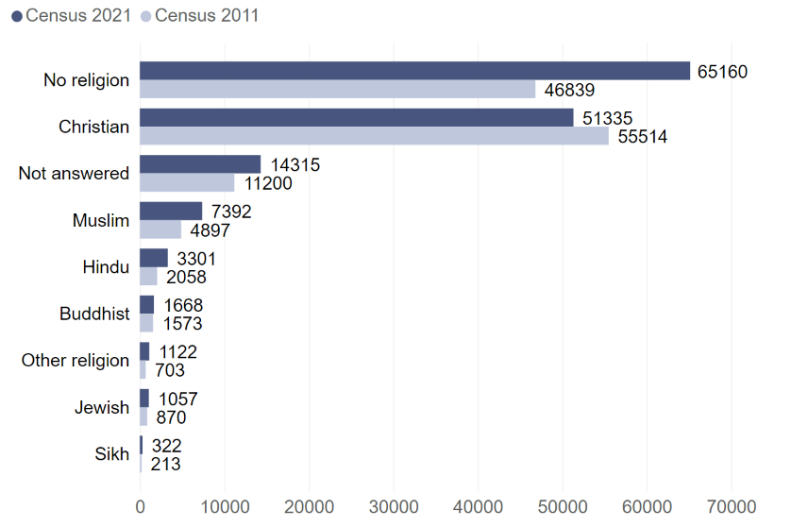
Cambridge: number of residents by religion Census 2011 and Census 2021

Slide 23
East Cambridgeshire

Slide 24
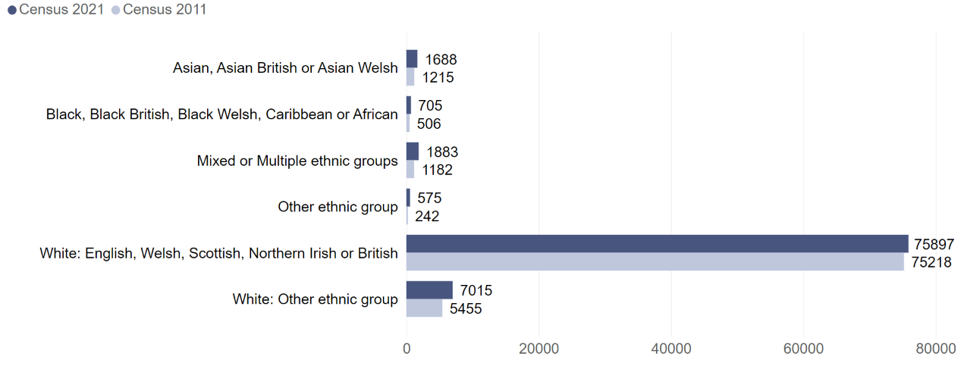
East Cambridgeshire: number of residents by ethnic group Census 2011 and Census 2021

Slide 25
East Cambridgeshire: per cent of residents by ethnic group Census 2011 and Census 2021

Slide 26
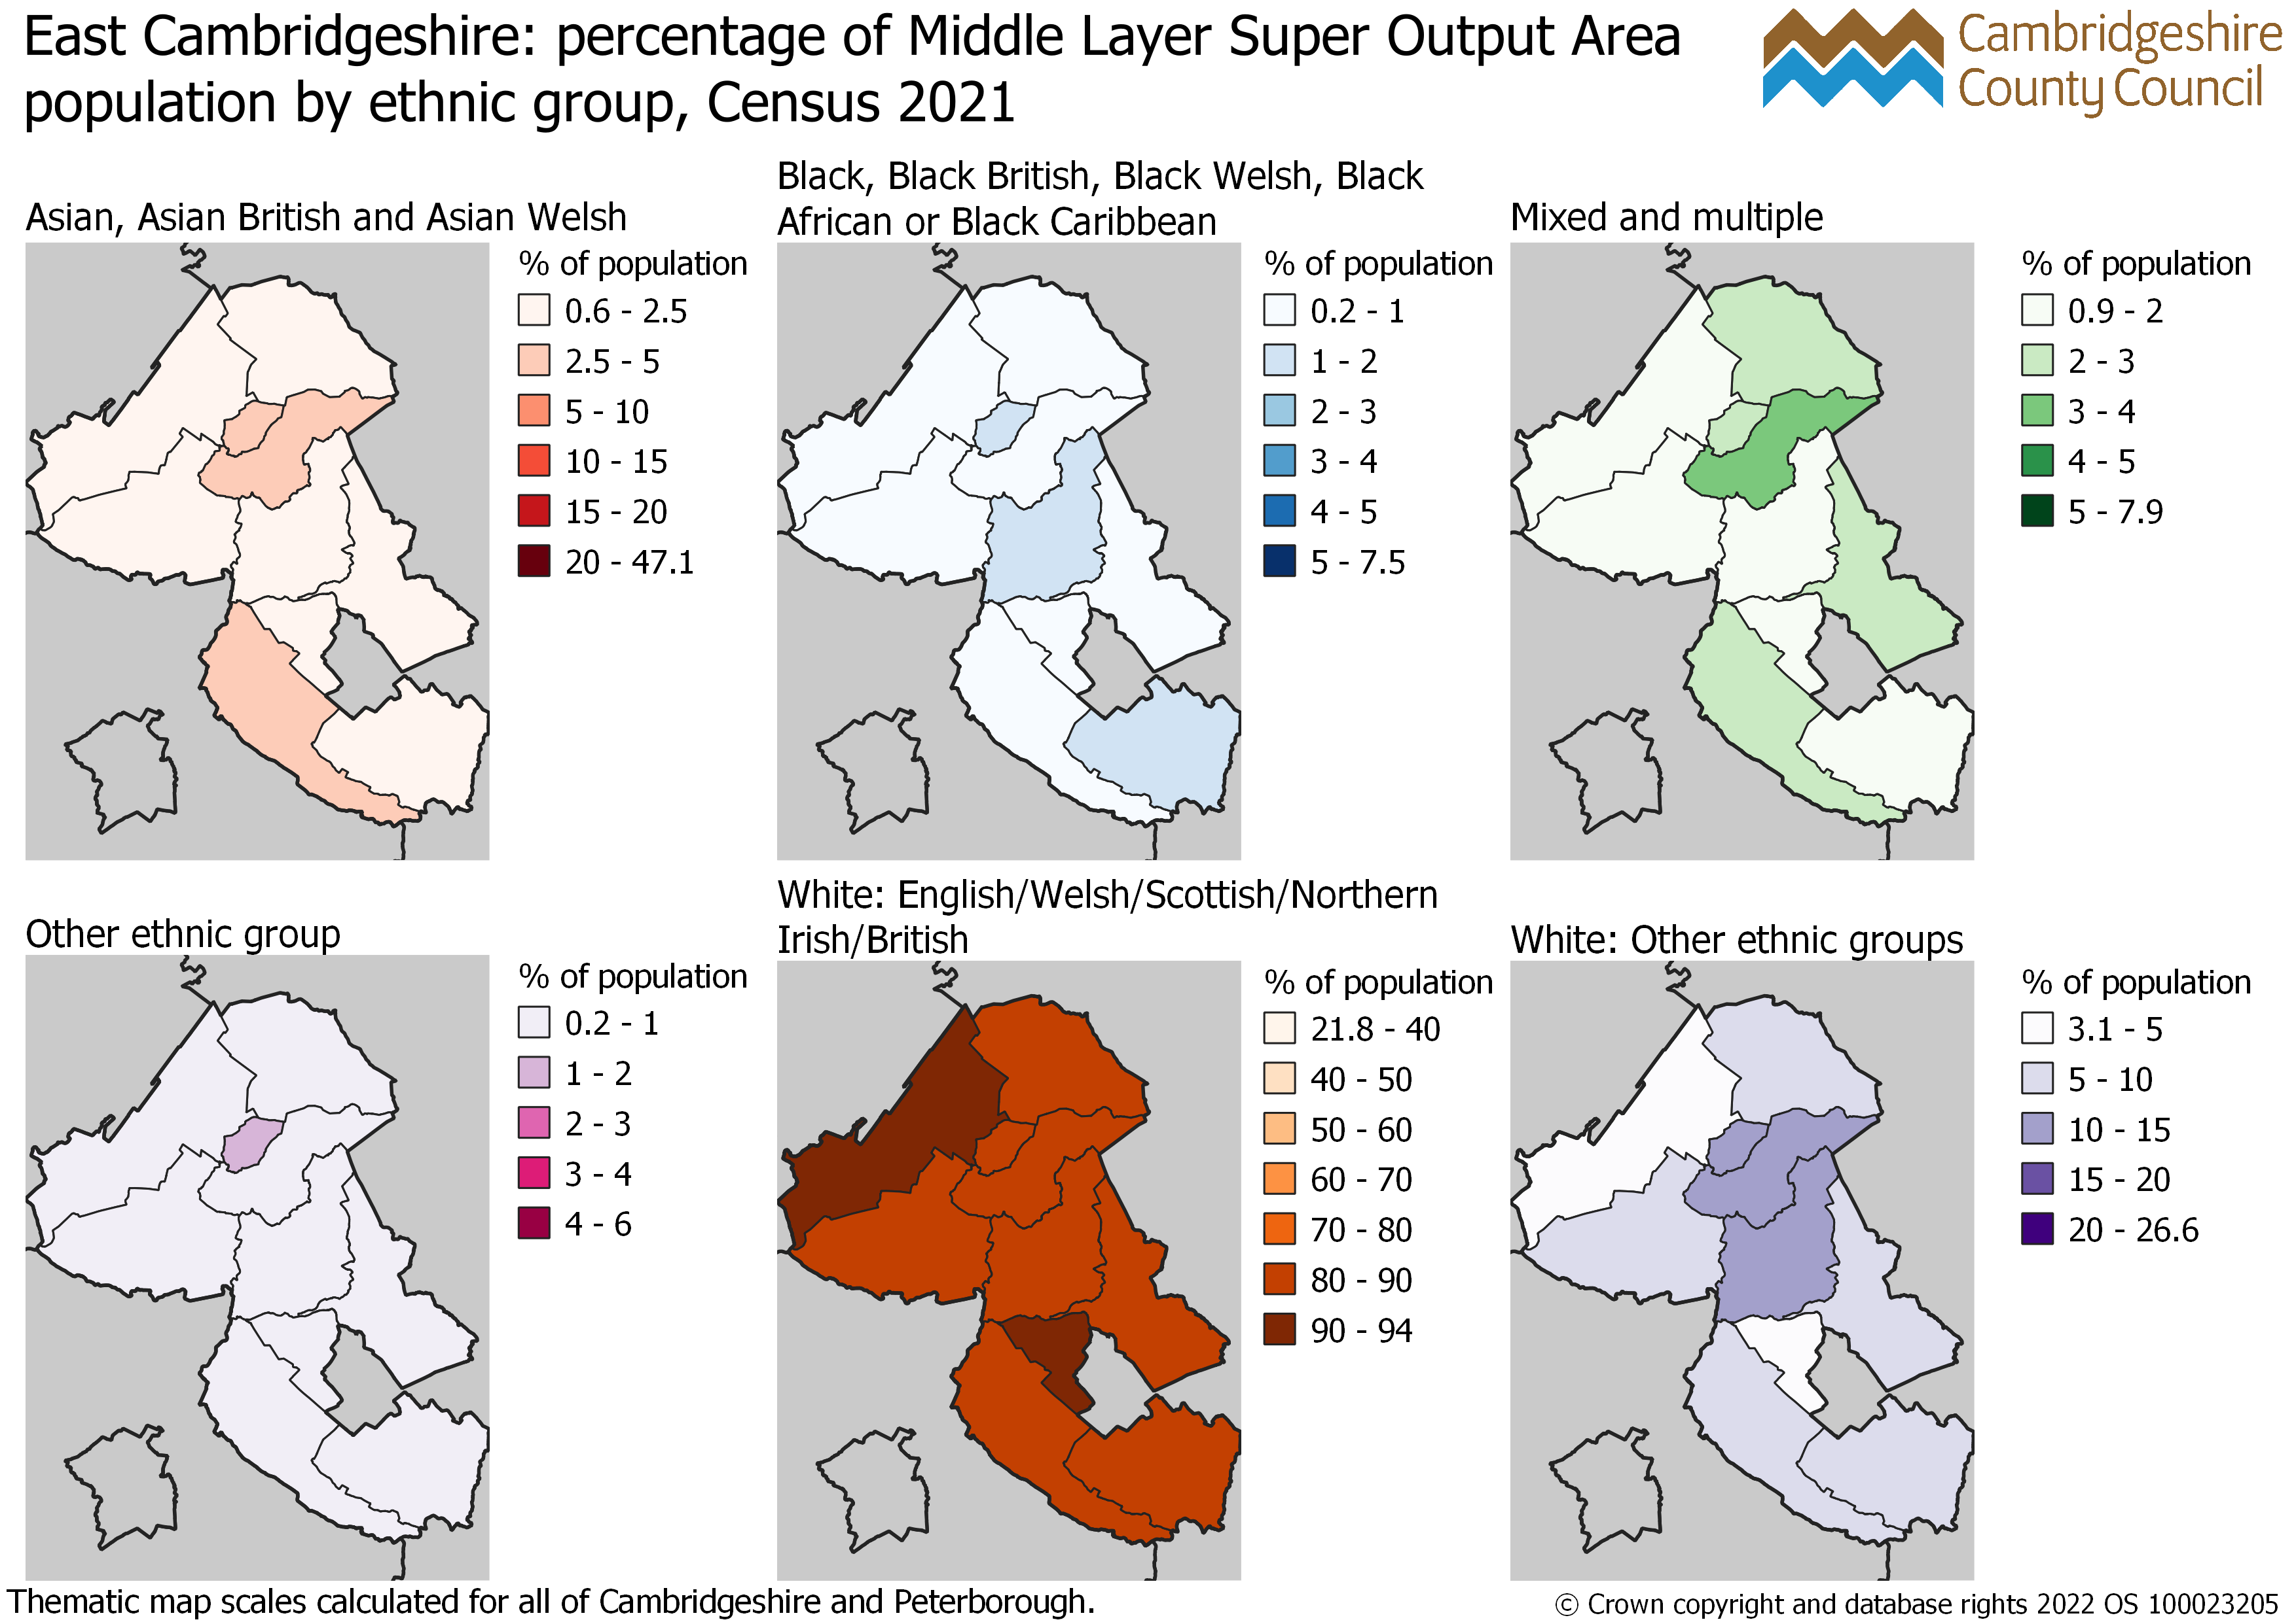
East Cambridgeshire: percentage of MSOA population by ethnic group, Census 2021

Slide 27
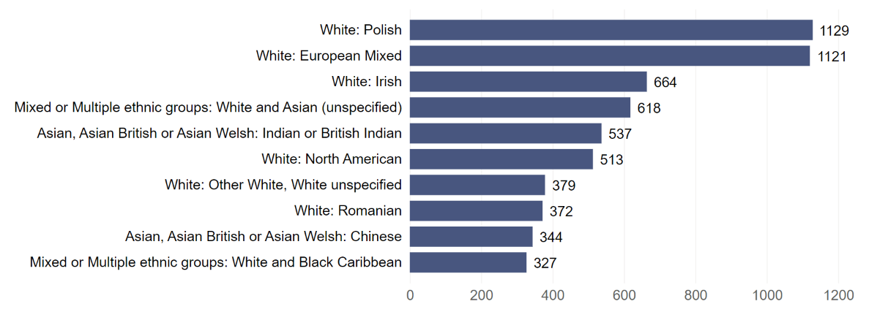
East Cambridgeshire: top 10 ethnic groups by population Census 2021
White: English, Welsh, Scottish, Northern Irish or British ethnic group excluded from the chart. There were 75,897 residents in East Cambridgeshire in this ethnic group at Census 2021.

Slide 28
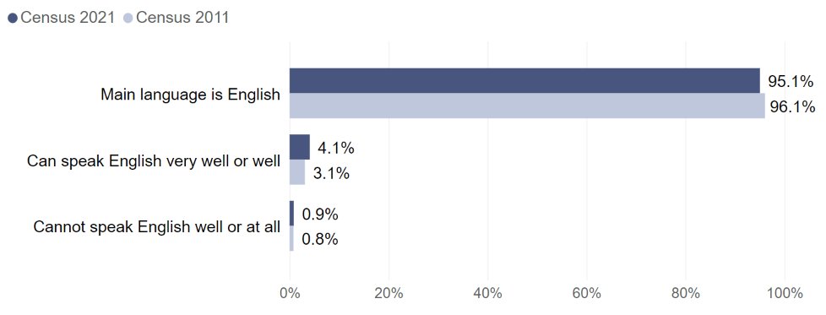
East Cambridgeshire: per cent of residents aged 3 years and over by proficiency in English, Census 2011 and Census 2021

Slide 29
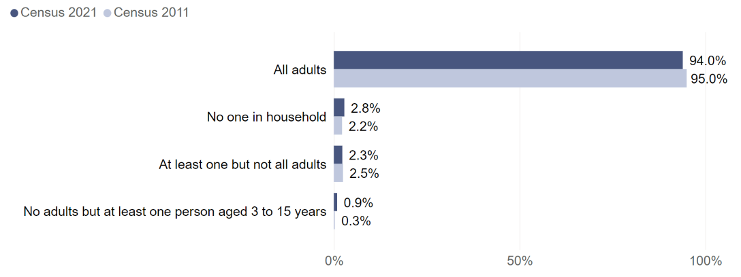
East Cambridgeshire: per cent of households by how many people in the household have English as a main language, Census 2011 and Census 2021

Slide 30
East Cambridgeshire: top 10 main languages by number of residents aged 3 years and over, Census 2011 and 2021
Residents with English as a main language are excluded from the chart. There were 80,970 residents aged 3 years and over in East Cambridgeshire who had English as a main language at Census 2021, compared to 77,308 at Census 2011

Slide 31
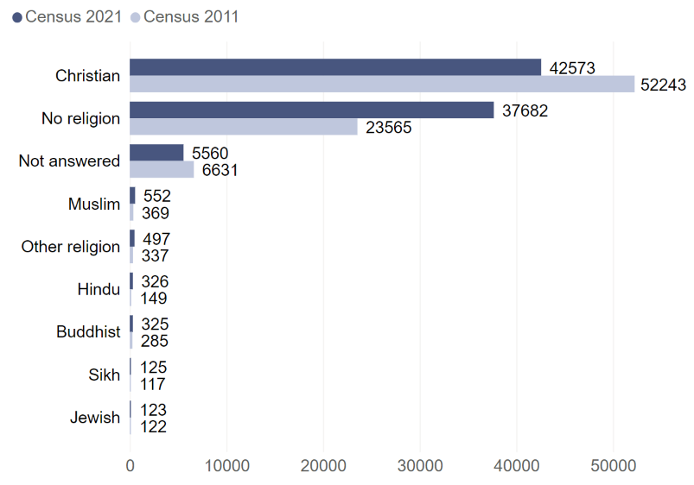
East Cambridgeshire: number of residents by religion Census 2011 and Census 2021

Slide 32
Fenland

Slide 33
Fenland: number of residents by ethnic group Census 2011 and Census 2021

Slide 34
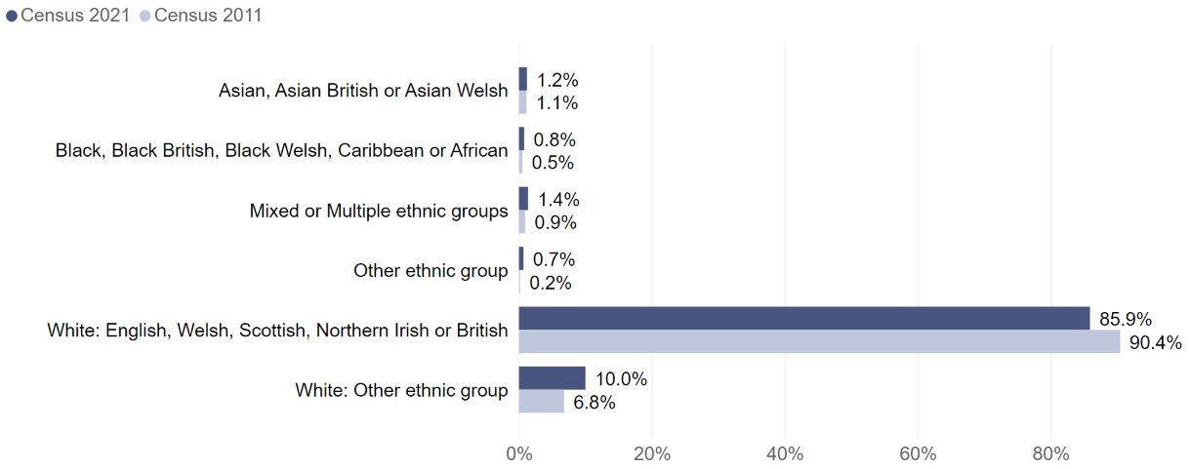
Fenland: per cent of residents by ethnic group Census 2011 and Census 2021

Slide 35
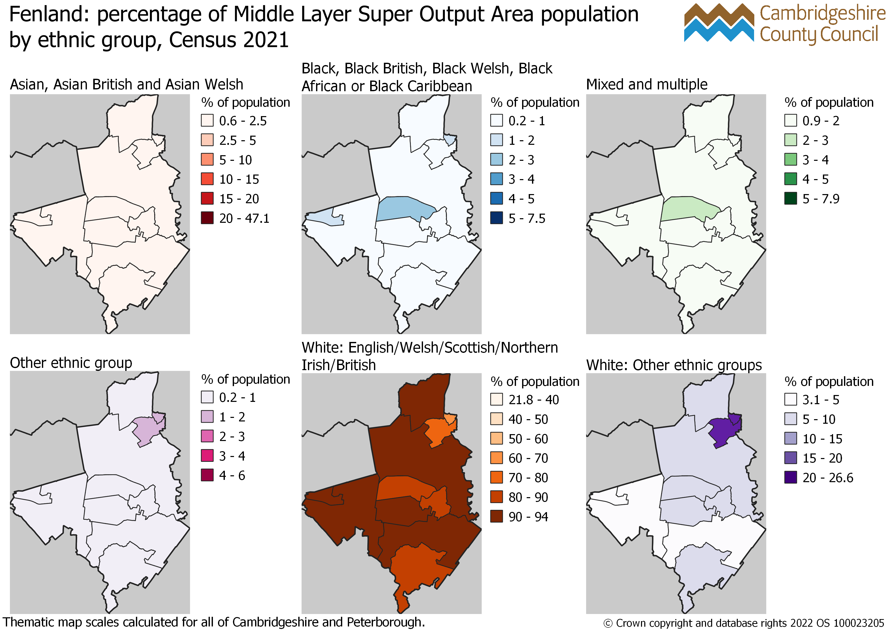
Fenland: percentage of MSOA population by ethnic group, Census 2021

Slide 36
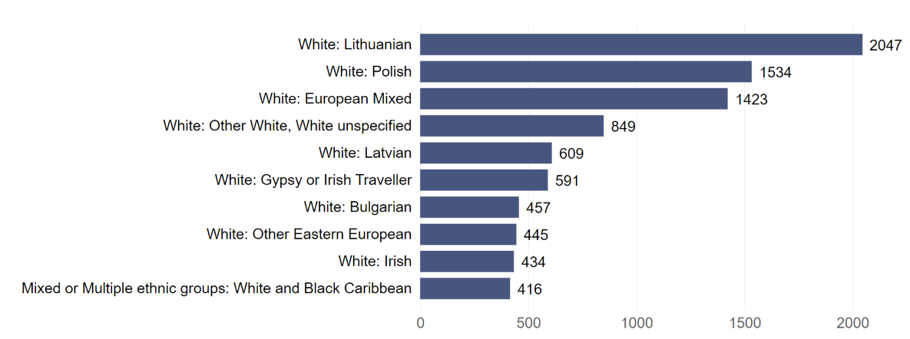
Fenland: top 10 ethnic groups by population Census 2021
White: English, Welsh, Scottish, Northern Irish or British ethnic group excluded from the chart. There were 88,028 residents in Fenland in this ethnic group at Census 2021.

Slide 37
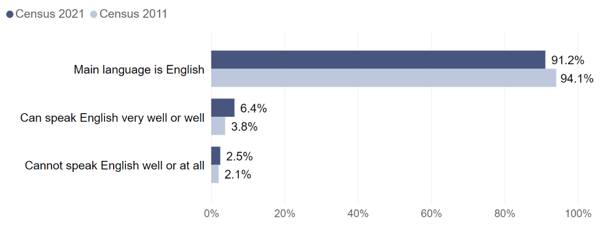
Fenland: per cent of residents aged 3 years and over by proficiency in English, Census 2011 and Census 2021

Slide 38
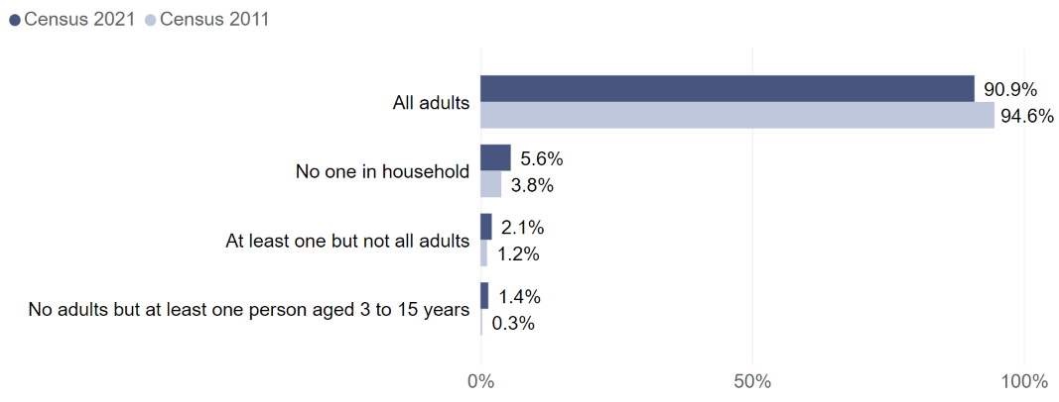
Fenland: per cent of households by how many people in the household have English as a main language, Census 2011 and Census 2021

Slide 39
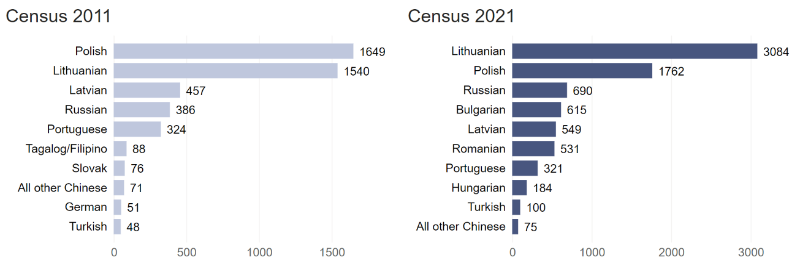
Fenland: top 10 main languages by number of residents aged 3 years and over, Census 2011 and 2021
Residents with English as a main language are excluded from the chart. There were 90,632 residents aged 3 years and over in Fenland who had English as a main language at Census 2021, compared to 86,707 at Census 2011

Slide 40
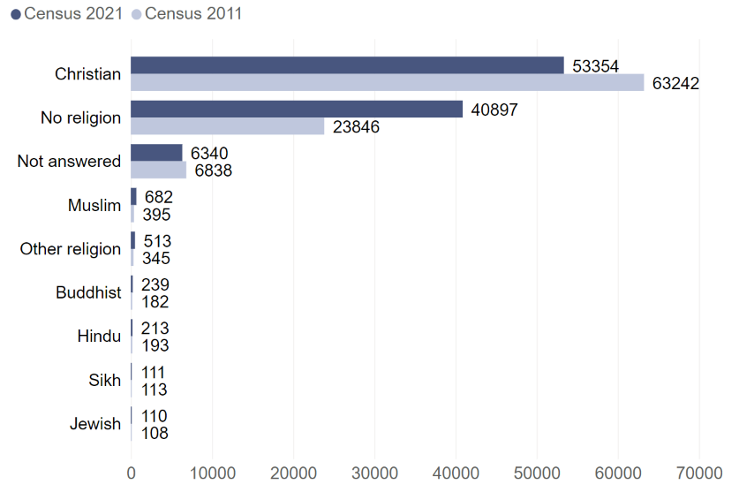
Fenland: number of residents by religion Census 2011 and Census 2021

Slide 41
Huntingdonshire

Slide 42
Huntingdonshire: number of residents by ethnic group Census 2011 and Census 2021

Slide 43
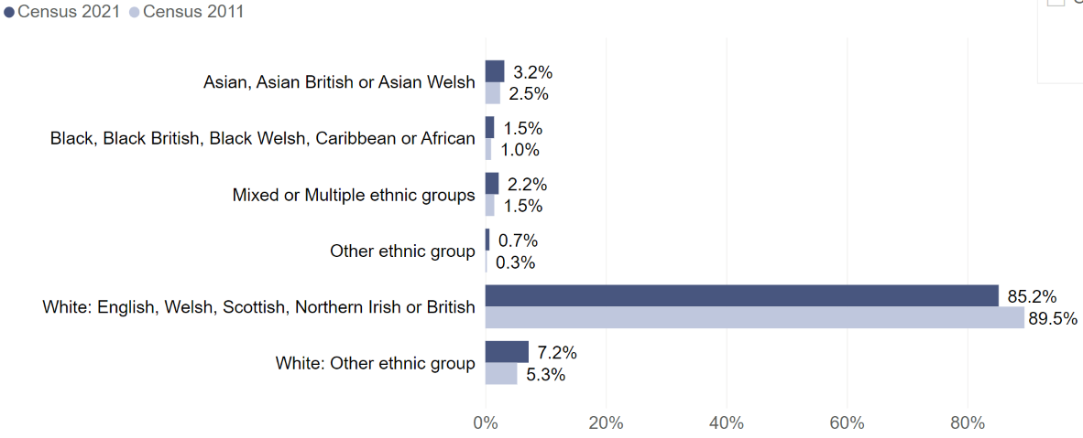
Huntingdonshire: per cent of residents by ethnic group Census 2011 and Census 2021

Slide 44
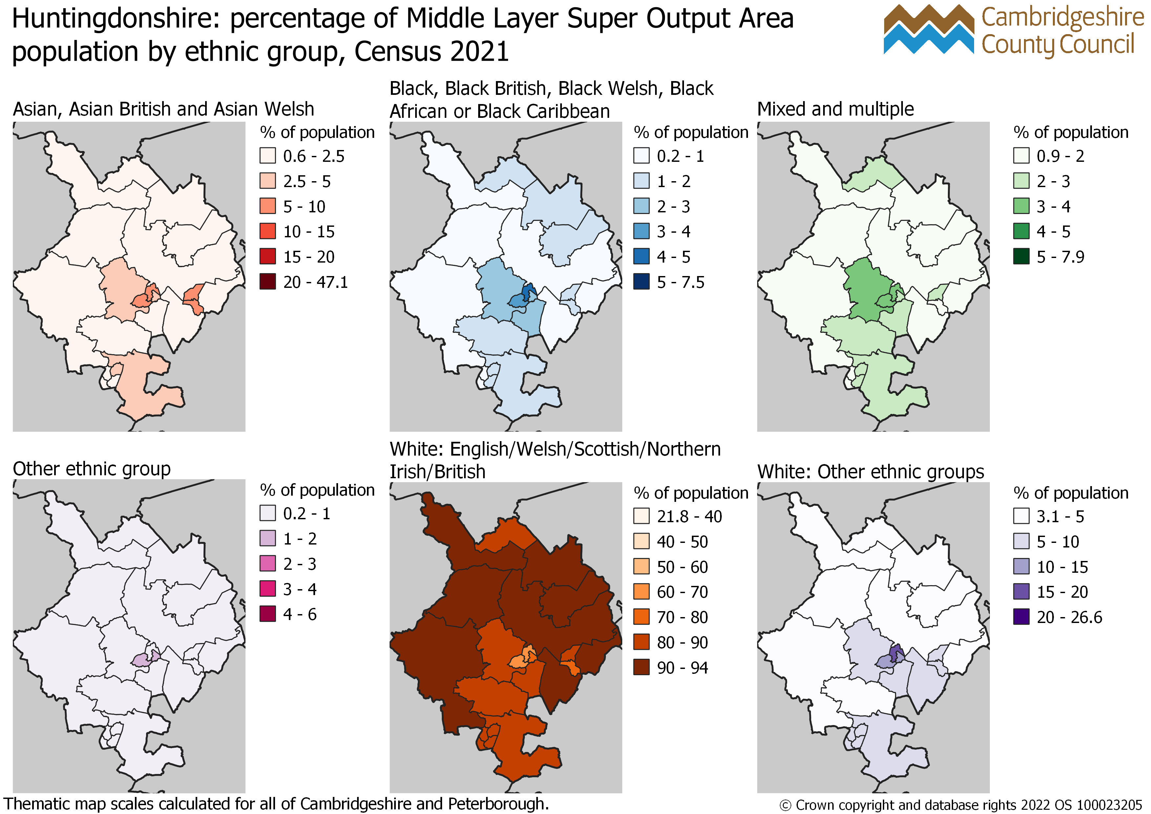
Huntingdonshire: percentage of MSOA population by ethnic group, Census 2021

Slide 45
Huntingdonshire: top 10 ethnic groups by population Census 2021
White: English, Welsh, Scottish, Northern Irish or British ethnic group excluded from the chart. There were 154,089 residents in Huntingdonshire in this ethnic group at Census 2021.

Slide 46
Huntingdonshire: per cent of residents aged 3 years and over by proficiency in English, Census 2011 and Census 2021

Slide 47
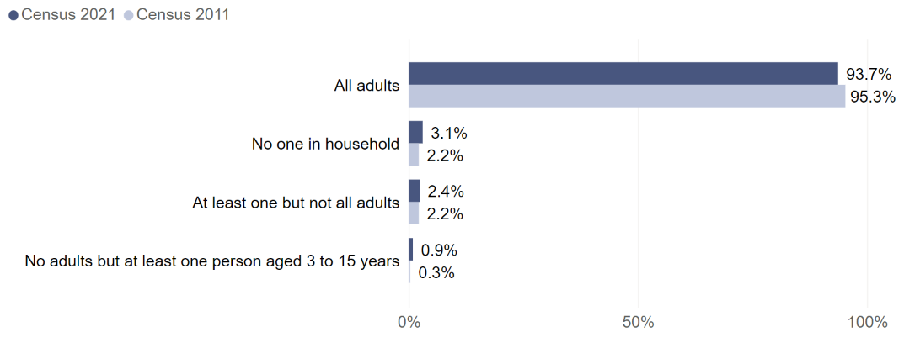
Huntingdonshire: per cent of households by how many people in the household have English as a main language, Census 2011 and Census 2021

Slide 48
Huntingdonshire: top 10 main languages by number of residents aged 3 years and over, Census 2011 and 2021
Residents with English as a main language are excluded from the chart. There were 165,858 residents aged 3 years and over in Huntingdonshire who had English as a main language at Census 2021, compared to 157,024 at Census 2011.

Slide 49
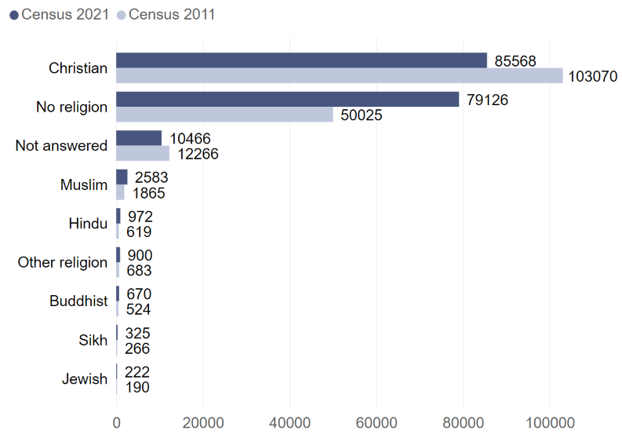
Huntingdonshire: number of residents by religion Census 2011 and Census 2021

Slide 50
South Cambridgeshire

Slide 51
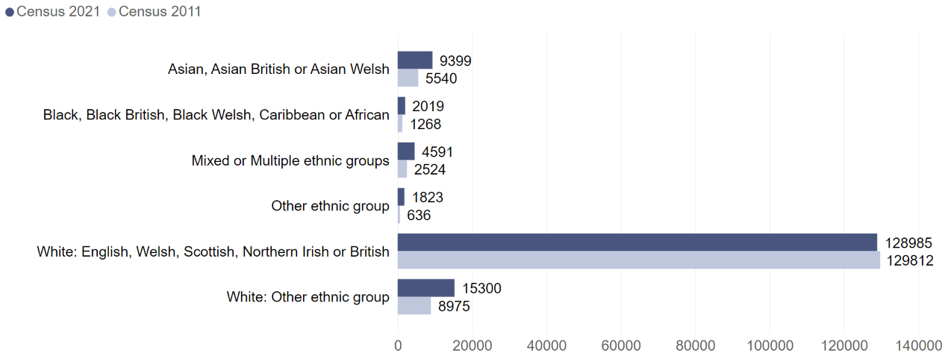
South Cambridgeshire: number of residents by ethnic group Census 2011 and Census 2021

Slide 52
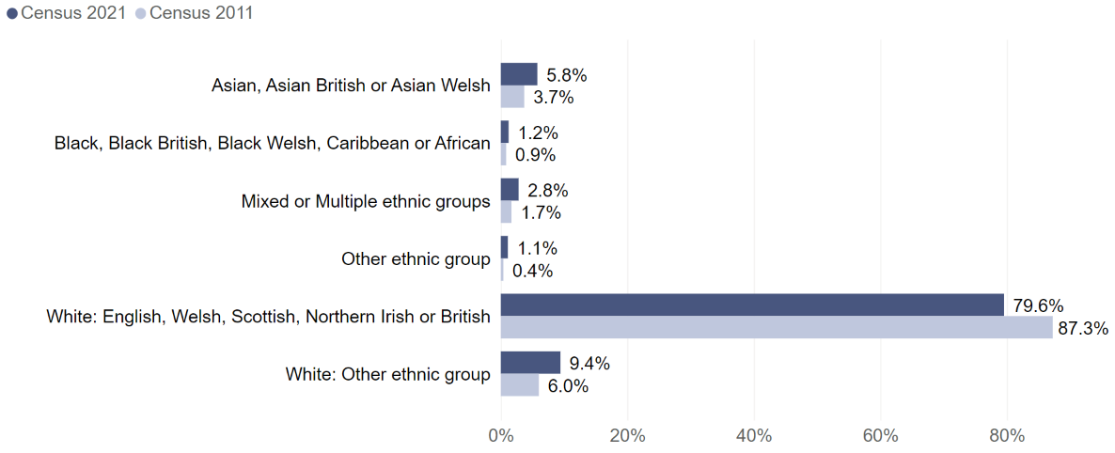
South Cambridgeshire: per cent of residents by ethnic group Census 2011 and Census 2021

Slide 53
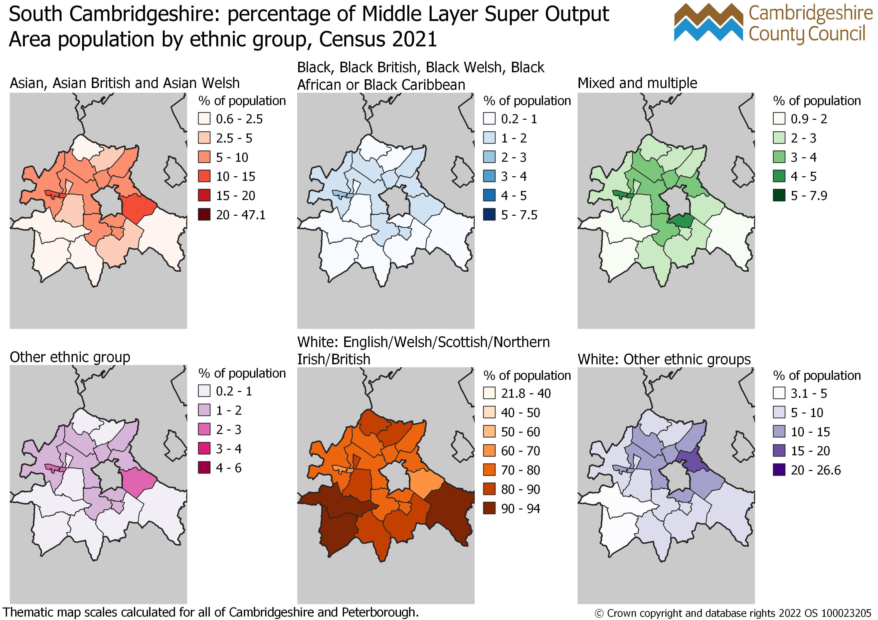
South Cambridgeshire: percentage of MSOA population by ethnic group, Census 2021

Slide 54
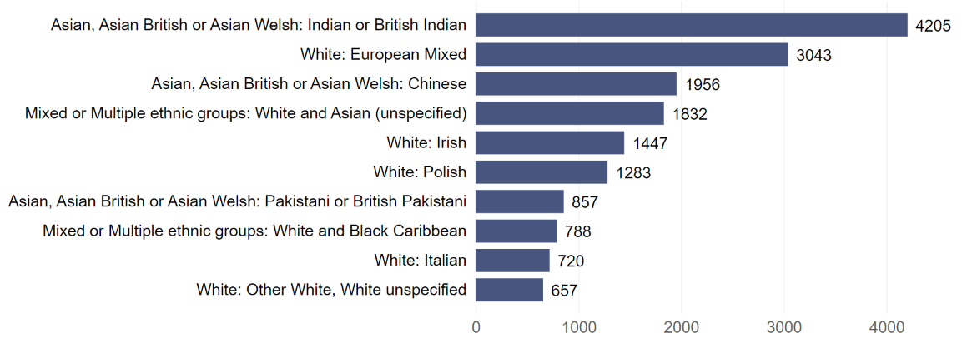
South Cambridgeshire: top 10 ethnic groups by population Census 2021
White: English, Welsh, Scottish, Northern Irish or British ethnic group excluded from the chart. There were 128,985 residents in South Cambridgeshire in this ethnic group at Census 2021.

Slide 55
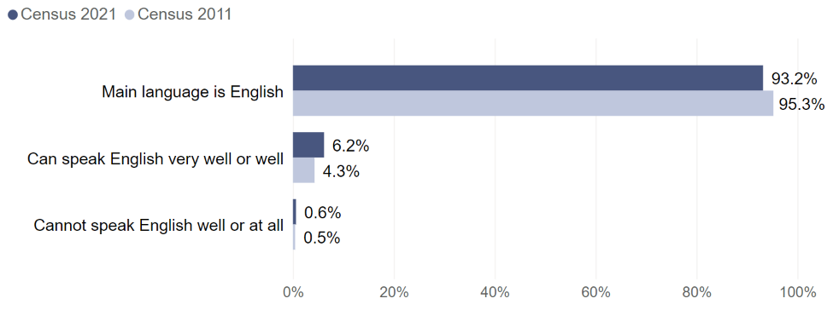
South Cambridgeshire: per cent of residents aged 3 years and over by proficiency in English, Census 2011 and Census 2021

Slide 56
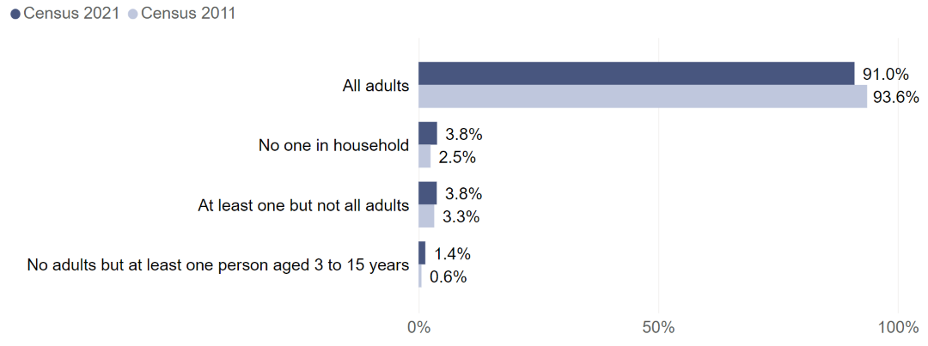
South Cambridgeshire: per cent of households by how many people in the household have English as a main language, Census 2011 and Census 2021

Slide 57
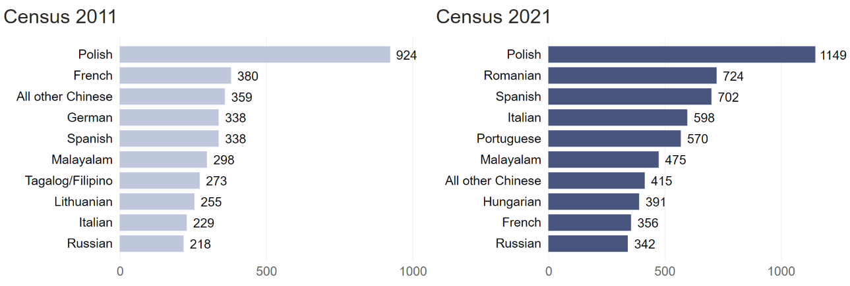
South Cambridgeshire: top 10 main languages by number of residents aged 3 years and over, Census 2011 and 2021
Residents with English as a main language are excluded from chart. There were 146,396 residents aged 3 years and over in South Cambridgeshire who had English as a main language at Census 2021, compared to 136,429 at Census 2011.

Slide 58
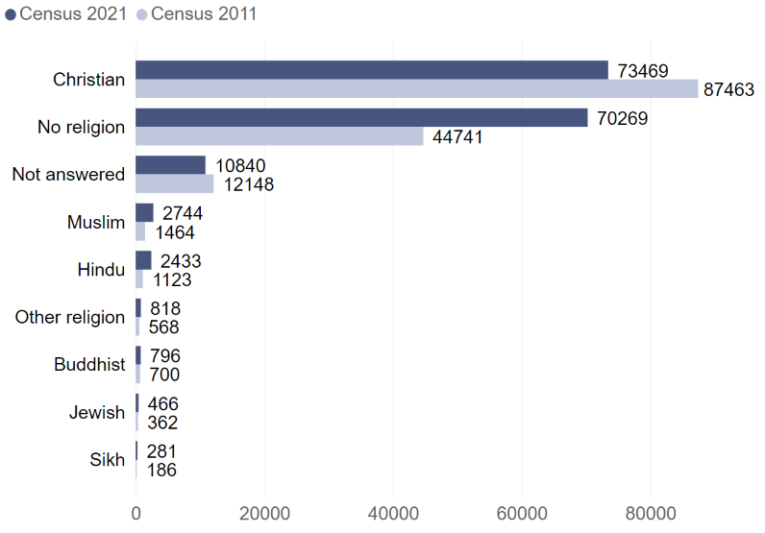
South Cambridgeshire: number of residents by religion Census 2011 and Census 2021

Slide 59
Peterborough

Slide 60
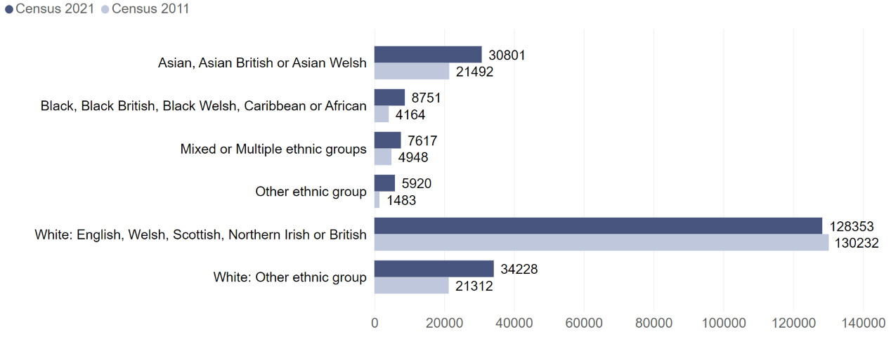
Peterborough: number of residents by ethnic group Census 2011 and Census 2021

Slide 61
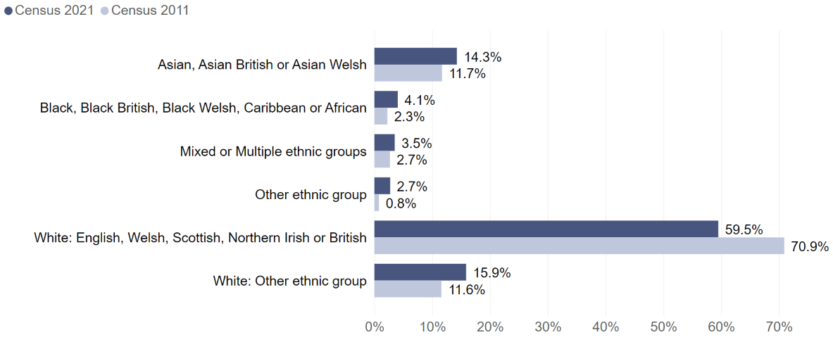
Peterborough: per cent of residents by ethnic group Census 2011 and Census 2021

Slide 62
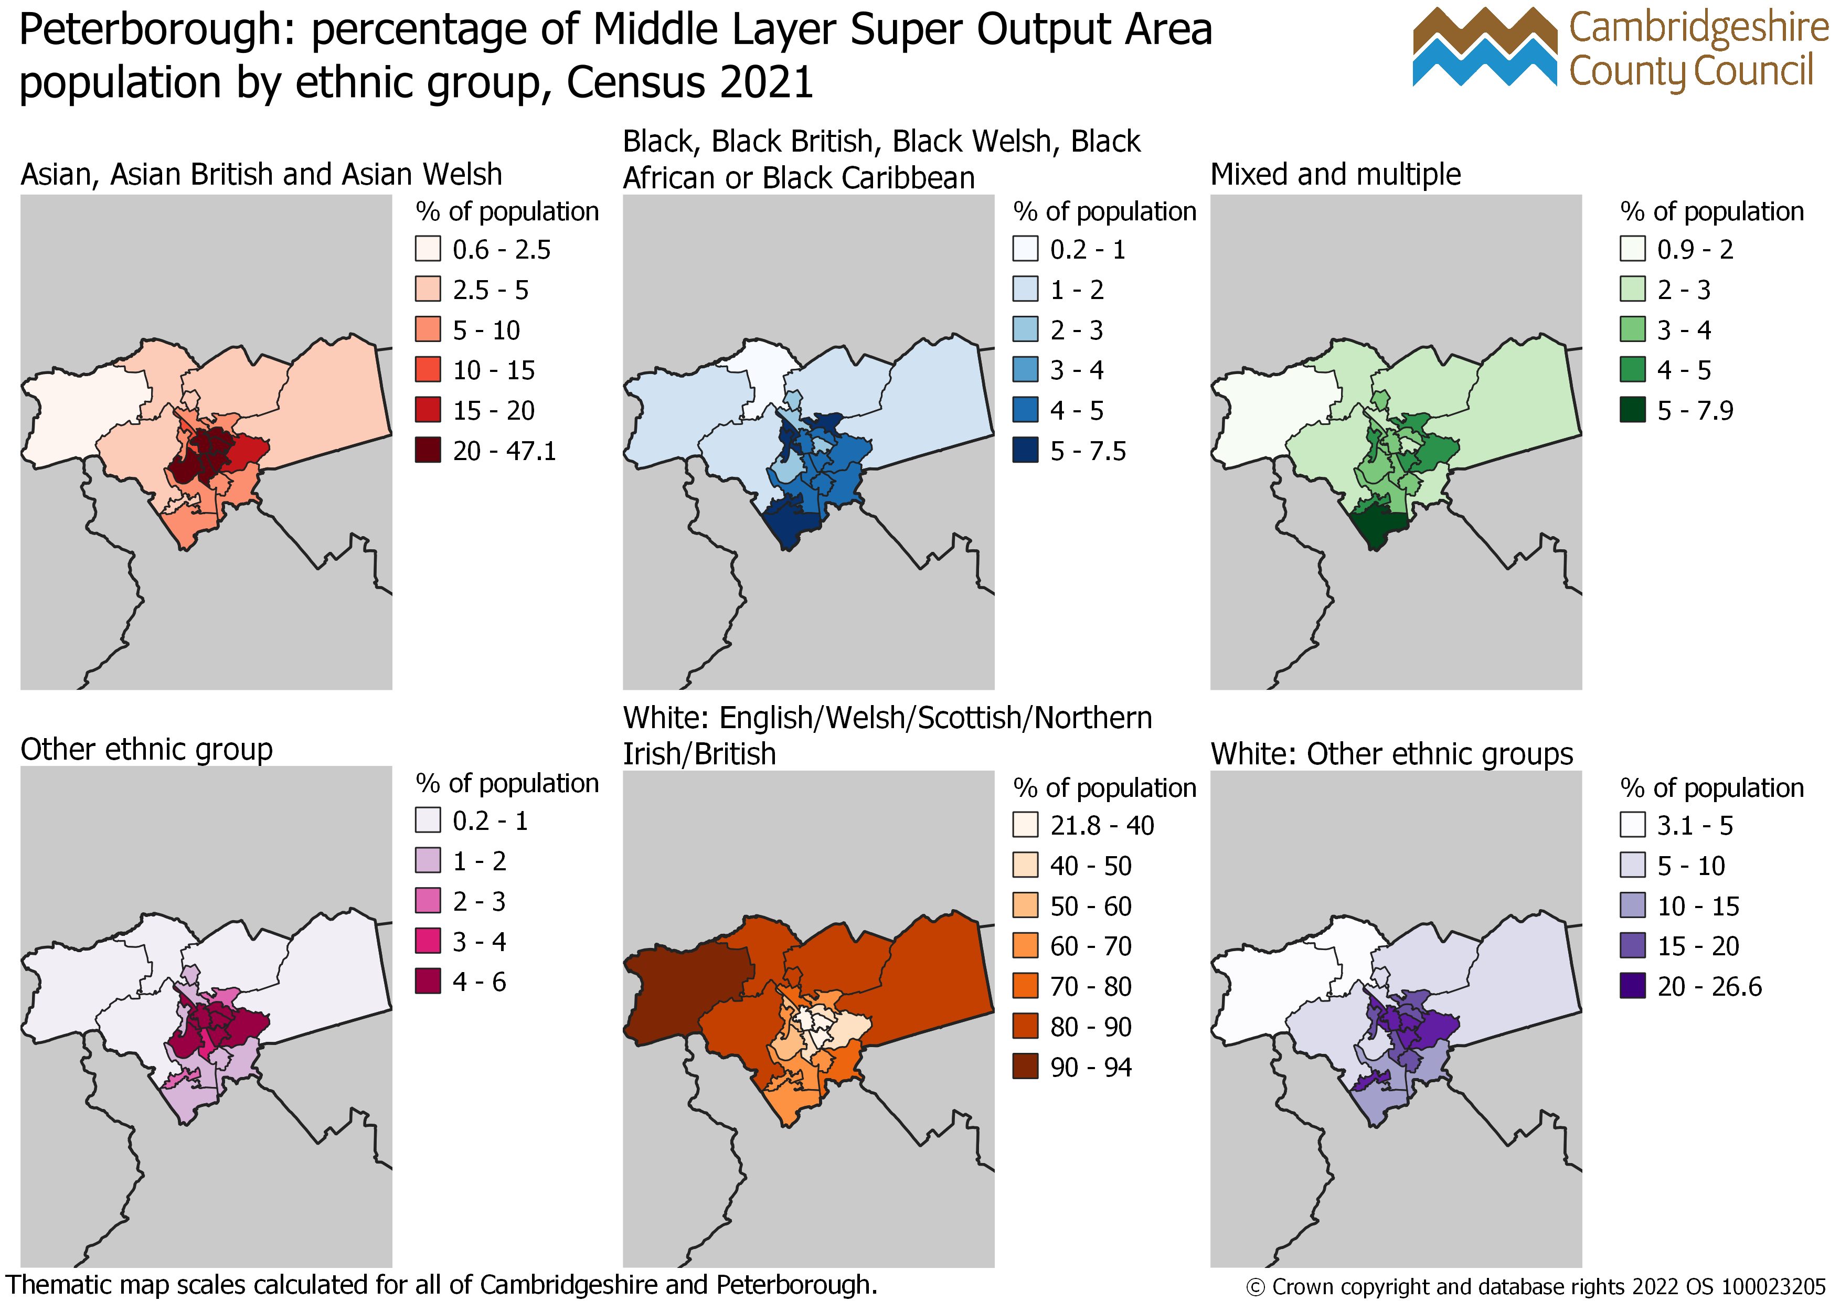
Peterborough: percentage of MSOA population by ethnic group, Census 2021

Slide 63
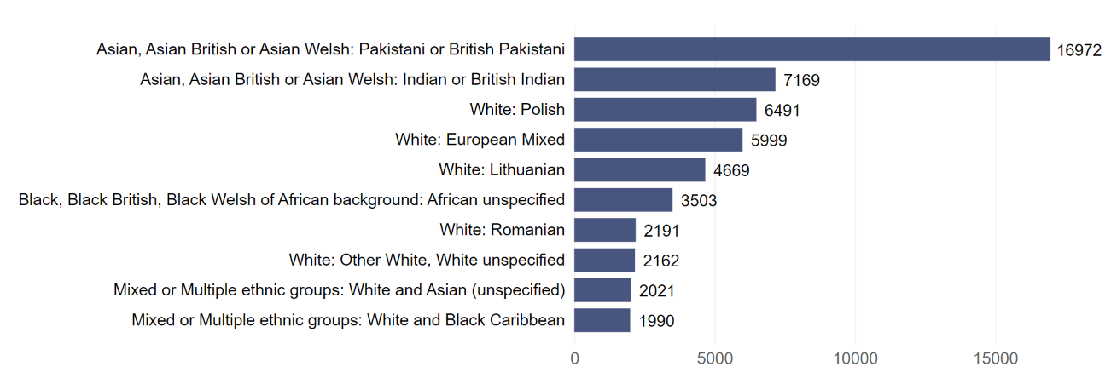
Peterborough: top 10 ethnic groups by population Census 2021
White: English, Welsh, Scottish, Northern Irish or British ethnic group excluded from the chart. There were 128,353 residents in Peterborough in this ethnic group at Census 2021.

Slide 64
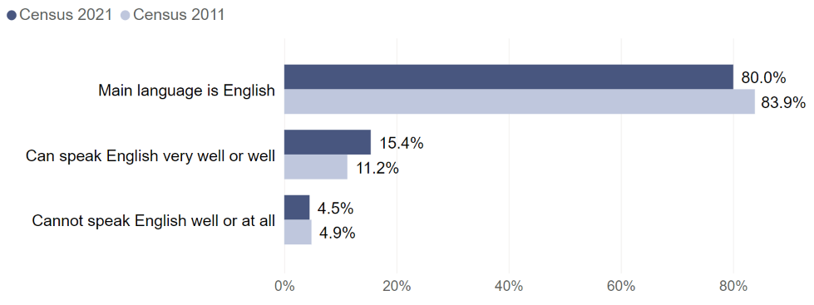
Peterborough: per cent of residents aged 3 years and over by proficiency in English, Census 2011 and Census 2021

Slide 65
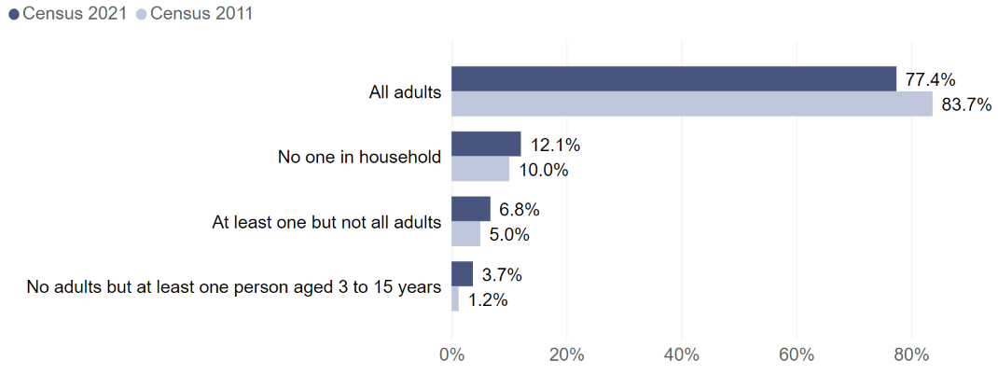
Peterborough: per cent of households by how many people in the household have English as a main language, Census 2011 and Census 2021

Slide 66
Peterborough: top 10 main languages by number of residents aged 3 years and over, Census 2011 and 2021
Residents with English as a main language are excluded from the chart. There were 166,028 residents aged 3 years and over in Peterborough who had English as a main language at Census 2021, compared to 146,880 at Census 2011.

Slide 67
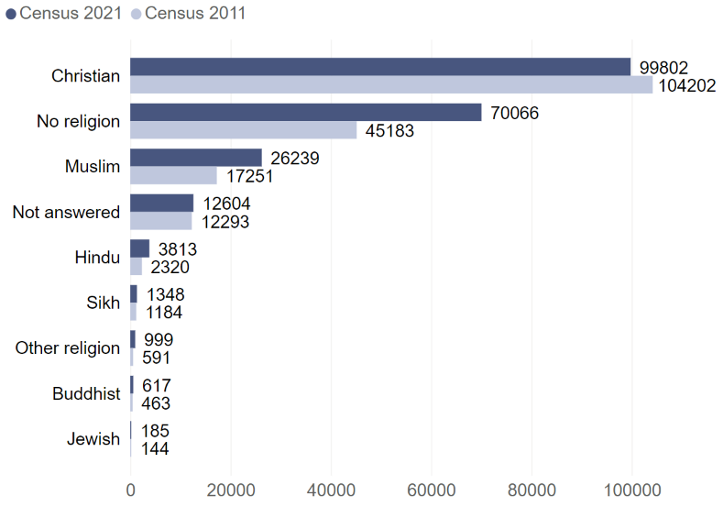
Peterborough: number of residents by religion Census 2011 and Census 2021

Slide 68
Census 2021: useful links
Census 2021 Cambridgeshire Insight – Population – Census 2021 webpages on Cambridgeshire Insight, including:
Census 2021 first results: published report, recorded presentation and dataset,
Demography and migration topic summary,
Armed forces veterans topic summary
Cambs Insight tools already have first results, and they will be updated with the release of each topic summary:
Map explorer
Data explorer
Interactive reports
Census 2021 data published on the ONS website and on NOMIS
ONS tools:
Census maps – population and identity maps released, will be updated with future topic summary releases
Area profiles – available on NOMIS at local authority level. Build your own area profiles has a provisional release between December 2022 and January 2023
How your area has changed in 10 years: Census 2021 - provisional release between December 2022 and January 2023

