Slide 1
Health and Wellbeing & ICS Strategy
Notes:
The development of ICS strategy is a significant and multifaceted piece of work.
Organisations have agreed to work together as an Integrated Care Partnership and commit to a single strategy with the allowance of time to develop this in 2022/23 in line with national guidance.
The Health & Wellbeing Board has merged into one and aligned with the Integrated Care Partnership. Statutory accountabilities remain.
This is a positive system wide step to align services for residents/patients

Slide 2
An integrated approach
Share experience, knowledge and expertise
Make better use of resources by sharing priorities, outcomes and cost efficiencies
Jointly develop services that help improve the lives of people in our communities
Act as 'one public service' with our partners, our workforce and our communities
Form new and deeper partnerships with communities, the voluntary sector and business – speak as one voice
Design how it all fits together around people, rather than the needs of individual organisations
Notes:
Whilst development has focused on cementing the vision, aims and priorities for the HWB-ICP, work is underway to co-ordinate and gather all existing and developing work relating to system owned strategies in one place, under an aligned framework.

Slide 3
Key features of the system strategy
Mission statement
All together
for healthier futures
Overarching H&WB
ambitions
Have better outcomes for our children
Reduce inequalities in deaths under 75 years
Increase the number of years that people live in good health
Create an environment to give people the opportunity to be as healthy as they can be
Ensure our children are ready to enter education and exit, prepared for the next phase of their lives
Promote early intervention and prevention measures to improve mental health and wellbeing
Reduce poverty through better employment and housing
System priorities
System
delivery
objectives
Development of system priority action plans, co-production, engagement and consultation
Notes:
Our system leaders have a shared vision and already agreed strategic objectives and outcomes. It brings together key strategies that have already been developed by the system and emerging nationally mandated strategy areas (such as our VCSE, the Green Plan) into one place describing how they support the delivery of the System strategic objectives of the ICS.

Slide 4
Our overarching health and wellbeing ambitions
Better outcomes for children
Why? Cambridgeshire and Peterborough children are faring less well than children in similar areas.
Purpose: Better outcomes for our children, especially when compared to other LAs with similar makeup.
Reduce inequalities in deaths
under 75
Why? Strong link in Cambridgeshire and Peterborough between neighbourhood rates of early death from preventable disease, and the deprivation of the local area.
Purpose: Reduce the inequalities of for our more deprived people who are much more likely to die young.
Increase the number of years
in good health
Why? ‘Healthy life expectancy’ measures the number of years in good health (rather than overall lifespan).
Purpose: Increase healthy life expectancy by at least two years for men and women in our areas.
Notes:
Ambitious but achieveable

Slide 5
Leads for the four priorities of the H&W and integrated care strategy,
Priority | Leads
1. Ensure our children are ready to enter education and exit, prepared for the next phase of their lives | Matthew Winn (Chief Executive, Cambridgeshire Community Services) Jonathan Lewis (Director of Education, Cambridgeshire and Peterborough)
2. Create an environment to give people the opportunities to be as healthy as they can be | Jyoti Atri (Director of Public Health, Cambridgeshire and Peterborough) Louis Kamfer (Managing Director, Strategic Commissioning ABU/Deputy Chief Exec, ICB)
3. Reduce poverty through better employment and better housing | Fliss Miller (Acting Director of Skills, Cambridgeshire and Peterborough Combined Authority) Liz Watts (Chief Executive of South Cambridgeshire District Council) Jo Lancaster (Managing Director of Huntingdonshire District Council)
4. Promote early intervention and prevention measures to improve mental health and wellbeing | Vicki Evans (Assistant Chief Constable, Cambridgeshire Police) Stephen LeGood (Director of People and Business, CPFT)
The role of the leads (TBA):
To provide strategic leadership on the development of the system-wide strategy for each of the four priorities, within the agreed framework and with support from public health team and delivery group
To facilitate prioritisation of activities that build on existing programmes, address population needs, have measurable outcomes and deliver added value
To help ensure alignment with relevant strategies and to promote a collaborative approach across all stakeholders

Slide 6
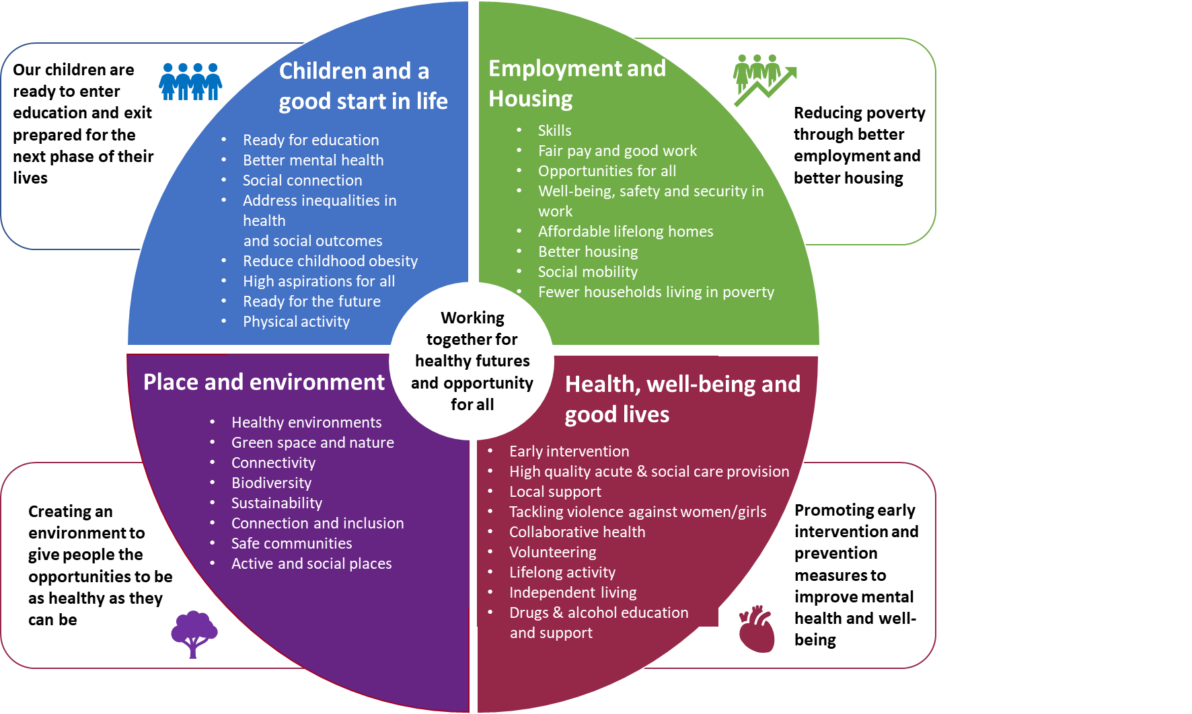
Linking outcomes and activity
Phase 1:
Stocktake to map what work/projects already underway across system
Phase 2:
Collate and review to identify gaps and where additional activity needs to take place
Phase 3:
Identify key activities/ programmes to fully deliver on the four priorities and identify what resources are needed to facilitate this

Slide 7
Key questions Priority: Reduce poverty through better employment and better housing
What’s the difference you’re trying to make and why? What are the outcomes you are trying to change
What is already in place?
What are some quick wins?
What are the difficult issues that need to be addressed (longer term wins)?

Slide 8
Engagement and delivery timescales
Planning | Phase 1 | Phase 2 | Phase 3 | Refine | Delivery
July
Agree approach
Nat guidance issued
Aug
Finalise action plan
Stocktake to map existing projects
September
Collate to identify gaps and where additional activity needs to take place
October
Identify key activities/ programmes to fully deliver on priorities and resources needed
November
First draft of strategy
December
Strategy published
Scoping
Branding
Engage
Review
Engage
Mapping existing groups
Identifying & agreeing key areas for engagement
Creating and agreeing partnership branding ‘wrapper’
Engagement prior to strategy creation.
Focused areas of engagement that will make an impact on the strategy
Review feedback and work into strategy draft.
Impact of engagement shared with those involved
Engagement* around final draft strategies with local people & communities. Concluded prior to submission of strategies
* - presumption formal consultation is not required

