Slide 1


GCP Economy & Employment Quarterly Update
July 2022
Research Group, Cambridgeshire County Council
Research.Group@Cambridgeshire.gov.uk

Slide 2
Consumer Behaviour

Slide 3
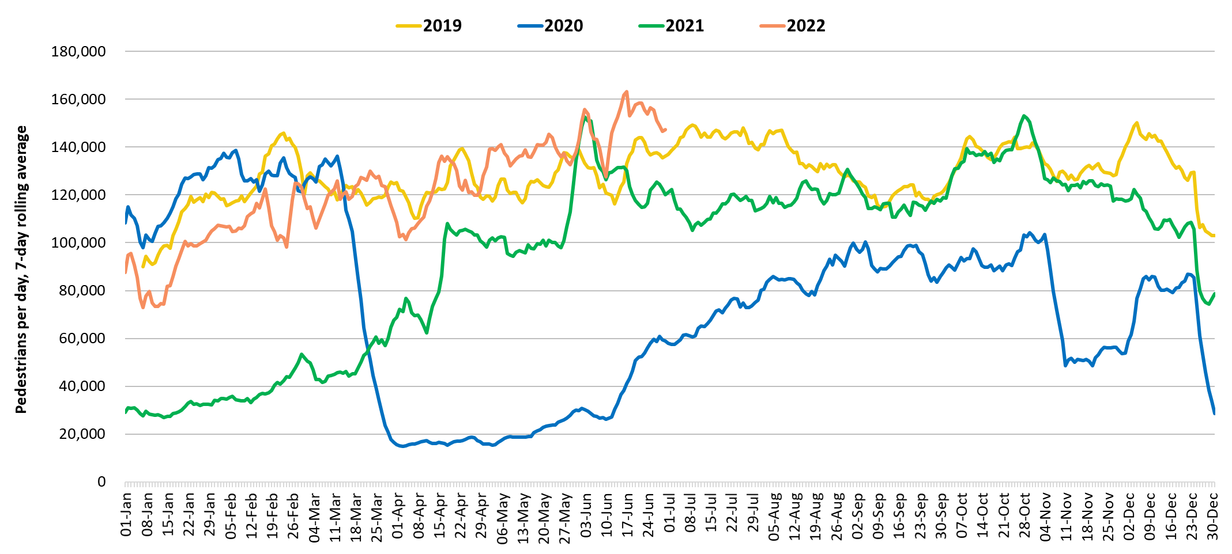
Retail footfall: Central Cambridge
Third lockdown
Second lockdown
First lockdown
 | Pre-COVID vs Now: |  |  | Mid-COVID vs Now: | Previous month vs Now:
 | June 2019 to June 2022 |  |  | June 2020 to June 2022 | March 2022 to June 2022
 | Mon-Sun | Weekdays | Weekends | Mon-Sun | Mon-Sun | Weekdays | Weekends
Cambridge Retail | +7% | +12% | +4% | +228% | +28% | +37% | +9%
Notes:
Commentary:​
Retail footfall has seen overall increases in the last month, driven by large increases across weekdays and smaller increases across weekends. Overall numbers across the week are exceeding June 2020 figures and back to pre-pandemic (June 2019) at the weekends and across weekdays.
​
*June 2019 and June 2020 data includes all locations except for King’s Parade. The King’s Parade sensor was recalibrated in 2021 and therefore counts are no longer comparable.​
​
Source: Cambridge BID footfall data​
​

Slide 4
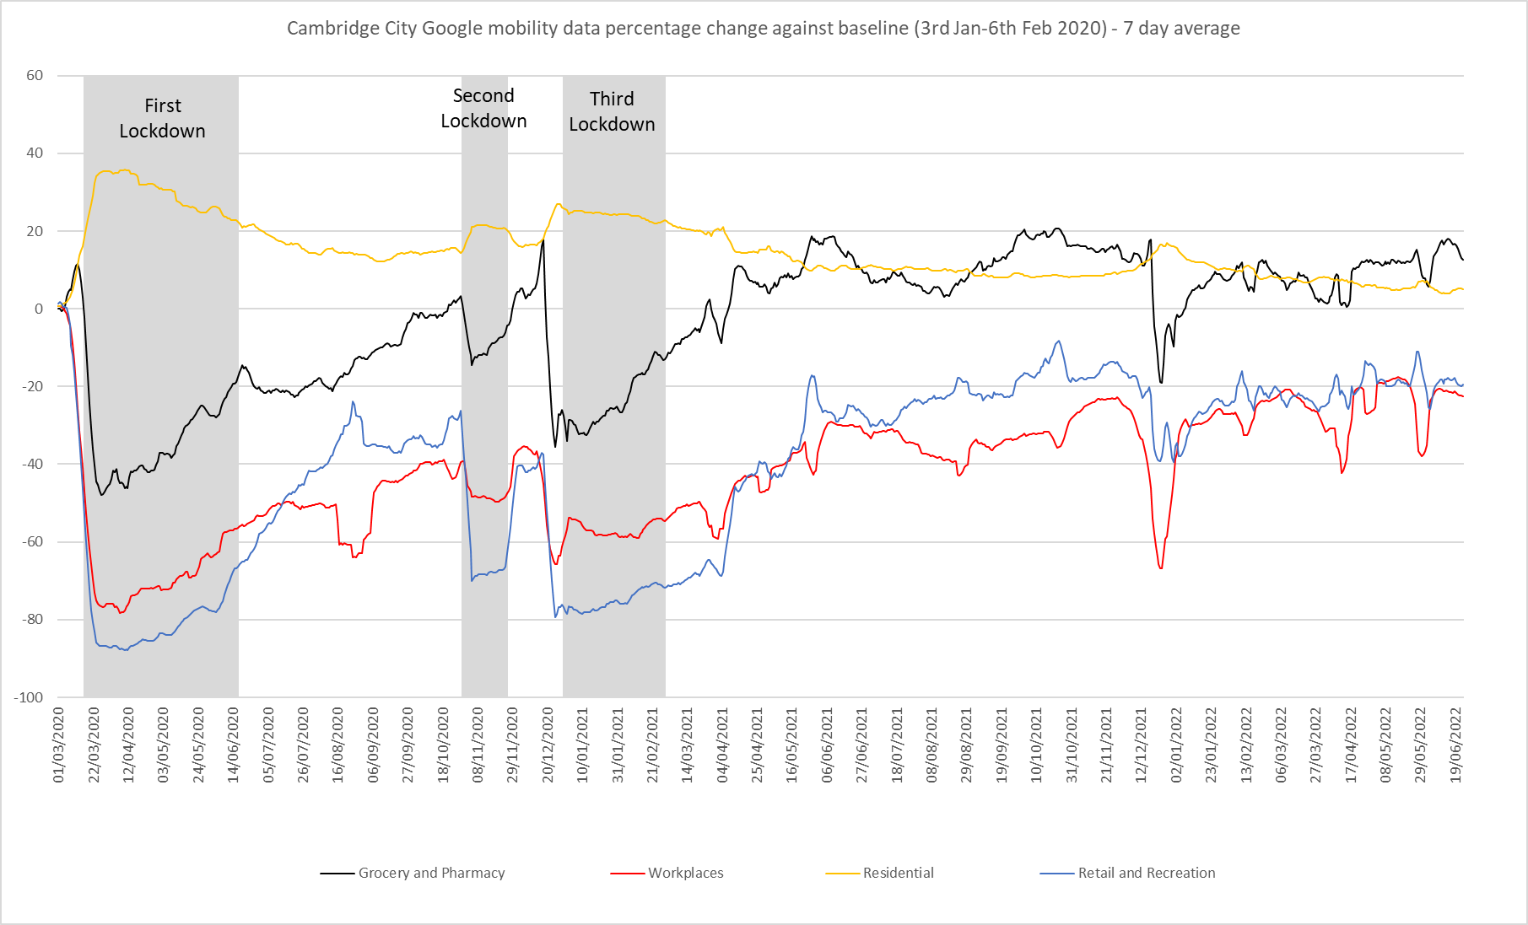
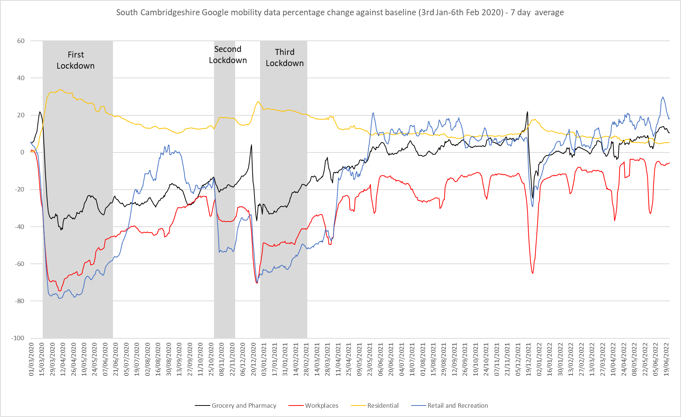
Google Mobility
Pre-COVID vs Now: Jan/Feb 2020 to July 2022 | Cambridge | South Cambridgeshire
Grocery and Pharmacy | +14% | +10%
Workplaces | -26% | -12%
Residential | +5% | +6%
Retail and Recreation | -19% | +19%
Google LLC "Google COVID-19 Community Mobility Reports". https://www.google.com/covid19/mobility/ Accessed: 18/08/2022
Notes:
The charts above show data gathered from Google account holders location history. The comparison of social mobility change is based on the most recent several weeks up to the report date (30th June 2022) compared to the median of the corresponding day in the baseline period (3rd Jan-6th Feb 2020).
This data indicates that in June 2022 visits to the Workplace showed levels furthest from the baseline across the GCP area, particularly in Cambridge where visits were -26% below pre-pandemic levels, in South Cambridgeshire, visits were closer at -12% below the baseline.
In Cambridge, Retail and Recreation visits followed after this, at second lowest compared to the baseline. Increases were evident in visits to Retail and Recreation locations from the 19th of July 2021 when all remaining restrictions were lifted but visits still remain -19% below the baseline in June 2022. This contrasts with South Cambridgeshire where Retail and Recreation visits were +19% above the baseline in the same period.
Residential visits were above the baseline in both Cambridge and South Cambridgeshire (+5% and +6% above the baseline respectively), this is partly influenced by many people working from home.
Grocery visits were +14% above the baseline in Cambridge in June 2022, in South Cambridgeshire, they were +10% above the baseline for this period.

Slide 5
Unemployment Trends

Slide 6
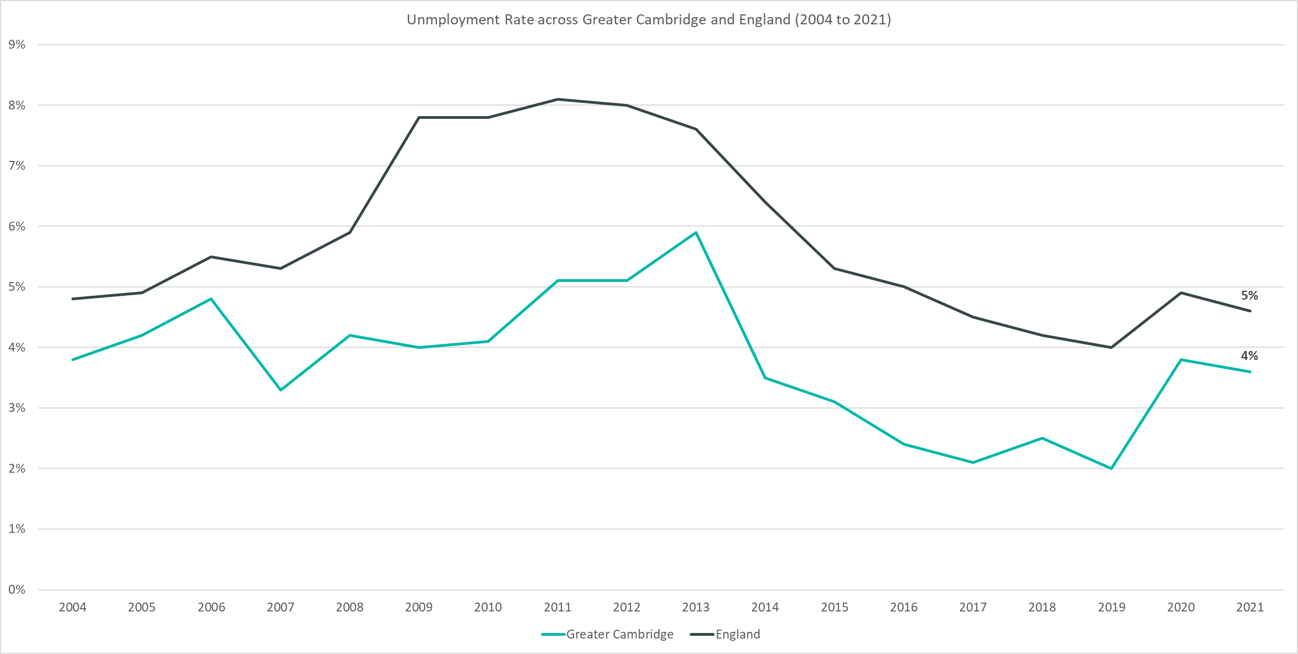
Employment Trends – Unemployment Rate Overall (3.9%, April 21 – March 22)
Data not available for 2018
Rolling Quarterly change
(Jan – Mar 22):
Rolling Quarterly change
(Jan – Mar 2022):
Previous change
(Oct – Dec 21):
Change since December 2019:
+0.3%
+0.3pp
+0.2pp
+1.9pp
Change since December 2019:
+0.2%
+1.9%
Comparing April 2021 – March 2022 with January 2021 – December 2021
Comparing January 2021 – December 2021 with October 2020 – September 2021
Comparing April 2021 – March 2022 with January 2019 – December 2019
Please note: estimates and confidence intervals are unreliable due to small sample sizes for 2016-2020 and so show be treated as indicative.
Notes:
The above chart shows the unemployment rate across Greater Cambridge and England from 2004 to 2021.
The unemployment rate has been consistently below the national level and has broadly followed the same pattern as seen nationally.
Since December 2019 the unemployment rate has increased by +1.9pp, although the level is lower than the height of the pandemic period.
The unemployment rate has slightly increased between January 2021 – December 2021 and April 2021 – March 2022

Slide 7
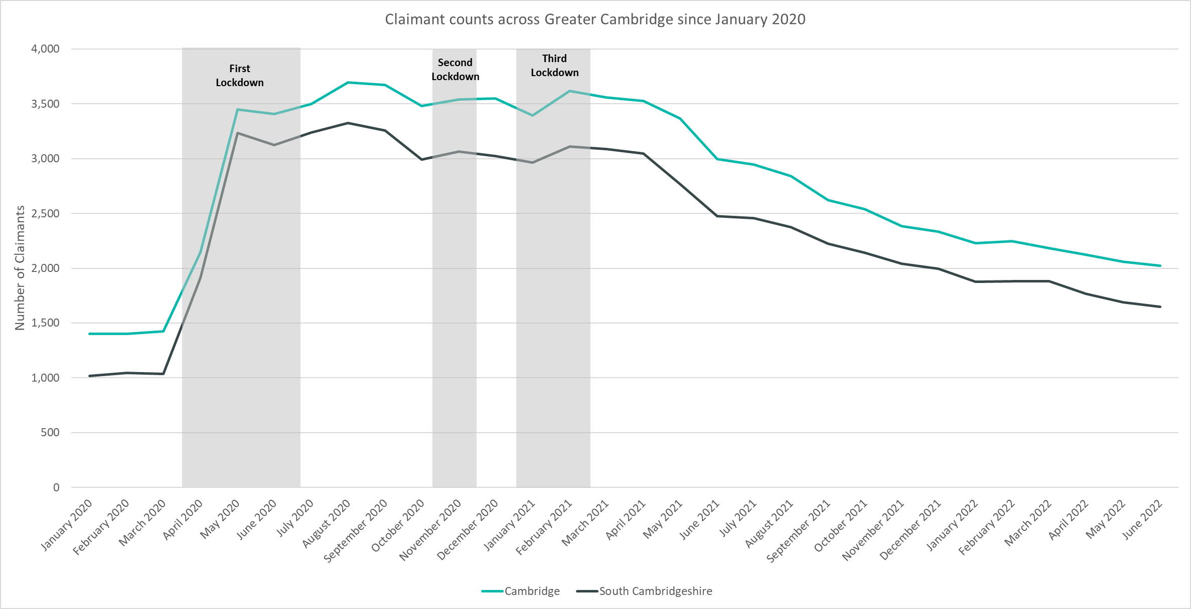
Labour Market – Claimant Count
*this figure includes all residents over the age of 16 (not just working age)
Claimant Counts | Number of claimants June 2022 | % of residents aged 16+ June 2022 | Pre-COVID vs Now: March 2020 to June 2022 | Previous update vs Now: Mar 2022 to June 2022
Cambridge | 2,025 | 2.0% | +42% | -7%
South Cambridgeshire | 1,650 | 1.3% | +59% | -12%
Notes:
The Claimant Count measures the number of people (age 16+) claiming benefit principally for the reason of being unemployed. We use data on claimants rather than unemployed numbers because – although the numbers are lower – they are more up to date, and therefore we expect it to indicate to us any impact trends sooner. It is however a narrower measure of unemployment, and as such does not cover all those out of work, since not all can claim assistance. The claimant count data is a snapshot of the number of claimants on the 9th June 2022.
The above chart presents claimant counts across Greater Cambridge from January 2020 to June 2022.
June 2022 data showed decreases in claimant counts, there was a -10% decrease from March 2022 across Greater Cambridge, with a -7% decrease in Cambridge, a -12% decrease in South Cambridgeshire, and a -11% decrease across England overall.
3,675 claimants* across the GCP area; 1.6% of residents aged 16+, compared to 3.0% across England. This compares to 2,460 claimants (1.1% of residents aged 16+) across the GCP area in March 2020, a +49% increase.
Cambridge City 2,025 (2.0%) .
South Cambridgeshire 1,650 (1.3%) –– South Cambridgeshire still has the lowest proportion of residents aged 16+ claiming (1.3%) compared to the rest of the county.
In Cambridgeshire there were 9,565 claimants (1.8% of residents aged 16+).
*this figure includes all residents over the age of 16 (not just working age).

Slide 8
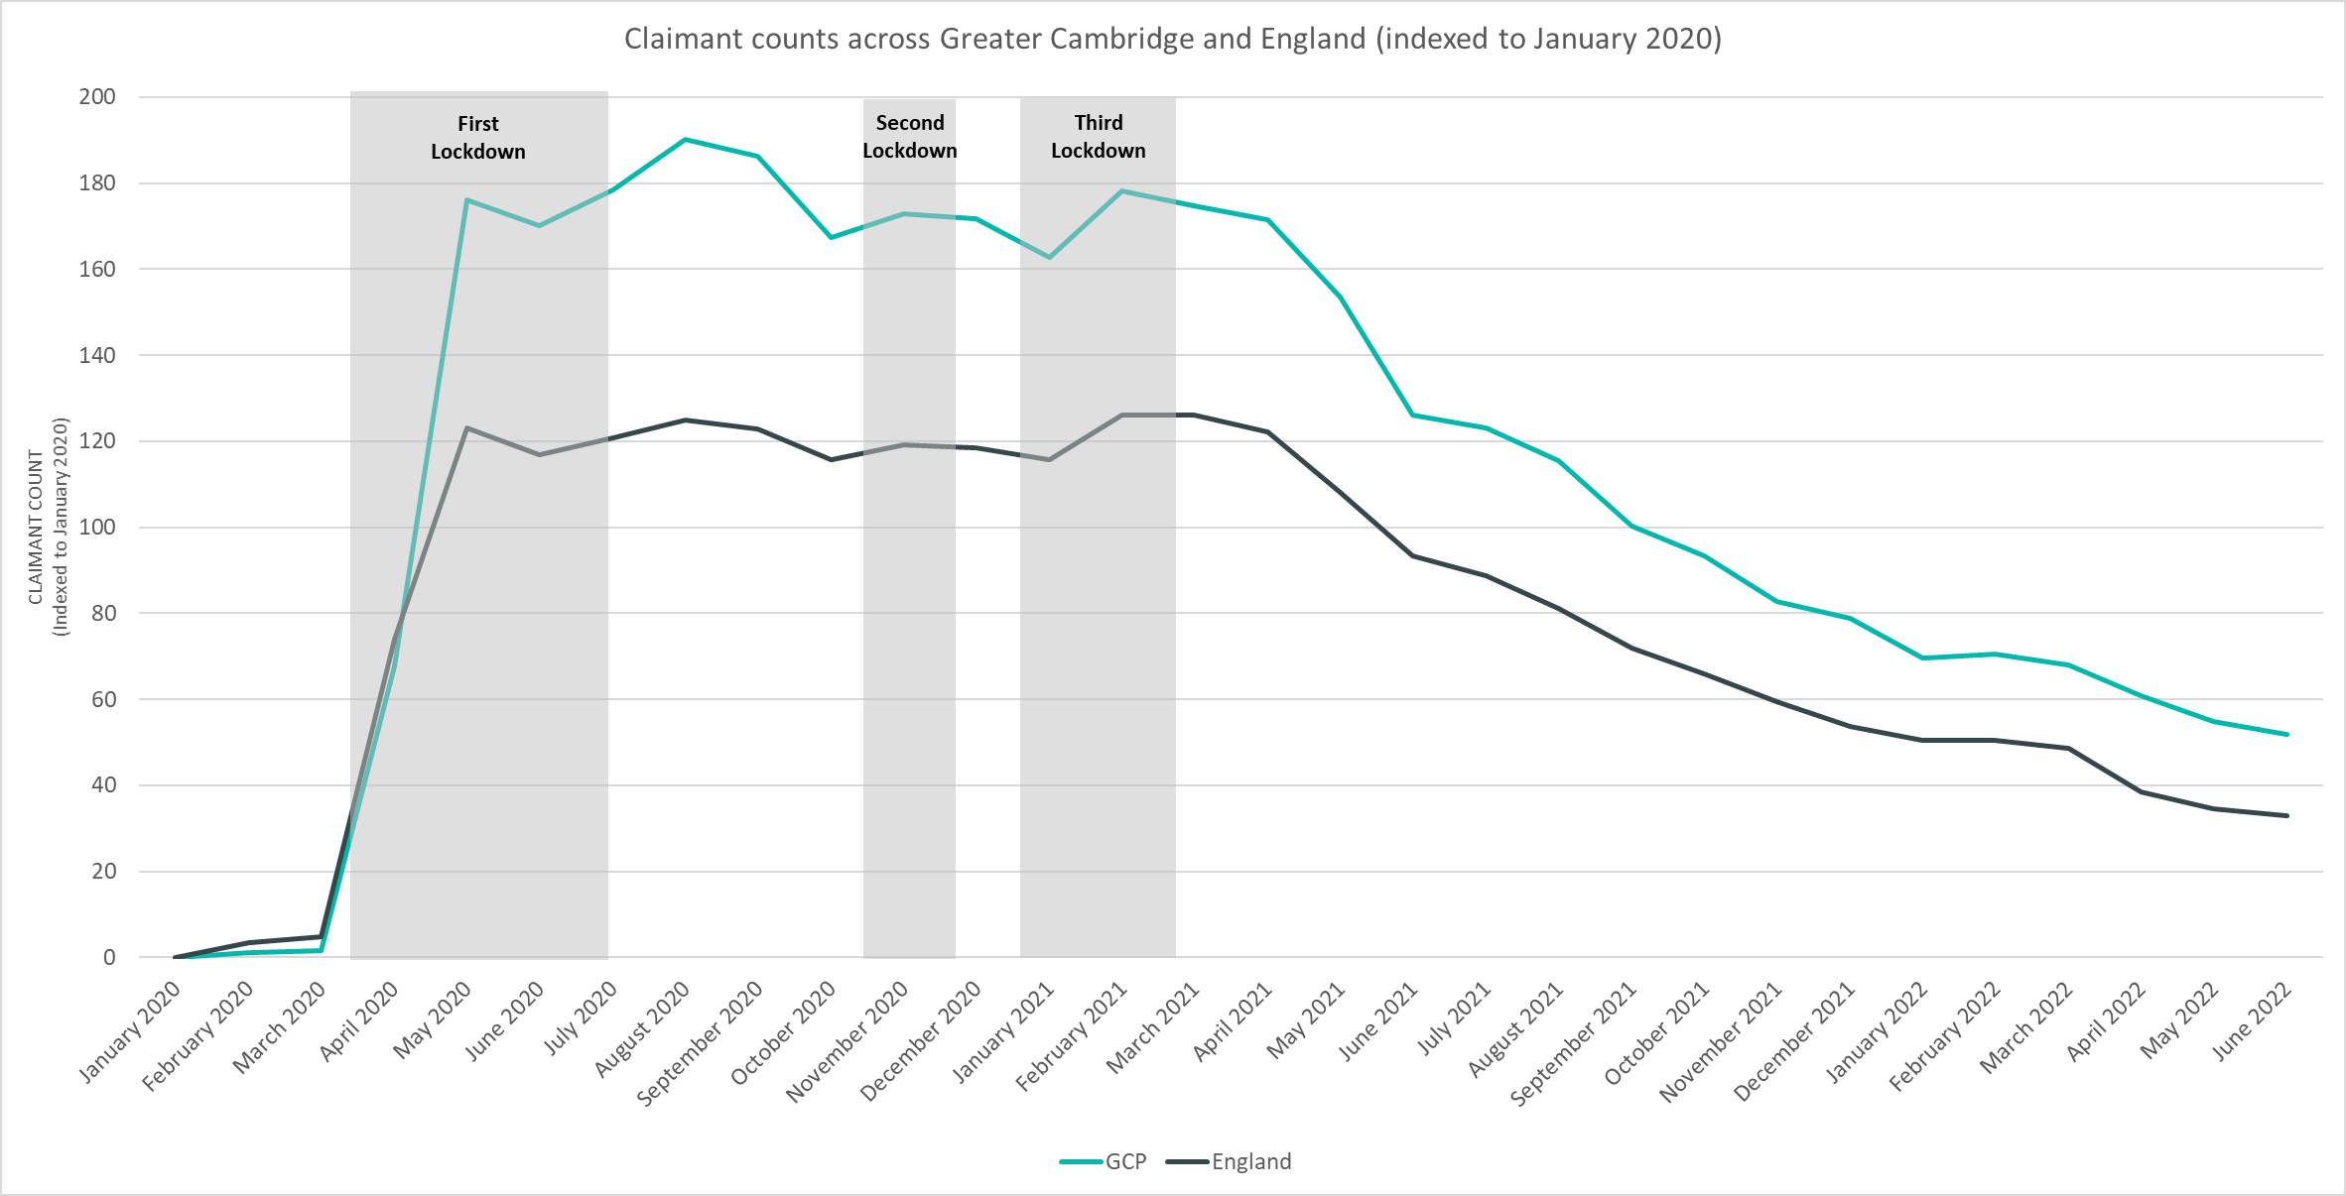
Labour Market – Claimant Count
*this figure includes all residents over the age of 16 (not just working age)
Notes:
The above chart presents claimant counts across Greater Cambridge and England indexed to January 2020. This presents a more effective way to visualise recovery than using raw numbers of counts.
Although Greater Cambridge saw claimant counts closer to the January 2020 baseline in February and March 2020 than England, counts quickly increased and Greater Cambridge saw claimant counts substantially higher than the January 2020 baseline from April 2020 onwards when compared to England.
The gap between Greater Cambridge and England was greatest across the last three quarters of 2020.
Across 2021 and into 2022, the gap between Greater Cambridge and England has narrowed. However, Greater Cambridge is still higher than England when compared to the January 2020 baseline.
*this figure includes all residents over the age of 16 (not just working age).

Slide 9
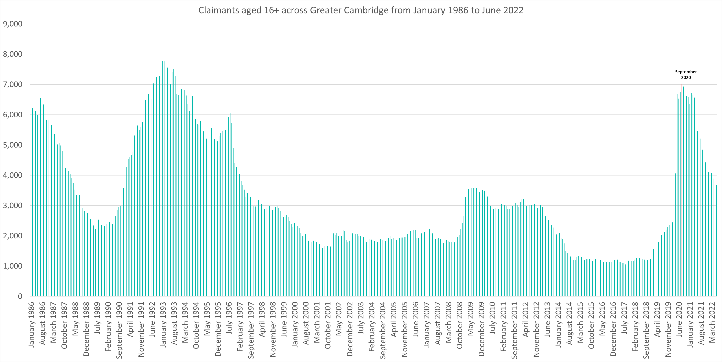
Labour Market – Claimant counts across time
Notes:
The above chart presents claimant counts across Greater Cambridge from January 1986 to June 2022.
September 2020 saw the highest number of claimants (6,930) since 1992.
Claimant counts have decreased at a faster rate than seen from 1992 but are still above pre pandemic levels and those seen in 2008/2009.
*this figure includes all residents over the age of 16 (not just working age).

Slide 10
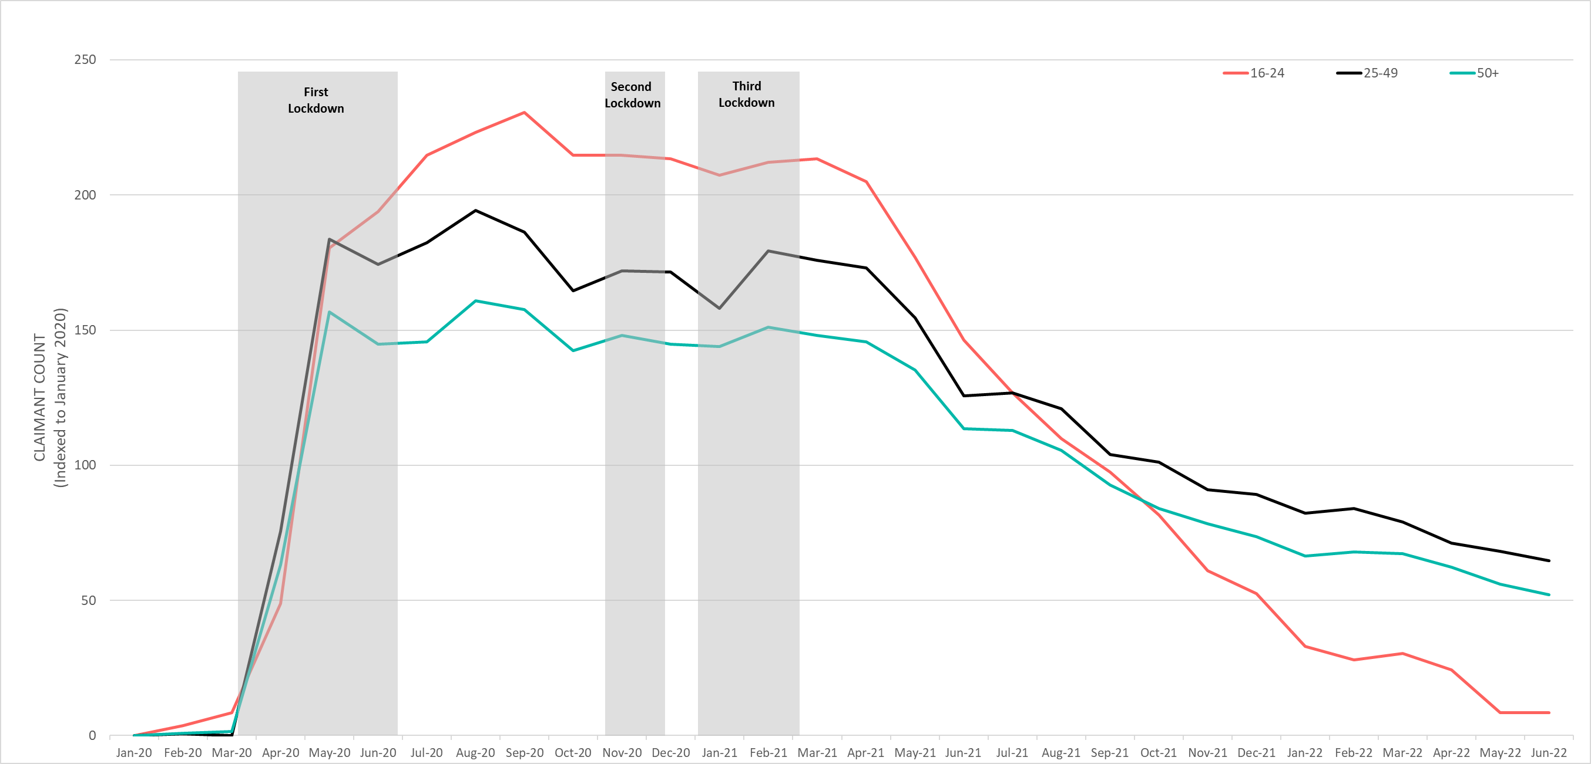
Labour Market – Claimant counts by age
June 2022 Claimant Counts by Age Group (Indexed to January 2020)
Claimant Counts | 16-24 March 2022 to June 2022 | 25-49 March 2022 to June 2022 | 50+ March 2022 to June 2022
Greater Cambridge | -17% | -8% | -9%
Claimant Rates | 16+ June 2022 | 16-17 June 2022 | 18-24 June 2022 | 25-49 June 2022 | 50+ June 2022
Cambridge | 2.0% | 0.2% | 0.9% | 3.1% | 1.5%
South Cambridgeshire | 1.3% | 0.1% | 2.0% | 2.0% | 0.7%
Notes:
National statistics on claimant count since the pandemic have indicated that younger age groups have been disproportionately impacted. The above chart highlights the levels of change each age group has seen in claimant counts across the Greater Cambridge area.
The above chart presents claimant count data by age indexed to January 2020, we use an indexed chart to show the impacts of COVID-19 and the levels of change seen across each age group compared to their pre-Covid-19 baseline.
In June 2022, there was a -17% decrease in claimants aged 16-24 from March 2022, a -8% decrease in claimants aged 25-49 and a -9% decrease in claimants aged 50+. This has created a large gap across claimant rates between claimants aged 16-24 and 25+.
In South Cambridgeshire, residents in the 18-24 and 25-49 age range have the highest claimant rate (both 2.0%). In Cambridge, the 25-49 age group had the largest claimant rate (3.1%).
Although claimants aged 16-24 saw the highest rise during the pandemic they continue to see the fastest return to pre-pandemic levels

Slide 11
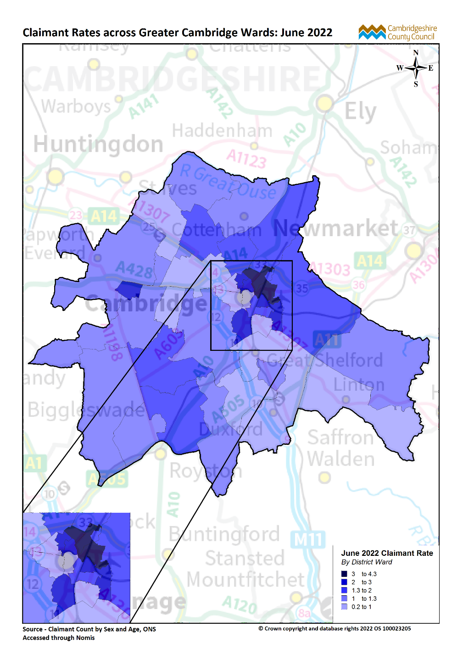
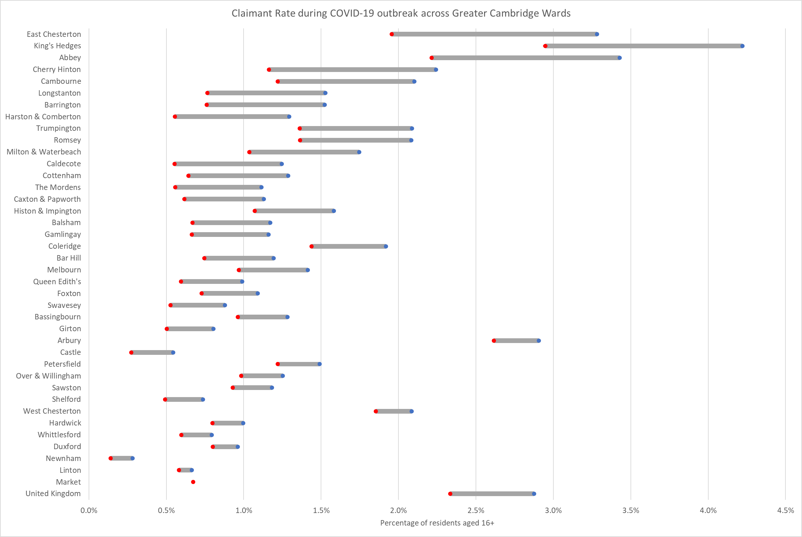
Labour Market – Claimant counts by location
March 2020
June 2022
Notes:
The above map illustrates claimant rate by ward across the Greater Cambridge area. We use this to highlight the wards with the highest claimant rate (represented in dark blue), rather than looking at a percentage change since a pre-Covid-19 period. This is because some wards within the GCP area had very low numbers of claimants, therefore the changes in these areas are against a very low base. Looking at claimant rate as absolute figures allows us to see the areas with the highest number of claimants for the population.
With the exception of Cambourne (2.1%) the top 10 wards with the highest claimant rates in June 2022 are all in Cambridge City, with Kings Hedges having the highest claimant rate (4.2%) across Greater Cambridge.
All areas have seen decreases in claimant counts across the last year, in June 2021, the claimant rate in Kings Hedges was (6.1%), 1.9pp higher than June 2022.
The lowest claimant rates across Greater Cambridge are in the Newnham (0.3%), Castle (0.6%), and Linton wards (0.7%).
Top 5 wards with highest claimant rates are (June 2022): Kings Hedges (4.2%), Abbey (3.4%), East Chesterton (3.3%), Arbury (2.0%) and Cherry Hinton (2.2%).
*The top 5 wards with the highest claimant rate are the same as in March 2022
The above chart illustrates the change in claimant rates from pre-Covid-19 (March 2020) to June 2022 by ward across the Greater Cambridge area.
East Chesterton and King’s Hedges have seen the largest increase in claimant rate from March 2020 to June 2022 (+1.3pp). Abbey (+1.2pp) and Cherry Hinton (+1.1pp) also have larger increases relative to the majority of wards.
In March 2020, Kings Hedges was the only ward with a higher claimant rates than the United Kingdom. In June 2022, King Hedges (4.2%), Abbey (3.4%) and East Chesterton (3.3%) all had higher claimant rates than the United Kingdom (2.9%)
Market now has no difference in claimant rate between March 2020 and June 2022.
The United Kingdom saw an increase of +0.5pp between March 2020 and June 2022.

Slide 12
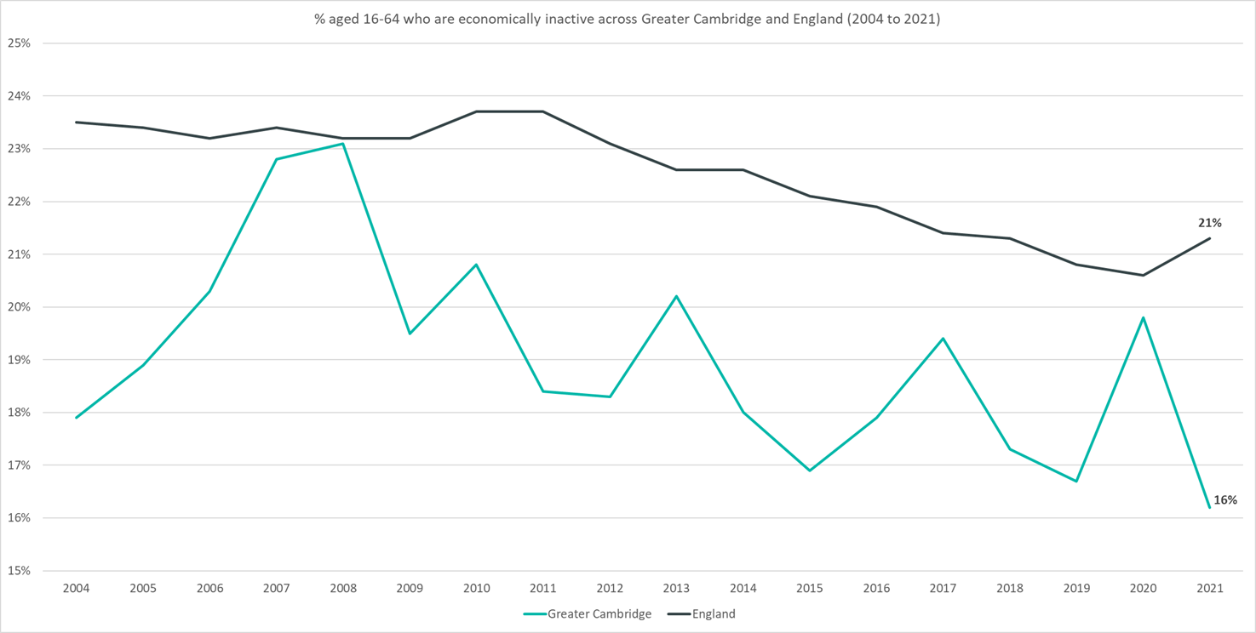
Employment Trends – Economically Inactive (15.5%, April 21 – March 22)
Data not available for 2018
Rolling Quarterly change
(Jan – Mar 22):
Rolling Quarterly change
(Jan – Mar 2022):
Previous change
(Oct – Dec 21):
Change since December 2019:
+0.3%
-0.6pp
-3.4pp
-1.2pp
Change since December 2019:
+0.2%
+1.9%
Comparing April 2021 – March 2022 with January 2021 – December 2021
Comparing January 2021 – December 2021 with October 2020 – September 2021
Comparing April 2021 – March 2022 with January 2019 – December 2019
Please note: estimates and confidence intervals are unreliable due to small sample sizes for 2016-2020 and so show be treated as indicative.
Notes:
The above chart shows the percentage of those aged 16-64 who are economically inactive across Greater Cambridge and England from 2004 to 2021.
The percentage of those economically inactive has been consistently below the national level. Note that the pattern is likely to be more sporadic given the smaller geography.
After increasing in 2020, compared to pre-pandemic levels, the percentage of those economically inactive is now -1.2pp behind.
The percentage of those economically inactive has slightly decreased between January 2021 – December 2021 and April 2021 – March 2022

Slide 13
Impacts of COVID-19

Slide 14
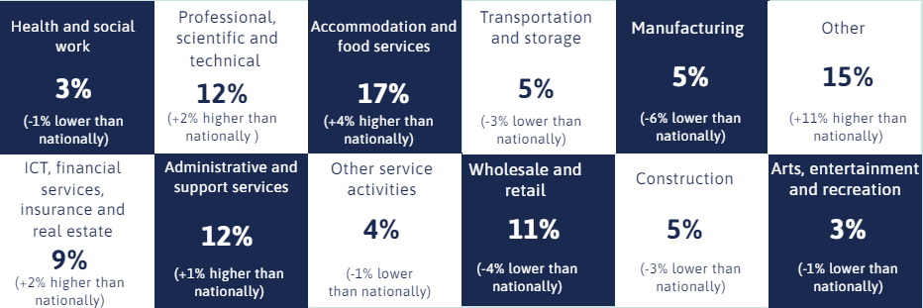
Impacts of COVID-19 – Sectors most affected by end of furlough (30th September 2021)
4,000 employments across Greater Cambridge on furlough as of 30th September 2021
Notes:
The above gird shows a breakdown of employments furloughed by sector for the Greater Cambridge area compared with data for the United Kingdom overall using data from the Governments Coronavirus Job Retention Scheme Statistics: 16 December 2021. This is the final update and represents all employments furloughed by sector across all waves of the CRJS.
Across the Greater Cambridge area overall, the sector with highest proportion of employments furloughed (17%) was the Accommodation and food services sector. This compares to 13% of employments furloughed nationally. Cambridge has a higher proportion of employments furloughed in this sector (24%) than South Cambridgeshire (11%).
The Other* sector had the second highest proportion of employments furloughed (15% across the Greater Cambridge area overall compared with 4% nationally). This is because it includes the Education sector. This is most notable in Cambridge (19%).
The Professional, Scientific and Technical sector accounted for 12% of employments furloughed across the GCP area, 13% in South Cambridgeshire and 10% in Cambridge.
*The sectors in the chart above have been abbreviated for clarity, the full list of sector names can be seen in the notes below.
*Wholesale and retail; repair of motor vehicles.
*Information and communication, Financial and insurance & Real Estate.
*The 'Other' category contains the following sectors: Agriculture, forestry and fishing; Mining and quarrying; Education; Energy production and supply; Water supply, sewerage and waste; Public administration and defence; social security; Households; and Unknown and other.
*Education is now listed under the ‘Other’ category. This has been done to avoid disclosure and dominance at the more granular breakdown with the decreasing number of employments on furlough.

Slide 15
Employment Trends

Slide 16
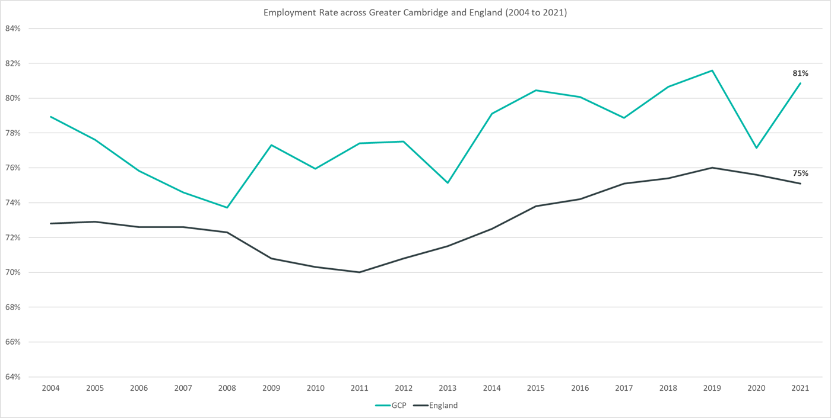
Employment Trends – Employment Rate Overall (81.2%, April 21 – March 22)
Data not available for 2018
Rolling Quarterly change
(Jan – Mar 22):
Rolling Quarterly change
(Jan – Mar 2022):
Previous change
(Oct – Dec 21):
Change since December 2019:
+0.3%
+0.3pp
+3.2pp
-0.4pp
Change since December 2019:
+0.2%
+1.9%
Comparing April 2021 – March 2022 with January 2021 – December 2021
Comparing January 2021 – December 2021 with October 2020 – September 2021
Comparing April 2021 – March 2022 with January 2019 – December 2019
Please note: estimates and confidence intervals are unreliable due to small sample sizes for 2016-2020 and so show be treated as indicative.
Notes:
The above chart shows the employment rate across Greater Cambridge and England from 2004 to 2021.
The employment rate across Greater Cambridge has been consistently higher than the rate seen nationally. Note that the pattern is likely to be more sporadic given the smaller geography.
After falling in 2020, compared to pre-pandemic levels, the employment rate is now -0.4pp behind.
The employment rate has slightly increased between January 2021 – December 2021 and April 2021 – March 2022

Slide 17
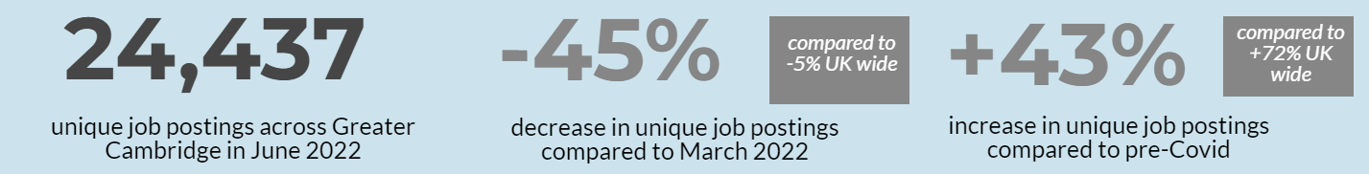
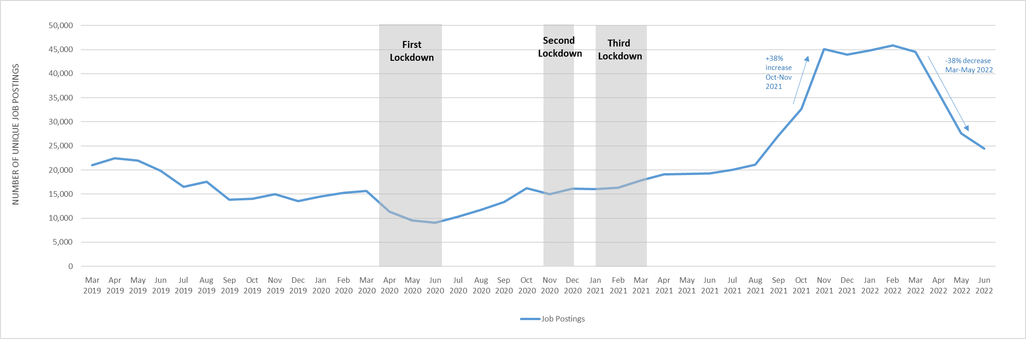
Employment Trends – Vacancies
Monthly job postings across Greater Cambridge
Notes:
The above chart illustrates online vacancy data across the Greater Cambridge area since March 2019. This data is provided through Lightcast by the Cambridgeshire and Peterborough Combined Authority.
There were 24,437 unique job postings across Greater Cambridge in June 2022, down by -45% from March 2022. Nationally, job postings decreased by -5% in the same period.
February 2022 saw the highest number of vacancies across Greater Cambridge for the past ten years.
In the last three months (April - June 2022) job postings were up by +53% when compared to April - June 2021. When compared to the same period in 2019, there was a +37% increase in job postings.
When comparing vacancies in the latest month to a pre-Covid-19 period*, postings were up by +43%. Nationally, they were +72% higher.
The number of vacancies increased rapidly in the final quarter of 2021 but appear to have peaked in early 2022 and are now decreasing rapidly in the last quarter
*Lightcast vacancy data is available from 2012 onwards.
*The pre-Covid-19 comparison period is based on a twelve month average from March 2019-February 2020.

Slide 18
Employment Trends – Vacancies by Industry
Notes:
The above table details vacancies by industry data from Lightcast and gives insight on how different industries are recovering from COVID-19 as well as changes from the last update in March 2022.
Across Greater Cambridge all sectors are higher than pre-Covid levels.
Human Health and Social Work Activities (+109%), Accommodation and Food Service Activities (+91%) and Transportation and Storage (+70%) are furthest from pre-Covid levels.
All sectors across Greater Cambridge in June 2022 saw decreases from March 2022. Transportation and Storage (-66%), Construction (-60%) and Manufacturing (-56%) saw the largest percentage decreases whilst Information and Communication (-3,392), Manufacturing (-1,888) and Administrative and Support Service Activities (-1,555) saw the largest raw number decreases.
Nationally all sectors are higher than pre-Covid levels with only Accommodation and Food Service Activities and Other Service Activities seeing increases from March 2022
*The pre-Covid-19 comparison period is based on a twelve month average from March 2019-February 2020.

