Slide 1


GCP Economy & Employment Quarterly Update
October 2022
Research Group, Cambridgeshire County Council
Research.Group@Cambridgeshire.gov.uk

Slide 2
Consumer Behaviour

Slide 3
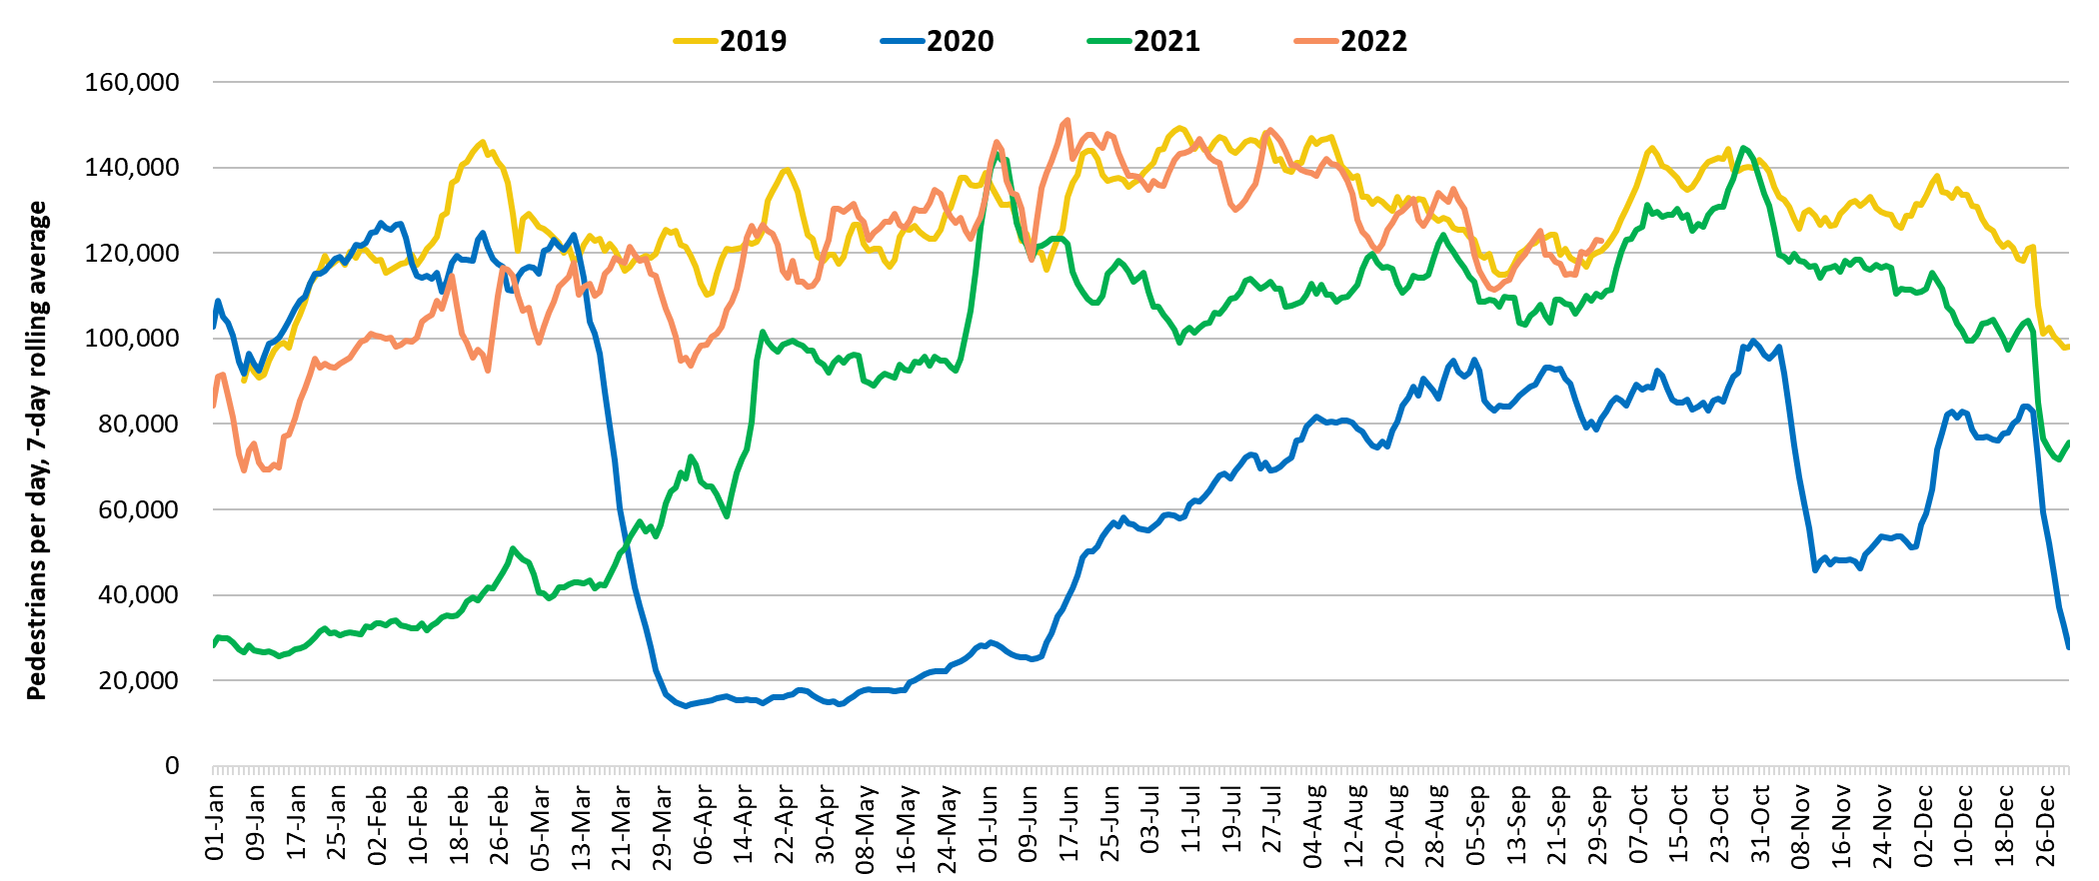
Retail footfall: Central Cambridge
Third lockdown
Second lockdown
First lockdown
 | Pre-COVID vs Now: |  |  | Mid-COVID vs Now: | Previous month vs Now:
 | Sept 2019 to Sept 2022 |  |  | Sept 2020 to Sept 2022 | Aug 2022 to Sept 2022
 | Mon-Sun | Weekdays | Weekends | Mon-Sun | Mon-Sun | Weekdays | Weekends
Cambridge Retail | -5% | -9% | +3% | +33% | -9% | -14% | +1%
Notes:
Commentary:​
Retail footfall has decreased overall in the last month, driven by large decreases across weekdays. Overall numbers across the week are exceeding September 2020 figures but are lower than pre-pandemic (September 2019) across weekdays.
​
*June 2019 and June 2020 data includes all locations except for King’s Parade. The King’s Parade sensor was recalibrated in 2021 and therefore counts are no longer comparable.​
​
Source: Cambridge BID footfall data​
​

Slide 4
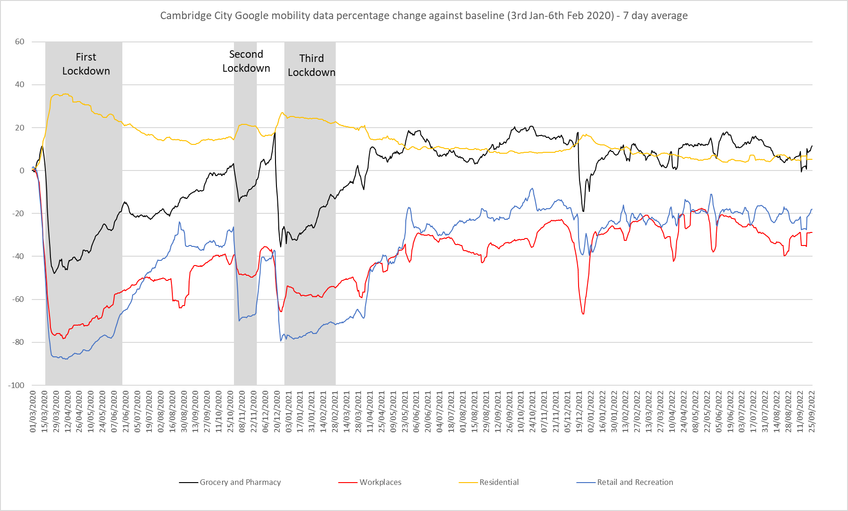
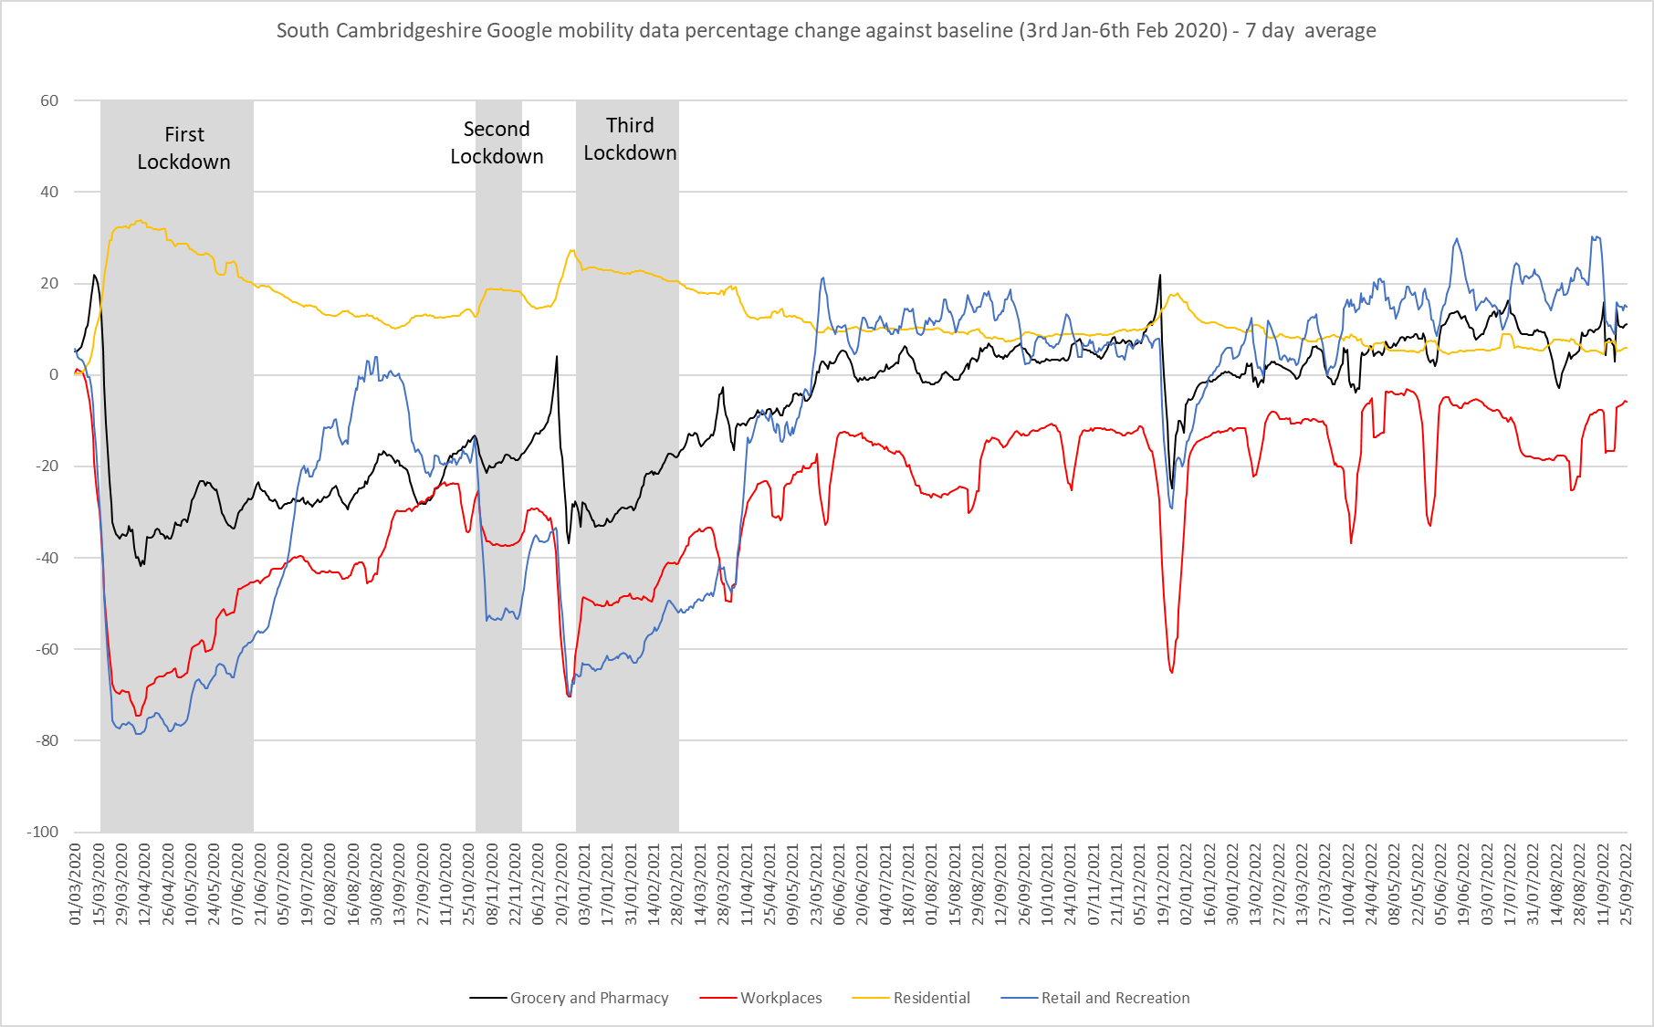
Google Mobility - Final Update
Pre-COVID vs Now: Jan/Feb 2020 to September 2022 | Cambridge | South Cambridgeshire
Grocery and Pharmacy | +6% | +9%
Workplaces | -31% | -11%
Residential | +6% | +6%
Retail and Recreation | -23% | +19%
*Please note that this will be the last Google Mobility update as Google will stop publishing reports in October 2022
Google LLC "Google COVID-19 Community Mobility Reports". https://www.google.com/covid19/mobility/ Accessed: 06/10/2022
Notes:
The charts above show data gathered from Google account holders location history. The comparison of social mobility change is based on the most recent several weeks up to the report date (30th September 2022) compared to the median of the corresponding day in the baseline period (3rd Jan-6th Feb 2020). Please note that this will be the last Google Mobility update as Google will stop publishing reports in October 2022.
This data indicates that in September 2022 visits to the Workplace showed levels furthest from the baseline across the GCP area, particularly in Cambridge where visits were -31% below pre-pandemic levels, in South Cambridgeshire, visits were closer at -11% below the baseline.
In Cambridge, Retail and Recreation visits followed after this, at second lowest compared to the baseline. Increases were evident in visits to Retail and Recreation locations from the 19th of July 2021 when all remaining restrictions were lifted but visits still remain -23% below the baseline in September 2022. This contrasts with South Cambridgeshire where Retail and Recreation visits were +19% above the baseline in the same period.
Residential visits were above the baseline in both Cambridge and South Cambridgeshire (+6% above the baseline), this is partly influenced by many people working from home.
Grocery visits were +6% above the baseline in Cambridge in September 2022, in South Cambridgeshire, they were +9% above the baseline for this period.

Slide 5
Labour Market Overview

Slide 6
Unemployment Rate Overall – 3.5% (July 21 - June 22)
Quarterly change
(April – Jun 22):
Previous change
(Jan 21 – Mar 22):
Change since December 2019:
The unemployment rate to June 2022 was 3.5% (lower than the 3.9% nationally), this has decreased by 0.4 percentage points since the last quarter but remains higher than the pre-pandemic period.
Rolling Quarterly change
(Jan – Mar 2022):
+0.3%
+0.2%
+1.9%
-0.4pp
+0.3pp
+1.5pp
Employment Rate Overall – 82.4% (July 21 - June 22)
Change since December 2019:
The employment rate to June 2022 was 82.4% (higher than the 75.7% nationally), this has increased by 1.2 percentage points since the last quarter and is now higher than the pre-pandemic period.
Quarterly change
(April – Jun 22):
Previous change
(Jan – Mar 22):
Rolling Quarterly change
(Jan – Mar 2022):
Change since December 2019:
+0.2%
+0.8pp
+1.9%
+0.3%
+1.2pp
+0.3pp
Economically Inactive – 14.7% (July 21 - June 22)
Quarterly change
(April – Jun 22):
Previous change
(Jan – Mar 22):
Change since December 2019:
14.7% were economically inactive in the quarter to June 2022 (lower than the 21.2% nationally), this has decreased by 0.8 percentage points since the last quarter.
Rolling Quarterly change
(Jan – Mar 2022):
+0.3%
Change since December 2019:
+0.2%
+1.9%
-0.8pp
-0.6pp
-2.0pp
* Please note: estimates and confidence intervals are unreliable due to small sample sizes and so should be treated as indicative.

Slide 7
Unemployment Rate and
Claimant Counts

Slide 8
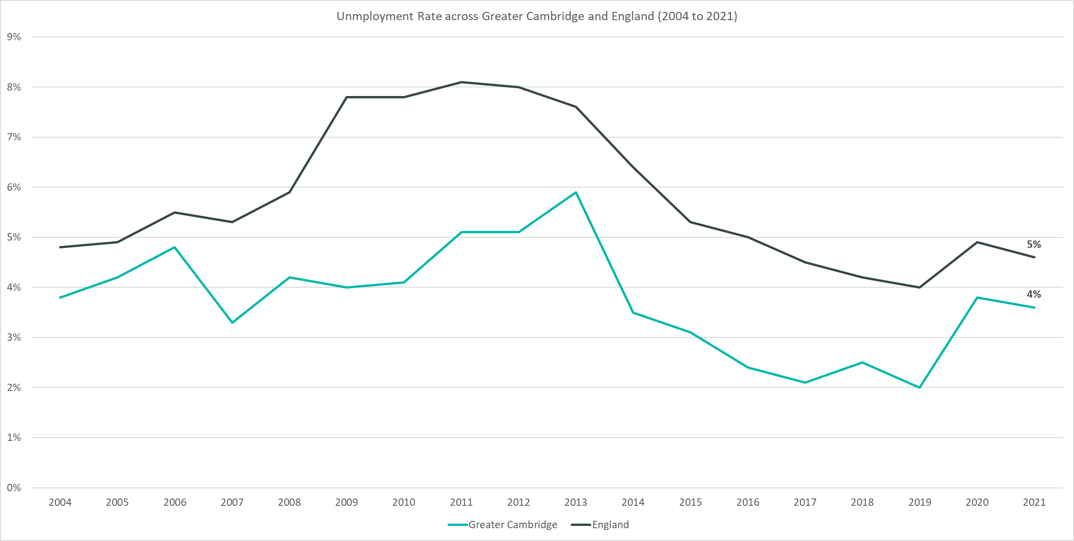
Overall Unemployment Rate - 3.5% (July 21 - June 22)
Rolling Quarterly change
(April – Jun 22):
Rolling Quarterly change
(Jan – Mar 2022):
Previous change
(Jan 21 – June 22):
Change since December 2019:
+0.3%
-0.4pp
+0.3pp
+1.5pp
Change since December 2019:
+0.2%
+1.9%
Comparing July 2021 – June 2022 with April 2021 – March 2022
Comparing April 2021 – March 2022 with January 2021 – December 2021
Comparing July 2021 – June 2022 with January 2019 – December 2019
Please note: estimates and confidence intervals are unreliable due to small sample sizes for 2016-2020 and so show be treated as indicative.
Notes:
The above chart shows the unemployment rate across Greater Cambridge and England from 2004 to 2021.
The unemployment rate to June 2022 was 3.5% (lower than the 3.9% nationally). Whilst this quarter the UK saw its lowest unemployment rate since 1974, this is not the case for Greater Cambridge which saw a lower unemployment rate at the same point last year (2.9% between July 2020 and Jun 2021).
The unemployment rate has been consistently below the national level and has broadly followed the same pattern as seen nationally.
Since December 2019 the unemployment rate has increased by +1.5pp, although the level is lower than the height of the pandemic period.
The unemployment rate has slightly decreased between April 2021 – March 2022 and July 2021 – June 2022

Slide 9
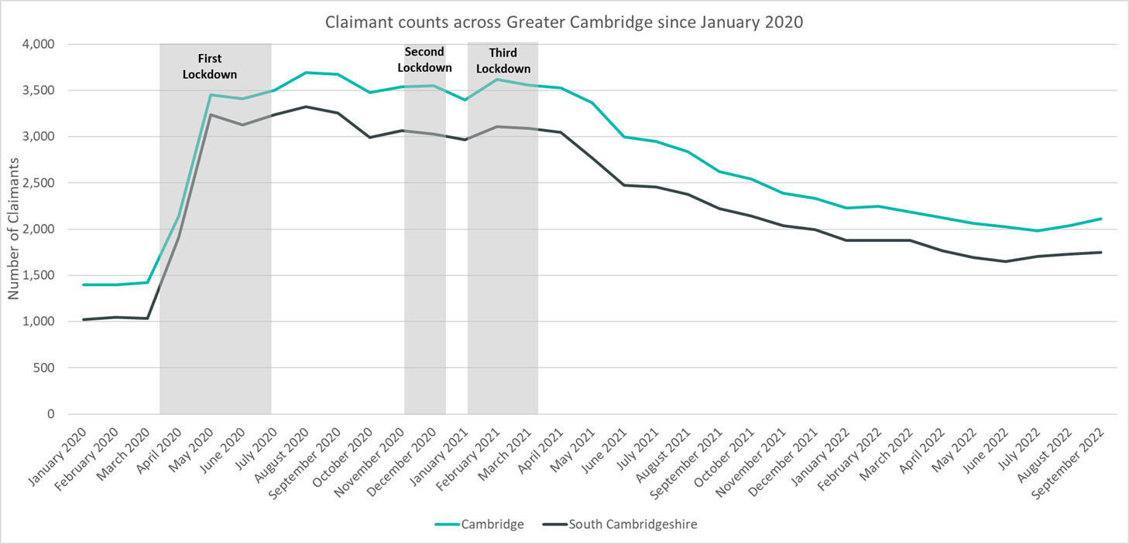
Labour Market – Claimant Count
*this figure includes all residents over the age of 16 (not just working age)
Claimant Counts | Number of claimants September 2022 | % of residents aged 16+ September 2022 | Pre-COVID vs Now: March 2020 to September 2022 | Previous update vs Now: June 2022 to September 2022
Cambridge | 2,110 | 2.0% | +48% | +4%
South Cambridgeshire | 1,750 | 1.4% | +69% | +6%
Greater Cambridge Total | 3,860 | 1.7% | +57% | +5%
Notes:
The Claimant Count measures the number of people (age 16+) claiming benefit principally for the reason of being unemployed. We use data on claimants rather than unemployed numbers because – although the numbers are lower – they are more up to date, and therefore we expect it to indicate to us any impact trends sooner. It is however a narrower measure of unemployment, and as such does not cover all those out of work, since not all can claim assistance. The claimant count data is a snapshot of the number of claimants on the 8th September 2022.
The above chart presents claimant counts across Greater Cambridge from January 2020 to September 2022.
September 2022 data showed increases in claimant counts, there was a +4% increase from June 2022 across Greater Cambridge, with a +4% increase in Cambridge, a +6% increase in South Cambridgeshire, and a +5% increase across England overall.
3,860 claimants* across the GCP area, 1.7% of residents aged 16+ compared to 2.9% across England. This compares to 2,460 claimants across the GCP area in March 2020, a +57% increase.
Cambridge City 2,110 (2.0%)
South Cambridgeshire 1,750 (1.4%)
In Cambridgeshire there were 9,665 claimants (1.8% of residents aged 16+).
*this figure includes all residents over the age of 16 (not just working age).

Slide 10
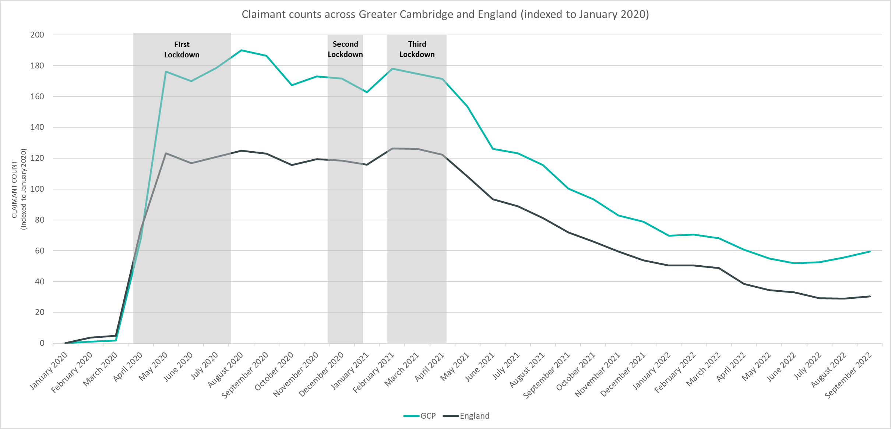
Labour Market – Claimant Count
*this figure includes all residents over the age of 16 (not just working age)
Notes:
The above chart presents claimant counts across Greater Cambridge and England indexed to January 2020. This presents a more effective way to visualise recovery than using raw numbers of counts.
Although Greater Cambridge saw claimant counts closer to the January 2020 baseline in February and March 2020 than England, counts quickly increased and Greater Cambridge saw claimant counts substantially higher than the January 2020 baseline from April 2020 onwards when compared to England.
The gap between Greater Cambridge and England was greatest across the last three quarters of 2020.
Across 2021 and into 2022, the gap between Greater Cambridge and England had narrowed but has widened again over the last two months. Greater Cambridge is still higher than England when compared to the January 2020 baseline.
*this figure includes all residents over the age of 16 (not just working age).

Slide 11
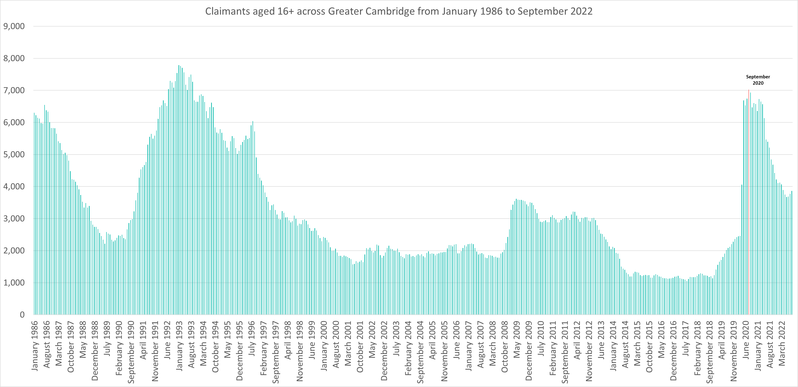
Labour Market – Claimant counts across time
Notes:
The above chart presents claimant counts across Greater Cambridge from January 1986 to September 2022.
September 2020 saw the highest number of claimants (6,930) since 1992.
Claimant counts have decreased at a faster rate than seen from 1992 but are still above pre pandemic levels and those seen in 2008/2009.
*this figure includes all residents over the age of 16 (not just working age).

Slide 12
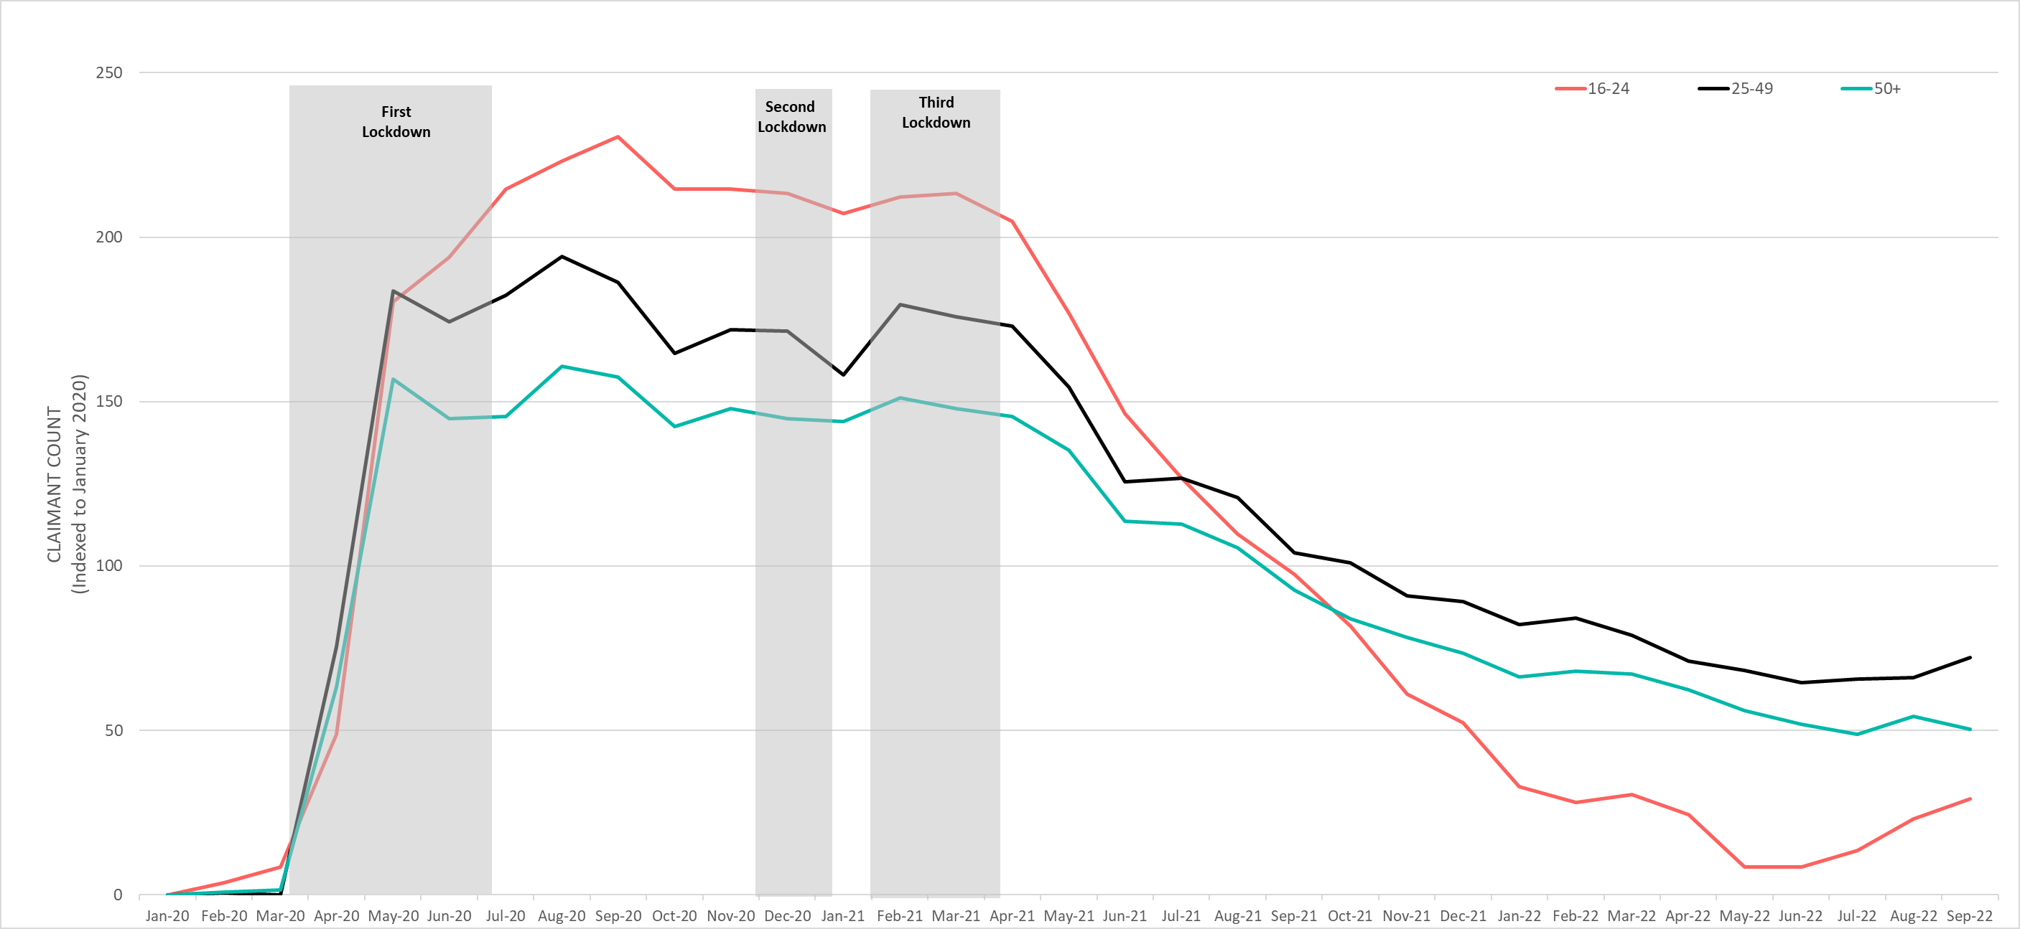
Labour Market – Claimant counts by age
June 2022 Claimant Counts by Age Group (Indexed to January 2020)
Claimant Counts | 16-24 June 2022 to September 2022 | 25-49 June 2022 to September 2022 | 50+ June 2022 to September 2022
Greater Cambridge | +19% | +5% | -1%
Claimant Rates | 16+ September 2022 | 16-17 September 2022 | 18-24 September 2022 | 25-49 September 2022 | 50+ September 2022
Cambridge | 2.0% | 0.2% | 1.1% | 3.2% | 1.5%
South Cambridgeshire | 1.4% | 0.0% | 2.3% | 2.2% | 0.7%
Notes:
National statistics on claimant count since the pandemic have indicated that younger age groups have been disproportionately impacted. The above chart highlights the levels of change each age group has seen in claimant counts across the Greater Cambridge area.
The above chart presents claimant count data by age indexed to January 2020, we use an indexed chart to show the impacts of COVID-19 and the levels of change seen across each age group compared to their pre-Covid-19 baseline.
In September 2022, there was a +19% increase in claimants aged 16-24 from June 2022, a +5% increase in claimants aged 25-49 and a -1% decrease in claimants aged 50+. This has narrowed the gap across claimant rates between claimants aged 16-24 and 25+, but it remains relatively large
In South Cambridgeshire, residents in the 18-24 and 25-49 age range have the highest claimant rate ( 2.3%, 2.2% respectively). In Cambridge, the 25-49 age group had the largest claimant rate (3.2%).
Although claimants aged 16-24 saw the highest rise during the pandemic, and despite a rise in claimants over the last quarter, they continue to see the fastest return to pre-pandemic levels

Slide 13
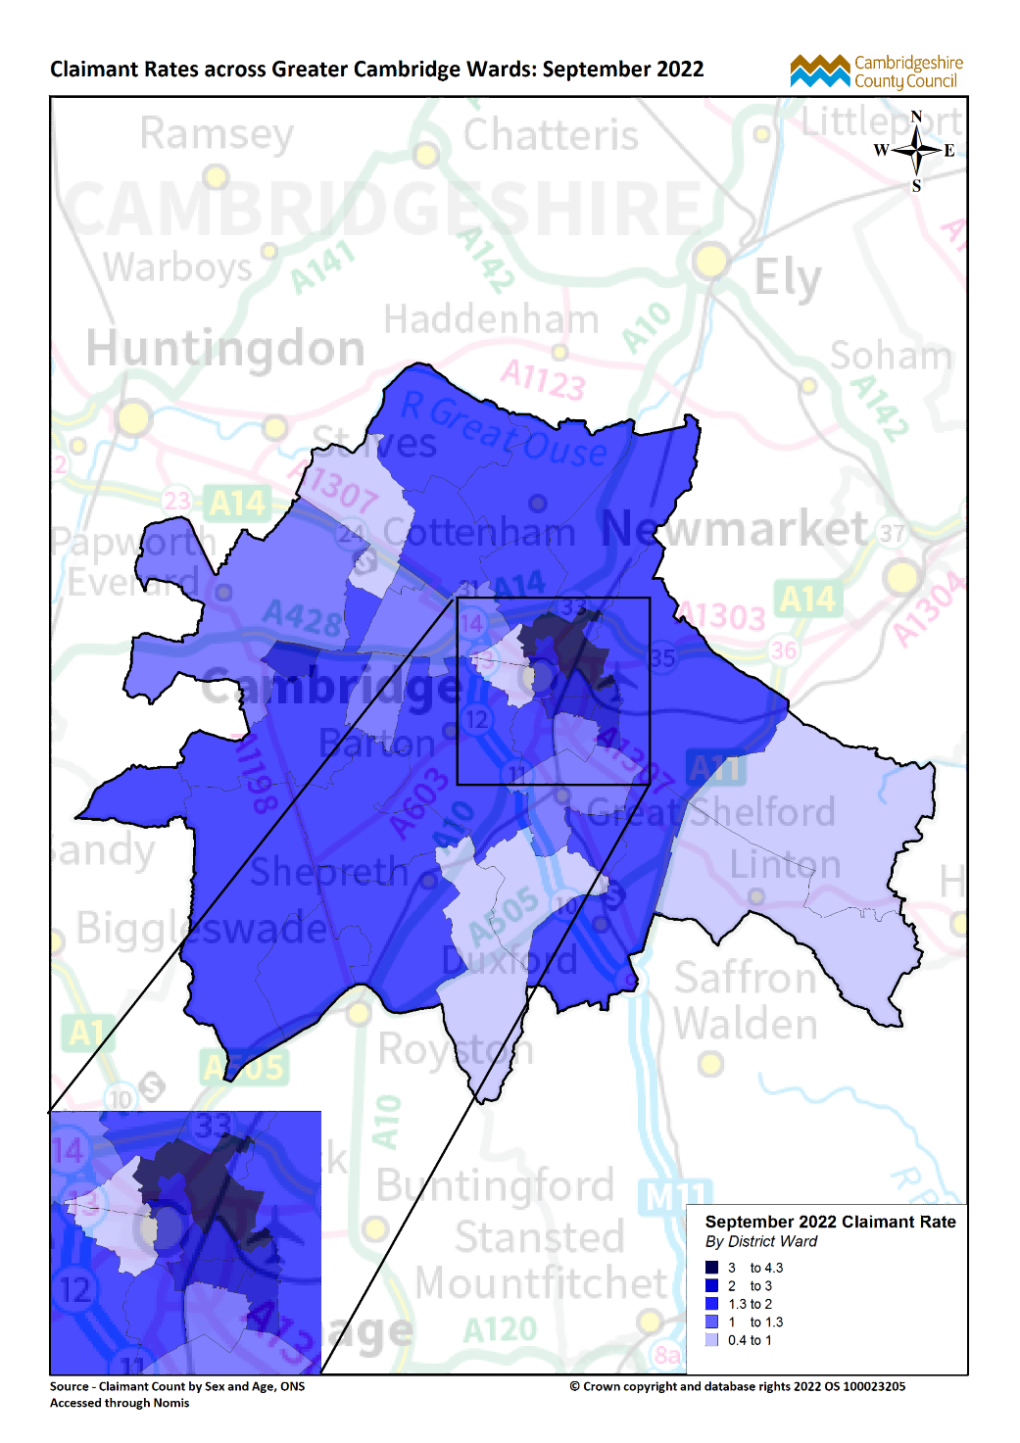
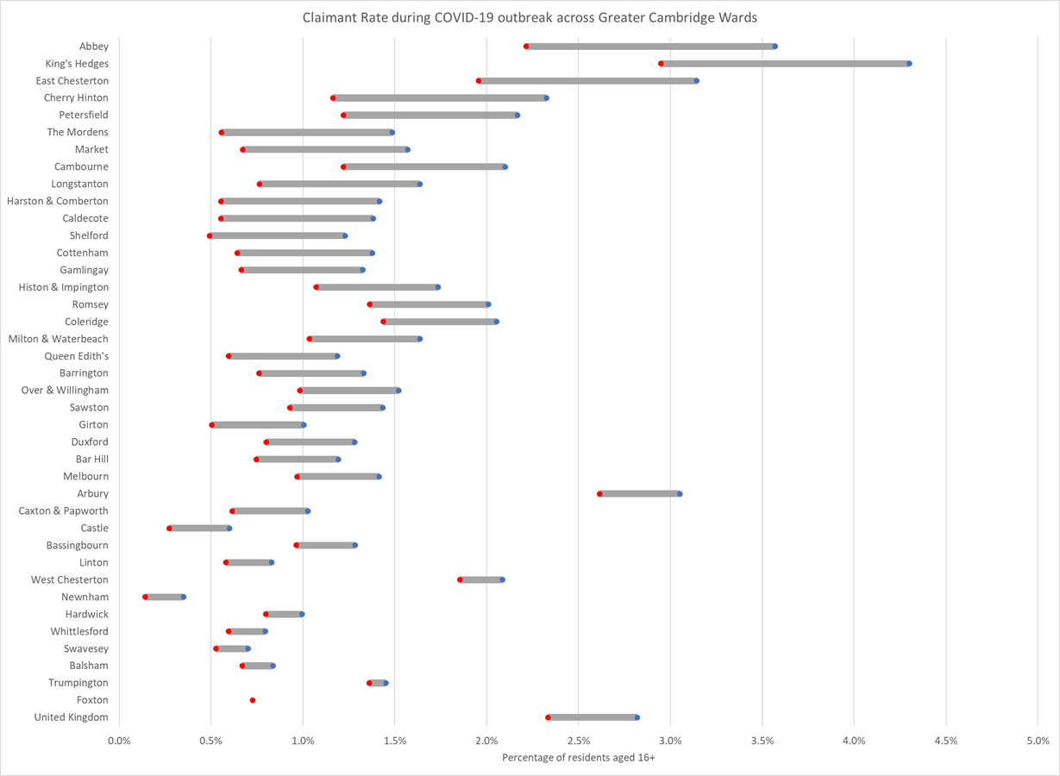
Labour Market – Claimant counts by location
March 2020
September 2022
Notes:
The above map illustrates claimant rate by ward across the Greater Cambridge area. We use this to highlight the wards with the highest claimant rate (represented in dark blue), rather than looking at a percentage change since a pre-Covid-19 period. This is because some wards within the GCP area had very low numbers of claimants, therefore the changes in these areas are against a very low base. Looking at claimant rate as absolute figures allows us to see the areas with the highest number of claimants for the population.
With the exception of Cambourne (2.1%) the top 10 wards with the highest claimant rates in September 2022 are all in Cambridge City, with Kings Hedges having the highest claimant rate (4.3%) across Greater Cambridge.
All areas have seen decreases in claimant counts across the last year, in September 2021, the claimant rate in Kings Hedges was (5.7%), 1.4pp higher than September 2022.
The lowest claimant rates across Greater Cambridge are in the Newnham (0.4%), Castle (0.6%), and Swavesey ward (0.7%).
Top 5 wards with highest claimant rates are (September 2022): Kings Hedges (4.3%), Abbey (3.6%), East Chesterton (3.1%), Arbury (3.1%) and Cherry Hinton (2.3%).
*The top 5 wards with the highest claimant rate are the same as in June 2022
The above chart illustrates the change in claimant rates from pre-Covid-19 (March 2020) to September 2022 by ward across the Greater Cambridge area.
King’s Hedges and Abbey have seen the largest increase in claimant rate from March 2020 to September 2022 (+1.4pp). East Chesterton (+1.2pp) has also seen a larger increase relative to the majority of wards.
In March 2020, Kings Hedges was the only ward with a higher claimant rates than the United Kingdom. In September 2022, King Hedges (4.3%), Abbey (3.6%), East Chesterton (3.1%) and Arbury (3.1%) all had higher claimant rates than the United Kingdom (2.8%)
Foxton now has no difference in claimant rate between March 2020 and September 2022.
The United Kingdom saw an increase of +0.5pp between March 2020 and September 2022.

Slide 14
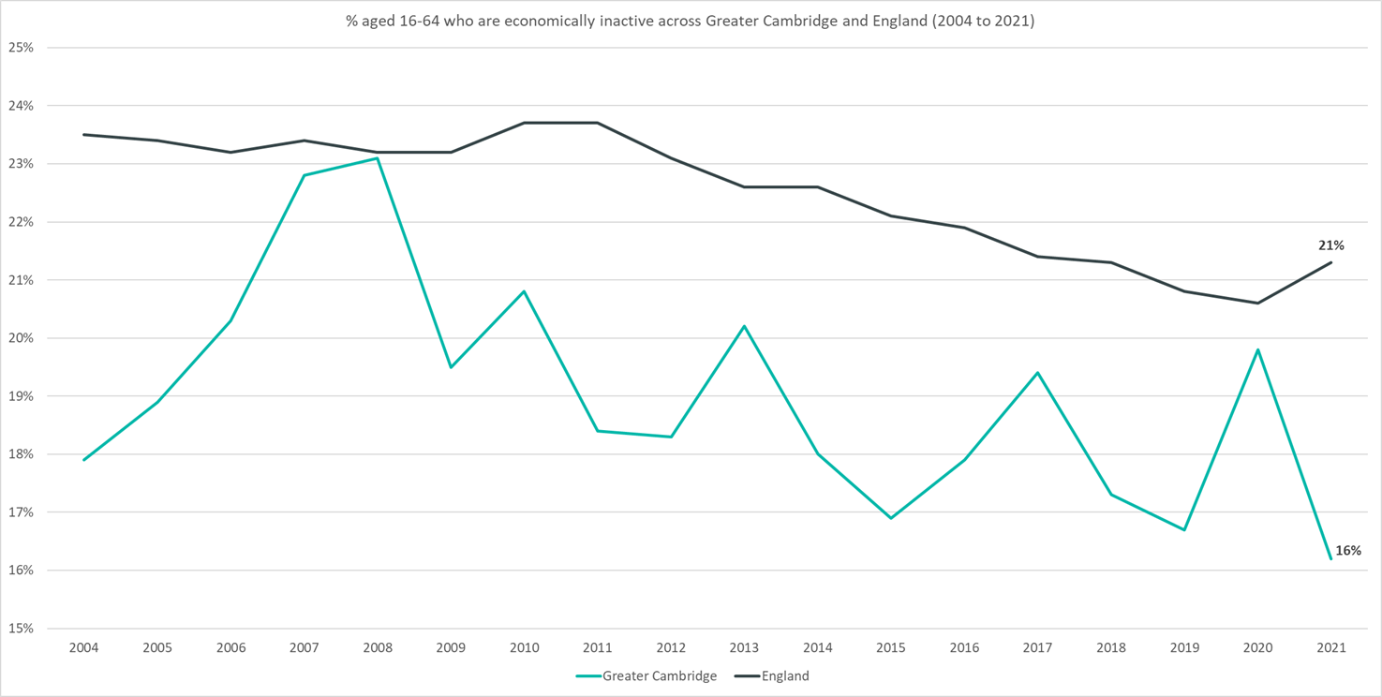
Employment Trends – Economically Inactive 14.7% (July 21 - June 22)
Data not available for 2018
Rolling Quarterly change
(April – Jun 22):
Rolling Quarterly change
(Jan – Mar 2022):
Previous change
(Jan – Mar 22):
Change since December 2019:
+0.3%
-0.8pp
-0.6pp
-2.0pp
Change since December 2019:
+0.2%
+1.9%
Comparing July 2021 – June 2022 with April 2021 – March 2022
Comparing April 2021 – March 2022 with January 2021 – December 2021
Comparing July 2021 – June 2022 with January 2019 – December 2019
Please note: estimates and confidence intervals are unreliable due to small sample sizes for 2016-2020 and so show be treated as indicative.
Notes:
The above chart shows the percentage of those aged 16-64 who are economically inactive across Greater Cambridge and England from 2004 to 2021.#
The percentage of those economically inactive has been consistently below the national level. Note that the pattern is likely to be more sporadic given the smaller geography.
After increasing in 2020, compared to pre-pandemic levels, the percentage of those economically inactive is now -2pp behind.
The percentage of those economically inactive has slightly decreased between April 2021 – March 2021 and July 2021 – June 2022.

Slide 15
Employment Trends

Slide 16
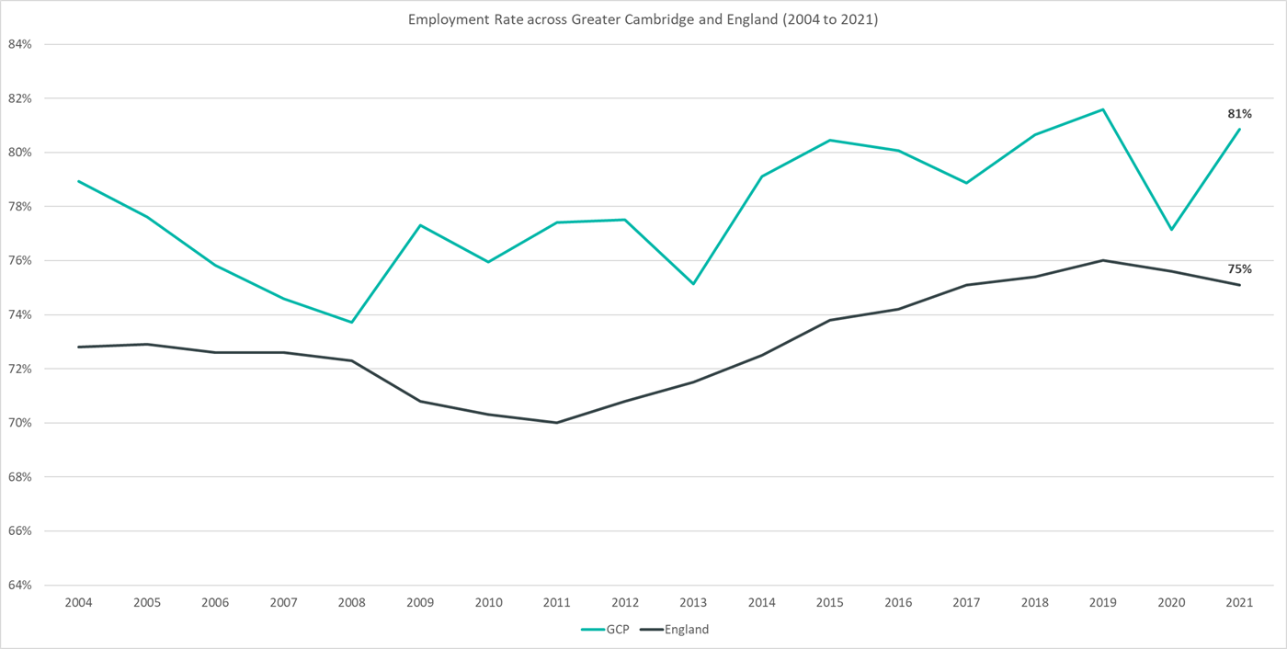
Employment Trends – Overall Employment Rate 82.4% (July 21 - June 22)
Data not available for 2018
Rolling Quarterly change
(April – Jun 22):
Rolling Quarterly change
(Jan – Mar 2022):
Previous change
(Jan – Mar 22):
Change since December 2019:
+0.3%
+1.2pp
+0.3pp
+0.8pp
Change since December 2019:
+0.2%
+1.9%
Comparing July 2021 – June 2022 with
April 2021 – March 2022
Comparing April 2021 – March 2022 with January 2021 – December 2021
Comparing July 2021 – June 2022 with
January 2019 – December 2019
Please note: estimates and confidence intervals are unreliable due to small sample sizes for 2016-2020 and so show be treated as indicative.
Notes:
The above chart shows the employment rate across Greater Cambridge and England from 2004 to 2021.
The employment rate across Greater Cambridge has been consistently higher than the rate seen nationally. Note that the pattern is likely to be more sporadic given the smaller geography.
After falling in 2020, compared to pre-pandemic levels, the employment rate is now +0.8pp ahead
The employment rate has increased between April 2021 – March 2022 and July 2021 – June 2022

Slide 17
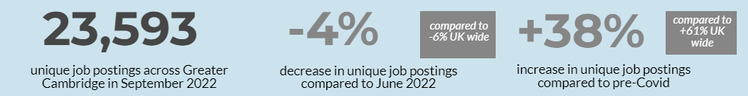
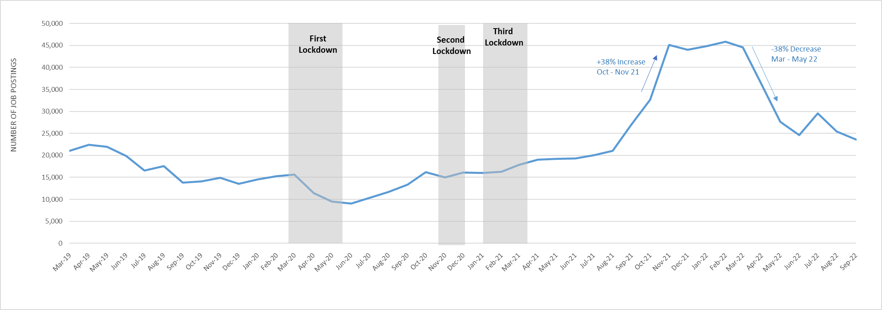
Employment Trends – Vacancies
Monthly job postings across Greater Cambridge
Notes:
The above chart illustrates online vacancy data across the Greater Cambridge area since March 2019. This data is provided through Lightcast by the Cambridgeshire and Peterborough Combined Authority.
There were 23,593 unique job postings across Greater Cambridge in September 2022, down by -4% from June 2022. Nationally, job postings decreased by -6% in the same period.
February 2022 saw the highest number of vacancies across Greater Cambridge for the past ten years.
July 2022 is the first month since February 2022 to see an increase in job vacancies
In the last three months (July – September 2022) job postings were up by +15% when compared to July - September 2021. When compared to the same period in 2019, there was a +64% increase in job postings.
When comparing vacancies in the latest month to a pre-Covid-19 period*, postings were up by +38%. Nationally, they were +61% higher.
The number of vacancies increased rapidly in the final quarter of 2021 but have peaked in early 2022, decreased rapidly across Q2 before appearing to stabilise in Q3
*Lightcast vacancy data is available from 2012 onwards.
*The pre-Covid-19 comparison period is based on a twelve month average from March 2019-February 2020.

Slide 18
Employment Trends – Vacancies by Industry
Notes:
The above table details vacancies by industry data from EMSI/Burning Glass and gives insight on how different industries are recovering from COVID-19 as well as changes from the last update in June 2022.
Across Greater Cambridge all sectors are above the pre-Covid average
Accommodation and Food Service Activities (+91%), Real Estate Activities (73%) and Transportation and Storage (+70%) are furthest above their pre-Covid levels.
The sectors in Greater Cambridge in September 2022 which saw the largest percentage decreases from June 2022 are: Human Health and Social work (-35%), Education (-9%) and Public administration and defence (-8%).
The sectors in Greater Cambridge in September 2022 which saw the largest raw number decreases from June 2022 are: Human Health and Social work (-1,134), Education (-116), Information and Communication (-116) and Arts, Entertainment and Recreation (-48).
Nationally all sectors are higher than pre-Covid levels with only Wholesale and retail trade; repair of motor vehicles and motorcycles and Manufacturing seeing substantial increases from June 2022.
*The pre-Covid-19 comparison period is based on a twelve month average from March 2019-February 2020.

