Slide 1


GCP Economy & Employment Quarterly Update
Quarter January – March 2022
Research Group, Cambridgeshire County Council
Research.Group@Cambridgeshire.gov.uk

Slide 2
Consumer Behaviour

Slide 3
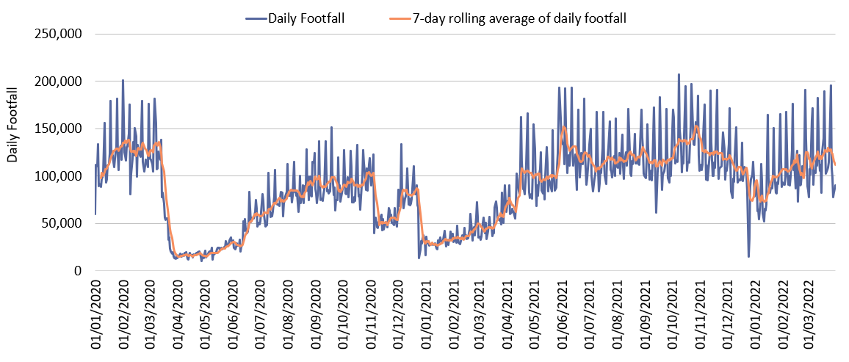
Retail footfall: Central Cambridge
First Lockdown
Second Lockdown
Third Lockdown
 | Pre-COVID vs Now: |  |  | Mid-COVID vs Now: | Previous month vs Now:
 | Feb 2020 to March 2022 |  |  | March 2021 to March 2022 | Feb 2022 to March 2022
 | Mon-Sun | Weekdays | Weekends | Mon-Sun | Mon-Sun | Weekdays | Weekends
Cambridge Retail | -8% | -16% | +11% | +125% | +5% | No change | +15%
Notes:
Commentary:​
Retail footfall has seen overall increases in the last month, due to increases at weekends. Overall numbers across the week are exceeding March 2021 figures (during 3rd COVID-19 lockdown) but not back to pre-pandemic (Feb 2020), except for at the weekends, where footfall is 11% higher than pre pandemic levels.
​
*March 2020 includes all locations except for King’s Parade. The King’s Parade sensor was recalibrated in 2021 and therefore counts are no longer comparable.​
​

Slide 4
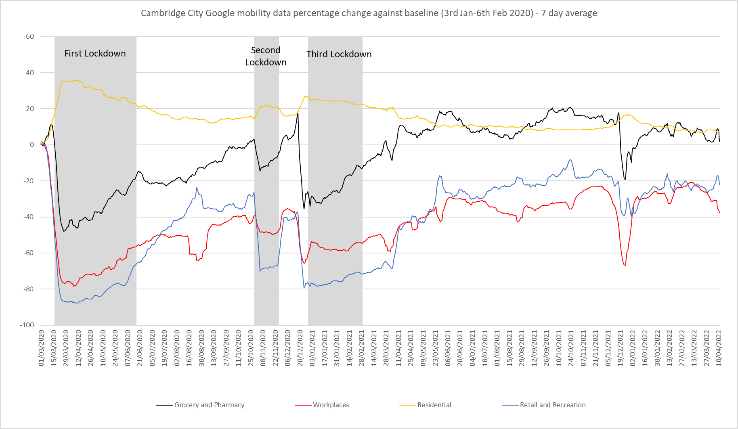
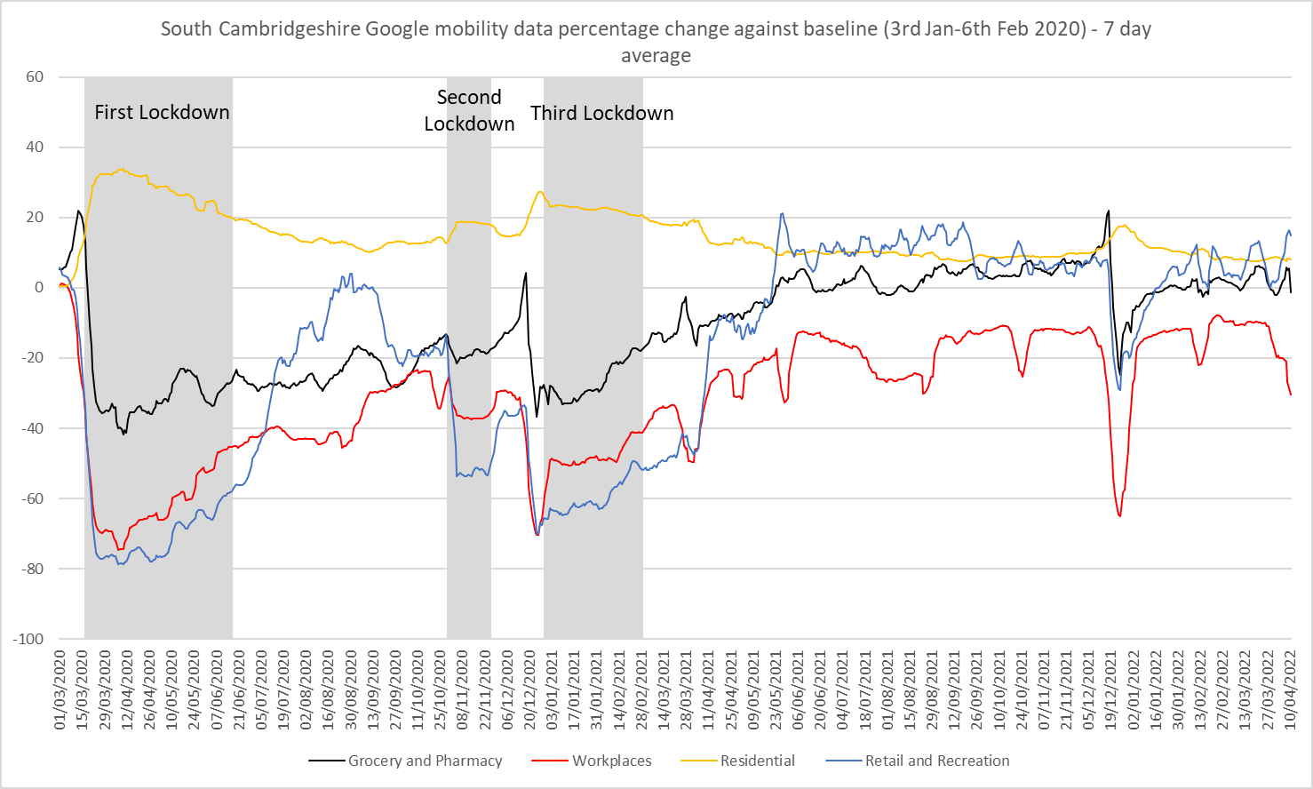
Google Mobility
Pre-COVID vs Now: Jan/Feb 2020 to Mar 2022 | Cambridge | South Cambridgeshire
Grocery and Pharmacy | +7% | +3%
Workplaces | -24% | -11%
Residential | +8% | +8%
Retail and Recreation | -23% | +6%
Google LLC "Google COVID-19 Community Mobility Reports". https://www.google.com/covid19/mobility/ Accessed: 21/04/2022
Notes:
The charts above show data gathered from Google account holders location history. The comparison of social mobility change is based on the most recent several weeks up to the report date (17th April 2022) compared to the median of the corresponding day in the baseline period (3rd Jan-6th Feb 2020).
This data indicates that in March 2022 visits to the Workplace showed levels furthest from the baseline across the GCP area, particularly in Cambridge where visits were -24% below pre-pandemic levels, in South Cambridgeshire, visits were closer at -11% below the baseline.
In Cambridge, Retail and Recreation visits followed after this, at second lowest compared to the baseline. Increases were evident in visits to Retail and Recreation locations from the 19th of July when all remaining restrictions were lifted but visits still remain -23% below the baseline in April 2022. This contrasts with South Cambridgeshire where Retail and Recreation visits were +6% above the baseline in the same period.
Residential visits were above the baseline in both Cambridge and South Cambridgeshire (both +8% above the baseline), this is partly influenced by many people working from home.
Grocery visits were +7% above the baseline in Cambridge in April 2022, in South Cambridgeshire, they were +3% above the baseline for this period.

Slide 5
Unemployment Trends

Slide 6
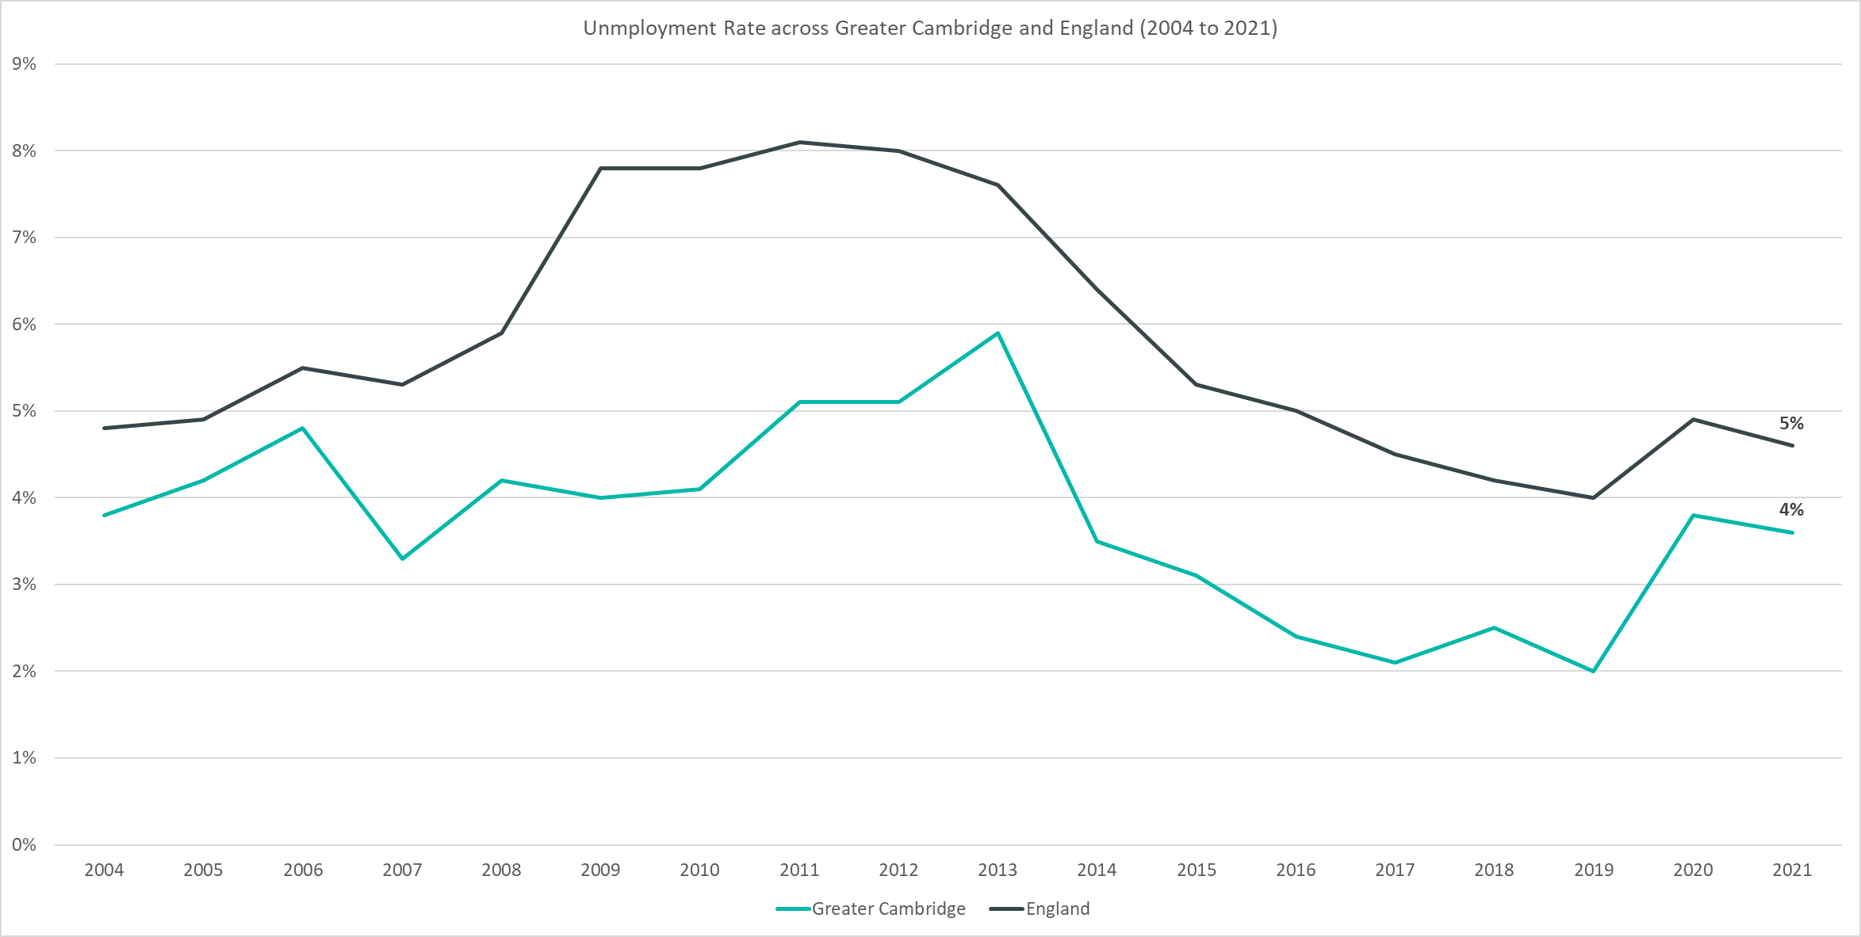
Employment Trends – Unemployment Rate Overall (3.6% Jan-Dec 2021)
Data not available for 2018
Quarterly change
(Oct – Dec 21):
Previous change
(Jul – Sep 21):
Change since December 2019:
+0.2pp
+0.5pp
+1.6pp
Please note: estimates and confidence intervals are unreliable due to small sample sizes for 2016-2020 and so show be treated as indicative.
Notes:
The above chart shows the unemployment rate across Greater Cambridge and England from 2004 to 2021.
The unemployment rate has been consistently below the national level and has broadly followed the same pattern as seen nationally.
Since December 2019 the unemployment rate has increased by +1.6pp, although the level is lower than the height of the pandemic period.
After an initial fall in early 2021, data suggests that since July unemployment rates have been slowly creeping upwards.

Slide 7
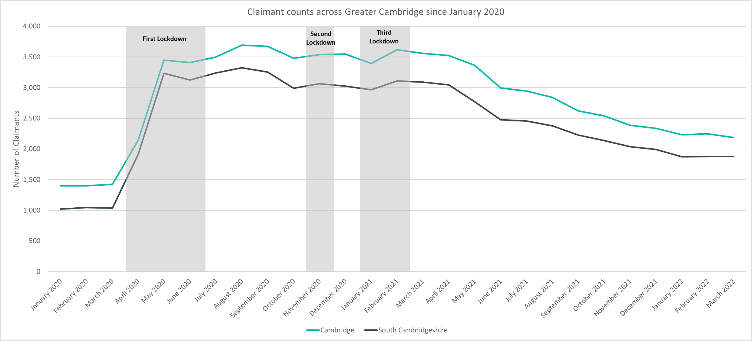
Labour Market – Claimant Count
*this figure includes all residents over the age of 16 (not just working age)
Claimant Counts | Number of claimants Mar 2022 | % of claimants aged 16-64 Mar 2022 | Pre-COVID vs Now: Feb 2020 to Mar 2022 | Previous update vs Now: Dec 2021 to Mar 2022
Cambridge | 2,185 | 2.5% | +53% | -6%
South Cambridgeshire | 1,880 | 1.9% | +82% | -6%
Notes:
The Claimant Count measures the number of people (age 16+) claiming benefit principally for the reason of being unemployed. We use data on claimants rather than unemployed numbers because – although the numbers are lower – they are more up to date, and therefore we expect it to indicate to us any COVID-19 impact trends sooner. It is however a narrower measure of unemployment, and as such does not cover all those out of work, since not all can claim assistance. The claimant count data is a snapshot of the number of claimants on the 10th March 2022.
The above chart presents claimant counts across Greater Cambridge from January 2020 to March 2022.
March 2022 data showed decreases in claimant counts, there was a -6% decrease from December 2021 across Greater Cambridge, with a -6% decrease in Cambridge and South Cambridgeshire, and a -5% decrease across England overall.
4,065 claimants* across the GCP area; 2.2% of people aged 16-64, compared to 4.3% across England. This compares to 2,460 claimants (1.3% of people aged 16-64) across the GCP area in March 2020, a +65% increase.
Cambridge City 2,185 (2.5%) .
South Cambridgeshire 1,880 (1.9%) –– South Cambridgeshire still has the lowest proportion of residents aged 16-64 claiming (1.9%) compared to the rest of the county.
In Cambridgeshire there were 10,345 claimants (2.5% of the working age population).
*this figure includes all residents over the age of 16 (not just working age).

Slide 8
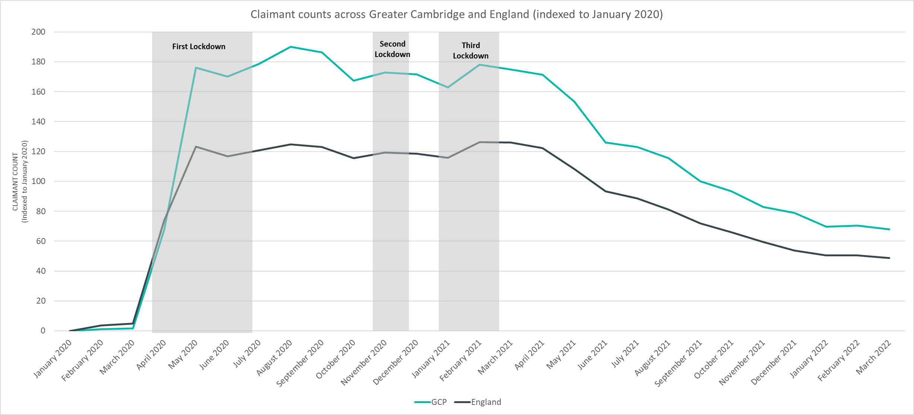
Labour Market – Claimant Count
*this figure includes all residents over the age of 16 (not just working age)
Notes:
The above chart presents claimant counts across Greater Cambridge and England indexed to January 2020. This presents a more effective way to visualise recovery than using raw numbers of counts.
Although Greater Cambridge saw claimant counts closer to the January 2020 baseline in February and March 2020 than England, counts quickly increased and Greater Cambridge saw claimant counts substantially higher than the January 2020 baseline from April 2020 onwards when compared to England.
The gap between Greater Cambridge and England was greatest across the last three quarters of 2020.
Across 2021 and into 2022, the gap between Greater Cambridge and England has narrowed. However, Greater Cambridge is still higher than England when compared to the January 2020 baseline.
*this figure includes all residents over the age of 16 (not just working age).

Slide 9
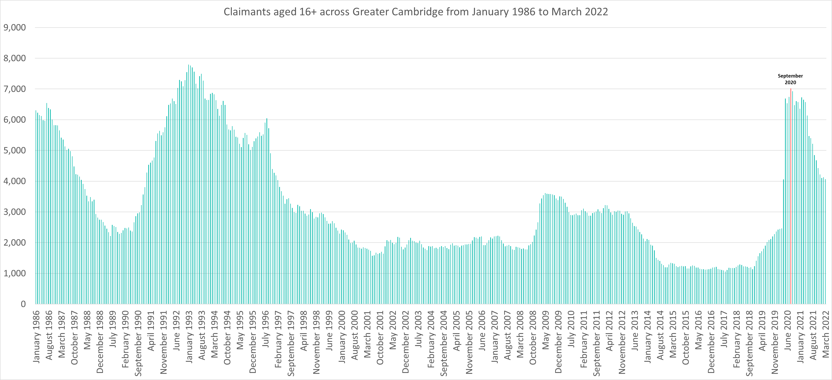
Labour Market – Claimant counts across time
Notes:
The above chart presents claimant counts across Greater Cambridge from January 1986 to March 2022.
September 2020 saw the highest number of claimants (6,930) since 1992.
Claimant counts have decreased at a faster rate than seen from 1992 but are still above pre pandemic levels and those seen in 2008/2009.
*this figure includes all residents over the age of 16 (not just working age).

Slide 10
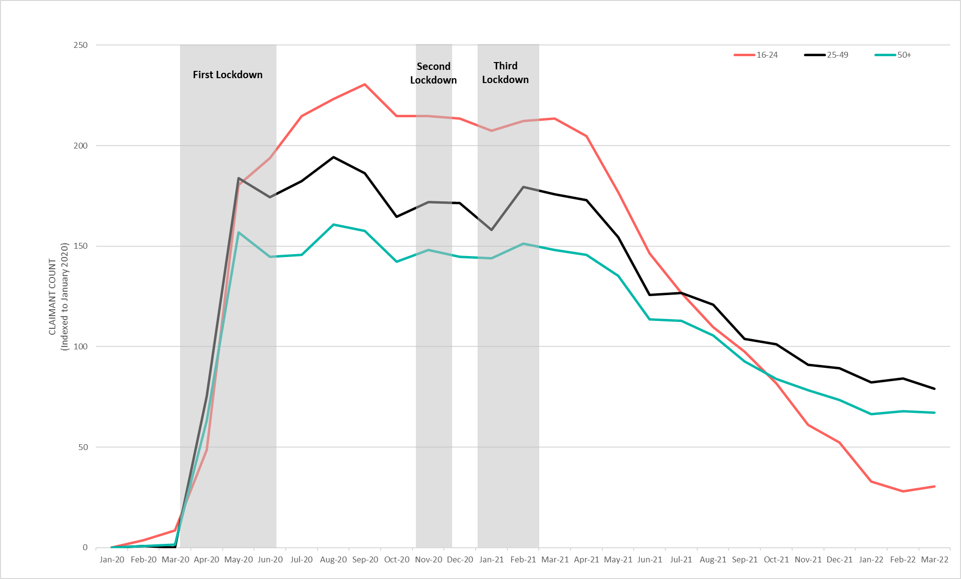
Labour Market – Claimant counts by age
March 2022 Claimant Counts by Age Group (Indexed to January 2020)
Claimant Counts | 16-24 Dec 2021 to Mar 2022 | 25-49 Dec 2021 to Mar 2022 | 50+ Dec 2021 to Mar 2022
Greater Cambridge | -42% | -11% | -9%
Claimant Rates | 16-64 March 2022 | 16-17 March 2022 | 18-24 March 2022 | 25-49 March 2022 | 50+ March 2022
Cambridge | 2.5% | 0.4% | 1.1% | 3.4% | 1.6%
South Cambridgeshire | 1.9% | 0.0% | 2.6% | 2.2% | 0.7%
Notes:
National statistics on claimant count since the pandemic have indicated that younger age groups have been disproportionately impacted. The above chart highlights the levels of change each age group has seen in claimant counts across the Greater Cambridge area.
The above chart presents claimant count data by age indexed to January 2020, we use an indexed chart to show the impacts of COVID-19 and the levels of change seen across each age group compared to their pre-Covid-19 baseline.
In March 2022, there was a -42% decrease in claimants aged 16-24 from December 2021, a -11% decrease in claimants aged 25-49 and a -9% decrease in claimants aged 50+. This has created a large gap across claimant rates between claimants aged 16-24 and 25+.
In South Cambridgeshire, residents in the 18-24 age range have the highest claimant rate (2.6%). In Cambridge, the 25-49 age group account for the largest proportion of claimants (3.4%).

Slide 11
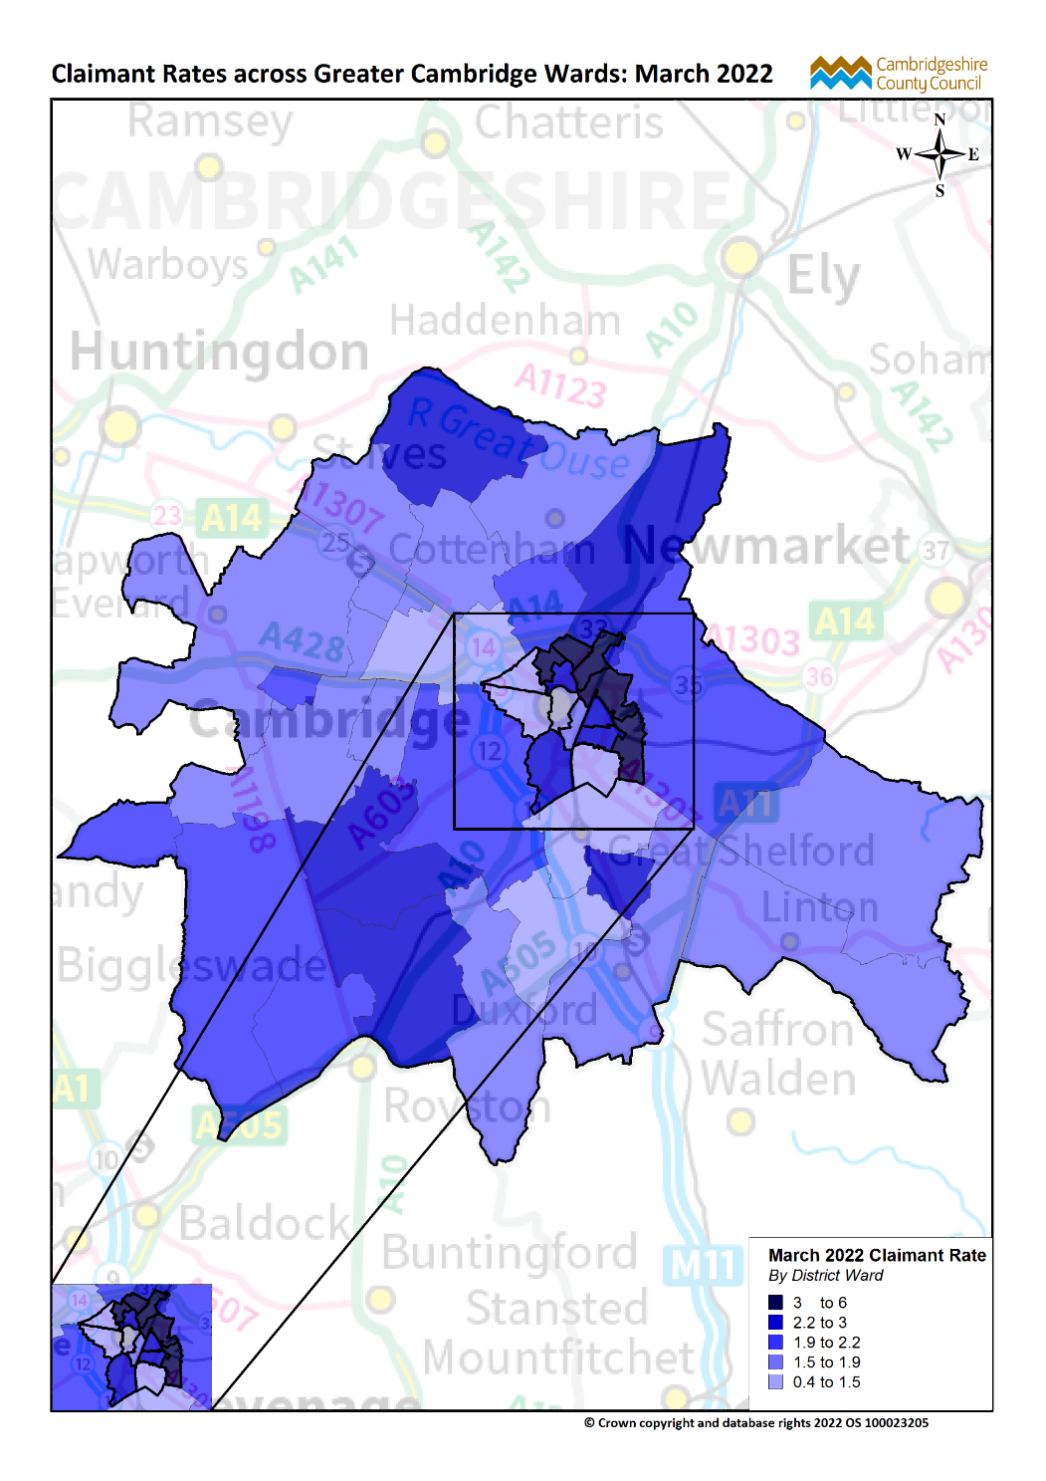
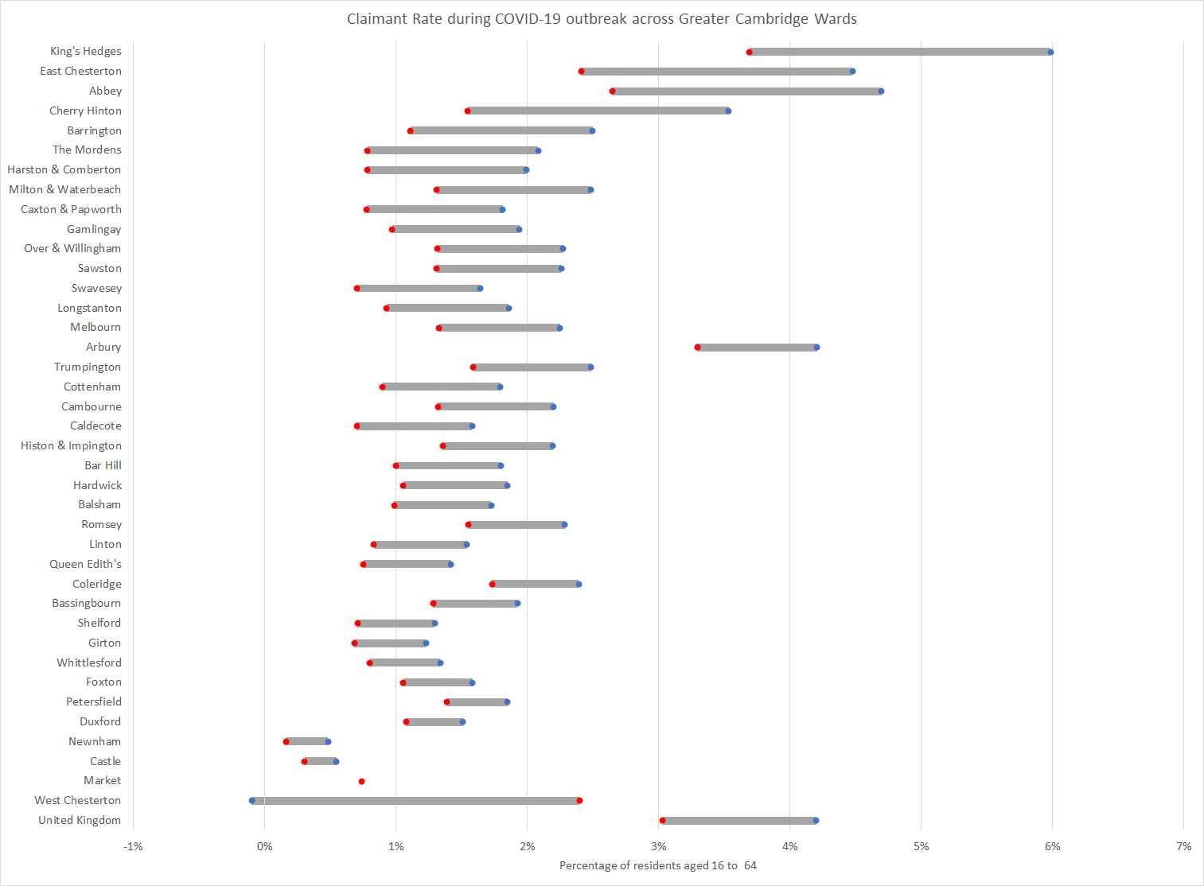
Labour Market – Claimant counts by location
March 2020
March 2022
Notes:
The above map illustrates claimant rate by ward across the Greater Cambridge area. We use this to highlight the wards with the highest claimant rate (represented in dark blue), rather than looking at a percentage change since a pre-Covid-19 period. This is because some wards within the GCP area had very low numbers of claimants, therefore the changes in these areas are against a very low base. Looking at claimant rate as absolute figures allows us to see the areas with the highest number of claimants for the population.
With the exception of Barrington (2.5%) and Milton & Waterbeach, the top 10 wards with the highest claimant rates in March 2022 are all in Cambridge City, with Kings Hedges having the highest claimant rate (6%) across Greater Cambridge.
All areas have seen decreases in claimant counts across the last year, in March 2021, the claimant rate in Kings Hedges was (9.4%), 3.4pp higher than March 2022.
The lowest claimant rates across Greater Cambridge are in the Newnham (0.5%), Castle (0.6%), and Market wards (0.7%).
Top 5 wards with highest claimant rates are (March 2022): Kings Hedges (6%), Abbey (4.7%), East Chesterton (4.5%), Arbury (4.2%) and Cherry Hinton (3.5%).
The top 5 wards with the highest claimant rate remain similar to December 2021 with East Chesterton making the top 5 in March 2022.
The above chart illustrates the change in claimant rates from pre-Covid-19 (March 2020) to March 2022 by ward across the Greater Cambridge area.
King’s Hedges had the largest increase in claimant rate from March 2020 to March 2022 (+2.3pp), East Chesterton (+2.1pp), Cherry Hinton (+2.0pp), Abbey (+2.0pp) and Cherry Hinton (+2.0pp) also have larger increases relative to the majority of wards.
In March 2020, Kings Hedges and Arbury were the only wards with higher claimant rates than the United Kingdom. In March 2022, King Hedges (6.0%), Abbey (4.7%) and East Chesterton (4.5%) all had higher claimant rates than the United Kingdom (4.2%)
West Chesterton now has a lower claimant rate in March 2022 than in March 2020 and Market now has no difference in claimant rate between March 2020 and March 2022.
The United Kingdom saw an increase of +1.2pp between March 2020 and March 2022.

Slide 12
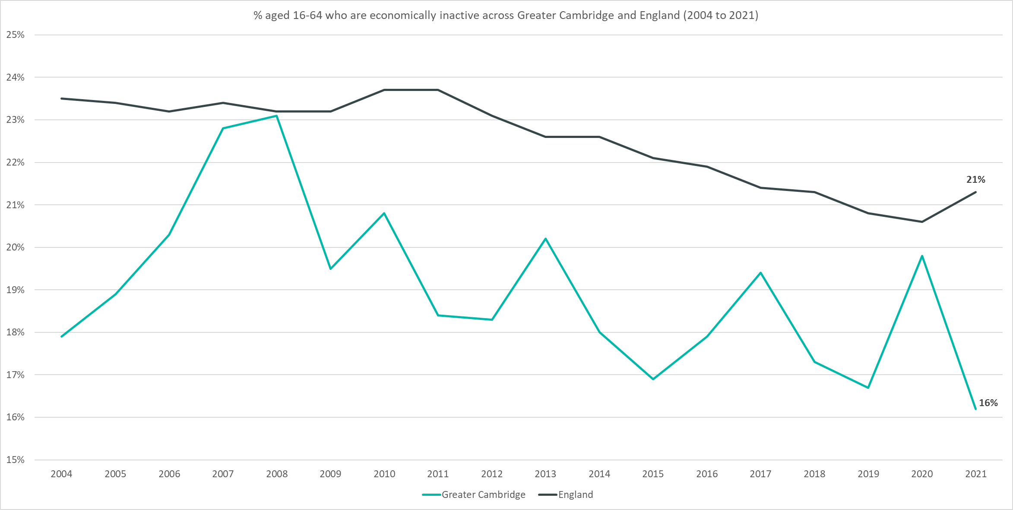
Employment Trends – Economically Inactive (16.1% Jan-Dec 2021)
Quarterly change
(Oct – Dec 21):
Previous change
(Jul – Sep 21):
Change since December 2019:
-3.3pp
-1.2pp
-0.5pp
Please note: estimates and confidence intervals are unreliable due to small sample sizes for 2016-2020 and so show be treated as indicative.
Notes:
The above chart shows the percentage of those aged 16-64 who are economically inactive across Greater Cambridge and England from 2004 to 2021.
The percentage of those economically inactive has been consistently below the national level. Note that the pattern is likely to be more sporadic given the smaller geography.
After increasing in 2020, compared to pre-pandemic levels, the percentage of those economically inactive is now -0.5pp behind.
After a small decrease at the beginning of 2021, the last quarter saw a –3.3pp decrease.

Slide 13
Impacts of COVID-19

Slide 14
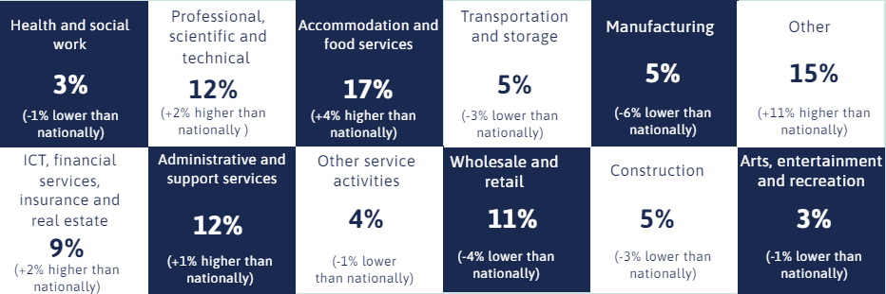
Impacts of COVID-19 – Sectors most affected by end of furlough (30th September 2021)
4,000 employments across Greater Cambridge on furlough as of 30th September 2021
Notes:
The above gird shows a breakdown of employments furloughed by sector for the Greater Cambridge area compared with data for the United Kingdom overall using data from the Governments Coronavirus Job Retention Scheme Statistics: 16 December 2021. This is the final update and represents all employments furloughed by sector across all waves of the CRJS.
Across the Greater Cambridge area overall, the sector with highest proportion of employments furloughed (17%) was the Accommodation and food services sector. This compares to 13% of employments furloughed nationally. Cambridge has a higher proportion of employments furloughed in this sector (24%) than South Cambridgeshire (11%).
The Other* sector had the second highest proportion of employments furloughed (15% across the Greater Cambridge area overall compared with 4% nationally). This is because it includes the Education sector. This is most notable in Cambridge (19%).
The Professional, Scientific and Technical sector accounted for 12% of employments furloughed across the GCP area, 13% in South Cambridgeshire and 10% in Cambridge.
*The sectors in the chart above have been abbreviated for clarity, the full list of sector names can be seen in the notes below.
*Wholesale and retail; repair of motor vehicles.
*Information and communication, Financial and insurance & Real Estate.
*The 'Other' category contains the following sectors: Agriculture, forestry and fishing; Mining and quarrying; Education; Energy production and supply; Water supply, sewerage and waste; Public administration and defence; social security; Households; and Unknown and other.
*Education is now listed under the ‘Other’ category. This has been done to avoid disclosure and dominance at the more granular breakdown with the decreasing number of employments on furlough.

Slide 15
Employment Trends

Slide 16
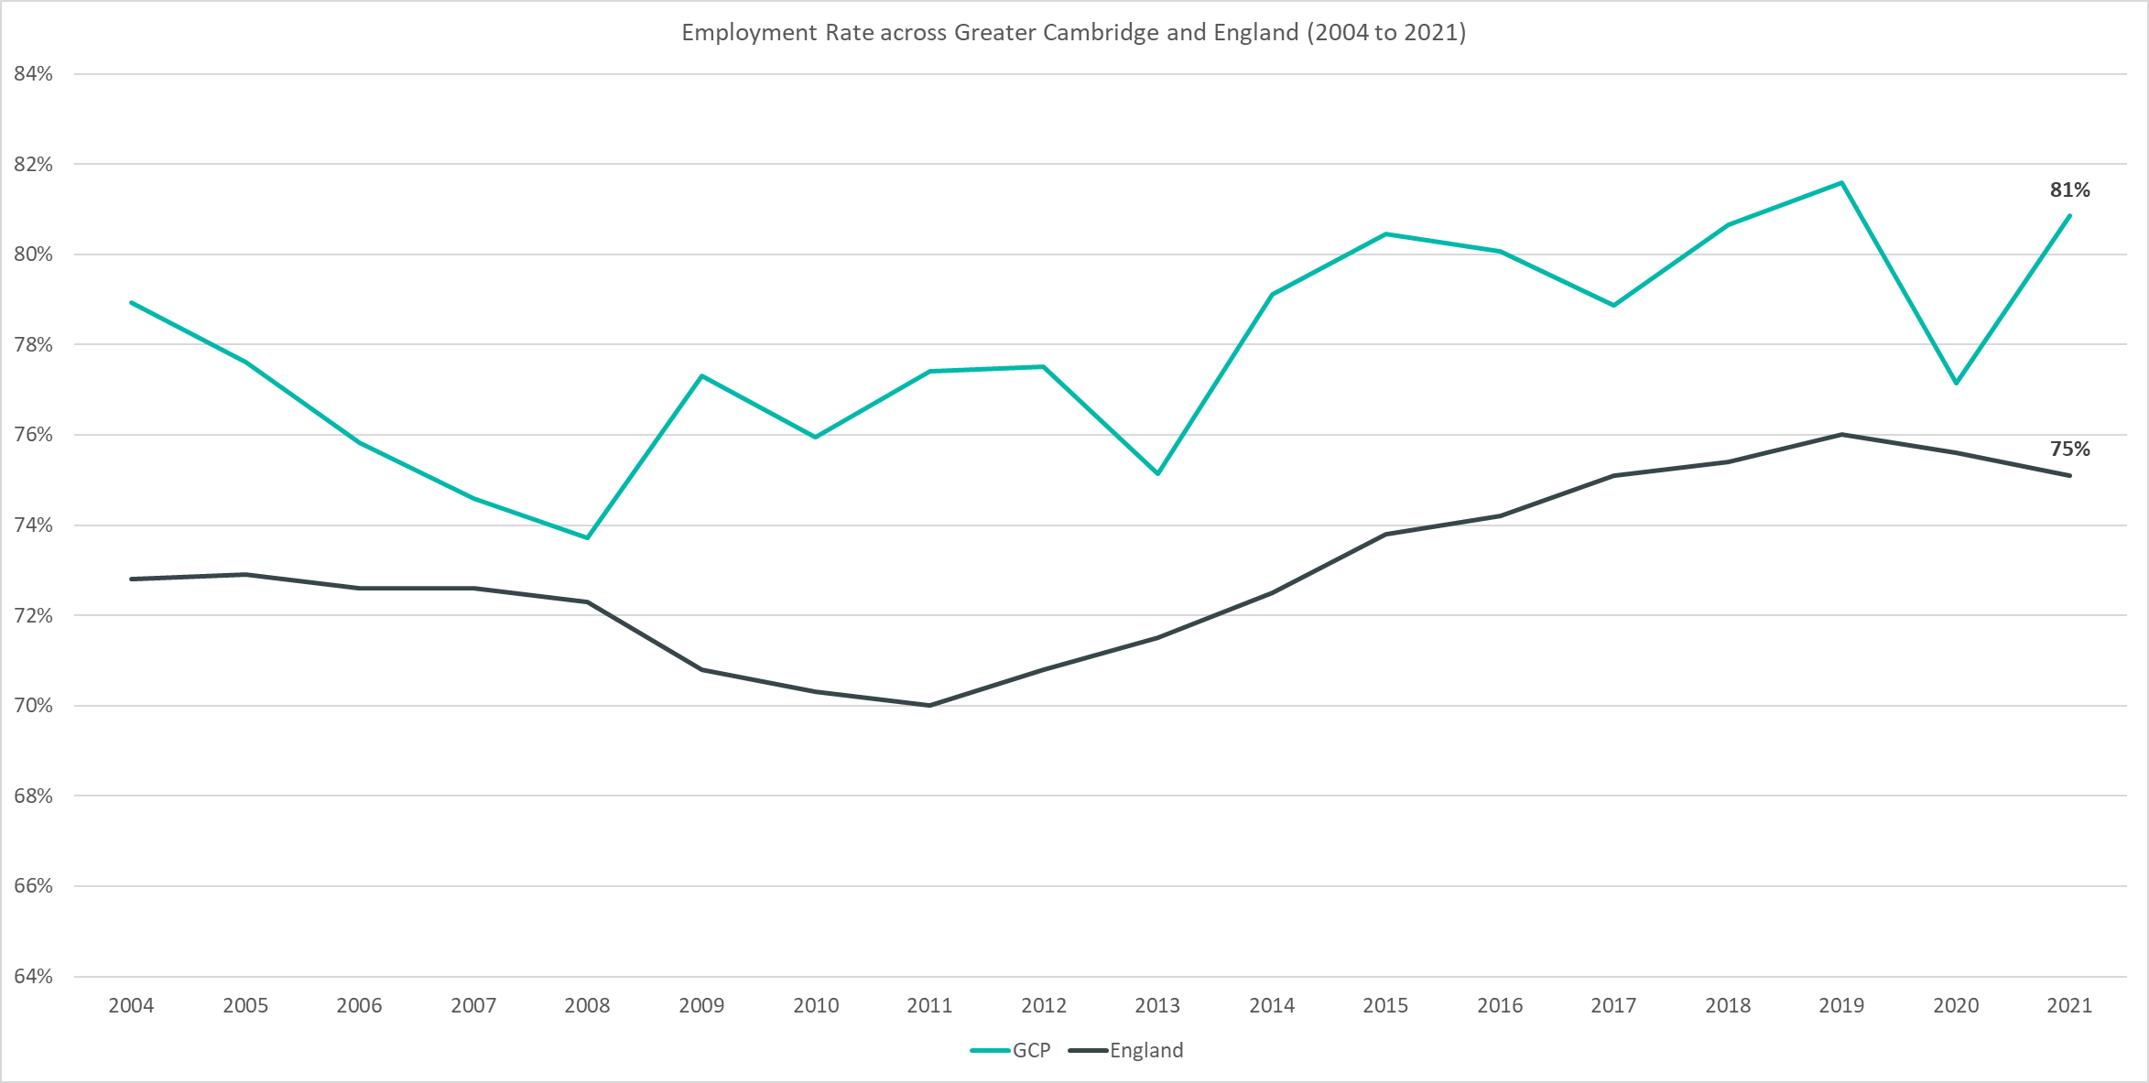
Employment Trends – Employment Rate Overall (80.9% Jan-Dec 2021)
Quarterly change
(Oct – Dec 21):
Previous change
(Jul – Sep 21):
Change since December 2019:
+3.1pp
+0.8pp
-0.7pp
Notes:
The above chart shows the employment rate across Greater Cambridge and England from 2004 to 2021.
The employment rate across Greater Cambridge has been consistently higher than the rate seen nationally. Note that the pattern is likely to be more sporadic given the smaller geography.
After falling in 2020, compared to pre-pandemic levels, the employment rate is now -0.7pp behind.
After small increases in the beginning of 2021, the last quarter saw a +3.1pp increase.

Slide 17
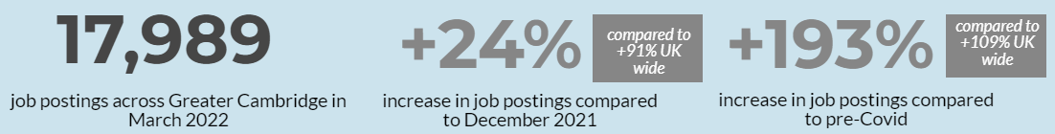
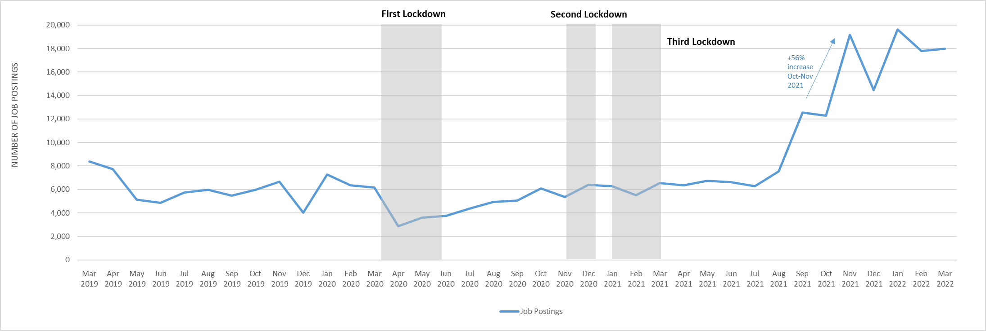
Employment Trends – Vacancies
Monthly job postings across Greater Cambridge
Notes:
The above chart illustrates online vacancy data across the Greater Cambridge area since March 2019. This data is provided through EMSI | Burning Glass by the Cambridgeshire and Peterborough Combined Authority.
There were 17,989 job postings across Greater Cambridge in March 2022, up by +24% from December 2021. Nationally, job postings increased by +91% in the same period.
January 2022 saw the highest number of vacancies across Greater Cambridge for the past ten years.
In the last three months (January - March 2022) job postings were up by +202% when compared to January - March 2021. When compared to the same period in 2019, there was a +188% increase in job postings.
When comparing vacancies in the latest month to a pre-Covid-19 period*, postings were up by +193%. Nationally, they were +109% higher.
*EMSI | Burning Glass vacancy data is available from 2012 onwards.
*The pre-Covid-19 comparison period is based on a twelve month average from March 2019-February 2020.

Slide 18
Employment Trends – Vacancies by Industry
Notes:
The above table details vacancies by industry data from EMSI/Burning Glass and gives insight on how different industries are recovering from COVID-19 as well as changes from the last update in December 2021.
Across Greater Cambridge all sectors with the exception of Other Service Activities (-7%) are higher than pre-Covid levels.
Transportation and Storage (+527%), Information and Communication (+295%) and Public Administration and Defence; Compulsory Social Security (+286%) are furthest from pre-Covid levels.
With the exception of Financial and Insurance Activities (-28%) and Public Administration and Defence; Compulsory Social Security (-4%) all sectors across Greater Cambridge in March 2022 saw increases from December 2021.
Nationally all sectors are higher than pre-Covid levels and all sectors saw increases from December 2021.
*The pre-Covid-19 comparison period is based on a twelve month average from March 2019-February 2020.
*To aid comparison to pre-Covid these postings had to include employer and industry information

Slide 19
Final Thoughts

