Slide 1
Full Asylum Dispersal Regional Allocation Plan Cambridgeshire and Peterborough Data Pack
This data pack has been compiled by the Research Group Cambridgeshire County Council from a range of data sources to provide a profile of service demands locally.
Contents:
Ukrainian refugee response – current demand data
Journey times to key services – Nationally defined measures using 2019 data
Schools – Local insight into current capacity and nationally derived journey times
Health – Location information and nationally derived journey times
Community Safety – mapped local crime and anti-social behaviour rates
Job vacancies – Relevant subset of job vacancies data
IMD Barriers to Housing and Services – 2019 nationally available data exploring the housing domain
Housing development and population growth – local population forecasts and development data
House prices – Nationally available data at district level
For further information contact research.group@cambridgeshire.gov.uk

Slide 2
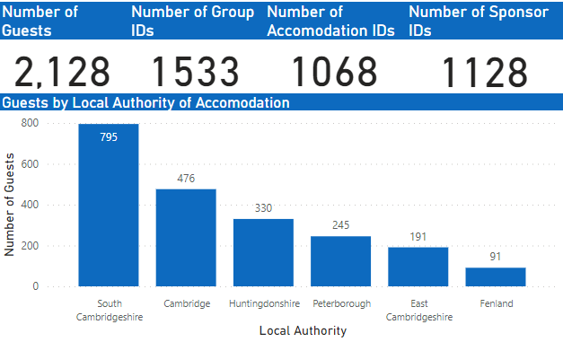
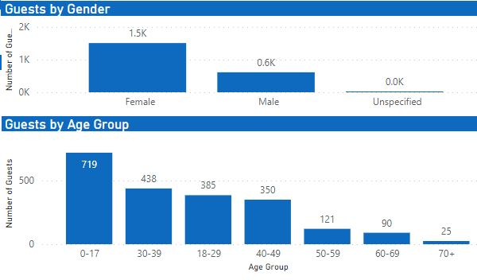
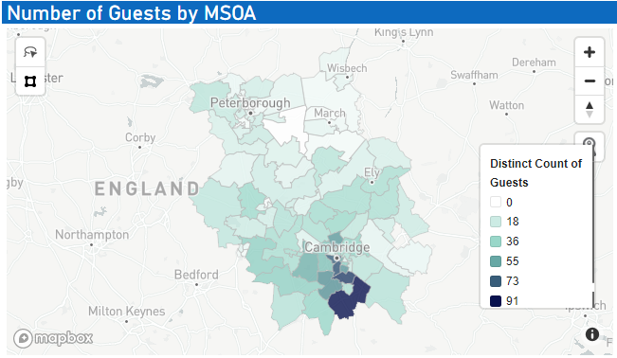
Ukrainian refugee local response
As of 24th July 2022 data on the Homes for Ukraine scheme shows 2,128 guest applications for Cambridgeshire & Peterborough where the visa status is either approved, issued or pending. 1,458 guests are recorded as having already arrived.
South Cambridgeshire has the highest proportion of guests, accounting for 37% of all guests. National Home Office data as of 19th July 2022 shows South Cambridgeshire as the 7th highest English lower tier local authority for total number of visa applications received.
The impact of the arrival of Ukrainian refugees through both the Homes for Ukraine and Ukraine Family Scheme on local services will not yet be reflected in the data produced in this pack. As such these additional pressures should be taken into consideration in the interpretation of the data presented.
Notes:
Source: Data taken from Foundry and analysed by Research Group, Cambridgeshire County Council
Cambridgeshire County Council has been leading on data sharing for the county in order to provide support to system colleagues welcoming Ukraine guests.

Slide 3
Access to services – journey times
Average minimum journey time to reach 8 key services*, by mode of travel, 2019
East Cambridgeshire has the longest minimum journey time to the nearest key services via public transport or walking at 32 minutes.
Cambridge and Peterborough have the shortest average minimum journey times by public transport or walking at 14.4 minutes and 18.5 minutes respectively.
 | Public Transport/ Walking | Cycle | Car | Walking
Cambridge | 14.4 | 11.5 | 9.2 | 18.8
East Cambridgeshire | 31.9 | 30.5 | 15.0 | 52.8
Fenland | 27.3 | 25.6 | 12.7 | 40.1
Huntingdonshire | 26.7 | 19.5 | 11.7 | 39.1
South Cambridgeshire | 28.1 | 24.2 | 13.4 | 52.2
Peterborough | 18.5 | 14.1 | 9.8 | 25.5
Source: Department for Transport Journey Time Statistics https://www.gov.uk/government/statistics/journey-time-statistics-england-2019
*The 8 key services included are: employment centre, primary school, secondary school, further education, GP, hospital food store and town centre.
N.B. Journey times data is produced by modelling theoretical journeys between known sets of origins (single point of Output Areas) and destinations using information on the road network, traffic speeds and public transport timetables. Journey times are representative of the morning peak (7-10am). Full details relating to the source datasets and methodology used in the production of these statistics can be found here: https://assets.publishing.service.gov.uk/government/uploads/system/uploads/attachment_data/file/853603/notes-and-definitions.pdf

Slide 4
School capacity overview
Cambridgeshire County Council Place Planning Team has been monitoring and sharing information on current capacity. The following issues are highlighted;
Schools located in areas of high housing growth (e.g. Northstowe) will have high levels of capacity, however, this capacity will be automatically filled through population growth in the new build locations
Schools where full classes have been removed will show as having capacity, however, school places would not immediately be available. This would be dependant on the ability to recruit teachers which is a current challenge nationally.
Homes for Ukraine is placing additional pressures on school places. At the time of writing demand is outstretching capacity in South Cambridgeshire and Cambridge City.

Slide 5
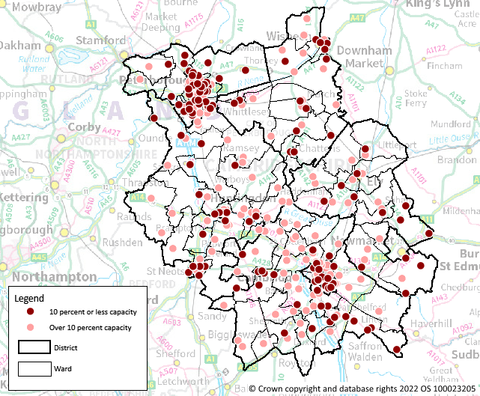
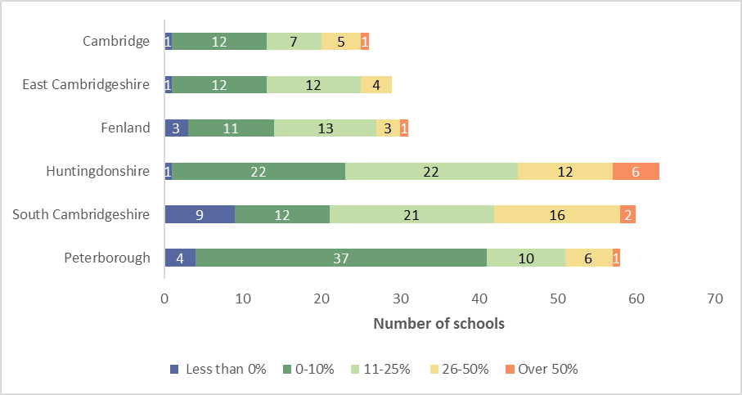
Primary school capacity (2021)
South Cambridgeshire had the highest proportion of oversubscribed primary schools (15%)
The majority of primary schools in Peterborough had 10% or less capacity (71%)
Map of primary schools including 2021 capacity
Primary schools by remaining capacity, 2021
Notes:
Source: Cambridgeshire County Council Place Planning Team primary schools capacity and vacancies data as at January 2021.

Slide 6
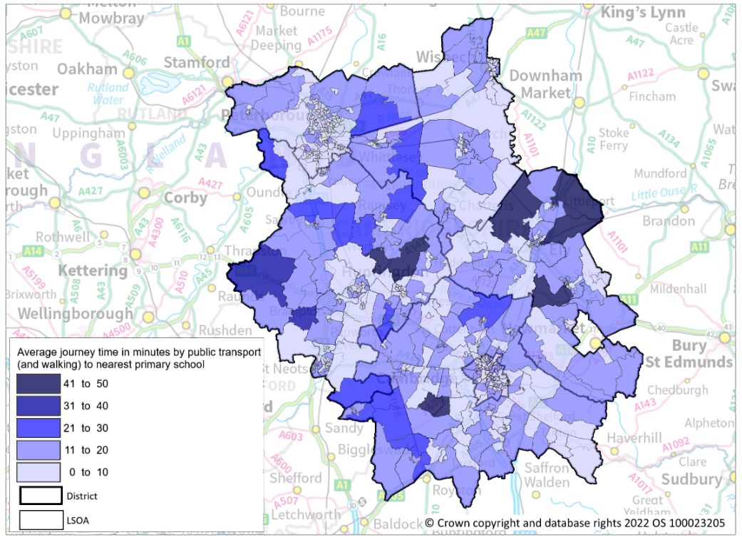
Journey times to primary schools
Map of average minimum journey time to nearest primary school by public transport/walking, by LSOA (2019)
The districts with the highest proportion of LSOAs with an average minimum journey time to the nearest primary school of longer than 20 minutes by public transport/walking are Huntingdonshire (9%) and East Cambridgeshire (8%).
In South Cambridgeshire 4% of LSOAs have an average minimum journey time longer than 20 minutes to the nearest primary school.
Notes:
Source: Department for Transport Journey Time Statistics. National data on journey times to key services by lower super output area: https://www.gov.uk/government/statistical-data-sets/journey-time-statistics-data-tables-jts#journey-times-to-key-services-by-lower-super-output-area-jts05

Slide 7
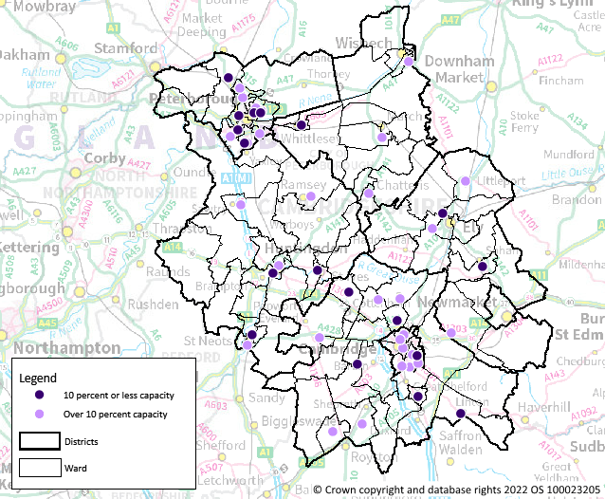
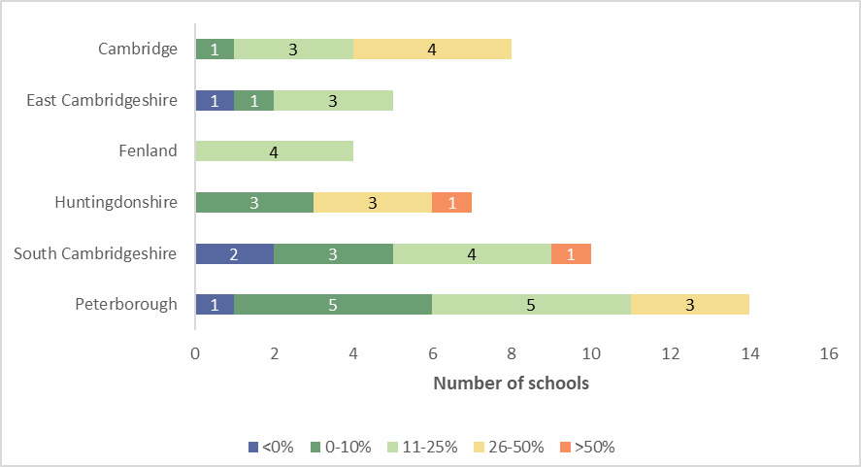
Secondary school capacity (2021)
Map of secondary schools including 2021 capacity
South Cambridgeshire had the highest proportion of oversubscribed secondary schools (20%)
Peterborough and Huntingdonshire have the highest proportion of secondary schools with 10% or less capacity
Secondary schools by remaining capacity, 2021
Notes:
Source: Cambridgeshire County Council Place Planning Team secondary schools capacity and vacancies data as at January 2021.

Slide 8
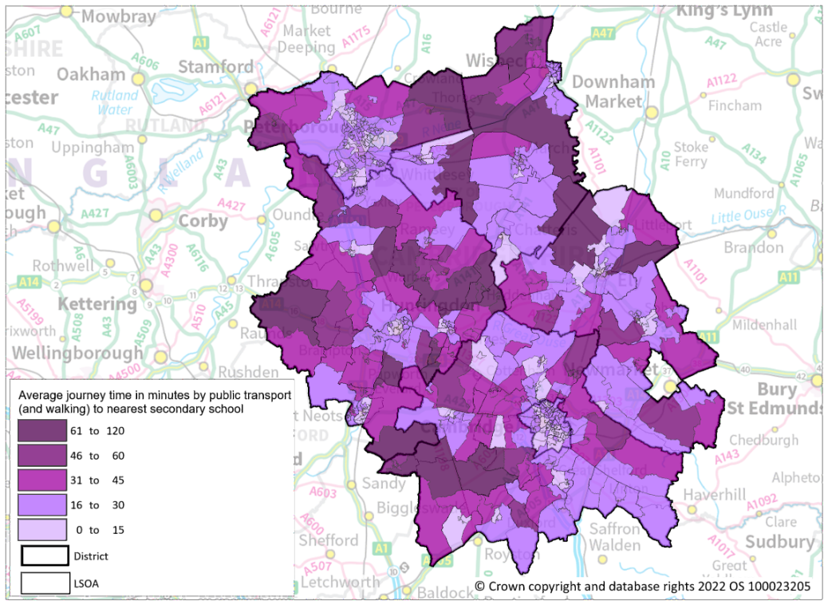
Journey times to secondary schools
Map of average minimum journey time to nearest secondary school by public
transport/walking, by LSOA (2019)
South Cambridgeshire and Huntingdonshire has the highest proportion of LSOAs with an average journey time of longer than 30 minutes to the nearest secondary school by public transport/walking at 41% and 38% respectively.
14% of LSOAs in Huntingdonshire has an average minimum journey time of over 45 minutes to the nearest secondary school by public transport or walking.
Notes:
Source: Department for Transport Journey Time Statistics. National data on journey times to key services by lower super output area: https://www.gov.uk/government/statistical-data-sets/journey-time-statistics-data-tables-jts#journey-times-to-key-services-by-lower-super-output-area-jts05

Slide 9
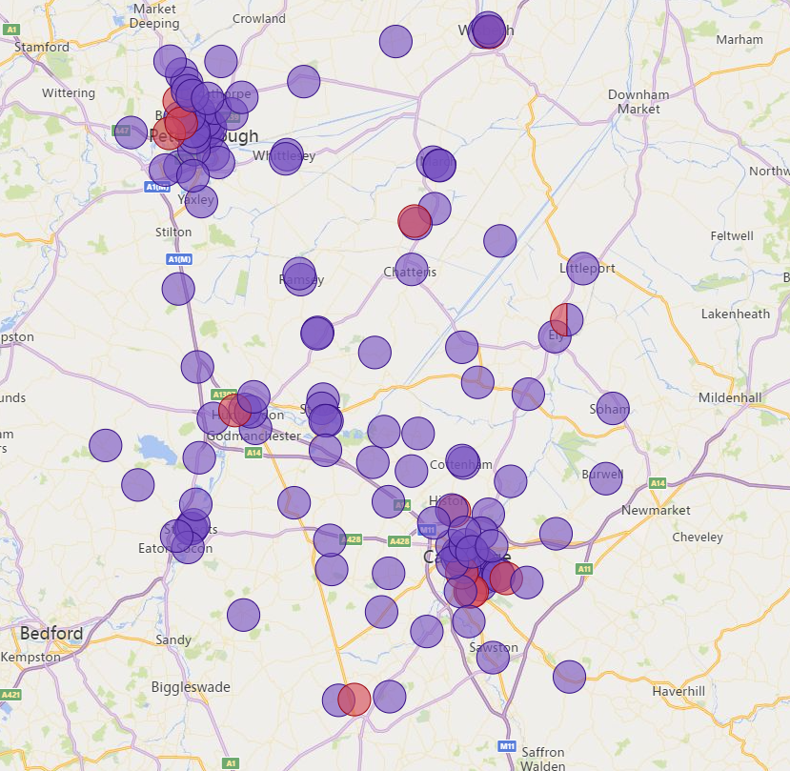
Health
Map of health services in Cambridgeshire & Peterborough
Current factors in accessing local health care;
Impact of COVID-19 on waiting times still being understood.
Increased workload, even small additional asks, can have major impact on GP practices ability to cope
GP related request that are perceived to sit outside of the core GMS contract and place additional burdens on workload might require actional funding.
Additional factors
Availability of information in multiple languages relevant to access health services
Distance and travel options to access services
Notes:
Source: Feedback provided to the Research Group, Cambridgeshire County Council by the Cambridgeshire & Peterborough Integrated Care System (ICS)

Slide 10
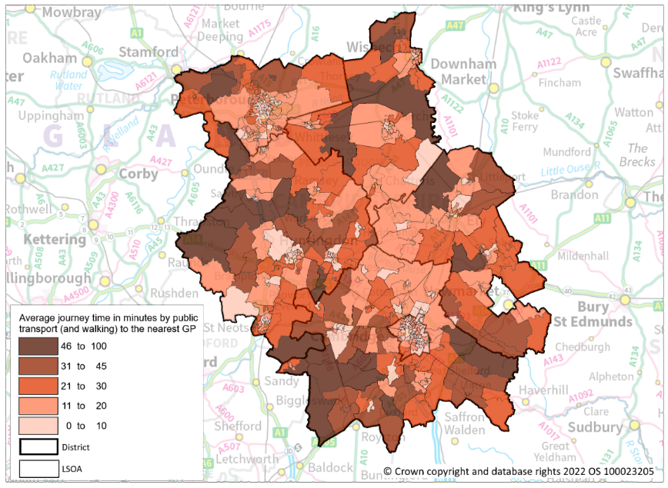
Journey times to GP surgeries
Map of average minimum journey time to nearest GP surgery by public transport/
walking, by LSOA (2019)
South Cambridgeshire has the highest proportion of LSOAs with an average minimum journey time of longer than 30 minutes to the nearest GP by public transport/walking at 25%.
Huntingdonshire and East Cambridgeshire has the next highest proportion each with 12%.
Notes:
Source: Department for Transport Journey Time Statistics. National data on journey times to key services by lower super output area: https://www.gov.uk/government/statistical-data-sets/journey-time-statistics-data-tables-jts#journey-times-to-key-services-by-lower-super-output-area-jts05

Slide 11
Community Safety
Crime, Hate Crime and ASB Rates per 1,000 population, April 2021 – March 2022
 | Crime rate per 1,000 population | Hate crime* rate per 1,000 population | Anti-social behaviour incident rate per 1,000 population
Cambridge | 114.5 | 3.2 | 23.8
East Cambridgeshire | 45.4 | 1.0 | 10.0
Fenland | 80.1 | 1.7 | 17.9
Huntingdonshire | 59.0 | 1.1 | 12.2
South Cambridgeshire | 44.8 | 1.1 | 9.0
Peterborough | 112.3 | 3.1 | 23.8
Source: Cambridgeshire Constabulary recorded crime and incident data and ONS mid-year 2020 population estimates
*Hate crimes refer to any offence committed which had a marker attached for being hate-related. Hate crimes are typically underreported.
Notes:
Source: Cambridgeshire Constabulary police recorded crime and police recorded anti-social behaviour incidents analysed by the Research Group, Cambridgeshire County Council.

Slide 12
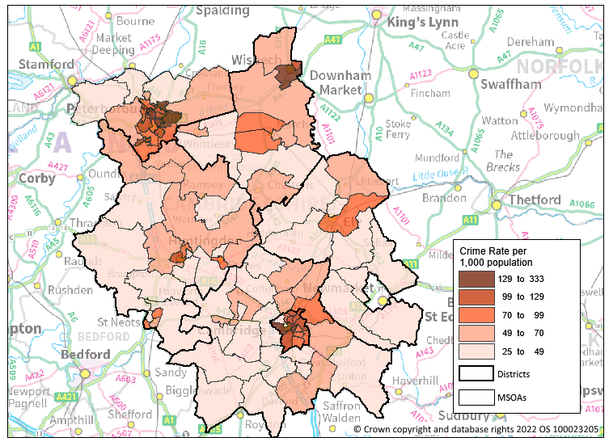
Crime
Map of police recorded crime rate per 1,000 population* by MSOA
*Source: ONS mid-year 2020 population estimates
Notes:
Source: Cambridgeshire Constabulary police recorded crime data, analysed by the Research Group, Cambridgeshire County Council.

Slide 13
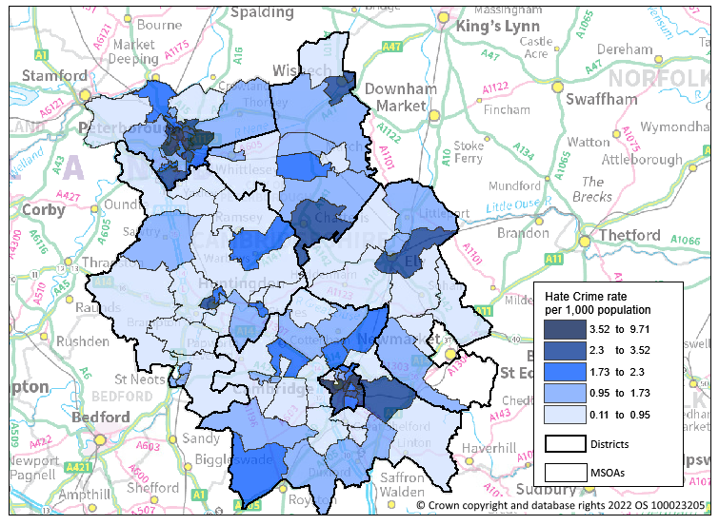
Hate Crime
Map of police recorded hate crime rate per 1,000 population* by MSOA
*Source: ONS mid-year 2020 population estimates
Notes:
Source: Cambridgeshire Constabulary police recorded crime data, analysed by the Research Group, Cambridgeshire County Council.

Slide 14
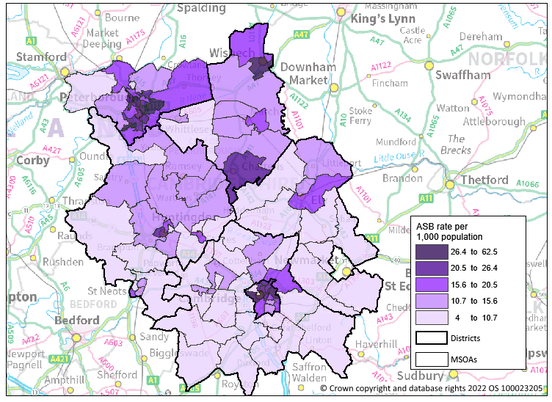
Anti-social behaviour
Map of police recorded ASB incidents per 1,000 population* by MSOA
*Source: ONS mid-year 2020 population estimates
Notes:
Source: Cambridgeshire Constabulary police recorded anti-social behaviour incident data, analysed by the Research Group, Cambridgeshire County Council.

Slide 15
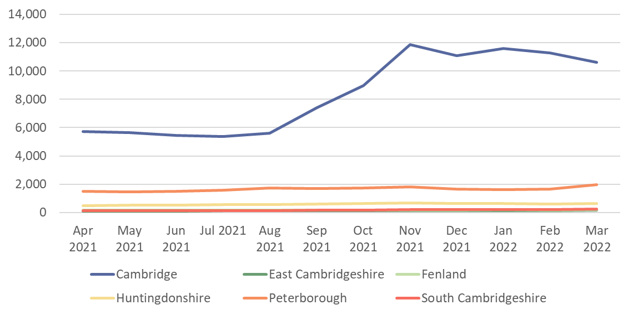
Employment – job vacancies
The Home Office may grant permission to work to asylum seekers whose claim has been outstanding for more than 12 months through no fault of their own. Under this policy, those who are allowed to work are restricted to jobs on the shortage occupation list published by the Home Office: https://www.gov.uk/government/publications/handling-applications-for-permission-to-take-employment-instruction/permission-to-work-and-volunteering-for-asylum-seekers-accessible-version
Monthly count of job vacancies in occupation categories where all jobs feature on the Shortage Occupation List
 | Average monthly number of job vacancies, Apr 2021 – Mar 2022 in occupation categories where all jobs feature on the Shortlist Occupation List
Cambridge | 8,378
East Cambridgeshire | 123
Fenland | 179
Huntingdonshire | 586
South Cambridgeshire | 169
Peterborough | 1,655
*Source: Lightcast job postings data, access provided by the Cambridgeshire & Peterborough Combined Authority
N.B. See Notes for all occupations on the shortage occupation list. Occupations where only specific jobs were eligible have been excluded from the analysis as job vacancies could not be matched at that level of detail
Notes:
Shortage occupations where applicants for entry clearance or permission to stay may be paid 80% of the going rate for the occupation code:
1181 Health services and public health managers and directors - all jobs
1242 Residential, day and domiciliary care managers and proprietors - all jobs
2112 Biological scientists and biochemists – all jobs
2121 Civil engineers – all jobs
2122 Mechanical engineers – all jobs
2123 Electrical engineers – all jobs
2124 Electronics engineers – all jobs
2126 Design and development engineers – all jobs
2127 Production and process engineers – all jobs
2129 Engineering professionals not elsewhere classified – all jobs
2135 IT business analysts, architects and systems designers – all jobs
2136 Programmers and software development professionals – all jobs
2137 Web design and development professionals – all jobs
2216 Veterinarians – all jobs
2431 Architects – all jobs
2461 Quality control and planning engineers – all jobs
3111 Laboratory technicians - all jobs
3411 Artists – all jobs
3416 Arts officers, producers and directors – all jobs
3421 Graphic designers – all jobs
6146 Senior care workers - all jobs
Specific jobs only (not included in job vacancies analysis):
2113 Physical scientists - only the following jobs in the construction-related ground engineering industry: • engineering geologist • hydrogeologist • geophysicist
2113 Physical scientists – only the following jobs in the oil and gas industry:
2114 Social and humanities scientists – only archaeologists
2139 Information technology and communications professionals not elsewhere classified – only cyber security specialists
2425 Actuaries, economists and statisticians – only bio-informaticians and informaticians
3414 Dancers and choreographers – only skilled classical ballet dancers or skilled contemporary dancers who meet the standard required by internationally recognised UK ballet or contemporary dance companies. The company must be endorsed as being internationally recognised by a UK industry body such as the Arts Councils (of England, Scotland or Wales).
3415 Musicians – only skilled orchestral musicians who are leaders, principals, sub-principals or numbered string positions, and who meet the standard required by internationally recognised UK orchestras. The orchestra must be a full member of the Association of British Orchestras.
5215 Welding trades – only high integrity pipe welders, where the job requires 3 or more years’ related on-the-job experience. This experience must not have been gained through working illegally.
Shortage occupations in eligible health and education occupation codes where going rates are based on national pay scales:
2211 Medical practitioners – all jobs
2212 Psychologists – all jobs
2213 Pharmacists – all jobs
2217 Medical radiographers – all jobs (including radiotherapy practitioners / technologists)
2219 Health professionals not elsewhere classified – all jobs
2221 Physiotherapists – all jobs 2222 Occupational therapists – all jobs
2223 Speech and language therapists – all jobs 2231 Nurses – all jobs
2442 Social workers – all jobs
3213 Paramedics – all jobs
6141 Nursing auxiliaries and assistants – all jobs
Specific jobs only (not included in job vacancies analysis):
2314 Secondary education teaching professionals – only teachers in maths, physics, science (where an element of physics will be taught), computer science and modern foreign languages
Shortage Occupations which are otherwise not eligible for the Skilled Worker route:
6145 Care workers and home carers

Slide 16
Index of Multiple Deprivation (IMD) 2019
The IMD provides a set of relative measures of deprivation for small geographical areas (Lower-layer Super Output Areas) across England, based on seven different domains of deprivation.
The Barriers to Housing and Services Domain measures the physical and financial accessibility of housing and local services. The domain is made up of indicators from 2 sub domains – ‘geographical barriers’ and ‘wider barriers’.
Barriers to Housing and Services
Geographical Barriers
(Road distance to: post office; primary school; general store or supermarket; GP surgery)
Wider Barriers (Housing)
(Household overcrowding; homelessness; housing affordability)
Across Cambridgeshire & Peterborough each district has at least 30% of its LSOAs in the top 30% most deprived nationally on the Barriers to Housing and Services domain.
Peterborough has the highest proportion of LSOAs in the top 30% most deprived nationally at just under half (48%).
District | Proportion of LSOA’s in the top 30% most deprived for Barriers to Housing and Services
Cambridge | 30%
East Cambridgeshire | 40%
Fenland | 33%
Huntingdonshire | 37%
South Cambridgeshire | 41%
Peterborough | 48%
Notes:
Source: national relative deprivation data published 26 September 2019: https://www.gov.uk/government/statistics/english-indices-of-deprivation-2019

Slide 17
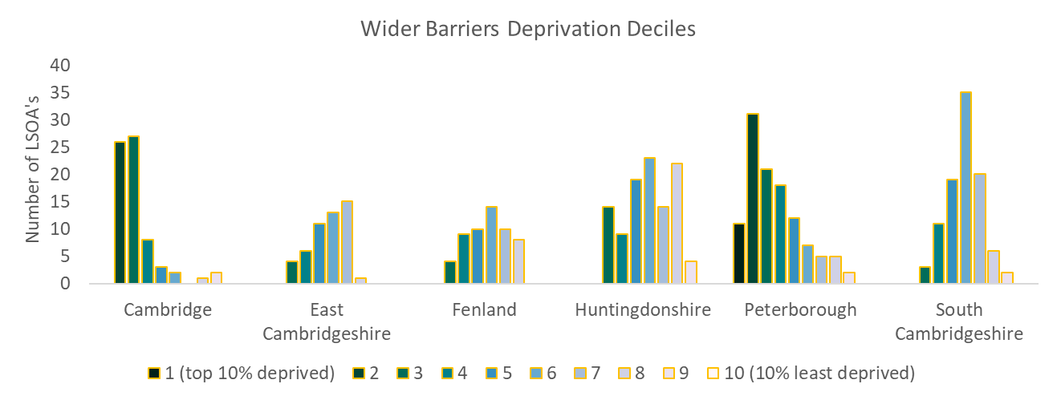
IMD Housing Barriers
District | Wider Barriers (Housing) Average LSOA Decile (1 = 10% most deprived, 10 = 10% least deprived) | Percentage of LSOA’s in the top 30% most deprived for Wider Barriers (Housing)
Cambridge | 3 | 76.8%
East Cambridgeshire | 6 | 8.0%
Fenland | 6 | 7.3%
Huntingdonshire | 6 | 13.3%
South Cambridgeshire | 6 | 3.1%
Peterborough | 4 | 56.3%
The ‘wider barriers’ sub-domain is based on household overcrowding, homelessness and housing affordability.
Cambridge and Peterborough have the highest levels of deprivation on this sub-domain.
Just over three quarters of Cambridge LSOA’s (77%) are in the top 30% most deprived nationally.
Over half of Peterborough LSOA’s (56%) are in the top 30% most deprived nationally.
Notes:
Source: national relative deprivation data published 26 September 2019: https://www.gov.uk/government/statistics/english-indices-of-deprivation-2019

Slide 18
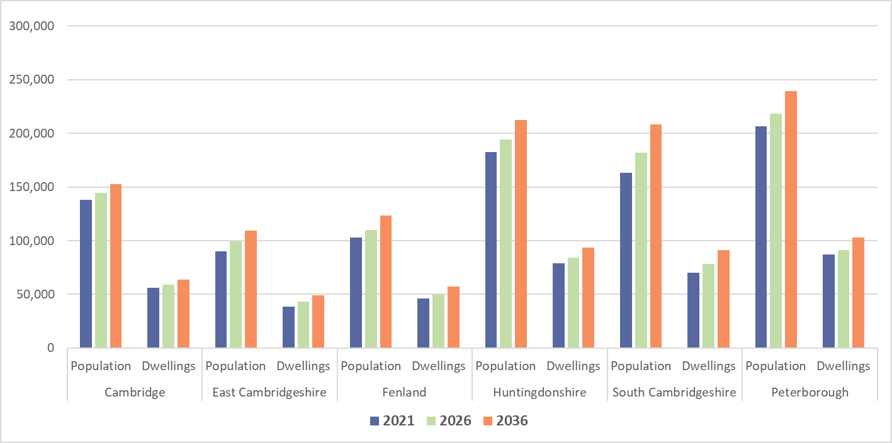
Population and housing growth forecasts
The population forecasts show that South Cambridgeshire and East Cambridgeshire are predicted to have the highest proportionate population growth between 2021 and 2026 with both seeing increase of 11%.
The latest population statistics released from the initial 2021 census results show higher 2021 population levels for Cambridge (145,700 compared to 137,950) and Peterborough (215,700 compared to 206,710). As such, the forecasts for these districts are likely to be revised to higher levels.
Cambridgeshire County Council’s 2020 based population and dwelling forecasts
Notes:
Source: Cambridgeshire County Council's 2020-based population and dwelling forecasts 2020-2041, compiled by the Cambridgeshire Research Group.

Slide 19
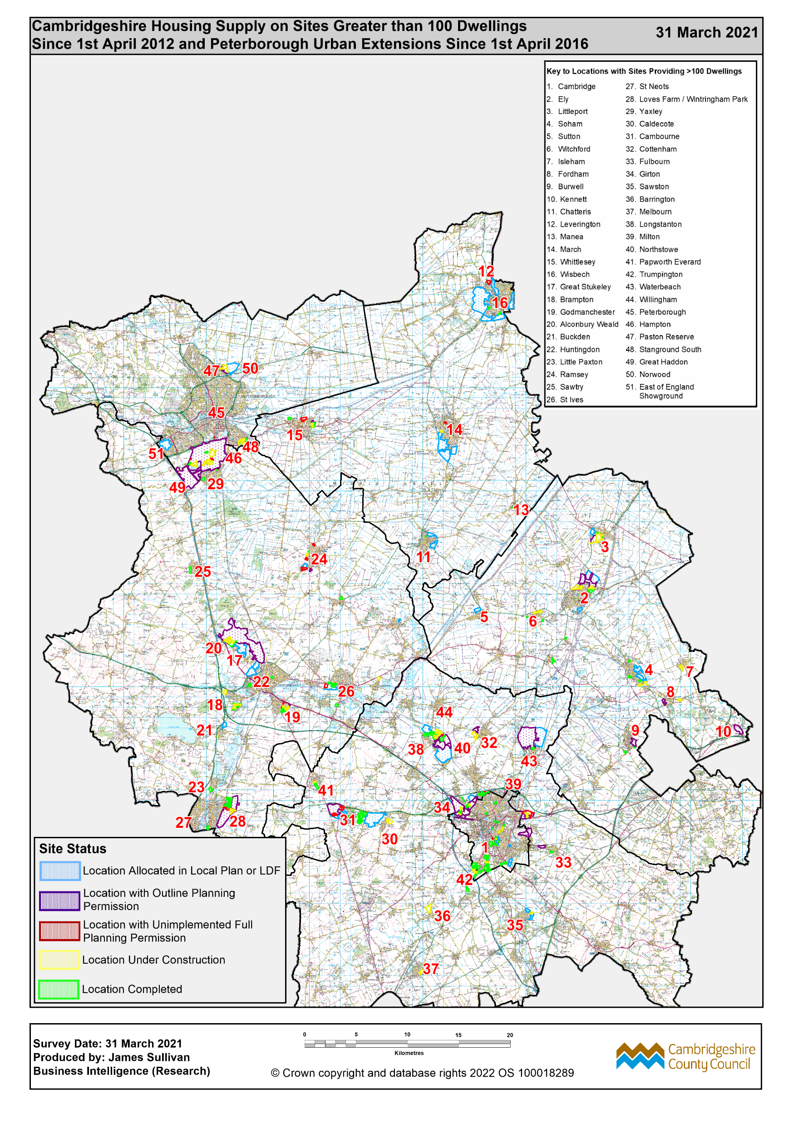
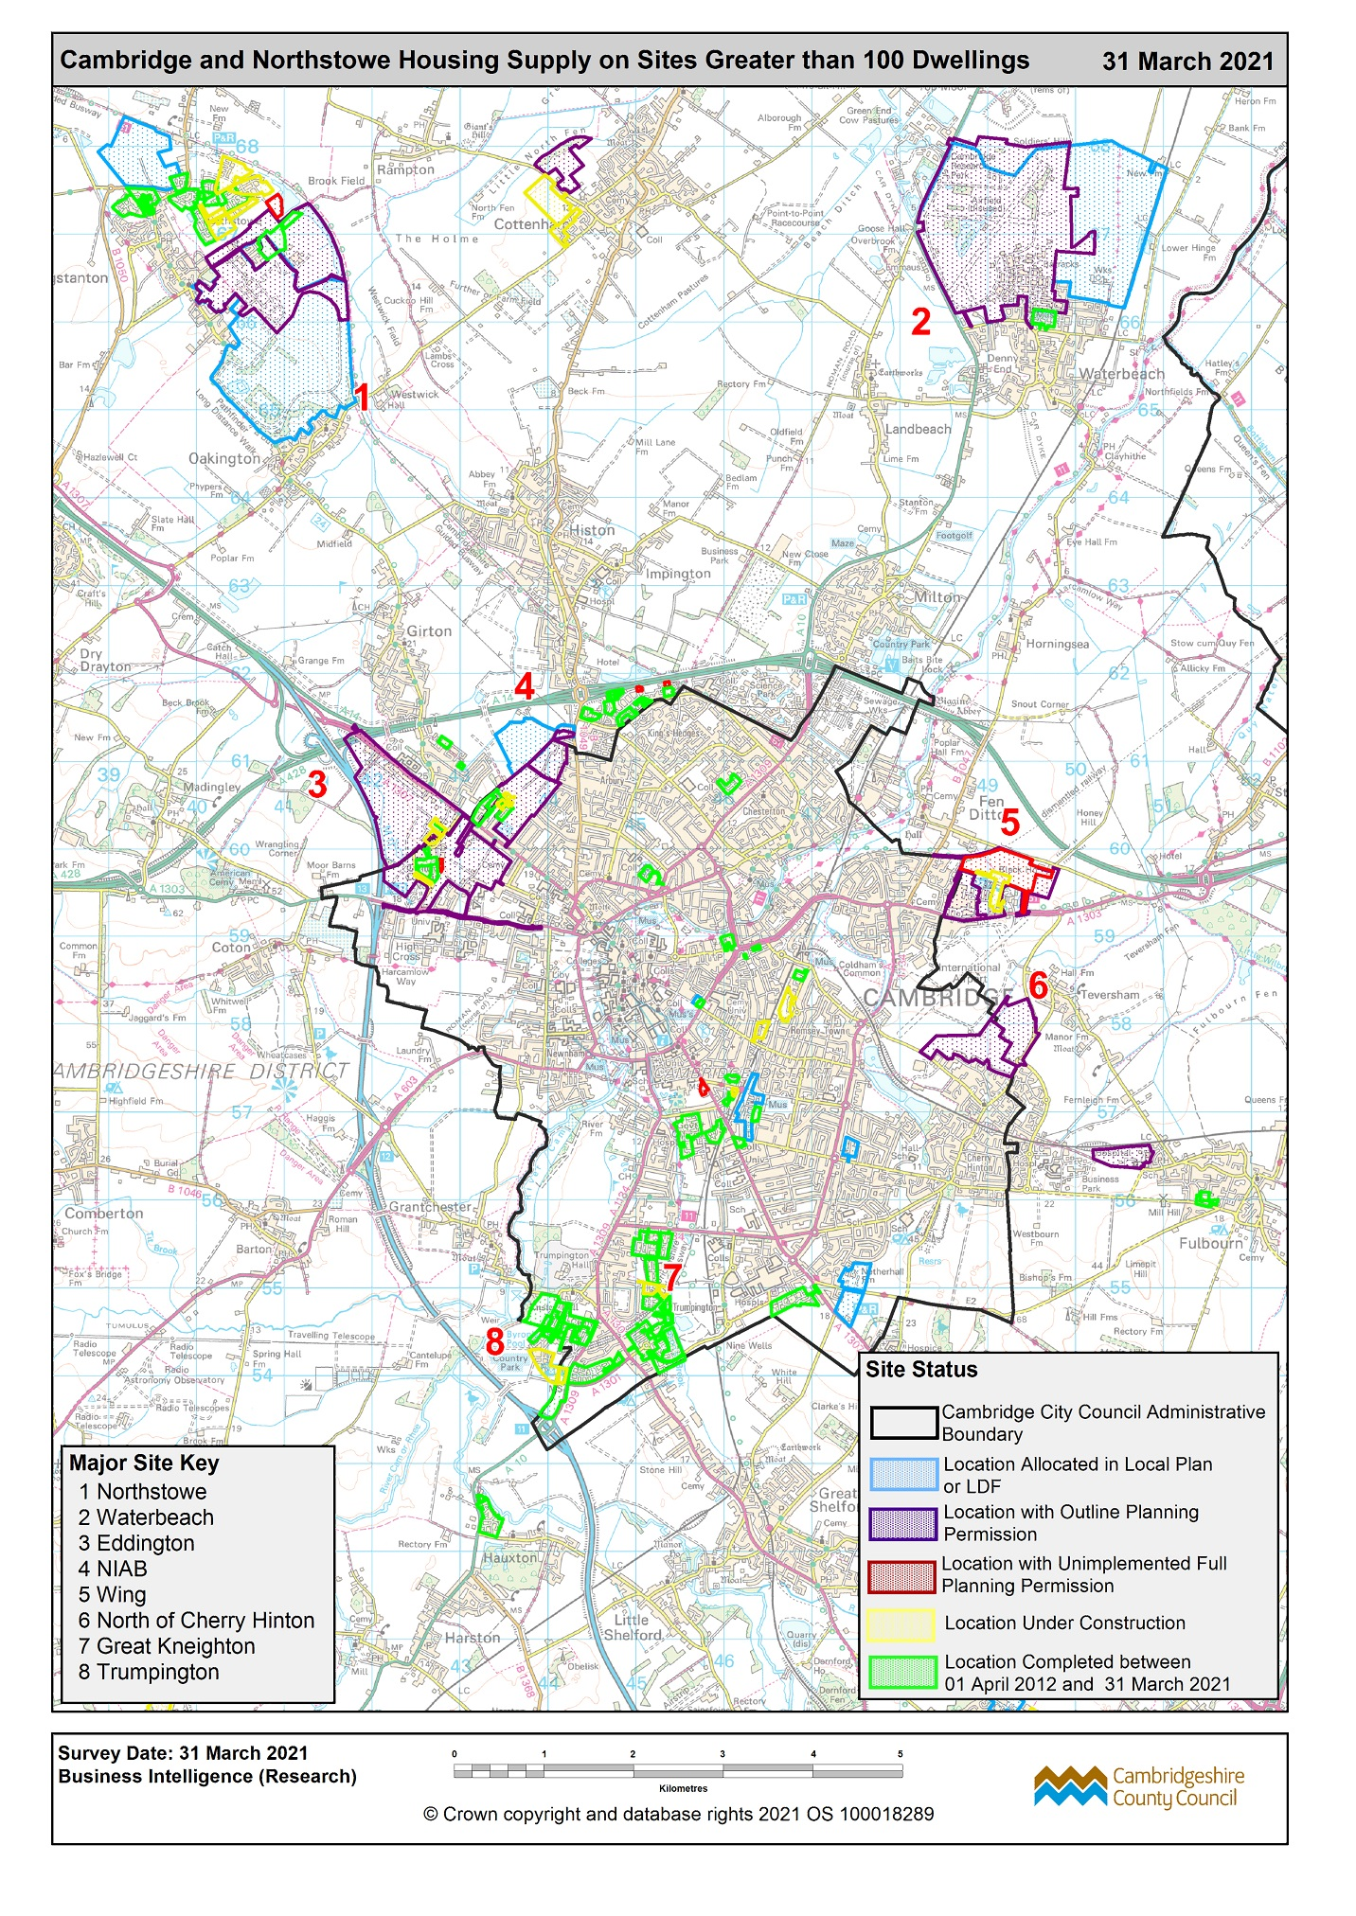
Areas of major housing development
Notes:
Source: Cambridgeshire County Council Housing Development survey data on sites with over 100 dwellings. Produced by the Cambridgeshire County Council Research Team.

Slide 20
House Prices
The average house price in England in April 2022 was £291,644. Peterborough and Fenland are the only districts in Cambridgeshire and Peterborough that have average house prices below this national average.
Cambridge has the highest average property price at over £500,000, 48% above East of England average.
South Cambridgeshire has the second highest average property price at over £450,000, 33% above the East of England average.
 | Average property price April 2022
Cambridge | £508,914
East Cambridgeshire | £338,596
Fenland | £234,461
Huntingdonshire | £306,851
South Cambridgeshire | £456,952
Peterborough | £230,416
East of England | £344,434
England | £291,644
Source: HM Land Registry, UK House Price Index April 2022
https://www.gov.uk/government/statistical-data-sets/uk-house-price-index-data-downloads-april-2022#contents

Slide 21
District Summary
District | Theme | Key Findings
Cambridge | Journey times Job vacancies School capacity Community safety Housing barriers (IMD) Property prices | The shortest average minimum journey time to key services by public transport/walking at under 15 minutes The highest number of average monthly job postings for occupations on the Shortage Occupation List Homes for Ukraine is placing additional pressures on school places, with demand outstretching capacity in Cambridge City Highest rate of crime, ASB and hate crimes per 1,000 population in Cambridgeshire & Peterborough Highest level of deprivation on the IMD housing barrier sub-domain with 77% of LSOA’s in the top 30% most deprived nationally. Cambridge has the highest average property price at over £500,000, 48% above the East of England average.
East Cambridgeshire | Journey times Population growth | The longest average minimum journey time to key services via public transport/ walking at 32 minutes. The second highest proportion of LSOAs with an average minimum journey time to the nearest primary school of longer than 20 minutes by public transport/walking (8%) The highest predicted proportional population growth between 2021 and 2026, along with South Cambridgeshire (+11%).
Fenland | Property prices | Fenland and Peterborough are the only districts in Cambridgeshire and Peterborough with house prices below the national average.

Slide 22
District Summary
District | Theme | Key Findings
Huntingdonshire | Housing development Journey times | Huntingdonshire and South Cambridgeshire have the most areas of major housing development (2021) The highest proportion of LSOAs with an average minimum journey time by public transport/walking of over 20 minutes to the nearest primary school (9%) and second highest proportion with a minimum journey time of over 30 minutes to the nearest secondary school (38%).
South Cambridgeshire | Housing development Homes for Ukraine School capacity Journey times Population growth Property prices | South Cambridgeshire and Huntingdonshire have the most areas of major housing development (2021) The highest proportion of guests under the Homes for Ukraine scheme, accounting for 37% of all guests in Cambridgeshire and Peterborough. The highest proportion of oversubscribed primary schools (15%) and secondary schools (20%). Additional pressures on school places resulting from Homes for Ukraine means demand is currently outstretching capacity in South Cambridgeshire. Higher proportion of LSOAs with longer average journey times by public transport/walking: 41% longer than 30 minutes to the nearest secondary school 25% longer than 30 minutes to the nearest GP. The highest predicted proportional population growth between 2021 and 2026 along with East Cambridgeshire (+11%). The second highest average property price at over £450,000, 33% above the East of England average.

Slide 23
District Summary
District | Theme | Key Findings
Peterborough | Journey times House prices School capacity Community Safety Housing Barriers (IMD) | The second shortest average minimum journey time to key services by public transport/walking at under 20 minutes Peterborough and Fenland are the only districts in Cambridgeshire and Peterborough with house prices below the national average. The majority of primary schools in Peterborough (71%) had 10% or less capacity in 2021. The second highest rate of crime, and hate crimes per 1,000 population and joint highest ASB rate in Cambridgeshire & Peterborough Second highest level of deprivation on the IMD housing barrier sub-domain with 56% of LSOA’s in the top 30% most deprived nationally.

