Slide 1
Census 2021: demography and migration topic summary Overview for Cambridgeshire and Peterborough
Research Team, Business Intelligence
3rd November 2022
Research.group@cambridgeshire.gov.uk

Slide 2
Themes covered
A first overview of some of the local authority level Cambridgeshire and Peterborough data from the Demography and Migration topic summary published by the Office for National Statistics (ONS)
By local authority:
Usual resident population by single year of age
Occupied household and communal establishment populations
Average household sizes
Usual resident population by country of birth
Length of residence in UK
The release of data helps us to begin to understand any potential impacts of Covid-19 on the Census 2021 results for Cambridgeshire and Peterborough

Slide 3
Definitions
Usual resident population
Anyone in the UK and had stayed or intended to stay in the UK for a period of 12 months or more; or
Had a permanent UK address and was outside the UK and intended to be outside the UK for less than 12 months.
Occupied households
One person living alone; or
A group of people (not necessarily related) living at the same address, who share cooking facilities and share a living room or sitting room or dining area
Must contain at least one usual resident
Communal establishment population
Usual residents living in establishments which provide managed residential accommodation, such as care homes, student halls of residence

Slide 4
Overview: total usual resident population by age
The size of the very young population (0-3 years) is smaller at Census 2021 than at Census 2011 for Cambridgeshire and Peterborough
The Census 2021 school aged population (4-15 years) is much larger than at Census 2011 for all districts:
Ranging from an increase of 2.7% (Huntingdonshire) to 13.4% (South Cambridgeshire) in the more rural districts
In Cambridge the school aged population is 27.9% larger and in Peterborough 32.4% larger
In the rural districts, the over 65 years population has grown a lot more than the working age population
Working age population (16-64 years) has increased by 0.1% (East Cambridgeshire) to 4.1% (South Cambridgeshire)
65 years and over populations have increased by at least 21.1% (Fenland)
Cambridge and Peterborough:
Population growth since Census 2011 is more evenly spread across all age groups
Working age populations (16-64 years) have increased by 18.3% and 14.5% respectively

Slide 5
Overview: household populations and average household sizes
The size of the population living in households has increased across all local authorities in Cambridgeshire and Peterborough compared to Census 2011
Census 2021 average household sizes:
for England are unchanged compared to Census 2011,
have reduced in the more rural local authorities of Cambridgeshire,
have increased in the urban centres of Cambridge and Peterborough (where populations compared to Census 2011 are significantly higher)

Slide 6
Overview: average household sizes
District | Census 2011 household population | Census 2011 number of households | Census 2011 average household size (number of residents per household) | Census 2021 household population | Census 2021 number of households | Census 2021 average household size (number of residents per household) | Change in average household size, Census 2011 to Census 2021
Cambridge | 107,345 | 46,714 | 2.30 | 126,382 | 52,472 | 2.41 | 0.11
East Cambridgeshire | 83,056 | 34,614 | 2.40 | 87,000 | 37,203 | 2.34 | -0.06
Fenland | 93,934 | 40,620 | 2.31 | 101,057 | 44,083 | 2.29 | -0.02
Huntingdonshire | 166,952 | 69,333 | 2.41 | 178,376 | 76,880 | 2.32 | -0.09
South Cambridgeshire | 146,779 | 59,960 | 2.45 | 160,792 | 66,996 | 2.40 | -0.05
Cambridgeshire | 598,066 | 251,241 | 2.38 | 653,607 | 277,634 | 2.35 | -0.03
Peterborough | 181,827 | 74,023 | 2.46 | 213,464 | 84,533 | 2.53 | 0.07

Slide 7
Overview: household size by number of occupants
Numbers of households with one occupant have increased in all districts, and notably in East Cambridgeshire, Huntingdonshire and South Cambridgeshire
In Cambridge the increase is much smaller
In Cambridge, Huntingdonshire and South Cambridgeshire there have been notable rises in the number of households with 2 and 3 occupants
There has been an increase in the number of households with 5 or more occupants in Peterborough, and to a lesser extent in Cambridge

Slide 8
Overview: communal establishment populations
Overall the proportions of the population living in households and those living in communal establishments are little changed from Census 2011 across the districts
Apart from Cambridge and South Cambridgeshire there have only been small changes in numbers living in communal establishments
Cambridge - increased by almost 3 thousand
South Cambridgeshire - fell by 650
There is no further breakdown by communal establishment type yet, but these changes are likely to be related to student populations

Slide 9
Overview: population by country of birth
International migration has continued to shape the populations of Cambridgeshire and Peterborough
Numbers of usual residents born outside the UK have increased by 7.6% to 8.6% in Cambridge and Peterborough
In Cambridge population born outside the UK represents 38.0% of the total population compared to 29.4% at Census 2011
In Peterborough population born outside the UK represents 28.2% of the total population compared to 20.6% at Census 2011
In other Cambridgeshire districts the numbers of usual residents born outside the UK have increased by 2.0% to 5.0%
Data on length of residence suggests that international in-migration to Cambridge has continued to be high in the last 2 years

Slide 10
Overview: top 5 countries of birth by local authority
Top 5 countries of birth by number of residents, excluding UK
Cambridge | East Cambridgeshire | Fenland | Huntingdonshire | South Cambridgeshire | Peterborough
India | Poland | Lithuania | Poland | India | Poland
China | United States | Poland | United States | Poland | Lithuania
United States | Romania | Romania | Romania | United States | Pakistan
Italy | Germany | Germany | Germany | South Africa | India
Poland | South Africa | Portugal | India | Germany | Romania

Slide 11
Cambridge

Slide 12
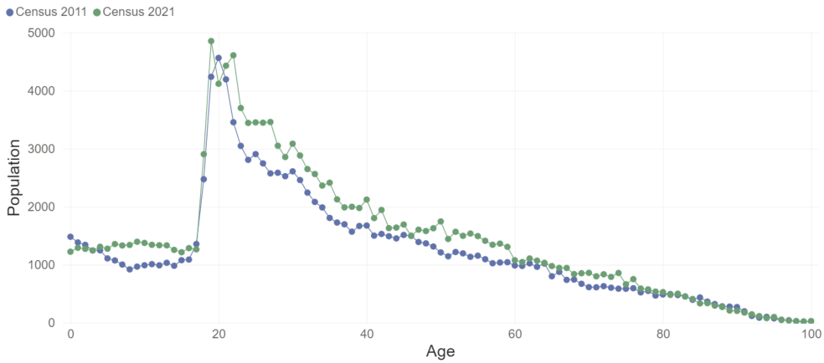
Cambridge: population by single year of age

Slide 13
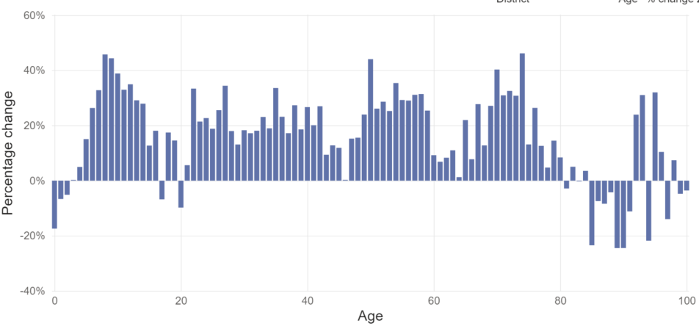
Cambridge: percentage change in population Census 2011 to 2021 by age

Slide 14
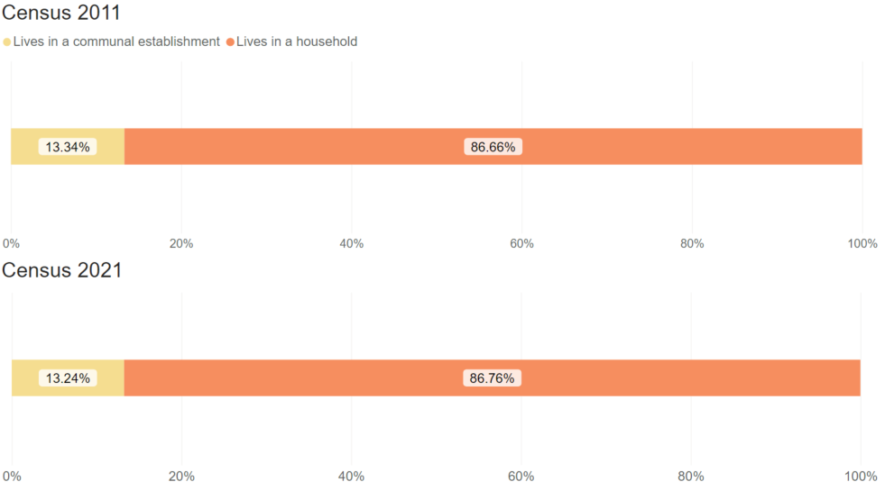
Cambridge: per cent of population by residence type

Slide 15
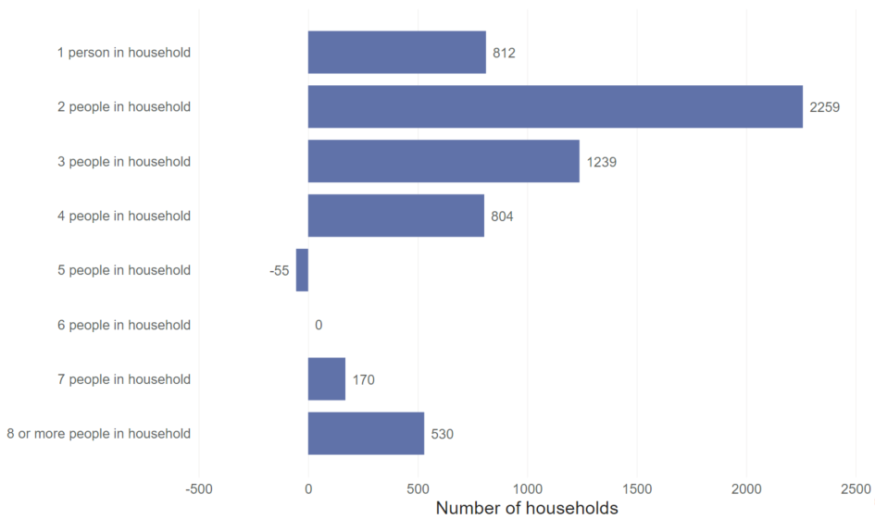
Cambridge: net change in households by size, 2011 to 2021

Slide 16
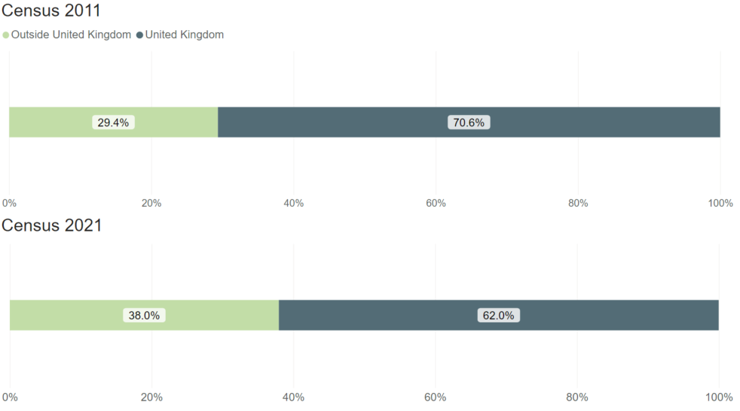
Cambridge: per cent of population by country of birth

Slide 17
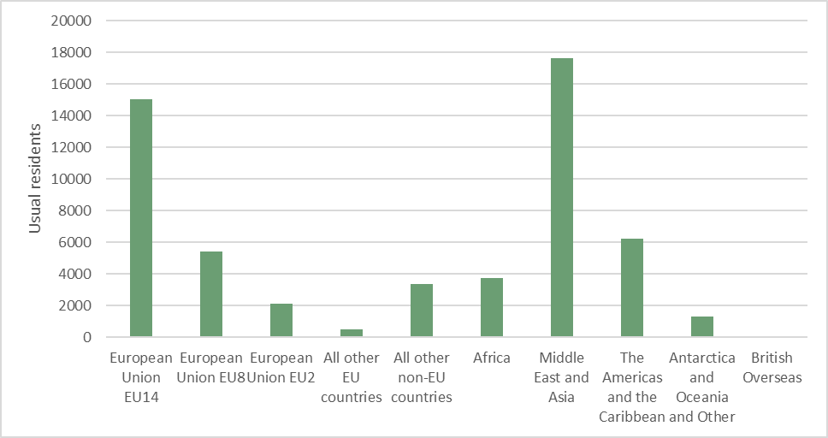
Cambridge: population by country of birth, non UK

Slide 18
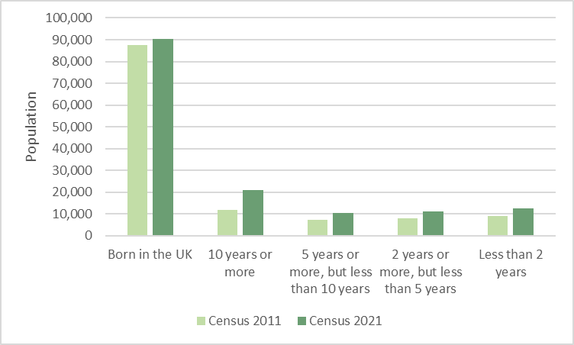
Cambridge: length of residence in UK

Slide 19
East Cambridgeshire

Slide 20
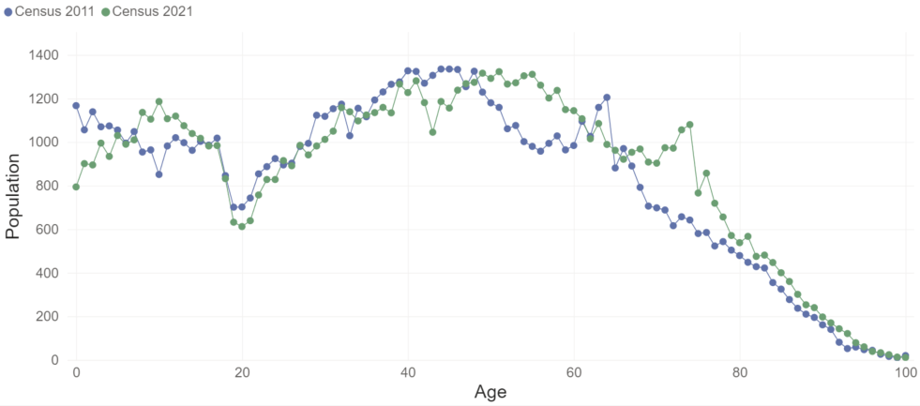
East Cambridgeshire: population by single year of age

Slide 21
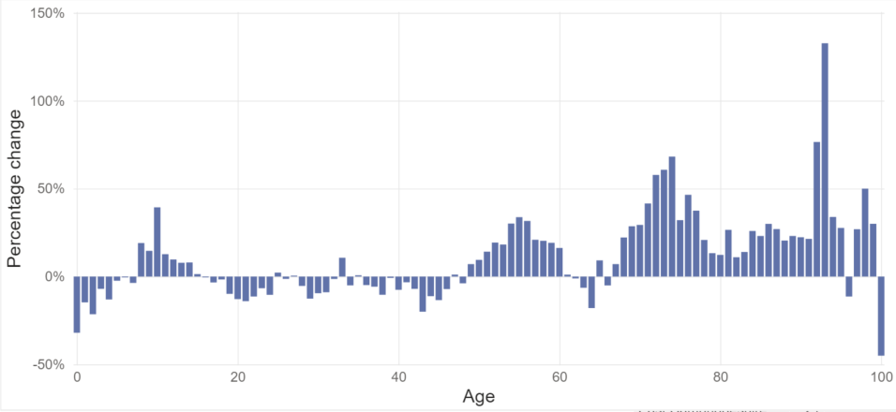
East Cambridgeshire: percentage change in population Census 2011 to 2021 by age

Slide 22
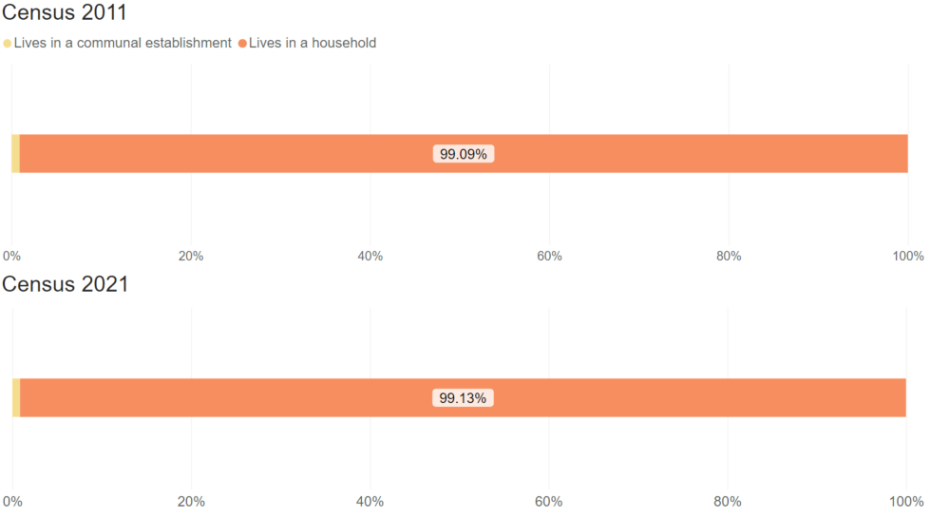
East Cambridgeshire: per cent of population by residence type

Slide 23
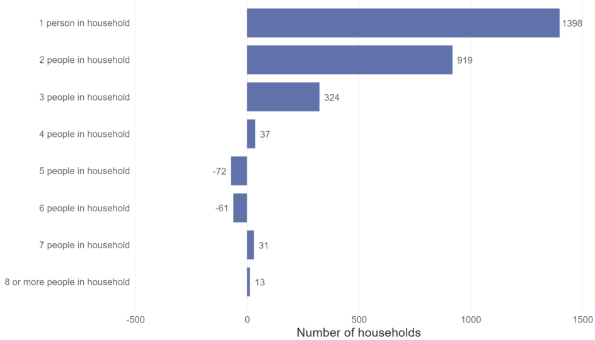
East Cambridgeshire: net change in households by size, 2011 to 2021

Slide 24
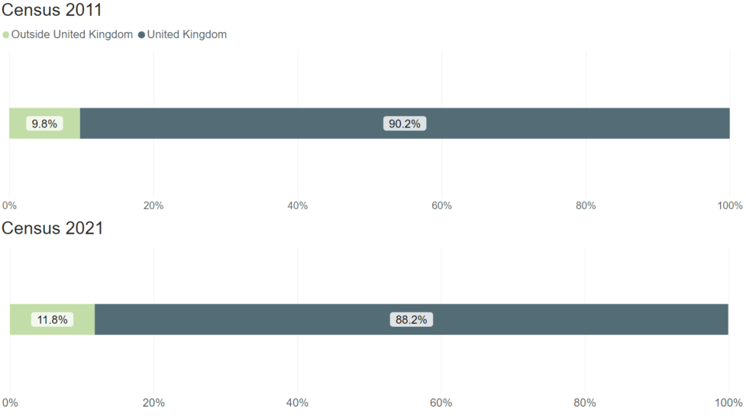
East Cambridgeshire: per cent of population by country of birth

Slide 25
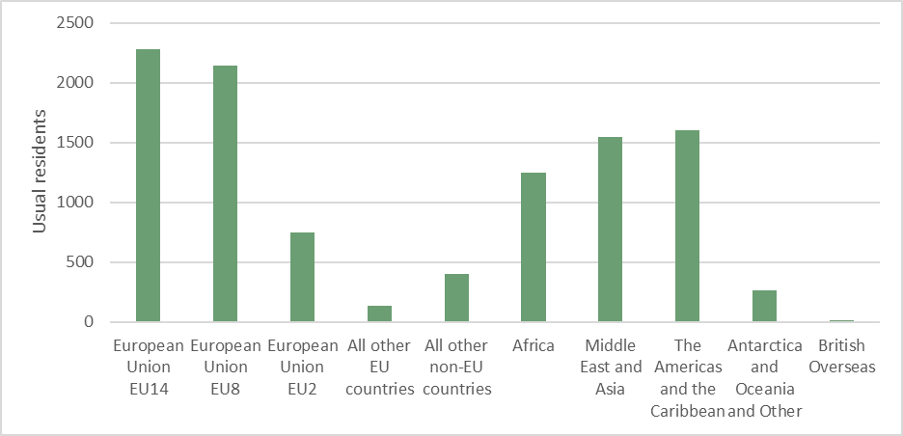
East Cambridgeshire: population by country of birth, non UK

Slide 26
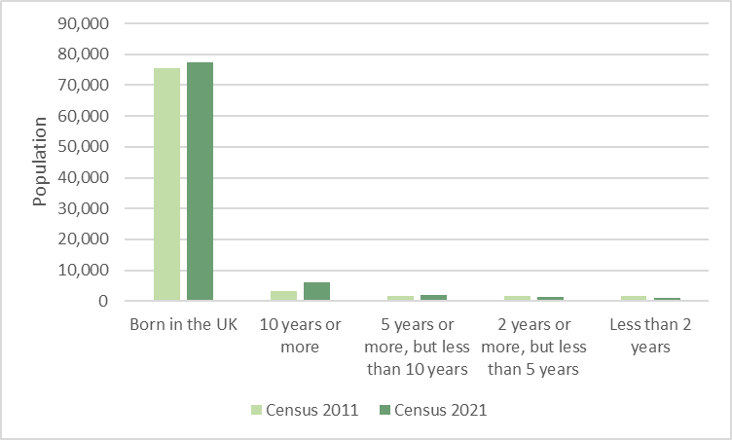
East Cambridgeshire: length of residence in UK

Slide 27
Fenland

Slide 28
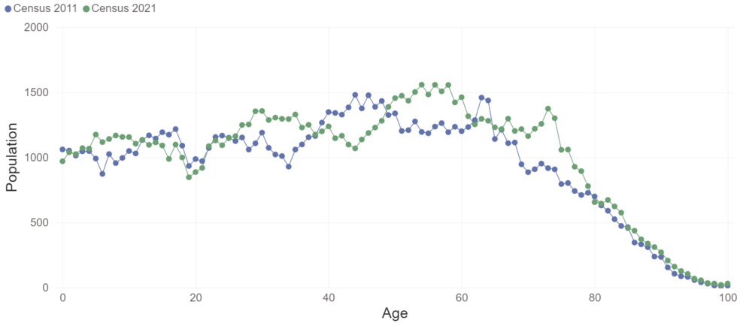
Fenland: population by single year of age

Slide 29
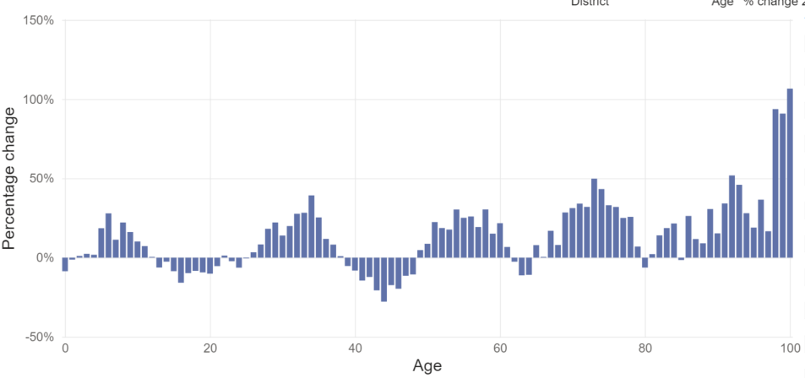
Fenland: percentage change in population Census 2011 to 2021 by age

Slide 30
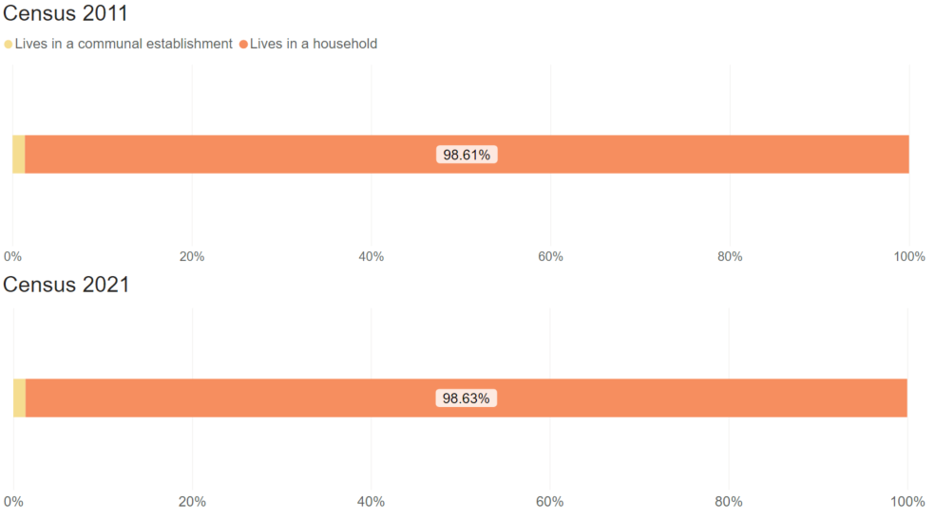
Fenland: per cent of populations by residence type

Slide 31
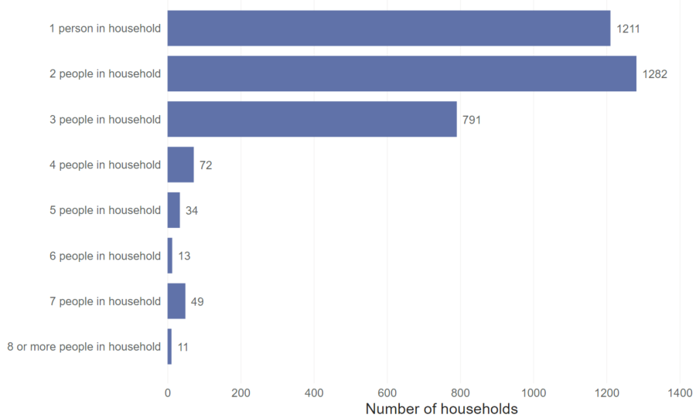
Fenland: net change in households by size, 2011 to 2021

Slide 32
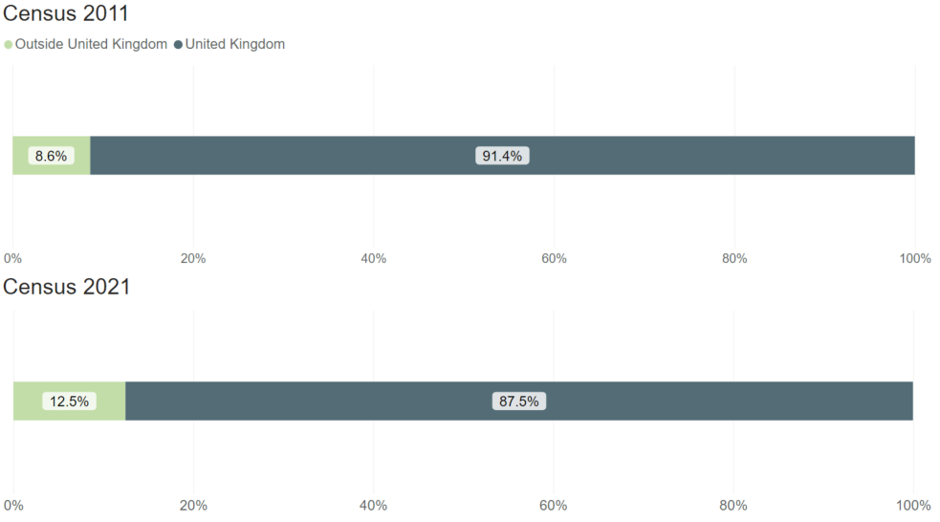
Fenland: per cent of population by country of birth

Slide 33
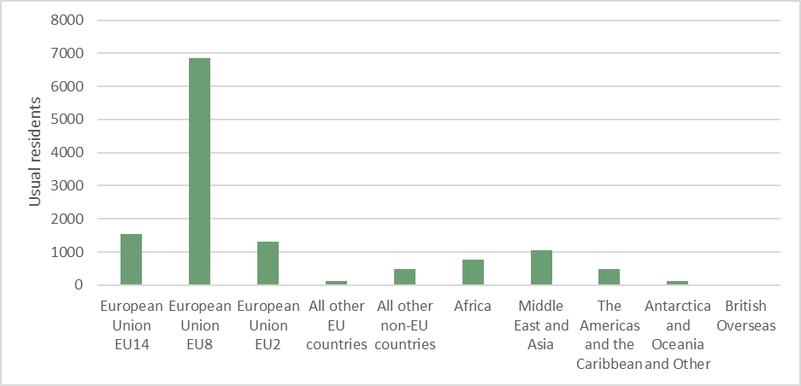
Fenland: population by country of birth, non UK

Slide 34
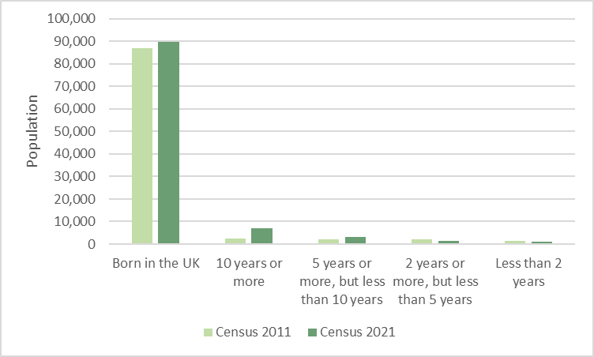
Fenland: length of residence in UK

Slide 35
Huntingdonshire

Slide 36
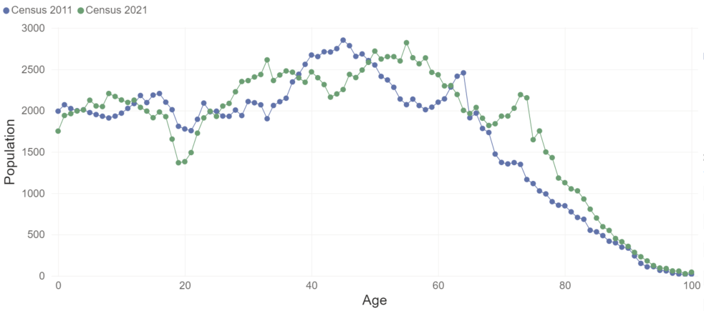
Huntingdonshire: population by single year of age

Slide 37
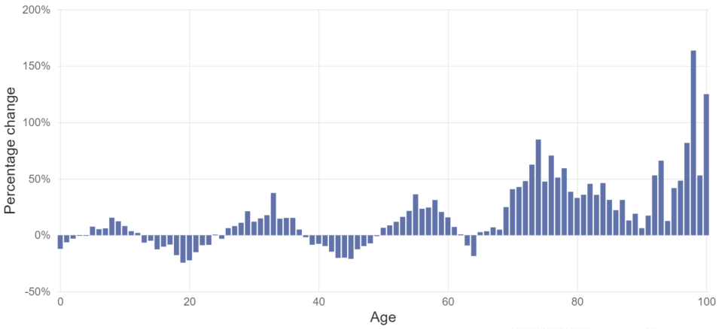
Huntingdonshire: percentage change in population Census 2011 to 2021 by age

Slide 38
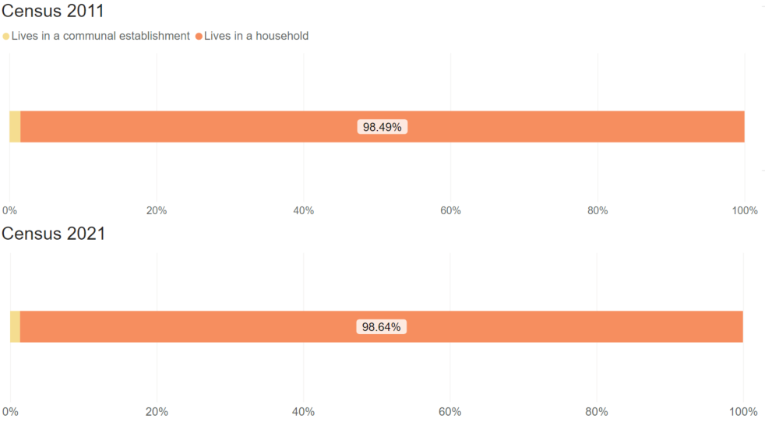
Huntingdonshire: per cent of population by residence type

Slide 39
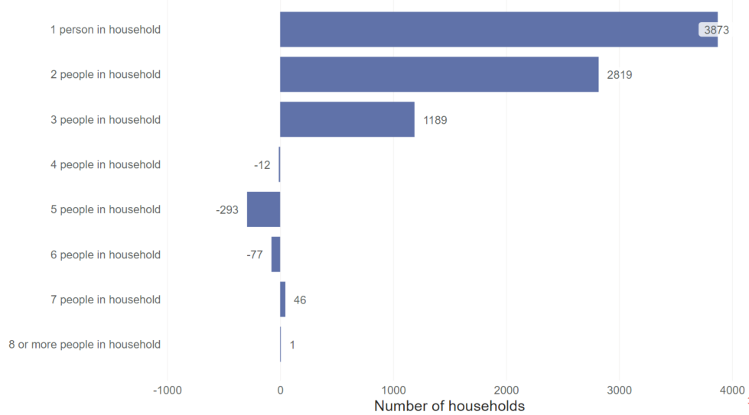
Huntingdonshire: net change in households by size, 2011 to 2021

Slide 40
Huntingdonshire: per cent of population by country of birth

Slide 41
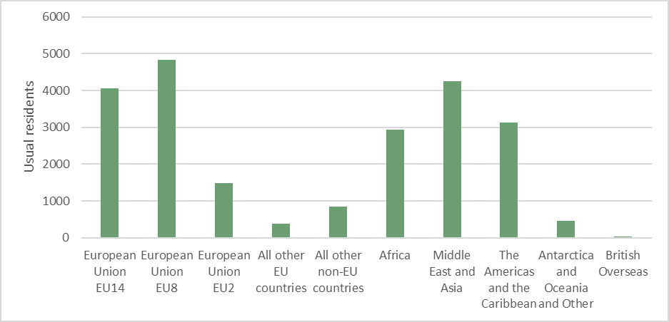
Huntingdonshire: population by country of birth, non UK

Slide 42
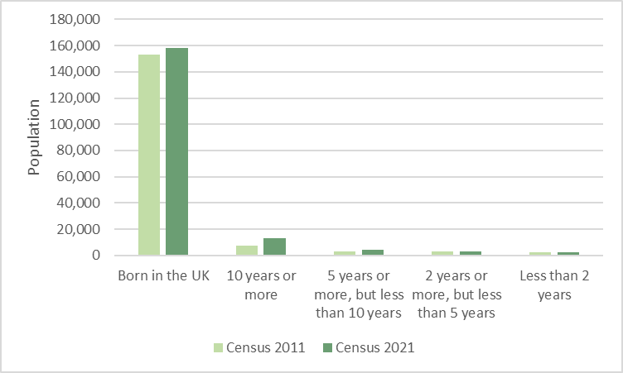
Huntingdonshire: length of residence in UK

Slide 43
South Cambridgeshire

Slide 44
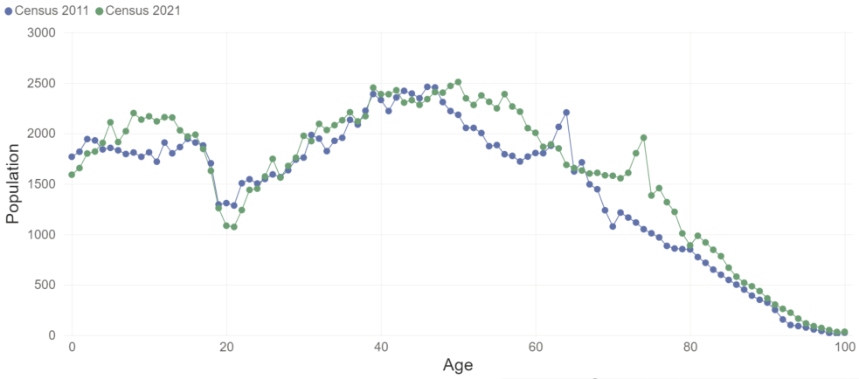
South Cambridgeshire: population by single year of age

Slide 45
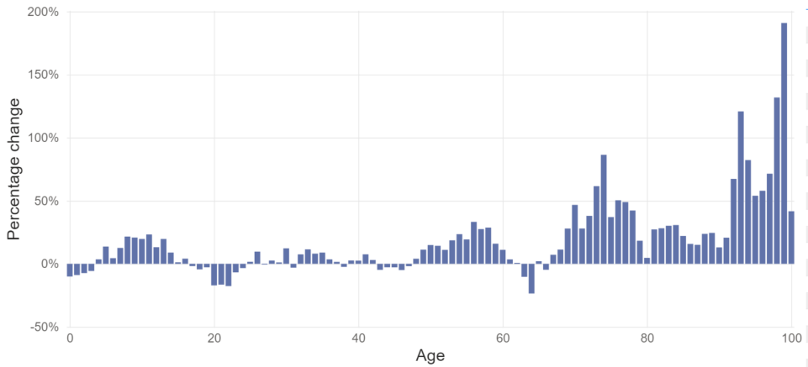
South Cambridgeshire: percentage change in population Census 2011 to 2021 by age

Slide 46
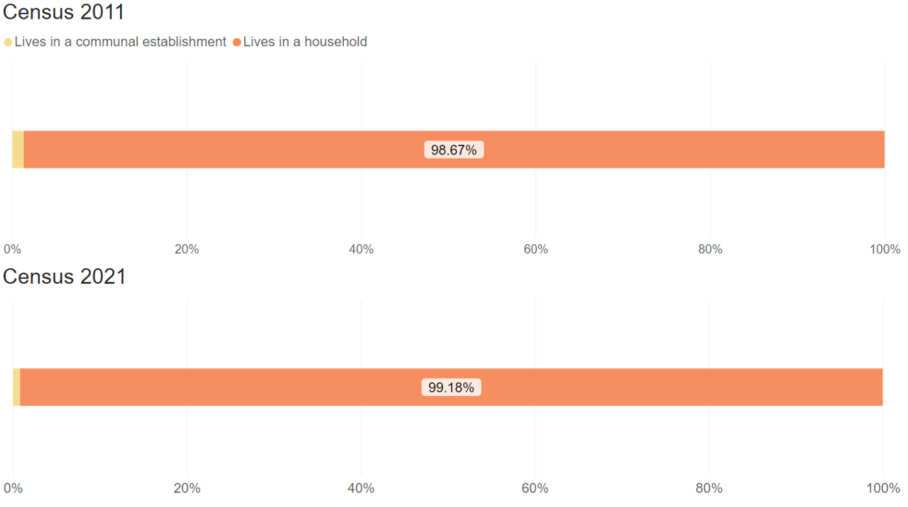
South Cambridgeshire: per cent of population by residence type

Slide 47
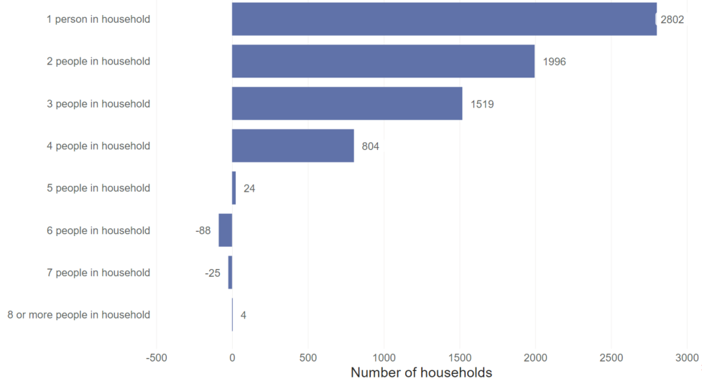
South Cambridgeshire: net change in households by size, 2011 to 2021

Slide 48
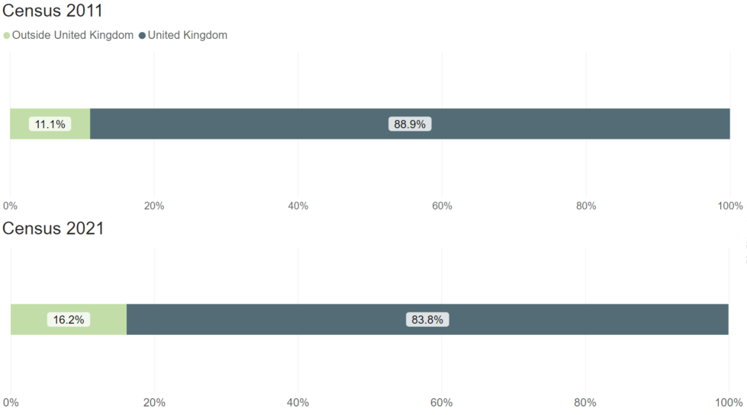
South Cambridgeshire: per cent of population by country of birth

Slide 49
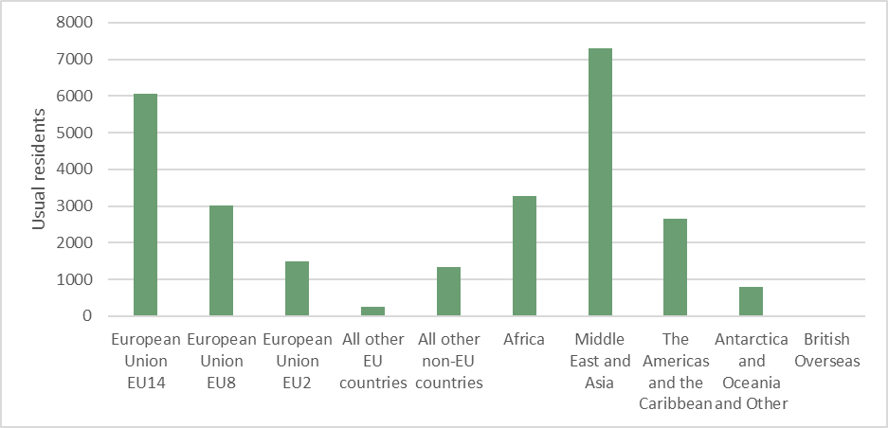
South Cambridgeshire: population by country of birth, non UK

Slide 50
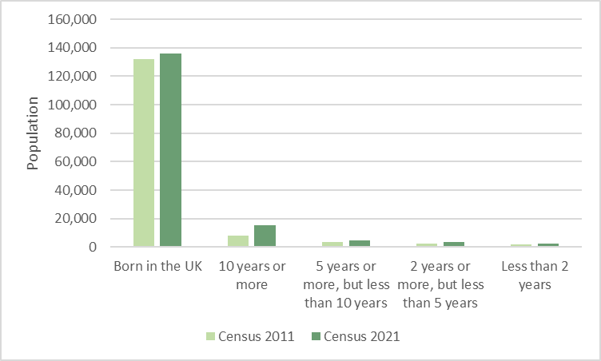
South Cambridgeshire: length of residence in UK

Slide 51
Peterborough

Slide 52
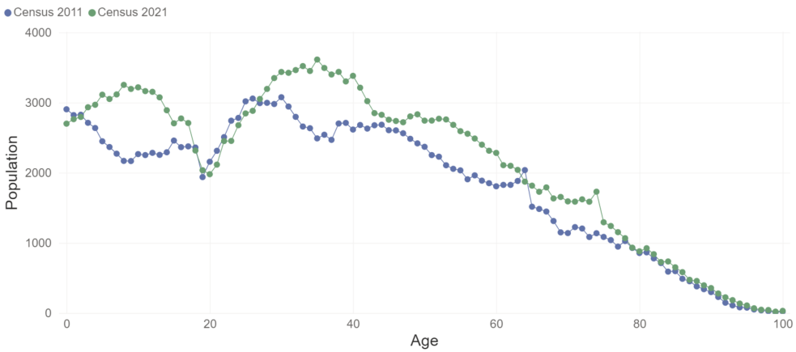
Peterborough: population by single year of age

Slide 53
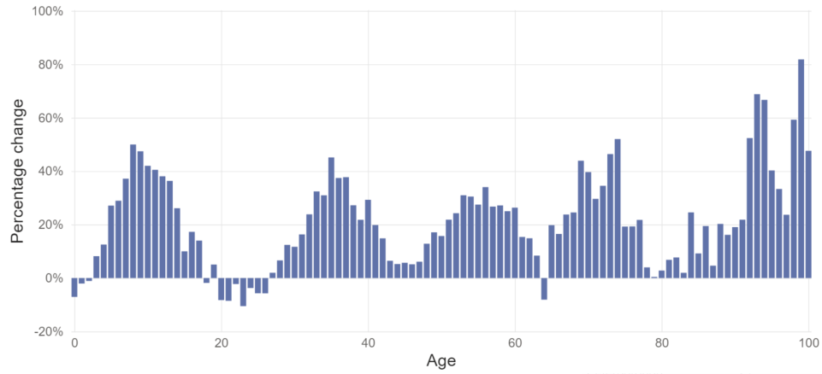
Peterborough: percentage change in population Census 2011 to 2021 by age

Slide 54
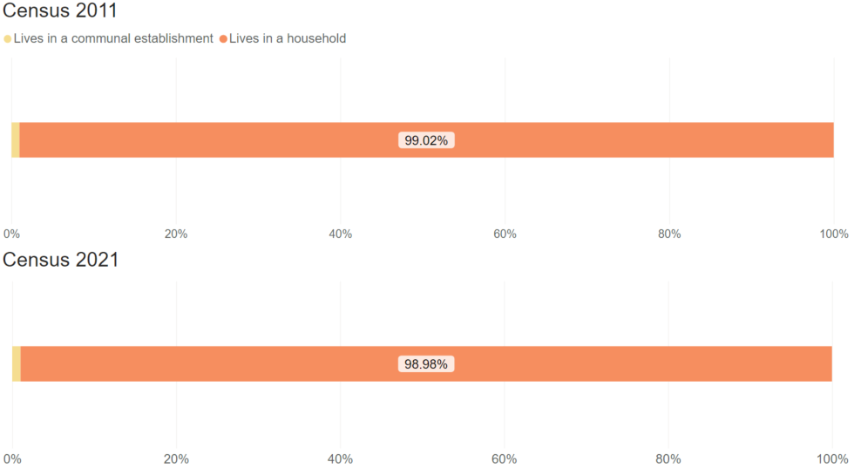
Peterborough: per cent of population by residence type

Slide 55
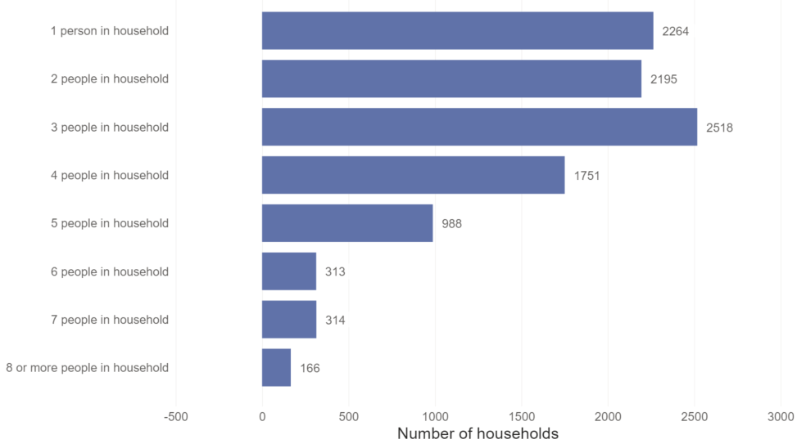
Peterborough: net change in households by size, 2011 to 2021

Slide 56
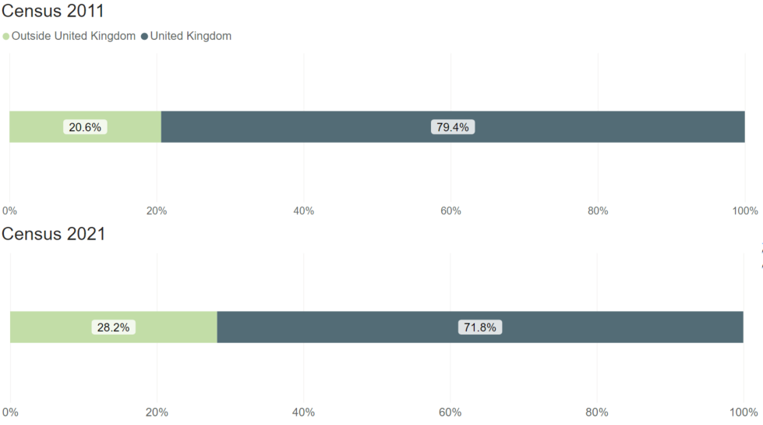
Peterborough: per cent of population by country of birth

Slide 57
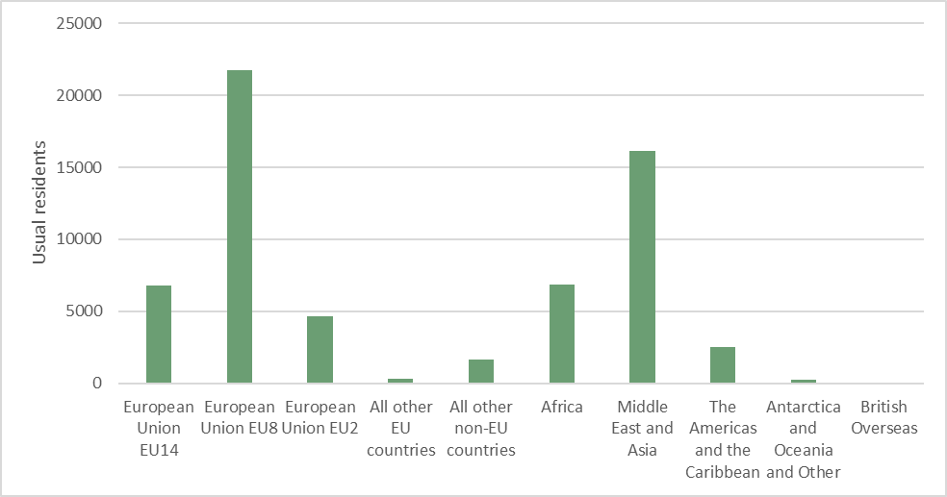
Peterborough: population by country of birth, non UK

Slide 58
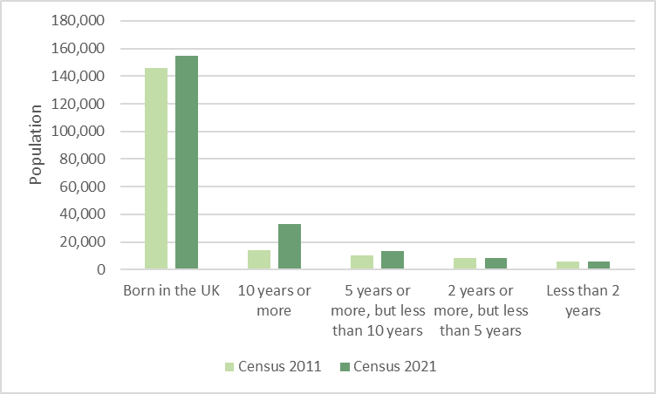
Peterborough: length of residence in UK

Slide 59
When is the next release of data by the ONS?
8 topic summaries and area profiles, releasing between November 2022 and January 2023:
Demography and migration – 2nd November 2022 (published)
UK armed forces veterans – 10th November 2022 (confirmed)
Ethnic group, national identity, language and religion – 29th November 2022 (provisional)
Labour market and travel to work – 8th December 2022 (provisional)
Housing – 5th January 2023 (provisional)
Sexual orientation and gender identity – 6th January 2023 (provisional)
Education – 10th January 2023 (provisional)
Health, disability, and unpaid care – 19th January 2023 (provisional)
Phase 2, early 2023 – multivariate data
Phase 3, Spring 2023 - data related to alternative population bases, small population data, origin destination data and micro-data

Slide 60
Useful links
Demography and Migration topic summary published by the Office for National Statistics (ONS) Demography and migration data, England and Wales - Office for National Statistics (ons.gov.uk)
ONS mapping tool ONS Census maps
Cambridgeshire Insight: Census 2021 updates and Cambridgeshire Insight Census 2021
Census 2021 data in the tools available on Cambridgeshire Insight, such as the Map Explorer and Interactive Reports
Further analysis and ward level estimates, where possible at this stage, are being progressed and will be published on Cambridgeshire Insight
Census data published by the ONS is also available on the Nomis website Dataset Selection - Query - Nomis - Official Census and Labour Market Statistics (nomisweb.co.uk)

