Slide 1
Resources: Changing Futures C&P team outline
Changing Future Cambridgeshire & Peterborough governance
Team manager
Learning & Development Manager
Systems Change Manager
Co-production & Lived Exp. Manager
Trusted Persons Network Manager
Programme Manager
Communications Manager
Office manager incl
data / digital support
Lived Experience Facilitator
Trusted Persons Coordinator x 3
Community systems change leaders
People with Lived Experience
Trusted Persons
Key
FTE = full time equivalent
People with Multiple Disadvantage
Funded using CP C&F budget
Exist within system – possible need for a small resource
Notes:
Tom
Funding for full team, approx. one third in place, scaling up to full team ~end March 2023 – recruitment process for Fenland & ECDC - building a new operational partnership there – what interim role will be tasked with over 3 months

Slide 2
Coproduction Hubs
Cambridge & South
Priorities
Ensure everyone has access to support when accommodated when it is needed
A more trauma informed criminal justice system
A positive experience when seeking support for homelessness
Ability to be digitally included
Improved access to healthcare
2. Peterborough
Collaboration with Aspire, Outside Links and Garden House
3. Wisbech
Collaboration with The Ferry Project
4. Ely
Collaboration with the Lighthouse
5. Huntingdon

Slide 3
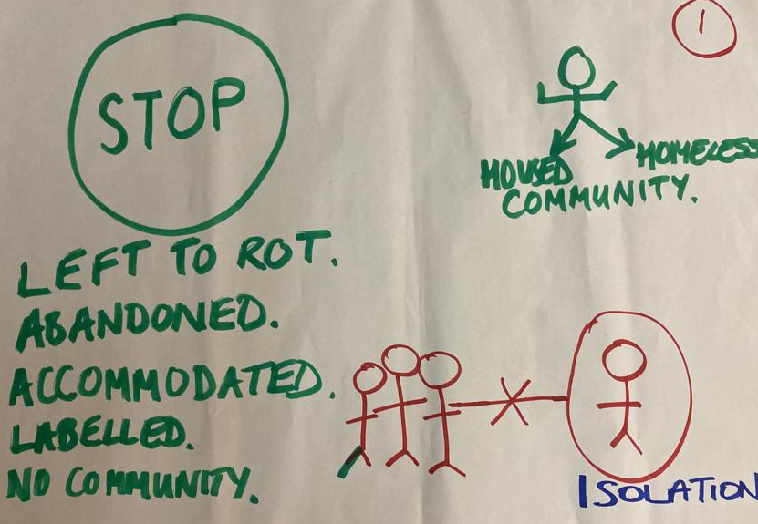
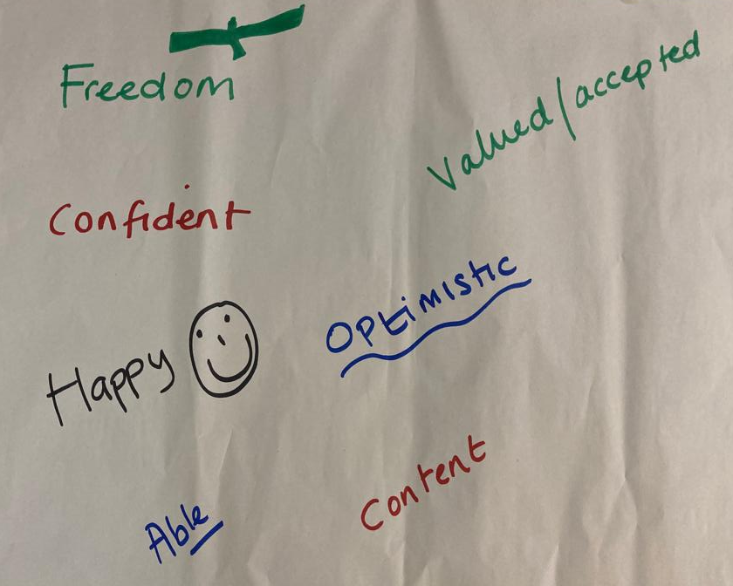
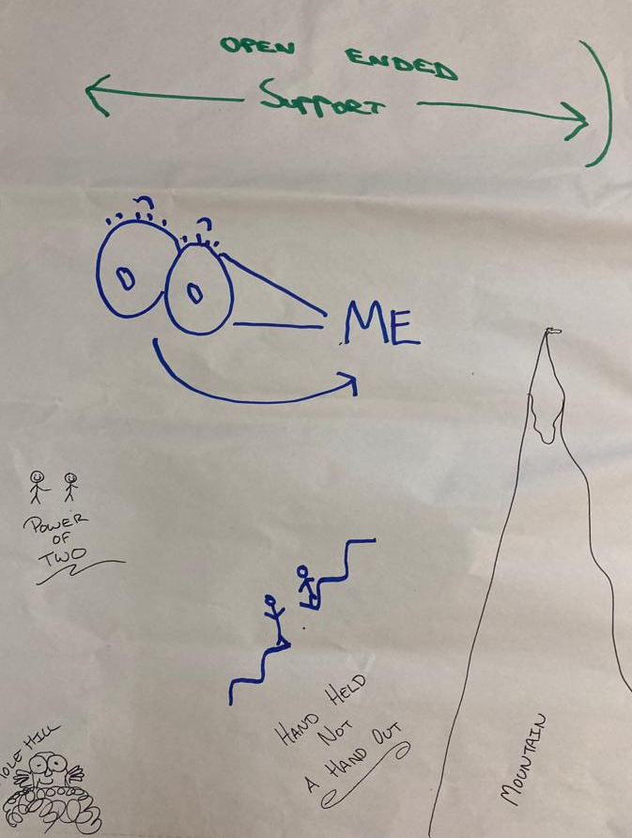
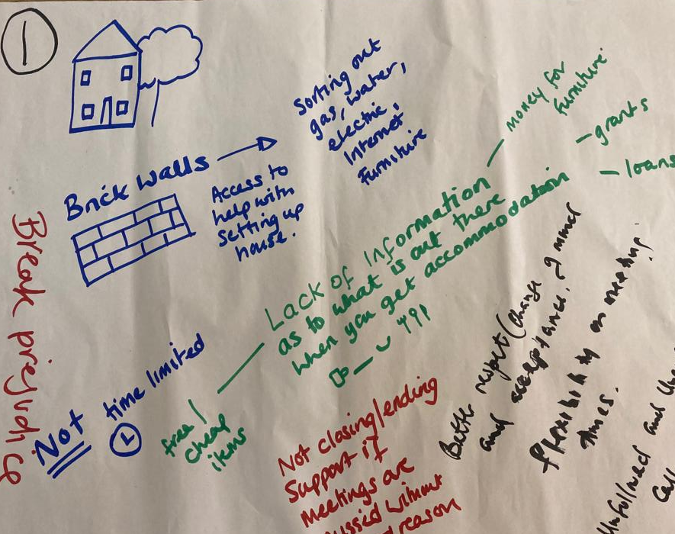
Co production inquiries
Notes:
Tom
1. Ensure everyone has access to support when accommodated – not just in the first few weeks, but ongoing and when they need it. 2. Create a better experience for people experiencing multiple disadvantage in approaching the Council for support with accommodation. 3. Work with the criminal justice systems to make it more trauma informed so as to support people suffering from mental ill health. STRESS INSIGHTS ALREADY EMERGING

Slide 4
Changing Futures C&P Learning Structure
Supported Housing providers
Op’s case-load
Council
Adult social care
Tactical group
Strategic group
MEAM cohort
Coordinator
Service / Systems Issues
Embedded systems issues
Embedded systems issues
Systems Flex
Change forum
Systems Change
Systems Change
Police
Voluntary sector
Coproduction Hubs
Lived experience
Systems agents
Systems Agent Support Network
Service / Systems Issues
Systems Flex
Other parts of the system

Slide 5
Inputs to Change Forum
Learning and identifying barriers from:
Changing Futures Cohort
Coproduction Hubs or other lived experience groups / individuals
Systems Agents
Other parts of the system surrounding multiple disadvantage

