Slide 1
Changing Futures Update
- Cambridgeshire and PETERBOROUGH
6th October 2022

Slide 2
Contents
Overview of Area and National Support Offer
Overall Learnings
How to measure progress
Example Learning Systems
Data Learnings

Slide 3
Overview – CF vs. MEAM Support
Changing Futures Only
Mixture of MEAM and FL / CF
MEAM/CF
FL / CF
New MEAM Areas
v
Buckinghamshire
Herefordshire
Windsor and Maidenhead
Oxfordshire
Medway
Essex
Northumbria
Surrey
Stoke
Cumbria
Lincoln
Somerset
Hertfordshire
Sheffield
Sussex
S Tees
Bristol
Original MEAM areas
Basingstoke
Calderdale
Cambridgeshire
Durham
North Lincolnshire
Windsor and Maidenhead
Leicester
Lancashire
Westminster
Southend on Sea
Redcar and Cleveland
Peterborough
Reading
Redbridge
Norwich
Hackney
Camden
Cornwall
Stafford
West Yorkshire
Greater Manchester
Hull
York
Exeter
Middlesborough
North Devon
Haringey
Newham
Nottinghamshire
Plymouth
Notes:
Basingstoke
Bristol
Calderdale
Cambridgeshire
Camden
Cornwall
Durham
Exeter
Greater Manchester
Hackney
Haringey
Hull
Lancashire
Middlesbrough
Newham
North Devon
North Lincolnshire
Norwich
Nottingham
Peterborough
Plymouth
Reading
Redbridge
Redcar & Cleveland
Southend-on-Sea
Stafford
Stoke-on-Trent
Surrey
Sussex
West Yorkshire
Windsor & Maidenhead
York

Slide 4
Overview of our support
Local Support
Dedicated Area Support Lead within the Social Finance / Revolving Doors team
Guided reflection sessions, helping areas take a birds eye view of their programme and challenging areas on their thinking, and explore any areas where further support could be offered
End-to-end support including: helping areas set their vision for the programme through guided workshops, helping areas mobilise through support with recruitment, onboarding and training, and helping areas develop their ambition through support prioritising their systems change objectives, building partnership buy-in, and embedding coproduction
A few areas also receive deep-dive support to help them determine the root drivers of systemic problems impacting on people experiencing multiple disadvantage
National Support
We provide support on themes including co-production, systems change, data + digital, partnership working and commissioning, as well as thematic areas linked to Multiple Disadvantage
We lead regular guided learning sessions to support areas build their expertise in these topics, combining tutorials, case studies, and peer-to-peer learning
Every quarter, we bring together the wider Changing Futures partnership for National Learning Events, which are day long events with keynote speakers, opportunities for networking and workshops on themes including: pushing the envelope on systems change, deliberative problem solving, and how to sustain impact
As well as this, we coordinate four Communities of Practice for: Senior Responsible Officers; Partnership Leads; Lived Experience Leads and Data Leads, with a new Community of Practice being set up for Systems Change and Learning Leads

Slide 5
Overall Learnings to date (1/2)
Changing Futures core teams operate similar to a backbone organisation in a Collective Impact model
    Effective ‘backbone support’ has been shown to be a ‘critical condition’ for achieving collective impact – that is the impact made by a network of organisations, community members and institutions who work as equal partners to advance equity and create better system outcomes.
    The ‘backbone’ provides: vision and strategy for other partners, supports aligned partner activities, establishes shared measurement practices, builds public will, advances policy and mobilises funding.
Areas have often found it challenging to recruit to systems change lead roles
    Areas are more successful with recruitment when they broaden their remit to consider the wider transferable skills required for these roles, rather than simply looking for people with previous exposure to system change work or multiple disadvantage.
    Transferable skills could include programme management, ability to understand complexity and ability to work across organisational boundaries.
    One area refined its approach to recruitment and managed to find a perfect fit: an engineer by practice in the Ministry of Defence.
The Value of Backbone Organizations in Collective Impact - Collective Impact Forum
Notes:
Backbone organizations serve as coordinating bodies that bring together a diversity of stakeholders and lead a synchronized effort to achieve a common goal
Backbone organizations are a central element of the Collective Impact theory, which states that “no single policy, government department, organization or program can tackle or solve the increasingly complex social problems we face as a society.”

Slide 6
Overall Learnings to date (2/2)
Building partnerships for change takes time to get right
In building the partnership, it can be quite easy and a default to take things for granted, e.g., buy in from stakeholders, and as a result push the programme forward without people having full understanding of what they are signing off. However, without more explicit agreement and engagement earlier on this risks the pace of progress down the line.
    It’s important to ensure in seeking buy in, partnership stakeholders ask questions and are given time to consider what they are buying into.
    Set clear expectations from what you want your stakeholders to do and achieve both individually and together
Notes:
Senior stakeholders often need encouragement to speak up, particularly those who are more used to signing things off rather than engaging in the detail. However, passive engagement is unsustainable long term
To do this you have to create safe and neutral spaces,
Create individual personal manifestos

Slide 7
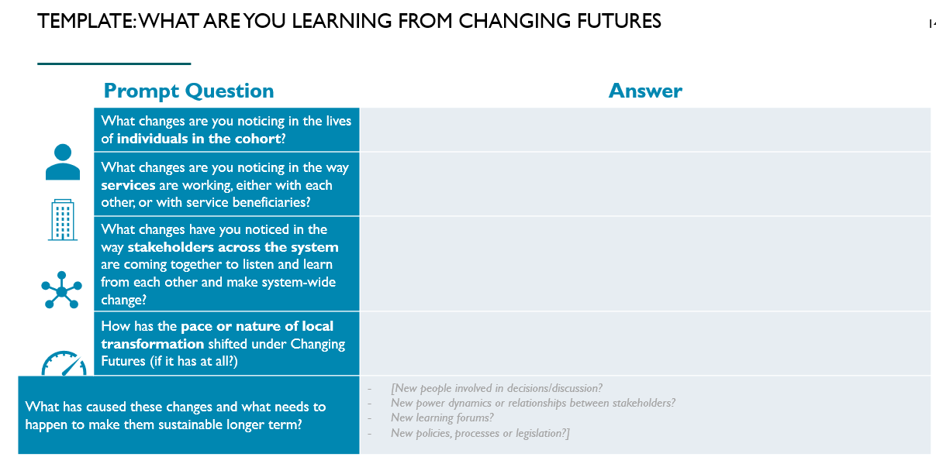
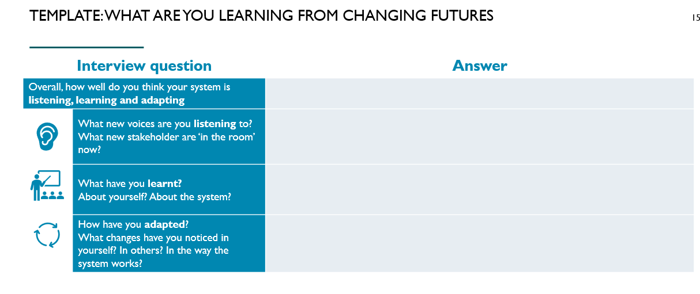
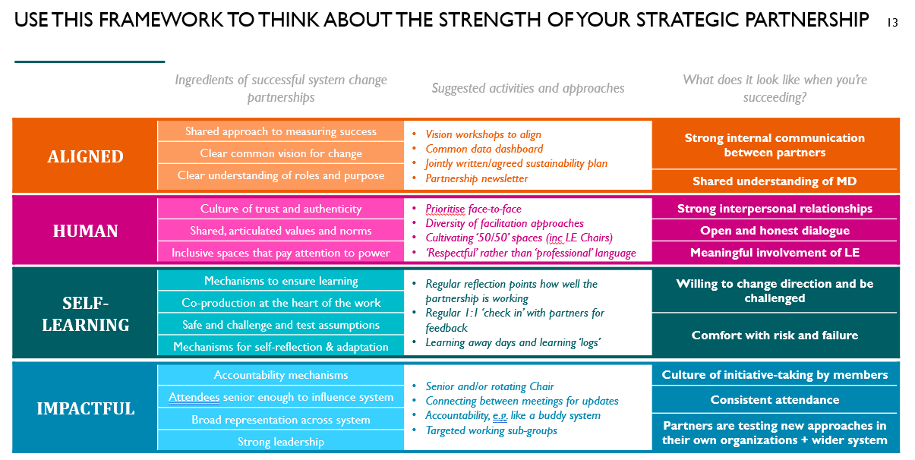
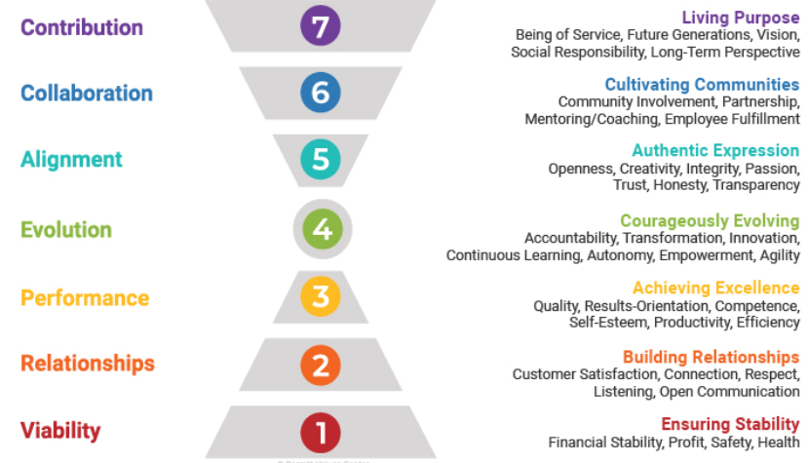
How do they measure progress of their work against key principles
* Templates to capture qualitative insight on the extent to which you are working in line with your programme principles can be useful tool to capture qualitative insight on the partnership on an ongoing basis
We have developed a learning case study template to support areas to reflect on what they’re learning in their partnerships and how their local ecosystem culture shifting.
Our healthy partnership tool is a framework areas can use to reflect on how their system change partnerships are performing
Some areas are also exploring the Barrett Centre approach: Barrett Values Centre | Your Organization, Thriving
Notes:
As part of its Cultural Entropy® services, Barrett Values Center measures an organization’s level of dysfunction within its culture by identifying values associated with conflict, friction and frustration. Our services provide a greater understanding of the culture by comparing your organizational functionality to that Barrett Values Center has developed over many years of assessing organizational dysfunction

Slide 8
Use this framework to think about the strength of your strategic partnership
 | Ingredients of successful system change partnerships | Suggested activities and approaches | What does it look like when you’re succeeding?
ALIGNED | Shared approach to measuring success | Vision workshops to align Common data dashboard Jointly written/agreed sustainability plan Partnership newsletter | Strong internal communication between partners
 | Clear common vision for change
 | Clear understanding of roles and purpose
 |  |  | Shared understanding of MD
HUMAN | Culture of trust and authenticity | Prioritise face-to-face Diversity of facilitation approaches Cultivating ‘50/50’ spaces (inc LE Chairs) ‘Respectful’ rather than ‘professional’ language | Strong interpersonal relationships
 | Shared, articulated values and norms |  | Open and honest dialogue
 | Inclusive spaces that pay attention to power |  | Meaningful involvement of LE
SELF-LEARNING | Mechanisms to ensure learning | Regular reflection points how well the partnership is working Regular 1:1 ‘check in’ with partners for feedback Learning away days and learning ‘logs’ | Willing to change direction and be challenged
 | Co-production at the heart of the work
 | Safe and challenge and test assumptions |  | Comfort with risk and failure
 | Mechanisms for self-reflection & adaptation |  | Comfort with risk and failure
IMPACTFUL | Accountability mechanisms | Senior and/or rotating Chair Connecting between meetings for updates Accountability, e.g. like a buddy system Targeted working sub-groups | Culture of initiative-taking by members
 | Attendees' senior enough to influence system |  | Consistent attendance
 | Broad representation across system |  | Consistent attendance
 |  |  | Partners are testing new approaches in their own organizations + wider system
 | Strong leadership

Slide 9







TEMPLATE: WHAT ARE YOU LEARNING FROM CHANGING FUTURES
Prompt Question
 | What changes are you noticing in the lives of individuals in the cohort?
 | What changes are you noticing in the way services are working, either with each other, or with service beneficiaries?
 | What changes have you noticed in the way stakeholders across the system are coming together to listen and learn from each other and make system-wide change?
 | How has the pace or nature of local transformation shifted under Changing Futures (if it has at all?)
What has caused these changes and what needs to happen to make them sustainable longer term?
Interview question
Overall, how well do you think your system is listening, learning and adapting
 | What new voices are you listening to? What new stakeholder are ‘in the room’ now?
 | What have you learnt? About yourself? About the system?
 | How have you adapted? What changes have you noticed in yourself? In others? In the way the system works?
Notes:
Feedback on the case study template
Unpack the co-production element more
What are you struggling to change?
Make the focus clearly on mindset changes

Slide 10
Outcomes framework

Slide 11
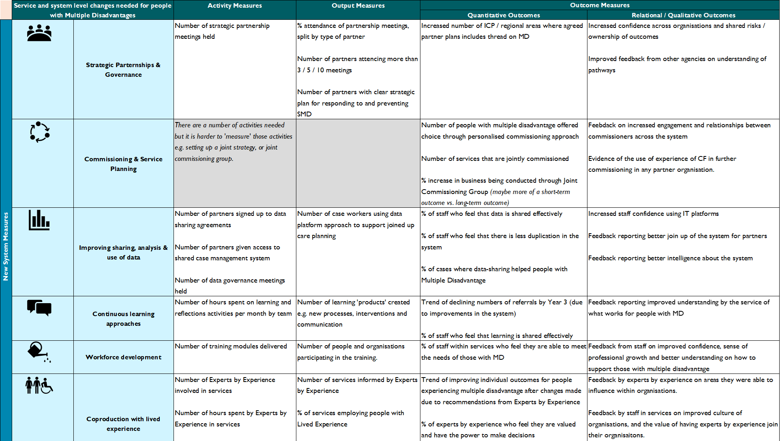
Note: List of example measures are not exhaustive
Include: To what extent are we delivering with fidelity to principles

Slide 12



CAPTURE
UNDERSTAND & ACTION
Audience / lens
Method
Co-production Groups
Programme
Board
meeting
(quarterly)
People with Lived Experience
Virtual Learning Logs
Insights Session
@ Programme Group meeting (quarterly)
Frontline Staff
Project Deliverables
MDSC
Meetings
Highlight Report Template
Analysis & Affinity Synthesis
Learning & Reflection Sessions
Programme / Project Team(s)
CoPs
Programme Insights [Log]
CF National Partnership & Consortium
Performance & Impact Framework
Performance & Impact Data
TBC
Research

Slide 13
CAPTURE
UNDERSTAND & ACTION
REVIEW & FEEDBACK
Programme
Board
meeting
(quarterly)
Performance & Impact Framework - Core Measures
(secondary) Learning Measures
Programme Analysis & Affinity Synthesis Required at these stages
Programme/ Project Work
Project Deliverables
(e.g. VAWG systems mapping, reports, etc)
Insights Session
@ Programme Group meeting (quarterly)
Programme Insights [Log]
MDSC
Meetings
Programme
Comms
DLUHC Quarterly Report
Learning & Reflection Sessions
Highlight Report Template
Action(s) - as directed by MDSC
Prompting questions / lines of enquiry
Frontline
Experiences
Virtual Learning Logs
Activity / Action
Product

Slide 14
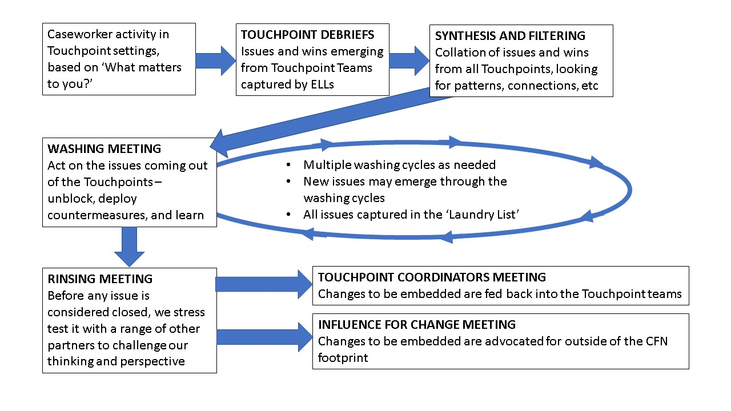
Northumbria “laundry cycle”
Notes:
This document outlines the key meetings that occur on a regular basis and how these each feed into our overall process of systems change. The core activity that occurs before this process is the work of the caseworkers in the Touchpoint teams, working in a bespoke, ‘liberated’ way with people experiencing multiple and complex needs, based on each individual’s conception of what matters to them.

Slide 15
Learnings from the data and digital work on changing futures
Key insights and learnings
Plymouth: shifting from tech-first to user-first
As part of their remit for Changing Futures, Plymouth have been considering creating a digital app for people with lived experience, living in the city. This was a top-down decision to create a tech-first solution. However, the CF data team have recognized there is greater impact in putting user-needs first and that there is a bigger opportunity around getting agencies to work more effectively together, which can be enabled by tech.
To sustain data transformation for multiple disadvantage it does not always require more data collection or analysis, or new technological change, often it requires greater collaboration across partners who continually look at user-needs first.
Plymouth’s leadership would like support on how to thoughtfully understand their data problem and think differently about tech and its role in local data transformation.
1
Easier to know what data service users want and find meaningful compared to other stakeholders such as operational staff and/or senior leadership. This can present challenges in knowing what data to communicate to stakeholders and how to do it effectively. If data collected for staff is not linked with what service users care about, it limits the justification to collect that data.
2
Building spaces for peer-to-peer learning or sharing, and connecting people with similar approaches or technology has been integral to supporting CF delivery
3
There is growing interest to find new ways to powerfully communicate data analysis which aligns better with what people want to do and who they want to communicate the data for

Slide 16




CHALLENGES ON DATA TO PROGRESS UNDERSTANDING AND OUTCOMES ON MULTIPLE DISADVANTAGE
A range of barriers exist across Changing Future areas depending on where they are in their data journey. The main barriers are:
Other challenges include:
Supporting practitioners on how to ask questions of service users to prevent bias during data collection
Developing analytical skills
Designing alternative data visualization
Getting teams to switch to new tools, CMS’s and systems
Supplementing quantitative data e.g., on access and referrals with qualitative insight
Data sharing agreements
Getting the right people involved
Meaningful analysis
Case management systems
MD requires partnership across organizations and departments e.g., housing and criminal justice but there are challenges in getting DSA’s in place. This includes setting up new agreements or extending existing agreements to include new partners
MD is not always embedded in local system change plans and areas hope to understand who the relevant data stakeholders are to engage with, to raise the profile of MD work locally and nationally
CF areas intend to map system change objectives directly with data collected and understand how data can be best analyzed and shared even when it’s limited
Some CF areas are in the process of procuring case management solutions and are trying to understand the feasibility of different delivery approaches or considerations for how these systems make use of data

