Slide 1
Census 2021: population and household estimates, Cambridgeshire and Peterborough
Research Team, Business Intelligence
28th October 2022
Research.Group@cambridgeshire.gov.uk
Notes:
Today I will be going through the first data that was released from Census 2021. Census day took place on 21 March 2021. It is worth noting that Census 2021 took place during a period of uncertainty, with COVID-19 lockdown restrictions still in place. The first results, released in June 2022, are local authority level estimates of the usual resident population and an estimate of the number of occupied households, along with a 5 year age and sex breakdown of the population estimates. We are also expecting the imminent publication of the next set of Census data, which I will discuss at the end of this presentation.
If you would like the data and analysis provided in this presentation in a different accessible format, then please email research.group@cambridgeshire.gov.uk.

Slide 2
Definitions
Usual resident population
Anyone in the UK and had stayed or intended to stay in the UK for a period of 12 months or more; or
Had a permanent UK address and was outside the UK and intended to be outside the UK for less than 12 months.
Households
One person living alone; or
A group of people (not necessarily related) living at the same address, who share cooking facilities and share a living room or sitting room or dining area
Must contain at least one usual resident
All data in the Census 2021 first release is rounded to 100
Notes:
To begin, I would like to cover two key definitions used in Census 2021 data that I will be referring to throughout this presentation.
The first is usual resident population. All population figures in this presentation are referring to the usual resident population, which is defined as anyone in the UK who had stayed or intended to stay in the UK for a period of 12 months or more; or had a permanent UK address and was outside the UK and intended to be outside the UK for less than 12 months.
The second is households. A household can either be one person living alone, or a group of people (not necessarily related) living at the same address who share cooking facilities and share a living room or sitting room or dining area. It must contain at least one usual resident. All household estimates in this presentation are referring to the number of occupied households.
Finally, just to note that all data from the Census 2021 first release is rounded to the nearest 100.

Slide 3
Headline figures: population and household estimates
Cambridgeshire
Usual resident population has grown by 9.2% to 678,600, an increase of 57,400 from Census 2011 (population 621,200)
Total number of households has increased by 10.5% to 277,600, an increase of 26,400 from Census 2011 (251,200 households)
Peterborough
Usual resident population has grown by 17.5% to 215,700, an increase of 32,100 from Census 2011 (population 183,600)
Total number of households has increased by 14.2% to 84,500, an increase of 10,500 from Census 2011 (74,000 households)
Notes:
We’ll start with the headline figures on population and households for Cambridgeshire and Peterborough. For Cambridgeshire the usual resident population was 678,600 at Census 2021, growth of 9.2% since Census 2011, or 57,400 additional residents. The total number of households has increased by 10.5% to 277,600, which is 26,400 additional households.
For Peterborough the usual resident population was 215,700 at Census 2021, growth of 17.5% since Census 2011, or 32,100 additional residents. The total number of households has increased by 14.2% to 84,500 – 10,500 more households

Slide 4
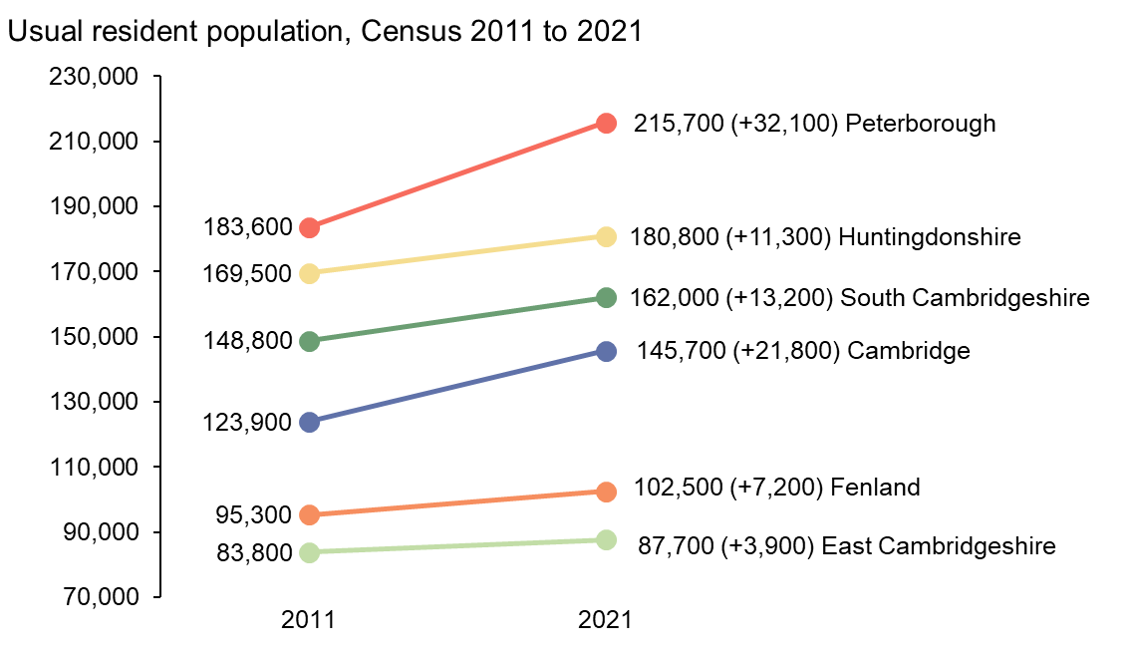
Census 2021 population compared to Census 2011
Notes:
The slope chart here shows the usual resident population for each local authority in Cambridgeshire and Peterborough at Census 2011 and Census 2021, and the net change in population. You can see by the angle of the slope the higher growth in population in Cambridge and Peterborough, with increases of 21,800 and 32,100 residents respectively. In contrast, there have been lower levels of growth for the more rural districts between Census 2011 and 2021, ranging between increases of 3,900 and 13,200 residents.

Slide 5
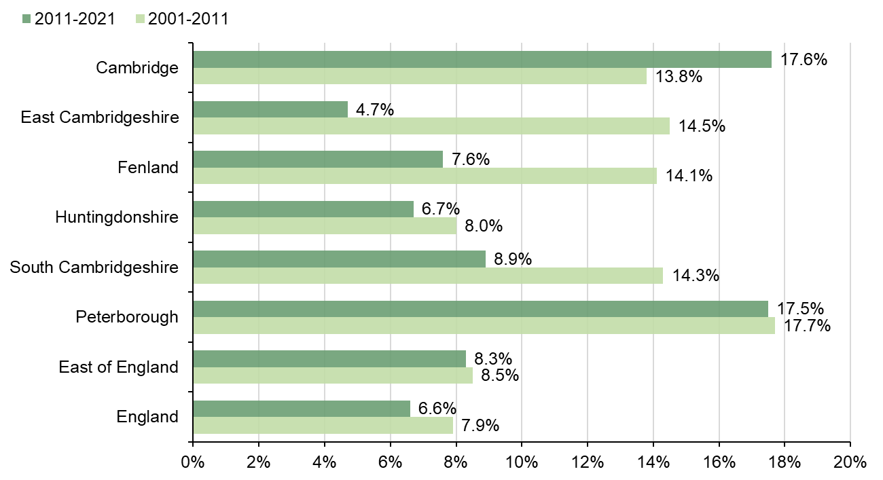
Census 2001-21: percentage change in usual resident population
Notes:
The bar chart shows the percentage change in population between Census 2011 and 2021 and compares it to the percentage change between Census 2001 and 2011.
Cambridge and Peterborough have both seen high population growth of 17.6% and 17.5% respectively between Census 2011 and Census 2021. For Peterborough, this was a similar rate of growth as was seen there between Census 2001 and Census 2011 when it was 17.7%. For Cambridge, percentage growth is higher between Census 2011 and 2021 than the 13.8% seen between Census 2001 and Census 2011.
For the more rural local authorities, population growth has not been as high, and the percentage rate of growth has been lower than was seen between Census 2001 and 2011. In East Cambridgeshire the population has increased by 4.7% between 2011 and 2021, compared to 14.5% between Census 2001 and 2011. Fenland 7.6% compared to 14.1%, Huntingdonshire 6.7% compared to 8% and South Cambridgeshire 8.9% compared to 14.3%.
This chart also includes figures for England as a whole, and the East of England region. All local authorities within Cambridgeshire and Peterborough, with the exception of East Cambridgeshire, are above the England average of population growth between 2011 and 2021 of 6.6%. For the East of England average of 8.3%, Cambridge, South Cambridgeshire and Peterborough all have higher percentage increases in population.

Slide 6
Census 2001-21: Usual resident population
Area | Census 2001 | Census 2011 | Census 2021 | Change 2001-2011, % | Change 2011-2021, % | Change 2001-2021, %
Cambridge | 108,900 | 123,900 | 145,700 | 13.8 | 17.6 | 33.8
East Cambridgeshire | 73,200 | 83,800 | 87,700 | 14.5 | 4.7 | 19.8
Fenland | 83,500 | 95,300 | 102,500 | 14.1 | 7.6 | 22.8
Huntingdonshire | 157,000 | 169,500 | 180,800 | 8.0 | 6.7 | 15.2
South Cambridgeshire | 130,100 | 148,800 | 162,000 | 14.3 | 8.9 | 24.5
Cambridgeshire | 552,700 | 621,200 | 678,600 | 12.4 | 9.2 | 22.8
Peterborough | 156,100 | 183,600 | 215,700 | 17.7 | 17.5 | 38.2
East of England | 5,388,100 | 5,847,000 | 6,334,500 | 8.5 | 8.3 | 17.6
England | 49,138,800 | 53,012,500 | 56,489,800 | 7.9 | 6.6 | 15.0
Notes:
This table shows the usual resident population for each district, as well as England and the East of England, for Census 2001, 2011 and 2021, as well as the percentage changes between these three datapoints.

Slide 7
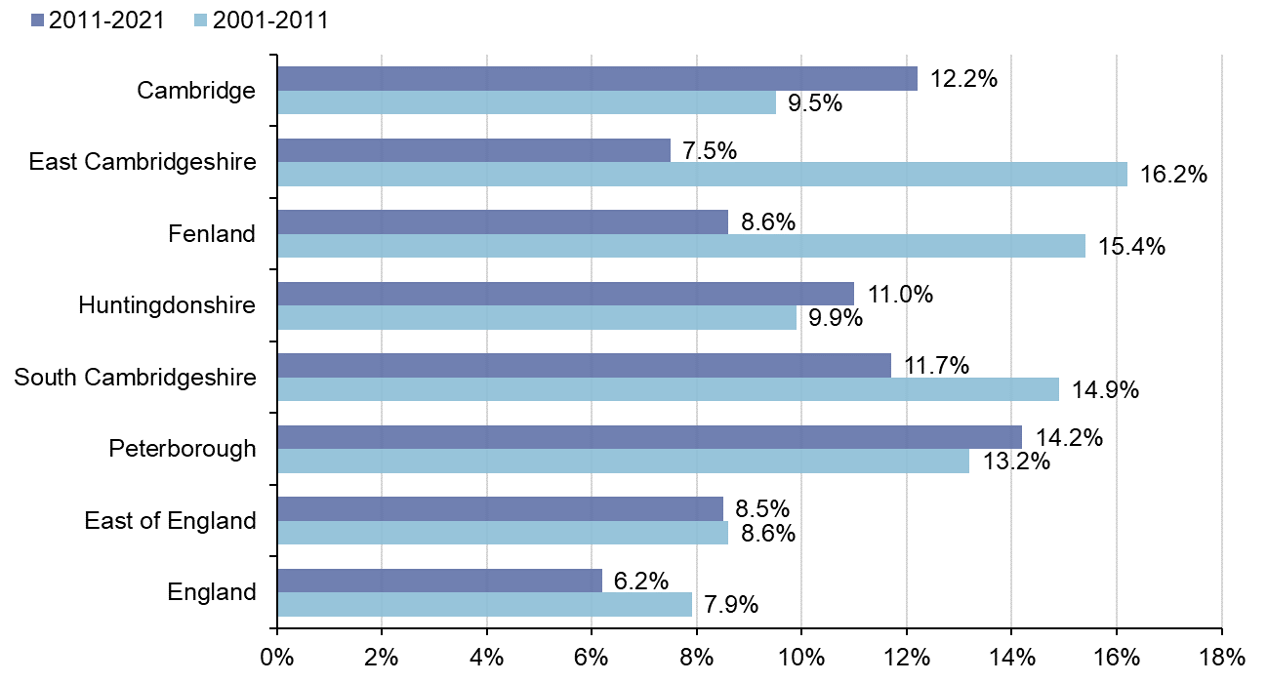
Census 2001-21: percentage change in number of occupied households
Notes:
The bar chart shown here compares the percentage change in households between Census 2011 and 2021 and compares it to the percentage change between Census 2001 and 2011.
East Cambridgeshire, Fenland and South Cambridgeshire have lower percentage change in the growth of number of households between Census 2011 and 2021, compared to the previous ten year period. Huntingdonshire, Peterborough and Cambridge have a slightly higher percentage increase in number of households between 2011 and 2021, compared to previous ten year period.
Percentage change in number of households between 2011 and 2021 is above the England average of 6.2% for all local authorities within Cambridgeshire and Peterborough, and all except for East Cambridgeshire have growth above the East of England average of 8.5%.

Slide 8
Census 2001-21: Number of occupied households
Area | Census 2001 | Census 2011 | Census 2021 | Change 2001-2011, % | Change 2011-2021, % | Change 2001-2021, %
Cambridge | 42,700 | 46,700 | 52,400 | 9.5 | 12.2 | 22.7
East Cambridgeshire | 29,800 | 34,600 | 37,200 | 16.2 | 7.5 | 24.8
Fenland | 35,200 | 40,600 | 44,100 | 15.4 | 8.6 | 25.3
Huntingdonshire | 63,100 | 69,300 | 76,900 | 9.9 | 11.0 | 21.9
South Cambridgeshire | 52,200 | 60,000 | 67,000 | 14.9 | 11.7 | 28.4
Cambridgeshire | 222,900 | 251,200 | 277,600 | 12.7 | 10.5 | 24.5
Peterborough | 65,400 | 74,000 | 84,500 | 13.2 | 14.2 | 29.2
East of England | 2,232,000 | 2,423,000 | 2,628,700 | 8.6 | 8.5 | 17.8
England | 20,451,400 | 22,063,400 | 23,435,700 | 7.9 | 6.2 | 14.6
Notes:
This table shows the number of households for each district, as well as England and the East of England, for Census 2001, 2011 and 2021, as well as the percentage changes between these three datapoints.

Slide 9
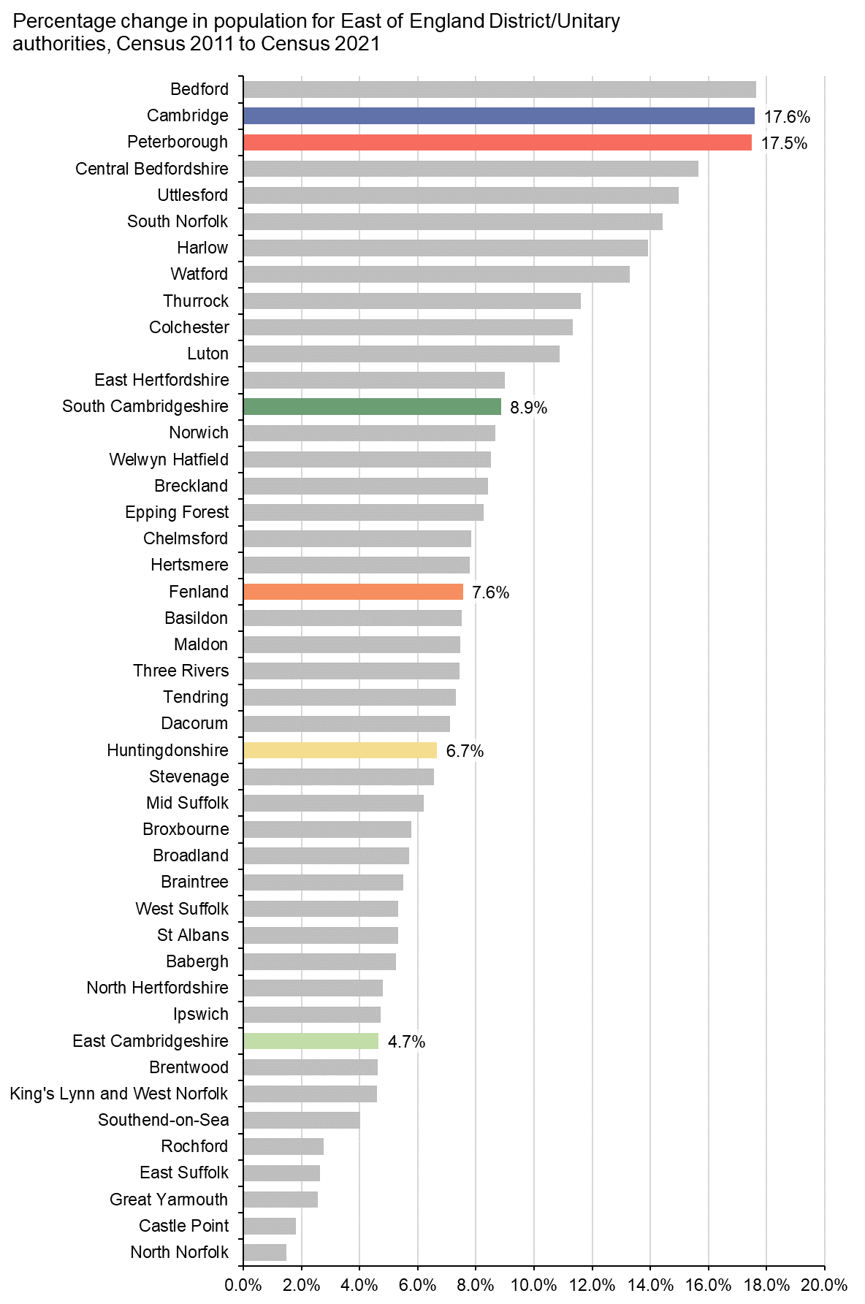
Chart continued on next slide
Notes:
In the previous charts and tables I’ve provided a comparison to the East of England region as a whole, but how do the individual districts in this region compare to the districts in Cambridgeshire and Peterborough? This slide and the next one show a bar chart of the percentage change in population from Census 2011 to Census 2021 for district and unitary authorities in the East of England, ordered from highest change to lowest change. This first slide shows the top 22 local authorities by their percentage population growth.
Cambridge and Peterborough are the 2nd and 3rd fastest growing in the East with 17.6% and 17.5% growth, with Bedford seeing the highest population growth of 17.7%. When you compare Cambridge and Peterborough to all local authorities in England, they have seen some of the highest percentage increases in population in England since Census 2011, topped only by Tower Hamlets (22.1%), Dartford (20%), Barking and Dagenham (17.7%), and Bedford (17.7%).
South Cambridgeshire and Fenland also feature in this first slide. South Cambridgeshire with 8.9% growth is similar to growth in East Hertfordshire and Norwich, while Fenland with 7.6% growth is similar to Basildon and Maldon in Essex.

Slide 10
Notes:
This second slide shows the remaining 23 local authorities in the East of England region. Huntingdonshire with 6.7% growth is similar to Stevenage, while East Cambridgeshire with 4.7% growth is similar to Ipswich and Brentwood.

Slide 11
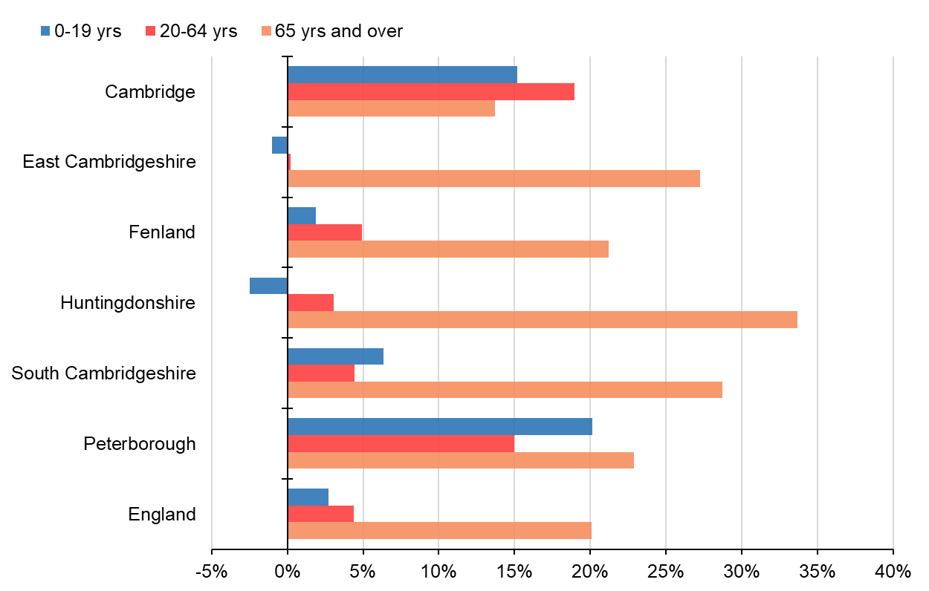
Percentage change by age group, Census 2011 to Census 2021
Notes:
We have discussed the percentage change for the population as a whole, but what about different age groups? This bar chart shows the percentage change between Census 2011 and Census 2021 that has occurred for different broad age groups, by each of the districts and as compared to the change for England as a whole. The blue bar of each district cluster shows the percentage change that has occurred in the 0-19yrs age group, the red bar in the middle the 20-64 years age group, and the orange bar the 65 years and over population.
Cambridge and Peterborough, when compared to the more rural districts and for England as a whole, have a more even spread of the population growth across the age groups and a notable increase in the young and working age populations. For the more rural districts, East Cambridgeshire and Huntingdonshire stand out as having seen very little change in the size of young and working age populations but notable increases in the size of the populations aged 65 years and over.
In all districts apart from Cambridge the 65 years and over population has increased by more than the change for this age group in England as a whole.

Slide 12
(Colours are calculated relative to each individual district, see district breakdowns for detail and figures)

Slide 13
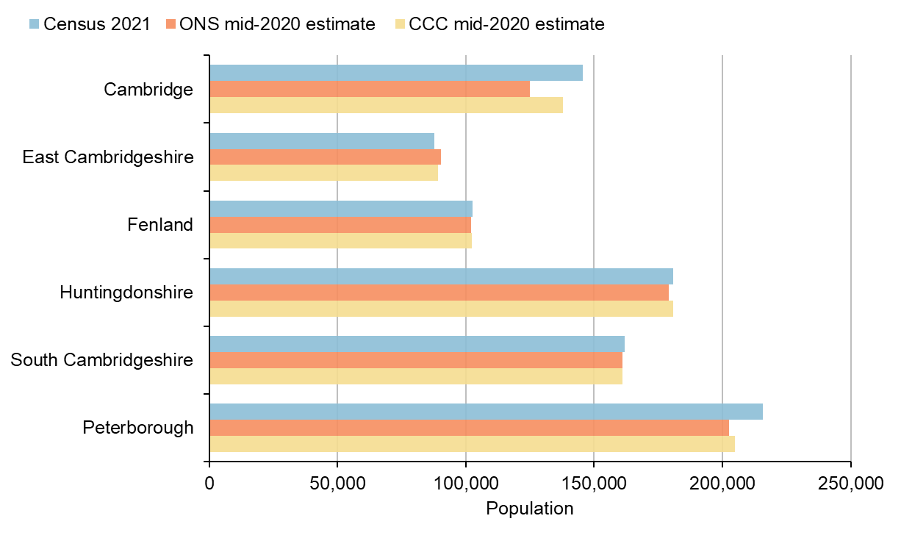
Census 2021 compared to 2020 population estimates
Notes:
This bar chart compares the population from Census 2021 with population estimates for 2020, which were produced before the results from Census 2021 were released. The orange bar represents the Office for National Statistics (ONS) official mid-year 2020 population estimate, while the yellow bar represents the mid-year 2020 population estimate produced by the Cambridgeshire County Council Research Group (CCC).
The most significant differences are the notably higher Census 2021 populations for Cambridge and Peterborough, with smaller differences for the other districts. For both these local authorities, there is a notable difference between the Census 2021 population and ONS 2020 estimate, especially for Cambridge.
For Cambridge, the most significant difference between Census 2021 and the 2020 population estimates is found with the 25-44 age group, while in Peterborough the most significant differences are found in the 15-44 age group.

Slide 14
Census 2021 compared to population estimates
District | Census 2021 | Census 2011 | ONS Mid-2020 | CCC Mid-2020
Cambridge | 145,700 | 123,900 | 125,100 | 137,800
East Cambridgeshire | 87,700 | 83,800 | 90,200 | 89,100
Fenland | 102,500 | 95,300 | 102,100 | 102,400
Huntingdonshire | 180,800 | 169,500 | 179,000 | 180,800
South Cambridgeshire | 162,000 | 148,800 | 160,900 | 161,000
Peterborough | 215,700 | 183,600 | 202,600 | 204,900
Notes:
This table provides the population figures for Census 2021, Census 2011, ONS mid-2020 estimate and CCC mid-2020 estimate.

Slide 15
Cambridgeshire

Slide 16
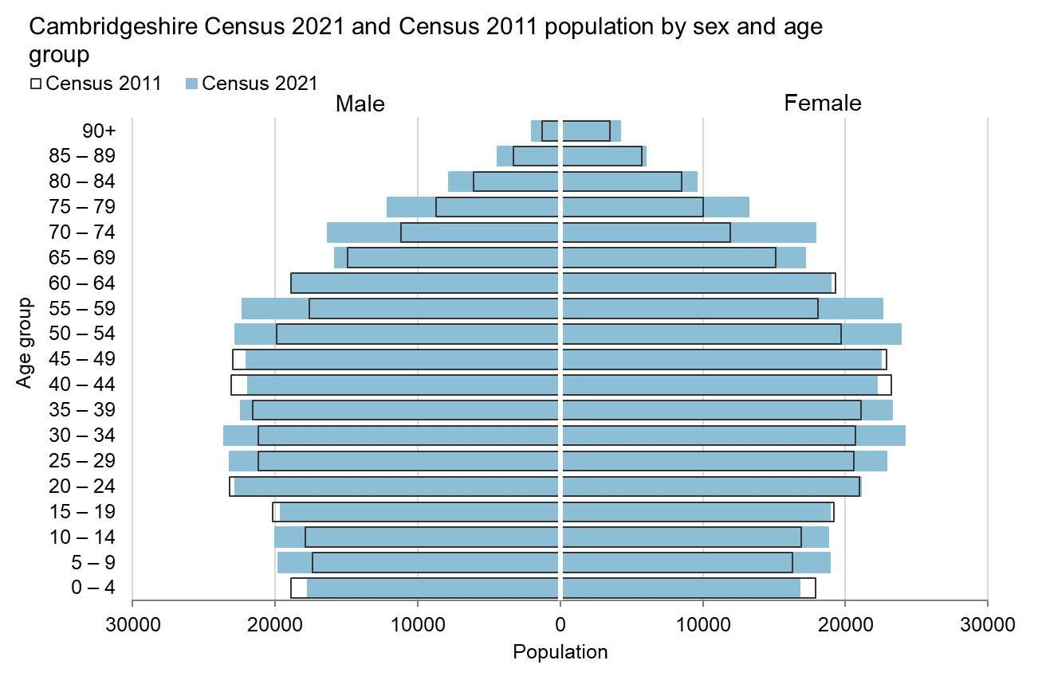
Notes:
Each population pyramid shows the usual resident population at Census 2021 and Census 2011 by sex and five year age group. The black outlined bars are for Census 2011 and the solid blue bars are for Census 2021. If there is a white gap between the blue bar and black outline, this signifies a decrease in population between 2011 and 2021, whereas if the blue bar extends beyond the black outline, this signifies a population increase between 2011 and 2021.
This first chart is for Cambridgeshire. The key trends for Cambridgeshire shown here are the population decrease in the 0-4 age group and the notable population increases in the 50-59 and 70-79 age groups.

Slide 17
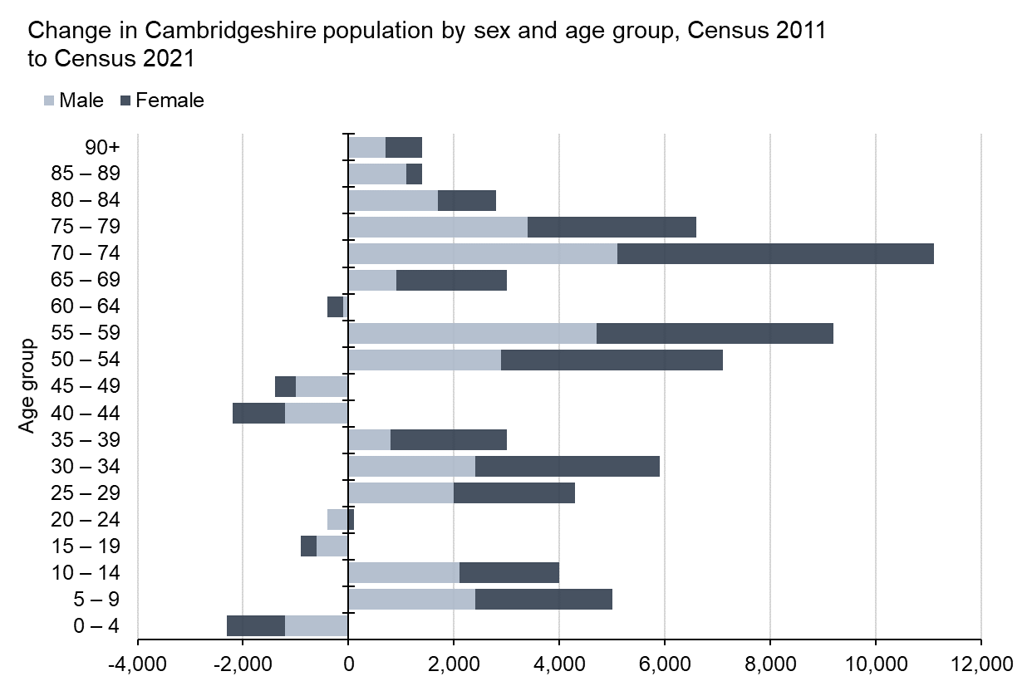

Slide 18
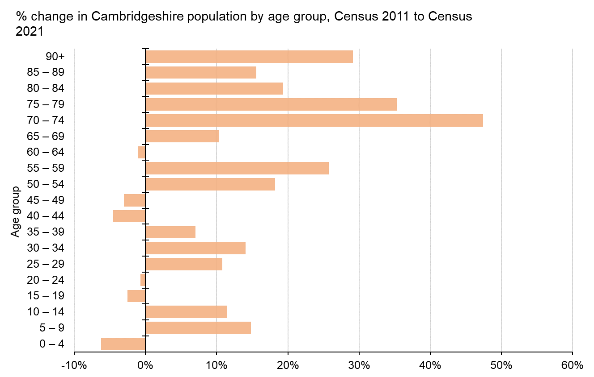
Notes:
This second chart is a bar chart of the percentage change in the population by five year age group between Census 2011 and Census 2021. The key trends in this chart are that the older population groups have seen the highest percentage increases, most notably the 70-74, 75-79 and 90+ age groups, while there has been a decrease in the 0-4 age group.

Slide 19
Cambridge

Slide 20
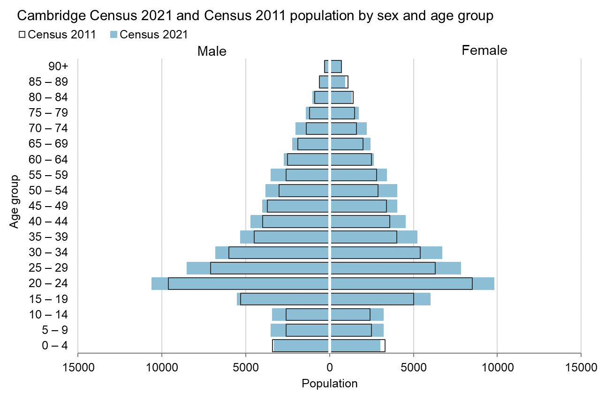
Notes:
Next, Cambridge. The key trends for Cambridge shown in this chart are that population growth has been more evenly spread across the age groups, with only a notable decrease in population for the 0-4 and 85-89 age groups.

Slide 21
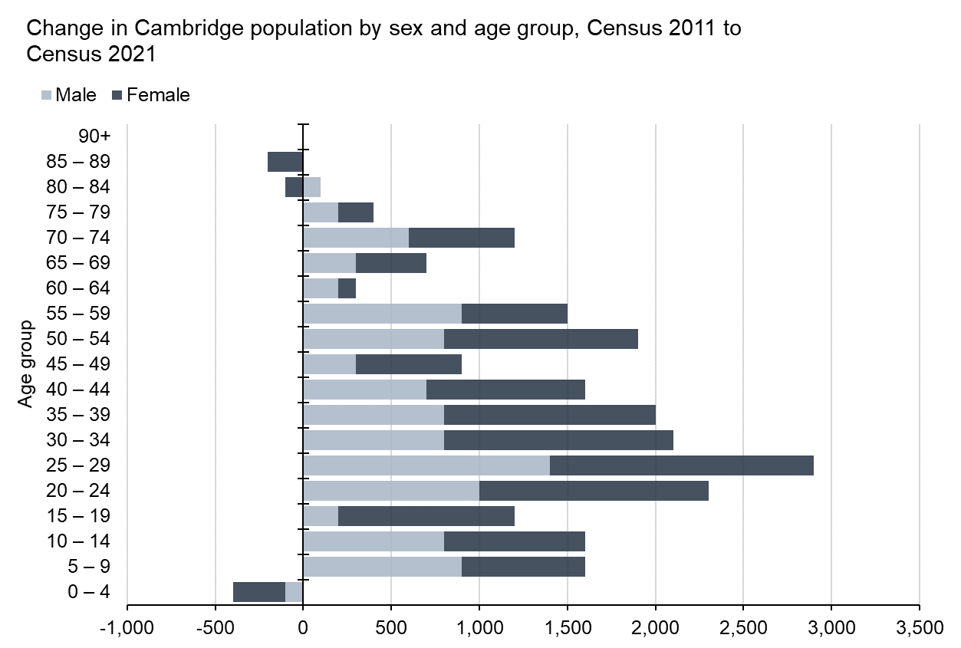

Slide 22
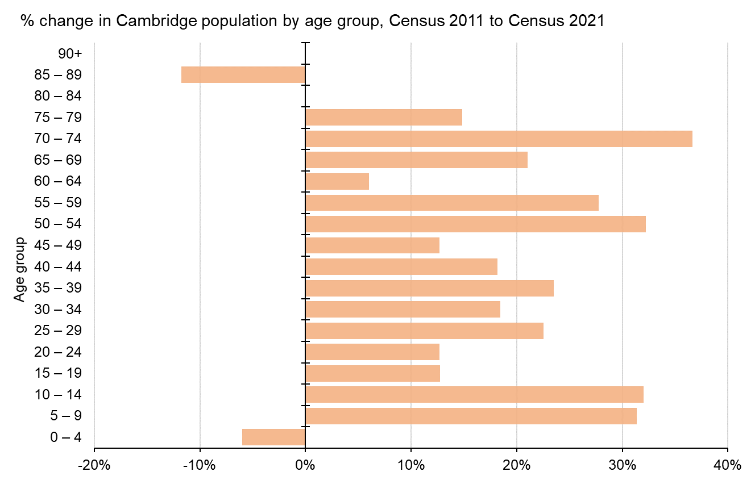
Notes:
For the percentage population change bar chart, this again demonstrates how population growth has been more evenly spread between age groups in Cambridge. This can be seen by the over 30% population growth for the 70-74, 50-54 and 5-14 age groups.

Slide 23
East Cambridgeshire

Slide 24
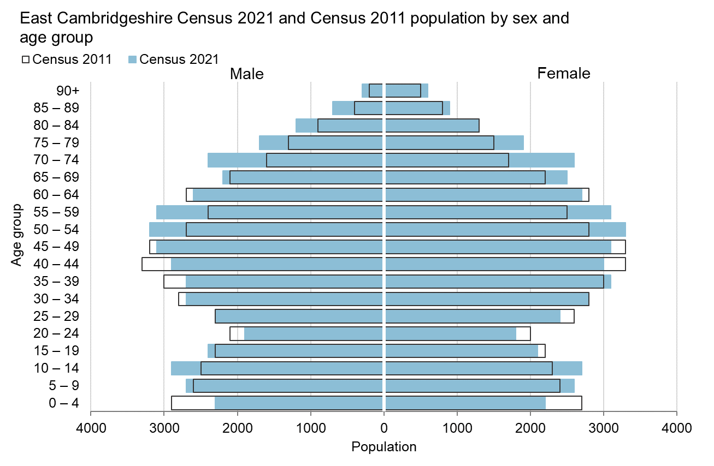
Notes:
Next, East Cambridgeshire. The key trends for East Cambridgeshire shown in this chart are some very notable population decreases between Census 2011 and 2021, in particular the 0-4 age group and the 20-49 age groups. In contrast, there has been notable growth for the 5-14, 50-59 and 70-79 age groups.

Slide 25
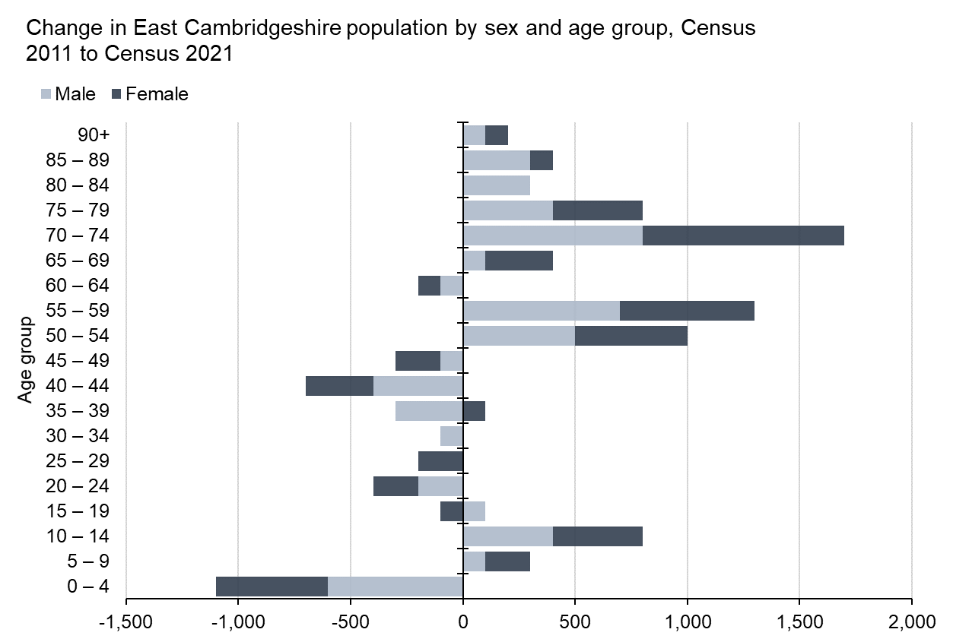

Slide 26
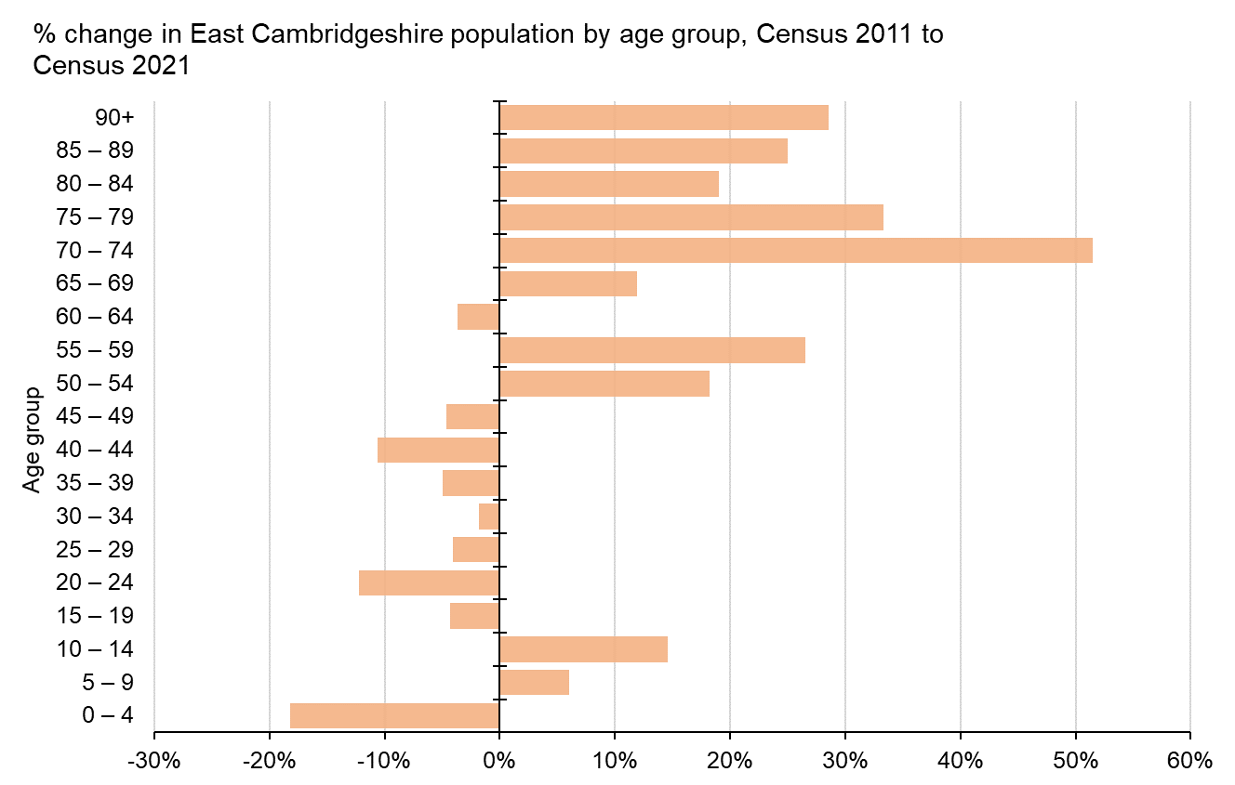
Notes:
For the percentage population change bar chart, the notable trends in East Cambridgeshire are that there have been population increases in almost all age groups aged 50 and over, except for a decrease in the 60-64 age group. In contrast there have been population decreases in the population aged 49 and under, except for growth for the 5-14 age groups. Notable percentage changes are the 52% increase in the population aged 70-74 and the 18% decrease in the population aged 0-4.

Slide 27
Fenland

Slide 28
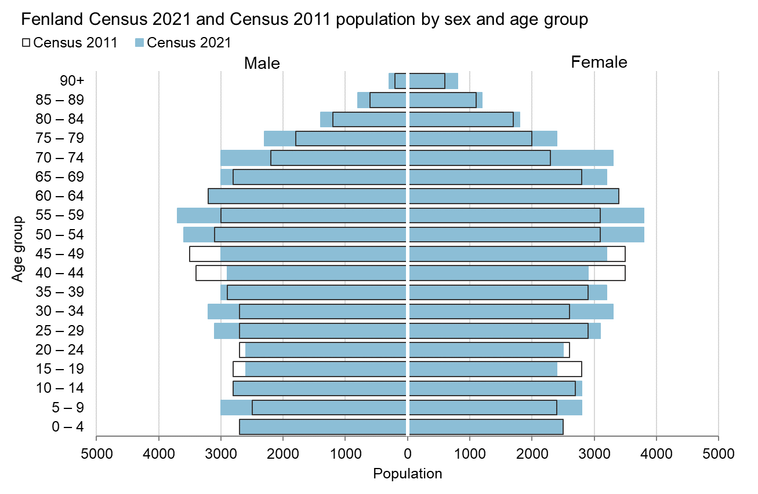
Notes:
Next, Fenland. The key trends for Fenland shown in this chart are some notable population decreases in the 15-24 and 40-49 age groups. In contrast, there has been notable growth for the 5-9, 25-34, 50-59 and 70-79 age groups.

Slide 29
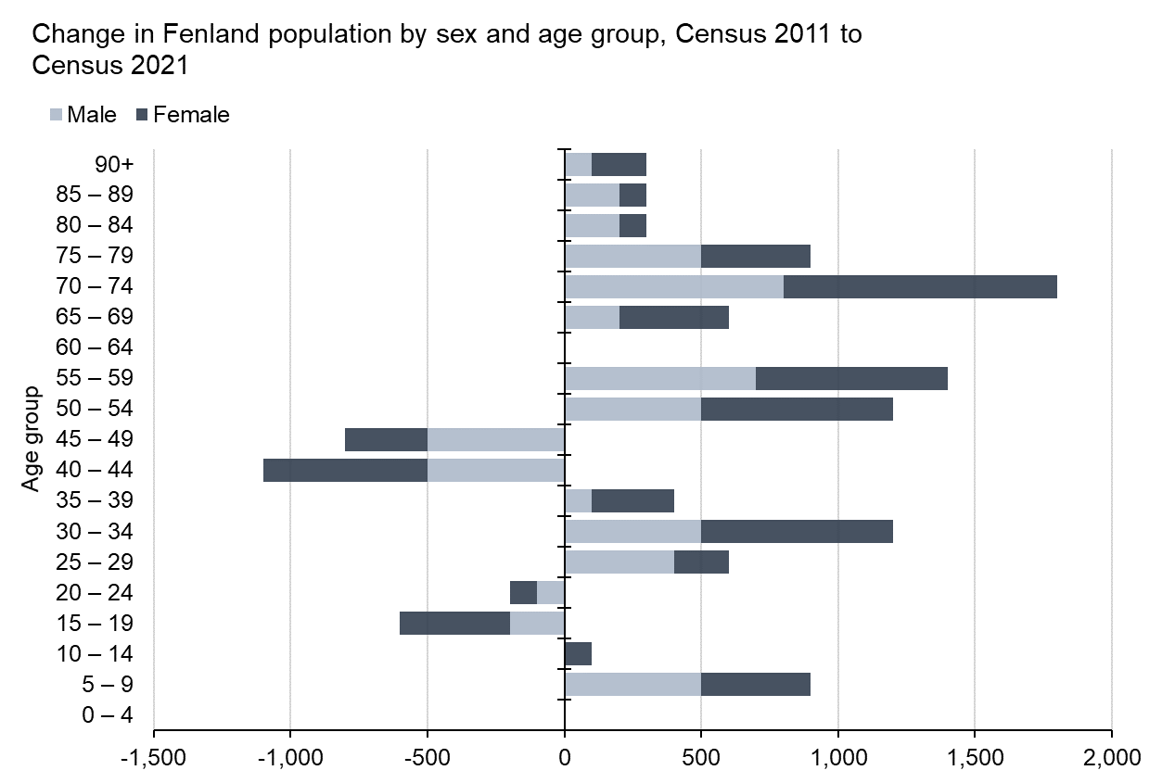

Slide 30
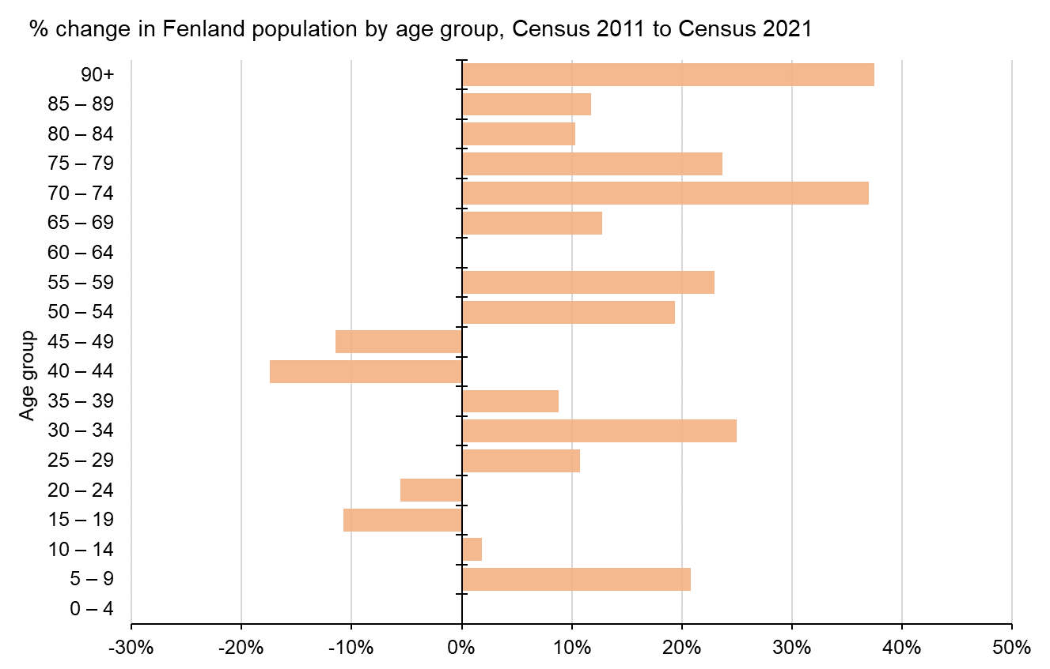
Notes:
For the percentage population change bar chart, the notable trends in Fenland are the 37% and 38% growth in the population aged 70-74 and 90+ respectively. All age groups for 65 and above have seen population growth of at least 10% since Census 2011.

Slide 31
Huntingdonshire

Slide 32
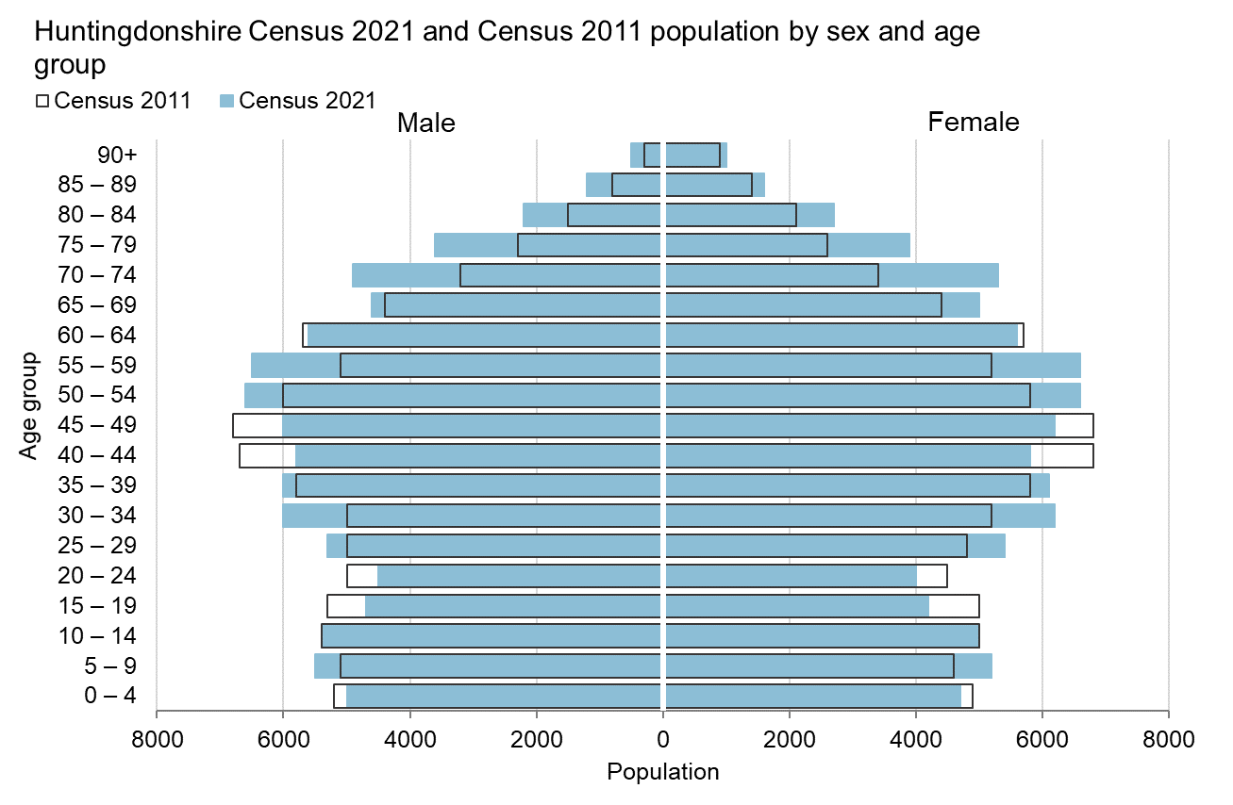
Notes:
Next, Huntingdonshire. The key trends for Huntingdonshire shown in this chart are some notable population decreases in the 0-4, 15-24 and 40-49 age groups. In contrast, there has been notable growth for the 25-39, 50-59 and 70-79 age groups.

Slide 33
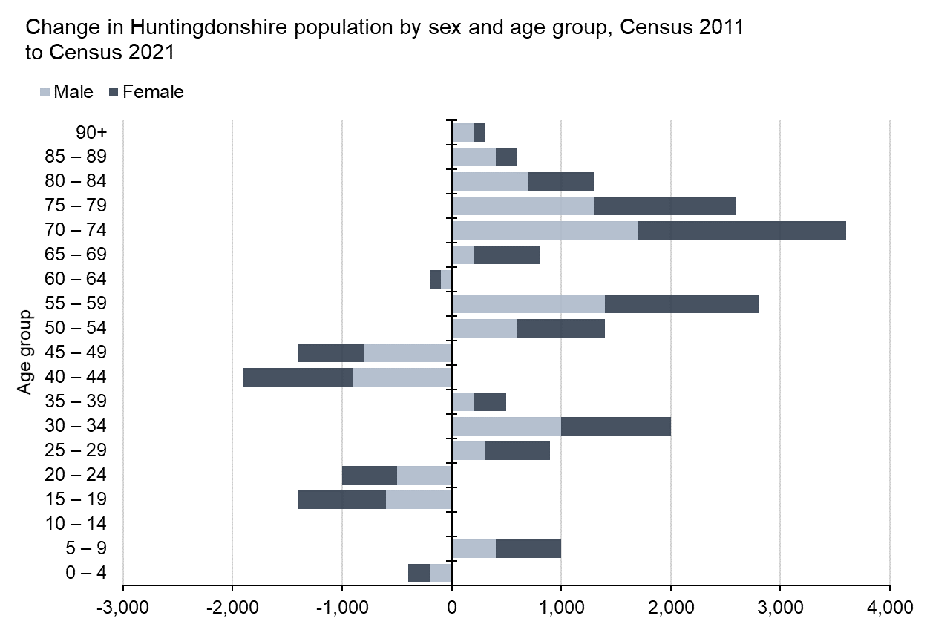

Slide 34
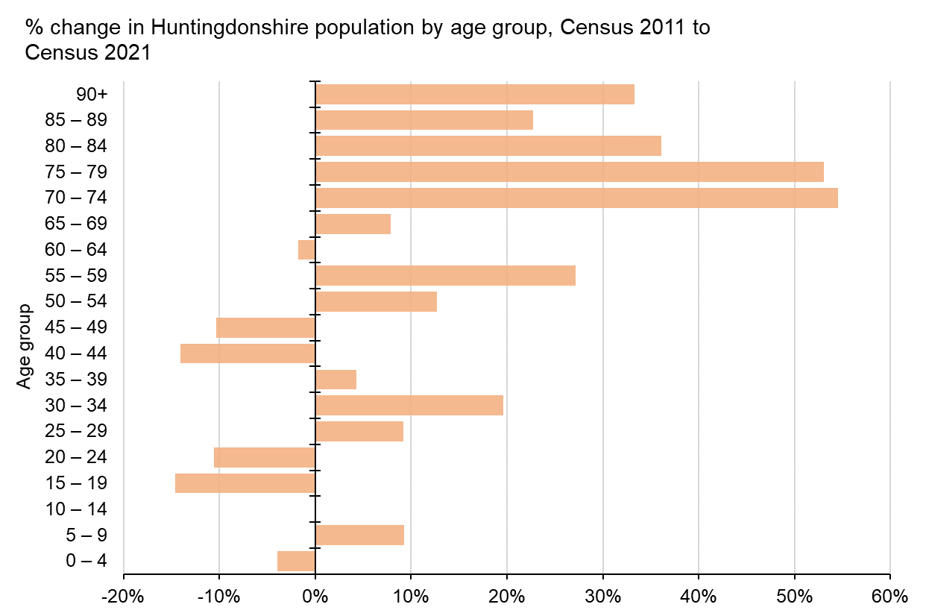
Notes:
For the percentage population change bar chart, the notable trends in Huntingdonshire are the 55% and 53% growth in the population aged 70-74 and 75-79 respectively. All age groups for 70 and above have seen population growth of at least 20% since Census 2011. For the population aged 64 and below, there is a mix of increases and decreases.

Slide 35
South Cambridgeshire

Slide 36
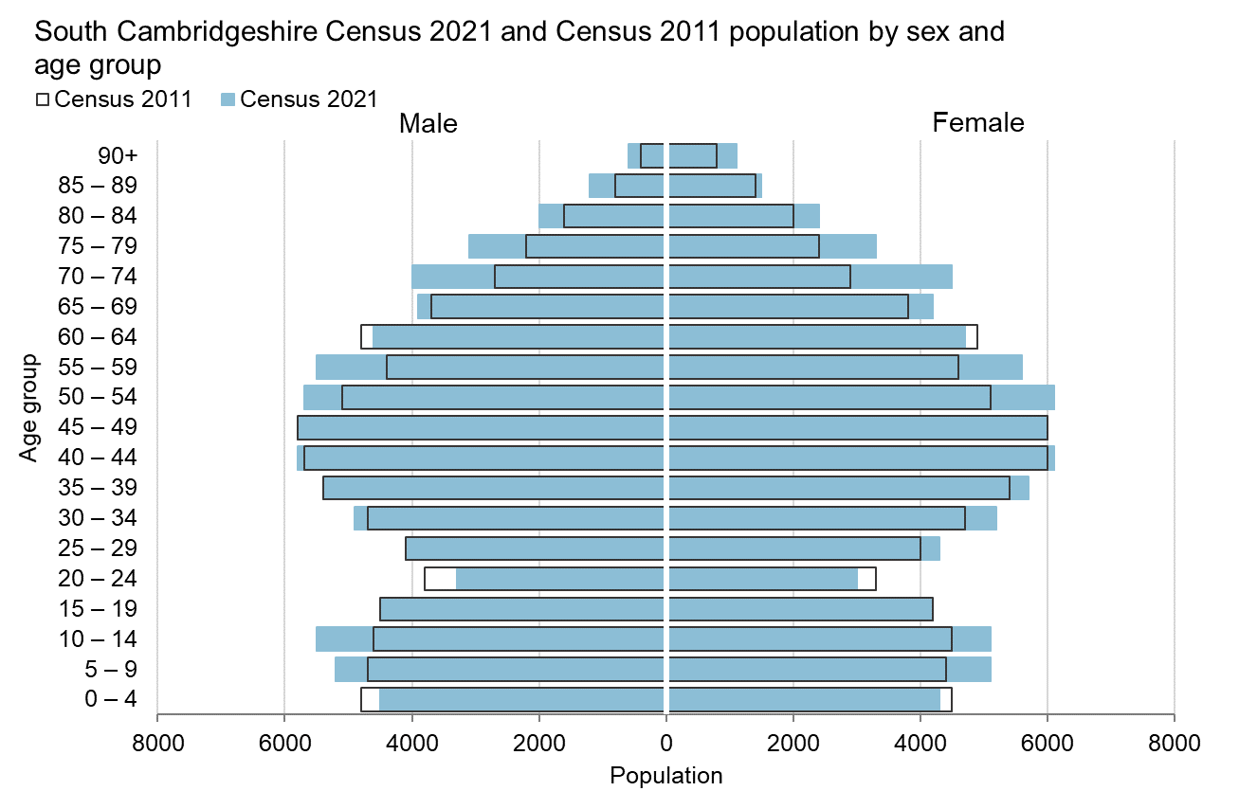
Notes:
Next, South Cambridgeshire. The key trends for South Cambridgeshire shown in this chart are some notable population decreases in the 0-4, 20-24 and 60-64 age groups. In contrast, there has been notable growth for the 5-14, 50-59 and 70-79 age groups.

Slide 37
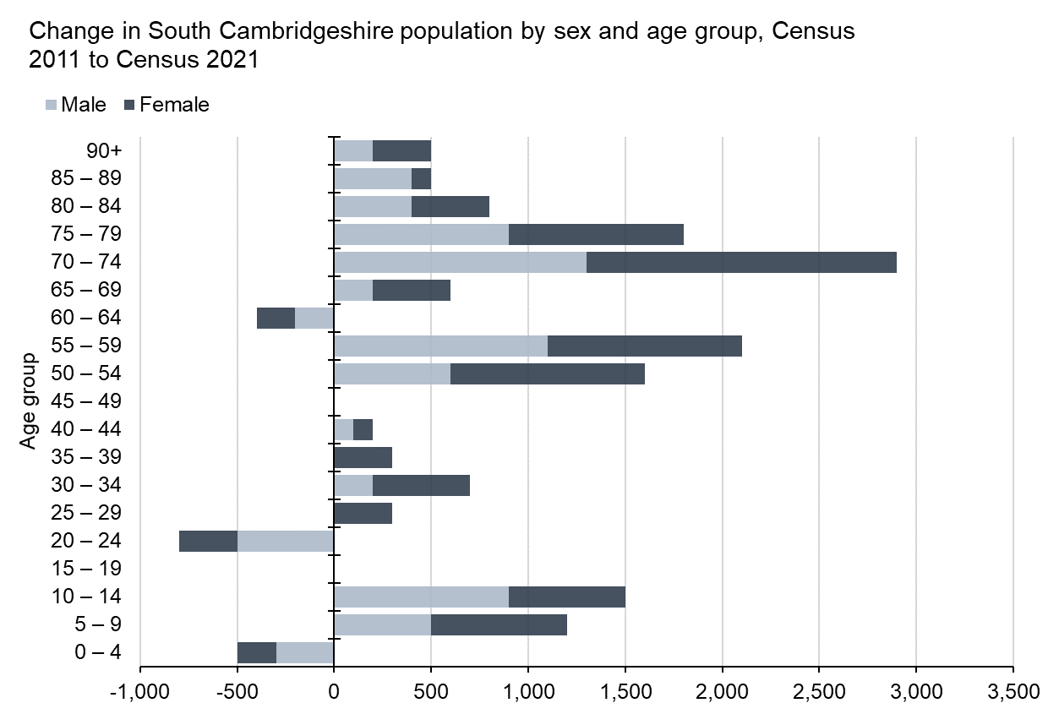

Slide 38
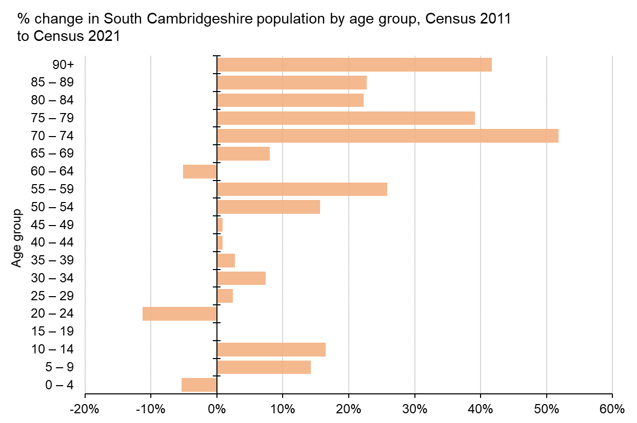
Notes:
For the percentage population change bar chart, the notable trends in South Cambridgeshire are the 52% increase in the population aged 70-74. All age groups for 70 and above have seen population growth of at least 20% since Census 2011. For the population aged 64 and below, there are a mix of increases and decreases. Most notably, an 11% decrease in the population aged 20-24, and population growth of less than 10% in the 25-49 age groups.

Slide 39
Peterborough

Slide 40
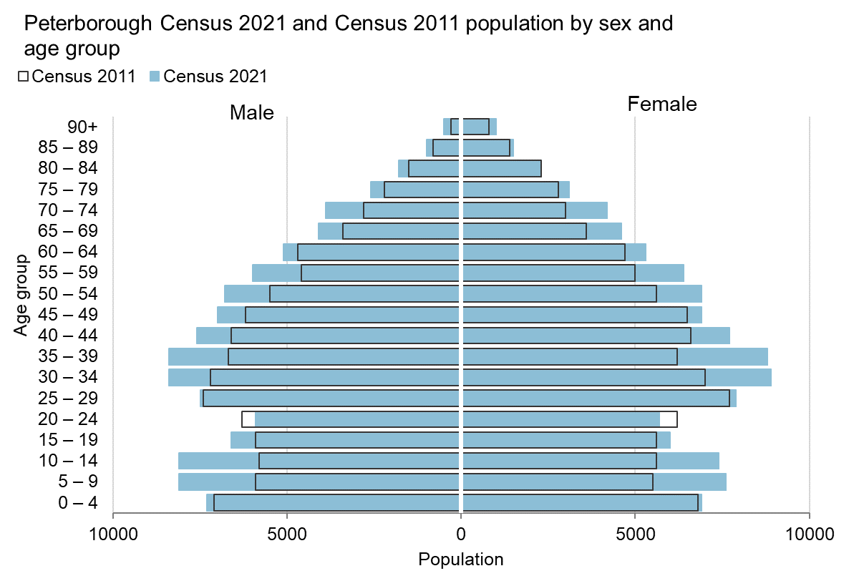
Notes:
Finally, Peterborough. The key trends shown in this chart are that Peterborough has seen population increases for all age groups except for the 20-24 age group, which has decreased. As with Cambridge, growth is more evenly spread between age groups, with notable population increases for the 5-14 and 30-39 age groups.

Slide 41
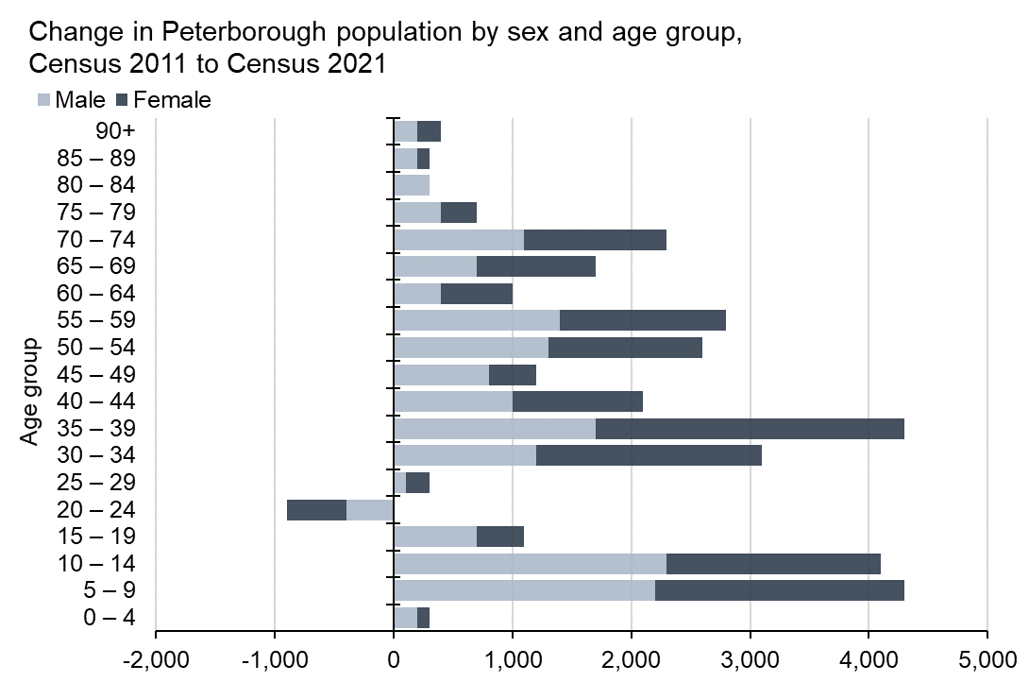

Slide 42
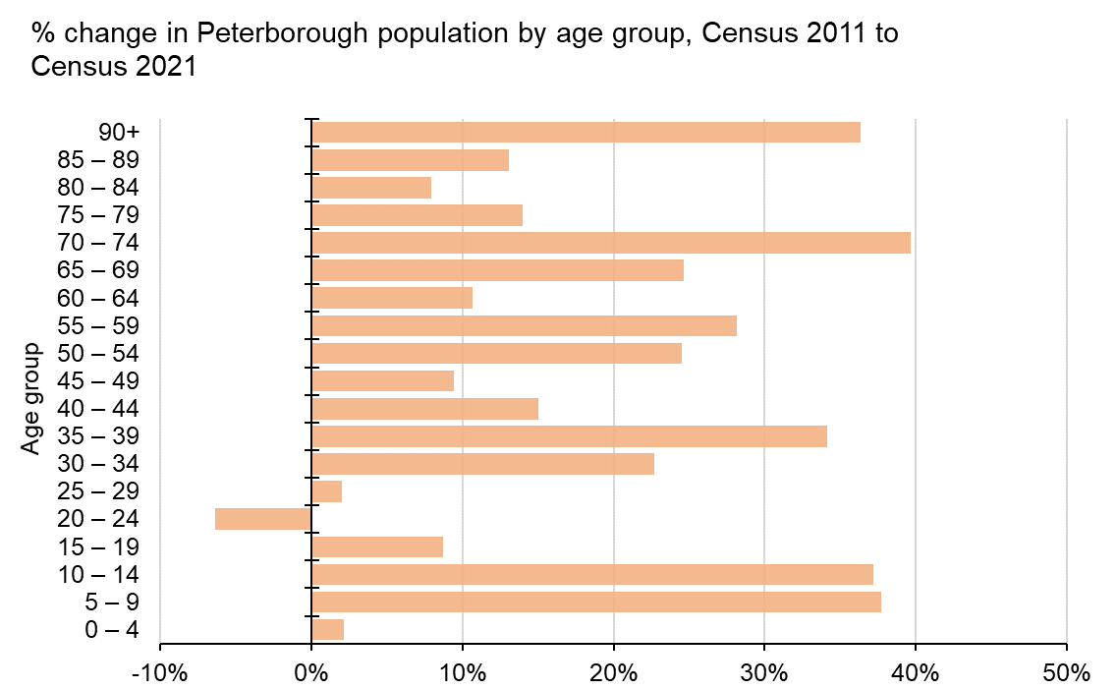
Notes:
For the percentage population change bar chart, this again demonstrates how population growth has been more evenly spread between different age groups. This is demonstrated by population growth of over 30% in the 5-14, 35-39, 70-74 and 90+ age groups.

Slide 43
Summary
The population has increased more in the urban centres;
Very significant population growth in the urban areas, Cambridge and Peterborough (+17% from Census 2011)
Growth in more rural districts ranges between 4.7% and 8.9%
In the rural districts, the over 65 population has grown a lot more than the young and working age population, whereas;
In Cambridge and Peterborough population growth since Census 2011 is more evenly spread across all age groups.
Notes:
To summarise the key findings from the first set of Census outputs are:
Very significant population growth in the urban areas of Cambridge and Peterborough, with these 2 areas seeing some of the highest growth in the country, and this population growth more evenly spread across all age groups
In contrast, population increases in more rural districts are less notable, ranging between 4.7% and 8.9%, and in these districts the over 65 population has grown a lot more than the young and working age population.

Slide 44
When is the next release of data?
8 topic summaries and area profiles, releasing between November 2022 and January 2023:
Demography and migration – 2nd November 2022 (confirmed)
UK armed forces veterans – 10th November 2022 (confirmed)
Ethnic group, national identity, language and religion – 29th November 2022 (provisional)
Labour market and travel to work – 8th December 2022 (provisional)
Housing – 5th January 2023 (provisional)
Sexual orientation and gender identity – 6th January 2023 (provisional)
Education – 10th January 2023 (provisional)
Health, disability, and unpaid care – 19th January 2023 (provisional)
Phase 2, early 2023 – multivariate data
Phase 3, Spring 2023 - data related to alternative population bases, small population data, origin destination data and micro-data
Notes:
More data from Census 2021 will continue to be released. The next Census 2021 data releases will be a series of eight topic summaries, which are datasets grouped by a theme. The ONS will publish the first of these, the topic summary on demography and migration, on 2nd November 2022 and the last by January 2023. Each topic summary will include data tables for single variables (for example, age, household size, country of birth), published down to the lowest geographies where possible. Some of these data tables can be aggregated to administrative boundaries such as wards and parishes, although this may not immediately be available.
We keep our website Cambridgeshire Insight updated with the release order and dates. I will provide some links in the next slide.
Phase 2 will include multivariate data, which are data tables that include more than one variable, and will feature the more complex analysis based on usual resident population. This is expected to be published from early 2023.
Phase 3 will then follow from Spring 2023, and this will see the start of publication of data related to alternative population bases, small population data, origin destination data and micro-data.

Slide 45
Useful links
We have a page for Census 2021 updates and analysis on our website Cambridgeshire Insight: https://cambridgeshireinsight.org.uk/population/census-2021/
Census 2021 data will become available to use in the tools available on Cambridgeshire Insight, such as the Map Explorer and Interactive Reports
The first results are already available in some of these tools, and they will continue to be updated as more Census 2021 data releases
Census 2021 updates and data are also available directly from the ONS website: https://www.ons.gov.uk/census
Notes:
Finally, I would like to share some links to the data and analysis used in this presentation, as well as where you can find further Census 2021 updates.
We have a page for Census 2021 updates and analysis for Cambridgeshire and Peterborough Census data on our website Cambridgeshire Insight, which is where you can find analysis of the first results as covered in this presentation.
Census 2021 data will become available to use in the tools available on Cambridgeshire Insight, such as the Map Explorer and Interactive Reports. The first results are already available in some of these tools, and they will continue to be updated as more Census 2021 data releases, although there will be a short delay between when the data is published and when the tools are updated.
Census 2021 updates, data and resources are also available directly from the ONS website. Some of the resources the ONS is producing for Census 2021 are interactive articles, online game and producing area profiles from Census 2021 data.

