Slide 1
Changing Futures Cambridgeshire & Peterborough
Homelessness
Domestic Abuse
Substance
Misuse
Update 23 September 2022 for CPPSB
Mental
health
Criminal
Justice
Notes:
Tom

Slide 2
Resources: Changing Futures C&P team outline
Changing Future Cambridgeshire & Peterborough governance
Team manager
Learning & Development Manager
Systems Change Manager
Co-production & Lived Exp. Manager
Trusted Persons Network Manager
Programme Manager
Communications Manager
Office manager incl
data / digital support
Lived Experience Facilitator
Trusted Persons Coordinator x 3
Community systems change leaders
People with Lived Experience
Trusted Persons
Key
FTE = full time equivalent
People with Multiple Disadvantage
Funded using CP C&F budget
Exist within system – possible need for a small resource
Notes:
Tom
Funding for full team, approx. one third in place, scaling up to full team ~end March 2023 – recruitment process for Fenland & ECDC - building a new operational partnership there – what interim role will be tasked with over 3 months

Slide 3
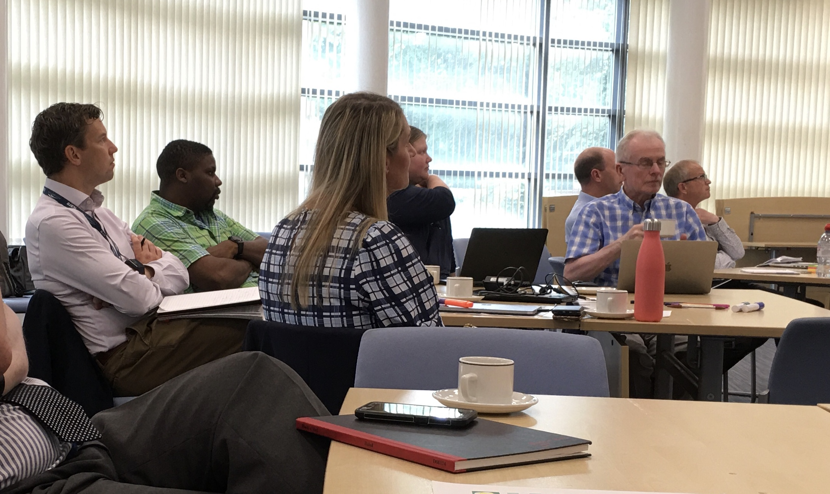
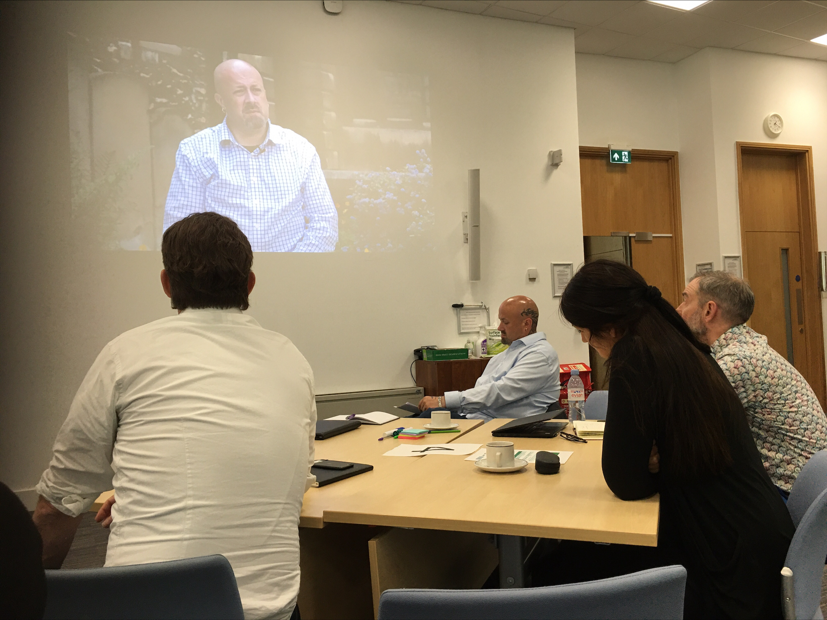
Strategic board and principles: building trust in a complex system
All the organisations
Individuals
Trusted People
The programme
CPSL Mind
Women’s Aid
MEAM
Office of Police & Crime Commissioner
County Council
The Coproduction Group
It Takes a City
Cambs & Peterborough Combined Authority
Clinical Commissioning Group (ICS)
DWP
The Ferry Project
Probation
Cambridge Women's Resource Centre
CGL
Public Health
City & District Councils
Notes:
Sue
Well attended – around 35 participants across sectors, including people with lived experience as part of the governance. First steps to building a movement, changing how we talk about what we do in a “place of safety” so we can share, be honest, learn and come up with solutions. The principles are building trust, recognizing it’s a complex system.
Trust to build between: • Organisations and the programme • Between organisations • Between organisations and the person needing help • Between organisations and trusted persons
Next meeting online on 6 Oct afternoon.

Slide 4
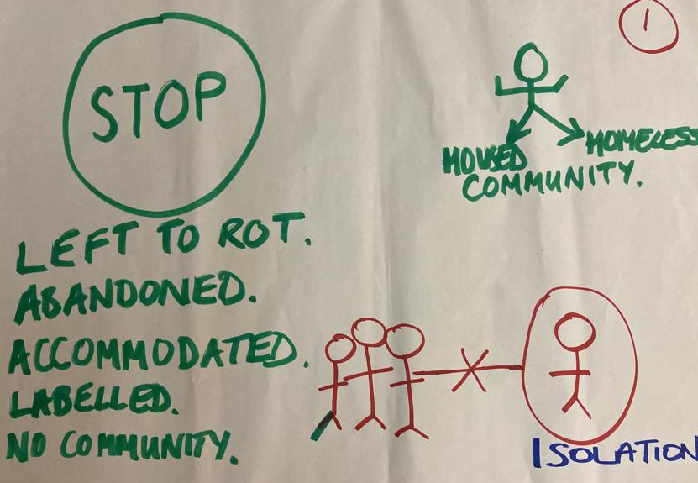
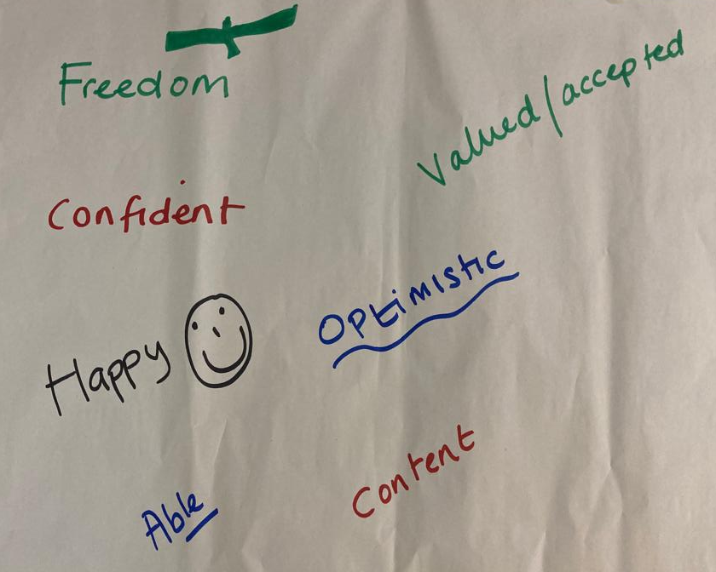
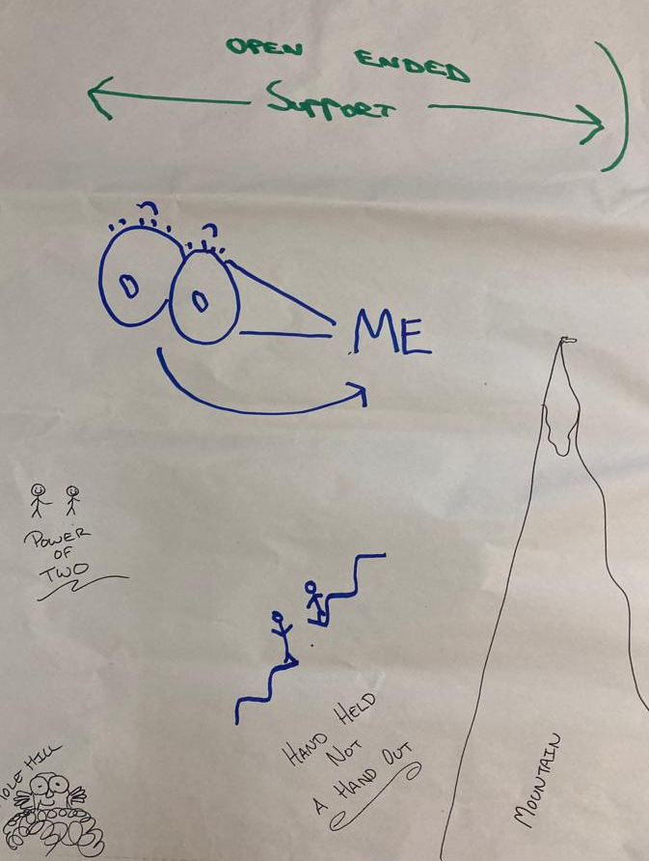
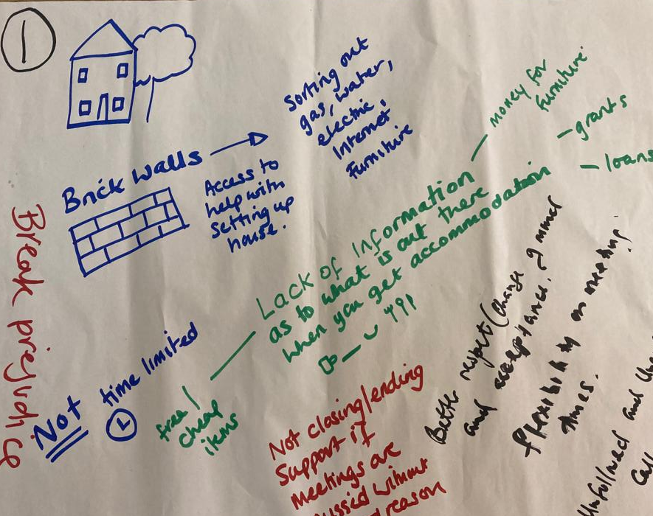
Co production inquiries
Notes:
Tom
1. Ensure everyone has access to support when accommodated – not just in the first few weeks, but ongoing and when they need it. 2. Create a better experience for people experiencing multiple disadvantage in approaching the Council for support with accommodation. 3. Work with the criminal justice systems to make it more trauma informed so as to support people suffering from mental ill health. STRESS INSIGHTS ALREADY EMERGING

Slide 5
Change Forum
Notes:
Tom
Already forming in Peterborough (reflective practice) jut adding resource to provide the support needed. Lessons from op partnerships, inquiry groups, co production groups feed in to Change Forum; starts enabling learning to be used across the system.

Slide 6
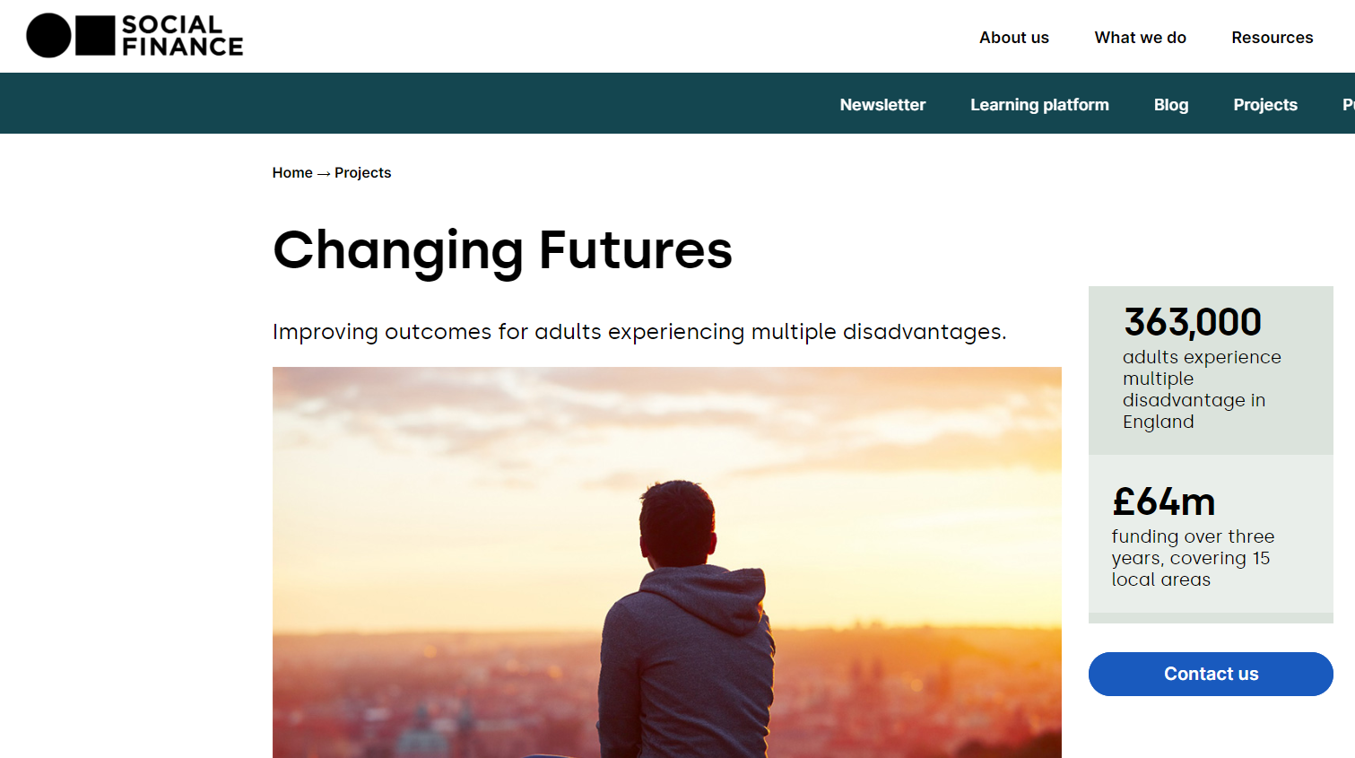
The national programme
Notes:
Sue
Mutual learning between national and local programme, esp data and digital (Val K, Social Finance, Robert on expert panel). National programme has recognized our progress (even without the govt grant), and already has credibility for our progress and as a collective endeavour. Plan to bring progress update to CPPSB early in 2023.

