Slide 1
All-age Autism Needs Assessment
Public Health Team CCC & PCC

Slide 2
Contents
Abbreviations
Definitions
Acknowledgements
1. Executive Summary
Introduction
Aims
Scope
Key findings
Recommendations
2. Introduction
Contextual background
Aims
Autism
Risk Factors
Co-morbidities
Barriers to accessing support
3. National Context
NICE guidance on supporting people with autism
National policy context
4. Local Policy Context

Slide 3
Contents cont.
5. Methods
6. Epidemiological Needs Assessment
Prevalence
ASC in school-aged children
ASC in Adults
Health, social and inequalities in people with ASC
7. Corporative Needs Assessment
Mapping our services: assets and gaps
Insider perspectives
8. Comparative Needs Assessment
Learning from other areas
9. Next steps & recommendations

Slide 4
Abbreviations
ASC | Autistic Spectrum Conditions
CAMHS | Child and Adolescent Mental Health Services
CCC | Cambridgeshire County Council
CCG | Clinical Commissioning Group
CiN | Child in Need
CJS | Criminal Justice System
GP | General Practitioner
EHA | Early Help Assessment
EHCP | Educational Health and Care Plan
HNA | Health Needs Assessments
ICD | International Classification of Diseases
JSNA | Joint Strategic Needs Assessment
LA | Local Authority
NICE | National Institute of Clinical Excellence
NHS | National Health Service
PANSI | Projecting Adult Needs and Services Information
PCC | Peterborough City Council
PHOF | Public Health Outcomes Frames
POPPI | Projecting Older People Population Information
QOF | Quality and Outcomes Framework
SLC | Speech, Language and Communication
UK | United Kingdom

Slide 5
Definitions
Autistic Spectrum Disorder (ASD) | Defined by ICD-11; “persistent deficits in the ability to initiate and to sustain reciprocal social interaction and social communication, and by a range of restricted, repetitive and inflexible patterns of behaviour and interests. The onset of the disorder occurs during the developmental period, typically in early childhood, but symptoms may not become fully manifested until later, when social demands exceed limited capacities. Deficits are sufficiently severe to cause impairment in personal, family, social, educational, occupational or other important area of functioning and are usually a pervasive features of the individuals functioning observable in all settings, although they may vary according to social, educational, or other context. Individuals along the spectrum exhibit a full range of intellectual functioning and language abilities”
Autistic Spectrum Conditions (ASC) | used in some publications as an alternative to ASD as it can be considered the more appropriate wording to reflect the life course experiences of persons with autism. It recognises that although they will have autism throughout their life, it will only impact them at certain times and in differing ways, thus eliminating any perceived stigmatism and promotes their individual strengths
Education, Health and Care Plans (EHCP) | A the legal document outlining a child or young person’s special educational, health and social care needs and what additional help and support is required in order to meet those needs
Learning Disability | having intellectual abilities that result in a person experiencing difficulties with everyday activities. Whilst some people with autism have a learning disability, ASC itself is not considered a learning disability.
Learning Difficulty | learning difficulties (sometimes referred to as specific learning difficulties [SLD]) affect the way information is learnt and processed – examples include dyslexia, dyscalculia, dyspraxia and attention hyperactivity deficit disorder (ADHD). Learning difficulties can occur alongside autism
Special Educational Needs (SEN) | The Children’s and Families Act (2014) defines SEN as “a learning disability or difficulty which calls for special education provision to be made”
ASC is used throughout this needs assessment

Slide 6
1. Executive Summary

Slide 7
Introduction: ASC
Developmental condition characterised through differences in social interactions, perceptions, behaviours, communication and imagination
Affects the way in which a person with ASC understands, functions in and interacts with the environment in which they inhabit
Prevalence is thought to be ~1% of the population
Not considered to be a mental health condition or learning disability, but many people with ASC also have one/or both of these conditions

Slide 8
Aims
Understand the characteristics and health needs of people of all ages living with ASC in Cambridgeshire and Peterborough
Use local and national sources to estimate the numbers of people with ASC and how these numbers are predicted to change with time
Identify the service assets and gaps currently provided including the perspective and insights from service users and their carers
Identify good practice in other areas of the UK
Use the information to identify recommendations and to help inform an All Age Autism Strategy for Cambridgeshire and Peterborough

Slide 9
Scope
1. Estimated prevalence rates of the number of people in Cambridgeshire and Peterborough living with autism, including:
- Those living with co-morbidities
- Trends over time
2. Descriptions of the health and educational needs of people with autism in Cambridgeshire and Peterborough by age:
-Early Years, Childhood and Adolescent (5-24 years)
- Adulthood (25 years +)
3. Mapping of existing services and identification of any potential gaps or opportunities for improvement and stakeholder engagement.
5. Comparison with other regions and identification of “best practices”.
6. Recommendations for CCC and PCC to inform a strategy intent to improve outcomes for people living with autism.

Slide 10
Key Findings
Estimated 5966 adults (25+) with ASC across Cambridgeshire and Peterborough in 2020 which is expected to increase overtime in line with increases in population size (6501 by 2035).
Percentage of cases in the over 65s is set to increase from 25% to 32% by 2035 in line with population changes.
Estimated 1840 school-aged CYPs (aged 5-17) and 2740 CYPs (aged 5-25) in 2020. These numbers are predicted to decrease slightly in the 5-17 category to 1740 but increase overall in the 5-25 category to 2780 by 2035.
In 2019, 1912 children were known to have ASC in state-funded schools (primary, secondary and special). This is slightly higher than the predicted.
Peterborough has a higher rate and Cambridgeshire a lower rate of ASC in primary school aged children compared to the national average. The rate of ASC among secondary school aged children is similar across the region and similar to the national average.
Notes:
Change to 5-24

Slide 11
Key Findings cont.
~14% of CYPs (5-18 years) with ASC also have a form of disability and this is slightly higher in Cambridgeshire (~15%) compared to Peterborough (~10%).
~30% (776) of all community paediatric referrals are for ASC assessments (from CCS). Number of assessments for ASC varies from ~40-80 a month at CCS. CPFT equivalent data not available.
13 CYPs are on the transforming care register (at risk of hospital admission), the majority of girls on the register have an eating disorder and are currently T4 residents and the majority of boys on the register have a challenging behaviour and live at home. All CYPs on the transforming care register have ASC. There are no CYPs on the transforming care register with LD only and no ASC.
For the last 3 years, the number of referrals for diagnostic assessment for ASC in adults has been 3-4 x higher than CPFT is commissioned to perform. Limited post-diagnostic or specialist services commissioned for adults with ASC. Particularly for adults with ASC but without learning disabilities.

Slide 12
Recommendations
All-age Autism Strategy Board: Establishment of a multi-agency All-age Autism Board for Cambridgeshire & Peterborough to provide strategic oversight and co-ordination with clear governance structures and links to operational groups which would report to the Board. One of the responsibilities of the All-Age Autism Board should be to develop an All-Age Autism Strategy for Cambridgeshire and Peterborough which should be co-produced with people with ASC and/or their family members/carers.
Joint commissioning: of seamless and integrated services and improvement on how to navigate through the system for all ages.
Early intervention: needs-led holistic support for children and families as well as building relationships and resilience in families and increasing capacity in assessment and post-assessment support courses. Commissioning of services for CYPs requiring behavioural support and social skills/relationship training for adolescents and young adults with ASC.
Diagnosis: Ensuring that education and healthcare workers are aware of the typical signs of ASC in females to ensure appropriate identification and referral.
Workforce: Increased workforce capacity and increased provision of training and awareness of ASC across the wider workforce as outlined in the Autism Act. ASC training of staff in Education settings is well established across CCC and PCC but more ASC awareness and training is needed among employers and services.
Employment: Increased employment opportunities for people with ASC.

Slide 13
2. Introduction

Slide 14
ASC definition & prevalence
ICD 2019:
"Autism spectrum condition is characterized by persistent deficits in the ability to initiate and to sustain reciprocal social interaction and social communication, and by a range of restricted, repetitive, and inflexible patterns of behaviour and interests. The onset of the disorder occurs during the developmental period, typically in early childhood, but symptoms may not become fully manifest until later, when social demands exceed limited capacities. Deficits are sufficiently severe to cause impairment in personal, family, social, educational, occupational or other important areas of functioning and are usually a pervasive feature of the individual’s functioning observable in all settings, although they may vary according to social, educational, or other context. Individuals along the spectrum exhibit a full range of intellectual functioning and language abilities."
1 % prevalence: increased in recent years, likely to be due to improved diagnostics.
More common in males (maybe due to under-diagnosis in females. See page 73.)
Source: Research Autism. ICD-11 Autism (Autistic Spectrum Disorder). Available at; http://www.researchautism.net/conditions/7/autism-(autism-spectrum-disorder)/Diagnosis

Slide 15
Risk Factors
Genetic and environmental risk factors but none are necessary or sufficient for ASC:
Older parental age at conception
Exposure to chemicals/pollutants during fetal development
Maternal nutritional status during pregnancy (under/over nutrition, and vitamin deficiencies
Prenatal exposure to certain drugs/medication
No evidence of an association between MMR (mumps, measles, rubella) vaccine with autism.
Source: Gialloretti, E.L. Et al. (2019). Risk and Protective Factors Associated with Autism Spectrum Disorder: Evidence Based Principles and Recommendations. Journal of Clinical Medicine. Vol.8. Pp.217-240;
Lai, MC. Lombardo, MV. & Baron-Cohen, S. (2014). Autism. The Lancet. Vol.383. Pp.896-910
Notes:
Gialloretti, E.L. Et al. (2019). Risk and Protective Factors Associated with Autism Spectrum Disorder: Evidence Based Principles and Recommendations. Journal of Clinical Medicine. Vol.8. Pp.217-240. Available at; https://www.ncbi.nlm.nih.gov/pmc/articles/PMC6406684/pdf/jcm-08-00217.pdf
Lai, MC. Lombardo, MV. & Baron-Cohen, S. (2014). Autism. The Lancet. Vol.383. Pp.896-910

Slide 16
Co-morbidities
70% of primary ASC diagnoses have a co-morbidity
Condition | Estimated proportion of people with ASC affected
Developmental
Learning disability | 45%
Attention Hyper Deficit Disorder (ADHD) | 28-44%
Tic disorders (including Tourette’s Syndrome) | 14-38%
Motor abnormality | ≤79%
General Medical
Epilepsy | 8-30%
Gastrointestinal | 9-70%
Immune Dysregulation | ≤38%
Genetic Syndromes | 5%
Sleep Disorders | 50-80%
Source: Lai, MC. Lombardo, MV. & Baron-Cohen, S. (2014). Autism. The Lancet. Vol.383. Pp.896-910
Notes:
Lai, MC. Lombardo, MV. & Baron-Cohen, S. (2014). Autism. The Lancet. Vol.383. Pp.896-910

Slide 17
Co-morbidities cont.
Condition | Estimated proportion of people with ASC affected
Personality Disorders
Anxiety | 42-56%
Depression | 12-70%
Obsessive-compulsive disorders | 7-24%
Psychotic disorders | 12-17%
Oppositional Defiance disorder | 16-28%
Eating disorders | 4-5%
Avoidant Personality Disorder | 13-25%
Behavioural
Aggressive behaviours | ≤68%
Self-harm | ≤50%
Suicidal ideation/intent or attempt | 11-14%
Substance misuse | ≤16%
Source: Lai, MC. Lombardo, MV. & Baron-Cohen, S. (2014). Autism. The Lancet. Vol.383. Pp.896-910
Notes:
Lai, MC. Lombardo, MV. & Baron-Cohen, S. (2014). Autism. The Lancet. Vol.383. Pp.896-910

Slide 18
Barriers to Support
Spectrum: therefore needs vary greatly, also the presence of co-morbidities requires appropriate tailored support
2011 study of ASC in the community found a majority of adults with ASC without a formal diagnosis
People with ASC may face difficulty accessing universal services – mitigated by wide-spread workforce training on ASC awareness
Source: Brugha, TS. Et al. (2011). Epidemiology of Autism Spectrum Disorders in Adults in the Community in England. Journal Archive of General Psychiatry. Vol.68, No.5, Pp.459-465.
Social Care, Local Government and Care Partnership Directorate. (2014). Think Autism: Fulfilling and rewarding lives, the strategy for adults with autism in England – an update. Available at; https://assets.publishing.service.gov.uk/government/uploads/system/uploads/attachment_data/file/299866/Autism_Strategy.pdf

Slide 19
Aims
Understand the characteristics and health needs of people of all ages living with ASC in Cambridgeshire and Peterborough
Use local and national sources to estimate the numbers of people with ASC and how these numbers are predicted to change with time
Identify the service assets and gaps currently provided including the perspective and insights from service users and their carers
Identify good practice in other areas of the UK
Use the information to identify recommendations and to help inform an All Age Autism Strategy for Cambridgeshire and Peterborough

Slide 20
3. National Context

Slide 21
NICE Guidance
ASC in <19 year olds
ASC in adults
Identification
Identification, assessment, diagnosis
Referral
Assessment
Management
Diagnosis
Management
Transition to adult services
Notes:
https://pathways.nice.org.uk/pathways/autism-spectrum-disorder#content=view-node%3Anodes-transition-to-adult-services

Slide 22
NICE Guidance
NICE guidance on ASC in adults: diagnosis and management (2016)
NICE guidance on ASC in under 19s: support and management (2013)
Key principles for working with people with ASC and their families:
Working in partnership
Offering support and care
Building relationships
Training of staff on ASC awareness
Multi-agency local autism strategy group, with representation from people with ASC.
Notes:
https://pathways.nice.org.uk/pathways/autism-spectrum-disorder#content=view-node%3Anodes-transition-to-adult-services

Slide 23
National Policy Context
Autism Act 2009:
National government to develop a nation autism strategy for Adults in England
“Fulfilling and Rewarding Lives” published in 2010 and “Think Autism” in 2014:
Local authorities and health trusts to implement the National Strategy

Slide 24
National Policy Context
“Fulfilling and Rewarding Lives”:
ASC awareness training for staff in public, heath and social care services
Setting up local diagnostic pathway based on NICE guidance and increasing diagnostic capacity
Ensuring adults with ASC and their carers have access to local support and services enabling them to live independently within their community
Person-centred assessment and personalised care and support for those diagnosed with ASC
Supporting CYPs with ASC transitioning in adult services
Supporting adults with ASC into meaningful employment and having a choice and control about where they live
Involve adults with ASC and their carers in the development of local services

Slide 25
National Policy Context
“Think Autism”:
Autism Aware communities: establishing autism awareness projects within local communities
Funding local projects that promote innovative services and preventative support
Raising awareness across public services through ASC awareness training programmes
Improving data collection and sharing between relevant services
Local authorities required to improve services for adults with autism and to implement the National Autism Strategy (possibly through setting up an “Autism Partnership Board”.
Notes:
Partnership Board)

Slide 26
4.Local Context

Slide 27
Local Policy Context
Cambridgeshire and Peterborough aim to help people to live independent lives in the community; to protect the most vulnerable in society and to provide support to people when they need it most.
Currently there are three strategies for ASC across Cambridgeshire and Peterborough. Cambridgeshire has one strategy for CYPS (2016) and one for adults and Peterborough had one strategy for all ages (2018, still in draft) and there are three ASC strategy boards.
The degree of co-production of these strategies has been inconsistent.
While training is available to improve ASC awareness among health and social care staff, these courses only occur a few times a year.

Slide 28
5. Methods

Slide 29
Type of Needs Assessment
Epidemiological:
Department of Education (2018-2019)
CCG/service data (Liquid Logic)
National prevalence estimates applied to local data (Poppi and Pansi)
Corporate:
Engagement with service users and their families/carers
Mapping of services and identifying gaps
Comparative:
Comparison with services offered in other areas
Identifying best practices
Notes:
and

Slide 30
Data
Source | Purpose
Literature Review | Risk factors, guidance, best practice
Poppi/Pansi | ASC prevalence predictions
Department for Education** | ASC in school-aged children
ONS | Population estimates
Fingertips | Local ASC prevalence compared with other areas
Liquid Logic | ASC and children with disabilities
CCG | Adult referrals and diagnoses
CCS | ASC community paediatric referrals
PinPoint & Family Voice | Service user feedback
**Limitations: only information from state funded schools
Notes:
and

Slide 31
6.Epidemiological Needs Assessment

Slide 32
ASC Prevalence

Slide 33
CYP Prevalence estimates 2019
NB: prevalence estimates of ASC in 0-4 year olds is unavailable as ASC assessments tend to occur from the age of 5+
Prevalence | 5-10 year olds ¹ | 11-16 year olds ¹ | 17-19 year olds ¹ | 20-24 year olds ²
Boys | 2.5% | 1.8% | 1.0% | 2.2%
Girls | 0.4% | 0.7% | 0.0% | 0.7%
Total | 1.5% | 1.2% | 0.5% | 1.5%
Local Authority | Estimated number of children and young people
 | 5-10 year olds | 11-17 year olds | 18-24 year olds | Total
Cambridge | 130 | 100 | 320 | 550
East Cambridgeshire | 110 | 90 | 70 | 260
Fenland | 100 | 90 | 90 | 280
Huntingdonshire | 190 | 160 | 140 | 490
South Cambridgeshire | 190 | 160 | 110 | 460
Cambridgeshire | 720 | 600 | 730 | 2,040
Peterborough | 280 | 200 | 170 | 660
Total | 1000 | 800 | 900 | 2700
Source: ¹Mental Health of Children and Young People in England, 2017 and mid 2019 population estimates, Office for National Statistics and ²Adults Psychiatric Morbidity Survey, 2014, NHS Digital
Notes:
These prevalence estimates are much lower than the % on slides 45 onwards

Slide 34
CYP Prevalence cont.
Cambridgeshire | 2019 | 2020 | 2025 | 2030 | 2035
5-10 years | 720 | 720 | 680 | 640 | 620
11-17 years | 600 | 620 | 680 | 660 | 620
18-24 years | 730 | 720 | 710 | 800 | 830
Total | 2,040 | 2,060 | 2,080 | 2,100 | 2,070
Peterborough | 2019 | 2020 | 2025 | 2030 | 2035
5-10 years | 280 | 290 | 280 | 260 | 260
11-17 years | 200 | 210 | 260 | 260 | 240
18-24 years | 170 | 170 | 170 | 200 | 220
Total | 660 | 680 | 710 | 720 | 710
Totals | 2019 | 2020 | 2025 | 2030 | 2035
Cambridgeshire & Peterborough 5-17 years | 1800 | 1840 | 1900 | 1820 | 1740
Cambridgeshire & Peterborough 5-24 years | 2,700 | 2,740 | 2,790 | 2,820 | 2,780
Source: Mental Health of Children and Young People in England, 2017 and mid 2019 population estimates, Office for National Statistics and Adults Psychiatric Morbidity Survey, 2014, NHS Digital

Slide 35
Adult Prevalence
Cambridgeshire | 2019 | 2020 | 2025 | 2030 | 2035
25-34 years | 852 | 850 | 818 | 778 | 805
35-44 years | 826 | 825 | 845 | 851 | 824
45-54 years | 910 | 900 | 847 | 832 | 860
55-64 years | 795 | 815 | 881 | 869 | 826
65-74 years | 664 | 664 | 668 | 787 | 824
75+ years | 520 | 542 | 674 | 749 | 835
Total population 25 years + | 4567 | 4596 | 4733 | 4866 | 4974
Peterborough | 2019 | 2020 | 2025 | 2030 | 2035
25-34 years | 314 | 313 | 294 | 277 | 286
35-44 years | 291 | 294 | 312 | 314 | 299
45-54 years | 260 | 261 | 263 | 276 | 293
55-64 years | 211 | 215 | 237 | 242 | 240
65-74 years | 161 | 163 | 170 | 193 | 211
75+ years | 120 | 124 | 153 | 174 | 198
Total population 25 years + | 1357 | 1370 | 1429 | 1476 | 1527
Cambridgeshire & Peterborough 25 year + | 5924 | 5966 | 6162 | 6342 | 6501
Source: Pansi and Poppi

Slide 36
ASC in >65 year olds
Percentage of predicted ASC cases to be aged 65+ from 2019-2035
 | 2019 | 2020 | 2025 | 2030 | 2035
Cambridgeshire | 26 % | 26 % | 28 % | 32 % | 33 %
Peterborough | 21 % | 21 % | 23 % | 25 % | 27 %
Cambridgeshire and Peterborough | 25 % | 25 % | 27 % | 30 % | 32 %
Source: Pansi and Poppi

Slide 37
ASC in school-aged children

Slide 38
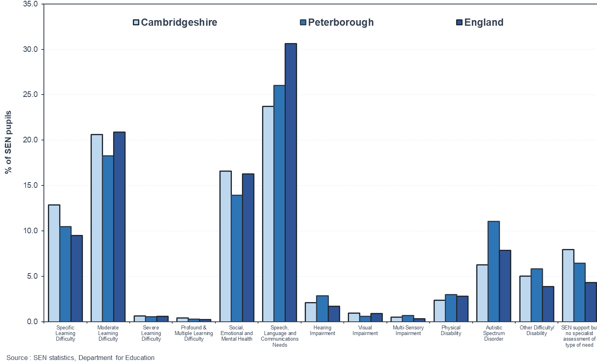
Primary School Aged children
 | Number of children with ASC | % of SEN with ASC | Rate of ASC per 1000 pupils
England | 52,808 | 7.9% | 11.2
Cambridgeshire | 447 | 6.3% | 8.6
Peterborough | 316 | 11.1% | 11.2
Notes:
Missed diagnosis in Cambridgeshire?

Slide 39
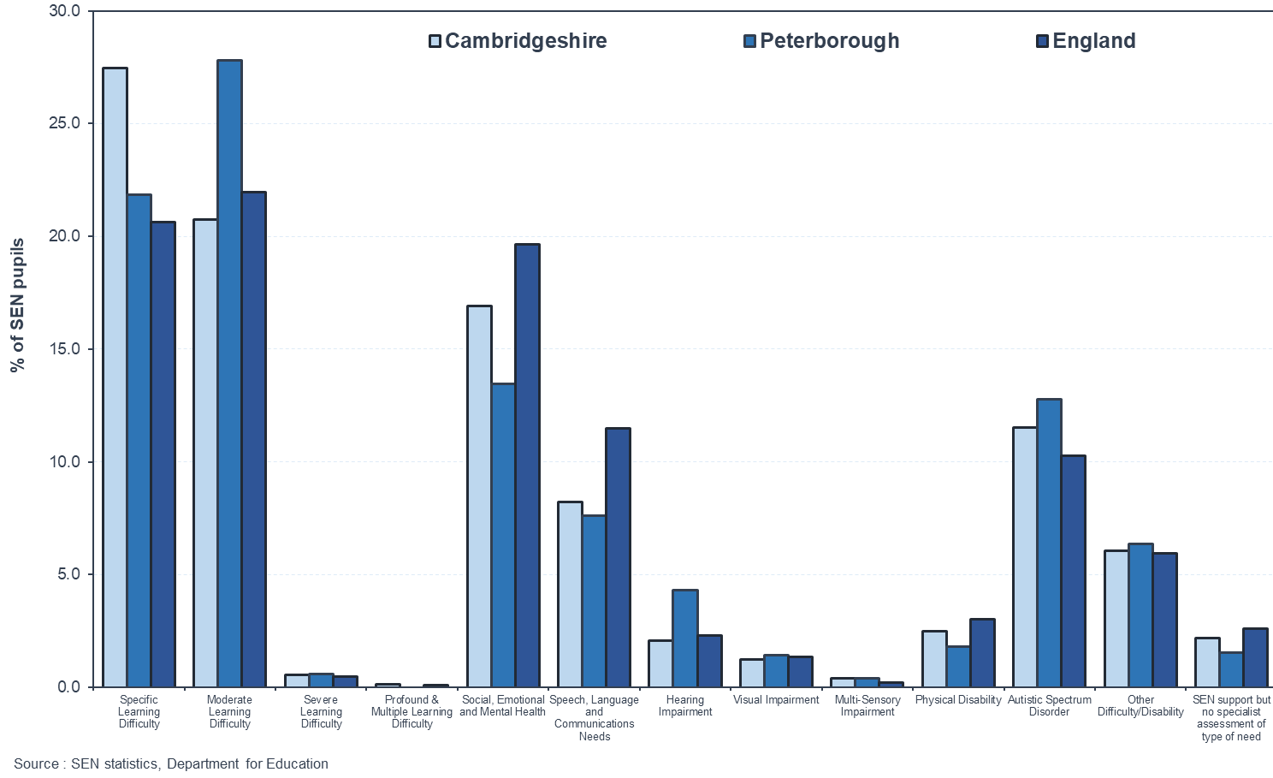
Secondary School Aged Children
 | Number of children with ASC | % of SEN with ASC | Rate of ASC per 1000 pupils
England | 42,555 | 10.3 | 12.8
Cambridgeshire | 440 | 11.5 | 13.4
Peterborough | 213 | 12.8 | 13.3

Slide 40
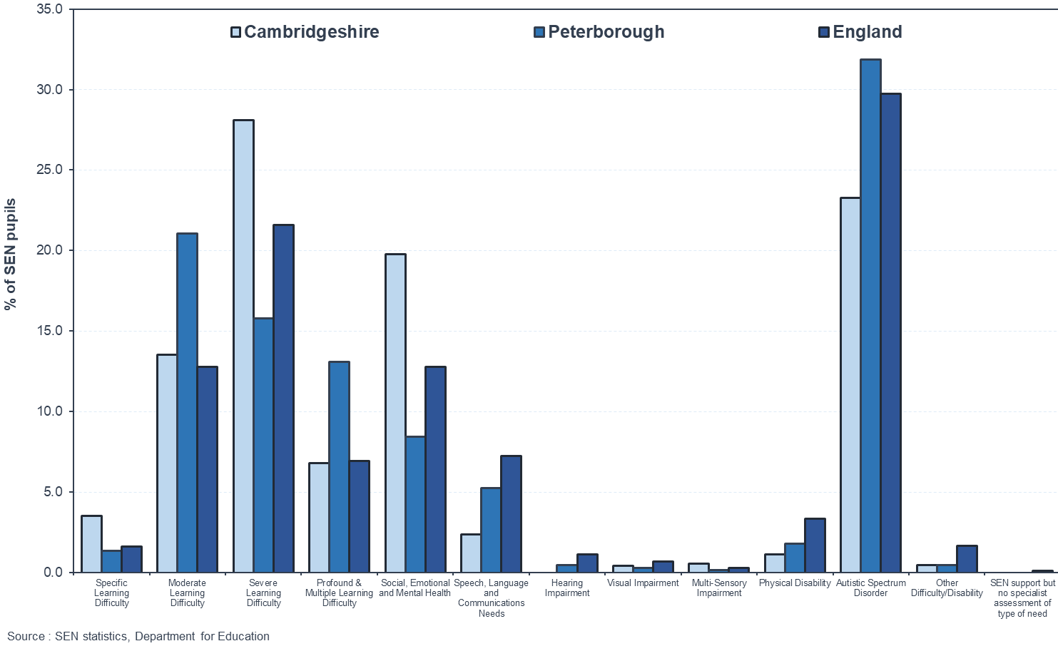
Special School Children
 | Number of children with ASC | % of SEN with ASC | Rate of ASC per 1000 pupils
England | 36,982 | 29.8 | 303.8
Cambridgeshire | 284 | 23.3 | 232.8
Peterborough | 212 | 31.9 | 318.3
Notes:
Underdiagnosis in Cambridgeshire?

Slide 41
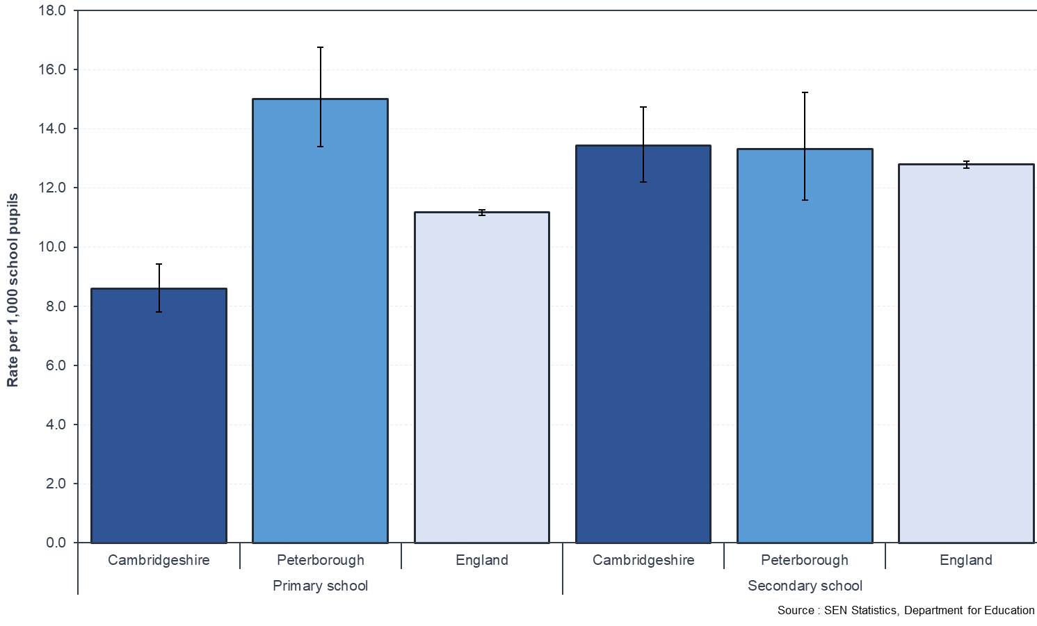
Rate of ASC per 1000 school pupils

Slide 42
All school aged children
 | Number of school aged children with ASC* | Rate of ASC per 1000 pupils*
England | 132,345 | 16.2
Cambridgeshire | 1,171 | 13.6
Peterborough | 741 | 19.6
Cambridgeshire & Peterborough School aged children with ASC | 1912
Predicted number based on national prevalence | 1800
*Includes state funded primary, secondary and special schools. Source: DfE, State funded schools. January 2019

Slide 43
CWD and ASC (5-18 years)
 | Total ASC | Total CWD | Total CWD with ASC | % of CWD with ASC | % of ASC with CWD**
Cambridgeshire | 1,171 | 463 | 174 | 37.6% | 14.8%
Peterborough | 741 | 295 | 76 | 25.8% | 10.3%
Cambridgeshire & Peterborough | 1,912 | 758 | 250 | 32.9% | 13.7%
**Likely to be an underestimation.
Source: CWD data is obtained from Liquid Logic CCC & PCC, Snap-shot 30/06/2020. 5-18 years of age

Slide 44
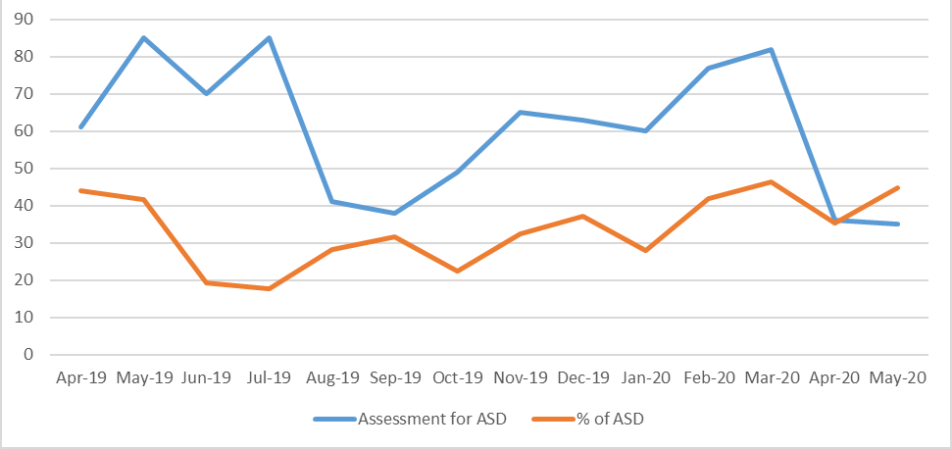
Annual Assessments for ASC in CYPs in Cambridgeshire (CCS)
CCS has an 18 week pathway from accepting a referral to first appointment.
Although not all referrals are accepted (prioritisation based on need and younger age)
~30% of ASC assessments are are in females
Annual Assessments in Cambridgeshire 2019-2020
Annual assessments for ASC: | 776 (29% of all community paediatric assessments)

Slide 45
Transforming Care Register
Characteristics | Description
Males | 57% challenging behaviour
Females | 66% eating disorder
All CYPs on the transforming care register have ASC. There are no CYPs on the transforming care register with LD only and no ASC.
Source: CCG- Transforming Care Register Jun 2020, CYPs ASC who are at risk of hospital admission to T4* (mental health inpatient setting)
Notes:
Do we need more information on those in T4?

Slide 46
ASC in adults

Slide 47
Adult referral/diagnosis
Year | No. of referrals | No. of diagnostic assessments | % People who get a diagnosis
2016-2017 | 386 | 144 | 87.50%
2017-2018 | 349 | 135 | 81%
2018-2019 | 453 | 132 | 79.50%
Substantial mismatch in supply and demand of number of diagnostic assessments commissioned
Source: CCG 2020

Slide 48
Adult characteristics data: PCC
95 adults (18-64) with open cases on Mosaic database at PCC
79 % are white British
11 % are Asian or Asian British
4 % are Black or Black British
4 % mixed ethnicity
2 % unstated ethnicity
79 % for learning disability support
3 % for disability support
5 % for mental health support
2 % for physical support
5 % for social support
6 % for support unknown

Slide 49
Health, Social and Inequalities in people with ASC

Slide 50
Health inequalities and ASC
People with ASC are more likely to experience health inequality compared with those without ASC¹. Contributing factors include:
lower attainment at schools
greater unemployment, social exclusion and
less access to housing.
Studies have shown that life expectancy in ASC is lower than the general population (54 vs 70 years respectively)² and are 7.5x more likely to die by suicide.
Improving access to education, health and social care services may help to reduce the health inequalities.
¹Shropshire Council. Shropshire Autism Needs Assessment for Children and Young People Aged 0-25. 2016. Available from: http://www.shropshiretogether.org.uk/wpcontent/uploads/2016/05/Final-Shropshire-Autism-Needs-Assessment-edited-Jan2016.pdf
²Hirvikoski T, Mittendorfer-Rutz E, Boman M, Larsson H, Lichtensten P, Bolte S. Premature mortality in autism spectrum disorder. The British Journal of Psychiatry. 2016;208(3):232-238.

Slide 51
Co-morbidities and health needs
Condition | Estimated proportion of people with ASC affected¹ | Estimated numbers in Cambridgeshire and Peterborough in 2020
Developmental
Learning disability | 45% | 3917
Attention Hyper Deficit Disorder (ADHD) | 28-44% | 2437-3831
Tic disorders (including Tourette’s Syndrome) | 14-38% | 1219-3308
Motor abnormality | ≤79% | 6878
General Medical
Epilepsy | 8-30% | 696-2612
Gastrointestinal | 9-70% | 784-6094
Immune Dysregulation | ≤38% | 3308
Genetic Syndromes | 5% | 435
Sleep Disorders | 50-80% | 4353-6945
¹Co-morbidity prevalence in ASC obtained from: Lai MC, Lambardo MV, Baron-Cohen S. Autism. The Lancet. 2014;383:896-910.

Slide 52
Co-morbidities and health needs
Condition | Estimated proportion of people with ASC affected¹ | Estimated numbers in Cambridgeshire and Peterborough
Personality Disorders
Anxiety | 42-56% | 3656-4875
Depression | 12-70% | 1045-6093
Obsessive-compulsive disorders | 7-24% | 609-2089
Psychotic disorders | 12-17% | 1044-1480
Oppositional Defiance disorder | 16-28% | 1393-2437
Eating disorders | 4-5% | 348-435
Avoidant Personality Disorder | 13-25% | 1132-2176
Behavioural
Aggressive behaviours | ≤68% | 5919
Self-harm | ≤50% | 4352
Suicidal ideation/intent or attempt | 11-14% | 957-1218
Substance misuse | ≤16% | 1393
¹Co-morbidity prevalence in ASC obtained from: Lai MC, Lambardo MV, Baron-Cohen S. Autism. The Lancet. 2014;383:896-910.
Notes:
Lai, MC. Lombardo, MV. & Baron-Cohen, S. (2014). Autism. The Lancet. Vol.383. Pp.896-910

Slide 53
7. Corporate Needs Assessment & Service Mapping

Slide 54
Services, assets and gaps

Slide 55
Service mapping: CYPs
Healthy Child Programme (0-19 yrs):
Provides information and phone line for support for all health. C&P
CAMHS: Mental health support for CYPs. Referred to the service via MASH. C&P
Early Support: multiagency coordination of care for children with significant lifelong developmental conditions including ASC. C&P
FCAMHS: Mental health support for <18 year olds with concerning behaviours that may be at risk to others. Referred to by professional (e.g. social care or education). C&P
CHUMS: Emotional and mental health. Self-referral. C&P
Post assessment support Preschool: SCILS multiagency (education and health) educational and support course for parents of children 0-5 yrs with ASC /or social communication difficulties (online Covid offer in development)
Continuing Care: Health Support or Funding for CYP not met by HCP. Continuing care assessments. C&P
Portage: Home-visiting educational service for pre-schoolers with additional needs. Peterborough.
Transforming Care: Support for CYPs with an LD and/or ASC who are at risk of hospital admission to T4 to have support at home where possible. Referral to this service initially for a CETR. C&P
Post assessment support primary school age: Cygnet multiagency educational and support course for parents of children 6-11yrs with ASC /or significant social communication difficulties (online Covid version running)
SALT assessment: diagnostic assessment and SLT offer of advice for communication impairments for preschool children
Health Visiting: support on sleep and managing challenging behaviours including eating
Locality Team/Family Workers support (universal/targeted)
Social care disabilities team

Slide 56
Service mapping: National/Charities/Parents
Autism Support App:
App designed to support people with ASC and carers.
Family Voice: Support for parents/carers of a CYP with SEND. Peterborough
Romsey Mill Youth Club: for children with ASC 8 yrs (Cambridge region only)
National Autistic Society: Online information for anyone with ASC and carers.
Pinpoint: Support for parents/carers of CYPs with additional needs or disability. Cambridgeshire
Parent Relate: Support for parents/carers of CYPs with ASC in Peterborough, Self-referral.
Contact a Family: Support for families of CWD

Slide 57
CYPs: Assets
Early help and diagnosis of ASC in children has good partnership working.
Self-assessment completed by both LA on current assessment of statutory duties ( September 2018 )
Development of transforming care services for Children with ASC and complex needs
Good parent/carer groups with regular workshops
Some training in ASC awareness:
Cambridgeshire County Council holds a Strategic Partner and Training Hub licence from the Autism Education Trust (AET) to train educational professionals in Early Years Settings, Schools and Post-16 settings. The trainers are all Educational Psychologists, Specialist Teachers, and Specialist Practitioners within the SEND Service 0-25 and train ~ 1000 educational professionals in Cambridgeshire per year.
Medehamstede School in Peterborough is delivering training (through AET) to Early Years settings and school across Peterborough.

Slide 58
CYPs: Gaps
Behaviour support services for children with ASC especially for those with aggression and violence - current supports are Family Worker at targeted level only with no route for escalation
Large number of families who fall into a gap between universal/targeted services and high level specialist services e.g. CAMH - if they don't have a mental health problem.
Insufficient capacity in assessment services for school-aged children
Difficulty accessing mental health services for CYPs with ASC as the threshold is high and ASC may be an additional barrier.
Capacity of Cygnet and SCILS courses is insufficient to meet demand and are commissioned/funded beyond core provision of overall services. There are long waiting lists for these courses and this has been exacerbated by Covid-19.
Social skills/relationship training for adolescents and young adults across C&P
CYPs who have experienced adversity in early life and require multi-agency support are often not accepted as their needs are attributed to their early life events and therefore they do not meet the eligibility criteria required to access commissioned services for developmental and mental health conditions.

Slide 59
CYPs: Gaps
Central way to collect local information on need with partners on ASC
Improvement on how to navigate through the system when first needing help
Better training and awareness of the needs of people with ASC across the wider workforce. ASC training of staff in Education settings is well established across CCC and PCC but more ASC awareness and training is needed among employers and services
More co-production of the recommendations and development of services with people with ASC and their families
Early intervention and support and building resilience in families- improved support services particularly around behaviour both parents, schools and children (to prevent absences from school due to mental health or behavioural problems)
Improved transition from child to adult services
Improving work and employment opportunities
Lack of services for CYPs with an ASC diagnosis who don't have an EHCP, are not eligible to Social Care and do not have a Continuing Care need
Need for more preventative services for CYPs with “ASC only” diagnoses

Slide 60
Adults with ASC and no LD: Assets & gaps
NICE Recommended Function | Local Availability | Is it a gap?
Specialist diagnostic and assessment services | Service available | Demand Capacity mismatch
Early identification, preventative (including post diagnostic) specialist care and interventions | Not commissioned, service provides only in exceptional circumstances, by bespoke arrangement | yes
Advice and training to other health and social care professionals on the diagnosis assessment, care and interventions for adults with autism (as not all may be in the care of a specialist team) | Not commissioned, service provides only in exceptional circumstances by bespoke arrangement, “National culture” of exclusion from generic mental health services if not MH primary need | yes
Support in accessing, and maintaining contact with, housing, educational and employment, and social care | Commissioned locally by the local authorities = Autism Adult Team in Cambridgeshire only Health inequality for people living in Peterborough | yes
Support to families, partners and carers where appropriate | CPFT service - Not commissioned, service provides only in exceptional circumstances, by bespoke arrangement Social care service commissioned | CPFT – yes Social care - no
Care and interventions for adults with autism living in specialist residential accommodation | Not commissioned, service provides only in exceptional circumstances, by bespoke arrangement | Yes
Training, support and consultation for staff who care for adults with autism in residential and community settings. | Not commissioned, service provides only in exceptional circumstances, by bespoke arrangement | Yes
Source: CCG 2020.

Slide 61
Adults with ASC and no LD: assets & gaps cont.
Role, Recommended by NICE | Local Availability | Is it a gap
clinical psychologists | Yes, but for assessment only, not enough | Yes
nurses | No | Yes
occupational therapists | No | Yes
psychiatrists | Yes, but for assessment only, not enough | Yes
social workers | Yes | No
speech and language therapists | No | Yes
support staff (for example, staff supporting access to housing, educational and employment | Social Care – Yes CPFT - No | No Yes
services, financial advice, and personal and community safety skills). | Social care – Yes | Partial (demand)
Source: CCG 2020.

Slide 62
Adults with ASC and a Learning Disability
The learning and disability partnership (LDP) provides supports with housing, employment and social care for adults with ASC who also have a LD.
LDP also provides specific services for adults with ASC who also have a LD. These include: psychologists, psychiatrists (for pre- and post-diagnostic support), nurses and speech and language therapists.
LDP also provides advice and training on ASC for staff in provider services

Slide 63
Service User (& Family member) Experience

Slide 64
Adults Experience
Long waiting lists for diagnosis
No post-diagnostic support
Need to travel to London for specialist interventions
Source: CCG 2020.

Slide 65
CYP & Carer Experience
Diagnosis for girls is more difficult
No post-diagnostic support. Given a diagnosis with no explanation as to what it means
Navigating the system is difficult- EHCP process is too complicated
Long waiting lists for Webster-Stratton
The Croft is excellent!
Too many professionals involved in EHCP process
Large focus on education attainment – not appropriate for ASC
Source: PinPoint & Family Voice

Slide 66
CYP & Carer Suggestions
More support for adolescents with ASC
Booklet for parents/carers for post diagnosis of CYP with an explanation of the local offer, links to websites & charities
Support for parents to be able to support their CYP
Parent support groups
Sex education, life skills training tailored for ASC
Better ASC awareness for mainstream schools
Family support workers to use the “Croft” approach
Source: PinPoint & Family Voice

Slide 67
8. Comparative Needs Assessment

Slide 68
Comparing with other areas

Slide 69
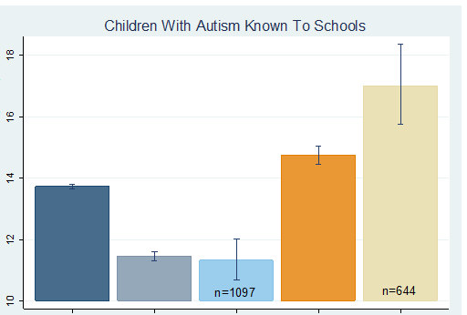
Comparing with other areas for CYPs
Rate of ASC among school aged children:
higher in Peterborough compared to the National average and their nearest neighbours.
Lower in Cambridgeshire compared to the national average.
Children with autism/1000 children (95% CI)
England Cambridgeshire Cambridgeshire Peterborough Peterborough Nearest Neighbours Nearest Neighbours
Source: Fingertips 2018

Slide 70
Recommendations from other areas/organisations.

Slide 71
NHS England Recommendations
Source: NHS England and NHS improvement Autism Diagnosis and Support

Slide 72
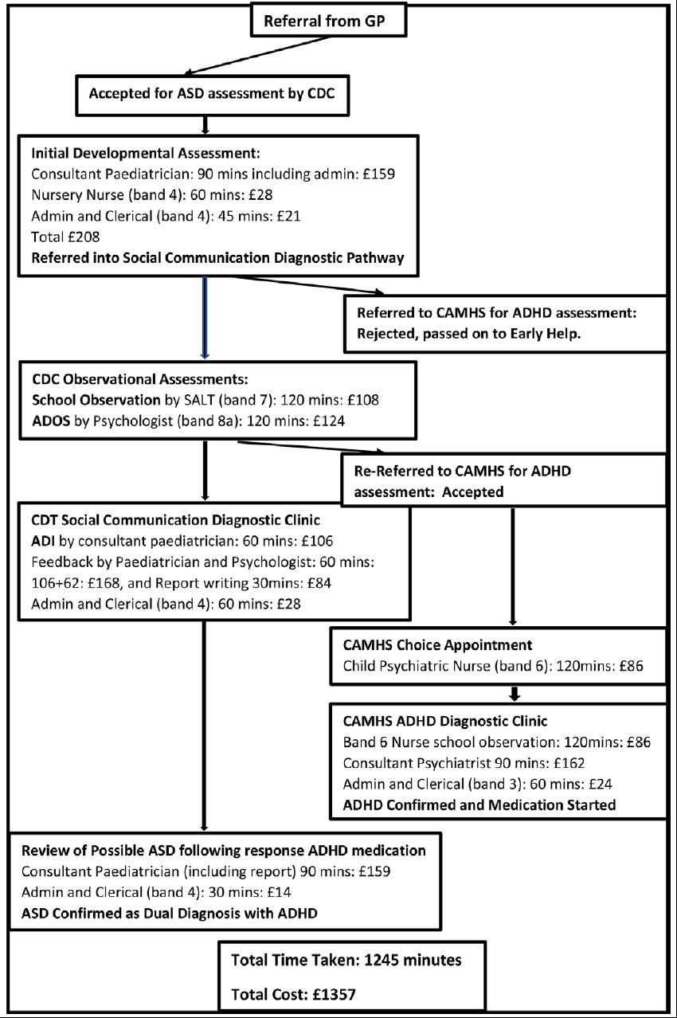
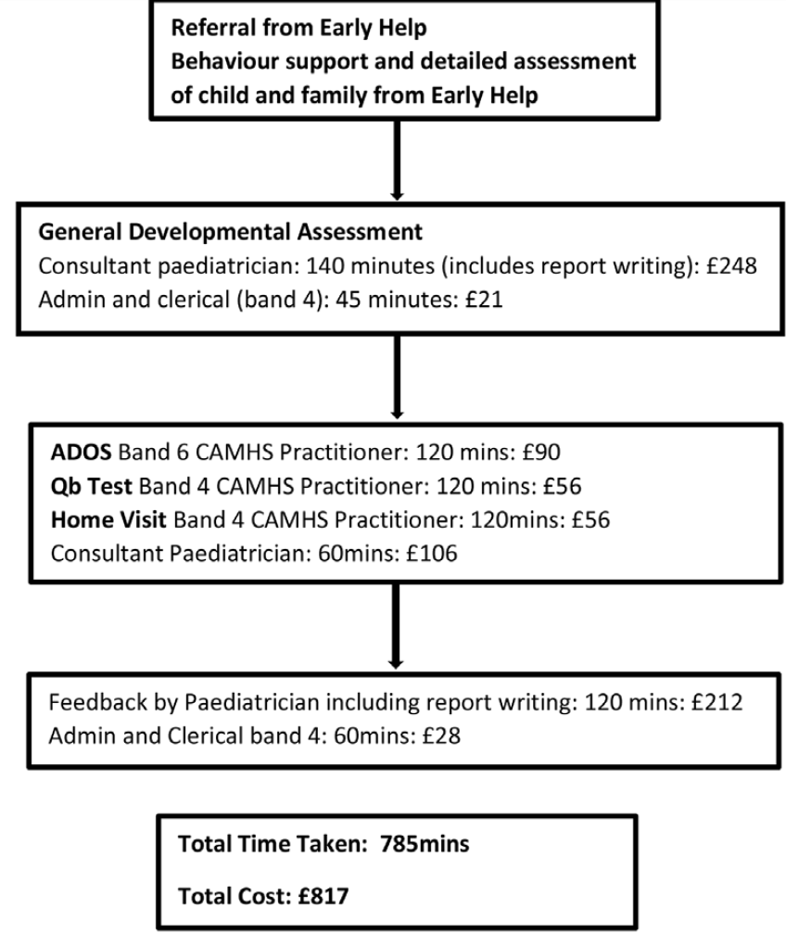
ASC assessment in CYPs: Integrated vs non- integrated approach
Using an integrated approach makes the process cheaper and quicker
Source: Ian Male et al. Should clinical services for children with possible ADHD, autism or related conditions be delivered in an integrated neurodevelopmental pathway? Integrated Healthcare Journal. 2020

Slide 73
Autistica Recommendations
Austistica (UK autism research charity) recommendations for CYPs with ASC:
Threshold for access to CAMHS too high: many CYPs with ASC and mental health needs have been denied access to CAMHS.
Keyworkers: keyworker support should focus on identifying mental health needs early on to prevent escalation
Eating disorders and ASC: 1 in 5 women with anorexia in eating disorder services may also have ASC and so their eating disorders may have different underlying causes.
Diagnosing ASC in women and girls: women and girls have been reported to be diagnosed later, and are less likely to be diagnosed than male counterparts with similar levels of autistic traits. Due to:
biases in the design and application of autism diagnostic tools and gender-specific stereotypes around ASC
women and girls with ASC have been found to hide autistic traits leading to the absence of or a much later diagnosis.
Source: Midlands Transforming Care review

Slide 74
Autistica Survey Result
Supporting people with neurodevelopment disorders. Recommendations:
Diagnosis: waiting times for diagnoses are very long and diagnostic pathways should take account of high levels of multi-morbidity and waiting times should be time limited and monitored.
Support: people with neurodevelopmental conditions and their families are often inadequately supported in many areas of their lives. At diagnosis, people should be informed about what their diagnosis is likely to mean for them and which other conditions or challenges they might experience. Public services of all kinds should take greater account of the needs of people with neurodevelopment disorders through better training, reasonable adjustments and proactive supports.
Research: greater investment is needed in research into neurodevelopmental conditions. Research funders should seek to increase their impact by identifying opportunities to tackle challenges which cross diagnostic boundaries. Further research to understand the true overlap between conditions and the common challenges faced by people with neurodevelopmental conditions should be undertaken, both to improve outcomes and to suggest new ways to deliver more joined-up diagnosis and services.
*56% of the survey participants had ASC
Source: Embracing Complexity Towards New Approaches for Supporting People with Neurodevelopmental Conditions. 2019

Slide 75
The Midlands Transforming Care
The Midlands have developed a new approach for 16-25 year olds with ASC and LD. The key recommendations were:
Family resilience: timely and appropriate interventions and access to a keyworker and stepping up and stepping down specialist care and support when needed.
Early intervention and prevention: health, education and social care agencies using SEND and EHCP processes effectively to deliver early intervention and support and for there to be support for transition to adult service.
Diagnosis in girls: presentation of ASC may be different in males and females and diagnostic assessment tools should include ASC traits that are common in females.
Joint commissioning of health, education and social care: commissioning of mental health services that have effective ASC-specific therapies and approaches. Commissioning of crisis support for families and CYPs. Commissioning of support during the school holidays and commissioning of clear transitions pathway for CYPs.
Engagement and co-production: engagement with local family forums and the voluntary sector.
Workforce: expanding the ASC workforce (including CAMHS) to reduce waiting times to prevent escalation and admissions and for practitioners to use evidence-based practise for ASC in their own practice.
Employment opportunities: local service leaders to ensure clear employment guidance offer is available
Source: Midlands Transforming Care review

Slide 76
Norfolk All-Age ASC Strategy
Three Key Aims:
1. Enabling autistic people and their families/carers to have timely access to and specific support from public and voluntary services (including health, social care, criminal justice system, employment, education, housing and public transport) which is accessible, integrated and focused on outcomes that improve their lives.
2. Increasing awareness and understanding of autism.
3. Ensuring Norfolk County Council and local NHS bodies will meet their legal duties and how the autism community can help them do it.
Source: Norfolk All- Age Autism Strategy 2019-2024. “My Autism, Our Lives, Our Norfolk”.

Slide 77
Norfolk All-Age ASC Strategy
Eight Key Priorities:
1. Increasing the awareness and acceptance of autism in the wider community by, among other aims, overseeing the development of a multi-agency work workforce plan.
2. Influencing and monitoring the development of clear and consistent pathways for diagnosis for assessment of needs at all ages, including offers of support for autistic people and their families/carers following diagnosis.
3. Influencing and enabling access to all relevant services, including the development of clear, consistent services and support for young autistic people making the transition to adulthood. To also influence and monitor the development of clear, consistent services and support for autistic people making other transitions, including, for example, to later life.
4. To influence and monitor the development of advocacy services to support autistic people to access health and social care along with other services.
5. To ensure the right support is available at the right time by working with key partners to enable better access to, and better experiences of, education, training and work. To aid this, we aim to influence and monitor the development of clear and consistent support for autistic people.
6. To enable autistic people to be an equal part of the wider community, including social inclusion, housing support and keeping them safe.
7. To involve the families/carers of autistic people and to influence and enable the development of support for them.
8. To influence and monitor the strategic planning and operational delivery of services for autistic people
Source: Norfolk All- Age Autism Strategy 2019-2024. “My Autism, Our Lives, Our Norfolk”.

Slide 78
9. Recommendations

Slide 79
Recommendations
All-age Autism Strategy Board: Establishment of a multi-agency All-age Autism Board for Cambridgeshire & Peterborough to provide strategic oversight and co-ordination with clear governance structures and links to operational groups which would report to the Board. One of the responsibilities of the All-Age Autism Board should be to develop an All-Age Autism Strategy for Cambridgeshire and Peterborough which should be co-produced with people with ASC and/or their family members/carers.
Joint commissioning: of seamless and integrated services and improvement on how to navigate through the system for all ages.
Early intervention: needs-led holistic support for children and families as well as building relationships and resilience in families and increasing capacity in assessment and post-assessment support courses. Commissioning of services for CYPs requiring behavioural support and social skills/relationship training for adolescents and young adults with ASC.
Diagnosis: Ensuring that education and healthcare workers are aware of the typical signs of ASC in females to ensure appropriate identification and referral.
Workforce: Increased workforce capacity and increased provision of training and awareness of ASC across the wider workforce as outlined in the Autism Act. ASC training of staff in Education settings is well established across CCC and PCC but more ASC awareness and training is needed among employers and services.
Employment: Increased employment opportunities for people with ASC.

