Slide 1
Operation Pheasant Fenland DC’s approach to tackling Modern slavery and exploitation
Sarah Gove
A successful multi-agency approach that has addressed the problems of exploitation, fraud, crime and conditions of private rented housing

Slide 2
Context: Wisbech
Largest town in Fenland - population of 34000 people
Deprivation; 3 wards are in top 10% most deprived in country
Constant flow of migrant population who come to Wisbech to work, mainly in agriculture
A central hub for HMOs; estimated in 2012 to be 500-800+ HMOs in Wisbech, and 92% of all private rented homes (2300)in Wisbech 2/3rds of social housing here too
Many HMO tenants working in Wisbech and surrounding counties – central location, plentiful supply of HMO’s, very affordable stock from an investment perspective
Many coming to Fenland in a false promise of work and high wages

Slide 3
The warning signs…
2012 –
increase in rough sleeping
Increase in theft of food
Increase in assaults
Linked back to HMO’s via former migrant workers who were homeless and living in a night shelter
Early intelligence that exploitation had taken place
Joint partnership formed, FDC & Police, Operation Pheasant was born….

Slide 4
Forming the partnership and our approach
Police and Private sector formed a partnership – joint informal visits to known properties (intel from former tenants)
Community safety style approach - making sure properties were safe
Lithuanian PCSO set up Facebook page to encourage people to share their concerns
A night of action at a large HMO revealed multiple faults and failings, unsafe electrics, a bed in a shed and early signs that exploitation of some of the occupants was taking place
One property agent managed 500 HMO’s
Strong links with unlicenced Gangmasters
Home owners living out of area were unaware of how their home was being used
Police mapped intelligence of ‘controlled’ addresses

Slide 5
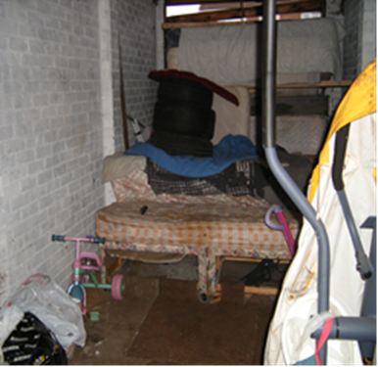
Migrant exploitation….
Issues of high rent, overcrowding, unsafe/unpleasant living conditions, illegal eviction, beds in sheds…
Properties discovered following inspections in Wisbech

Slide 6
Challenges
Wide range of interlinked problems linked to gangmaster activity;
Overcrowded and unsafe properties
Hostility: cohesion issues/language barrier
Increased incidents of anti-social behaviour; street drinking, noise nuisance, waste issues often due to illegal eviction, rough sleeping
Negative perception of the town and Fenland
Increased fraud (benefit/credit)
Migrants victims of modern day slavery
Increased emergency demand on council, police and fire services – issues too great to tackle in isolation

Slide 7
Meeting the challenge
Effective multi-agency partnership approach adopted to meet particular issues of exploitation, fraud, crime and conditions of private rented housing through Operation Pheasant
Fenland District Council, the Police, Immigration Enforcement, Gangmaster Licensing Authority (GLA), HM Revenues & Customs (HMRC), Cambridgeshire Fire & Rescue
Successful bids to government to increase the team - 2014/15 £179k Rogue Landlord Fund £44,500 in 2016, 2017 £93k Controlling Migration fund
Co-ordinated action
Improved information sharing and communications
Trust, commitment and a shared one team culture
Reduction in ‘double-doing’
Proactive and reactive community work
Nationally recognised as best practice – 3 national awards won

Slide 8
Operation Endeavour
Intelligence gained from Operation Pheasant led to Operation Endeavour in October 2013…
Largest ever operation of its kind; 300 people involved in implementation
Surprise raids at 4am leading to 9 arrests, 9 company vehicles grounded. 3 gangmasters, 2 recruitment agencies having licenses revoked, 10000 wage slips being examined
Welfare of 82 victims paramount; Red Cross and Salvation Army also involved in running rest centre set up by FDC and the Police for 3 days. 39 people into the National Referral Mechanism
December 2014 2 custodial sentences
Our unique partnership was key to this success

Slide 9
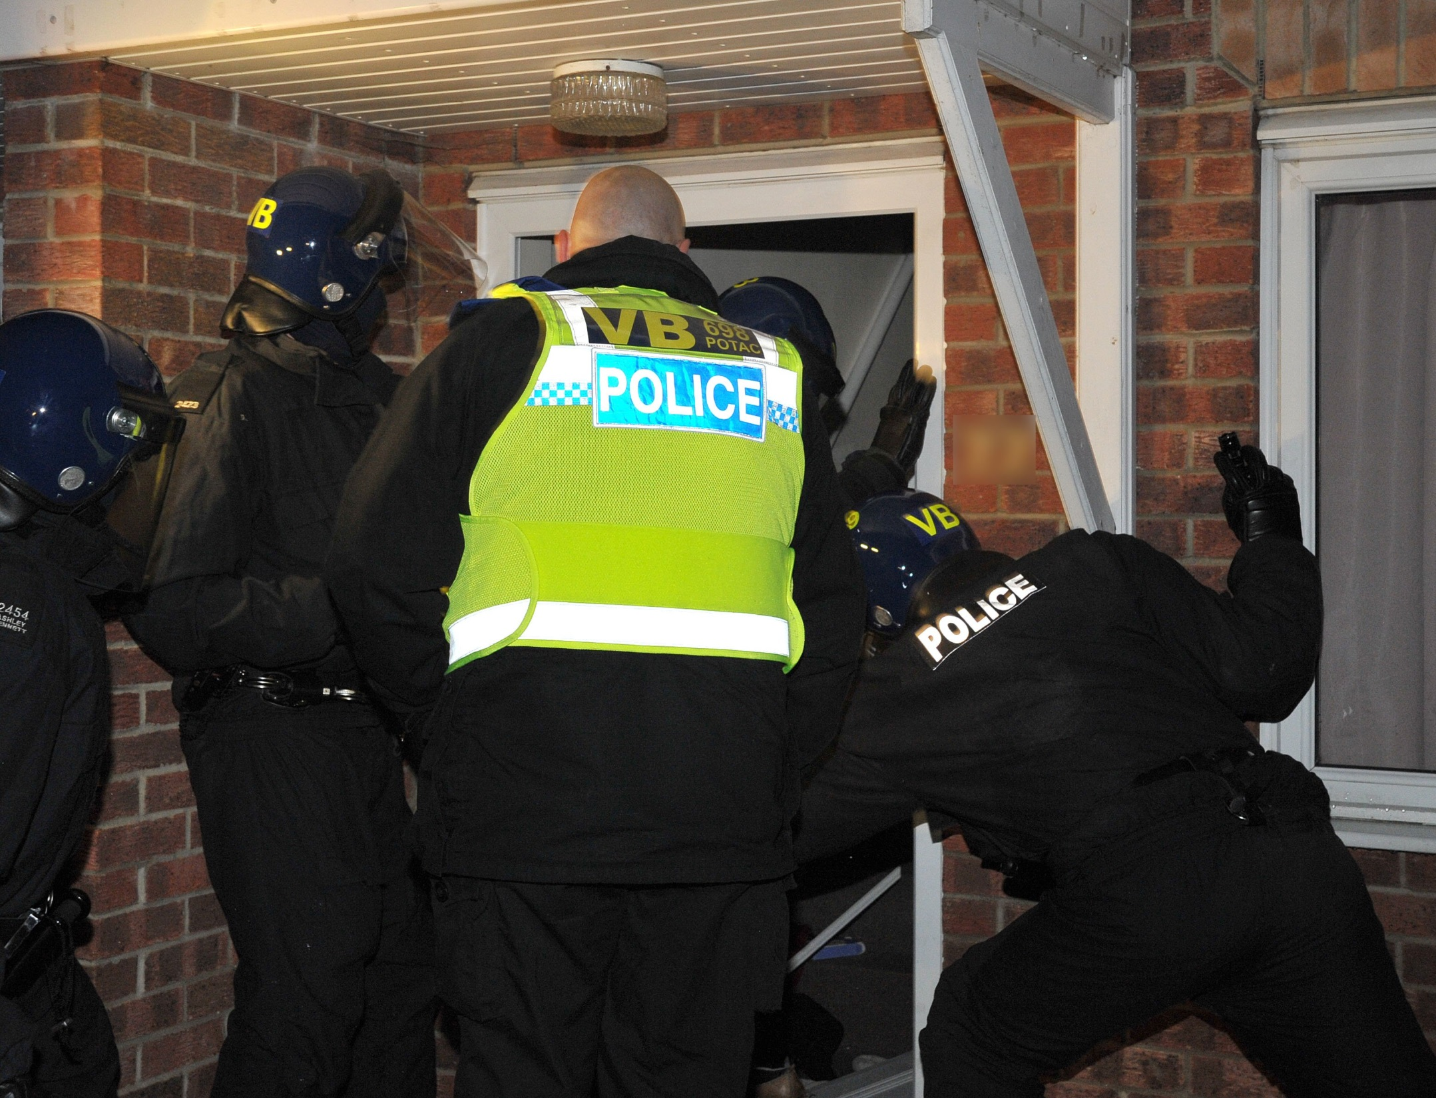

Slide 10
The results 2012 - 2014
Since January 2014:
240 inspections
270 notices under housing and planning legislation
213 Category 1 hazards removed
257 Category 2 hazards removed
6 premises closed
205 people no longer illegally housed
53 people voluntarily repatriated
216 cases of gangmaster activity discovered
182 cases of poor management addressed (illegal eviction / harassment)
11 cases of human trafficking
247 benefit offences uncovered
Operation Pheasant has influenced the Modern Day Slavery Bill
Improved living conditions and clear outcomes that have made a difference to people’s lives….

Slide 11
What happened next…..
Ensuring successful partnership of Op Pheasant continued:
Intelligence lead investigations
Continue with proactive approach of joint property inspections
Review of Housing Enforcement:
Selective Licencing Consultation (popular with tenants, but not with landlords and members)
Maintain a tough stance on illegal eviction/exploitation by gangmasters and rogue landlords
Share our experience approach and learning with others
Introduction of Civil Prosecutions 2016
Amendments to national Mandatory Licencing in 2018
Introduction of robust Housing Enforcement policy 2019

Slide 12
Enforcement results Sept 2019-Mar 2022
54 Civil Penalty Notices served
Total of £271,437 in fines
£70,553 collected
100% of appeal cases upheld by RPT
Income used to fund future resourcing of team (2 x FTE Enforcement Officers and 1 x 0.5 FTE Admin post)

Slide 13
What has been the impact and what have we learnt?
Improved knowledge of PRS in Fenland
We now know more landlords & good relationships with agents
Positive Relationship with landlords
Landlords encouraged to work with us proactively
Offering property health checks
Bi-annual Landlord Forums
Consistent approach sets out expectation
Rogue agents eradicated
Fair but robust approach to enforcement
91 registered HMO’s
Quality of the private rented sector improved
Take time to build ‘One team’ – trust, shared cultures, goals and learning etc
Operation Pheasant has become the day job

Slide 14
Thank you for listening
Do you have any questions

