Slide 1
Housing affordability 2022
The diamonds report
Sue Beecroft for the Housing Board, August 2022

Slide 2
Introduction to the diamonds

Slide 3
Update
First diamonds report was published in 2018, based largely on 2016-17 data
Now updated using 2020-21 data; due to publish in 2022. Working with a small project team.
Census 2022 has started being released but not in enough detail to provide what we need for this project, so for the moment using Census 2011 as our context
For this presentation, Greater Cambridge has been used (apologies!)
However all the data is assembled for Cambridgeshire, Peterborough and West Suffolk.

Slide 4
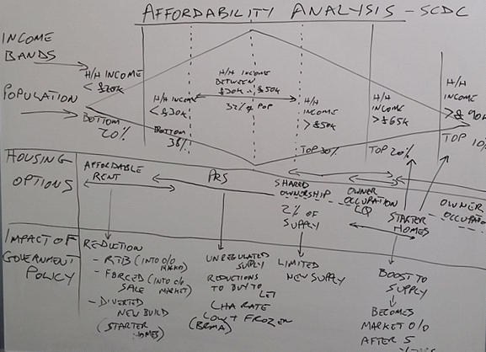
Why diamonds?
We needed to invent a way of comparing income distribution to housing costs, visually, to see where different housing ‘products’ it, and which income groups they are aimed at
This would be useful to see who was over-and under-provided, and to assess new tenures and housing incentives relative to our local housing markets…

Slide 5
Ingredients
Income distribution & change in income over time (from CACI, 2016-17and 2020-21)
Weekly housing cost for all tenures, aligned to income distribution (various sources including Hometrack, statutory returns, homes England data and VOA)
Pay scales for particular workforces (national and local data, building on the 2018 report)
Dwellings: stock, turnover and new build figures (variety of national and local data sets from government Homes England and Census 2011, draft AMR figures)
Context (mainly Census 2011, with some updates to 2021 where possible)

Slide 6
Method

Slide 7
The template
Start with a blank diamond of 200 squares

Slide 8
CACI income data
Count of households in £5,000 income bands, secured via annual subscription to Hometrack

Slide 9
Converting data to diamond format
Use CACI data for each area covered for Jan 2020 to Jan 2021, to see how many households are in each £5,000 income band (income includes benefits)

Slide 10
Use CACI data to shade diamond template
Shade the template to show the number of households in each £5,000 income band

Slide 11
Identify weekly housing costs (2020/21)
Cambridge | 1bed | 2bed | 3bed
1 LA social rent | £4,476 | £5,249 | £5,951
2 HA social rent | £4,928 | £5,820 | £6,406
3 HA affordable rent | £6,773 | £7,663 | £8,747
4 LA affordable rent | £7,095 | £8,174 | £9,592
5 Intermediate rent | £9,399 | £12,376 | £14,040
6 Median private rent | £11,765 | £15,483 | £17,563
7 Homebuy | £12,012 | £17,433 | £21,580
8 LQ resale | £11,232 | £15,145 | £21,749
9 Avg resale | £13,429 | £18,356 | £24,843
10 LQ new build | £13,819 | £21,190 | £24,245
11 Avg new build | £16,705 | £23,868 | £26,975
South Cambs | 1bed | 2bed | 3bed
1 LA social rent | £4,596 | £5,398 | £5,713
2 HA social rent | £4,734 | £5,663 | £6,414
3 HA affordable rent | £6,781 | £7,924 | £9,071
4 LA affordable rent | £6,722 | £7,834 | £9,331
5 Intermediate rent | £7,384 | £9,165 | £11,219
6 Median private rent | £9,256 | £11,466 | £14,027
7 Homebuy | £8,944 | £12,779 | £16,549
8 LQ resale | £7,462 | £10,907 | £16,380
9 Avg resale | £9,035 | £13,000 | £19,032
10 LQ new build | £14,976 | £18,044 | £17,797
11 Avg new build | £14,976 | £21,814 | £20,670
For each tenure and size of home, identify weekly cost. Excludes deposits, legal fees etc to enable like for like comparison between rent and sale.

Slide 12
Graphs comparing weekly housing costs
Key to tenure groups: 1 Local Authority social rent; 2 Housing Association social rent ; 3 Housing Association ‘affordable’ rent; 4 Local Authority affordable rent; 5 Intermediate rent; 6 Median private rent; 7 Buying 40% share through HomeBuy; 8 Buying a lower quartile resale; 9 Buying an average resale; 10 Buying a lower quartile new build; 11 Buying an average new build

Slide 13
Some of our visuals

Slide 14
Income needed for housing costs at 35%

Slide 15
Income needed for housing costs at 35%
Apply a % of income it is reasonable to spend on housing in this district: standard % is 35% and also apply the % identified in GLHearn’s report (which varies from district to district).
“Place” each box, representing 1 2 and 3 beds, in line with the diamond-o-gram, to indicate the income needed for each…

Slide 16
Zoom in on Greater Cambridge: income for housing at 35%

Slide 17
Income needed for ‘broad’ tenures (Greater Cambridge – others on later slide)
Using the power of “outlines” each tenure’s cost data can be summarized into broad groupings, covering 1, 2 and 3 beds. In this diagram the number of dwellings and % of stock is included in each box, where known.

Slide 18
Developing this idea…
In this diagram (Greater Cambridge) instead of just the number of dwellings being typed in, the box height is adjusted to indicate the % of stock in this area, of each tenure.
Where very small numbers, a standard height is used (e.g. intermediate rent)…

Slide 19
The diamond-o-gram 2016-17 vs 2020-21
2016-17
2020-21
CACI data; Greater Cambridge only

Slide 20
Making the comparison easier to read
2016-17 and 2020-21 CACI data; Greater Cambridge only

Slide 21
Using the income bands to apply to Local Plan figures
In 2021 GLHearn (consultants) provided the Cambridgeshire and West Suffolk authorities with evidence to inform their local plans, around housing needs. This evidence is used to inform Local Plan making.
GLHearn set out an annual requirement for 1,745 homes and projected an increase of 70,260 households from 2020 to 2040 for Greater Cambridge.
Using the CACI income distribution for 2020-21 we could imagine that:
33% of the new households or 23,186 might earn less than £30K
28% of the new households or 19,673 might earn £30-50K
39% of the new households or 27,401 might earn more than £50K+

Slide 22
“The staircase”
Shows 1, 2 & 3 beds for Cambridge and SCDC; with an indication of stock and turnover

Slide 23
1 bed staircase
1 beds only shown, Greater Cambridge

Slide 24
2 bed staircase
2 beds only shown, Greater Cambridge

Slide 25
3 bed staircase
3 beds only shown, Greater Cambridge

Slide 26
Context: Dwelling stock, turnover & new build
Greater Cambridge. Grey = dwellings excl turnover, blue = turnover, red = new build

Slide 27
Context: Dwelling stock, turnover & new build
Shows turnover and new build as a % of each tenure group.
Grey = dwellings excl turnover, blue = turnover, red = new build

Slide 28
Context: Likely movers
Census 2011 asked if a household had wholly or partly moved in the year leading up to Census night.
The pie chart shows the totals for Greater Cambridge

Slide 29
Context: Likely movers
We can cross-refer this with tenure to see differences in “likelihood to move”.
This is a guide only and we can’t make big assumptions based on the data, but useful to be aware of…
Will want to compare to 2022 Census which will have several different influences, will be released eventually…
Tenure group (GC) | % moved in year before Census 2011 | % did not move in year before Census 2011
Outright owners | 10% | 90%
Owners with a mortgage or S/O | 19% | 81%
Social renters | 18% | 82%
Private renters | 58% | 42%

Slide 30
Context: household tenure & size
Census 2011 data, number of households in tenure group and size of home; depends on respondent accuracy!

Slide 31
Looking across the area

Slide 32
Across the area: income
Divides into 3 reasonably distinct groups:
Cambridge and South Cambs (also presented as Greater Cambridge)
Fenland and Peterborough
East Cambs, Huntingdonshire and West Suffolk

Slide 33
Across the area: costs
Sets out the income needed to afford weekly costs at 35% across the whole area
Due to huge differences from one district to another, there is simply a wide range of costs for all tenures.
LA and Ha tends to be at the lower end with narrower range of prices, private rent and Homebuy / shared ownership in the middle, and ownership showing a very broad range – unsurprisingly, new build at the upper end of the spectrum

Slide 34
Zoom in on costs

Slide 35
Across the area: income needed x size
Introduces cost by size as well as tenure, so although complex to read, sheds light on ranges of cost.
Range depends a great deal on location
The wider “bars” will include data on e.g. a 1 bed new build in Fenland at the left hand end, and a 1 bed new build in South Cambridgeshire at the right hand end.
This gives a picture of costs across our area and perhaps the relationship between different sizes and tenures on the “housing ladder”.
More on this later…

Slide 36
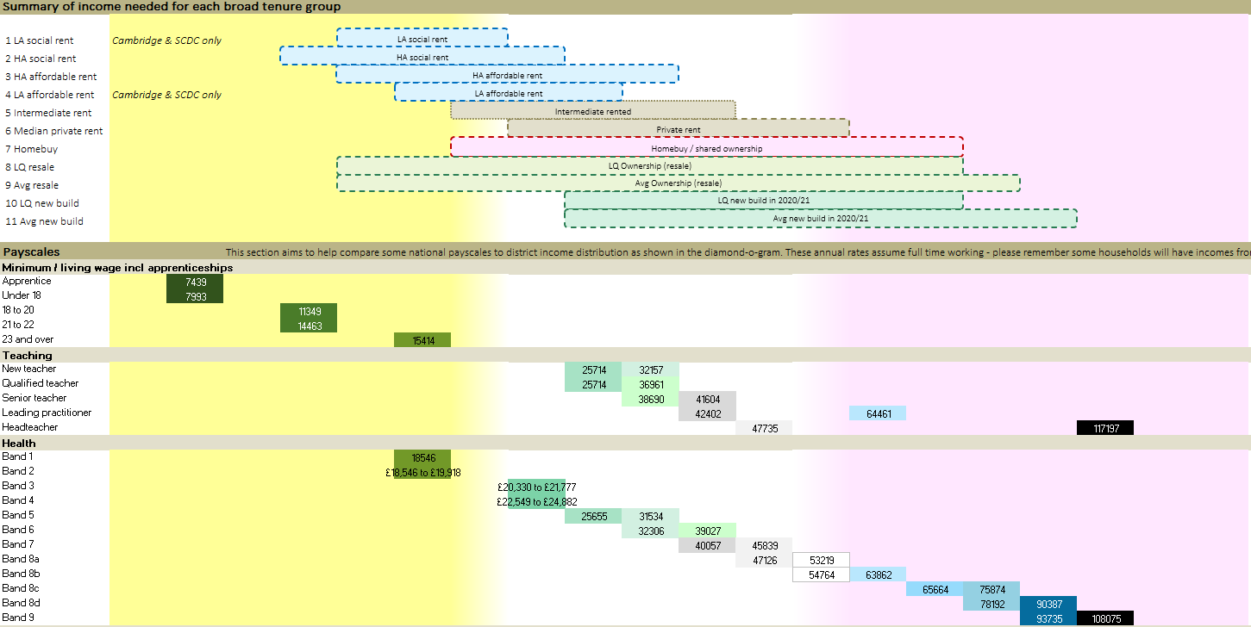
Across the area: costs vs pay scales
Sets the broad cost of tenures against pay-scales identified
Pay-scale boxes (in dark green) on the left side indicate a household needing benefits to meet any housing option.
Once there is an “overlap” between the tenure boxes above and the pay-scales below, we start to see some affordability
This shows how different workers can and cannot afford different tenures, even if all were extremely mobile in terms of live/work location
Size of home needed will also have a big impact

Slide 37
Looking for patterns…

Slide 38
Home ownership (resale)
Home ownership (resale)
Affordable & social rented
Private rent
Intermediate rent
Home ownership (resale)
By tenure
Homebuy / shared ownership
New build
Home ownership (resale)
Affordable & social rented
Homebuy / shared ownership
Intermediate rent
New build (3beds)
Private rent
Home ownership (resale)
Homebuy / shared ownership
Affordable & social rented
New build
Private rent
Intermediate rent
Homebuy / shared ownership
New build
Affordable & social rented
Home ownership (resale)
Intermediate rent
Private rent
Affordable & social rented
Homebuy / shared ownership
New build
Intermediate rent
Private rent
Home ownership (resale)
Affordable & social rented
Private rent
Intermediate rent
Homebuy / shared ownership
New build
Affordable & social rented
Private rent
Intermediate rent
Homebuy / shared ownership
New build

Slide 39
Intermediate rent
Home ownership (resale)
Private rent
Home ownership (resale)
Intermediate rent
Affordable & social rented
Private rent
Home ownership (resale)
Intermediate rent
Affordable & social rented
Private rent
By district
Homebuy / shared ownership
New build
Intermediate rent
Home ownership (resale)
Private rent
Homebuy / shared ownership
Affordable & social rented
New build (3beds)
Home ownership (resale)
Intermediate rent
Private rent
Affordable & social rented
Homebuy / shared ownership
New build
Affordable & social rented
Homebuy / shared ownership
Home ownership (resale)
Intermediate rent
New build
Private rent
Homebuy / shared ownership
Home ownership (resale)
Intermediate rent
New build
Affordable & social rented
Private rent
Homebuy / shared ownership
Affordable & social rented
New build
Homebuy / shared ownership
New build

Slide 40
1 LA social rent |  |  |  |  | 1 bed | 2 bed | 3 bed
1 LA social rent |  |  |  |  | 1 bed | 2 bed
 |  |  |  |  |  | 3 bed
2 HA social rent |  |  |  |  |  | 1 bed | 2 bed
 |  |  |  |  |  |  | 3 bed
2 HA social rent |  |  |  |  |  | 1 bed | 3 bed
 |  |  |  |  |  | 2 bed
2 HA social rent |  |  |  |  | 1 bed |  | 2 bed | 3 bed
2 HA social rent |  |  |  | 1 bed |  | 2 bed | 3 bed
2 HA social rent |  |  |  |  | 1 bed |  | 2 bed | 3 bed
2 HA social rent |  |  |  |  | 1 bed | 2 bed | 3 bed
2 HA social rent |  |  |  |  | 1 bed | 2 bed | 3 bed
3 HA affordable rent |  |  |  |  |  |  | 1 bed | 2 bed | 3 bed
3 HA affordable rent |  |  |  |  |  |  | 1 bed | 3 bed
 |  |  |  |  |  |  | 2 bed
3 HA affordable rent |  |  |  |  | 1 bed |  |  | 2 bed | 3 bed
3 HA affordable rent |  |  |  |  |  |  | 1 bed | 2 bed | 3 bed
3 HA affordable rent |  |  |  |  |  |  | 1 bed |  | 2 bed | 3 bed
3 HA affordable rent |  |  |  |  |  | 1 bed | 2 bed | 3 bed
3 HA affordable rent |  |  |  |  |  |  |  | 1 bed | 2 bed | 3 bed
4 LA affordable rent |  |  |  |  |  |  | 1 bed | 2 bed | 3 bed
4 LA affordable rent |  |  |  |  |  | 1 bed | 2 bed | 3 bed
5 Intermediate rent |  |  |  |  |  |  |  |  | 1 bed | 2 bed | 3 bed
5 Intermediate rent |  |  |  |  |  |  | 1 bed | 2 bed | 3 bed
5 Intermediate rent |  |  |  |  |  |  | 1 bed |  | 2 bed | 3 bed
5 Intermediate rent |  |  |  |  |  |  | 1 bed | 2 bed | 3 bed
5 Intermediate rent |  |  |  |  |  |  | 1 bed |  | 2 bed | 3 bed
5 Intermediate rent |  |  |  |  |  |  | 1 bed | 2 bed | 3 bed
5 Intermediate rent |  |  |  |  |  |  |  | 1 bed | 2 bed | 3 bed
6 Median private rent |  |  |  |  |  |  |  |  |  | 1 bed |  | 2 bed | 3 bed
6 Median private rent |  |  |  |  |  |  |  | 1 bed | 2 bed | 3 bed
6 Median private rent |  |  |  |  |  |  |  |  | 1 bed | 2 bed | 3 bed
6 Median private rent |  |  |  |  |  |  |  | 1 bed | 2 bed | 3 bed
6 Median private rent |  |  |  |  |  |  |  |  | 1 bed | 2 bed | 3 bed
6 Median private rent |  |  |  |  |  |  |  | 1 bed |  | 2 bed | 3 bed
6 Median private rent |  |  |  |  |  |  |  |  | 1 bed | 2 bed | 3 bed
7 Homebuy |  |  |  |  |  |  |  |  |  | 1 bed |  |  | 2 bed |  | 3 bed
7 Homebuy |  |  |  |  |  |  | 1 bed |  |  | 2 bed |  | 3 bed
7 Homebuy |  |  |  |  |  |  | 1 bed |  | 2 bed |  | 3 bed
7 Homebuy |  |  |  |  |  |  | 1 bed |  | 2 bed |  | 3 bed
7 Homebuy |  |  |  |  |  |  | 1 bed |  | 2 bed |  | 3 bed
7 Homebuy |  |  |  |  |  |  |  | 1 bed |  | 2 bed |  | 3 bed
7 Homebuy |  |  |  |  |  |  |  | 1 bed |  | 2 bed | 3 bed
8 LQ resale |  |  |  |  |  |  |  |  |  | 1 bed |  | 2 bed |  |  | 3 bed
8 LQ resale |  |  |  |  |  |  | 1 bed | 2 bed |  |  |  | 3 bed
8 LQ resale |  |  |  |  | 1 bed |  | 2 bed |  |  |  | 3 bed
8 LQ resale |  |  |  |  |  |  | 1 bed |  | 2 bed |  | 3 bed
8 LQ resale |  |  |  |  |  |  | 1 bed | 2 bed |  |  | 3 bed
8 LQ resale |  |  |  |  |  |  | 1 bed |  | 2 bed |  |  | 3 bed
8 LQ resale |  |  |  |  |  |  |  | 1 bed | 2 bed |  | 3 bed
9 Avg resale |  |  |  |  |  |  |  |  |  |  | 1 bed |  | 2 bed |  |  | 3 bed
9 Avg resale |  |  |  |  |  |  |  | 1 bed | 2 bed |  |  |  | 3 bed
9 Avg resale |  |  |  |  | 1 bed |  | 2 bed |  |  |  |  | 3 bed
9 Avg resale |  |  |  |  |  |  | 1 bed |  | 2 bed |  |  | 3 bed
9 Avg resale |  |  |  |  |  |  | 1 bed |  | 2 bed |  |  | 3 bed
9 Avg resale |  |  |  |  |  |  |  | 1 bed |  |  | 2 bed |  | 3 bed
9 Avg resale |  |  |  |  |  |  |  |  | 1 bed | 2 bed |  | 3 bed
10 LQ new build |  |  |  |  |  |  |  |  |  |  | 1 bed |  |  | 2 bed | 3 bed
10 LQ new build |  |  |  |  |  |  |  |  |  |  |  |  | 3 bed
10 LQ new build |  |  |  |  |  |  |  |  | 1 bed | 2 bed |  | 3 bed
10 LQ new build |  |  |  |  |  |  |  |  |  | 1 bed | 2 bed |  | 3 bed
10 LQ new build |  |  |  |  |  |  |  |  | 1 bed | 2 bed |  | 3 bed
10 LQ new build |  |  |  |  |  |  |  |  |  |  | 1 bed |  | 2 bed
 |  |  |  |  |  |  |  |  |  |  |  |  | 3 bed
10 LQ new build |  |  |  |  |  |  |  |  |  |  | 1 bed | 2 bed | 3 bed
11 Avg new build |  |  |  |  |  |  |  |  |  |  |  |  | 1 bed |  | 2 bed |  | 3 bed
11 Avg new build |  |  |  |  |  |  |  |  |  |  |  |  |  | 3 bed
11 Avg new build |  |  |  |  |  |  |  |  | 1 bed | 2 bed |  |  | 3 bed
11 Avg new build |  |  |  |  |  |  |  |  |  | 1 bed | 2 bed |  |  | 3 bed
11 Avg new build |  |  |  |  |  |  |  |  | 1 bed | 2 bed |  | 3 bed
11 Avg new build |  |  |  |  |  |  |  |  |  |  | 1 bed |  |  | 3 bed | 2 bed
11 Avg new build |  |  |  |  |  |  |  |  |  |  | 1 bed | 2 bed |  | 3 bed
LA Social
HA Social
HA Affordable Rent
LA Affordable Rent
Intermediate
1 beds
Median private rent
HomeBuy / SO
LQ second hand sale
Avg second hand sale
LQ new build
Avg new build
LA Social
HA Social
HA Affordable Rent
LA Affordable Rent
Intermediate
2 beds
Median private rent
HomeBuy / SO
LQ second hand sale
Avg second hand sale
LQ new build
Avg new build
LA Social
HA Social
HA Affordable Rent
LA Affordable Rent
Intermediate
Median private rent
3 beds
HomeBuy / SO
LQ second hand sale
Avg second hand sale
LQ new build
Avg new build
LA affordable rent
LA affordable rent
LA affordable rent
Private rent
Private rent
Private rent
Homebuy / shared ownership
Homebuy / shared ownership
Homebuy / shared ownership
LQ Ownership (resale)
LQ Ownership (resale)
LQ Ownership (resale)
Avg Ownership (resale)
Avg Ownership (resale)
Avg Ownership (resale)
LQ new build in 2020/21
LQ new build in 2020/21
LQ new build in 2020/21

Slide 41
Drawing conclusions…
Your thoughts welcome on ways to bring the information together – we (the project team) want to create “pithy” conclusions…
Could use a matrix to give a score for each factor
Could use a map to click on, setting out each district’s ”headline” stats
Or publish a summary report with link to the detailed spreadsheets…
We need to bear in mind accessibility requirements…

Slide 42
Thank you
We are making good progress to publication but there is devil in the detail!
Please contact the project team via Sue if you have ideas or suggestions, or want to find out more before making comments ☺
Sue.beecroft@cambridge.gov.uk
07715 200 730

