Slide 1
COVID-19: Review of emerging evidence of needs and impacts on Children and Young People in Cambridgeshire and Peterborough
Slide Pack 2
Published: July 2022
Produced by: CCC/PCC Public Health Intelligence, Business Intelligence and Clinical Commissioning Group Intelligence teams
Notes:
Title Slide.

Slide 2
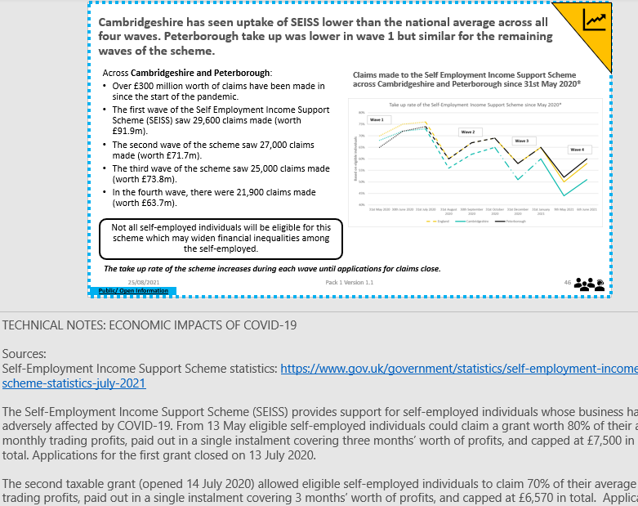
Slide Layout
'Impact Type' icon
Key findings can be found in the slide title
'Life Stage or Household' icon
Public data slides are shown by a broken blue border and a ‘Public/ Open Information’ comment highlighted in blue. These slides can be shared.
Technical notes can be found in the 'Notes' section below the slide.
Data sources will be listed in the 'Notes' section
Public/ Open Information
Notes:
Slide Layout.

Slide 3









Impact Type Icons
Direct Health Impacts of COVID-19
Prevention pathway Impacts
Environmental Impacts
Crime and Criminal Justice System Impacts
Indirect Health Impacts of COVID-19
Social and Educational Impacts
Mental Health Impacts
Economic Impacts
Vulnerable Groups Impacts
Public/ Open Information
Notes:
Impact type icons.

Slide 4
Demographic changes in Children and Young People
C&YP
Notes:
This slide is intentionally left blank to divide sections of the pack.

Slide 5
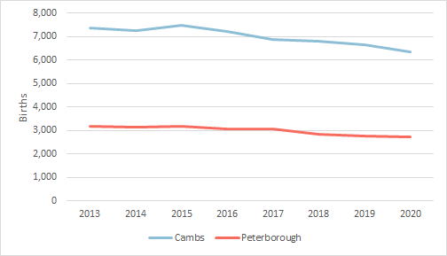
A trend of falling number of births between 2013 and 2020 in Cambridgeshire and Peterborough has led to a lower intake of 3-4 year olds in early years settings.
Annual Births in Cambridgeshire and Peterborough 2013-20
In line with national trend, the trend in births in Cambridgeshire and Peterborough have fallen over recent years up to 2020
Cambridgeshire recorded a notable drop in the number of annual births between 2016 and 2020
Peterborough recorded a notable drop in the number of births between 2017 and 2018
Based on current trends, it is expect that there will be fluctuations in intakes of 3 / 4 year olds at a lower level in the short term.
However, recent data from our local hospitals (next slide) shows that this trend has reversed in the most recent data and the number of maternities in 2021/22 has probably increased.
Notes:
Source:
Source: ONS, calendar year birth registrations
Contact:
Cambridgeshire Research Group: Business Intelligence, Cambridgeshire County Council (Research.Group@cambridgeshire.gov.uk)

Slide 6
The number of mothers giving birth who are registered as Cambridgeshire & Peterborough CCG patients is likely to be higher at the end of 21/22 than in previous years.
Data is only available at present for the first three quarters of 2021/22, but extrapolating from this we expect around 9,560 mothers who are Cambridgeshire & Peterborough CCG registered patients for the full year. This would represent a 5.5% increase on the total number of maternities recorded in all of 2020/21 (9,064).
Hospital/Trust of birth | 15/16 | 16/17 | 17/18 | 18/19 | 19/20 | 20/21 | 21/22 (esti-mated)
Cambridge University Hospitals NHS Foundation Trust | 4,121 | 3,919 | 3,778 | 3,731 | 3,774 | 3,629 | 3,907
Hinchingbrooke Hospital | 2,261 | 2,106 | 2,094 | 1,963 | 1,962 | 1,888 | 2,076
Peterborough City Hospital | 3,632 | 3,478 | 3,516 | 3,249 | 3,185 | 3,126 | 3,116
Queen Elizabeth Hospital | 498 | 452 | 470 | 451 | 299 | 410 | 416
Total (including births elsewhere) | 10,549 | 9,995 | 9,889 | 9,422 | 9,255 | 9,064 | 9,560
Notes:
TECHNICAL NOTES:
Source/Contact:
Data on number of maternities in Cambridgeshire and Peterborough CCG-registered patients. Data is from Smoking at the Time of Delivery data source - Cambridgeshire & Peterborough Clinical Commissioning Group,
Contact: Public Health Intelligence Team Cambridgeshire County Council and Peterborough City Council, PHI-Team@cambridgeshire.gov.uk

Slide 7
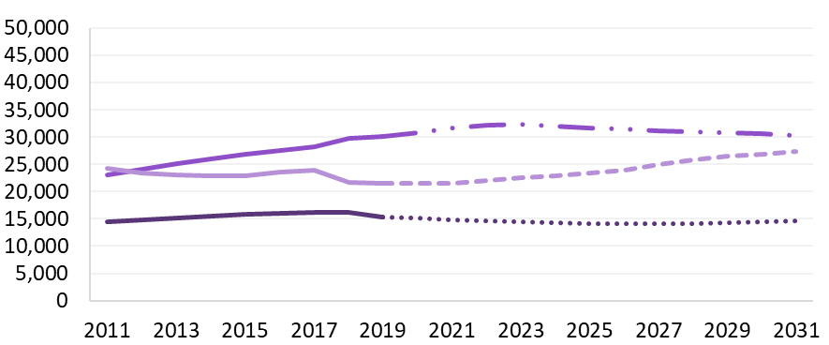
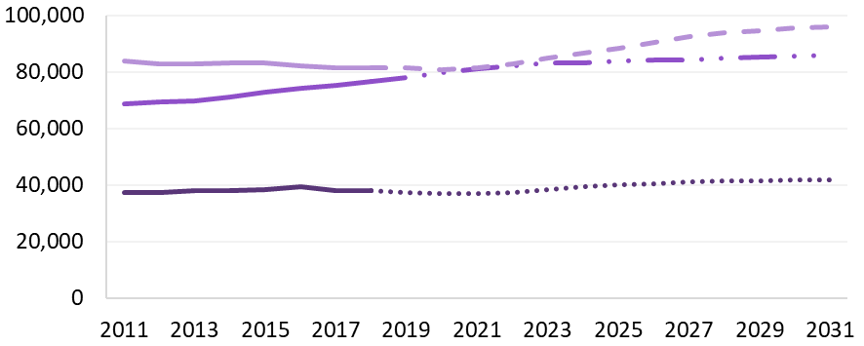
Local population estimates and forecasts for 2011-2036 show a variation between Cambridgeshire and Peterborough. Both Cambridgeshire and Peterborough are forecast to have increase in 15-24 year olds, whilst Cambridgeshire is also forecast to have an increase in 5-14 year olds.
Peterborough 2019 Based Population Estimates and Forecasts
The population forecasts for Peterborough indicate that the number of 0-4 and 5-14 year olds will remain steady up to 2031, while the number of 15-24 year olds is forecast to increase.
The population forecasts for Cambridgeshire indicate that the number of 0-4 year olds will remain unchanged by 2031, while the number of 5-14 and 15-24 year olds will increase.
Cambridgeshire 2018 Based Population Estimates and Forecasts
Cambridgeshire estimates and forecasts are based on data from 2018. Peterborough estimates and forecasts are based on data from 2019.
The national Census 2021 will provide a new baseline for local population estimates. The data has yet to be released by the Office for National Statistics.
Notes:
TECHNICAL NOTES:
Population estimates are a mid-year estimate of the resident population of Cambridgeshire or Peterborough. The definition of resident population is the same as that used in the 2011 Census: students are counted as resident at their term-time address and the estimate includes persons living in communal establishments as well as those in private households.
Population forecasts are potential future population levels of Cambridgeshire or Peterborough. These forecasts are ‘policy-led’, so that they are consistent with planned levels of house-building. The Cambridgeshire forecast is based on data from 2018, so the forecast begins from 2019. The Peterborough forecast is based on data from 2019, so the forecast begins from 2020.
Please note that the charts are not to the same scale as the total population size of Cambridgeshire is higher than Peterborough.
For more information on our local population estimates and forecasts visit: https://cambridgeshireinsight.org.uk/population/population-forecasts/
Contact:
Cambridgeshire Research Group: Business Intelligence, Cambridgeshire County Council (Research.Group@cambridgeshire.gov.uk)

Slide 8
Direct Health Impacts Children and Young People
C&YP
Notes:
This slide is intentionally left blank to divide sections of the pack.

Slide 9
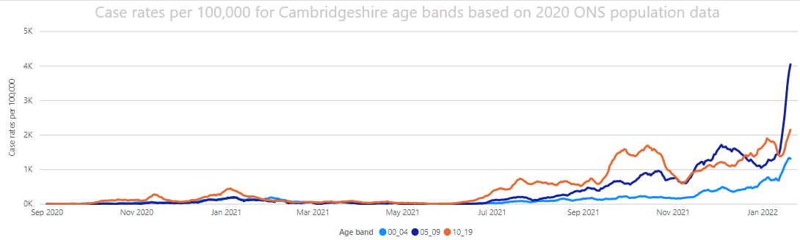
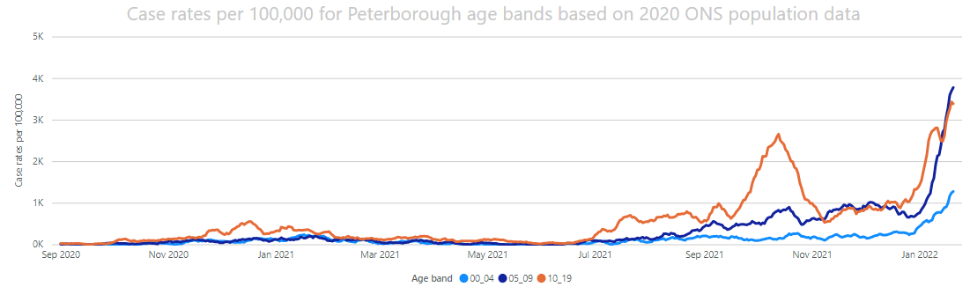

Longer term trend of Covid-19 case rates among younger age groups shows significantly increased case rates in the 2021/22 academic year, to date, compared to earlier in the pandemic
2020/21
2021/22
E
E
(A)
(B)
Reported Covid-19 case rates per 100,000 in 0-17 year olds have been much higher in the 2021/22 academic year compared to 2020/21. ​
​
(A) In the 2021/22 Autumn term (Sept-Dec 2021) higher case rates in 11- 17 year olds affected secondary schools.​
​
(B) In the first part of the 2021/22 Spring term to date (Jan 2020-) high case rates in 5-10 year olds have affected primary schools.​
Data shown: 01/09/2020-19/01/2022
Regular asymptomatic testing begins (8 March)
Regular asymptomatic testing begins (8 March)
C&YP
Notes:
TECHNICAL NOTES:
Data from 1/Sept/2020 - 19/Jan/2022, extracted January 2022
Official Source. Coronavirus.data.gov.uk
Contact: Public Health Intelligence Team Cambridgeshire County Council and Peterborough City Council, PHI-Team@cambridgeshire.gov.uk

Slide 10
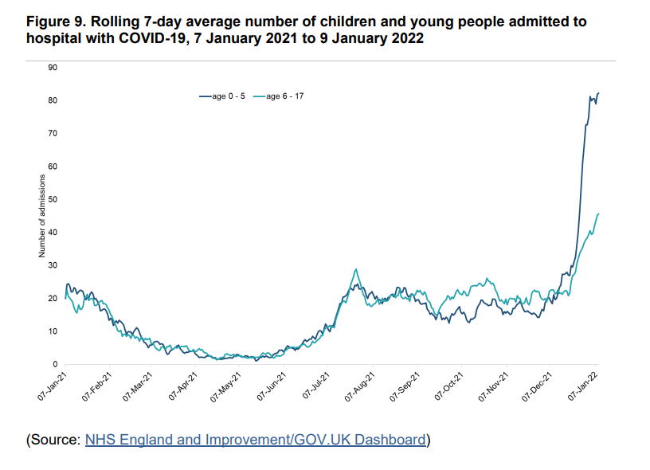

The direct health impact of Covid on children has tended to be relatively mild, with few being hospitalised. With the advent of the Omicron variant the number of hospitalisations in children has increased though initial clinical review has confirmed that Omicron is not a more serious disease in children
Good evidence that children who have Covid-19 are much less likely to develop severe symptoms or die from the disease compared to adults [1], [2], [3].
Covid-19 illness lasted on average for 5 days in younger children (5-11 years old) and 7 days in older children aged 12-17 [4].
1 in 20 children experienced symptoms for 4 weeks or more, while only 1 in 50 children had symptoms lasting more than 8 weeks [4].
1 in 70 to 1 in 100 children may experience longer-term consequences of a Covid-19 infection [5].
Other reports show that 1 in 7 children who caught SARS-CoV-2 may still have symptoms 15 weeks later [6].
Data suggesting that children from an ethnic minority background may be at higher risk of severe disease [7], [8] .
There is a link between Covid-19 infection and the very rare development of multisystem inflammatory syndrome and Kawasaki disease in children [9], [10], [11], [12].
Child mortality from any cause actually fell during the first year of the pandemic, compared to the previous year [13]
UKHSA technical briefing 34
C&YP
Notes:
TECHNICAL NOTES
1. Zimmermann P, Curtis N. Why is COVID-19 less severe in children? A review of the proposed mechanisms underlying the age-related difference in severity of SARS-CoV-2 infections. Arch Dis Child. 2020 Dec 1:archdischild-2020-320338. doi: 10.1136/archdischild-2020-320338. Epub ahead of print. PMID: 33262177.
2. Clinical characteristics of children and young people hospitalised with covid-19 in the United Kingdom: prospective observational cohort study’ by Olivia V Swann et al. 2020 British Medical Journal BMJ2020;370:m3249 Clinical characteristics of children and young people admitted to hospital with covid-19 in United Kingdom: prospective multicentre observational cohort study (bmj.com)
3. https://post.parliament.uk/latest-evidence-on-impacts-of-covid-19-in-children-march-2021/
4. https://www.kcl.ac.uk/news/long-covid-uncommon-in-children
5. https://covid.joinzoe.com/post/covid-in-children-webinar
6. Stephenson T, Pereira S, Shafran R, et al . Long covid—the physical and mental health of children and non-hospitalised young people 3 months after SARS-CoV-2 infection; a national matched cohort study (The CLoCk) Study.2021. doi:10.21203/rs.3.rs-798316/v1
7. Saatci D, Ranger TA, Garriga C, et al. Association Between Race and COVID-19 Outcomes Among 2.6 Million Children in England. JAMA Pediatr. 2021;175(9):928–938. doi:10.1001/jamapediatrics.2021.1685
8. https://adc.bmj.com/content/early/2021/03/09/archdischild-2020-320388
9. Sarzaeim M, Rezaei N. Kawasaki Disease and Multisystem Inflammatory Syndrome in Children with COVID-19. SN Compr Clin Med. 2020 Oct 6:1-6. doi: 10.1007/s42399-020-00558-9. Epub ahead of print. PMID: 33043252; PMCID: PMC7538055.
10. Shakeel S, Ahmad Hassali MA. Post-COVID-19 Outbreak of Severe Kawasaki-like Multisystem Inflammatory Syndrome in Children. Malays J Med Sci. 2021 Feb;28(1):109-116. doi: 10.21315/mjms2021.28.1.14. Epub 2021 Feb 24. PMID: 33679227; PMCID: PMC7909350
11. Marzano AV, Cassano N, Moltrasio C, Verdoni L, Genovese G, Vena GA. Multisystem Inflammatory Syndrome in Children Associated with COVID-19: A Review with an Emphasis on Mucocutaneous and Kawasaki Disease-Like Findings. Dermatology. 2021 Jun 1:1-9. doi: 10.1159/000515449. Epub ahead of print. PMID: 34062530; PMCID: PMC8247806.
12. Lee MS, Liu YC, Tsai CC, Hsu JH, Wu JR. Similarities and Differences Between COVID-19-Related Multisystem Inflammatory Syndrome in Children and Kawasaki Disease. Front Pediatr. 2021 Jun 18;9:640118. doi: 10.3389/fped.2021.640118. PMID: 34222140; PMCID: PMC8249705.
13. Odd, D, Stoianova S, Williams T, Fleming F, Luyt K. Child mortality in England during the first year of the COVID-19 pandemic. Archives of Disease in Childhood. 2022, 107:e22. doi:10.1136/archdischild-2021-323370
UKHSA Technical Briefing 34 -SARS-CoV-2 variants of concern and variants under investigation- Technical briefing 34 (publishing.service.gov.uk)
Hospital admission data is reported by NHS England and Improvement and include people admitted to hospital who either tested positive for COVID-19 during their admission or in the previous 14 days before their admission. The number of paediatric admissions with COVID-19 infection began to rise from 26 December 2021, from an average of 40 admissions per day to 120 per day, a 3-fold rise in 2 weeks.
Further analysis by age group shows that the rise is most rapid among children under 5 years, and highest in infants aged under 1 year (Figure 9). This data is for all COVID-19 infections including all variants, but it should be noted that Omicron represented over 90% of sequenced samples in the UK from end November 2021 (Figure 5). The top 3 complaints on hospital attendance records for children under 5 remain consistent with respiratory infection. A clinical case review of a small number of Omicron admissions in infants found those admitted were not severely unwell. The Royal College of Paediatrics and Child Health (RCPCH) has issued a statement to confirm that paediatricians are not reporting Omicron to be a more serious or severe disease in children and young people in the UK.
Contact: Public Health Intelligence Team Cambridgeshire County Council and Peterborough City Council, PHI-Team@cambridgeshire.gov.uk

Slide 11
School disruption
C&YP
Notes:
This slide is intentionally left blank to divide sections of the pack.

Slide 12
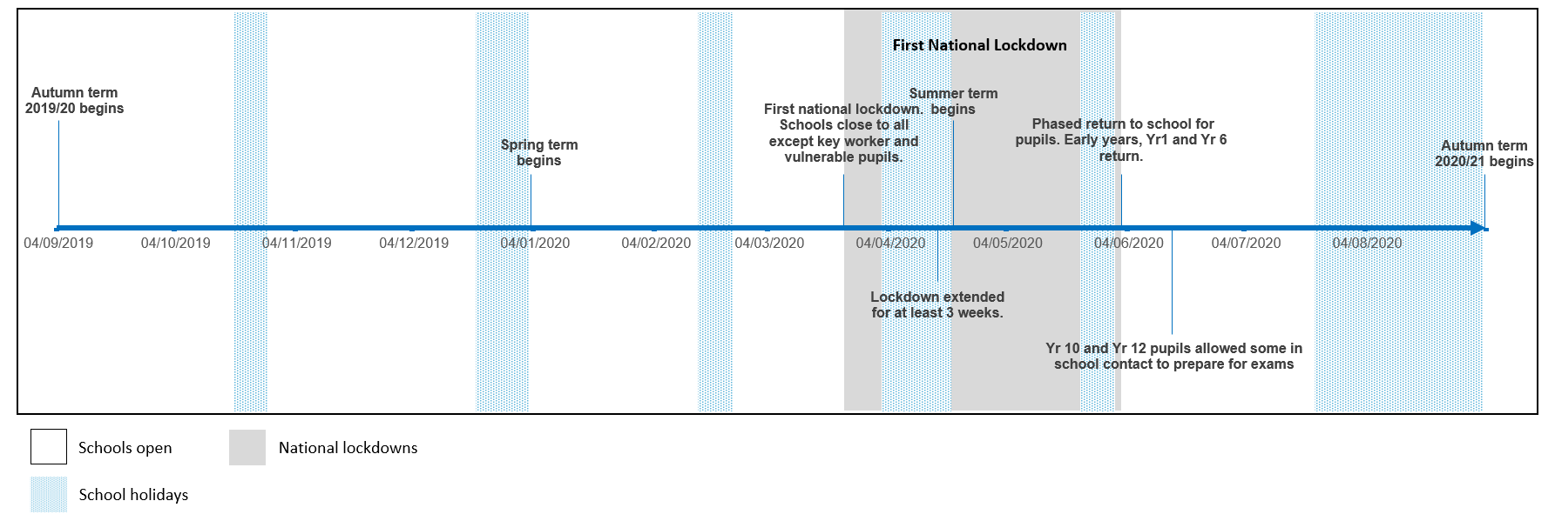
Timeline 2019/20 academic year
Notes:
TECHNICAL NOTES:
Sources:
DfE 2021: Evidence summary July 2021 (publishing.service.gov.uk)
Contact:
Cambridgeshire Research Group: Business Intelligence, Cambridgeshire County Council (Research.Group@cambridgeshire.gov.uk)
Dates:
04/09/2019 - Autumn term 2019/20 begins
03/01/2020 - Spring term begins
23/03/2020 - First national lockdown. Schools close to all except key worker and vulnerable pupils.
16/04/2020 - Lockdown extended for at least 3 weeks.
20/04/2020 - Summer term begins
02/06/2020 - Phased return to school for pupils. Early years, Yr1 and Yr 6 return.
15/06/2020 - Year 10 and Year 12 pupils allowed some in school contact to prepare for exams
03/09/2020 - Autumn term 2020/21 begins

Slide 13
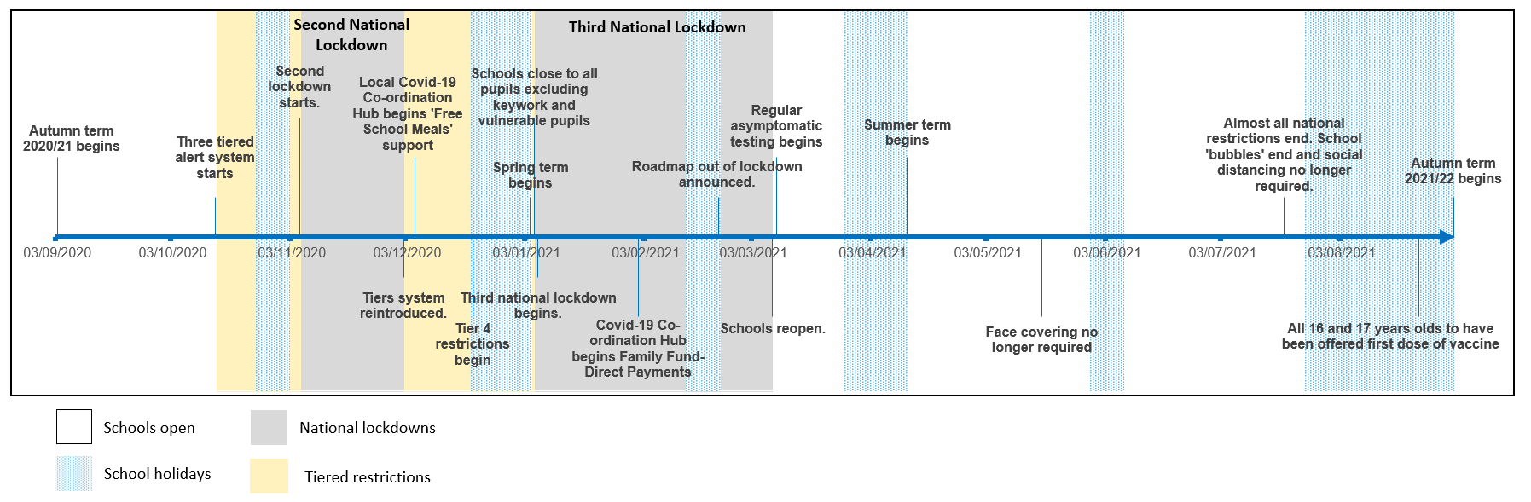
Timeline 2020/21 academic year
Notes:
TECHNICAL NOTES:
Sources:
DfE 2021: Evidence summary July 2021 (publishing.service.gov.uk)
Contact:
Cambridgeshire Research Group: Business Intelligence, Cambridgeshire County Council (Research.Group@cambridgeshire.gov.uk)
Dates:
03/09/2020 - Autumn term 2020/21 begins
14/10/2020 - Three tiered alert system starts
05/11/2020 - Second lockdown starts.
02/12/2020 - Tiers system reintroduced.
05/12/2020 - Local Covid-19 Co-ordination Hub begins 'Free School Meals' support
20/12/2020 - Tier 4 restrictions begin
04/01/2021 - Spring term begins
05/01/2021 - Third national lockdown begins. Schools close to all pupils excluding keywork and vulnerable pupils
01/02/2021 - Covid-19 Co-ordination Hub begins Family Fund-Direct Payments
22/02/2021 - Roadmap out of lockdown announced.
08/03/2021 - Schools reopen. Regular asymptomatic testing begins
12/04/2021 - Summer term begins
17/05/2021 - Face covering no longer required
19/07/2021 - Almost all national restrictions end. School 'bubbles' end and social distancing no longer required.
23/08/2021 - All 16 and 17 years olds to have been offered first dose of vaccine
01/09/2021 - Autumn term 2021/22 begins

Slide 14
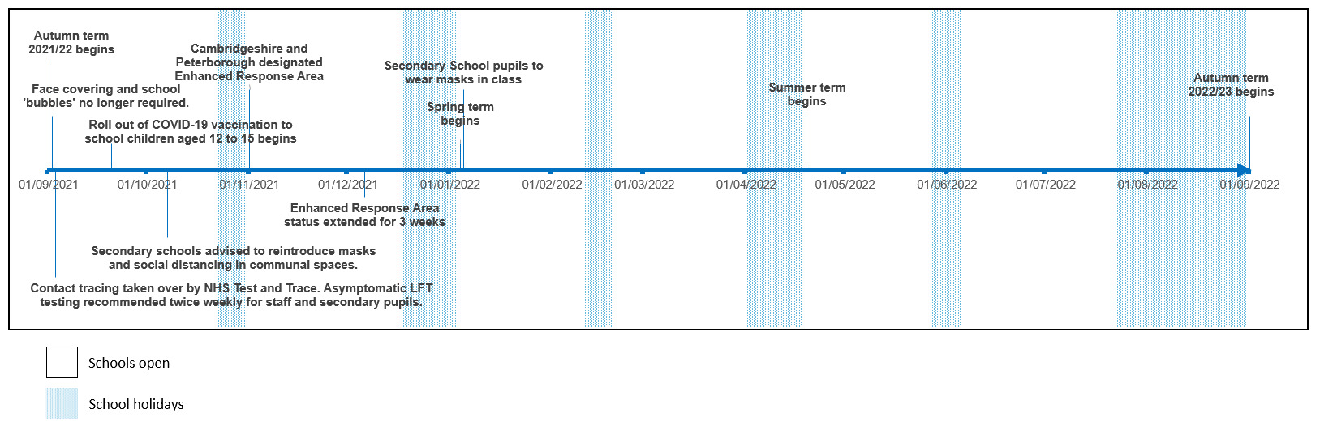
Timeline 2021/22 academic year (as of 7th January 2021)
Notes:
TECHNICAL NOTES:
Sources:
DfE 2021: Evidence summary July 2021 (publishing.service.gov.uk)
Contact:
Cambridgeshire Research Group: Business Intelligence, Cambridgeshire County Council (Research.Group@cambridgeshire.gov.uk)
Dates:
01/09/2021 - Autumn term 2021/22 begins. Face covering and school 'bubbles' no longer required. Contact tracing taken over by NHS Test and Trace. Asymptomatic LFT testing recommended twice weekly for staff and secondary pupils.
20/09/2021 - Roll out of COVID-19 vaccination to school children aged 12 to 15 begins
07/10/2021 - Secondary schools advised to reintroduce masks and social distancing in communal spaces.
01/11/2021 - Cambridgeshire and Peterborough designated Enhanced Response Area
06/12/2021 - Enhanced Response Area status extended for 3 weeks
04/01/2022 - Spring term begins. Secondary School pupils to wear masks in class
19/04/2022 - Summer term begins
01/09/2022 - Autumn term 2022/23 begins

Slide 15
Learning Loss
C&YP
Notes:
This slide is intentionally left blank to divide sections of the pack.

Slide 16
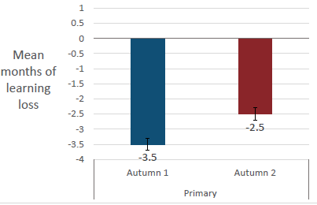
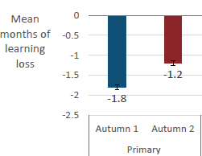
National evidence suggests that 'learning loss' of primary school aged children has already begun to reduce since schools fully re-opened in school year 2020/21
Children were affected by learning loss despite remote learning.
In the first half of the autumn term 2021, primary school children lost 1.8 months in reading and 3.5 months in mathematics on average.
Results show that in the second half of the autumn term 2021, children recovered some of the months lost.
Reading loss reduced to 1.2 months and mathematics loss reduced to 2.5 months on average.
Estimated mean learning loss by autumn 1 and 2 in school year 2020/2021, in months mathematics (Renaissance Learning, Education Policy Institute and DfE 2021)
Estimated mean learning loss by autumn 1 and 2 in school year 2020/2021, in months in reading (Renaissance Learning, Education Policy Institute and DfE 2021)
Children eligible for free school meals (FSM) fell 0.5-1 more months behind in comparison to other pupils especially in relation to mathematics. Children with English as additional language were most disadvantaged in reading (DfE 2021 and RL 2021). Younger year groups presented the largest drops in achievement (RS Assessment and School Dash 2021)
Notes:
TECHNICAL NOTES:
Renaissance Learning:
Renaissance is a leading provider of assessment and practice solutions that put learning analytics to work for teachers, saving hours of preparation time while making truly personalised learning possible. Almost 7,000 schools nationwide use data-driven Renaissance solutions to analyse students’ abilities and guide high-quality instruction to improve academic outcomes. Founded by parents, upheld by educators, and enriched by data scientists, Renaissance knows learning is a continual journey – from year to year, and for a lifetime. For more information, visit www.renlearn.co.uk
Data used for the study:
The study is based on assessment data from Renaissance Learning’s Star Reading and Star Maths in the spring term of the 2020/21 academic year. These data have been linked with data held by the Department for Education in the National Pupil Database, enabling us to control for a range of pupil characteristics
Sources:
Renaissance Learning (Education Policy Institute) 2021: Pupils' progress in the 2020 to 2021 academic year: interim report - GOV.UK (www.gov.uk)
DfE 2021: Evidence summary July 2021 (publishing.service.gov.uk)
RS Assessment and School Dash 2021: RS Assessment from Hodder Education - Primary Assessments (risingstars-uk.com)
Contact:
Cambridgeshire Research Group: Business Intelligence, Cambridgeshire County Council (Research.Group@cambridgeshire.gov.uk)

Slide 17
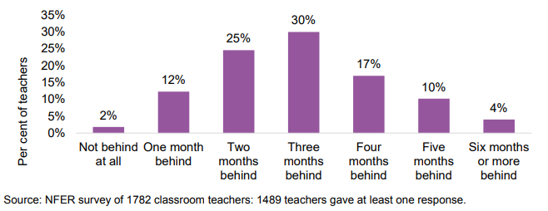
85% of teachers in a national survey reported that pupils were 2 or more months behind the normal expectations in curriculum learning.
It is worth noting that not all studies and surveys have drawn the same conclusions in terms of learning loss
International studies of potential learning loss from other crises (e.g. Hurricane Katrina) reported that after initial increases in learning loss pupils' in fact achieved expected or in some cases better than expected results. Showing that with the right mitigation the impact can be reduced.
Pupils' curriculum learning to normal expectations in July 2020
Existing inequalities are likely to be exacerbated by a variety of factors and it is worth noting that academic achievement as measured by GCSE scores is worse for all ethnic minorities compared to white students from high income families. The impact of home support during remote learning is unknown at this time*.
Notes:
Technical Notes:
Source: https://www.nfer.ac.uk/media/4119/schools_responses_to_covid_19_the_challenges_facing_schools_and_pupils_in_september_2020.pdf
See survey sample size detail within the report but the survey responses represented approximately 7% of primary schools and 20% of secondary schools
Source: * https://rs-delve.github.io/reports/2020/07/24/balancing-the-risk-of-pupils-returning-to-schools.html#schools-and-learning-loss
Contact:
Cambridgeshire Research Group: Business Intelligence, Cambridgeshire County Council (Research.Group@cambridgeshire.gov.uk)

Slide 18
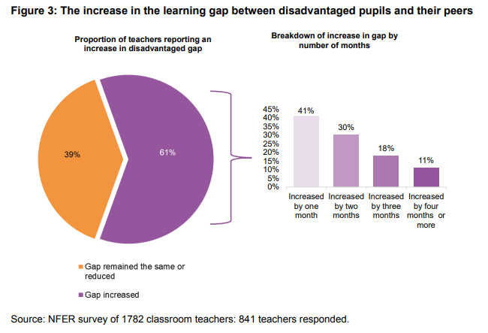
61% of teachers in a national survey reported that the learning gap between disadvantaged pupils and their peers has widened since the previous year, although there was a wide range of responses in relation to how wide the gap had become.
The increase in the learning gap between disadvantaged pupils and their peers
Only 7% of the teachers that responded felt that the gap had reduced between disadvantaged pupils and their peers.
Teachers in the most deprived schools are over three times more likely to report that their pupils are four months or more behind in their curriculum related learning in July, compared to teachers in the least deprived schools (53 per cent compared to 15 per cent).
3% of primary and secondary schools in Cambridgeshire and 47% in Peterborough are located within the top 20% of disadvantaged areas (Lower Super Output Areas, or LSOAs) in the English Indices of Multiple Deprivation 2019
Notes:
Technical Notes:
Source: https://www.nfer.ac.uk/media/4119/schools_responses_to_covid_19_the_challenges_facing_schools_and_pupils_in_september_2020.pdf
See survey sample size detail within the report but the survey responses represented approximately 7% of primary schools and 20% of secondary schools
The Index of Multiple Deprivation (IMD) is the official measure of relative deprivation for small areas (lower super output areas) in England. IMD deciles range from the most deprived 10 per cent of small areas nationally (decile 1) to the least deprived 10 per cent of small areas nationally (decile 10). IMD 2019 has been used for 2019/20 and earlier years are based on IMD data that was available at the time. More information about IMD (Cambridgeshire Insight – Deprivation – Indices of Multiple Deprivation).
Contact:
Cambridgeshire Research Group: Business Intelligence, Cambridgeshire County Council (Research.Group@cambridgeshire.gov.uk)

Slide 19
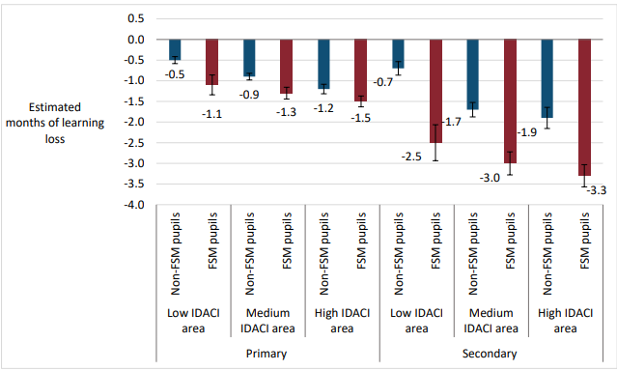
National evidence suggests that during 2020/21 academic year, pupils from disadvantaged backgrounds* experienced greater learning losses in reading than their more affluent peers as a result of the pandemic.
As well as variation by pupil disadvantage, there was found to be variation by the level of deprivation of the area in which pupils live.
Non-disadvantaged primary pupils in areas with medium/high levels of deprivation experienced a similar degree of learning loss to disadvantaged pupils in areas with low levels of deprivation. This is important to note as disadvantage clearly impacts learning losses at both an area-level as well as at pupil level.
Estimated mean learning loss by summer term, in months, in reading (primary and secondary schools) by pupil and area-level disadvantage
The learning loss in reading in secondary school disadvantaged pupils in medium and high IDACI areas was nearly twice as much as non-disadvantaged pupils in the same areas.
*primarily those eligible for free school meals (FSM) at some point in the last six year
Notes:
TECHNICAL NOTES:
Source:
Understanding Progress in the 2020/21 Academic Year
Findings from the summer term and summary of all previous findings
October 2021
Department for Education
Table 1
Understanding Progress in the 2020/21 Academic Year - summer term and summary of all previous findings October 2021 (publishing.service.gov.uk)
Effectively we are saying “what would pupils have achieved in 2020/21 if they had progressed at the same rate as pupils in 2019/20” (for the summer term, we are saying ““what would pupils have achieved in 2020/21 if they had progressed at the same rate as pupils in 2018/19”), and the difference is what we refer to as “learning loss”. (pg8)
*primarily those eligible for free school meals (FSM) at some point in the last six year
IDACI: Income Deprivation Affecting Children Index (IDACI) data. IDACI ranks are taken from the English Indices of Multiple Deprivation (IMD) for 2019 published by the Ministry for Housing, Communities and Local Government. IDACI is a measure of income deprivation and identifies the proportion of children in out-of-work households or on low incomes.
Contact:
Cambridgeshire Research Group: Business Intelligence, Cambridgeshire County Council (Research.Group@cambridgeshire.gov.uk)

Slide 20
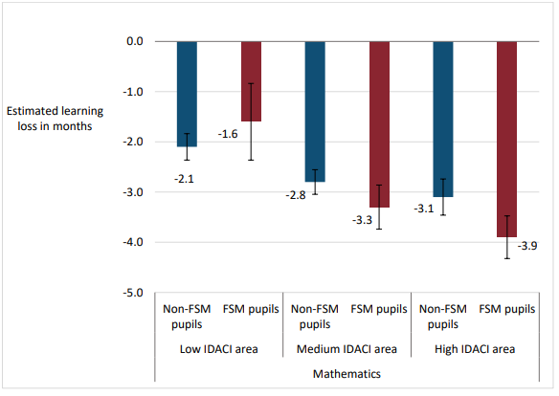
National evidence suggests that during 2020/21 academic year, pupils from disadvantaged backgrounds* experienced greater learning losses in mathematics than their more affluent peers as a result of the pandemic.
Estimated mean learning loss by summer term, in months, in mathematics (primary schools only) by pupil and area-level disadvantage
As well as variation by pupil disadvantage, there was found to be variation by the level of deprivation of the area in which pupils live.
Non-disadvantaged primary aged pupils in areas with medium/high levels of deprivation experienced a greater degree of learning loss in mathematics to disadvantaged pupils in areas with low levels of deprivation. This is important to note as disadvantage clearly impacts learning losses at both an area-level as well as at pupil level.
The biggest impact sees on learning loss in mathematics in primary pupils appears to be the deprivation of the area, rather than the pupil level.
*primarily those eligible for free school meals (FSM) at some point in the last six year
Notes:
TECHNICAL NOTES:
Source:
Understanding Progress in the 2020/21 Academic Year
Findings from the summer term and summary of all previous findings
October 2021
Department for Education
Table 1
Understanding Progress in the 2020/21 Academic Year - summer term and summary of all previous findings October 2021 (publishing.service.gov.uk)
Effectively we are saying “what would pupils have achieved in 2020/21 if they had progressed at the same rate as pupils in 2019/20” (for the summer term, we are saying ““what would pupils have achieved in 2020/21 if they had progressed at the same rate as pupils in 2018/19”), and the difference is what we refer to as “learning loss”. (pg8)
*primarily those eligible for free school meals (FSM) at some point in the last six year
IDACI: Income Deprivation Affecting Children Index (IDACI) data. IDACI ranks are taken from the English Indices of Multiple Deprivation (IMD) for 2019 published by the Ministry for Housing, Communities and Local Government. IDACI is a measure of income deprivation and identifies the proportion of children in out-of-work households or on low incomes.
Contact:
Cambridgeshire Research Group: Business Intelligence, Cambridgeshire County Council (Research.Group@cambridgeshire.gov.uk)

Slide 21
Early Years health and child development services
Notes:
This slide is intentionally left blank to divide sections of the pack.

Slide 22

Attendance at early years settings increased at a faster rate in Cambridgeshire following the first lockdown than in Peterborough.
Attendance of all children at early years settings
Attendance at early years settings in Peterborough increased steadily following the first national lockdown.
In contrast, attendance in Cambridgeshire increased at a faster rate following the first national lockdown.
However, during the third national lockdown, Peterborough had a large decrease in attendance, whereas in Cambridgeshire attendance was relatively unchanged.
Attendance in both Cambridgeshire and Peterborough was increasing following the third national lockdown
Attendance of vulnerable children at early years settings
In Cambridgeshire, the attendance of vulnerable children at early years settings has steadily increased since the first lockdown. However in Peterborough, attendance peaked in July 2020 and has remained below this since.
Attendance is based on data collected from Early Years providers by Local Authorities. Estimates could be affected by the number of providers submitting their information, so there is a high degree of uncertainty around the figures.
Notes:
TECHNICAL NOTES:
Source: https://explore-education-statistics.service.gov.uk/find-statistics/attendance-in-education-and-early-years-settings-during-the-coronavirus-covid-19-outbreak/2021-week-48
Vulnerable children and young people include those who:
are assessed as being in need under section 17 of the Children Act 1989, including children and young people who have a child in need plan, a child protection plan or who are a looked-after child
have an education, health and care (EHC) plan
have been identified as otherwise vulnerable by educational providers or local authorities (including children’s social care services)
Definition source: https://www.gov.uk/government/publications/coronavirus-covid-19-maintaining-educational-provision/guidance-for-schools-colleges-and-local-authorities-on-maintaining-educational-provision
Estimates on the proportion of vulnerable children attending early years settings are not calculated by the DFE. Estimated proportions for vulnerable children attending all schools are available, but are noted to be an undercount since the estimate excludes “otherwise vulnerable” children. For more details see: https://explore-education-statistics.service.gov.uk/methodology/attendance-in-education-and-early-years-settings-during-the-coronavirus-covid-19-outbreak-methodology
Contact:
Cambridgeshire Research Group: Business Intelligence, Cambridgeshire County Council (Research.Group@cambridgeshire.gov.uk)

Slide 23
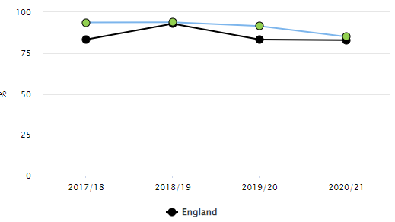
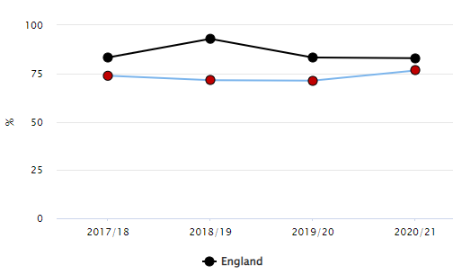
The percentage of children achieving a 'good level of development at 2 – 2 ½ years' reduced in Cambridgeshire in 2020/21 compared to 2019/20, whereas in Peterborough it increased. Numbers of assessments decreased in both areas. However, Cambridgeshire remains statistically significantly higher than England for this measure whereas Peterborough remains statistically significantly worse.
Cambridgeshire
Percentage of children achieving a good level of development at 2 – 2 ½ years
Time period | Cambridgeshire | Peterborough | England
2017/18 | 93.7% | 73.8% | 83.3%
2018/19 | 93.9% | 71.5% | 92.9%
2019/20 | 91.5% | 71.2% | 83.3%
2020/21 | 85.0% | 76.5% | 82.9%
Peterborough
C&YP
Notes:
TECHNICAL NOTES:
Source: Child and Maternal Health - Data - OHID (phe.org.uk)
Contact: Public Health Intelligence Team Cambridgeshire County Council and Peterborough City Council, PHI-Team@cambridgeshire.gov.uk

Slide 24
Physical health impacts
C&YP
Notes:
This slide is intentionally left blank to divide sections of the pack.

Slide 25

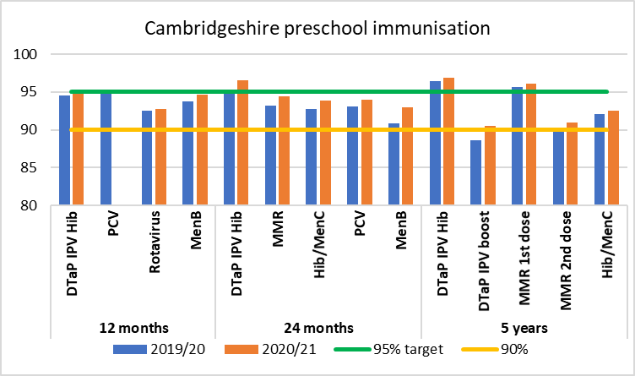
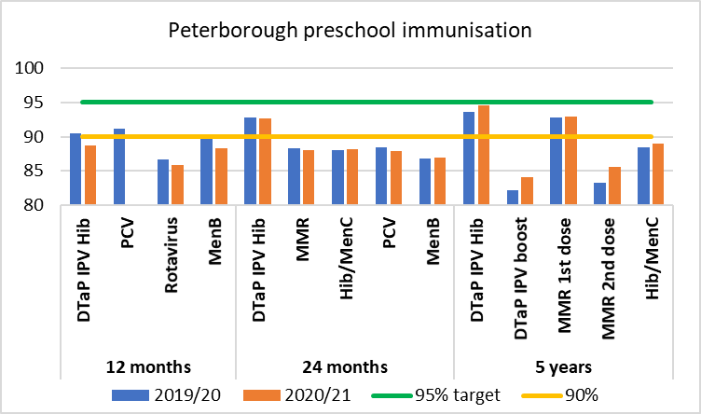
In Peterborough preschool vaccination rates are lower than in Cambridgeshire and although the pandemic did not appear to influence uptake in older children, vaccine uptake at 12m has dropped.
Uptake has increased for vaccinations in Cambridgeshire, suggesting that the pandemic did not adversely affect childhood vaccination. In Peterborough rates are lower than in Cambridgeshire although the pandemic did not appear to influence uptake.
Vaccinations in older children tend to show lower rates.
Public/ Open Information
Notes:
TECHNICAL NOTES:
Sources:
NHS Digital childhood vaccination coverage statistics, Childhood Vaccination Coverage Statistics - 2020-21 - NHS Digital
Definitions:
DTaP = Diphtheria Tetanus and Pertussis
PCV = Pneumococcal Conjugate Vaccine
MenB = Meningitis B
IPV = Injected Polio Vaccine
Hib = Haemophilus influenzae type B
MMR = Measles Mumps and Rubella
MenC = Meningitis C
Contact: Public Health Intelligence Team Cambridgeshire County Council and Peterborough City Council, PHI-Team@cambridgeshire.gov.uk

Slide 26
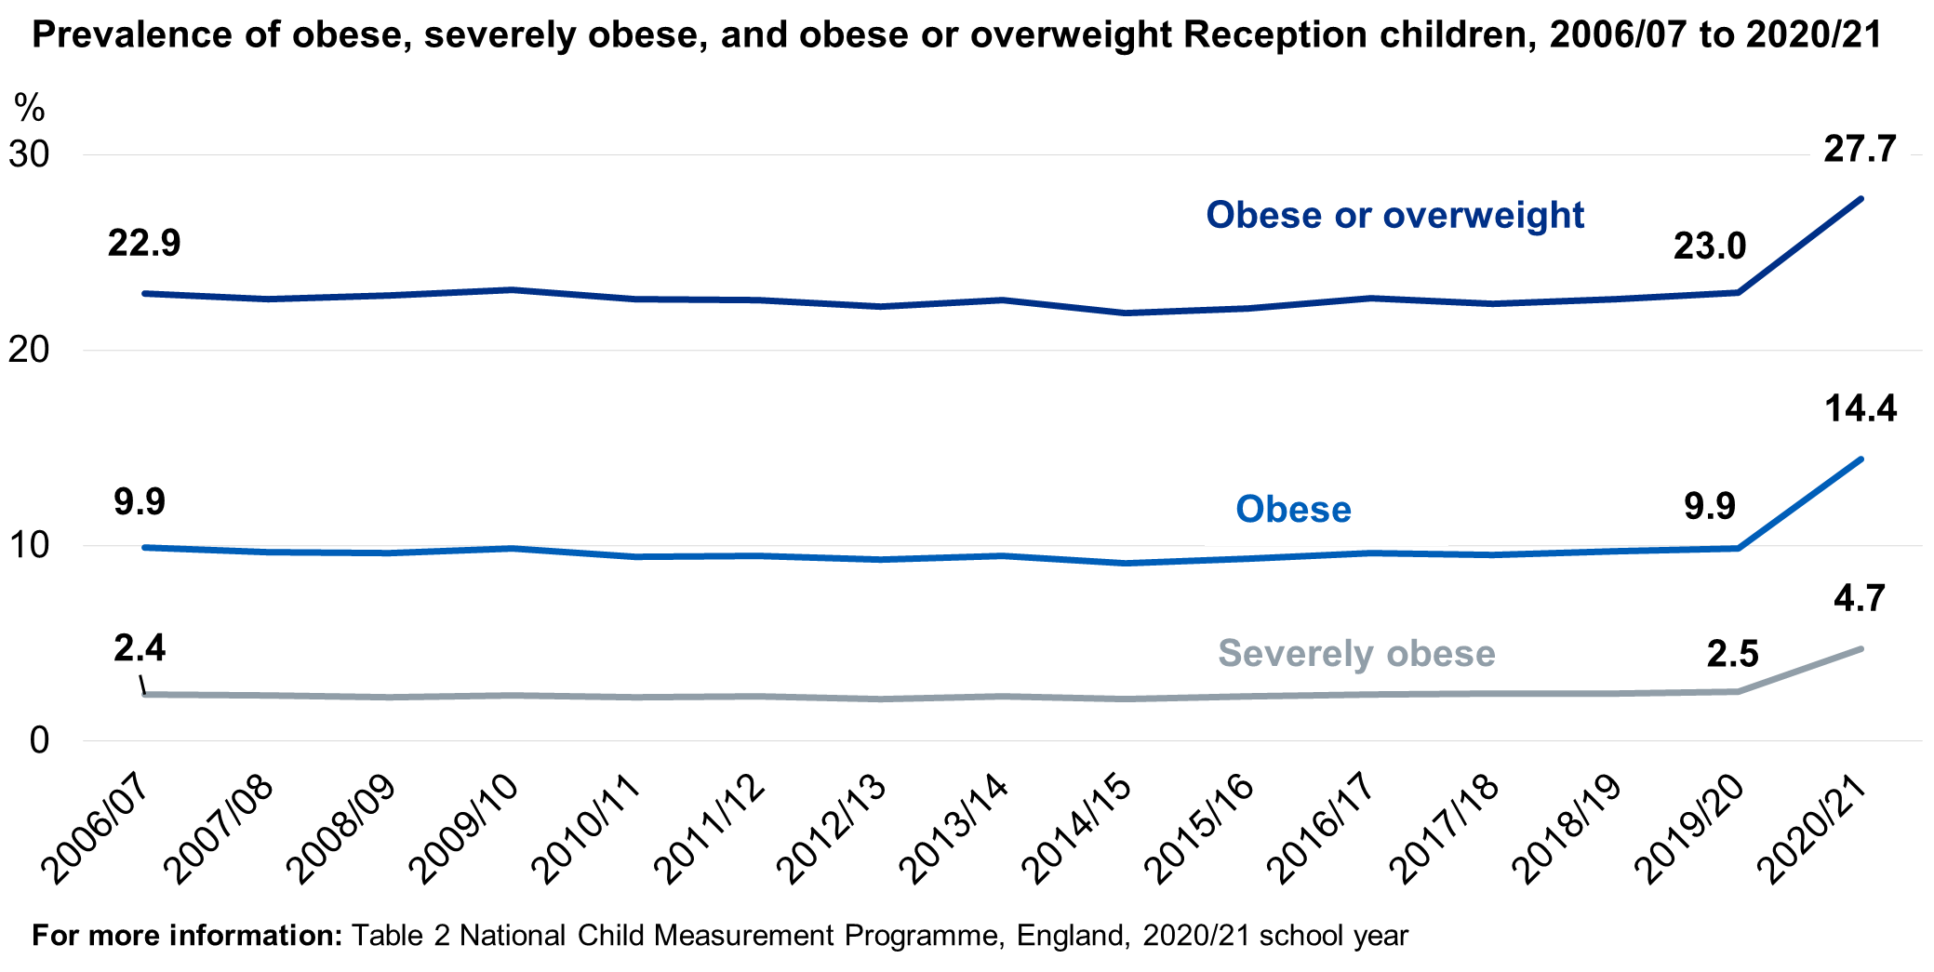
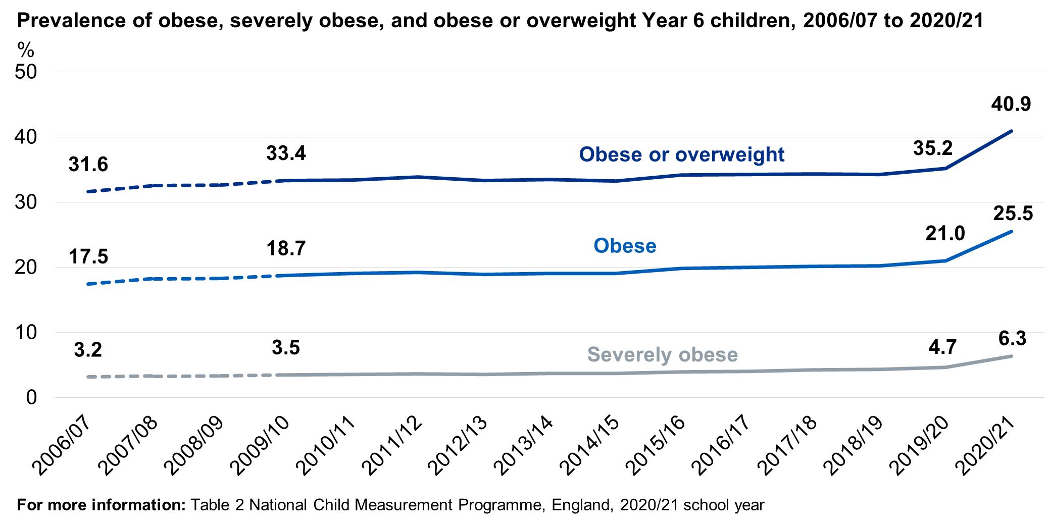
National obesity data shows the largest single year increase in Childhood obesity equivalent to a 10-year increase
The big change in obesity and overweight should cause considerable concern and is likely to lead to poorer health outcomes in later life.
We expect to see the same broad trends in Cambridgeshire and Peterborough, though local data for the most recent year is unreliable.
Public/ Open Information
Notes:
TECHNICAL NOTES:
Source: National Child Measurement Programme; National Child Measurement Programme, England 2020/21 School Year - NHS Digital Part 1: Age, time series and sex.
2020/21 figures are based on weighted data due to a smaller sample of measurements collected than previous years. See Methodology and Data Quality section for more information.
"Figures for 2020/21 are broadly comparable to previous years although some caution is advised about the exact size of the increase because 2020/21 is an incomplete year of data collection. However, it does appear to be clear that there has been an increase in obesity prevalence in 2020/21. More data is needed to know whether this is a longer term increase in childhood obesity prevalence. The picture will become clearer when data for 2021/22 and future years is available as that will cover the whole academic year and will represent periods when schooling was less disrupted." Part 1: Age, time series and sex - NHS Digital
Contact: Public Health Intelligence Team Cambridgeshire County Council and Peterborough City Council, PHI-Team@cambridgeshire.gov.uk

Slide 27
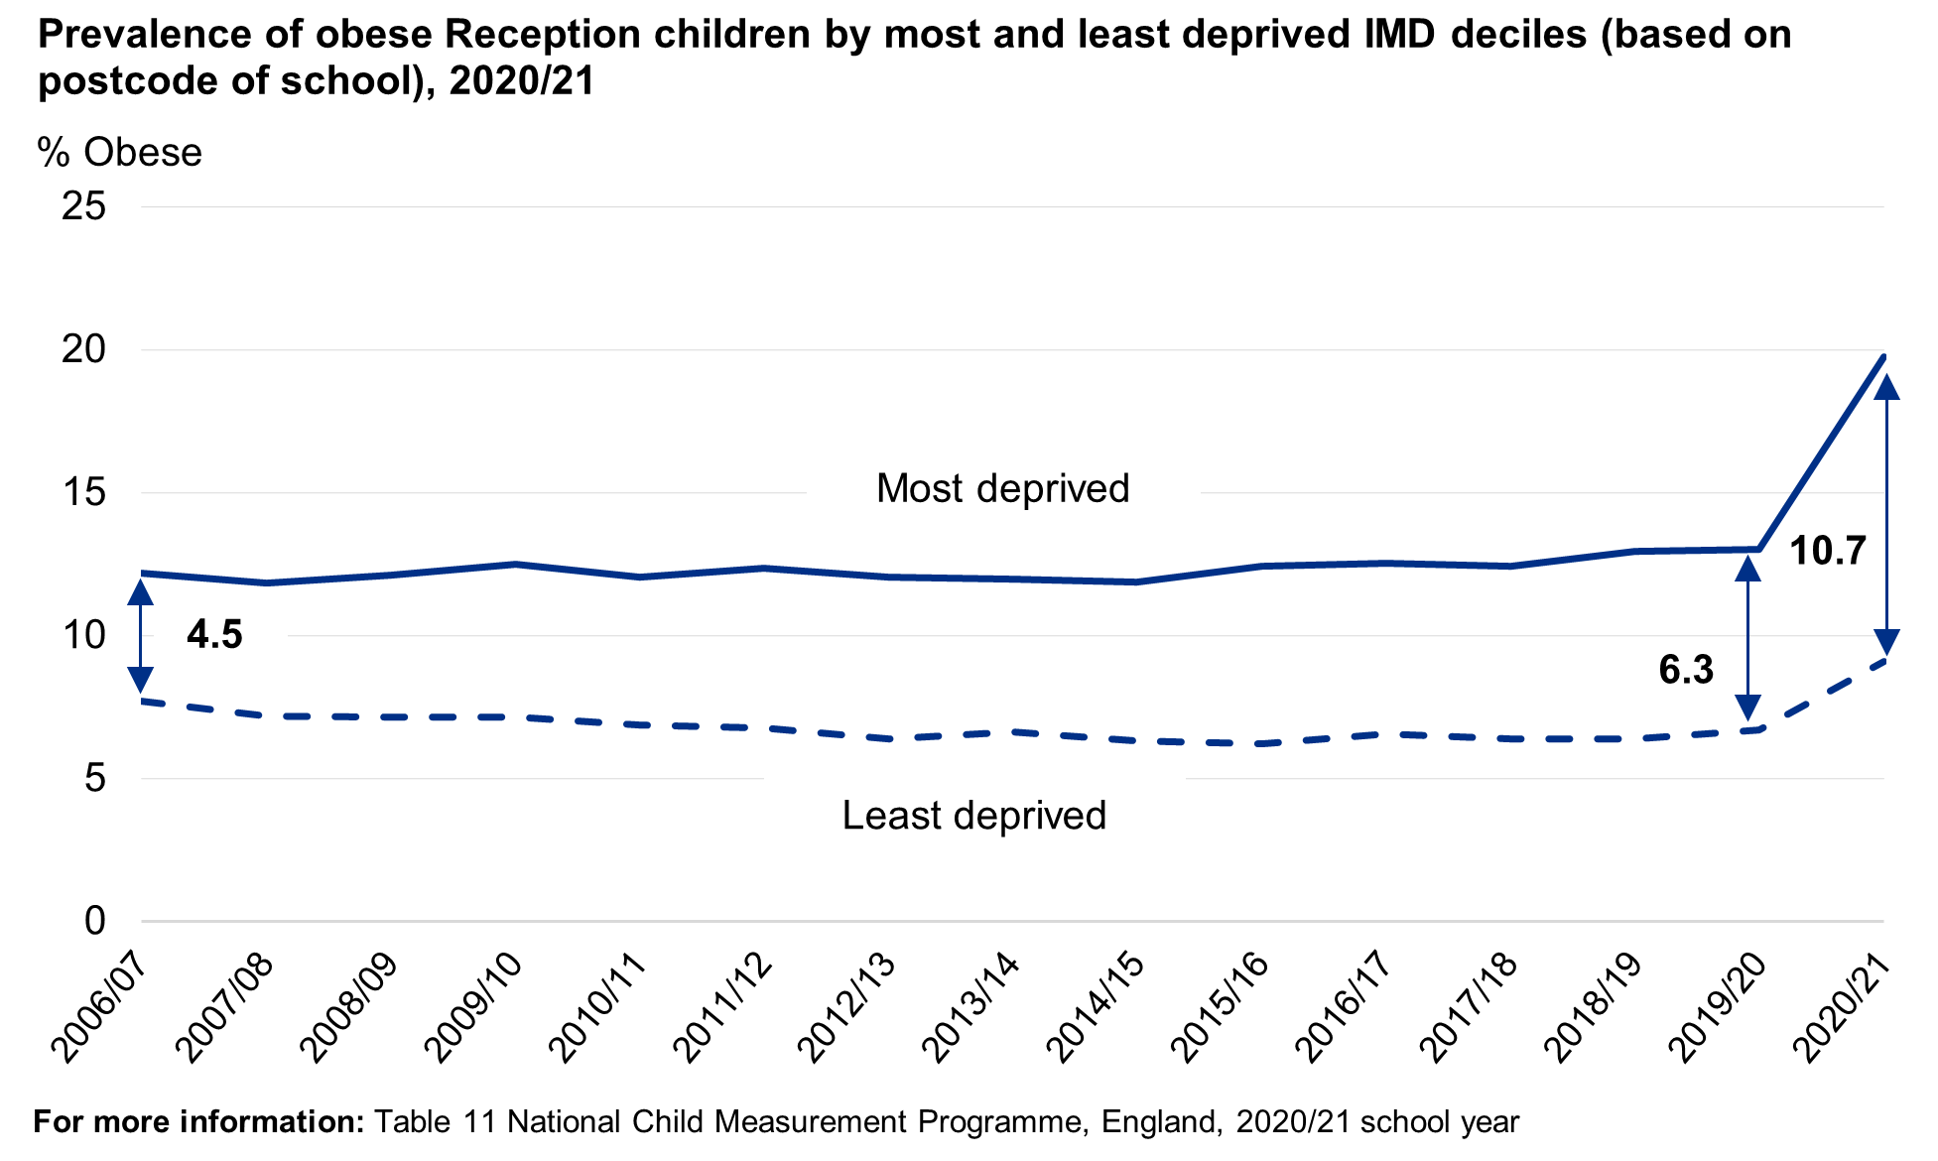
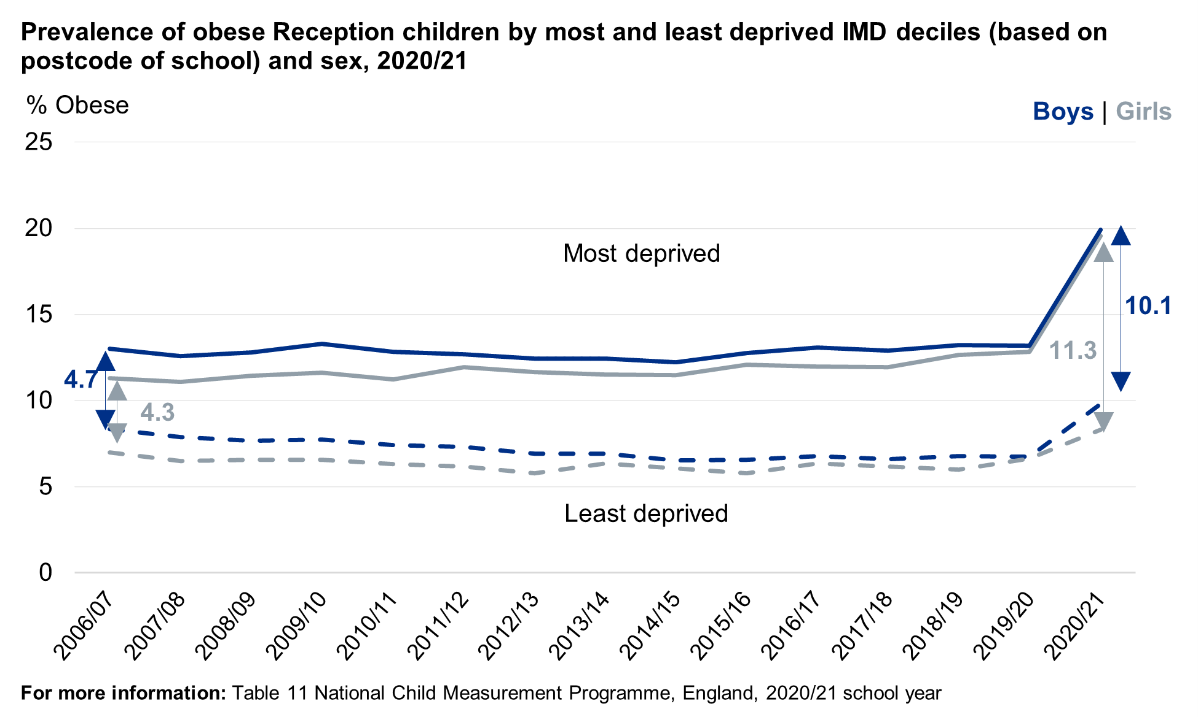
National obesity data in reception pupils (aged 4-5) shows an increase in inequalities
Between 2006/07 and 2020/21 the gap between obesity prevalence for children attending schools in the most and least deprived areas increased from 4.5 to 10.7 percentage points.
In the most deprived areas obesity prevalence increased over the period. In the least deprived areas there was a slight reduction but then obesity prevalence increased again in recent years.
The gap in 2020/21 is estimated to be 11.3 percentage points for girls and 10.1 percentage points for boys.
Time series deprivation is based on the postcode of the school.
Public/ Open Information
Notes:
TECHNICAL NOTES:
Source: National Child Measurement Programme; National Child Measurement Programme, England 2020/21 School Year - NHS Digital Part 4: Deprivation
2020/21 figures are based on weighted data due to a smaller sample of measurements collected than previous years. See Methodology and Data Quality section for more information.
The Index of Multiple Deprivation (IMD) is the official measure of relative deprivation for small areas (lower super output areas) in England. IMD deciles range from the most deprived 10 per cent of small areas nationally (decile 1) to the least deprived 10 per cent of small areas nationally (decile 10). IMD 2019 has been used for 2019/20 and earlier years are based on IMD data that was available at the time. More information about IMD (Cambridgeshire Insight – Deprivation – Indices of Multiple Deprivation).
Contact: Public Health Intelligence Team Cambridgeshire County Council and Peterborough City Council, PHI-Team@cambridgeshire.gov.uk

Slide 28
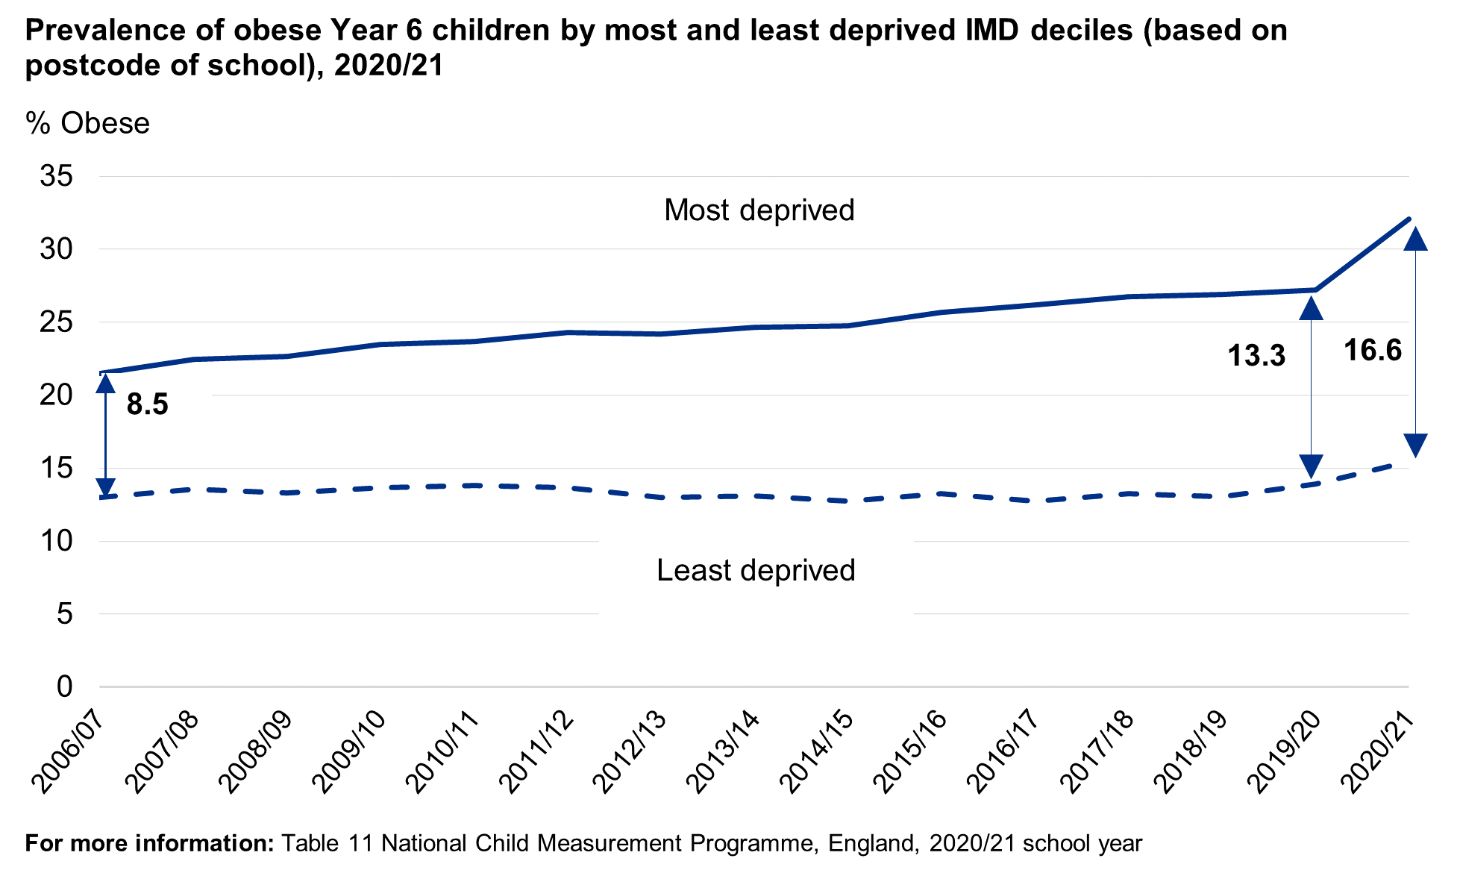
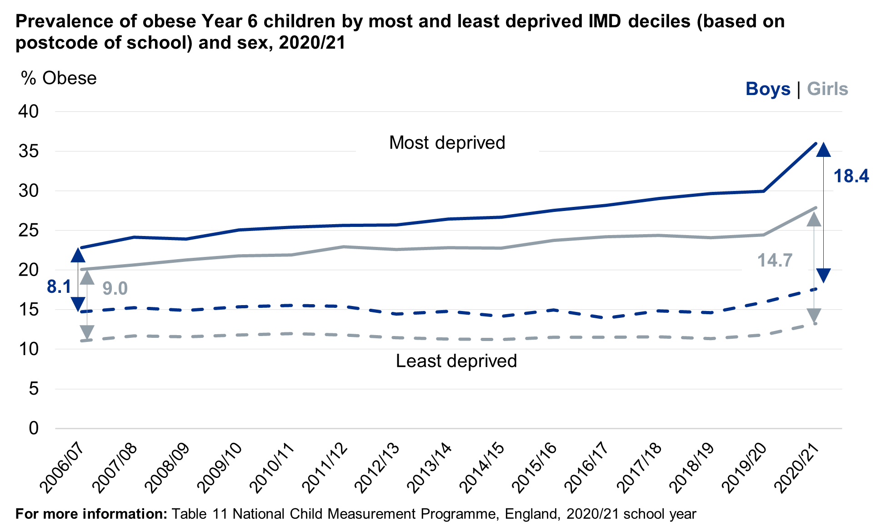
National obesity data in Year 6 pupils (aged 10-11) also shows an increase in inequalities
Between 2006/07 and 2020/21 the gap between obesity prevalence for children attending schools in the most and least deprived areas increased from 8.5 to 16.6 percentage points.
In the most deprived areas obesity prevalence increased over the period. In the least deprived areas obesity prevalence remained stable over time but then increased in 2019/20 and 2020/21.
The gap in 2020/21 is estimated to be 18.4 percentage points for boys and 14.7 percentage points for girls.
Time series deprivation is based on the postcode of the school
Public/ Open Information
Notes:
TECHNICAL NOTES:
Source: National Child Measurement Programme; National Child Measurement Programme, England 2020/21 School Year - NHS Digital Part 4: Deprivation
2020/21 figures are based on weighted data due to a smaller sample of measurements collected than previous years. See Methodology and Data Quality section for more information.
The Index of Multiple Deprivation (IMD) is the official measure of relative deprivation for small areas (lower super output areas) in England. IMD deciles range from the most deprived 10 per cent of small areas nationally (decile 1) to the least deprived 10 per cent of small areas nationally (decile 10). IMD 2019 has been used for 2019/20 and earlier years are based on IMD data that was available at the time. More information about IMD (Cambridgeshire Insight – Deprivation – Indices of Multiple Deprivation).
Contact: Public Health Intelligence Team Cambridgeshire County Council and Peterborough City Council, PHI-Team@cambridgeshire.gov.uk

Slide 29
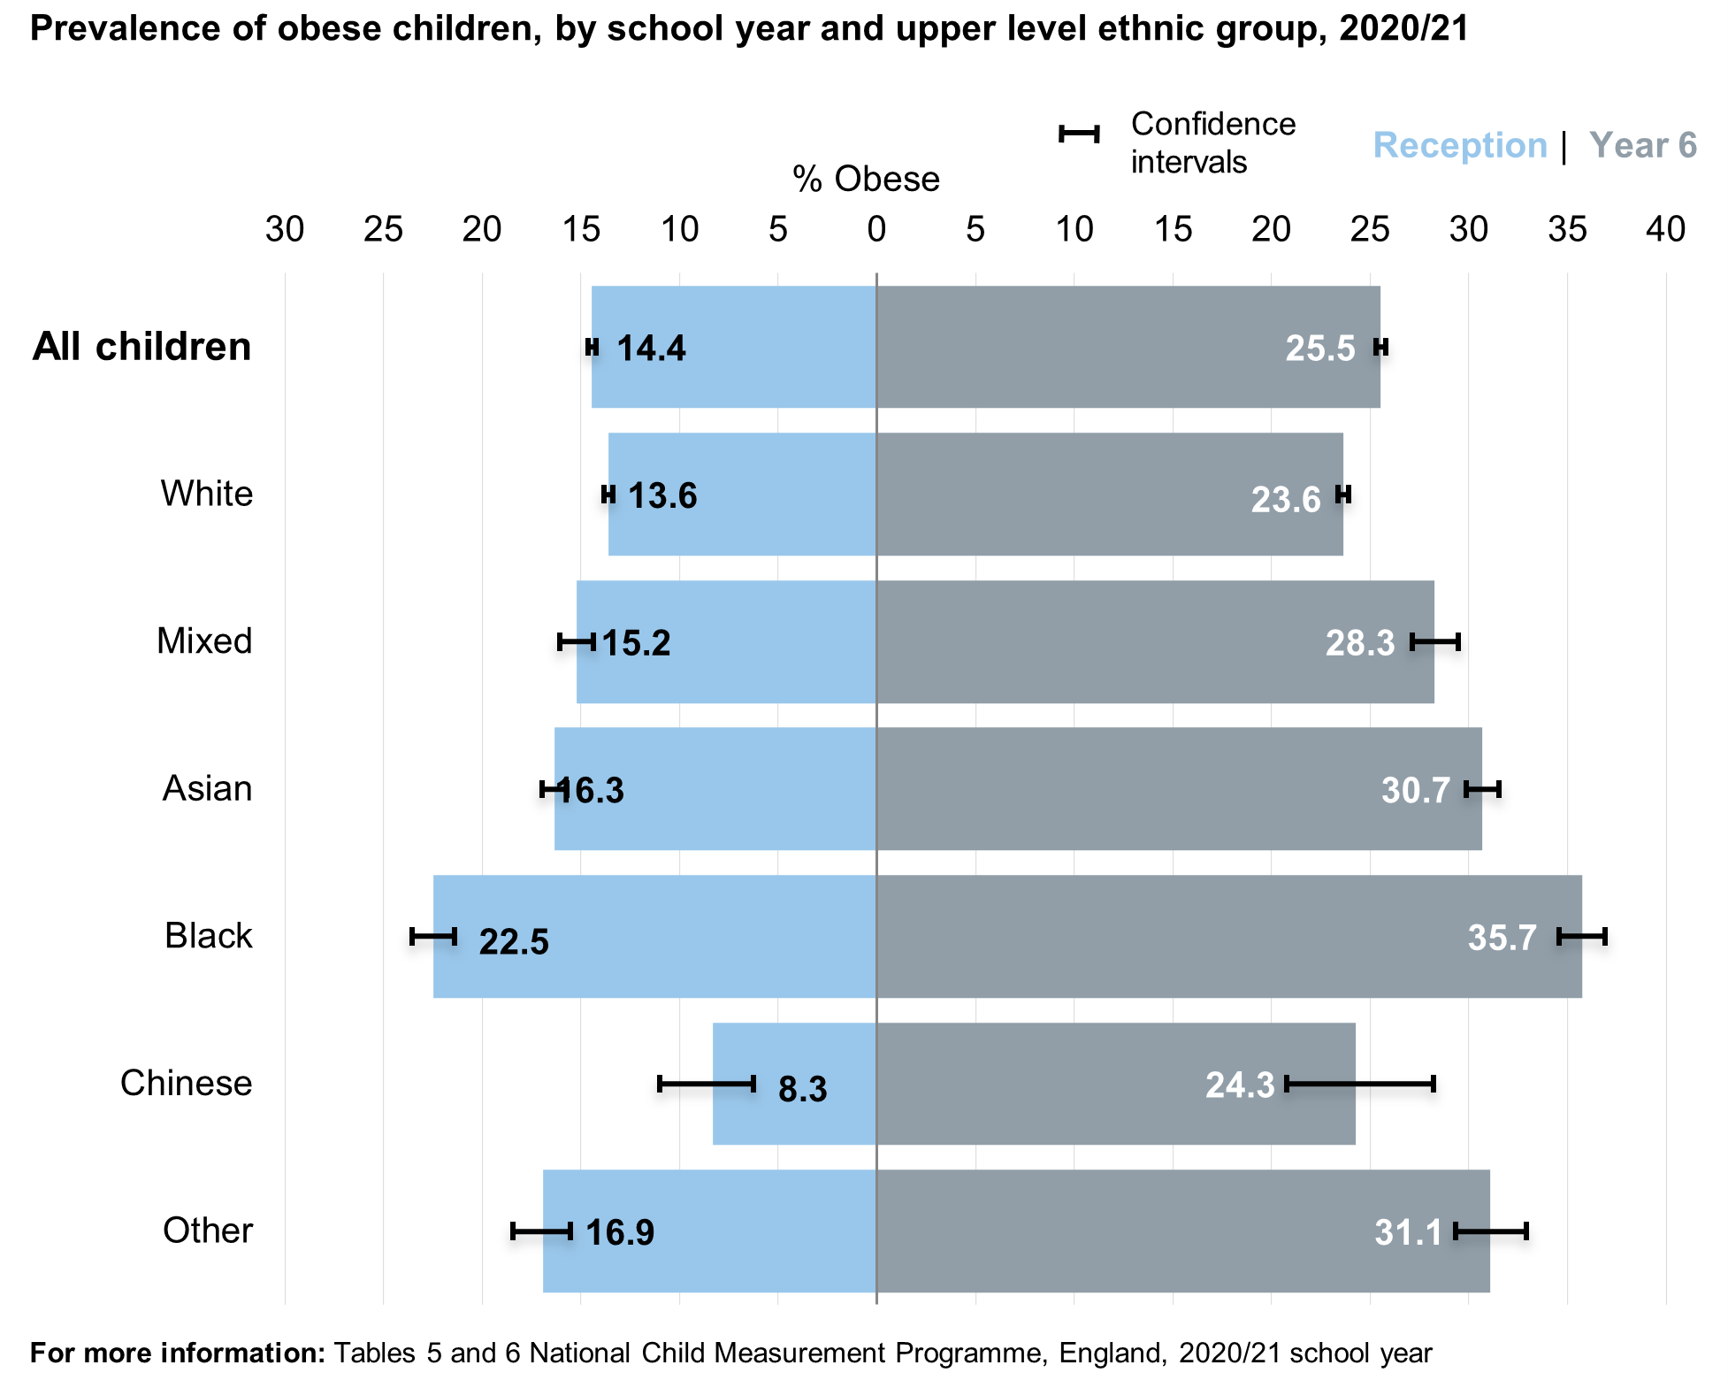
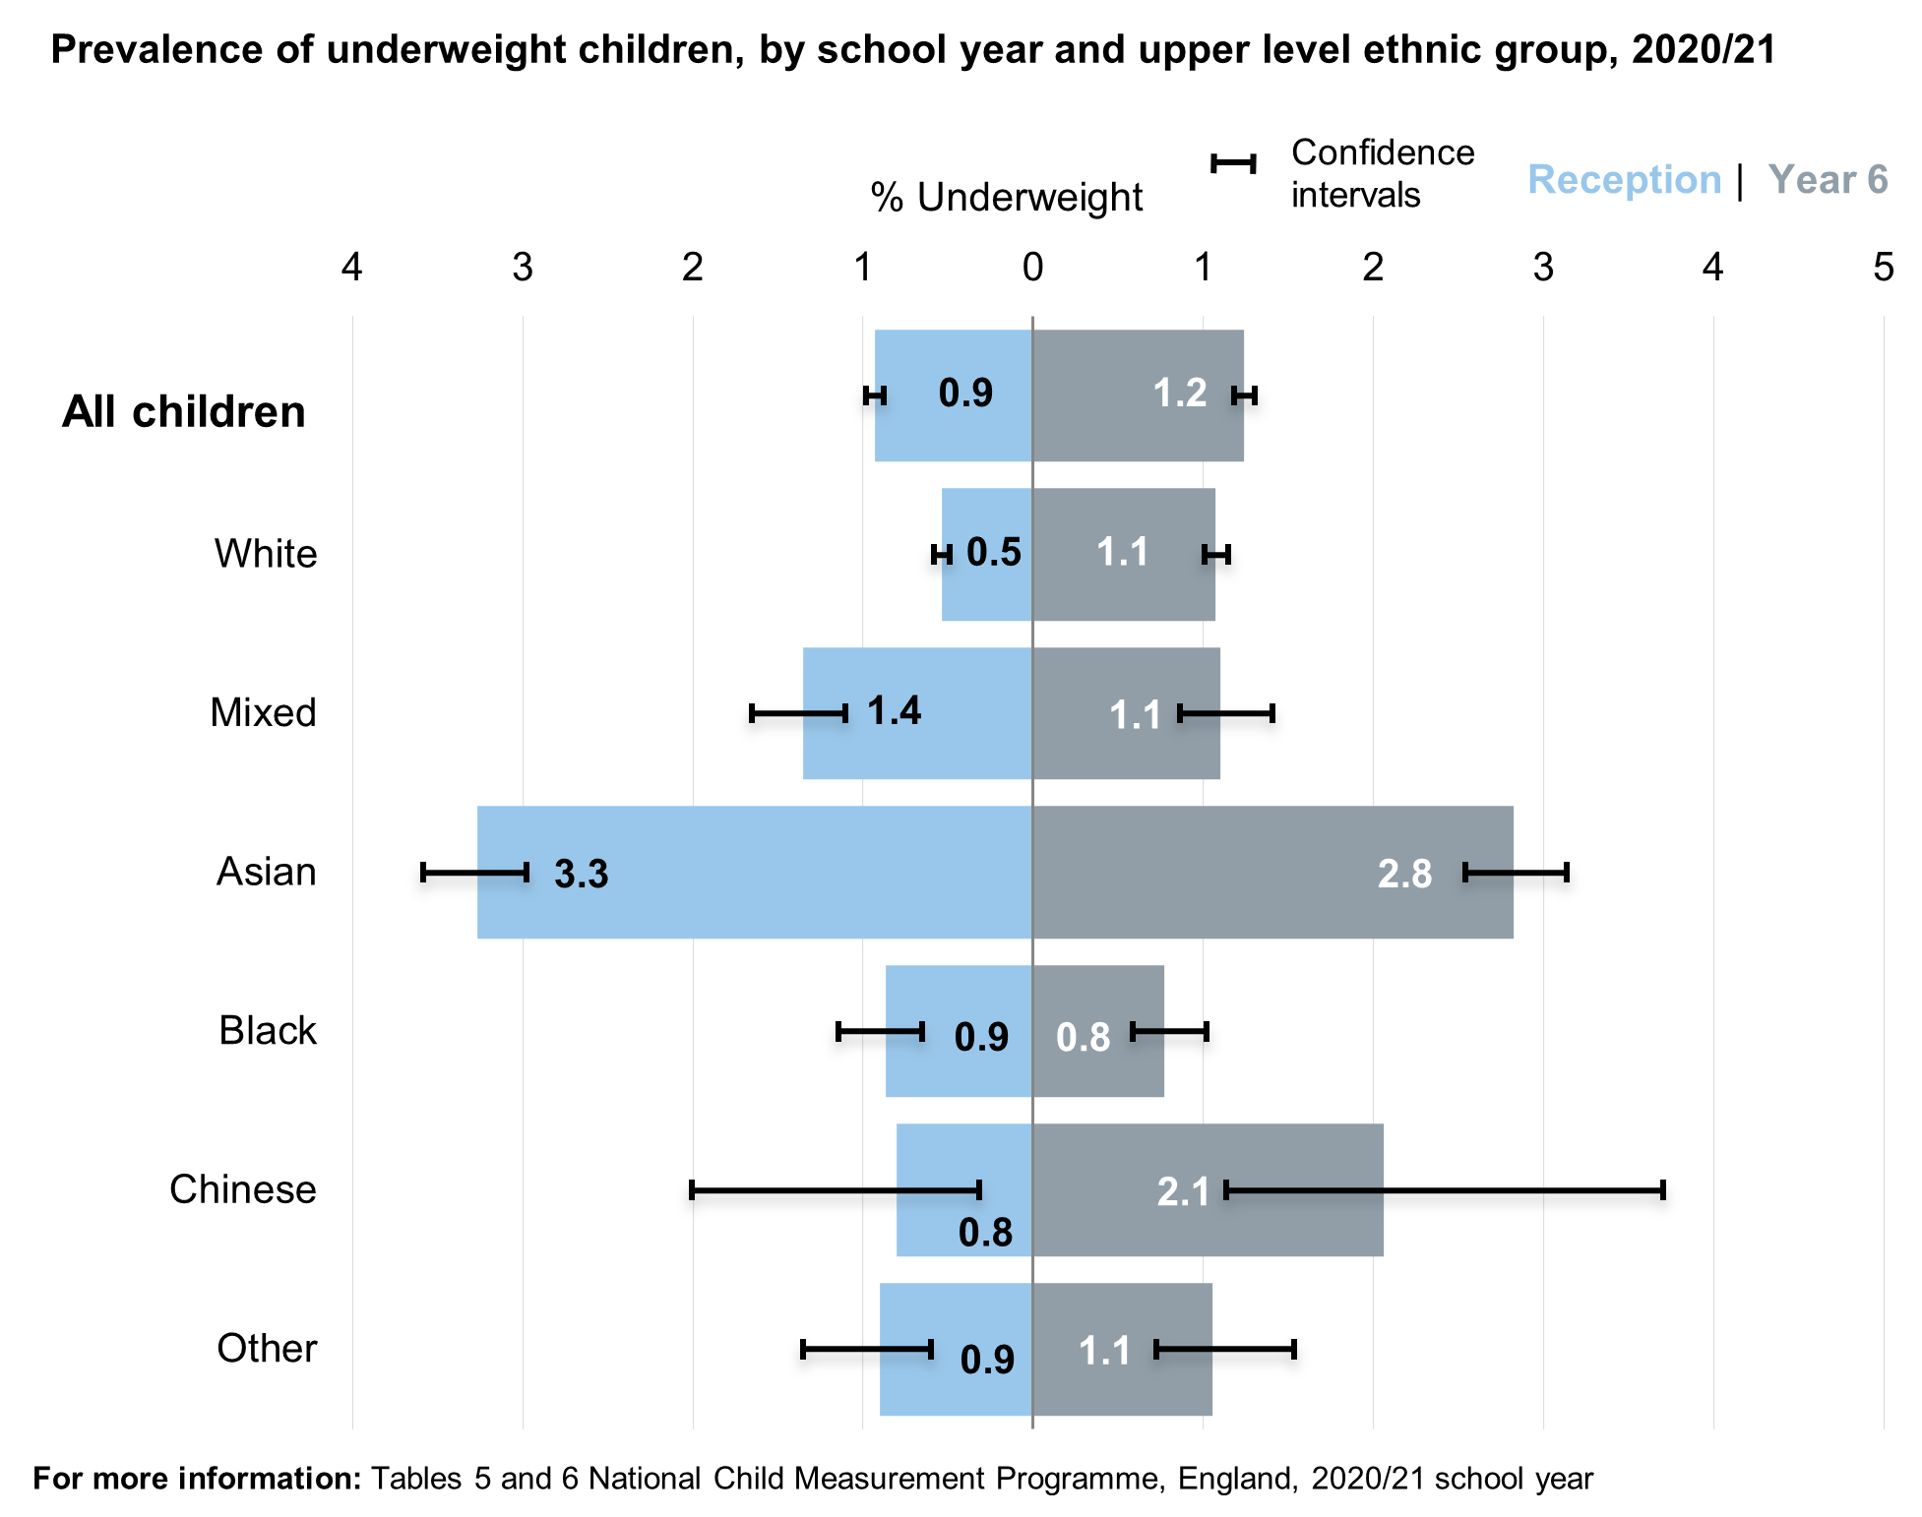
National data shows rates of obesity vary with ethnicity.
Obesity rates in children vary by ethnicity, demonstrating a health inequality.
Obesity prevalence was highest for Black children in both reception and year 6. It was lowest for Chinese children in reception and White and Chinese children in year 6.
Underweight prevalence was highest for Asian children in both reception and year 6.
Public/ Open Information
Notes:
TECHNICAL NOTES:
Source: National Child Measurement Programme; National Child Measurement Programme, England 2020/21 School Year - NHS Digital Part 3: Ethnicity
2020/21 figures are based on weighted data due to a smaller sample of measurements collected than previous years. See Methodology and Data Quality section for more information.
"Data quality checks have been undertaken to ensure that the dataset remains representative by ethnic group. Analyses indicate that the ethnicity data presented in this section is broadly comparable with previous years. See the Methodology and Data Quality section for more information." National Child Measurement Programme, England 2020/21 School Year - NHS Digital
Contact: Public Health Intelligence Team Cambridgeshire County Council and Peterborough City Council, PHI-Team@cambridgeshire.gov.uk

Slide 30
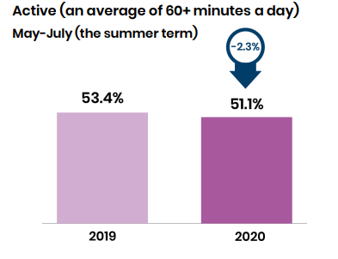
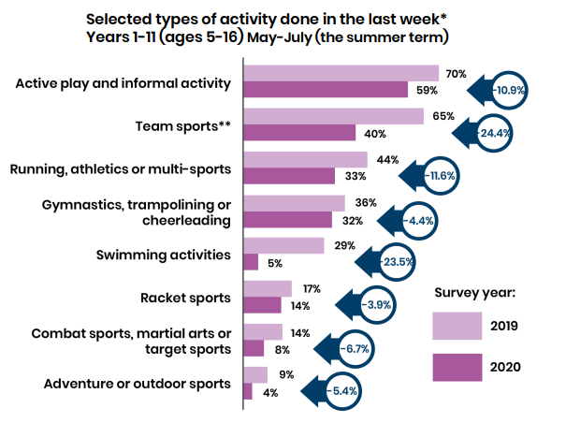
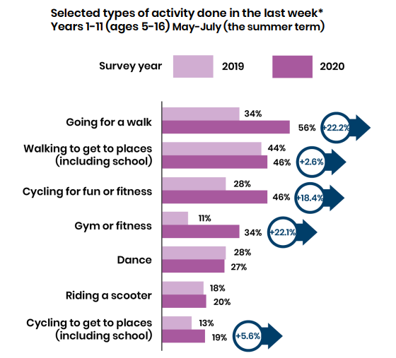
Physical activity opportunities reduced while children were not attending school and there were differences by sex and ethnicity
51.1% of children in the 2020 Summer Term achieved the Chief Medical Officer guideline minimum of 60+ minutes of physical activity a day – a decrease from 53.4% in the previous year.
Team sports and swimming showed the biggest declines, whereas activities such as walking and cycling had some of the largest increases.
36% of children said that they had fewer opportunities to be physically active when not attending school.
Children and young people from ethnic minority communities were most likely to be less active.
Activity reduced more substantially in boys than in girls during periods of lockdown.
Public/ Open Information
Notes:
TECHNICAL NOTES:
Sources:
Active Lives Children and Young People Survey Coronavirus (Covid-19) Report Mid-May to late-July 2020 (the summer term), published July 2021
PowerPoint Presentation (sportengland-production-files.s3.eu-west-2.amazonaws.com)
Contact: Public Health Intelligence Team Cambridgeshire County Council and Peterborough City Council, PHI-Team@cambridgeshire.gov.uk

Slide 31
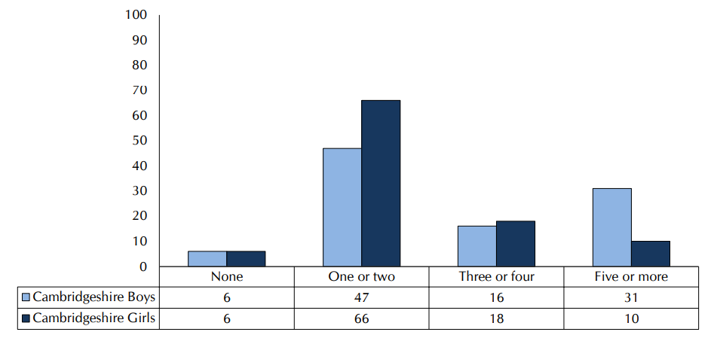
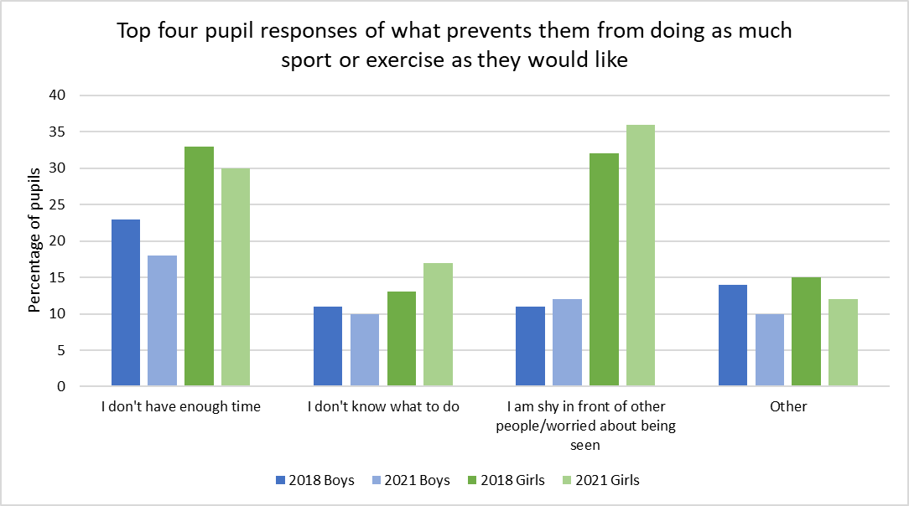
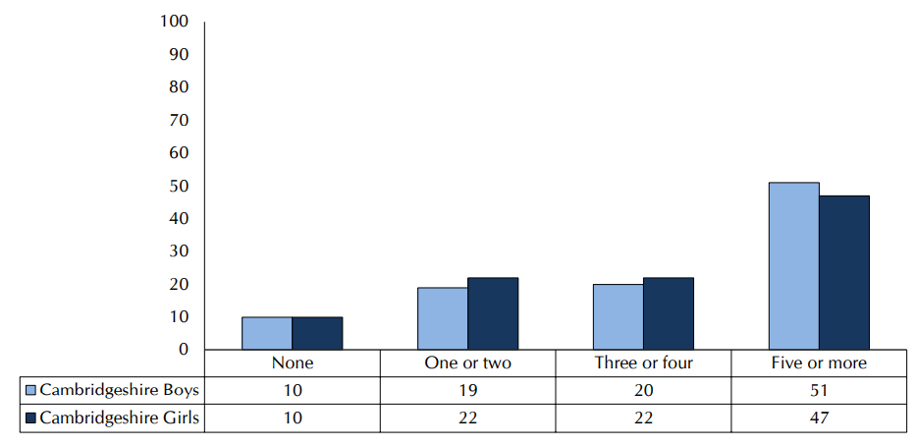
The main reported barriers to physical activity for children in Cambridgeshire are similar for boys and girls, though larger proportions of girls identify these as barriers.
Number of days pupils were physically active for 30 minutes or more last week: IN SCHOOL (Q16a)
The 2021 Health Related Behaviour Survey for Cambridgeshire identified that the percentage of pupils who weren't physically inactive was similar for boys and girls.
Pupil responses on what prevents them from participating more in physical activity included lack of time and being worried about being seen as key issues for both boys and girls, but more so for girls than for boys.
37% of pupils responded that they were physically active for 30 minutes or more on at least three days in school in the week before the survey; 20% said they were active on at least five days.
Number of days pupils were physically active for 30+ minutes last week: OUT OF SCHOOL (Q16b)
69% of pupils responded that they were physically active for 30 minutes or more on at least three days out of school in the week before the survey; 48% said they were active on at least five days.
Public/ Open Information
Notes:
TECHNICAL NOTES:
Sources:
Schools Health Education Unit (2021) The Cambridgeshire Children and Young People’s Health and Wellbeing Survey 2021
The Health-Related Behaviour Survey, developed by the Schools Health Education Unit, is designed for young people of primary and secondary school age. In 2021 in Cambridgeshire 8502 children took part from Years 8 and 10 of secondary school.
(Peterborough did not partake in the 2021 survey)
Contact: Public Health Intelligence Team Cambridgeshire County Council and Peterborough City Council, PHI-Team@cambridgeshire.gov.uk

Slide 32
Cambridgeshire survey data shows some issues of concern around young people’s diet, activity, and substance use.
In our Year 10 pupils, clear sex-based differences emerge in self-reported activity and eating behaviours.
Girls were much more likely to say they would like to lose weight, and more likely to skip breakfast or go a day with no food.
Boys were more likely to describe themselves as 'definitely active'.
There were fewer sex differences in terms of tobacco, drug and alcohol use.
It is notable that as many pupils used non-prescription drugs for weight control as for getting high.
Health Related Behaviour Survey carried out in 2021 in a sample of Cambridgeshire schools.
C&YP
Notes:
TECHNICAL NOTES:
Sources:
Schools Health Education Unit (2021) The Cambridgeshire Children and Young People’s Health and Wellbeing Survey 2021
The Health-Related Behaviour Survey, developed by the Schools Health Education Unit, is designed for young people of primary and secondary school age. In 2021 in Cambridgeshire 8502 children took part from Years 8 and 10 of secondary school.
(Peterborough did not partake in the 2021 survey)
Contact: Public Health Intelligence Team Cambridgeshire County Council and Peterborough City Council, PHI-Team@cambridgeshire.gov.uk

Slide 33
Well-being & Mental Health: Children and Young People
C&YP
Notes:
This slide is intentionally left blank to divide sections of the pack.

Slide 34
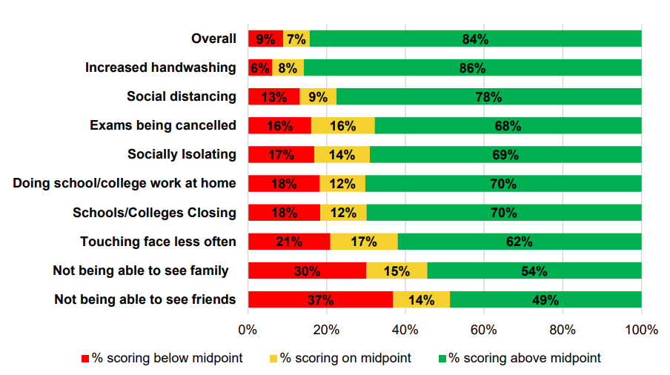

National data indicates that many children and young people experienced a considerable negative impact during the first lockdown in spring 2020, with increased loneliness and social isolation.
While being a young adult was already a risk factor for loneliness, there was even greater risk of this during the early Covid pandemic. Students were also at greater risk of loneliness compared with before the pandemic.
Older children and young people with a probable or possible mental health disorder were more likely to report feeling often or always lonely.
Children reported that the aspects of coronavirus that they struggled to cope with most were being unable to see friends (37%) and family (30%).
Children overall still reported being happy with their relationship with their friends, but 11% reported being unhappy, an increase compared to previous years
Extent to which children (aged 10 to 17) feel they are coping with Coronavirus changes (April- June 2020) (source: Children’s Society Life on Hold report)
Children scored each Coronavirus change on a scale of 0 to 10, so the midpoint refers to a score of 5. Chart excludes those who responded “prefer not to say”.
Notes:
TECHNICAL NOTES:
Sources:
First bullet point: F. Bu, A. Steptoe, and D. Fancourt, Who is lonely in lockdown? Cross-cohort analyses of predictors of loneliness before and during the COVID-19 pandemic, Public Health September 2020 https://www.sciencedirect.com/science/article/pii/S0033350620302742?via%3Dihub, https://www.ons.gov.uk/peoplepopulationandcommunity/birthsdeathsandmarriages/ageing/articles/coronavirusandthesocialimpactsonyoungpeopleingreatbritain/3aprilto10may2020?mc_cid=29060f9fe0&mc_eid=65ff89c91d#impacts-on-well-being
Bu et al: pre-pandemic survey data used is the UK Household Longitudinal Study, collected between January 2017 and June 2019 with a sample of 34,976 participants. Pandemic survey data used is UCL Covid-19 Social Study collected from 21 March 2020 to 21 May 2020 with a sample of 67,142 participants.
ONS: ONS Opinions and Lifestyle Survey was a weekly survey used to collect data on the impact of Covid-19 on day-to-day life in Great Britain. The results are weighted to be nationally represented. The data referenced in this slide is from the survey conducted from 3 April to 10 May 2020, with a sample of 6,400 adults.
Second bullet point: https://files.digital.nhs.uk/97/B09EF8/mhcyp_2021_rep.pdf
The Mental Health of Children and Young People survey provides England’s official statistics on trends in child mental health. It compares face-to-face survey data collected in 2017 (from children aged 2 to 19 years old and their parents) with online survey data collected in Summer 2020 and Spring 2021 from participants who took part in the original 2017 survey and consented to take part in future research. 9,117 children took part in the 2017 survey, 3,570 took part in the 2020 survey and 3,667 took part in the 2021 survey.
Third and fourth bullet point, and chart: https://www.childrenssociety.org.uk/information/professionals/resources/life-on-hold ; life-on-hold-childrens-well-being-and-covid-19.pdf (childrenssociety.org.uk)
The Children’s Society household survey was carried out in April to June 2020, covering 2,000 parents and their children aged 10 to 17 from all four nations of the UK. Children were selected to closely match the demographic and socio-economic make-up of the wider population. Survey findings complemented by an online consultation with 150 young people aged 8 to 19 years old.
Children scored the Coronavirus changes on a 0 to 10 scale (where 0 indicated they had not coped very well and 10 that they had coped very well). References to the midpoint on this scale refer to a score of 5.
Contact: Cambridgeshire Research Group: Business Intelligence, Cambridgeshire County Council (Research.Group@cambridgeshire.gov.uk)

Slide 35
Local data, collected in 2021 from Cambridgeshire schools only, indicates that there have been some considerable changes in several areas for secondary school pupils since 2018.
Resilience
The ‘Health Related Behaviours Survey’ takes place regularly in a sample of Cambridgeshire schools only, including young people in years 8 and 10.
The most recent survey shows some significant differences compared with 2018, which may be attributable to the pandemic.
Students have lower resilience and poorer wellbeing on many measures, and life satisfaction has fallen.
Poverty is affecting more pupils.
However the picture on health behaviour is more mixed, and there is some positive news that fewer students reported alcohol, tobacco and drug use, and fewer risky sexual behaviours. However, sleep is poorer in 2021 and fewer pupils agree they are in charge of their own health.
Health behaviour
Wellbeing
Poverty
Survey carried out in 2021 in a sample of Cambridgeshire schools.
Notes:
TECHNICAL NOTES:
Sources:
Schools Health Education Unit (2021) The Cambridgeshire Children and Young People’s Health and Wellbeing Survey 2021
The Health-Related Behaviour Survey, developed by the Schools Health Education Unit, is designed for young people of primary and secondary school age. In 2021, in Cambridgeshire 8502 children took part from Years 8 and 10 of secondary school.
(Peterborough did not partake in the 2021 survey)
Contact: Cambridgeshire Research Group: Business Intelligence, Cambridgeshire County Council (Research.Group@cambridgeshire.gov.uk)

Slide 36
Local survey data in Cambridgeshire shows some issues of concern around young people’s wellbeing; particularly in girls.
Cambridgeshire pupils reported a high level of worry about school work and exams in year 8, and this increased further in year 10 pupils. Girls were much more likely to report worry on this topic than boys in both year groups.
Many pupils had a low overall measure of resilience, and again this was more marked in girls.
Boys were more likely than girls to report overall satisfaction with life at present, but for both sexes this was lower in Y10 than in Y8.
Health Related Behaviour Survey carried out in 2021 in a sample of Cambridgeshire schools.
Notes:
TECHNICAL NOTES:
Source:
Schools Health Education Unit (2021) The Cambridgeshire Children and Young People’s Health and Wellbeing Survey 2021
(Peterborough did not partake in the 2021 survey)
Contact: Public Health Intelligence Team Cambridgeshire County Council and Peterborough City Council, PHI-Team@cambridgeshire.gov.uk

Slide 37
The issues around mental health needs in children and young people are visible in the data on open Early Help episodes in Cambridgeshire children’s services
Factors in open Early Help Assessments in Cambridgeshire, January 2022
Poor mental health and related issues are common.
The most common factors of behavioural problems at home, mental health needs of child / young person, and Special Educational Needs are often seen as multiple factors across the same Early Help Assessment.
Need Type | Category of Need | Latest Authorised Assessments on Open Episodes
Behavioural problems at home | Category F | 2254
Mental health needs of child/young person | Category F | 1914
Child Young person has learning disability, SEN or EHCP | Category F | 1798
Poor emotional wellbeing | Category F | 1750
Low self-esteem | Category F | 1648
Challenging behaviour at school | Category B | 1636
Mental health needs of parent/carer | Category F | 1628
Parenting concerns (including routines & boundaries) | Category C | 1590
Seeking ASD/ADHD assessment | Category F | 1245
School attendance concerns | Category B | 1146
Notes:
TECHNICAL NOTES:
Source: January 2022 Early Help Quarterly Report; CCC business intelligence
Across Cambridgeshire and Peterborough there are approximately 3500 families with Early Help support from the local authorities. This support is provided where there are needs in the family but the risk of harm to the child is not high enough to warrant statutory intervention by Children’s Social Care.
Table of Factors in open Early Help Assessments in Cambridgeshire (January 2022) shows Top Ten Needs on Open Episodes at Last Quarter End, based on data from each Latest Assessment.
Contact: Cambridgeshire Research Group: Business Intelligence, Cambridgeshire County Council (Research.Group@cambridgeshire.gov.uk)

Slide 38
The issues around mental health needs in children and young people are visible in the data on open Early Help episodes in Peterborough children’s services
Factors in open Early Help Assessments in Peterborough, January 2022
As in Cambridgeshire, poor mental health and related issues are common.
The most common factors of behavioural problems at home, mental health needs of child / young person, and Special Educational Needs are often seen as multiple factors across the same Early Help Assessment.
Need Type | Category of Need | Latest Authorised Assessments on Open Episodes
Behavioural problems at home | Category F | 2441
Mental health needs of child/young person | Category F | 2080
Poor emotional wellbeing | Category F | 1919
Child Young person has learning disability, SEN or EHCP | Category F | 1908
Challenging behaviour at school | Category B | 1832
Low self-esteem | Category F | 1796
Parenting concerns (including routines & boundaries) | Category C | 1751
Mental health needs of parent/carer | Category F | 1714
Seeking ASD/ADHD assessment | Category F | 1550
School attendance concerns | Category B | 1268
Notes:
TECHNICAL NOTES:
Source: PCC business intelligence
Across Cambridgeshire and Peterborough there are approximately 3500 families with Early Help support from the local authorities. This support is provided where there are needs in the family but the risk of harm to the child is not high enough to warrant statutory intervention by Children’s Social Care.
Table of Factors in open Early Help Assessments in Cambridgeshire (January 2022) shows Top Ten Needs on Open Episodes at Last Quarter End, based on data from each Latest Assessment.
Contact: Cambridgeshire Research Group: Business Intelligence, Cambridgeshire County Council (Research.Group@cambridgeshire.gov.uk)

Slide 39
Safeguarding: Children and Young People
C&YP
Notes:
This slide is intentionally left blank to divide sections of the pack.

Slide 40
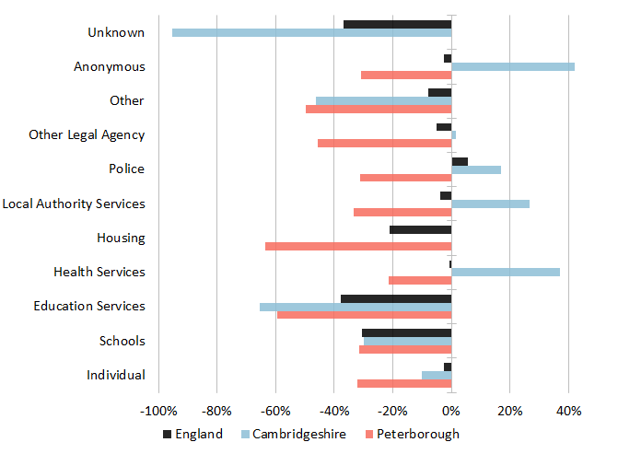
Referrals to children’s social care have fallen nationally, driven by restrictions affecting school attendance. This trend has also been seen locally.
Percentage change in number of referrals to children’s social care services by source, 2019/20 to 2020/21 (Source: DFE)
Up to March 2021 referrals to children’s social care services have decreased nationally.
Nationally the decrease has been driven by a 31% decrease in referrals from schools (a fall of just under 36,000 referrals compared to the previous year.)
The national decrease in referrals from schools is attributed to restrictions on school attendance at various points through the year ending March 2021.
Peterborough referrals from all sources fell between 2019/20 and 2020/21. The same pattern was not seen in Cambridgeshire.
Cambridgeshire recorded increases as follows;
- Health services: 37% (742 – 1017 referrals)
- LA services: 27% (663 – 839 referrals)
- Police: 16% (1238 – 1447 referrals)
Notes:
TECHNICAL NOTES:
Note that some of the year on year percentage changes are from a small base. For example Anonymous source referrals were both under 100 in the year ending March 2020 for Cambridgeshire and Peterborough.
Source:
Characteristics of children in need, Reporting Year 2021
https://explore-education-statistics.service.gov.uk/find-statistics/characteristics-of-children-in-need
A referral is defined as a request for services to be provided by children’s social care and is in respect of a child who is not currently in need. A re-referral occurs where a child has been referred within 12 months of a previous referral.
In (the year ending 31 March) 2021, the number of referrals had the sharpest fall in the series and is now at its lowest point since 2013. This was driven by a fall in referrals from schools (see “Source of referrals”). The number of re-referrals also decreased and is now at its lowest point in the series.
‘This is the first release in the series to be fully impacted by the coronavirus (COVID-19) pandemic. In the year ending 31 March 2021, there was a 31% decrease in referrals from schools (a fall of just under 36,000 referrals), reflective of the restrictions on school attendance in place for parts of the year.’
2) CCC Children's Services CIN Census Report (Cambridgeshire County Council Business Intelligence) 2021.
Contact:
Cambridgeshire Research Group: Business Intelligence, Cambridgeshire County Council (Research.Group@cambridgeshire.gov.uk)

Slide 41
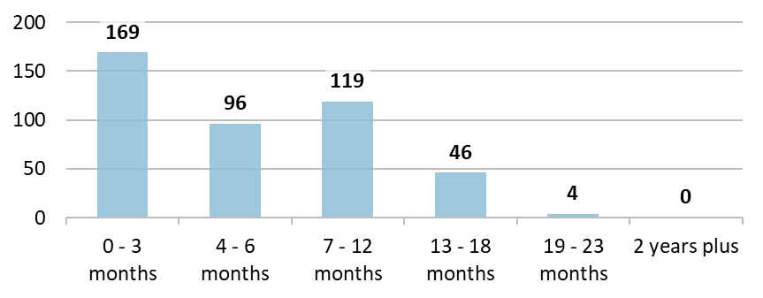
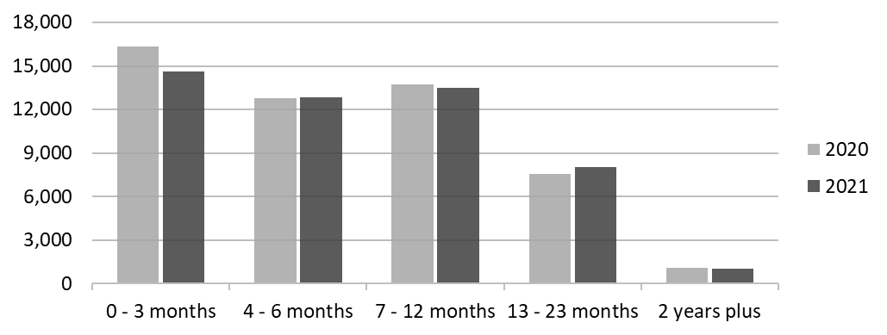
The increase in the number of children subject to longer child protection plans in Cambridgeshire may be in part due to the impact of the move to more virtual engagement with families during the pandemic. Other factors such as the level of complexity will have impacted this.
Length of time that children have been subject to a child protection plan in Cambridgeshire as of end of June 2021
In most circumstances, children should not be subject to a child protection plan for longer than 12 months.
There has been an increase in the number of children subject to plans for between 13 and 23 months in Cambridgeshire. This same trend has also occurred nationally.
Length of time that children have been subject to a child protection plan in England as of 31 March
Notes:
TECHNICAL NOTES:
Source:
Service Director Report – Children and Safeguarding (Cambridgeshire County Council Children’s Services) 14 September 2021: https://cambridgeshire.cmis.uk.com/CCC_live/Document.ashx?czJKcaeAi5tUFL1DTL2UE4zNRBcoShgo=rV5cU62Brt9fr5l%2fkcYASD2i4GCnkZnfzJpw84GDgmJ8ddXxX%2bDIdQ%3d%3d&rUzwRPf%2bZ3zd4E7Ikn8Lyw%3d%3d=pwRE6AGJFLDNlh225F5QMaQWCtPHwdhUfCZ%2fLUQzgA2uL5jNRG4jdQ%3d%3d&mCTIbCubSFfXsDGW9IXnlg%3d%3d=hFflUdN3100%3d&kCx1AnS9%2fpWZQ40DXFvdEw%3d%3d=hFflUdN3100%3d&uJovDxwdjMPoYv%2bAJvYtyA%3d%3d=ctNJFf55vVA%3d&FgPlIEJYlotS%2bYGoBi5olA%3d%3d=NHdURQburHA%3d&d9Qjj0ag1Pd993jsyOJqFvmyB7X0CSQK=ctNJFf55vVA%3d&WGewmoAfeNR9xqBux0r1Q8Za60lavYmz=ctNJFf55vVA%3d&WGewmoAfeNQ16B2MHuCpMRKZMwaG1PaO=ctNJFf55vVA%3d
Length of time that children have been subject to a child protection plan in England: https://explore-education-statistics.service.gov.uk/find-statistics/characteristics-of-children-in-need
A child becomes the subject of a child protection plan if they are assessed as being at risk of harm, at an initial child protection conference. Once a child becomes the subject of a child protection plan, their plan should be reviewed within the first 3 months and then at intervals of not more than 6 months. Definition source: https://explore-education-statistics.service.gov.uk/methodology/characteristics-of-children-in-need-methodology
Contact:
Cambridgeshire Research Group: Business Intelligence, Cambridgeshire County Council (Research.Group@cambridgeshire.gov.uk)

Slide 42
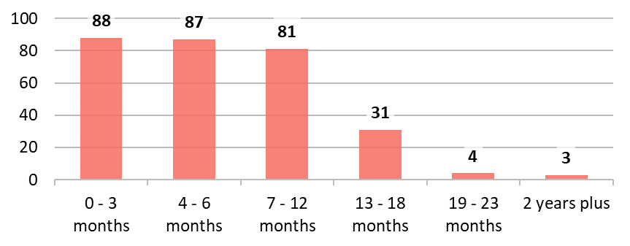
The increase in children subject to longer child protection plans in Peterborough highlights the impact of the move to more virtual engagement with families during the pandemic
Length of time that children have been subject to a child protection plan in Peterborough as of end of June 2021
In most circumstances, children should not be subject to a child protection plan for longer than 12 months.
There has been an increase in the number of children subject to plans for between 13 and 23 months in Peterborough. This same trend has also occurred nationally.
This relates to the reduced effectiveness of virtual working for families facing very complex issues.
Length of time that children have been subject to a child protection plan in England as of 31 March
C&YP
Notes:
TECHNICAL NOTES:
Source: Peterborough City Council Business Intelligence analysis completed Jan 2022.
Length of time that children have been subject to a child protection plan in England: https://explore-education-statistics.service.gov.uk/find-statistics/characteristics-of-children-in-need
A child becomes the subject of a child protection plan if they are assessed as being at risk of harm, at an initial child protection conference. Once a child becomes the subject of a child protection plan, their plan should be reviewed within the first 3 months and then at intervals of not more than 6 months. Definition source: https://explore-education-statistics.service.gov.uk/methodology/characteristics-of-children-in-need-methodology
Contact:
Cambridgeshire Research Group: Business Intelligence, Cambridgeshire County Council (Research.Group@cambridgeshire.gov.uk)

Slide 43
Children and young people going missing from home or at risk of exploitation
C&YP
Notes:
This slide is intentionally left blank to divide sections of the pack.

Slide 44
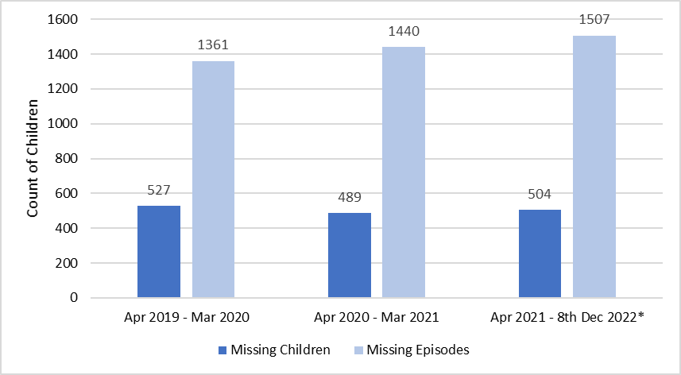
Compared to the pre-pandemic year, the number of children reported missing from home or care in Cambridgeshire has increased, as well as the number of missing episodes.
A child can have multiple episodes of missing from home or care during each year.
The number of children reported missing from home between 1st April 2021 and 8th December 2021 (approximately 8 months) has already exceeded the number for the total previous 12 months (April-March 2020/21).
The number of episodes where a child was missing between 1st April 2021 and 8th December 2021 (approximately 8 months) has also increased compared to the pre-pandemic year 2019/20.
Children Missing from home or care in Cambridgeshire*
The most recent Missing from home data shown for the latest year here covers 1st April- 8th Dec 2021 only. Anecdotally the reporting of young people missing from home during national lockdown periods may have been influenced by reluctance of families to report to police that they are likely in breach of COVID-19 restrictions at the time.
Notes:
TECHNICAL NOTES:
Going missing from home or care is a known risk factor for exploitation of young people i.e. CCE and CSE.
This risk can be:
Because a child is going missing as they are already being exploited.
Because of fewer protective factors when a child goes missing, meaning they are more at risk of being exploited whilst missing.
Sources:
Data sourced from CCC BI team.
Contact:
Cambridgeshire Research Group: Business Intelligence, Cambridgeshire County Council (Research.Group@cambridgeshire.gov.uk)

Slide 45
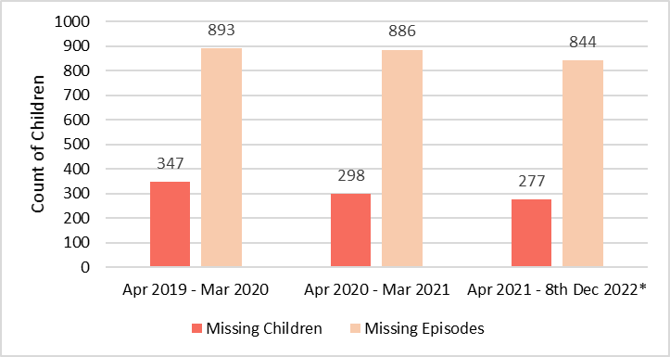
Unlike Cambridgeshire the number of children reported missing from home or care in Peterborough between April 2021 and January 2022 is at a slightly lower level to the complete previous year (2020/21). It is unclear if it will remain in-line with last year, once the full year of data is available.
277 children were reported missing from home in Peterborough between 1st April 2021 and 13th January 2022 (approximately 9 months). This is marginally lower than the total number of missing children (298) for the previous 12 months (2020/21).
The number of episodes where a child was missing in the same 9 months period follow a similar trend. The number of missing episodes is almost equivalent to the pre-pandemic years (844 missing episodes in 2021/2022 vs. 886 in 2020/21 and 893 in 2019/2020)
Children Missing from home or care in Peterborough*
The most recent Missing from home data shown for the latest year here covers 1st April- 8th Dec 2021 only. Anecdotally the reporting of young people missing from home during national lockdown periods may have been influenced by reluctance of families to report to police that they are likely in breach of COVID-19 restrictions at the time.
Notes:
TECHNICAL NOTES:
Going missing from home or care is a known risk factor for exploitation of young people i.e. CCE and CSE.
This risk can be:
Because a child is going missing as they are already being exploited.
Because of fewer protective factors when a child goes missing, meaning they are more at risk of being exploited whilst missing.
Sources:
Exploitation Data sourced from PCC BI team.
Contact:
Cambridgeshire Research Group: Business Intelligence, Cambridgeshire County Council (Research.Group@cambridgeshire.gov.uk)

Slide 46
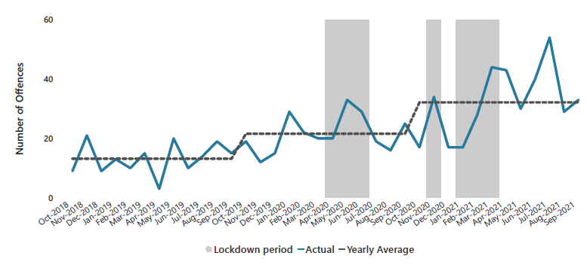
Child Sexual Exploitation (CSE) recorded by police in Cambridgeshire and Peterborough continues a trend of increase since before the COVID-19 pandemic, with possible increases coinciding with lockdown periods.
In the year ending March 2019 11,554 police recorded offences in England and Wales were flagged as CSE. This is the most recent national figure on CSE specifically.
Local data for Cambridgeshire and Peterborough shows Police recorded offences flagged as CSE continue a trend of increase since the beginning of 2020.
The average number of offences has more than doubled in the last 2 years. There was an average of 13 offences per month in the year ending September 2019 and 32 offences per month in the year ending September 2021.
Whilst CSE crimes are low in total volume, CSE is an underreported crime type. The true extent of this issue is likely much higher.
Police recorded CSE marker offences in Cambridgeshire and Peterborough October 2018 – September 2021.
Data is not currently available to understand the demographics of the CSE victims of these offences.
The trends identified in Police recorded data may be influenced by changes in police priorities and recording practices. Offences here relate to the date of recording rather than the date when the offence took place.
Notes:
TECHNICAL NOTES:
Child sexual exploitation: A form of child sexual abuse where an individual or group takes advantage of an imbalance of power to coerce, manipulate, or deceive a child or young person under the age of 18 years into sexual activity in exchange for something the victim needs or wants and/or for the financial advantage or increased status of the perpetrator or facilitator. The victim may have been sexually exploited even if the sexual activity appears consensual. Child sexual exploitation does not always involve physical contact; it can also occur through the use of technology. Definition of Child Sexual Exploitation:
Child sexual exploitation is a form of child sexual abuse where an individual or group takes advantage of an imbalance of power to coerce, manipulate, or deceive a child or young person under the age of 18 years into sexual activity in exchange for something the victim needs or wants and/or for the financial advantage or increased status of the perpetrator or facilitator. The victim may have been sexually exploited even if the sexual activity appears consensual. Child sexual exploitation does not always involve physical contact; it can also occur through the use of technology. (source: ONS Child abuse in England and Wales - Office for National Statistics (ons.gov.uk))
Source:
1. Child Abuse in England and Wales, ONS 2019 Child abuse in England and Wales - Office for National Statistics (ons.gov.uk; Child abuse in England and Wales: March 2020 Appendix Table 35b: Number of offences flagged as child sexual exploitation (CSE), by offence, year ending March 2018 to year ending March 2019; Data for offences where child sexual exploitation is not specified in the definition of the offence have been extracted using the CSE flag. This information is not always provided, therefore it is not possible to identify all CSE offences recorded by the police. However, the CSE flag has the potential to identify offences which would otherwise not be distinguishable as constituting child sexual exploitation
2. Cambridgeshire Constabulary data sourced Oct 2021 (CCC Research Group analysis); data extracted selecting all crimes which have a CSE flag.
Contact:
Cambridgeshire Research Group: Business Intelligence, Cambridgeshire County Council (Research.Group@cambridgeshire.gov.uk)

Slide 47
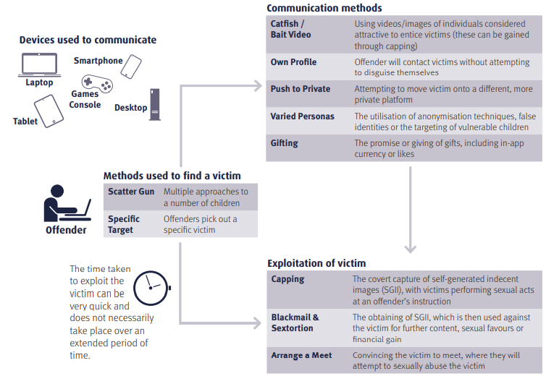
Context: Increased time online during lockdown (for both perpetrators and potential victims) has been linked to an increased risk of Child Sexual Abuse by national agencies
National Crime Agency summary of Technology Assisted Grooming
The National Crime Agency annual strategic assessment for 2021 highlights increased online (perpetrator) activity relating to Child Sexual Abuse during lockdowns and an expectation that this will continue beyond lockdown periods.
The increased time children have spent online during lockdowns has also been highlighted as a risk factor for Technology Assisted Grooming as a whole.
Notes:
TECHNICAL NOTES:
Figure sourced from pg. 21 of NCA Strategic Assessment of Serious and Organised Crime 2021. (URL:
https://nationalcrimeagency.gov.uk/who-we-are/publications/533-national-strategic-assessment-of-serious-and-organised-crime-2021)
Isolated and struggling: social isolation and the risk of child maltreatment, in lockdown and beyond (nspcc.org.uk)
Contact:
Cambridgeshire Research Group: Business Intelligence, Cambridgeshire County Council (Research.Group@cambridgeshire.gov.uk)

Slide 48
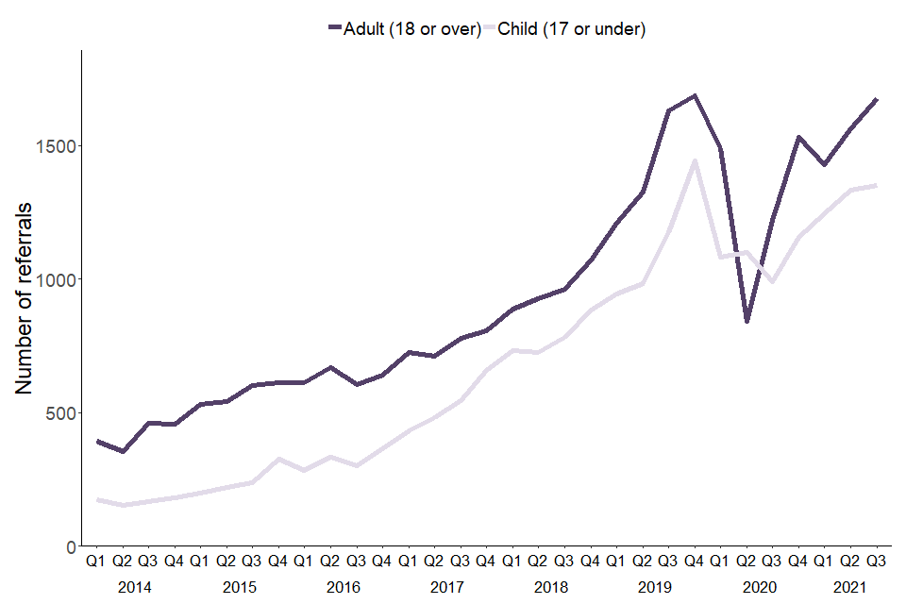
National Context: Child Criminal Exploitation
National Referral Mechanism (NRM) figures show a long term increase in under 18s referred as potential victims of modern slavery (including Criminal Exploitation) nationally since 2014.
There was a temporary decrease in referrals in 2020, coinciding with national lockdowns.
The level of referrals has subsequently risen to pre-pandemic levels.
Number of quarterly NRM referrals by age group of exploitation (Source: Home Office)
Vulnerability to criminal exploitation can be increased where young people are experiencing economic difficulty or deprivation and as such the economic context for young people since 2020 needs to be considered as a risk factor here.
Child criminal exploitation is a poorly reported and sometimes challenging to identify. This chart excludes referrals where the age group at exploitation is unknown.
Notes:
TECHNICAL NOTES:
Definition of Child Criminal Exploitation:
Child Criminal Exploitation is common in county lines and occurs where an individual, or group, takes advantage of an imbalance of power to coerce, control, manipulate or deceive a child or young person under the age of 18. The victim may have been criminally exploited even if the activity appears consensual. Child Criminal Exploitation does not always involve physical contact; it can also occur through the use of technology.
(Source: Child Exploitation Strategy 2021-2025 | Cambridgeshire and Peterborough Safeguarding Partnership Board (safeguardingcambspeterborough.org.uk))
NRM (National Referral Mechanism)
Modern slavery is a term that includes any form of human trafficking, slavery, servitude or forced labour, as set out in the Modern Slavery Act 2015. Potential victims of modern slavery in the UK that come to the attention of authorised ‘first responder’ organisations are referred to the NRM. When referred to the NRM, the SCA within the Home Office makes a ‘reasonable grounds’ decision on whether an individual could be a victim of modern slavery.
Adults given a positive reasonable grounds decision can have access to support (including accommodation, subsistence, legal aid and counselling) pending a ‘conclusive grounds’ decision on their case. Local authorities support children.
Figure source: Modern Slavery: National Referral Mechanism and Duty to Notify statistics UK, Quarter 3 2021 – July to September - GOV.UK (www.gov.uk)
Figure 2: Number of quarterly NRM referrals by age group of exploitation
Contact:
Cambridgeshire Research Group: Business Intelligence, Cambridgeshire County Council (Research.Group@cambridgeshire.gov.uk)

Slide 49
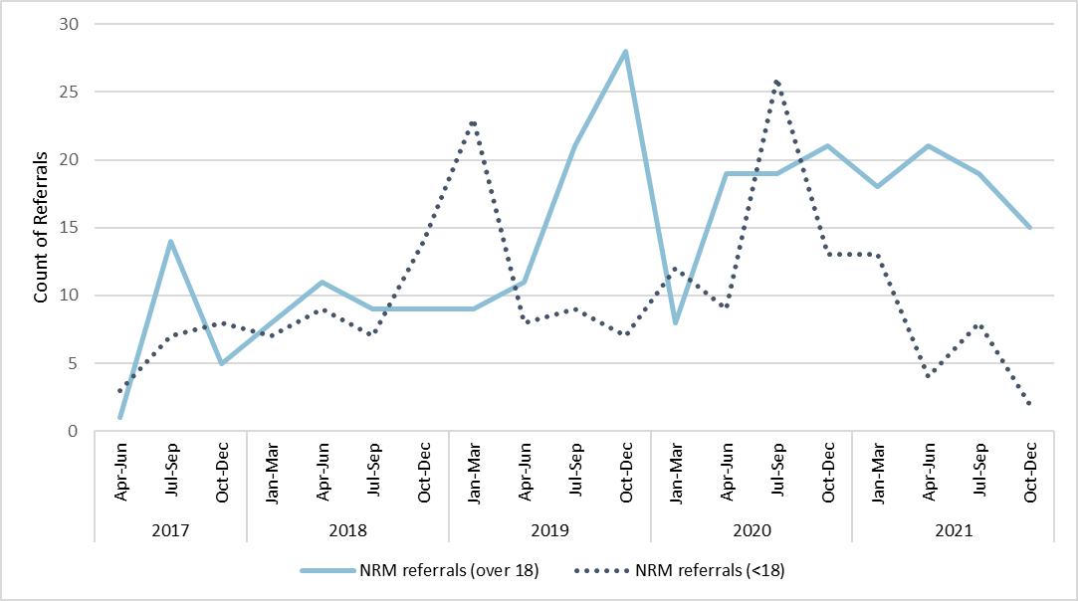
In Cambridgeshire there has been an overall reduction in the number of referrals for under 18s to the National Referral Mechanism as potential victims of Modern Slavery in the latest year (2021).
Referrals to the National Referral Mechanism in Cambridgeshire and Peterborough have seen a long term increase from 2017-2019, in line with national trend.
In 2020 there was a peak in referrals for under 18s (Oct-Dec) which surpassed all previous quarterly counts recorded for this age group.
Referrals for adults did not peak in the same way since the pandemic began, but have remained relatively stable since early 2020.
The total number of referrals was similar in 2019 (123) and 2020 (121) and there was a slightly lower total of 111 referrals in 2021.
In 2019 and 2020 44-45% of NRM referrals were for under 18s, whereas 34% were for under 18s in 2021.
Number of quarterly NRM referrals in Cambridgeshire and Peterborough by age group
This figures here relate to age at point of referral not age at which a (potential) victim was first exploited. Re-referrals could feature in this data and therefore this does not necessarily show the total number of victims.
Notes:
TECHNICAL NOTES:
Definition of Child Criminal Exploitation:
Child Criminal Exploitation is common in county lines and occurs where an individual, or group, takes advantage of an imbalance of power to coerce, control, manipulate or deceive a child or young person under the age of 18. The victim may have been criminally exploited even if the activity appears consensual. Child Criminal Exploitation does not always involve physical contact; it can also occur through the use of technology.
(Source: Child Exploitation Strategy 2021-2025 | Cambridgeshire and Peterborough Safeguarding Partnership Board (safeguardingcambspeterborough.org.uk))
NRM (National Referral Mechanism)
Modern slavery is a term that includes any form of human trafficking, slavery, servitude or forced labour, as set out in the Modern Slavery Act 2015. Potential victims of modern slavery in the UK that come to the attention of authorised ‘first responder’ organisations are referred to the NRM. When referred to the NRM, the SCA within the Home Office makes a ‘reasonable grounds’ decision on whether an individual could be a victim of modern slavery.
Adults given a positive reasonable grounds decision can have access to support (including accommodation, subsistence, legal aid and counselling) pending a ‘conclusive grounds’ decision on their case. Local authorities support children.
Figure source:
Cambridgeshire Constabulary - referrals will mainly be from police as first responder but other partner first responder organisation referrals are included in these figures.
Figures here do not exclude re-referrals. Data only available from 2017 onwards.
Contact:
Cambridgeshire Research Group: Business Intelligence, Cambridgeshire County Council (Research.Group@cambridgeshire.gov.uk)

Slide 50
Domestic Abuse
C&YP
Notes:
This slide is intentionally left blank to divide sections of the pack.

Slide 51
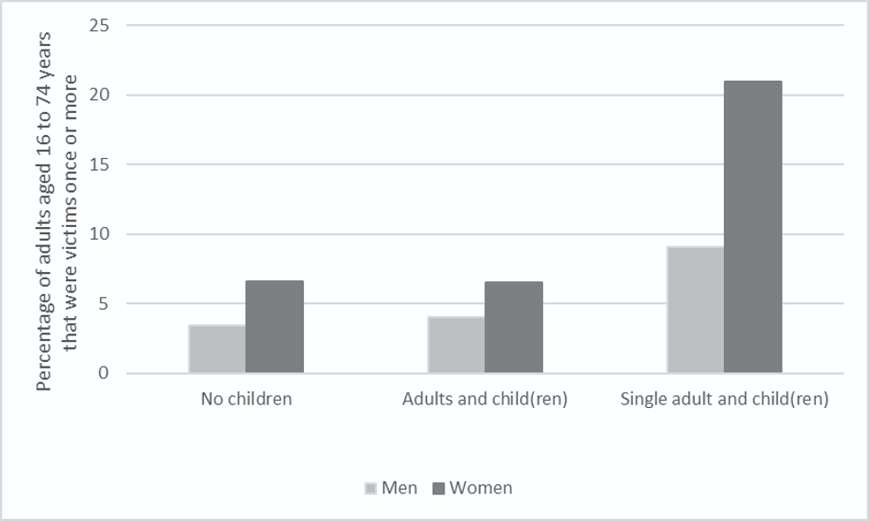
The national data from the Crime Survey for England and Wales (CSEW year ending March 2020) showed that, of men and women aged 16 to 74 years, those who lived in a single-parent household were more likely to have experienced domestic abuse in the last year than those living in a no-children household or a household with other adults and children.
Prevalence of domestic abuse in the last year for adults aged 16 to 74 years by household structure, England and Wales, year ending March 2020
Source: ONS
Children are often living in households where domestic abuse is taking place, and can be directly victimised, witnessing or aware of the abuse and risk.
Recent national analysis of 124 Domestic Homicide Reviews (DHRs) found that 41% of the DHRs recorded that there were dependent children (aged under 18) living in the household at the time of the homicide.
Taking into account the age of the victim (i.e. those under 60) the proportion of DHRs in this analysis with dependent children in the household was 52%.
Notes:
TECHNICAL NOTES:
A Domestic Homicide Review (DHR) is a multi-agency review, commissioned by a community safety partnership, of the circumstances in which the death of a person aged 16 or over has, or appears to have, resulted from violence, abuse or neglect by a person to whom they were related or with whom they were, or had been, in an intimate personal relationship, or a member of the same household.
Bullet 1 - Source: https://www.ons.gov.uk/peoplepopulationandcommunity/crimeandjustice/articles/domesticabusevictimcharacteristicsenglandandwales/yearendingmarch2020#household-structure
Bullet 2 – Source: Key findings from analysis of domestic homicide reviews - GOV.UK (www.gov.uk)
Contact:
Cambridgeshire Research Group: Business Intelligence, Cambridgeshire County Council (Research.Group@cambridgeshire.gov.uk)

Slide 52
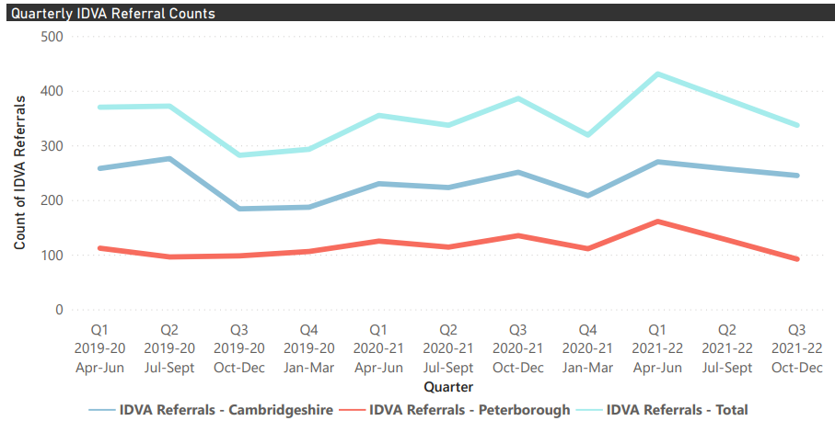
The Independent Domestic Violence Advisor (IDVA) service supports medium-high risk victims of domestic abuse., a group of particular concern during the pandemic. Referrals to the Cambridgeshire & Peterborough IDVA service peaked in the first quarter of 2021/22: April – June 2021 above pre-pandemic levels. But have since reduced.
IDVAs work with adults, but often women experiencing domestic violence have children who are also at risk.
IDVA referrals increased from Q4 2019-2020 to Q1 2020-2021 across Cambridgeshire and Peterborough, but especially in Cambridgeshire.
IDVA referrals steadily increased throughout 2020-2021 and sharply peaked after the third national lockdown in Q1 2021-2022 with 270 referrals in Cambridgeshire and 161 referrals in Peterborough.
In the Q2 and Q3 of 2021-2022, referrals decreased and returned to a similar level as the Q3 in 2020-2021.
Quarterly IDVA Referrals Counts in Cambridgeshire and Peterborough
IDVA referrals have different risk levels. The data in this slide show all risk levels. Some IDVAS only work with victims at high risk, others work with victims at all risk levels. Risk level is assessed by the DASH (Domestic Abuse, Stalking and Honour Based Violence) risk assessment checklist.
Notes:
TECHNICAL NOTES:
Explanation on DASH referrals and risk levels: Welcome to Cambridgeshire DASV Partnership (cambsdasv.org.uk)
Source:
Domestic Abuse Team - Quarterly DA Performance Report, Cambridgeshire and Peterborough (2019-2021)
Contact:
Cambridgeshire Research Group: Business Intelligence, Cambridgeshire County Council (Research.Group@cambridgeshire.gov.uk)

Slide 53
Employment and NEET impacts
C&YP
Notes:
This slide is intentionally left blank to divide sections of the pack.

Slide 54
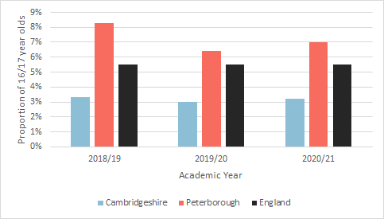
The proportion of 16 and 17 year olds that were either NEET or not known in Cambridgeshire remained relatively stable from 2018/19 to 2020/21. There was a slight reduction in Peterborough over the same period.
Cambridgeshire data remains below the national average, whilst Peterborough remains above.
The proportion of 16 and 17 year olds who were not in education, employment or training (NEET) or whose activities were unknown increased from 3.0% to 3.2% in Cambridgeshire and from 6.4% to 7.0% in Peterborough from 2019 to 2020 (national average 2020: 5.5%).
Caution should be taken as the full impact on educational attainment and retention into learning will not be clear for some time to come as pupils age through schools.
This year's data (available in March 2022) will help provide more of a picture.
Proportion of 16- and 17-year old's known to be NEET and Not Known – February Average
Particularly vulnerable cohorts of young people that are overrepresented in the NEET are young offenders and children in care and care leavers.
Notes:
TECHNICAL NOTES:
Source:
DfE Local Authority NEET comparison tables
Contact:
Cambridgeshire Research Group: Business Intelligence, Cambridgeshire County Council (Research.Group@cambridgeshire.gov.uk)

Slide 55
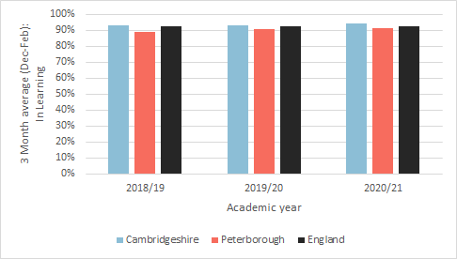
In both Cambridgeshire and Peterborough there has been a small increase in the proportion of 16 and 17 year remaining in learning, although the increase in Peterborough was larger.
Proportion of 16 and 17 year olds In Learning 3-month average (December – February)
For Peterborough, data indicates an increase in the proportion of those in learning from 88.9% in 2018/19 to 91.3% in 2020/21. This brings it closer to the national average of 92.8%.
For Cambridgeshire, the data shows a smaller increase from 93.1% in 2018/19 to 94.3% in 2020/21. It remains above the national average.
Impacts might not be seen from the current data available and revisiting this data after February 2022 is advisable
Notes:
TECHNICAL NOTES:
Source:
DfE Local Authority NEET comparison tables
Contact: Cambridgeshire Research Group: Business Intelligence, Cambridgeshire County Council (Research.Group@cambridgeshire.gov.uk)

Slide 56
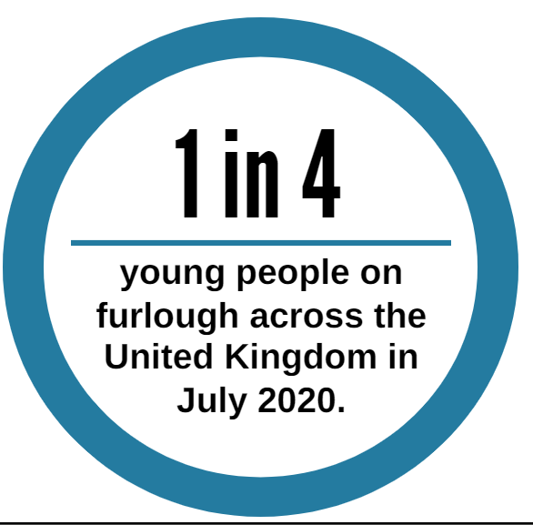



Nationally, the 16-24 age group saw unemployment levels increase at a faster rate during the pandemic
Nationally, the pandemic saw increases in long-term unemployment rates in all age groups but this increase was seen earlier for young people aged 16 – 24¹
In July 2020, 1 in 4 young people nationally were furloughed on the Job Retention Scheme². After a decline in late 2020, furlough rates increased to a similar proportion during the early 2021 lockdowns.
The Learning and Work Institute³ found over 25% of employers said they needed more experienced candidates for job roles whilst almost 20% said young people were unlikely to hold the right qualifications for their roles.
Young people were more likely to be on zero-hours contracts (11% of 16-24 years olds vs. 2% of 25-34)⁴.
Impact of pandemic on 16 – 24 year olds nationally
²
¹
Young people with ‘No qualifications’ or ‘Other qualifications’ saw the greatest percentage change in hours worked during the pandemic (-34% and -42%).⁴
³
⁴
Unemployment rates for 16 – 24 year olds have historically been higher than for other age ranges, even pre-pandemic. However, long-term unemployment is usually less common amongst young people than older age groups.
Notes:
TECHNICAL NOTES:
Sources:
1. Annual Population Survey, ONS
2. Coronavirus Job Retention Scheme statistics, HM Revenue & Customs.
3. Facing the future: Employment prospects for young people after Coronavirus, Princes Trust, March 2021. Facing the future: employment prospects for young people after coronavirus (princes-trust.org.uk)
4. Labour Force Survey 2020, ONS
Contact:
Cambridgeshire Research Group: Business Intelligence, Cambridgeshire County Council (Research.Group@cambridgeshire.gov.uk)

Slide 57


16 – 24 year olds in Cambridgeshire and Peterborough faced decreased economic activity and increased benefits claims during the pandemic. Factors for this include students counted within the economically inactive group & impact of furlough.
In Cambridgeshire and Peterborough, about 91,600 people fall within the 16 – 24 working age bracket – known as ‘young people’¹. However, the total 16 – 24 population has been declining in recent years
Employment rates in Cambridgeshire decreased in 2020 by 11ppts to 45% but increased in Peterborough by 5ppts to 56%, the highest since 2008.²
Economic inactivity in young people increased during 2020 by 12ppts in Cambridgeshire and 3ppts in Peterborough. ³
Benefit claimant numbers in the 16 – 24 age bracket increased by 134% between March 2020 and June 2020 and counts remain high, with rates for September 2021 being 95% higher than in September 2019.⁴
Economic inactivity rates for Cambridgeshire (top) and Peterborough (bottom)³
The pandemic may have exacerbated existing inequalities within the region, with the highest proportions of claimant counts occurring in the north of the Cambridgeshire and Peterborough area.
Unemployment among those aged 16-24 has been notably higher compared to other age groups, with the pandemic having a greater effect and seeing unemployment levels increase at a faster rate.
Notes:
TECHNICAL NOTES:
Sources:
1. ONS Mid-2020 population estimates.
2. Annual Population Survey, Employment Rate by age
3.Annual Population Survey, Economic inactivity rate by age
4.Claimant count by sex and age, Office for National Statistics.
Contact:
Cambridgeshire Research Group: Business Intelligence, Cambridgeshire County Council (Research.Group@cambridgeshire.gov.uk)

Slide 58

Locally, young people’s interaction with education has been affected by the pandemic. Whilst some educational opportunities have seen increases, others have decreased
Change in apprenticeship starts up to Q3 from 2019/20 to 2020/21 across Cambridgeshire and Peterborough²
In 2020, young people (16-24 year olds) in full-time education increased by 11% in Cambridgeshire but decreased by 9% in Peterborough¹.
There was a 5% decrease in apprenticeship starts between Q3 of 2020/21 and 2019/20. However, uptake varies by age and apprenticeship type, with Intermediate Apprenticeships and Under 19s seeing the largest declines in starts².
Decreases in education during the pandemic is likely to have an impact on the future skills and employability of young people entering the workforce.
In the past 10 years, the proportions of 18-24 year olds in full time education in Cambridgeshire and Peterborough has generally been lower than the national average, usually fluctuating around 31 – 33%.¹
Notes:
TECHNICAL NOTES:
Sources
1. Annual Population Survey, Economic Activity of those aged 18-24, ONS
2.Apprenticeships and Traineeships, Academic year 2020/21. Department for Education.
Contact:
Cambridgeshire Research Group: Business Intelligence, Cambridgeshire County Council (Research.Group@cambridgeshire.gov.uk)

