Slide 1
Review of drugs part two: prevention, treatment, and recovery

Slide 2
Dame Carol Black’s independent review of drugs
Part one of the review, was published in February 2020. It examined the illicit drugs market, worth almost £10 billion a year, with 3 million users and an increasingly violent and exploitative supply chain and the scale of increasing harm.
It also highlighted that the quality and capacity of drug treatment services have significantly reduced in recent years, and that entrenched drug use and premature deaths occur disproportionately more in deprived areas, particularly in the north.
Part two was commissioned by DHSC and focuses on treatment and recovery.
The overarching aim of the review was to ensure that vulnerable people with substance misuse problems get the support they need.
Published on 8th July, it makes policy recommendations to government, including around funding, as well how services are commissioned and local bodies are held accountable to ensure they are effective in preventing, treating and supporting recovery from drug problems.

Slide 3
Part 1 identified why the review is needed
The capacity and quality of treatment have declined, and the prevalence of use and harm have increased
Since 2013 a significant increase in the number of opiate and crack users
Since 2005 in London a sharp decline in estimated opiate and crack users, but prevalence in the North East has steadily risen
Use of other drugs by adults has increased since 2012 after nearly ten years of decline
Drug use among school-aged children has increased significantly
Numbers in treatment are falling and prevalence is increasing, so the level of unmet treatment need among opiate users has increased
The proportion of people completing treatment each year has decreased and the rate of people dying during treatment has increased significantly
Only one in three of those needing treatment after release from prison go on to receive it

Slide 4
Review methodology
An expert reference group was formed from those working across the sector, including experts by experience and representatives from government departments. Professor Keith Humphreys and Dr Ed Day were special advisors, and the Kings Fund were commissioned to write a report on ‘models for commissioning and accountability’
A call for evidence was issued, with 156 responses from the public and organisations working in drug treatment and recovery
Meetings and focus groups were held with stakeholders from across the sector - NHS & third sector orgs., professional bodies, mutual aid groups, individuals with lived experience, academics, and representatives of government departments

Slide 5
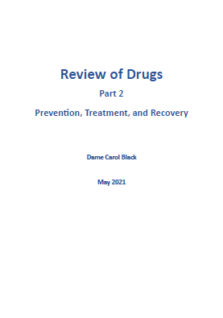
The main conclusion of part two is:
that the public provision currently in place for prevention, treatment and recovery is not fit for purpose, and in urgent need of reform.
“
Government faces an unavoidable choice: invest in tackling the problem or keep paying for the consequences. A whole-system approach is needed…This part of my review offers concrete proposals, deliverable within this Parliament, to achieve this.
“

Slide 6
Review findings and recommendations
The review includes a 32 recommendations falling to government departments, local government and other organisations to implement.
“These should be seen as a package of reforms that are interdependent and mutually reinforcing”
Diverting more offenders into treatment and recovery services
Employment support
Housing
Mental health
Physical healthcare
Prevention and early intervention
Research
Reform of central government leadership
Increased funding for drug treatment and wider recovery support
Allocating and protecting funding
Commissioning
Strengthening local authority accountability
Rebuilding services:
workforce
treatment
recovery support

Slide 7
Whole system reform
The review’s recommendations seek to improve the whole treatment system:
Improved systems of accountability of local areas to national government.
Greater local partnership working
Increase in size and professionalism of the workforce
Holistic treatment and recovery package, including mental health care, housing and employment support
All underpinned by additional investment

Slide 8
Reform of central government leadership
Home Office
Ministry of Justice
Department for Education
Ministry of Housing, Communities and Local Government
Department for Work and Pensions
Department of Health and Social Care
The review recommends the formation of a central Drugs Unit with ministerial sponsorship, sitting in the appropriate department or joint arrangement. The unit should be responsible for setting clear objectives and targets for the rest of government, feeding into a new National Outcomes Framework. The sponsoring minister should report to Parliament on progress on an annual basis.
Central drugs unit

Slide 9
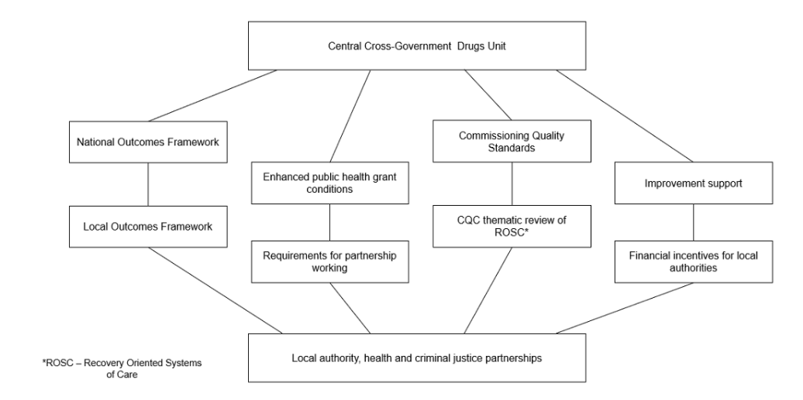
Accountability between local and national government needs to be strengthened
A new local and national outcomes framework and a commissioning quality standard are two of the review’s recommendations, focused on increasing accountability. Enhanced improvement support will also be vital.
A local outcomes framework will be used by the Office for Health Promotion to hold local authorities and other relevant local partner agencies to account. It will be developed in conjunction with those working in the system.

Slide 10
Increased funding for drug treatment and wider recovery support
Based on current evidence of prevalence, an additional £552 million is needed from DHSC by year 5, additional to the baseline annual expenditure of £680million from the public health grant, to provide the full range of high-quality drug treatment and recovery services.
year 1: | £119 million
year 2: | £231 million
year 3: | £396 million
year 4: | £484 million
year 5: | £552 million
year 1: | £6 million
year 2: | £11 million
year 3: | £16.5 million
year 4: | £15.9 million
year 5: | £15.1 million
An additional £15 million by year 5 is needed from DWP for employment support.
MHCLG will also need to bid for additional funds for housing support at the next Spending Review

Slide 11
Commissioning
The review includes a recommendation for DHSC to develop a national Commissioning Quality Standard (CQS), to be based on clinical guidelines, specifying the range of treatment services that need to be made available in each local area.
CQS to exist alongside strong local leadership, with local authorities working closely with NHS organisations and wider recovery partners.
Commissioners should also work more collaboratively with providers to encourage service stability and improvements to quality.
Commissioning arrangements should mirror NHS practice where there is a move away from competition towards collaboration.

Slide 12
Rebuilding services
The drug treatment and recovery workforce has deteriorated significantly in quantity, quality and morale in recent years, with excessive caseloads, decreased training and a lack of adequate clinical supervision
DHSC should commission Health Education England (HEE) to devise a workforce strategy for substance misuse treatment and give it sufficient new funding to support the required training.
DHSC should support structured peer-led recovery networks in every local area, to complement the professional workforce
Workforce
Local authorities should commission a full range of evidence-based harm reduction and treatment services to meet the needs of their local population
High cost but low volume services, such as inpatient detoxification should be covered by a new regional or sub-regional approach to commissioning
More funding needs to be available to improve capacity and quality of specialist substance misuse services in response to increased drug use among children and young people
Treatment
DHSC and the Office for Health Promotion should support local areas to ensure that thriving communities of recovery are linked to every drug treatment system, working to standards on quality and governance developed by the government’s Drug Recovery Champion and the Office for Health Promotion
Recovery support

Slide 13
Diverting more offenders into treatment and recovery services
Too many people with addictions are cycling in and out of prison, without achieving rehabilitation or recovery. The recent sentencing white paper committed to greater use of police diversions and community sentences with treatment as an alternative to custody. This must now be put into action, alongside extra funding for treatment places to accommodate the extra demand.
In prisons, MoJ should work with DHSC and NHSE to improve the experience of treatment, with prisoners always taken to their treatment appointments.
On release from prison, prisoners must have ID and a bank account and the ability to claim benefits on the day of release.
Those with drug dependence should be helped to continue with drug treatment in the community as soon as possible.

Slide 14
Employment support
Employment is an essential part of recovery, both for financial stability and to offer something meaningful to do. Intensive, employer-focused employment support in treatment services has shown promising results, based on a recent trial of Individual Placement and Support (IPS) in 7 local authorities.
The IPS model should be rolled out in treatment settings across the whole of England
DWP should recruit peer mentors (one in each Jobcentre Plus area), to encourage people dependent on drugs to claim all relevant benefits and access employment support

Slide 15
Housing
Drug dependence can be both a cause and consequence of homelessness and rough sleeping. MHCLG has estimated that almost two-thirds of people who sleep rough have a current drug or alcohol problem. PHE’s drug treatment data shows that one-fifth of adults starting treatment in 2019 to 2020 reported a housing problem, increasing to one-third of people in treatment for opiates.
MHCLG and DHSC have secured welcome substantial additional funding to improve treatment services for people who sleep rough. We know that housing and housing support have a crucial role to play in the success of drug treatment and that many of those entering treatment report a housing need.
MHCLG should work with DHSC to assess the types and levels of housing related needs among people with substance misuse problems.

Slide 16
Mental health
For many people, mental health problems and trauma lie at the heart of their drug and alcohol dependence. However, they are too often excluded from mental health services until they resolve their drug problem and excluded from drug services until their mental health problems have been addressed.
DHSC and NHSE should work together to set out a plan to resolve this, including considering contractual requirements, incentivisation and commissioning drug treatment services to treat common mental health problems
The workforce in both services should be trained to better respond to co-existing drug and mental health problems. This should be a key component of HEE’s competency and training requirements for the workforce.

Slide 17
Physical healthcare
Many drug users have poor overall health. The NHS is poor at engaging with the wider health needs of drug users with medical co-morbidities (for example hepatitis C, HIV, heart and lung disease), many of whom are ill-equipped to navigate complex pathways, and feel stigmatised.
DHSC and NHSE should work together to develop an action plan on improving access to physical healthcare, making it a core component of the work of integrated care systems.

Slide 18
Prevention and early intervention
Preventing drug misuse is more cost-effective and socially desirable than dealing with the consequences of misuse. The Smoking, Drinking and Drug Use among Young People in England survey has shown that drug use among children (aged 11 to 15) has increased by over 40% since 2014, reversing a previous long-term downward trend.
The Department for Education (DfE) must ensure that schools seize the major prevention opportunity presented by the statutory guidance for Relationships, Sex and Health Education (RSHE).
It is equally important that children attend school and have rewarding, fulfilling activities available to them outside of school. They also need adequate support services, particularly for mental health.
Local authorities should identify, and provide additional support to, those young people most at risk of being drawn into using illicit substances or involvement in supply.
DfE and the Department for Digital, Culture, Media and Sport (DCMS) should lead investment in age-appropriate evidence-based services and support all young people to build resilience and avoid substance misuse.
DHSC should increase the funding available to specialist substance misuse services for young people, to improve the capacity and quality of these services

Slide 19
Research
Research in many areas of addiction is underdeveloped and under-resourced, with the exception of opioid substitution treatment.
Current service models often do not provide the stability, expertise or right staff mix to undertake high quality research.
DHSC and the Department for Business, Energy & Industrial Strategy (BEIS) should encourage and facilitate research into what works to combat substance misuse, across supply, prevention, treatment and recovery.
DHSC should promote innovative research on addiction and its implementation in practice by offering incentives or rewards to companies and other organisations for effective developments in this field.
There a lack of evidence on what works to deter people from taking drugs recreationally. Recreational drug users do often not see themselves as having a drug problem and it is a difficult population to influence. However, this misuse carries risks and fuels the illicit drug market.
Government should invest in an innovation fund to test out which marketing and behavioural interventions could work in the UK to reduce recreational drug use, building on evidence from abroad.

Slide 20
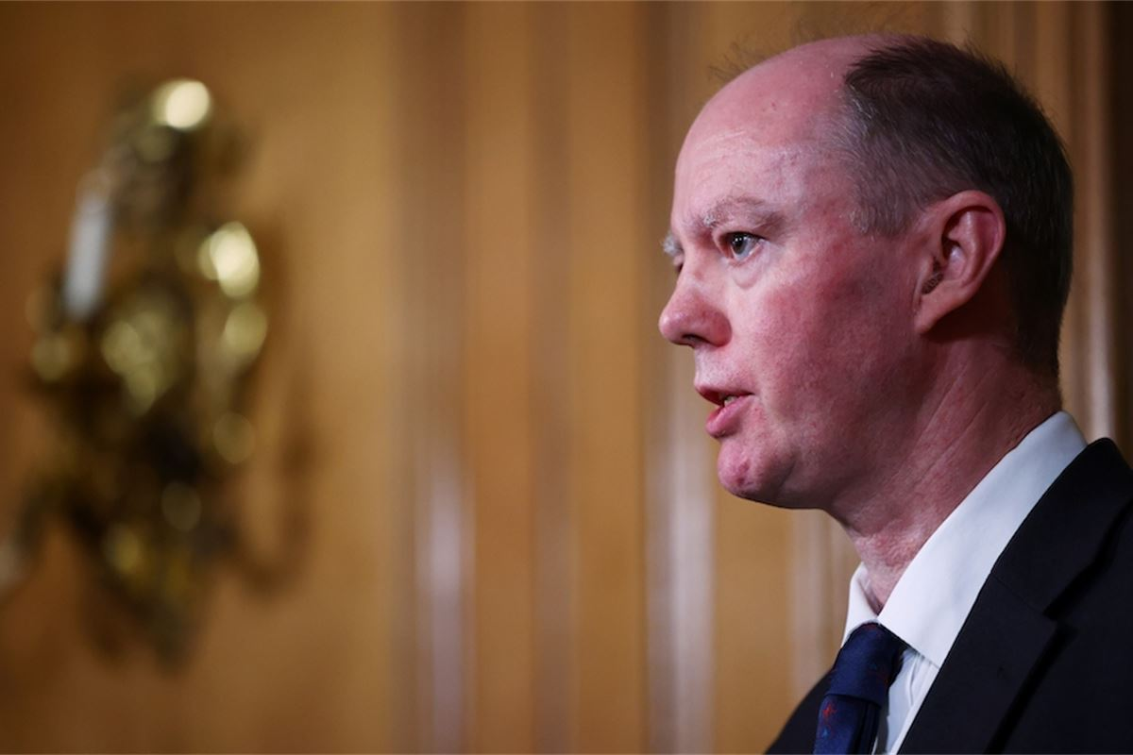
The Office for Health Promotion
All PHE and DHSCs drug and alcohol functions, both National and Regional , will transfer into the Office for Health Promotion from October 2021
A Deputy Chief Medical Officer (DCMO) and a DHSC Director General will lead
Organisational structures are out to staff consultation but we anticipate drug and alcohol work will be well placed in the new structure

Slide 21
This is a pivotal moment and opportunity
An initial government response is due soon, with further detail following the spending review which is planned for the autumn
PHE and DHSC stand ready to support the implementation of the recommendations, and they will be a priority
This work will carry on in the new Office for Health Promotion
Government engagement with the review is high
PHE and DSHC are supporting the establishment of the new Cross Government Drugs Unit, which was announced by the Minster for Crime and Policing at the launch of the review

Slide 22
Appendix

Slide 23
List of recommendations
1. The government should establish a central Drugs Unit with strong analytical capacity which would develop a National Outcomes Framework and hold departments to account. The sponsoring minister should report annually to Parliament on progress in tackling drug misuse, including publication of relevant data.
2. We recommend that the government invests, by the end of year 5 of this programme, an additional £552 million in the treatment system through DHSC and an additional £15 million in employment support through DWP. MHCLG will also need to bid for additional funds for housing support at the next Spending Review.
3. We recommend that from 2022 to 2023, DHSC require local authorities to spend drug treatment funding, current and additional, on these services and not on other things. Similarly, we recommend that DWP and MHCLG protect any future additional funding provided for employment services and housing support for people dependent on drugs.
4. We recommend that DHSC, DWP and MHCLG make sure that funding for treatment, employment and housing support is distributed fairly on the basis of need.
5. We recommend that DHSC introduce a national Commissioning Quality Standard and require local authorities, as a condition of funding, to work with health, housing and employment support, and criminal justice partners to develop a joint needs assessment and publish a commissioning plan to direct spending from 2022 to 2023. Government should make provision for budgets to be aligned or pooled at local level and each department should use its policy levers to require a strong partnership approach locally.
6. We recommend that DHSC and the Office for Health Promotion review the effect of frequent retendering on quality and cost-effectiveness of substance misuse treatment services.

Slide 24
List of recommendations
7. We recommend that DHSC introduce, for 2022 to 2023 and beyond, a Local Outcomes Framework to increase transparency and local authorities’ accountability for their treatment and recovery outcomes. DHSC should consider introducing incentive payments for local authorities to deliver improved outcomes.
8. We recommend that DHSC ensure that the Office for Health Promotion has the capacity and capability to monitor local performance against the Local Outcomes Framework, and report to the new central cross-government Drugs Unit to:
hold local areas to account for meeting the new Commissioning Quality Standard
improve outcomes
work with the Local Government Association (LGA) to provide a comprehensive improvement support offer for local authorities
9. We recommend that DHSC commission HEE to devise by the end of 2021 a comprehensive strategy to increase the number of professionally qualified drug treatment staff (psychiatrists and other doctors, psychologists and other therapists, nurses and social workers), and set occupational standards, competency and training requirements for drug workers and peer recovery workers. Government should also fund HEE to cover the costs of training the workforce.
10. We recommend that the Academy of Medical Royal Colleges, working with appropriate other bodies, be commissioned to develop a professional body, a Centre for Addictions, for all members of the substance misuse workforce. DHSC should provide seed funding to enable this.
11. We recommend that local authorities commission a full range of evidence-based harm reduction and treatment services to meet the needs of their local population in line with the new national Commissioning Quality Standard.
12. We recommend that DHSC, NHSE and the Office for Health Promotion review by the end of 2021 to 2022 the commissioning and funding mechanisms for high-cost but low-volume services such as inpatient detoxification and residential rehabilitation. DHSC should introduce a regional or sub-regional approach to commissioning these services to ensure national coverage.

Slide 25
List of recommendations
13. We recommend that DHSC make increased funding available to specialist substance misuse services for young people to improve the capacity and quality of these services, and also through the national Commissioning Quality Standard ensure that these services are linked with other local services for vulnerable young people and that family interventions are more widely available.
14. We recommend that DHSC and the Office for Health Promotion support local areas to ensure that thriving communities of recovery are linked to every drug treatment system. The government’s Drug Recovery Champion should work with the Office for Health Promotion to develop standards to raise the quality and improve the governance of the recovery sector.
15. We recommend that MoJ, HO and DHSC, with the support of NHSE and the Office for Health Promotion, work together to ensure that the additional funding for drug treatment announced in January 2021 contributes to improved treatment pathways from criminal justice settings. In particular, action should be taken to divert drug users from the criminal justice system into treatment, and maximise the use of Community Sentence Treatment Requirements (CSTRs).
16. We recommend that DHSC and NHSE expand their CSTR programme to 100% of the country by the end of this Parliament. NHSE and HMPPS should work closely with local commissioners of substance misuse treatment to seize the opportunity presented by the recently announced increase in funding for such treatment in 2021 and 2022.
17. We recommend that MoJ, DHSC and NHSE work together to improve by the end of 2021 to 2022 the transparency and accountability of the commissioning and delivery of substance misuse services in prisons, including through publishing how much money is spent each year on these services. HM Prison Service should make sure that enough staff are available to take prisoners to their treatment appointments within the prison.
18. We recommend that MoJ ensure that everyone leaving prison has identification and a bank account and that those who cannot claim benefits online get the opportunity, from the day of release, to access DWP’s telephony service. MoJ and its partners should make sure that prisoners with drug dependence can access and receive drug treatment in the community as soon as possible after release.

Slide 26
List of recommendations
19. We recommend that MoJ fund their new health and justice partnership co-ordinator role within the probation service, so that it covers all local probation areas in England, in tandem with the introduction by the NHS of new integrated care systems.
20. We recommend that DWP work with the Office for Health Promotion to roll out IPS to all areas in England within the forthcoming Spending Review period.
21. We recommend that DWP recruit peer mentors (one in each Jobcentre Plus area), to encourage people dependent on drugs to claim all relevant benefits and access employment support, with funding for the posts agreed at the Spending Review.
22. We recommend that DWP augment Jobcentre Plus support by equipping staff to reach out into the community and work more intensively with those with complex needs, including working in drug and alcohol treatment services with people with addictions.
23. We recommend that MHCLG and DHSC work together to gain better understanding of the types and levels of housing-related need among people with a substance misuse problem, with early findings feeding into the next Spending Review.
24. We recommend that DHSC and NHSE develop, publish and implement by the end of 2021 an action plan that improves the provision of mental health treatment to people with drug dependence. This should include consideration of the introduction of contractual requirements or incentives so that NHS mental services target dependent drug users. Consideration should also be given to commissioning substance misuse services to treat some mental health co-morbidities without referring people on to specialist mental health services.
25. Linked to recommendations 9 and 10, we recommend that DHSC commission Health Education England to develop competency and training requirements for all staff working with people with co-existing mental health problems and drug dependence. Resources and standards should be applicable and applied across the mental health and substance misuse workforces.

Slide 27
List of recommendations
26. We recommend that DHSC, NHSE and the Office for Health Promotion ensure that opportunities for integrated commissioning of mental health and substance misuse services are explored proactively and articulated as part of the next stages of integrated care system development. This includes ensuring that proposed legislation facilitates integrated commissioning and provision.
27. We recommend that DHSC and NHSE develop, publish and implement by the end of 2021 an action plan for improving the provision of physical healthcare to people with drug dependence, which should be an integral part of local integrated care systems.
28. We recommend that DfE make an assessment of the support available to teachers in rolling out the new Relationship, Health and Sex Education (RSHE) curriculum, and continue to monitor implementation, with a view to more detailed evaluation after 2 years of full curriculum delivery.
29. We recommend that DfE and DCMS, with support from DHSC and the Office for Health Promotion, invest in age-appropriate evidence-based services and support all young people to build resilience and to avoid substance misuse. Local authorities should identify, and provide additional support to, those young people most at risk of being drawn into using illicit substances or involvement in supply.
30. We recommend that the government (either HO or DHSC) establish an innovation fund to research which interventions are most effective at changing the behaviour of recreational drug users.
31. We recommend that DHSC and BEIS encourage more research into what works to combat substance misuse, across supply, prevention, treatment and recovery.
32. We recommend that the government promote greater innovation in research, for example in pharmaceuticals, by offering incentives or rewards to companies or organisations whose developments prove beneficial in practice in the addiction field.

