Slide 1
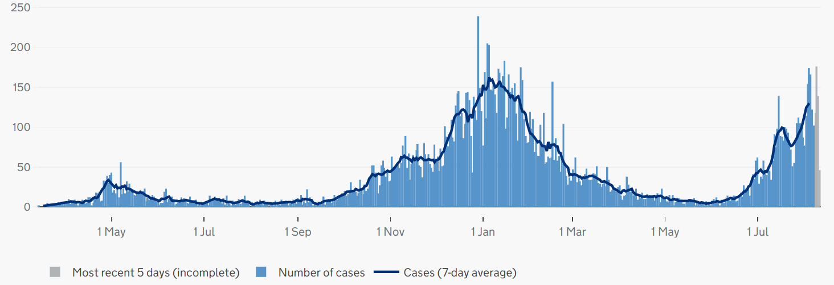
Covid-19 cases in Cambridgeshire and Peterborough
CONFIRMED CASES – most recent data
• 2007 new lab-confirmed Covid-19 cases were detected in Cambridgeshire and 909 Covid-19 cases in Peterborough in the last 7-day recording period (1 – 7 August).
• The case rate per 100,000 for Cambridgeshire was a rate of 305.4 per 100,000 for the 7-day period up to 7 August, substantially higher compared to a rate of 229.8 per 100,000 in the previous week up to 31 July.
• The case rate per 100,000 for Peterborough was a rate of 448.6 per 100,000 for the 7-day period up to 7 August, substantially higher compared to a rate of 318.3 per 100.000 in the previous week up to 31 July.
• At a district level, South & East Cambridgeshire, Fenland, Cambridge, and Huntingdonshire have all reported an increase in case rates per 100,000 in the latest reporting week (1 – 7 August) compared to the previous week up to 31 July.
CONFIRMED CASES - trend
Cambridgeshire
Peterborough
Please note the y-axis on the charts have different values
Source: PHE, https://coronavirus.data.gov.uk/ data updated Thursday 12 August 2021 at 4:00pm
Slides produced by PHI, 13 August 2021

Slide 2
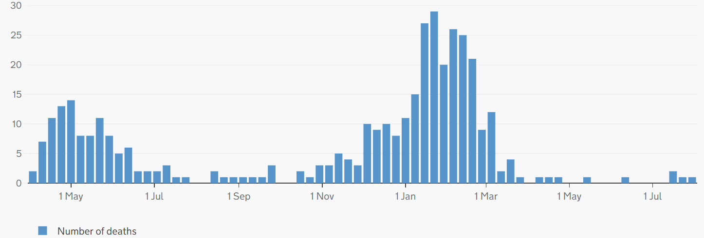
Covid-19 and all-cause mortality in Cambridgeshire and Peterborough
ONS reporting Week 30 (ending Friday 30 July 2021):
Weekly deaths with COVID-19 on the death certificate by date registered
Cambridgeshire
4 Covid-19 related deaths were registered in Cambridgeshire & Peterborough in ONS reporting week 30 ending 30 July, as in ONS Week 29.
There were 144 all-cause deaths in Cambridgeshire and Peterborough in ONS reporting week 30 (compared to 154 in week 29).
Cambridge (+2), East Cambridgeshire(+9), and Peterborough (+3) had increased all-cause deaths in Week 30 compared to Week 29; Fenland (-7), Huntingdonshire (-5), and South Cambridgeshire (-12) reported fewer all-cause deaths in Week 30 compared to Week 29.
Peterborough
Please note the y-axis on the charts have different values
Source: ONS, published 10 August 2021
Slide produced by PHI, 13 August 2021

