Slide 1
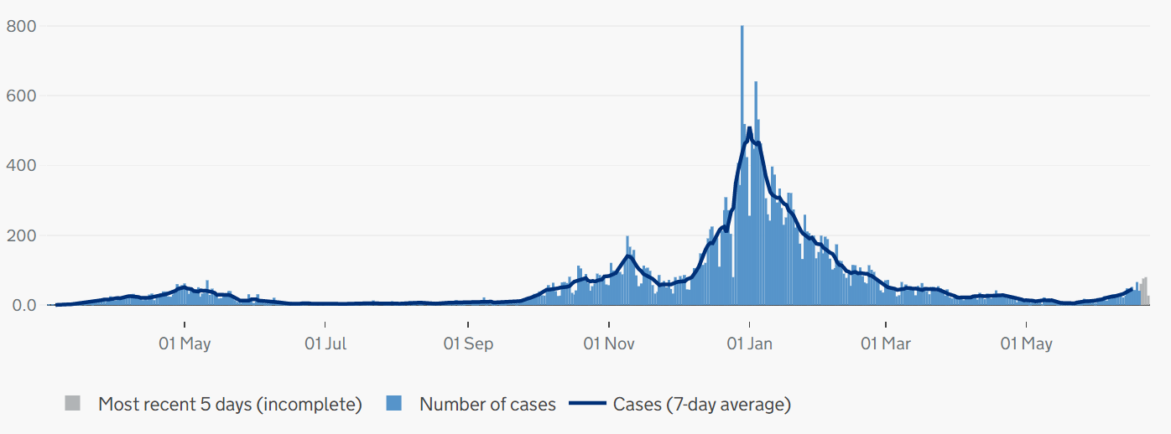
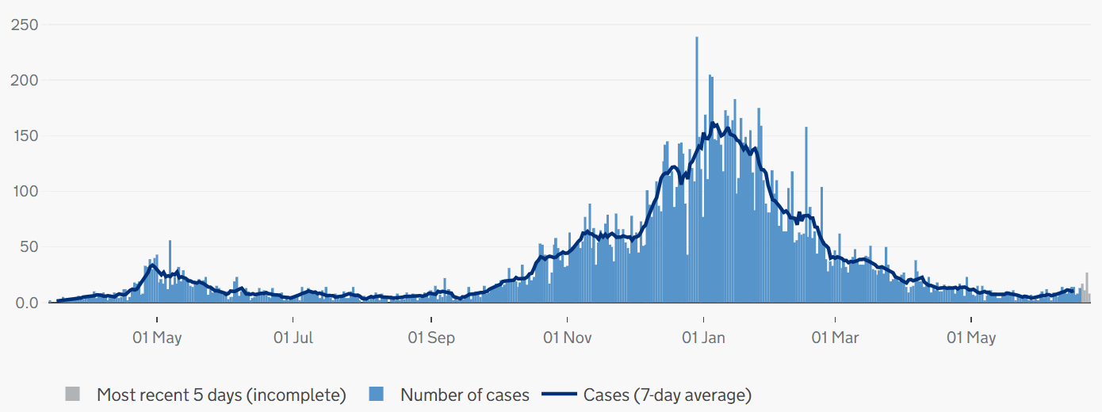
Covid-19 cases in Cambridgeshire and Peterborough
CONFIRMED CASES – most recent data
• 322 new lab-confirmed Covid-19 cases were detected in Cambridgeshire and 74 Covid-19 cases in Peterborough in the last 7-day recording period (13 – 19 June).
• The case rate per 100,000 for Cambridgeshire was a rate of 49.3 per 100,000 for the 7-day period up to 19 June, higher compared to a rate of 27.8 per 100,000 in the previous week up 12 June.
• The case rate per 100,000 for Peterborough was a rate of 36.6 per 100,000 for the 7-day period up to 19 June, higher compared to a rate of 27.2 per 100.000 in the previous week up to 12 June.
• At a district level, all five districts have reported an increase in case rates per 100,000 in the latest reporting week (13 - 19 June) compared to the previous week up to 12 June.
CONFIRMED CASES - trend
Cambridgeshire
Peterborough
Please note the y-axis on the charts have different values
Source: PHE, https://coronavirus.data.gov.uk/ data updated Thursday 24 June 2021 at 4:00pm
Slides produced by PHI, 25 June 2021

Slide 2
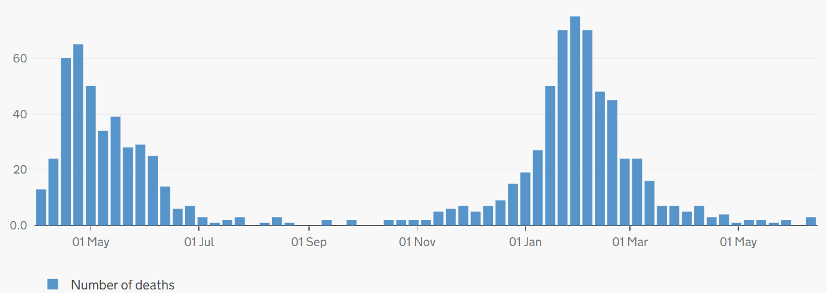
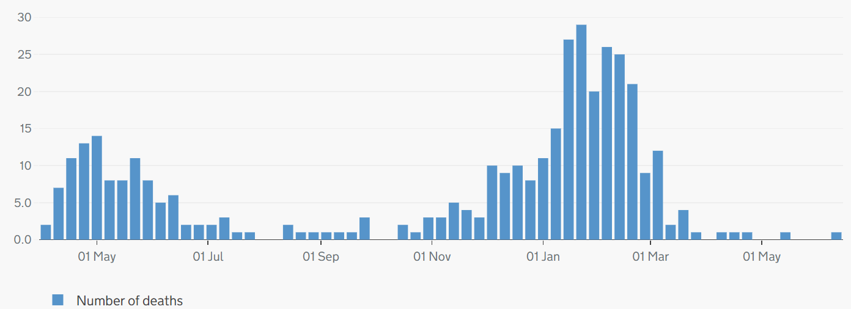
Covid-19 and all-cause mortality in Cambridgeshire and Peterborough
ONS reporting Week 23 (ending Friday 11 June 2021):
Weekly deaths with COVID-19 on the death certificate by date registered
Cambridgeshire
4 Covid-19 related deaths were registered in Cambridgeshire & Peterborough in ONS reporting week 23, ending 11 June.
There were 144 all-cause deaths in Cambridgeshire and Peterborough in ONS reporting week 23 (compared to 109 in week 22).
At district level, increased all-cause deaths were reported in Cambridge (+8), Peterborough (+5), Fenland (+14), Huntingdonshire (+7), and South Cambridgeshire (+1), while East Cambridgeshire reported the same all-cause deaths as in the previous week (18).
Peterborough
Please note the y-axis on the charts have different values
Source: ONS, published 22 June 2021
Slide produced by PHI, 25 June 2021

