Slide 1
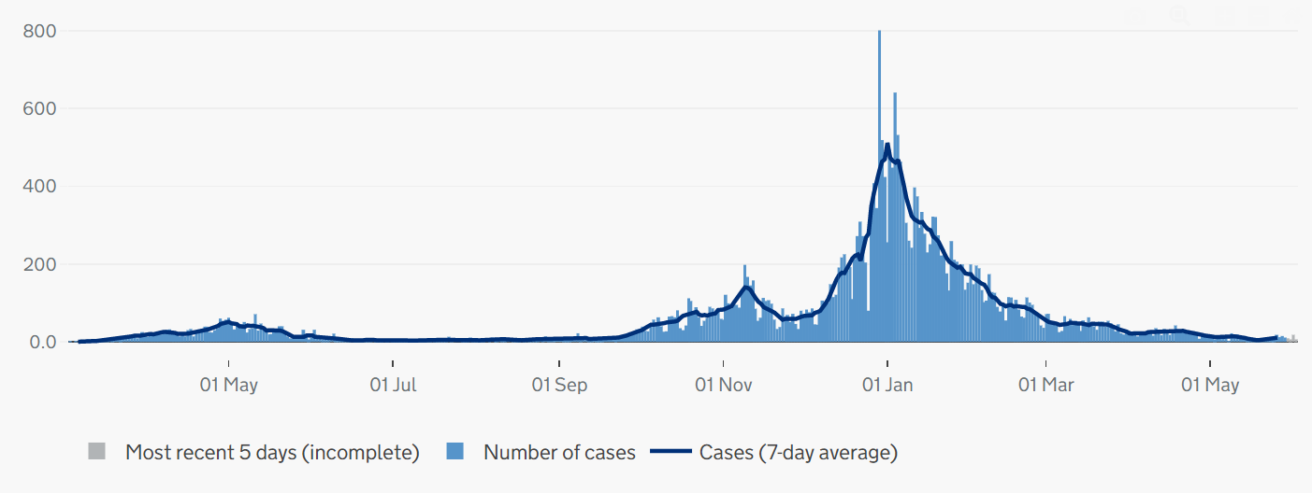
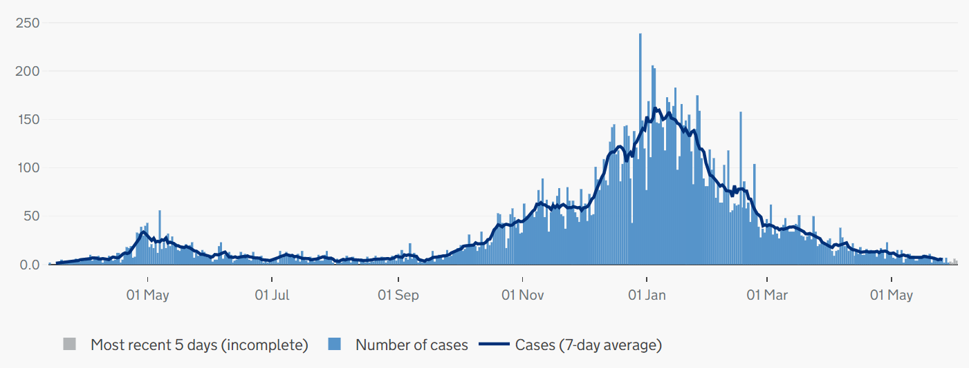
Covid-19 cases in Cambridgeshire and Peterborough
CONFIRMED CASES – most recent data
• 74 new lab-confirmed Covid-19 cases were detected in Cambridgeshire and 34 Covid-19 cases in Peterborough in the last 7-day recording period (23 – 29 May).
• The case rate per 100,000 for Cambridgeshire was a rate of 11.3 per 100,000 for the 7-day period up to 29 May, higher compared to a rate of 4.4 per 100,000 in the previous week up to 22 May.
• The case rate per 100,000 for Peterborough was a rate of 16.8 per 100,000 for the 7-day period up to 29 May, lower compared to a rate of 27.7 in the previous week up to 22 May.
• At a district level, South Cambridgeshire and Huntingdonshire districts have reported an increase in case rates per 100.000, and East Cambridgeshire district has reported a decrease in case rates per 100,000 on the latest reporting week (23 - 29 May) compared to the previous week up to 22 May. Fenland case rates per 100.000 are now back to 22nd of May rates.
CONFIRMED CASES - trend
Cambridgeshire
Peterborough
Please note the y-axis on the charts have different values
Source: PHE, https://coronavirus.data.gov.uk/ data updated Thursday 3 June 2021 at 6:51pm
Slides produced by PHI, 04 June 2021

Slide 2
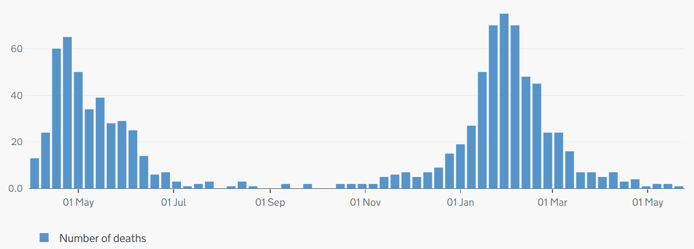
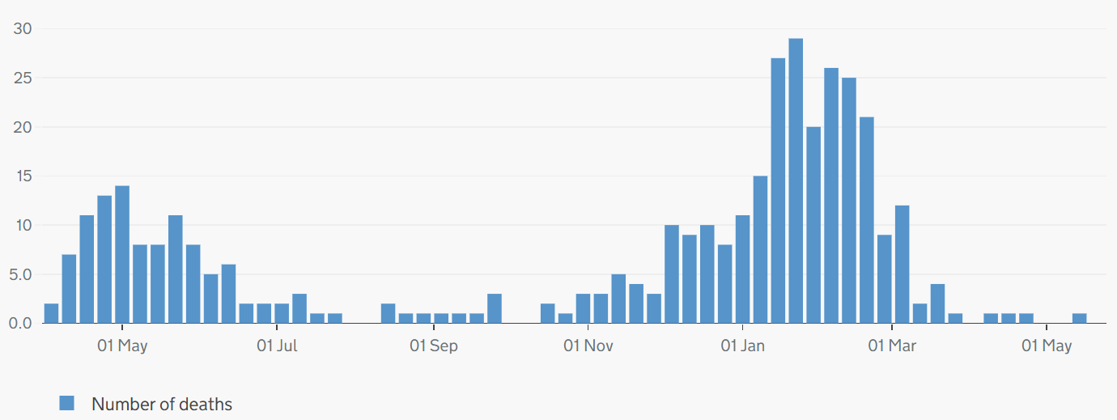
Covid-19 and all-cause mortality in Cambridgeshire and Peterborough
ONS reporting Week 20 (ending Friday 21 May 2021):
Weekly deaths with COVID-19 on the death certificate by date registered
Cambridgeshire
1 Covid-19 related death was registered in Cambridgeshire (Huntingdonshire) and 0 Covid-19 related deaths were registered in Peterborough in ONS reporting week 20, 2021.
There were 136 all-cause deaths in Cambridgeshire and Peterborough in ONS reporting week 20, (compared to 120 in week 19). Peterborough had increased all-cause deaths (29) than the previous week (23).
At district level, Cambridge (-8) has reported a decrease, while East Cambridgeshire (+8), South Cambridgeshire (+3), Fenland (+1), and Huntingdonshire (+6) have all reported an increase in all-cause deaths compared to the previous week.
Peterborough
Please note the y-axis on the charts have different values
Source: ONS, published 02 June 2021
Slide produced by PHI, 04 June 2021

