Slide 1
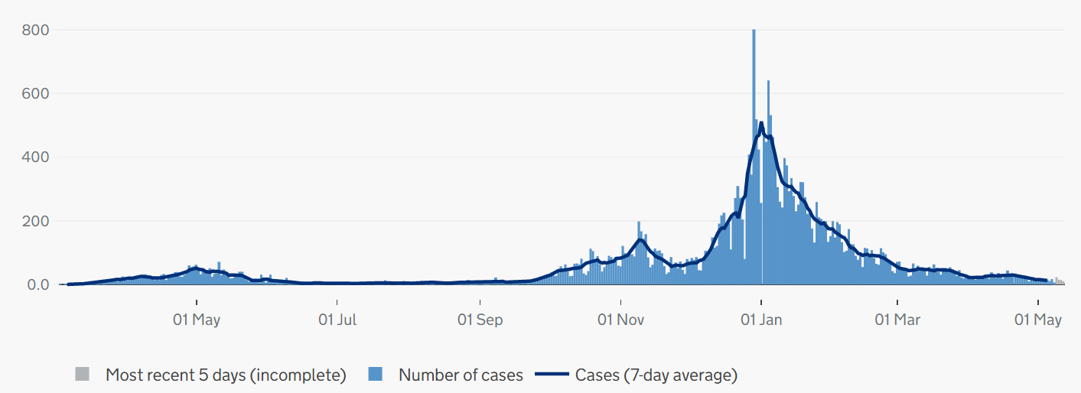
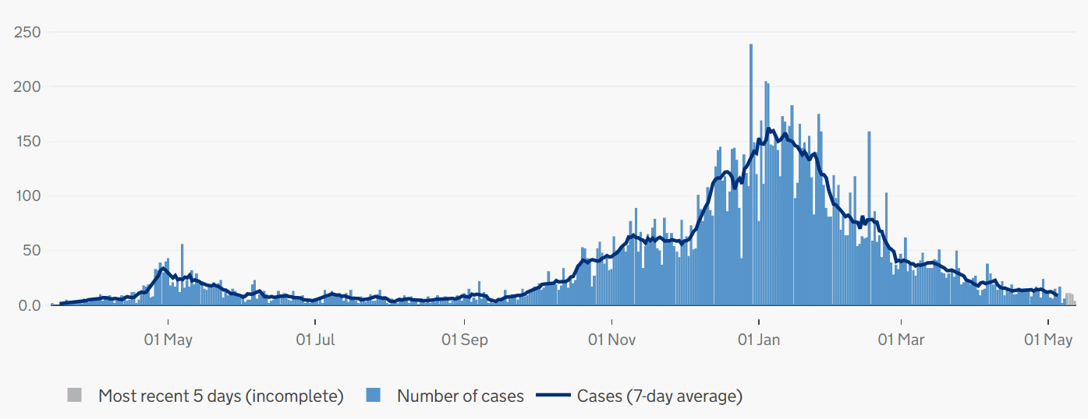
Covid-19 cases in Cambridgeshire and Peterborough
CONFIRMED CASES – most recent data
• 88 new lab-confirmed Covid-19 cases were detected in Cambridgeshire and 63 Covid-19 cases in Peterborough in the last 7-day recording period (02 – 08 May).
• The case rate per 100,000 for Cambridgeshire was a rate of 13.5 per 100,000 for the 7-day period up to 08 May, lower compared to a rate of 20.5 per 100,000 in the previous week up to 01 May.
• The case rate per 100,000 for Peterborough was a rate of 31.1 per 100,000 for the 7-day period up to 08 May, lower compared to a rate of 50.4 per 100,000 in the previous week up to 01 May.
• At a district level, all districts reported a decrease in case rates per 100,000 on the latest reporting week (02 -08 May) than the previous week.
CONFIRMED CASES - trend
Cambridgeshire
Peterborough
Please note the y-axis on the charts have different values
Source: PHE, https://coronavirus.data.gov.uk/ data updated Thursday 13 May at 4:00pm
Slides produced by PHI, 14 May 2021

Slide 2
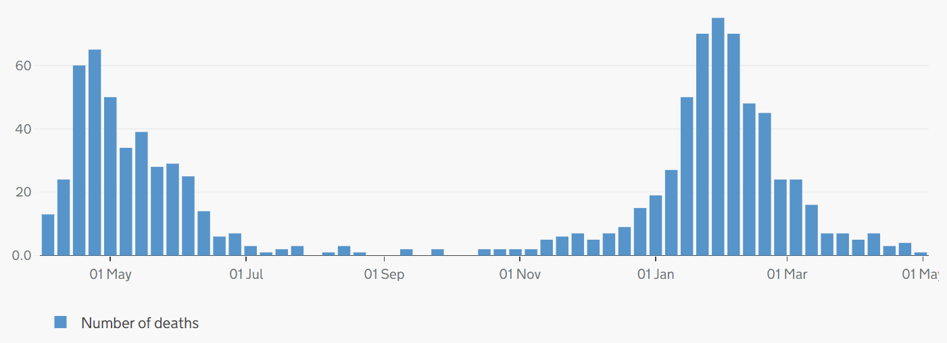
Covid-19 and all-cause mortality in Cambridgeshire and Peterborough
ONS reporting Week 17 (ending Friday 30 April 2021):
Weekly deaths with COVID-19 on the death certificate by date registered
1 Covid-19 related death was registered in Cambridgeshire and no deaths were registered in Peterborough in ONS reporting week 17, 2021 (compared to 5 deaths in week 16).
There were 127 all-cause deaths in Cambridgeshire and Peterborough in ONS reporting week 17, (down from 134 in week 16). Peterborough had fewer all-cause deaths (28) than the previous week (39).
At a district level, Cambridge (+4) and East Cambridgeshire (+10) reported an increase in all-cause deaths compared to the previous week.
Cambridgeshire
Peterborough
Please note the y-axis on the charts have different values
Source: ONS, published 11 May 2021
Slide produced by PHI, 14 May 2021

