Slide 1
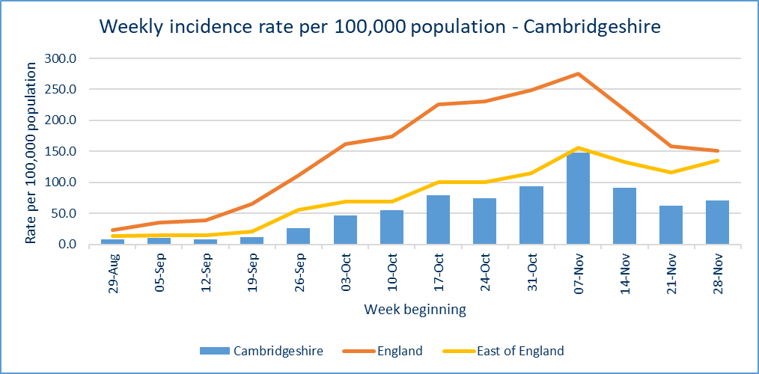
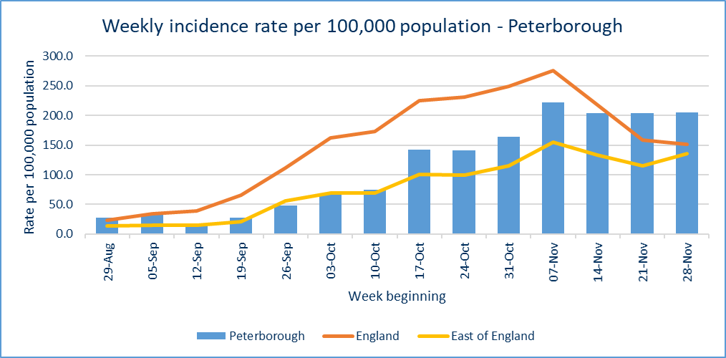
Covid-19 cases
CONFIRMED CASES – most recent data
876 new lab-confirmed Covid-19 cases were detected in Cambridgeshire (461) and Peterborough (415) in the latest reporting week, 28 Nov – 4 Dec. This is 57 more than the previous reporting week.
At a district level, all districts except Cambridge and Huntingdonshire reported an increase in positive cases when compared to the previous week.
Incidence rate of Covid-19 cases per 100,000 residents
CONFIRMED CASES - trend
Confirmed cases, and incidence rates, have increased in Cambridgeshire, Peterborough and the East of England, in the last reporting week.
The weekly incidence rate of confirmed cases is currently below the regional and national rates for Cambridgeshire, and above for Peterborough.
Source: PHE, https://coronavirus.data.gov.uk/ data extracted Wednesday 09 December
Slides produced by PHI, 10 December 2020

Slide 2
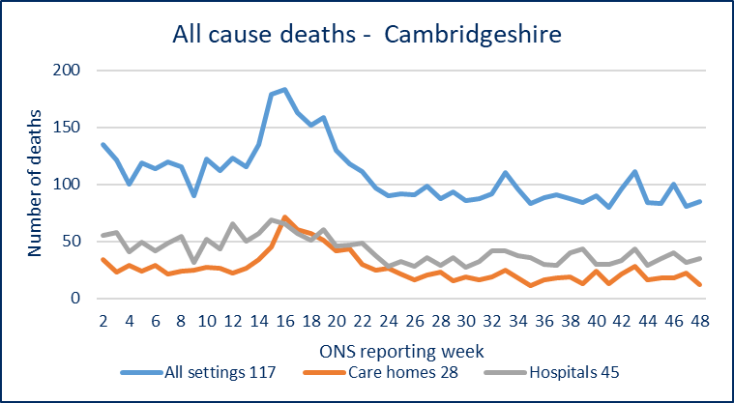
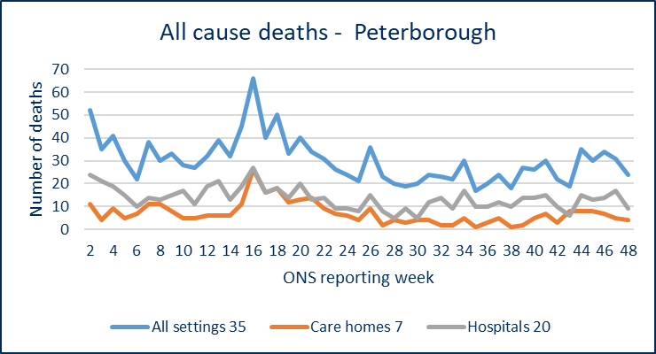
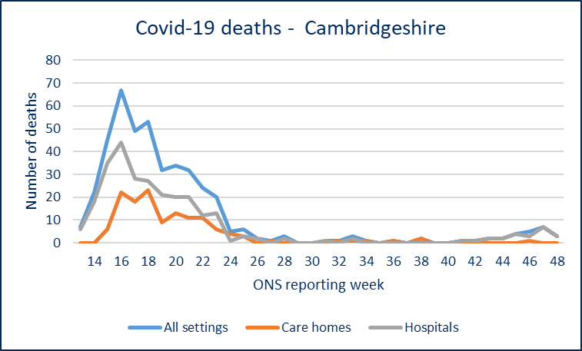
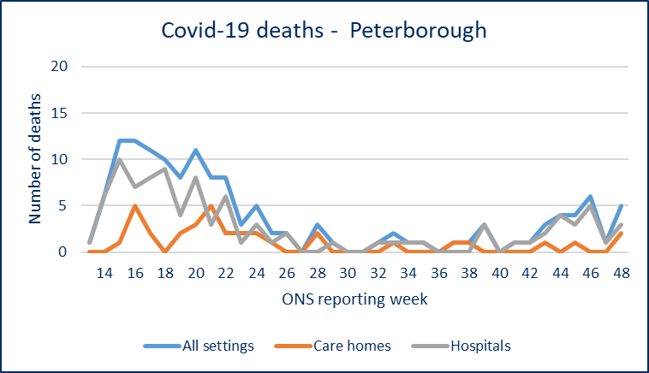
Covid-19 and all-cause mortality in Cambridgeshire and Peterborough
Please note the y-axis on the charts have different values
ONS reporting Week 48 (ending Friday 27 November 2020):
ALL-CAUSE DEATHS
DEATHS
8 Covid-19 related deaths occurred in Cambridgeshire (3) and Peterborough (5) in ONS reporting week 48. This compares to 8 in Week 47.
There were 109* all-cause deaths in Cambridgeshire and Peterborough in week 48 (down from 112 in week 47).
At a district level, Cambridge and Huntingdonshire reported decreases in all-cause deaths in week 48 compared to week 47. Peterborough also reported a decrease.
COVID-19 RELATED DEATHS
*a data lag may affect this figure
Source: ONS, published 08 December
Slide produced by PHI, 10 December 2020

