Slide 1
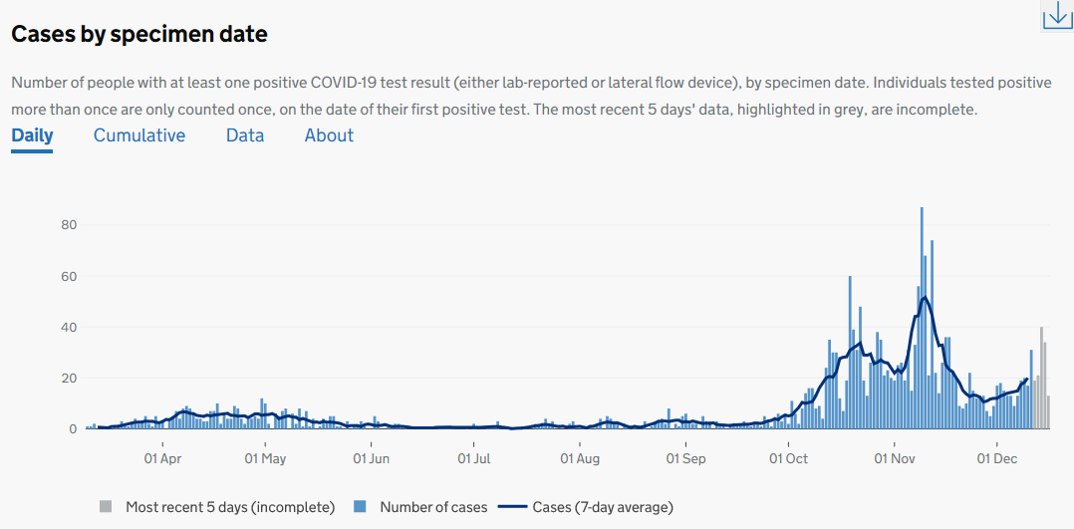
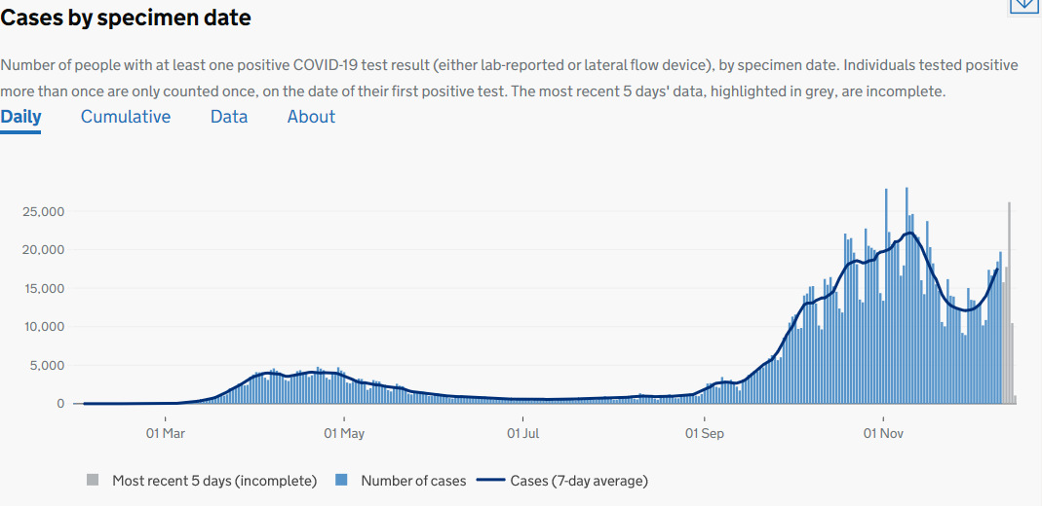
Covid-19 update
Cambridge
Cases: data extracted on 17 December 2020
Direction of travel compared to the previous week:
Increasing
Decreasing
No change
Covid-19 cases in the last 7 days (06 -12 Dec) 128
Weekly incidence rate per 100,000
102.6
Incidence rate for England: 206.6
+42.2%
Cambridge
England
Source: https://coronavirus.data.gov.uk/

Slide 2
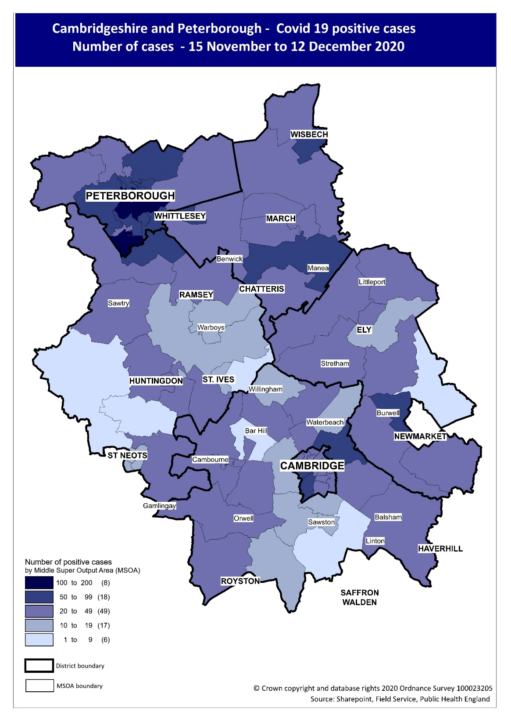

Slide 3
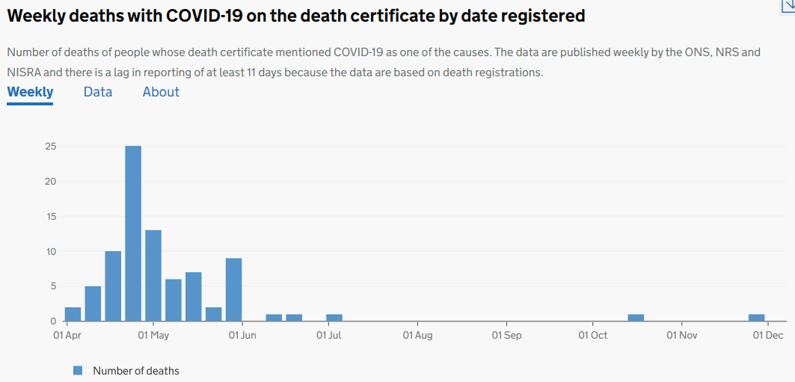
Mortality: Deaths registered up to 04 December 2020
Covid-19 deaths for week ending 04 Dec
0
-1
Total Covid-19 deaths since 1 Jan 2020
84
Please note: numbers in recent days may rise, reflecting diagnostic and reporting turnaround. All detail within this report is the latest data available prior to publishing (17 Dec 2020)
Source: https://coronavirus.data.gov.uk/

