Slide 1
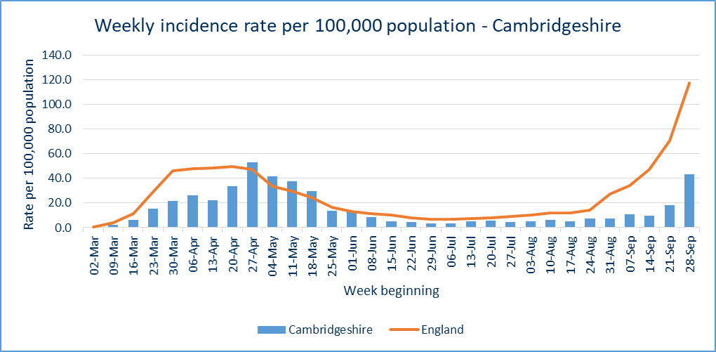
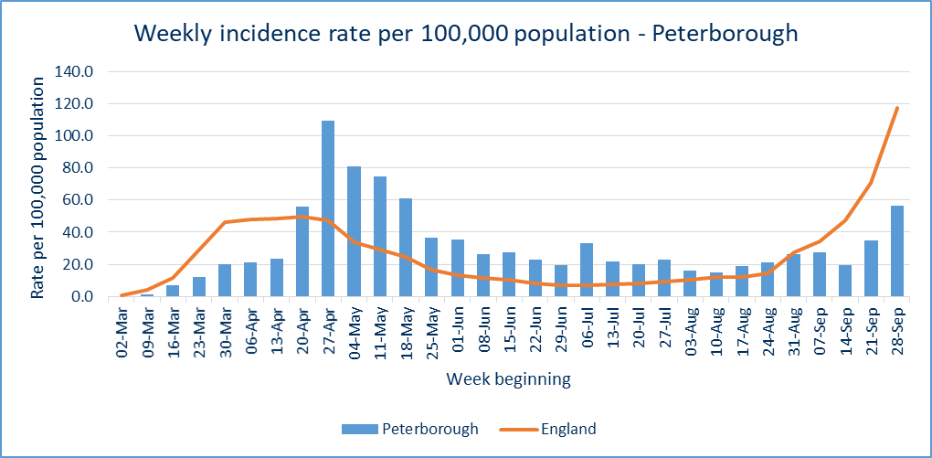
Covid-19 cases – pillar 1 and pillar 2
CONFIRMED CASES
396 new lab-confirmed Covid-19 cases were detected in Cambridgeshire (282) and Peterborough (114) in the latest reporting week, 28 Sept – 04 October. This is 207 more than the previous reporting week.
The cumulative rate of Covid-19 cases per 100,000 population in Peterborough (969.5) remain statistically significantly higher than the national rate (827.4).
Incidence rate of Covid-19 cases per 100,000 residents
CONFIRMED CASES - TREND
Confirmed cases have increased in Cambridgeshire (+164), Peterborough (+43), and each of the Cambridgeshire districts compared to the previous week. A trend also seen nationally.
Recent weekly incidence rates for Cambridgeshire and Peterborough remain lower than the national rates.
Source: PHE, https://coronavirus.data.gov.uk/ data extracted Wednesday 07 October
Slides produced by PHI, 08 October 2020

Slide 2
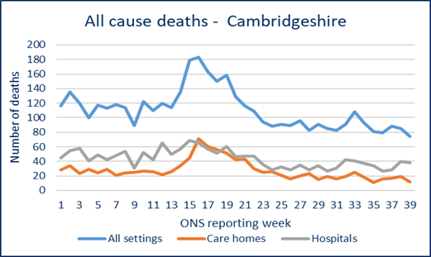
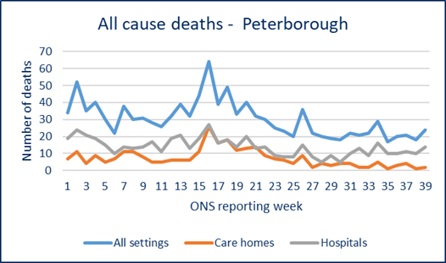
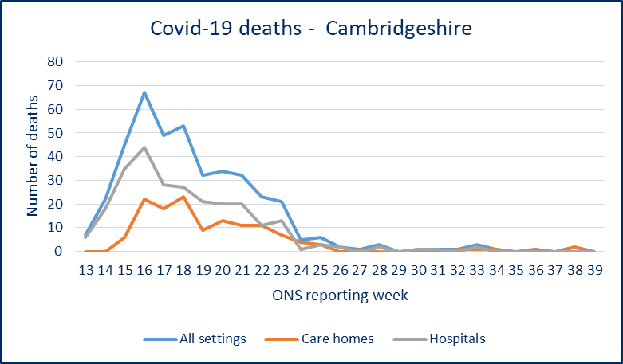
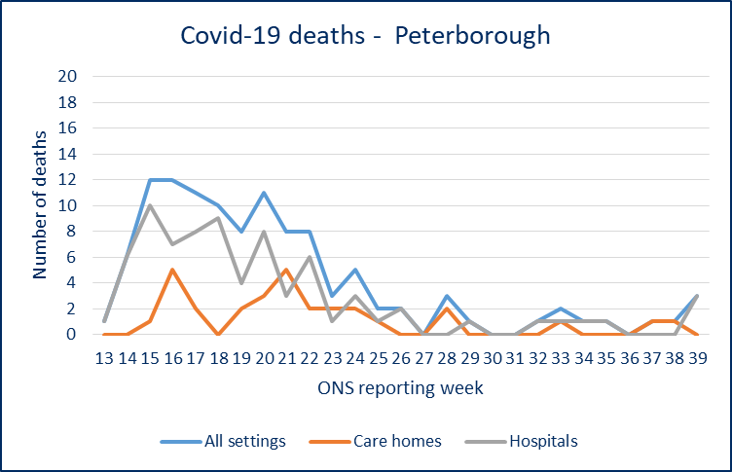
Covid-19 and all-cause mortality
ONS reporting Week 39 (ending Friday 25 September 2020):
DEATH TRENDS – Cambridgeshire and Peterborough
Please note the y-axis on the charts have different values
DEATHS
3 Covid-19 related deaths occurred in Peterborough, and no Covid-19 deaths in Cambridgeshire, in ONS reporting week 39. All three deaths occurred in a hospital setting.
There were 98 all-cause deaths in Cambridgeshire and Peterborough in week 39 (down from 103 in week 38).
At a district level, all districts reported a decrease in all-cause deaths compared to the previous week except East Cambridgeshire, where all-cause deaths remain static to the previous week.
Peterborough has an increase in all-cause deaths (+6) compared to the previous week.
EXCESS DEATHS
The number of all-cause deaths is below the 2014-18 average in Cambridgeshire, Peterborough, and all districts except South Cambridgeshire (similar) for week 39.
The number of all-cause deaths in care homes is below the 2014-18 average in Cambridgeshire, Peterborough and all five districts for week 39.
ALL-CAUSE DEATHS
COVID-19 RELATED DEATHS
Source: ONS, published 06 October
Source: ONS, provided by PHE (death occurrences)
Slides produced by PHI, 08 October 2020

