Slide 1
NEW HORIZONS Impact analysis from MOW Feedback Tool : Oct 16-Sep 19
Prepared by: Ann Grimsdale
New Horizons Project Officer, CHS Group
18.10.19

Slide 2
Context – who enrols with NH
 | New Horizons enrolled | UK population profile | NH Index vs. UK population
 | % | % | 1=parity
Men | 42 | 49 | 0.86
Women | 58 | 51 | 1.14
Any disability/longstanding disability* | 67 | 26* | 2.57
Aged under 25 | 25 | 12 | 2.08
25-49/25-54* | 49 | 53 | Circa 1
50+/55+* | 25 | 35 | Circa 0.5
Single adult, with dependent kids | 16 | 3 | 5.33
Econ inactive, inc. NEET | 60 | 16 | 3.75
Unemployed | 40 | 7 | 5.71
Given the recruitment criteria for the project, unsurprisingly those who enrol with New Horizons are far more likely to be unemployed or economically inactive than the UK population overall.
They are also much more likely to be in ‘single adult, with kids’ households – and to be somewhat younger than the overall UK population.
Finally, 2 in 3 New Horizons enrollers report a disability, compared with only about a quarter of the overall UK population to declare a longstanding disability.
Base: Approx 450 NH enrolled to Sep19. UK population data from Money Advice Service Jan 19 Market Segmentation Study.

Slide 3
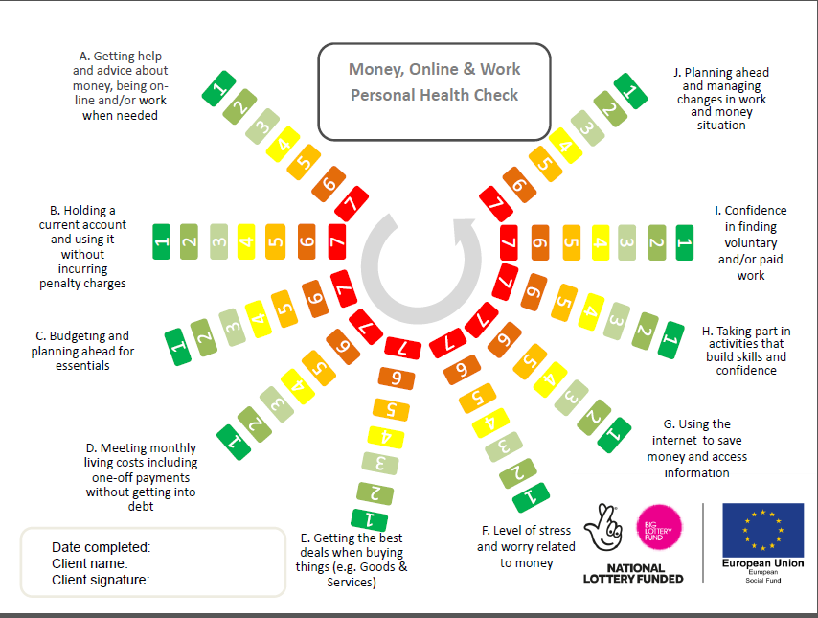

Slide 4
Context: MOW variables
Item | MOW focus | Short name | Full variable description
A | Multi | GETHELP | Getting help and advice about money, being online and/or work when needed
B | Money | BANKING | Holding a current account and using it without incurring penalty charges
C | Money | BUDGETING | Budgeting and planning ahead for essentials
D | Money | ENDSMEET | Meeting monthly living costs including one-off payments without getting into debt
E | Money | GETDEALS | Getting the best deals when buying things (e.g. goods and services)
F | Money | STRESS | Level of stress and worry related to money
G | Online | NETUSE | Using the internet to save money and access information
H | Multi | SELFDEV | Taking part in activities that build skills and confidence
I | Work | WORKCONF | Confidence in finding voluntary and/or paid work
J | Multi | CHANGE | Planning ahead and managing changes in work and money situation
MOW RATING SCALE
‘I am good at this’
‘I am not sure’
‘This causes me problems’

Slide 5
Key Findings – OVERVIEW
At the outset, almost all MOW aspects are scored ‘ in the red’ – that is participants report MOW mean scores of 3 or below out of 7. Amongst those had engaged with the project by September 2019 (i.e. having given at least one round of further MOW feedback) MOW mean scores rise, on average, by between 1.5 and 2.5 points, i.e to around 5 out of 7.
The strongest successes for the project appear to lie in reducing money-related stress and worry. It would appear to do this most clearly by helping participants work out how to budget and meet their monthly living costs, and equipping them with the knowledge about where to get help and advice in future.
The least successful initial impacts appear to relate to issues such as being able to plan ahead to manage change, and gaining confidence around work.

Slide 6
A: ‘GETHELP’: Getting help and advice about money, being online and/or work when needed. Entry (ALL) vs. post-engagement
It appears that the specialist, tailored coaching approach is helping to signpost help clearly for participants, and this is a key benefit to participants in the New Horizons project. This MOW variable covers all three MOW aspects (Money, Online and Work), and the change is dramatic: from about 3 in 5 finding it a problem, to about 4 in 5 saying they are now good at this aspect of MOW management. (And it records one of the strongest rises in mean scores, of +2.5)
Any ‘RED’ = 61%
Any ‘GREEN’ = 22%
NET Sentiment
-39
+72
Base: ALL entry (approx. 450). ENGAGERS post (approx. 190). NET sentiment=‘Any Green’ % minus ‘Any Red’ %. Could range from +100 to -100

Slide 7
B: ‘BANKING’: Holding a current account and using it without incurring penalty charges. Entry (ALL) vs. post-engagement
Whilst relatively fewer people report this as a problem (compared with other MOW aspects), it’s still a clear success for the project – post engagement only 1 in 10 regard holding a bank account without charges as a problem, and nearly 9 in 10 feel confident to say they are good at this.
Any ‘RED’ = 38%
Any ‘GREEN’ = 50%
NET Sentiment
+12
+76
Base: ALL entry (approx. 450). ENGAGERS post (approx. 190). NET sentiment=‘Any Green’ % minus ‘Any Red’ %. Could range from +100 to -100

Slide 8
C: ‘BUDGETING’: Budgeting & planning ahead for essentials. Entry (ALL) vs. post-engagement
A good outcome for this MOW variable. Nearly 2 in 3 participants are experiencing problems with budgeting for essentials when they arrive at NH; but a greater proportion, 3 in 4, are feeling confident about it once they have received the 121 coaching help.
Any ‘RED’ = 64%
Any ‘GREEN’ = 25%
NET Sentiment
-39
+60
Base: ALL entry (approx. 450). ENGAGERS post (approx. 190). NET sentiment=‘Any Green’ % minus ‘Any Red’ %. Could range from +100 to -100

Slide 9
D: ‘ENDSMEET’: Meeting monthly living costs, including one-off payments without getting into debt. Entry (ALL) vs. post-engagement
As with budgeting for essentials, this is another good success factor for the project. About two-thirds feel that meeting monthly living costs without getting into debt is a problem at the start of the project; this changes dramatically to three-quarters saying they are good at this post-engagement. (And the rise in mean score is one of the strongest, at +2.5 points).
Any ‘RED’ = 67%
Any ‘GREEN’ = 19%
NET Sentiment
-48
+62
Base: ALL entry (approx. 450). ENGAGERS post (approx. 190). NET sentiment=‘Any Green’ % minus ‘Any Red’ %. Could range from +100 to -100

Slide 10
E: ‘GETDEALS’: Getting the best deals when buying things (e.g. goods and services). Entry (ALL) vs. post-engagement
Perhaps because of the circumstances which accompany participants at the outset of the project, enrollers are already relatively confident at feeling they obtain the best deals when buying things. Net sentiment is positive (i.e. 7% more state they are good at this than that is causes them a problem) at the beginning of the project. Nonetheless, once people have engaged, getting deals becomes one of the strongest positive outcomes for the project, with some 85% saying they are good at this aspect.
Any ‘RED’ = 38%
Any ‘GREEN’ = 45%
NET Sentiment
+7
+78
Base: ALL entry (approx. 450). ENGAGERS post (approx. 190). NET sentiment=‘Any Green’ % minus ‘Any Red’ %. Could range from +100 to -100

Slide 11
F: ‘STRESS’: Level of stress & worry related to money Entry (ALL) vs. post-engagement
4 in 5 participants are reporting a problem with their levels of stress and worry related to money at the outset of the project. Indeed, with 1 in 2 ticking the lowest possible rung on the ladder, it’s by far the MOW aspect on which participants appear to struggle the most. The change to being ‘ in the green’ (any of the three boxes indicating ‘I am good at this’) post-engagement with New Horizons is impressive – with the majority, 62%, being able to say they are now good at (managing this stress. It would be interesting to monitor this over time, once the 121 coaching ends.
Any ‘RED’ = 80%
Any ‘GREEN’ = 12%
NET Sentiment
-68
+40
Base: ALL entry (approx. 450). ENGAGERS post (approx. 190). NET sentiment=‘Any Green’ % minus ‘Any Red’ %. Could range from +100 to -100

Slide 12
G: ‘NETUSE’: Using the internet to save money and access information. Entry (ALL) vs. post-engagement
Given the levels of money-related stress that enrollers report, growing internet skills appears to be marginally a second-issue order of importance. Even though about half of all those entering the project report having a problem with using the internet to save money and access information, that still leaves it as one of the issues causing relatively lower levels of reported problems than others. Post-engagement, whilst 7 in 10 say they are good at this online MOW aspect, this in fact places it at a relatively low level of success (compared with other factors).
Any ‘RED’ = 53%
Any ‘GREEN’ = 29%
NET Sentiment
-24
+50
Base: ALL entry (approx. 450). ENGAGERS post (approx. 190). NET sentiment=‘Any Green’ % minus ‘Any Red’ %. Could range from +100 to -100

Slide 13
H: ‘SELFDEV’: Taking part in activities that build skills and confidence. Entry (ALL) vs. post-engagement
As with gaining internet skills, there are relatively lower percentages of people claiming confidence building as a problem at the outset, and the rise to those ‘in the green’ is also relatively modest. That said, it still means a swing from 6 in 10 finding it a problem at the outset to 7 in 10 saying they are good at this, post engagement. This may be another variable to track over time?
Any ‘RED’ = 57%
Any ‘GREEN’ = 22%
NET Sentiment
-35
+49
Base: ALL entry (approx. 450). ENGAGERS post (approx. 190). NET sentiment=‘Any Green’ % minus ‘Any Red’ %. Could range from +100 to -100

Slide 14
I: ‘WORKCONF’: Confidence in finding voluntary and /or paid work Entry (ALL) vs. post-engagement
This is an issue to watch; net positive sentiment post engagement at +35 is the just the lowest for all the variables measured, and not dissimilar to the outcomes for managing monetary stress and being able to manage change. Indeed, 1 in 4 report it still being a problem, post engagement. Anecdotally, it has been posited that a potential reason for this is that the combination of people’s work & mental health histories may mean they are not yet in a position to gain work confidence. One to monitor in future, perhaps?
Any ‘RED’ = 63%
Any ‘GREEN’ = 21%
NET Sentiment
-42
+35
Base: ALL entry (approx. 450). ENGAGERS post (approx. 190). NET sentiment=‘Any Green’ % minus ‘Any Red’ %. Could range from +100 to -100

Slide 15
J: ‘CHANGE’: Planning ahead and managing changes in work and money situation. Entry (ALL) vs. post-engagement
This appears to represent another big issue – feeling able to manage change is the next biggest problem area (after stress) for participants on entry, with about 3 in 4 reporting it as a problem. Whilst the shift is to about 6 in 10 saying they are good at this, post-engagement, it is perhaps important to note that only 14% feel able to tick the top positive box on this aspect (as is the case with managing stress).
Any ‘RED’ = 73%
Any ‘GREEN’ = 13%
NET Sentiment
-60
+41
Base: ALL entry (approx. 450). ENGAGERS post (approx. 190). NET sentiment=‘Any Green’ % minus ‘Any Red’ %. Could range from +100 to -100

Slide 16
What’s next for New Horizons?
Thinking about targets – are we struggling to move people from economically inactive into job search because we are enrolling people who really need a different service? Is there a gap for people who need longer term support and employment isn’t the right/only answer?
Our conference – November 21st at Eddington. Fully booked but will share outcomes from the day with this group
Evaluation: focus on participants who have left the project - 6 months plus. What can we learn about effecting real change?
The voice of lived experience – focus groups with the University, aims to link in with other lived experience groups
Food poverty event in March on February 19th

