Slide 1
Peterborough Partnershsips PCN
Data pack
November 2019

Slide 2
Peterborough Partnerships PCN – summary
There are almost 40,500 people registered with Peterborough Partnerships PCN, with a smaller older population compared to the North Alliance, CCG and England. The population is estimated to increase at a much lower rate than the CCG as a whole between 2019 and 2036 The PCN has a lower proportion of White British ethnic group when compared to the North Alliance, CCG and England and higher proportions from all other ethnic groups Relative deprivation is higher in the PCN compared to the North Alliance, CCG and England. Approximately 20.6% of children and 19% of older people live in poverty It is estimated that on average there are 555 births a year in the PCN. Birth rates and the proportion of babies born with a low birth weight are statistically similar to the North Alliance, which in itself has a noticeably high birth rate compared to the CCG It is estimated that male and female life expectancy within the Peterborough Partnerships PCN are both statistically similar to the North Alliance at 79.5 and 82.9 years respectively Recorded obesity in adults is statistically significantly lower than the North Alliance average It is estimated that 21.4% of adults smoke, which is statistically significantly higher than the North Alliance | Estimates of people reporting long-term activity-limiting illness and being in Good or Very Good health are statistically similar to averages for the North Alliance On average there are around 211 deaths a year in the PCN, with around 40% of these in people aged under 75 years The PCN has statistically significantly low recorded prevalence of CHD, hypertension, stroke, asthma, COPD and cancer compared to the North Alliance averages. As these data are not age-standardised, this may be a reflection of the relatively young population of the PCN. All-age all cause mortality rates are statistically similar to the North Alliance average in Peterborough Partnerships PCN and under 75 mortality rates for all causes are statistically significantly higher than the North Alliance average Prevalence of serious mental illness is statistically significantly higher and dementia prevalence is statistically significantly lower than the North Alliance. The PCN has statistically significantly higher rates of children’s early help cases than the North Alliance. The overall adult social care usage rate for the PCN are statistically similar to the North Alliance.

Slide 3
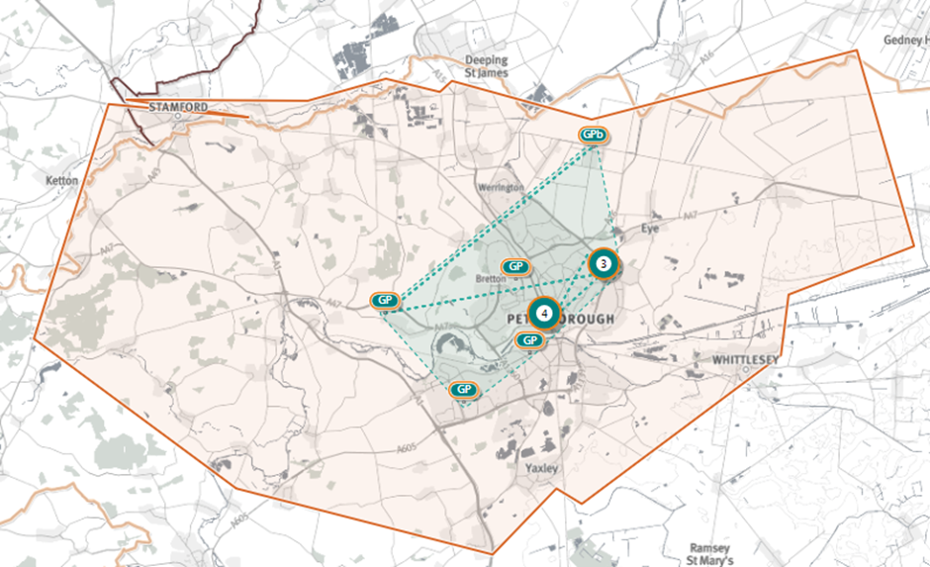
Peterborough Partnerships PCN
Source: Shape Atlas GP registered population, October 2019, NHS Digital.

Slide 4
Demography and key population characteristics

Slide 5
GP registered population
Peterborough Partnerships PCN has a higher proportion of people aged 18 and under and lower proportion aged 65 and over compared with North Alliance, CCG and England.
Source: GP registered population, April 2019, NHS Digital. Population forecasts based on population distribution at ward level (Apr 19), Mid 2015 based population forecasts Cambridgeshire County Council

Slide 6
Population forecasts
The population of Peterborough Partnerships PCN is forecast to grow at a much lower rate than the CCG as a whole and decreases in registered population are expected between 2026 – 2031 and 2031 – 2036, during which time it is anticipated the CCG will continue to experience population growth.
Source: GP registered population, April 2019, NHS Digital. Population forecasts based on population distribution at ward level (Apr 19), Mid 2015 based population forecasts Cambridgeshire County Council

Slide 7
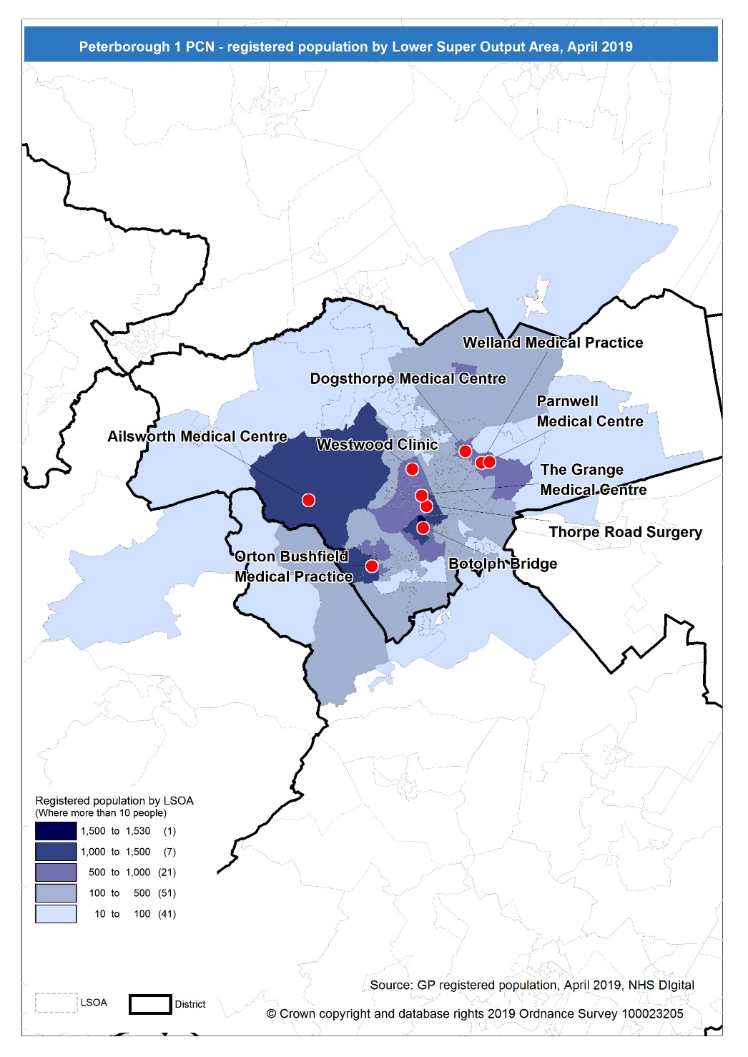
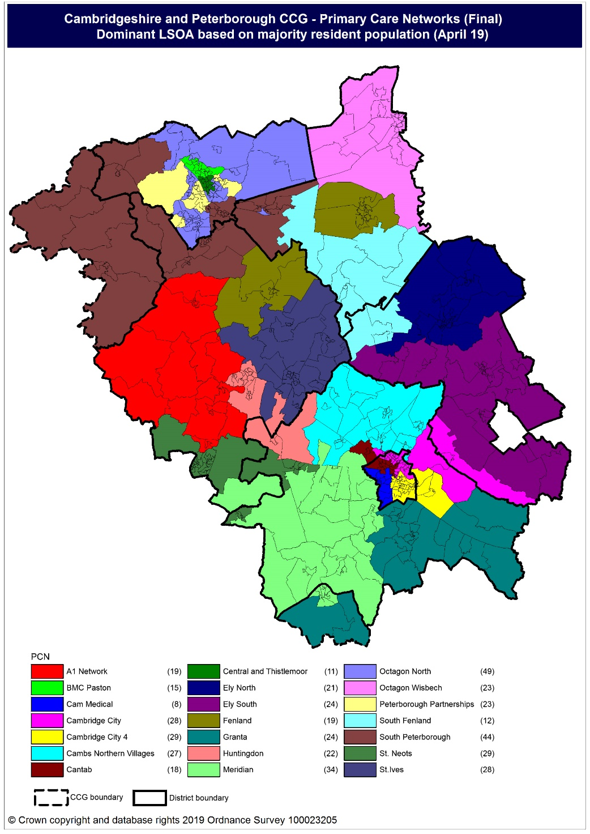
Population distribution
Source: GP registered population data by Lower Super Output Area, April 19, NHS Digital
Population
distribution
PCN dominant
population

Slide 8
Ethnicity
Peterborough Partnerships PCN has a lower proportion of population from the White British ethnic group and higher proportions from all other ethnic groups compared to North Alliance, Cambridgeshire & Peterborough CCG and England.
Source: Census 2011 data applied to GP registered population using Census 2011 ethnic group proportions; England data from NOMIS (patients registered at a GP Practice by LSOA, July 2018, NHS Digital)

Slide 9
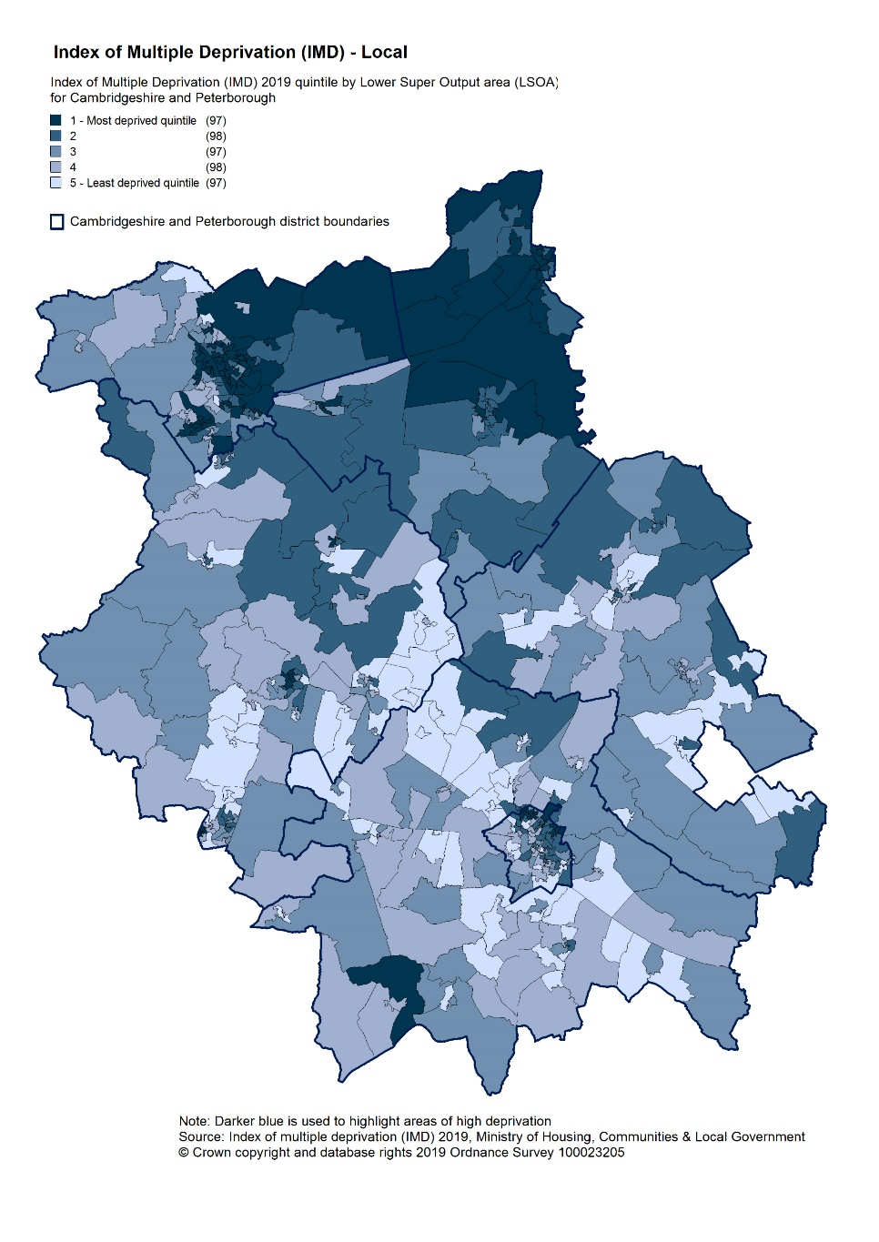
Deprivation
Peterborough Partnerships is one of the most deprived PCNs within C&P CCG, with the majority of practices within the PCN having higher levels of observed deprivation than North Alliance, CCG and England averages. Approximately 20.6% of children and 19% of older people registered with Peterborough Partnerships practices live in poverty.
Source: C&P PHI derived from Indices of Multiple Deprivation 2019, MHCLG and GP registered population data for July 2018. Practice data from PHE Fingertips.
Index of Multiple Deprivation, 2019, by LSOA

Slide 10
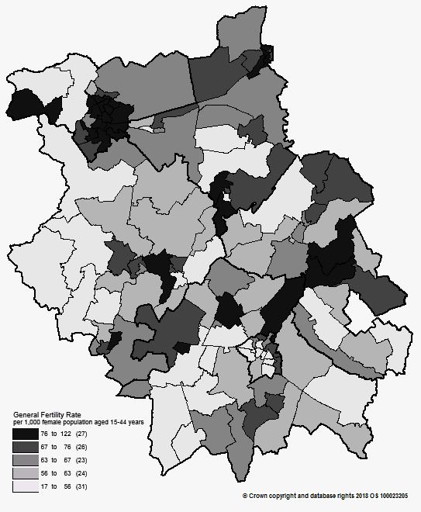
Births and Fertility
Birth rates and low birth weight births in Peterborough Partnerships PCN are statistically similar to the averages for the North Alliance.
Note: Relates to Cambridgeshire and Peterborough residents only Source: C&P PHI based on NHS Digital Civil Registration Data, 2014-2016 and patients registered at a GP Practice by LSOA, July 2018, NHS Digital
Birth rates by ward

Slide 11
Self-reported limiting long-term illness and general health status
It is estimated that the proportion of people that reported that they had a long-term activity-limiting illness in the 2011 Census was statistically similar to the North Alliance average. It is also estimated that the proportion of people that reported that they were in good or very good health in the 2011 Census was statistically similar to the North Alliance average.
Source: C&P PHI from Census 2011, NOMIS and patients registered at a GP Practice by LSOA, July 2018, NHS Digital

Slide 12
Life expectancy
Male and female life expectancy are statistically similar to North Alliance in Peterborough Partnerships PCN. North Alliance male and female life expectancy is statistically significantly lower than the CCG
Source: C&P PHI based, derived from NHS Digital Civil Registration data and GP registered population data 2013 – 2017

Slide 13
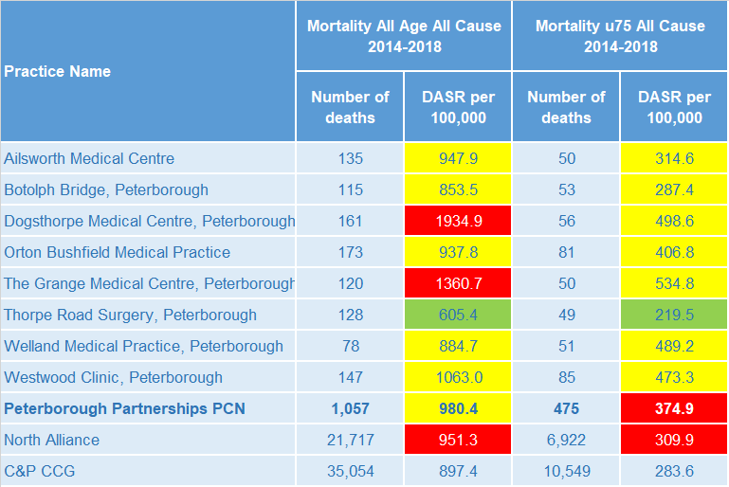
Mortality – all causes
The PCN has a statistically significantly high premature all cause mortality rate compared to the North Alliance. All age all cause mortality is statistically similar to the North Alliance.
DASR = directly age standardised rate per 100,000 population Source: C&P PHI, from NHS Digital Civil Registration Data and NHS Digital GP registered population data, 2014-2018

Slide 14
Selected lifestyle behaviour risk factors

Slide 15
Risk factors
Recorded prevalence of obesity is statistically significantly lower in Peterborough Partnerships PCN compared to the average for North Alliance. Estimated smoking prevalence is statistically significantly higher in Peterborough Partnerships PCN compared to the average for North Alliance.
Source: Obesity - C&P PHI derived from NHS Digital QOF data for 2017/18; Estimated smoking - C&P PHI derived from the QOF based smoking prevalence estimate from the Public Health England (PHE) National General Practice Profiles at https://fingertips.phe.org.uk/profile/general-practice

Slide 16
Prevalence and mortality from principal diseases

Slide 17
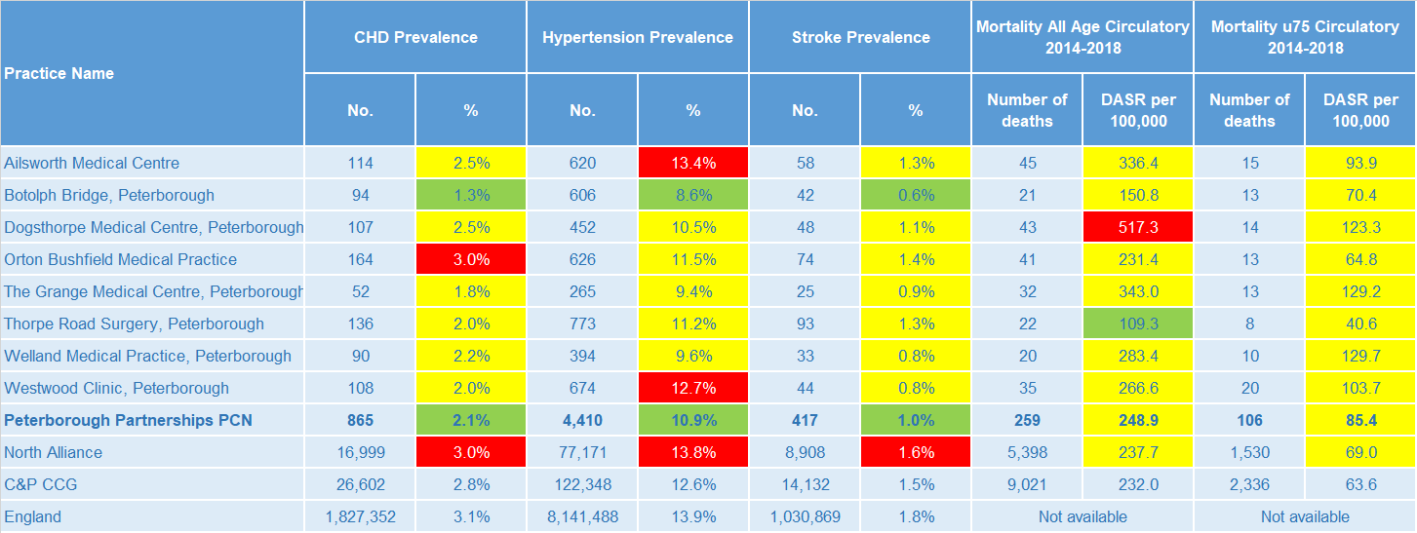
Circulatory disease
The PCN prevalence rates of CHD, hypertension and stroke are statistically significantly low compared to North Alliance. PCN all age and premature mortality rates for circulatory disease are statistically similar to the North Alliance.
Note: Prevalence data are not available by age i.e. it is not age weighted so differences may be explained by differing age structures; DASR = Directly age standardised rate per 100,000 population Source: Prevalence (recorded) - C&P PHI from QOF, NHS Digital, 2017/18; Mortality - C&P PHI, from NHS Digital Civil Registration Data and NHS Digital GP registered population data, 2014-2018

Slide 18
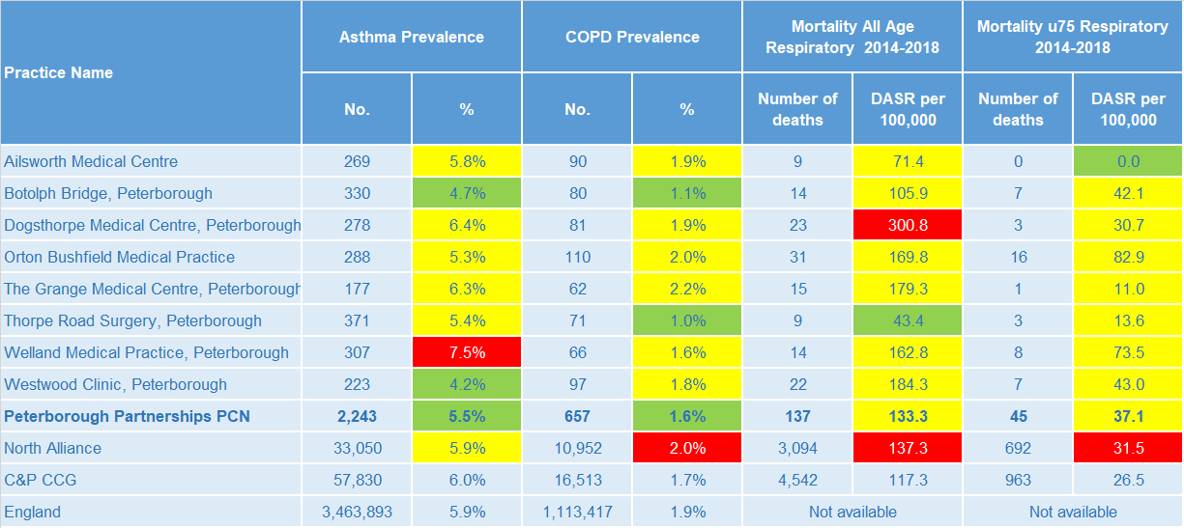
Respiratory disease
Asthma and COPD prevalence is statistically significantly low compared to the North Alliance in Peterborough Partnerships PCN and rates of mortality from respiratory causes are statistically similar to the North Alliance.
Note: Prevalence data are not available by age i.e. it is not age weighted so differences may be explained by differing age structures; DASR = Directly age standardised rate per 100,000 population Source: Prevalence (recorded) - C&P PHI from QOF, NHS Digital, 2017/18; Mortality - C&P PHI, from NHS Digital Civil Registration Data and NHS Digital GP registered population data, 2014-2018

Slide 19
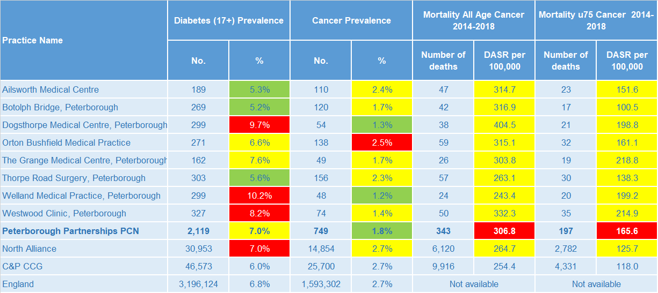
Long term conditions
The PCN has a diabetes prevalence statistically similar to North Alliance and cancer prevalence statistically significantly lower than North Alliance. All age and premature cancer mortality rates are statistically significantly higher than North Alliance.
Note: Prevalence data are not available by age i.e. it is not age weighted so differences may be explained by differing age structures; DASR = Directly age standardised rate per 100,000 population Source: Prevalence (recorded) - C&P PHI from QOF, NHS Digital, 2017/18; Mortality - C&P PHI, from NHS Digital Civil Registration Data and NHS Digital GP registered population data, 2014-2018

Slide 20
Mental health, dementia and learning disability
PCN prevalence of serious mental illness is statistically significantly higher than the North Alliance. Dementia prevalence is statistically significantly lower and depression and learning disability prevalence is statistically similar.
Note: Prevalence data are not available by age i.e. it is not age weighted so differences may be explained by differing age structures Source: Prevalence (recorded) - C&P PHI from QOF, NHS Digital, 2017/18; Mortality - C&P PHI, from NHS Digital Civil Registration Data and NHS Digital GP registered population data, 2013-2017

Slide 21
Service provision and utilisation

Slide 22
PCN workforce

Slide 23
Who works within the Health and Social Care services for the PCN?
Patients receive health care from a range of individuals and organisations
94 staff are employed through Peterborough Partnerships PCN Practices, the majority of which will be directly in contact with patients.
Data Sources: Local Authority Data extract; PCN Practice data; CPFT data extract

Slide 24
Who works within the Health and Social Care services for the PCN?
Patients receive health care from a range of individuals and organisations
There are currently 19,137 patients under CPFT caseload across the services listed. Caseloads rates for Peterborough Partnerships PCN are generally lower compared to the rest of Cambridgeshire and Peterborough. Additional patients will be inpatients in rehab wards and part of the multi-disciplinary team caseload. Bushfield has the highest number of caseloads for Peterborough Partnerships PCN.
Data Sources: Local Authority Data extract; PCN Practice data; CPFT data extract

Slide 25
Social Care Services

Slide 26
Children’s Social Care
It is estimated that the North Alliance has statistically significantly high rates of social care involvement cases, early help cases and education, health and care plans compared to the CCG average. It is estimated that Peterborough Partnerships PCN has a statistically significantly higher rate of early help cases than the North Alliance and the estimated social care involvement cases and education, health and care plans rates are statistically similar to the North Alliance rates.
Source: Cambridgeshire County Council, BI team. Estimates derived from the LSOA level data, (for those LSOAs in Cambridgeshire or Peterborough only) available as an open data release here: https://data.cambridgeshireinsight.org.uk/dataset/cambridgeshire-and-peterborough-adult-social-care-long-term-service-users-31-march-2019 and GP Registered Population April 2019

Slide 27
Adult Social Care
Overall, the adult social care usage rate for the Peterborough Partnerships PCN is statistically similar to the North Alliance. The overall adult social care usage rate for the North Alliance is statistically significantly higher than the CCG.
Source: Cambridgeshire County Council, BI team. Estimates derived from the LSOA level data, (for those LSOAs in Cambridgeshire or Peterborough only) available as an open data release here: https://data.cambridgeshireinsight.org.uk/dataset/cambridgeshire-and-peterborough-adult-social-care-long-term-service-users-31-march-2019 and GP Registered Population April 2019

Slide 28
Secondary Care Services

Slide 29
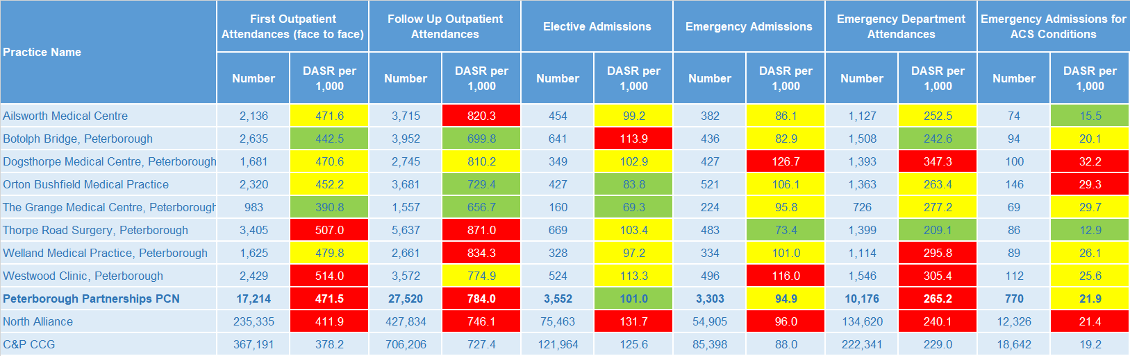
Secondary Care Services
North Alliance has statistically significantly high rates of secondary care use compared with the CCG average. Peterborough Partnerships PCN has statistically significantly higher rates of first outpatient attendance, follow up outpatient attendances and emergency department attendances than the North Alliance. Ophthalmology and Trauma & Orthopaedics account for the most outpatient attendances. This was the case for both 17/18 and 18/19. Together they make up 22% of the activity for 18/19. The most common elective admissions are for General Surgery, Gastroenterology, Trauma & Orthopaedics, and related conditions.
Note: DASR = Directly age standardised rate per 1,000 population, reference population used is the ONS National Standard Population. Source: C&P PHI, from HED Tool, 2018/19; Cambridgeshire and Peterborough “Practice Benchmarker”

Slide 30
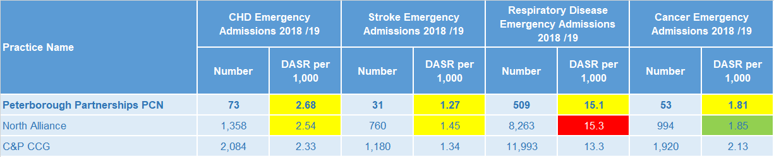
Disease Specific Emergency Hospital Admission Rates
The disease specific PCN emergency admission rates shown are statistically similar to the North Alliance average. For Peterborough Partnerships PCN there were 3.173 emergency admissions during 2018/19. 4 of the 8 practices had a higher admission rate than Cambridgeshire and Peterborough. The majority of emergency admissions were for Paediatric Medicine. There were more than twice as many admissions for Paediatric Medicine than Geriatric Medicine. This ties in with there being more younger residents for Peterborough Partnerships PCN. There are 15% more residents in the paediatric age bracket than residents aged 65 plus.
Note: DASR = Directly age standardised rate per 1,000 population, reference population used is the ONS National Standard Population. Source: C&P PHI, from HED Tool, 2018/19; Cambridgeshire and Peterborough “All Trusts 18/19”

Slide 31
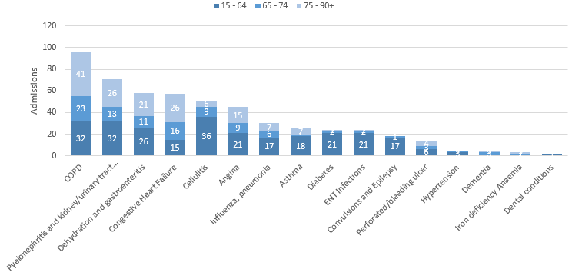
Potentially Avoidable Hospital Admissions
Peterborough Partnerships PCN’s older citizens contribute to the high rate of potentially avoidable admissions.
Selected Ambulatory Care Sensitive Conditions NEL admissions in 2018/19 by age
There are more potentially avoidable emergency admissions for Peterborough Partnerships PCN. Although there was a 6% increase for these across Cambridgeshire and Peterborough, year on year ACSC admissions for Peterborough Partnerships PCN increased 3%.
Those aged over 65 account for the majority of the 5 most common potentially preventable (ACSC) related admissions during 18/19. COPD and Congestive Heart Failure were most common for the higher age bands (over 65 years old).
Cellulitis, COPD, and Pyelonephritis and kidney/urinary tract infections are common for the younger age bracket.
Data Source: Cambridgeshire and Peterborough “Practice Benchmarker”

Slide 32
Glossary of key methods and terms
To assess statistical significance, 95% confidence intervals are calculated which provide a measure of uncertainty around the calculated value which arises due to random variation. If the confidence interval for a value excludes the value for the relevant benchmark, the difference between the local value and the benchmark is said to be ‘statistically significant’. The following hierarchy of benchmarks has been used in this profile: practice to PCN; PCN to Alliance; Alliance to CCG and CCG to England. The most commonly used RAG-rating in this profile: Exceptions to this are life expectancy which is RAG rated like this: And self-reported limiting long-term illness and general health status which is RAG rated like this: DASR = directly age standardised rate per 100,000 population C&P PHI = Cambridgeshire and Peterborough Public Health Intelligence QOF = Quality Outcomes Framework. Prevalence data are not available by age i.e. it is not age weighted so differences may be explained by differing age structures.

Slide 33
Produced by:
Cambridgeshire and Peterborough Public Health Intelligence Team
Contact:
PHI-team@Cambridgeshire.gov.uk
Date updated:
29th November 2019

