Slide 1
Octagon North PCN
Data pack
November 2019

Slide 2
Octagon PCN – summary
There are approximately 94,000 people registered with Octagon PCN, with a smaller older population compared to the North Alliance, CCG and England. The population of Octagon PCN is expected to grow at a rate relatively similar to that of the CCG over the period 2019-2026, with lower growth predicted within the PCN compared to the CCG between 2026 and 2036. The PCN has a lower proportion of White British ethnic group persons when compared to the North Alliance, CCG and England. Relative deprivation is higher in the PCN compared to the North Alliance, CCG and England. Approximately 20% of children and 19% of older people live in poverty. It is estimated that on average there are around 1,234 births a year in the PCN. Birth rates and the proportion of babies born with a low birth weight are statistically similar to the North Alliance, which in itself has a noticeably high birth rate compared to the CCG. Both male and female life expectancy values for Octagon PCN are statistically significantly worse than North Alliance averages. Recorded obesity in adults is statistically significantly lower than the North Alliance. It is estimated that 20.9% of adults smoke, which is statistically significantly higher than the North Alliance. | Estimates of people reporting long-term activity-limiting illness and being in Good or Very Good health are statistically similar to North Alliance averages. On average there are 770 deaths a year in the PCN, with around a third of these in people aged under 75 years. The PCN has statistically significantly low recorded prevalence of CHD, hypertension, asthma, COPD and cancer compared to the North Alliance and statistically significantly high prevalence of diabetes, mental health disorders, depression and dementia. All-cause mortality rates are statistically significantly higher than the North Alliance for Octagon PCN for both all age and under 75s. The all age respiratory disease mortality rate is also statistically significantly higher than the North Alliance. The PCN has statistically significantly higher rates of children’s social care involvement cases and early help cases than the North Alliance whereas the education, health and care plans rate is statistically similar to the North Alliance rate. The PCN has a statistically similar overall rate of adult social care compared to the North Alliance. The PCN has statistically significantly higher rates of first outpatient attendance, follow up outpatient attendances and emergency department attendances compered with the North Alliance.

Slide 3
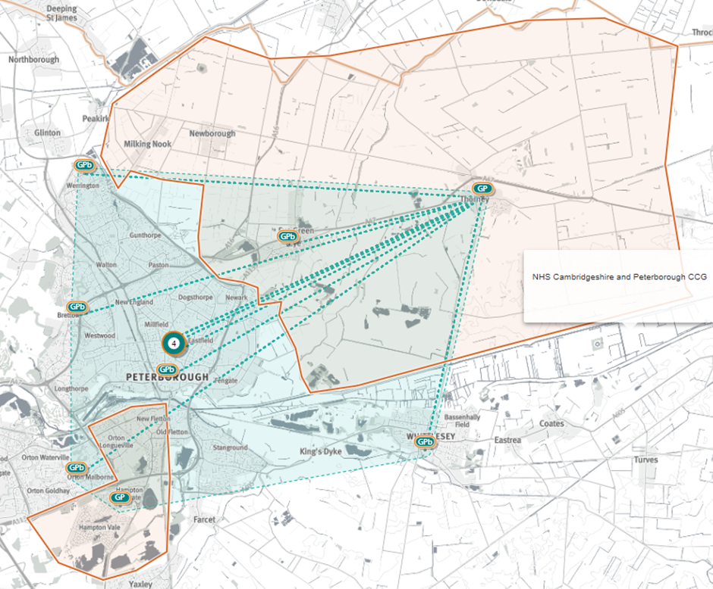
Octagon North PCN
Source: Shape Atlas GP registered population, October 2019, NHS Digital.

Slide 4
Demography and key population characteristics

Slide 5
GP registered population
Octagon North PCN has a higher proportion of people aged 18 and under and lower proportion aged 65 and over compared with North Alliance, CCG and England.
Source: GP registered population, April 2019, NHS Digital. Population forecasts based on population distribution at ward level (Apr 19), Mid 2015 based population forecasts Cambridgeshire County Council

Slide 6
Population forecasts
The population of Octagon North PCN is expected to grow at a rate relatively similar to that of the CCG over the period 2019-2026, with lower growth predicted within the PCN compared to the CCG between 2026 and 2036.
Source: GP registered population, April 2019, NHS Digital. Population forecasts based on population distribution at ward level (Apr 19), Mid 2015 based population forecasts Cambridgeshire County Council

Slide 7
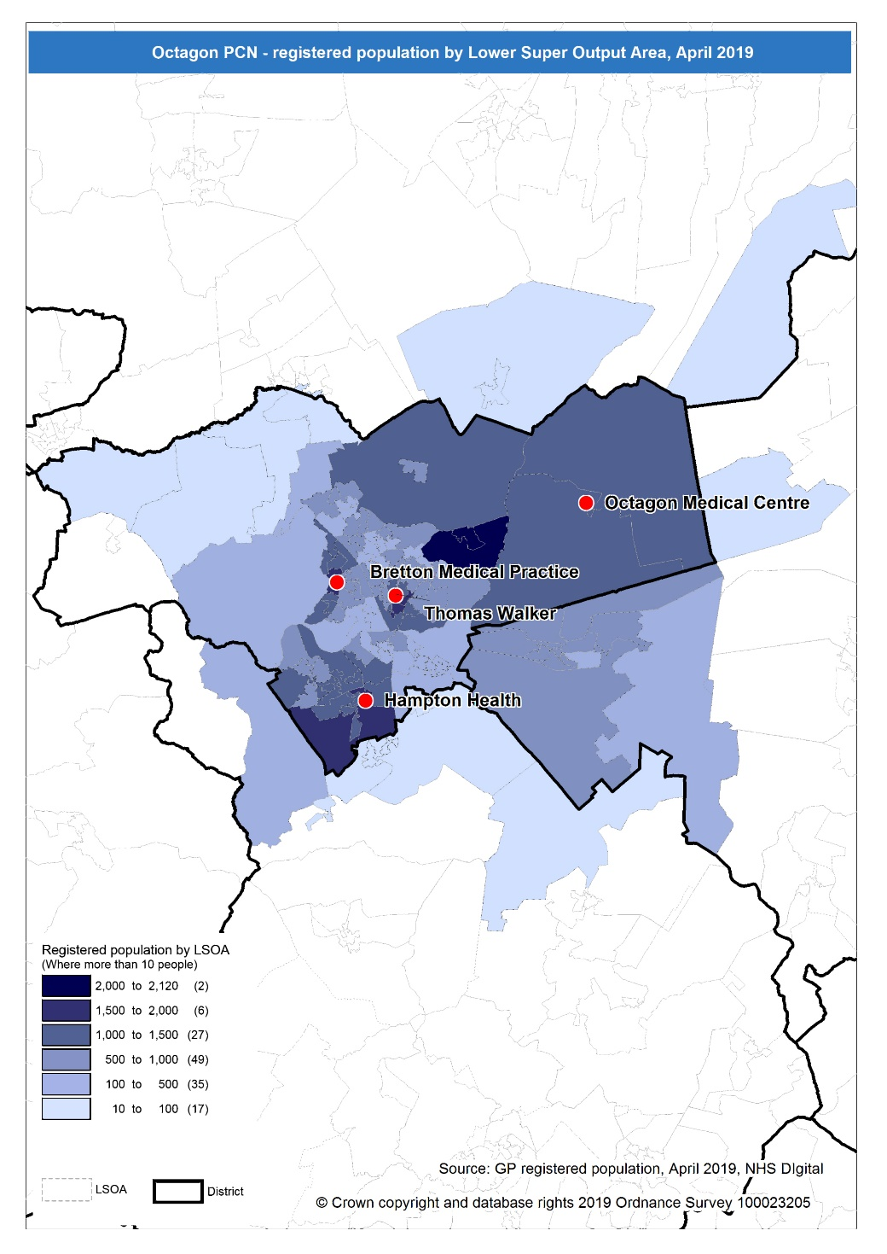
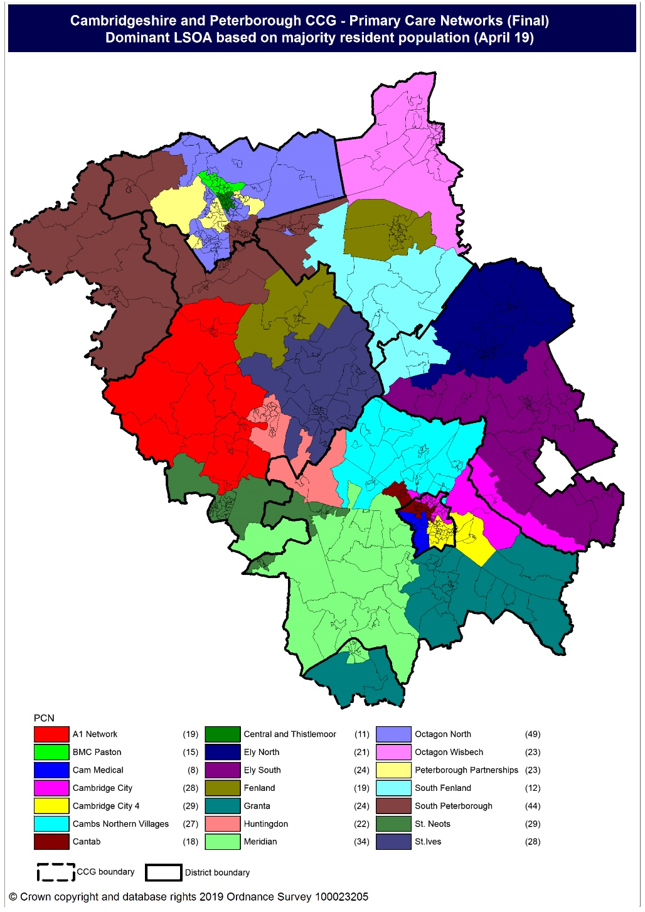
Population distribution
Source: GP registered population data by Lower Super Output Area, April 19, NHS Digital
Population
distribution
PCN dominant
population

Slide 8
Ethnicity
Octagon North PCN has a lower proportion of population from the White British ethnic group and higher proportions from all other ethnic groups in comparison to North Alliance and the CCG.
Source: Census 2011 data applied to GP registered population using Census 2011 ethnic group proportions; England data from NOMIS (patients registered at a GP Practice by LSOA, July 2018, NHS Digital)

Slide 9
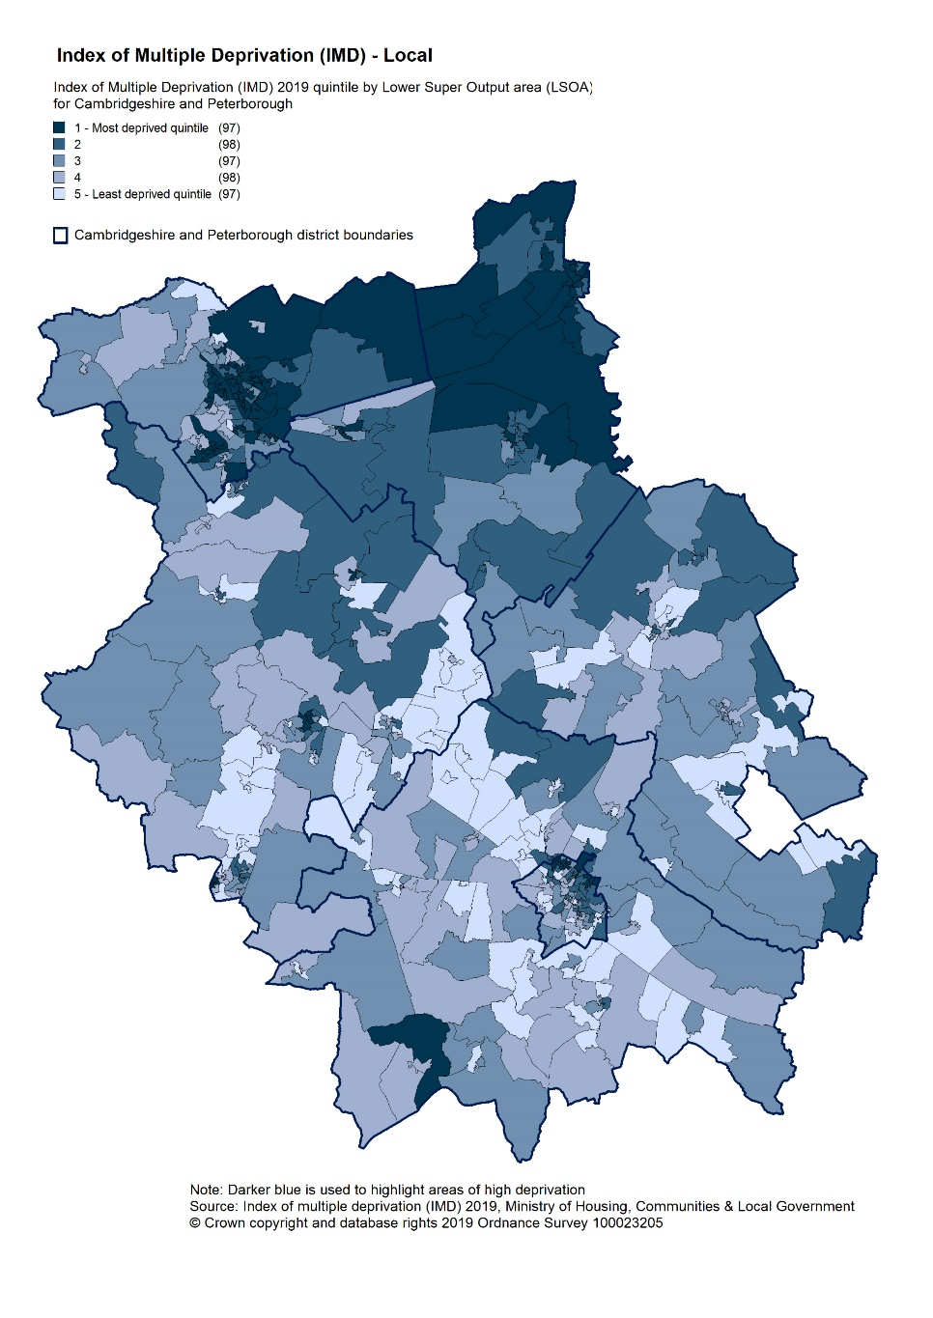
Deprivation
Relative deprivation is higher in Octagon North PCN than the North Alliance, C&P CCG and England averages. Approximately 20.3% of children and 19.3% of older people live in income deprived households in Octagon North PCN; higher than the averages for North Alliance and CCG.
Source: C&P PHI derived from Indices of Multiple Deprivation 2019, MHCLG and GP registered population data for July 2018. Practice data from PHE Fingertips.
Index of Multiple Deprivation, 2019, by LSOA

Slide 10
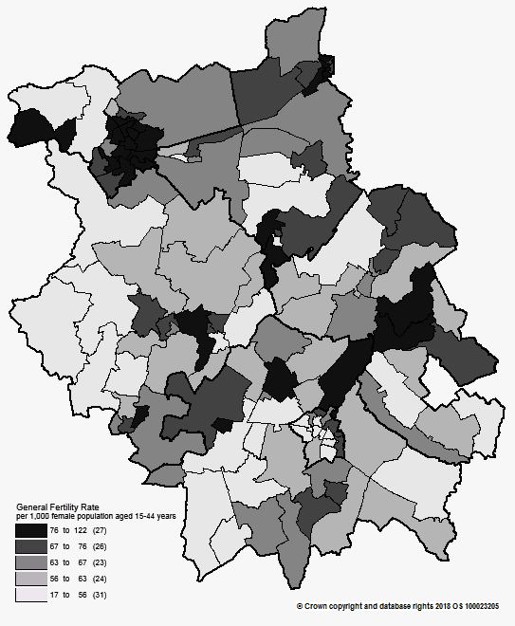
Births and Fertility
Birth rates and low birth weight births in Octagon North PCN are statistically similar to the averages for the North Alliance.
Note: Relates to Cambridgeshire and Peterborough residents only Source: C&P PHI based on NHS Digital Civil Registration Data, 2014-2016 and patients registered at a GP Practice by LSOA, July 2018, NHS Digital
Birth rates by ward

Slide 11
Self-reported limiting long-term illness and general health status
It is estimated that Octagon North PCN has a statistically similar proportion of residents with long-term activity-limiting illness and good or very good health when compared to the North Alliance.
Source: C&P PHI from Census 2011, NOMIS and patients registered at a GP Practice by LSOA, July 2018, NHS Digital

Slide 12
Life expectancy
Both male and female life expectancy values are statistically significantly lower in Octagon North PCN compared to the North Alliance. The North Alliance male and female life expectancy is statistically significantly lower than the CCG.
Source: C&P PHI based, derived from NHS Digital Civil Registration data and GP registered population data 2013 – 2017

Slide 13
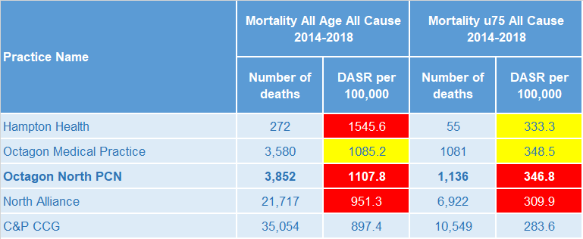
Mortality – all causes
There are on average 770 deaths a year in Octagon North PCN, approximately a third are in people aged under 75 years. All-cause mortality for all ages and under 75s only is statistically significantly higher than the North Alliance.
DASR = directly age standardised rate per 100,000 population Source: C&P PHI, from NHS Digital Civil Registration Data and NHS Digital GP registered population data, 2014-2018

Slide 14
Selected lifestyle behaviour risk factors

Slide 15
Risk factors
Recorded prevalence of obesity is statistically significantly lower in Octagon North PCN compared to the average for North Alliance. Estimated smoking prevalence is statistically significantly higher in Octagon North PCN compared to the average for North Alliance.
Source: Obesity - C&P PHI derived from NHS Digital QOF data for 2017/18; Estimated smoking - C&P PHI derived from the QOF based smoking prevalence estimate from the Public Health England (PHE) National General Practice Profiles at https://fingertips.phe.org.uk/profile/general-practice

Slide 16
Prevalence and mortality from principal diseases

Slide 17
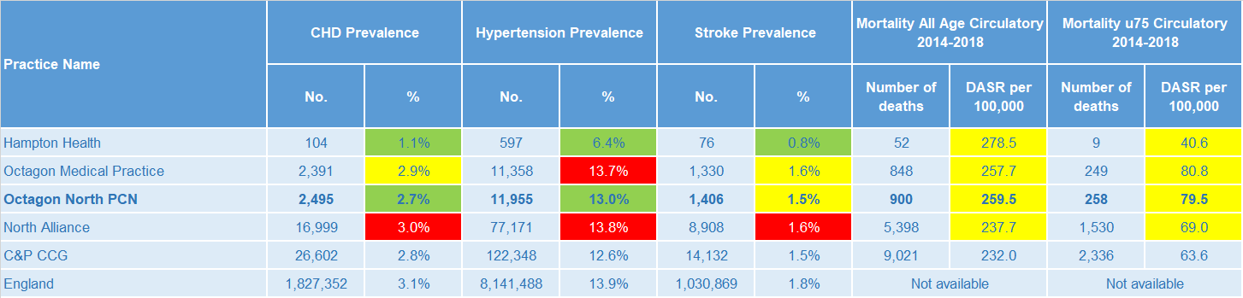
Circulatory disease
Octagon North PCN prevalence rates of CHD and hypertension are statistically significantly low compared to the North Alliance average and stroke prevalence is statistically similar. Circulatory disease all-age and premature mortality rates are statistically similar to North Alliance.
Note: Prevalence data are not available by age i.e. it is not age weighted so differences may be explained by differing age structures; DASR = Directly age standardised rate per 100,000 population Source: Prevalence (recorded) - C&P PHI from QOF, NHS Digital, 2017/18; Mortality - C&P PHI, from NHS Digital Civil Registration Data and NHS Digital GP registered population data, 2014-2018

Slide 18
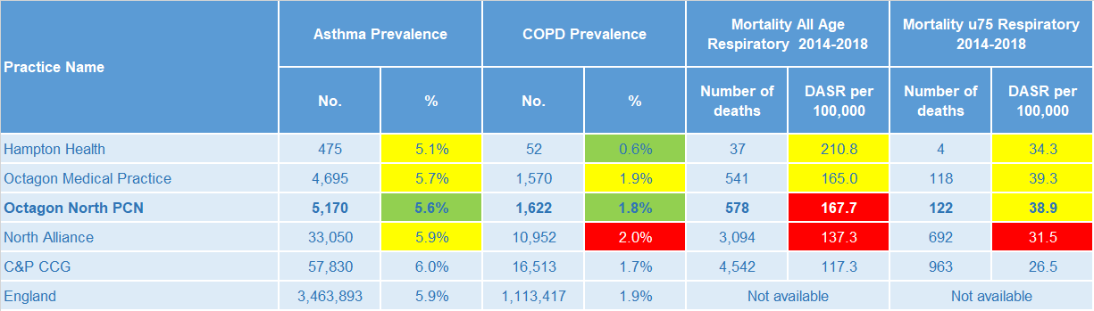
Respiratory disease
Asthma and COPD prevalence are both statistically significantly low in Octagon North PCN compared to North Alliance. Mortality rates for respiratory disease (all age) are statistically significantly worse for Octagon North PCN than the North Alliance and statistically similar for under 75s only.
Note: Prevalence data are not available by age i.e. it is not age weighted so differences may be explained by differing age structures; DASR = Directly age standardised rate per 100,000 population Source: Prevalence (recorded) - C&P PHI from QOF, NHS Digital, 2017/18; Mortality - C&P PHI, from NHS Digital Civil Registration Data and NHS Digital GP registered population data, 2014-2018

Slide 19
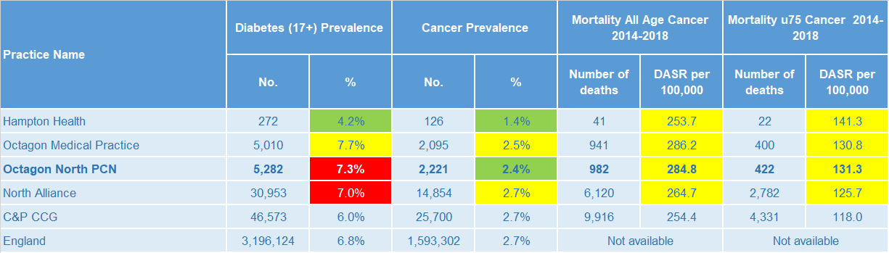
Long term conditions
Diabetes prevalence is statistically significantly high in Octagon North PCN compared to North Alliance, whereas cancer prevalence is statistically significantly low. The PCN has statistically similar all-age and premature cancer mortality rates to the North Alliance.
Note: Prevalence data are not available by age i.e. it is not age weighted so differences may be explained by differing age structures; DASR = Directly age standardised rate per 100,000 population Source: Prevalence (recorded) - C&P PHI from QOF, NHS Digital, 2017/18; Mortality - C&P PHI, from NHS Digital Civil Registration Data and NHS Digital GP registered population data, 2014-2018

Slide 20
Mental health, dementia and learning disability
Octagon North PCN prevalence rates of severe mental illness, depression and dementia are statistically significantly higher than North Alliance and learning disability prevalence is statistically similar to North Alliance average.
Note: Prevalence data are not available by age i.e. it is not age weighted so differences may be explained by differing age structures Source: Prevalence (recorded) - C&P PHI from QOF, NHS Digital, 2017/18

Slide 21
Service provision and utilisation

Slide 22
PCN workforce

Slide 23
Who works within the Health and Social Care services for the PCN?
Patients receive health care from a range of individuals and organisations
103 staff are employed through Octagon North PCN’s Practices. The majority of which will be directly in contact with patients.
Data Sources: Local Authority Data extract; PCN Practice data; CPFT data extract

Slide 24
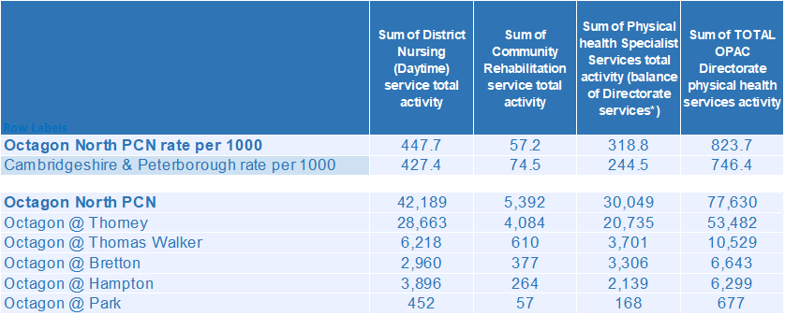
Who works within the Health and Social Care services for the PCN?
Patients receive health care from a range of individuals and organisations
There are currently 77,630 patients under CPFT caseload across the services listed. Caseloads rates for Octagon North PCN are generally higher compared to the rest of Cambridgeshire and Peterborough. Additional patients will be inpatients in rehab wards and part of the multi-disciplinary team caseload. Octagon, Thorney has the highest number of caseloads for Octagon North PCN.
Data Sources: Local Authority Data extract; PCN Practice data; CPFT data extract

Slide 25
Social Care Services

Slide 26
Children’s Social Care
Octagon North PCN has statistically significantly higher rates of social care involvement cases and early help cases than the North Alliance and the education, health and care plans rate is statistically similar to the North Alliance rate. North Alliance has statistically significantly high rates of social care involvement cases, early help cases and education, health and care plans compared to the CCG averages.
Source: Cambridgeshire County Council, BI team. Estimates derived from the LSOA level data, (for those LSOAs in Cambridgeshire or Peterborough only) available as an open data release here: https://data.cambridgeshireinsight.org.uk/dataset/cambridgeshire-and-peterborough-adult-social-care-long-term-service-users-31-march-2019 and GP Registered Population April 2019

Slide 27
Adult Social Care
Octagon North PCN has a statistically similar overall rate of adult social care compared to the North Alliance. North Alliance has a statistically significantly higher overall rate of adult social care compared with the CCG average.
Source: Cambridgeshire County Council, BI team. Estimates derived from the LSOA level data, (for those LSOAs in Cambridgeshire or Peterborough only) available as an open data release here: https://data.cambridgeshireinsight.org.uk/dataset/cambridgeshire-and-peterborough-adult-social-care-long-term-service-users-31-march-2019 and GP Registered Population April 2019

Slide 28
Secondary Care Services

Slide 29
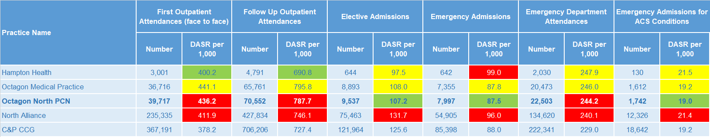
Secondary Care Services
Octagon North PCN has statistically significantly higher rates of first outpatient attendance, follow up outpatient attendances and emergency department attendances than the North Alliance. North Alliance has statistically significantly higher rates of secondary care use compared with the CCG average. A&E Attendances increased 5% year on year. Peterborough and Stamford Hospital saw a 5% increase in attendances from Octagon North PCN residents. Referrals from "Health Care Provider: same or other" increased 56% (1,526) while other referral types either decreased or stayed the same. Ophthalmology and Trauma & Orthopaedics account for the most outpatient attendances. This was the case for both 17/18 and 18/19. Together they make up 24% of the activity for 18/19. The most common elective admissions are for General Surgery, Trauma & Orthopaedics, and Gastroenterology related conditions.
Note: DASR = Directly age standardised rate per 1,000 population, reference population used is the ONS National Standard Population. Source: C&P PHI, from HED Tool, 2018/19; Cambridgeshire and Peterborough “Practice Benchmarker”

Slide 30
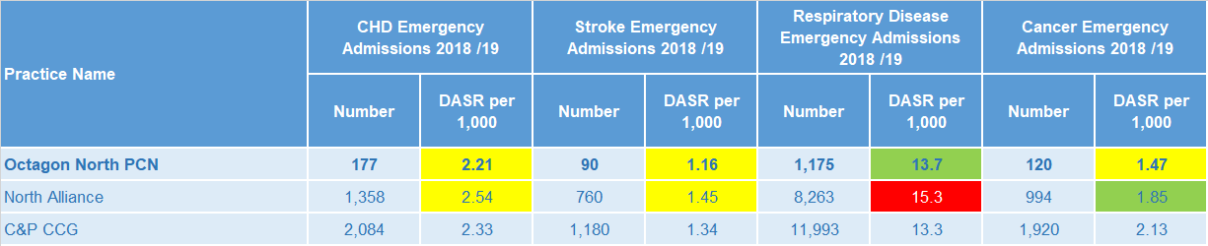
Disease Specific Emergency Hospital Admission Rates
The PCN emergency admission rate for respiratory disease is statistically significantly lower than the North Alliance average. For Octagon North PCN there were 7,825 emergency admissions during 2018/19. The majority of emergency admissions were for Paediatric Medicine. The highest number of primary diagnosis' were for Urinary Tract Infections which increased by 54% year on year. Sepsis, Lower Respiratory Infections, and Pneumonia formed the rest of the top 5 emergency primary diagnoses but these either stayed the same or showed a decrease.
Note: DASR = Directly age standardised rate per 1,000 population, reference population used is the ONS National Standard Population. Source: C&P PHI, from HED Tool, 2018/19, Cambridgeshire and Peterborough “All Trusts 18/19”

Slide 31
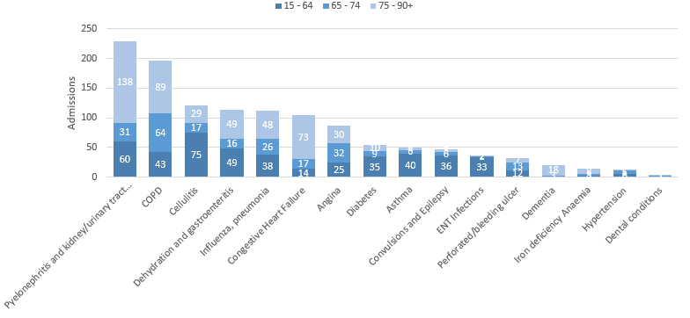
Potentially Avoidable Hospital Admissions
Octagon’s older citizens contribute to their rate of potentially avoidable admissions
Selected Ambulatory Care Sensitive Conditions NEL admissions in 2018/19 by age
There are more potentially avoidable emergency admissions for Octagon North PCN. Although there was a 6% increase for these across Cambridgeshire and Peterborough, year on year ACSC admissions for Octagon increased by 1%.
For 6 of the 7 most common potentially preventable admission types, the majority of admissions are for those aged over 65. Pyelonephritis and kidney/urinary tract infections and COPD were most common for those aged 65 and above.
Cellulitis and Pyelonephritis and kidney/urinary tract infections were also common for the younger age bracket as well as dehydration/ gastroenteritis, COPD, and Asthma.
Data Source: Cambridgeshire and Peterborough “Practice Benchmarker”

Slide 32
Glossary of key methods and terms
To assess statistical significance, 95% confidence intervals are calculated which provide a measure of uncertainty around the calculated value which arises due to random variation. If the confidence interval for a value excludes the value for the relevant benchmark, the difference between the local value and the benchmark is said to be ‘statistically significant’. The following hierarchy of benchmarks has been used in this profile: practice to PCN; PCN to Alliance; Alliance to CCG and CCG to England. The most commonly used RAG-rating in this profile: Exceptions to this are life expectancy which is RAG rated like this: And self-reported limiting long-term illness and general health status which is RAG rated like this: DASR = directly age standardised rate per 100,000 population C&P PHI = Cambridgeshire and Peterborough Public Health Intelligence QOF = Quality Outcomes Framework. Prevalence data are not available by age i.e. it is not age weighted so differences may be explained by differing age structures.

Slide 33
Produced by:
Cambridgeshire and Peterborough Public Health Intelligence Team
Contact:
PHI-team@Cambridgeshire.gov.uk
Date updated:
29th November 2019

