Slide 1
Fenland PCN
Data pack
November 2019

Slide 2
Fenland PCN – summary
There are almost 30,500 people registered with Fenland PCN, with a larger older population compared to the North Alliance, CCG and England. The PCN's registered population is predicted to increase from 30,444 in 2019 to 37,270 in 2036, one of the largest increases (24%) within the CCG The PCN has a higher proportion of White British ethnic group residents when compared to the North Alliance, CCG and England Relative deprivation is higher in the PCN compared to the North Alliance, CCG and England. Approximately 17% of children and 13% of older people live in poverty It is estimated that on average there are approximately 310 births a year in the PCN. Birth rates and the proportion of babies born with a low birth weight are statistically similar to the North Alliance, which in itself has a noticeably high birth rate compared to the CCG It is estimated that male life expectancy in the PCN is statistically similar to the North Alliance average at around 79.8 years and female life expectancy, at 82.8 years, is also statistically similar to the North Alliance average Recorded obesity in adults is statistically significantly higher than the North Alliance in Fenland PCN | It is estimated that 20.1% of adults smoke, which is statistically similar to the North Alliance Estimates of people reporting long-term activity-limiting illness and being in Good or Very Good health are statistically significantly worse than the averages for the North Alliance. On average there are 348 deaths a year in the PCN, with around a third of these in people aged under 75 years The PCN has statistically significantly high recorded prevalence of CHD, hypertension, stroke, asthma, COPD, diabetes, cancer, depression and learning disabilities compared to the North Alliance averages. All cause mortality rates for all ages and under 75s are statistically similar in Fenland PCN to the North Alliance, as are rates of mortality from circulatory disease, respiratory disease and cancer. Fenland PCN has a statistically significantly higher rate of children’s social care involvement cases than the North Alliance. Fenland PCN has a statistically significantly higher overall rate of adult social care when compared to the North Alliance. Fenland PCN has statistically significantly higher rates of secondary care service use than the North Alliance.

Slide 3
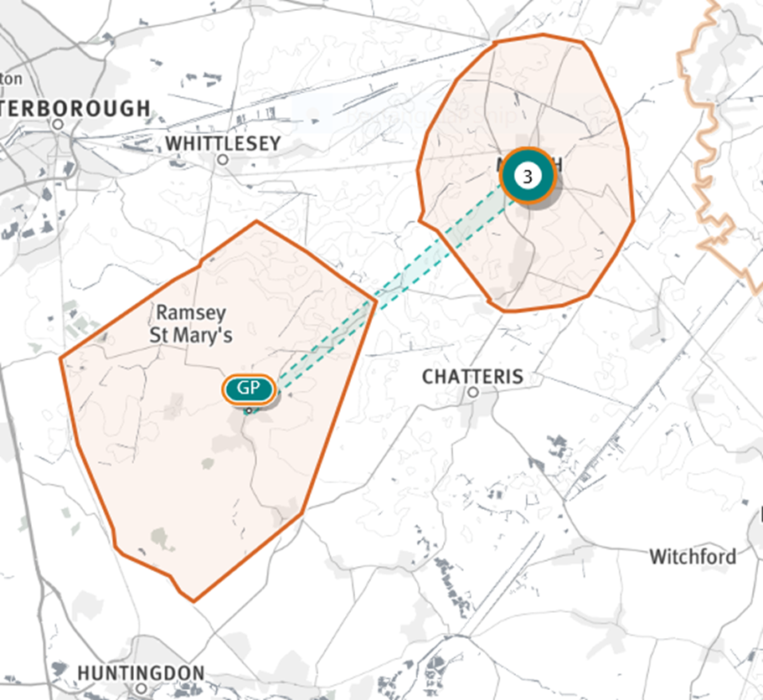
Fenland PCN
Source: Shape Atlas GP registered population, October 2019, NHS Digital.

Slide 4
Demography and key population characteristics

Slide 5
GP registered population
Fenland PCN has a lower proportion of people aged 18 and under and higher proportion aged 65 and over compared with North Alliance, CCG and England.
Source: GP registered population, April 2019, NHS Digital. Population forecasts based on population distribution at ward level (Apr 19), Mid 2015 based population forecasts Cambridgeshire County Council

Slide 6
Population forecasts
The population of Fenland PCN is forecast to grow at a higher rate than the CCG as whole from 2021 onwards. Growth is predicted to be 13.2% from 2019 to 2026, an increase from 30,444 to 34,449. This makes Fenland one of the fastest growing PCNs within C&P CCG.
Source: GP registered population, April 2019, NHS Digital. Population forecasts based on population distribution at ward level (Apr 19), Mid 2015 based population forecasts Cambridgeshire County Council

Slide 7
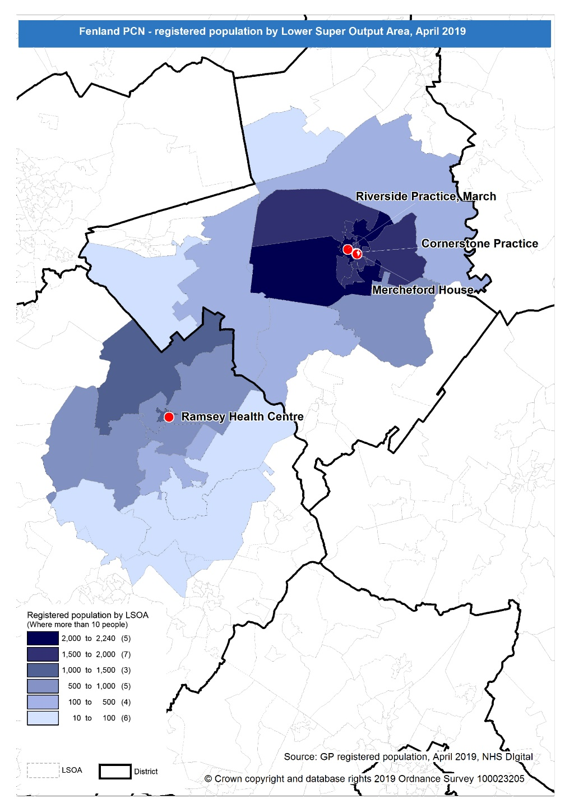
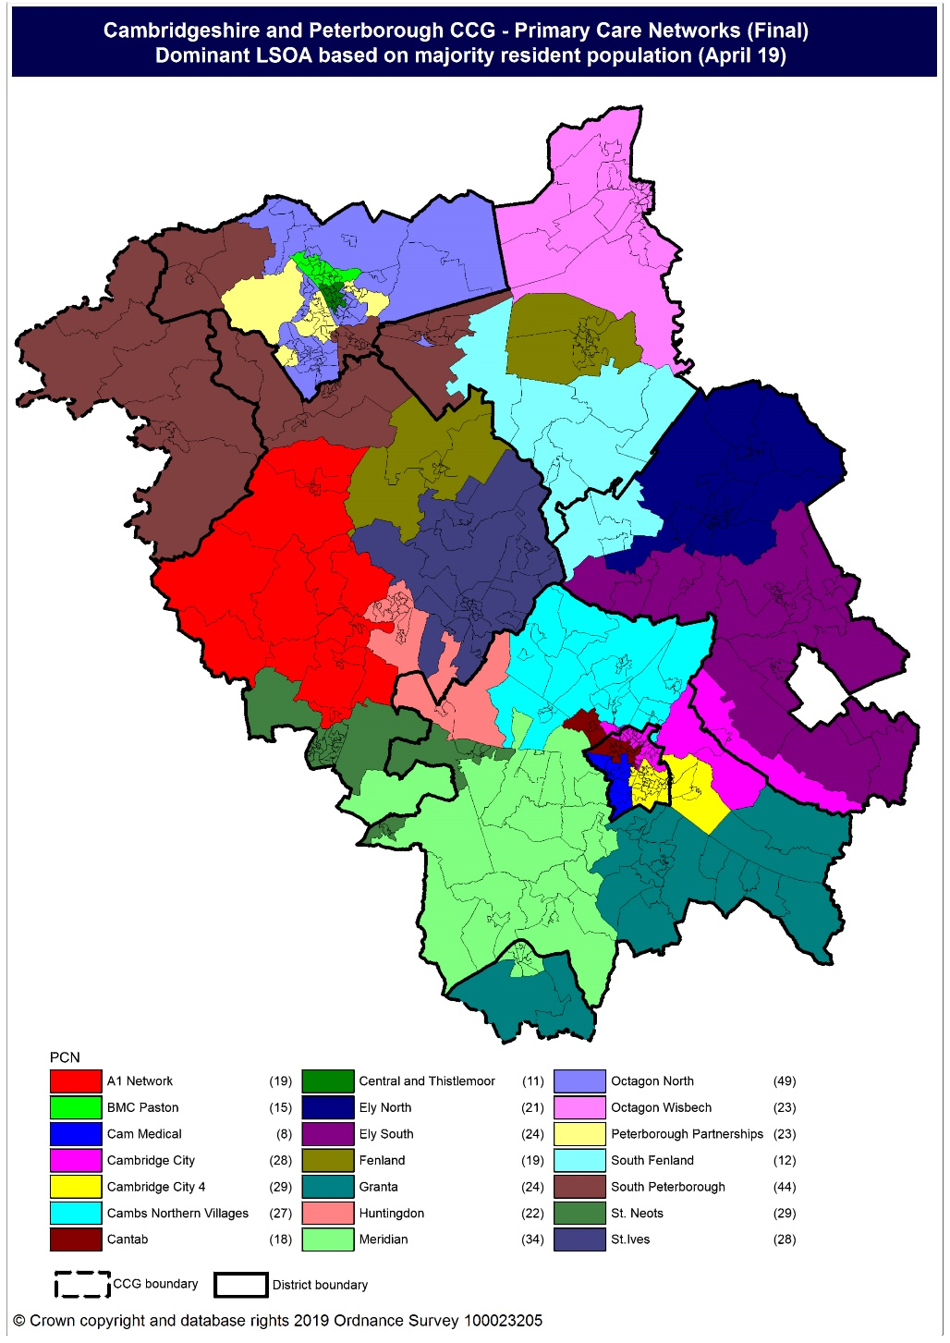
Population distribution
Source: GP registered population data by Lower Super Output Area, April 19, NHS Digital
Population
distribution
PCN dominant
population

Slide 8
Ethnicity
Fenland PCN has a higher proportion of population from the White British ethnic group and lower proportions from other ethnic groups compared to the North Alliance, CCG and England averages.
Source: Census 2011 data applied to GP registered population using Census 2011 ethnic group proportions; England data from NOMIS (patients registered at a GP Practice by LSOA, July 2018, NHS Digital)

Slide 9
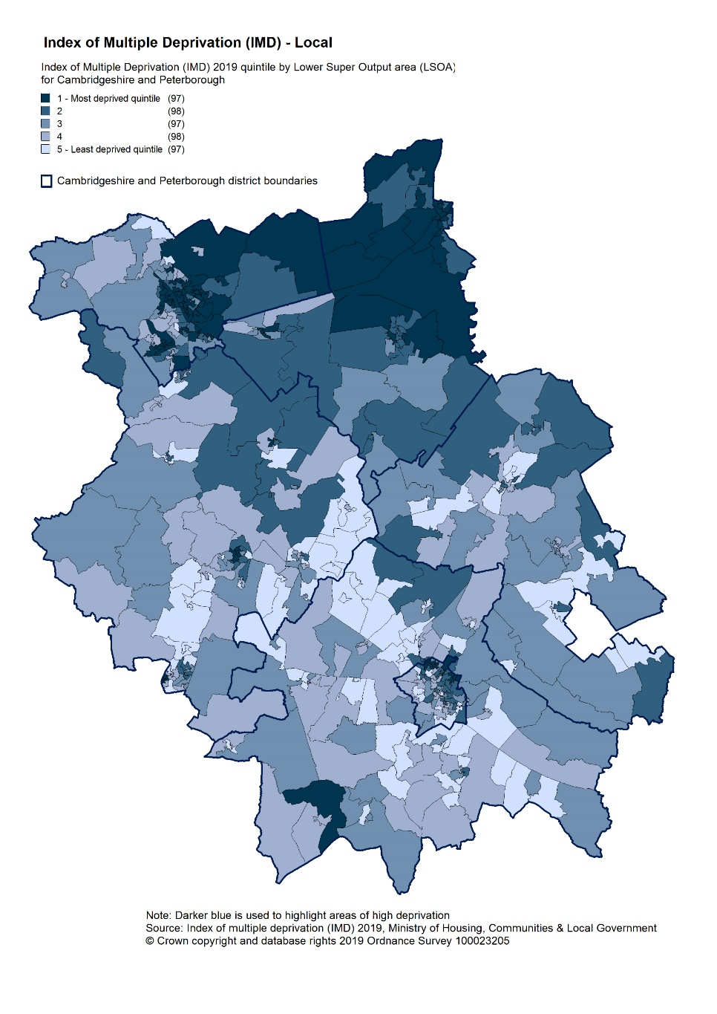
Deprivation
Relative deprivation is approximately similar to that of England but higher than C&P CCG. Approximately 17% of children and 13% of older people live in income deprived households in Fenland PCN; both lower than the England average but above the CCG average.
Source: C&P PHI derived from Indices of Multiple Deprivation 2019, MHCLG and GP registered population data for July 2018. Practice data from PHE Fingertips.
Index of Multiple Deprivation, 2019, by LSOA

Slide 10
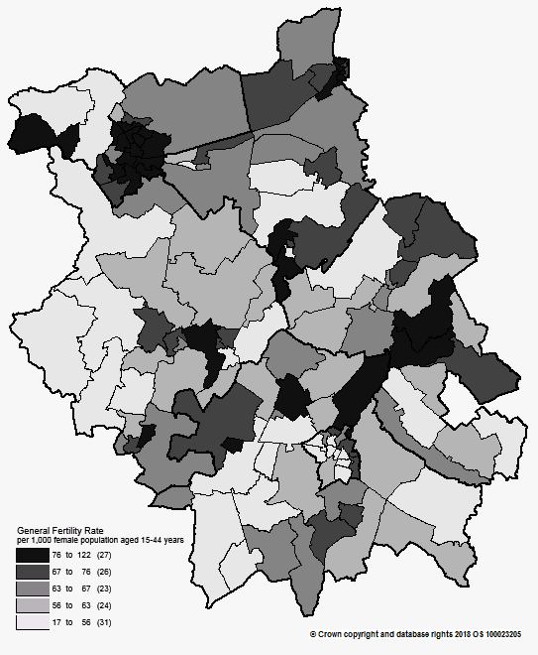
Births and Fertility
Birth rates and low birth weight births in Fenland PCN are statistically similar to the averages for the North Alliance.
Note: Relates to Cambridgeshire and Peterborough residents only Source: C&P PHI based on NHS Digital Civil Registration Data, 2014-2016 and patients registered at a GP Practice by LSOA, July 2018, NHS Digital
Birth rates by ward

Slide 11
Self-reported limiting long-term illness and general health status
It is estimated that the proportion of people that reported that they had a long-term activity-limiting illness in the 2011 Census was statistically significantly higher in Fenland PCN than the North Alliance average. It is estimated that the proportion of people that reported that they were in good or very good health in the 2011 Census was statistically significantly lower in Fenland PCN than the North Alliance average.
Source: C&P PHI from Census 2011, NOMIS and patients registered at a GP Practice by LSOA, July 2018, NHS Digital

Slide 12
Life expectancy
Male and female life expectancy is statistically similar in Fenland PCN to the North Alliance averages. North Alliance male and female life expectancy is statistically significantly lower than the CCG.
Source: C&P PHI based, derived from NHS Digital Civil Registration data and GP registered population data 2013 – 2017

Slide 13
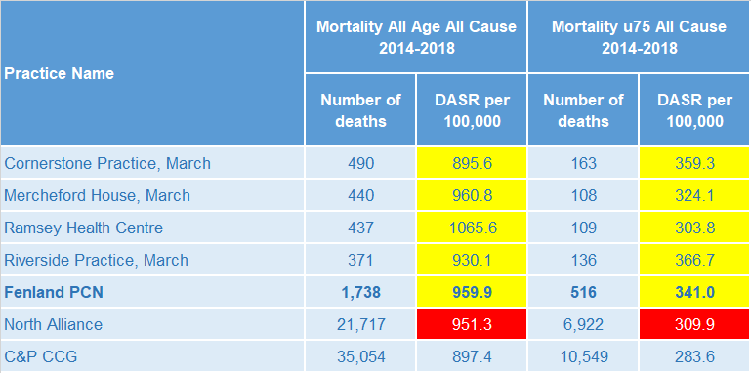
Mortality – all causes
There are on average 349 deaths a year in Fenland PCN, approximately a third are in people aged under 75 years. Cornerstone Practice has a statistically significantly higher under 75 mortality rate compared to North Alliance. All other practice mortality rates are statistically similar to North Alliance.
DASR = directly age standardised rate per 100,000 population Source: C&P PHI, from NHS Digital Civil Registration Data and NHS Digital GP registered population data, 2014-2018

Slide 14
Selected lifestyle behaviour risk factors

Slide 15
Risk factors
Recorded prevalence of obesity is statistically significantly higher in Fenland PCN compared to the average for North Alliance. Estimated smoking prevalence is statistically similar in Fenland PCN to the average for North Alliance.
Source: Obesity - C&P PHI derived from NHS Digital QOF data for 2017/18; Estimated smoking - C&P PHI derived from the QOF based smoking prevalence estimate from the Public Health England (PHE) National General Practice Profiles at https://fingertips.phe.org.uk/profile/general-practice

Slide 16
Prevalence and mortality from principal diseases

Slide 17
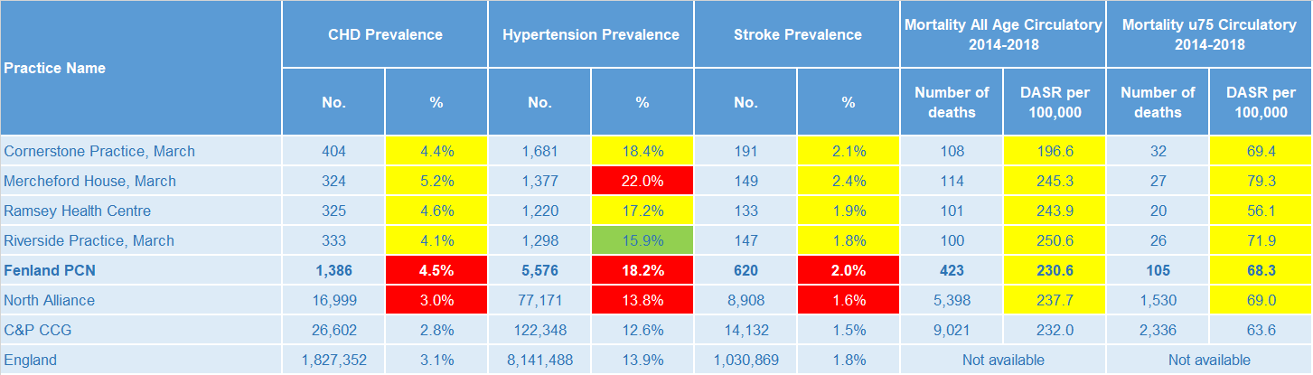
Circulatory disease
Fenland PCN prevalence rates of CHD, hypertension and stroke are statistically significantly high compared to North Alliance. Circulatory disease all-age and under 75 mortality rates for the PCN are statistically similar to North Alliance.
Note: Prevalence data are not available by age i.e. it is not age weighted so differences may be explained by differing age structures; DASR = Directly age standardised rate per 100,000 population Source: Prevalence (recorded) - C&P PHI from QOF, NHS Digital, 2017/18; Mortality - C&P PHI, from NHS Digital Civil Registration Data and NHS Digital GP registered population data, 2014-2018

Slide 18
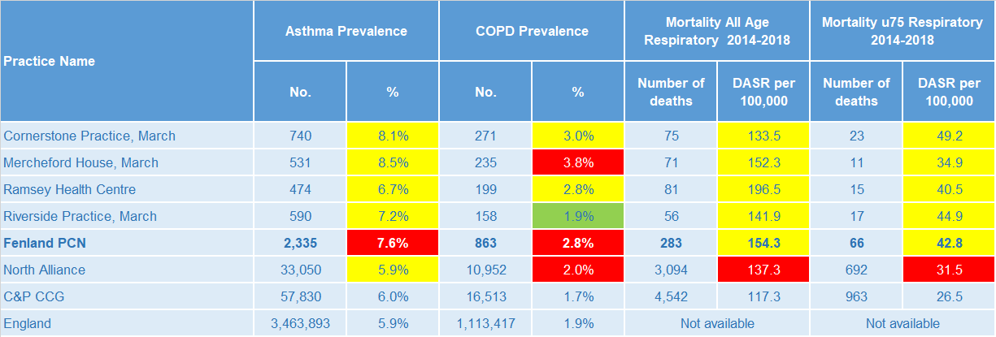
Respiratory disease
Fenland PCN asthma and COPD prevalence rates are statistically significantly higher than the North Alliance average. PCN mortality rates for respiratory diseases, for people of all ages and under 75 years, are statistically similar to North Alliance.
Note: Prevalence data are not available by age i.e. it is not age weighted so differences may be explained by differing age structures; DASR = Directly age standardised rate per 100,000 population Source: Prevalence (recorded) - C&P PHI from QOF, NHS Digital, 2017/18; Mortality - C&P PHI, from NHS Digital Civil Registration Data and NHS Digital GP registered population data, 2014-2018

Slide 19
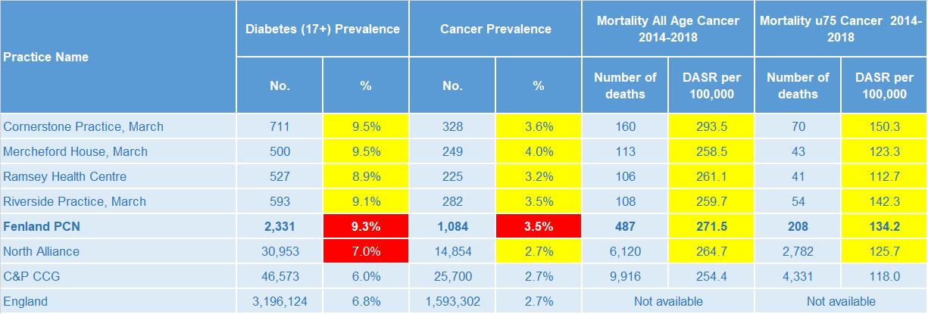
Long term conditions
PCN diabetes and cancer prevalence rates are statistically significantly higher than the North Alliance. The PCN has statistically similar all-age and premature cancer mortality rates to the North Alliance.
Note: Prevalence data are not available by age i.e. it is not age weighted so differences may be explained by differing age structures; DASR = Directly age standardised rate per 100,000 population Source: Prevalence (recorded) - C&P PHI from QOF, NHS Digital, 2017/18; Mortality - C&P PHI, from NHS Digital Civil Registration Data and NHS Digital GP registered population data, 2014-2018

Slide 20
Mental health, dementia and learning disability
Fenland PCN prevalence rates of mental health conditions and dementia are statistically similar to North Alliance averages, whereas prevalence of depression and learning disabilities are statistically significantly higher than the North Alliance.
Note: Prevalence data are not available by age i.e. it is not age weighted so differences may be explained by differing age structures Source: Prevalence (recorded) - C&P PHI from QOF, NHS Digital, 2017/18

Slide 21
Service provision and utilisation

Slide 22
PCN workforce

Slide 23
Who works within the Health and Social Care services for the PCN?
Patients receive health care from a range of individuals and organisations
116 staff are employed through Fenland PCN’s practices; the majority of which will be directly in contact with patients.
Data Sources: Local Authority Data extract; PCN Practice data; CPFT data extract

Slide 24
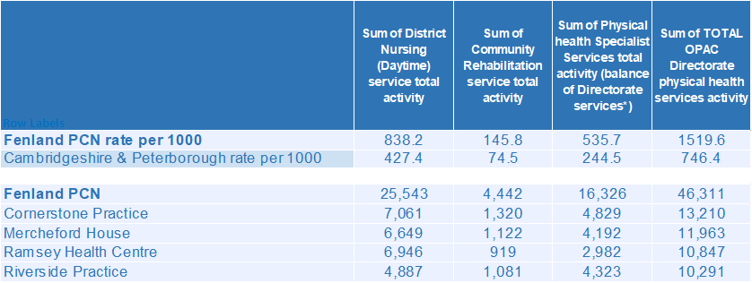
Who works within the Health and Social Care services for the PCN?
Patients receive health care from a range of individuals and organisations
There are currently 46,311 patients under CPFT caseload across the services listed. Caseloads rates for Fenland PCN are higher compared to the rest of Cambridgeshire and Peterborough. Additional patients will be inpatients in rehab wards and part of the multi-disciplinary team caseload. Cornerstone Practice has the highest number of caseloads for Fenland PCN.
Data Sources: Local Authority Data extract; PCN Practice data; CPFT data extract

Slide 25
Social Care Services

Slide 26
Children’s Social Care
Fenland PCN has a statistically significantly higher rate of children’s social care involvement cases than the North Alliance. The early help cases and education, health and care plan rates are statistically similar to the North Alliance. North Alliance has statistically significantly higher rates of social care involvement cases, early help cases and education, health and care plans when compared to the CCG average.
Source: Cambridgeshire County Council, BI team. Estimates derived from the LSOA level data, (for those LSOAs in Cambridgeshire or Peterborough only) available as an open data release here: https://data.cambridgeshireinsight.org.uk/dataset/cambridgeshire-and-peterborough-adult-social-care-long-term-service-users-31-march-2019 and GP Registered Population April 2019

Slide 27
Adult Social Care
Fenland PCN has a statistically significantly higher overall rate of adult social care usage when compared to the North Alliance. North Alliance has a statistically significantly higher overall rate of adult social care usage when compared with the CCG average.
Source: Cambridgeshire County Council, BI team. Estimates derived from the LSOA level data, (for those LSOAs in Cambridgeshire or Peterborough only) available as an open data release here: https://data.cambridgeshireinsight.org.uk/dataset/cambridgeshire-and-peterborough-adult-social-care-long-term-service-users-31-march-2019 and GP Registered Population April 2019

Slide 28
Secondary Care Services

Slide 29
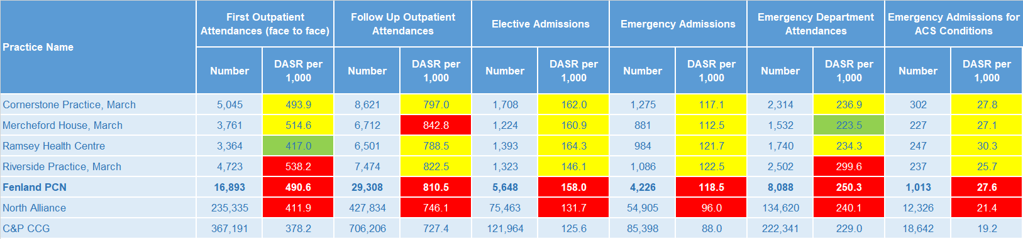
Secondary Care Services
Mercheford House practice follow up outpatient attendances rate is statistically significantly higher than the PCN. Riverside Practice first outpatient attendance and emergency department attendance rates are statistically significantly higher than the Fenland PCN averages. Fenland PCN has statistically significantly higher rates of secondary care service use than the North Alliance. North Alliance has statistically significantly high rates of secondary care service use compared with the CCG average. Ophthalmology and Trauma & Orthopaedics account for the most outpatient attendances. This was the case for both 17/18 and 18/19. Together they make up 26% of the activity for 18/19. 8% of first outpatient attendances are sight related. The most common elective admissions are for Gastroenterology, General Surgery, and Trauma & Orthopaedics.
Note: DASR = Directly age standardised rate per 1,000 population, reference population used is the ONS National Standard Population. Source: C&P PHI, from HED Tool, 2018/19, Cambridgeshire and Peterborough “Practice Benchmarker”

Slide 30
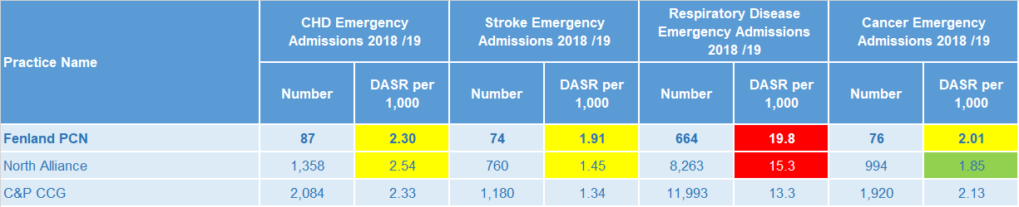
Disease Specific Emergency Hospital Admission Rates
The PCN emergency admission rates for respiratory disease is statistically significantly higher than the North Alliance average. For Fenland PCN there were 4,080 emergency admissions during 2018/19. All 4 practices had a higher admission rate than Cambridgeshire and Peterborough. Pneumonia, Unspecified Acute Lower Respiratory Infections, Urinary Tract Infections, and Sepsis are the four most prevalent primary diagnoses. The fifth highest number of emergency admissions were COPD related.
Note: DASR = Directly age standardised rate per 1,000 population, reference population used is the ONS National Standard Population. Source: C&P PHI, from HED Tool, 2018/19, Cambridgeshire and Peterborough “All Trusts 18/19”

Slide 31
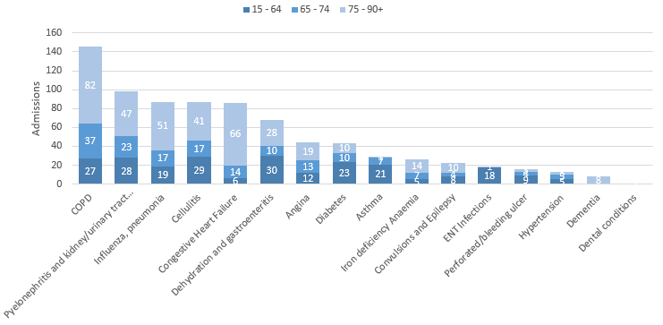
Potentially Avoidable Hospital Admissions
Having an older population has contributed to Fenland PCN having a high number of potentially avoidable admissions
Selected Ambulatory Care Sensitive Conditions NEL admissions in 2018/19 by age
There was a 6% increase for potentially avoidable emergency admissions across Cambridgeshire and Peterborough. ACSC admissions for Fenland PCN increased 11%. All 4 practices had a higher rate of ACSC admissions compared to the Cambridgeshire and Peterborough area.
Influenza pneumonia, COPD, Pyelonephritis and kidney/urinary tract infections, Dehydration/gastroenteritis, and Congestive Heart Failure were most common for the older age bands.
Dehydration/gastroenteritis, Cellulitis, and Diabetes were the most common condition for the younger age bracket. This is closely followed by Convulsions and Epilepsy.
Data Source: Cambridgeshire and Peterborough “Practice Benchmarker”

Slide 32
Glossary of key methods and terms
To assess statistical significance, 95% confidence intervals are calculated which provide a measure of uncertainty around the calculated value which arises due to random variation. If the confidence interval for a value excludes the value for the relevant benchmark, the difference between the local value and the benchmark is said to be ‘statistically significant’. The following hierarchy of benchmarks has been used in this profile: practice to PCN; PCN to Alliance; Alliance to CCG and CCG to England. The most commonly used RAG-rating in this profile: Exceptions to this are life expectancy which is RAG rated like this: And self-reported limiting long-term illness and general health status which is RAG rated like this: DASR = directly age standardised rate per 100,000 population C&P PHI = Cambridgeshire and Peterborough Public Health Intelligence QOF = Quality Outcomes Framework. Prevalence data are not available by age i.e. it is not age weighted so differences may be explained by differing age structures.

Slide 33
Produced by:
Cambridgeshire and Peterborough Public Health Intelligence Team
Contact:
PHI-team@Cambridgeshire.gov.uk
Date updated:
29th November 2019

