Slide 1
Cambridge City 4 PCN
Data pack
November 2019

Slide 2
Cambridge City 4 PCN – summary
There are 56,400 people registered with Cambridge City 4 PCN, with a higher proportion aged 16-64 and lower proportions aged 65+ Cambridge City 4 PCN has a lower proportion of White British population compared to South Alliance and C&P CCG and higher proportions of all other ethnic groups Relative deprivation is lower in Cambridge City 4 PCN than in C&P CCG and England. Approximately 9% of children and 10% of older people live in poverty On average there are around 530 births a year in the PCN. The birth rate in Cambridge City 4 PCN is statistically significantly lower than the average for the South Alliance. The low birth weight proportion is statistically similar to the South Alliance Life expectancy is statistically significantly lower than the South Alliance for both males and females in Cambridge City 4 PCN Recorded obesity in adults is statistically significantly lower in Cambridge City 4 than the South Alliance It is estimated that 13.6% of adults smoke, which is statistically similar to the South Alliance | Estimates of people reporting long-term activity-limiting illness and being in Good or Very Good health are statistically similar to the averages for the South Alliance On average, there are around 362 deaths a year in the PCN, with around a quarter of these in people aged under 75 years The PCN has statistically significantly low recorded prevalence of a number of conditions compared to the South Alliance, including CHD, hypertension, stroke, asthma, COPD, diabetes and dementia All age, all cause mortality rate is statistically significantly higher than South Alliance in Cambridge City 4 PCN. Prevalence of serious mental illness is statistically significantly higher than the South Alliance. Children’s social care rates are statistically similar to the South Alliance. Overall adult social care rates are statistically similar to the South Alliance. The rates of secondary care services used are statistically significantly higher than the South Alliance except the rate of emergency admissions for ACS conditions which is statistically similar to the South Alliance.

Slide 3
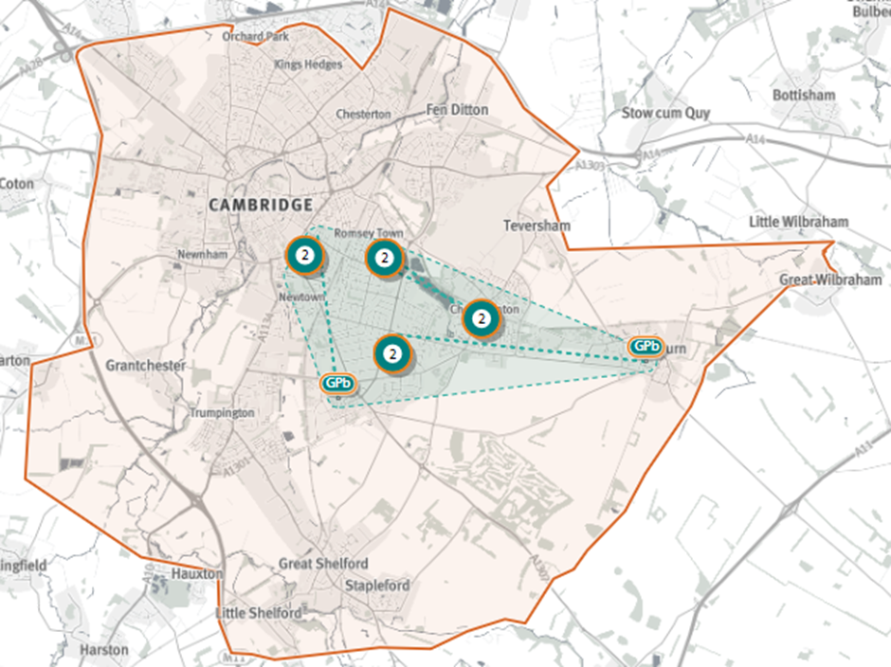
Cambridge City 4 PCN
Source: Shape Atlas GP registered population, October 2019, NHS Digital.

Slide 4
Demography and key population characteristics

Slide 5
GP registered population
Cambridge City 4 PCN has very similar proportions of patients aged under 18 years to the South Alliance, with a higher proportion aged 16-64 and lower proportions aged 65+.
Source: GP registered population, April 2019, NHS Digital. Population forecasts based on population distribution at ward level (Apr 19), Mid 2015 based population forecasts Cambridgeshire County Council

Slide 6
Population forecasts
The population of Cambridge City 4 PCN is forecast to grow at a lower rate than the CCG between 2021 and 2031 and it is estimated to grow by 9.1% between 2019 and 2026.
Source: GP registered population, April 2019, NHS Digital. Population forecasts based on population distribution at ward level (Apr 19), Mid 2015 based population forecasts Cambridgeshire County Council

Slide 7
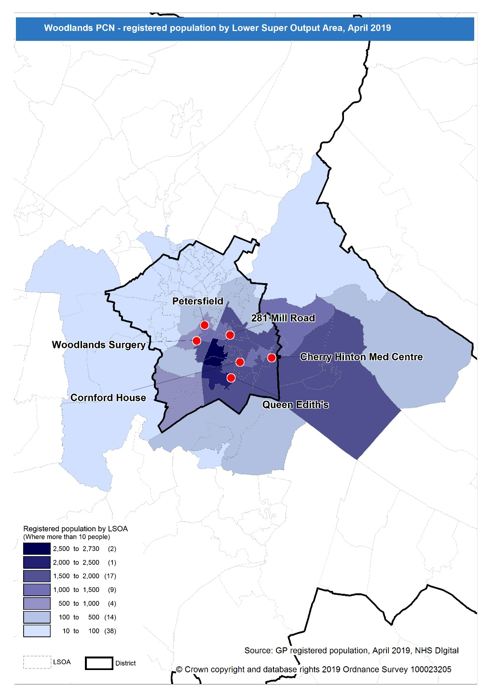
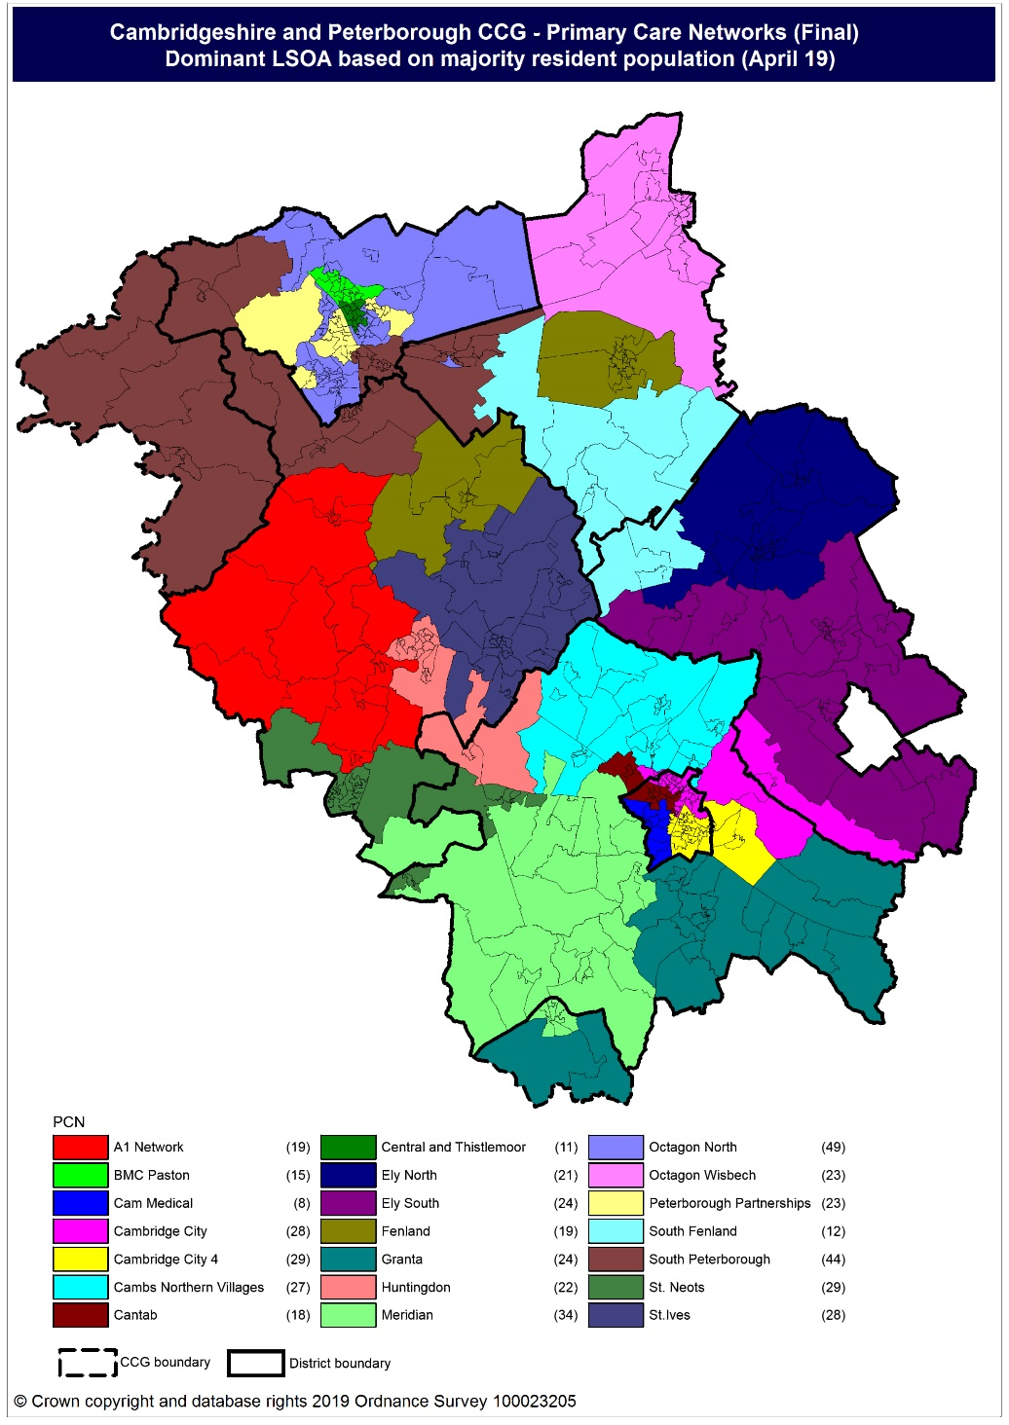
Population distribution
Source: GP registered population data by Lower Super Output Area, April 19, NHS Digital
Population
distribution
PCN dominant
population

Slide 8
Ethnicity
Cambridge City 4 PCN has a lower proportion of White British population and higher proportions of all other ethnic groups compared to South Alliance and C&P CCG .
Source: Census 2011 data applied to GP registered population using Census 2011 ethnic group proportions; England data from NOMIS (patients registered at a GP Practice by LSOA, July 2018, NHS Digital)

Slide 9
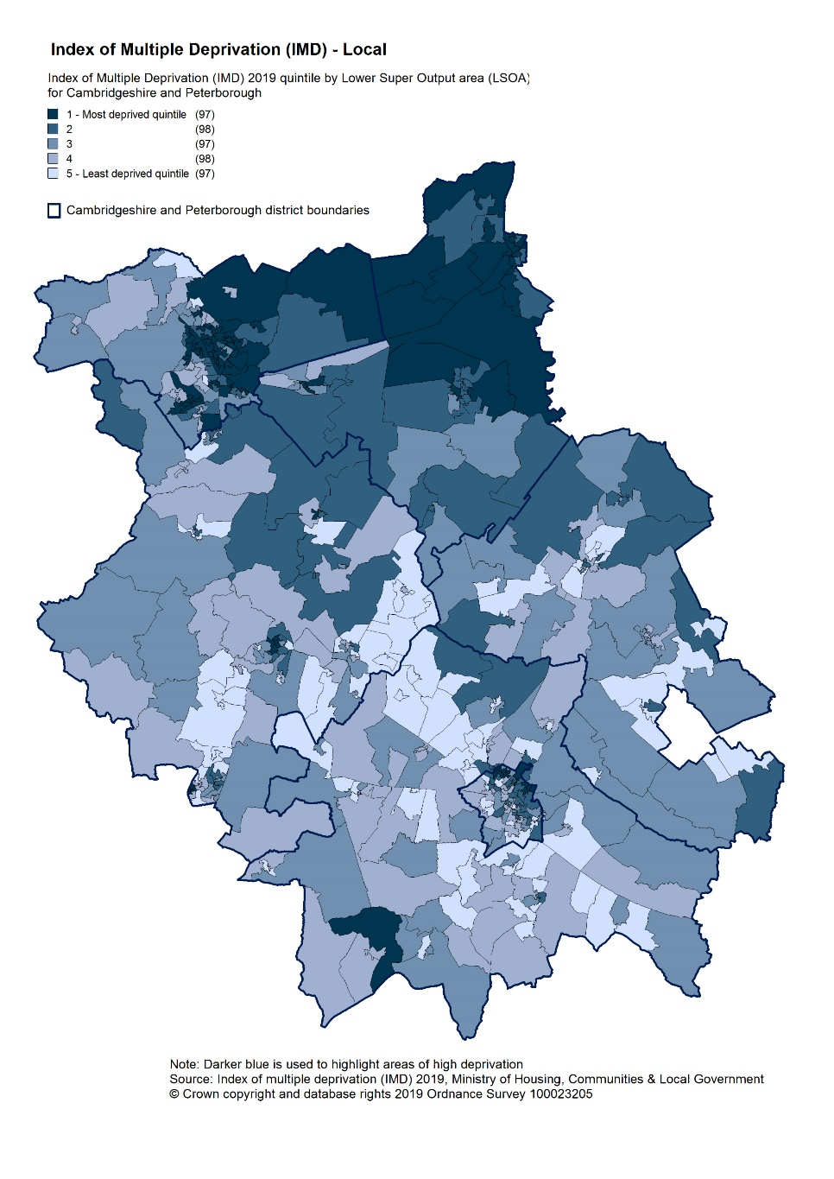
Deprivation
Relative deprivation is lower in Cambridge City 4 PCN than in C&P CCG and England. Approximately 9.1% of children and 10.1% of older people live in poverty.
Source: C&P PHI derived from Indices of Multiple Deprivation 2019, MHCLG and GP registered population data for July 2018. Practice data from PHE Fingertips.
Index of Multiple Deprivation, 2019, by LSOA

Slide 10
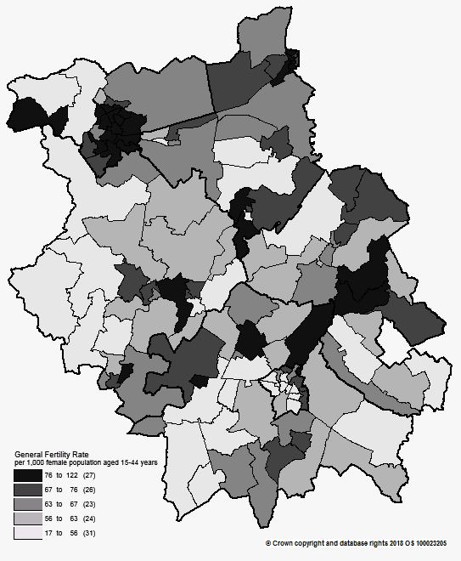
Births and Fertility
Birth rates in Cambridge City 4 PCN are statistically significantly lower than the average for the South Alliance. The low birth weight proportion is statistically similar to the South Alliance.
Note: Relates to Cambridgeshire and Peterborough residents only Source: C&P PHI based on NHS Digital Civil Registration Data, 2014-2016 and patients registered at a GP Practice by LSOA, July 2018, NHS Digital
Birth rates by ward

Slide 11
Self-reported limiting long-term illness and general health status
It is estimated that the proportion of people that reported that they had a long-term activity-limiting illness in the 2011 Census was statistically similar in Cambridge City 4 PCN compared to the South Alliance average It is estimated that the proportion of people that reported that they were in good or very good health in the 2011 Census was also statistically similar in Cambridge City 4 PCN compared to the South Alliance average
Source: C&P PHI from Census 2011, NOMIS and patients registered at a GP Practice by LSOA, July 2018, NHS Digital

Slide 12
Life expectancy
Male and female life expectancies in Cambridge City 4 PCN are statistically significantly low compared to the life expectancies for the South Alliance
Source: C&P PHI based, derived from NHS Digital Civil Registration data and GP registered population data 2013 – 2017

Slide 13
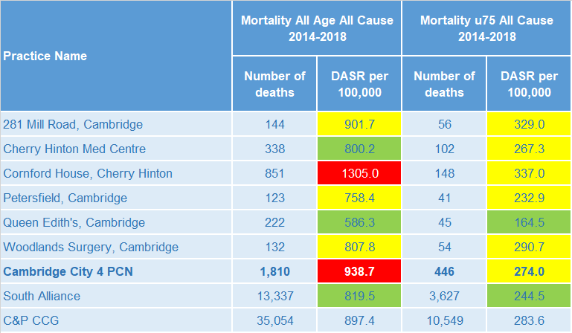
Mortality – all causes
There have been on average 362 deaths a year in Cambridge City 4 PCN, approximately a quarter are in people aged under 75 years. All age, all cause mortality rates for the PCN are statistically significantly higher than the South Alliance average.
DASR = directly age standardised rate per 100,000 population Source: C&P PHI, from NHS Digital Civil Registration Data and NHS Digital GP registered population data, 2014-2018

Slide 14
Selected lifestyle behaviour risk factors

Slide 15
Risk factors
Recorded prevalence of obesity is statistically significantly lower in Cambridge City 4 PCN compared to the average for South Alliance Estimated smoking prevalence is statistically similar in Cambridge City 4 PCN compared to the average for South Alliance
Source: Obesity - C&P PHI derived from NHS Digital QOF data for 2017/18; Estimated smoking - C&P PHI derived from the QOF based smoking prevalence estimate from the Public Health England (PHE) National General Practice Profiles at https://fingertips.phe.org.uk/profile/general-practice

Slide 16
Prevalence and mortality from principal diseases

Slide 17
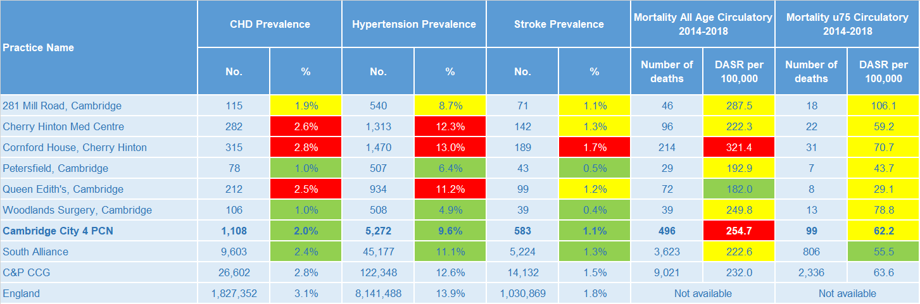
Circulatory disease
The prevalence rates of CHD, hypertension and stroke in Cambridge City 4 PCN are statistically significantly low compared to South Alliance. The Cambridge City 4 PCN all age mortality rate from circulatory disease is statistically significantly higher than the South Alliance average.
Note: Prevalence data are not available by age i.e. it is not age weighted so differences may be explained by differing age structures; DASR = Directly age standardised rate per 100,000 population Source: Prevalence (recorded) - C&P PHI from QOF, NHS Digital, 2017/18; Mortality - C&P PHI, from NHS Digital Civil Registration Data and NHS Digital GP registered population data, 2014-2018

Slide 18
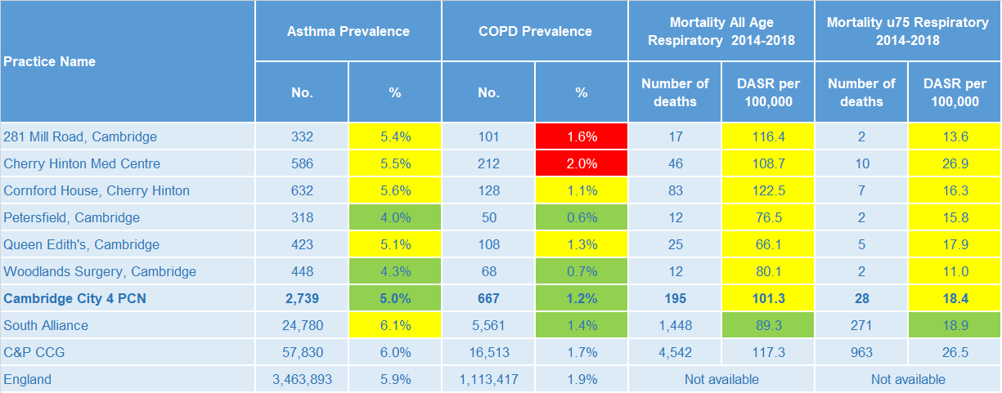
Respiratory disease
Asthma and COPD prevalence is statistically significantly low in Cambridge City 4 PCN compared to the South Alliance, whereas mortality rates for all ages and under 75 years as a result of respiratory diseases are statistically similar to the South Alliance.
Note: Prevalence data are not available by age i.e. it is not age weighted so differences may be explained by differing age structures; DASR = Directly age standardised rate per 100,000 population Source: Prevalence (recorded) - C&P PHI from QOF, NHS Digital, 2017/18; Mortality - C&P PHI, from NHS Digital Civil Registration Data and NHS Digital GP registered population data, 2014-2018

Slide 19
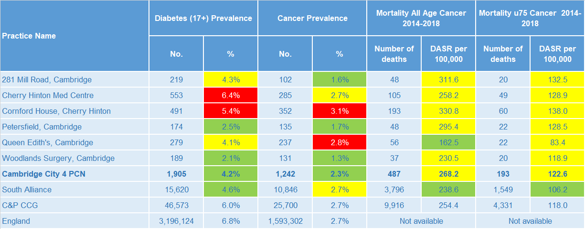
Long term conditions
Cambridge City 4 diabetes and cancer prevalence rates are statistically significantly lower than the South Alliance. Mortality rates from cancer (all age and under 75 only) are statistically similar to South Alliance averages.
Note: Prevalence data are not available by age i.e. it is not age weighted so differences may be explained by differing age structures; DASR = Directly age standardised rate per 100,000 population Source: Prevalence (recorded) - C&P PHI from QOF, NHS Digital, 2017/18; Mortality - C&P PHI, from NHS Digital Civil Registration Data and NHS Digital GP registered population data, 2014-2018

Slide 20
Mental health, dementia and learning disability
Cambridge City 4 PCN has a statistically significantly high prevalence of serious mental illness and a statistically significantly low prevalence of dementia compared to the South Alliance. Depression and learning disability prevalence is statistically similar.
Note: Prevalence data are not available by age i.e. it is not age weighted so differences may be explained by differing age structures Source: Prevalence (recorded) - C&P PHI from QOF, NHS Digital, 2017/18

Slide 21
Service provision and utilisation

Slide 22
PCN workforce

Slide 23
Who works within the Health and Social Care services for the PCN?
Patients receive health care from a range of individuals and organisations
130 staff are employed through Cambridge City 4 PCN’s practices, the majority of which will be directly in contact with patients.
Data Sources: Local Authority Data extract; PCN Practice data; CPFT data extract

Slide 24
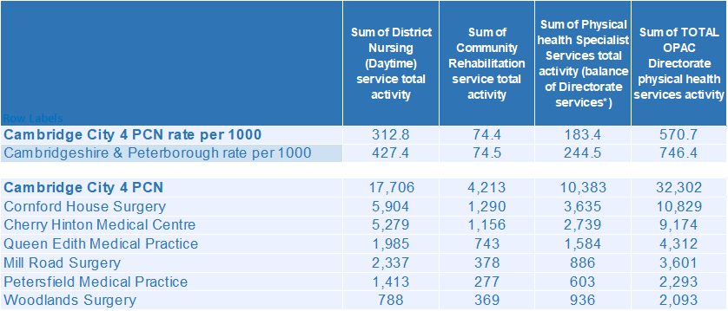
Who works within the Health and Social Care services for the PCN?
Patients receive health care from a range of individuals and organisations
There are currently 32,302 patients under CPFT caseload across the services listed. Caseloads rates for Cambridge City 4 PCN are lower compared to the rest of Cambridgeshire and Peterborough. Additional patients will be inpatients in rehab wards and part of the multi-disciplinary team caseload. Cornford House Surgery has the highest number of caseloads for Cambridge City 4 PCN.
Data Sources: Local Authority Data extract; PCN Practice data; CPFT data extract

Slide 25
Social Care Services

Slide 26
Children’s Social Care
It is estimated that the South Alliance has statistically significantly low rates of social care involvement cases, early help cases and education, health and care plans compared to the CCG average. The Cambridge City 4 PCN has statistically similar rates of social care involvement cases, early help cases and education, health and care plans compared to the South Alliance.
Source: Cambridgeshire County Council, BI team. Estimates derived from the LSOA level data, (for those LSOAs in Cambridgeshire or Peterborough only) available as an open data release here: https://data.cambridgeshireinsight.org.uk/dataset/cambridgeshire-and-peterborough-adult-social-care-long-term-service-users-31-march-2019 and GP Registered Population April 2019

Slide 27
Adult Social Care
Overall adult social care rates for Cambridge City 4 PCN are statistically similar to the South Alliance. Overall adult social care rates for South Alliance are statistically significantly lower than the CCG rates.
Source: Cambridgeshire County Council, BI team. Estimates derived from the LSOA level data, (for those LSOAs in Cambridgeshire or Peterborough only) available as an open data release here: https://data.cambridgeshireinsight.org.uk/dataset/cambridgeshire-and-peterborough-adult-social-care-long-term-service-users-31-march-2019 and GP Registered Population April 2019

Slide 28
Secondary Care Services

Slide 29
Secondary Care Services
. Cambridge City 4 PCN has statistically significantly higher rates of secondary care use than the South Alliance; The rate of emergency admissions for ACS conditions is statistically similar to the South Alliance. Rates of overall secondary care services for the South Alliance is statistically significantly lower than the CCG. Type 1 A&E Attendances increased 3% year on year. Cambridge University Hospitals saw a 4% increase in attendances from Cambridge City 4 PCN citizens. Referrals from “Health Care Provider” more than doubled and GP referrals increased 20% while the majority of other referral types showed no significant change. Clinical Physiology and Ophthalmology account for the most outpatient attendances. This was the case for both 17/18 and 18/19. Together they make up 20% of the activity for 18/19. 8% of first outpatient attendances are sight related. The most common elective admissions are for Gastroenterology, Medical Oncology, and Clinical Haematology.
Note: DASR = Directly age standardised rate per 1,000 population, reference population used is the ONS National Standard Population. Source: C&P PHI, from HED Tool, 2018/19, Cambridgeshire and Peterborough “Practice Benchmarker”

Slide 30
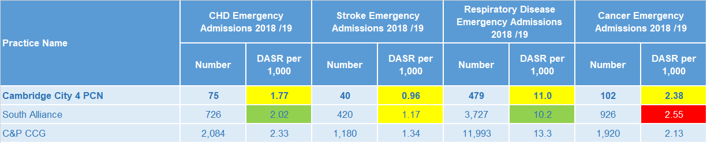
Disease Specific Emergency Hospital Admission Rates
The PCN disease specific emergency admission rates shown are statistically similar to the South Alliance average. For Cambridge City 4 PCN there were 3,755 emergency admissions during 2018/19. 2 of the 6 practices had a higher admission rate than Cambridgeshire and Peterborough. Lobar Pneumonia, Sepsis, and Urinary Tract Infections are the three most prevalent primary diagnoses. The fifth highest number of emergency admissions were related to chest pains (the second highest was uncoded).
Note: DASR = Directly age standardised rate per 1,000 population, reference population used is the ONS National Standard Population. Source: C&P PHI, from HED Tool, 2018/19, Cambridgeshire and Peterborough “All Trusts 18/19”

Slide 31
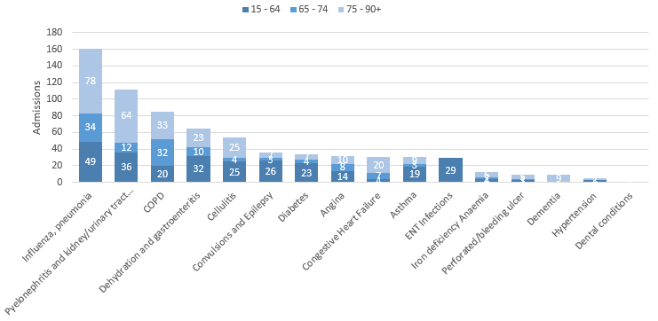
Potentially Avoidable Hospital Admissions
Cambridge City 4 PCN has a lower proportion of those aged over 65 compared to the rest of the South Alliance but those aged over 65 still contribute more to the potentially avoidable admissions
Selected Ambulatory Care Sensitive Conditions NEL admissions in 2018/19 by age
There was a 6% increase for potentially avoidable emergency admissions across Cambridgeshire and Peterborough. The number of ACSC admissions for Cambridge City 4 PCN increased by 1 during 18/19.
Those aged over 65 account for most of the potentially preventable (ACSC) related admissions during 18/19. This is despite having a lower proportion of those aged over 65 compared to the South Alliance.
Influenza, Pyelonephritis and kidney/urinary tract infections, and Dehydration and Gastroenteritis were most common for the younger bracket.
Data Source: Cambridgeshire and Peterborough “Practice Benchmarker”

Slide 32
Glossary of key methods and terms
To assess statistical significance, 95% confidence intervals are calculated which provide a measure of uncertainty around the calculated value which arises due to random variation. If the confidence interval for a value excludes the value for the relevant benchmark, the difference between the local value and the benchmark is said to be ‘statistically significant’. The following hierarchy of benchmarks has been used in this profile: practice to PCN; PCN to Alliance; Alliance to CCG and CCG to England. The most commonly used RAG-rating in this profile: Exceptions to this are life expectancy which is RAG rated like this: And self-reported limiting long-term illness and general health status which is RAG rated like this: DASR = directly age standardised rate per 100,000 population C&P PHI = Cambridgeshire and Peterborough Public Health Intelligence QOF = Quality Outcomes Framework. Prevalence data are not available by age i.e. it is not age weighted so differences may be explained by differing age structures.

Slide 33
Produced by:
Cambridgeshire and Peterborough Public Health Intelligence Team
Contact:
PHI-team@Cambridgeshire.gov.uk
Date updated:
29th November 2019

