Slide 1
Cam Medical PCN
Data pack
November 2019

Slide 2
Cam Medical PCN – summary
There are almost 46,500 people registered with Cam Medical PCN, with lower proportions of the population over 65 and under 18 compared to the South Alliance, CCG and England. The population is estimated to increase by almost 4.8% between 2021 and 2036. The PCN has a lower proportion of White British ethnic group compared to the South Alliance, CCG and England Relative deprivation is lower for the PCN compared to the South Alliance, CCG and England. Approximately 8.1% of children and 8.9% of older people live in poverty On average there are around 273 births a year in the PCN. The birth rate in Cam Medical PCN is statistically significantly lower than the average for the South Alliance. The low birth weight proportion is statistically similar to the South Alliance. It is estimated that male life expectancy is around 84.4 years in the PCN and female life expectancy 87.4 years, both statistically significantly higher than the South Alliance average Recorded obesity in adults is statistically significantly lower than the South Alliance It is estimated that 7.2% of adults smoke, which is statistically significantly lower than the South Alliance | Estimates of people reporting long-term activity-limiting illness and being in Good or Very Good health are statistically significantly better than the averages for the South Alliance. On average, there are around 135 deaths a year in the PCN, with around a fourth of these in people aged under 75 years. The PCN has statistically significantly low recorded prevalence of CHD, hypertension, stroke, asthma, COPD, diabetes and cancer compared to the South Alliance averages The PCN has statistically significantly lower all-age and premature all cause mortality rates compared to South Alliance. PCN all-age and premature mortality rates for circulatory disease, respiratory disease and cancer are statistically similar to South Alliance. Serious Mental Illness, Depression, Dementia and Learning Disability prevalence is statistically significantly lower than the South Alliance. Children’s social care involvement cases and early help cases are statistically similar to the South Alliance; Education, health and care plans rate is statistically significantly lower than the South Alliance. Overall adult social care usage rates are statistically significantly lower than the South Alliance.

Slide 3
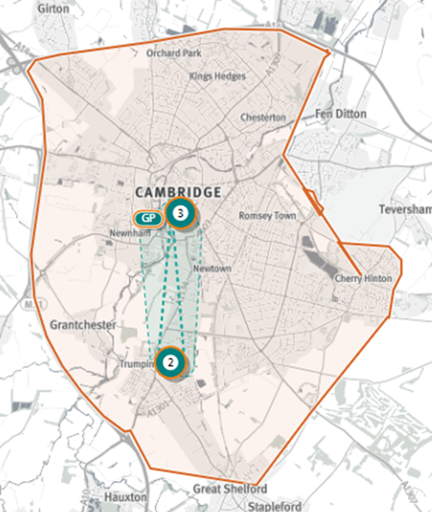
Cam Medical PCN
Source: Shape Atlas GP registered population, October 2019, NHS Digital.

Slide 4
Demography and key population characteristics

Slide 5
GP registered population
Cam Medical Network PCN has lower proportions of people aged under 18 and over 65 compared with South Alliance, CCG and England and a higher proportion aged 16-64.
Source: GP registered population, April 2019, NHS Digital. Population forecasts based on population distribution at ward level (Apr 19), Mid 2015 based population forecasts Cambridgeshire County Council

Slide 6
Population forecasts
The population of Cam Medical Network PCN is forecast to grow at a higher rate than the CCG between 2019 and 2021 and at a lower rate than the CCG between 2021 and 2036; the population is expected to increase by almost 4.8% between 2021 and 2036
Source: GP registered population, April 2019, NHS Digital. Population forecasts based on population distribution at ward level (Apr 19), Mid 2015 based population forecasts Cambridgeshire County Council

Slide 7
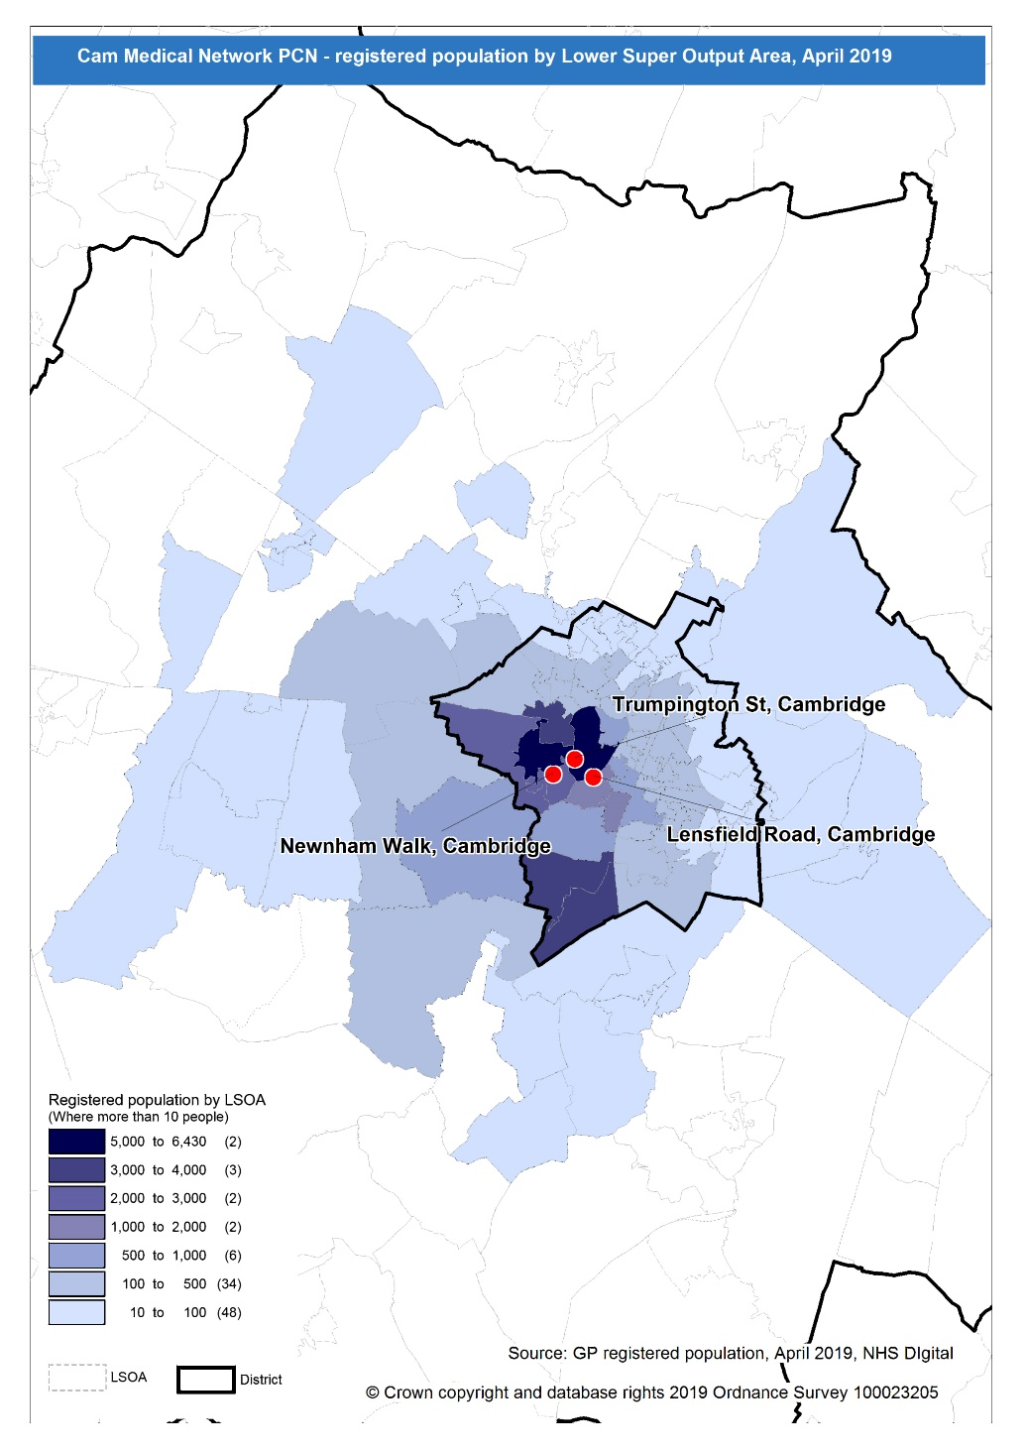
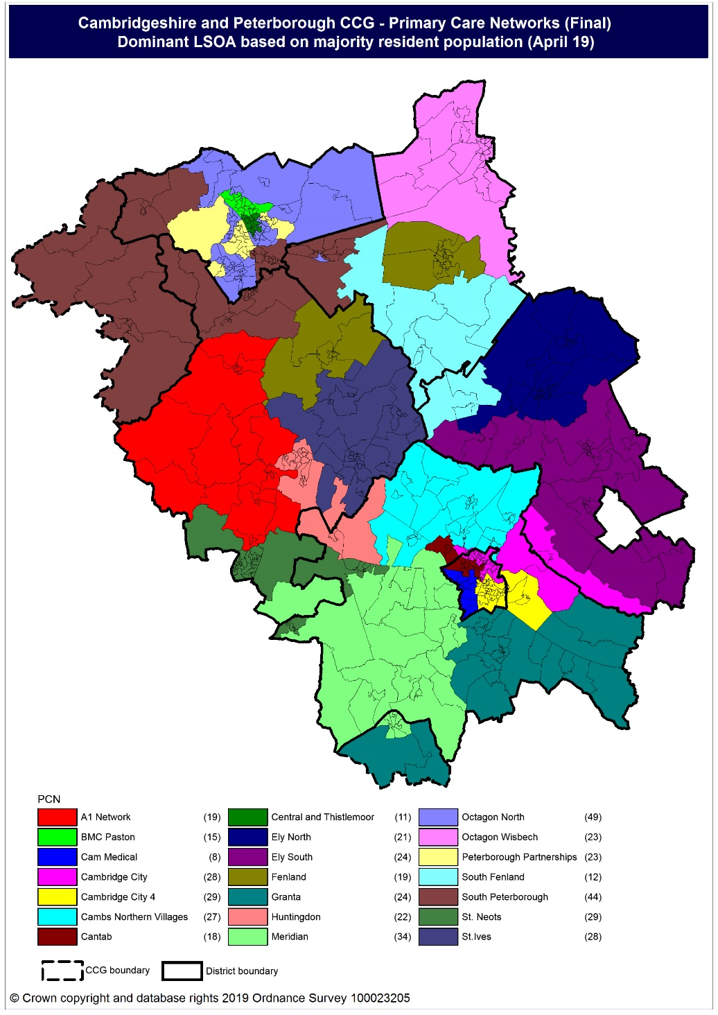
Population distribution
Source: GP registered population data by Lower Super Output Area, April 19, NHS Digital
Population
distribution
PCN dominant
population

Slide 8
Ethnicity
Cam Medical Network PCN has lower proportion of White British and higher proportions of White other, Mixed and Asian: Chinese ethnic groups compared to the South Alliance and CCG averages
Source: Census 2011 data applied to GP registered population using Census 2011 ethnic group proportions; England data from NOMIS (patients registered at a GP Practice by LSOA, July 2018, NHS Digital)

Slide 9
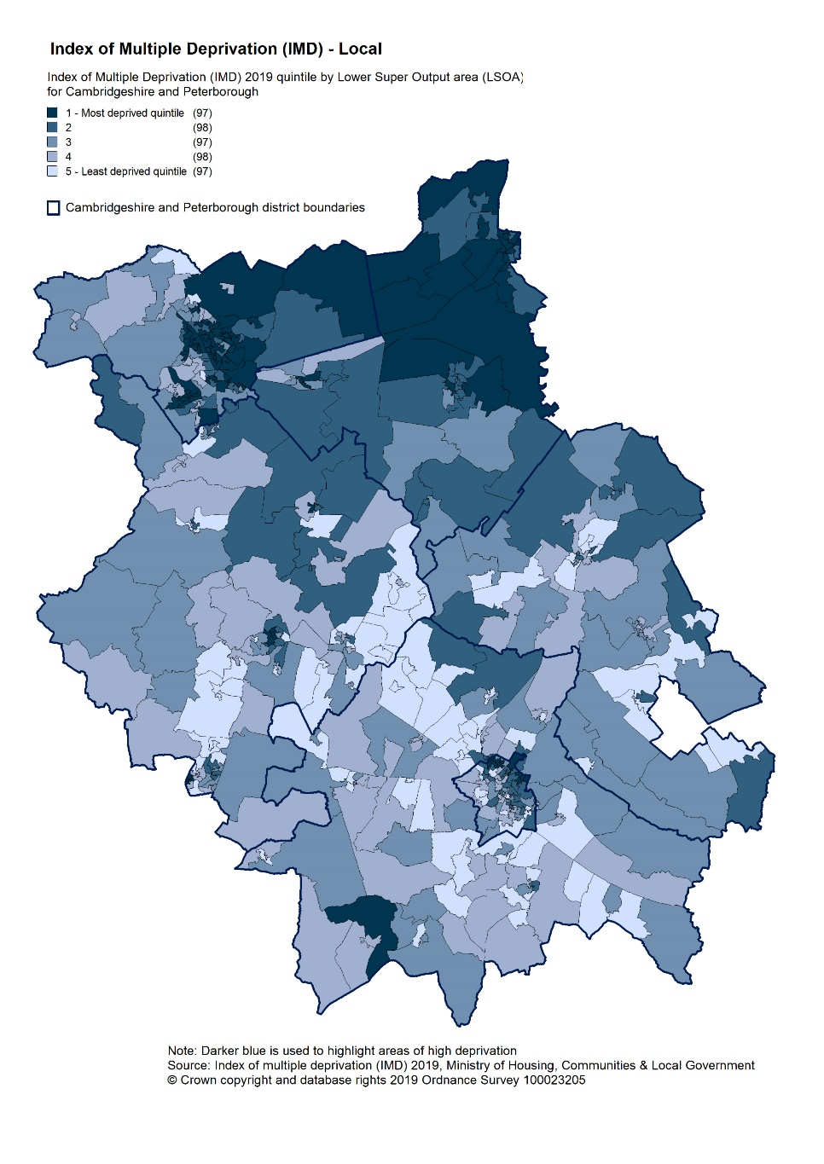
Deprivation
Relative deprivation is lower in Cam Medical Network PCN compared to South Alliance, CCG and England. Two practices, Lensfield Medical Practice and Trumpington St. have higher relative deprivation than South Alliance. Approximately 8.1% of children and 8.9% of older people live in income deprived households in the PCN; lower than the averages for South Alliance, CCG and England.
Source: C&P PHI derived from Indices of Multiple Deprivation 2019, MHCLG and GP registered population data for July 2018. Practice data from PHE Fingertips.
Index of Multiple Deprivation, 2019, by LSOA

Slide 10
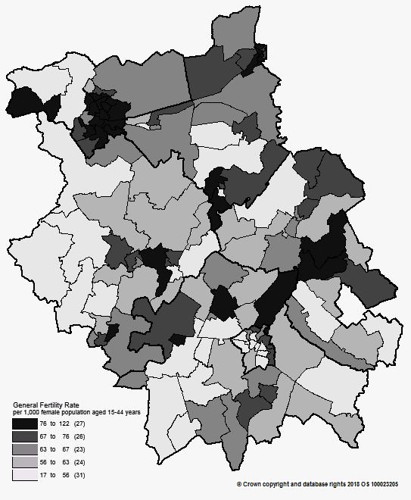
Births and Fertility
The birth rate in Cam Medical Network PCN is statistically significantly lower than the average for the South Alliance. The low birth weight proportion is statistically similar to the South Alliance.
Note: Relates to Cambridgeshire and Peterborough residents only Source: C&P PHI based on NHS Digital Civil Registration Data, 2014-2016 and patients registered at a GP Practice by LSOA, July 2018, NHS Digital
Birth rates by ward

Slide 11
Self-reported limiting long-term illness and general health status
It is estimated that the proportion of people that reported that they had a long-term activity-limiting illness in the 2011 Census was statistically significantly lower than the South Alliance average It is estimated that the proportion of people that reported that they were in good or very good health in the 2011 Census was statistically significantly higher than the South Alliance average
Source: C&P PHI from Census 2011, NOMIS and patients registered at a GP Practice by LSOA, July 2018, NHS Digital

Slide 12
Life expectancy
Male and female life expectancies in Cam Medical network PCN are statistically significantly higher than the South Alliance and C&P CCG
Source: C&P PHI based, derived from NHS Digital Civil Registration data and GP registered population data 2013 – 2017

Slide 13
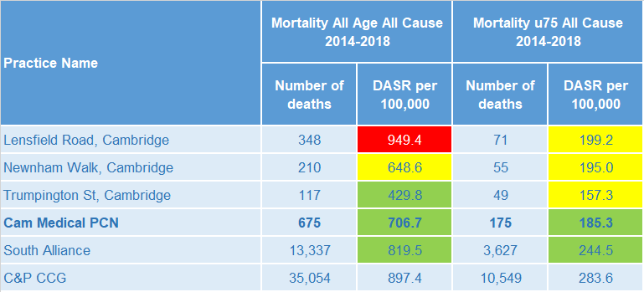
Mortality – all causes
There have been on average 135 deaths a year in Cam Medical Network PCN; approximately a fourth are in people aged under 75 years. The PCN all-age and premature all cause mortality rates are statistically significantly lower than the South Alliance average.
DASR = directly age standardised rate per 100,000 population Source: C&P PHI, from NHS Digital Civil Registration Data and NHS Digital GP registered population data, 2014-2018

Slide 14
Selected lifestyle behaviour risk factors

Slide 15
Risk factors
Recorded prevalence of obesity is statistically significantly lower in Cam Medical Network PCN compared to the average for South Alliance Estimated smoking prevalence is statistically significantly lower in Cam Medical Network PCN compared to the average for South Alliance
Source: Obesity - C&P PHI derived from NHS Digital QOF data for 2017/18; Estimated smoking - C&P PHI derived from the QOF based smoking prevalence estimate from the Public Health England (PHE) National General Practice Profiles at https://fingertips.phe.org.uk/profile/general-practice

Slide 16
Prevalence and mortality from principal diseases

Slide 17
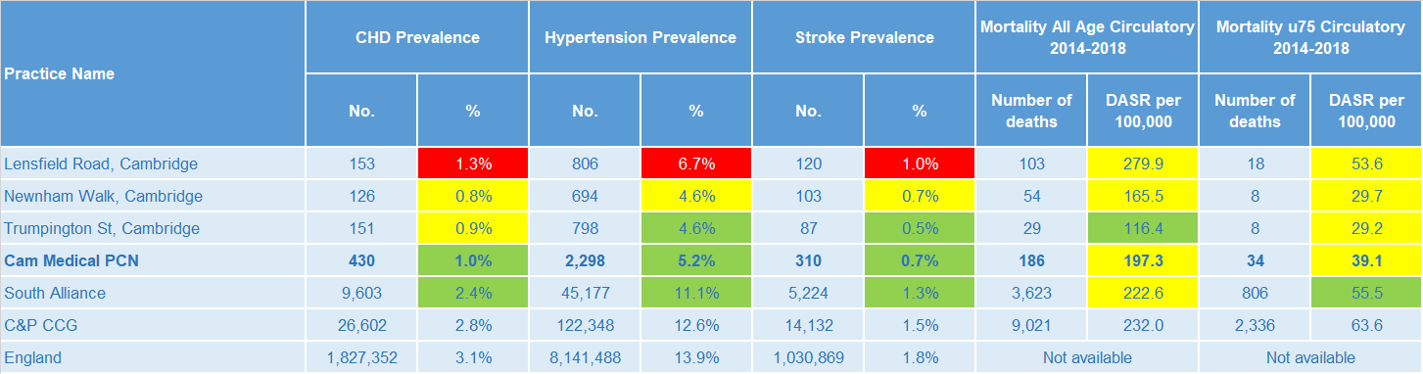
Circulatory disease
The prevalence rates of CHD, hypertension and stroke are statistically significantly lower than the South Alliance for all practices. The circulatory all-age and premature mortality rates for the PCN are statistically similar to the South Alliance average.
Note: Prevalence data are not available by age i.e. it is not age weighted so differences may be explained by differing age structures; DASR = Directly age standardised rate per 100,000 population Source: Prevalence (recorded) - C&P PHI from QOF, NHS Digital, 2017/18; Mortality - C&P PHI, from NHS Digital Civil Registration Data and NHS Digital GP registered population data, 2014-2018

Slide 18
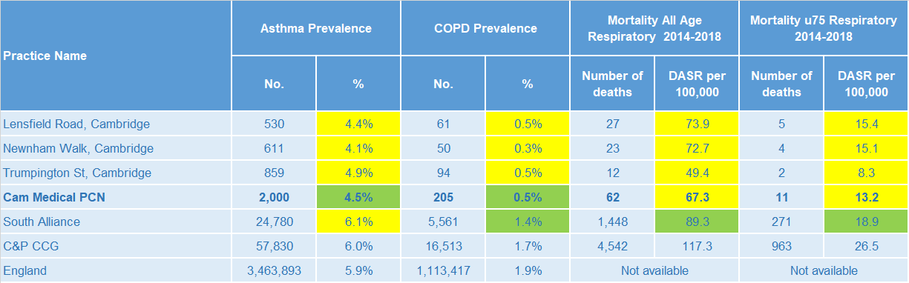
Respiratory disease
Asthma and COPD prevalence for PCN are statistically significantly lower than South Alliance. The PCN all age and premature mortality rates for respiratory disease are statistically similar to the South Alliance average.
Note: Prevalence data are not available by age i.e. it is not age weighted so differences may be explained by differing age structures; DASR = Directly age standardised rate per 100,000 population Source: Prevalence (recorded) - C&P PHI from QOF, NHS Digital, 2017/18; Mortality - C&P PHI, from NHS Digital Civil Registration Data and NHS Digital GP registered population data, 2014-2018

Slide 19
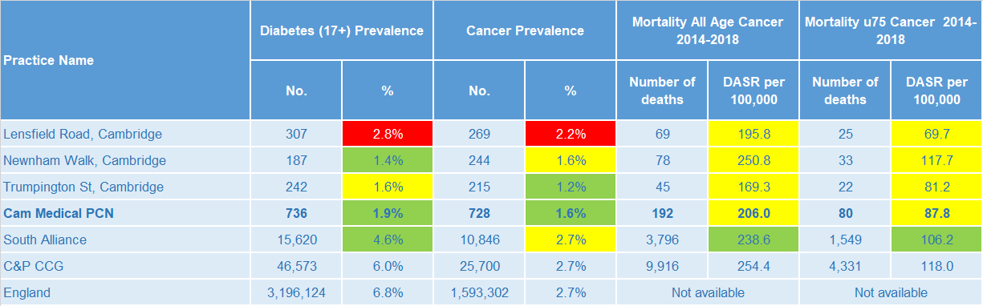
Long term conditions
Cam Medical Network PCN diabetes and cancer prevalence rates are statistically significantly lower than the South Alliance. The PCN all-age and premature cancer mortality rates are statistically similar to the South Alliance.
Note: Prevalence data are not available by age i.e. it is not age weighted so differences may be explained by differing age structures; DASR = Directly age standardised rate per 100,000 population Source: Prevalence (recorded) - C&P PHI from QOF, NHS Digital, 2017/18; Mortality - C&P PHI, from NHS Digital Civil Registration Data and NHS Digital GP registered population data, 2014-2018

Slide 20
Mental health, dementia and learning disability
Cam Medical PCN mental health prevalence rates are statistically significantly lower than the South Alliance. Lensfield Road Practice has statistically significantly high prevalence of severe mental illness and dementia that the Cam Medical PCN.
Note: Prevalence data are not available by age i.e. it is not age weighted so differences may be explained by differing age structures Source: Prevalence (recorded) - C&P PHI from QOF, NHS Digital, 2017/18

Slide 21
Service provision and utilisation

Slide 22
PCN workforce

Slide 23
Who works within the Health and Social Care services for the PCN?
Patients receive health care from a range of individuals and organisations
100 staff are employed through CAM Medical PCN’s practices, the majority of which will be directly in contact with patients.
Data Sources: Local Authority Data extract; PCN Practice data; CPFT data extract

Slide 24
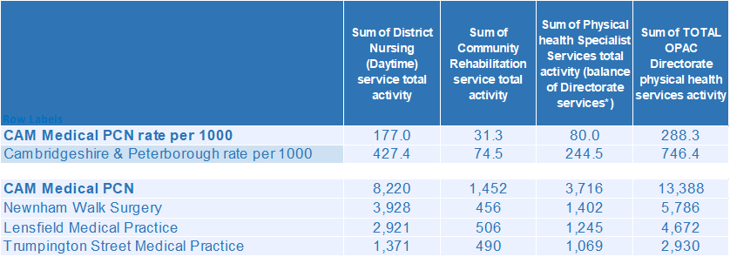
Who works within the Health and Social Care services for the PCN?
Patients receive health care from a range of individuals and organisations
There are currently 13,388 patients under CPFT caseload across the services listed. Caseloads rates for CAM Medical PCN are lower compared to the rest of Cambridgeshire and Peterborough. Additional patients will be inpatients in rehab wards and part of the multi-disciplinary team caseload. Newnham Walk Surgery has the highest number of caseloads for CAM Medical PCN.
Data Sources: Local Authority Data extract; PCN Practice data; CPFT data extract

Slide 25
Social Care Services

Slide 26
Children’s Social Care
It is estimated that the South Alliance has statistically significantly low rates of social care involvement cases, early help cases and education, health and care plans compared to the CCG average. It is estimated that social care involvement cases and early help cases are statistically similar to the South Alliance rates for Cam Medical Network PCN; Education, health and care plans rate is statistically significantly lower than the South Alliance.
Source: Cambridgeshire County Council, BI team. Estimates derived from the LSOA level data, (for those LSOAs in Cambridgeshire or Peterborough only) available as an open data release here: https://data.cambridgeshireinsight.org.uk/dataset/cambridgeshire-and-peterborough-adult-social-care-long-term-service-users-31-march-2019 and GP Registered Population April 2019

Slide 27
Adult Social Care
Overall adult social care rates for Cam Medical PCN are statistically significantly lower than the South Alliance. South Alliance overall adult social care rates are statistically significantly lower than the CCG.
Source: Cambridgeshire County Council, BI team. Estimates derived from the LSOA level data, (for those LSOAs in Cambridgeshire or Peterborough only) available as an open data release here: https://data.cambridgeshireinsight.org.uk/dataset/cambridgeshire-and-peterborough-adult-social-care-long-term-service-users-31-march-2019 and GP Registered Population April 2019

Slide 28
Secondary Care Services

Slide 29
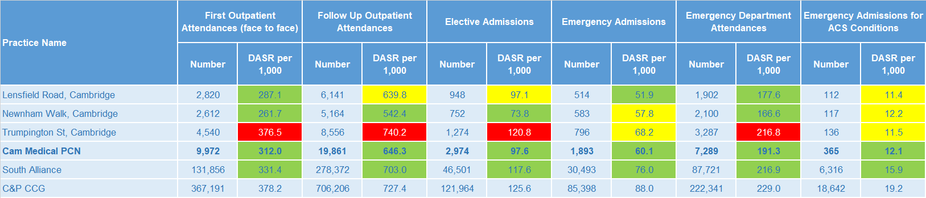
Secondary Care Services
South Alliance has statistically significantly low rates of secondary care use compared with the CCG average. Cam Medical PCN rates of secondary care services are statistically significantly lower than the South Alliance rates. Trumpington Street Medical Practice rates of first outpatient attendances, follow up outpatient attendances, elective admissions and emergency department attendances are statistically significantly higher than the Cam Medical PCN. Clinical Physiology and Ophthalmology account for the most outpatient attendances. This was the case for both 17/18 and 18/19. Together they make up 18% of the activity for 18/19. 8% of first outpatient attendances are sight related. The most common elective admissions are for Gastroenterology, Medical Oncology, and Clinical Haematology. Type 1 A&E Attendances increased 9% year on year. Cambridge University Hospitals saw a 9% increase in attendances. A&E referrals from “Health Care Provider: same or other” almost doubled year on year. Self referrals increased 5% (205) while GP referrals rose 34% (239). The majority of other referral types showed no significant change.
Note: DASR = Directly age standardised rate per 1,000 population, reference population used is the ONS National Standard Population. Source: C&P PHI, from HED Tool, 2018/19, Cambridgeshire and Peterborough “Practice Benchmarker”

Slide 30
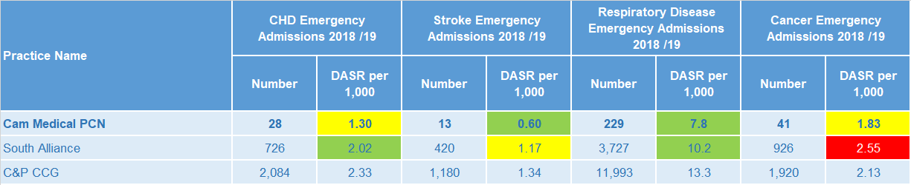
Disease Specific Emergency Hospital Admission Rates
The PCN emergency admission rates for stroke and respiratory disease are statistically significantly lower than the South Alliance average. For CAM Medical PCN there were 1,793 emergency admissions during 2018/19. Abdomen pain, Poisoning: 4-Aminophenol derivatives (paracetamol toxicity), and Lobar Pneumonia are the three most prevalent primary diagnoses. The fifth highest number of emergency admissions were related to Urinary Tract Infections.
Note: DASR = Directly age standardised rate per 1,000 population, reference population used is the ONS National Standard Population. Source: C&P PHI, from HED Tool, 2018/19, Cambridgeshire and Peterborough “All Trusts 18/19”

Slide 31
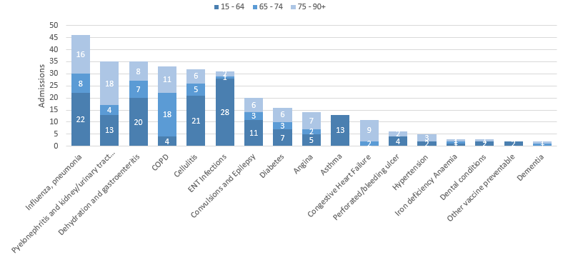
Potentially Avoidable Hospital Admissions
CAM Medical PCN has a younger population but those aged over 60 still contribute more to their potentially avoidable admissions
Selected Ambulatory Care Sensitive Conditions NEL admissions in 2018/19 by age
There was a 6% increase for potentially avoidable emergency admissions across Cambridgeshire and Peterborough. ACSC admissions for CAM Medical PCN increased 7%.
Those aged under 65 account for most of the potentially preventable (ACSC) related admissions during 18/19. ENT Infections, Influenza, and Cellulitis were most common for the younger bracket.
Data Source: Cambridgeshire and Peterborough “Practice Benchmarker”

Slide 32
Glossary of key methods and terms
To assess statistical significance, 95% confidence intervals are calculated which provide a measure of uncertainty around the calculated value which arises due to random variation. If the confidence interval for a value excludes the value for the relevant benchmark, the difference between the local value and the benchmark is said to be ‘statistically significant’. The following hierarchy of benchmarks has been used in this profile: practice to PCN; PCN to Alliance; Alliance to CCG and CCG to England. The most commonly used RAG-rating in this profile: Exceptions to this are life expectancy which is RAG rated like this: And self-reported limiting long-term illness and general health status which is RAG rated like this: DASR = directly age standardised rate per 100,000 population C&P PHI = Cambridgeshire and Peterborough Public Health Intelligence QOF = Quality Outcomes Framework. Prevalence data are not available by age i.e. it is not age weighted so differences may be explained by differing age structures.

Slide 33
Produced by:
Cambridgeshire and Peterborough Public Health Intelligence Team
Contact:
PHI-team@Cambridgeshire.gov.uk
Date updated:
29th November 2019

