Slide 1
A1 Network PCN
Data pack
November 2019

Slide 2
A1 Network PCN – summary
There are almost 33,400 people registered with A1 Network PCN, with a larger older population compared to the North Alliance, CCG and England. The population is estimated to increase by 21% between 2019 and 2031, one of the largest increases of any PCN within the CCG The PCN has a higher proportion of White British ethnic group when compared to the North Alliance, CCG and England Relative deprivation is lower in the PCN compared to the North Alliance, CCG and England. Approximately 8% of children and 7% of older people live in poverty. It is estimated that on average there are 280 births a year in the PCN. The PCN birth rate is statistically significantly lower than the North Alliance and the percentage of low birth weight births is statistically similar to the North Alliance It is estimated that both male and female life expectancy within the PCN is statistically significantly higher than the North Alliance, at 82.6 and 85.8 years respectively Recorded obesity in adults is statistically significantly lower than the North Alliance. It is estimated that 11.3% of adults smoke, which is statistically significantly lower than the North Alliance | Estimates of people reporting long-term activity-limiting illness and being in Good or Very Good health are statistically better than the averages for the North Alliance On average there are 241 deaths a year in the PCN, with around a third of these in people aged under 75 years The PCN has statistically significantly high recorded prevalence of coronary heart disease, hypertension, stroke, asthma and cancer compared to the North Alliance, which may be a reflection of the older population of the A1 Network Mortality rates within the A1 Network are generally statistically significantly better than the North Alliance averages The PCN has statistically significantly lower rates of children’s social care cases than the North Alliance except for estimated education, health and care plans rate, which is statistically similar to the North Alliance. The PCN has statistically significantly low rates for adult social care use compared to North Alliance. Secondary care rates are statistically significantly lower than North Alliance except for the elective admissions rate which is statistically significantly higher than the North Alliance average

Slide 3
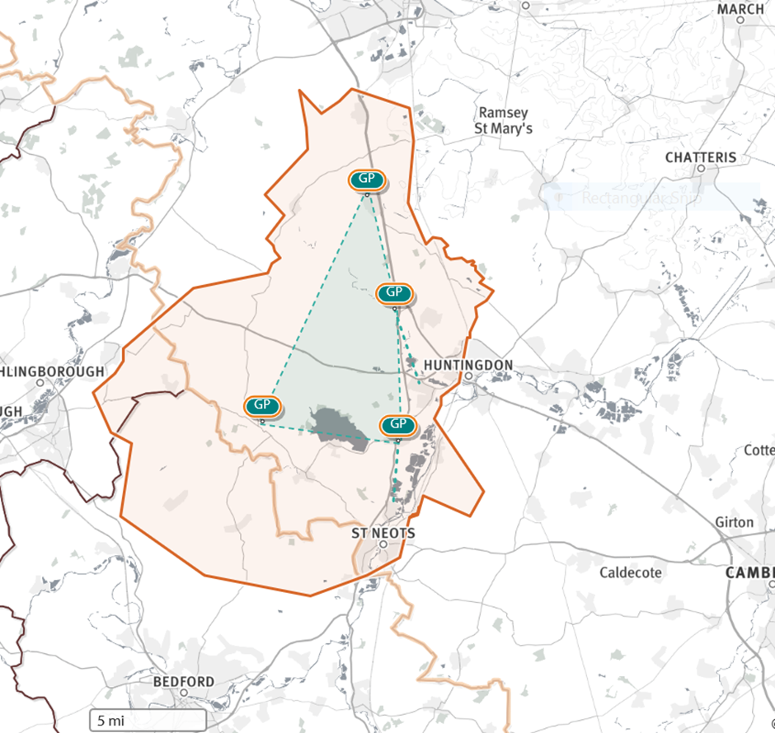
A1 Network PCN
Source: Shape Atlas GP registered population, October 2019, NHS Digital.

Slide 4
Demography and key population characteristics

Slide 5
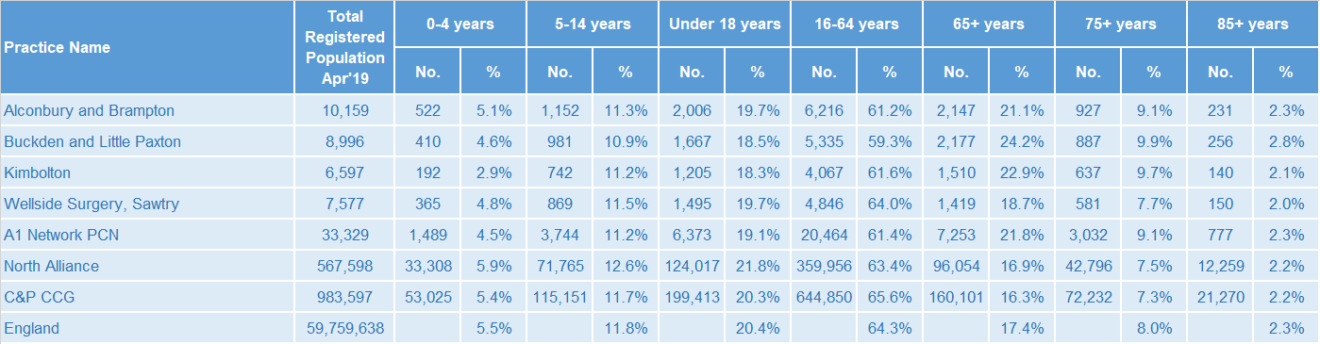
GP registered population
A1 Network PCN has a lower proportion of people aged 18 and under and higher proportion aged 65 and over compared with North Alliance, CCG and England.
Source: GP registered population, April 2019, NHS Digital. Population forecasts based on population distribution at ward level (Apr 19), Mid 2015 based population forecasts Cambridgeshire County Council

Slide 6
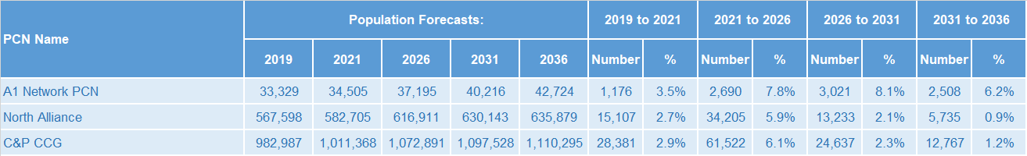
Population forecasts
The population of A1 Network PCN is forecast to grow at a higher rate than the CCG as whole. Predicted growth of 7.8% between 2021 and 2026 and 8.1% between 2026 and 2031 is among the highest observed within C&P CCG.
Source: GP registered population, April 2019, NHS Digital. Population forecasts based on population distribution at ward level (Apr 19), Mid 2015 based population forecasts Cambridgeshire County Council

Slide 7
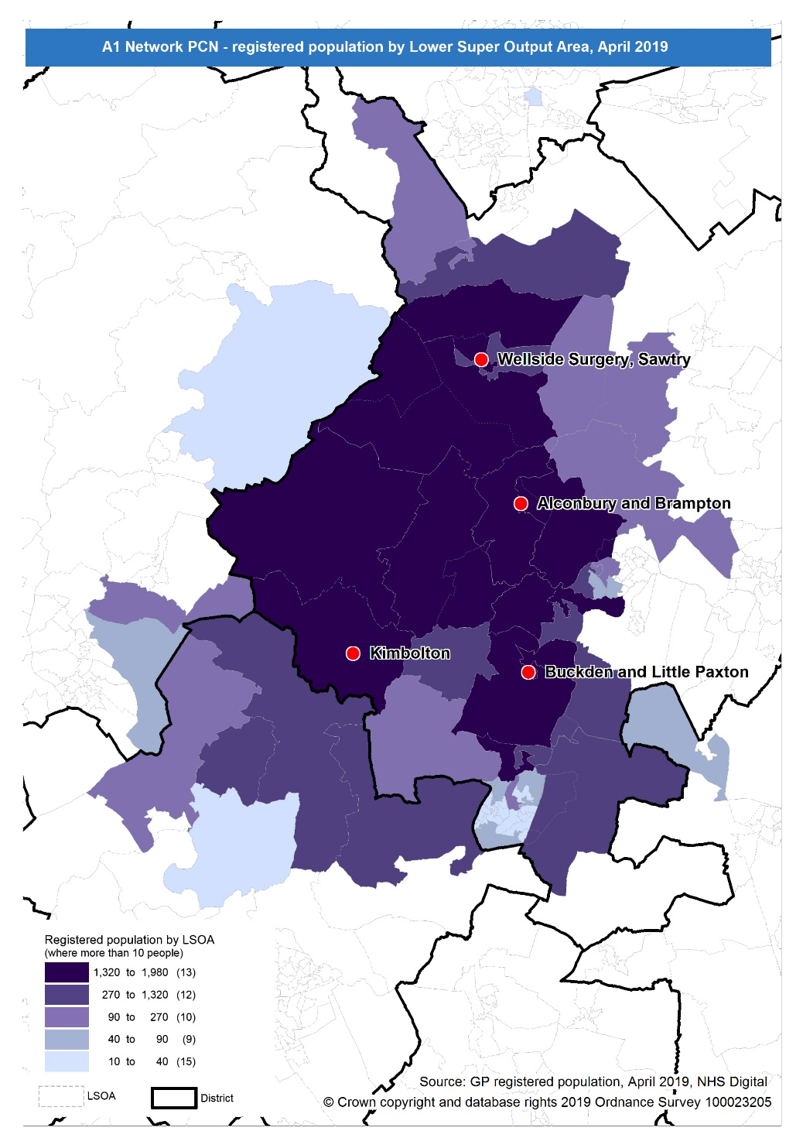
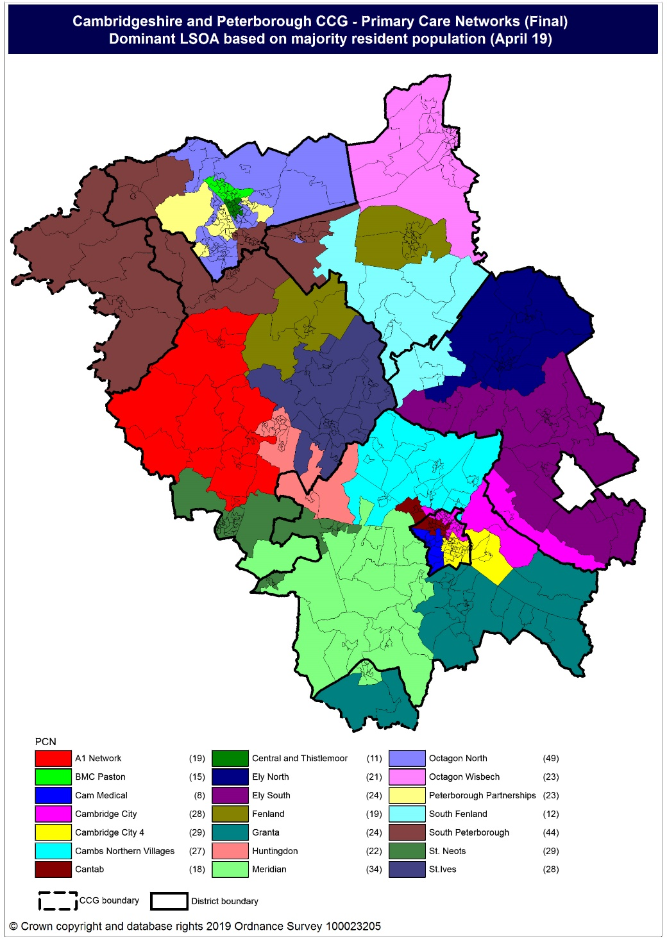
Population distribution
Source: GP registered population data by Lower Super Output Area, April 19, NHS Digital
Population
distribution
PCN dominant
population

Slide 8
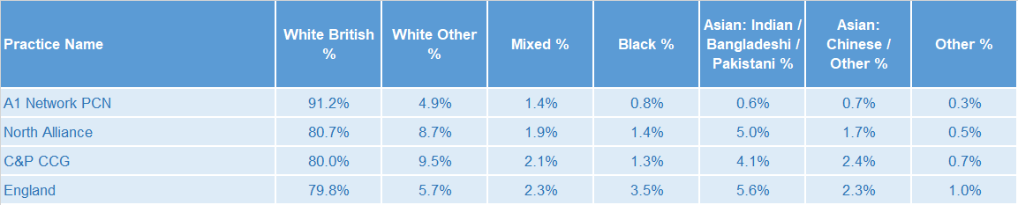
Ethnicity
A1 Network PCN has a higher proportion of population from the White British ethnic group and lower proportions from all other ethnic groups compared to the North Alliance, CCG and England averages.
Source: Census 2011 data applied to GP registered population using Census 2011 ethnic group proportions; England data from NOMIS (patients registered at a GP Practice by LSOA, July 2018, NHS Digital)

Slide 9
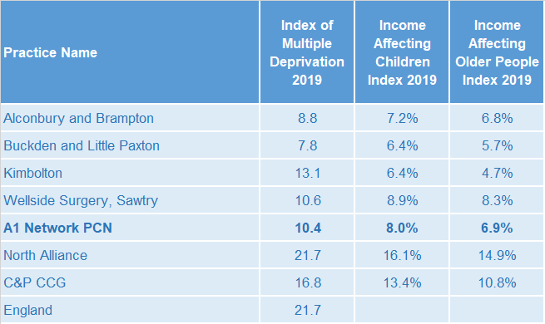
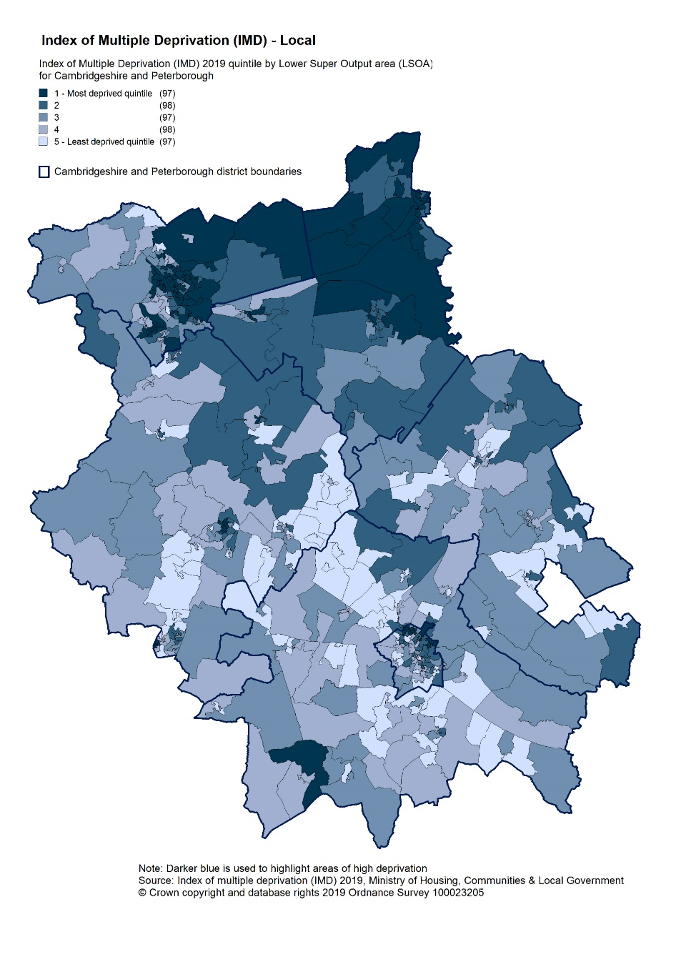
Deprivation
Relative deprivation is lower in A1 Network PCN and each of its constituent practices when compared to the North Alliance, CCG and England. Approximately 8% of children and 7% of older people live in income deprived households in A1 Network PCN; lower than the averages for North Alliance and CCG.
Source: C&P PHI derived from Indices of Multiple Deprivation 2019, MHCLG and GP registered population data for July 2018. Practice data from PHE Fingertips.
Index of Multiple Deprivation, 2019, by LSOA

Slide 10
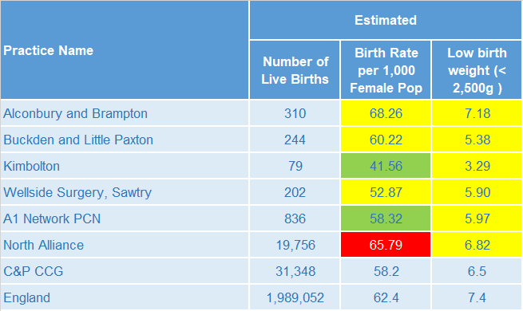
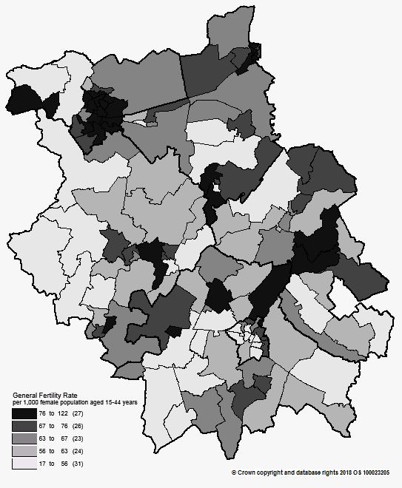
Births and Fertility
The birth rate for A1 Network PCN is statistically significantly lower than North Alliance and the low birth weight proportion within the PCN is statistically similar to the North Alliance average.
Note: Relates to Cambridgeshire and Peterborough residents only Source: C&P PHI based on NHS Digital Civil Registration Data, 2014-2016 and patients registered at a GP Practice by LSOA, July 2018, NHS Digital
Birth rates by ward

Slide 11
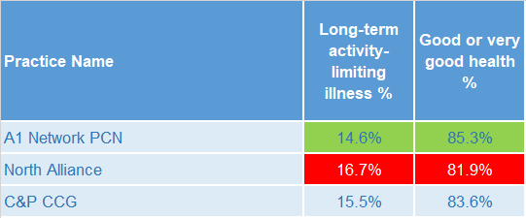
Self-reported limiting long-term illness and general health status
It is estimated that the proportion of people in the A1 Network PCN that reported that they had a long-term activity-limiting illness in the 2011 Census was statistically significantly lower than the North Alliance average. It is also estimated that the proportion of people in the A1 Network PCN that reported that they were in good or very good health in the 2011 Census was statistically significantly higher than the North Alliance average.
Source: C&P PHI from Census 2011, NOMIS and patients registered at a GP Practice by LSOA, July 2018, NHS Digital

Slide 12
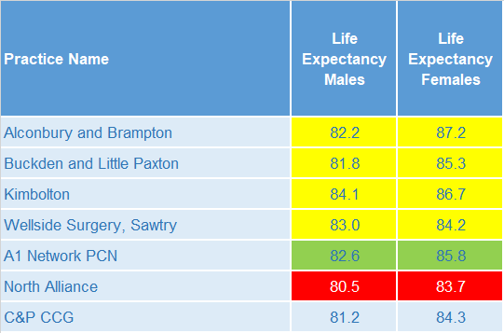
Life expectancy
Male and female life expectancy in A1 Network PCN are statistically significantly higher than both North Alliance and CCG values.
Source: C&P PHI based, derived from NHS Digital Civil Registration data and GP registered population data, 2013 – 2017

Slide 13
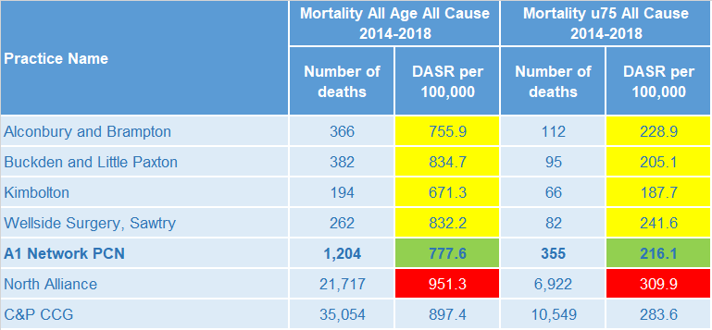
Mortality – all causes
There are on average 241 deaths a year in A1 Network PCN, approximately a third are in people aged under 75 years. The A1 Network has statistically significantly lower directly age-standardised rates of all-age and under 75 mortality compared to the North Alliance.
DASR = directly age standardised rate per 100,000 population Source: C&P PHI, from NHS Digital Civil Registration Data and NHS Digital GP registered population data, 2014-2018

Slide 14
Selected lifestyle behaviour risk factors

Slide 15
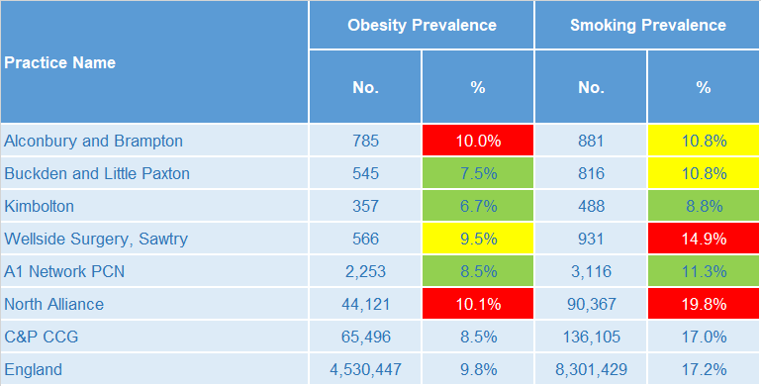
Risk factors
Recorded prevalence of obesity is statistically significantly lower in A1 Network PCN compared to the average for North Alliance. Estimated smoking prevalence is also statistically significantly lower in A1 Network PCN compared to the average for North Alliance.
Source: Obesity - C&P PHI derived from NHS Digital QOF data for 2017/18; Estimated smoking - C&P PHI derived from the QOF based smoking prevalence estimate from the Public Health England (PHE) National General Practice Profiles at https://fingertips.phe.org.uk/profile/general-practice

Slide 16
Prevalence and mortality from principal diseases

Slide 17
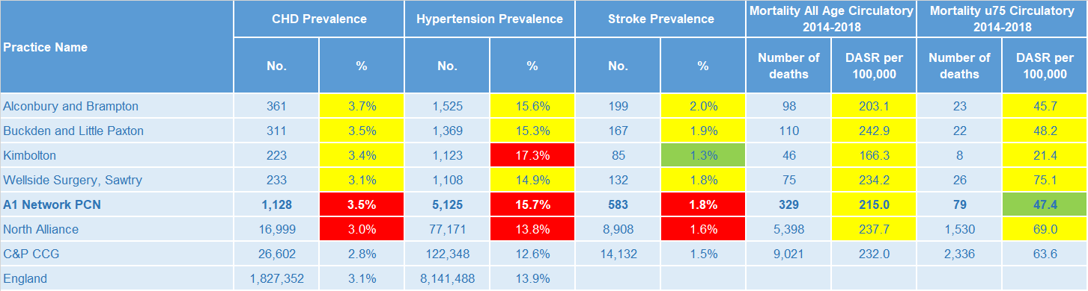
Circulatory disease
A1 Network PCN prevalence rates of CHD, hypertension and stroke are statistically significantly high compared to North Alliance. The data are not age-standardised and therefore this may partly be as a result of the PCN’s relatively older population. The all-age mortality rate from circulatory disease is statistically similar to the North Alliance and for under 75s only, the mortality rate is statistically significantly lower than the North Alliance.
Note: Prevalence data are not available by age i.e. it is not age weighted so differences may be explained by differing age structures; DASR = Directly age standardised rate per 100,000 population Source: Prevalence (recorded) - C&P PHI from QOF, NHS Digital, 2017/18; Mortality - C&P PHI, from NHS Digital Civil Registration Data and NHS Digital GP registered population data, 2014-2018

Slide 18
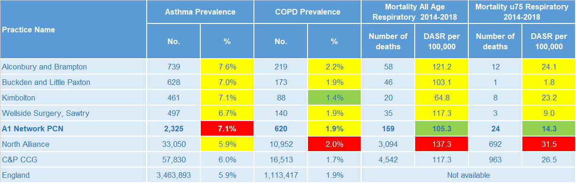
Respiratory disease
Asthma prevalence is statistically significantly high in the A1 Network PCN compared to the North Alliance, whereas COPD prevalence is statistically similar. Directly age-standardised rates of mortality as a result of respiratory disease are statistically significantly lower in the A1 Network PCN than in the North Alliance for both all ages and under 75 years only.
Note: Prevalence data are not available by age i.e. it is not age weighted so differences may be explained by differing age structures; DASR = Directly age standardised rate per 100,000 population Source: Prevalence (recorded) - C&P PHI from QOF, NHS Digital, 2017/18; Mortality - C&P PHI, from NHS Digital Civil Registration Data and NHS Digital GP registered population data, 2014-2018

Slide 19
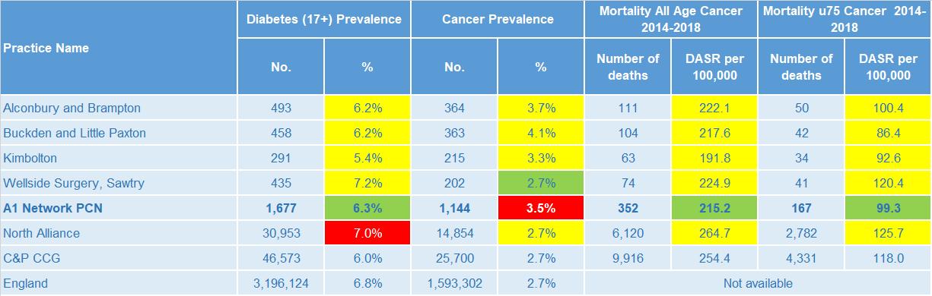
Long term conditions
Diabetes prevalence is statistically significantly low within the A1 Network compared to the North Alliance, whereas cancer prevalence is statistically significantly high. The A1 Network PCN has statistically significantly low directly age-standardised rates of mortality from cancer compared to the North Alliance for all ages and for under 75s only.
Note: Prevalence data are not available by age i.e. it is not age weighted so differences may be explained by differing age structures; DASR = Directly age standardised rate per 100,000 population Source: Prevalence (recorded) - C&P PHI from QOF, NHS Digital, 2017/18; Mortality - C&P PHI, from NHS Digital Civil Registration Data and NHS Digital GP registered population data, 2014-2018

Slide 20
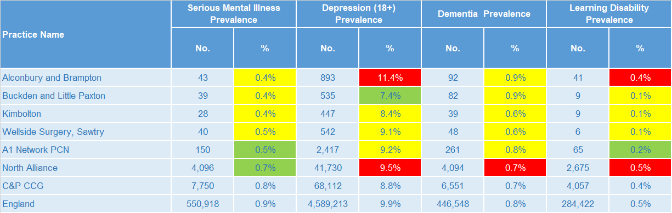
Mental health, dementia and learning disability
The A1 Network PCN has statistically significantly low prevalence of mental health disorders and registered patients with learning disabilities compared to the North Alliance and is statistically similar to the North Alliance with regards to depression and dementia prevalence. However, Alconbury and Brampton has statistically significantly high depression and learning disability prevalence compared to A1 Network PCN.
Note: Prevalence data are not available by age i.e. it is not age weighted so differences may be explained by differing age structures Source: Prevalence (recorded) - C&P PHI from QOF, NHS Digital, 2017/18

Slide 21
Service provision and utilisation

Slide 22
PCN workforce

Slide 23
Who works within the Health and Social Care services for A1 Network PCN?
Patients receive health care from a range of individuals and organisations
120 staff are employed through A1 Network PCN practices; the majority of which will be directly in contact with patients.
Data Sources: Local Authority Data extract; PCN Practice data; CPFT data extract

Slide 24
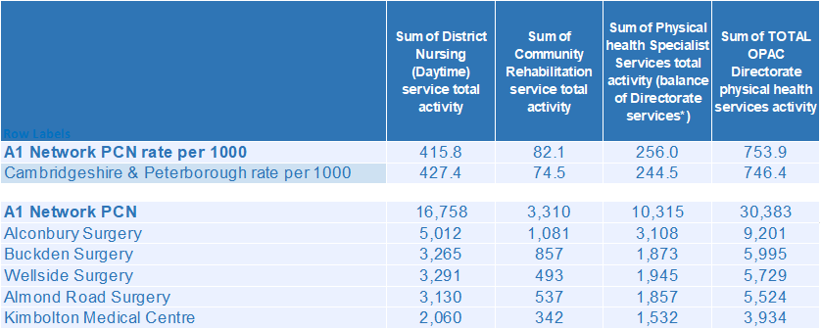
Who works within the Health and Social Care services for A1 Network PCN?
Patients receive health care from a range of individuals and organisations
There are currently 30,383 patients under CPFT caseload across the services listed. Community rehab and physical health caseload rates for A1 Network are higher compared to the rest of Cambridgeshire and Peterborough. Additional patients will be inpatients in rehab wards and part of the multi-disciplinary team caseload. Alconbury Surgery has the highest number of caseloads for A1 Network PCN.
Data Sources: Local Authority Data extract; PCN Practice data; CPFT data extract

Slide 25
Social Care Services

Slide 26
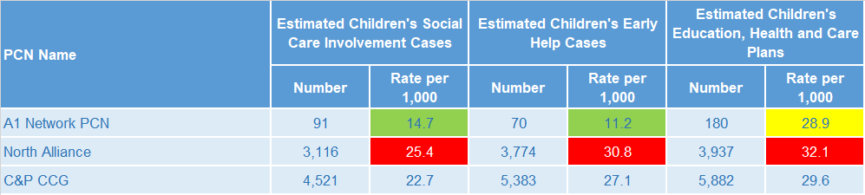
Children’s Social Care
It is estimated that the North Alliance has statistically significantly high rates of social care involvement cases, early help cases and education, health and care plans compared to the CCG average. A1 Network has statistically significantly lower rates of social care involvement cases and early help cases than the North Alliance but the estimated education, health and care plans rate is statistically similar to the North Alliance.
Source: Cambridgeshire County Council, BI team. Estimates derived from the LSOA level data, (for those LSOAs in Cambridgeshire or Peterborough only) available as an open data release here: https://data.cambridgeshireinsight.org.uk/dataset/cambridgeshire-and-peterborough-adult-social-care-long-term-service-users-31-march-2019 and GP Registered Population April 2019

Slide 27
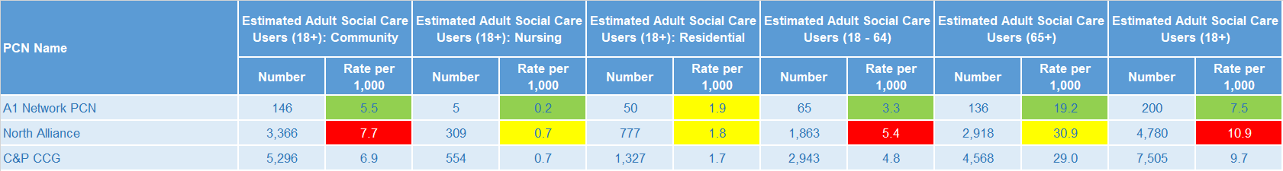
Adult Social Care
North Alliance has statistically significantly high rates of adult social care users compared with the CCG average, except for the rates for nursing and residential care and users aged 65+ which are statistically similar to the CCG rates. A1 Network PCN has statistically significantly low rates for adult social care compared to North Alliance with the exception of the residential care rate, which is statistically similar to the North Alliance.
Source: Cambridgeshire County Council, BI team. Estimates derived from the LSOA level data, (for those LSOAs in Cambridgeshire or Peterborough only) available as an open data release here: https://data.cambridgeshireinsight.org.uk/dataset/cambridgeshire-and-peterborough-adult-social-care-long-term-service-users-31-march-2019 and GP Registered Population April 2019

Slide 28
Secondary Care Services

Slide 29
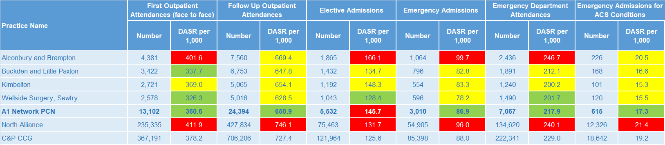
Secondary Care Services
The elective admissions rate for A1 Network is statistically significantly higher than the North Alliance average. North Alliance has statistically significantly high rates of secondary care use compared with the CCG average. A1 Network PCN has fewer outpatient attendances when compared to the rest of Cambridgeshire and Peterborough. Outpatient attendances increased 5% during 18/19. Ophthalmology and Trauma & Orthopaedics account for the most outpatient attendances. This was the case for both 17/18 and 18/19. Together they make up 23% of the activity for 18/19. 7% of first outpatient attendances are sight related. The most common elective admissions are for Gastroenterology, General Surgery, and Medical Oncology. Type 1 A&E Attendances increased 9% year on year. Hinchingbrooke Health Care NHS Trust saw an 8% increase in attendances. A&E referrals from “Health Care Provider: same or other” almost doubled year on year. Self referrals increased 7% (304) where the majority of the other referral types showed no significant change.
Note: DASR = Directly age standardised rate per 1,000 population, reference population used is the ONS National Standard Population. Source: C&P PHI, from HED Tool, 2018/19; Cambridgeshire and Peterborough “Practice Benchmarker”

Slide 30
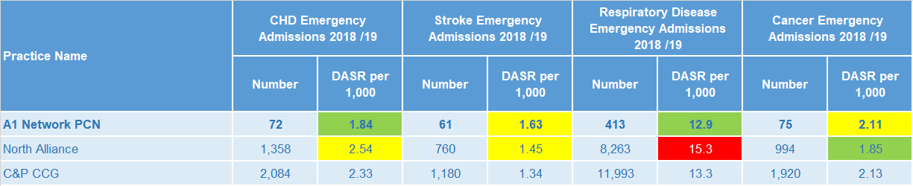
Disease Specific Emergency Hospital Admission Rates
The PCN emergency admission rates for CHD and respiratory disease are statistically significantly lower than the North Alliance average. For A1 Network PCN there were 2,698 emergency admissions during 2018/19. Just 1 of the 4 practices had a higher admission rate than Cambridgeshire and Peterborough. Lobar Pneumonia, Acute Lower Respiratory Infections, and Urinary Tract Infections are the three most prevalent primary diagnoses. The fourth highest number of emergency admissions were related to chest pain.
Note: DASR = Directly age standardised rate per 1,000 population, reference population used is the ONS National Standard Population. Source: C&P PHI, from HED Tool, 2018/19, Cambridgeshire and Peterborough “All Trusts 18/19”

Slide 31
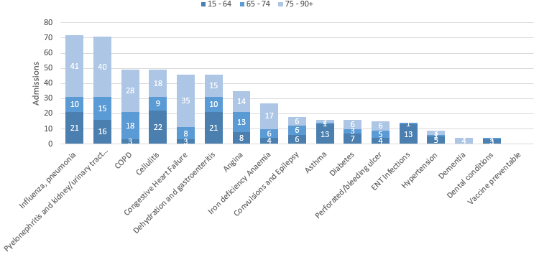
Potentially Avoidable Hospital Admissions
A1 Network PCN's older age bracket contributes more to their potentially avoidable admissions
Selected Ambulatory Care Sensitive Conditions NEL admissions in 2018/19 by age
There was a 6% increase for potentially avoidable emergency admissions across Cambridgeshire and Peterborough.
ACSC admissions for A1 Network increased 13%.
The number of conditions not normally requiring admission has seen a 13% year on year increase for A1 Network PCN. Those aged over 65 account for the majority of the most common potentially preventable (ACSC) related admissions during 18/19.
Cellulitis, Influenza, Dehydration and Gastroenteritis, and Urinary Tract Infections were most common for the younger bracket.
Data Source: Cambridgeshire and Peterborough “Practice Benchmarker”

Slide 32
Glossary of key methods and terms
To assess statistical significance, 95% confidence intervals are calculated which provide a measure of uncertainty around the calculated value which arises due to random variation. If the confidence interval for a value excludes the value for the relevant benchmark, the difference between the local value and the benchmark is said to be ‘statistically significant’. The following hierarchy of benchmarks has been used in this profile: practice to PCN; PCN to Alliance; Alliance to CCG and CCG to England. The most commonly used RAG-rating in this profile: Exceptions to this are life expectancy which is RAG rated like this: And self-reported limiting long-term illness and general health status which is RAG rated like this: DASR = directly age standardised rate per 100,000 population C&P PHI = Cambridgeshire and Peterborough Public Health Intelligence QOF = Quality Outcomes Framework. Prevalence data are not available by age i.e. it is not age weighted so differences may be explained by differing age structures.

Slide 33
Produced by:
Cambridgeshire and Peterborough Public Health Intelligence Team
Contact:
PHI-team@Cambridgeshire.gov.uk
Date updated:
29th November 2019

