Slide 1
South Peterborough PCN
Data pack
November 2019

Slide 2
South Peterborough PCN – summary
There are just over 67,000 people registered with practices in South Peterborough PCN, with a higher proportion of people aged 65 and over, compared to the North Alliance, CCG and England. The population is estimated to increase by 5.8% between 2019 and 2026, and then stabilise to 2036 South Peterborough PCN has a higher proportion of population from the White British ethnic group and lower proportions from Mixed, Black and Asian ethnic origins compared to the North Alliance, CCG and England averages. Relative deprivation for South Peterborough PCN overall is lower than for the North Alliance and England. Approximately 14% of children and 11% of older people live in poverty It is estimated that on average there are 676 births a year in the PCN. Birth rates are statistically significantly higher than the North Alliance rate. Low birth weight births in South Peterborough PCN are statistically similar to the average for the North Alliance. It is estimated that male and female life expectancy in South Peterborough PCN is statistically significantly higher than the North Alliance at around 82.1 years and 85.3 years respectively. Recorded obesity in adults is statistically significantly lower than the North Alliance. | It is estimated that 15.8% of adults smoke, which is statistically significantly lower than the North Alliance Estimates of people reporting long-term activity-limiting illness and being in Good or Very Good health are statistically similar to the averages for the North Alliance. On average there are around 490 deaths a year in the PCN, with around a third of these in people aged under 75 years The PCN has statistically significantly high recorded prevalence of hypertension and cancer compared to the North Alliance averages. The PCN has statistically significantly low recorded prevalence of asthma and learning disability. All-age, all cause mortality rates for the PCN are statistically significantly lower than the rates for the North Alliance. South Peterborough PCN has statistically significantly lower children’s social care rates than the North Alliance averages. South Peterborough PCN has a statistically significantly lower overall rate of adult social care when compared to the North Alliance. South Peterborough PCN has statistically significantly higher rates of first outpatient attendances and follow up outpatient attendances than the North Alliance rates.

Slide 3
Demography and key population characteristics

Slide 4
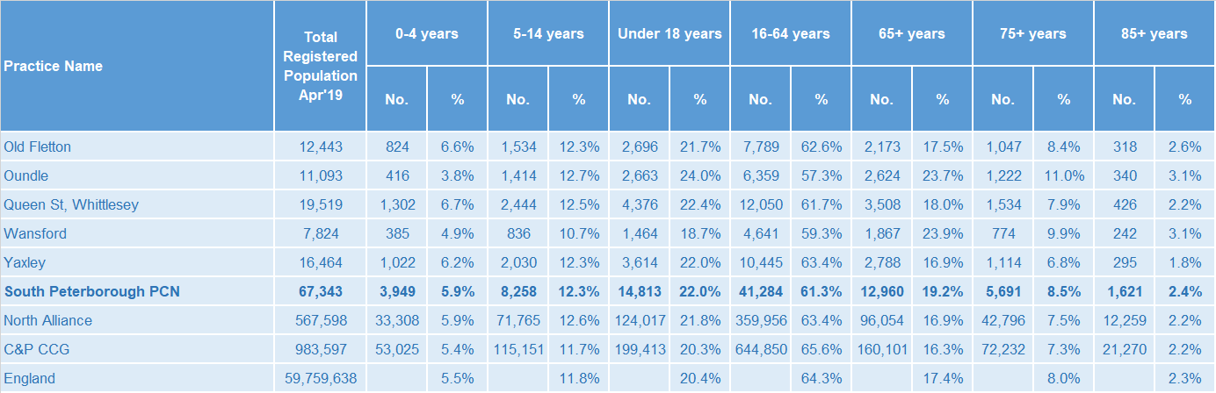
GP registered population
South Peterborough PCN has a higher proportion of people aged 65 and over compared with North Alliance, CCG and England.
Source: GP registered population, April 2019, NHS Digital. Population forecasts based on population distribution at ward level (Apr 19), Mid 2015 based population forecasts Cambridgeshire County Council

Slide 5
Population forecasts
The population of South Peterborough PCN is forecast to grow at a slower rate than the CCG as whole. The population is expected to increase by 5.8% between 2019 and 2026 and then stabilise to 2036.
Source: GP registered population, April 2019, NHS Digital. Population forecasts based on population distribution at ward level (Apr 19), Mid 2015 based population forecasts Cambridgeshire County Council

Slide 6
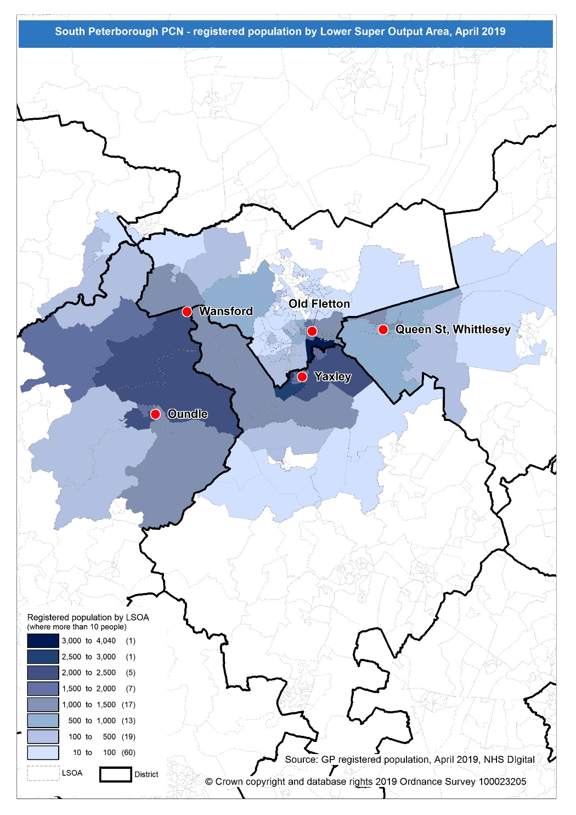
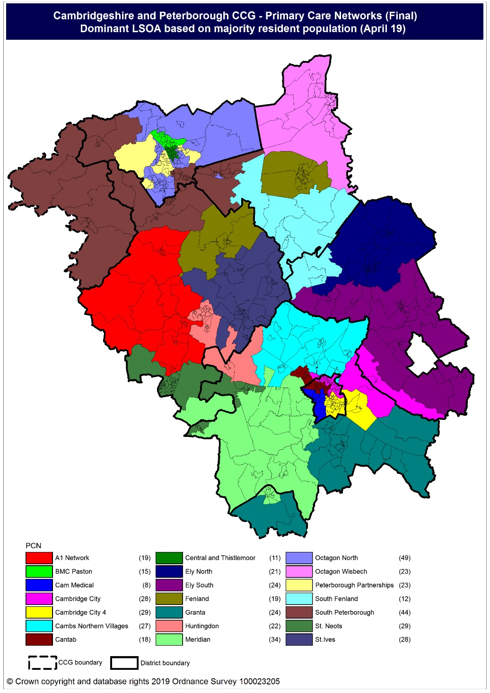
Population distribution
Source: GP registered population data by Lower Super Output Area, April 19, NHS Digital
Population
distribution
PCN dominant
population

Slide 7
Ethnicity
South Peterborough PCN has a higher proportion of population from the White British ethnic group and lower proportions from Mixed, Black and Asian ethnic origins compared to the North Alliance, CCG and England averages.
Source: Census 2011 data applied to GP registered population using Census 2011 ethnic group proportions; England data from NOMIS (patients registered at a GP Practice by LSOA, July 2018, NHS Digital)

Slide 8
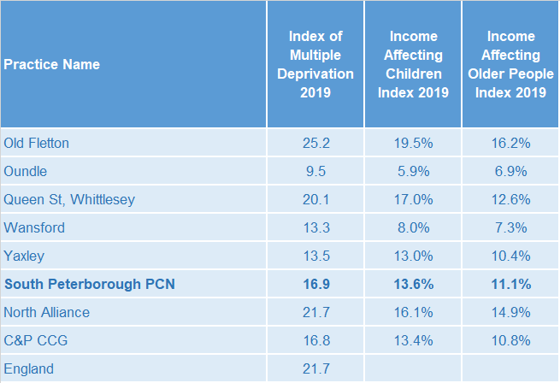
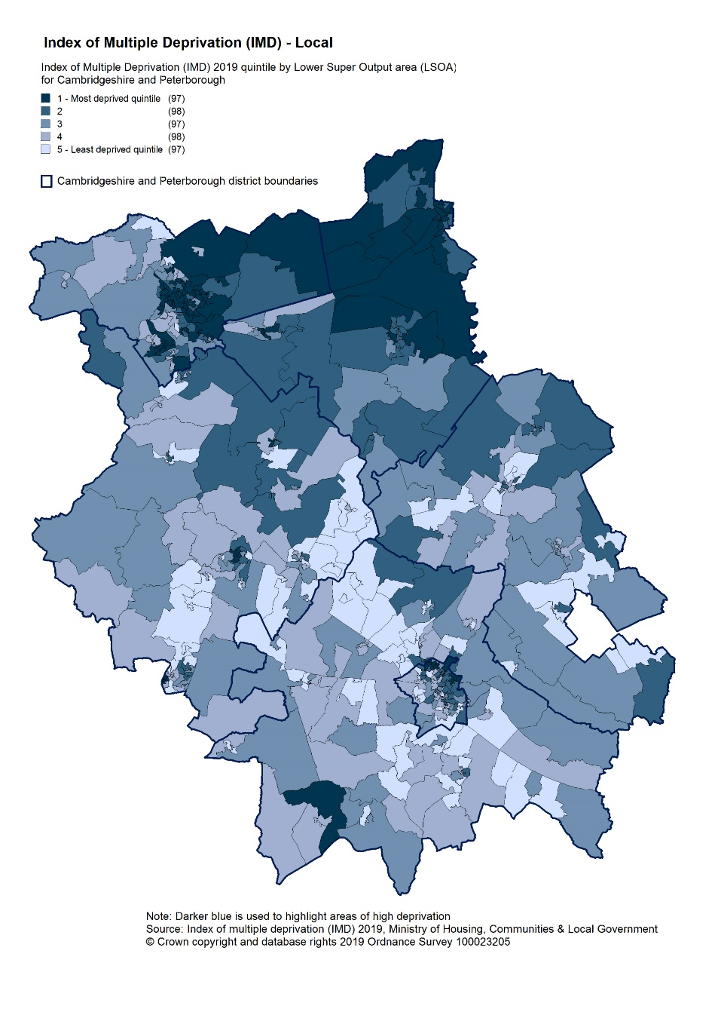
Deprivation
Relative deprivation for South Peterborough PCN overall is lower than for the North Alliance, CCG and England. Three practices have lower relative deprivation when compared to North Alliance, CCG and England. Queen St has higher relative deprivation than the CCG average and Old Fletton higher than North Alliance, CCG and England. Approximately 14% of children and 11% of older people live in income deprived households in South Peterborough PCN; lower than the averages for North Alliance, CCG and England.
Source: C&P PHI derived from Indices of Multiple Deprivation 2019, MHCLG and GP registered population data for July 2018. Practice data from PHE Fingertips.
Index of Multiple Deprivation, 2019, by LSOA

Slide 9
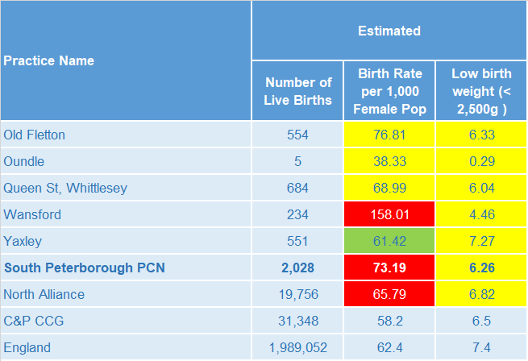
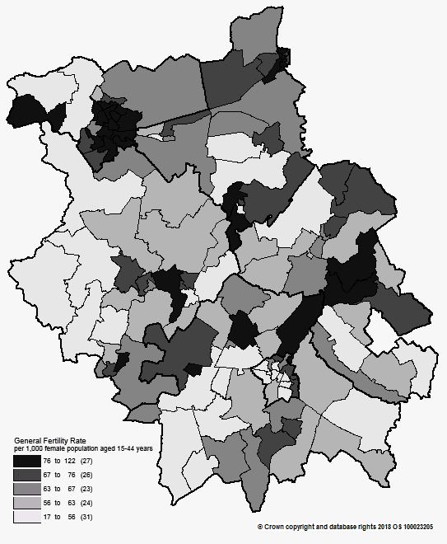
Births and Fertility
South Peterborough PCN birth rates are statistically significantly higher than the North Alliance rate. Low birth weight births in South Peterborough PCN are statistically similar to the average for the North Alliance.
Note: Relates to Cambridgeshire and Peterborough residents only Source: C&P PHI based on NHS Digital Civil Registration Data, 2014-2016 and patients registered at a GP Practice by LSOA, July 2018, NHS Digital
Birth rates by ward

Slide 10
Self-reported limiting long-term illness and general health status
It is estimated that the proportion of people that reported that they had a long-term activity-limiting illness in the 2011 Census was statistically similar to the North Alliance average. It is estimated that the proportion of people that reported that they were in good or very good health in the 2011 Census was statistically similar to the North Alliance average.
Source: C&P PHI from Census 2011, NOMIS and patients registered at a GP Practice by LSOA, July 2018, NHS Digital

Slide 11
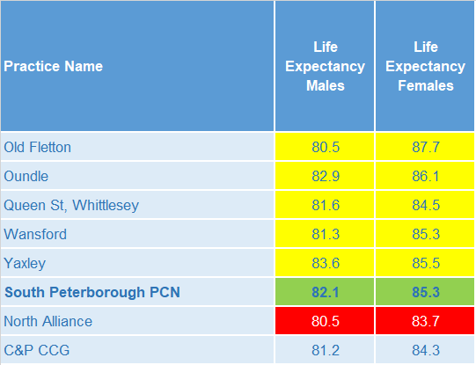
Life expectancy
Male and female life expectancy in South Peterborough PCN is statistically significantly higher than the North Alliance. North Alliance male and female life expectancy is statistically significantly lower than the CCG.
Source: C&P PHI based, derived from NHS Digital Civil Registration data and GP registered population data 2013 – 2017

Slide 12
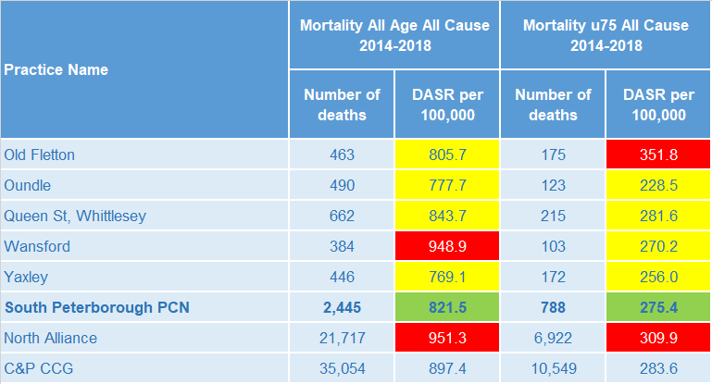
Mortality – all causes
There have been on average 489 deaths a year in South Peterborough PCN, approximately a third are in people aged under 75 year olds. All-age and premature all cause mortality rates for the PCN are statistically significantly lower than the rates for the North Alliance
DASR = directly age standardised rate per 100,000 population Source: C&P PHI, from NHS Digital Civil Registration Data and NHS Digital GP registered population data, 2014-2018

Slide 13
Selected lifestyle behaviour risk factors

Slide 14
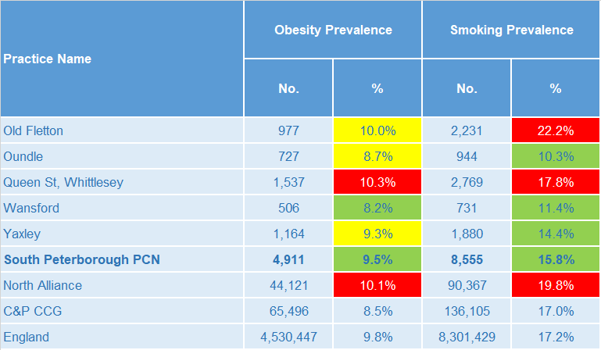
Risk factors
Recorded prevalence of obesity is statistically significantly lower in South Peterborough PCN compared to the average for North Alliance. Estimated smoking prevalence is statistically significantly lower in South Peterborough PCN compared to the average for North Alliance.
Source: Obesity - C&P PHI derived from NHS Digital QOF data for 2017/18; Estimated smoking - C&P PHI derived from the QOF based smoking prevalence estimate from the Public Health England (PHE) National General Practice Profiles at https://fingertips.phe.org.uk/profile/general-practice

Slide 15
Prevalence and mortality from principal diseases

Slide 16
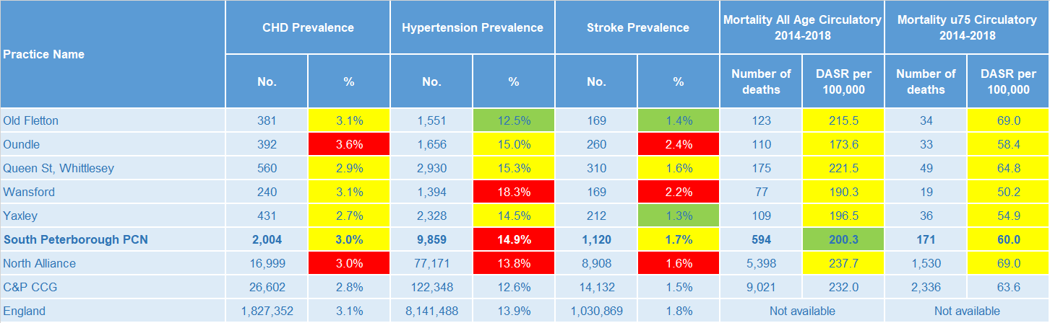
Circulatory disease
PCN level prevalence rates of CHD and stroke are statistically similar when compared to North Alliance but with variation across practices. Hypertension prevalence for the PCN is statistically significantly higher than North Alliance. The PCN circulatory disease all-age mortality rates is statistically significantly lower than North Alliance and the circulatory disease premature rate is statistically similar to North Alliance.
Note: Prevalence data are not available by age i.e. it is not age weighted so differences may be explained by differing age structures; DASR = Directly age standardised rate per 100,000 population Source: Prevalence (recorded) - C&P PHI from QOF, NHS Digital, 2017/18; Mortality - C&P PHI, from NHS Digital Civil Registration Data and NHS Digital GP registered population data, 2014-2018

Slide 17
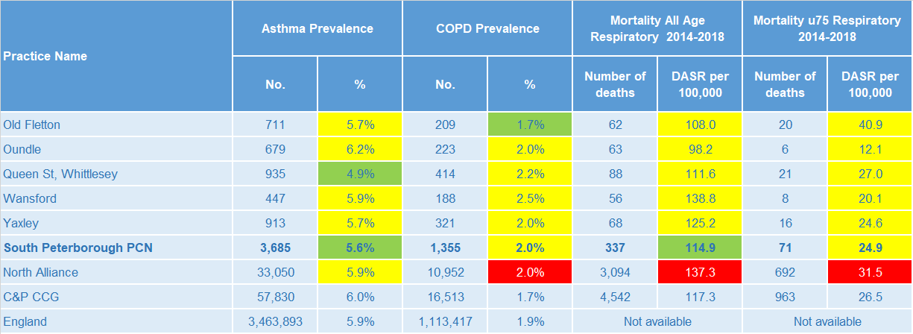
Respiratory disease
Asthma prevalence is statistically significantly lower compared to the North Alliance. COPD prevalence is statistically similar to the North Alliance at PCN level. The PCN mortality rate for respiratory diseases, for people of all ages, is statistically significantly lower than North Alliance. The PCN mortality rate for respiratory diseases, for people aged under 75, is statistically similar to the North Alliance.
Note: Prevalence data are not available by age i.e. it is not age weighted so differences may be explained by differing age structures; DASR = Directly age standardised rate per 100,000 population Source: Prevalence (recorded) - C&P PHI from QOF, NHS Digital, 2017/18; Mortality - C&P PHI, from NHS Digital Civil Registration Data and NHS Digital GP registered population data, 2014-2018

Slide 18
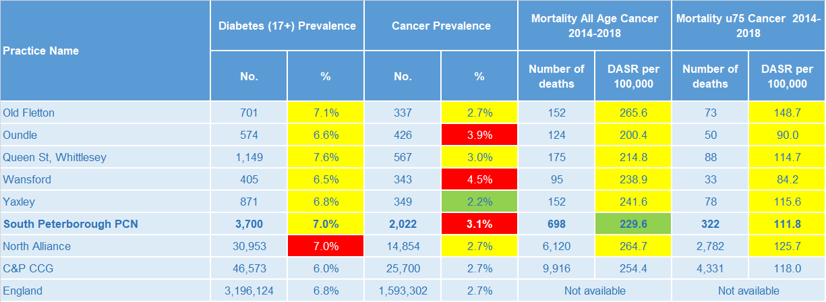
Long term conditions
PCN level Diabetes prevalence is statistically similar to the North Alliance. Cancer prevalence for the PCN is statistically significantly higher than the North Alliance average, with variation across practices. The PCN has a statistically significantly lower all-age cancer mortality rate and a statistically similar premature cancer mortality rate compared to the North Alliance.
Note: Prevalence data are not available by age i.e. it is not age weighted so differences may be explained by differing age structures; DASR = Directly age standardised rate per 100,000 population Source: Prevalence (recorded) - C&P PHI from QOF, NHS Digital, 2017/18; Mortality - C&P PHI, from NHS Digital Civil Registration Data and NHS Digital GP registered population data, 2014-2018

Slide 19
Mental health, dementia and learning disability
PCN level prevalence rates of severe mental illness, depression and dementia are statistically similar to the North Alliance average. The PCN has a statistically significantly low learning disability prevalence compared to the North Alliance.
Note: Prevalence data are not available by age i.e. it is not age weighted so differences may be explained by differing age structures Source: Prevalence (recorded) - C&P PHI from QOF, NHS Digital, 2017/18

Slide 20
Service provision and utilisation

Slide 21
PCN workforce

Slide 22
Who works within the Health and Social Care services for the PCN?
Patients receive health care from a range of individuals and organisations
201 staff are employed through South Peterborough PCN’s Practices, the majority of which will be directly in contact with patients.
Data Sources: Local Authority Data extract; PCN Practice data; CPFT data extract

Slide 23
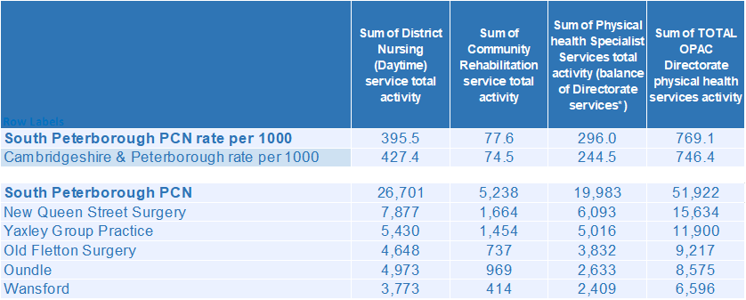
Who works within the Health and Social Care services for the PCN?
Patients receive health care from a range of individuals and organisations
There are currently 51,922 patients under CPFT caseload across the services listed. Caseloads rates for South Peterborough PCN are generally higher compared to the rest of Cambridgeshire and Peterborough. Additional patients will be inpatients in rehab wards and part of the multi-disciplinary team caseload. New Queen Street Surgery has the highest number of caseloads for South Peterborough PCN.
Data Sources: Local Authority Data extract; PCN Practice data; CPFT data extract

Slide 24
Social Care Services

Slide 25
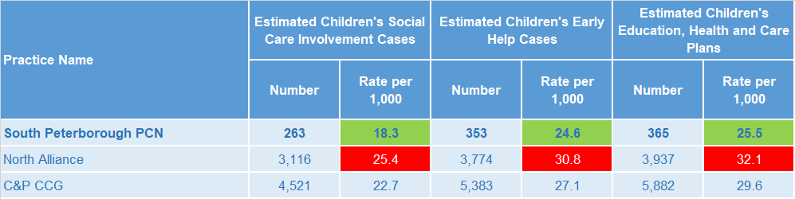
Children’s Social Care
South Peterborough PCN has statistically significantly lower children’s social care usage rates than the North Alliance averages. North Alliance has statistically significantly higher children’s social care usage rates than the CCG average.
Source: Cambridgeshire County Council, BI team. Estimates derived from the LSOA level data, (for those LSOAs in Cambridgeshire or Peterborough only) available as an open data release here: https://data.cambridgeshireinsight.org.uk/dataset/cambridgeshire-and-peterborough-adult-social-care-long-term-service-users-31-march-2019 and GP Registered Population April 2019

Slide 26
Adult Social Care
South Peterborough PCN has a statistically significantly lower overall rate of adult social care usage when compared to the North Alliance. North Alliance has a statistically significantly higher overall rate of adult social care usage when compared with the CCG average.
Source: Cambridgeshire County Council, BI team. Estimates derived from the LSOA level data, (for those LSOAs in Cambridgeshire or Peterborough only) available as an open data release here: https://data.cambridgeshireinsight.org.uk/dataset/cambridgeshire-and-peterborough-adult-social-care-long-term-service-users-31-march-2019 and GP Registered Population April 2019

Slide 27
Secondary Care Services

Slide 28
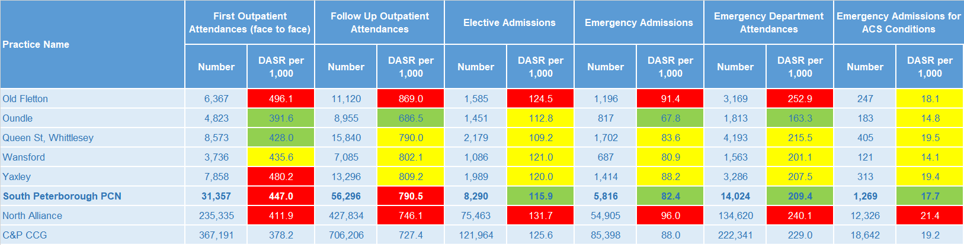
Secondary Care Services
The secondary care service rates for the Old Fletton Surgery are statistically significantly higher than the South Peterborough PCN rates; with the exception of the emergency admissions for ACS conditions rate, which is statistically similar to the PCN. The first outpatient attendances rate for the Yaxley Group Practice is statistically significantly higher than the PCN average. South Peterborough PCN has statistically significantly higher rates of first outpatient attendances and follow up outpatient attendances than the North Alliance rates. North Alliance has statistically significantly high rates of secondary care use compared with the CCG average. Ophthalmology and Trauma & Orthopaedics account for the most outpatient attendances. This was the case for both 17/18 and 18/19. Together they make up 25% of the activity for 18/19. 21% of first outpatient attendances are hearing and sight related. The most common elective admissions are for General Surgery, Gastroenterology and Trauma & Orthopaedics related conditions.
Note: DASR = Directly age standardised rate per 1,000 population, reference population used is the ONS National Standard Population. Source: C&P PHI, from HED Tool, 2018/19; Cambridgeshire and Peterborough “Practice Benchmarker”

Slide 29
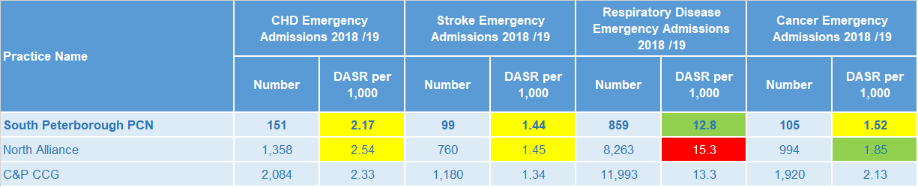
Disease Specific Emergency Hospital Admission Rates
The PCN emergency hospital admission rates shown are statistically similar to the North Alliance average, except for respiratory disease admission rates which are statistically significantly lower than North Alliance. For South Peterborough PCN there were 5,650 emergency admissions during 2018/19. Just 1 of the 5 practices had a higher admission rate than Cambridgeshire and Peterborough. The majority of emergency admissions were for Paediatric Medicine, General Medicine and Geriatric Medicine. The fourth highest number of emergency admissions were related to Nephrology.
Note: DASR = Directly age standardised rate per 1,000 population, reference population used is the ONS National Standard Population. Source: C&P PHI, from HED Tool, 2018/19; Cambridgeshire and Peterborough “All Trusts 18/19”

Slide 30
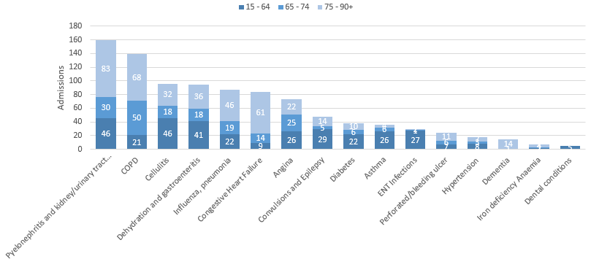
Potentially Avoidable Hospital Admissions
Having the second largest over 75’s population for Cambridgeshire and Peterborough has contributed to South Peterborough PCN having a high number of potentially avoidable admissions.
Selected Ambulatory Care Sensitive Conditions NEL admissions in 2018/19 by age
There are more potentially avoidable emergency admissions for South Peterborough PCN. Although there was a 6% increase for these across Cambridgeshire and Peterborough, ACSC admissions for South Peterborough PCN increased by 9%.
Pyelonephritis and kidney/urinary tract infections and COPD were most common for the higher age bands.
Pyelonephritis and kidney/urinary tract infections are also common for the younger age bracket as well as Cellulitis and Dehydration/Gastroenteritis.
Data Source: Cambridgeshire and Peterborough “Practice Benchmarker”

Slide 31
Glossary of key methods and terms
To assess statistical significance, 95% confidence intervals are calculated which provide a measure of uncertainty around the calculated value which arises due to random variation. If the confidence interval for a value excludes the value for the relevant benchmark, the difference between the local value and the benchmark is said to be ‘statistically significant’. The following hierarchy of benchmarks has been used in this profile: practice to PCN; PCN to Alliance; Alliance to CCG and CCG to England. The most commonly used RAG-rating in this profile: Exceptions to this are life expectancy which is RAG rated like this: And self-reported limiting long-term illness and general health status which is RAG rated like this: DASR = directly age standardised rate per 100,000 population C&P PHI = Cambridgeshire and Peterborough Public Health Intelligence QOF = Quality Outcomes Framework. Prevalence data are not available by age i.e. it is not age weighted so differences may be explained by differing age structures.

Slide 32
Produced by:
Cambridgeshire and Peterborough Public Health Intelligence Team
Contact:
PHI-team@Cambridgeshire.gov.uk
Date updated:
29th November 2019

