Slide 1
South Alliance
Data pack
November 2019

Slide 2
South Alliance – summary
There are almost 416,000 people registered with South Alliance practices, with a higher proportion of the population aged between 16 and 64 compared to the CCG and England. The population is estimated to increase by almost 10% between 2019 and 2026. South Alliance has slightly higher proportions of White Other, Mixed, Asian Chinese/Other and Other ethnic groups compared to the CCG and England. Relative deprivation is lower in the South Alliance compared to the CCG and England. Approximately 9% of children and 10% of older people live in poverty. The birth rate in South Alliance is statistically significantly lower than the average for the CCG. The low birth weight proportion is statistically similar to the CCG. It is estimated that male life expectancy is around 82.3 years in the South Alliance and female life expectancy 85.1 years, both statistically significantly higher compared to the CCG. Recorded obesity prevalence and estimated smoking prevalence in adults are statistically significantly lower than the CCG average. It is estimated that 6.4% of adults are obese and 13.3% of adults smoke. | Estimates of people reporting long-term activity-limiting illness and being in Good or Very Good health are statistically significantly better than the averages for the CCG. On average, there are almost 2,700 deaths a year in the South Alliance, with around a quarter of these in people aged under 75 years. South Alliance has statistically significantly low recorded prevalence of CHD, hypertension, stroke, COPD and diabetes compared to the CCG averages South Alliance has statistically significantly lower all-age and premature all cause mortality rates compared to the CCG. All age and premature mortality rates for respiratory and cancer are statistically significantly lower than the CCG. All age mortality rates for circulatory diseases are statistically similar to the CCG and premature circulatory mortality rates are statistically significantly lower. South Alliance has statistically significantly low rates of children’s and adult social care users compared to the CCG average. South Alliance has statistically significantly low rates of secondary care use compared with the CCG average.

Slide 3
Demography and key population characteristics

Slide 4
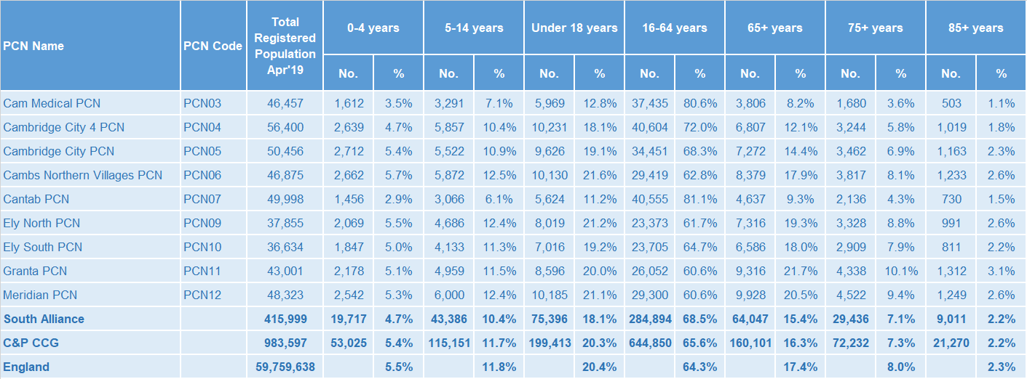
GP registered population
South Alliance has lower proportions of people aged under 18 years and a higher proportion of people aged 16-64 years old compared with the CCG as a whole and England
Source: GP registered population, April 2019, NHS Digital. Population forecasts based on population distribution at ward level (Apr 19), Mid 2015 based population forecasts Cambridgeshire County Council

Slide 5
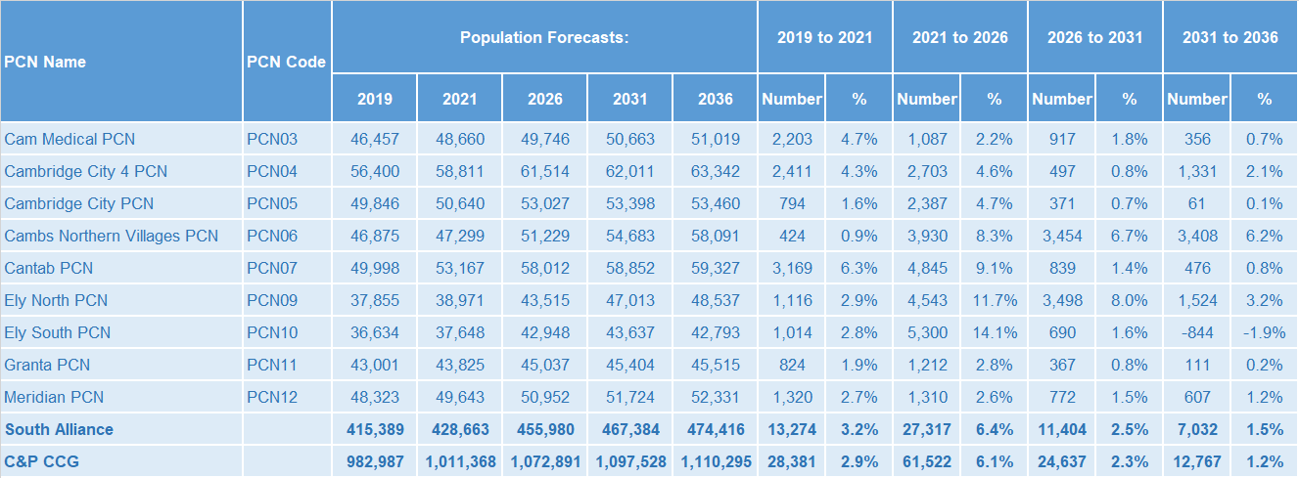
Population forecasts
The population of the South Alliance is forecast to grow at a slightly higher rate than the CCG as whole. The population is expected to increase by 9.8% between 2019 and 2026, compared with 9.1% for the CCG as a whole.
Source: GP registered population, April 2019, NHS Digital. Population forecasts based on population distribution at ward level (Apr 19), Mid 2015 based population forecasts Cambridgeshire County Council

Slide 6
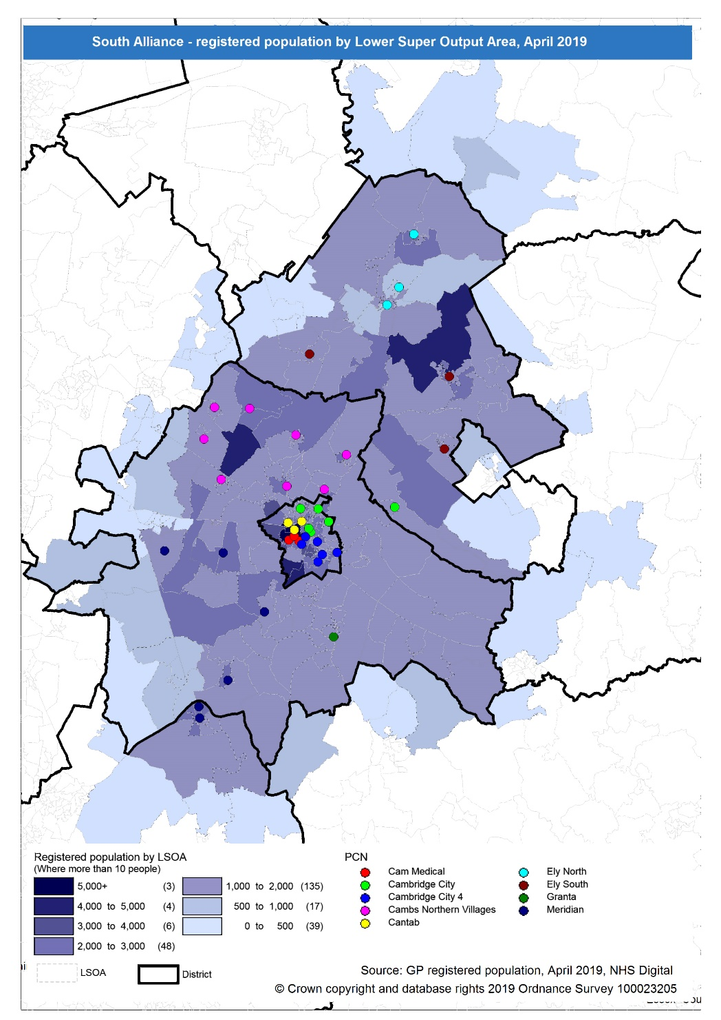
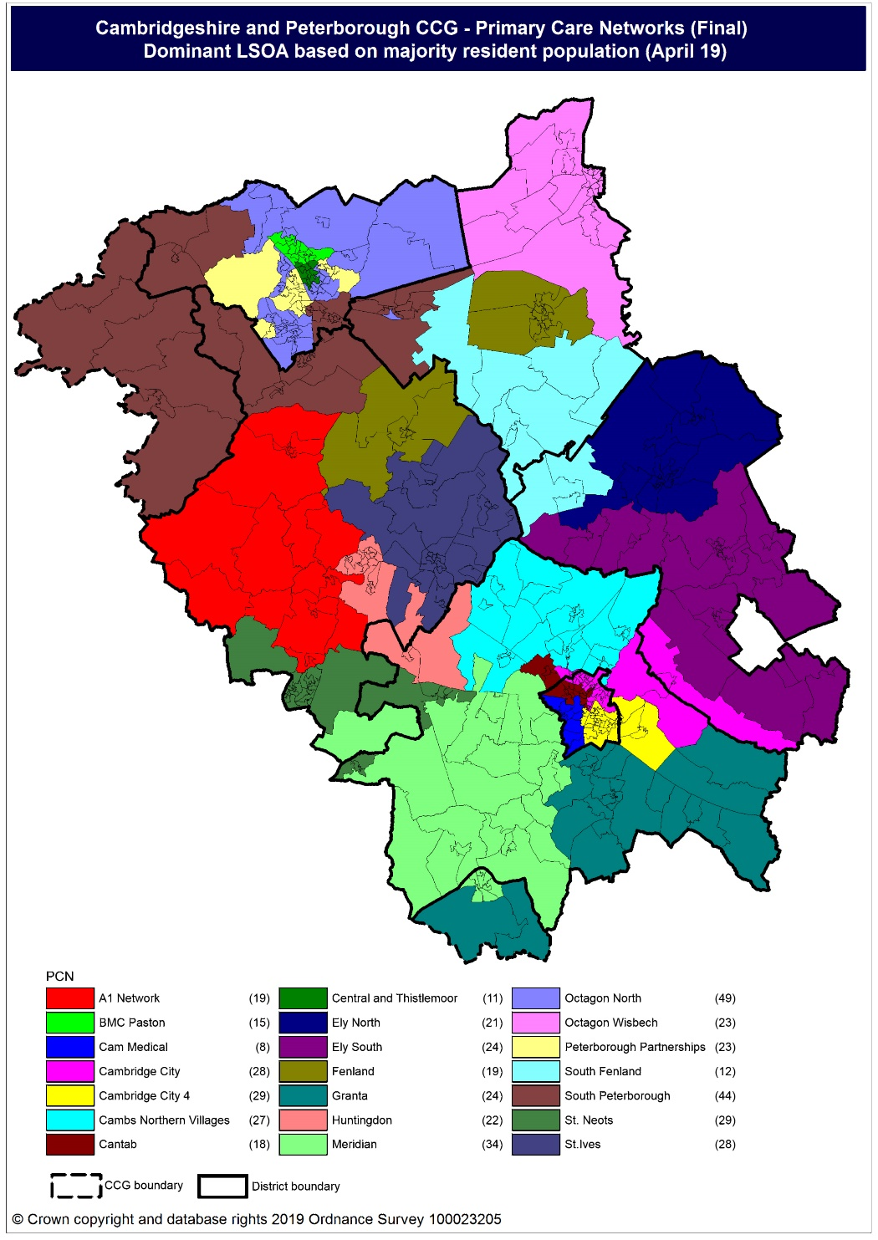
Population distribution
Source: GP registered population data by Lower Super Output Area, April 19, NHS Digital
Population
distribution
PCN dominant
population

Slide 7
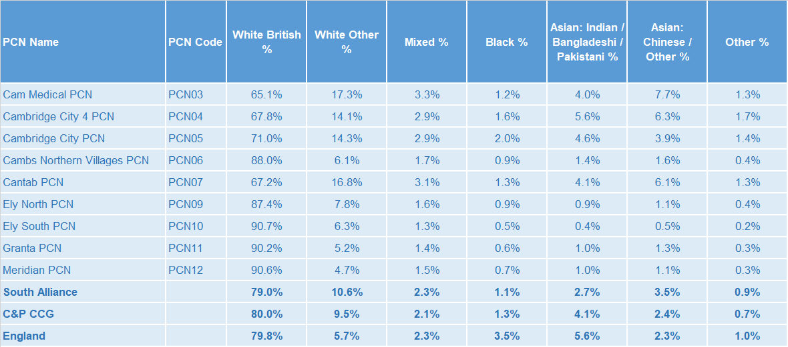
Ethnicity
South Alliance has slightly higher proportions of White Other, Mixed, Asian: Chinese/Other and Other ethnic groups compared to the CCG and England averages and lower proportions of White British, Black and Asian: Indian/Bangladeshi/Pakistani.
Source: Census 2011 data applied to GP registered population using Census 2011 ethnic group proportions; England data from NOMIS (patients registered at a GP Practice by LSOA, July 2018, NHS Digital)

Slide 8
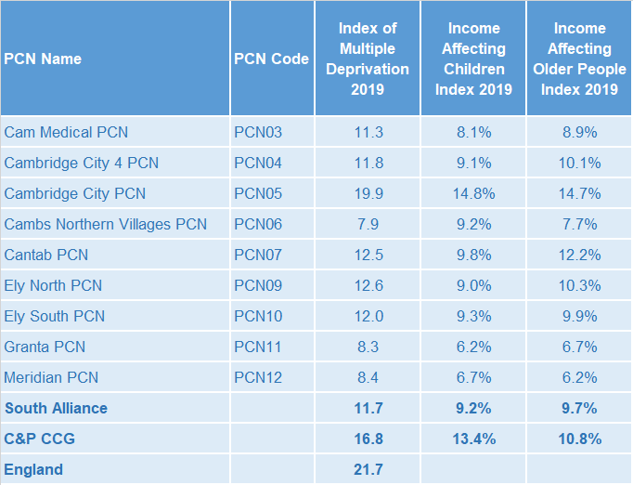
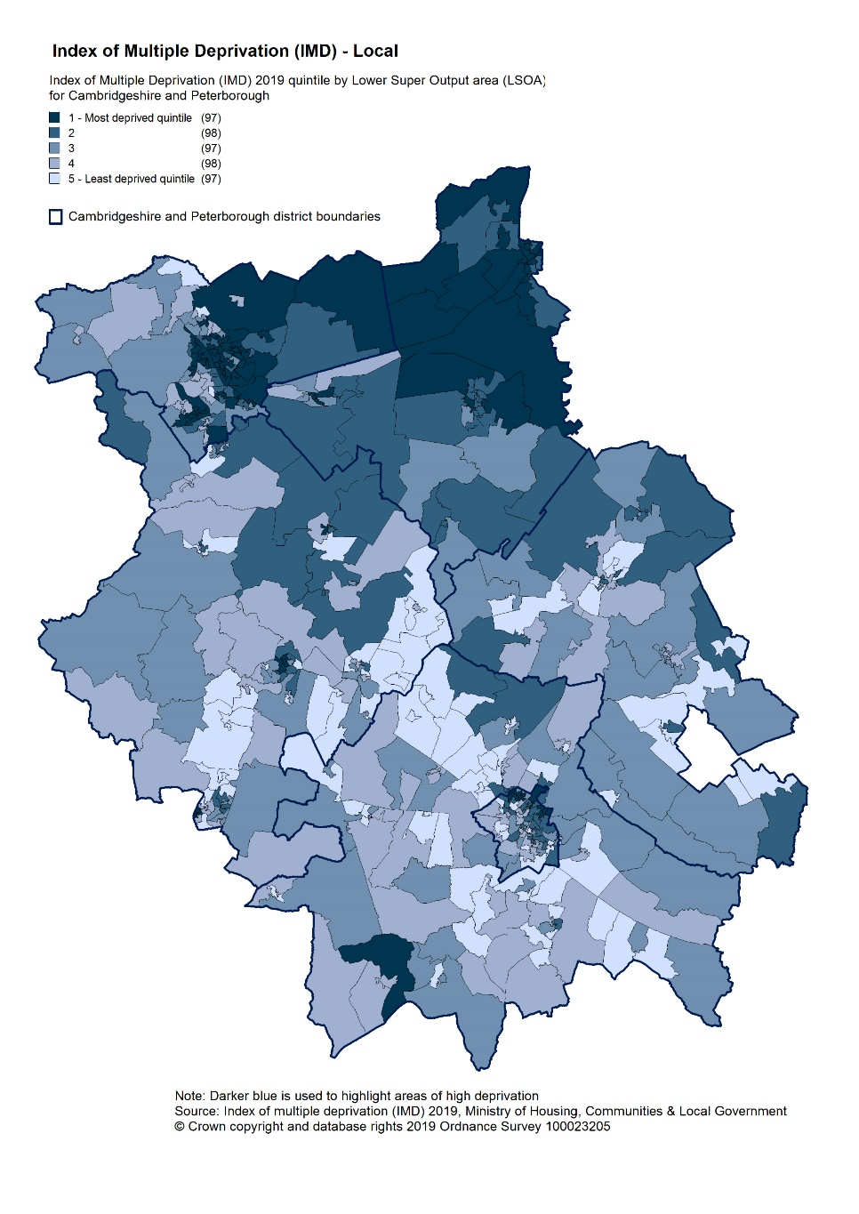
Deprivation
Relative deprivation is lower in South Alliance compared to the CCG and England. Only Cambridge City PCN has higher relative deprivation compared with the CCG. Approximately 9% of children and 10% of older people live in income deprived households in South Alliance, lower than the CCG and England.
Source: C&P PHI derived from Indices of Multiple Deprivation 2019, MHCLG and GP registered population data for July 2018. Practice data from PHE Fingertips.
Index of Multiple Deprivation, 2019, by LSOA

Slide 9
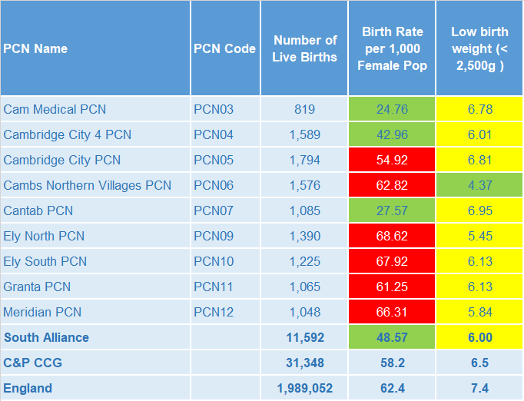
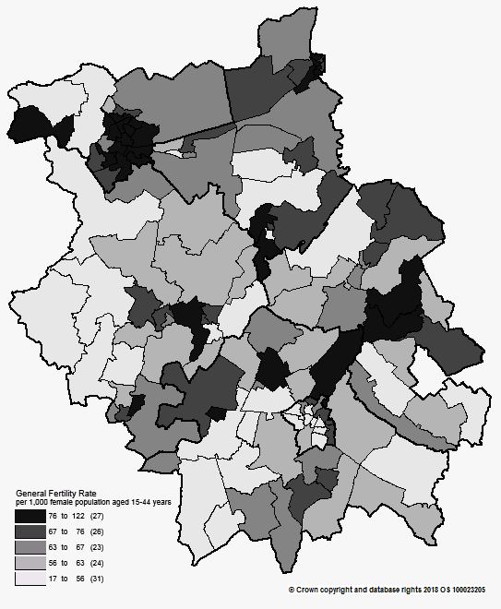
Births and Fertility
The birth rate for South Alliance overall is statistically significantly lower than the average for the CCG. The low birth weight proportion is statistically similar to the CCG average.
Note: Relates to Cambridgeshire and Peterborough residents only Source: C&P PHI based on NHS Digital Civil Registration Data, 2014-2016 and patients registered at a GP Practice by LSOA, July 2018, NHS Digital
Birth rates by ward

Slide 10
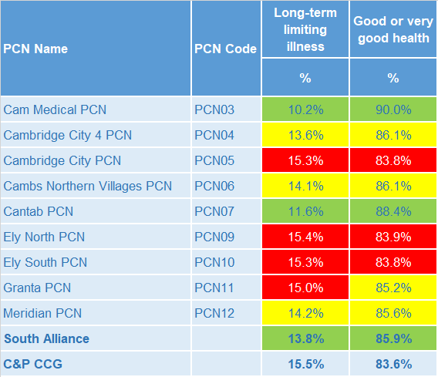
Self-reported limiting long-term illness and general health status
The proportion of the population reporting a long term activity limiting illness is statistically significantly lower in South Alliance than in the CCG. The proportion of people reporting Good or Very Good health is statistically significantly higher in South Alliance.
Source: C&P PHI from Census 2011, NOMIS and patients registered at a GP Practice by LSOA, July 2018, NHS Digital

Slide 11
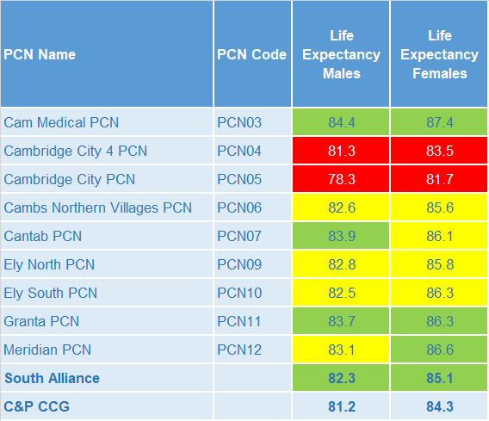
Life expectancy
Male and female life expectancies in South Alliance are statistically significantly higher compared to life expectancies for the CCG.
Source: C&P PHI based, derived from NHS Digital Civil Registration data and GP registered population data 2013 – 2017

Slide 12
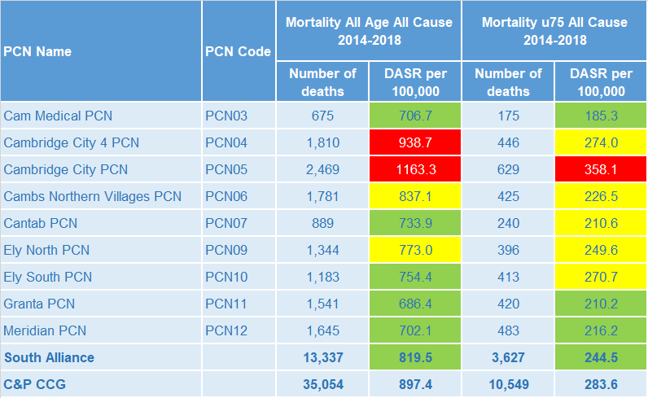
Mortality – all causes
South Alliance has statistically significantly lower all-age and premature all cause mortality rates compared to the CCG.
DASR = directly age standardised rate per 100,000 population Source: C&P PHI, from NHS Digital Civil Registration Data and NHS Digital GP registered population data, 2014-2018

Slide 13
Selected lifestyle behaviour risk factors

Slide 14
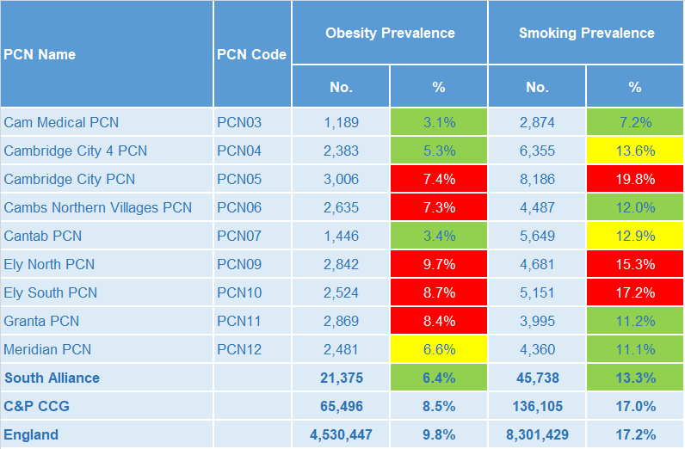
Risk factors
Recorded prevalence of obesity and estimated smoking prevalence are statistically significantly lower in South Alliance compared to the average for the CCG.
Source: Obesity - C&P PHI derived from NHS Digital QOF data for 2017/18; Estimated smoking - C&P PHI derived from the QOF based smoking prevalence estimate from the Public Health England (PHE) National General Practice Profiles at https://fingertips.phe.org.uk/profile/general-practice

Slide 15
Prevalence and mortality from principal diseases

Slide 16
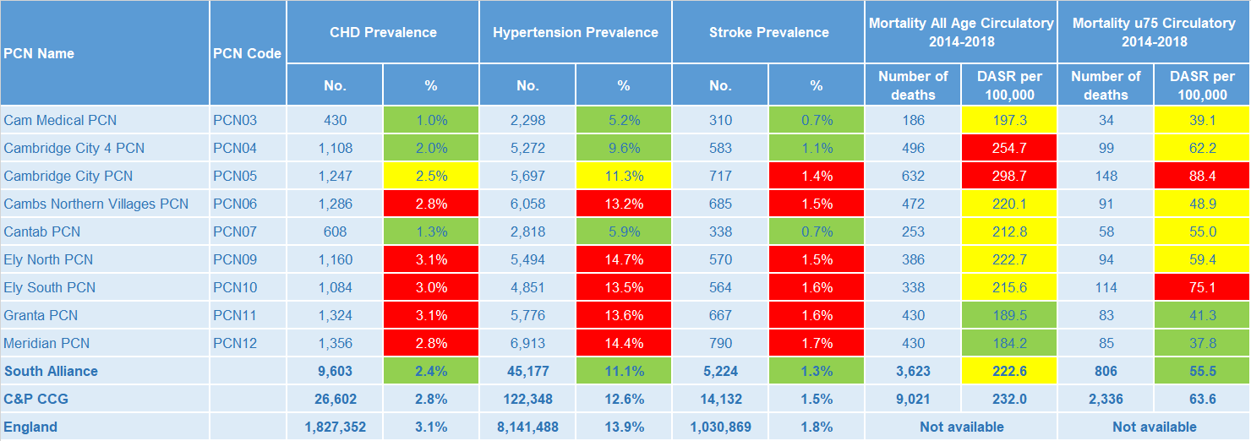
Circulatory disease
South Alliance prevalence rates for CHD, hypertension and stroke are statistically significantly low compared to CCG. Circulatory disease all-age mortality rates are statistically similar to the CCG and premature mortality rates for circulatory disease are statistically significantly low compared to the CCG.
Note: Prevalence data are not available by age i.e. it is not age weighted so differences may be explained by differing age structures; DASR = Directly age standardised rate per 100,000 population Source: Prevalence (recorded) - C&P PHI from QOF, NHS Digital, 2017/18; Mortality - C&P PHI, from NHS Digital Civil Registration Data and NHS Digital GP registered population data, 2014-2018

Slide 17
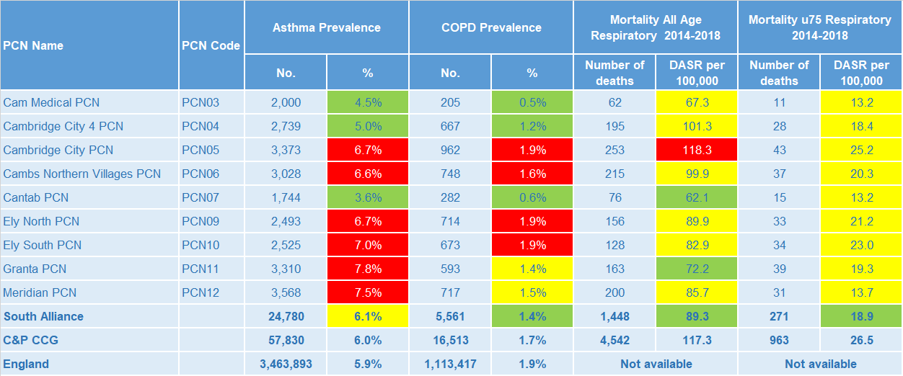
Respiratory disease
South Alliance prevalence rates for Asthma are statistically similar to the CCG and COPD prevalence is statistically significantly lower than the CCG. Respiratory disease all-age and premature mortality rates are statistically significantly low compared to the CCG.
Note: Prevalence data are not available by age i.e. it is not age weighted so differences may be explained by differing age structures; DASR = Directly age standardised rate per 100,000 population Source: Prevalence (recorded) - C&P PHI from QOF, NHS Digital, 2017/18; Mortality - C&P PHI, from NHS Digital Civil Registration Data and NHS Digital GP registered population data, 2014-2018

Slide 18
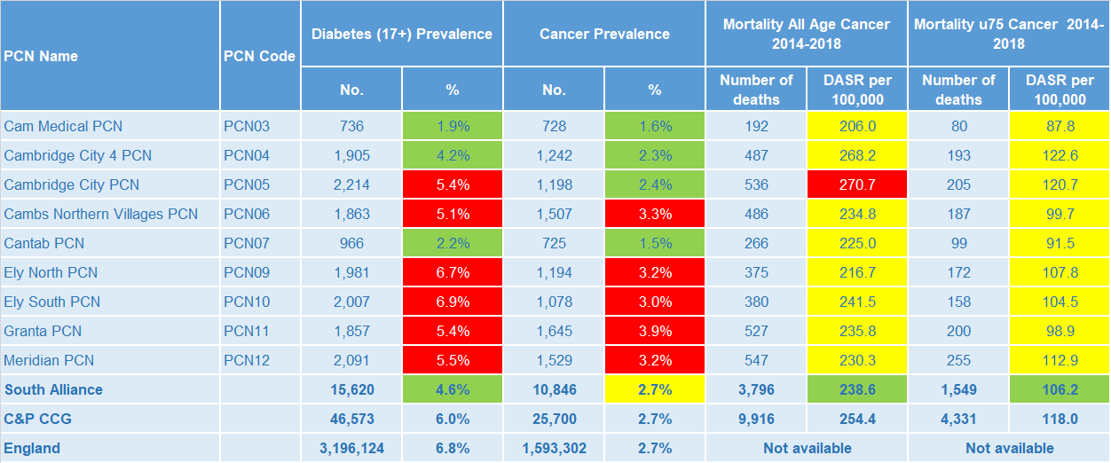
Long term conditions
Diabetes prevalence rates are statistically significantly lower than the CCG, and cancer prevalence is statistically similar to the CCG. South Alliance all age and premature cancer mortality rates are statistically significantly lower the CCG.
Note: Prevalence data are not available by age i.e. it is not age weighted so differences may be explained by differing age structures; DASR = Directly age standardised rate per 100,000 population Source: Prevalence (recorded) - C&P PHI from QOF, NHS Digital, 2017/18; Mortality - C&P PHI, from NHS Digital Civil Registration Data and NHS Digital GP registered population data, 2014-2018

Slide 19
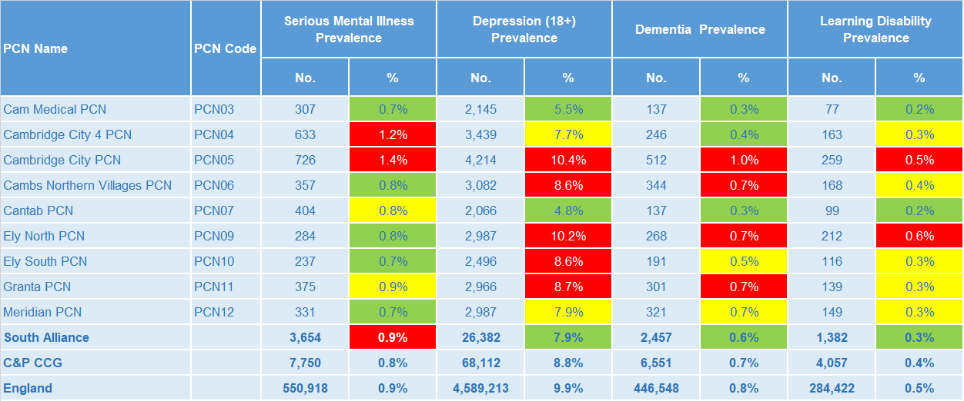
Mental health, dementia and learning disability
Serious mental illness prevalence in South Alliance is statistically significantly higher than the CCG average. Depression, dementia and learning disability prevalence is statistically significantly lower for the South Alliance overall when compared to the CCG average.
Note: Prevalence data are not available by age i.e. it is not age weighted so differences may be explained by differing age structures Source: Prevalence (recorded) - C&P PHI from QOF, NHS Digital, 2017/18

Slide 20
Service provision and utilisation

Slide 21
Social Care Services

Slide 22
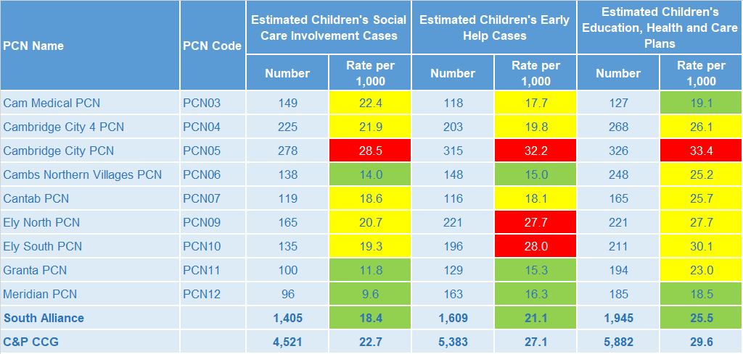
Children’s Social Care
It is estimated that the South Alliance has statistically significantly low rates of social care involvement cases, early help cases and education, health and care plans compared to the CCG average.
Source: Cambridgeshire County Council, BI team. Estimates derived from the LSOA level data, (for those LSOAs in Cambridgeshire or Peterborough only) available as an open data release here: https://data.cambridgeshireinsight.org.uk/dataset/cambridgeshire-and-peterborough-adult-social-care-long-term-service-users-31-march-2019 and GP Registered Population April 2019

Slide 23
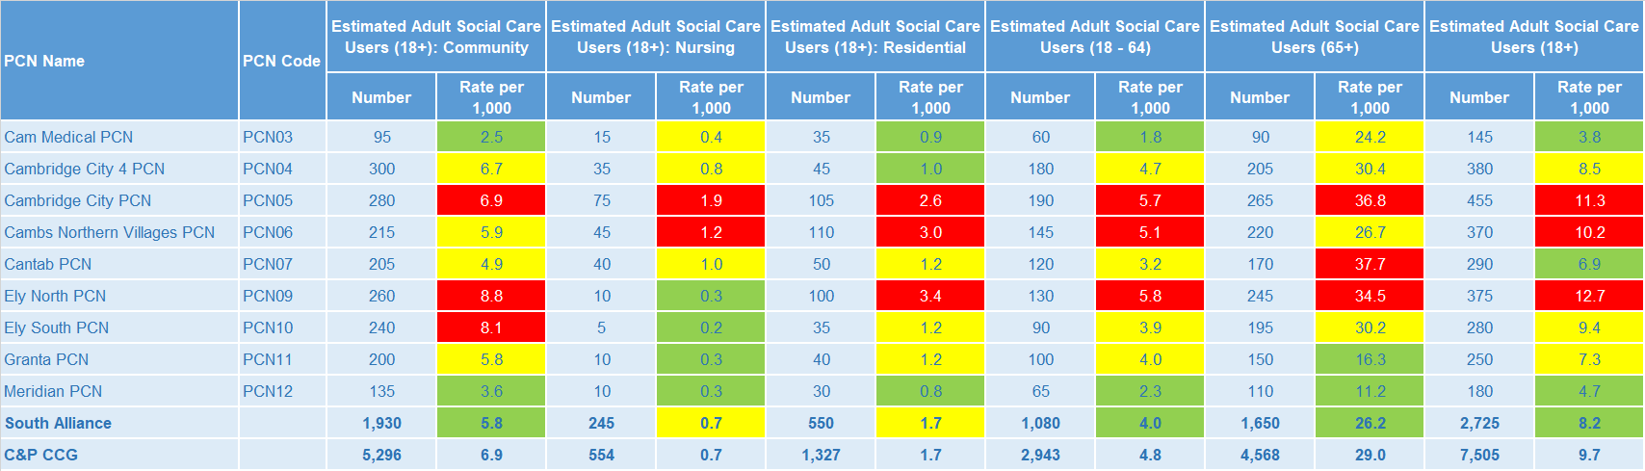
Adult Social Care
South Alliance has statistically significantly low overall rates of adult social care use compared with the CCG average.
Source: Cambridgeshire County Council, BI team. Estimates derived from the LSOA level data, (for those LSOAs in Cambridgeshire or Peterborough only) available as an open data release here: https://data.cambridgeshireinsight.org.uk/dataset/cambridgeshire-and-peterborough-adult-social-care-long-term-service-users-31-march-2019 and GP Registered Population April 2019

Slide 24
Secondary Care Services

Slide 25
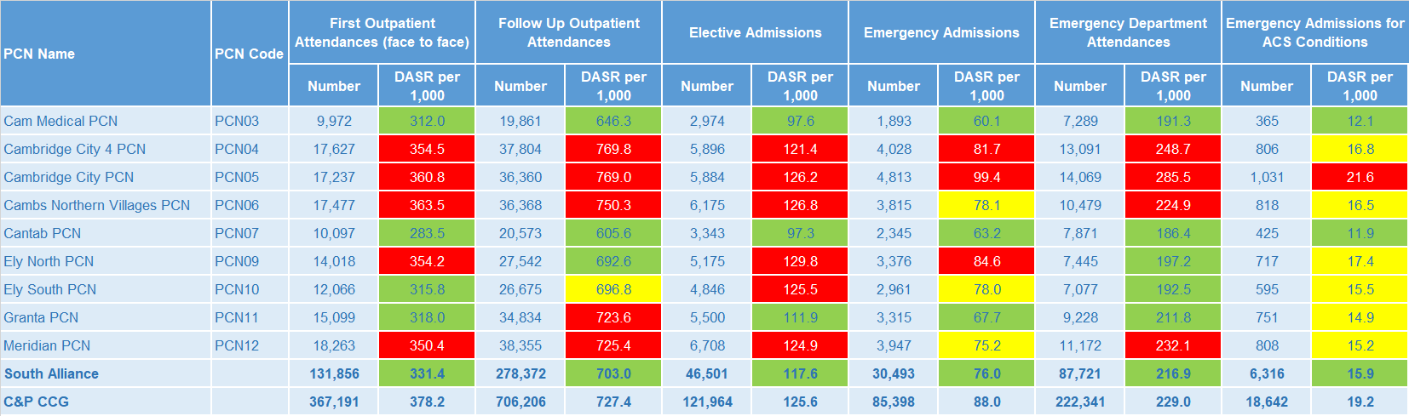
Secondary Care Services
South Alliance has statistically significantly low rates of secondary care use compared with the CCG average.
Note: DASR = Directly age standardised rate per 1,000 population, reference population used is the ONS National Standard Population. Source: C&P PHI, from HED Tool, 2018/19, Cambridgeshire and Peterborough “Practice Benchmarker”

Slide 26
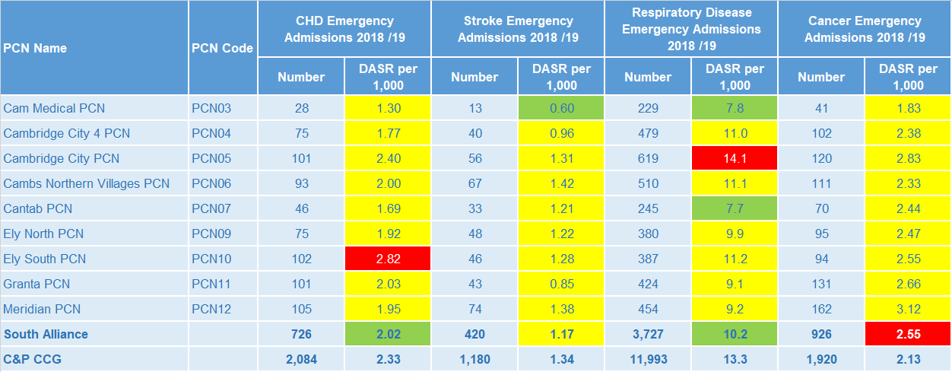
Disease Specific Emergency Hospital Admission Rates
South Alliance emergency admission rates for cancer are statistically significantly higher than the CCG average. South Alliance emergency admission rates for stroke are statistically similar compared to the CCG. South Alliance emergency admission rates for CHD and respiratory disease are statistically significantly lower than the CCG average.
Note: DASR = Directly age standardised rate per 1,000 population, reference population used is the ONS National Standard Population. Source: C&P PHI, from HED Tool, 2018/19, Cambridgeshire and Peterborough “All Trusts 18/19”

Slide 27
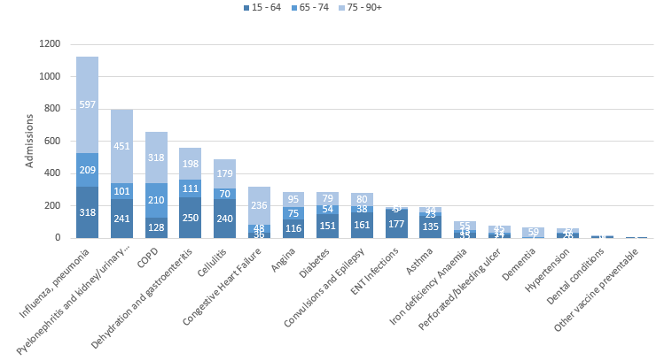
Ambulatory Care Sensitive Conditions
Data Source: Cambridgeshire and Peterborough “Practice Benchmarker”
South Alliance Ambulatory Care Sensitive Conditions NEL Admissions for 18/19 by age
The number of conditions not normally requiring admission saw a 3% (157) year on year increase for the South Alliance. Those aged over 65 account for the majority of the most common potentially preventable (ACSC) related admissions during 18/19.
Influenza/Pneumonia, Dehydration and Gastroenteritis, Pyelonephritis and kidney/urinary tract infections, Cellulitis, and ENT Infections were most common for the younger bracket.

Slide 28
Glossary of key methods and terms
To assess statistical significance, 95% confidence intervals are calculated which provide a measure of uncertainty around the calculated value which arises due to random variation. If the confidence interval for a value excludes the value for the relevant benchmark, the difference between the local value and the benchmark is said to be ‘statistically significant’. The following hierarchy of benchmarks has been used in this profile: practice to PCN; PCN to Alliance; Alliance to CCG and CCG to England. The most commonly used RAG-rating in this profile: Exceptions to this are life expectancy which is RAG rated like this: And self-reported limiting long-term illness and general health status which is RAG rated like this: DASR = directly age standardised rate per 100,000 population C&P PHI = Cambridgeshire and Peterborough Public Health Intelligence QOF = Quality Outcomes Framework. Prevalence data are not available by age i.e. it is not age weighted so differences may be explained by differing age structures.

Slide 29
Produced by:
Cambridgeshire and Peterborough Public Health Intelligence Team
Contact:
PHI-team@Cambridgeshire.gov.uk
Date updated:
29th November 2019

