Slide 1
Granta PCN
Data pack
November 2019

Slide 2
Granta PCN – summary
There are just over 43,000 people registered with Granta PCN, with a higher proportion of the population aged over 65 compared to the South Alliance, CCG and England. There is little ethnic diversity in the area, with a notably high White British population Granta PCN is one of the least deprived practices in Cambridgeshire and Peterborough There is a statistically significantly high birth rate compared to the South Alliance rate, with low birth weight (under 2,500g) births similar to those seen within the Alliance. Life expectancy in males and females is statistically significantly higher than the South Alliance. Recorded obesity in adults is statistically significantly higher than the South Alliance. Estimated smoking prevalence is statistically significantly low in comparison to the South Alliance. Estimates of people reporting long-term activity-limiting illness are statistically significantly worse than the averages for the South Alliance, which may be a reflection of the relatively high older people population in the area. All age and premature all cause mortality is statistically significantly low in Granta PCN compared to the South Alliance and CCG. | The PCN has statistically significantly high recorded prevalences of CHD, hypertension, stroke, asthma, diabetes, cancer, depression and dementia when compared to the averages for the South Alliance. Mortality rates for circulatory disease, in people of all ages and those aged under 75 years, are statistically significantly lower than South Alliance rates. Granta PCN has statistically significantly lower rates of Children’s social care involvement cases and early help cases than the South Alliance but estimated rates for education, health and care plans are statistically similar to the South Alliance. Overall adult social care rates are statistically similar to the South Alliance. The PCN has a statistically significantly high follow up attendance rate when compared to the South Alliance.

Slide 3
Demography and key population characteristics

Slide 4
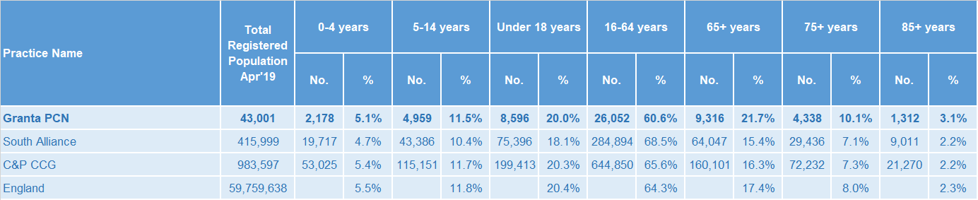
GP registered population
Granta PCN has a notably high proportion of older people compared to the averages for South Alliance, the CCG and England.
Source: GP registered population, April 2019, NHS Digital. Population forecasts based on population distribution at ward level (Apr 19), Mid 2015 based population forecasts Cambridgeshire County Council

Slide 5
Population forecasts
The population of Granta PCN is forecast to grow at a slower rate than the CCG as whole. It is estimated to increase by 4.7% between 2019 and 2026.
Source: GP registered population, April 2019, NHS Digital. Population forecasts based on population distribution at ward level (Apr 19), Mid 2015 based population forecasts Cambridgeshire County Council

Slide 6
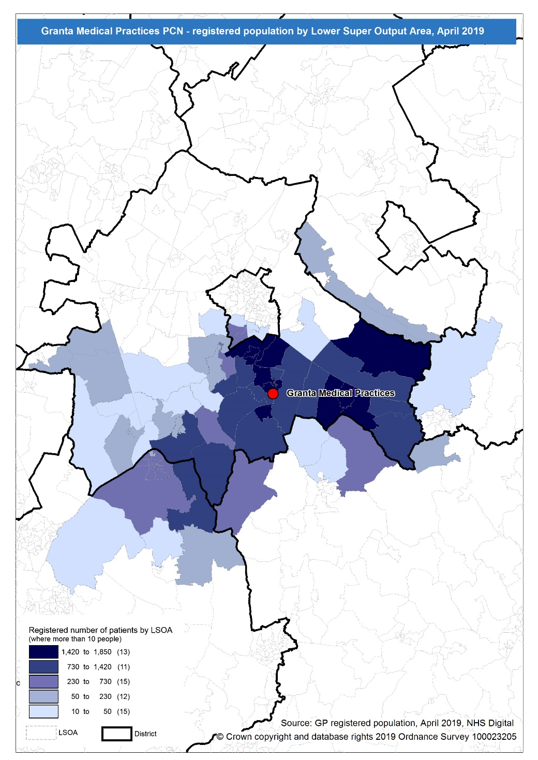
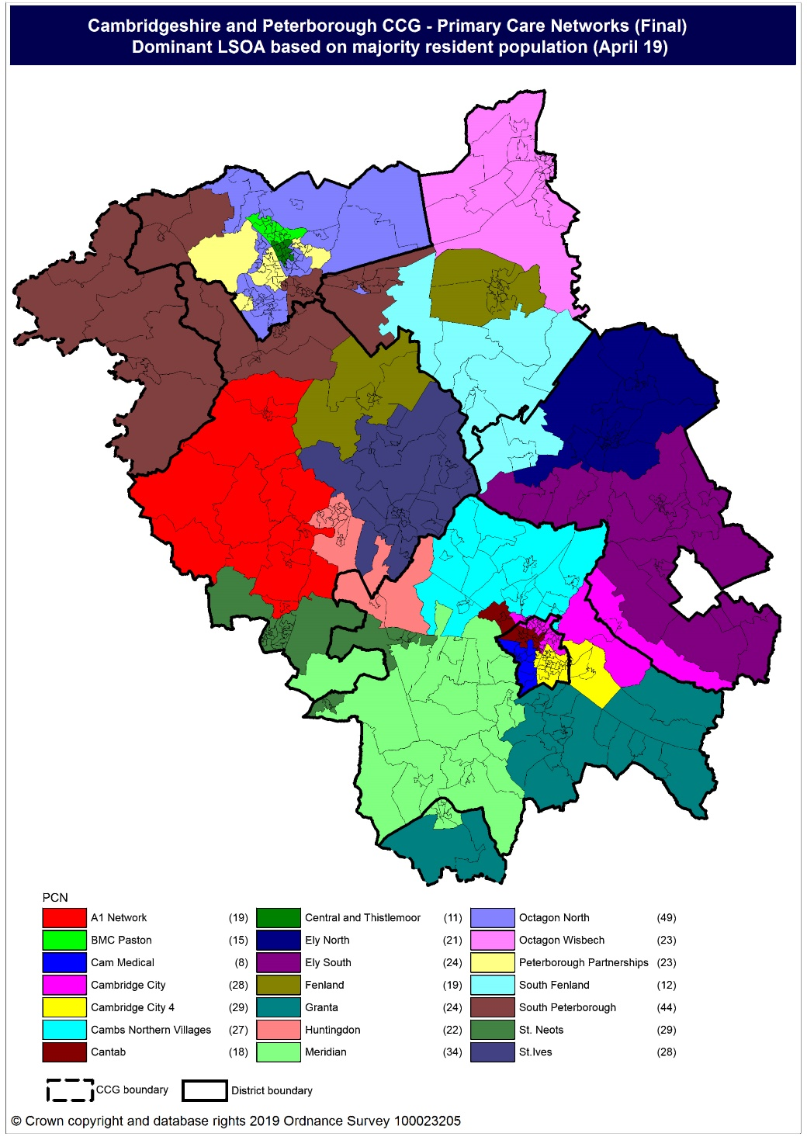
Population distribution
Source: GP registered population data by Lower Super Output Area, April 19, NHS Digital
Population
distribution
PCN dominant
population

Slide 7
Ethnicity
Granta PCN has relatively little ethnic diversity, with a noticeably high proportion of population from the White British ethnic group
Source: Census 2011 data applied to GP registered population using Census 2011 ethnic group proportions; England data from NOMIS (patients registered at a GP Practice by LSOA, July 2018, NHS Digital)

Slide 8
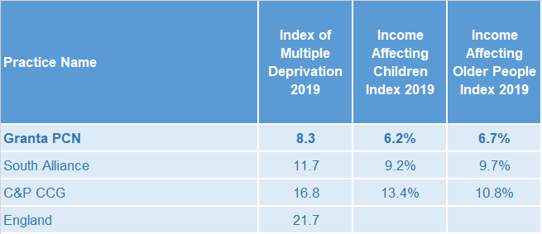
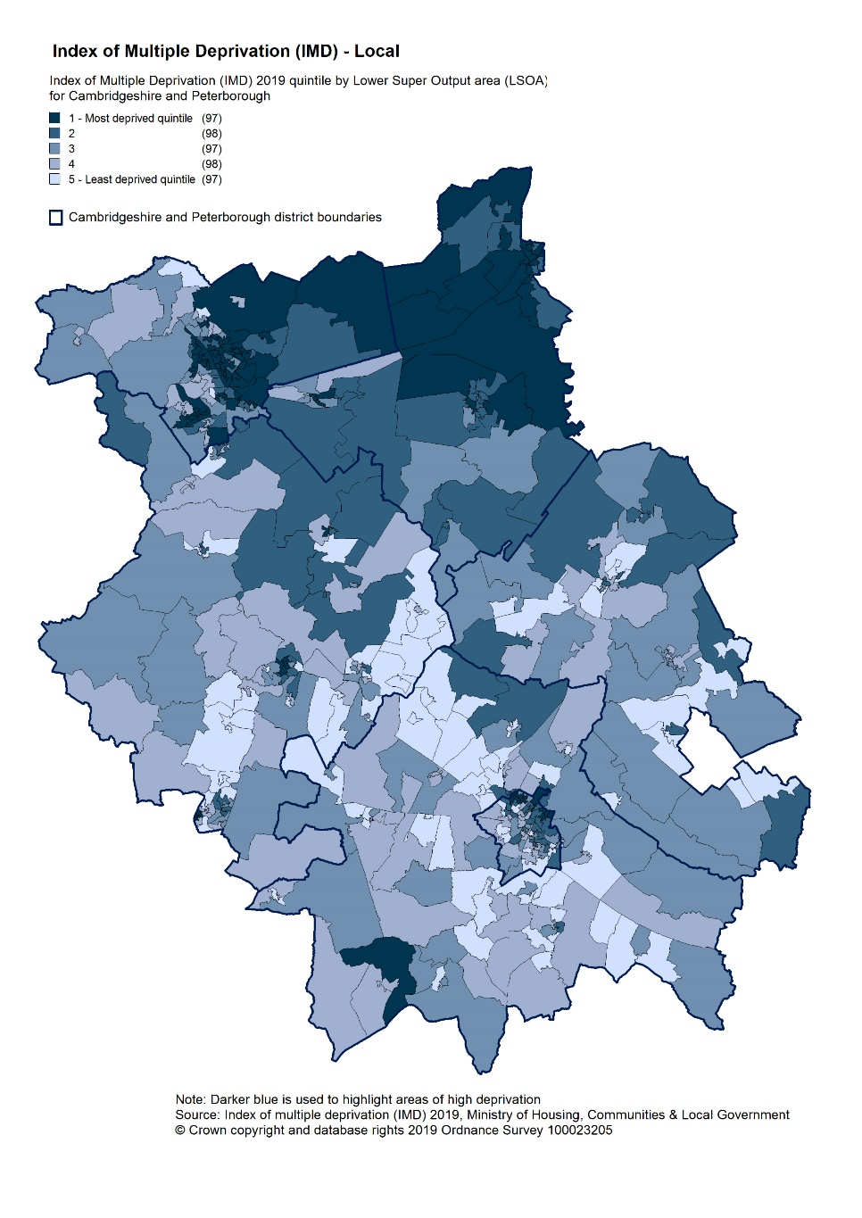
Deprivation
Overall deprivation levels are relatively low in Granta PCN when compared to South Alliance, CCG and England. Approximately 6.2% children and 6.7% of older people live in income deprived households.
Source: C&P PHI derived from Indices of Multiple Deprivation 2019, MHCLG and GP registered population data for July 2018. Practice data from PHE Fingertips.
Index of Multiple Deprivation, 2019, by LSOA

Slide 9
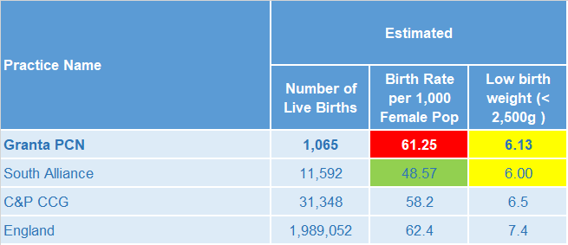
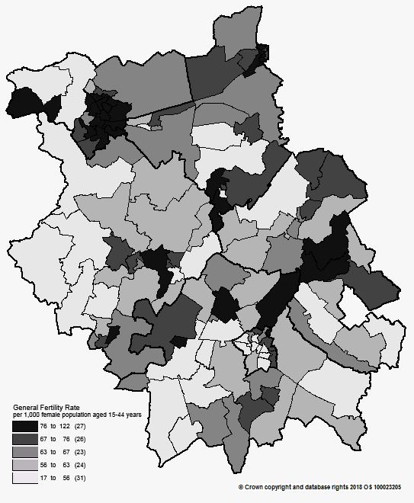
Births and Fertility
Granta PCN has a statistically significantly high birth rate compared to South Alliance (this may be due to a methodological reason relating to estimating the female population aged 15 to 44 years outside of Cambridgeshire) Low birth weight births for Granta PCN are statistically similar to the average for South Alliance, and lower than the CCG average.
Note: Relates to Cambridgeshire and Peterborough residents only Source: C&P PHI based on NHS Digital Civil Registration Data, 2014-2016 and patients registered at a GP Practice by LSOA, July 2018, NHS Digital
Birth rates by ward

Slide 10
Self-reported limiting long-term illness and general health status
It is estimated that the proportion of people that reported that they had a long-term activity-limiting illness in the 2011 Census was statistically significantly higher than the South Alliance average, with levels lower than the average for the CCG. It is estimated that the proportion of people that reported that they were in good or very good health in the 2011 Census was statistically similar to the South Alliance average. The proportions could be associated with Granta PCN having an overall older population than Alliance/CCG averages.
Source: C&P PHI from Census 2011, NOMIS and patients registered at a GP Practice by LSOA, July 2018, NHS Digital

Slide 11
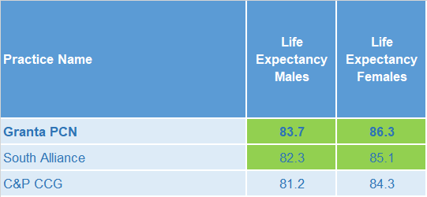
Life expectancy
Life expectancy is statistically significantly higher in both males and females in Granta PCN when compared to South Alliance
Source: C&P PHI based, derived from NHS Digital Civil Registration data and GP registered population data 2013 – 2017

Slide 12
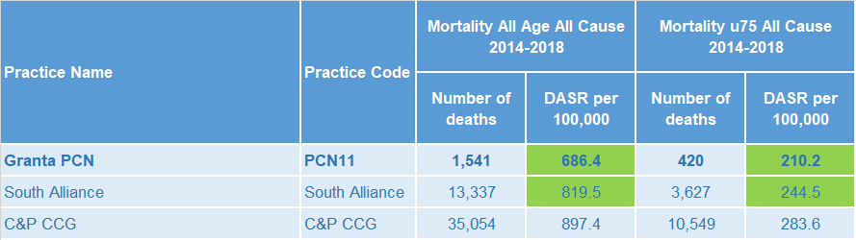
Mortality – all causes
All-age all-cause and premature all cause mortality rates are statistically significantly lower than the South Alliance rate.
DASR = directly age standardised rate per 100,000 population Source: C&P PHI, from NHS Digital Civil Registration Data and NHS Digital GP registered population data, 2014-2018

Slide 13
Selected lifestyle behaviour risk factors

Slide 14
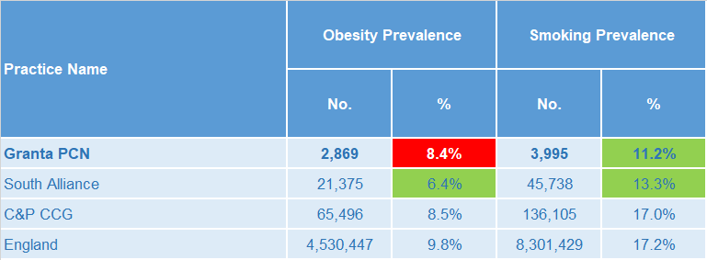
Risk factors
Recorded prevalence of obesity is statistically significantly high in Granta PCN compared to the average for South Alliance. Estimated smoking prevalence is statistically significantly lower in Granta PCN compared to the average for South Alliance.
Source: Obesity - C&P PHI derived from NHS Digital QOF data for 2017/18; Estimated smoking - C&P PHI derived from the QOF based smoking prevalence estimate from the Public Health England (PHE) National General Practice Profiles at https://fingertips.phe.org.uk/profile/general-practice

Slide 15
Prevalence and mortality from principal diseases

Slide 16
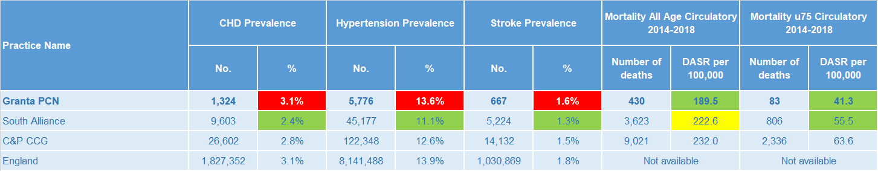
Circulatory disease
Recorded prevalence is statistically significantly higher in Granta PCN than South Alliance for all the circulatory diseases reported, and also slightly higher than the CCG averages – this could be partly due to Granta PCN’s older population profile. Circulatory disease mortality rates, in all ages and in under 75 year olds, are statistically significantly lower than the South Alliance rates.
Note: Prevalence data are not available by age i.e. it is not age weighted so differences may be explained by differing age structures; DASR = Directly age standardised rate per 100,000 population Source: Prevalence (recorded) - C&P PHI from QOF, NHS Digital, 2017/18; Mortality - C&P PHI, from NHS Digital Civil Registration Data and NHS Digital GP registered population data, 2014-2018

Slide 17
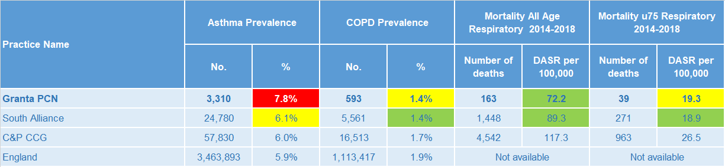
Respiratory disease
Asthma prevalence is statistically significantly higher in Granta PCN than the average for South Alliance, and notably higher than the CCG average. COPD prevalence is similar to the South Alliance and lower than the average for the CCG. Mortality rates for respiratory diseases, for people of all ages is statistically significantly lower than the South Alliance average.
Note: Prevalence data are not available by age i.e. it is not age weighted so differences may be explained by differing age structures; DASR = Directly age standardised rate per 100,000 population Source: Prevalence (recorded) - C&P PHI from QOF, NHS Digital, 2017/18; Mortality - C&P PHI, from NHS Digital Civil Registration Data and NHS Digital GP registered population data, 2014-2018

Slide 18
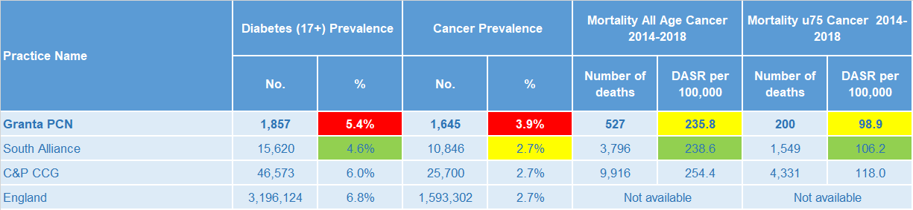
Long term conditions
Diabetes and cancer prevalence rates are statistically significantly higher than the South Alliance average. Cancer mortality rates, in people of all ages and in under 75 year olds, are statistically similar to the South Alliance rates.
Note: Prevalence data are not available by age i.e. it is not age weighted so differences may be explained by differing age structures; DASR = Directly age standardised rate per 100,000 population Source: Prevalence (recorded) - C&P PHI from QOF, NHS Digital, 2017/18; Mortality - C&P PHI, from NHS Digital Civil Registration Data and NHS Digital GP registered population data, 2014-2018

Slide 19
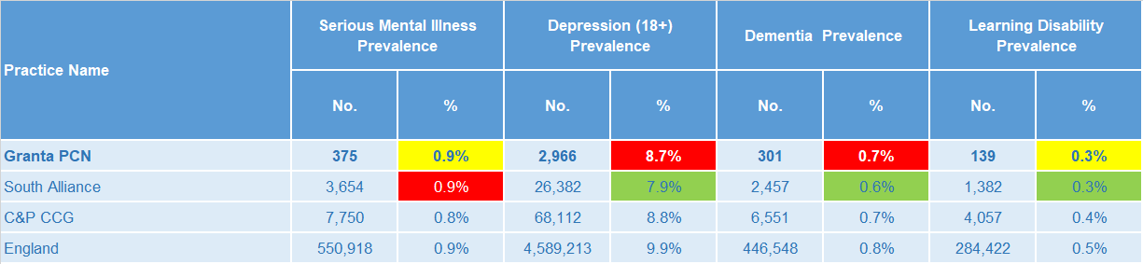
Mental health, dementia and learning disability
Prevalence of severe mental illness and learning disabilities are statistically similar to the South Alliance average. Prevalence of depression and dementia are statistically significantly higher than the South Alliance.
Note: Prevalence data are not available by age i.e. it is not age weighted so differences may be explained by differing age structures Source: Prevalence (recorded) - C&P PHI from QOF, NHS Digital, 2017/18

Slide 20
Service provision and utilisation

Slide 21
PCN workforce

Slide 22
Who works within the Health and Social Care services for the PCN?
Patients receive health care from a range of individuals and organisations
146 staff are employed through Granta PCN’s practices, the majority of which will be directly in contact with patients.
Data Sources: Local Authority Data extract; PCN Practice data; CPFT data extract

Slide 23
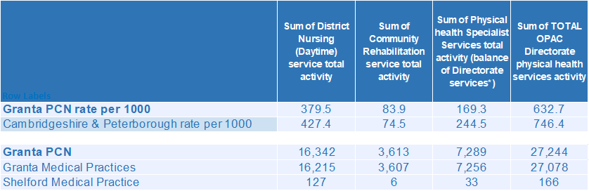
Who works within the Health and Social Care services for the PCN?
Patients receive health care from a range of individuals and organisations
There are currently 27,244 patients under CPFT caseload across the services listed. Caseloads rates for Granta PCN are generally lower compared to the rest of Cambridgeshire and Peterborough. Additional patients will be inpatients in rehab wards and part of the multi-disciplinary team caseload.
Data Sources: Local Authority Data extract; PCN Practice data; CPFT data extract

Slide 24
Social Care Services

Slide 25
Children’s Social Care
It is estimated that the South Alliance has statistically significantly low rates of social care involvement cases, early help cases and education, health and care plans compared to the CCG average. Granta PCN has statistically significantly lower rates of social care involvement cases and early help cases than the South Alliance but estimated rates for education, health and care plans are statistically similar to the South Alliance.
Source: Cambridgeshire County Council, BI team. Estimates derived from the LSOA level data, (for those LSOAs in Cambridgeshire or Peterborough only) available as an open data release here: https://data.cambridgeshireinsight.org.uk/dataset/cambridgeshire-and-peterborough-adult-social-care-long-term-service-users-31-march-2019 and GP Registered Population April 2019

Slide 26
Adult Social Care
The overall adult social care usage rate for Granta PCN is statistically similar to the South Alliance. The South Alliance overall adult social care usage rate is statistically significantly lower that the CCG.
Source: Cambridgeshire County Council, BI team. Estimates derived from the LSOA level data, (for those LSOAs in Cambridgeshire or Peterborough only) available as an open data release here: https://data.cambridgeshireinsight.org.uk/dataset/cambridgeshire-and-peterborough-adult-social-care-long-term-service-users-31-march-2019 and GP Registered Population April 2019

Slide 27
Secondary Care Services

Slide 28
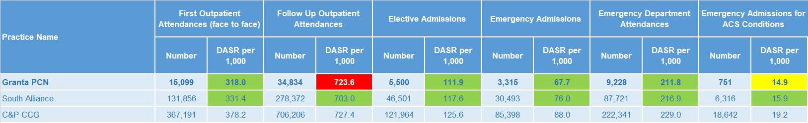
Secondary Care Services
South Alliance has statistically significantly low rates of secondary care use compared with the CCG average. Granta PCN has statistically significantly lower rates of secondary care services overall but statistically significantly higher rates of follow up outpatient attendances than the South Alliance. Outpatient follow-up attendances increased 5% during 18/19. Clinical Physiology and Ophthalmology account for the most outpatient attendances. This was the case for both 17/18 and 18/19. Together they make up 22% of the activity for 18/19. 8% of first outpatient attendances are sight related. Type 1 A&E Attendances increased 2% year on year. Cambridge University Hospitals saw a 1% increase in attendances from Granta PCN citizens. Referrals from “Health Care Provider” more than doubled. GP referrals increased 14% while the majority of other referral types showed no significant change. The most common elective admissions are for Gastroenterology, Medical Oncology, and Clinical Haematology.
Note: DASR = Directly age standardised rate per 1,000 population, reference population used is the ONS National Standard Population. Source: C&P PHI, from HED Tool, 2018/19, Data Source: Cambridgeshire and Peterborough “Practice Benchmarker”

Slide 29
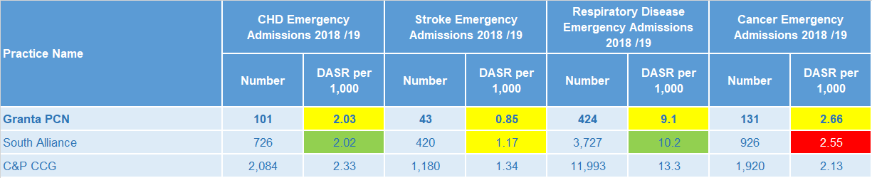
Disease Specific Emergency Hospital Admission Rates
The disease specific PCN emergency admission rates shown are statistically similar to the South Alliance averages. For Granta PCN there were 3,280 emergency admissions during 2018/19. Lobar Pneumonia, Urinary Tract Infections, and the tendency to fall are the three most prevalent primary diagnoses. The fifth highest number of emergency admissions were Sepsis related (the third highest was uncoded).
Note: DASR = Directly age standardised rate per 1,000 population, reference population used is the ONS National Standard Population. Source: C&P PHI, from HED Tool, 2018/19, Cambridgeshire and Peterborough “All Trusts 18/19”

Slide 30
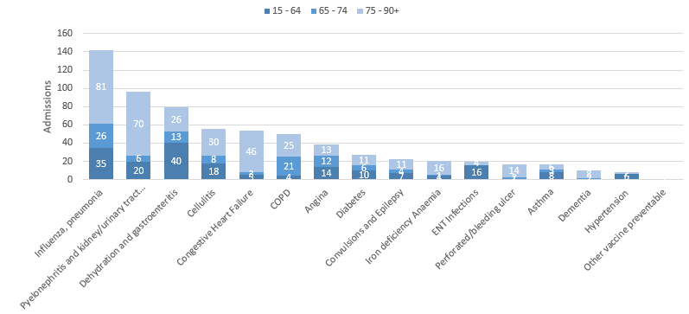
Potentially Avoidable Hospital Admissions
Granta PCN has a higher proportion of those aged over 65 compared to the rest of the South Alliance who contribute more to the potentially avoidable admissions.
Selected Ambulatory Care Sensitive Conditions NEL admissions in 2018/19 by age
There was an 6% increase for potentially avoidable emergency admissions across Cambridgeshire and Peterborough. ACSC admissions for Granta PCN increased 8% during 18/19.
Dehydration and gastroenteritis, Influenza, and Pyelonephritis and kidney/urinary tract infections were most common for the younger bracket.
Data Source: Cambridgeshire and Peterborough “Practice Benchmarker”

Slide 31
Glossary of key methods and terms
To assess statistical significance, 95% confidence intervals are calculated which provide a measure of uncertainty around the calculated value which arises due to random variation. If the confidence interval for a value excludes the value for the relevant benchmark, the difference between the local value and the benchmark is said to be ‘statistically significant’. The following hierarchy of benchmarks has been used in this profile: practice to PCN; PCN to Alliance; Alliance to CCG and CCG to England. The most commonly used RAG-rating in this profile: Exceptions to this are life expectancy which is RAG rated like this: And self-reported limiting long-term illness and general health status which is RAG rated like this: DASR = directly age standardised rate per 100,000 population C&P PHI = Cambridgeshire and Peterborough Public Health Intelligence QOF = Quality Outcomes Framework. Prevalence data are not available by age i.e. it is not age weighted so differences may be explained by differing age structures.

Slide 32
Produced by:
Cambridgeshire and Peterborough Public Health Intelligence Team
Contact:
PHI-team@Cambridgeshire.gov.uk
Date updated:
29th November 2019

