Slide 1
Central and Thistlemoor PCN
Data pack
November 2019

Slide 2
Central and Thistlemoor PCN – summary
There are just over 38,000 people registered with Central and Thistlemoor PCN, with a higher proportion of people aged 18 and under and lower proportion aged 65 and over compared with the North Alliance, CCG and England. The population is estimated to increase by 4.6% between 2019 and 2026, and then stabilise to 2036. Central and Thistlemoor PCN has a much lower proportion of population from the White British ethnic group and much higher proportions from White Other and Asian ethnic origins compared to the North Alliance, CCG and England averages. Relative deprivation is higher in Central and Thistlemoor PCN and each of the constituent practices when compared to the North Alliance, CCG and England. Approximately 23% of children and 29% of older people live in poverty It is estimated that on average there are around 510 births a year in the PCN. The birth rate is statistically significantly higher than North Alliance. The proportion of babies born with a low birth weight is statistically similar to the North Alliance. It is estimated that male and female life expectancy in the PCN is statistically similar to the North Alliance average at around 79.9 years and 84.0 years respectively. Recorded obesity in adults is statistically significantly lower than the North Alliance | It is estimated that 36.9% of adults smoke, which is statistically significantly higher than the North Alliance Estimates of people reporting long-term activity-limiting illness are statistically similar to North Alliance. Estimates of people reporting Good or Very Good health are statistically worse than the average for the North Alliance On average there are around 92 deaths a year in the PCN, with around a half of these in people aged under 75 years The PCN has statistically significantly low recorded prevalence of CHD, hypertension, stroke, asthma, COPD, diabetes and cancer compared to the North Alliance averages All age and premature all cause mortality rates for the PCN are statistically similar when compared to the North Alliance. The PCN has statistically significantly low prevalence rates of severe mental illness, depression, dementia and learning disability compared to the North Alliance. The PCN has statistically similar rates of children’s social care involvement cases, early help cases and education, health and care plans compared to the North Alliance average. The PCN has a statistically significantly higher overall rate of adult social care use than the North Alliance. Central and Thistlemoor PCN has a statistically significantly high rate of first outpatient attendances compared with the North Alliance

Slide 3
Demography and key population characteristics

Slide 4
GP registered population
Central and Thistlemoor PCN has a higher proportion of people aged 18 and under and lower proportion aged 65 and over compared with North Alliance, CCG and England.
Source: GP registered population, April 2019, NHS Digital. Population forecasts based on population distribution at ward level (Apr 19), Mid 2015 based population forecasts Cambridgeshire County Council

Slide 5
Population forecasts
The population of Central and Thistlemoor PCN is forecast to grow at a slower rate than the CCG as whole. The population is expected to increase by 4.6% between 2019 and 2026 and then stabilise to 2036.
Source: GP registered population, April 2019, NHS Digital. Population forecasts based on population distribution at ward level (Apr 19), Mid 2015 based population forecasts Cambridgeshire County Council

Slide 6
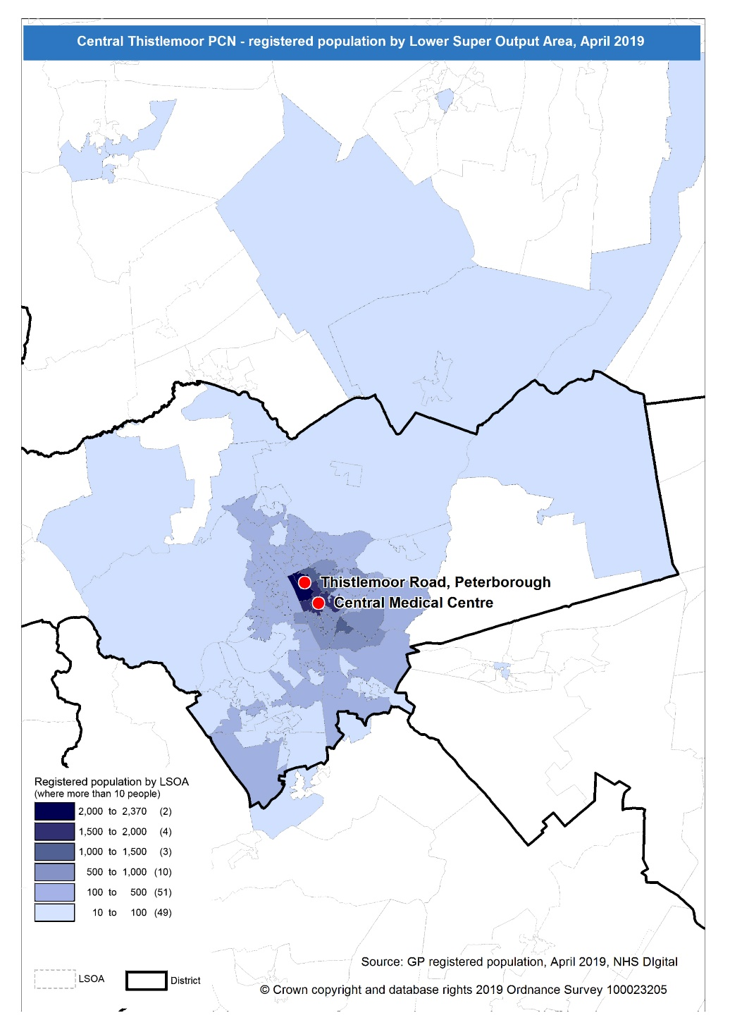
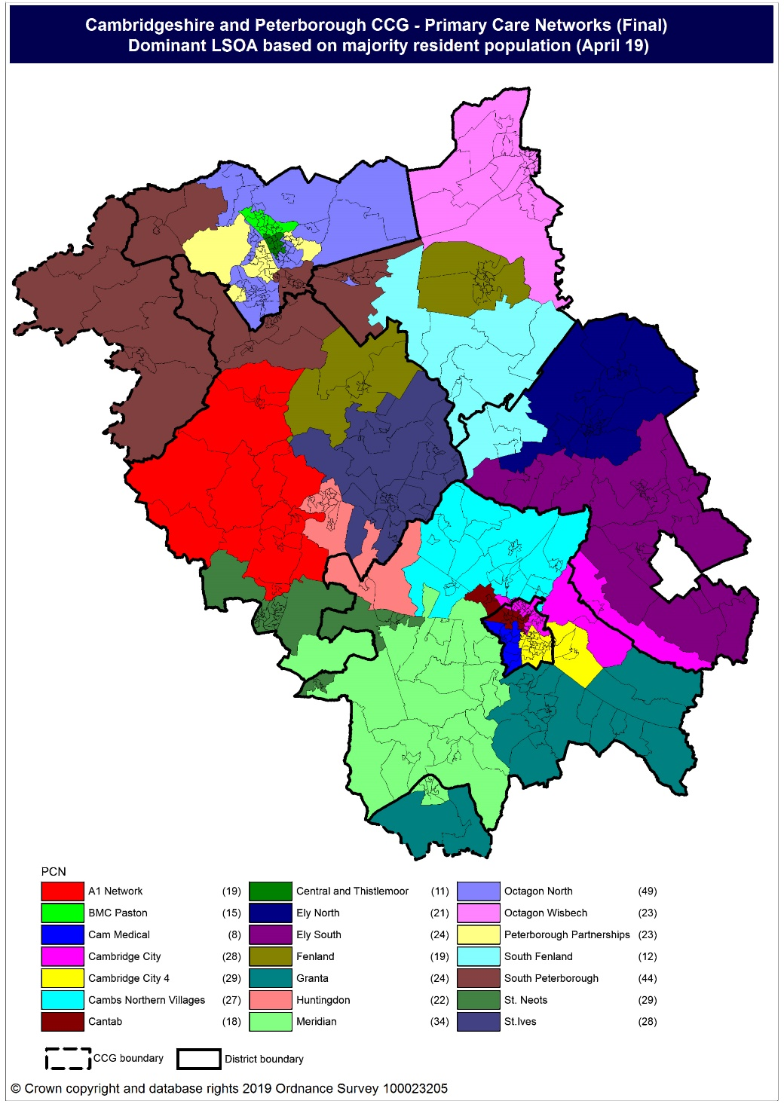
Population distribution
Source: GP registered population data by Lower Super Output Area, April 19, NHS Digital
Population
distribution
PCN dominant
population

Slide 7
Ethnicity
Central and Thistlemoor PCN has a much lower proportion of population from the White British ethnic group and much higher proportions from White Other and Asian ethnic origins compared to the North Alliance, CCG and England averages.
Source: Census 2011 data applied to GP registered population using Census 2011 ethnic group proportions; England data from NOMIS (patients registered at a GP Practice by LSOA, July 2018, NHS Digital)

Slide 8
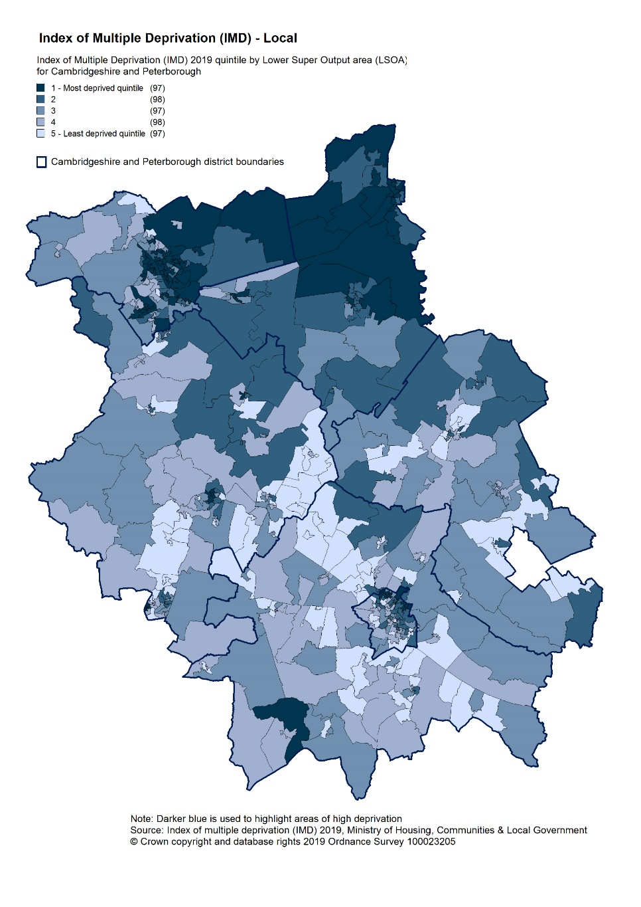
Deprivation
Relative deprivation is higher in Central and Thistlemoor PCN and each of the constituent practices when compared to the North Alliance, CCG and England. Approximately 23% of children and 29% of older people live in income deprived households in Central and Thistlemoor PCN; higher than the averages for North Alliance, CCG and England.
Source: C&P PHI derived from Indices of Multiple Deprivation 2019, MHCLG and GP registered population data for July 2018. Practice data from PHE Fingertips.
Index of Multiple Deprivation, 2019, by LSOA

Slide 9
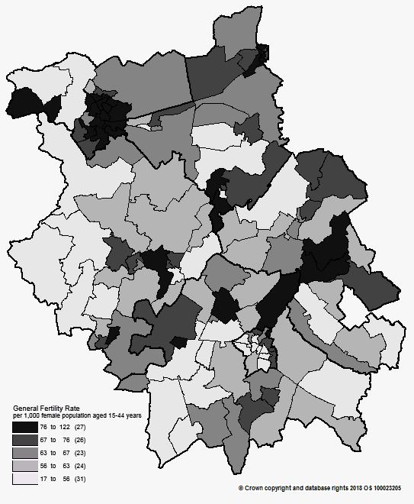
Births and Fertility
Central and Thistlemoor PCN birth rates are statistically significantly higher than the North Alliance rate. Low birth weight births in Central and Thistlemoor are statistically similar to the average for the North Alliance.
Note: Relates to Cambridgeshire and Peterborough residents only Source: C&P PHI based on NHS Digital Civil Registration Data, 2014-2016 and patients registered at a GP Practice by LSOA, July 2018, NHS Digital
Birth rates by ward

Slide 10
Self-reported limiting long-term illness and general health status
It is estimated that the proportion of people that reported that they had a long-term activity-limiting illness in the 2011 Census was statistically similar to the North Alliance average. It is estimated that the proportion of people that reported that they were in good or very good health in the 2011 Census was statistically significantly lower than the North Alliance average.
Source: C&P PHI from Census 2011, NOMIS and patients registered at a GP Practice by LSOA, July 2018, NHS Digital

Slide 11
Life expectancy
Male and female life expectancy in Central and Thistlemoor PCN is statistically similar to the North Alliance. North Alliance male and female life expectancy is statistically significantly lower than the CCG.
Source: C&P PHI based, derived from NHS Digital Civil Registration data and GP registered population data 2013 – 2017

Slide 12
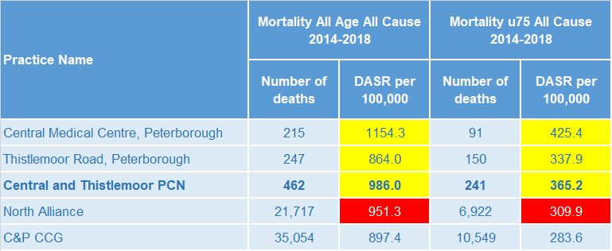
Mortality – all causes
There have been on average 92 deaths a year in Central and Thistlemoor PCN, approximately half are people aged under 75 year olds. The PCN has all age and premature mortality rates which are statistically similar to the North Alliance.
DASR = directly age standardised rate per 100,000 population Source: C&P PHI, from NHS Digital Civil Registration Data and NHS Digital GP registered population data, 2014-2018

Slide 13
Selected lifestyle behaviour risk factors

Slide 14
Risk factors
Recorded prevalence of obesity is statistically significantly lower in Central and Thistlemoor PCN compared to the average for North Alliance. Estimated smoking prevalence is statistically significantly higher in Central and Thistlemoor PCN compared to the average for North Alliance.
Source: Obesity - C&P PHI derived from NHS Digital QOF data for 2017/18; Estimated smoking - C&P PHI derived from the QOF based smoking prevalence estimate from the Public Health England (PHE) National General Practice Profiles at https://fingertips.phe.org.uk/profile/general-practice

Slide 15
Prevalence and mortality from principal diseases

Slide 16
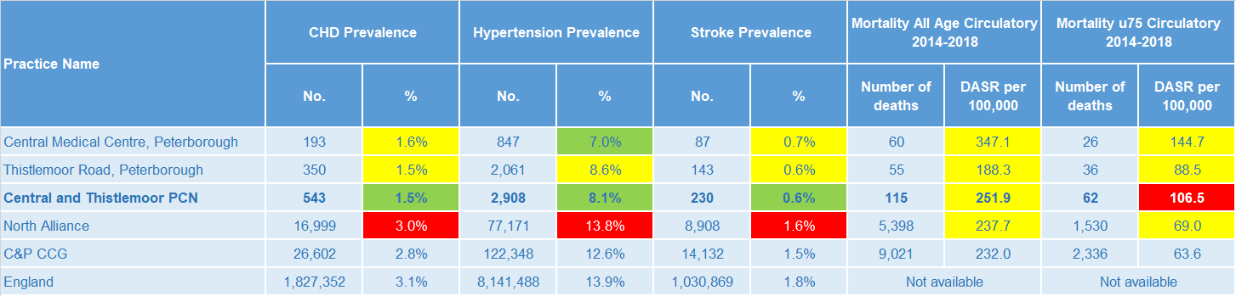
Circulatory disease
Central and Thistlemoor PCN prevalence rates of CHD, hypertension and stroke are statistically significantly low compared to North Alliance. Circulatory disease premature mortality rates for the PCN are statistically significantly higher than the North Alliance average.
Note: Prevalence data are not available by age i.e. it is not age weighted so differences may be explained by differing age structures; DASR = Directly age standardised rate per 100,000 population Source: Prevalence (recorded) - C&P PHI from QOF, NHS Digital, 2017/18; Mortality - C&P PHI, from NHS Digital Civil Registration Data and NHS Digital GP registered population data, 2014-2018

Slide 17
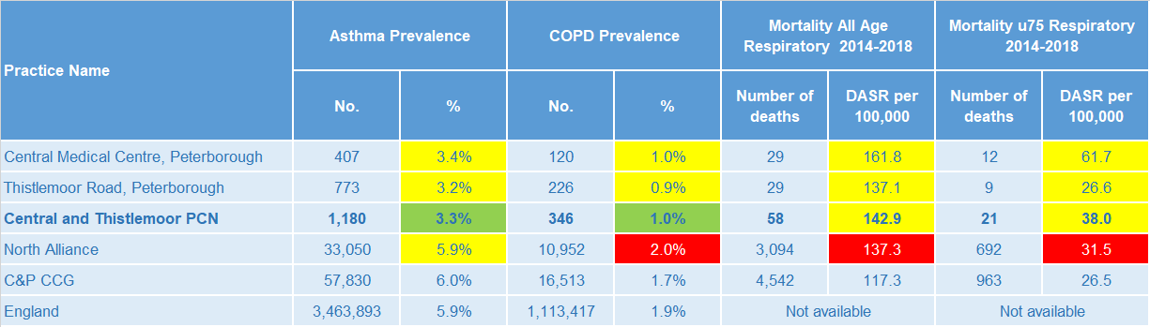
Respiratory disease
Central and Thistlemoor PCN prevalence rates of Asthma and COPD are statistically significantly low compared to North Alliance. Mortality rates for respiratory diseases, for people of all ages and under 75 years, are statistically similar to the North Alliance rates.
Note: Prevalence data are not available by age i.e. it is not age weighted so differences may be explained by differing age structures; DASR = Directly age standardised rate per 100,000 population Source: Prevalence (recorded) - C&P PHI from QOF, NHS Digital, 2017/18; Mortality - C&P PHI, from NHS Digital Civil Registration Data and NHS Digital GP registered population data, 2014-2018

Slide 18
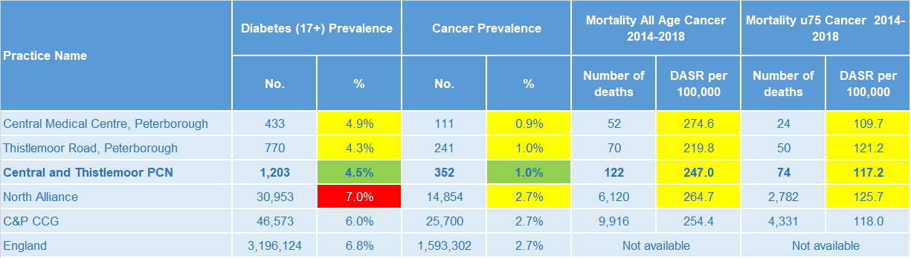
Long term conditions
Central and Thistlemoor PCN prevalence rates of Diabetes and Cancer are statistically significantly low compared to North Alliance. All practice mortality rates and the PCN mortality rate are statistically similar to the North Alliance rate.
Note: Prevalence data are not available by age i.e. it is not age weighted so differences may be explained by differing age structures; DASR = Directly age standardised rate per 100,000 population Source: Prevalence (recorded) - C&P PHI from QOF, NHS Digital, 2017/18; Mortality - C&P PHI, from NHS Digital Civil Registration Data and NHS Digital GP registered population data, 2014-2018

Slide 19
Mental health, dementia and learning disability
Central and Thistlemoor PCN has prevalence rates of severe mental illness, depression, dementia and learning disability that are all statistically significantly low when compared to the North Alliance average.
Note: Prevalence data are not available by age i.e. it is not age weighted so differences may be explained by differing age structures Source: Prevalence (recorded) - C&P PHI from QOF, NHS Digital, 2017/18

Slide 20
Service provision and utilisation

Slide 21
PCN workforce

Slide 22
Who works within the Health and Social Care services for the PCN?
Patients receive health care from a range of individuals and organisations
117 staff are employed through Central and Thistlemoor PCN’s practices. The majority of which will be directly in contact with patients.
Data Sources: Local Authority Data extract; PCN Practice data; CPFT data extract

Slide 23
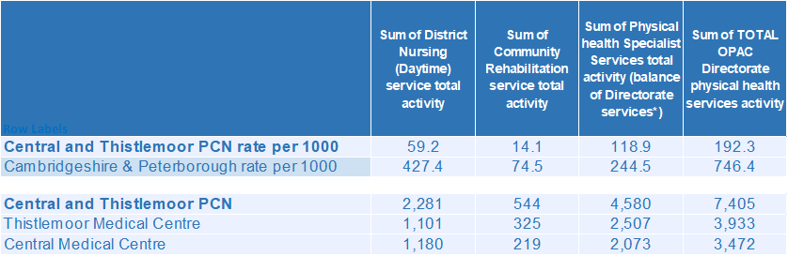
Who works within the Health and Social Care services for the PCN?
Patients receive health care from a range of individuals and organisations
There are currently 7,405 patients under CPFT caseload across the services listed. Caseloads rates for Central and Thistlemoor PCN are lower compared to the rest of Cambridgeshire and Peterborough. Additional patients will be inpatients in rehab wards and part of the multi-disciplinary team caseload. Thistlemoor Medical Centre has the highest number of caseloads for Central and Thistlemoor PCN.
Data Sources: Local Authority Data extract; PCN Practice data; CPFT data extract

Slide 24
Social Care Services

Slide 25
Children’s Social Care
Central and Thistlemoor PCN has statistically similar rates of social care involvement cases, early help cases and education, health and care plans compared to the North Alliance average. North Alliance has statistically significantly high rates of social care involvement cases, early help cases and education, health and care plans compared to the CCG average.
Source: Cambridgeshire County Council, BI team. Estimates derived from the LSOA level data, (for those LSOAs in Cambridgeshire or Peterborough only) available as an open data release here: https://data.cambridgeshireinsight.org.uk/dataset/cambridgeshire-and-peterborough-adult-social-care-long-term-service-users-31-march-2019 and GP Registered Population April 2019

Slide 26
Adult Social Care
The PCN has a statistically significantly higher overall rate of adult social care use than the North Alliance. North Alliance has a statistically significantly higher overall rate of adult social care use than the CCG average.
Source: Cambridgeshire County Council, BI team. Estimates derived from the LSOA level data, (for those LSOAs in Cambridgeshire or Peterborough only) available as an open data release here: https://data.cambridgeshireinsight.org.uk/dataset/cambridgeshire-and-peterborough-adult-social-care-long-term-service-users-31-march-2019 and GP Registered Population April 2019

Slide 27
Secondary Care Services

Slide 28
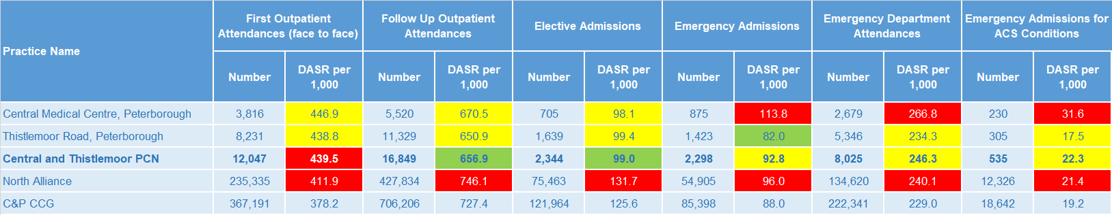
Secondary Care Services
Central Medical Centre rates of emergency admissions, emergency department attendances and emergency admissions for ACS conditions are statistically significantly higher than the PCN rates. Thistlemoor Medical Centre rates for secondary care services are statistically similar compared to the PCN rates except for the emergency admissions rate which is statistically significantly lower than the PCN rate. Central and Thistlemoor PCN has a statistically significantly high rate of first outpatient attendances compared with the North Alliance. North Alliance has statistically significantly high rates of secondary care use compared with the CCG average. Although there is increasing activity, the increasing practice list size means that rates are decreasing. Central and Thistlemoor PCN patients average over 2,000 contacts with acute services every week in 2018/19. Most common reasons for elective admission was for General Surgery, Trauma and Orthopaedics, and Gastroenterology. For first outpatient appointments, Paediatrics is the most common specialty for Central and Thistlemoor PCN, with 1,254 appointments in 2018/19. This is followed by Trauma and Orthopaedics with 913 appointments.
Note: DASR = Directly age standardised rate per 1,000 population, reference population used is the ONS National Standard Population. Source: C&P PHI, from HED Tool, 2018/19, Cambridgeshire and Peterborough “Practice Benchmarker”

Slide 29
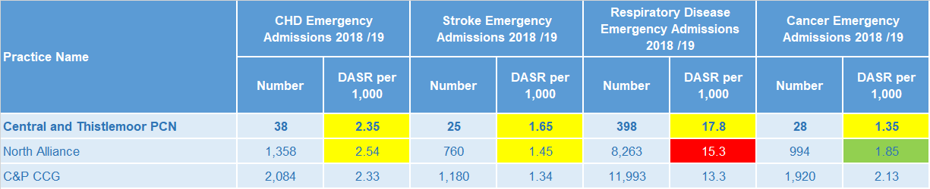
Disease Specific Emergency Hospital Admission Rates
The PCN emergency hospital admission rates shown are statistically similar to the North Alliance average For Central and Thistlemoor PCN there were 2,203 emergency admissions during 2018/19. Central Medical Centre had a higher admission rate compared to Cambridgeshire and Peterborough while Thistlemoor Road’s rate was lower. The majority of emergency admissions were for Paediatric Medicine, Geriatric Medicine, and General Medicine. Paediatric Medicine made up 28% of emergency admissions during 18/19. Paediatric Medicine related admissions increased 6% year on year. The most in demand speciality was General Medicine which made up 12% of emergency admissions for 18/19. The rate of emergency admissions for Endocrinology more than doubled during 18/19.
Note: DASR = Directly age standardised rate per 1,000 population, reference population used is the ONS National Standard Population. Source: C&P PHI, from HED Tool, 2018/19, Cambridgeshire and Peterborough “All Trusts 18/19”

Slide 30
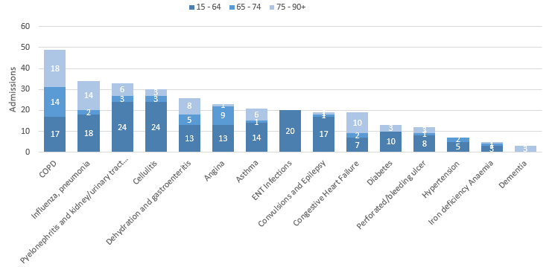
Potentially Avoidable Hospital Admissions
Younger residents account for the majority of conditions not requiring admission
Selected Ambulatory Care Sensitive Conditions NEL admissions in 2018/19 by age
There were 315 potentially avoidable admissions to hospital in 2018/19.
The majority of these were for COPD (49), ‘flu and Pneumonia (34) and UTIs (33). The majority (193) of avoidable admissions were for the 15-64 age group.
Cellulitis and kidney/urinary tract infections were more common for the younger age bracket (15-64 year olds).
Chronic Obstructive Pulmonary (COPD) and Influenza and Pneumonia were the most common conditions for older (65 or older).
Data Source: Cambridgeshire and Peterborough “Practice Benchmarker”

Slide 31
Glossary of key methods and terms
To assess statistical significance, 95% confidence intervals are calculated which provide a measure of uncertainty around the calculated value which arises due to random variation. If the confidence interval for a value excludes the value for the relevant benchmark, the difference between the local value and the benchmark is said to be ‘statistically significant’. The following hierarchy of benchmarks has been used in this profile: practice to PCN; PCN to Alliance; Alliance to CCG and CCG to England. The most commonly used RAG-rating in this profile: Exceptions to this are life expectancy which is RAG rated like this: And self-reported limiting long-term illness and general health status which is RAG rated like this: DASR = directly age standardised rate per 100,000 population C&P PHI = Cambridgeshire and Peterborough Public Health Intelligence QOF = Quality Outcomes Framework. Prevalence data are not available by age i.e. it is not age weighted so differences may be explained by differing age structures.

Slide 32
Produced by:
Cambridgeshire and Peterborough Public Health Intelligence Team
Contact:
PHI-team@Cambridgeshire.gov.uk
Date updated:
29th November 2019

