Slide 1
Tackling Poverty and
Improving Social Mobility
19 July 2019
Notes:
E
Two parts:
Best of the Data from Business Intelligence
Highlights from the 219/20 Action Plan
To give you some background….

Slide 2
Context
Communities and Partnership Committee’s priorities:
- building community resilience
- tackling deprivation
- improving adult skills
- enhancing effective partnership working
Committee decision to form a cross-party working group to lead the development of a social mobility strategy and action plan
Working Group has:
  Considered the scope, reviewed data and existing complementary workstreams and work already taking place
  Developed a 12 month action plan and statement of commitment
  Agreed to work alongside partners to develop a shared approach to tackling poverty and disadvantage in the future
Notes:
Elaine
The Committee’s focus is on taking an active leadership role on behalf of the County Council in supporting system change, achieving practical collaboration with partners, and delivering sustained positive change for our communities.
In the Committee discussion in July, Members recognised the complex issues associated with poverty, its causes and effects, and also that in order to practically address these requires a system-wide approach. They therefore agreed to extend an invitation to join the Working Group to District Council representatives, and also to representatives of both the Health Committee and the Economy and Environment Committee of the County Council. Representation from both the County’s Adults Committee and the Children and Young People Committee was also agreed. Within the County Council, the Communities and Partnerships Committee will take the overall leadership role for this work on behalf of the other service committees, formally referring back to them on any relevant matters.
The Committee wants to add value, and to support the already excellent work being undertaken by the District Councils and others to tackle poverty. As well as specific projects the County Council may need to deliver, we are also keen to explore ways in which the progress of District Councils may be better supported through collaboration. For example, are there changes we can make to policy, delivery or spending in adults or children’s services to enable a service delivered by a District Council to prevent poverty more holistically.
The Committee’s initial focus to take forward work to tackle deprivation is to understand the cause of, and address the issues associated with, poverty.
The council is already delivering significant work towards tackling poverty and improving social mobility, but there is likely to be more we can do through better coordination and joined-up thinking across the organisation and our wider partnerships

Slide 3

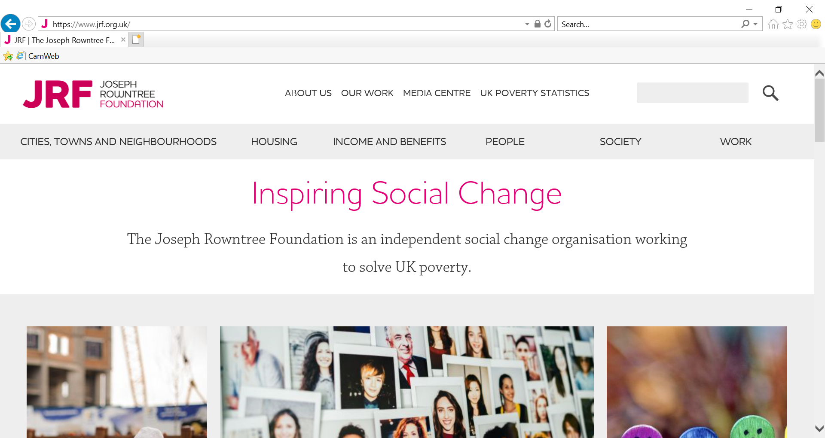

  What the data says about poverty in Cambridgeshire
Notes:
Elaine
- Data colleagues unable to be present. I will run through a very brief basic understanding and can take away any questions.

Slide 4
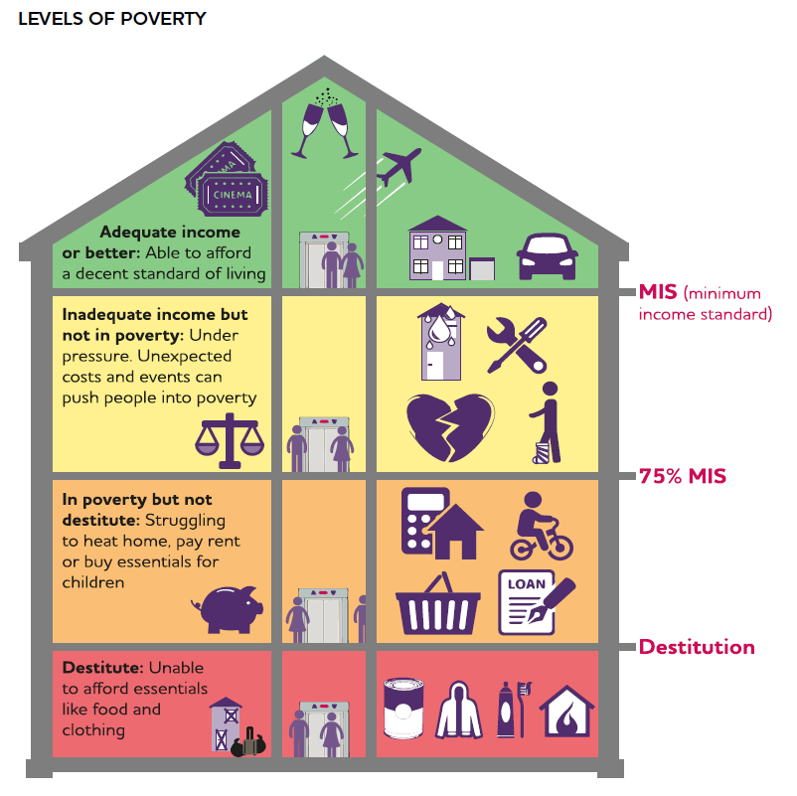
Background: Impact of living in poverty
In primary school, children from low-income backgrounds are more likely to have behavioural problems, and less likely to believe in their abilities or think that they can make a difference to their own lives.
…the stress of poverty is associated with high levels of anxiety and depression. Children living in socio-economic disadvantage have as high a risk of developing mental health issues as children of parents with mental health or substance misuse problems
If you have experienced poverty or live in a more deprived area, you are more likely to die sooner and to have fewer years free of ill-health or disability
Thinking about financial problems had an impact similar to losing a night’s sleep, leading to a reduction in measured IQ of 13 points.
At every stage of education, in every part of the UK, children from better-off backgrounds achieve better results at school than those from disadvantaged backgrounds.
Taken from https://www.jrf.org.uk/report/uk-poverty-causes-costs-and-solutions
Notes:
Elaine
This is unlikely to be news to those at this meeting.
Let’s look at impact of low income first
JRF has developed a Minimum Income Standard to try to describe some of the impacts – update this annually
75%

Slide 5
Understanding Levels of Poverty in Cambridgeshire
Multiple deprivation – material circumstances and impact of wider neighbourhood
‘Poverty threshold’ where household income is less than 60% of the median national household income.
Cambridgeshire: over 18% for parts of Wisbech, Huntingdon and Cambridge down under 9% for parts of Huntingdonshire and South Cambridgeshire.
Social Mobility: Significant gap in skills and income between different parts of Cambridge. Relatively low attainment in our schools for children on a low income (claiming free school meals) in parts of East Cambridgeshire and Fenland
Notes:
There is a difference between understanding people’s material circumstances (the extent to which someone is living in poverty) and looking at the various aspects pertaining to their personal lives or wider neighbourhood that leads to the persistence of the state of being in poverty (even across the generations), often referred to as multiple deprivation.
In England and Wales, the main measure of material circumstances takes a ‘poverty threshold’ approach with that poverty threshold being where household income is less than 60 per cent of the median national household income.
For Cambridgeshire, the percentage of people living with this level of very-low income ranged from over 18% for parts of Wisbech, Huntingdon and Cambridge down under 9% for parts of Huntingdonshire and South Cambridgeshire. Local research also shows that high housing costs in some areas make a significant difference to the numbers above or below the poverty threshold.
An alternative way of looking at the threshold at which point people may suffer hardship is to look at the numbers claiming benefits. One indicator that can be used is the number of people (of working age) on key-out-of-work benefits. Recent data shows just over 30,000 claimants fitting into this category with high numbers in appearing within areas of social housing, including within new developments such as Cambourne.
The main measure of multiple deprivation is the Indices of Multiple Deprivation or IMD 2015 (which is due to be updated in summer 2019). The Indices are based upon 37 separate indicators which are combined (using appropriate weighting) to form a general picture of the spread of multiple deprivation at a small area level. Detailed maps of the current IMD can be found on Cambridgeshire Insight, these show that over 20% of areas (LSOA) within Fenland being within the most deprived areas for the County as a whole.
The Social Mobility Index shows that Cambridgeshire has some issues with Social Mobility. The significant gap in skills and income between different parts of Cambridge has led to it being labelled as the UKs most unequal City. Elsewhere the issue of relatively low attainment in our schools for children on a low income (claiming free school meals) have led to parts of East Cambridgeshire and Fenland being identified for additional action.

Slide 6
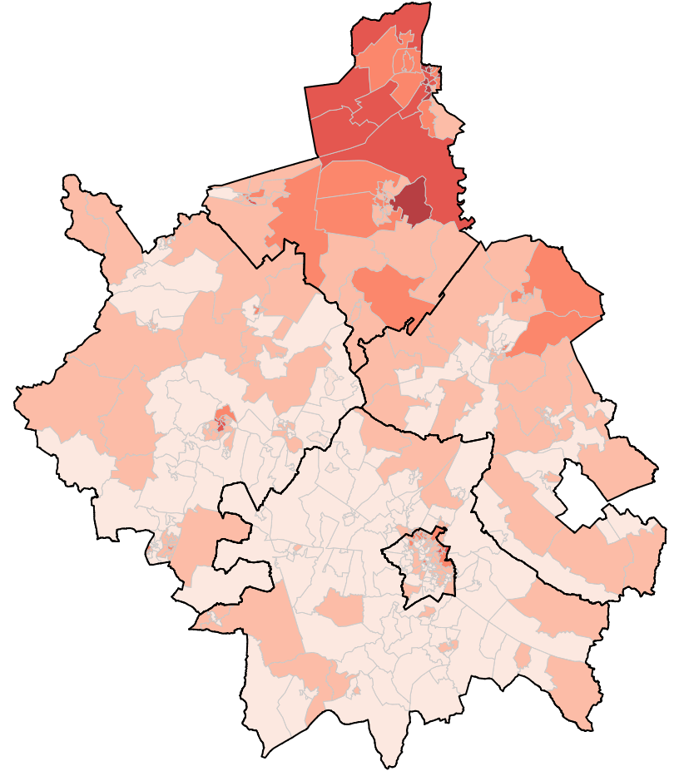
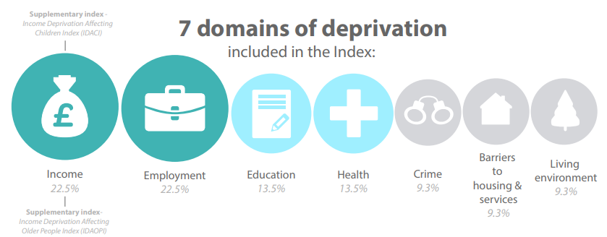
Indices of Multiple Deprivation (IMD 2015)
© Crown Copyright. All rights reserved 100023205 (2015)
Notes:
Just looking at POVERTY would only look at INCOME but the evidence is clear it has wider impacts.
We can consider Deprivation and the facets of deprivation and its impacts using the Indices of Multiple Deprivation; this index brings together data across 7 domains:
Income
Employment
Education
Health
Crime
Barriers to Housing and Services
Living Environment
The main measure of multiple deprivation is the Indices of Multiple Deprivation or IMD 2015 (which is due to be updated in summer 2019).
The Indices are based upon 37 separate indicators which are combined (and weighted) to form a general picture of the spread of multiple deprivation at a small area level.
at Lower Super Output Area (LSOA) level (around 250 households).
Detailed maps of the current IMD can be found on Cambridgeshire Insight,
over 20% of areas (LSOA) within Fenland being within the most deprived areas for the County as a whole.
Income,
employment,
education and skills,
health,
crime,
housing and services,
living environment
Image source: DCLG (https://assets.publishing.service.gov.uk/government/uploads/system/uploads/attachment_data/file/464431/English_Index_of_Multiple_Deprivation_2015_-_Infographic.pdf)
https://cambridgeshireinsight.org.uk/deprivation/reports/
https://cambridgeshireinsight.org.uk/deprivation/indices-of-multiple-deprivation/

Slide 7
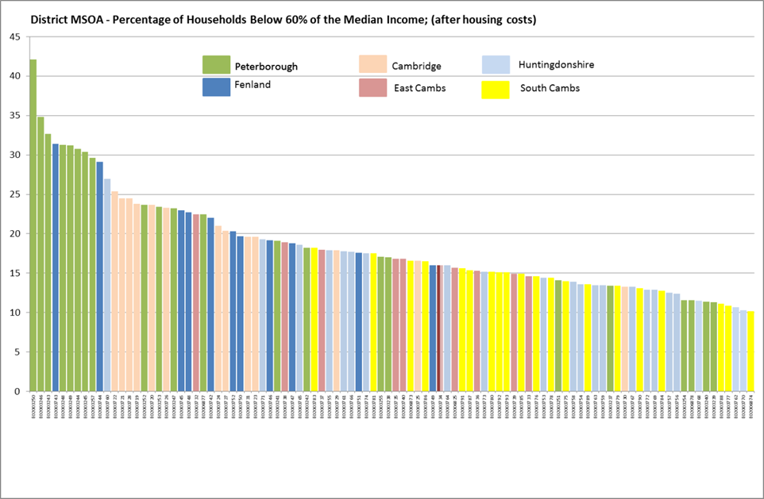
Poverty Threshold
Wisbech
Oxmoor
Abbey
Littleport
Source: ONS Small Area model-based households in poverty estimates (Financial Year end 2014), published April 2017. Based on National Family resources Survey as outlined: https://assets.publishing.service.gov.uk/government/uploads/system/uploads/attachment_data/file/530659/hbai-low-income-how-is-it-measured-infographic.pdf
Notes:
Each colour represents a place in a district (approximately 4000 households)
Higher % of people in poverty down the slope to the lower % of people in poverty.
Fenland (in Blue) (e.g. Wisbech) have levels of poverty aligned with an urban area like Peterborough (in green).
Even in South Cambridgeshire 10% of the population are at or below this threshold.
==========================================================
More data for smaller areas area are available on Cambridgeshire Insight

Slide 8
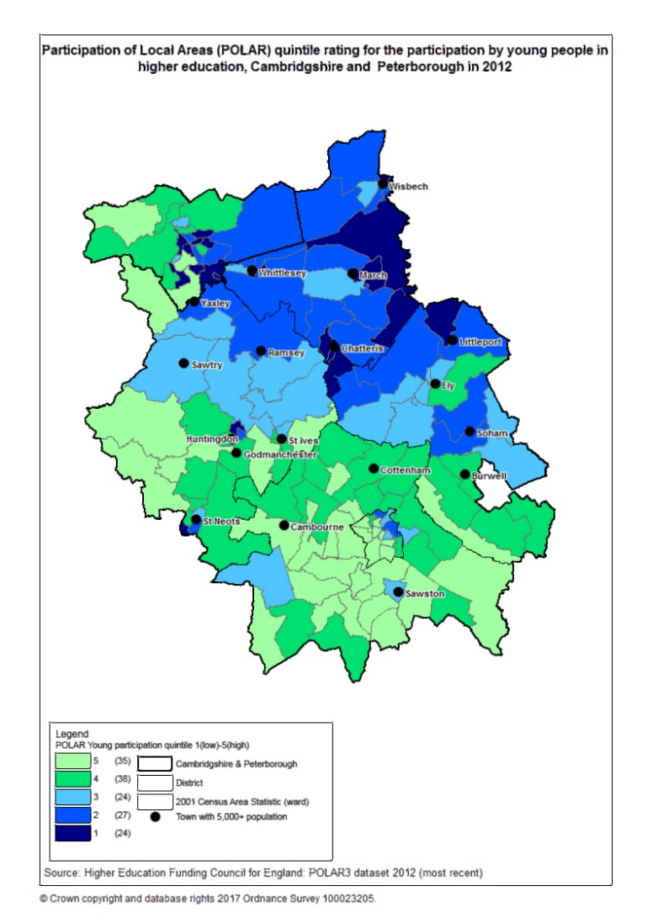
Education
Notes:
The working group looked at a number of themes including health, adult education.
As an example you can see that poverty has an impact on attainment at primary level right through to the application to university.
======================================
At Primary school age :
#FSM-6 = pupils had Free School Meals at any time in past 6 yrs
Later down the line research has shown Higher education participation also reflecting areas with households in poverty:
#POLAR – Participation of Local Areas ; the proportion of young people that participate in Higher Education (i.e. entering HE at 18/19 years old).
1= lowest participation. 5-highest
And in the long term:
Followup research from those students (so employment outcomes for those age 18 in 2005 indicates those from Lower quintile areas have lower rates of professional employment, compared to those from more advantaged areas.

Slide 9
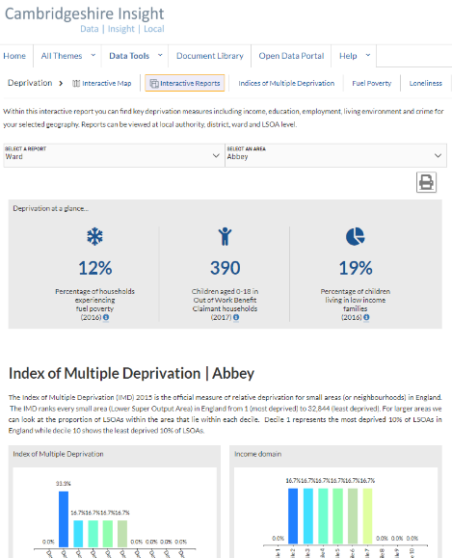


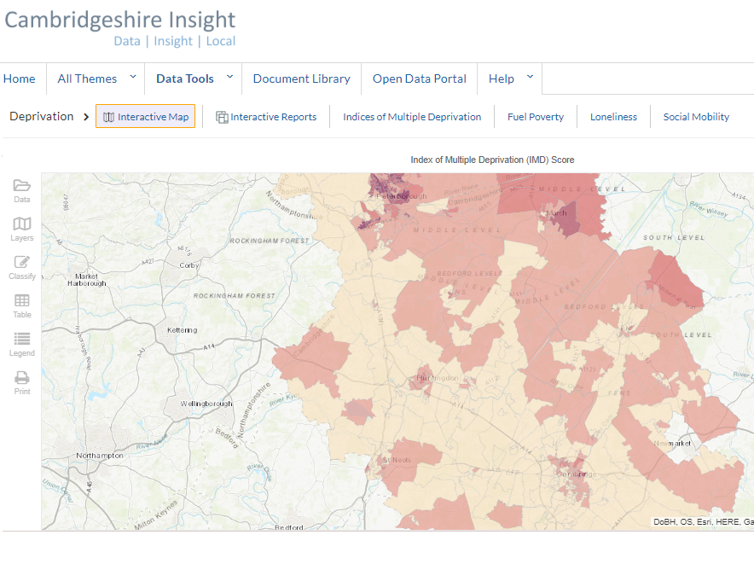
Resources:
Cambridgeshire Insight
https://cambridgeshireinsight.org.uk/
Two clicks to select a ward and view deprivation indicators report: https://bit.ly/2wQsOBV

Slide 10
Solving Poverty: Joseph Rowntree Foundation
-£78bn of public spending is linked to dealing with poverty and its consequences, including spending on healthcare, education, justice, child and adult social services.
- 2016 report, ‘We Can Solve Poverty in the UK’ suggests a five-point plan to solve poverty:
Boosting incomes and reducing costs
Improving education standards and raising skills
Strengthening families and communities, and
Delivering an effective benefit system
Promoting long-term economic growth benefiting everyone
Notes:
Elaine

Slide 11
Action Plan 2019/20 Highlights
Boosting Incomes and
Reducing Costs
Notes:
Diane

Slide 12
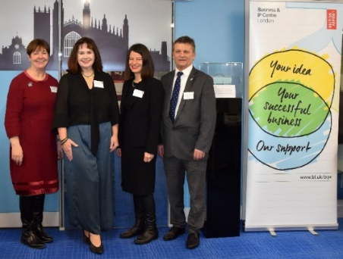

Business & Intellectual Property Centre
B & IPC’s in libraries - front door to business support for Start-ups, SMEs and entrepreneurs, from all walks of life providing trusted face-to-face Intellectual Property and innovation support
Key partners - British Library & Intellectual Property Office, Cambridgeshire Chambers of Commerce, Growth Hub and Intellectual Property Attorney
How can the Centres help? What can you do in the Centres?
Contact us: www.cambridgeshire.gov.uk/BIPC BIPC@cambridgeshire.gov.uk @BIPCCambs
Notes:
Diane
Cambridgeshire & Peterborough Libraries – a B & IPC in each Central Library. Each library in their respective communities are a touchpoint and front door to free or low cost business support at these centres.
Part of a national network of 13 B & IP Centres including London, in Libraries across the country and in Scotland.
Launched 1st February in Cambridge and 13th February Peterborough. Both are currently in a pilot phase.
How can we help ? We hold workshops, events and offer advice on a whole host of subjects from setting up your business to protecting your intellectual property. E.g. we provide access to a large collection of free business and IP information with expert staff on hand to guide people to the resources they need - market research databases , company information and more.
What can you do in the centre? Workshops and networking events - regular sessions with experts and professionals who offer their expertise for free on practical matters, such as - market research, building a social media presence, smart marketing and access to an IP attorney on a pro bono basis. Regular Inspiring Entrepreneur live streaming, plus webinars events in the Central Library.
Free bookable 1:1 sessions with our expert staff - held every week, who will discuss a business idea in confidence and help identify the most useful information and resources. Our monthly coffee mornings for entrepreneurs and those with a business idea are free and an opportunity to network and find out about the resources at the B & IP Centre.
Of priority is developing our partnerships with local Universities, business experts and advocates of the service, to support entrepreneurs and those with a business idea. Developing our work with Youth Employment UK. Contact us details on the slide to find out more .

Slide 13


Local Assistance Scheme (CLAS)
Provides information, advice and one off practical support and assistance in times of exceptional pressure (subject to eligibility) via:
21 CLAS Champions hosted by 16 organisations across the County
Universal access to info, advice & practical support from Citizens Advice Bureaux
Partnership working – linking with local charitable financial aid organisations & groups to improve coordination – e.g. new Charities Networks
Since April 2017: £266,316 distributed to 1,445 people awards via 3 types of awards:
Green Goods Vouchers – max £250 for recycled white goods, furniture and paint
New Goods – max £300/350 for cookers & mattresses only (max only for cookers)
Supermarket Vouchers – max £250 for clothing & food (where limited access to Foodbanks)
17/18 - Non cashable savings to the public purse £779K - where CLAS has prevented/delayed further issues
Contact Gerry Cano at CHS for more info
gerry.cano@chsgroup.org.uk
This help has been key to me moving into my new home and restoring self respect & dignity, I cannot thank you enough
Notes:
D
Main Message – the new CLAS model is adding value making our funding go further by:
- working in partnership with local charities, community and faith groups through the problem solving charity networks
giving people choice e.g. in selecting second hand goods, removes the stigma of being in receipt of charity
and supporting families financial resilience and capabilities, while recognising that many people in financial difficulty don’t have the headspace to engage and work with services while they’re in crisis.
CLAS has seen first-hand the impact of Universal Credit in Fenland (pilot area before national roll out) and fact that families are now in crisis more often and for longer as a result.
New model launched in April 2017
21 CLAS Champions hosted by 16 different organisations across the County
Citizens Advice Bureaux providing universal access to information, advice and practical support
Partnership working – linking with local charitable financial aid organisations and groups to improve local coordination, share knowledge and practice - Charities Network in ‘South’, Wisbech and March/Chatteris to connect local groups
Total number of awards
Green goods 760 – value £144,947
New goods 243 – value £66,314
Supermarket vouchers 501 – value £55,055
This new model is making the funding go further
e.g. the majority of funding is now spent on recycling goods – previously weren’t available in the previous scheme
e.g. of the 2429 people the CABx have seen - 1,409 were not eligible for CLAS but received help from other support services including ways to maximise income
Clients reported an increase in wellbeing valued at £1.8 million - budget to impact ratio of 1:3 (based on sample survey)
Non cashable savings to local authority £365k
Plans to:
Continue to work with Charities Network groups to coordinate local efforts and increase CLAS reach
Introduce Assured Water Tariff Passport Scheme for CLAS clients
Support development & implementation of the Cambridge Food Poverty Alliance Collaborative Food Action Plan
Focus on gaining better understanding of CLAS clients, backgrounds and issues, and prevention – aim is to influence policy and inform relevant provision for people in crisis
Share this info
Contact Gerry - attend Charities Networks
Background info
Champions
All authorised agents were invited to apply to host a Champion
Champions selected from the ones that applied to join the new network
Each have own budget allocation – these calculated on population numbers in the disadvantaged areas they work in and nos of awards made to the previous CLAS
Champions have access to CLAS for their own clients
Organisations not hosting a Champion can refer their clients to the CABx to be assessed for CLAS

Slide 14

Community
Energy Switch
A scheme where residents can sign up for free to take part in a group gas and electricity auction to receive cheaper energy tariffs. The supplier that can give the lowest tariffs “wins”. The resident can then choose whether to switch to this new supplier.
CCC takes part in two auctions a year: February and October. In the February 2019 auction we had over 500 registrants from across the County.
The auction produced an average annual saving per registrant of £127.46.
Help publicise the scheme by directing residents to https://www.cambridgeshire.gov.uk/business/economic-development/energy-across-cambridgeshire/cambridgeshire-energy-switch/
Email Energy.Switch@cambridgeshire.gov.uk for more information
Notes:
D
The Cambridgeshire Energy Switch is a scheme where residents can sign up for free to take part in a group gas and electricity auction to receive cheaper energy tariffs. The supplier that can give the lowest tariffs “wins”.
Residents provide details of their energy consumption and expenditure, and receive a personalised offer which is often cheaper than their existing contract. The resident can then choose whether to switch to this new supplier. The whole process is free and managed by iChoosr, who run the auction.
CCC takes part in two auctions a year: February and October. In the February 2019 auction we had over 500 registrant from across the County. The auction produced an average annual saving per registrant of £127.46.
Members can help publicise the scheme by directing residents to the www.Cambridgeshire.gov.uk website where we have the scheme advertised along with more information. Residents can also email me at Energy.Switch@cambridgeshire.gov.uk.
It is worth also noting that while the main mechanism for sign-up is via the website, residents can also give us a call and I can sign them up over the phone. However, I am still liaising with the Contact Centre to set this up properly!

Slide 15
Action Plan 2019/20 Highlights
Improving Education Standards & Raising Skills
Notes:
Education & skills
Opportunity Area with DoE – boost social mobility
Essential Life Skills
Talking Together
Libraries - Homework clubs and summer reading challenge, bookstart

Slide 16
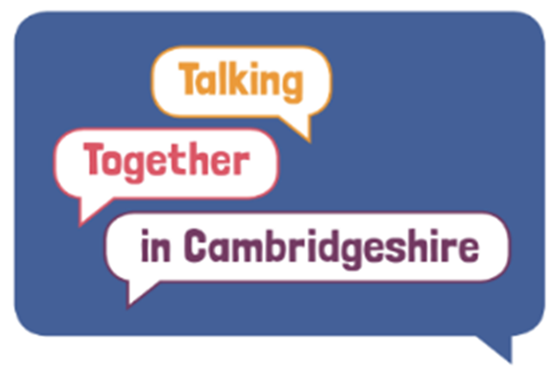
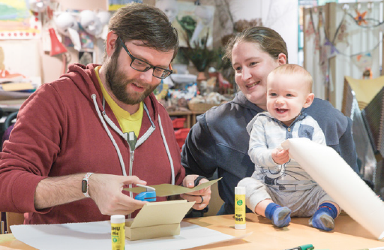
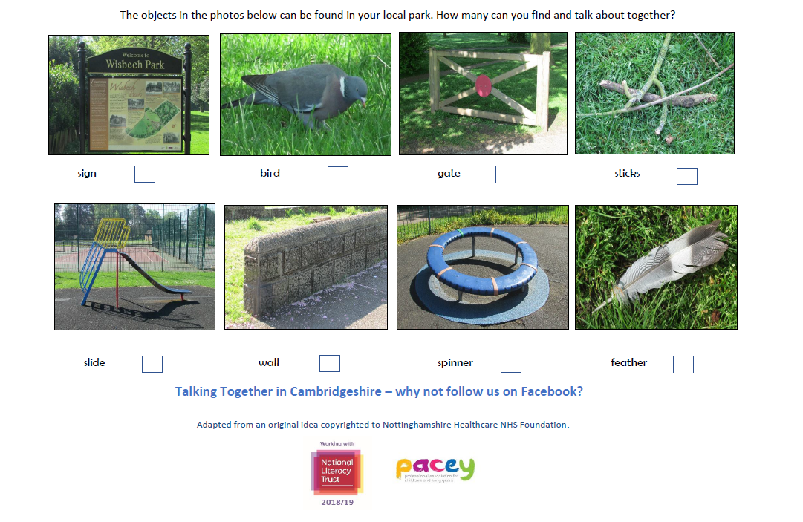

Talking Together in Cambridgeshire
Aim: Accelerate the achievement of children aged 0-6, living in areas of deprivation - focusing on early communication, language & literacy skills:
Areas: Wisbech, March, Chatteris, Huntingdon, North East Cambridge
£58k awarded in 18-19 to community-based projects (£20k in 19-20)
Activities have reached 750 children, 250 families and 90 practitioners
Update sign up: community.literacy@cambridgeshire.gov.uk
Follow: https://www.facebook.com/talkingtogethercambs/
Just learning a few tips to help M get less frustrated with his speech
Notes:
2 c)
funding allocated by Councillors in 2018
managed by CCC’s Early Years Service.
Focused on areas with higher levels of deprivation - to increase the awareness, knowledge and confidence of parents, practitioners, partners and the local community to identify and support children/parents/carers/community with communication, language and literacy needs.
works collaboratively with Early Years settings, community groups and organisations, the National Literacy Trust, PACEY – the Professional Association of Childcare and Early Years, Child and Family Centres, Libraries etc.
Funding a number of community based projects including recruit 24 Read Easy volunteer coaches from across NE Cambridge City to support adults who want to learn to read on a one to one basis.
Storytelling workshops and borrowing boxes containing story sacks, puppets, story cards & books.
Huntingdon – The Travelling Book Nook for fun family picturebook-based activities.
In Wisbech: literacy-based workshops for families and ‘bottle books’ which are bottles which contain props from a story - inspire children to talk and be interested in stories & make up stories with the aid of a bottle book, + workshop for parents on how to make the bottle books.
Created ‘Walk and Talk’ for parks and shops in our reach areas - more are planned. These maps promote conversation between parents and children, having fun in local places (for free) finding objects, whilst developing vocabulary. In Fenland this has gone one step further with Active Fenland who have made interactive treasure hunts with a wildgoose app.
These figures are growing weekly and include family activities with community groups and organisations, Child and Family Centres and free training sessions for early years practitioners
Background if needed:
NE Cambridge - covers Shirley, Chesterton, Kings Hedges, Arbury, Abbey Meadows, Grove, Fields and Colleges schools/nurseries.
Overall aim relates directly to those good level of development (GLD) scores at the end of the Early Years Foundation Stage. Children who achieve the GLD are on track to achieve the required GCSE’s which will enable them to be prepared for the future including access to higher education courses We need to see more children achieving the expected development in communication, language & literacy across our project reach area.
We know that parents want to do the best for their children but we’re also aware many parents are ‘time-poor’ and in times of austerity income is also an issue, and so we want to share ideas which enhance what parents are already doing.
In some cases, those working with children don’t yet feel confident to have what are perceived as difficult conversations with parents about children’s communication and language needs. We’re going to support practitioners to develop their knowledge about CL and offer training which supports their work with parents.

Slide 17
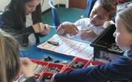
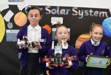
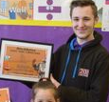

Essential Life Skills – “Bits & Bytes”
Designed to improve the social mobility of year 4/5 pupils in Fenland and East Cambs
16 weeks of activities designed to improve essential skills for life (such as problem solving, respect, resilience and curiosity), develop coding skills, introduce pupils to robotics and more
Starting to see increases in the number of children saying they want to go to university
For more info email Emma.Peppercorn@cambridgeshire.gov.uk
As a small primary school in the middle of Fenland, opportunities like this are incredibly valuable as we strive to provide children with experiences that will inspire them and lead to their aspirations growing - this project did.
I try to solve as many problems as I can, even problems I can’t
Notes:
2 q)
“Bits and Bytes”, a 16-week series of activities designed to improve the social mobility of year 4/5 pupils in Fenland and East Cambs. Designed to improve essential skills for life (such as problem solving, respect, resilience and curiosity), develop coding skills, introduce pupils to robotics and more.
Lead by 20Twenty – lots about team work…
Pictures of group work:
A UN-themed competition to make a robot that collects litter
Each team represented a nation
Any significant demonstrations of honesty, respect or problem solving are immediately awarded points. Any unwanted behaviours were penalised points appropriately.
Starting to see increases in the number of children saying they want to go to university
Background
In this first cohort of the programme, positive activities were delivered in five different classes across Murrow, Nene and Ramnoth, Leveringon and Kinderley primary schools in Fenland. 2nd cohort of primary schools planned.

Slide 18
Action Plan 2019/20 Highlights Strengthening Communities
& Families
Notes:
- CLLD, Time credits, ICF?
Best Start in Life > integrated, evidence based approach to early years provision > boost social mobility
Think Communities > Prototypes?

Slide 19
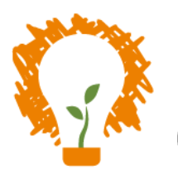

Supporting projects in areas of high need
Innovate and Cultivate Fund
Healthy Fenland Fund
Community Reach Fund
Support Cambridgeshire
Sport England Families Fund
Notes:
Innovate and Cultivate Fund
CCC fund for voluntary and community groups, social enterprises and public sector bodies.
Investing in projects and idea that improve the outcomes for local residents and reduce pressure on council services
Healthy Fenland Fund
Community Reach – small pots of money. We have recently had confirmation that more than 5 groups who were recently awarded up to £1k and supported by the YCC to take their first look at fundraising through grants schemes have now successfully been support to receive in excess of £70k.
Sport England - low income families to try out suitable sports activities. Roadshow Activators will signpost participants to other opportunities; with an online directory, maps and digital content of free ideas and information about family outdoor play and physical activity options. Expected number of families: 537 Award: £325,000

Slide 20
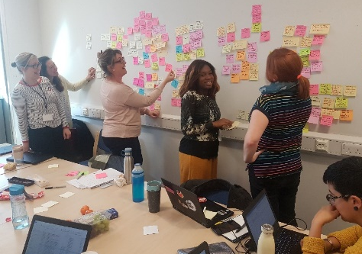
Best Start In Life Strategy
Information is really hard to come by through official channels unless you ask the right questions. It trickles through friendship groups based on what other friends have been told by professionals.
This will identify specific areas where we can work together to have the greatest impact on early year’s outcomes for children from pre-birth to 5.
We visited 18 locations in Cambridgeshire and talked to parents, carers and young children about their lived experience. These stories helped shape the strategy.
The strategy will be further refined over the summer, along with a model to bring together the various strands of early years provision in a more integrated way and presented to Health and Children and Young People’s committees in September.
For more information email Gwendolyn.Casazza@cambridgeshire.gov.uk
Notes:
Best Start in Life > integrated, evidence based approach to early years provision > boost social mobility

Slide 21
Action Plan 2019/20 Highlights
Delivering an Effective Benefit System
Notes:
Support and facilities offered in Libraries
Commissioned work > advice and guidance around finance that is built into all these contracts
More staff, community groups (& members?) Understanding benefits

Slide 22
Welfare Benefits Team
Provide advice, information and support with disability benefit claim forms (PIP/DLA/AA) via telephone and email – and home visits to complete disability benefit forms
Also provide training and information to staff and community organisations on welfare benefits
Last year, the team:
Carried out 352 home visits to help complete benefit claim forms
Helped people in Cambridgeshire to claim over £823,000 annualised benefits, and over £121,000 in arrears
Our total benefit gains for the year was £945,251,71
This was down on the previous year due to staff sickness and maternity leave - gains in 2017 was £1,099,402
Factsheets: https://www.cambridgeshire.gov.uk/residents/adults/organising-care-and-support/care-and-support-fact-sheets/
Email welfare.benefits@cambridgeshire.gov.uk
Notes:
Anjela to present
Countywide service as part of the Adult Early Help Team - 2.2 fte!
Provide advice on disability benefits and claim procedures to public, staff and community organisations.

Slide 23
Action Plan 2019/20 Highlights
Promoting Long-term Economic Growth Benefiting Everyone
Notes:
Adult Skills Service
Public Health

Slide 24

Get into and stay in work
Wisbech Community led Local Development: Funding
Volunteer opportunities – a route into work.
Help for those with long term health conditions to stay in work or get into work including improving referral processes with mental health services and other providers
Public Transport which enables people to continue to travel for work, education and access to essential services
Notes:
Time credits – 50,000 hours given; 1700 individuals earned, 70 organisations involved; 80 venues to spend.
CLLD – focus on …tackle a broad range of issues that stop local people from finding and keeping a job they enjoy, that provides a decent, living wage. EU funded – European Social fund
Volunteer opportunities – libraries, Time Credits for earn and spend .
Know what skills you need to get into work.
Work with combined authority to commission and provide public bus services where there is a demonstrable need and commercial services are not viable, enabling people to continue to travel for work, education and access to essential services.
“This is a fun activity which gives people a good time but also increases their confidence and skill levels. It really helps people to become more involved in a positive way with their community.”

Slide 25
Next steps, working with…..
  You !
  What can we do better together
  Who else should be involved
  What does next step look like?
  Partners - shared approach to tackling poverty and disadvantage in the future over the next 12 months
  Financial Capability Forum - to look at ‘what works’ locally and nationally and joining up services better
  Charities Networks - on successful approaches to Food Poverty
Notes:
Elaine
how do we connect, best points of contact to collaborate more on, where is it useful for us to input (resources allowing), what next?... is about a new or tweaked ‘approach’ – what would that look like?
Recognising that we are just part of this ecosystem of public, voluntary and community sector organisations who are doing work, often very successfully, in this area – being aware – making sure our colleagues are aware of what exists, signpost people to those services – and support it where it’s appropriate and makes sense – for example at the Wisbech food poverty group the Rosmini Centre have funding to offer benefits checks across Fenland – making the connecting with Welfare benefits team and also with libraries, where they want to base their drop ins.
Phase 2 – we want to work with these existing networks, so the Financial Capability Forum, faith groups, - be part of the network, building the relationships across CCC, playing our role, and help join it up.
Training for members?

Slide 26

Discussion

