Slide 1
Cambridge City PCN
Data pack
July 2019

Slide 2
Cambridge City PCN – summary
There are almost 50,500 people registered with Cambridge City PCN, with higher proportions of the population under 18 and over 85 years compared to the South Alliance, CCG and England. The population is estimated to increase by almost 7.3% between 2019 and 2036. The PCN has a lower proportion of White British ethnic group compared to the South Alliance, CCG and England Relative deprivation is higher for the PCN compared to the South Alliance and CCG but lower than England. Approximately 18.0% of children and 16.4% of older people live in poverty On average there are around 598 births a year in the PCN. Birth rate in Cambridge City PCN is statistically significantly higher than the average for the South Alliance. The low birth weight proportion is statistically similar to the South Alliance. It is estimated that male life expectancy is around 78 years in the PCN and female life expectancy 82 years, both statistically significantly lower than South Alliance average Recorded obesity in adults is statistically significantly higher than the South Alliance It is estimated that 8,186 of adults smoke, which is statistically significantly higher than the South Alliance | Estimates of people reporting long-term activity-limiting illness and being in Good or Very Good health are statistically significantly worse than the averages for the South Alliance. On average, there are around 500 deaths a year in the PCN, with around a fourth of these in people aged under 75 years. The PCN has statistically significantly high recorded prevalence of stroke, asthma, COPD and diabetes compared to the South Alliance averages Most practices have statistically significantly higher all-age and premature all cause mortality rates compared to South Alliance. All-age mortality rates for circulatory disease, respiratory disease and cancer are statistically significantly higher than South Alliance for the Cambridge City PCN. The premature mortality rates for respiratory disease and cancer are statistically similar to the South Alliance for all PCN practices.

Slide 3
Demography

Slide 4
GP registered population
Cambridge City PCN has higher proportions of people aged under 18 and over 85 years compared with South Alliance, CCG and England and a lower proportion aged 16-64 and over 65 years. The population of Cambridge City PCN is forecast to grow at a lower rate than the CCG as whole until 2036. The population is expected to increase by 7.3% between 2019 and 2036
Source: GP registered population, April 2019, NHS Digital. Population forecasts based on population distribution at ward level (Apr 19), Mid 2015 based population forecasts Cambridgeshire County Council
Age band | Cambridge City PCN |  | South Alliance | Cambridgeshire and Peterborough CCG | England
 | Number | %
Total | 50,456 | 100% | 415,999 | 983,597 | 59,759,638
0-4 years | 2,712 | 5.4% | 4.7% | 5.4% | 5.5%
5-14 years | 5,522 | 10.9% | 10.4% | 11.7% | 11.8%
Under 18 years | 9,626 | 19.1% | 18.1% | 20.3% | 20.4%
16-64 years | 34,451 | 68.3% | 68.5% | 65.6% | 64.3%
65+ years | 7,272 | 14.4% | 15.4% | 16.3% | 17.4%
75+ years | 3,462 | 6.9% | 7.1% | 7.3% | 8.0%
85+ years | 1,163 | 2.3% | 2.2% | 2.2% | 2.3%
Population forecasts
PCN | 2019 | 2021 | 2026 | 2031 | 2036 | 2019 to 2021 |  | 2021 to 2026 |  | 2026 to 2031 |  | 2031 to 2036
 |  |  |  |  |  | Number | % | Number | % | Number | % | Number | %
Cambridge City PCN | 49,846 | 50,640 | 53,027 | 53,398 | 53,460 | 794 | 1.6% | 2,387 | 4.7% | 371 | 0.7% | 61 | 0.1%
C&P CCG | 982,987 | 1,011,368 | 1,072,891 | 1,097,528 | 1,110,295 | 28,381 | 2.9% | 61,522 | 6.1% | 24,637 | 2.3% | 12,767 | 1.2%

Slide 5
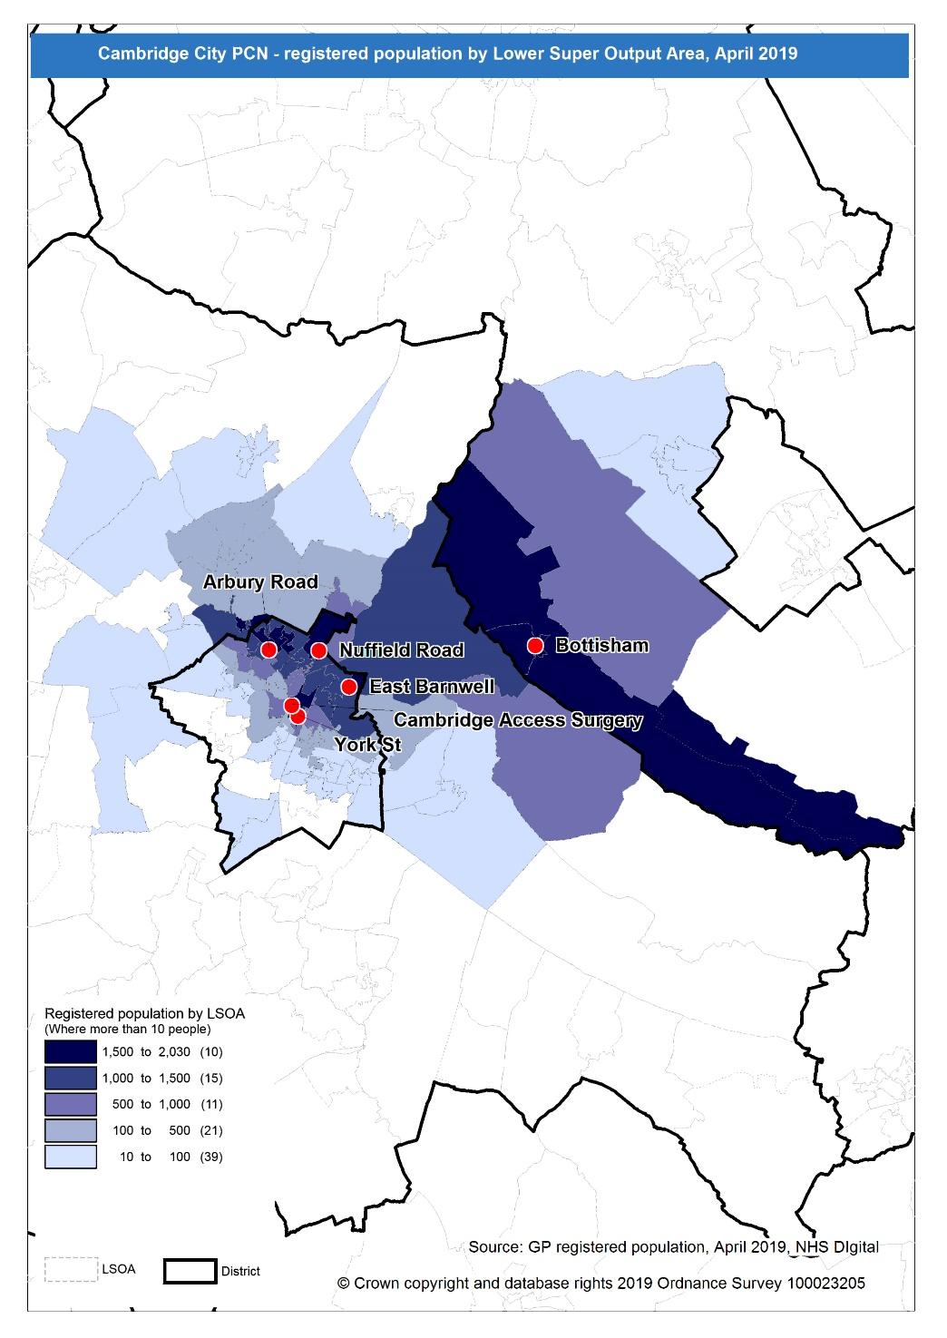
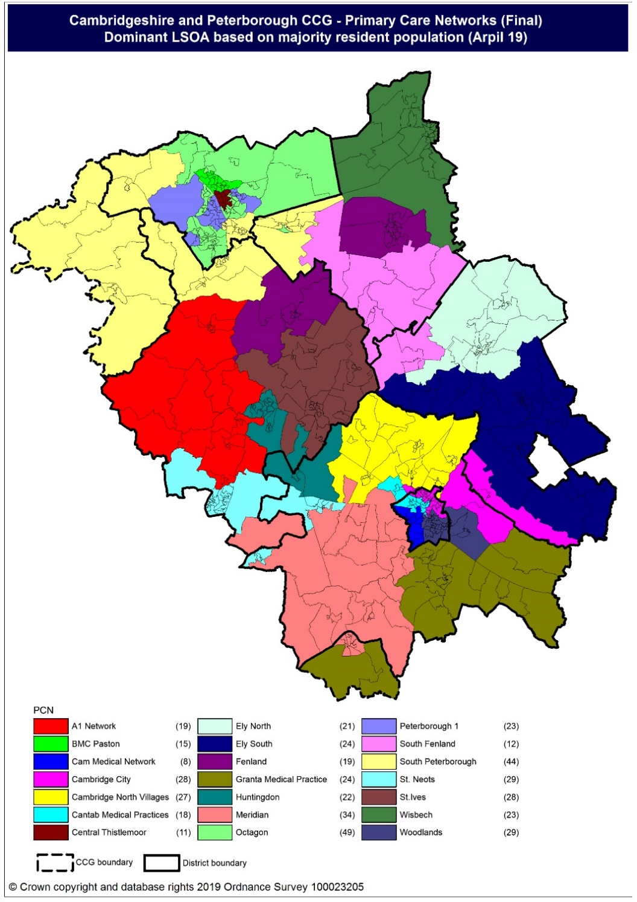
Population distribution
Source: GP registered population data by Lower Super Output Area, April 19, NHS Digital
Population
distribution
PCN dominant
population

Slide 6
Ethnicity
Cambridge City PCN has a lower proportion of White British and higher proportions of all other ethnicities compared to the South Alliance and CCG.
Source: Census 2011 data applied to GP registered population using Census 2011 ethnic group proportions; England data from NOMIS (patients registered at a GP Practice by LSOA, July 2018, NHS Digital)
PCN | White British | White Other | Mixed | Black | Asian: Indian/ Bangladeshi/ Pakistani | Asian: Chinese/Other | Other
Cambridge City PCN | 71.0% | 14.3% | 2.9% | 2.0% | 4.6% | 3.9% | 1.4%
South Alliance | 79.0% | 10.6% | 2.3% | 1.1% | 2.7% | 3.5% | 0.9%
Cambridgeshire and Peterborough CCG | 80.0% | 9.5% | 2.1% | 1.3% | 4.1% | 2.4% | 0.7%
England | 79.8% | 5.7% | 2.3% | 3.5% | 5.6% | 2.3% | 1.0%

Slide 7
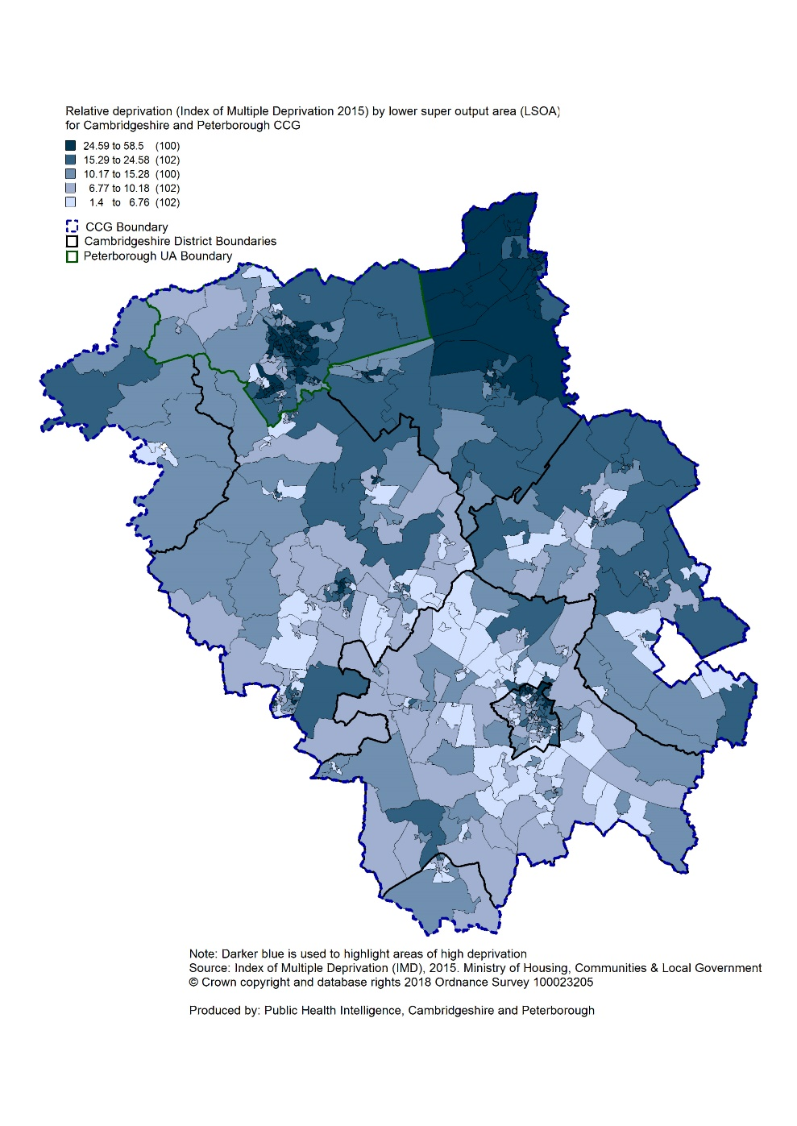
Deprivation
Relative deprivation is higher in Cambridge City PCN compared to South Alliance and CCG but lower than England. Approximately 18.0% of children and 16.4% of older people live in income deprived households in the PCN; higher than the averages for South Alliance and the CCG.
Source: C&P PHI derived from Indices of Multiple Deprivation 2015, DCLG and GP registered population data for July 2018. Practice data from PHE Fingertips.
 | Index of Multiple Deprivation | Income Affecting Children Index | Income Affecting Older People Index
Arbury Road Surgery | 21.1 | 22.0% | 18.1%
Bottisham Medical Practice | 9.7 | 6.8% | 10.5%
Cambridge Access Surgery | 16.5 | 16.1% | 14.0%
East Barnwell Health Centre | 26.5 | 22.6% | 18.1%
Nuffield Road Medical Centre | 18.3 | 20.3% | 18.0%
York Street medical Practice | 14.5 | 13.1% | 14.3%
Cambridge City PCN | 18.4 | 18.0% | 16.4%
South Alliance | 11.1 | 10.5% | 11.2%
C&P CCG | 17.2 | 15.4% | 14.3%
England | 21.8 | 19.9% | 16.2%
Index of Multiple Deprivation, 2015, by ward

Slide 8
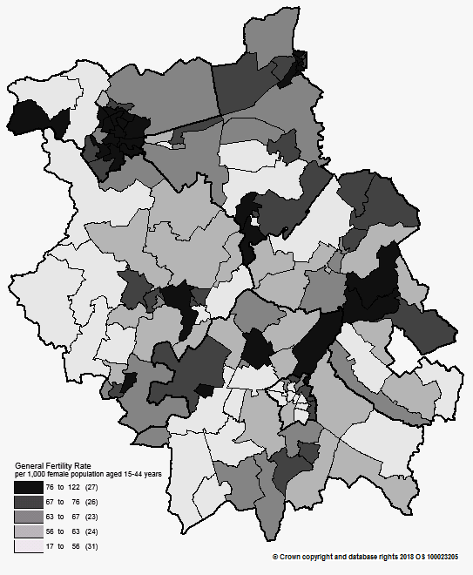
Births and Fertility
The birth rate in Cambridge City PCN is statistically significantly higher than the average for the South Alliance. The low birth weight proportion is statistically similar to the South Alliance.
Note: Relates to Cambridgeshire and Peterborough residents only Source: C&P PHI based on NHS Digital Civil Registration Data, 2014-2016 and patients registered at a GP Practice by LSOA, July 2018, NHS Digital (benchmark = South Alliance)
Birth rates by ward
 | Estimated
 | Number of live births (2014-2016) | Birth rate per 1,000 female population aged 15 to 44 years | Low birth weight births (under 2,500g)
Cambridge City PCN | 1,794 | 54.9 | 6.8%
South Alliance | 11,592 | 48.6 | 6.0%
Cambridgeshire and Peterborough CCG | 31,348 | 58.2 | 6.5%
England | 1,989,052 | 62.4 | 7.4%

Slide 9
Life expectancy
Male and female life expectancies in Cambridge City PCN are statistically significantly lower than life expectancies for the South Alliance and CCG
Source: C&P PHI based, derived from NHS Digital Civil Registration data and GP registered population data (benchmark = South Alliance), 2013 – 2017
 | Males (years) | Females (years)
Cambridge City PCN | 78.3 | 81.7
South Alliance | 82.3 | 85.1
Cambridgeshire and Peterborough CCG | 81.2 | 84.3

Slide 10
Risk factors

Slide 11
Risk factors
Recorded prevalence of obesity is statistically significantly higher in Cambridge City PCN compared to the average for South Alliance Estimated smoking prevalence is statistically significantly higher in Cambridge City PCN compared to the average for South Alliance, CCG and England
Source: Obesity - C&P PHI derived from NHS Digital QOF data for 2017/18 (benchmark = South Alliance) Estimated smoking - C&P PHI derived from the QOF based smoking prevalence estimate from the Public Health England (PHE) National General Practice Profiles at https://fingertips.phe.org.uk/profile/general-practice (benchmark = South Alliance)
 | Obesity |  | Estimated Smoking
 | Number | % | Number | %
Cambridge City PCN | 3,006 | 7.4% | 8,186 | 19.8%
South Alliance | 21,375 | 6.4% | 45,738 | 13.3%
Cambridgeshire and Peterborough CCG | 65,496 | 8.5% | 136,105 | 17.0%
England | 4,530,447 | 9.8% | 8,301,429 | 17.2%

Slide 12
Self-reported limiting long-term illness and general health status
It is estimated that the proportion of people that reported that they had a long-term activity-limiting illness in the 2011 Census was statistically significantly higher than the South Alliance average It is estimated that the proportion of people that reported that they were in good or very good health in the 2011 Census was statistically significantly lower than the South Alliance average
Source: C&P PHI from Census 2011, NOMIS and patients registered at a GP Practice by LSOA, July 2018, NHS Digital (benchmark = South Alliance)
 | Long-term activity-limiting illness | Good or very good health
Cambridge City PCN | 15.3% | 83.8%
South Alliance | 13.8% | 85.9%
Cambridgeshire and Peterborough CCG | 15.5% | 83.6%
England | 17.6% | 81.4 %

Slide 13
Diseases

Slide 14
Mortality – all causes
There have been on average 500 deaths a year in Cambridge City PCN, approximately a fourth are in people aged under 75 years. Most practices have statistically significantly higher all-age and premature all cause mortality rates compared to South Alliance.
DASR = directly age standardised rate per 100,000 population Source: C&P PHI, from NHS Digital Civil Registration Data and NHS Digital GP registered population data, 2013-2017 (benchmark = South Alliance)
 | All ages |  | Under 75 year olds
 | Number | DASR per 100,000 | Number | DASR per 100,000
Arbury Road, Cambridge | 316 | 748.6 | 112 | 279.6
Bottisham | 624 | 1,476.0 | 118 | 395.2
Cambridge Access Surgery | 44 | 1,322.6 | 44 | 1,453.4
East Barnwell, Cambridge | 176 | 659.3 | 70 | 283.5
Nuffield Road, Cambridge | 1,114 | 1,548.5 | 192 | 439.8
York Street, Cambridge | 225 | 788.5 | 91 | 298.3
Cambridge City PCN | 2,499 | 1,180.8 | 627 | 365.4
South Alliance | 13,293 | 831.3 | 3,592 | 248.4
Cambridgeshire and Peterborough CCG | 34,464 | 901.5 | 10,385 | 286.4

Slide 15
Circulatory disease
The prevalence rates of CHD and hypertension are statistically similar to the South Alliance. The prevalence of stroke is statistically significantly higher than the South Alliance The rates of circulatory all-age and premature mortality for the PCN are statistically significantly higher than the South Alliance.
Note: Prevalence data are not available by age i.e. it is not age weighted so differences may be explained by differing age structures DASR = Directly age standardised rate per 100,000 population Source: Prevalence (recorded) - C&P PHI from QOF, NHS Digital, 2017/18 (benchmark = South Alliance) Mortality - C&P PHI, from NHS Digital Civil Registration Data and NHS Digital GP registered population data, 2013-2017 (benchmark = South Alliance)
 | Prevalence |  |  |  |  |  |  | Mortality (circulatory)
 | Coronary heart disease |  | Hypertension |  | Stroke |  |  | All ages |  | Under 75 year olds
 | Number | % | Number | % | Number | % |  | Number | DASR per 100,000 | Number | DASR per 100,000
Arbury Road, Cambridge | 303 | 2.4% | 1,362 | 10.8% | 157 | 1.3% |  | 86 | 207.8 | 27 | 70.2
Bottisham | 213 | 3.6% | 1,079 | 18.3% | 143 | 2.4% |  | 149 | 348.6 | 33 | 109.1
Cambridge Access Surgery | 9 | 1.6% | 21 | 3.7% | <5 | 0.5% |  | <5 | 93.7 | <5 | 103.0
East Barnwell, Cambridge | 147 | 2.1% | 818 | 11.5% | 85 | 1.2% |  | 53 | 196.8 | 17 | 73.9
Nuffield Road, Cambridge | 405 | 2.8% | 1,649 | 11.6% | 241 | 1.7% |  | 261 | 353.3 | 33 | 77.1
York Street, Cambridge | 170 | 1.7% | 768 | 7.7% | 88 | 0.9% |  | 61 | 225.2 | 20 | 72.8
Cambridge City PCN | 1,247 | 2.5% | 5,697 | 11.3% | 717 | 1.4% |  | 613 | 290.0 | 134 | 82.2
South Alliance | 9,603 | 2.4% | 45,177 | 11.1% | 5,224 | 1.3% |  | 3,660 | 228.9 | 768 | 54.3
C&P CCG | 26,602 | 2.8% | 122,348 | 12.6% | 14,132 | 1.5% |  | 9,004 | 236.7 | 2,288 | 63.9
England | 1,827,352 | 3.1% | 8,141,488 | 13.9% | 1,030,869 | 1.8% |  | Not available

Slide 16
Respiratory disease
Asthma and COPD prevalence for the PCN and most practices are statistically significantly higher than South Alliance. The mortality rates for respiratory diseases, for people of all ages is statistically significantly higher for the PCN than the South Alliance and under 75 years is statistically similar to the South Alliance rate for all practices.
Note: Prevalence data are not available by age i.e. it is not age weighted so differences may be explained by differing age structures DASR = Directly age standardised rate per 100,000 population Source: Prevalence (recorded) - C&P PHI from QOF, NHS Digital, 2017/18 (benchmark = South Alliance) Mortality - C&P PHI, from NHS Digital Civil Registration Data and NHS Digital GP registered population data, 2013-2017 (benchmark = South Alliance)
 | Prevalence |  |  |  |  | Mortality
 | Asthma |  | Chronic Obstructive Pulmonary Disease |  |  | All ages |  | Under 75 years
 | Number | % | Number | %
 |  |  |  |  |  | Number | DASR per 100,000 | Number | DASR per 100,000
Arbury Road, Cambridge | 860 | 6.8% | 260 | 2.1% |  | 44 | 104.6 | 11 | 29.5
Bottisham | 482 | 8.2% | 137 | 2.3% |  | 66 | 152.2 | 6 | 20.4
Cambridge Access Surgery | 51 | 9.0% | 27 | 4.8% |  | <5 | 19.2 | <5 | 21.1
East Barnwell, Cambridge | 457 | 6.4% | 126 | 1.8% |  | 17 | 61.3 | <5 | 15.9
Nuffield Road, Cambridge | 975 | 6.8% | 282 | 2.0% |  | 119 | 153.5 | 12 | 27.5
York Street, Cambridge | 548 | 5.5% | 130 | 1.3% |  | 29 | 108.1 | 6 | 21.1
Cambridge City PCN | 3,373 | 6.7% | 962 | 1.9% |  | 275 | 126.8 | 40 | 24.1
South Alliance | 24,780 | 6.1% | 5,561 | 1.4% |  | 1,468 | 92.1 | 264 | 19.1
C&P CCG | 57,830 | 6.0% | 16,513 | 1.7% |  | 4,533 | 119.9 | 942 | 26.8
England | 3,463,893 | 5.9% | 1,113,417 | 1.9% |  | Not available

Slide 17
Long term conditions
Cambridge City PCN diabetes prevalence rate is statistically significantly higher than the South Alliance. The cancer prevalence rates for all practices are statistically significantly lower than the South Alliance except Bottisham where it is statistically significantly higher. The cancer mortality rate for all-age is statistically significantly higher than the South Alliance. All practices have statistically similar premature cancer mortality rates to the South Alliance.
Note: Prevalence data are not available by age i.e. it is not age weighted so differences may be explained by differing age structures DASR = Directly age standardised rate per 100,000 population Source: Prevalence (recorded) - C&P PHI from QOF, NHS Digital, 2017/18 (benchmark = South Alliance) Mortality - C&P PHI, from NHS Digital Civil Registration Data and NHS Digital GP registered population data, 2013-2017 (benchmark = South Alliance)
 | Prevalence |  |  |  |  | Mortality - Cancer
 | Diabetes (17+ years) |  | Cancer |  |  | All ages |  | Under 75 year olds
 | Number | % | Number | % |  | Number | DASR per 100,000 | Number | DASR per 100,000
Arbury Road, Cambridge | 565 | 5.6% | 264 | 2.1% |  | 91 | 218.7 | 41 | 104.0
Bottisham | 326 | 6.8% | 277 | 4.7% |  | 147 | 372.0 | 44 | 146.4
Cambridge Access Surgery | 16 | 2.8% | 5 | 0.9% |  | <5 | 101.6 | <5 | 111.7
East Barnwell, Cambridge | 358 | 6.3% | 151 | 2.1% |  | 63 | 246.8 | 33 | 138.0
Nuffield Road, Cambridge | 670 | 5.8% | 332 | 2.3% |  | 191 | 314.8 | 62 | 148.4
York Street, Cambridge | 279 | 3.4% | 169 | 1.7% |  | 75 | 262.8 | 36 | 125.5
Cambridge City PCN | 2,214 | 5.4% | 1,198 | 2.4% |  | 570 | 289.3 | 219 | 132.0
South Alliance | 15,620 | 4.6% | 10,846 | 2.7% |  | 3,809 | 244.0 | 1,604 | 112.9
C&P CCG | 46,573 | 6.0% | 25,700 | 2.7% |  | 9,902 | 259.5 | 4,411 | 123.2
England | 3,196,124 | 6.8% | 1,593,302 | 2.7% |  | Not available

Slide 18
Mental health
Cambridge City PCN and all practice prevalence rates of severe mental illness are statistically significantly higher than the South Alliance averages except Bottisham practice where it is statistically similar. Cambridge City PCN prevalence rates of depression, dementia and learning disabilities are statistically significantly higher than the South Alliance averages for most practices.
Note: Prevalence data are not available by age i.e. it is not age weighted so differences may be explained by differing age structures Source: Prevalence (recorded) - C&P PHI from QOF, NHS Digital, 2017/18 (benchmark = South Alliance) Mortality - C&P PHI, from NHS Digital Civil Registration Data and NHS Digital GP registered population data, 2013-2017 (benchmark = South Alliance)
 | Schizophrenia, bipolar affective disorder and other psychoses |  | Depression (18+ years) |  | Dementia |  | Learning disabilities
 | Number | % | Number | % | Number | % | Number | %
Arbury Road, Cambridge | 172 | 1.4% | 959 | 9.6% | 63 | 0.5% | 79 | 0.6%
Bottisham | 57 | 1.0% | 454 | 9.6% | 110 | 1.9% | 14 | 0.2%
Cambridge Access Surgery | 82 | 14.4% | 153 | 26.9% | <5 | 0.2% | 9 | 1.6%
East Barnwell, Cambridge | 90 | 1.3% | 859 | 15.2% | 31 | 0.4% | 41 | 0.6%
Nuffield Road, Cambridge | 193 | 1.4% | 1,155 | 10.1% | 285 | 2.0% | 87 | 0.6%
York Street, Cambridge | 132 | 1.3% | 634 | 7.8% | 22 | 0.2% | 29 | 0.3%
Cambridge City PCN | 726 | 1.4% | 4,214 | 10.4% | 512 | 1.0% | 259 | 0.5%
South Alliance | 3,654 | 0.9% | 26,382 | 7.9% | 2,457 | 0.6% | 1,382 | 0.3%
C&P CCG | 7,750 | 0.8% | 68,112 | 8.8% | 6,551 | 0.7% | 4,057 | 0.4%
England | 550,918 | 0.9% | 4,589,213 | 9.9% | 446,548 | 0.8% | 284,422 | 0.5%

