Slide 1
Cam Medical Network PCN
Data pack
July 2019

Slide 2
Cam Medical Network PCN – summary
There are almost 46,500 people registered with Cam Medical Network PCN, with lower proportions of the population over 65 and under 18 compared to the South Alliance, CCG and England. The population is estimated to increase by almost 4.8% between 2021 and 2036. The PCN has a lower proportion of White British ethnic group compared to the South Alliance, CCG and England Relative deprivation is lower for the PCN compared to the South Alliance, CCG and England. Approximately 8.3% of children and 9.3% of older people live in poverty On average there are around 273 births a year in the PCN. The birth rate in Cam Medical Network PCN is statistically significantly lower than the average for the South Alliance. The low birth weight proportion is statistically similar to the South Alliance. It is estimated that male life expectancy is around 84 years in the PCN and female life expectancy 87 years, both statistically significantly higher than the South Alliance average Recorded obesity in adults is statistically significantly lower than the South Alliance It is estimated that 2,874 of adults smoke (7.2%), which is statistically significantly lower than the South Alliance | Estimates of people reporting long-term activity-limiting illness and being in Good or Very Good health are statistically significantly better than the averages for the South Alliance. On average, there are around 131 deaths a year in the PCN, with around a fourth of these in people aged under 75 years. The PCN has statistically significantly low recorded prevalence of CHD, hypertension, stroke, asthma, COPD, diabetes and cancer compared to the South Alliance averages All practices have statistically significantly lower all-age and premature all cause mortality rates compared to South Alliance, except Lensfield Medical Practice where the rate is statistically significantly higher for all-age mortality. All-age and premature mortality rates for circulatory disease, respiratory disease and cancer are statistically similar to South Alliance for most practices.

Slide 3
Demography

Slide 4
GP registered population
Cam Medical Network PCN has lower proportions of people aged under 18 and over 65 compared with South Alliance, CCG and England and a higher proportion aged 16-64. The population of Cam Medical Network PCN is forecast to grow at a higher rate than the CCG between 2019 and 2021 and at a lower rate than the CCG between 2021 and 2036; the population is expected to increase by almost 4.8% between 2021 and 2036
Source: GP registered population, April 2019, NHS Digital. Population forecasts based on population distribution at ward level (Apr 19), Mid 2015 based population forecasts Cambridgeshire County Council
Age band | Cam Medical Network PCN |  | South Alliance | Cambridgeshire and Peterborough CCG | England
 | Number | %
Total | 46,457 | 100% | 415,999 | 983,597 | 59,759,638
0-4 years | 1,612 | 3.5% | 4.7% | 5.4% | 5.5%
5-14 years | 3,291 | 7.1% | 10.4% | 11.7% | 11.8%
Under 18 years | 5,969 | 12.8% | 18.1% | 20.3% | 20.4%
16-64 years | 37,435 | 80.6% | 68.5% | 65.6% | 64.3%
65+ years | 3,806 | 8.2% | 15.4% | 16.3% | 17.4%
75+ years | 1,680 | 3.6% | 7.1% | 7.3% | 8.0%
85+ years | 503 | 1.1% | 2.2% | 2.2% | 2.3%
Population forecasts
PCN | 2019 | 2021 | 2026 | 2031 | 2036 | 2019 to 2021 |  | 2021 to 2026 |  | 2026 to 2031 |  | 2031 to 2036
 |  |  |  |  |  | Number | % | Number | % | Number | % | Number | %
Cam Medical Network PCN | 46,457 | 48,660 | 49,746 | 50,663 | 51,019 | 2,203 | 4.7% | 1,087 | 2.2% | 917 | 1.8% | 365 | 0.7%
C&P CCG | 982,987 | 1,011,368 | 1,072,891 | 1,097,528 | 1,110,295 | 28,381 | 2.9% | 61,522 | 6.1% | 24,637 | 2.3% | 12,767 | 1.2%

Slide 5
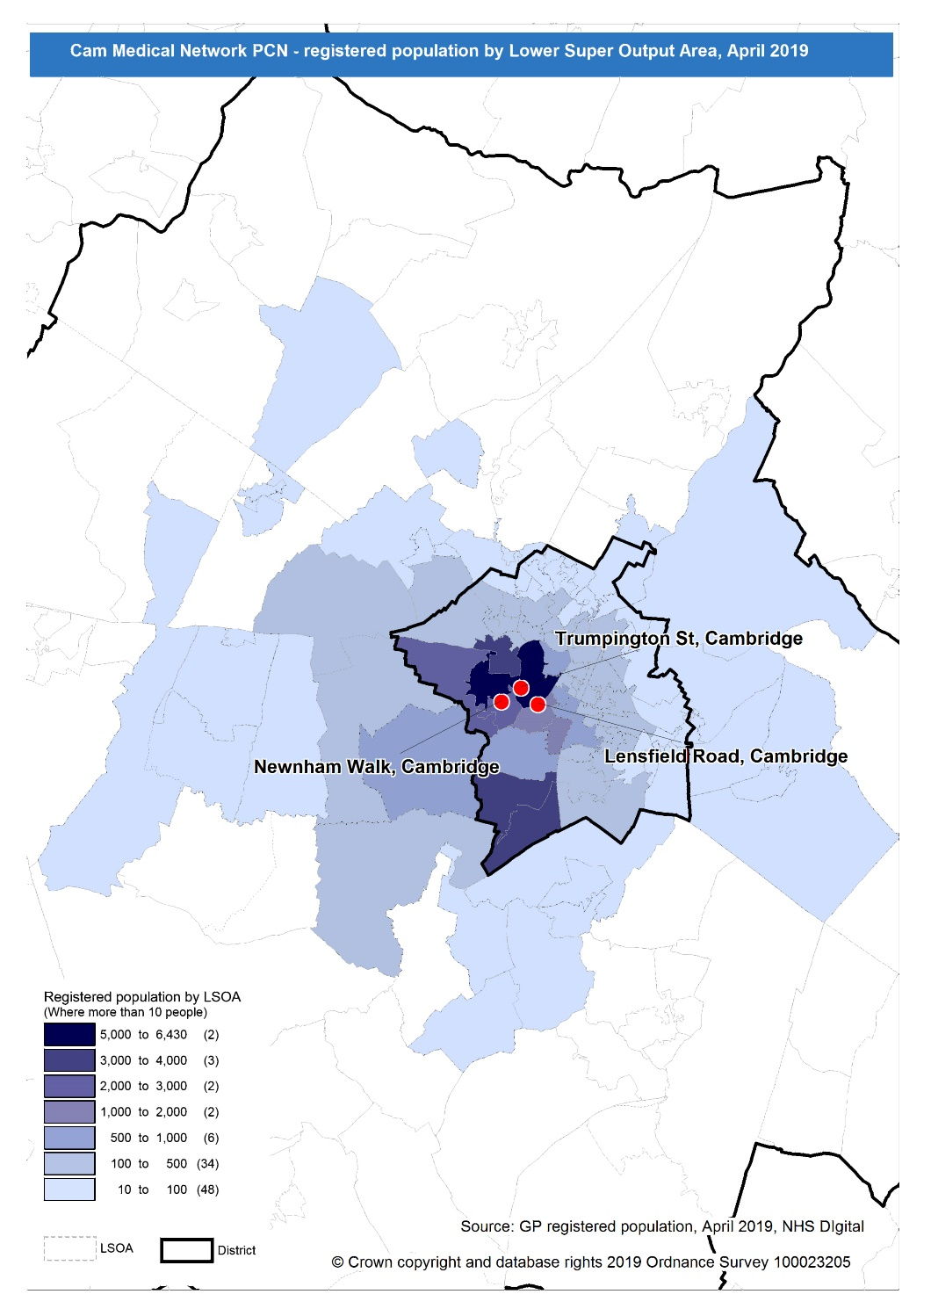
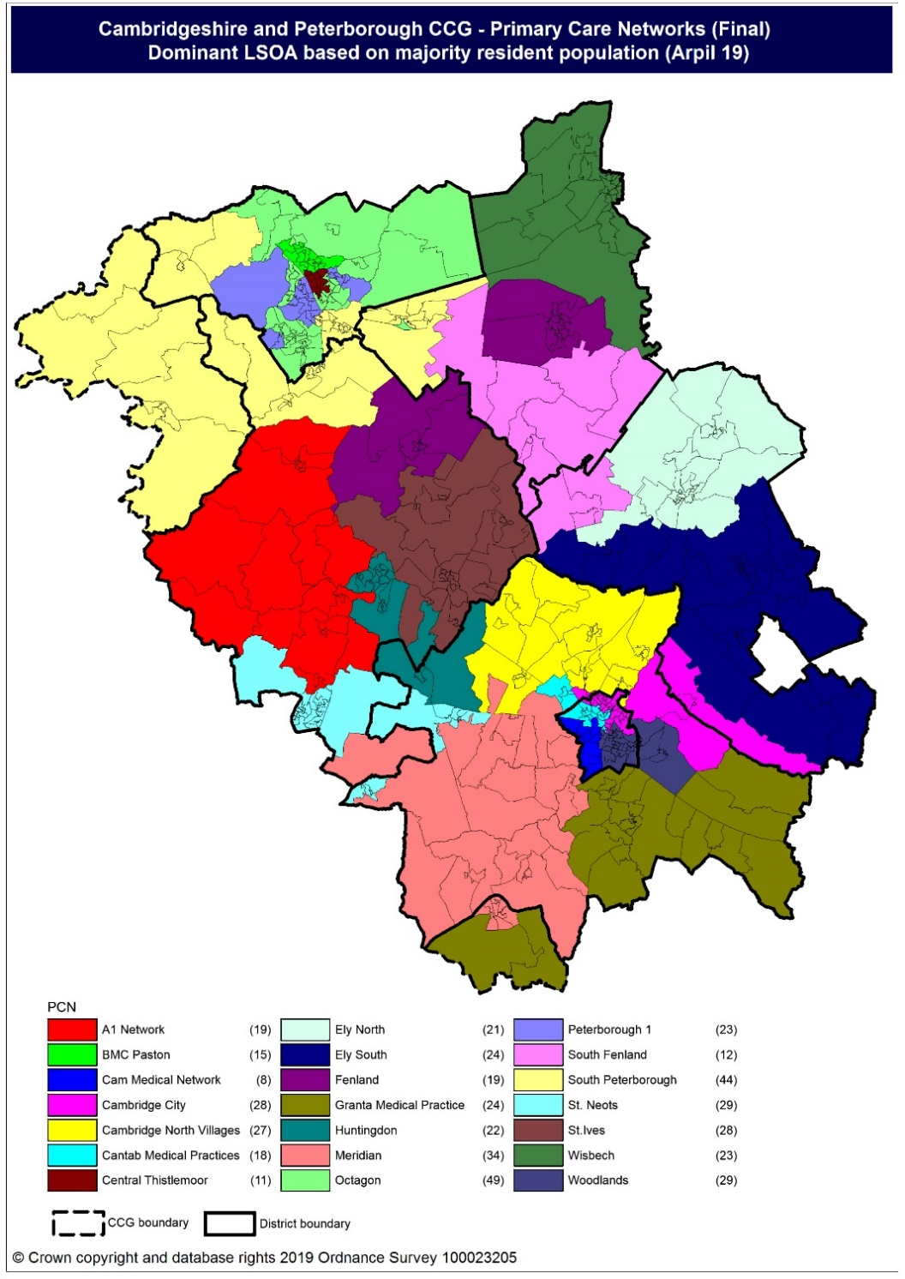
Population distribution
Source: GP registered population data by Lower Super Output Area, April 19, NHS Digital
Population
distribution
PCN dominant
population

Slide 6
Ethnicity
Cam Medical Network PCN has lower proportion of White British and higher proportions of White other, Mixed, Black and Asian ethnic groups compared to the South Alliance, CCG and England averages
Source: Census 2011 data applied to GP registered population using Census 2011 ethnic group proportions; England data from NOMIS (patients registered at a GP Practice by LSOA, July 2018, NHS Digital)
PCN | White British | White Other | Mixed | Black | Asian: Indian/ Bangladeshi/ Pakistani | Asian: Chinese/Other | Other
Cam Medical Network PCN | 65.1% | 17.3% | 3.3% | 1.2% | 4.0% | 7.7% | 1.3%
South Alliance | 79.0% | 10.6% | 2.3% | 1.1% | 2.7% | 3.5% | 0.9%
Cambridgeshire and Peterborough CCG | 80.0% | 9.5% | 2.1% | 1.3% | 4.1% | 2.4% | 0.7%
England | 79.8% | 5.7% | 2.3% | 3.5% | 5.6% | 2.3% | 1.0%

Slide 7
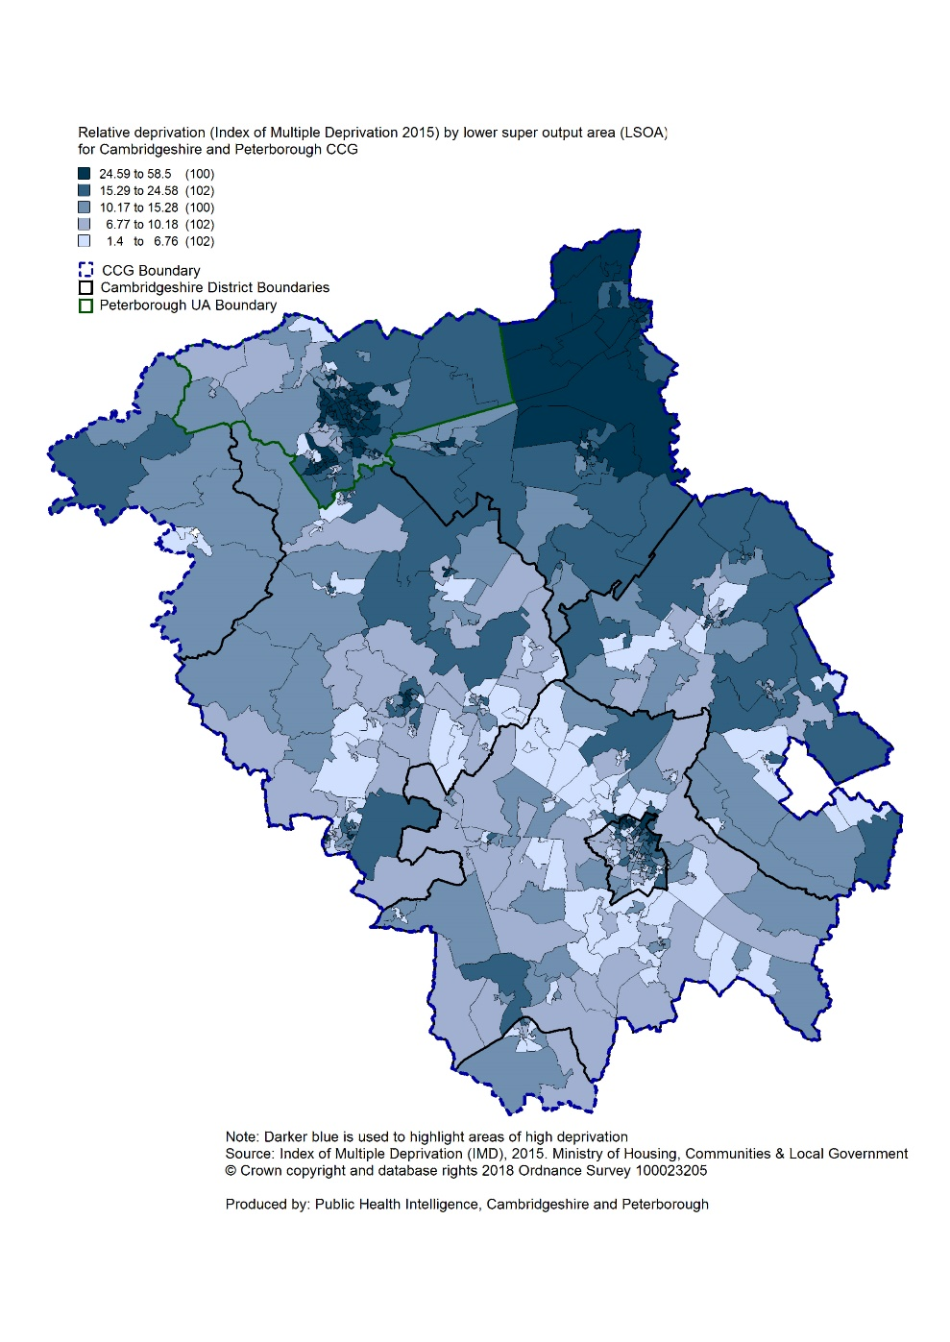
Deprivation
Relative deprivation is lower in Cam Medical Network PCN compared to South Alliance, CCG and England. One practice, Lensfield Medical Practice, has higher relative deprivation than South Alliance. Approximately 8.3% of children and 9.3% of older people live in income deprived households in the PCN; lower than the averages for South Alliance, CCG and England.
Source: C&P PHI derived from Indices of Multiple Deprivation 2015, DCLG and GP registered population data for July 2018. Practice data from PHE Fingertips.
 | Index of Multiple Deprivation | Income Affecting Children Index | Income Affecting Older People Index
Lensfield Medical Practice | 11.8 | 9.0% | 10.7%
Newnham Walk Surgery | 7.6 | 7.3% | 8.7%
Trumpington Street Medical Practice | 10.2 | 8.6% | 8.8%
Cam Medical Network PCN | 9.8 | 8.3% | 9.3%
South Alliance | 11.1 | 10.5% | 11.2%
C&P CCG | 17.2 | 15.4% | 14.3%
England | 21.8 | 19.9% | 16.2%
Index of Multiple Deprivation, 2015, by ward

Slide 8
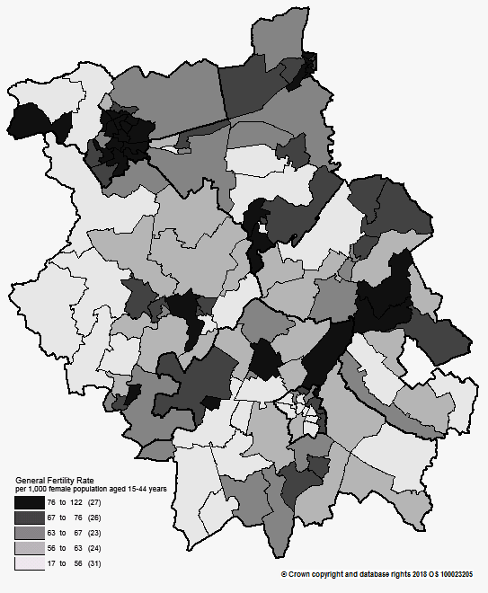
Births and Fertility
The birth rate in Cam Medical Network PCN is statistically significantly lower than the average for the South Alliance. The low birth weight proportion is statistically similar to the South Alliance.
Note: Relates to Cambridgeshire and Peterborough residents only Source: C&P PHI based on NHS Digital Civil Registration Data, 2014-2016 and patients registered at a GP Practice by LSOA, July 2018, NHS Digital (benchmark = South Alliance)
Birth rates by ward
 | Estimated
 | Number of live births (2014-2016) | Birth rate per 1,000 female population aged 15 to 44 years | Low birth weight births (under 2,500g)
Cam Medical Network PCN | 819 | 24.8 | 6.8%
South Alliance | 11,592 | 48.6 | 6.0%
Cambridgeshire and Peterborough CCG | 31,348 | 58.2 | 6.5%
England | 1,989,052 | 62.4 | 7.4%

Slide 9
Life expectancy
Male and female life expectancies in Cam Medical network PCN are statistically significantly higher than the South Alliance and C&P CCG
Source: C&P PHI based, derived from NHS Digital Civil Registration data and GP registered population data (benchmark = South Alliance), 2013 – 2017
 | Males (years) | Females (years)
Cam Medical Network PCN | 84.4 | 87.4
South Alliance | 82.3 | 85.1
Cambridgeshire and Peterborough CCG | 81.2 | 84.3

Slide 10
Risk factors

Slide 11
Risk factors
Recorded prevalence of obesity is statistically significantly lower in Cam Medical Network PCN compared to the average for South Alliance Estimated smoking prevalence is statistically significantly lower in Cam Medical Network PCN compared to the average for South Alliance
Source: Obesity - C&P PHI derived from NHS Digital QOF data for 2017/18 (benchmark = South Alliance) Estimated smoking - C&P PHI derived from the QOF based smoking prevalence estimate from the Public Health England (PHE) National General Practice Profiles at https://fingertips.phe.org.uk/profile/general-practice (benchmark = South Alliance)
 | Obesity |  | Estimated Smoking
 | Number | % | Number | %
Cam Medical Network PCN | 1,189 | 3.1% | 2,874 | 7.2%
South Alliance | 21,375 | 6.4% | 45,738 | 13.3%
Cambridgeshire and Peterborough CCG | 65,496 | 8.5% | 136,105 | 17.0%
England | 4,530,447 | 9.8% | 8,301,429 | 17.2%

Slide 12
Self-reported limiting long-term illness and general health status
It is estimated that the proportion of people that reported that they had a long-term activity-limiting illness in the 2011 Census was statistically significantly lower than the South Alliance average It is estimated that the proportion of people that reported that they were in good or very good health in the 2011 Census was statistically significantly higher than the South Alliance average
Source: C&P PHI from Census 2011, NOMIS and patients registered at a GP Practice by LSOA, July 2018, NHS Digital (benchmark = South Alliance)
 | Long-term activity-limiting illness | Good or very good health
Cam Medical Network PCN | 10.2% | 90.0%
South Alliance | 13.8% | 85.9%
Cambridgeshire and Peterborough CCG | 15.5% | 83.6%
England | 17.6% | 81.4 %

Slide 13
Diseases

Slide 14
Mortality – all causes
There have been on average 131 deaths a year in Cam Medical Network PCN; approximately a fourth are in people aged under 75 years. All practices have statistically significantly lower all-age and premature all cause mortality rates compared to South Alliance, except Lensfield Road practice where the rate is statistically significantly higher for all-age mortality and statistically similar for under 75 mortality.
DASR = directly age standardised rate per 100,000 population Source: C&P PHI, from NHS Digital Civil Registration Data and NHS Digital GP registered population data, 2013-2017 (benchmark = South Alliance)
 | All ages |  | Under 75 year olds
 | Number | DASR per 100,000 | Number | DASR per 100,000
Lensfield Road, Cambridge | 353 | 959.2 | 67 | 195.5
Newnham Walk, Cambridge | 188 | 604.8 | 44 | 161.2
Trumpington Street, Cambridge | 114 | 452.3 | 46 | 165.0
Cam Medical Network PCN | 655 | 707.7 | 157 | 175.2
South Alliance | 13,293 | 831.3 | 3,592 | 248.4
Cambridgeshire and Peterborough CCG | 34,464 | 901.5 | 10,385 | 286.4

Slide 15
Circulatory disease
The prevalence rates of CHD, hypertension and stroke are statistically significantly lower than the South Alliance for all practices. The circulatory all-age mortality for the PCN is statistically similar to the South Alliance. All practices have statistically similar rates of circulatory premature mortality compared to the South Alliance; the PCN has a statistically significantly lower rate of premature mortality than the South Alliance.
Note: Prevalence data are not available by age i.e. it is not age weighted so differences may be explained by differing age structures DASR = Directly age standardised rate per 100,000 population Source: Prevalence (recorded) - C&P PHI from QOF, NHS Digital, 2017/18 (benchmark = South Alliance) Mortality - C&P PHI, from NHS Digital Civil Registration Data and NHS Digital GP registered population data, 2013-2017 (benchmark = South Alliance)
 | Prevalence |  |  |  |  |  |  | Mortality (circulatory)
 | Coronary heart disease |  | Hypertension |  | Stroke |  |  | All ages |  | Under 75 year olds
 | Number | % | Number | % | Number | % |  | Number | DASR per 100,000 | Number | DASR per 100,000
Lensfield Road, Cambridge | 153 | 1.3% | 806 | 6.7% | 120 | 1.0% |  | 108 | 289.8 | 15 | 47.0
Newnham Walk, Cambridge | 126 | 0.8% | 694 | 4.6% | 103 | 0.7% |  | 55 | 173.6 | 6 | 23.4
Trumpington Street, Cambridge | 151 | 0.9% | 798 | 4.6% | 87 | 0.5% |  | 28 | 121.9 | 7 | 27.2
Cam Medical Network PCN | 430 | 1.0% | 2,298 | 5.2% | 310 | 0.7% |  | 191 | 208.0 | 28 | 33.9
South Alliance | 9,603 | 2.4% | 45,177 | 11.1% | 5,224 | 1.3% |  | 3,660 | 228.9 | 768 | 54.3
C&P CCG | 26,602 | 2.8% | 122,348 | 12.6% | 14,132 | 1.5% |  | 9,004 | 236.7 | 2,288 | 63.9
England | 1,827,352 | 3.1% | 8,141,488 | 13.9% | 1,030,869 | 1.8% |  | Not available

Slide 16
Respiratory disease
Asthma and COPD prevalence for PCN practices all statistically significantly lower than South Alliance. All practice mortality rates for respiratory diseases, for people of all ages and under 75 years, are statistically similar to the South Alliance rates; The PCN has a statistically significantly lower all-age mortality rate than the South Alliance.
Note: Prevalence data are not available by age i.e. it is not age weighted so differences may be explained by differing age structures DASR = Directly age standardised rate per 100,000 population Source: Prevalence (recorded) - C&P PHI from QOF, NHS Digital, 2017/18 (benchmark = South Alliance) Mortality - C&P PHI, from NHS Digital Civil Registration Data and NHS Digital GP registered population data, 2013-2017 (benchmark = South Alliance)
 | Prevalence |  |  |  |  | Mortality
 | Asthma |  | Chronic Obstructive Pulmonary Disease |  |  | All ages |  | Under 75 years
 | Number | % | Number | %
 |  |  |  |  |  | Number | DASR per 100,000 | Number | DASR per 100,000
Lensfield Road, Cambridge | 530 | 4.4% | 61 | 0.5% |  | 23 | 62.9 | <5 | 12.3
Newnham Walk, Cambridge | 611 | 4.1% | 50 | 0.3% |  | 20 | 63.2 | <5 | 11.7
Trumpington Street, Cambridge | 859 | 4.9% | 94 | 0.5% |  | 14 | 58.4 | <5 | 8.9
Cam Medical Network PCN | 2,000 | 4.5% | 205 | 0.5% |  | 57 | 62.7 | 9 | 11.1
South Alliance | 24,780 | 6.1% | 5,561 | 1.4% |  | 1,468 | 92.1 | 264 | 19.1
C&P CCG | 57,830 | 6.0% | 16,513 | 1.7% |  | 4,533 | 119.9 | 942 | 26.8
England | 3,463,893 | 5.9% | 1,113,417 | 1.9% |  | Not available

Slide 17
Long term conditions
Cam Medical Network PCN all practice diabetes and cancer prevalence rates are statistically significantly lower than the South Alliance. All practices have statistically similar all-age and premature cancer mortality rates to the South Alliance; the all-age cancer mortality rate for the PCN is statistically significantly lower than the South Alliance.
Note: Prevalence data are not available by age i.e. it is not age weighted so differences may be explained by differing age structures DASR = Directly age standardised rate per 100,000 population Source: Prevalence (recorded) - C&P PHI from QOF, NHS Digital, 2017/18 (benchmark = South Alliance) Mortality - C&P PHI, from NHS Digital Civil Registration Data and NHS Digital GP registered population data, 2013-2017 (benchmark = South Alliance)
 | Prevalence |  |  |  |  | Mortality - Cancer
 | Diabetes (17+ years) |  | Cancer |  |  | All ages |  | Under 75 year olds
 | Number | % | Number | % |  | Number | DASR per 100,000 | Number | DASR per 100,000
Lensfield Road, Cambridge | 307 | 2.8% | 269 | 2.2% |  | 73 | 211.7 | 28 | 82.1
Newnham Walk, Cambridge | 187 | 1.4% | 244 | 1.6% |  | 63 | 209.0 | 25 | 89.8
Trumpington Street, Cambridge | 242 | 1.6% | 215 | 1.2% |  | 45 | 180.5 | 23 | 94.9
Cam Medical Network PCN | 736 | 1.9% | 728 | 1.6% |  | 181 | 201.1 | 76 | 87.7
South Alliance | 15,620 | 4.6% | 10,846 | 2.7% |  | 3,809 | 244.0 | 1,604 | 112.9
C&P CCG | 46,573 | 6.0% | 25,700 | 2.7% |  | 9,902 | 259.5 | 4,411 | 123.2
England | 3,196,124 | 6.8% | 1,593,302 | 2.7% |  | Not available

Slide 18
Mental health
Cam Medical Network PCN mental health prevalence rate is statistically significantly lower than the South Alliance average for all practices except Lensfield Road practice where it is statistically similar to the South Alliance Cam Medical Network PCN and all practice prevalence rates of depression, dementia and learning disabilities are statistically significantly lower than the South Alliance averages except Lensfield Road practice where prevalence rates for dementia and learning disabilities are statistically similar to the South Alliance.
Note: Prevalence data are not available by age i.e. it is not age weighted so differences may be explained by differing age structures Source: Prevalence (recorded) - C&P PHI from QOF, NHS Digital, 2017/18 (benchmark = South Alliance) Mortality - C&P PHI, from NHS Digital Civil Registration Data and NHS Digital GP registered population data, 2013-2017 (benchmark = South Alliance)
 | Schizophrenia, bipolar affective disorder and other psychoses |  | Depression (18+ years) |  | Dementia |  | Learning disabilities
 | Number | % | Number | % | Number | % | Number | %
Lensfield Road, Cambridge | 129 | 1.1% | 543 | 5.1% | 60 | 0.5% | 37 | 0.3%
Newnham Walk, Cambridge | 65 | 0.4% | 830 | 6.1% | 43 | 0.3% | 18 | 0.1%
Trumpington Street, Cambridge | 113 | 0.6% | 772 | 5.3% | 34 | 0.2% | 22 | 0.1%
Cam Medical Network PCN | 307 | 0.7% | 2,145 | 5.5% | 137 | 0.3% | 77 | 0.2%
South Alliance | 3,654 | 0.9% | 26,382 | 7.9% | 2,457 | 0.6% | 1,382 | 0.3%
C&P CCG | 7,750 | 0.8% | 68,112 | 8.8% | 6,551 | 0.7% | 4,057 | 0.4%
England | 550,918 | 0.9% | 4,589,213 | 9.9% | 446,548 | 0.8% | 284,422 | 0.5%

