Slide 1
BMC Paston PCN
Data pack
August 2019

Slide 2
BMC Paston PCN – summary
There are almost 40,000 people registered with BMC Paston PCN, with a higher proportion of people aged 64 and over when compared to the North Alliance, CCG and England. The population is estimated to increase by 7.2% between 2019 and 2026, and then stabilise to 2036 BMC Paston PCN has a lower proportion of population from the White British ethnic group and higher proportions from White Other and Asian ethnic origins compared to the North Alliance, CCG and England averages. Relative deprivation is higher in BMC Paston PCN and each of the constituent practices when compared to the North Alliance, CCG and England. Approximately 25% of children and 24% of older people live in poverty It is estimated that on average there are around 500 births a year in the PCN. Birth rates and the proportion of babies born with a low birth weight are statistically similar to the North Alliance, which in itself has a noticeably high birth rate compared to the CCG It is estimated that male and female life expectancy in the PCN is statistically similar to the North Alliance average at around 79.8 years and 83.0 years respectively. Recorded obesity in adults is statistically significantly higher than the North Alliance It is estimated that 22.2% of adults smoke, which is statistically significantly higher than the North Alliance | Estimates of people reporting long-term activity-limiting illness and being in Good or Very Good health are statistically worse than the averages for the North Alliance. On average there are around 360 deaths a year in the PCN, with about a third of these in people aged under 75 years The PCN has statistically significantly high recorded prevalence of hypertension, stroke, COPD and diabetes compared to the North Alliance averages All-age, all cause mortality is statistically similar to the North Alliance rate but premature all-cause mortality is statistically significantly higher. All age and premature disease specific mortality rates for the PCN are statistically similar when compared with North Alliance, except for premature mortality for circulatory disease which is statistically significantly higher.

Slide 3
Demography

Slide 4
GP registered population
BMC Paston PCN has a higher proportion of people aged 65 and over compared with North Alliance, CCG and England. The population of BMC Paston PCN is forecast to grow at a similar rate to the CCG as whole. The population is expected to increase by 7.2% between 2019 and 2026 and then stabilise to 2036.
Source: GP registered population, April 2019, NHS Digital. Population forecasts based on population distribution at ward level (Apr 19), Mid 2015 based population forecasts Cambridgeshire County Council
Age band | BMC Paston PCN |  | North Alliance | Cambridgeshire and Peterborough CCG | England
 | Number | %
Total | 39,588 | 100% | 567,598 | 983,597 | 59,759,638
0-4 years | 2,279 | 5.8% | 5.9% | 5.4% | 5.5%
5-14 years | 5,022 | 12.7% | 12.6% | 11.7% | 11.8%
Under 18 years | 8,590 | 21.7% | 21.8% | 20.3% | 20.4%
16-64 years | 24,900 | 62.9% | 63.4% | 65.6% | 64.3%
65+ years | 6,941 | 17.5% | 16.9% | 16.3% | 17.4%
75+ years | 3,330 | 8.4% | 7.5% | 7.3% | 8.0%
85+ years | 1,123 | 2.8% | 2.2% | 2.2% | 2.3%
Population forecasts
PCN | 2019 | 2021 | 2026 | 2031 | 2036 | 2019 to 2021 |  | 2021 to 2026 |  | 2026 to 2031 |  | 2031 to 2036
 |  |  |  |  |  | Number | % | Number | % | Number | % | Number | %
BMC Paston PCN | 39,588 | 40,373 | 42,422 | 43,407 | 43,227 | 785 | 2.0% | 2,050 | 5.1% | 985 | 2.3% | -180 | -0.4%
C&P CCG | 982,987 | 1,011,368 | 1,072,891 | 1,097,528 | 1,110,295 | 28,381 | 2.9% | 61,522 | 6.1% | 24,637 | 2.3% | 12,767 | 1.2%

Slide 5
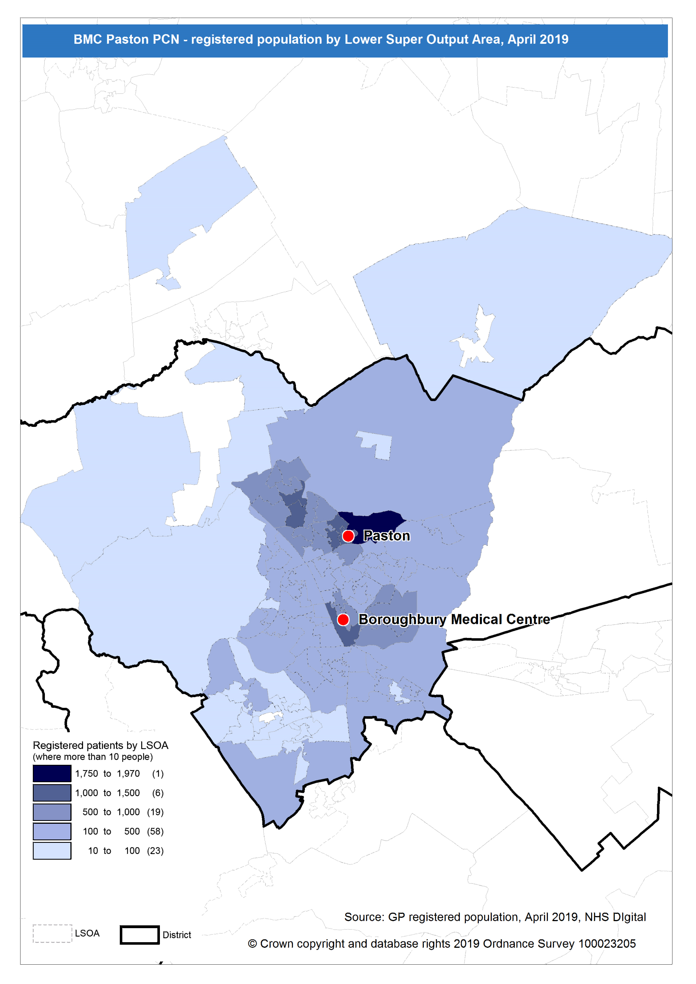
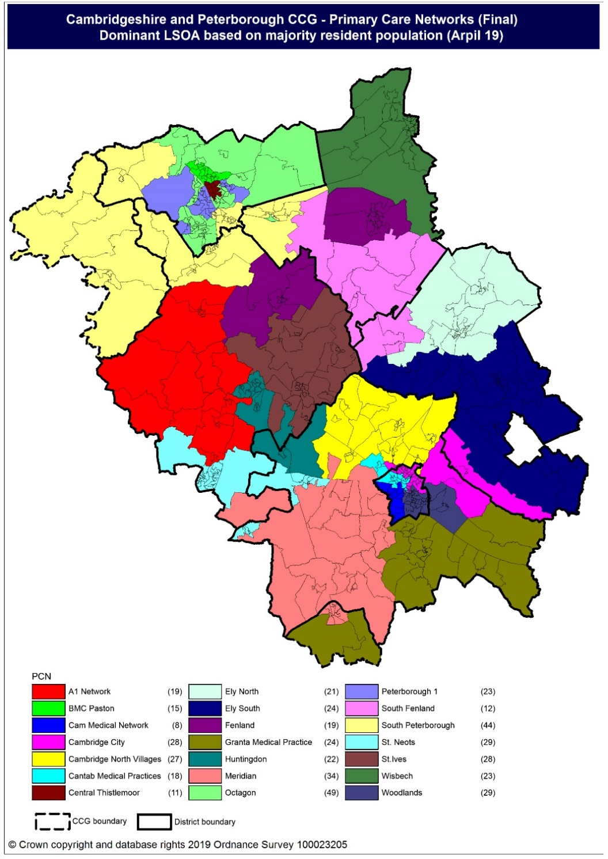
Population distribution
Source: GP registered population data by Lower Super Output Area, April 19, NHS Digital
Population
distribution
PCN dominant
population

Slide 6
Ethnicity
BMC Paston PCN has a lower proportion of population from the White British ethnic group and higher proportions from White Other and Asian ethnic origins compared to the North Alliance, CCG and England averages.
Source: Census 2011 data applied to GP registered population using Census 2011 ethnic group proportions; England data from NOMIS (patients registered at a GP Practice by LSOA, July 2018, NHS Digital)
PCN | White British | White Other | Mixed | Black | Asian: Indian/ Bangladeshi/ Pakistani | Asian: Chinese/Other | Other
BMC Paston PCN | 68.9% | 12.0% | 2.8% | 2.2% | 10.4% | 2.7% | 0.9%
North Alliance | 80.7% | 8.7% | 1.9% | 1.4% | 5.0% | 1.7% | 0.5%
Cambridgeshire and Peterborough CCG | 80.0% | 9.5% | 2.1% | 1.3% | 4.1% | 2.4% | 0.7%
England | 79.8% | 5.7% | 2.3% | 3.5% | 5.6% | 2.3% | 1.0%

Slide 7
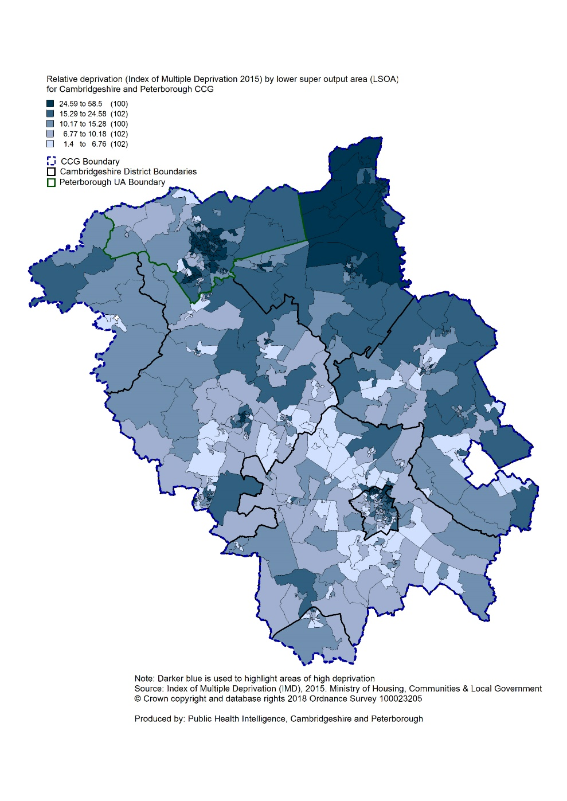
Deprivation
Relative deprivation is higher in BMC Paston PCN and each of the constituent practices when compared to the North Alliance, CCG and England. Approximately 25% of children and 24% of older people live in income deprived households in the PCN; higher than the averages for North Alliance, CCG and England.
Source: C&P PHI derived from Indices of Multiple Deprivation 2015, DCLG and GP registered population data for July 2018. Practice data from PHE Fingertips.
 | Index of Multiple Deprivation | Income Affecting Children Index | Income Affecting Older People Index
Boroughbury Medical Centre | 30.3 | 24.8% | 23.9%
Paston | 29.3 | 25.4% | 22.9%
BMC Paston PCN | 29.9 | 25.0% | 23.6%
North Alliance | 21.6 | 18.9% | 16.5%
C&P CCG | 17.2 | 15.4% | 14.3%
England | 21.8 | 19.9% | 16.2%
Index of Multiple Deprivation, 2015, by ward

Slide 8
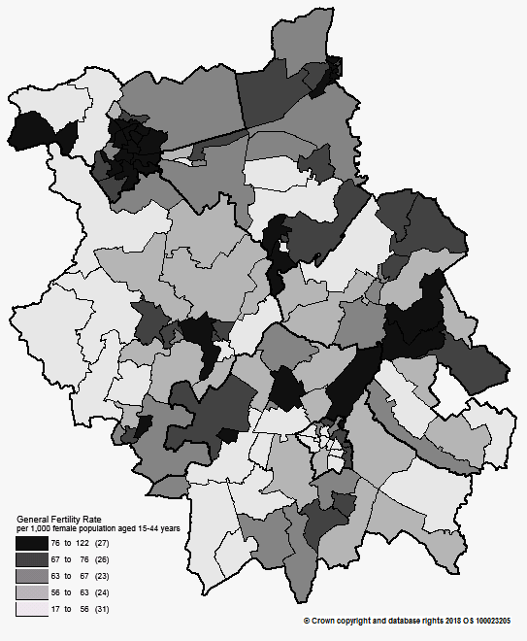
Births and Fertility
Birth rates and low birth weight births in BMC Paston PCN are statistically similar to the averages for the North Alliance.
Note: Relates to Cambridgeshire residents only Source: C&P PHI based on NHS Digital Civil Registration Data, 2014-2016 and patients registered at a GP Practice by LSOA, July 2018, NHS Digital (benchmark = North Alliance)
Birth rates by ward
 | Estimated
 | Number of live births (2014-2016) | Birth rate per 1,000 female population aged 15 to 44 years | Low birth weight births (under 2,500g)
BMC Paston PCN | 1,537 | 67.4 | 6.7%
North Alliance | 19,756 | 65.8 | 6.8%
Cambridgeshire and Peterborough CCG | 31,348 | 58.2 | 6.5%
England | 1,989,052 | 62.4 | 7.4%

Slide 9
Life expectancy
Male and female life expectancy in BMC Paston PCN is statistically similar to the North Alliance.
Source: C&P PHI based, derived from NHS Digital Civil Registration data and GP registered population data (benchmark = North Alliance), 2013 – 2017
 | Males (years) | Females (years)
BMC Paston PCN | 79.8 | 83.0
North Alliance | 80.4 | 83.7
Cambridgeshire and Peterborough CCG | 81.2 | 84.3

Slide 10
Risk factors

Slide 11
Risk factors
Recorded prevalence of obesity is statistically significantly higher in BMC Paston PCN compared to the average for North Alliance. Estimated smoking prevalence is statistically significantly higher in BMC Paston PCN compared to the average for North Alliance.
Source: Obesity - C&P PHI derived from NHS Digital QOF data for 2017/18 (benchmark = North Alliance) Estimated smoking - C&P PHI derived from the QOF based smoking prevalence estimate from the Public Health England (PHE) National General Practice Profiles at https://fingertips.phe.org.uk/profile/general-practice (benchmark = North Alliance)
 | Obesity |  | Estimated Smoking
 | Number | % | Number | %
BMC Paston PCN | 4,289 | 13.9% | 7,119 | 22.2%
North Alliance | 44,121 | 10.1% | 90,367 | 19.8%
Cambridgeshire and Peterborough CCG | 65,496 | 8.5% | 136,105 | 17.0%
England | 4,530,447 | 9.8% | 8,301,429 | 17.2%

Slide 12
Self-reported limiting long-term illness and general health status
It is estimated that the proportion of people that reported that they had a long-term activity-limiting illness in the 2011 Census was statistically significantly higher than the North Alliance average. It is estimated that the proportion of people that reported that they were in good or very good health in the 2011 Census was statistically significantly lower than the North Alliance average.
Source: C&P PHI from Census 2011, NOMIS and patients registered at a GP Practice by LSOA, July 2018, NHS Digital (benchmark = North Alliance)
 | Long-term activity-limiting illness | Good or very good health
BMC Paston PCN | 17.6% | 80.4%
North Alliance | 16.7% | 81.9%
Cambridgeshire and Peterborough CCG | 15.5% | 83.6%
England | 17.6% | 81.4 %

Slide 13
Diseases

Slide 14
Mortality – all causes
There have been on average 357 deaths a year in BMC Paston PCN, approximately a third are in people aged under 75 year olds. Paston has a statistically significantly higher premature mortality rate compared with North Alliance. All other rates are statistically similar to North Alliance.
DASR = directly age standardised rate per 100,000 population Source: C&P PHI, from NHS Digital Civil Registration Data and NHS Digital GP registered population data, 2013-2017 (benchmark = North Alliance)
 | All ages |  | Under 75 year olds
 | Number | DASR per 100,000 | Number | DASR per 100,000
Boroughbury Medical Centre | 1,327 | 946.9 | 381 | 343.6
Paston | 462 | 1032.9 | 182 | 394.4
BMC Paston PCN | 1,789 | 968.0 | 563 | 358.5
North Alliance | 21,171 | 949.8 | 6,793 | 311.9
Cambridgeshire and Peterborough CCG | 34,464 | 901.5 | 10,385 | 286.4

Slide 15
Circulatory disease
The BMC Paston PCN CHD prevalence rate is statistically similar to North Alliance whereas hypertension and stroke prevalence rates are statistically significantly high compared to North Alliance. Circulatory disease all-age and premature mortality rates are statistically similar to North Alliance at all practices.
Note: Prevalence data are not available by age i.e. it is not age weighted so differences may be explained by differing age structures DASR = Directly age standardised rate per 100,000 population Source: Prevalence (recorded) - C&P PHI from QOF, NHS Digital, 2017/18 (benchmark = North Alliance) Mortality - C&P PHI, from NHS Digital Civil Registration Data and NHS Digital GP registered population data, 2013-2017 (benchmark = North Alliance)
 | Prevalence |  |  |  |  |  |  | Mortality (circulatory)
 | Coronary heart disease |  | Hypertension |  | Stroke |  |  | All ages |  | Under 75 year olds
 | Number | % | Number | % | Number | % |  | Number | DASR per 100,000 | Number | DASR per 100,000
Boroughbury Medical Centre | 953 | 3.8% | 4,098 | 16.3% | 514 | 2.0% |  | 352 | 248.7 | 96 | 86.9
Paston | 313 | 2.2% | 1,673 | 11.9% | 184 | 1.3% |  | 109 | 247.1 | 42 | 95.5
BMC Paston PCN | 1,266 | 3.2% | 5,771 | 14.7% | 698 | 1.8% |  | 460 | 248.0 | 138 | 88.6
North Alliance | 16,999 | 3.0% | 77,171 | 13.8% | 8,908 | 1.6% |  | 5,344 | 241.0 | 1,520 | 70.4
C&P CCG | 26,602 | 2.8% | 122,348 | 12.6% | 14,132 | 1.5% |  | 9,004 | 236.7 | 2,288 | 63.9
England | 1,827,352 | 3.1% | 8,141,488 | 13.9% | 1,030,869 | 1.8% |  | Not available

Slide 16
Respiratory disease
Asthma prevalence is statistically significantly lower than North Alliance at PCN and practice level. COPD prevalence is statistically significantly high compared to the North Alliance at PCN level and at Boroughbury Medical Centre. Mortality rates for respiratory diseases, for people of all ages and under 75 years, are similar to the North Alliance rates.
Note: Prevalence data are not available by age i.e. it is not age weighted so differences may be explained by differing age structures DASR = Directly age standardised rate per 100,000 population Source: Prevalence (recorded) - C&P PHI from QOF, NHS Digital, 2017/18 (benchmark = North Alliance) Mortality - C&P PHI, from NHS Digital Civil Registration Data and NHS Digital GP registered population data, 2013-2017 (benchmark = North Alliance)
 | Prevalence |  |  |  |  | Mortality
 | Asthma |  | Chronic Obstructive Pulmonary Disease |  |  | All ages |  | Under 75 years
 | Number | % | Number | %
 |  |  |  |  |  | Number | DASR per 100,000 | Number | DASR per 100,000
Boroughbury Medical Centre | 1,295 | 5.1% | 651 | 2.6% |  | 212 | 146.5 | 44 | 39.4
Paston | 671 | 4.8% | 223 | 1.6% |  | 57 | 129.9 | 13 | 28.1
BMC Paston PCN | 1,966 | 5.0% | 874 | 2.2% |  | 269 | 142.4 | 57 | 36.6
North Alliance | 33,050 | 5.9% | 10,952 | 2.0% |  | 3,065 | 139.7 | 678 | 31.9
C&P CCG | 57,830 | 6.0% | 16,513 | 1.7% |  | 4,533 | 119.9 | 942 | 26.8
England | 3,463,893 | 5.9% | 1,113,417 | 1.9% |  | Not available

Slide 17
Long term conditions
Diabetes prevalence is statistically significantly higher than the North Alliance at PCN level and both practices. Cancer prevalence is statistically similar to the North Alliance average at PCN level with Boroughbury having statistically significantly higher prevalence and Paston significantly lower prevalence than North Alliance. All practices have statistically similar all-age and premature cancer mortality rates to the North Alliance.
Note: Prevalence data are not available by age i.e. it is not age weighted so differences may be explained by differing age structures DASR = Directly age standardised rate per 100,000 population Source: Prevalence (recorded) - C&P PHI from QOF, NHS Digital, 2017/18 (benchmark = North Alliance) Mortality - C&P PHI, from NHS Digital Civil Registration Data and NHS Digital GP registered population data, 2013-2017 (benchmark = North Alliance)
 | Prevalence |  |  |  |  | Mortality - Cancer
 | Diabetes (17+ years) |  | Cancer |  |  | All ages |  | Under 75 year olds
 | Number | % | Number | % |  | Number | DASR per 100,000 | Number | DASR per 100,000
Boroughbury Medical Centre | 1,850 | 9.0% | 752 | 3.0% |  | 342 | 254.0 | 137 | 124.0
Paston | 806 | 7.6% | 259 | 1.8% |  | 143 | 324.9 | 71 | 159.7
BMC Paston PCN | 2,656 | 8.5% | 1,011 | 2.6% |  | 485 | 271.3 | 208 | 133.8
North Alliance | 30,953 | 7.0% | 14,854 | 2.7% |  | 6,093 | 269.7 | 2,807 | 130.1
C&P CCG | 46,573 | 6.0% | 25,700 | 2.7% |  | 9,902 | 259.4 | 4,411 | 123.2
England | 3,196,124 | 6.8% | 1,593,302 | 2.7% |  | Not available

Slide 18
Mental health
PCN prevalence rates of severe mental illness, dementia and learning disability are all statistically significantly high when compared to the North Alliance average. BMC Paston PCN has a statistically significantly low depression prevalence compared to the North Alliance.
Note: Prevalence data are not available by age i.e. it is not age weighted so differences may be explained by differing age structures Source: Prevalence (recorded) - C&P PHI from QOF, NHS Digital, 2017/18 (benchmark = North Alliance) Mortality - C&P PHI, from NHS Digital Civil Registration Data and NHS Digital GP registered population data, 2013-2017 (benchmark = North Alliance)
 | Schizophrenia, bipolar affective disorder and other psychoses |  | Depression (18+ years) |  | Dementia |  | Learning disabilities
 | Number | % | Number | % | Number | % | Number | %
Boroughbury Medical Centre | 302 | 1.2% | 1,931 | 9.5% | 279 | 1.1% | 131 | 0.5%
Paston | 112 | 0.8% | 533 | 5.1% | 82 | 0.6% | 100 | 0.7%
BMC Paston PCN | 414 | 1.1% | 2,464 | 8.0% | 361 | 0.9% | 231 | 0.6%
North Alliance | 4,096 | 0.7% | 41,730 | 9.6% | 4,094 | 0.7% | 2,675 | 0.5%
C&P CCG | 7,750 | 0.8% | 68,112 | 8.9% | 6,551 | 0.7% | 4,057 | 0.4%
England | 550,918 | 0.9% | 4,589,213 | 9.9% | 446,548 | 0.8% | 284,422 | 0.5%

